Slide 1
Pavel Weber
FC-3 Helpdesk: status and roadmap
Karlsruhe Institute of Technology
Notes:
Ten minutes on the Helpdesk federating capability: what is required of your Node today, how support across Nodes works now, and how it will evolve.

Slide 2
FC-3 Helpdesk: what is it?
“Integrates the helpdesks of EOSC Nodes within the EOSC Federation to provide a federated support channel between users and providers.”
EOSC Federation Handbook
Mandatory today
Every Node operates a helpdesk, its own or a hosted one, with a support contact.
Own helpdesk
Each Node keeps its own helpdesk, tools and processes.
Provider and consumer
Any Node can send a ticket to another Node or receive one.
Recommended
Email integration with the FSU Helpdesk and other EOSC nodes.
Users stay with their Node
Users contact their own Node. They do not need to know which node owns their problem.
Exceptions to the FSU
A rotating Federation Support Unit handles what one Node cannot solve.
All functions of FC-3 are subject to GDPR
Notes:
All helpdesk functions, in each Node and across the federation, are subject to GDPR.

Slide 3
Roadmap: three phases
Phase 1
NOW
Phase 2
Phase 3
Email integration with the FSU
Email integration between Nodes
API-based full integration
FSU
FSU
N1
FSU
N2
FSU
N3
FSU
N4
FSU
N1
N2
N3
N4
N1
N2
N3
N4
messaging layer (AMS)
email
Every Node helpdesk linked to the FSU Helpdesk by email
Users contact their own Node
Rotating FSU duty crew
Direct email links between Nodes that share use cases
Remaining Nodes join
All Nodes connected through a messaging layer (AMS)
FSU queue synced into every Node’s helpdesk
Agents work in their own helpdesk
Starts when pairs of Nodes exchange tickets regularly
Starts when volume justifies API integration

Slide 4
Federation Support Unit with AI assistance
Exceptions only: AI suggests, a person decides
The FSU acts on five cases
FSU Helpdesk duty agent decides
1
Wrong assignment: the Node cannot tell who is responsible
Service gap candidate: no Node has the capability
asks
suggestion
2
AI suggestion service beside the helpdesk
3
Ownership dispute: Nodes decline it as out of scope
4
Federation scope: addressed to the federation as a whole
reads
Knowledge base
5
Escalation: a shared ticket has stopped moving
Node A
tenant
Node B
tenant
Node C
tenant
Federation
tenant
Duty crew: one Node on duty per month, no L1 work for any Node
Notes:
The FSU is a rotating group of agents from the Nodes. It does no L1 work for any Node; it acts only on five kinds of cases. An AI service beside the helpdesk suggests where a ticket should go, based on the documentation the Nodes contribute to the knowledge base. A person on duty always makes the decision.

Slide 5
Email integration in a nutshell
Each Node helpdesk exchanges tickets with the FSU by email
FSU Helpdesk
1
Node X passes the ticket to the FSU Helpdesk by email.
1
Node X group
2
User
Node X
helpdesk
Node Y
helpdesk
Node Y group
2
The duty crew moves it into Node Y’s group; a trigger forwards it to Node Y’s helpdesk.
3
one group per Node
3
3
Every article is synced between the FSU Helpdesk, Node X and Node Y.
Any helpdesk that sends and receives email can join
No API development needed
No child tickets, no status keywords
Tested without mail loops
Notes:
Each Node is a group in the FSU Helpdesk. Node X sends the ticket to the FSU Helpdesk by email. When the duty crew moves it into Node Y's group, a trigger forwards it to Node Y's helpdesk address. From then on every article, replies and internal notes, is synced between the FSU Helpdesk and the Nodes involved, so Node X can stay in the conversation with its user. Any helpdesk that can send and receive email can join; we tested it without mail loops.

Slide 6

Demo: a ticket crosses Nodes
One ticket shared across the Nodes and FSU Helpdesk
User
question
Data Terra helpdesk
Node X
FSU Helpdesk
duty crew routes the ticket
PaNOSC helpdesk
Node Y
answer
Video on Google Drive
Notes:
Recorded demo, about 2 min 46 s. A user writes to Node X about a problem that needs Node Y. Node X passes the ticket to the FSU, and the duty agent moves it into Node Y's group. Node X stays in the conversation: Node Y adds its findings, Node X answers the user, and all three helpdesks see the same conversation.

Slide 7
Routing a ticket in the federation
A cheat sheet for Nodes
yes
1 Resolve it locally
Can you resolve it alone?
yes
2 Keep it and ask another Node for input
no
A ticket reaches your helpdesk
Is it about your own service?
yes
3 Transfer it in full to that Node
no
Do you know the responsible Node?
One owner at a time
Ownership changes only when the receiving Node explicitly accepts.
5 Pass it to the FSU
no
dashed: no progress after three days, or transfer refused
Notes:
Three questions decide the path. Most tickets end at outcome 1. If another Node is responsible, the ticket is handed over in full. Whatever cannot be routed, or stops moving for three days, goes to the FSU. Throughout, exactly one Node owns the ticket, and ownership changes only on explicit acceptance.

Slide 8
Where we stand
Node readiness, ticket traffic, legal basis
Notes:
So much for how it works. Now where we stand: how many Nodes are ready, what already moves through the FSU Helpdesk, and what still keeps us from working on real tickets.

Slide 9
Node readiness
Status in October 2026
21
Nodes with a confirmed helpdesk
12
Nodes integrated with the FSU Helpdesk by email
9 on Zammad, 3 on other systems
Next: connect the remaining Nodes that already run a helpdesk.
Notes:
21 Nodes have confirmed a helpdesk, which is the mandatory minimum. 12 of them are already connected to the FSU Helpdesk by email: 9 run Zammad and 3 run other helpdesk systems, so the integration does not depend on one product. The next step is to connect the remaining Nodes that already run a helpdesk.

Slide 10
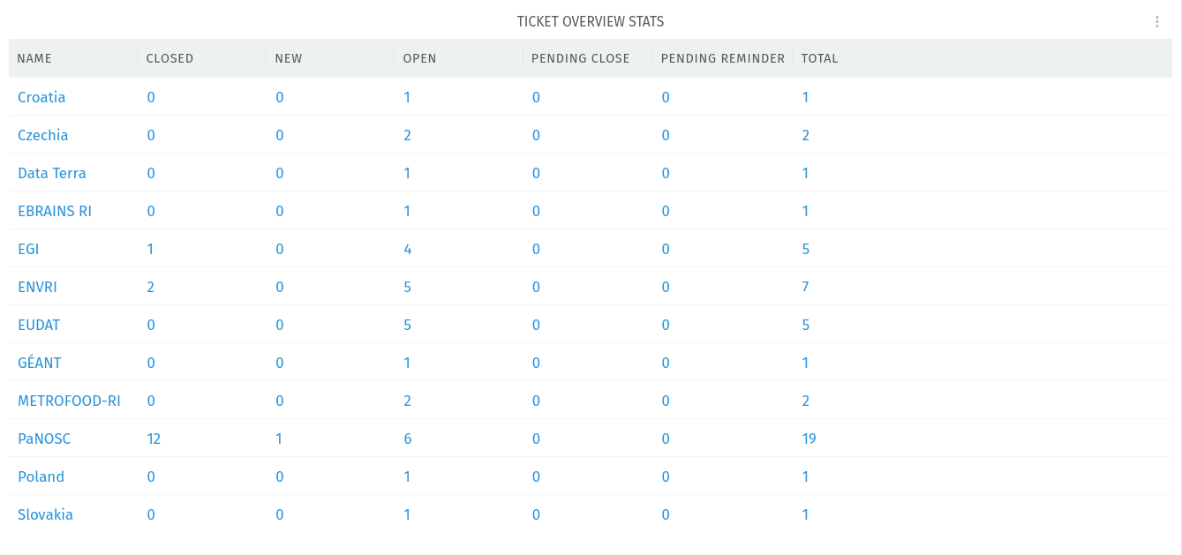
FSU Helpdesk dashboard
Tickets exchanged per Node, October 2026
Notes:
This is the live dashboard of the FSU Helpdesk, one line per Node group. It shows which Nodes have already exchanged tickets through the federation channel; most of them are the Nodes with email integration.

Slide 11
Exchanging real tickets needs a legal basis
GDPR: problem, proposed approach, what each Node should do
1
Problem
2
Proposed approach
3
What each Node should do
A ticket carries personal data
GDPR binds every Node that processes it
No common rules yet; bilateral contracts: ~400 for 28 Nodes
Inside a Node
Each Node is an independent controller; DPA with a hosting provider
1
Hosted helpdesk: sign a DPA
2
Apply the Federated Helpdesk Policy
3
Update your privacy notice
Between Nodes
Federated Helpdesk Policy under the Framework Agreement, in preparation
4
Share only what is needed
5
Name a data protection contact
Towards users
Privacy notice names other Nodes and the FSU as recipients
Apply the agreed retention period
6
7
Report breaches to involved Nodes
Notes:
A ticket holds personal data: name, email and whatever the user writes or attaches. When it moves between Nodes, several independent organisations process it, and GDPR applies to each of them. Today no common rules cover this, and bilateral contracts do not scale: close to 400 for about 28 Nodes. The proposed approach: each Node stays an independent controller of its own tickets, and signs a DPA if another organisation runs its helpdesk. Between Nodes, the Federated Helpdesk Policy under the Framework Agreement, now in preparation, replaces bilateral contracts; a Node is covered by joining the Framework Agreement. Towards users, the privacy notice names other Nodes and the FSU as possible recipients. Each Node then signs a DPA if its helpdesk is hosted, applies the Federated Helpdesk Policy, updates its privacy notice, shares only what is needed to solve the ticket, names a contact point for data protection requests, applies the agreed retention period, and tells the involved Nodes about breaches in exchanged tickets.

Slide 12
Next steps 2026-2027
Continue to enable email integration with the remaining Nodes
1
Enhance AI triage and the federated knowledge base
2
Settle the legal basis to work on real tickets
3
Involve further Nodes in federated support
4
Notes:
Four things drive the next months: more Nodes connected by email, a stronger AI and knowledge base for the duty crew, the legal basis that lets us work on real tickets, and further Nodes involved in federated support. And what we need from your Node: confirm and connect your helpdesk, nominate an agent for the FSU duty crew, add your documentation to the knowledge base, join the Working Group, and align your incident and request management with the federation SMS.

Slide 13
Thank you!
pavel.weber@kit.edu

