Slide 1
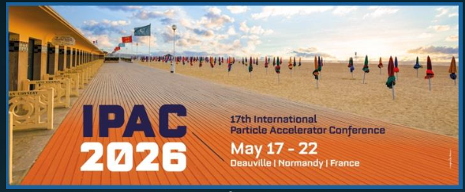
EIC Accelerator Collaboration
Institutional Board Meeting
Role of the Institutional Board
Wolfram Fischer (BNL), Co-Chair
Tatiana Pieloni (EPFL), Co-Chair
29 May 2026

Slide 2
EIC AC Institutional Board – membership
Lin Liu | LNLS | Brazil
Oliver Kester | TRIUMF | Canada
Guillaume Olry | IJCLab | France
Pierre Vedrine | CEA Saclay | France
Qing Qin | ESRF | France
Ralph Assmann | GSI/FAIR | Germany
Lucio Rossi | INFN Milano | Italy
Roberto Cimino | INFN-LNF | Italy
Moses Chung | Pohang Accelerator Lab | South Korea
Amalia Ballarino | CERN | Switzerland
Graeme Burt | Lancaster University | UK
Carsten Welsch | University of Liverpool | UK
Nik Templeton | STFC | UK
Phil Burrows | John Adams Institute | UK
Stewart Boogert | Cockcroft Institute | UK
Georg Hoffstaetter | Cornell University | United States
Jean Delayen | Old Dominion University | United States
John Power | ANL | United States
Mei Bai | SLAC | United States
Sam Posen | Fermilab | United States
Sarah Cousineau | ORNL | United States
Soren Prestemon | LBNL | United States
Young-Kee Kim | University of Chicago | United States
Yue Hao | FRIB | United States
Considering adding
Ex-offio members from
BNL and JLab

Slide 3
Documents for the Institutional Board
EIC Accelerator Collaboration Charter V02
Expression of Mutual Interest
Both posted on idico site for today’s meeting:
https://indico.global/event/18188/

Slide 4
EIC Accelerator Collaboration
Main Elements of the EIC Accelerator Collaboration:
Institutional Board
Co-Chairs
Working Groups
Collaboration Meetings
Fellowships (yet to be established)

Slide 5
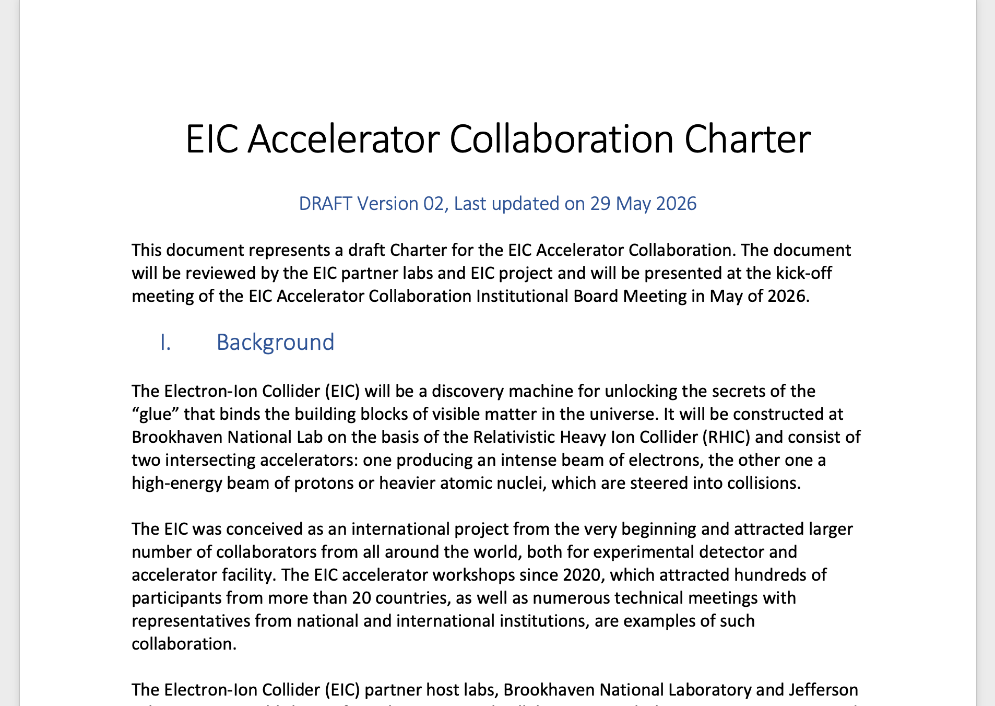
EIC Accelerator Collaboration Charter

Slide 6
EIC Accelerator Collaboration Charter
The EIC Accelerator Collaboration Charter is:
A living document to be maintained and modified by the Institutional Board and the Accelerator Collaboration Co-Chairs.
A procedural guide, describing the operation of the EIC accelerator collaborative work and how EIC accelerator collaboration members commit to interact constructively in good faith, and which is accompanying the EIC Accelerator Collaboration Expression of Mutual Interest (EMI), that can optionally be signed.
An informal agreement among EIC Accelerator Collaboration members that does not have any legal standing.
A public document, available for anyone to read and review. Comments about this document should be addressed to the Co-Chairs of the EIC Accelerator Collaboration.

Slide 7
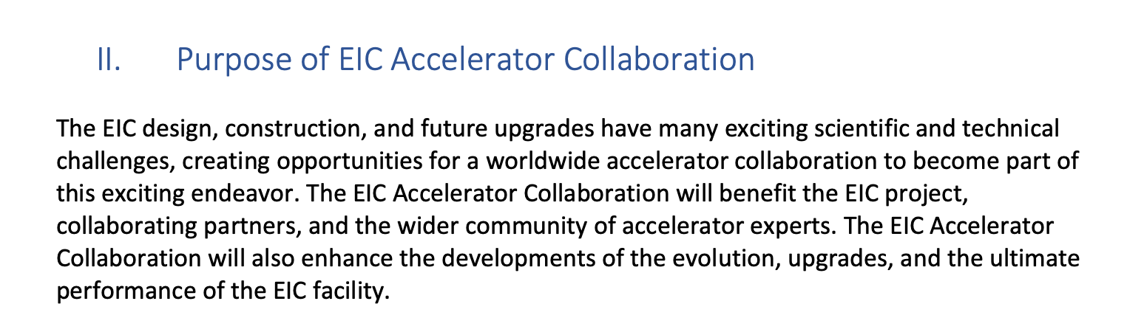
EIC Accelerator Collaboration Charter

Slide 8
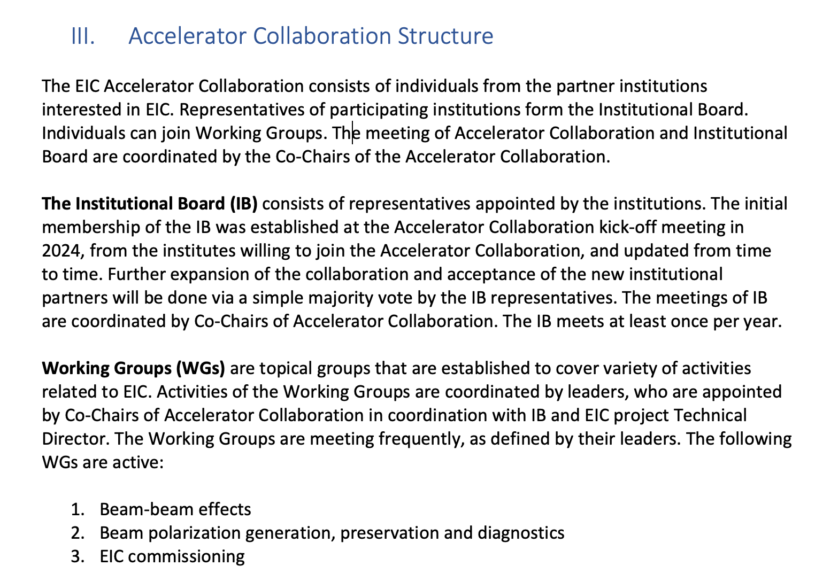
EIC Accelerator Collaboration Charter

Slide 9
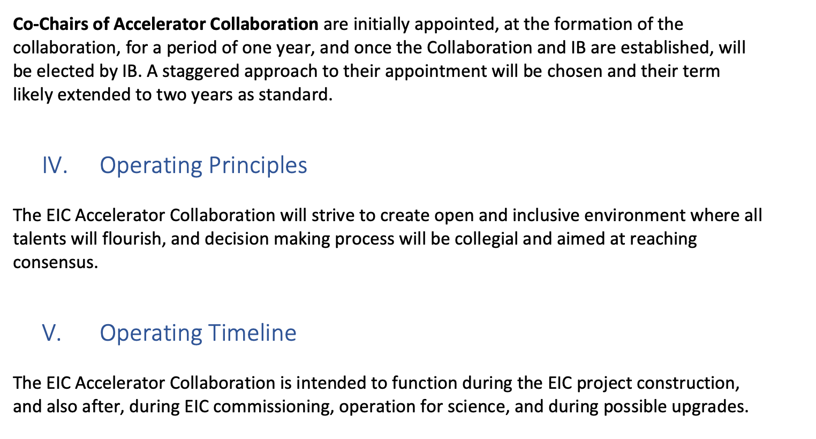
EIC Accelerator Collaboration Charter

Slide 10
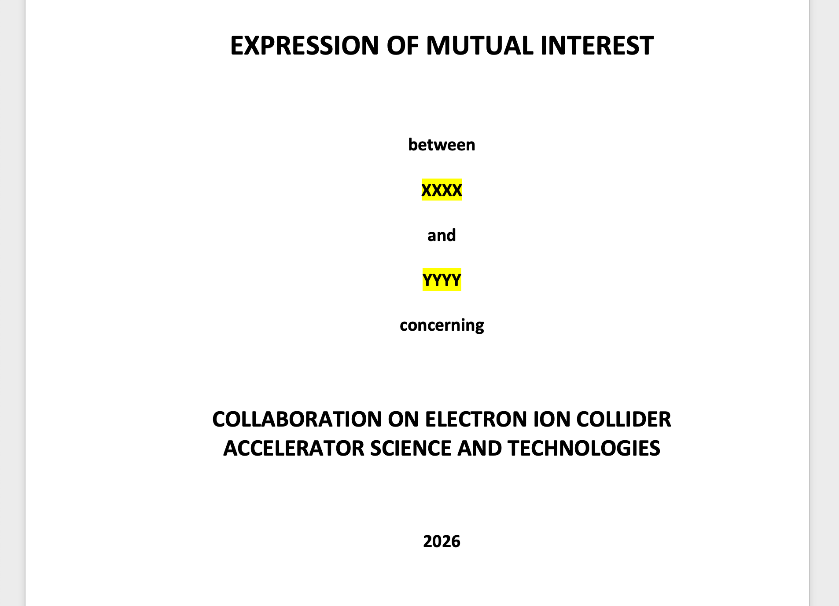
Expression of Mutual Interest
Indicates
  Common ground for certain topics
  Goodwill
  Intention to work collaboratively
Not a Memorandum of Understanding (MOU)
Not legally binding

Slide 11
Next steps
Will send out for comments
  Charter V02
  Expression of Mutual Interest DRAFT
Will send out for approval: charter
Will ask for election of Co-Chairs

