Slide 1
EIC IAC Working Groups
Tatiana Pieloni, École Polytechnique Fédérale de Lausanne, Switzerland
Wolfram Fischer,BNL, USA
co-chairs of
EIC Accelerator Collaboration
28th May 2026

Slide 2
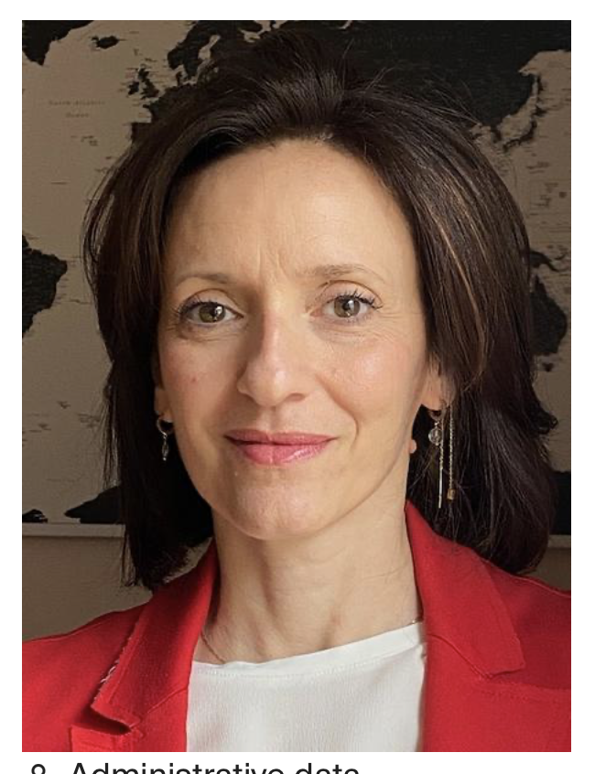
About me Tatiana Pieloni
Current Role:
Senior Scientist at EPFL Laboratory of Particle accelerator Physics lausanne CH
Swiss Institute of Accelerator Research and Technology Institute CHART executive board member
Experience:
- From 2004-2016 PHD-Staff at Accelerator Beam Phsyics CERN LHC beam dynamics, Beam-beam effects, Luminosity
- 2016-present EPFL → FCC related beam dynamics studies : ecloud, beam-beam, ERL , muon acceleration
Education: PHD at EPFL-LPAP and CERN 2008
Tatiana.Pieloni@epfl.ch

Slide 3
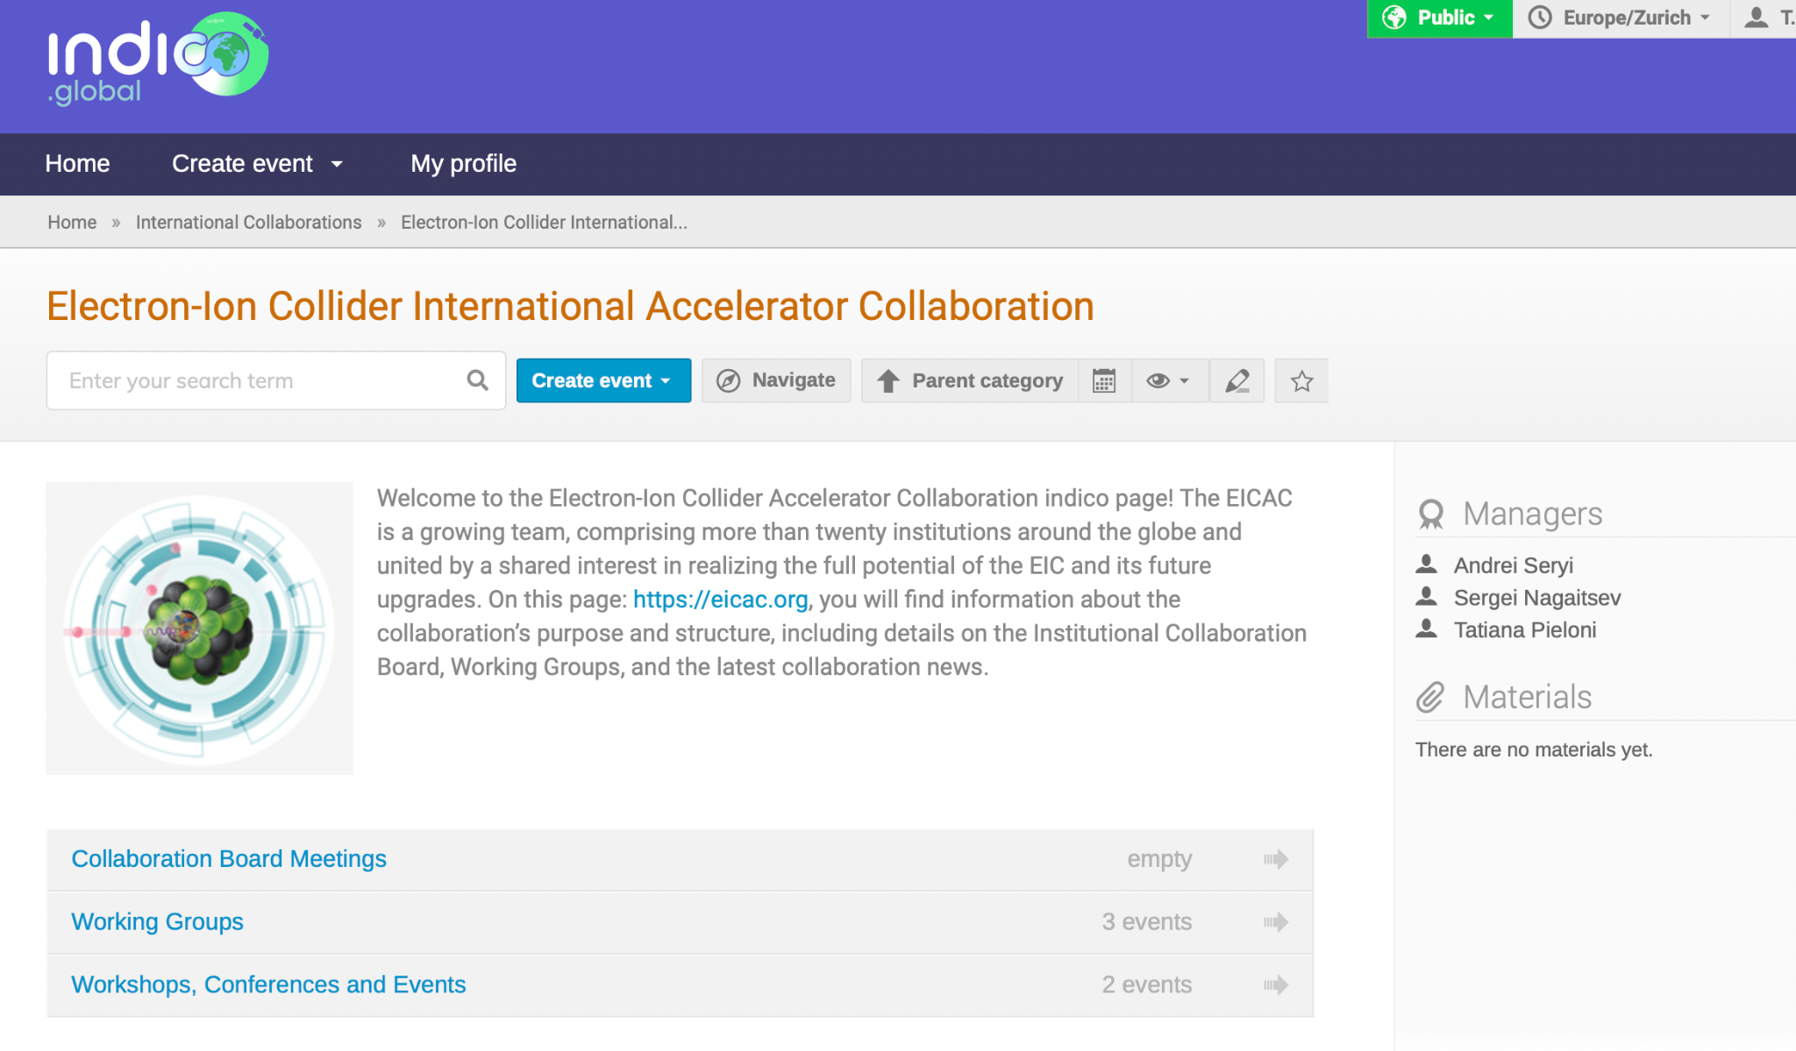
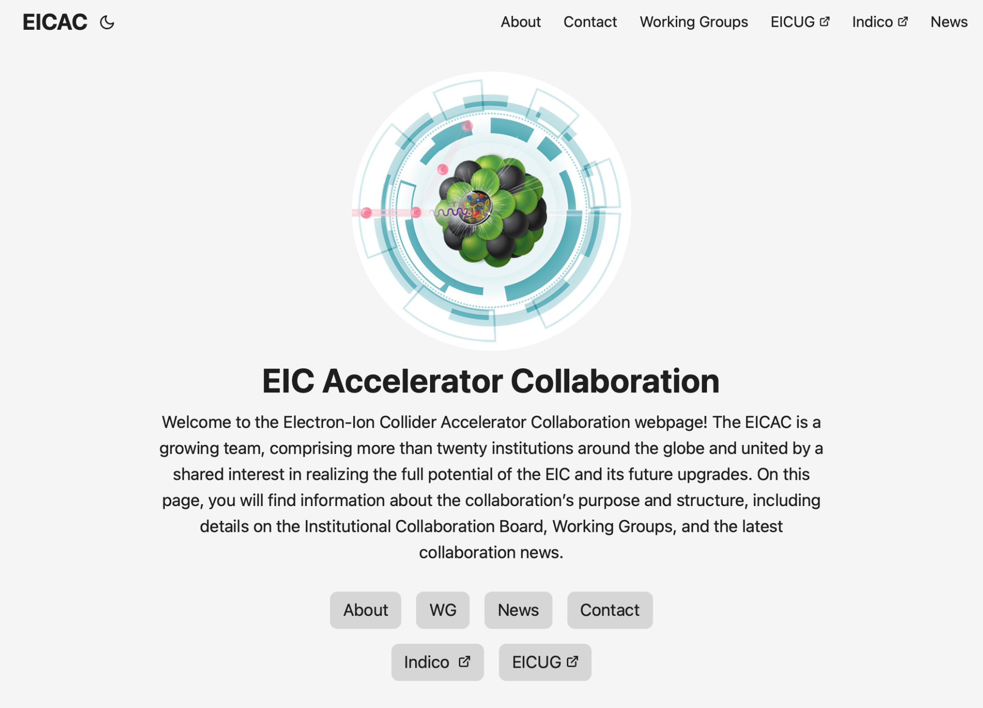
Information flow and Material Sharing
Official Webpage EICAC.org
All WG meetings and material migrated soon to: CERN Global Indico
Adding past meetings to the general page

Slide 4
Working Groups: Motivation and goals
Coordinate efforts across EIC studies and accelerator studies and technologies in the global community
Identify common priorities in areas of mutual scientific interest
Share expertise between teams working on similar challenges
Align technical developments such as beam dynamics, instrumentation, and simulation tools
Develop joint strategies for modelling, measurements, and beam‑dynamics studies, technology developments…
Promote synergy between ongoing EIC work and long‑term FCC/other R&D

Slide 5
Working Groups established:
Beam-beam effects C. Montag (BNL), X. Buffat (CERN)
Polarized Beams and Polarimetry F. Rathmann (BNL), G. Hoffstaetter(Cornell)
EIC commissioning Tools Y. Hao (MSU/BNL), J.L. Vay (LBNL)
Collimation, Machine protection and MDI – A. Natochii (BNL) and S. Redaelli (CERN)
Injection and sources R&D –tbc P. Craievich (PSI) recruiting co-chair
Impedance and Collective effects - tbc S. Antipov (DESY)
Second Interaction Region recruiting co-chairs
High Energy Beam Cooling tbc Fedotov recruiting co-chairs
Forum on EIC Synergies with Current and Future Projects –recruiting co-chairs
More WGs to come → Feel free to propose topics and technologies of interest

Slide 6
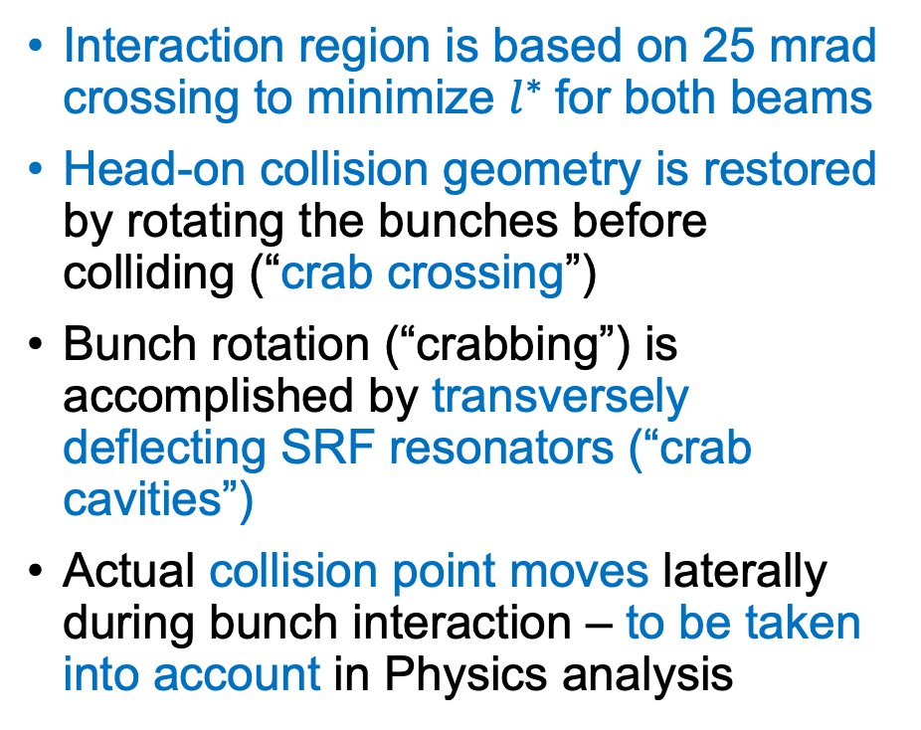
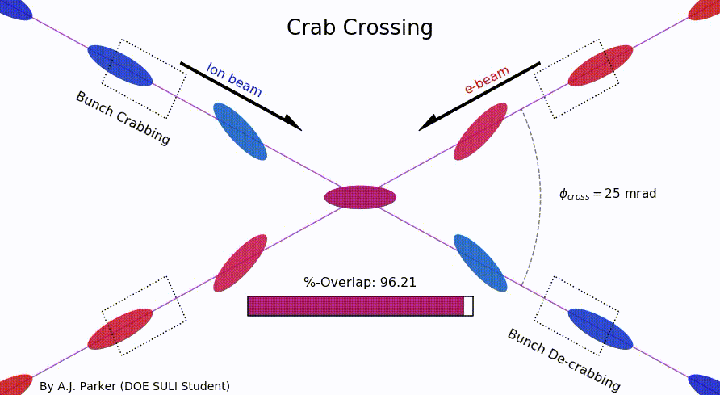
1. Beam-Beam WG
Coordinators: C. Montag(BNL), X. Buffat(CERN)
Synergies with HL-LHC and FCC-ee
Beam-beam parameter;
x=0.01 for protons and 0.1 for electrons

Slide 7
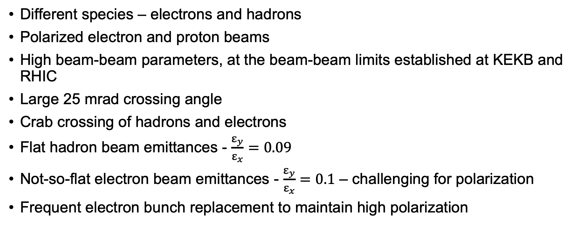
Beam-Beam Challenges in EIC
Transfering Material on Collaboration Indico

Slide 8
2. Polarized Beam and Polarimetry WG
Coordinators: Georg Hoffstaetter de Torqua and Frank Rathmann
Focus on important EIC-specific and general topics of polarized beams such as:
- Theory of spin dynamics in storage rings, including radiative depolarization, spin diffusion, and beam-beam forces.
- Spin simulation tools for polarized beams.
- Polarized beam manipulation and optimization techniques.
- Polarized hadron and atomic beam sources for protons, deuterons and Helios.
- Theory and technology of polarimetry.
- Polarized electron sources.
- Electron polarimetry based on Compton scattering.
Registered group members: 24 members from 8 institutions
Purpose:
Identify topics for polarized EIC beams that can receive significant attention from outside BNL.
Identify and form groups that attend to pertinent topics.
Identify funding sources (especially outside BNL).
Identify potential and help in manpower development.
Maintain contact to respective BNL groups and experts for polarized beams.
Transfering Material on Collaboration Indico

Slide 9
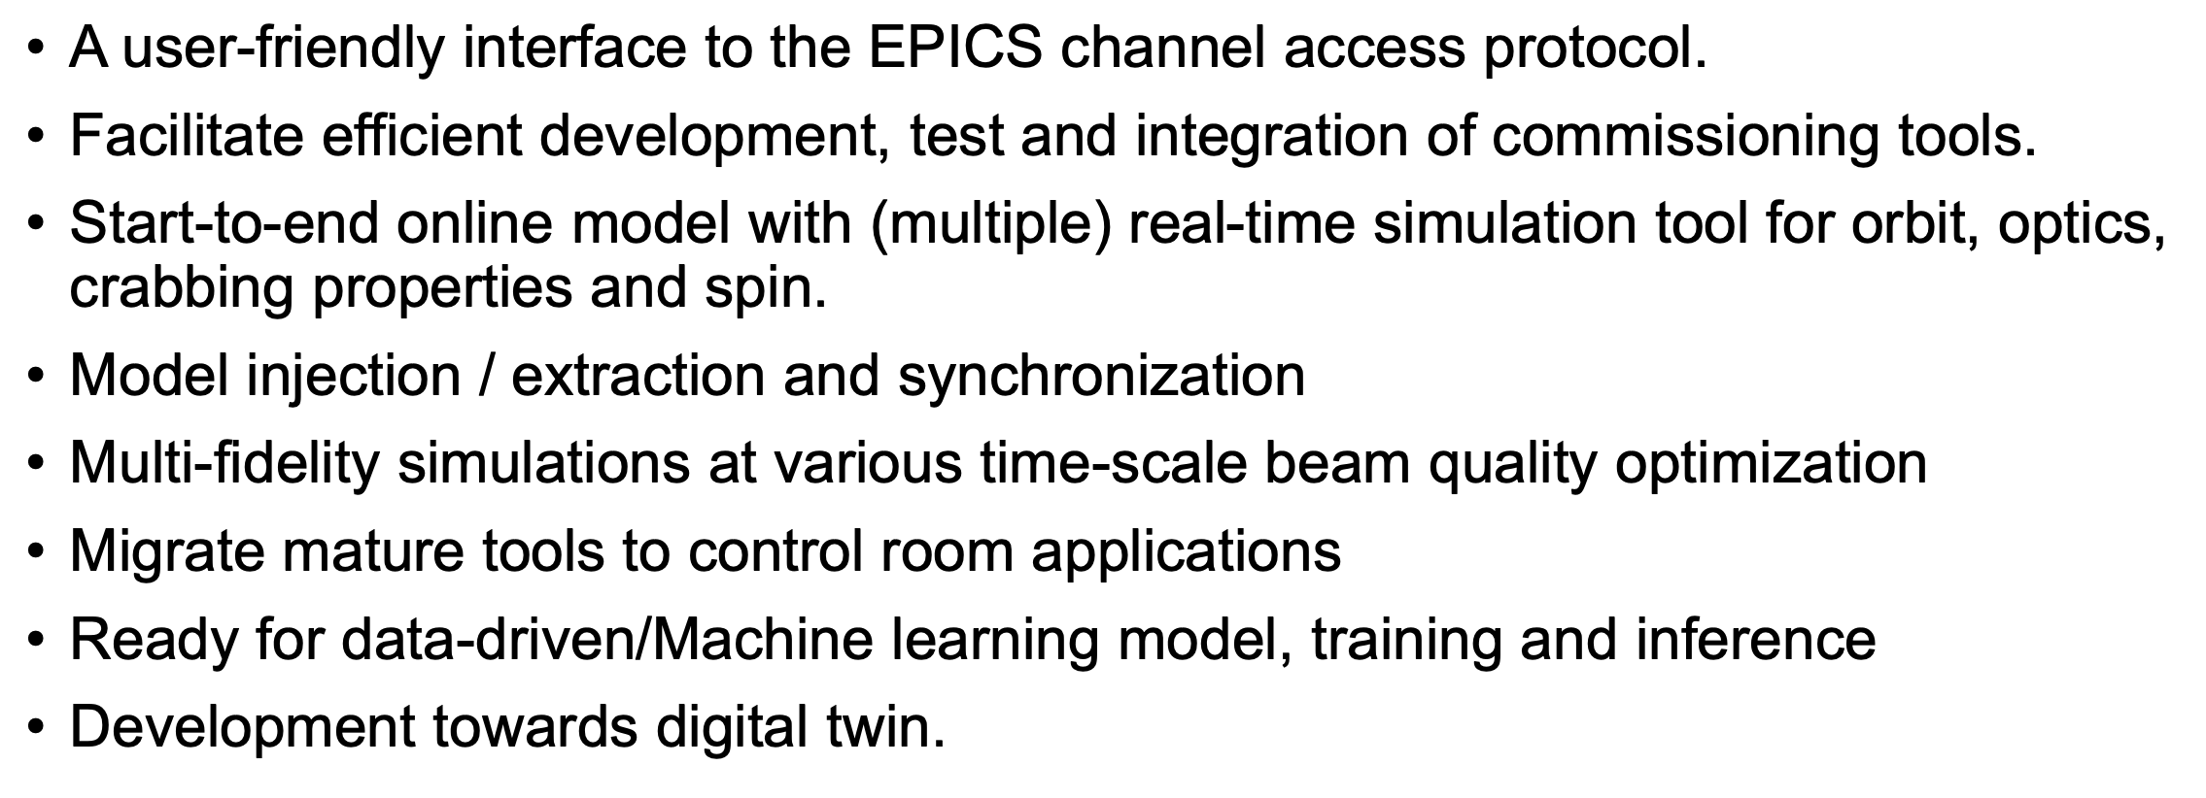
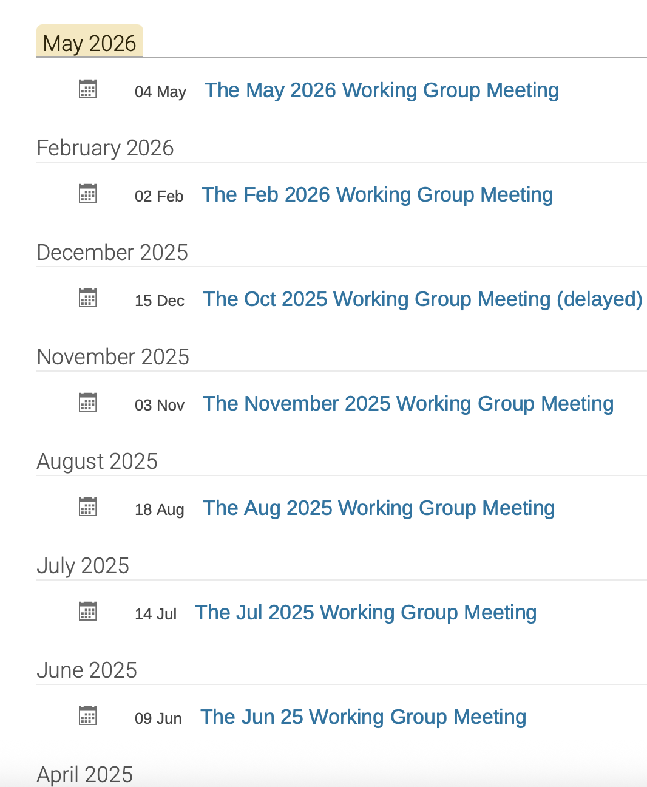
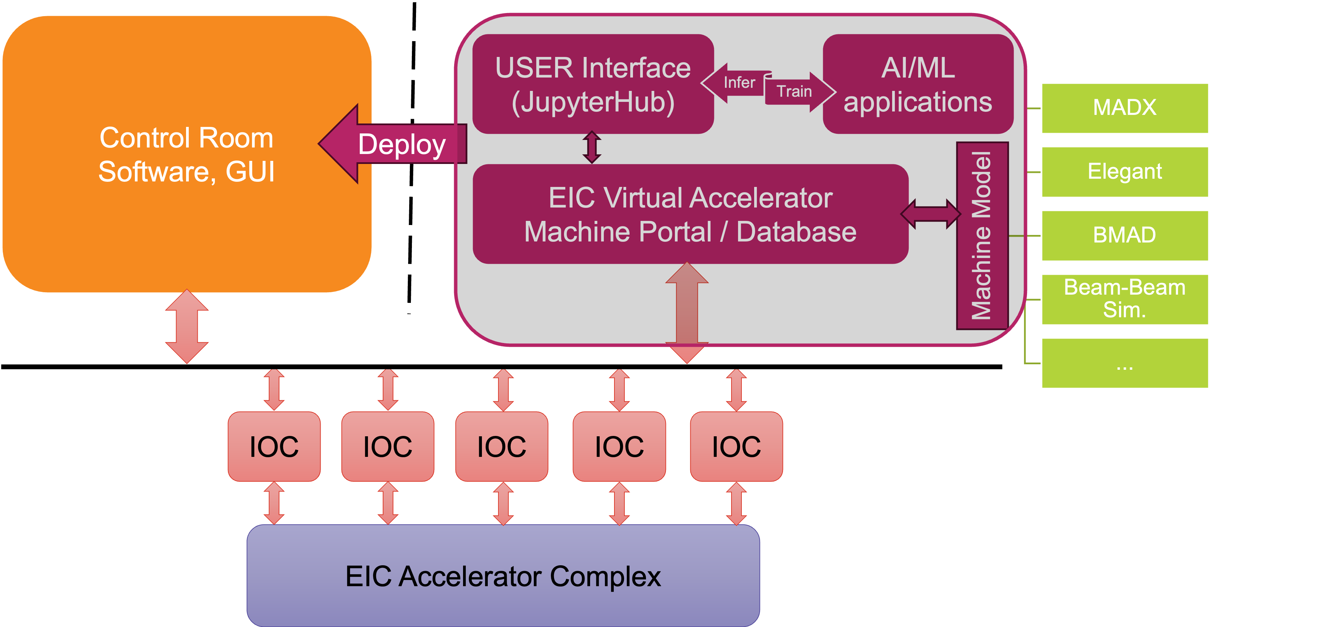
3. EIC Commissioning Tools
Coordinators: Y. Hao (MSU/BNL), J.L. Vay (LBNL)
Regular Meetings and great collaborative effort around tools for acc modelling and AI!
Esthablished parallel initiatives:
EIC-AI and
MOAT (Multi-Office particle Accelerator Team)

Slide 10
WGs next
Not a review, nor a workshop → Knowledge transfer and maximize performances
Cluster subjects that are closely related from a physics perspective and also from an operational perspective. Focus on preparing for a real machine and critical mass in WGs
Build a critical mass of expertise, Maintain high-level, frequent scientific discussions creating an ongoing forum for dialogue among different experts
AI initiatives should be embedded in the WGs→ try to identify key elements from established efforts (EIC-AI and MOAT) to be added to the WGs to push for innovative solutions AI oriented
Working groups under review to foster a more efficient and productive environment!

Slide 11
Conclusions and future plans
Collaboration keeps growing, with new partners and activities emerging
Working Groups are kicking off with activities and exchanges, and re‑optimization is ongoing
  Topics of mutual interest are being identified, and clustering is encouraged to build critical mass for discussions (proposals for new topics and interest are welcome)
  Include AI experts within the WGs to strengthen cross‑disciplinary work
Join the established EIC seminar series and include partners’ R&D topics
Need to establish a framework to foster research activities among collaborators (e.g. shared work packages or joint supervision models)
  EIC/CERN exchange fellowship program under discussion
  Potential extension to other laboratories and universities; feedback is very welcome
Ideas are under discussion and feedback is welcome from all collaborators

Slide 12
Thank you!

