Slide 1
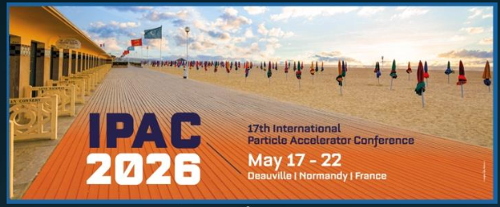
EIC Accelerator Collaboration
Institutional Board Meeting
Welcome
Wolfram Fischer (BNL), Co-Chair
Tatiana Pieloni (EPFL), Co-Chair
29 May 2026

Slide 2
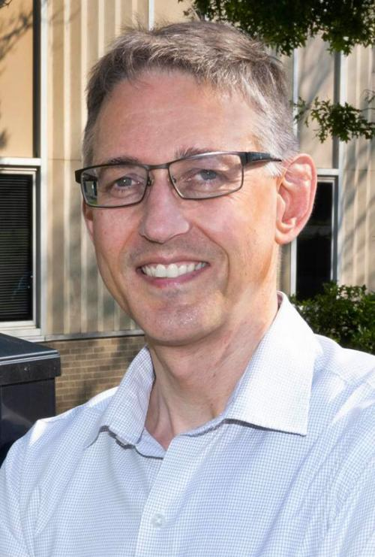
About Me - Wolfram Fischer
Current Role:
  Deputy ALD for Accelerators, Nuclear and Particle Physics Directorate
  Chair, Collider-Accelerator Department
  Co-Chair, EIC Accelerator Collaboration
Experience:
  1995-2026 BNL from post-doc to present position (1 year away in industry),
  focus on all aspects of the RHIC operation and upgrades
  Technical work on collider topics including DA, beam-beam and head-on
  beam-beam compensation, electron clouds, operational issues, automation
  Associate Editor – Physical Review Accelerator and Beams
  IEEE NPSS PAST Chair 2022-24; IPAC’24 Scientific Program Chair; FAIR MAC Chair 2023 –
Education:
  1995 PhD Hamburg University, experimental AP work at CERN and DESY
  2001 MS Management and Policy, Stony Brook University
  2020 US DOE Project Leadership Institute (PLI)

Slide 3
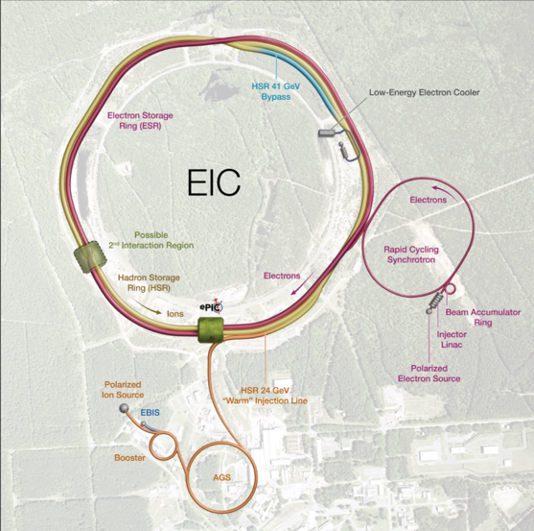
EIC Facility Requirements
Ultimate Performance Parameters
High Luminosity: L= 10³³ – 10³⁴cm⁻²sec⁻¹
Highly Polarized Beams: 70%
Large Center of Mass Energy Range: E_{cm} = 28 – 140 GeV
Large Ion Species Range: protons – Uranium
Large Detector Forward Acceptance and Low-Background Conditions
Possibility to Implement a Second Interaction Region (IR)
3

Slide 4
EIC Accelerator Collaboration
Main Elements of the EIC Accelerator Collaboration:
Institutional Board
Co-Chairs
Working Groups
Collaboration Meetings
Fellowships (yet to be established)

Slide 5
Welcome
First meeting of the
EIC Accelerator Collaboration Institutional Board
Thank you all for all for agreeing to be member of the
EIC Accelerator Collaboration Institutional Board

Slide 6
EIC AC Institutional Board – membership
Lin Liu | LNLS | Brazil
Oliver Kester | TRIUMF | Canada
Guillaume Olry | IJCLab | France
Pierre Vedrine | CEA Saclay | France
Qing Qin | ESRF | France
Ralph Assmann | GSI/FAIR | Germany
Lucio Rossi | INFN Milano | Italy
Roberto Cimino | INFN-LNF | Italy
Moses Chung | Pohang Accelerator Lab | South Korea
Amalia Ballarino | CERN | Switzerland
Graeme Burt | Lancaster University | UK
Carsten Welsch | University of Liverpool | UK
Nik Templeton | STFC | UK
Phil Burrows | John Adams Institute | UK
Stewart Boogert | Cockcroft Institute | UK
Georg Hoffstaetter | Cornell University | United States
Jean Delayen | Old Dominion University | United States
John Power | ANL | United States
Mei Bai | SLAC | United States
Sam Posen | Fermilab | United States
Sarah Cousineau | ORNL | United States
Soren Prestemon | LBNL | United States
Young-Kee Kim | University of Chicago | United States
Yue Hao | FRIB | United States

Slide 7
Agenda today
Welcome and Status of the EIC AC activities Wolfram 15 min
Working groups Tatiana 15 min
Role of the Institutional Board Wolfram 15 min
Timeline and next steps Tatiana 15 min

Slide 8
EIC Accelerator Collaboration – short history
Formed in 2023
Co-Chairs (~2-year terms, staggered)
  Carsten Welsch (U Liverpool) 2023 – 2024
  Andrei Seryi (JLab/ODU) 2023 – 2025
  Tatiana Pieloni (EPFL) 2025 –
  Wolfram Fischer (BNL) 2026 –

Slide 9
EIC Accelerator Collaboration – short history
Active Working Groups
  Beam-beam
  Christoph Montag (BNL) and Xavier Buffat (CERN)
  Polarized Beams & Polarimetry
  Frank Rathmann (BNL) and Georg Hoffstaetter (Cornell)
  Commissioning Tools
  Yue Hao (MSU) and Jean-Luc Vay (LBNL)

Slide 10
EIC Accelerator Collaboration – short history
Collaboration Meetings
  IPAC’24, Nashville
  IPAC’25, Taipei
  NAPAC’25, Sacramento
  IPAC’26, Deauville

Slide 11
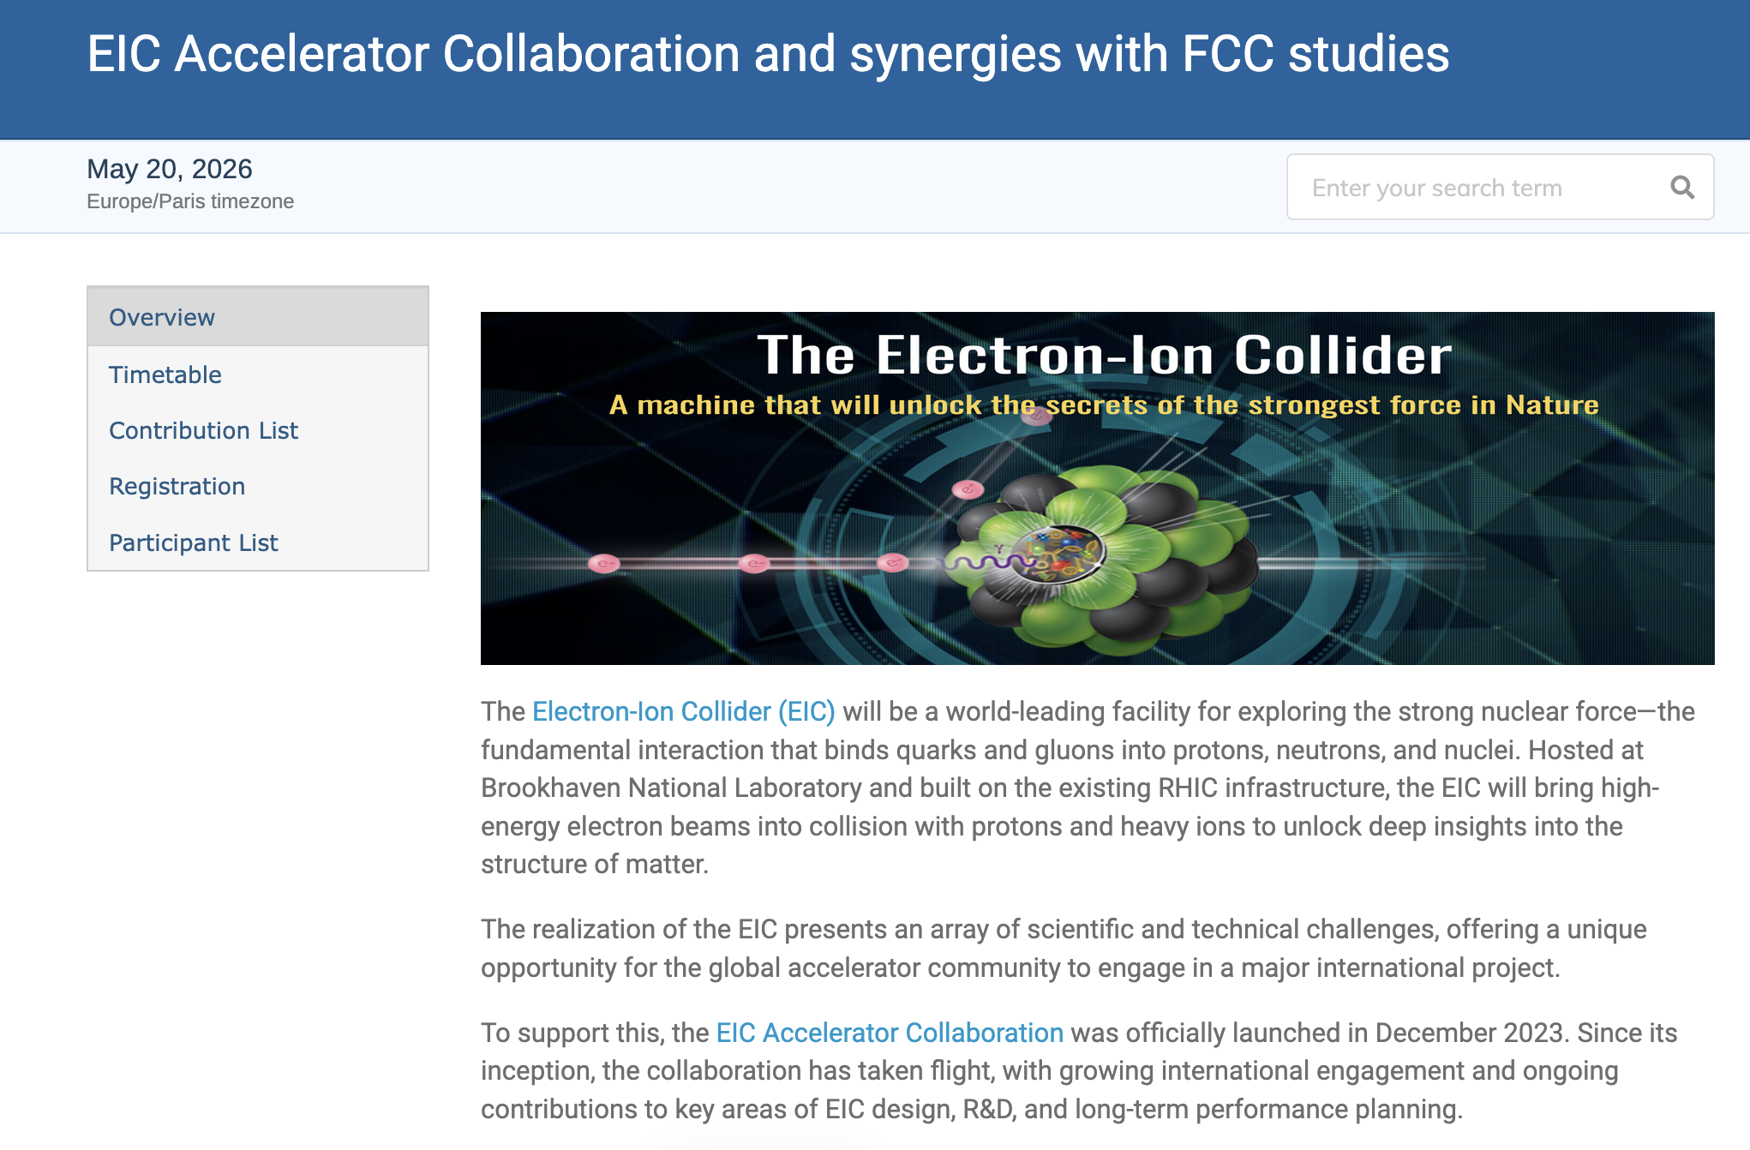
62 registratrants

Slide 12
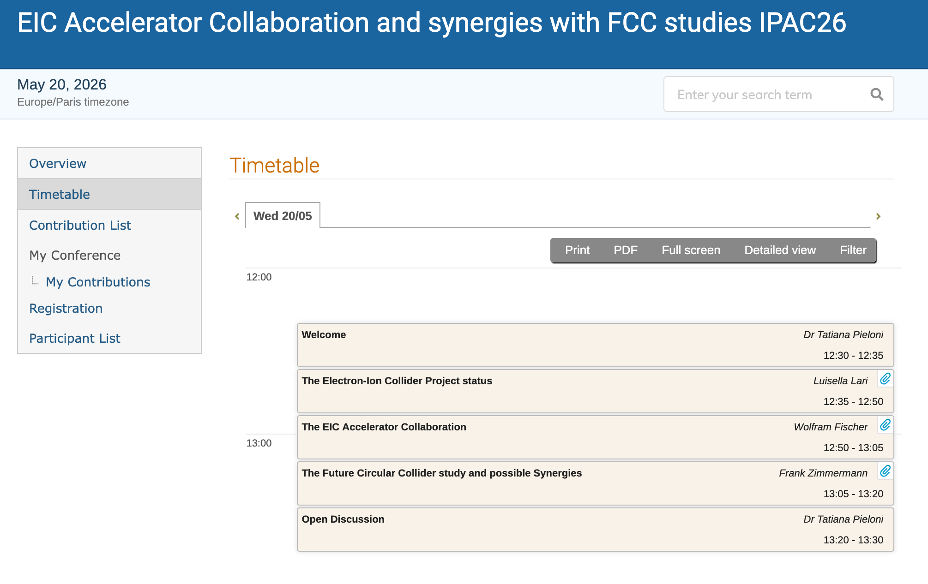

Slide 13
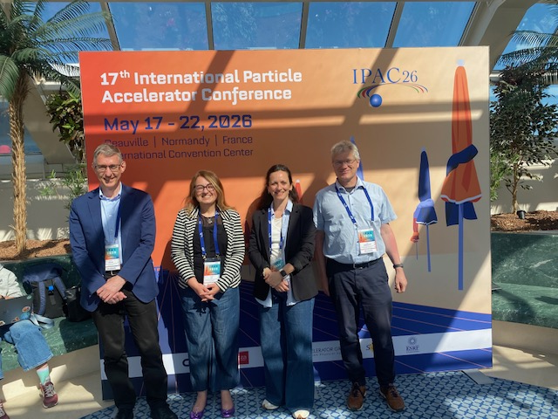
Luisella Lari (BNL)
Frank Zimmermann (CERN)
Wolfram Fischer (BNL)
Tatiana Pieloni (EPFL)

Slide 14
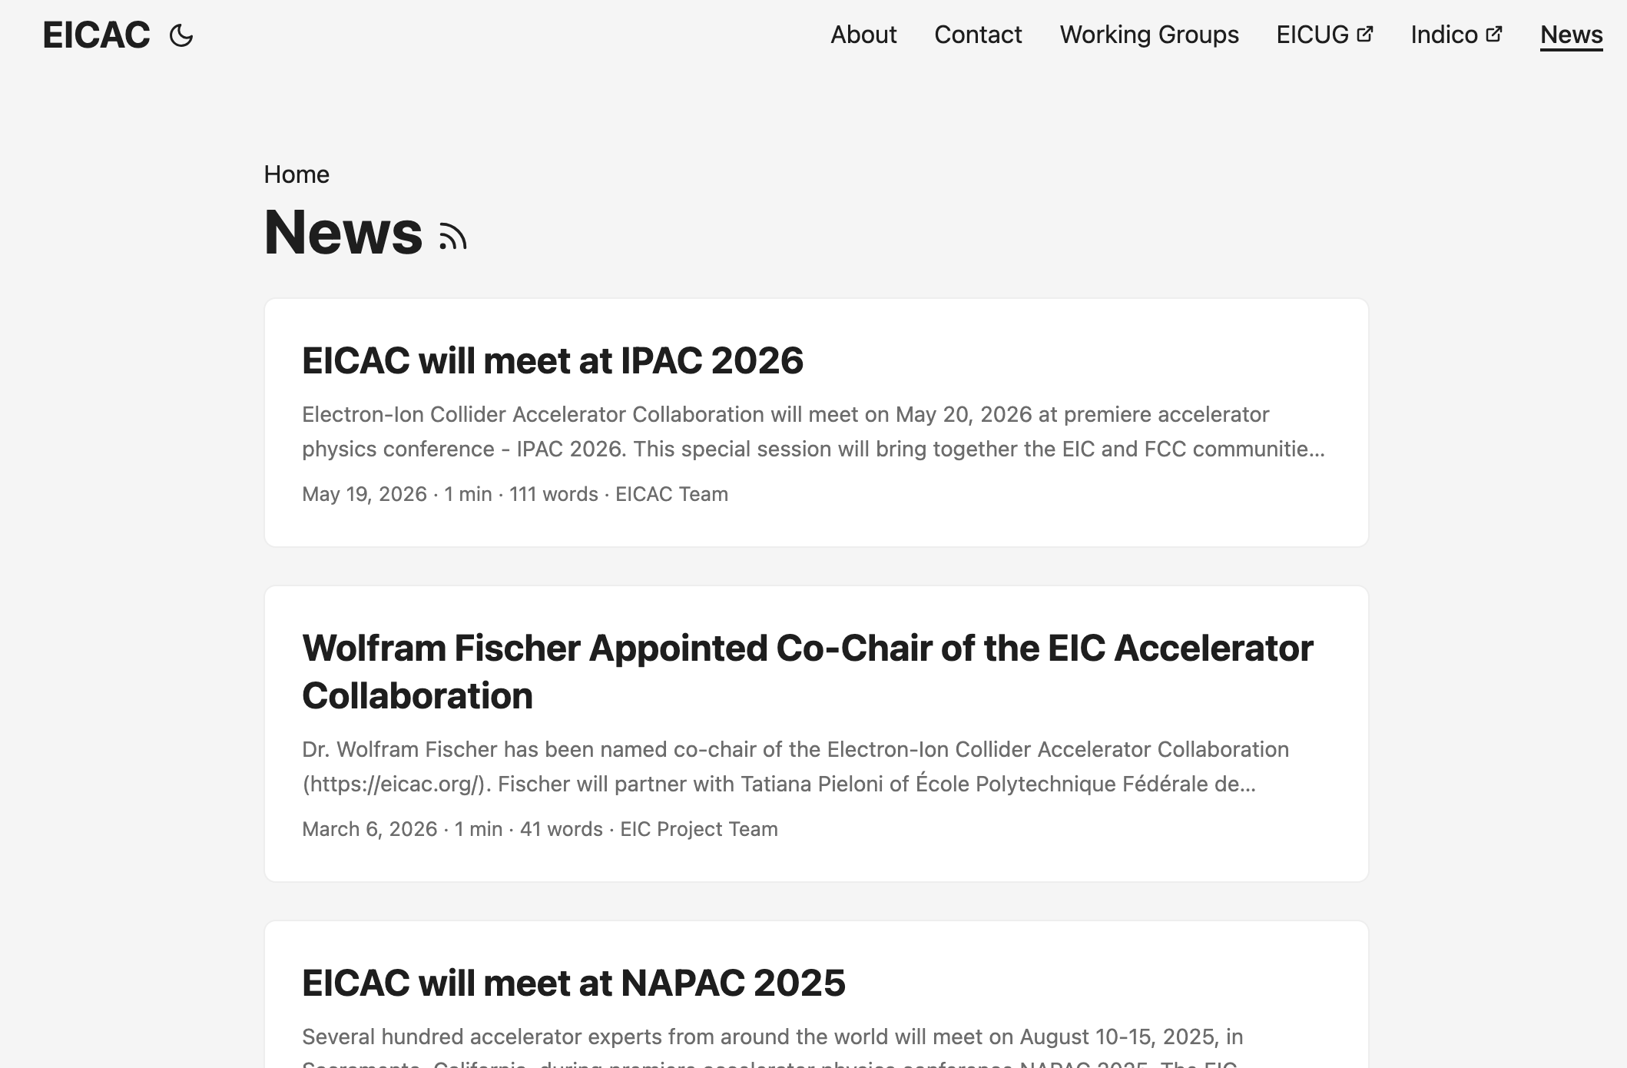
What is the EIC Accelerator Collaboration
https://eicac.org/

Slide 16
What is the EIC Accelerator Collaboration
We would like to collaborate with other labs in the world
  to realize the EIC, and
  for mutual benefit
On topics of common interest in
  Beam dynamics
  Technology

