Slide 1
US FCC Tracking/PID Meeting
13-May-2026
Summary
Carl Haber
Lawrence Berkeley National Lab
https://indico.global/event/17982/

Slide 2
This meeting originated out of the rescheduling of the international tracking meeting (5-8 May 2026 BNL)
Leadership believed it would still be useful for this community to meet in person
Also have been discussing a US MAPS meeting over the last 9 months
BNL presents an opportunity to meet up with ePIC/EIC colleagues who share many of the same tracking and PID/timing requirements
Take stock in where we are now
What are US opportunities? Can we be more strategic?

Slide 3
Where are we?
Our technical work has been funding limited
Strong effort in place, and supported, on straw tube tracking. Status and results have been presented in a number of recent meetings
Two funded MAPS efforts at SLAC and FNAL, but really not sufficient funding to have a large impact on the international effort yet
Strong interest in large open drift chambers
Novel schemes for mass reduction – CF wires
Limited funding so far from non-US HFCC sources – LDRD etc
Physics and performance studies – see next presentation (Christoph)
Genesis Mission?

Slide 4
US Technical Strengths
Wire chambers/straws/TPCs
ASIC engineering at national labs with university groups – ie Penn, etc
Fast timing LGADs, leading groups in silicon – UCSC, BNL, FNAL, SLAC, emerging SiC – LBNL, NCSU, BNL
Low mass mechanics and materials
DAQ
AI/ML + industry
Synergies with NP community ePIC/EIC, offices combined at DOE

Slide 5
What are important technical needs/opportunities?
dN/dx: Electronics UM, Penn?, Gas mixtures
MAPS – SLAC, FNAL, BNL, university groups
Very low mass mechanics – already very active (ALICE etc) but need to gain technical capabilities more broadly in USA
Novel low mass components and composites – ie CF wires, integrated structures, etc.
TOF optimized for low mass and good position resolution – wrapper layers which can contribute to momentum measurement
  Both technical developments and design/simulation/optimization
Electronics with minimal cooling requirements
How to control systematics in the design and function of the tracker/PID
  Alignment, acceptance, efficiency, role in flavor tagging – all important issues for the Z pole

Slide 6
What could a healthy US effort look like?
Strongly integrated into the international FCC MAPS community
Cultivated US foundry(s) to source MAPS components
US low mass mechanical resources – national labs and universities – are strongly engaged in both inner(pixel) and global support efforts
Major deliverables in the gaseous tracking – for example a large drift or straw tube chamber(s)
AI/ML developments in on-detector systems well established roles
Leverage our experience and expertise in fast timing towards high performance wrapper layer(s)
Concrete approaches to the control of systematic errors in the design of the tracker/PID system, integrated from the start

Slide 7
AM Agenda
Intro
FCCee Tracking: Christoph
MAPS
  FNAL: Artur
  BNL: Leonardo Cecconi
  SLAC: Caterina
LBNL FCCee LDRD: CH, did not have time to present, but posted
Discussion

Slide 8
PM Agenda
ePIC/EIC Overview: Ernst Sichtermann
ePIC SVT-1: Gian Michele Innocenti – ALICE → ePIC
ePIC SVT-2: Gregor Deptuch – ASIC developments
ePIC AC LGADS TOF and far forward: Alex Jentsch
Monolithic AC-LGADs: Alessandro Tricoli
Discussion

Slide 9
Tracking at FCCee (C.Paus)
Physics goal, run plan, requirements
LEP trackers → FCCee tracker options
How technology relates to resolution
Survey of technologies – MAPS/SS, Gaseous, PID, mechanics
PID solved? But TOF – role of an inner TOF (35-50 cm), t0 and pT cutoff
Emphasize B field discussion, leading into
Importance of early simulation efforts, many key studies remain to be done
  Magnetic field
  Tuning fast simulation
  BIB
Conclusions

Slide 14
MAPS USA
FNAL
  Arcadia collaboration
  Strong emphasis on (new) test and characterization capabilities – bench, test beam, HEERC facility
  3D MAPS project – integration of timing (LGAD structures) with MAPS
BNL
  Focus is working with ALICE3 (2033) to integrate knowledge from these efforts and then transition to FCCee, MOSAIX→ALMIRA
SLAC
  TPSCo 65 nm effort – SLAC/CERN/Brown/ORNL/Oregon collaboration
  Looking forward to LESA test beam facility FY27, 2-8 GeV low intensity e beam

Slide 21
1–few electrons per bunch will be available at 2.0-8.0 GeV energies, with a bunch spacing of up to 10 Hz

Slide 22
LBNL FY27 LDRD Proposal (under review)
Focus on acquiring new expertise/experience which would be relevant to a future Higgs factory
Design, fabrication, and manipulation of extremely thin and low mass structures
Leverage existing effort on wide-band-gap (SiC) LGADs towards the needs of an inner timing layer
Focus on appropriate readout electronics (also WBG) and system issues

Slide 23
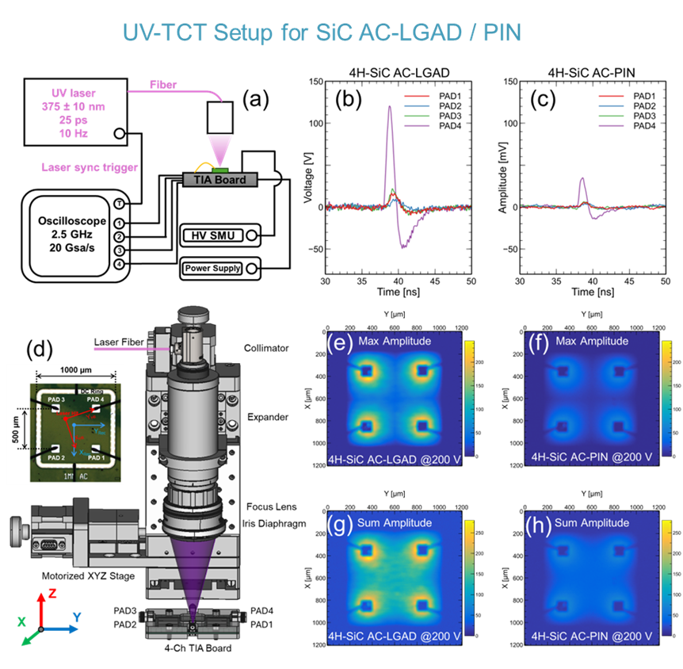
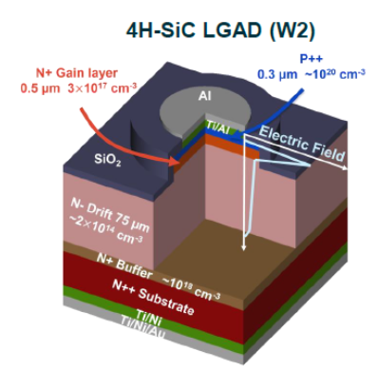
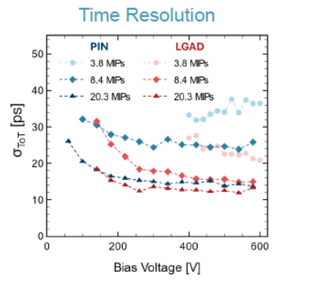
Target of Opportunity
For high resolution tracking the B field results in a cutoff > 1 GeV at 2m
Solution is a low mass inner timing layer at R=0.5 m but t_res ~20 ps
LBNL/NCSU/BNL have developed wide-band-gap Silicon Carbide LGADs
AC coupled with good spatial resolution (ML enhancements as well)
WBG/SiC = high temperature operation and very fast response
If implemented in a low mass layer with passive cooling and appropriate high temperature electronics this could be a great solution to an INNER FAST TIMING LAYER

Slide 24
LDRD Year 1 Proposal
We propose to focus on low mass and fast timing technologies
Leverages experience, facilities, and past LDRD and project investments
Eventual focus is an inner fast timing layer with only passive cooling by combining our SiC-LGADs with WBG ASICs and ultrathin supports
Manipulation of extremely thin semiconductors and carbon materials
Layout and design of a high performance inner fast timing/tracking layer
Emerging ASIC design using wide band gap WBG (SiC and GaN) processes to complement our SiC-LGAD effort
Simulation of extremely thin composite structures including thermal effects
Low mass electronic transmission lines in carbon nanotubes
A second year would extend the prototyping of mechanical structure and include a fabrication of wide band gap ASIC

Slide 25
ePIC/EIC Overview
Uploading of slides are pending
2034 eA collisions, subject to funding and etc. delays
Commonality of tracking requirements EIC/FCCee were clear already in the ECFA Detector R&D Roadmap
ePIC/EIC is a deep inelastic scattering experiment in an asymmetric collider configuration. Layout of subdetectors strongly coupled to kinematics – coverage of various regions of x and Q² ,electron/hadron hemispheres

Slide 30
ePIC-SVT1
Extensive review of ALICE ITS3 effort which dramatically advanced the state-of-the-art
  Relatively large bent sensors
  MOSAIX architecture
  Jumping off point for ePIC application (and FCCee?) MOSAIX → LAS
ePIC LAS changes driven by coverage, reduced hit rate, mass, integration, powering…
But scale demands a new approach to testing
Next challenges – data aggregation, application of ML to readout

Slide 34
ePIC-SVT2 – Beyond the ePIC baseline
Series of test chiplet submissions – ADC, driver, transmission, front end
3D stacked MAPS – to add additional functionality
anASIC – support/control and power management

Slide 37
ePIC TOF and far forward detectors
Extensive discussion of AC-LGADs deployed in the far forward system
Commonality of implementation with “central” TOF
Performance results of AC-LGADs from BNL
Presentation of EICROC dedicated readout ASIC for LGADs at EIC
Excellent results presented on spatial and temporal resolution when integrated with EICROC ASIC

Slide 41
Monolithic AC-LGADS
Effort embedded in the broader “4D-Tracking” community
Targets “silicon wrapper” and/or TOF layer(s)
Surveyed a variety of technical implementation underway
  Europe: CASSIA, MadPIX, Cactus-GL
  US/Japan (BNL et al): LGAD on CMOS, SOI AC-LGAD
    LGAD on CMOS – double metal, electronics on the periphery
    Vendor survey for SOI fabrication: LAPIS and XFAB
Use of machine learning for signal processing from AC-LGAD to improve position resolution*
* Have a parallel effort at LBNL on SiC-LGAD also using ML techniques to improve both time and position resolution

Slide 45
Conclusions (mine)
Believe a coherent and well-balanced program/opportunity exists for the US in tracking and timing
Some key elements are already in-place but funding commitments will be needed to really get this underway with more participation
Concerning performance the B-field/timing questions are an obvious set to address early on, and take a position
In spite of low funding from US HFCC there is a strong USA MAPS effort already underway in a broader (generic/4D/legacy) context
We already knew that the ePIC/EIC community faced similar tracking requirements
Impressive progress across a variety of technical fronts (!)
Interesting and collegial exchanges
Continued dialogue/collaboration with this community would be a very positive development – hope to see some representation at the US FCC Workshop in September (SLAC)

Slide 46
Backup Slides

Slide 47
Structure of this meeting
Hopefully ample time for unstructured discussions around talks
AM
Tracking overview from L1
3 presentations on US MAPS efforts
LBNL LDRD proposal
Lunch at the cafeteria
PM – meet with ePIC/EIC colleagues
ePIC/EIC overview
Several MAPS/SVT talks
PID/TOF with AC-LGADs
Dinner

