Slide 1
CuringBoxPCB_V0

Slide 2
Table of contents
PCB
Schematics
Communication protocols
Arduino-Code (C-language)

Slide 3
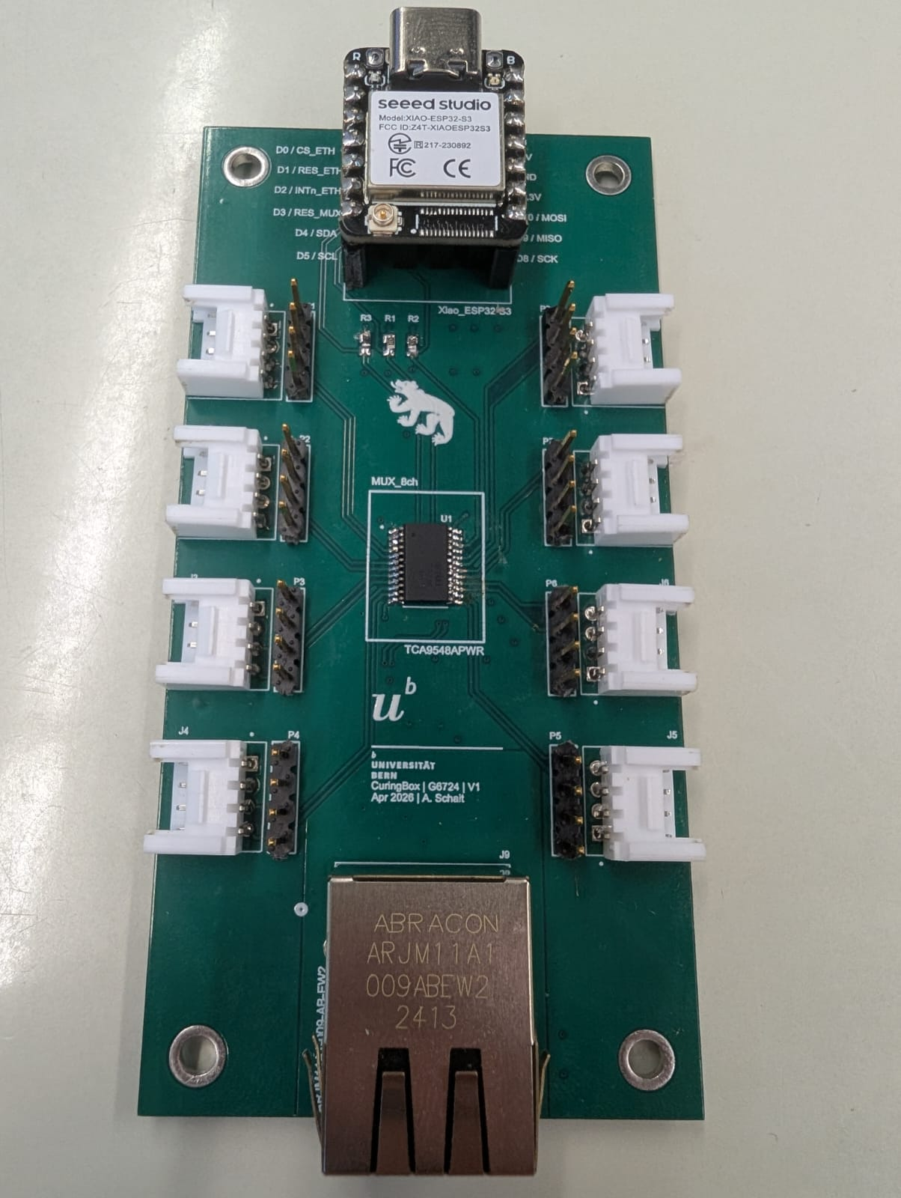
PCB_Top

Slide 4
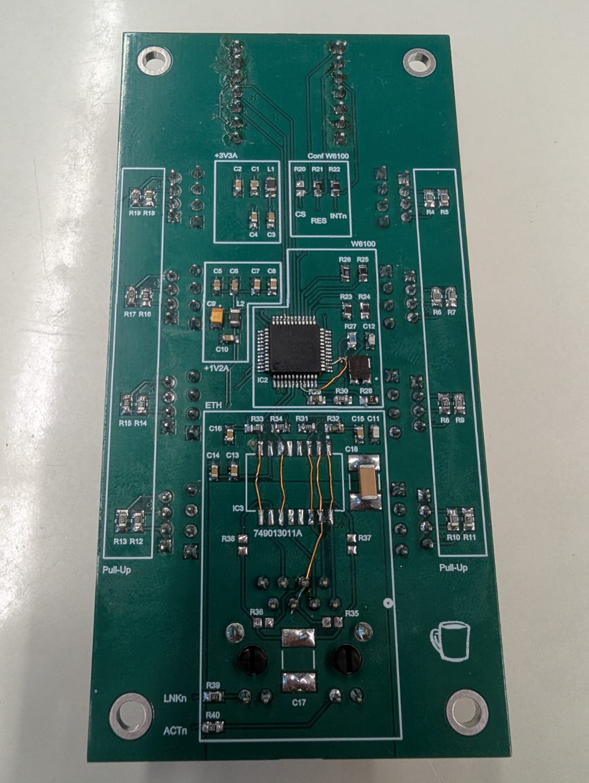
PCB_Bottom

Slide 5
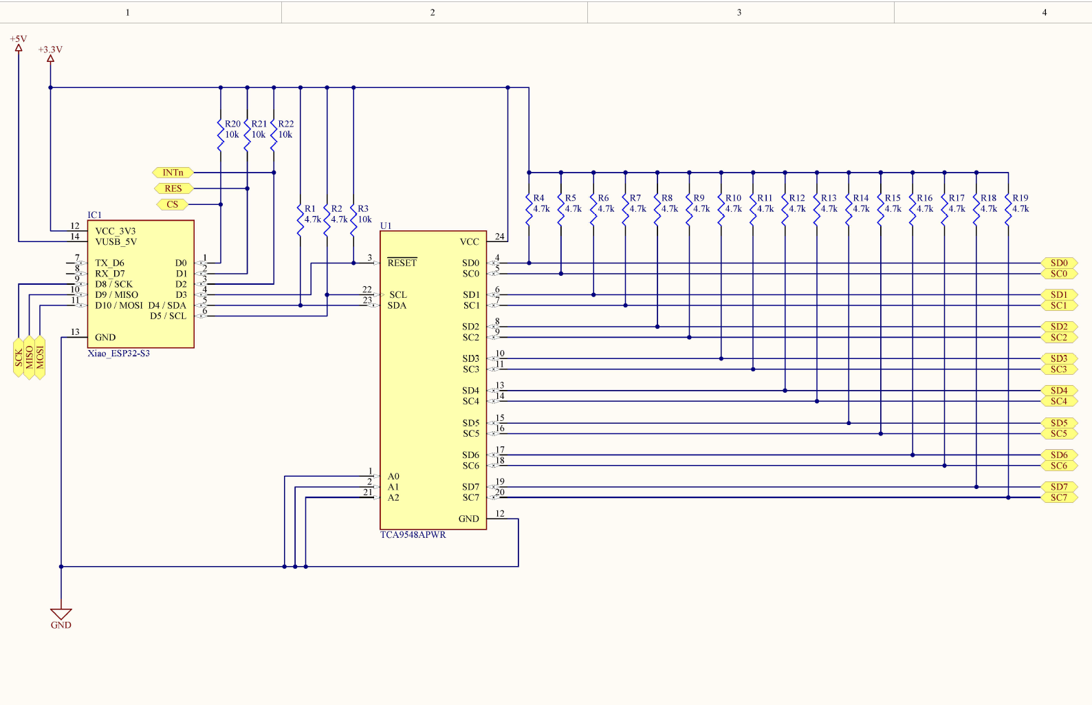

Slide 6
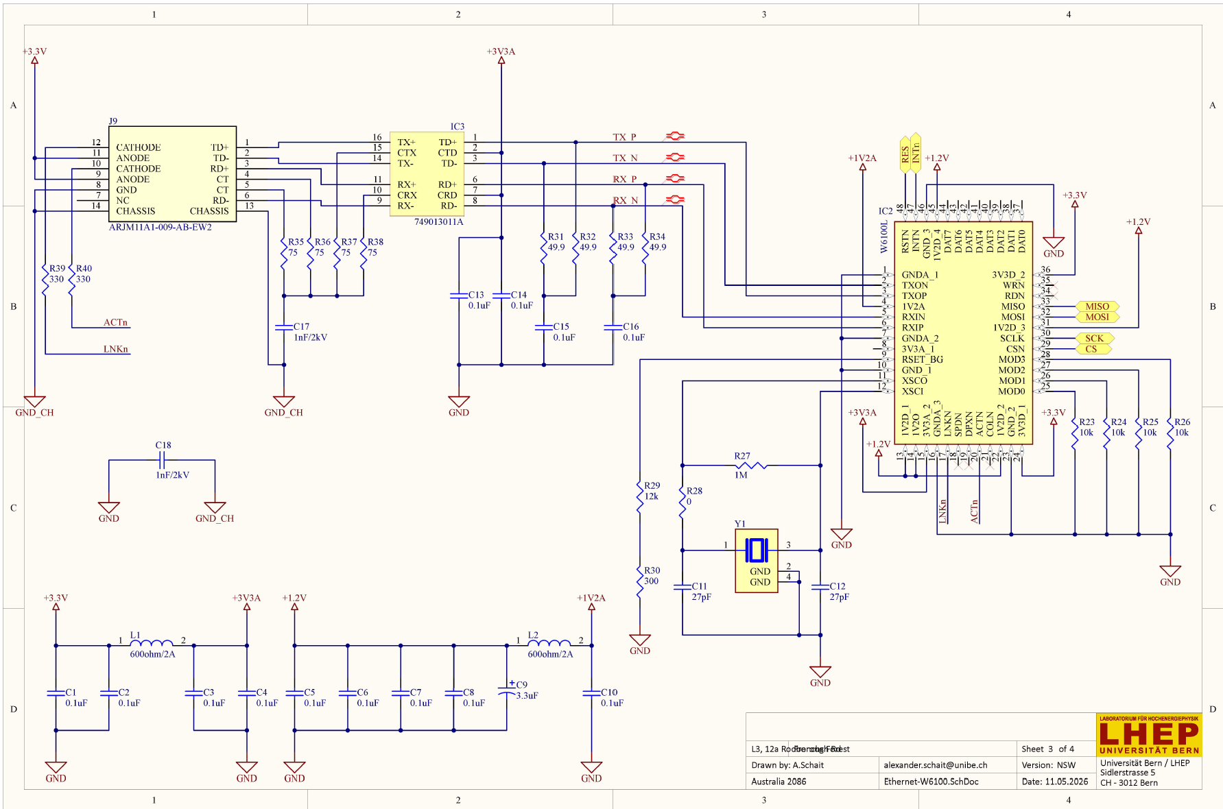

Slide 7
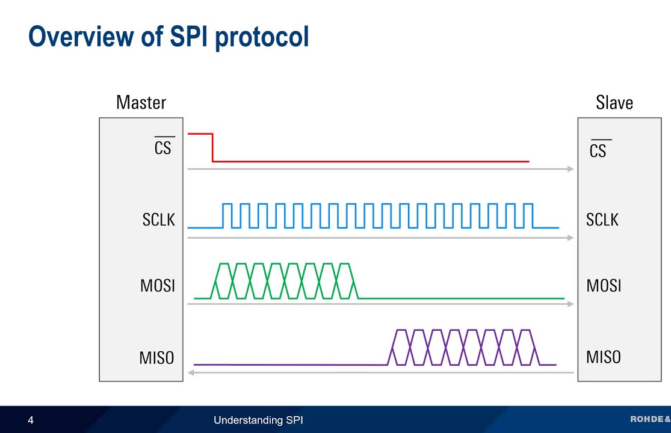
SPI – Serial Peripheral Interface
CS -> Chip Select / Slave Select
SCLK -> Serial Clock
MOSI -> Master Out Slave In
MISO -> Master In Slave Out
High data transfer rates [MHz] on short distance [PCB]
Full Duplex (simultaneous send & receive)

Slide 8
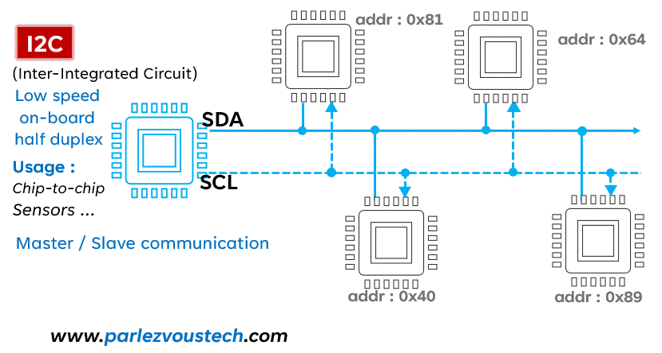
I2C – Inter Integrated Circuit
SCL -> Serial Clock
SDA -> Serial Data
Low data transfer rates [kHz] on longer distance than SPI
BUT distance of cable is restricted by physical capacitance
MUX: isolates the capacitance of each sensor branch

Slide 9
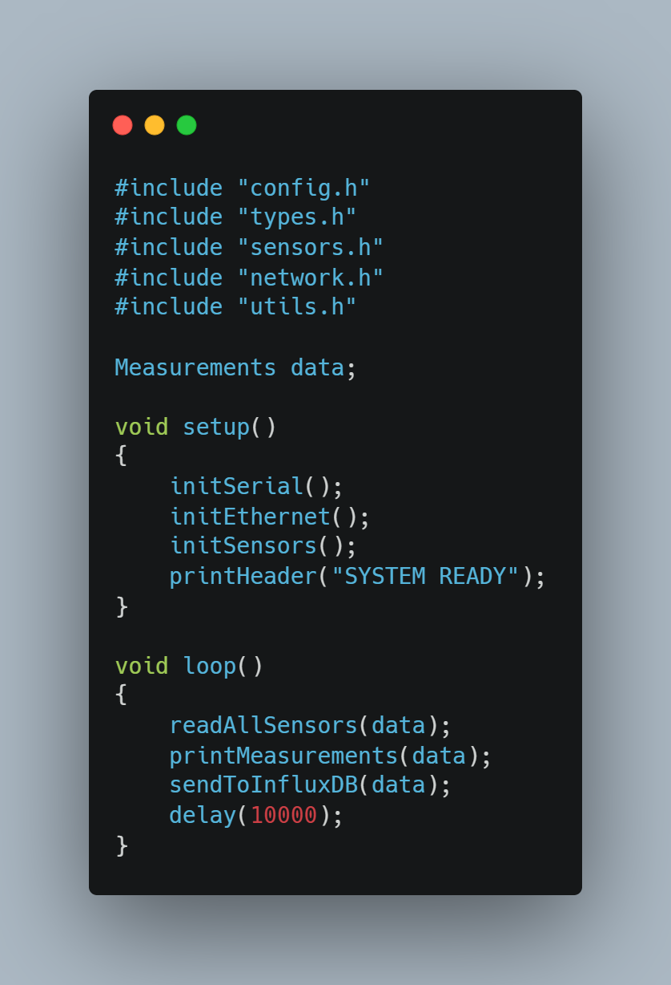
Arduino-Code
What to change to add a new sensor?
initSensors()
All 3 functions in loop()

Slide 10
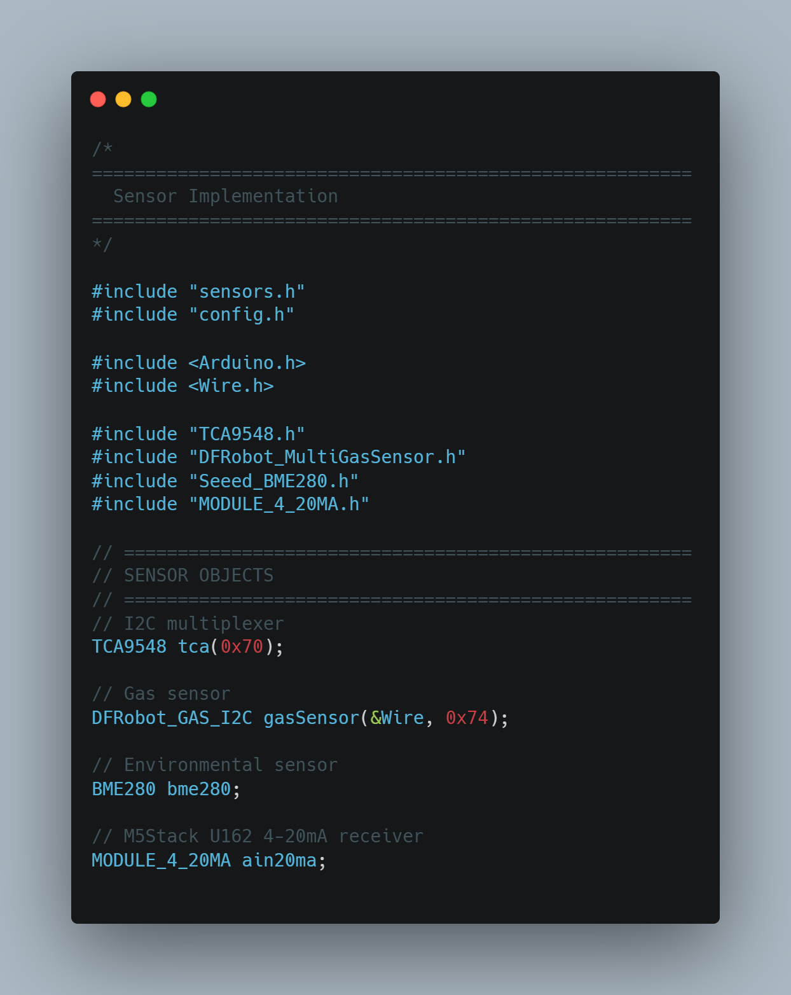
Define newSensor
Install & add library (library manager/GitHub)
Define & find I2C address
Initialize communication with sensor

Slide 11
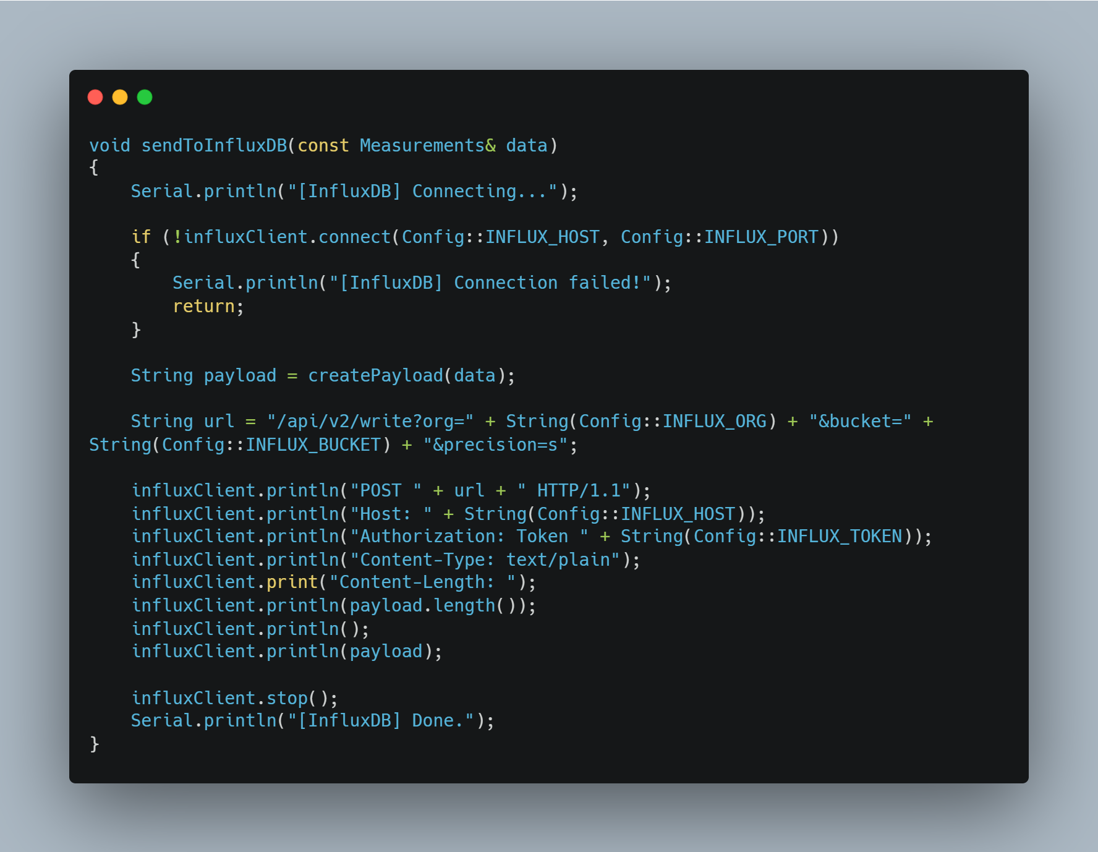
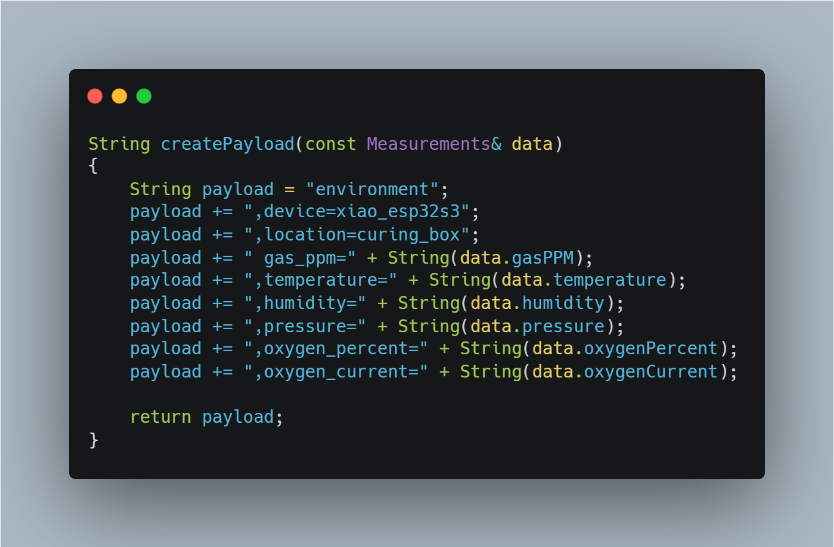
Send data to InfluxDB

