Slide 1



The Importance of Open Source Software in Open Data
Will Roper

Slide 2

A Little About Me
Credit: SWIFT
Research Fellow @ University of Sussex
Computational Astrophysicist
Essentially an RSE (and soon to transition officially)
Lead developer of the Synthesizer synthetic observations code.
Core developer and maintainer of the SWIFT cosmological simulation code

Slide 3
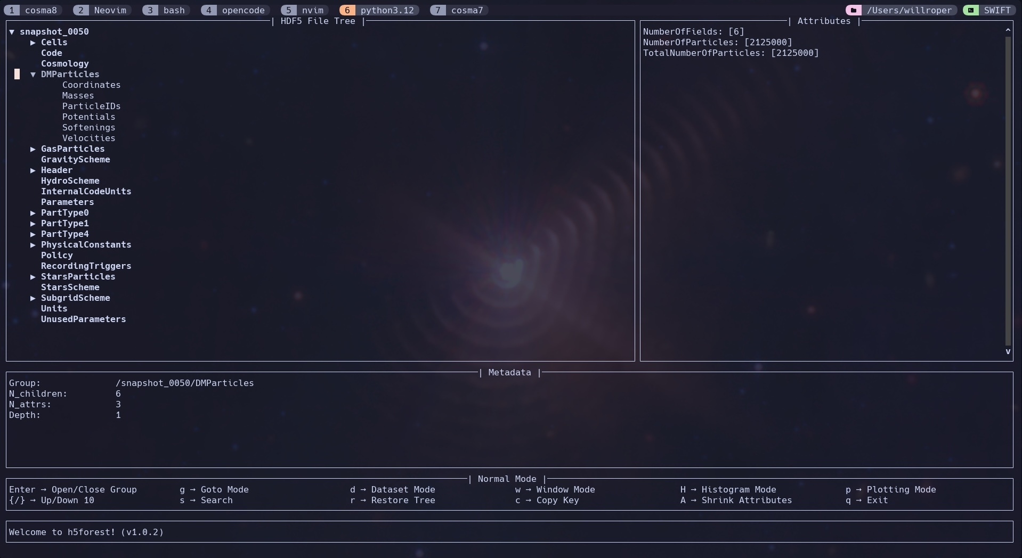
What does our data look like? (Bonus data round)
HDF5 files (the dark days of binary outputs are thankfully behind us).
Anything from Gigabytes to Petabytes!
Particle-based raw outputs at fixed times.
Derived datasets like galaxy catalogues.

Slide 4
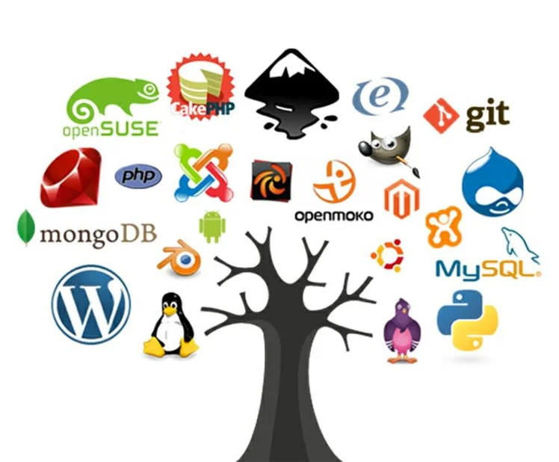
Why am I talking about OSS?
Data without a methodology is essentially useless.
The easiest way to share a detailed methodology is for it to be an open-source code.
Open Source Software is only as good as its interpretability.
Our codes and data are educational tools as much as research tools.
What happens when holding on to the data is more expensive than regenerating it?

Slide 5
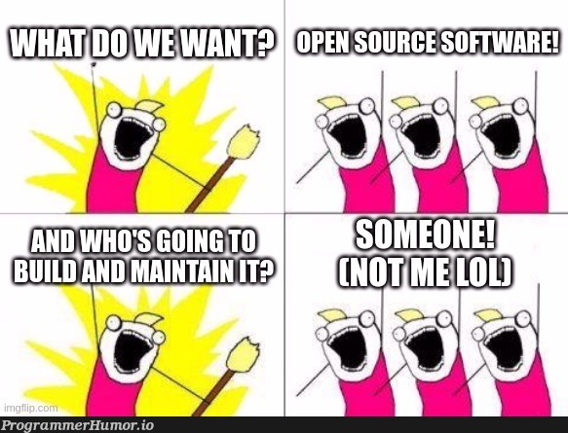
What makes good OSS?
Interpretability: How quickly can you understand it?
Reproducibility: How easily can you run it and get results?
Extensibility: How easy is it to extend the code?
Reliability: How confident can you be that it works as intended?

Slide 6
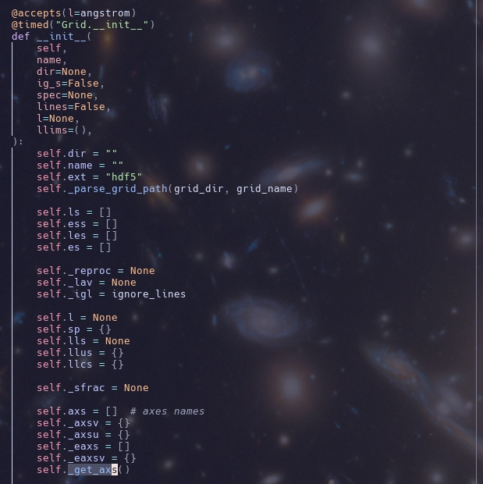
Code Quality

Slide 7
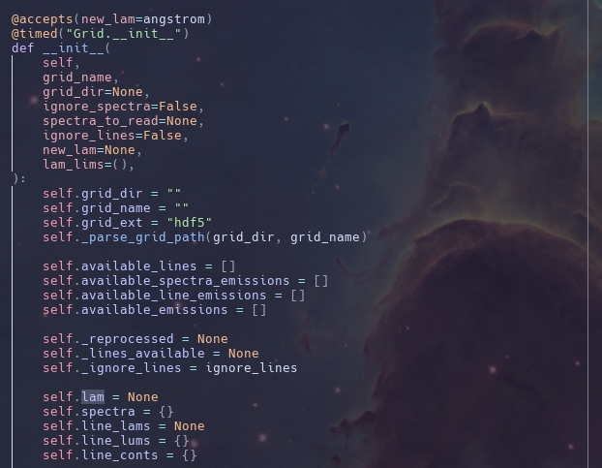
Code Quality

Slide 8
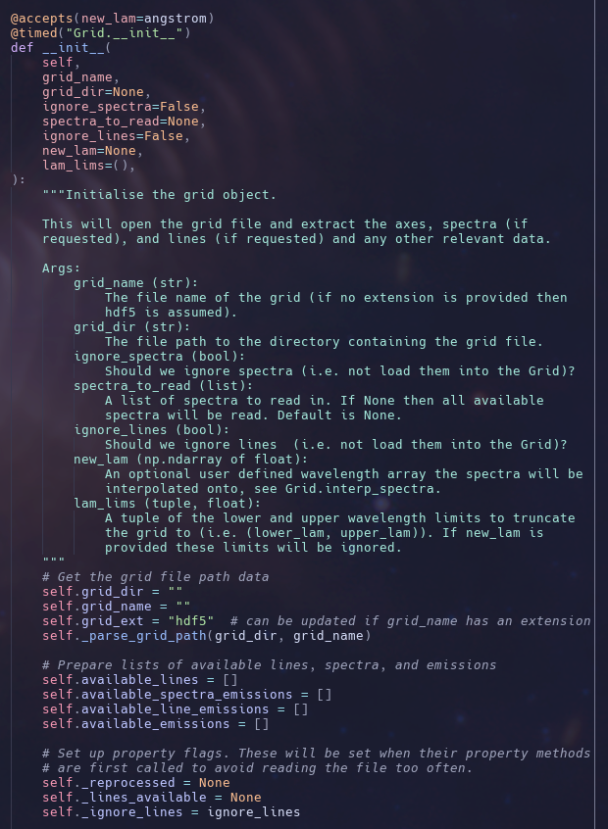
Code Quality (COMMENT YOUR CODE)

Slide 9
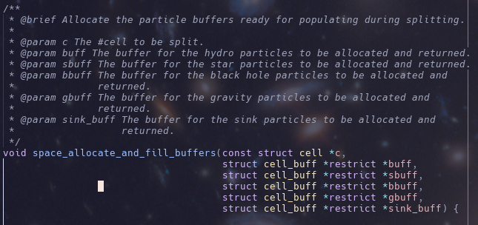
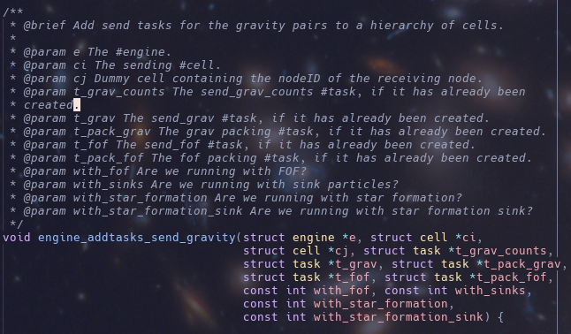
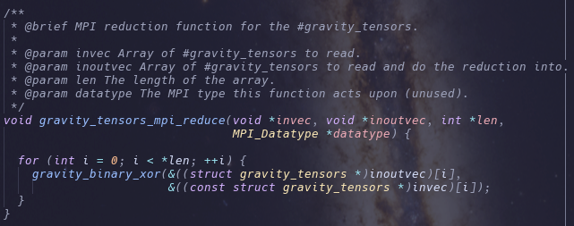
Code Quality (COMMENT YOUR CODE)

Slide 10
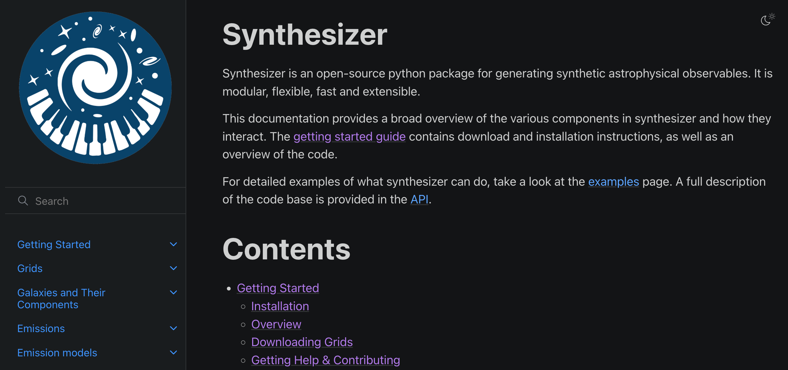
Documentation

Slide 11
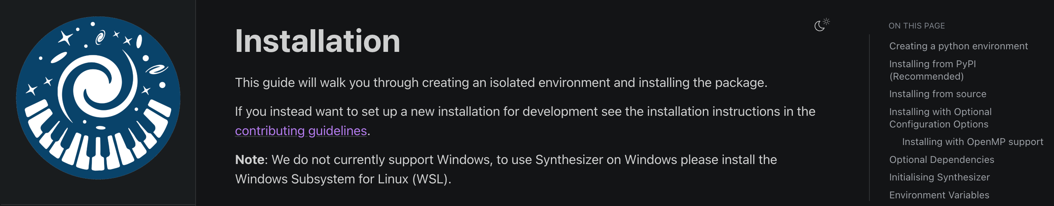
Documentation (For installation)

Slide 12
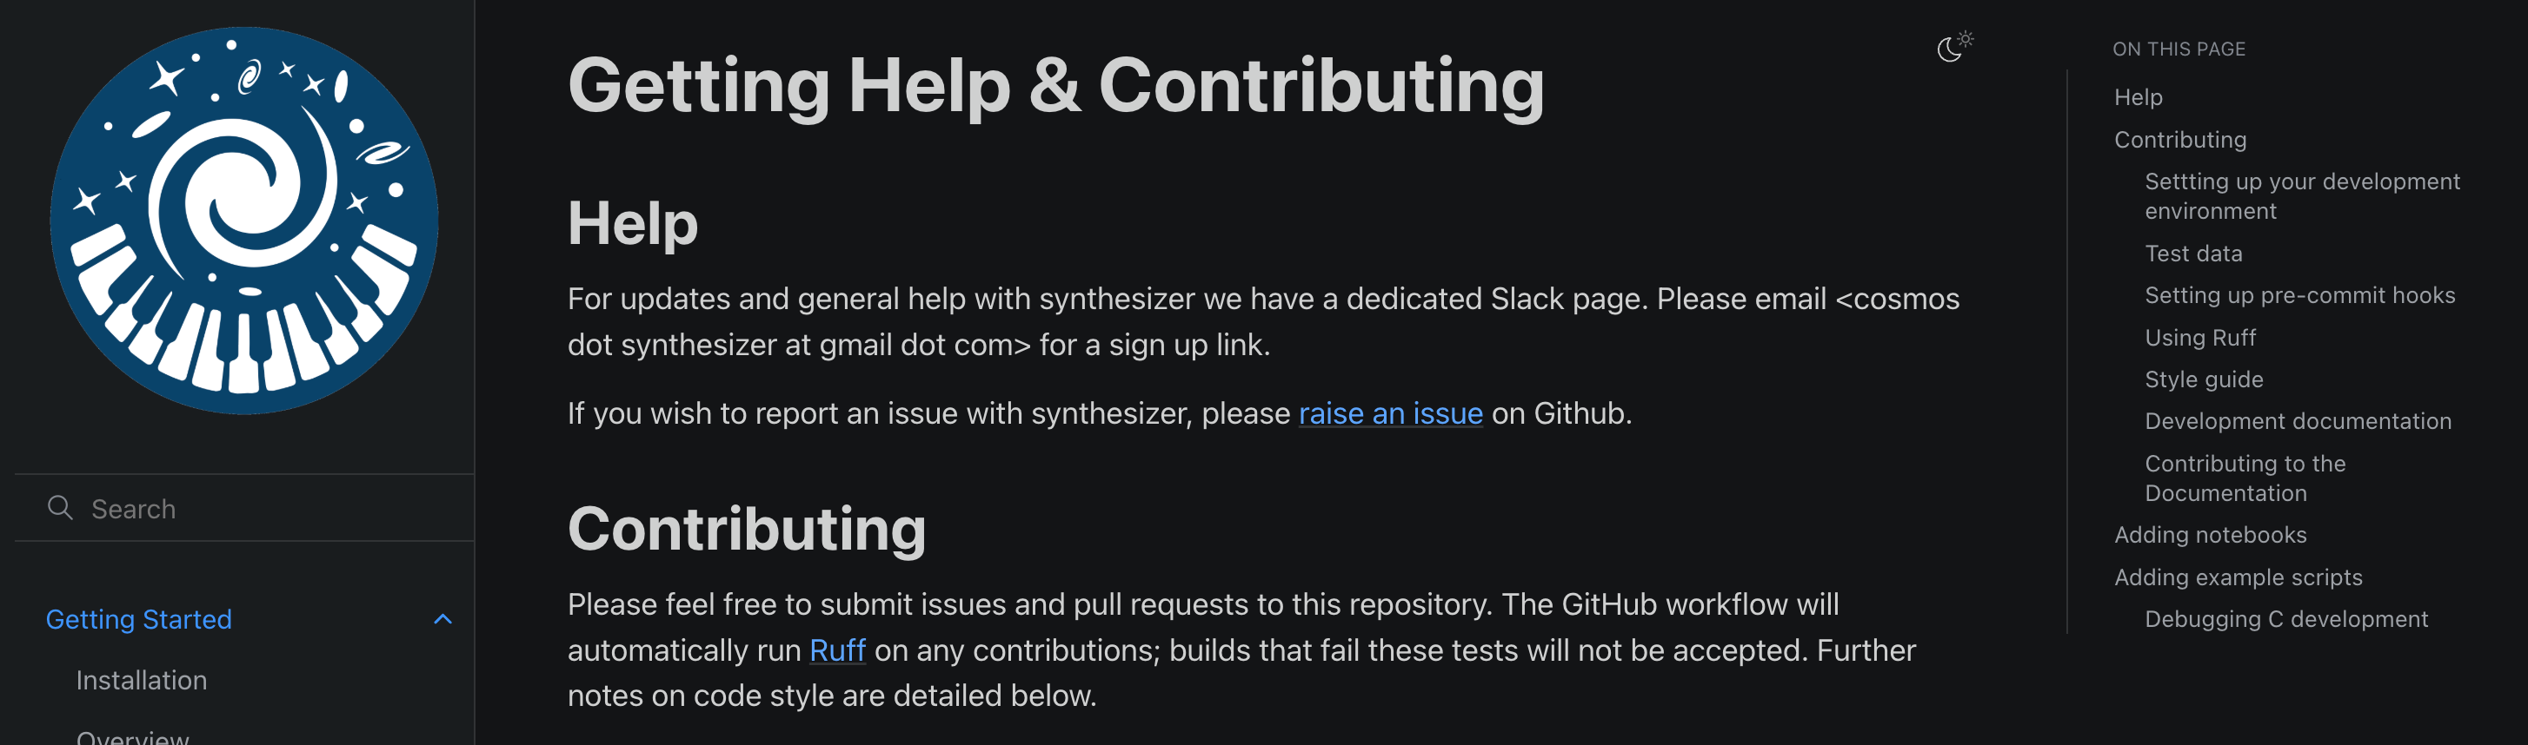
Documentation (For getting involved)

Slide 13
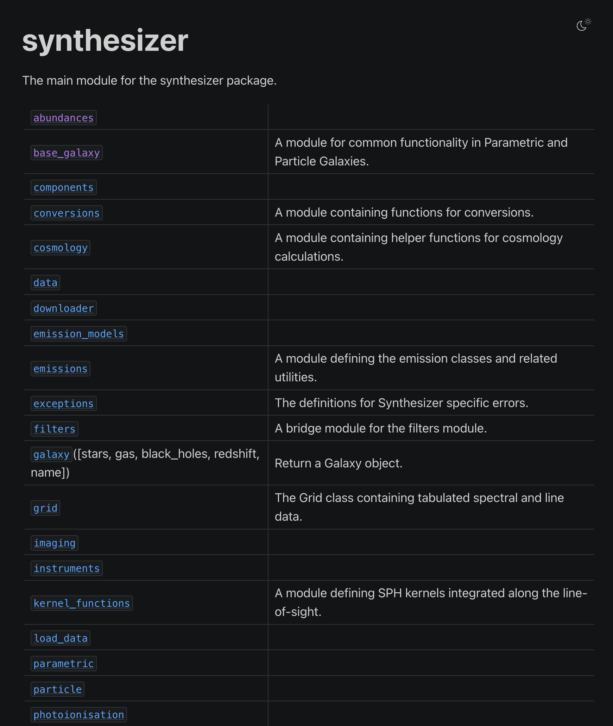
Documentation (For documenting…)

Slide 14
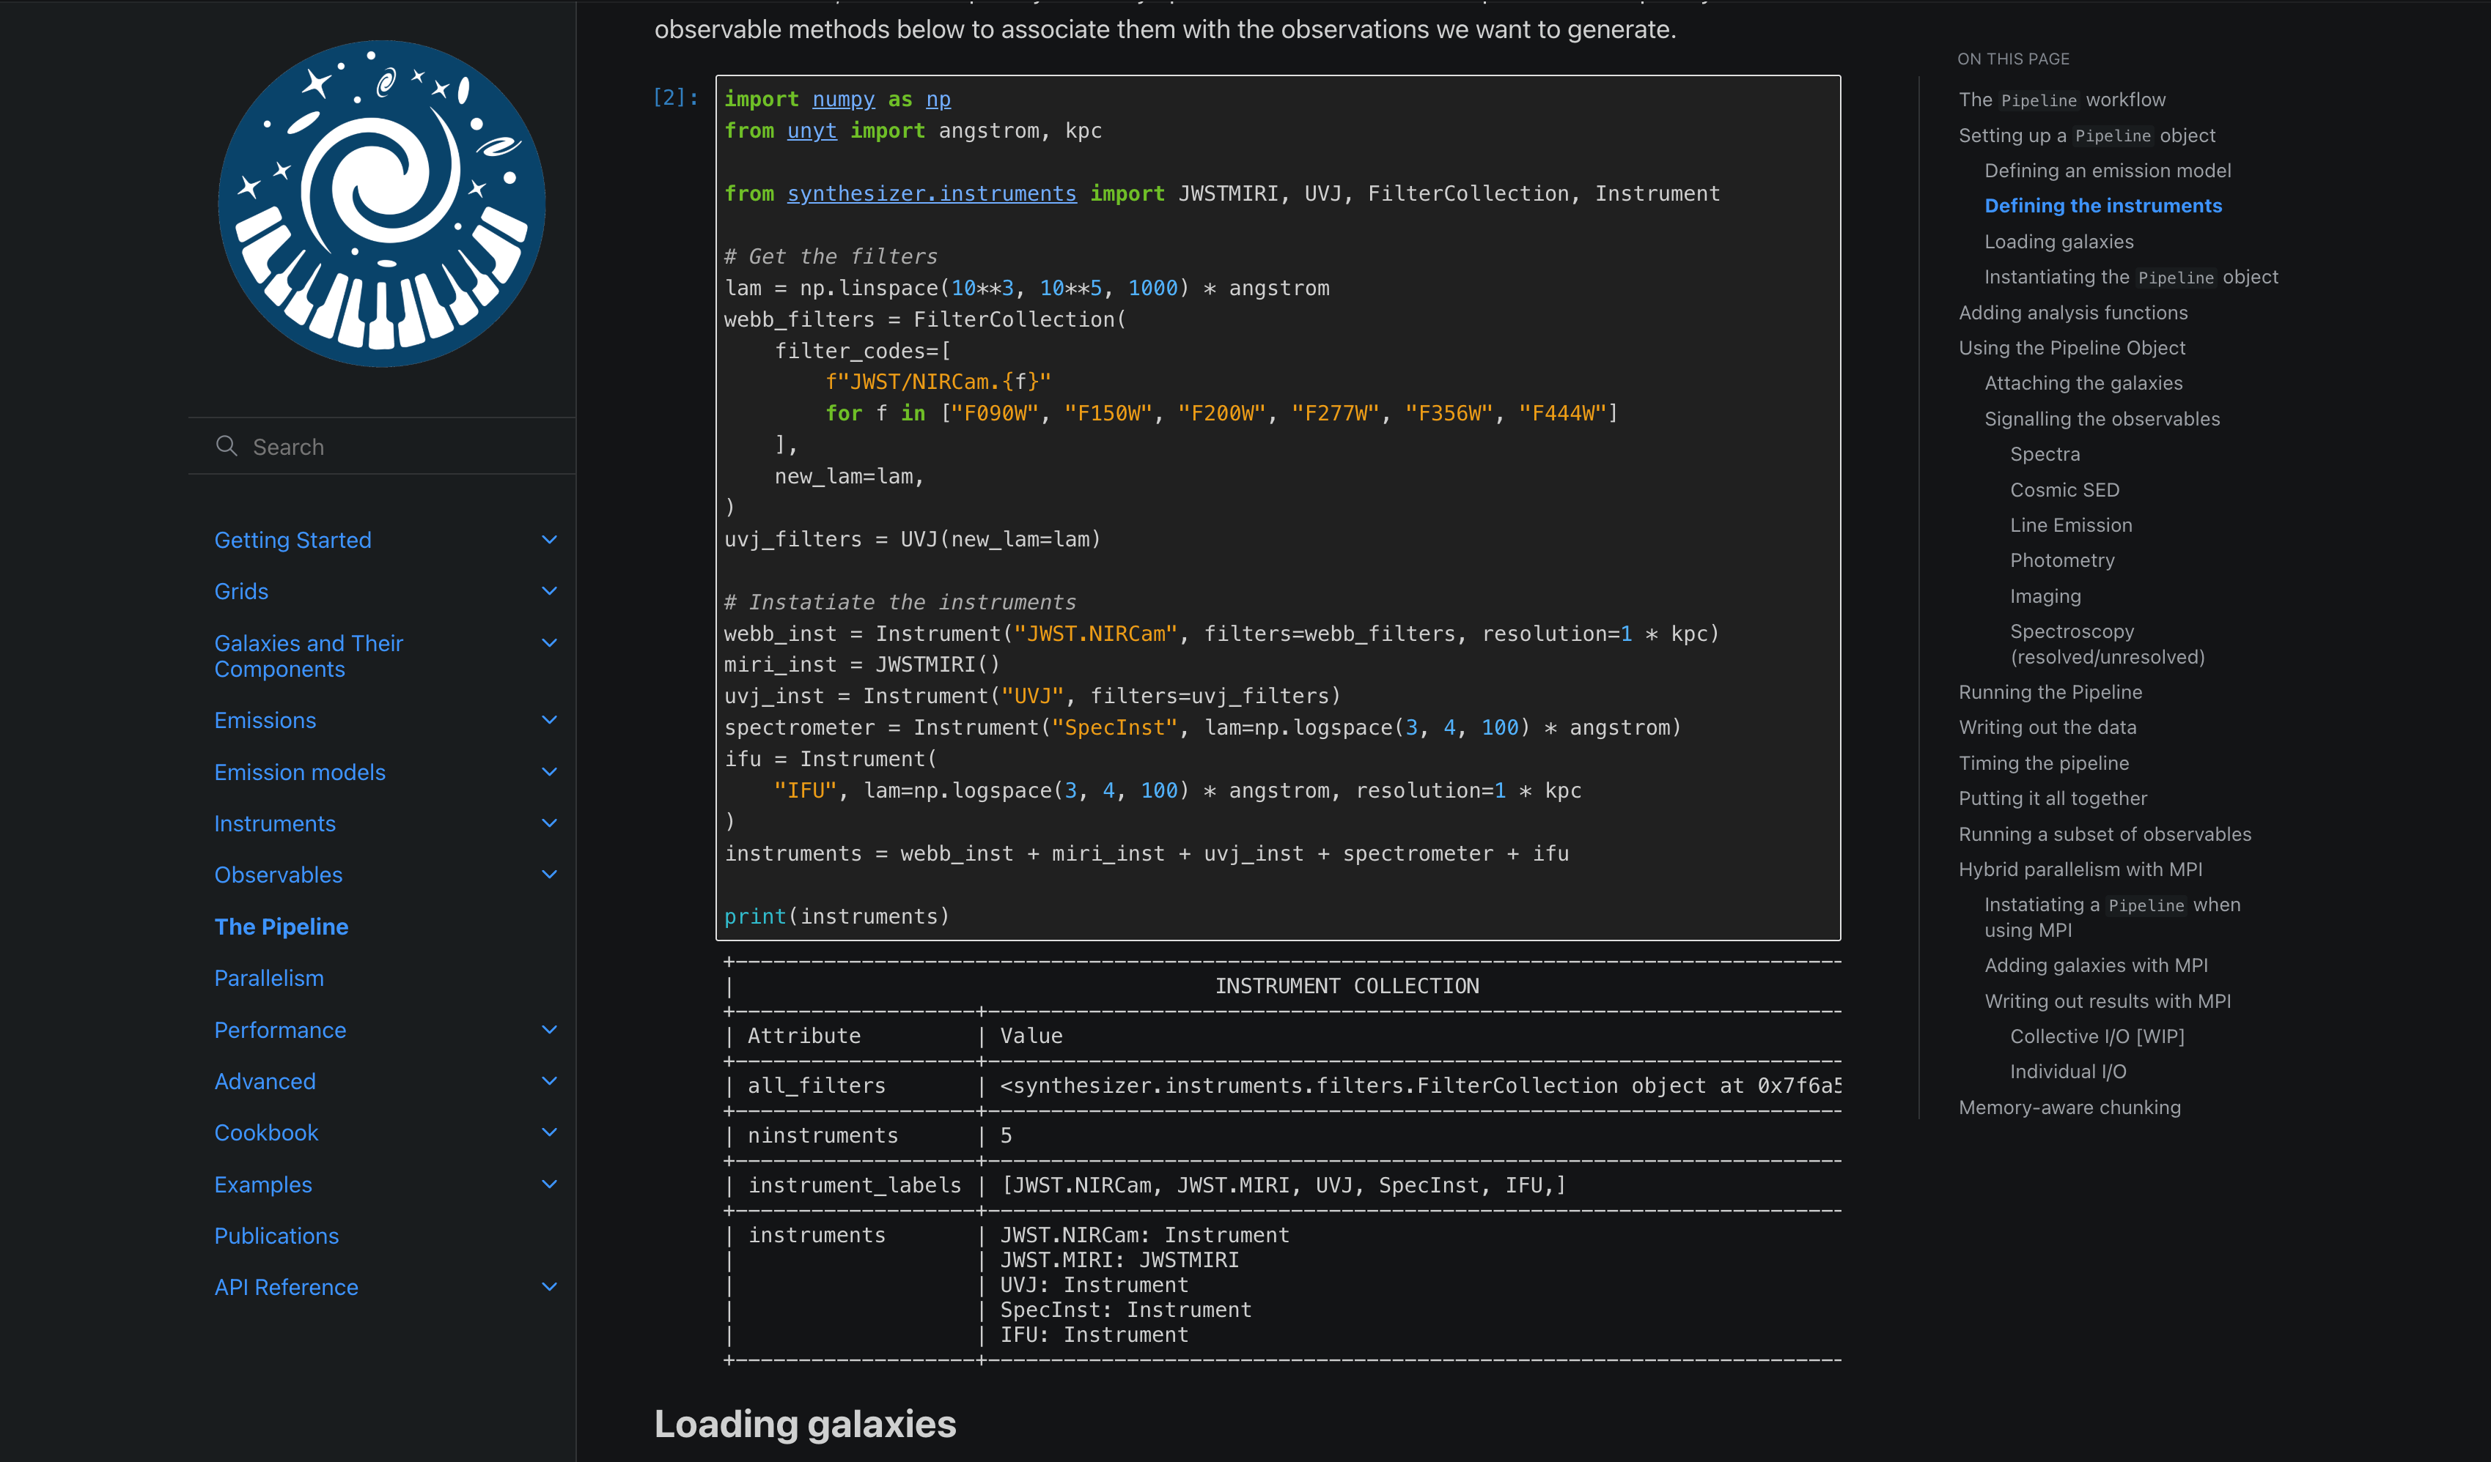
Documentation (For deep explanations)

Slide 15
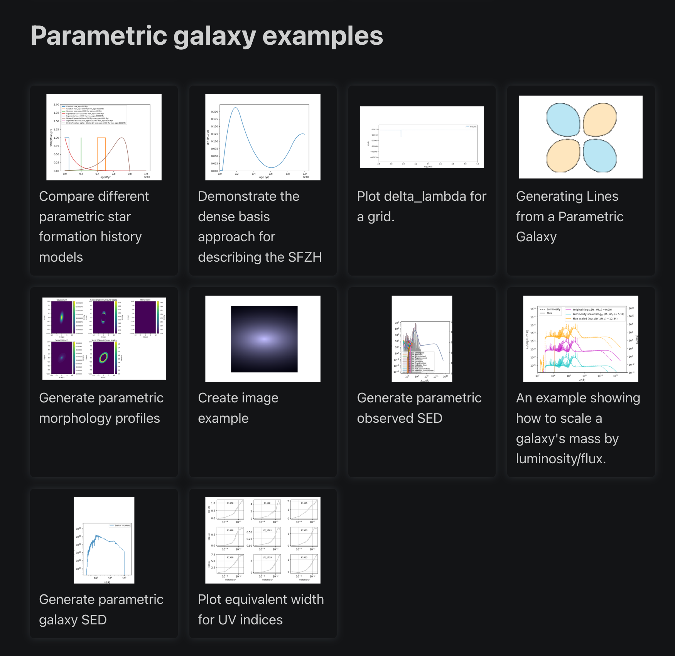
Documentation (for “pick up and play”)

Slide 16
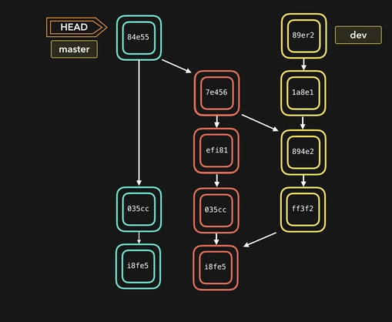
Versioning, Version Control and Hosts
Data releases need a clear version association for longevity.
Software need clear feature boundaries.
Enables seamless and safe collaboration with branches.
Combining with platforms such as GitHub or GitLab gives you a public facing collaboration management portal with Issues, PRs, Branches, Releases, and Discussions.

Slide 17
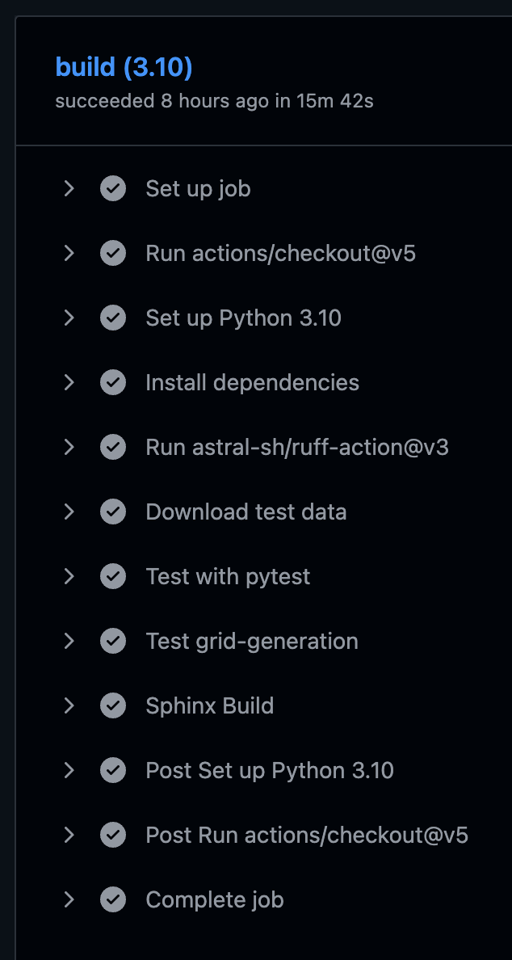
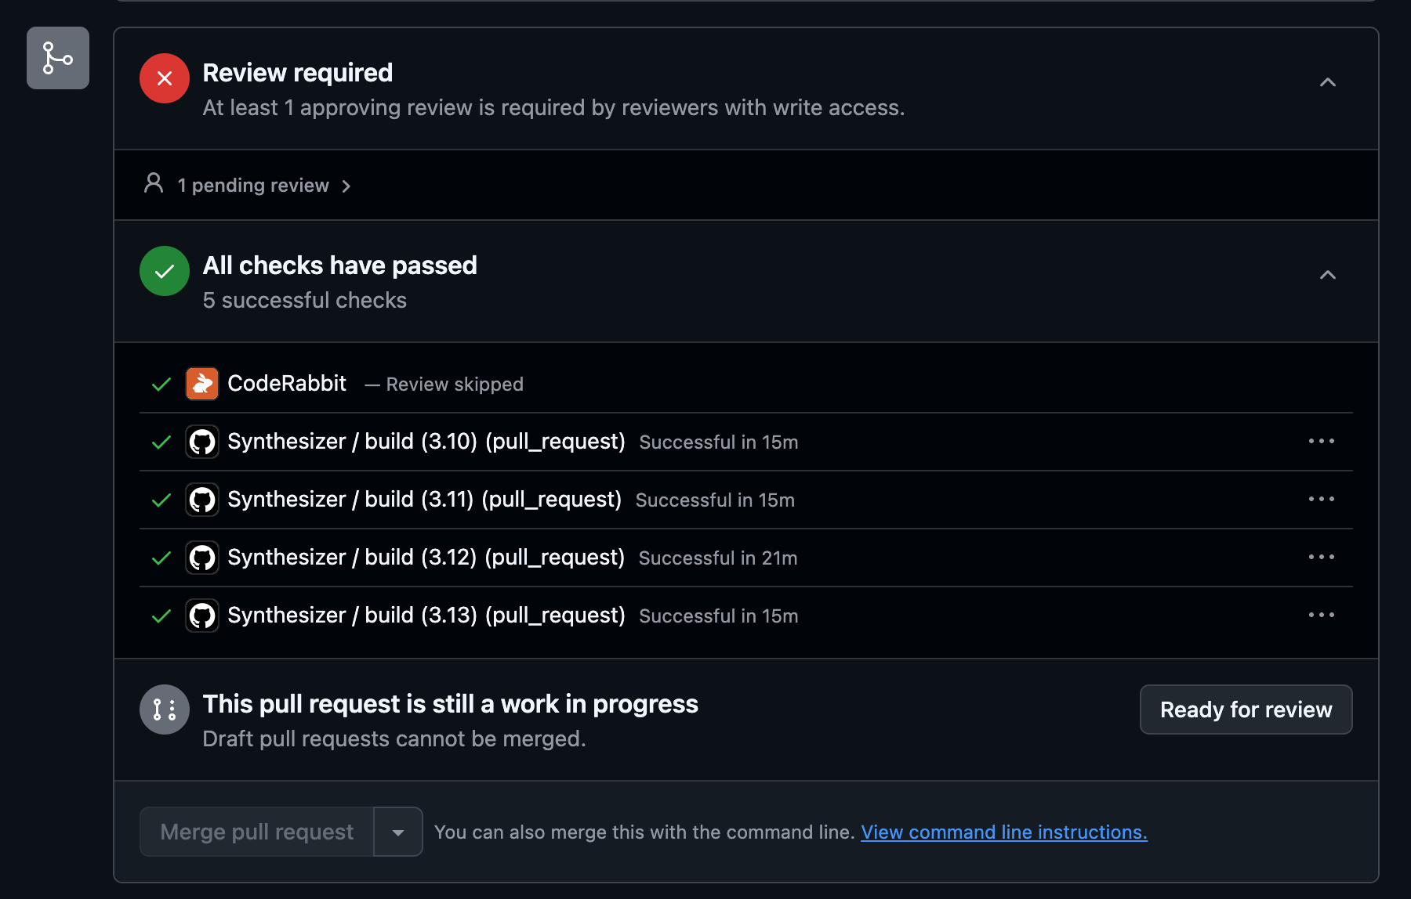
CI/CD Workflows For Correctness

Slide 18
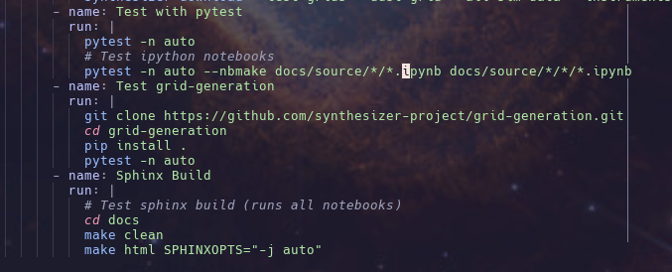
Documentation (As end-end tests)

Slide 19
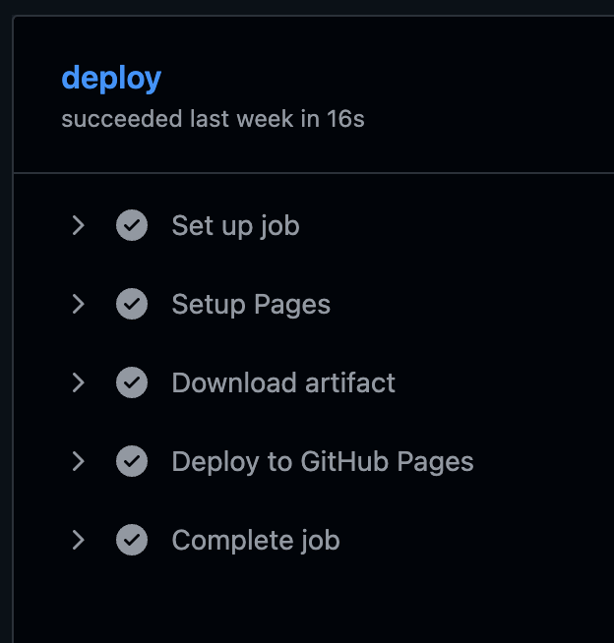
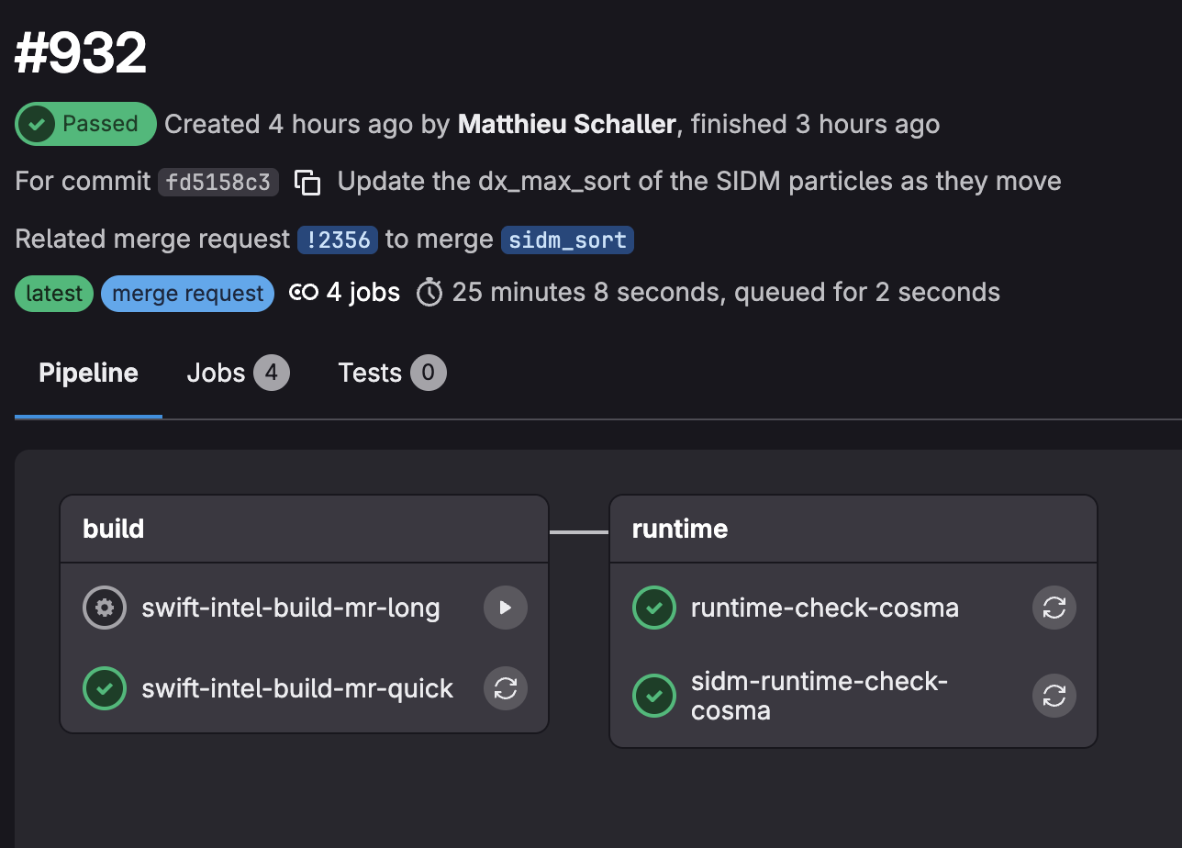
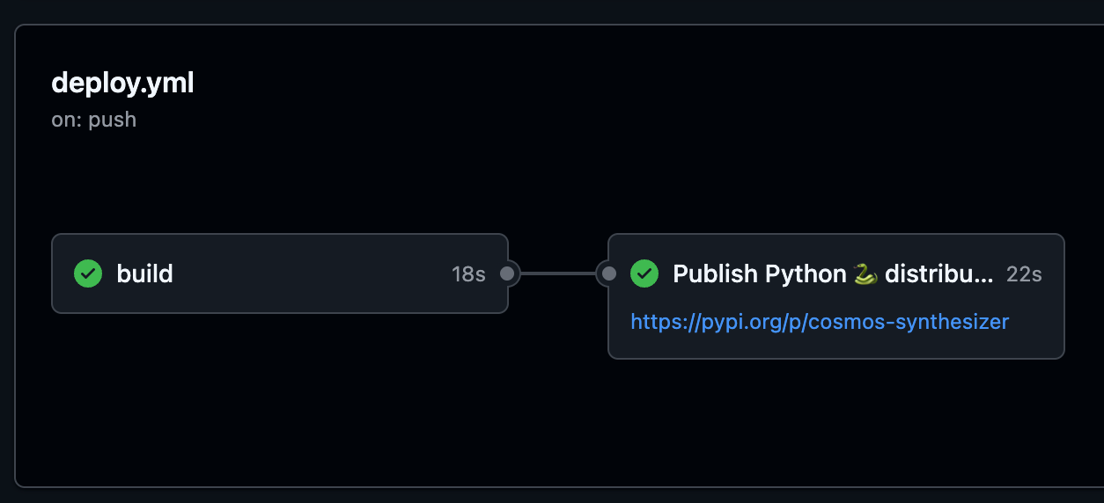
CI/CD Workflows For Correctness

Slide 20
What makes good OSS?
Interpretability: How quickly can you understand it?
Reproducibility: How easily can you run it and get results?
Extensibility: How easy is it to extend the code?
Reliability: How confident can you be that it works as intended?

Slide 21






Things I did not cover
Formatting: don’t underestimate the power of uniform formatting. Readability is king!
Version control: associating a version to released data or research using codes.
Collaborating on coding platforms like GitHub: Issues, Pull Requests, Releases, Deployment, etc.
Pre-commit hooks: pre-vetting code before it can even be pushed to the remote repo.

Slide 22
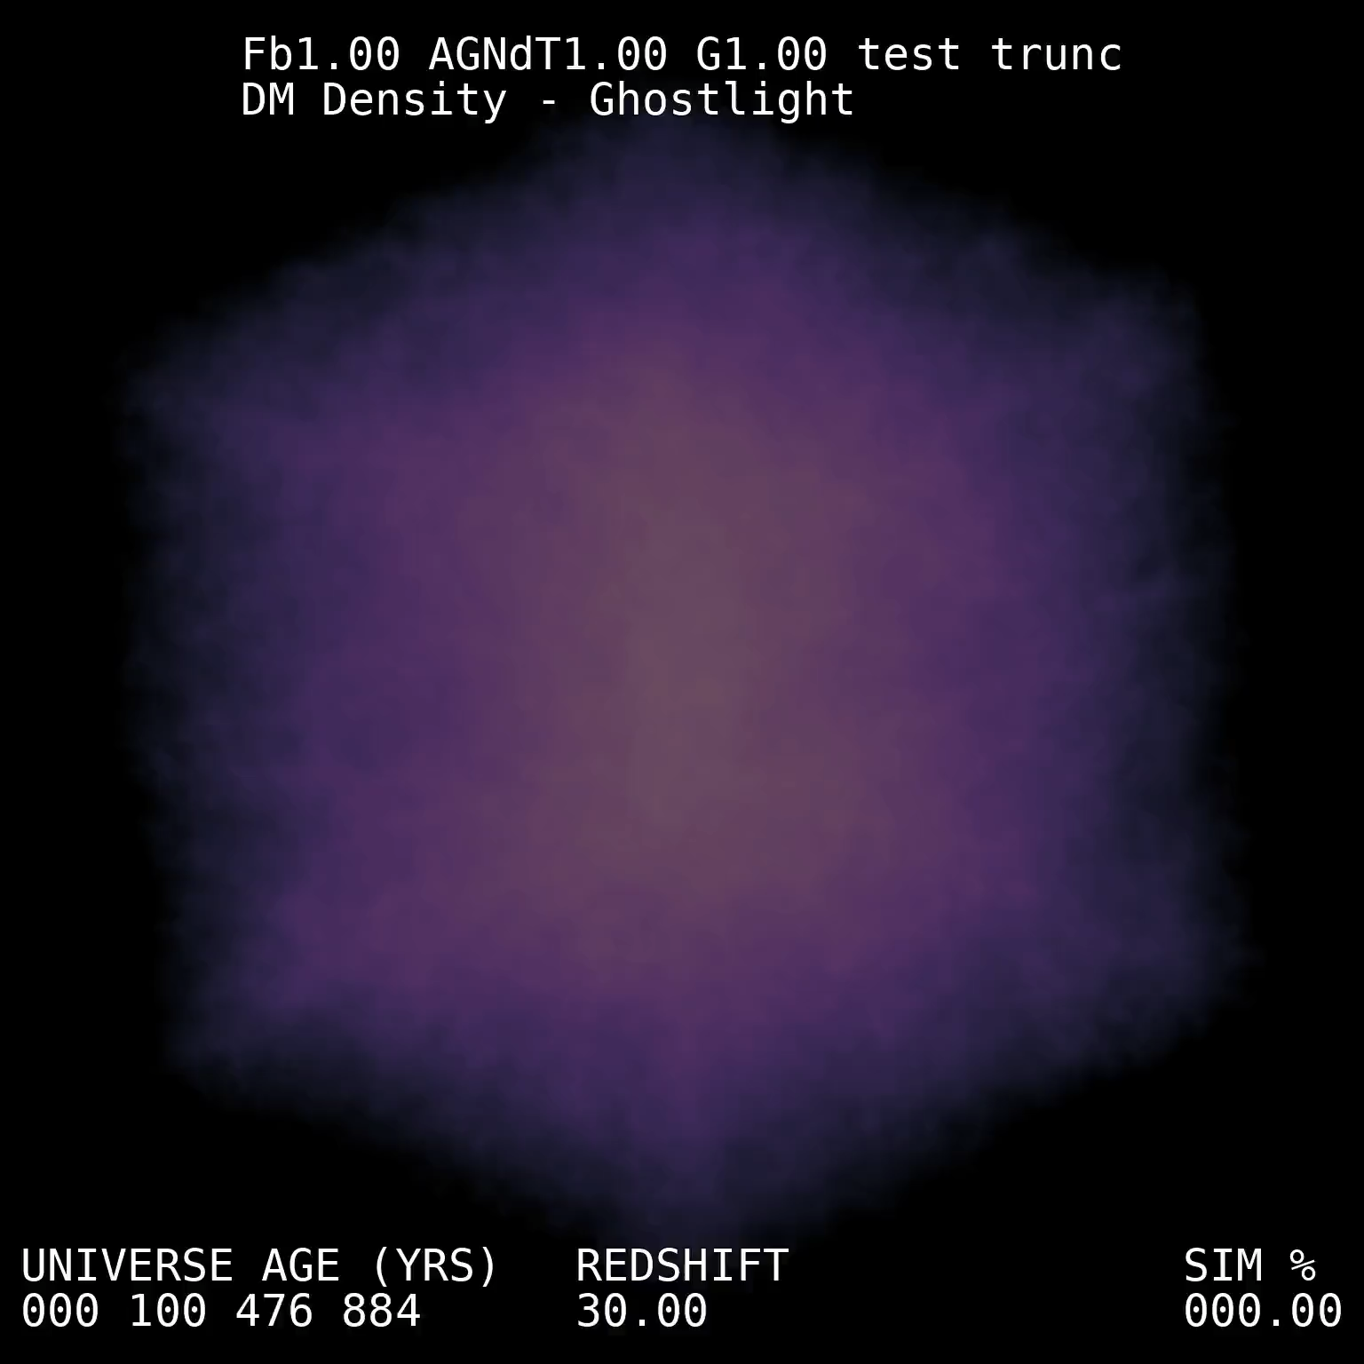
Summary
Open Data needs Open Source Software at its root.
Open Source Software only works when best practices are followed:
Thorough documentation.
Readable code.
Robust testing.
Following these principles with SWIFT and Synthesizer has led to quick wide spread adoption.
Following these practices will also mean you codes are “Agentic workflow ready”.

