Slide 1
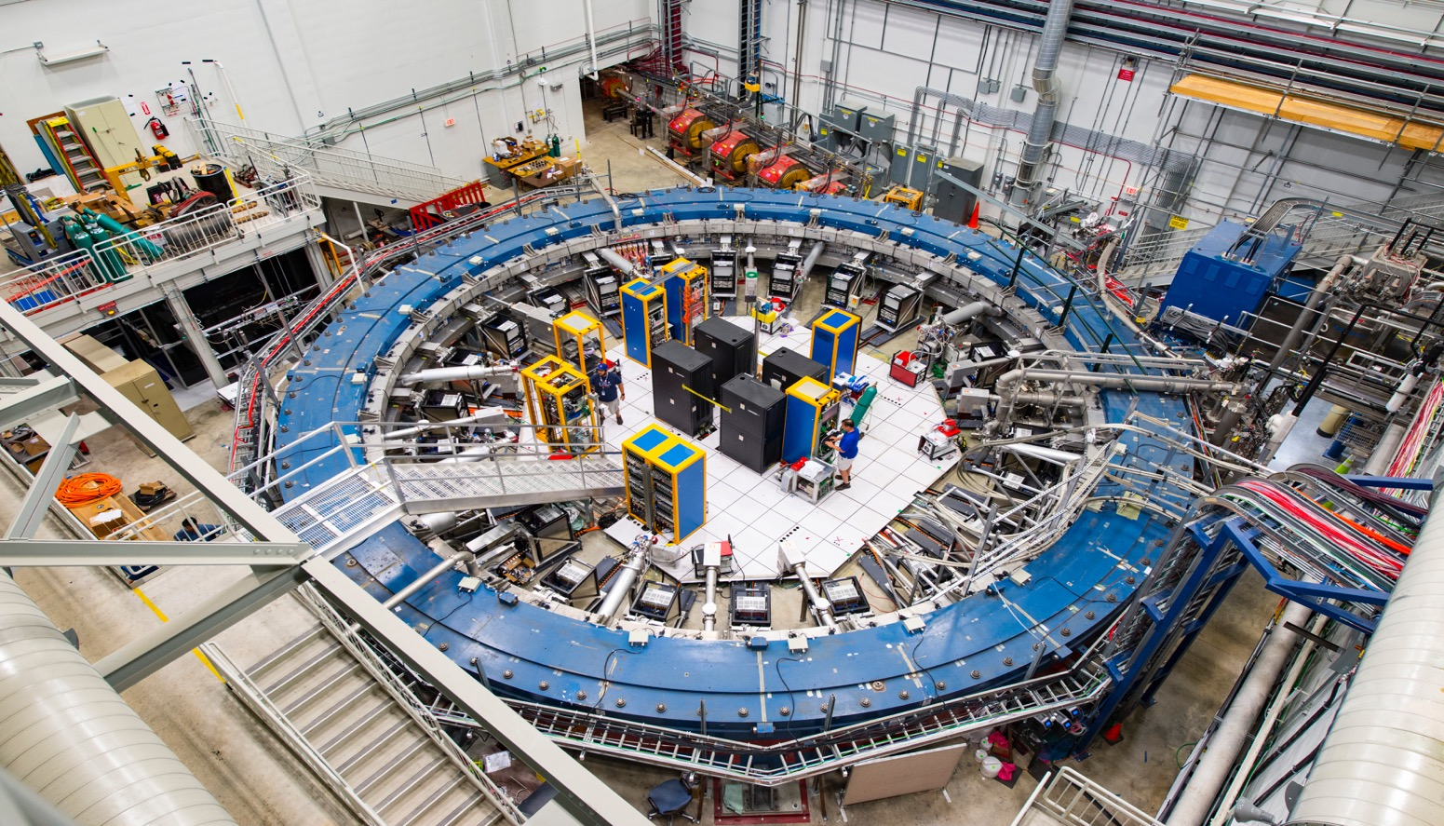
Muon g-2 Open Data
Is new physics hiding
in the magnetic
interaction of the muon ?
Mark Lancaster
Mark Lancaster

Slide 2
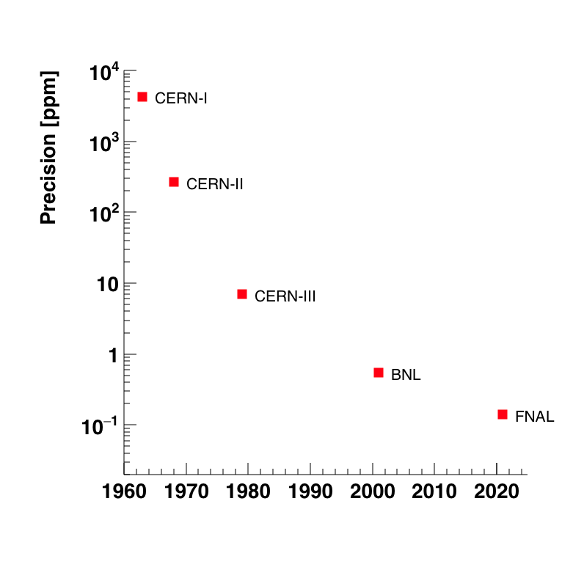
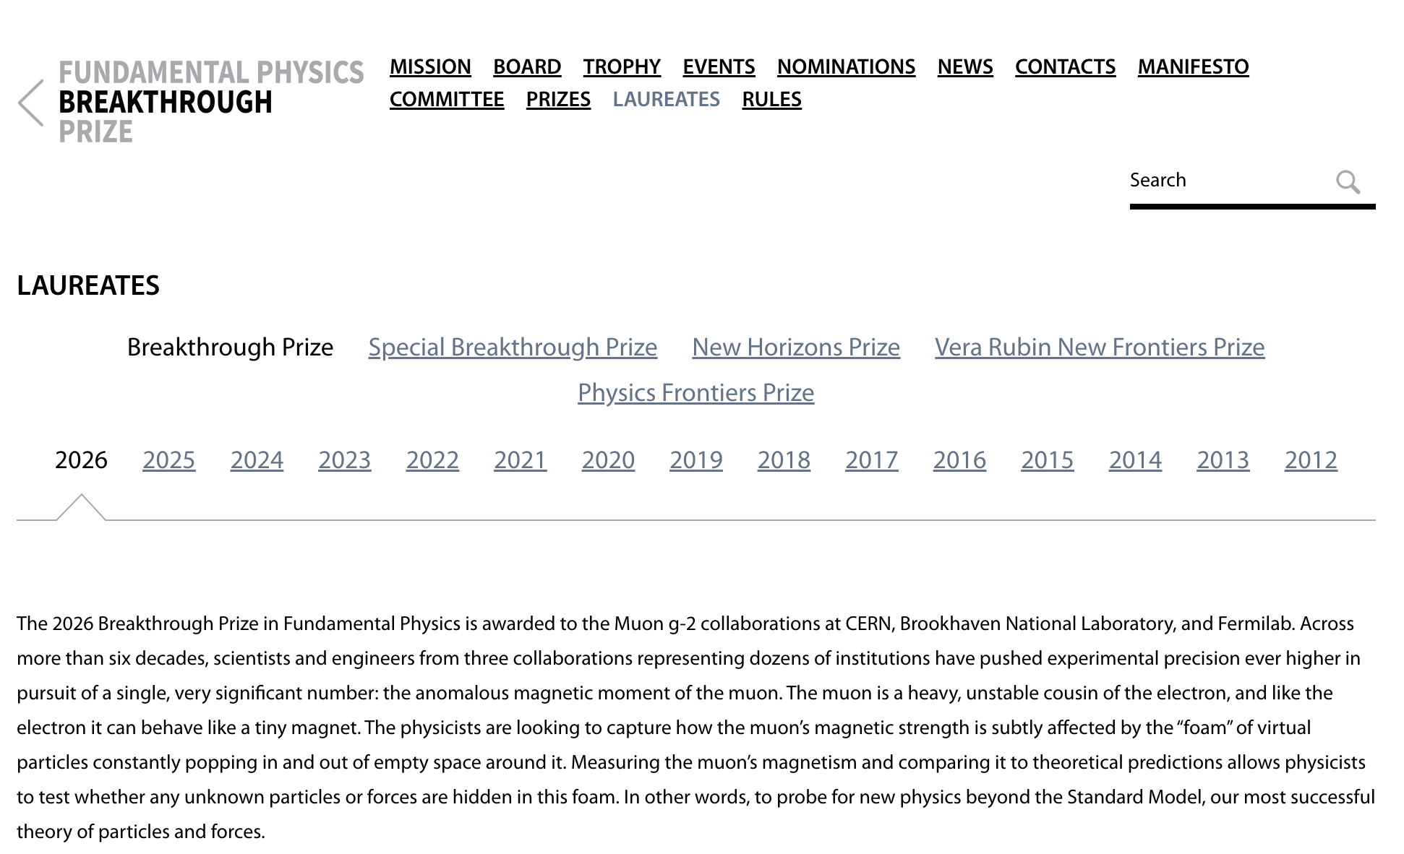
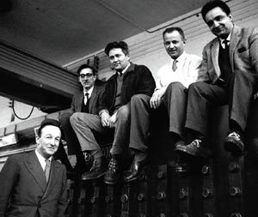
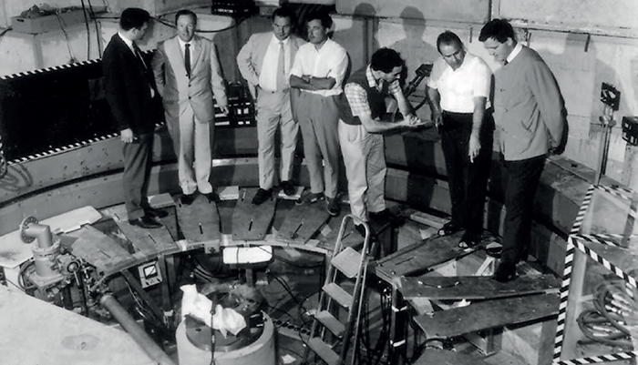
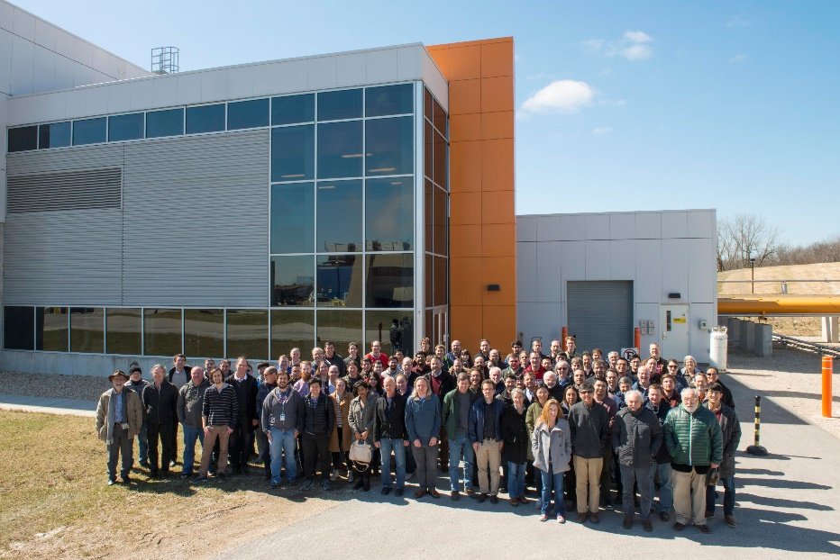
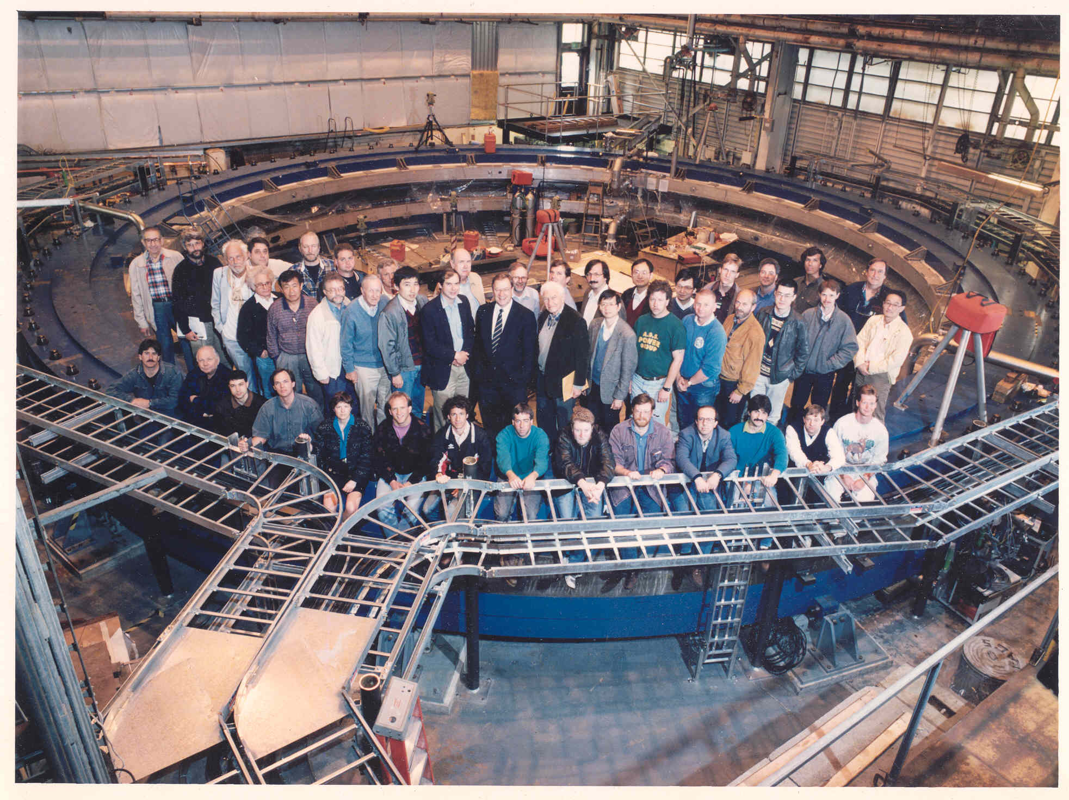
Long Road To Open Data …

Slide 3
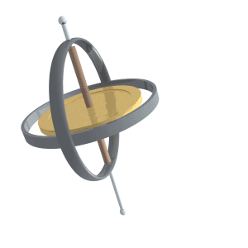
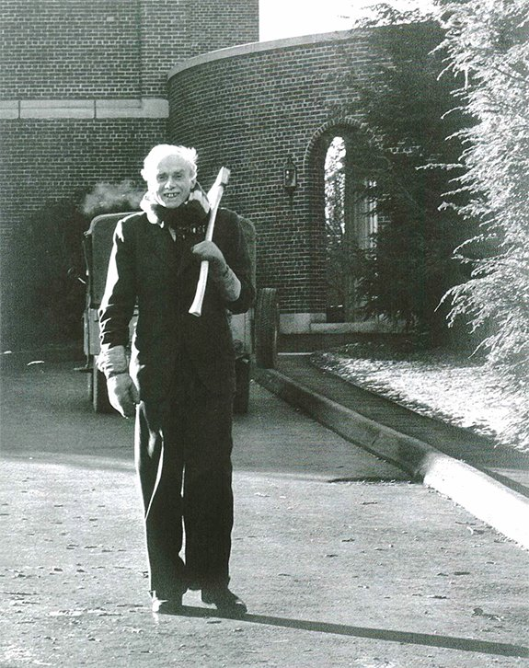
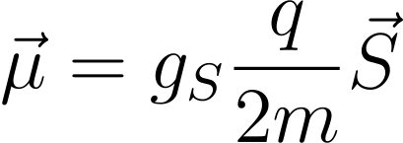
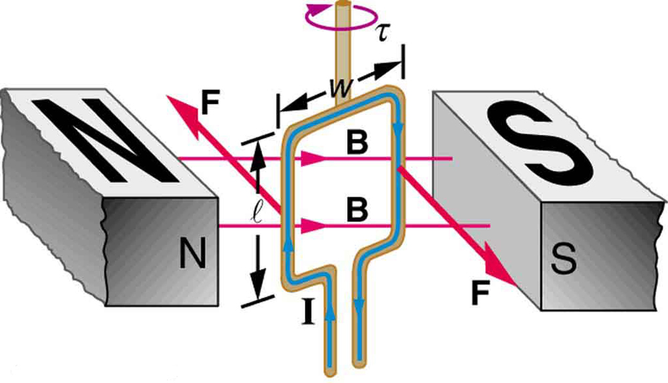
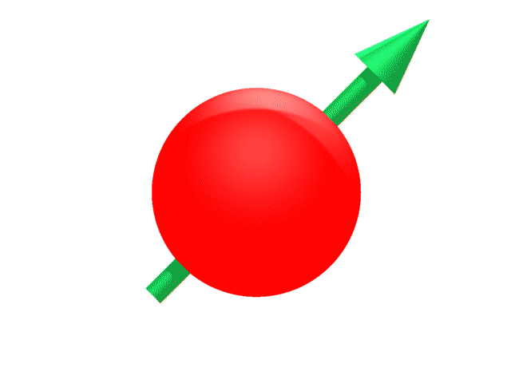
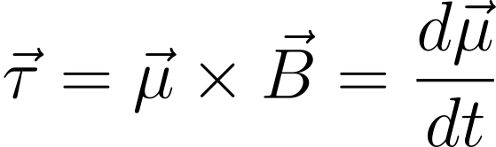
Magnetic Moments (μ)
g
B
Axis of rotation not parallel to force
Torque means axis of rotation (spin) “precesses”

Slide 4
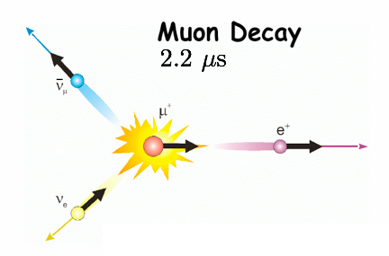
Muon Decay has useful property
Property of weak decay means that the positrons of the highest energy are emitted along the direction of the muon spin
So we know muon spin direction from direction of
highest energy decay e⁺
We know muon spin precesses in B-field and hence so should
direction of highest energy decay e⁺

Slide 5
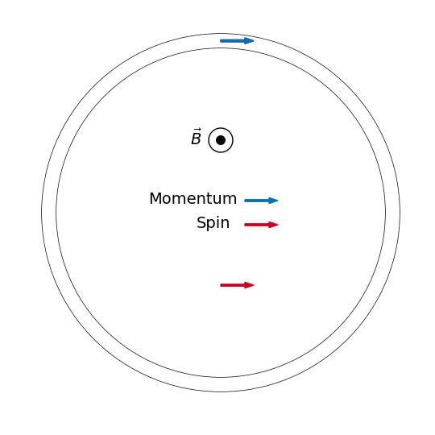
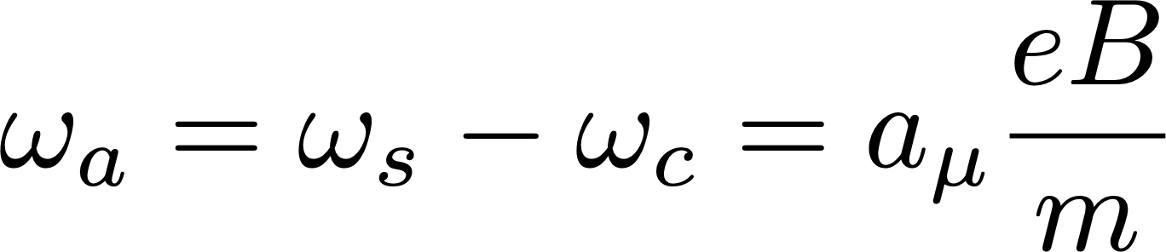
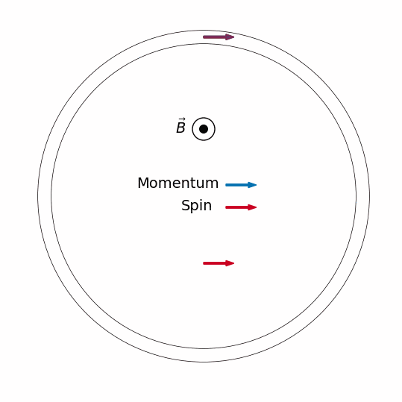
The two precessions : spin & momentum
We expect to see the number of highest energy
positrons rising and falling with time

Slide 6
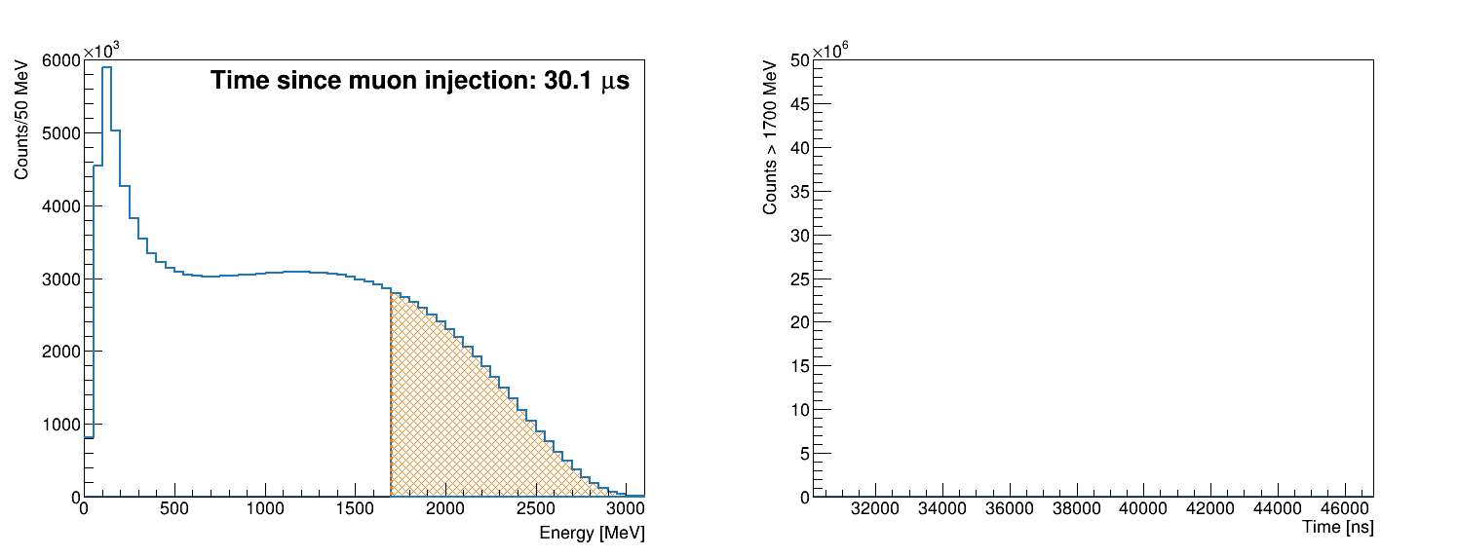
Highest energy e+ population oscillates…
Energy Spectrum
Time Spectrum
Threshold Energy

Slide 7
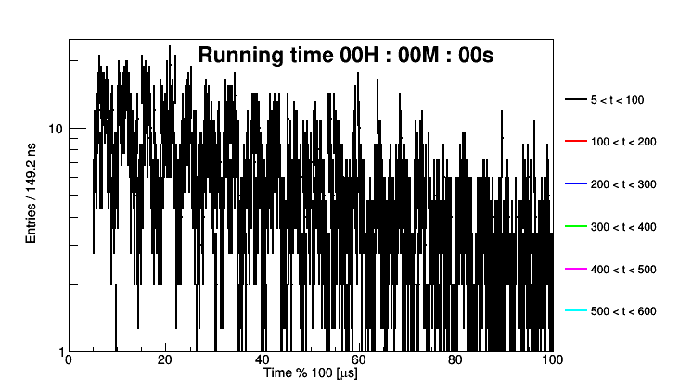
Highest energy e⁺ population oscillates…

Slide 8
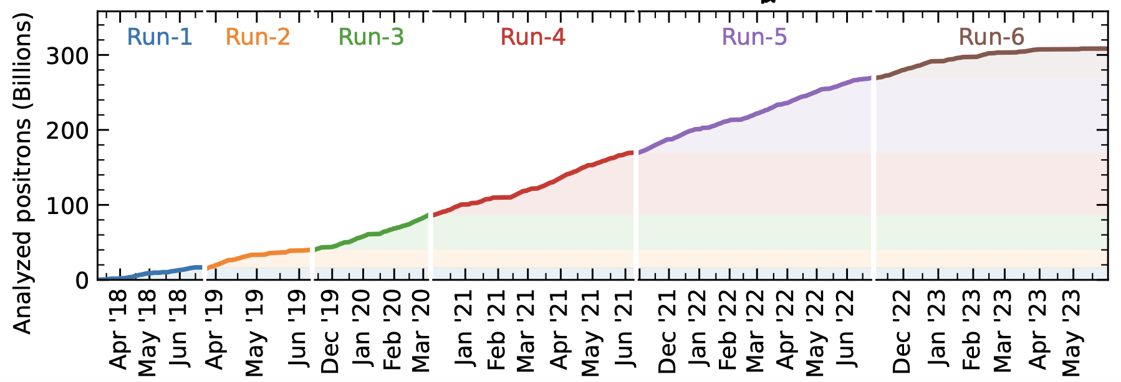
g-2 data was collected over 5 years
308.5B positrons recorded
Prototyping with (0.3%) 1.69B positrons from Nov/Dec 2019
The aim is largely educational (I have a teacher who has offered to help)
The entire open data team on the experiment is me …

Slide 9
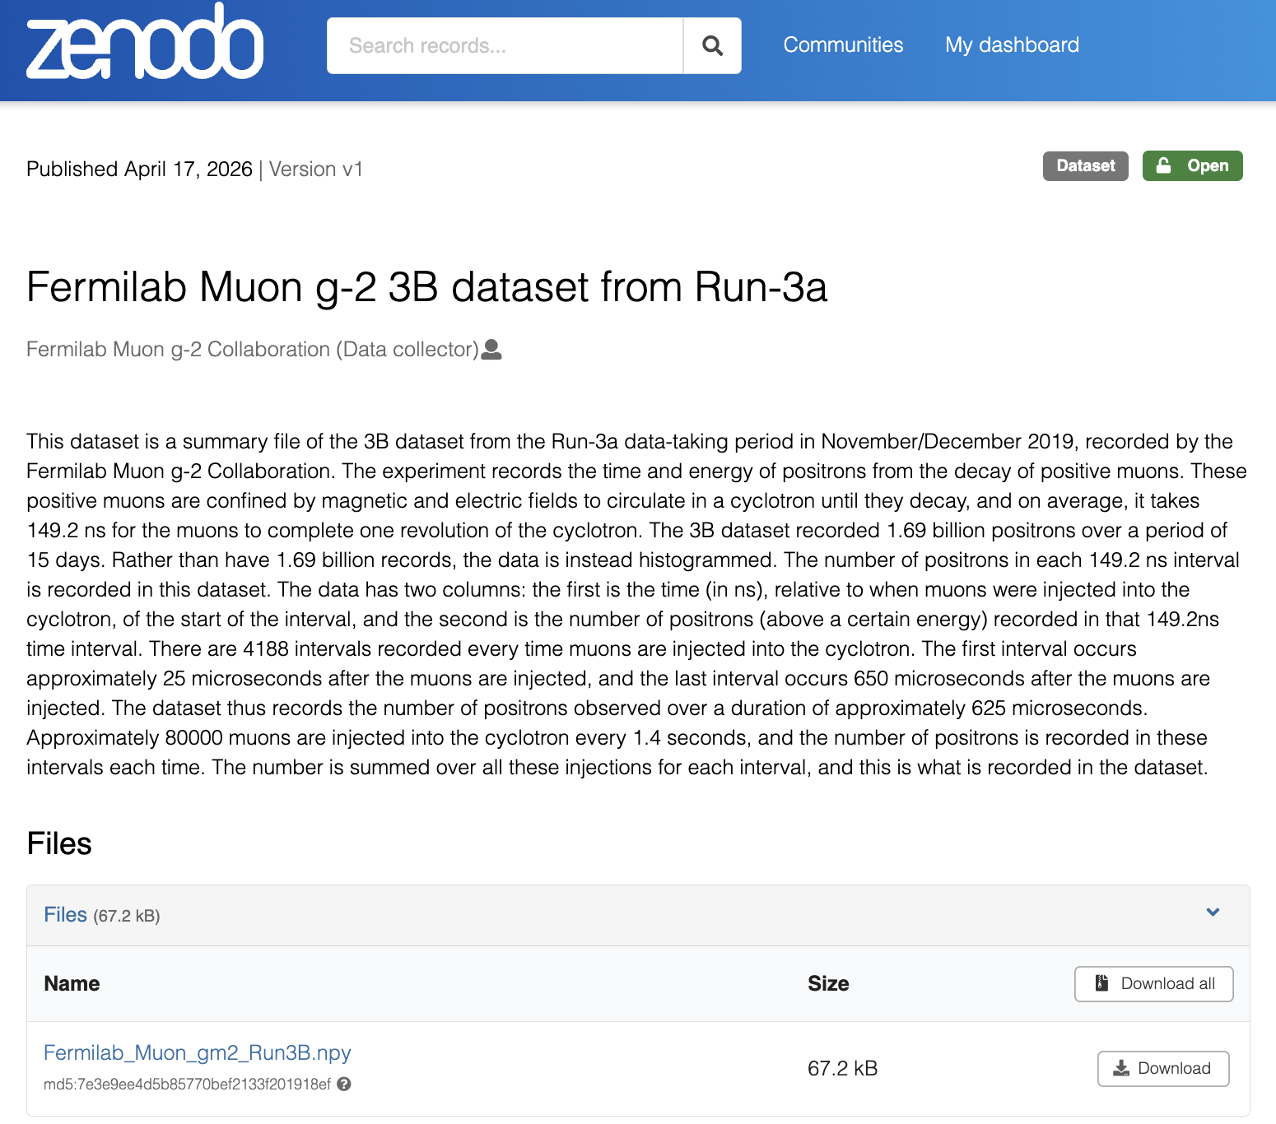
https://zenodo.org/records/19632588
The raw data of this 0.3%
snapshot is 110 Tb… and
requires a lot of expert
massaging to analyse
Histogram the data into
4188 (149.2 ns) time bins
with # positrons in each bin
Numpy binary file

Slide 10
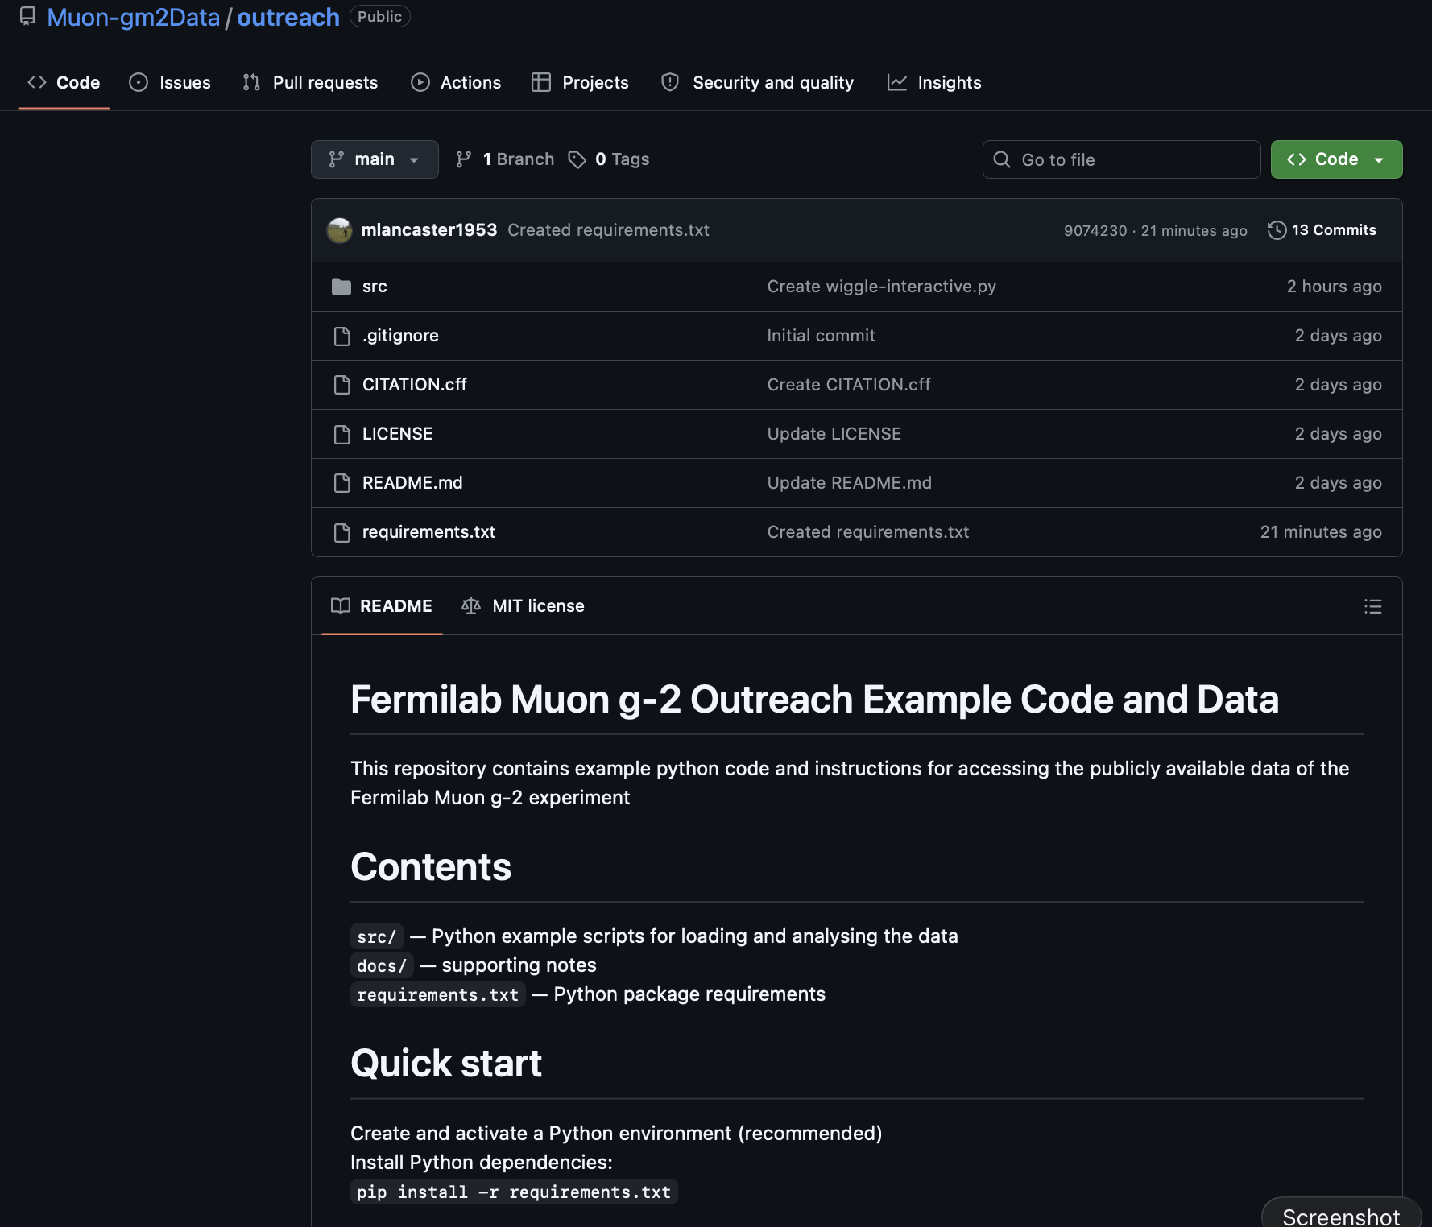
https://github.com/Muon-gm2/gm2outreach

Slide 11
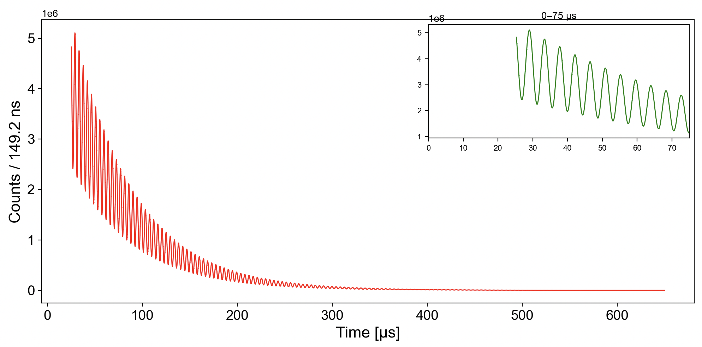
Simple 5 parameter fit of this data has χ²/df of ~ 7

Slide 12
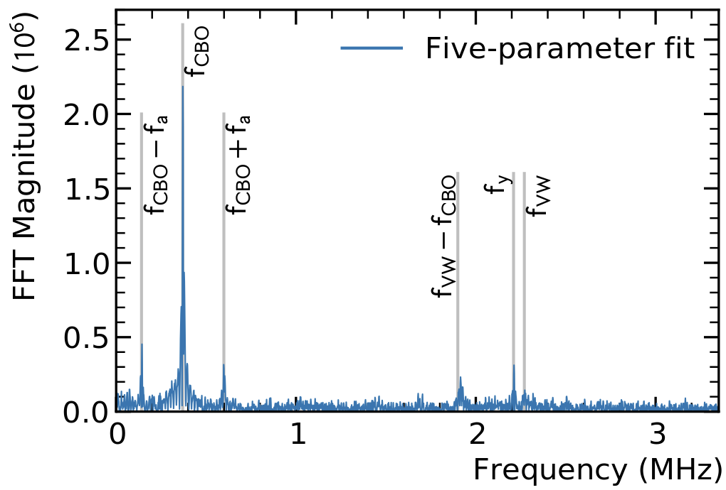
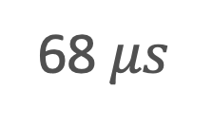
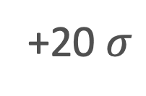
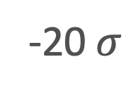

Corrections due to SHM of beam..
Residuals of 5-parameter fit (in frequency space) show the
Wiggles / motion expected from the 2D-SHM of the beam
N / 149 ns
+20 $σ$
-20 $σ$
5 $μs$
68 $μs$
Fit and pulls for ~ 1 lifetime
Fourier Transform of fit residuals

Slide 13
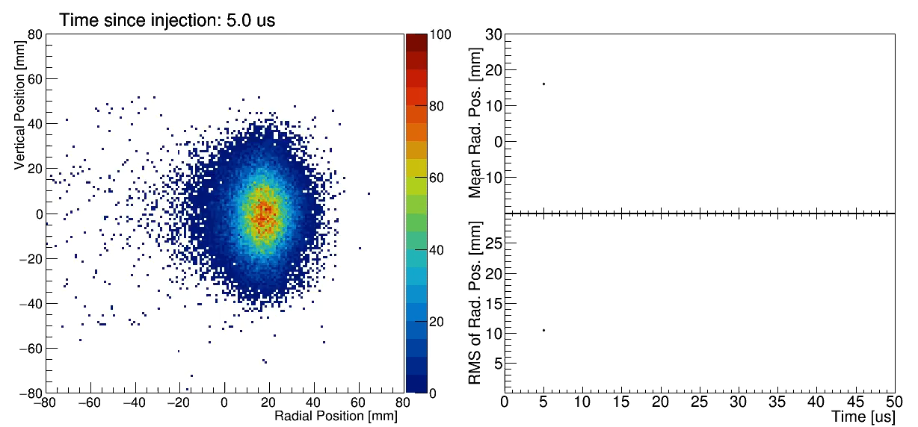

Slide 14
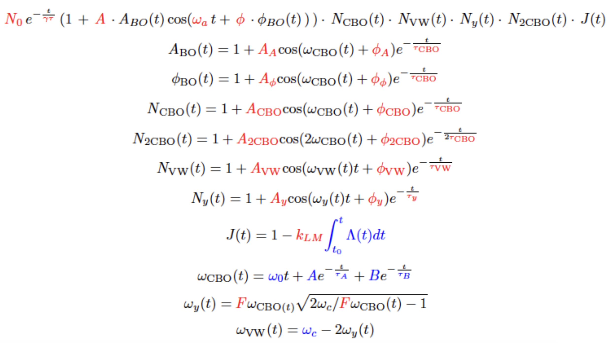

Result of large parameter fit
$χ^{2}$/ndf = 4007/4097
5-parameter fit
Full fit

Slide 15
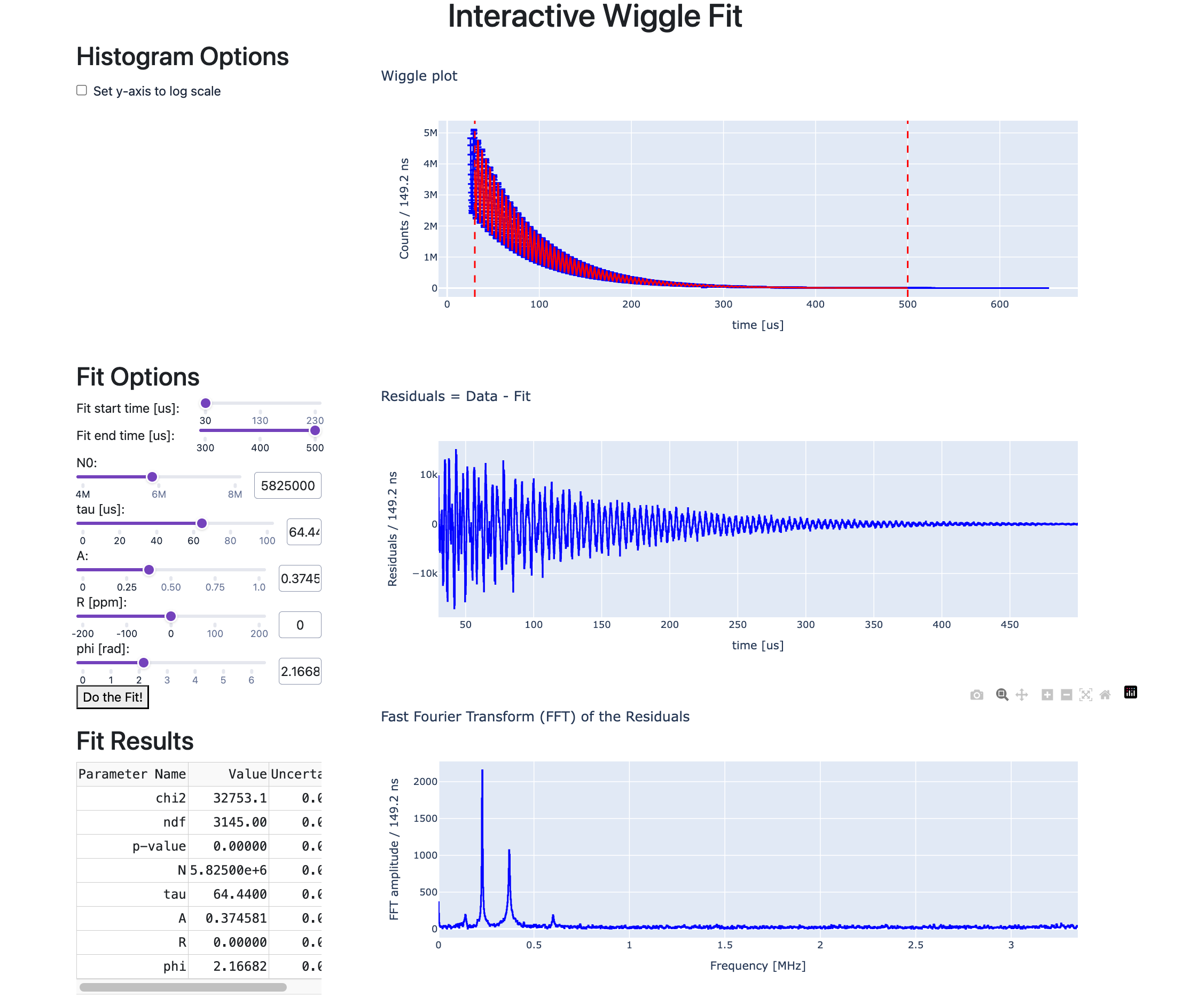
Interactive web-page to fit the data
dash,plotly,flask
Good enough
for a sub 1% (10000 ppm)
measurement of g-2
With tweaks --> few ppm
enough to see QED correction

Slide 16
What can this teach ?
Many aspects can be taught with this data
Exponential formula for a decay
Special relativity: time dilation
Magnetic Moment
Torques and precession
Motion of charged particle in a magnetic field
Fitting of data : importance of residuals
Fourier transforms
Simple Harmonic motion

Slide 17
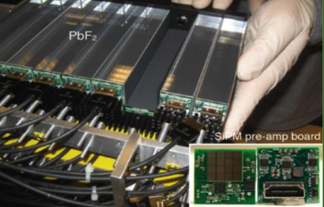
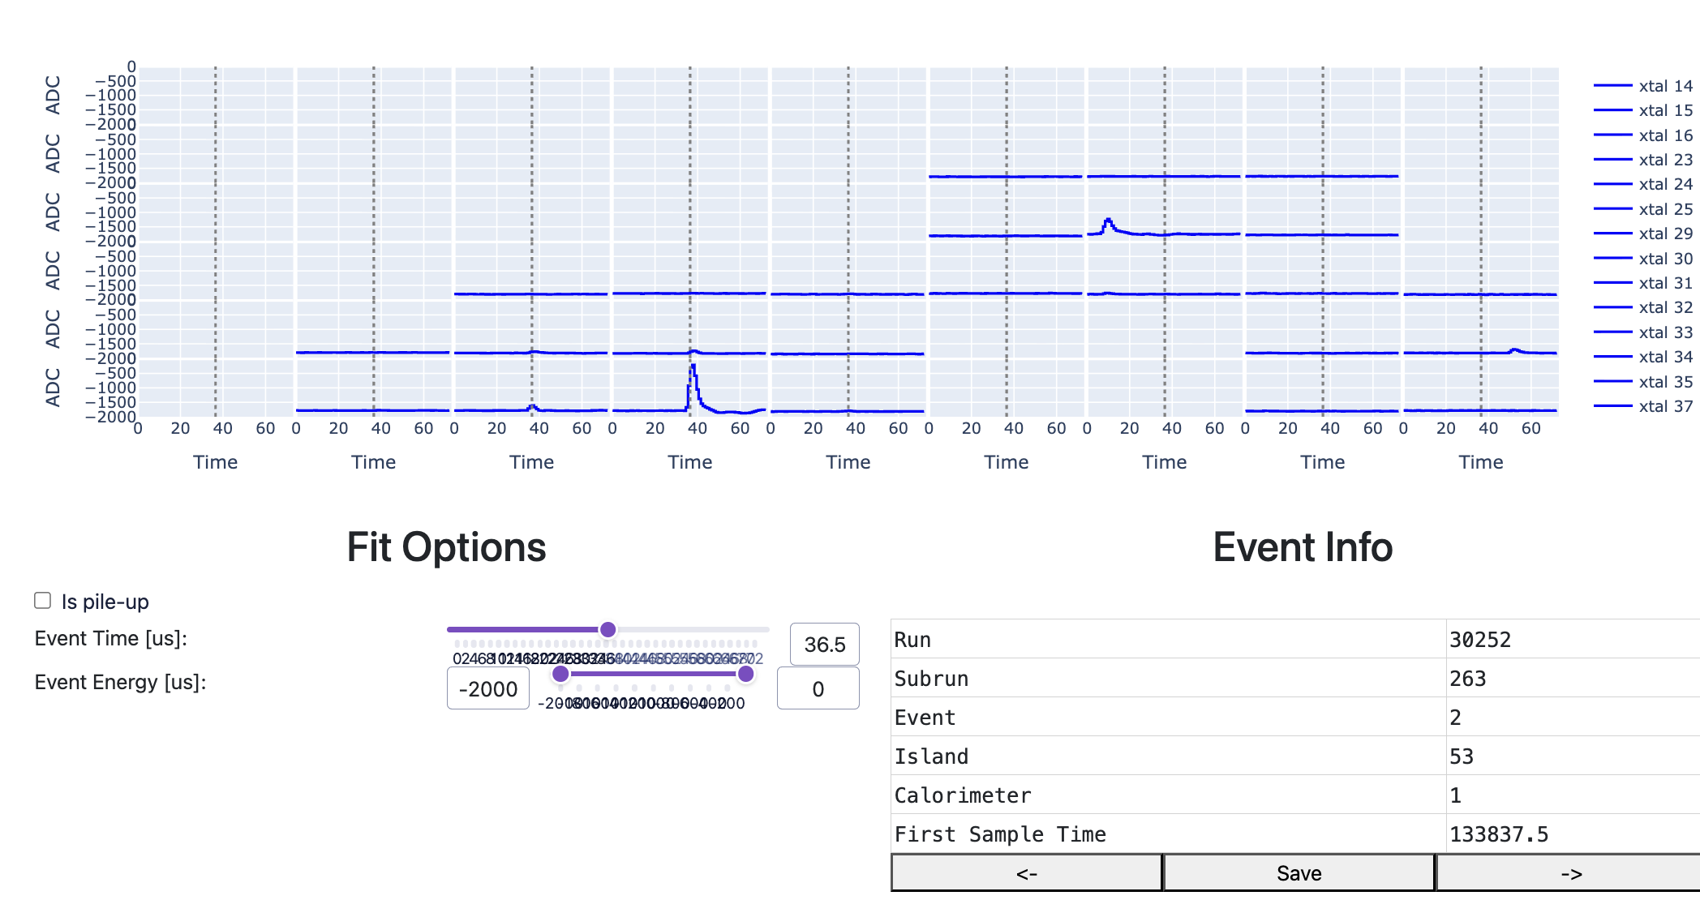
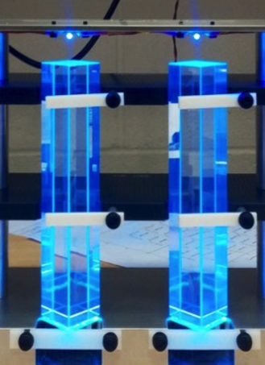
Raw Data ?
Also looking into template fitting /calibrating
raw calorimeter data to show how you go from
raw data to the histogram…

Slide 18
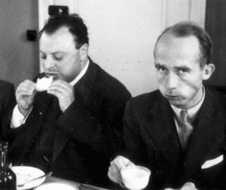
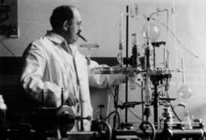
Also to demonstrate belligerence …
“If you enjoy doing difficult experiments, you can do them, but it is a waste of time and effort because the result is already known” : Pauli
"No experiment is so dumb, that it should not be tried” : Gerlach
“You do less damage if you let the thing
fall than if you try to catch it” : Stern
“the Muon obeys QED. g-2 is correct to 0.5%. In my opinion, it will be right to any accuracy. So it’s not worth doing the experiment” : Head of CERN Theory
“would you like to predict the result ?” : Francis Farley

