Slide 1
ATLAS Open Data in Schools: Student, Teacher, and Researcher Experiences
Seth Zenz and Nigel Sharma
Thursday 14 May 2026

Slide 2
Overview
Year-long activity for 15-18 year olds
ATLAS Open Data Project
Physics Research in School Environments (PRiSE)
Lessons Learned
Skills involved can be underestimated, for all of:
Students
Teachers
University-based Researchers
Clear, step-by-step self-guided activities are essential for success
Ideas for the Future

Slide 3
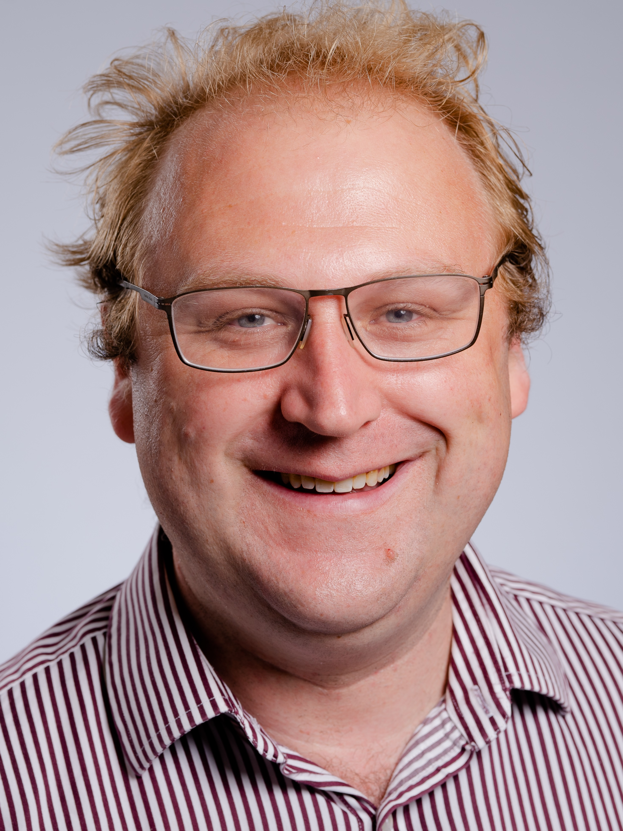
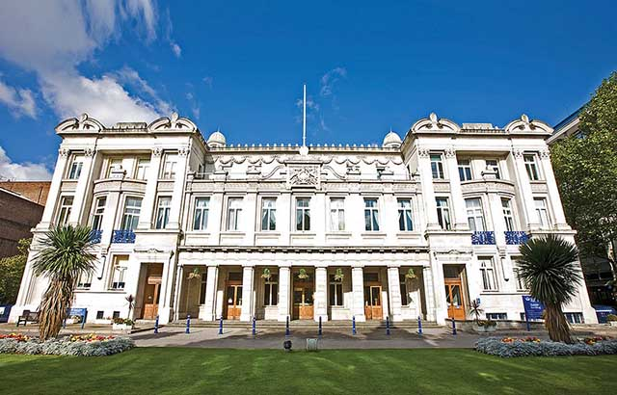
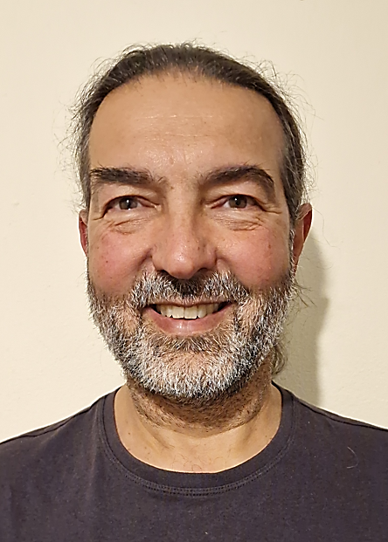
About Us
Seth Zenz
Reader in Experimental Particle Physics, Queen Mary University of London
Physics Research in School Environments - ATLAS Open Data (since 2019)
Higgs Boson Dominoes
STFC Advisory Panel for Public Engagement
User of ATLAS Open Data, but not a developer
Nigel Sharma
Former Secondary School Physics and Science Teacher since 2004
Focused entirely on Enrichment since 2017
Involved in running PRiSE projects in schools since 2017
Substantial experience running Science Enrichment activities in schools including Science Clubs, CREST projects, EPQs, Residential Science Weeks, Science competitions, Expos, Field trips

Slide 4
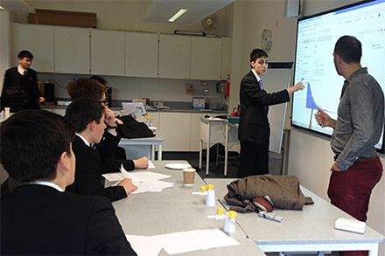
PRiSE Programme
Year-long programme
Kickoff in September-October
Final conference in March
Typical participants:
Enthusiastic 15-to-18 year old school students
No specific particle physics coursework (yet)
Teachers have exceptional STEM experience and “spare” time
Goals: science skills, STEM self-efficacy
Why 15-to-18 year olds?
Opportunity to develop their understanding of
what “real science” at university level will look like!

Slide 5
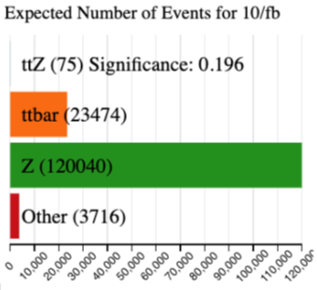
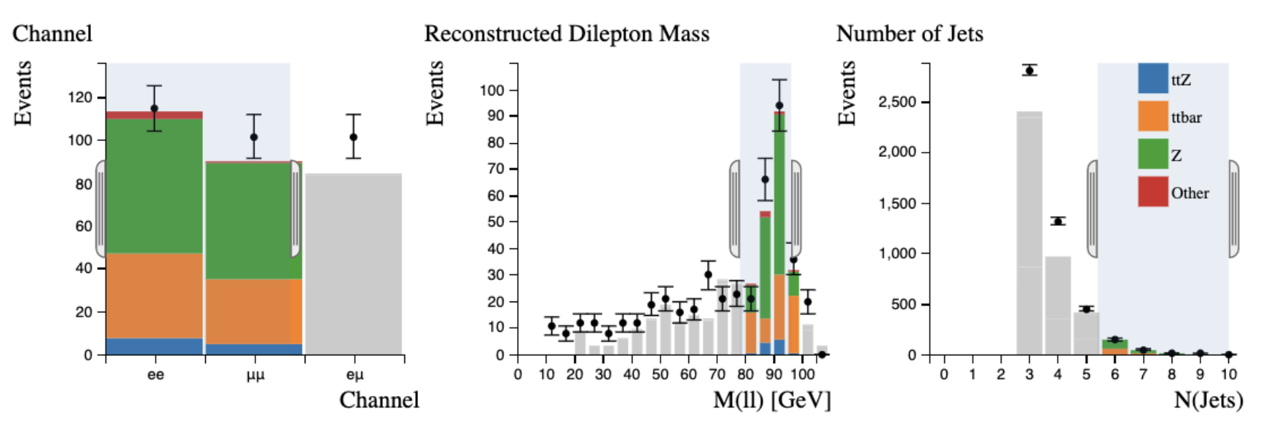
ATLAS PRiSE - Overview
We use resources from ATLAS Open Data: https://atlas.cern/Resources/Opendata
Typically we use the interactive histogram analyzer examples as a launch point
ttZ events: best-explained analysis
But physics context is daunting!

Slide 6
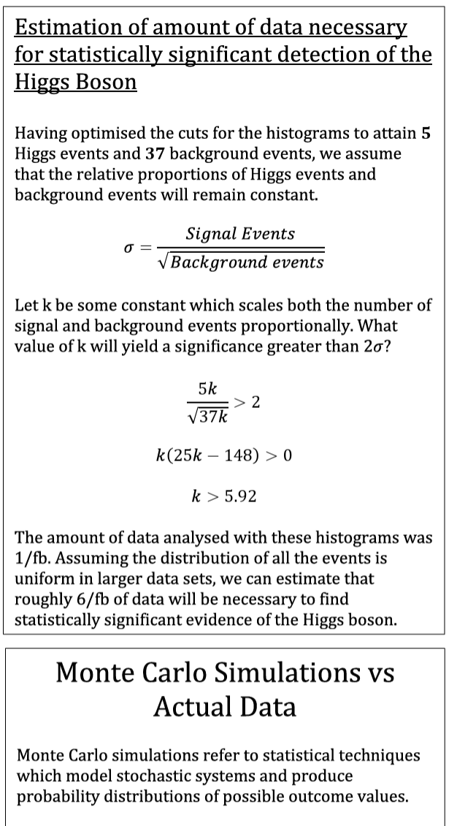
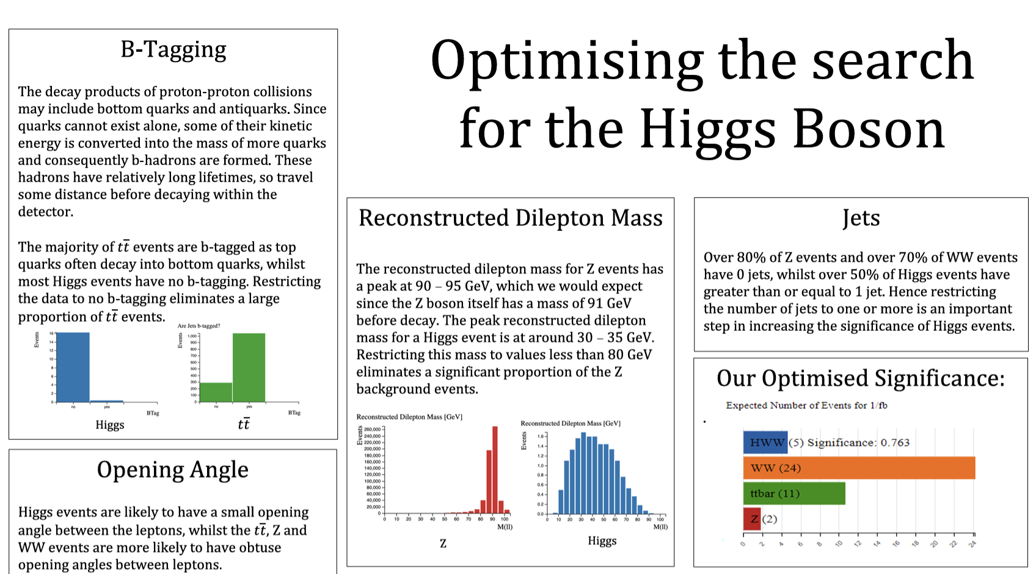
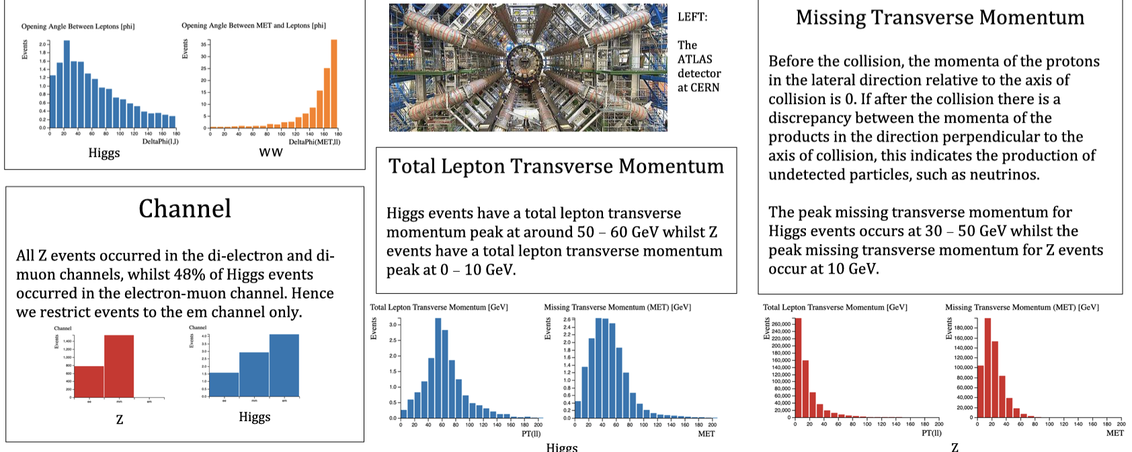
ATLAS PRiSE - Overview
We use resources from ATLAS Open Data: https://atlas.cern/Resources/Opendata
Typically we use the interactive histogram analyzer examples as a launch point
Final projects usually explain significance, signals and backgrounds, variables, why certain selections work – often without further data analysis

Slide 7
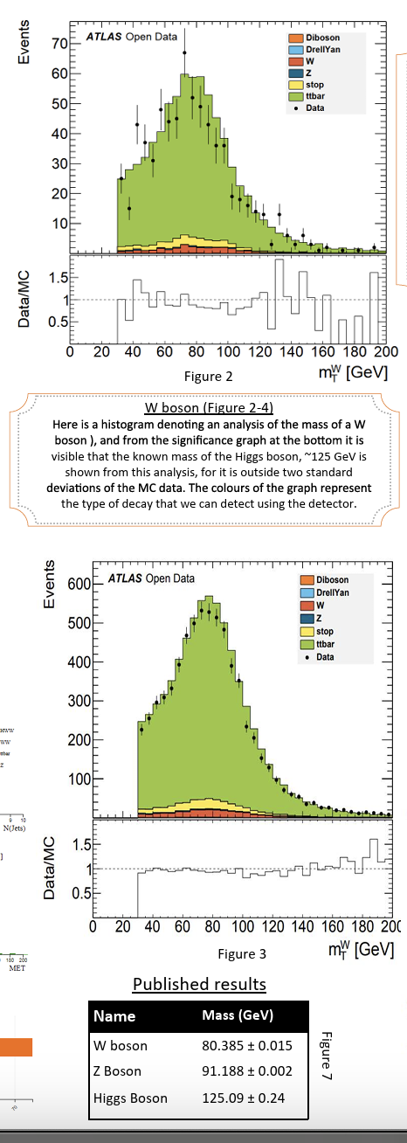
ATLAS PRiSE - Overview
We use resources from ATLAS Open Data: https://atlas.cern/Resources/Opendata
Typically we use the interactive histogram analyzer examples as a launch point
Final projects usually explain significance, signals and backgrounds, variables, why certain selections work – often without further data analysis
Rare exception at right: direct use of Open Data in ROOT format to make histograms
This has happened once in ~10 years as far as I know!

Slide 8
Skills Developed
Creative thinking
Working independently from adults
Teamwork
Problem solving
Analysis of complex data
Research skills
Presentation skills
Project and time management
Inspiration
How can we do more to develop these skills through the project?

Slide 9
Challenges Found
Guided activities are often more useful than providing “raw” data
Multivariable analysis frameworks are complex for secondary level, and would require detailed examples
Activities may be hard to follow if website is complex
Example: ATLAS Open Data website has multiple datasets and strands
Not always clear how to navigate between related pages without encountering extraneous pages
It may be difficult to identify whether explanatory pages are specific to the current activity
→ External guide to website may be developed by academics or teachers
Tiny changes to website can break existing guides/instructions!
Expertise in subject matter and website content needed to support independent student exploration → very little time for teachers to develop this!
Tension between science as an approach/skillset and science as a “fixed” collection of knowledge

Slide 10
How to get more out of the programme?
Teacher CPD
Particle physics background
Guiding students through independent projects
Useful training for researchers and academics as well!
Engage teachers in development
Guides to websites and choice of activities
Initial definition of guided activities, with datasets as integral components of those activities
Actively study student journeys through datasets/activities
What are the realistic self-guided projects that are available?
What features do they have?

Slide 11
Conclusions
ATLAS Open Data and activities built around it are effective for 15 year olds, with positive outcomes, but challenging to use
Skills involved are complex – and useful if we can develop them
Multivariate analysis: often not taught explicitly but essential for many modern careers. How do we teach it better?
Independent extended projects:
New to school students
Mostly new to teachers
University researchers and academics may need thinking and training on how to support them at this level!
“Student Journeys” need more systematic attention
Better connections to A Levels
Broader Geographic Range

Slide 12
Extra Info: Overview and Questions
This talk describes lessons learned from using ATLAS Open Data in the Physics Research in School Environments (PRiSE) Programme at Queen Mary University of London, which teaches physics and STEM skills through year-long projects to 15-18 year old GCSE and A-Level students. We focus here on identifying the range of skills involved in completing such projects, and the challenges experienced by the various people involved (i.e. students, teachers, and university researchers).
A question regarding a particular challenge in your work for which other participants may provide input: How do we realistically enable teachers and university researchers to support projects for GCSE and A-Level students using complex Open Data?
A statement on the future of Open Data in Higher Education, what we should do: Focus on robust presentation that is usable in a self-guided way by specific realistic target audiences (e.g. specific student year(s), teachers, etc.). Think of datasets as integral parts of specific activities with learning objectives and maximise involvement of educators at the target level in developing both the activities and the datasets themselves.
A suggestion for how this work or expertise may be useful to a broader audience or to colleagues in other fields: Multivariate analysis underpins an increasing number of jobs, notably in AI, but it is often underestimated as a taught skill and way of thinking. Even at UG project and PhD level we ask students to “learn on the job”, which is not always effective; working with younger audiences forces us to identify what to actively teach and how.

Slide 13
Extra Info – Skills Detail Notes
Creative thinking: The hardest part for nearly all students is deciding what to do their project on. Up till now they have almost always been told what to do, what to research, etc. They find it extremely difficult to cope with a blank slate and have to think of what they would like to research and what their project should be about.
Working independently from adults: This is necessitated, not only because teaching staff simply don’t have time to drill down into all the projects, but also the students are often going beyond the teacher’s own knowledge on their particular project. The physics teachers themselves often learn something from their students’ presentations!
Teamwork: I have seen team sizes from 2 up to 7 (and individuals) but in my personal opinion 4 is an optimum team size (depending on the number of tasks required). There are often a range of tasks that can be divided amongst the team such as research, calculations, programming, creating presentations, etc. I try to encourage the students to form teams where all participants have a common free period at least once a week, and this can be when they get together to discuss the project.
Problem solving: Speaks for itself. These projects always involve some degree of problem solving.
Analysis of complex data: Certainly up to GCSE and even up to A Level, students are taught that science experiments always involve one independent variable, one dependent variable and lots of control variables. They almost never have situations with multiple variables (that are not control variables) and yet this is often the reality in real life science experiments.
Research skills: The project will usually involve research to at least some degree. The students are encouraged to compare the research with their actual findings and to consider why the two may be different. This also encourages scientific integrity. In many school experiments it can be relatively easy to make the results fit what you want them to be, or think they should be!
Presentation skills: Presentation via posters as per normal scientific conferences forces the students to distil their project to a level that others can comprehend it. Some projects are presented via powerpoint at the Cosmic Con. I actually encouraged all my groups to produce powerpoint presentations that could be shared within the school, even if they were not chosen to present at Cosmic Con. Those that are chosen certainly get to think carefully about and hone their presentation skills. When my groups were chosen, I got them to present internally first so as to help polish their presentations.
Project and time management: The Cosmic Con deadline necessitates this. There are various deadlines within the deadline, e.g. for submitting posters, etc which forces groups to set their own internal deadlines; e.g. finishing research, finishing work on the project, analysing results, revisiting results, preparing the poster, etc.
Inspiration: The fact that the students are working on real data from real scientific experiments such as CERN and the Kepler Space Telescope is very inspiring to the students. The exoplanets they find are real exoplanets that actually exist out there in space. The students get a real taste of what university level research is like.

