Slide 1
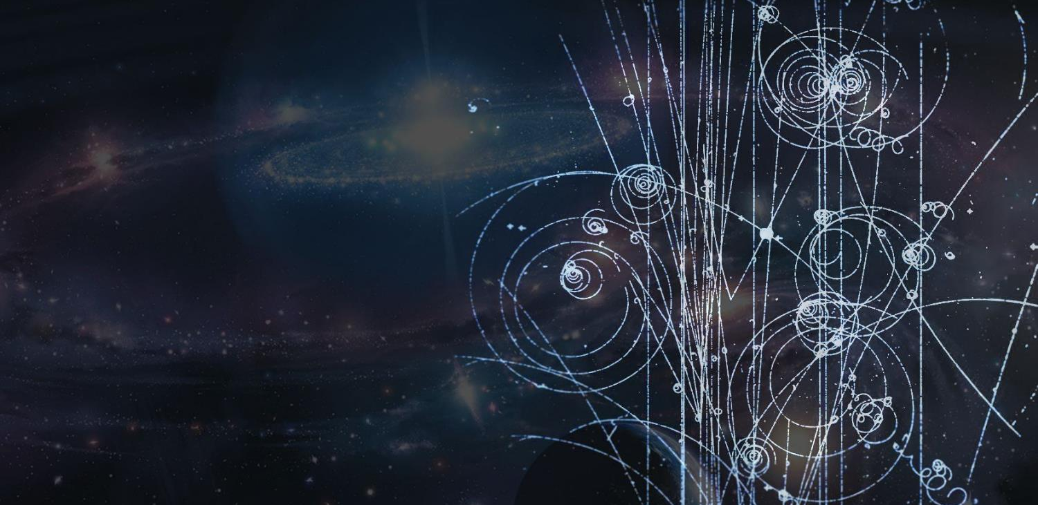

CERN Open Data Portal
Pablo Saiz
IOP Open Data Workshop for Higher Education
University of Sussex, UK 14 May 2026
Notes:
----

Slide 2


CERN Open Data Portal
Open Data is good
📊
Quantitative Metrics
downloads, citations, …
🟢
Qualitative Insights
FAIR Open Data is even better
case studies, stories, …
European
Open
Science
Cloud
👥
Equity & Inclusion
accessibility, diversity, …
How to measure impact
Other Fields

Slide 3
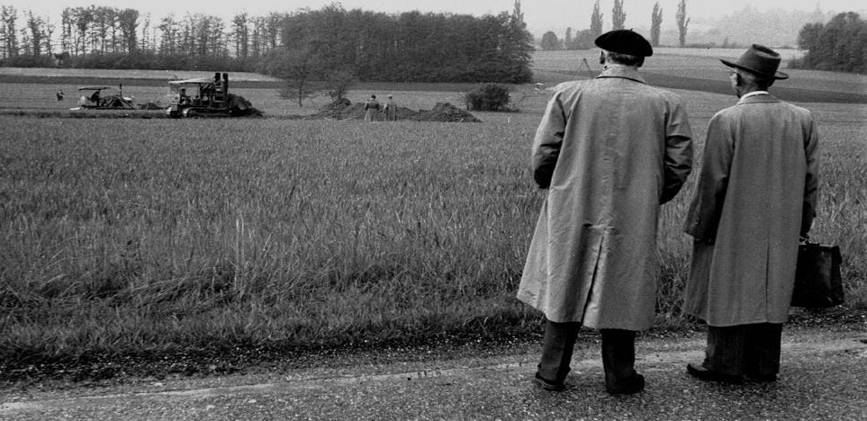


CERN
1954
Notes:
It is decided to build the «European Organization for Nuclear Research». It comes into existence in 1954.
Geneva is chosen for its central location, the neutrality of Switzerland, the International visibility.
International Organization format was chosed to guarantee neutrality and independance.
The Organization, unlike the Council, has labs and has research activties.
But as the Organization is still «led» by a Council, the CERN acronym was kept.

Slide 4
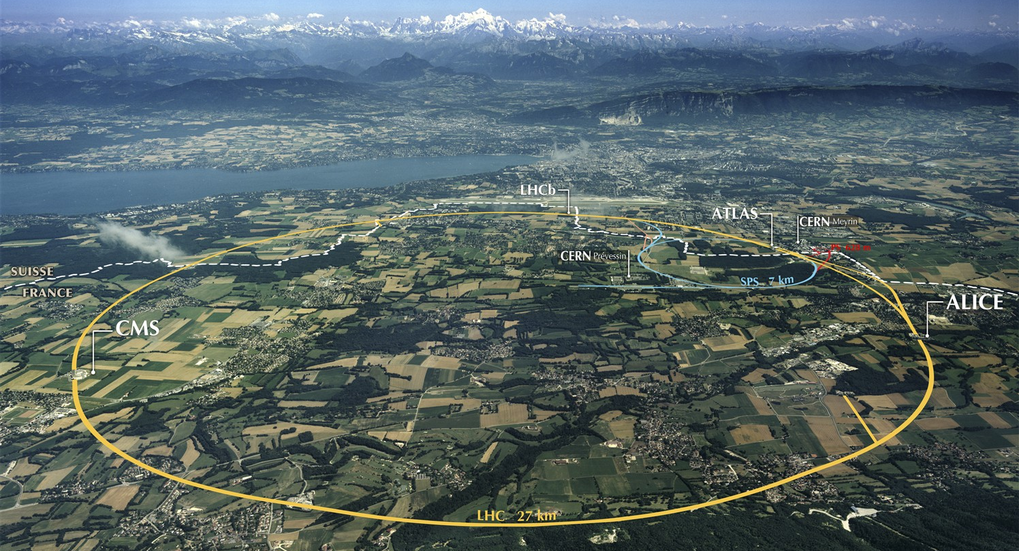
CERN
25 member states
8 associate members
4 Observers
2,000 staff
12,000 users

Slide 5
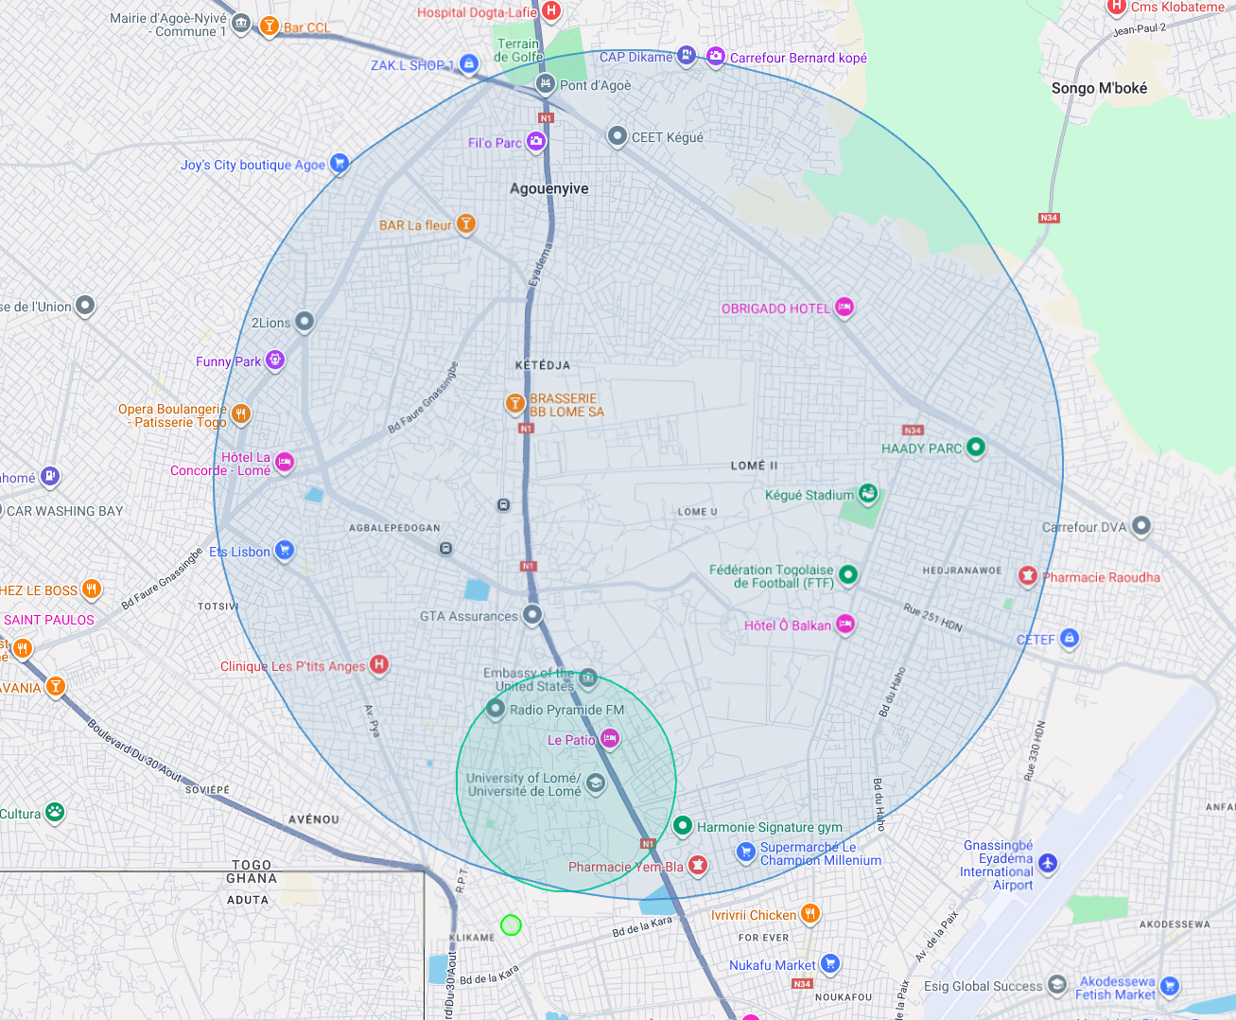
What if the LHC was in Togo?
What if it was in Lomé?
Notes:
Put here a map of the LHC in the city where your audience comes from.
This helps figuring out how large is the LHC in comparison to something they know.
You can create such a map on the www.howlargeisthelhc.com website. Don’t forget to select PS and SPS as well.

Slide 6
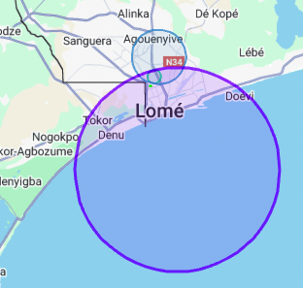
What if the LHC was in Togo?
What if it was in Lomé?
And with the FCC
Notes:
Put here a map of the LHC in the city where your audience comes from.
This helps figuring out how large is the LHC in comparison to something they know.
You can create such a map on the www.howlargeisthelhc.com website. Don’t forget to select PS and SPS as well.

Slide 7
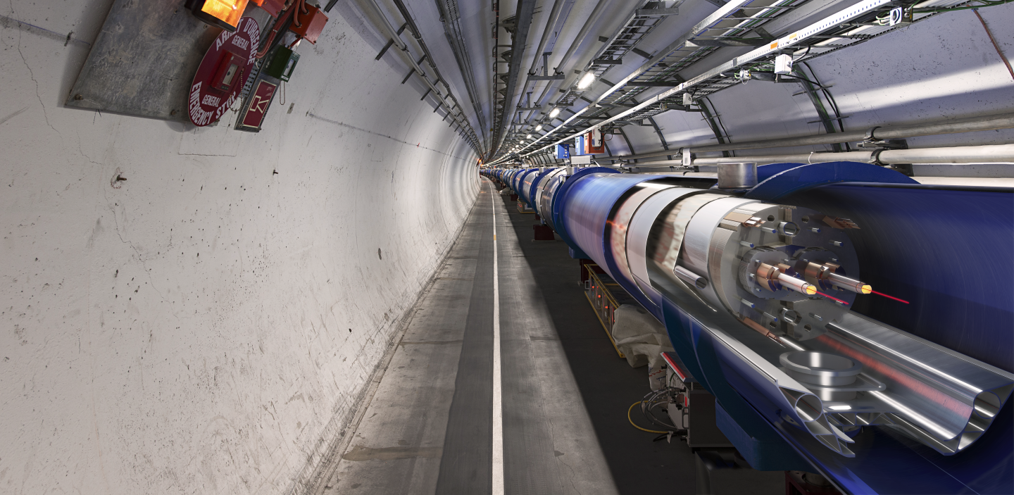
The most powerful magnets
Notes:
The LHC is built underground, mainly for financial reasons (would have cost too much to buy all the land and would have been impractical anyway).
It also provide natural shielding of radiations for the population but also shielding from cosmic rays to the 4 detectors.
The LCH is mainly hosted in a 3m diameter tunnel containing mostly superconducting magnets and some accelerating devices.
You can see on the picture that the 2 counter-rotating beams are hosted in different pipes, making collisions impossible there.

Slide 8
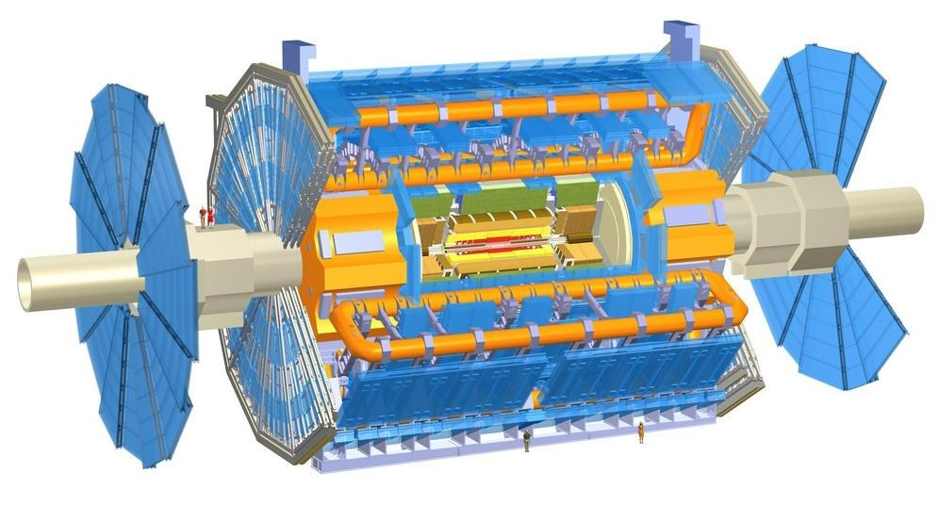
The largest detectors
into
By 401 058c CC BY-SA 2.5
Notes:
Now that we have accelerated the particles, let’s collide them!
This is possible only in the 4 points where we cross-over the beams.
The collision point is tinier than a needle head.
Here is the ATLAS detector, the largest of the 4 LHC detectors. Look at the small persons next to it.
It is 50 long, 25m diameter and weights 7’000 tonnes, the same as the Eiffel Tower.
The collision of protons will create new particles in all directions. That’s why the detector often have this cylindrical shape.

Slide 9

The largest detectors
Turning
Notes:
Now that we have accelerated the particles, let’s collide them!
This is possible only in the 4 points where we cross-over the beams.
The collision point is tinier than a needle head.
Here is the ATLAS detector, the largest of the 4 LHC detectors. Look at the small persons next to it.
It is 50 long, 25m diameter and weights 7’000 tonnes, the same as the Eiffel Tower.
The collision of protons will create new particles in all directions. That’s why the detector often have this cylindrical shape.

Slide 10
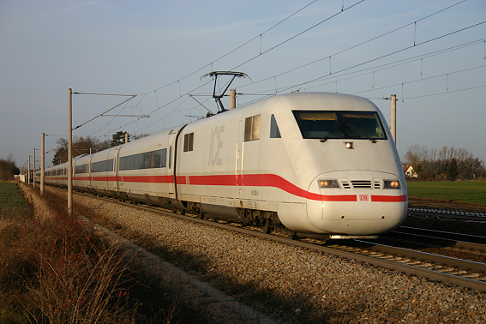
The largest detectors
Turning
into
By 401 058c CC BY-SA 2.5
Notes:
Now that we have accelerated the particles, let’s collide them!
This is possible only in the 4 points where we cross-over the beams.
The collision point is tinier than a needle head.
Here is the ATLAS detector, the largest of the 4 LHC detectors. Look at the small persons next to it.
It is 50 long, 25m diameter and weights 7’000 tonnes, the same as the Eiffel Tower.
The collision of protons will create new particles in all directions. That’s why the detector often have this cylindrical shape.

Slide 11
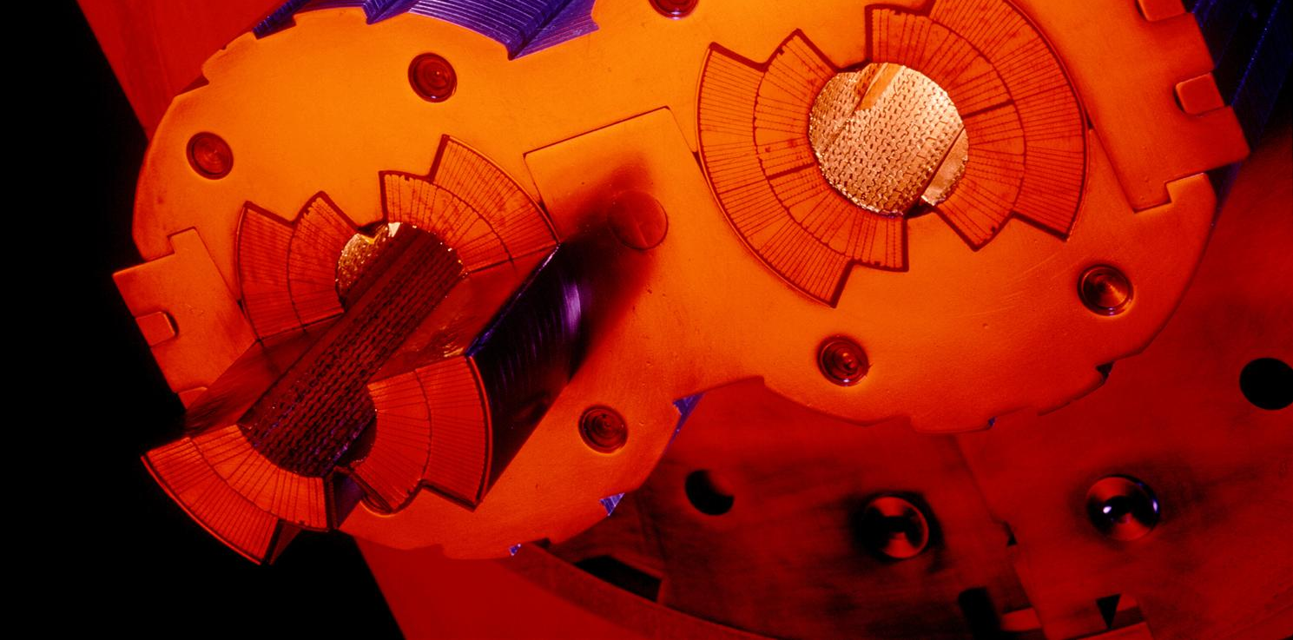
The biggest vaccum
Notes:
These 2 pipes need to be as empty as possible (otherwise protons would hit air molecules all the time).
Thanks to turbo-molecular pumps and other technologies, we reach a vacuum of 10^-13 atmosphere in the centre of the pipes: this is 10 times emptiers than on the surface of the Moon or as empty as in the solar system.
The magnetic field which curves the beam, is provided by the coils surrounding the pipes. As each beam holds as much energy as in a high-speed train, the magnets must deliver a tremendous magnetic field of 9 T (tesla). This equates to 200’000 times the magnetic field of Earth (ca 45 micro tesla)
For that, each of the small electric cableyou see around the vacuum pipes (1mm by 10mm section) a current of 11’000 amperes (in comparison in your home there is a current of about 20 amperes in the wires).

Slide 12
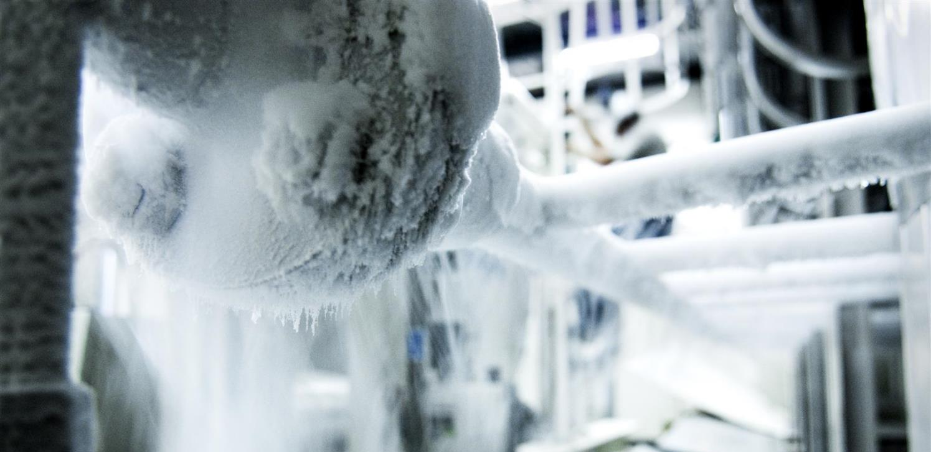
The coolest place
Notes:
That’s why we need to cool down the cables to the lowest temperature possible.
We have to reach -271°C (or 1.9° kelvin, which is 1.9° above the absolute zero).
At that temperature, the cables made of Niobium Titanium (NbTi) are «superconducting», it means they don’t heat up anymore as they have no electric resistance.
LHC is colder than the vast majority of the Universe whose average temperature is 2.725° kelvin (if you look for a «cool» place to work, CERN is a good one)
This is possible thanks to cryogenic facilities using 120 tonnes or 700’000 litres of Helium!

Slide 13
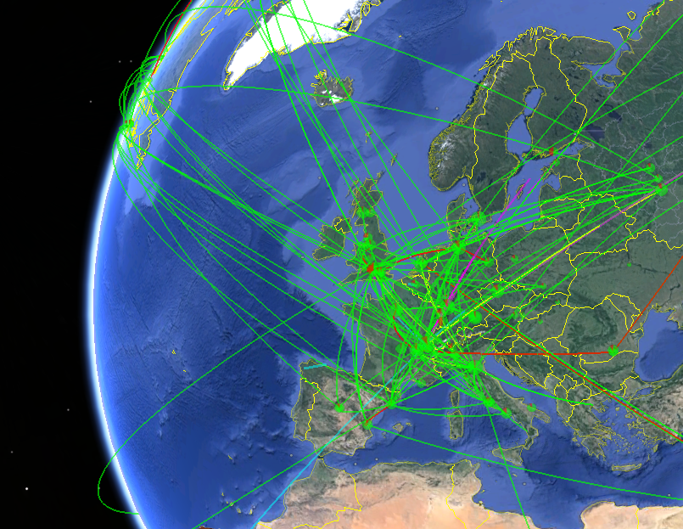

The biggest computing grid
Notes:
All these detectors will generate loads of data… about 1 PB (petabyte = million of gigabyte per… SECOND!)
Impossible to store so much data. Anyway not needed.
The event the experiments are trying to create and observe are very rare.
That’s why we make so many collisions but we keep only the interesting ones.
Therefore next to each detector is a «trigger», a kind of filter made of various layers (first electronic, then computers) which will select and keep only 1 collision out of a million average.
In the end will still generate dozens of Petabytes of data each year. We need more than 800’000 computer CPUs to analyze this data.
As CERN has only about 200’000 CPUS we share the date over more than 100 computer centre over the planet (usually located in the physics institutes participating to the LHC collaboration). This is the Computing Grid, a gigantic planetary computer and hard drive!

Slide 14
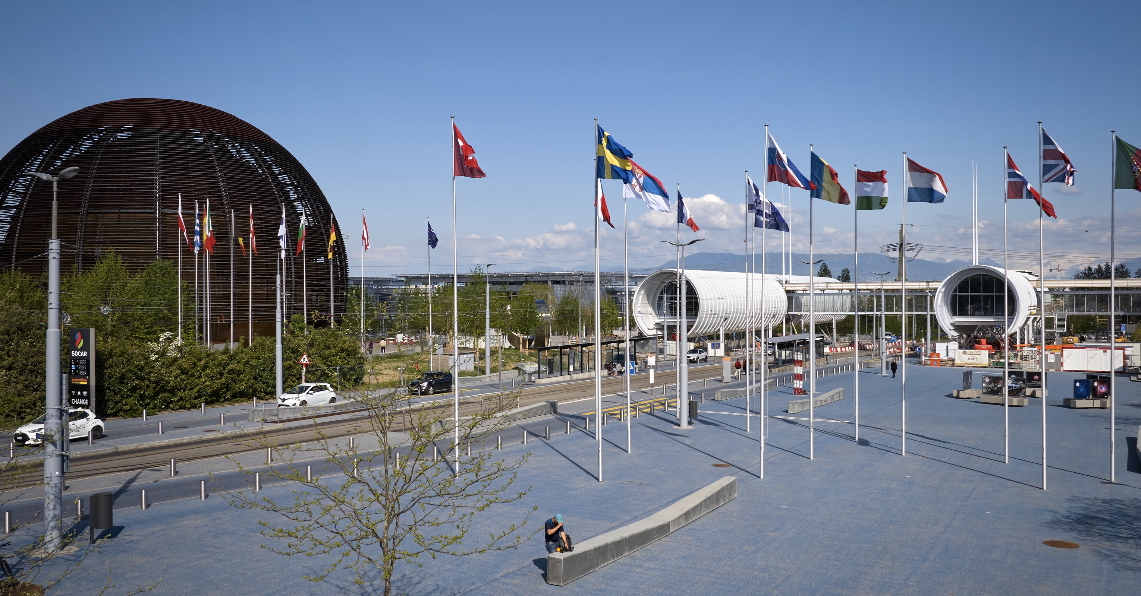




CERN Open Science
Notes:
The Sponsoring Consortium for Open Access Publishing in Particle Physics (SCOAP3) is a global partnership working towards the open access publishing of high-quality research articles in the field of particle physics. Established in 2014, SCOAP3 is one of the first collective open access initiatives, inspired by the long tradition of collaboration across CERNs experiments. It involvs 3000 stakeholders including publishers, libraries, funding agencies, and research institutions and is now converting more than 90% of the annual high-energy physics literature to immediate open access.
White Rabbit is an Ethernet-based network technology that enables users to precision time-tag measured data and trigger data taking in large installations while using the same network to transmit data. White Rabbit was developed as part of the timing system update for the CERN accelerator complex. In CERN’s flagship accelerator, the Large Hadron Collider (LHC), particles circulate over 11000 times per second. Components in the accelerator complex sometimes require extreme timing accuracy and synchronization down to 10 picoseconds. White Rabbit provides sub-nanosecond accuracy and a precision of a few picoseconds in the synchronization of large distributed systems.
Zenodo is a general-purpose research repository designed to facilitate the sharing, preservation, and dissemination of research outputs across all scientific disciplines. Launched in 2013 by the CERN, Zenodo offers researchers and institutions a user-friendly space to deposit and archive various types of scholarly content, including datasets, software, presentations, publications, and more

Slide 15
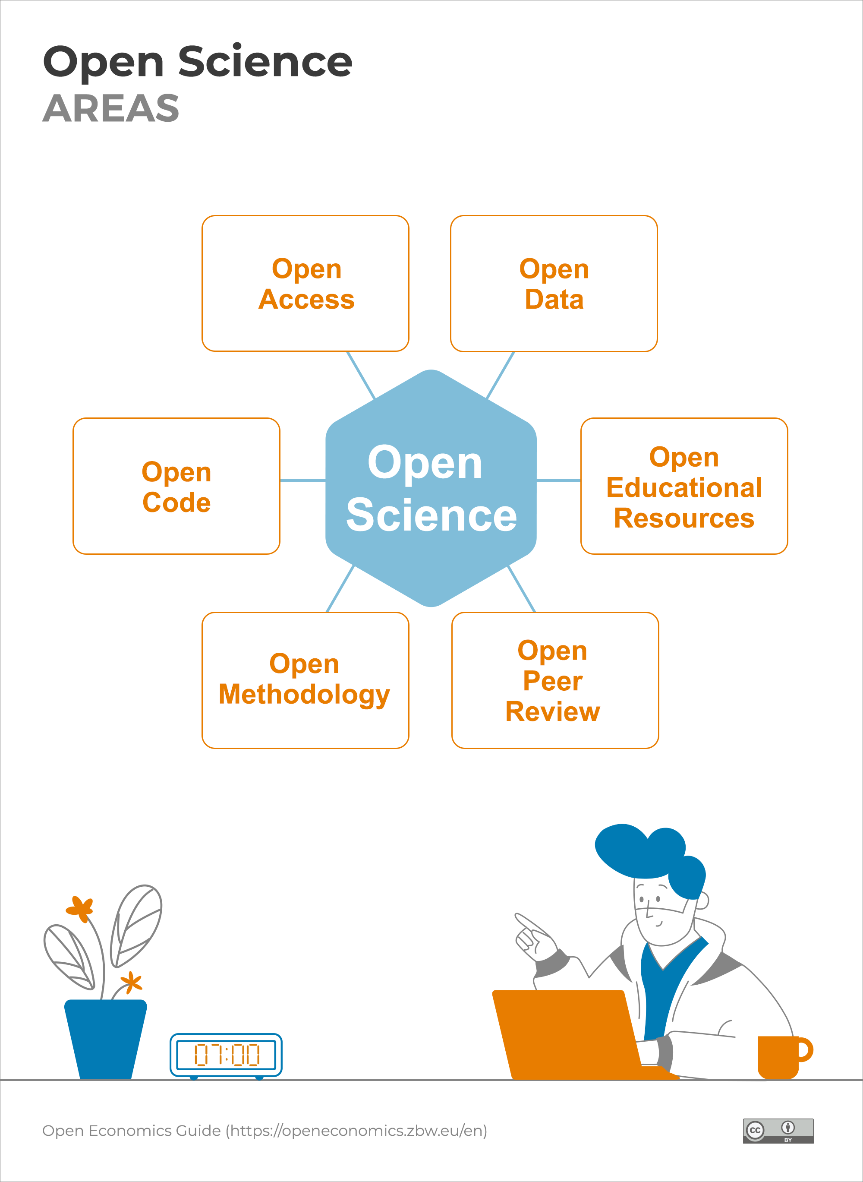

Open Science

Slide 16
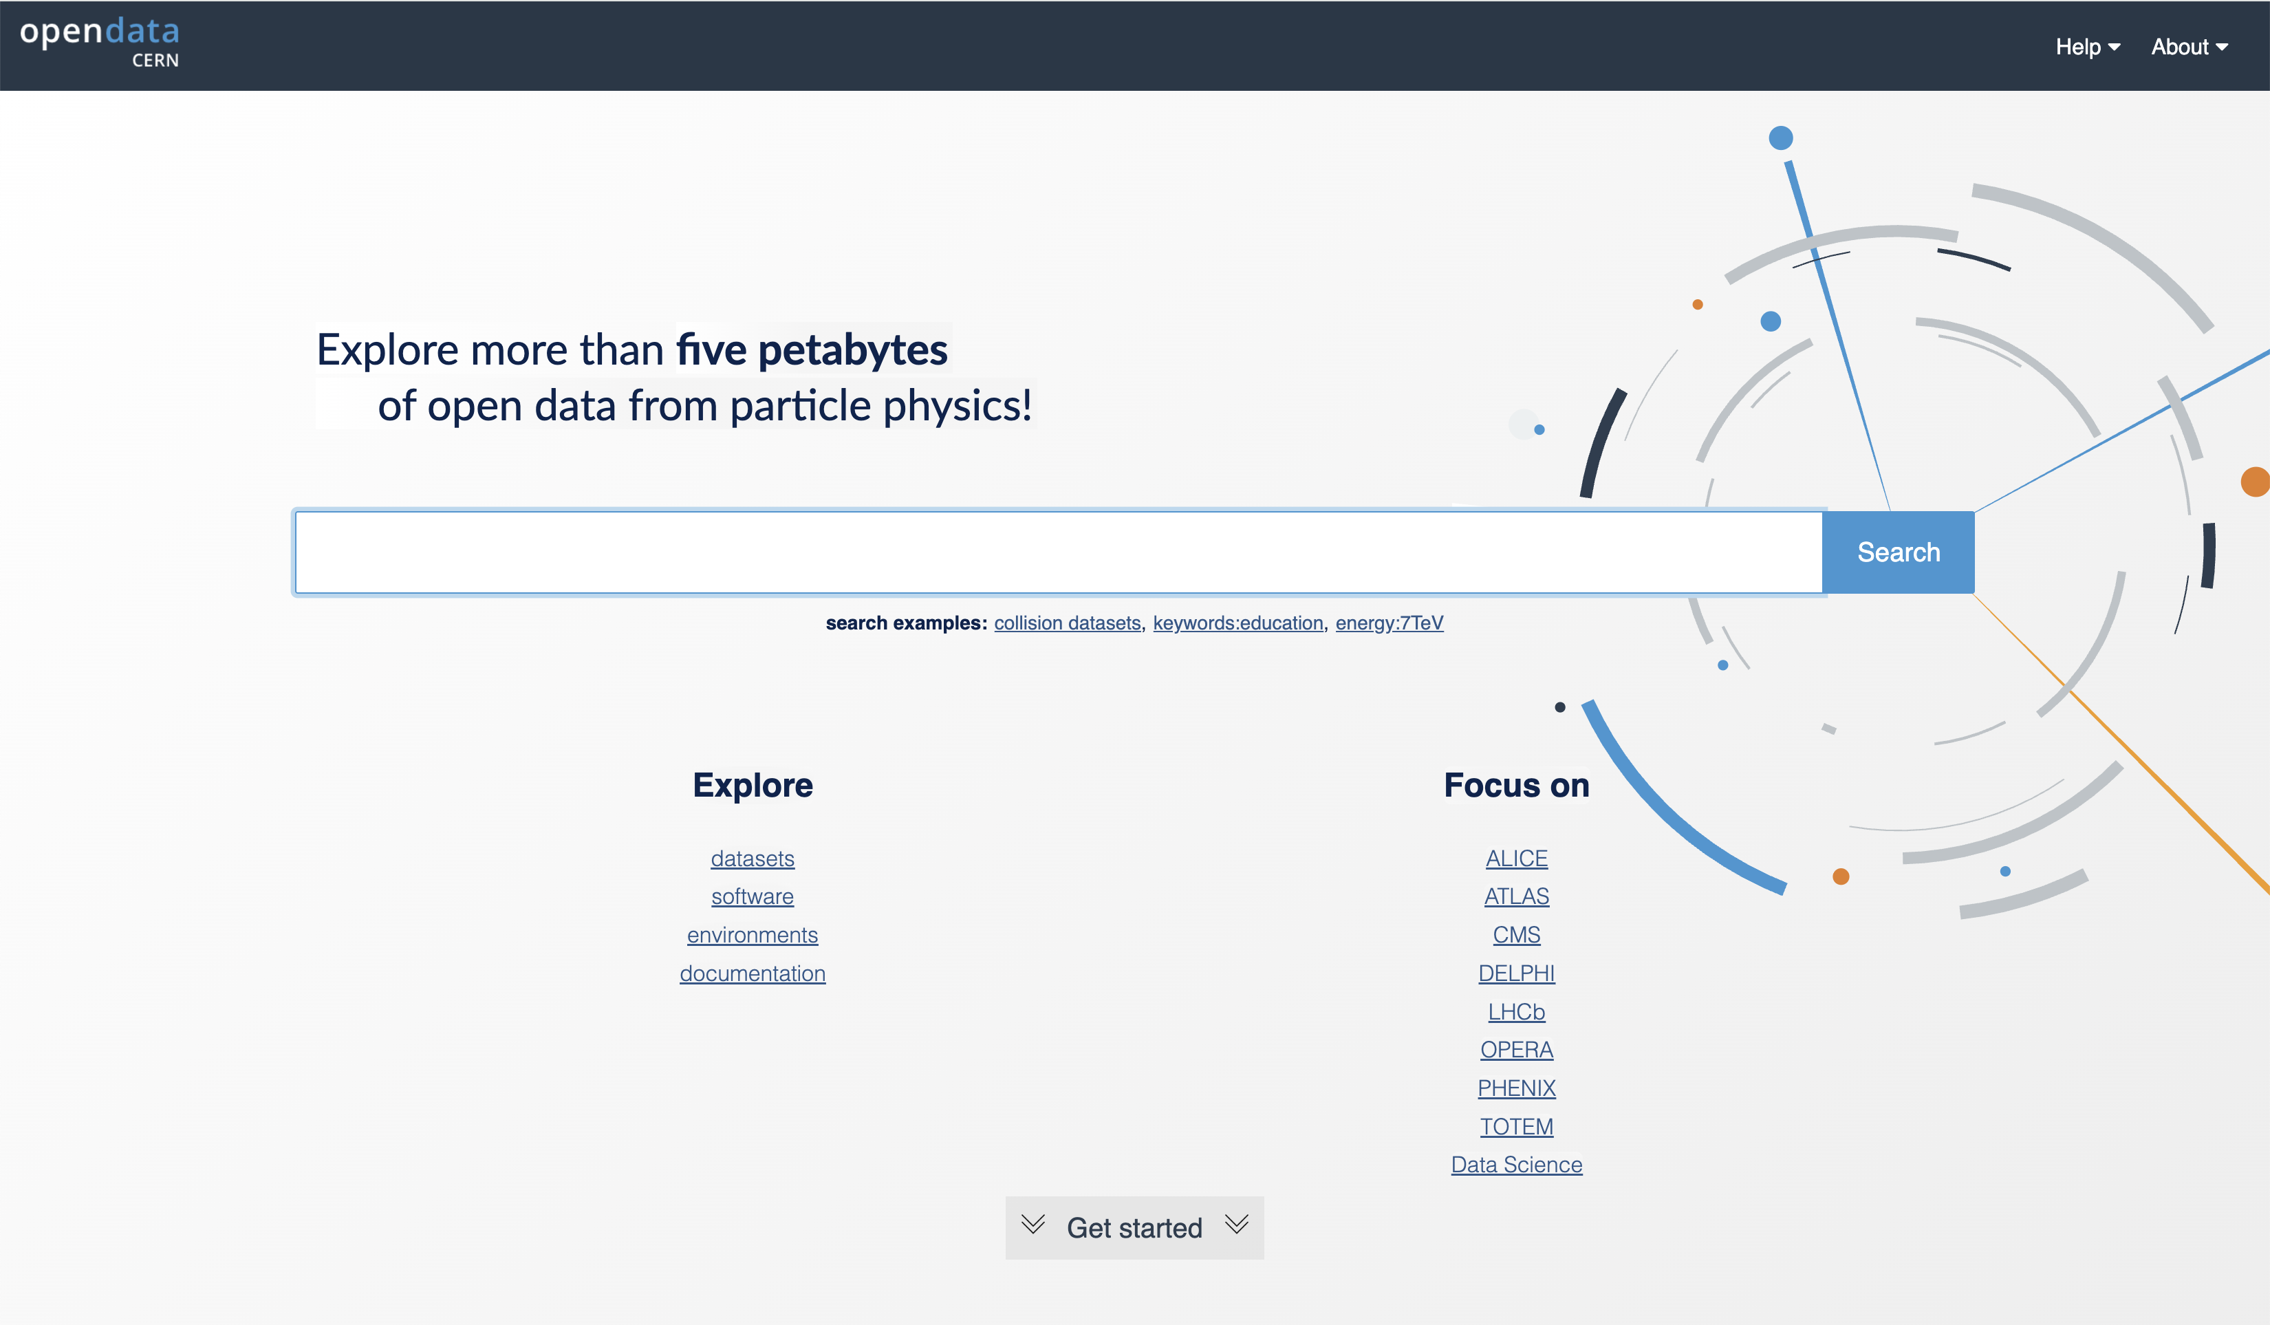
https://opendata.cern

Slide 17
The Turing Way Community, & Scriberia. (2020)
Illustrations from the Turing Way book dashes. Zenodo. https://doi.org/10.5281/zenodo.3695300

Slide 18
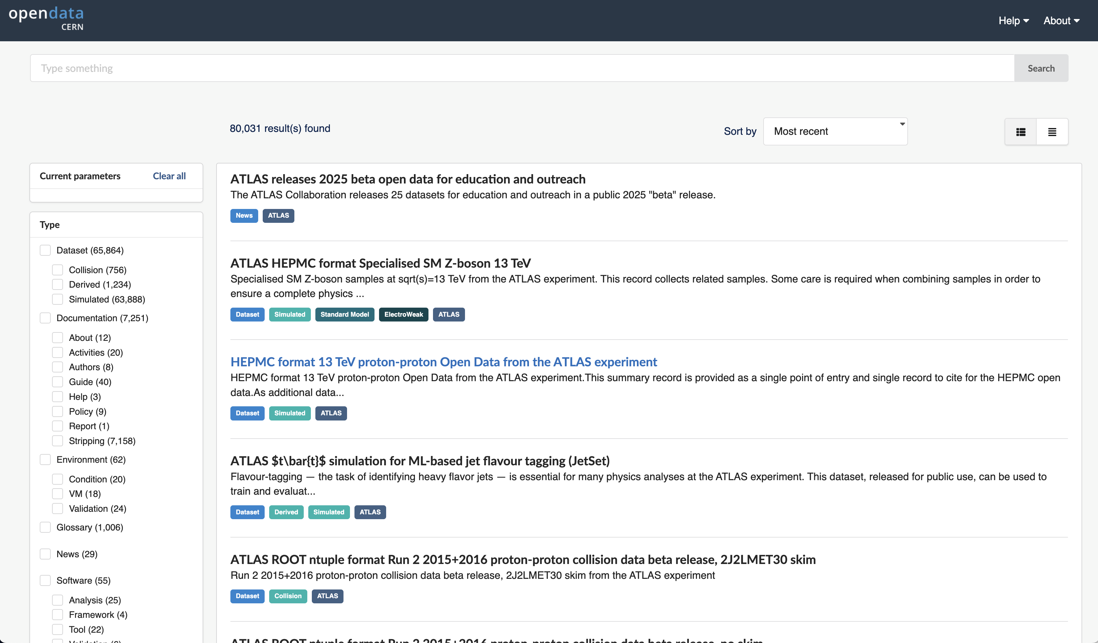

Slide 19
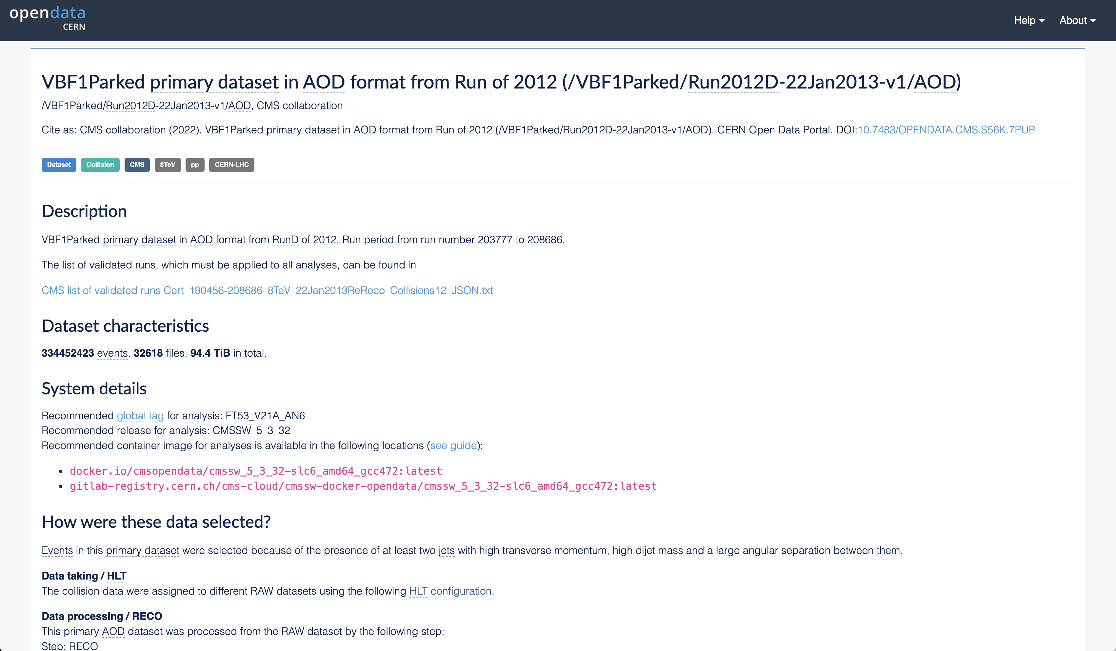
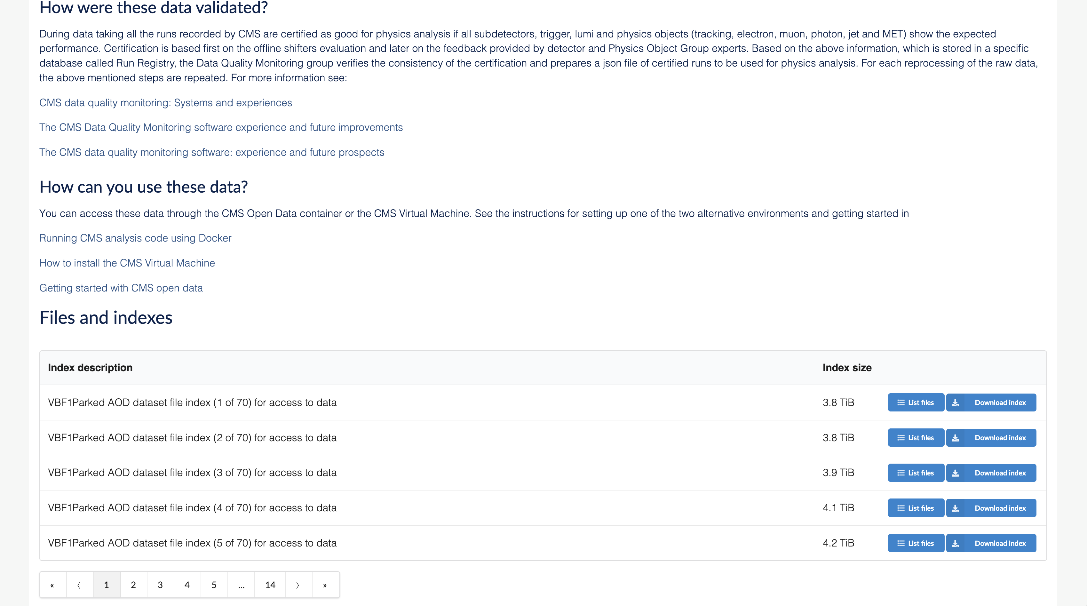

Slide 20
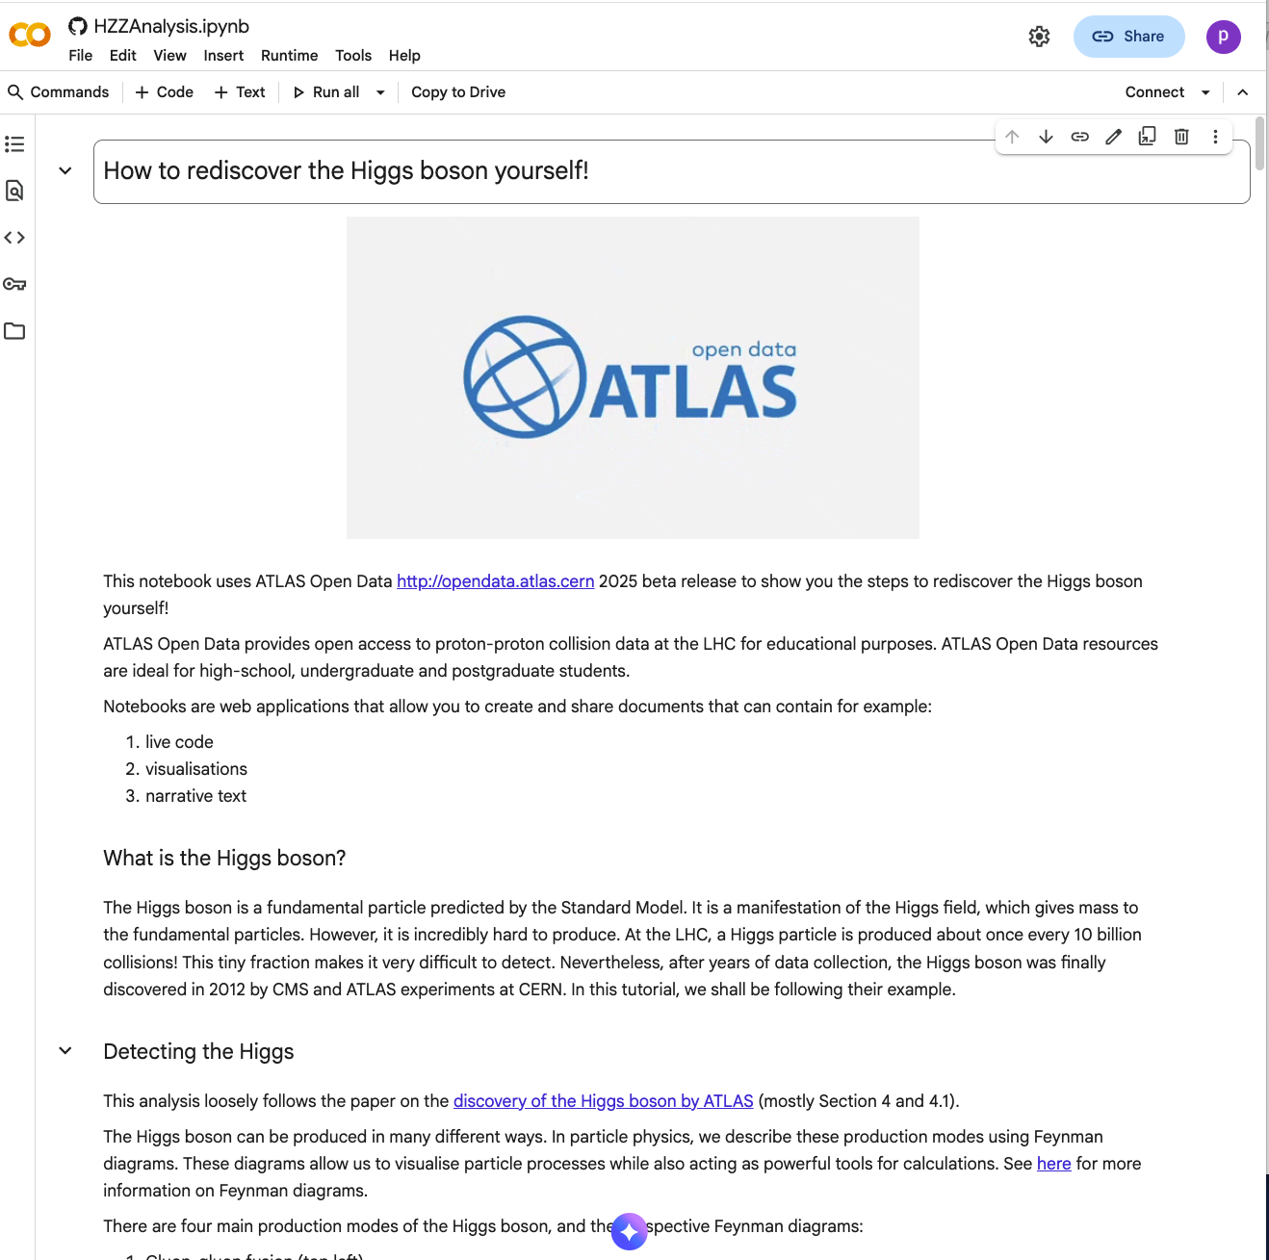
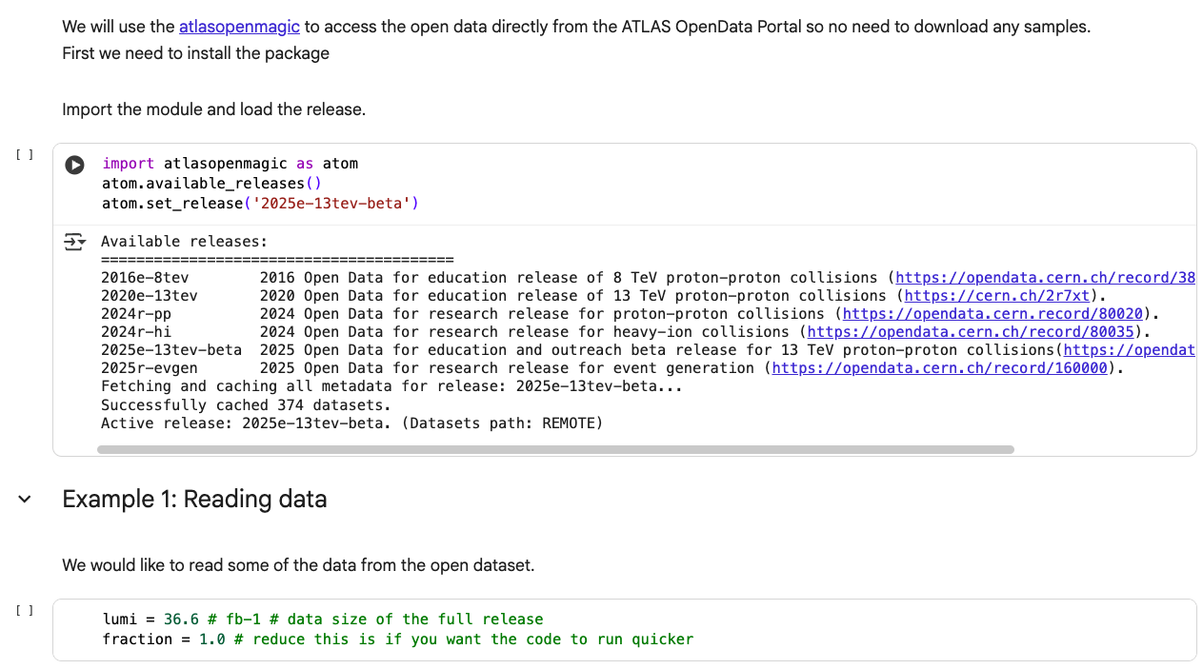
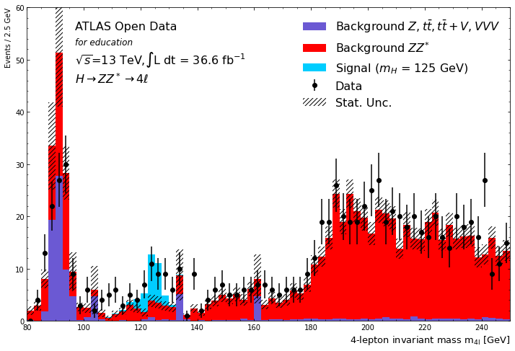

Slide 21
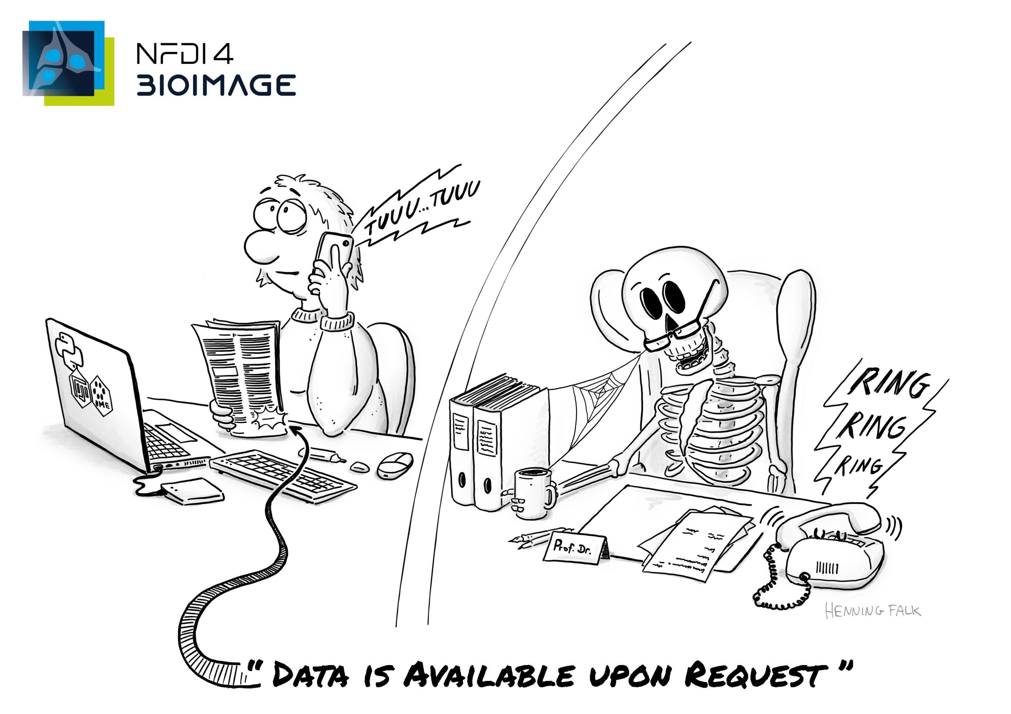
This cartoon is part of a series of post cards raising awareness for the work of the NFDI4BIOIMAGE consortium. Published under a CC BY 4.0 licence.

Slide 22
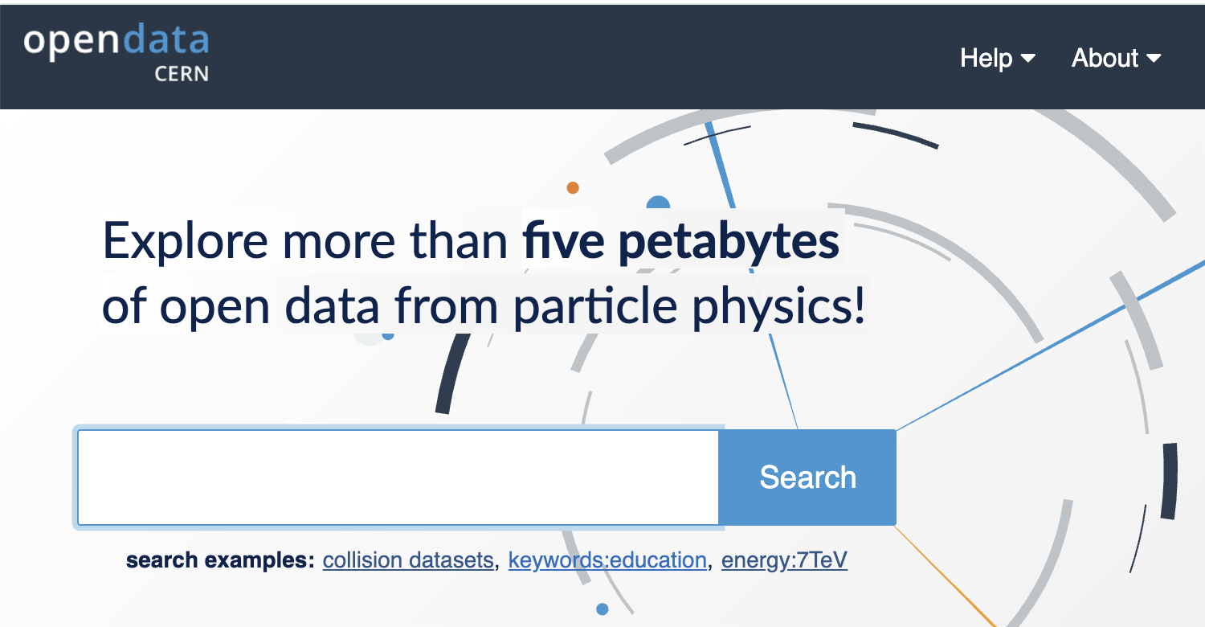
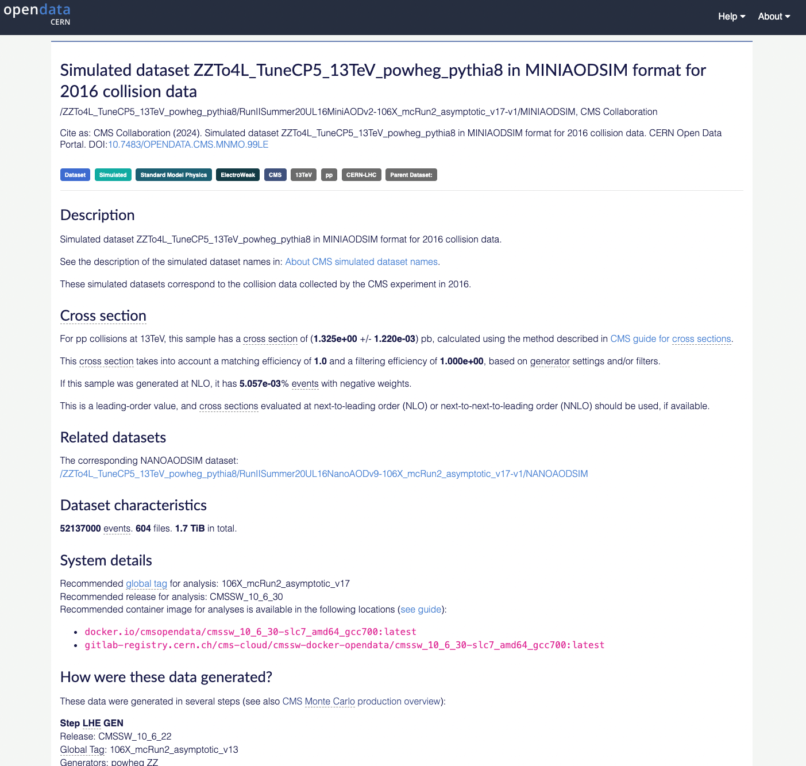
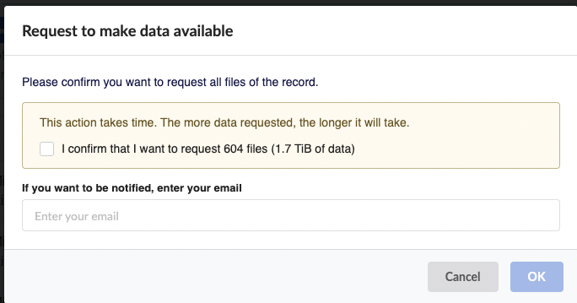
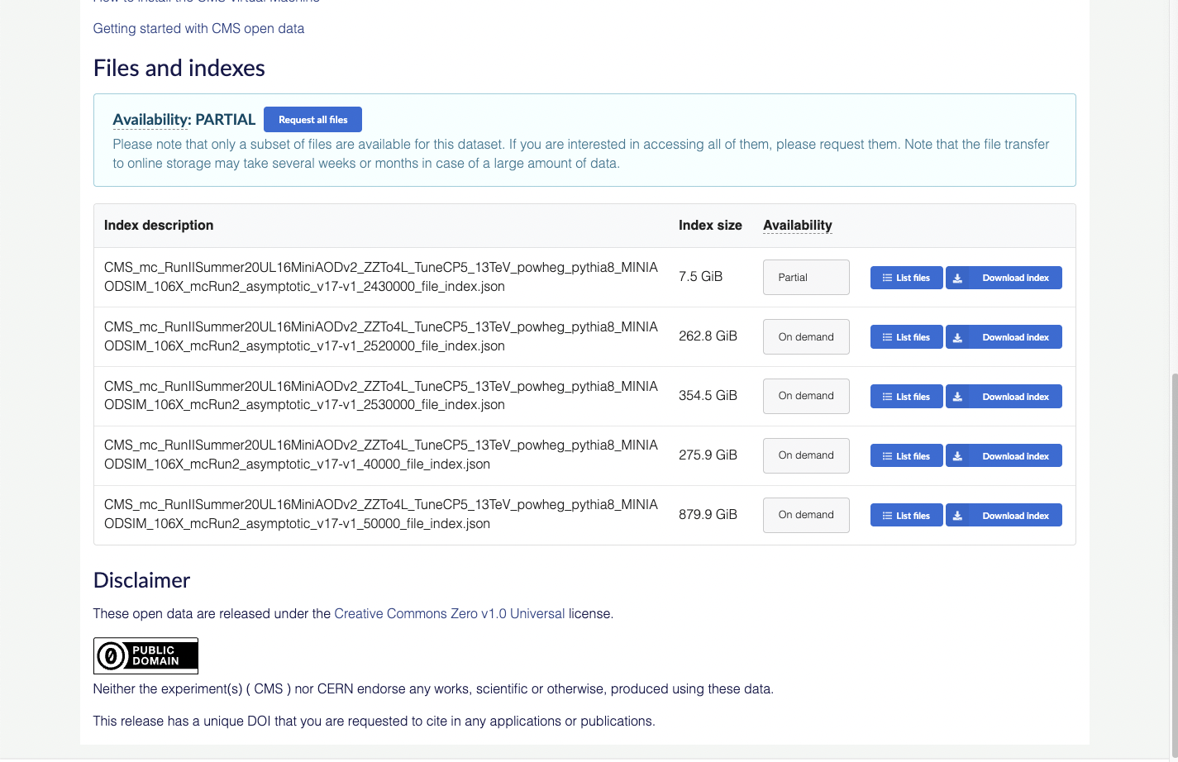
Cold Storage for CERN Open Data

Slide 23
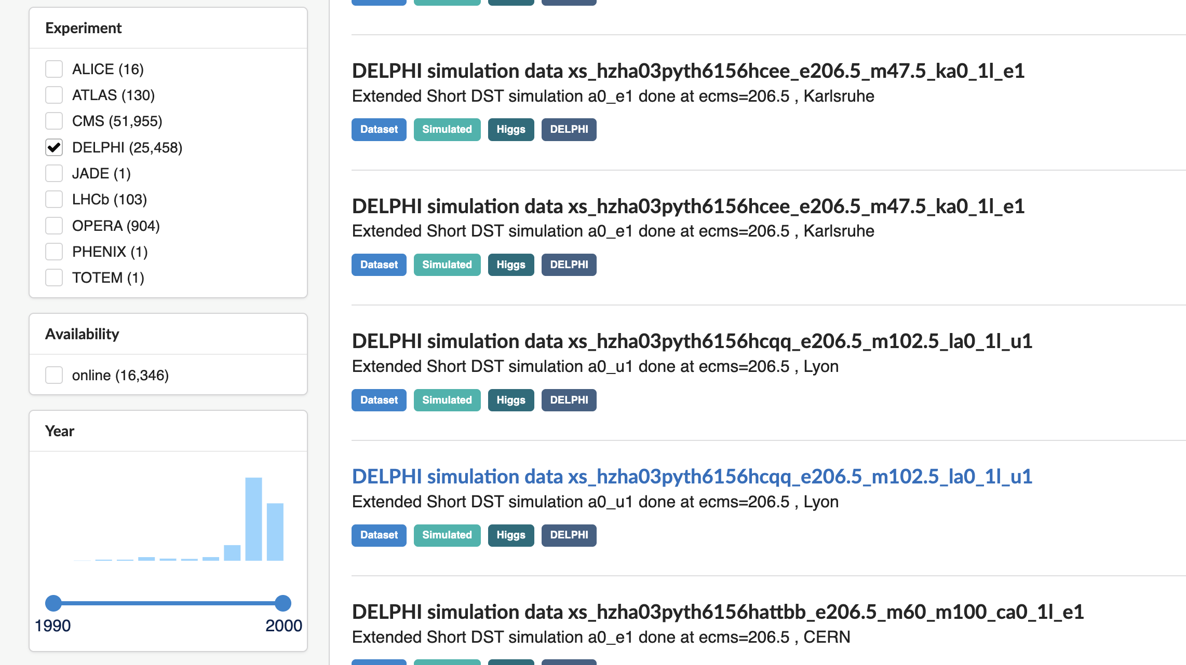
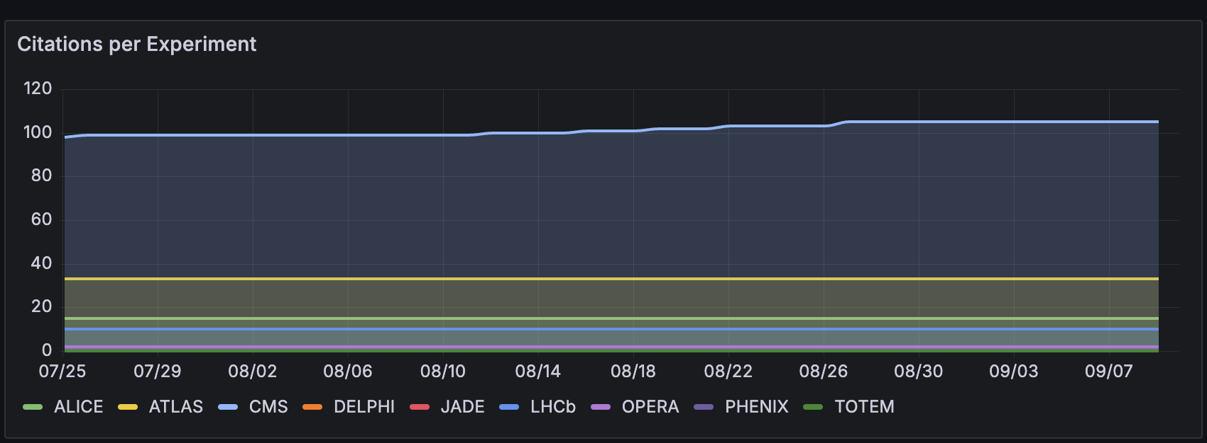
Long-term preservation

Slide 24
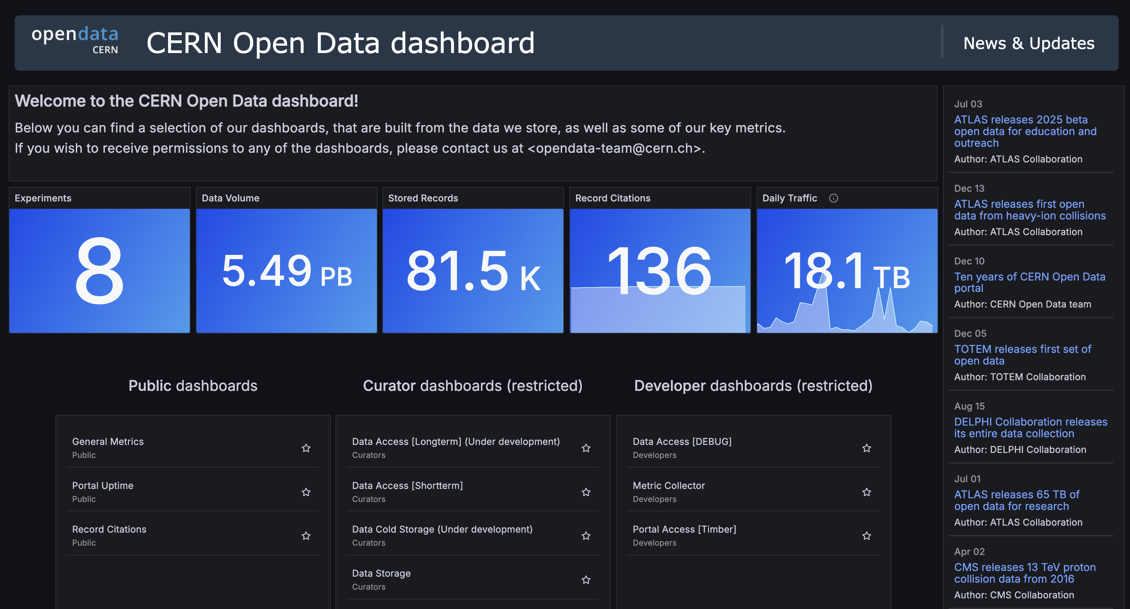
Pablo Saiz PWF Togo: Workshop on LHC Open Data

Slide 25
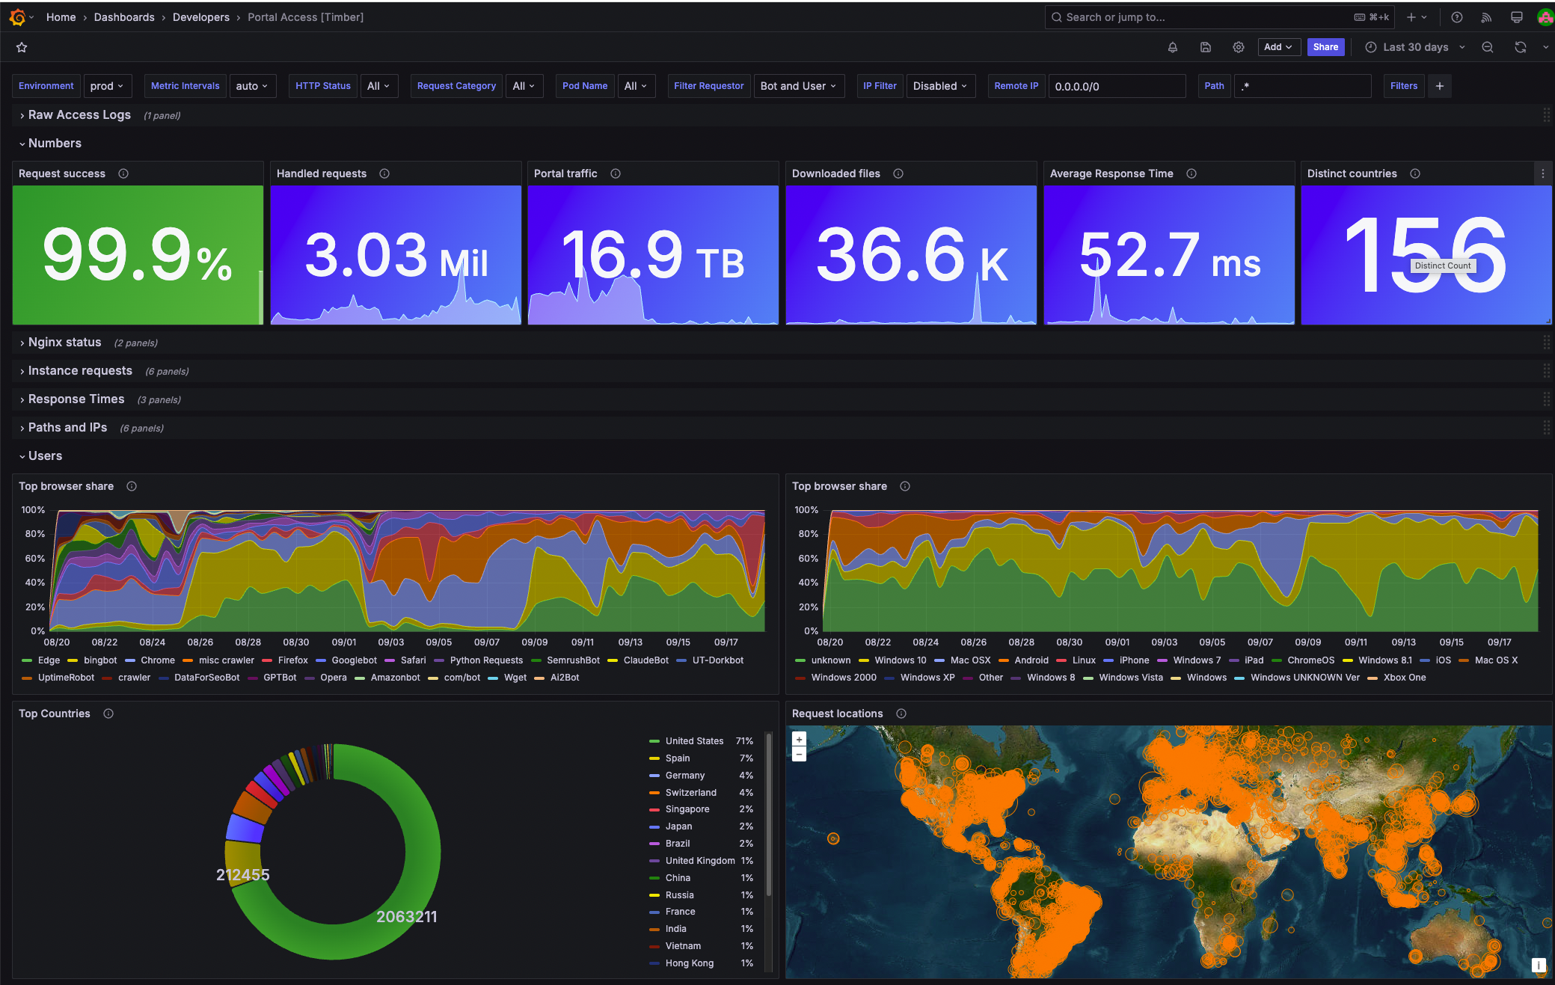
Pablo Saiz PWF Togo: Workshop on LHC Open Data

Slide 26
CERN Open Data Portal
Publicly available repository with more than 5 PB of physics data (and growing!)
  8 experiments, 80.000 records, 3.000.000 files
Curated by our experiment colleagues
  Datasets, metadata, provenance, tutorials, etc…
Following FAIR principles
  Findable
  Accessible
  Interoperable
  Reusable
Used for education, outreach, independent studies
Pablo Saiz PWF Togo: Workshop on LHC Open Data

Slide 27
Pablo Saiz PWF Togo: Workshop on LHC Open Data
27

Slide 28
backup

Slide 29
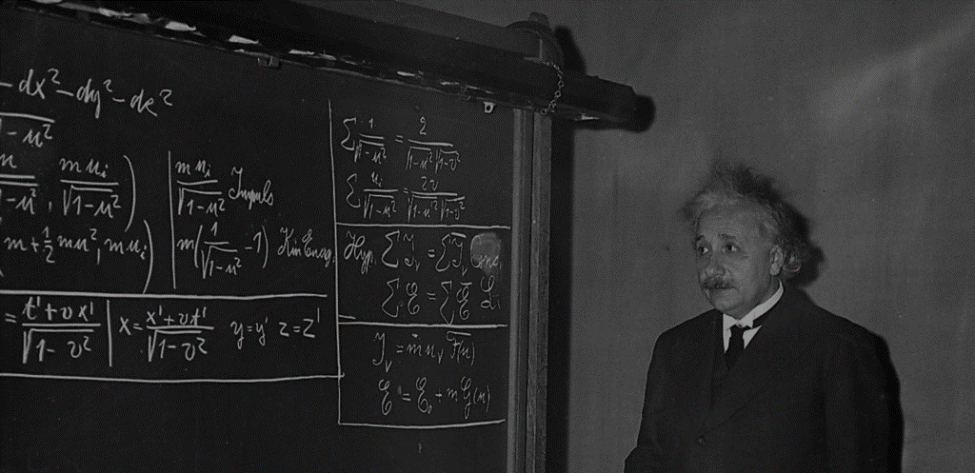














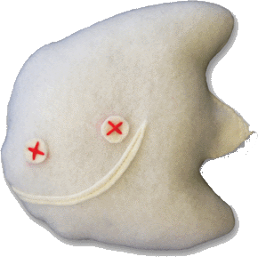



El modelo estándar
Imágenes: www.particlezoo.net
LEPTONS
QUARKS
MATERIA
ORDINARIA
ELECTRON
ELECTRON
NEUTRINO
UP
DOWN
MUON
MUON
NEUTRINO
CHARM
STRANGE
TAU
TAU
NEUTRINO
TOP
BOTTOM
4 forces
GLUONS
Fuerza nuclear fuerte
PHOTONS
Fuerza electromagnética
BOSONS W&Z
Fuerza nuclear débil
GRAVITON
Gravedad
HIGGS
Notes:
Amongst many other, one is very largely agreed upon: the standard model.
It is a kind of particle dictionnary.
It predicts there are 12 matter particles. But we can see that only 3 of them are sufficient to create all atoms (up quark and down quarks make protons and neutrons hence all nuclei, if you add electrons you have any atom…)
What are the others? They are particles which exists briefly in extreme conditions of energy. They tend to decay into less massive, more stable particles like the ones on the first line.
At CERN we are reproducing these extreme conditions of energy (on a microscopic and harmless level) which allows us to produce and observe these particles. For a very brief moment, but long enough.
In addition to the 12 matter particles, there are «force» particles which bound the matter ones together: gluons «glue» together the up and down quarks in protons and neutrons, photons are exchanged between electrons and nuclei making the electron orbit around it, W and Z bosons which are important in nuclear reactions were first observed at CERN in the 80s, only the Graviton has never been observed so far.
To be complete, for every particle, there is an «antiparticle». This is a particle with the same mass but with an opposite electric charge a bit like a reflection in a mirror.
With antiparticles you can make antiatoms, therefore antimatter.
Have you every manipulated antimatter? I hope not as matter and antimatter when they get in touch anihilate with 100% energy release. That means that 1g of matter put together 1g of antimatter would wipe out Geneva and its surroundings… So better not shake hands when you meet your antiyou.

Slide 31


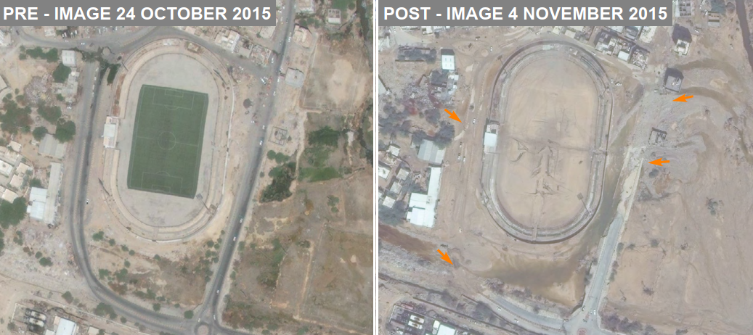
Misiones humanitarias
Notes:
CERN hosts UNOSAT, a UN agency specialized in the analysis of satellite images, especially comparing them before and after a natural disaster or a war.
This shows the report of analysis of satellite pictures taken in October 2015 and November 2015.
By comparing the situation before and after passage of Cyclone Chapala in and around the city of Mukalla, Hadramut Governorate, Yemen, it lists and highlights main and secondary roads affected by mud, debris and occasional standing water.
This helps teams on site to know where to put efforts first.
The power of Grid Computing allows to analyze very large territories in hours, instead of sending teams on the fields for days.
More information on https://unitar.org/maps/map/2298

