Slide 1


IUPAP WG14 on Accelerator Science
Christine Darve
of behalf of the International Union of Pure and Applied Physics (IUPAP)
WG14 on Accelerator Science
&
European Spallation Source, ERIC (ESS)
May 19, 2026
IPAC2026 - CC meeting @ Deauville, FR

Slide 2
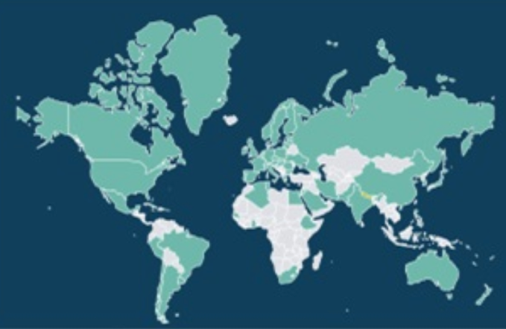
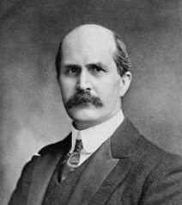

International Union of Pure and Applied Physics https://iupap.org/
IUPAP is the only global international Scientific Union dedicated to all areas of physics. Created in 1922 with 13 country members, it now has about 60 territorial members.
There are no individual members. Since 2021, there are also Corporate Associate Members, since 2023 a new membership category for territories with very small physics communities and since 2026 new standing committees.
IUPAP is a network of networks, a network of communities
It is organized and run by physicists from all fields and continents
Mission: To assist in the worldwide development of physics, to foster international cooperation in physics, and to help in the application of physics toward solving problems of concern to humanity
W.H. Bragg (1862-1942)
A driver for Peace !
- Sir William Henry Bragg: 1st president of International Union of Pure and Applied Physics (IUPAP)
- Sir William Lawrence Bragg: 1st president of International Union of Crystallography (IUCR)
[Introduction Globalizing Physics: One Hundred Years of the International Union of Pure and Applied Physics. An Introductory Essay Roberto Lalli, Jaume Navarro]
Mission: To assist in the worldwide development of physics, to foster international cooperation in physics, and to help in the application of physics toward solving problems of concern to humanity
Notes:
In between GAs, the decisions are made by the Executive Council in consultation with the chairs of the specialized commissions and affiliated commissions of the Union:
Assumptions that everyone know s.

Slide 3
Former IUPAP structure
& Rejuvenization in progress !
Affiliated Commissions (independent)
AC1: Intl Commission for Optics
AC2: Intl Commission on General Relativity and Gravitation
AC3: Intl Commission for Acoustics
AC4: Intl Commission on Med Physics
AC5: Affiliated Commission of Physics Students (IAPS)
AC6: Affiliated Commission on the History and Philosophy of Physics
Commissions (mainly organized by subfields)
C1: Policy & Finance
C2: Symbols, Units, Nomenclature, Atomic Masses and Fundamental Constants
C3: Statistical Physics
C4: Astroparticle Physics
C5: Low Temperature Physics
C6: Biological Physics
C8: Semiconductors
C9: Magnetism
C10: Structure and Dyn of Cond Matter
C11: Particles and Fields
C12: Nuclear Physics
C13: Physics for Development
C14: Physics Education
C15: Atomic, Molecular, and Optical Phys
C16: Plasma Physics
C17: Laser Physics and Photonics
C18: Mathematical Physics
C19: Astrophysics
C20: Computational Physics
Working Group (& new standing comities)
Temporary structures to address specific issues not covered by commissions
WG1: Intl Committee for Future Accelerators
WG5: Women in Physics (established in 1999!)
WG7: Intl Comm on Ultrahigh Intensity Lasers (ICUIL)
WG9: Intl Cooperation in Nuclear Physics
WG11: Gravitational Wave Intl Committee
WG13: Newtonian Constant of Gravitation
WG14: Accelerator Science
WG15: Soft Matter
WG16: Physics and Industry
WG17: IUPAP’s Centenary
WG18: Ethics
WG19: Quantum Science and Technology
WG20: Open Science (not yet set up)
WG21: Physics for Climate Change Action and Sustainability
Former Chairs :
2015-2021 Lia Merminga
2021-2024:Gianluigi Arduini (CERN)
Standing Committee on Physics Outside Academia
Notes:
EC&CC: meet at least once per year. Official observers are invited to attend.

Slide 4

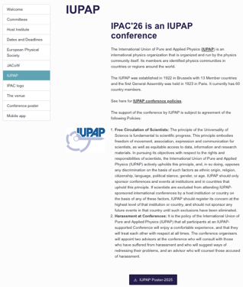
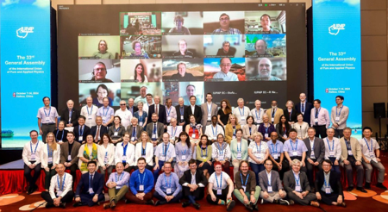
IUPAP — Building a Global Physics Community
IUPAP connects physics communities worldwide and promotes international scientific collaboration
as a driver for peace, innovation, education, and sustainable development.
Through its global network, IUPAP: IPAC Spondor →
Connects scientific communities and fosters collaboration
Promotes openness, integrity, and good scientific practices
Supports diversity, inclusion, and equal opportunities in physics
Strengthens links between academia, industry, and society
Supports students and early-career scientists worldwide
Advances open science, international exchange, and UN SDGs
IUPAP also actively supports women and underrepresented groups, inclusive standards, participation from developing countries, and equal access to scientific leadership and activities.
https://www.ipac26.org/iupap/
Together, we strengthen physics for science, society, sustainability, and international cooperation !

Slide 5
WG14 - Accelerator Science
Particle Accelerators for Science and Society
Currently: 22 international experts from 18 countries committed to promoting these objectives on a global scale, utilizing local expertise and networks!
Current members list:
Current Chair & co-Chair:
Christine Darve : ESS, SE;
Frank Tecker: CERN, CH
Maher Attal: SESAME, JO
Robert Bingham: STFC, UK
Ceri Brenner: ANSTO, AU
Swapan Chattopadhyay*: US
Simon Connell: UJ, SA
Fulvia Pilat: SNS, US
Oliver Kester: TRIUMF, CA
In Soo Ko: KBSI, KR
Tadashi Koseki: KEK, JP
Lin Liu: BSLL, BR
Michael Moyers: SPHIC, CN
Anke-Susanne Müller: KIT, DE
Simon Mark Mullins: BIUST, BW
Vaishali Naik: VECC, IN
Complementary to WG1 (ICFA) → Standing Committee
Qing Qin: ESRF, FR
Christoph Quitmann: RI, DE
Danas Ridikas: IAEA, AT
Leonid Rivkin*: PSI/EPFL, CH
Suzie Sheehy: Uni. Of M, AU
Liangting Sun: IMP/ CAS, CN
Bridinette Thiodjio Sendja: Uni. of Y, CM
Associate Members (ex-officio) (updated yearly)
Tsuneyuki Ozaki: INRS, CA – Inter. Committee on Ultra-High Intensity Lasers, WG7 Chair
Yuan He: IMPCAS, CN – ICFA Beam Dynamics Panel, Chair
Pierluigi Campana: IT - ICFA Chair
Ursel Fantz: MPI, DE– IUPAP Commission 16 on Plasma Physics, Chair
Peter McIntosch: STFC, UK –IPAC26 Coordination Committee, Chair
Thomas Roser: BNL, US – ICFA Panel on Sustainable Acc. and Colliders, Chair
Marcelo G. Munhoz: Uni. Od SP, BR – C11 Commission on Particles and Fields, Chair
Notes:
Institute of Modern Physics, Chinese Academy of Sciences
Variable Energy Cyclotron Centre

Slide 6
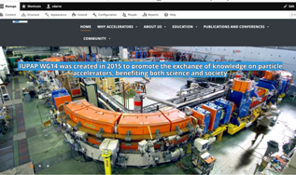
WG14 - Accelerator Science
Particle Accelerators for Science and Society
Meeting online at least three times per year and in hybrid format at IPAC
Proposed Mission and Scope:
Knowledge exchange: Strengthen the global accelerator community by uniting scientists and lab leaders through collaborative platforms, fostering knowledge exchange and accelerating innovation worldwide.
Promote applications: Support accelerator uses in industrial, medical, energy, and environmental sectors.
Sustainability alignment: Map and review accelerator applications supporting SDGs, including life sciences, healthcare, research, and technology.
Accelerate progress: Facilitate information sharing and the exchange of ideas among laboratories worldwide.

Slide 7
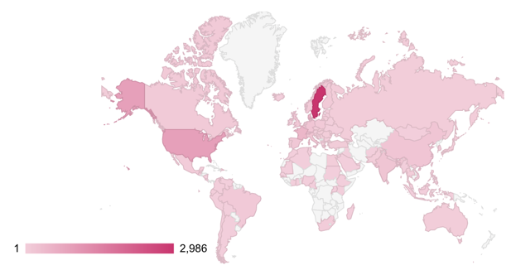
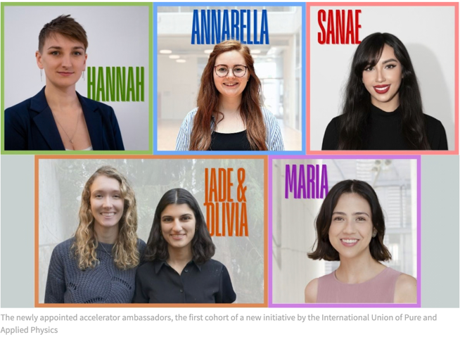
WG14 - Accelerator Science
Particle Accelerators for Science and Society
Talent development: Verify feasibility to train early-career scientists through lab-university collaborations, schools, MOOCs, providing access to leading experts, equipment, and techniques.
Resources & communication: Develop networks (e.g., Ambassadors), webpages, and conference presence to share scientific advancements and societal impacts.
NPAP reached > 22,200 NPAP learners across 104 countries!
Led by Suzie Sheehy and her team
A few Accelerator schools:
CAS, JUAS @ ESI, Science in School @ EIROforum
MOOCs: Nordic Particle Accelerator Project (NPAP)
Accelerator Engagement Ambassadors Initiative
Please follow, like and rePost :
LinkedIn Page – IUPAP Accelerator Science Communication
CERN Accelerating News:
“Meet the 2026 ambassadors bringing particle accelerators to the public” , March 2026
“Accelerators key to making our lives better’, says chair of physics union working group” Dec. 2025”

Slide 8

IUPAP-WG14 Hackathonino
Timeline
▪ Sunday, May 17 (11:00–12:00):
Project introduction & team building
▪ Monday–Wednesday: Meeting @ poster session & Industry area
▪ Wednesday, May 20:
Students presentations & Jury evaluation
▪ Thursday, May 21: Award, Follow-up discussions, sponsors and next steps
More than 65 participants from 19 countries, and 9 challenges
Proof of concept established during IPAC2026 to strengthen synergies among participants, research mentors, and companies, ensuring meaningful learning and engagement.
Activities are designed to build:
– Technical problem-solving skills
– Teamwork & collaboration
– Communication & presentation skills
– Insight into accelerator design and professional design tools
Jury Criteria :
- Innovative/creative solution
- Clarity of the proposal/presentation
- Networking with Companies and individuals
ARTIFACT team ! “AISSAI Hackathon on AI for Particle Accelerators ” Oct. 11-16, 2026 ; MORE DETAILS HERE
2nd international Accelerator Conference for Research and Innovation,22-26 June, 2026 Vienna IAEA
Notes:
(further integration of companies, IP)
Using diverse comms. Signal, meeting,

Slide 9
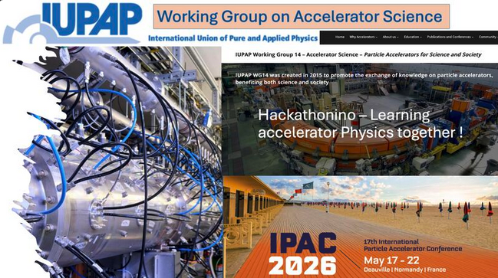
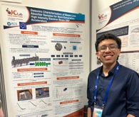
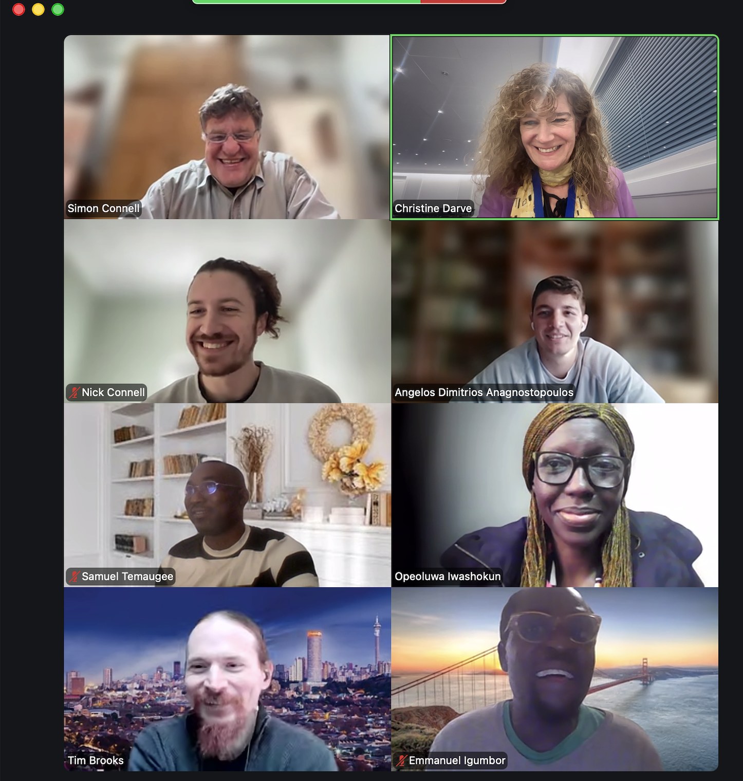
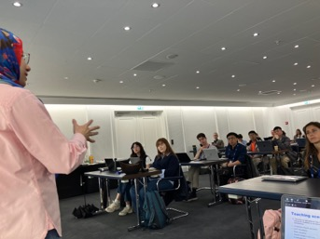
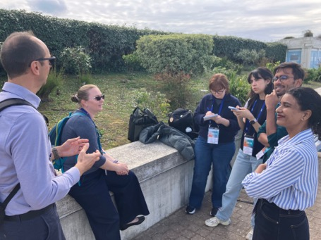
List of Challenges:
Broad topics include fault detection, beam optics, CANS, medical accelerators, infrastructure design, learning scenarios, and quantum computing
A | SE_ESS | Accelerator Beam Performance and First-fault Analysis
B | US_SNS | RF window failure detection
C | SA_UJ | Introduction to LLM for Topic Modelling
D | SA_UJ | Radiation Therapy Treatment Plan for cancer
E | MAXIV | Develop an educational idea to introduce students to accelerator simulations
F | DE_FZJ | Decision-Making for a Compact Neutron Source (CANS) Upgrade Strategy
G | US_MIT | Quantum Computing for Particle detection simulation
H | SE_ESS | Integrated Design Study for ESS Acc. Maintenance and Repair Facility
I | SE_ESS | AI-Driven Beam Dynamics Optimisation for High-Intensity Proton Linacs
Call for Corporate Engagement
Expression of Interest to support IUPAP- WG14
Together, we strengthen international collaboration, education, sustainability, and accelerator-enabled innovation worldwide

Slide 10

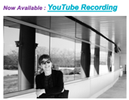
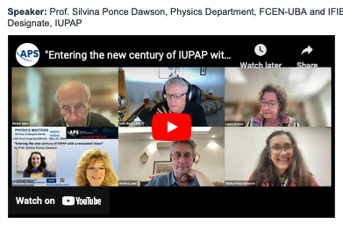
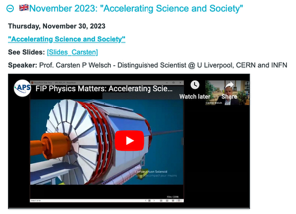
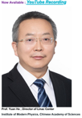
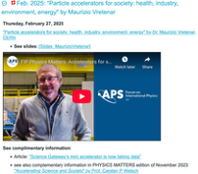
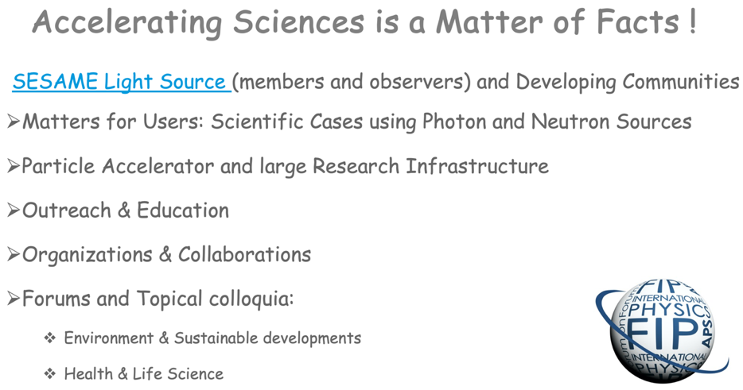
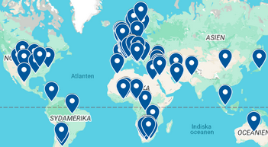
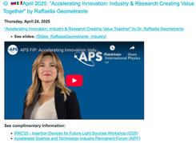
See also : “PHYSICS MATTERS” Colloquium series
@ Forum on International Physics (FIP) at APS
Nov 2022: “PHYSICS MATTERS to celebrate the 100 years of existence of the IUPAP”
May 2023: "Entering the new century of IUPAP with a renovated vision"
Dec 2022: “ALBA and the science for sustainability"
August 2023: "Accelerator driven systems – a solution to multiple problems of society"
Feb. 2023: “The I.FAST CBI”
April 2024: "Forum to accelerate a global digital world"
April 2025: “Accelerating Innovation: Industry & Research Creating Value Together"
Playlist !
Notes:
Convenient platform !
~66 popular science events since Nov.2020!
Connect up to 37 countries at once!
Audience: from 70 to 477 persons
20-40 min colloquium
Q&A sessions w/ experts & audience
and help spreading the word to build a curious and educated international connected Global Physical Society!

Slide 11

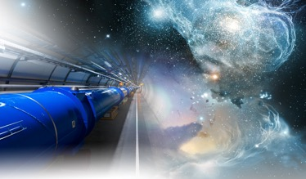
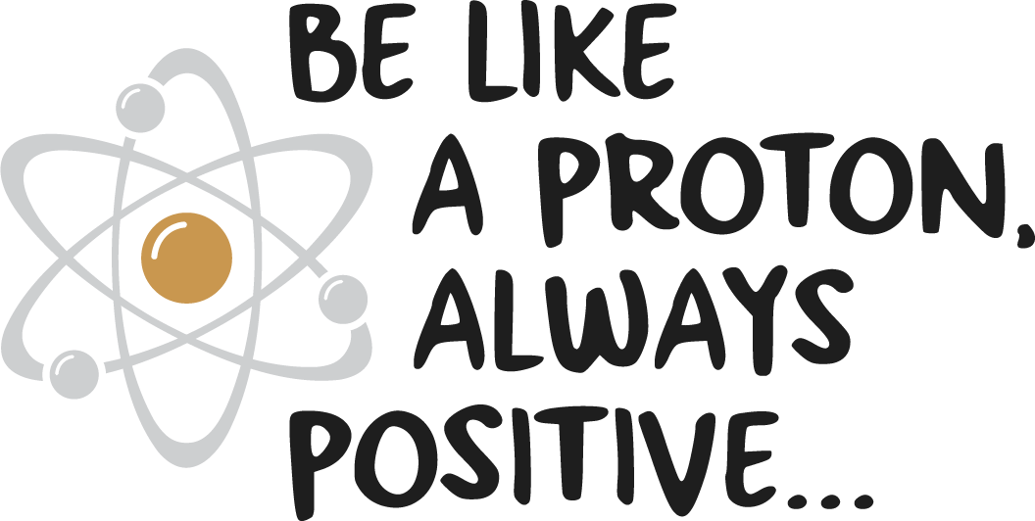
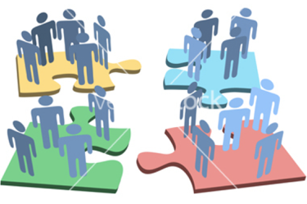
Conclusion
WG14 connects the global accelerator community to accelerate collaboration, innovation, and impact.
What we do
• Share knowledge and strengthen global networks
• Enable accelerator applications for society (health, industry, energy, environment)
• Support sustainability and UN SDGs
• Foster talent and early-career development
• Increase visibility and global outreach
A driver for Peace !
Accelerator Science Transcending Boundaries at every levels !
WG14 is a catalyst for a more connected, inclusive, and impactful accelerator ecosystem worldwide.
https://cdarve.web.cern.ch/

Slide 12
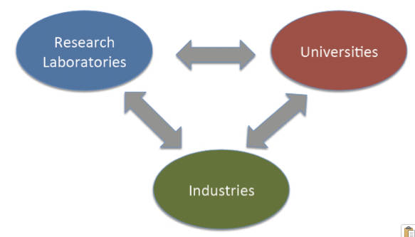
Context of Paradigm Evolution
Triangle of knowledge – The Ecosystem
Materials & life science facilities are keys to new economy
INDUSTRIAL
economy
INFORMATION
economy
MOLECULAR (NBIC)
economy
Organization
(society)
The Adaptive
Enterprise
Nanotechnology
Biotechnology
Information technology
Cognitive science
Materials
New media
IT services
Portals
Business
(maturity)
Economic value added
Chips
Operating systems
WWW
Technology
(growth)
Solid state physics
Information theory
Science
(gestation)
1750s
1850s
1950s
2050s
Year
It's Alive - The Coming Convergence of Information, Biology, and Business Christopher Meyer 2003

Slide 13
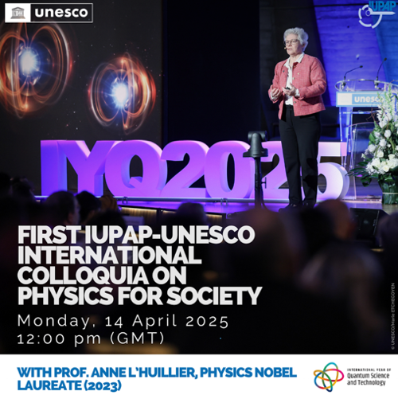
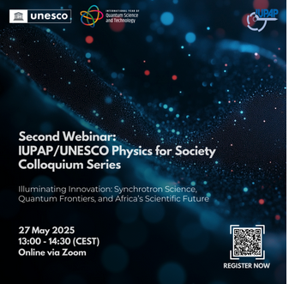
See also : IUPAP & UNESCO initiatives
International Colloquia on Physics For Society
IUPAP and UNESCO launched this initiative within the International Year of Quantum Science and Technology (IYQ 2025), under the broader framework of the International Decade of Sciences for Sustainable Development (IDSSD 2024–2033)
  ”Celebrate World Quantum Day with Prof. Anne L’Huillier - April 14!”
  “Illuminating Innovation: Synchrotron Science, Quantum Frontiers, and Africa’s Scientific Future”
  ”Quantum mechanics with patterns of light” by Andrew Forbes
  “Explore the intersection of industry and the quantum world”
  "With Nobel laureates in physics: “Quantum views” by Alain Aspect and William D. Phillips"
STAY TUNED !

