Slide 1
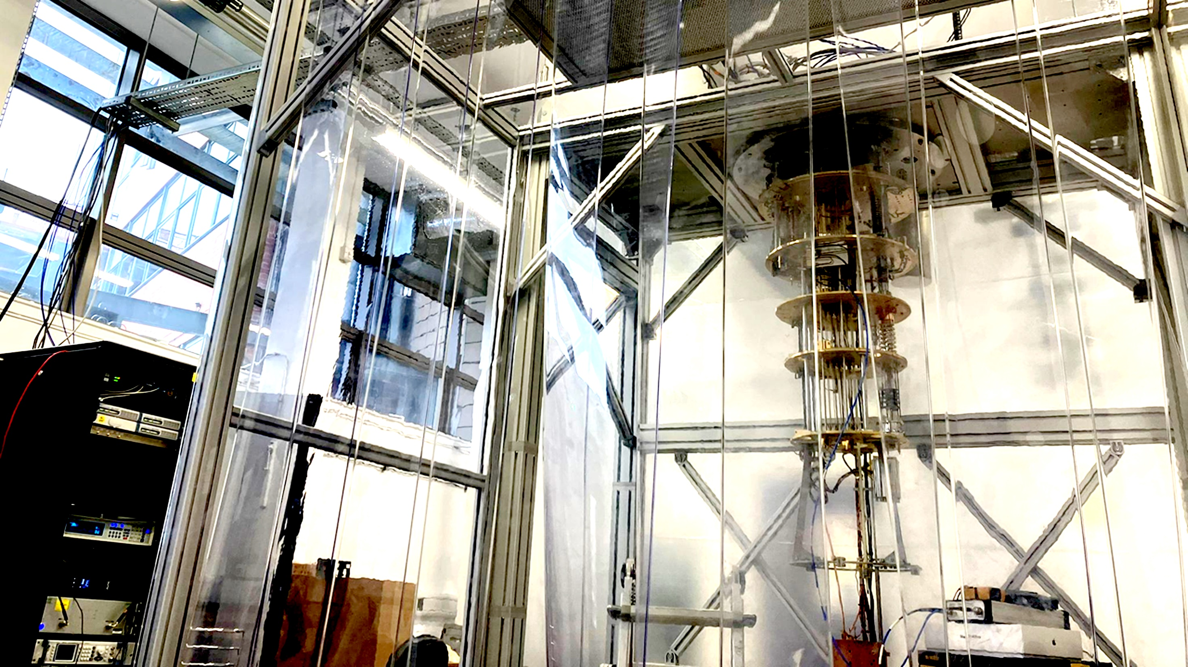


QSHS Analysis Early Pipeline and Injection Tests
Claude Mostyn

Slide 2


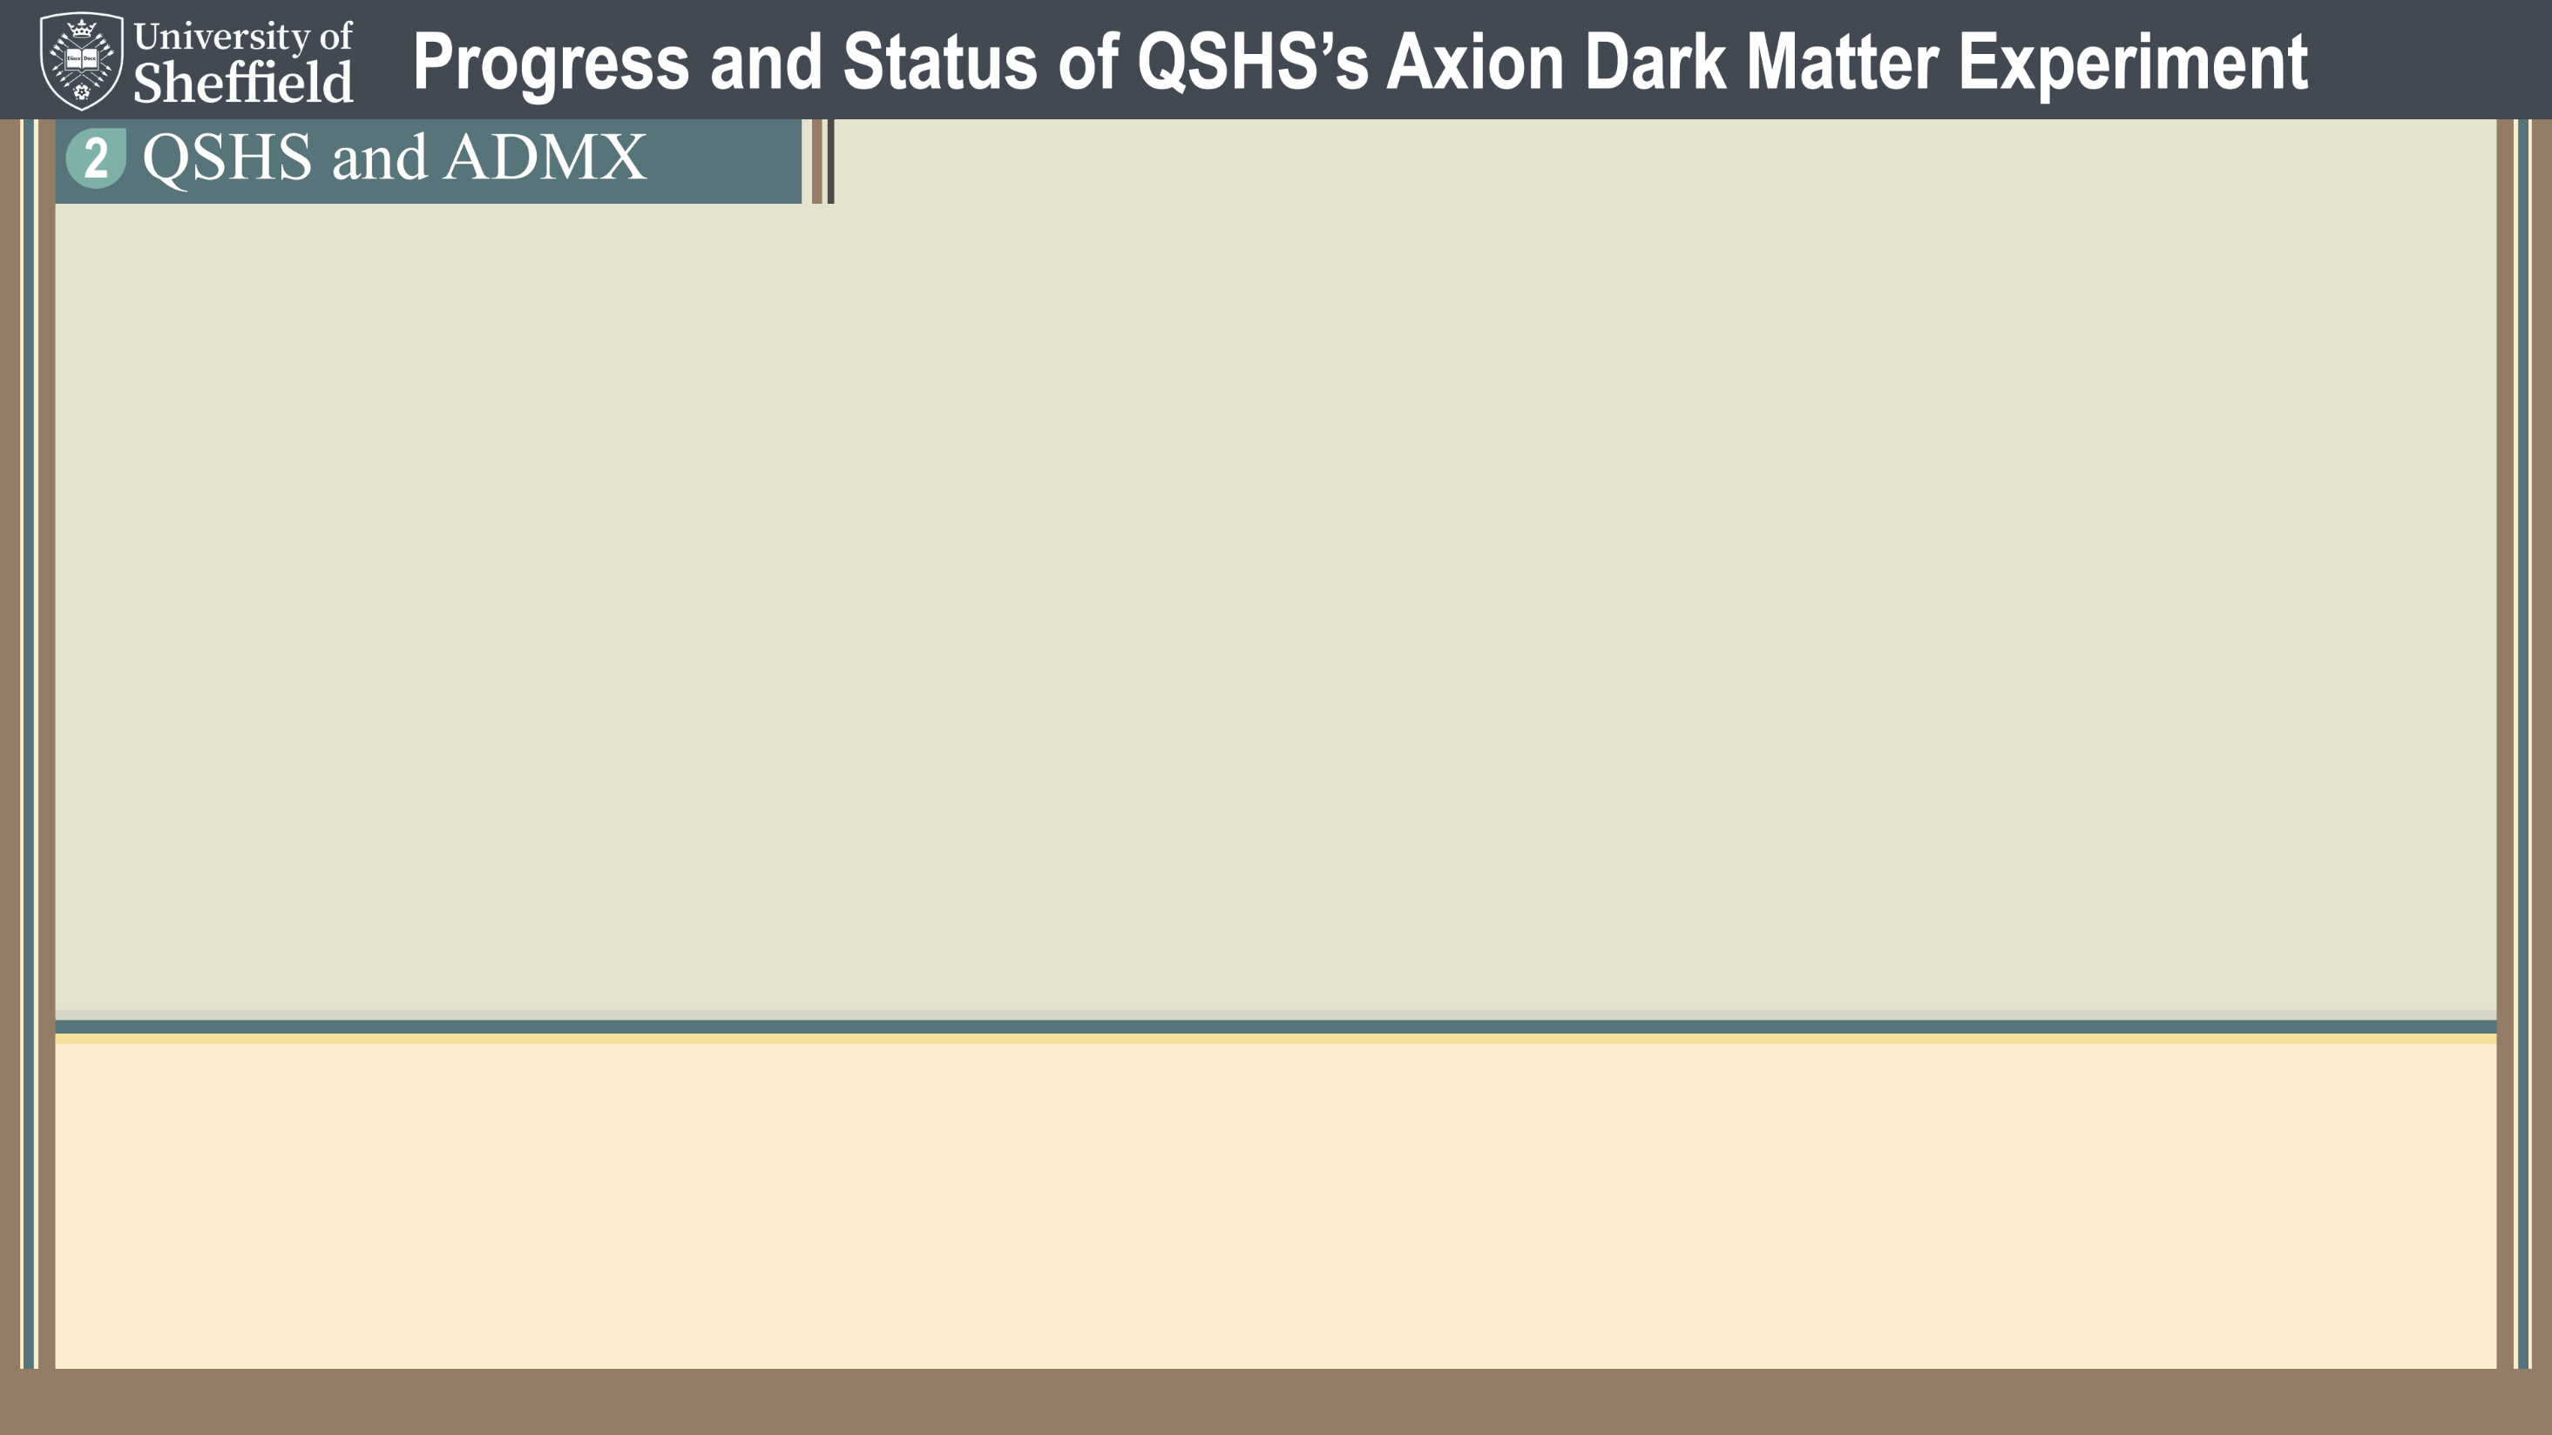
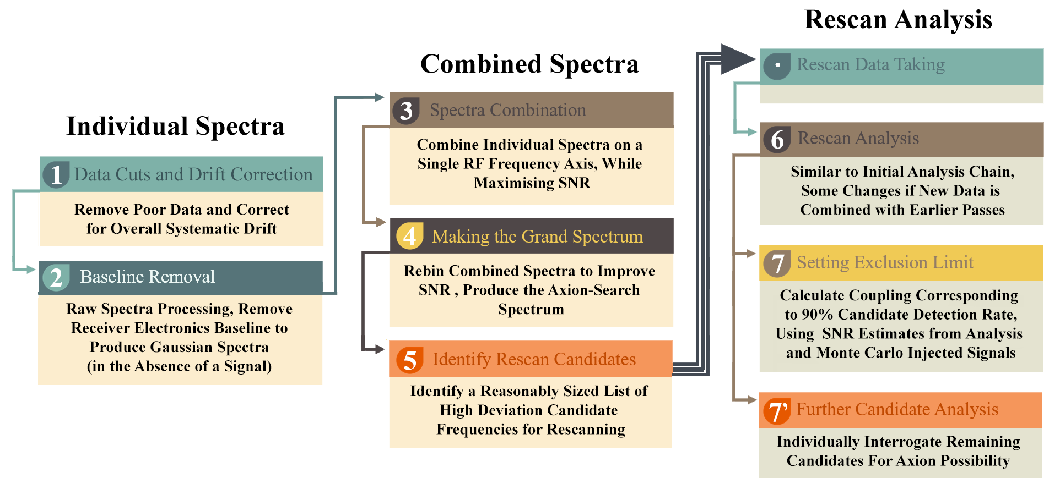
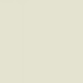

Claude
Mostyn
QSHS First Analysis Tests
The Overall Procedure

Slide 3
Claude
Mostyn
QSHS First Analysis Tests
The Overall Procedure

Slide 4
Claude
Mostyn
QSHS First Analysis Tests
The Overall Procedure

Slide 5

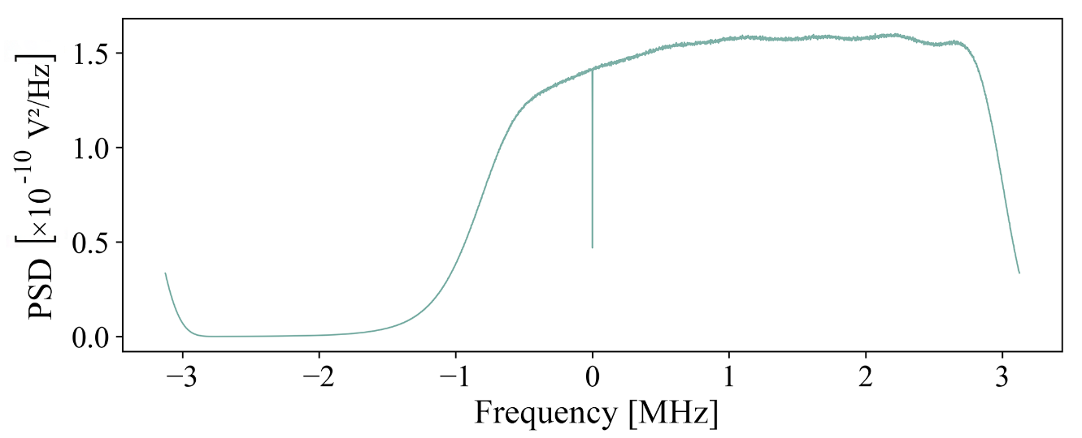


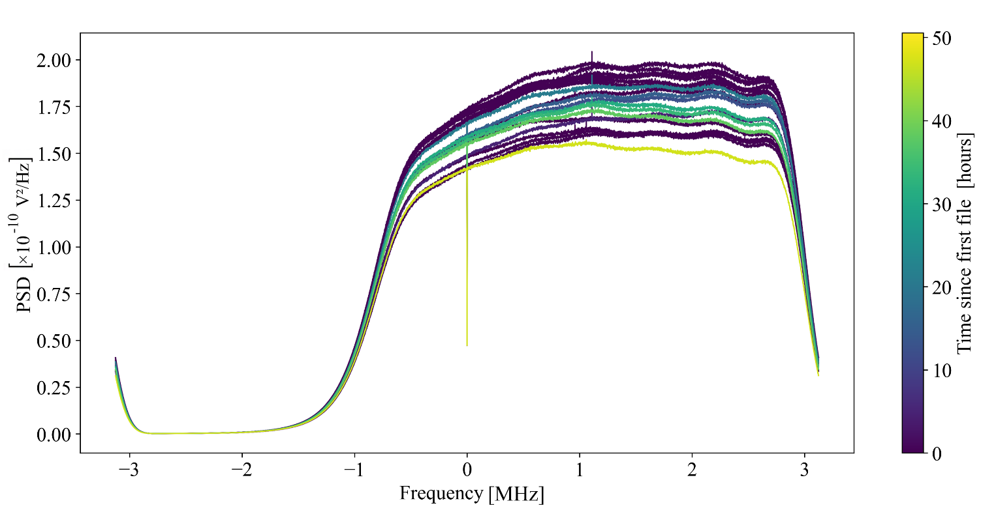

Claude
Mostyn
QSHS First Analysis Tests
0
The Data Set
Single Raw PSD
The data is a series of power spectral densities after double heterodyne and Welch average
Local oscillator tracks cavity resonance $20.5 \text{MHz}$ (hardware heterodyne), then digital uses LO $19.5 \text{MHz}$ - $f_{0}$ at $1 MHz$
Tuning range between 75 and 130º, TM₀₁₀ 4.25 to 5.4 GHz, step $≈$0.3$×$ the cavity FWHM
No antenna coupling/reflection measurements this run – both antenna undercoupled
100 sec integration times, long cable before first amplification at 4K plate
Signal line gain $≈$130 dB
PSDs throughout run

Slide 6
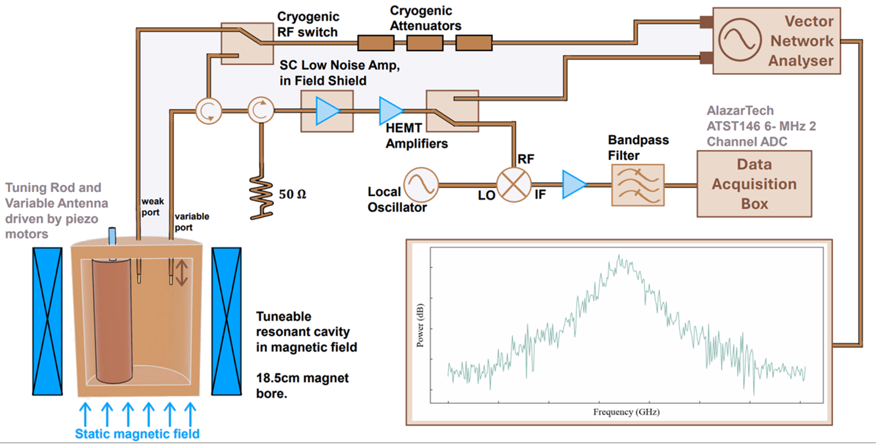

Claude
Mostyn
QSHS First Analysis Tests
0
The Data Set
Testing early hardware and software injection retrieval
CW hardware injections (single frequency) at -10/-20 dBm through $≈$120 attenuation, signal $≈{10}^{−16}/{10}^{−17}W$ at cavity
Hardware injection frequency tracked tuning rod, so we tune through multiple signals
Software “axion like” signals can be injected at random frequency into the raw PSDs before analysis - Maxwell–Boltzmann lineshape (∆f ≈ 3 kHz at 4.5 GHz)
100 random software injections per tested power used as first test
Receiver chain, Not fully implemented
Hardware injections are
$≈10^{7}×KSVZ$
No 1st-stage amp · 100 s integration · undercoupled antenna

Slide 7
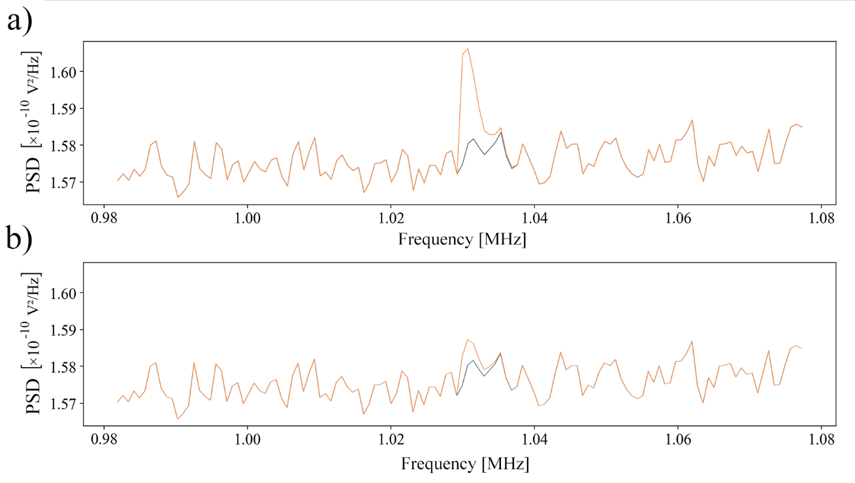

Claude
Mostyn
QSHS First Analysis Tests
0
The Data Set
Testing early hardware and software injection retrieval
CW hardware injections (single frequency) at -10/-20 dBm through $≈$120 attenuation, signal $≈{10}^{−16}/{10}^{−17}$ At cavity
Hardware injection frequency tracked tuning rod, so we tune through multiple signals
Software “axion like” signals can be injected at random frequency into the raw PSDs before analysis - Maxwell–Boltzmann lineshape (∆f ≈ 3 kHz at 4.5 GHz)
100 random software injections per tested power used as first test
Software injected signal examples,
a) peak amplitude =$3×10^{−12} V^{2}/Hz$, b) 0.8$×10^{−12} V^{2}/Hz$,

Slide 8

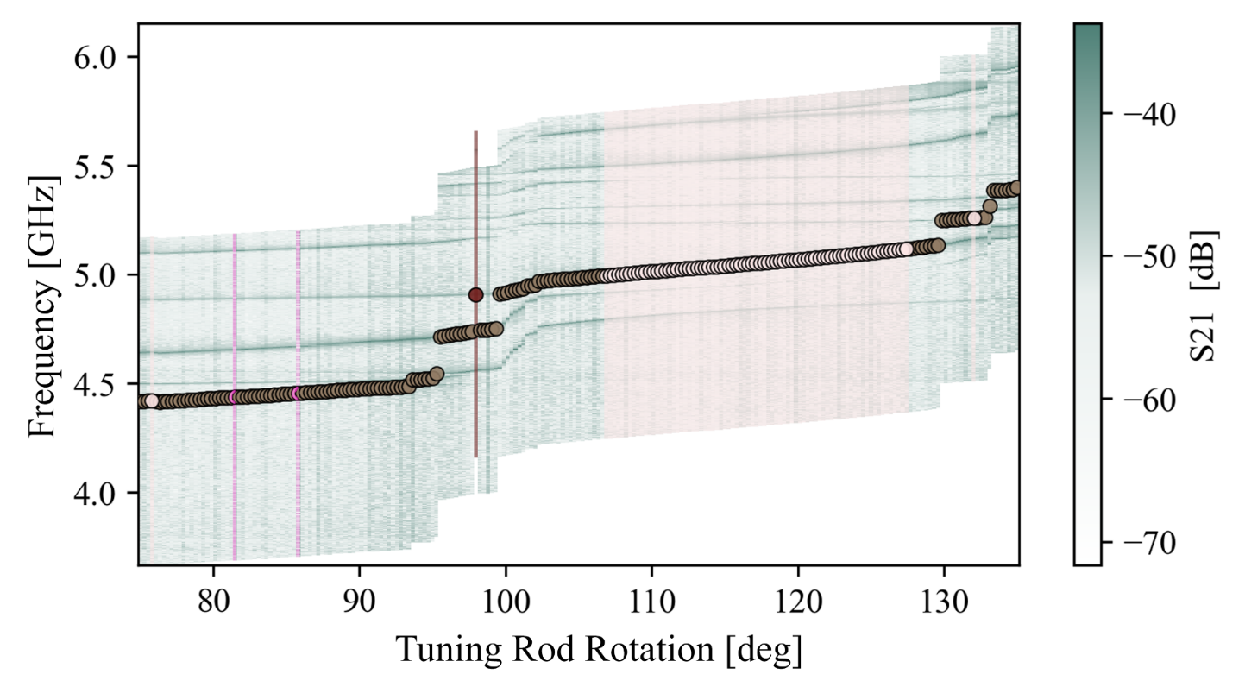


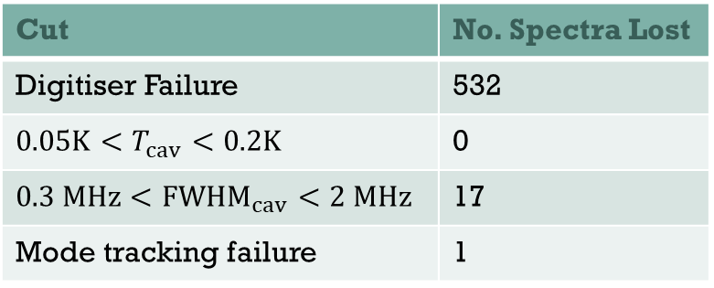
Claude
Mostyn
QSHS First Analysis Tests
1
Data Cuts + Cropping
Mode map
coloured by reason
for data cut,
-10dBm RUn
Predominant data loss was digitiser failure for first run, fixed by second run
IF band cropped to −0.3 to +2.3 MHz (centered on 1 MHz resonance bin)
DC zero gets averaged out
Mode crossings retained: too frequent at QSHS high range frequencies to cut; effects handled during analysis and candidate recovery instead
Gain-profile flatness cuts and frequency drift cuts not implemented for this short test run — both standard in ADMX/HAYSTAC
Good Data
Digitiser Failure
Mode Tracking Failure
Switching Failure
Cut | No. Spectra Lost
Digitiser Failure | 532
${0.05K<T}_{cav}<0.2K$ | 0
$0.3 MHz<FWHM_{cav}<2 MHz$ | 17
Mode tracking failure | 1
Data Lost over full CW injection test run

Slide 9
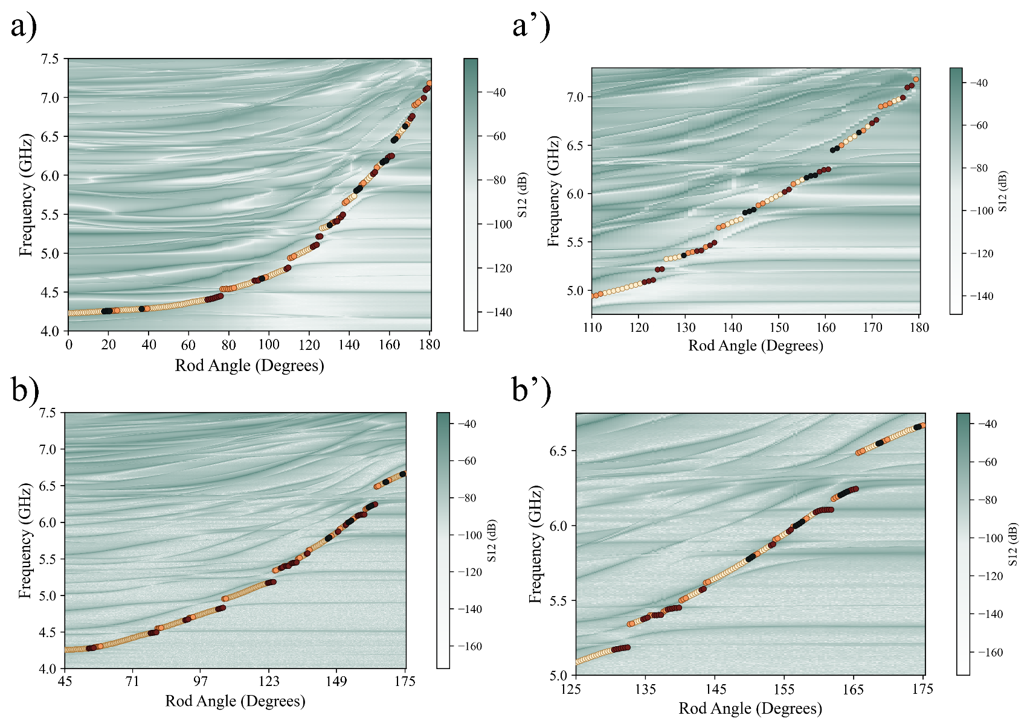

Claude
Mostyn
QSHS First Analysis Tests
1
Data Cuts + Cropping
Mode crossings retained: too frequent at QSHS high range frequencies to cut; effects handled during analysis and candidate recovery instead
QSHS cavity from simulations:
Approximately 60% is clear tuning state (well-separated from other mode)
40% sees some amount of form factor degradation, with $≈$22% seeing a >10% relative form factor drop
Clear tuning, high form factor
Mode crossing, reduced form factor
Post mode crossing, recovering form factor
Full experimental QSHS mode maps at RT (top) and LT (bottom)
Zoomed of high angle on right

Slide 10
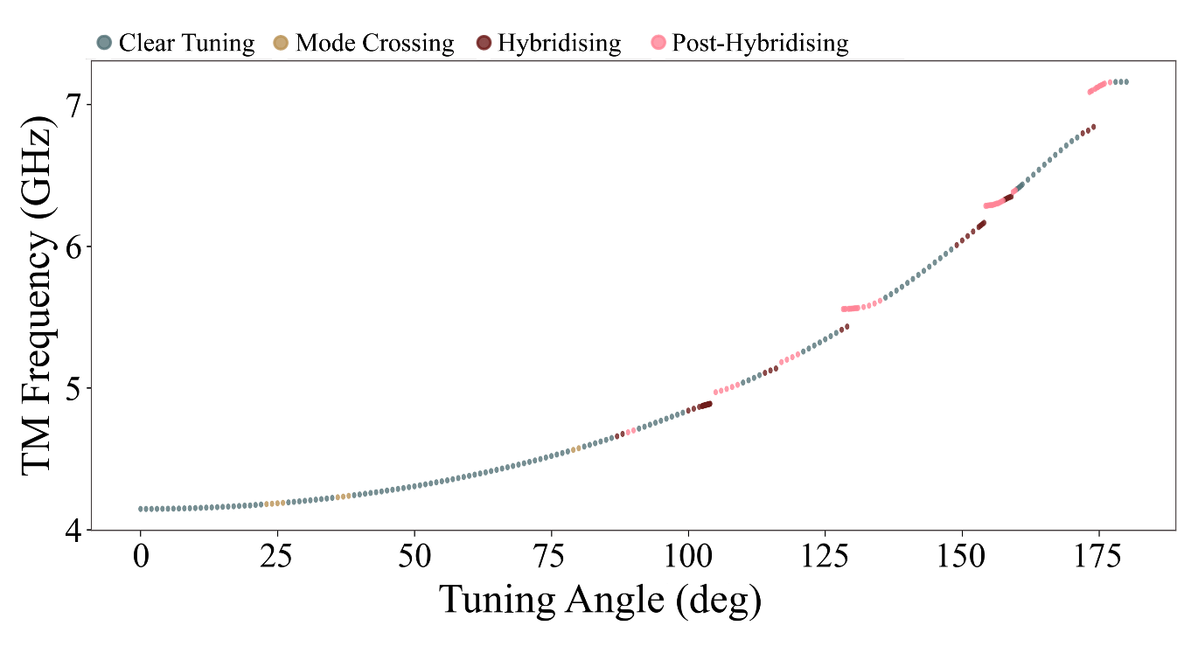
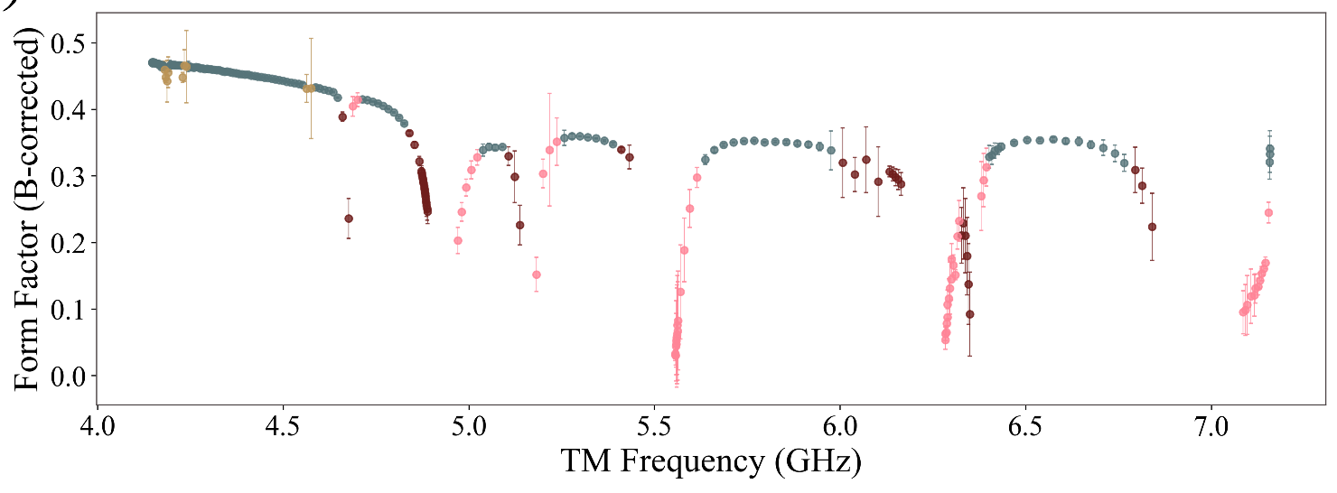
Claude
Mostyn
QSHS First Analysis Tests
1
Data Cuts + Cropping
Simulated (ANSYS HFSS) mode map, coloured by mode crossings
Predominant data loss was digitiser failure for first run, fixed by second run
IF band cropped to −0.3 to +2.3 MHz (centered on 1 MHz resonance bin)
DC zero gets averaged out
Mode crossings retained: too frequent at QSHS high range frequencies to cut; effects handled during analysis and candidate recovery instead
Gain-profile flatness cuts and frequency drift cuts not implemented for this short test run
Simulated form factor by frequency,
Coloured by mode crossings

Slide 11
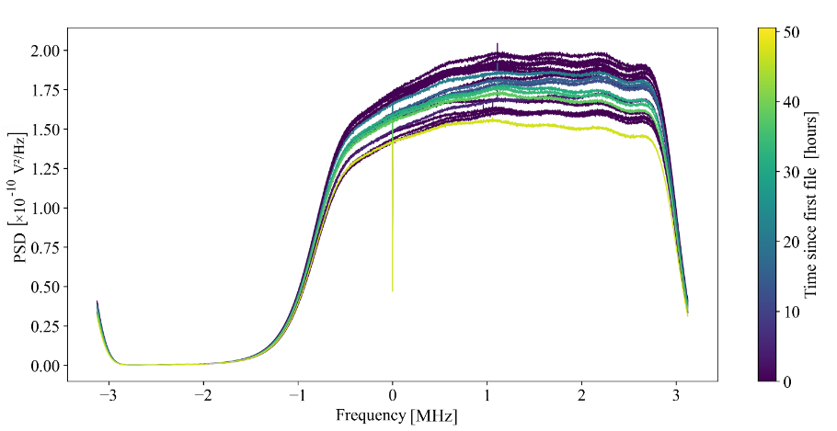
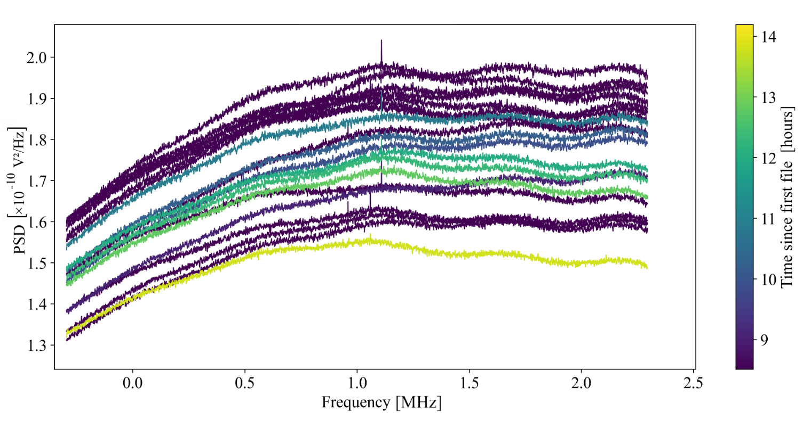
Claude
Mostyn
QSHS First Analysis Tests
1
Data Cuts + Cropping
Full PSDs, across -10dBm tests
Predominant data loss was digitiser failure for first run, fixed by second run
IF band cropped to −0.3 to +2.3 MHz (centered on 1 MHz resonance bin)
DC zero gets averaged out
Mode crossings retained: too frequent at QSHS high range frequencies to cut; effects handled during analysis and candidate recovery instead
Gain-profile flatness cuts and frequency drift cuts not implemented for this short test run
Cropped PSDs, across -10dBm tests

Slide 12



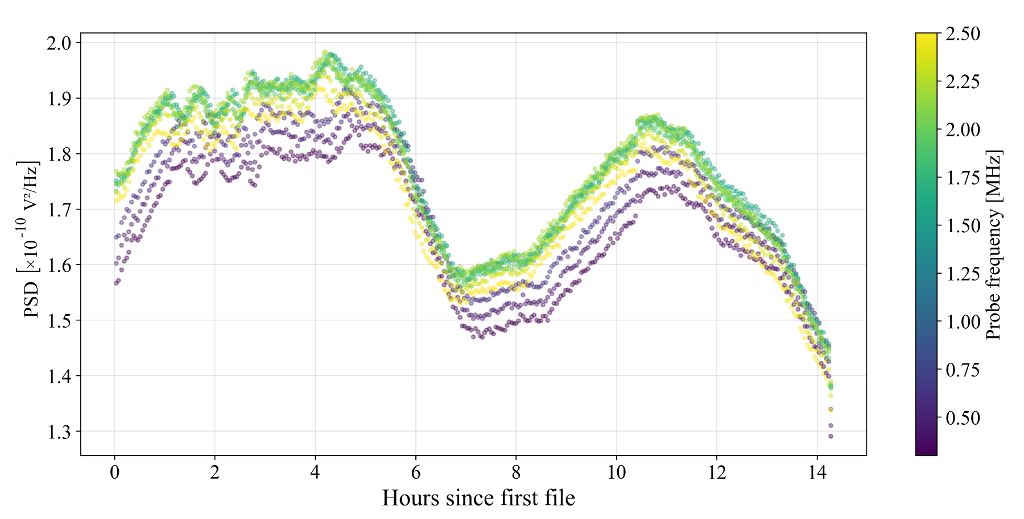
Claude
Mostyn
QSHS First Analysis Tests
1
Gain Drift
Temporal drift: <0.2% of mean PSD. Slight negative correlation with room temperature (RT amplifier)
Frequency-dependent drift dominates — primarily receiver electronics; consistent with hotload across different cools → calibration feasible
Q-dependent component: near mode crossings, falling cavity Q causes additional PSD amplitude decrease
Current correction: global median shift per PSD. Final model: data-driven hotload calibration (deferred to when full receiver chain installed)
Time dependence (~ frequency dependence) of PSD amplitude by IF frequency bin

Slide 13



Claude
Mostyn
QSHS First Analysis Tests
2
Baseline Removal
Goal: remove receiver electronics baseline per PSD without reducing axion-scale SNR; produce Gaussian residuals. Target: Gaussian to ~4.5σ
Warm baseline: first pass fits a single baseline to multiple PSDs to handle small scale structure without fitting out candidates
Cold baseline: second per-spectra fit pass to remove fast-moving with tuning angle broader frequency scale structure
Cropped PSDs, across -10dBm tests

Slide 14
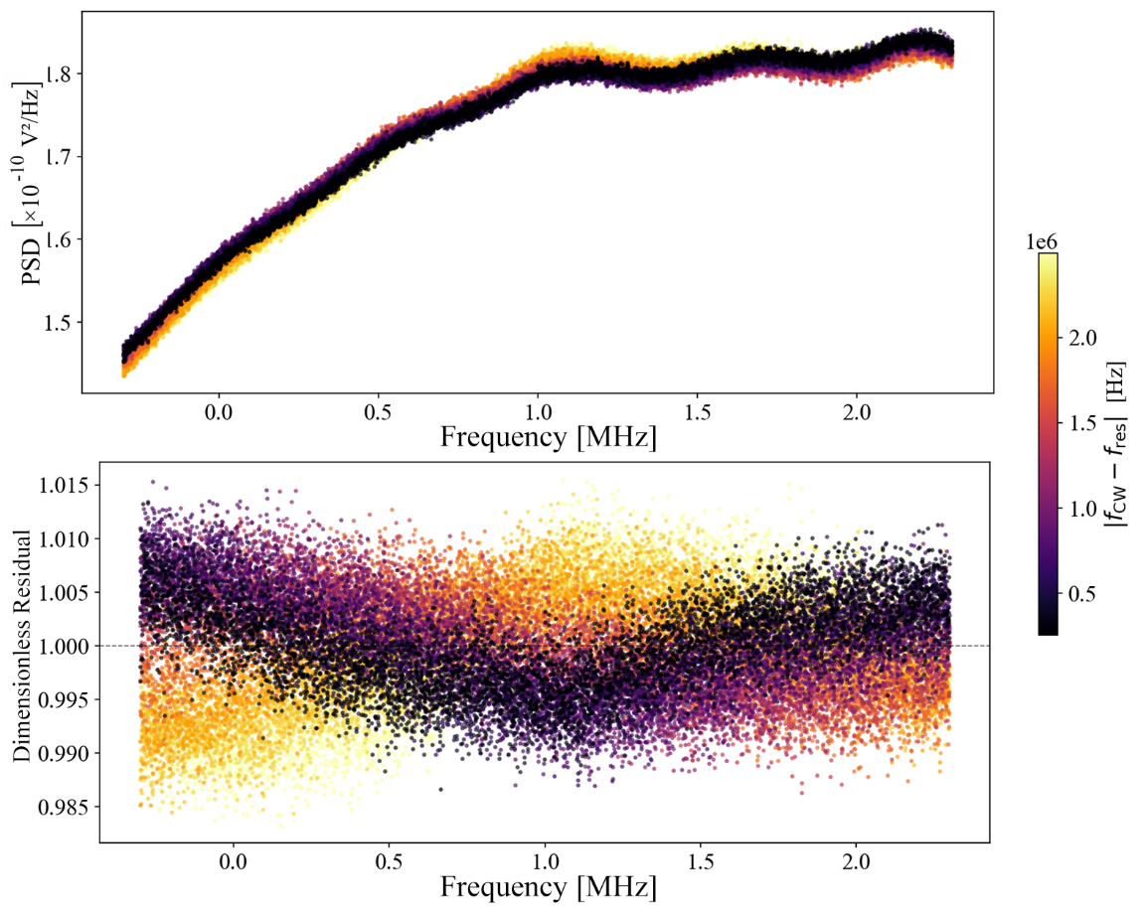
Claude
Mostyn
QSHS First Analysis Tests
2
Warm Baseline
Example PSD group, before and after first pass baseline removal
HAYSTAC-like method
Group PSDs by time intervals (30 minutes here) and produce a single averaged spectra
Perform a Savitsky Golay (window 251, order 2 vs. PSD length 3408) fit
Mask IF bins in individual PSDs >4.5σ from fit, repeat with new average PSD over 3 iterations

Slide 15
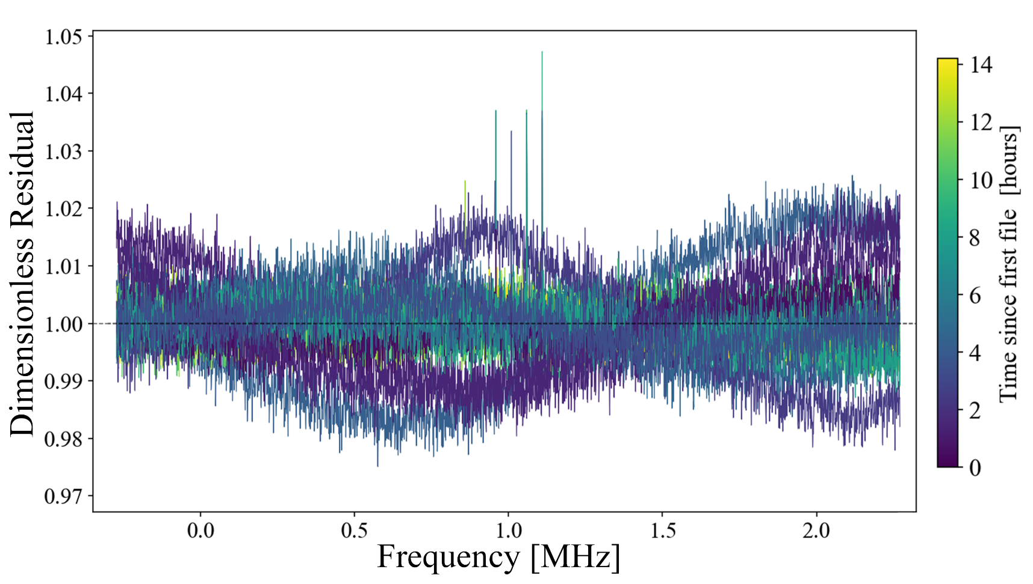
Claude
Mostyn
QSHS First Analysis Tests
2
Warm Baseline
HAYSTAC-like method
Group PSDs by time intervals (30 minutes here) and produce a single averaged spectra
Perform a Savitsky Golay (window 251, order 2 vs. PSD length 3408) fit
Mask IF bins in individual PSDs >4.5σ from fit, repeat with new average PSD over 3 iterations
PSDs post first pass/cold baseline removal, across -10dBm tests

Slide 16
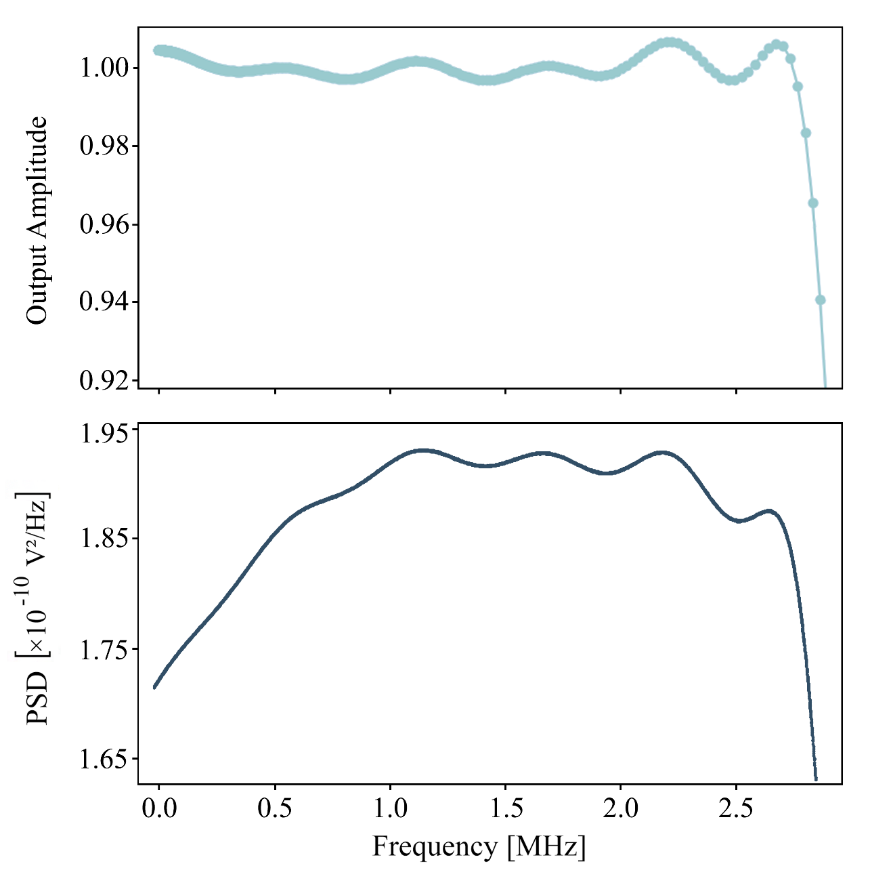
Claude
Mostyn
QSHS First Analysis Tests
2
Warm Baseline
FIR filter transfer function (top) and example PSD, peak structures align
Alternative hotload measurement or direct calibration
FIR1 (default ×8 decimation filter) introduces passband ripple that is baked into the power spectra once produced
FIR4 planned for next run
Overall shape of gain passband tracks hotload spectra
Could either implement a full hotload baseline spectra across tuning range, or develop a specific calibration model

Slide 17
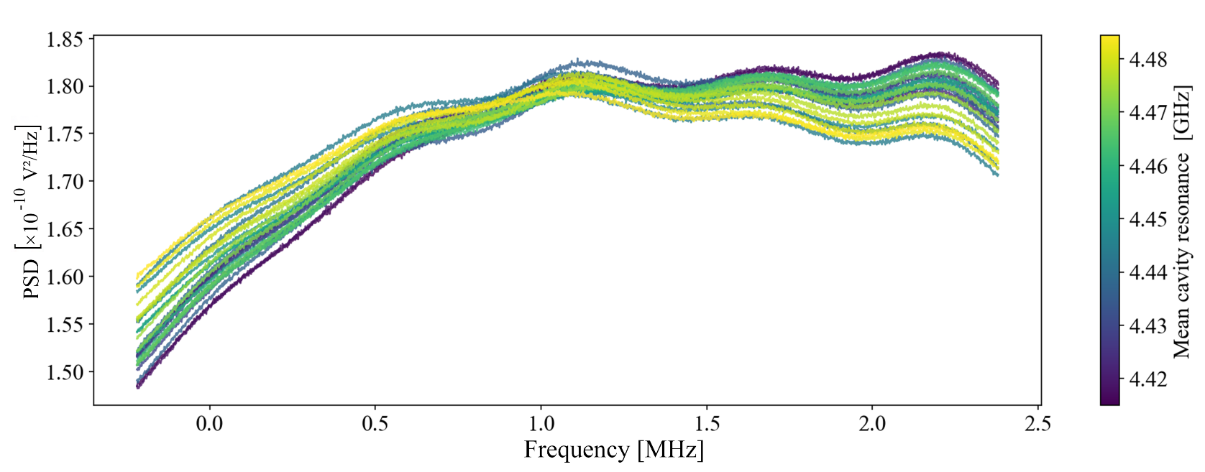
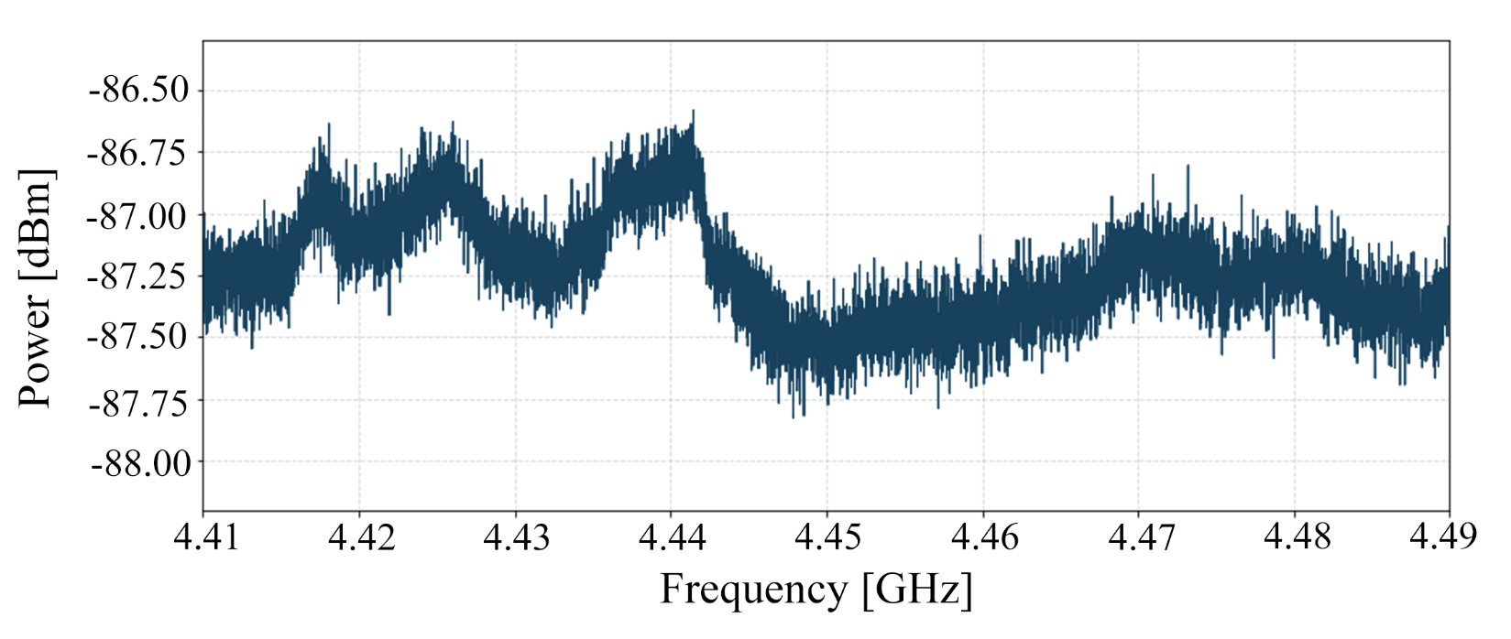
Claude
Mostyn
QSHS First Analysis Tests
2
Baseline Removal
All group averages from cold baseline pass
Alternative hotload measurement or direct calibration
FIR1 (default ×8 decimation filter) introduces passband ripple that is baked into the power spectra once produced
FIR4 planned for next run
Overall shape of gain passband tracks hotload spectra
Could either implement a full hotload baseline spectra across tuning range, or develop a specific calibration model
Hotload spectra from previous cool, peaks match the “tilt” seen in PSD groups

Slide 18
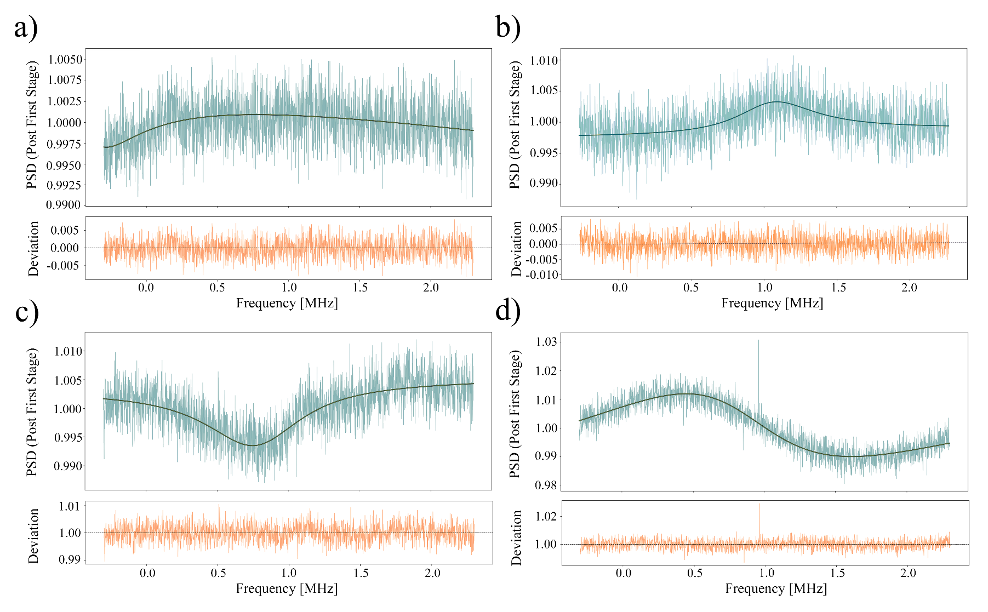

Claude
Mostyn
QSHS First Analysis Tests
2
Baseline Removal - Cold
Four post-warm categories: slow curves (a)/ cavity peaks (b) / cavity troughs (c) / S-shaped (d)
Using per-spectra fit of form
$$1+\frac{\left(A−1\right)+α_{asym}x}{1+x^{2}}$$
With
$$x=\frac{2\left(f−f_{0}\right)}{{FWHM}_{cav}}$$
Converges for all spectra, slightly underfits some sharp frequency structure (for $≈$3% of spectra)
Structure likely from standing waves in 0.8 m superconducting cable
Example individual PSD spectra and fits

Slide 19
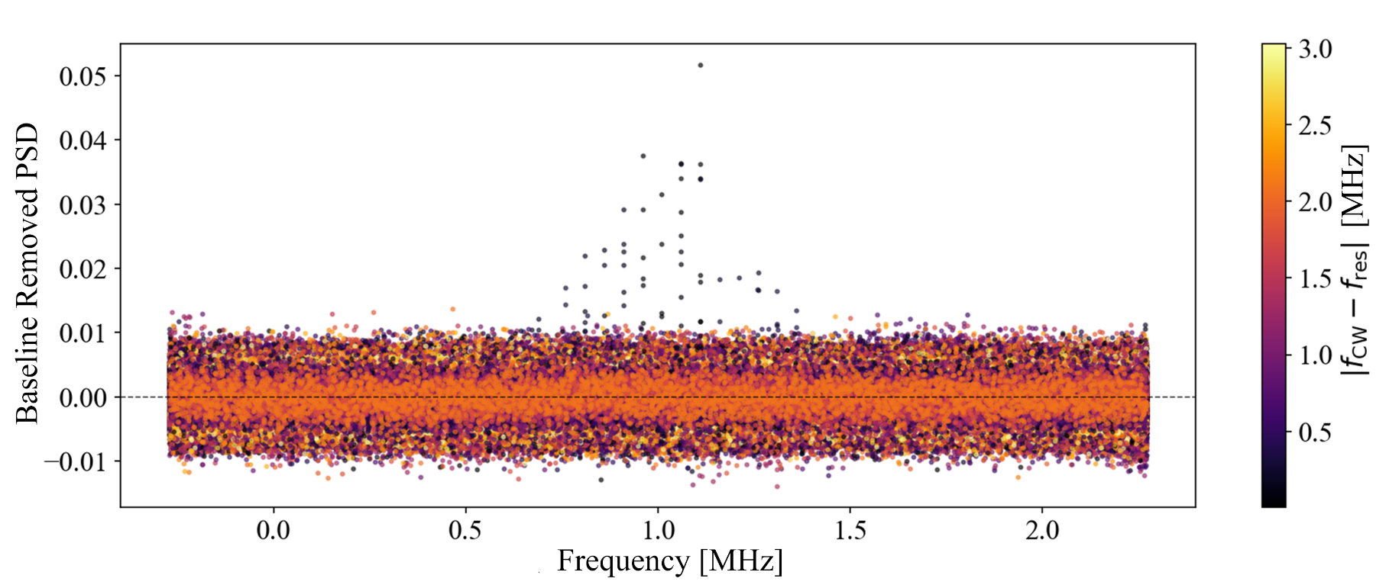

Claude
Mostyn
QSHS First Analysis Tests
2
Baseline Removal - Cold
PSDs reasonably flat post-baseline removal
SNR retention: 0.92 ± 0.06 (for high power CW injections)
Signal bins kept as single high $σ$ counts
Gaussian to $≈$3$σ$
No systematic IF interference bins identified (outside cavity resonance region) — noise predominantly stochastic
All PSDs from -10 dBm run post baseline removal

Slide 20
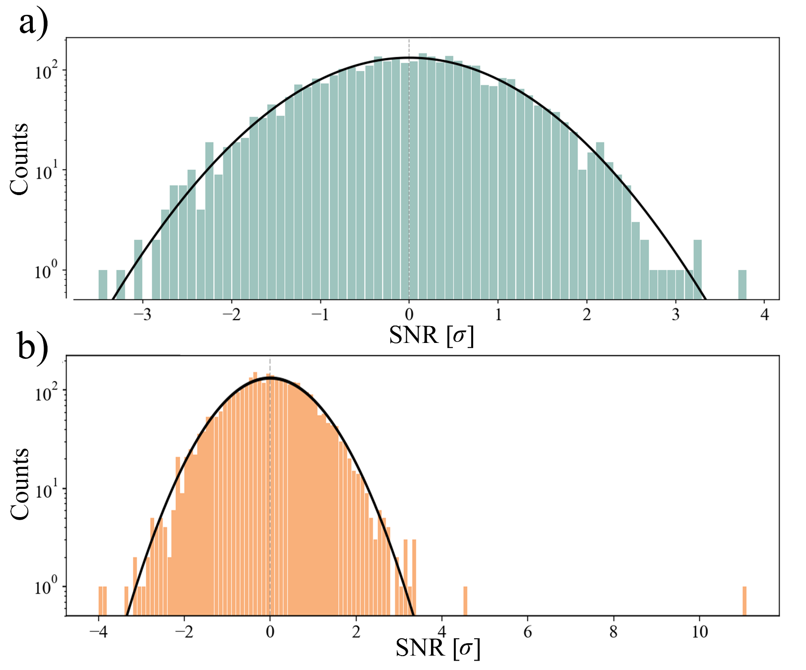
Claude
Mostyn
QSHS First Analysis Tests
2
Baseline Removal - Cold
Histogram for a single PSD post baseline removal, CW injection maximally detuned from cavity resonance
PSDs reasonably flat post-baseline removal
SNR retention: 0.92 ± 0.06 (for high power CW injections)
Signal bins kept as single high $σ$ counts
Gaussian to $≈$3$σ$
No systematic IF interference bins identified (outside cavity resonance region) — noise predominantly stochastic
CW injection maximally on cavity resonance

Slide 21
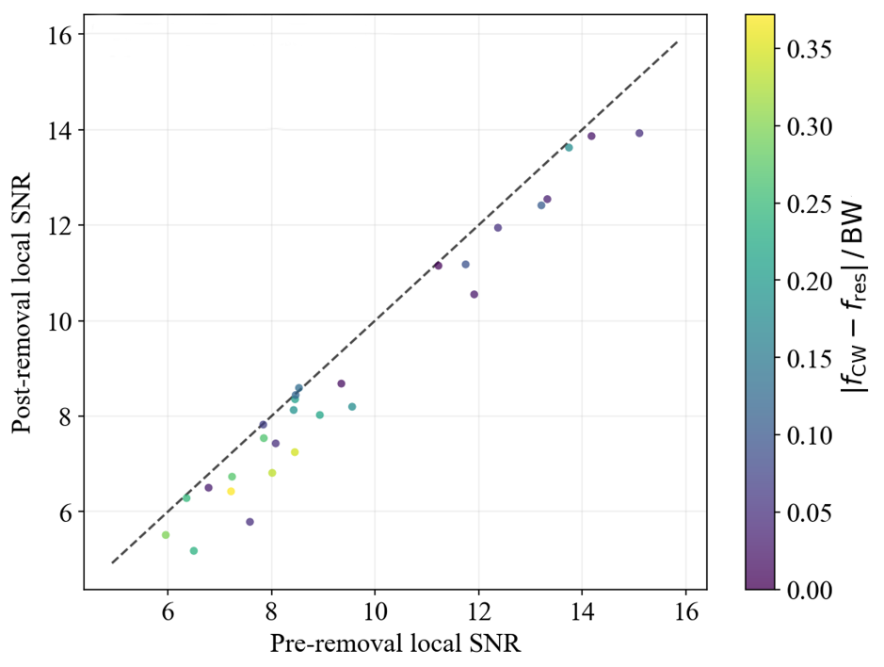
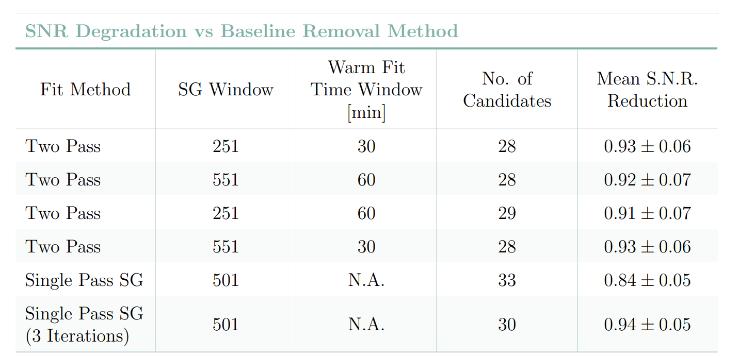

Claude
Mostyn
QSHS First Analysis Tests
2
Baseline Removal - Cold
-10 dBm CW injection signal heights before and after baseline removal, dashed line shows ideal no reduction
Coloured by minimum detuning of signal from resonance
SNR retention: 0.92 ± 0.06 (for high power CW injections)
Signal bins kept as single high $σ$ counts
Gaussian to $≈$3$σ$
No systematic IF interference bins identified (outside cavity resonance region) — noise predominantly stochastic
Comparison of different baseline methods and resulting signal SNR reduction
Single pass causes excess candidate

Slide 22
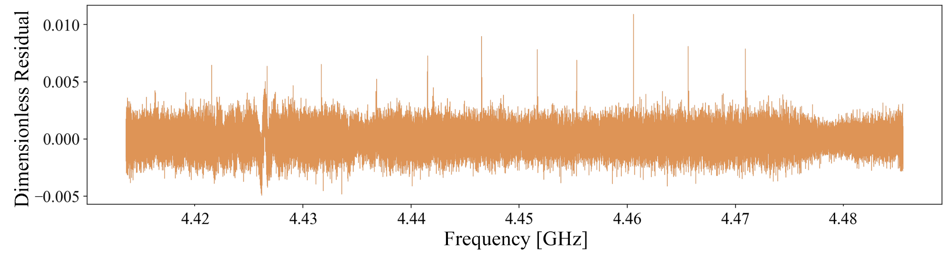

Claude
Mostyn
QSHS First Analysis Tests
3
Spectra Combination
RF mapping assumes constant conversion based on fixed 20.5 MHz offset of local oscillator
Lorentzian weights used as
$$w_{ik}=\frac{h_{ik}}{σ_{i}^{2}}$$
For $h$ the normalised Lorentzian transfer function, evaluated at each bin $k$, and $σ$ the per-spectrum ($i$) overall stan. dev.
Total integration time per frequency bin =100 secs $×$ contributing spectra (between 5 and 25 across range, dependent on cavity FWHM)
IF drift not monitored, no weighting based on system noise temperature, form factor, Q etc.
Combined Spectrum, for clear tuning region of -10dBm injection tests

Slide 23
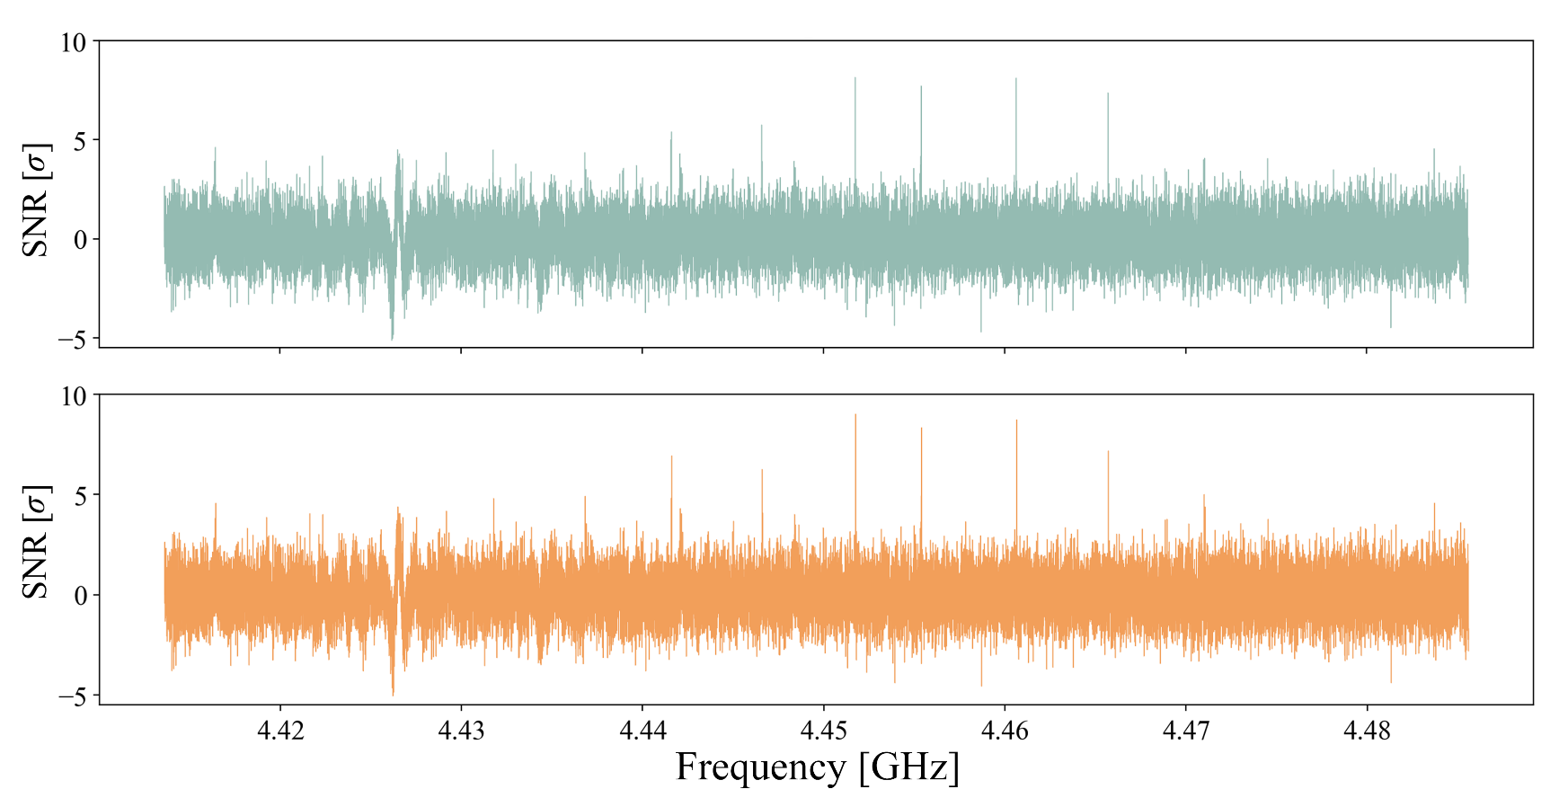

Claude
Mostyn
QSHS First Analysis Tests
4
Grand Spectrum Rebins
Combined spectrum bin width 763 Hz – to grand axion linewidth 2390 Hz
0.5 overlap fraction to reduce misalignment suppression of signals
Lineshape weighting found to have no notable effect on recovery of signals (either CW or software) at these power levels
Final conversion to $g_{aγγ}$ not yet done. Requires corrections for bin-bin correlations from baseline removal, any SNR suppression factors, bin-overlap DOF reduction, $T_{sys}$ calibration per grand bin etc.
Grand spectrum with inverse variance weighting only (top, blue), and with inverse variance and lineshape weighting (bottom, orange)

Slide 24
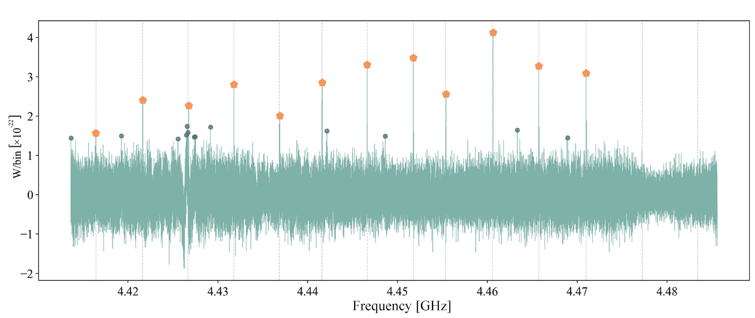
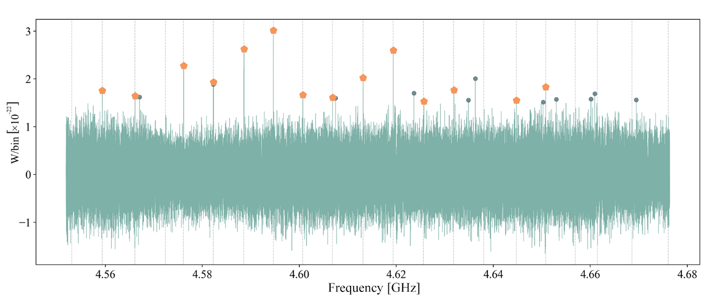

Claude
Mostyn
QSHS First Analysis Tests
5
Candidates - Hardware
Combined spectrum and top 25 candidates for -10 dBm clear region
Rolling σ cut: flag highest-$σ$ bin, mask neighbours, lower threshold, flag all beating threshold, repeat.
12/14 Candidates returned in first 25, 85% recovery at 0.35 candidates/MHz for -10 dBm tests, 108 candidates needed to return all CW injections
Frequency detuning: 0.03 ± 0.04 MHz, zero within error; positive bias in higher detuning cases consistent with a systematic in IF→RF conversion (LO or cavity drift)
Candidate clustering: residual baseline non-Gaussianity from standing waves in SC
Combined spectrum and top 25 candidates for -20 dBm higher frequency clear region

Slide 25
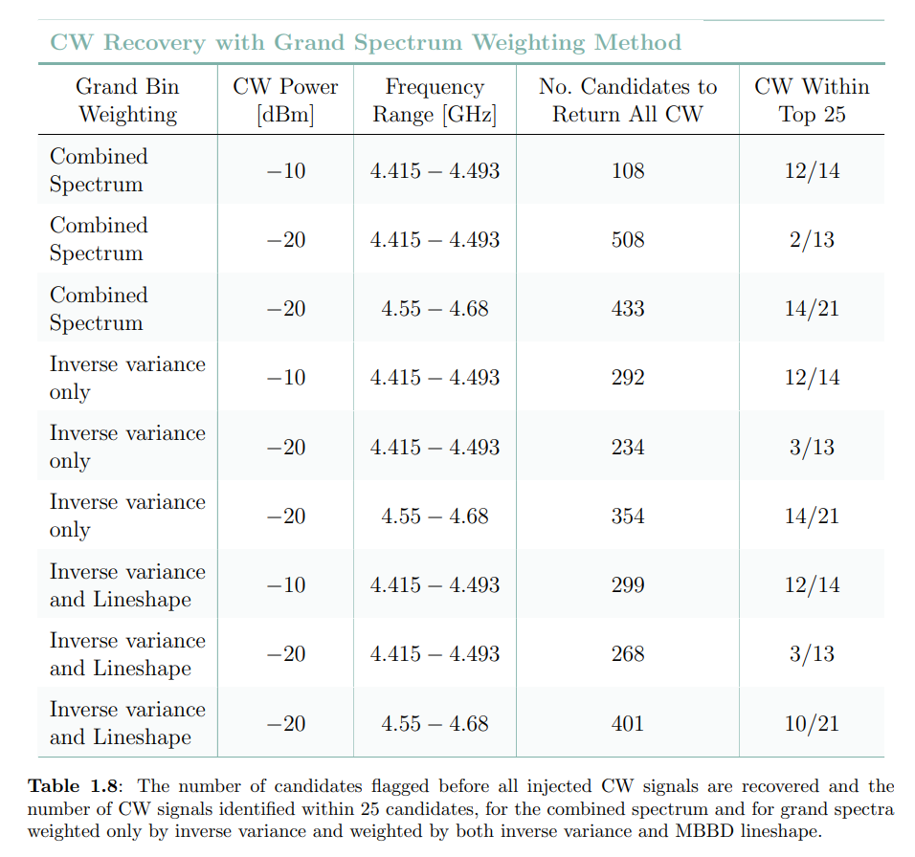
Claude
Mostyn
QSHS First Analysis Tests
5
Candidates - Hardware
Rolling σ cut: flag highest-$σ$ bin, mask neighbours, lower threshold, flag all beating threshold, repeat.
12/14 Candidates returned in first 25, 85% recovery at 0.35 candidates/MHz for -10 dBm tests, 108 candidates needed to return all CW injections
Frequency detuning: 0.03 ± 0.04 MHz, zero within error; positive bias in higher detuning cases consistent with a systematic in IF→RF conversion (LO or cavity drift)
Candidate clustering: residual baseline non-Gaussianity from standing waves in SC

Slide 26
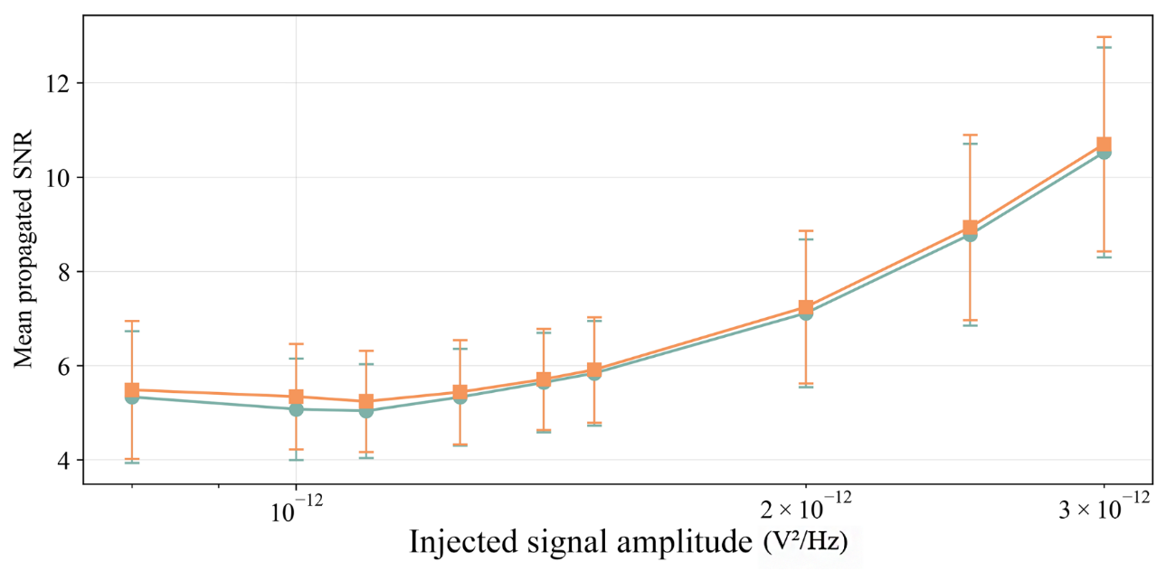
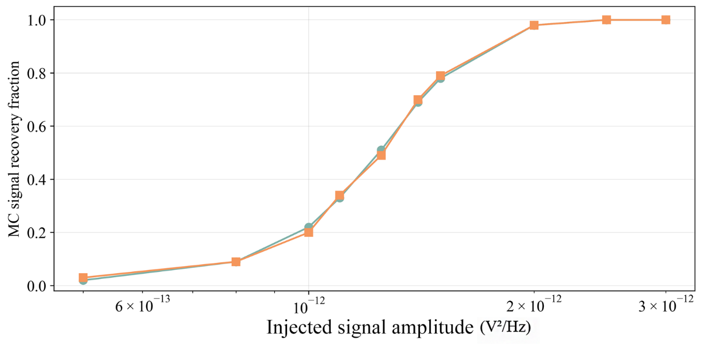

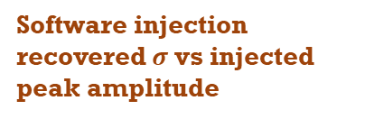
Claude
Mostyn
QSHS First Analysis Tests
5
Candidates, Software
Software injection recovered $σ$ vs injected peak amplitude
90% recovery threshold: peak injected power $≈ 2×{10}^{−12}V^{2}/Hz$→ $≈1.5×{10}^{−21} W$at cavity accounting for $≈$130 dB gain and bin width 763 Hz. $≈150× KSVZ$*.
Using only 100 MC injections here, propagated $σ$ needs calibrating with hardware injection tests
*- estimate based on uncertain gain
90% recovery point (current config)
Software injection recovery fraction vs injected peak amplitude

Slide 27
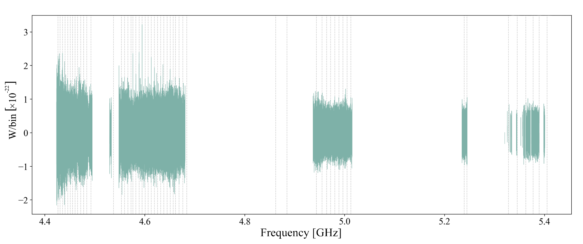
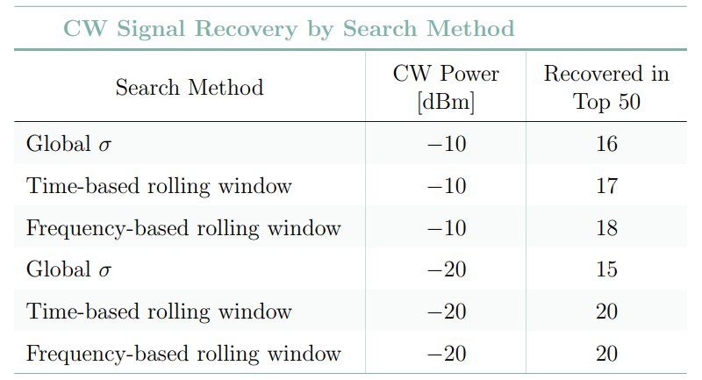

Claude
Mostyn
QSHS First Analysis Tests
Full Runs and Range
CW signal bins visible across most of accessible range; amplitude decreases toward higher frequencies (undercoupled static antenna + mode crossings)
Large frequency discontinuities in tuning range obvious and cause regions of low spectra coverage
Thermal settling after large rod movements: $≈$30 min to 1 hr cooldown required (relevant for rescan jumps)
Full combined spectrum, -20dBm run
CW injected signals recovered in top 50 using different search methods
Out of 35 total for -10 dBm run and out of 55 total for -20 dBm run

Slide 28
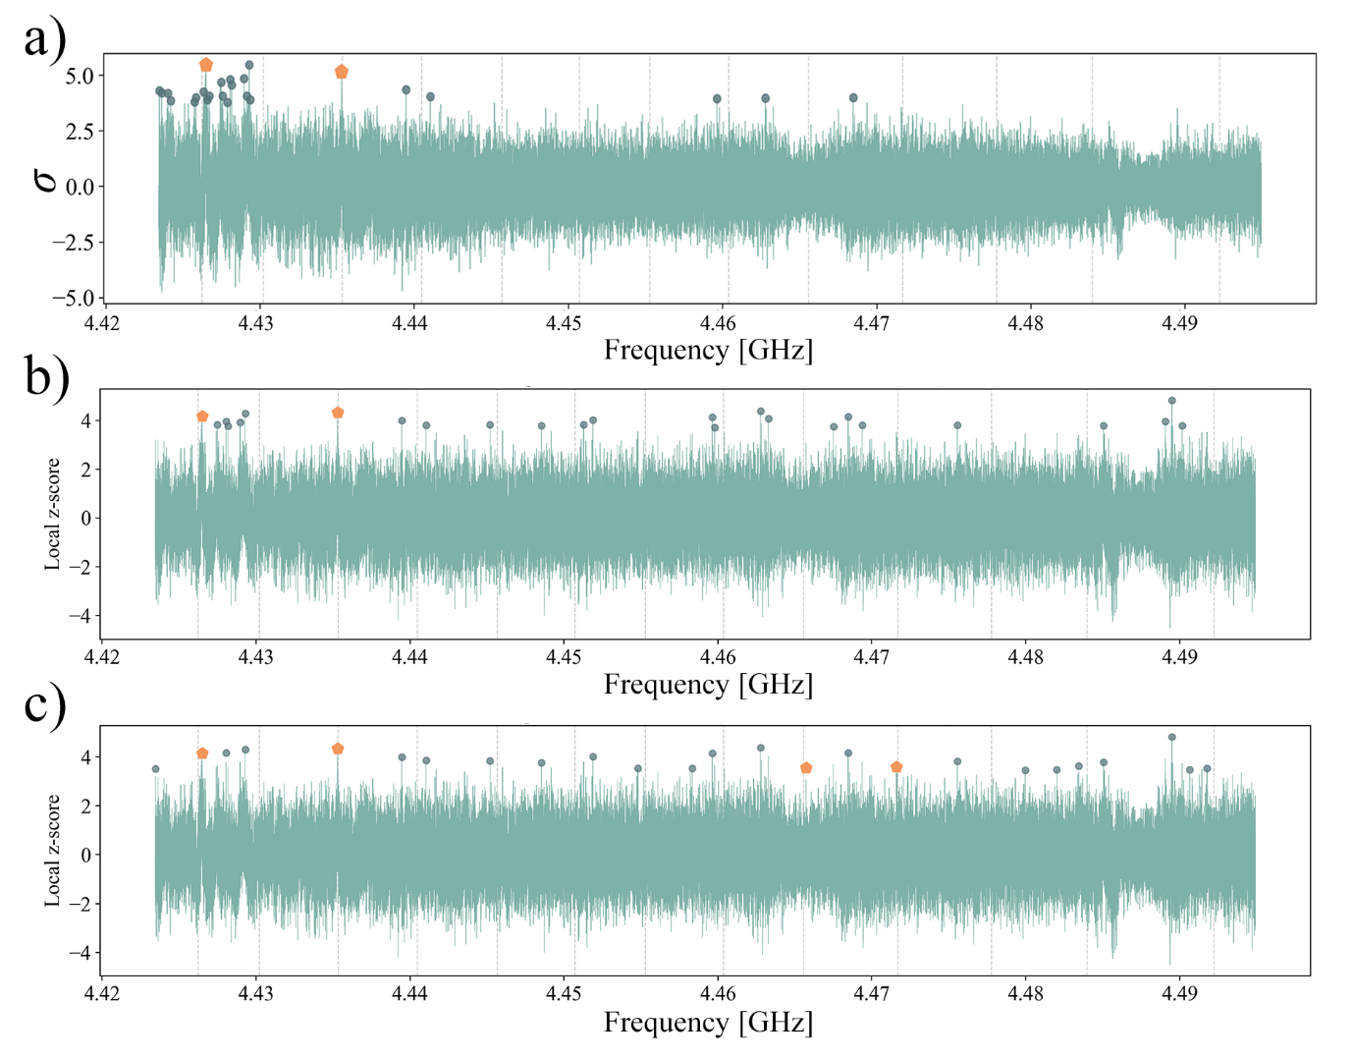

Claude
Mostyn
QSHS First Analysis Tests
5
Candidate Recovery
Top 25 candidates for -20dBm combined spectrum, using rolling $σ$ cut
Regular mode crossings create localised noise elevations — global σ cut clusters in these regions, need to either cut mode crossings (loses a lot of range for QSHS cavity) or use a local score
Rolling z-score (window ≈5 cavity linewidths ≈3.5 MHz) ranking each bin by deviation from local mean rather than global spectrum gives significantly improved results
108 → 28 candidates needed to recover all -10 dBm injections in the no-mode-crossing region
Top 25 candidates for -20dBm combined spectrum, using rolling local z-score cut

Slide 29
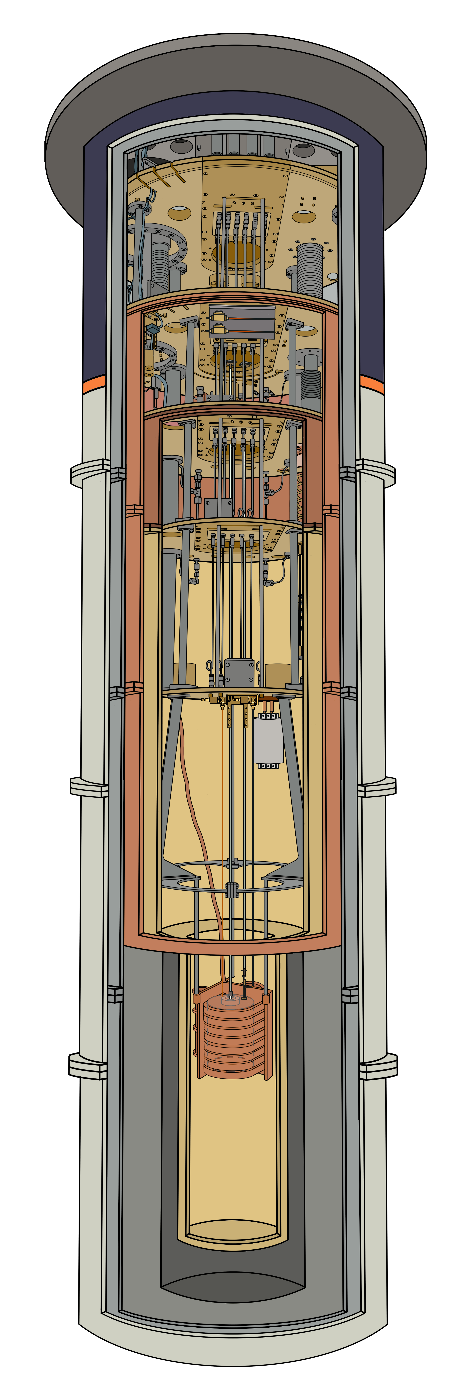

QSHS First Analysis Tests
Final data cut metrics need deciding.
Data Cuts & Drift
1st-stage amp + adjustable antenna should reduce fast varying small-scale structure/standing waves
Potentially develop direct calibration (FIR filter + hotload), or full hotload measurement for cold pass
Baseline Removal
May want to use more sophisticated weighting (considering form factor, system noise temperature measurements, etc.)
Spectra Combination
Statistics corrections (bin-bin correlations, SNR suppression factor, bin-overlap DOF, etc.)
Grand Spectrum
Final re-binning/search metric method needs to be decided
Target sensitivity or candidate number needs to be set
Candidate Recovery
Conversion to $g_{aγγ}$ - will require full noise temperature measurements and potentially full hardware injection campaign, improved lineshape hardware injection methods underway
Overall exclusion limit setting logic/final injection test suite needs deciding
Exclusion Limits
Altered analysis if combining original and rescan data sets
Rescan Analysis

Slide 30
Thank You!
Contact Details:
Claude Mostyn cfmostyn1@sheffield.ac.uk
Supervisor Ed Daw
e.daw@sheffield.ac.uk

Slide 31

Claude
Mostyn
QSHS First Analysis Tests
1
Gain Drift
Temporal drift: <0.2% of mean PSD. Slight negative correlation with room temperature (RT amplifier)
Frequency-dependent drift dominates — primarily receiver electronics; consistent with hotload across different cools → calibration feasible
Q-dependent component: near mode crossings, falling cavity Q causes additional PSD amplitude decrease
Current correction: global median shift per PSD. Final model: data-driven hotload calibration (deferred to when full receiver chain installed)
Temperature dependence of PSD mean

Slide 32

Claude
Mostyn
QSHS First Analysis Tests
1
Gain Drift
Temporal drift: <0.2% of mean PSD. Slight negative correlation with room temperature (RT amplifier)
Frequency-dependent drift dominates — primarily receiver electronics; consistent with hotload across different cools → calibration feasible
Q-dependent component: near mode crossings, falling cavity Q causes additional PSD amplitude decrease
Current correction: global median shift per PSD. Final model: data-driven hotload calibration (deferred to when full receiver chain installed)
Hotload spectrum (brown, noise in light brown) tracks PSD mean amplitude (blue), using hotload scaling factor (extra amplifier added)

Slide 33



Claude
Mostyn
QSHS First Analysis Tests
1
Gain Drift
Hotload spectrum tracks PSD mean amplitude
Temporal drift: <0.2% of mean PSD. Slight negative correlation with room temperature (RT amplifier)
Frequency-dependent drift dominates — primarily receiver electronics; consistent with hotload across different cools → calibration feasible
Q-dependent component: near mode crossings, falling cavity Q causes additional PSD amplitude decrease
Current correction: global median shift per PSD. Final model: data-driven hotload calibration (deferred to when full receiver chain installed)
PSD mean amplitude becomes approximately linear in $Q$ where $A<5000$

