Slide 1
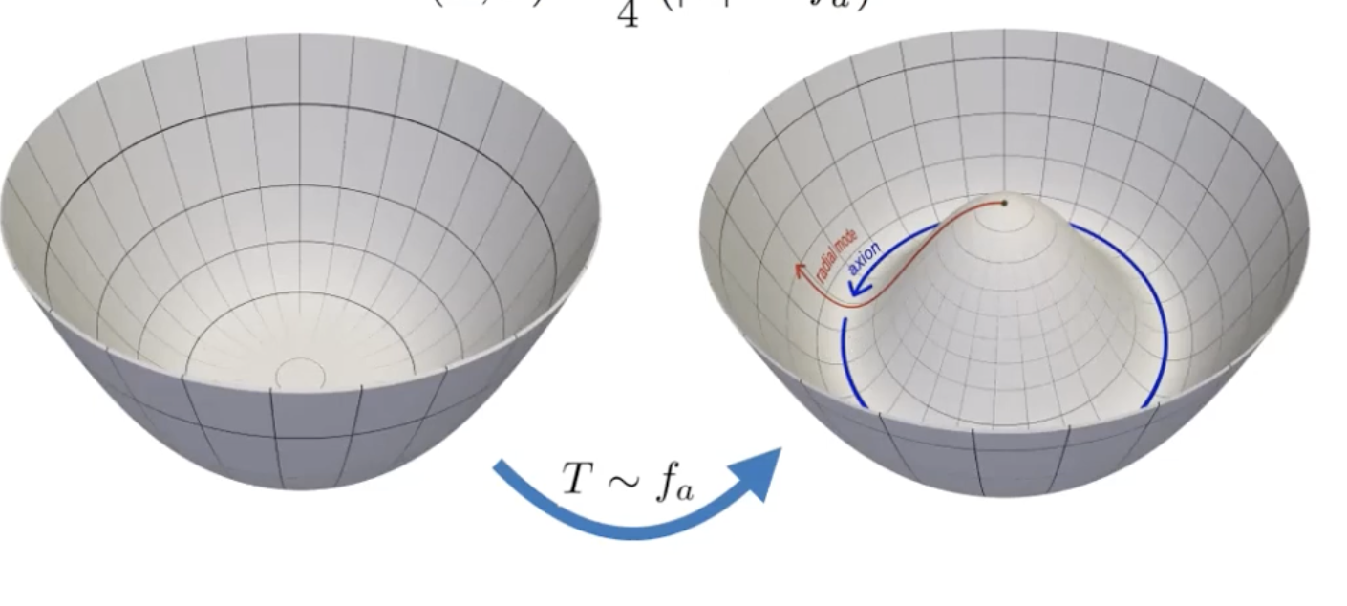
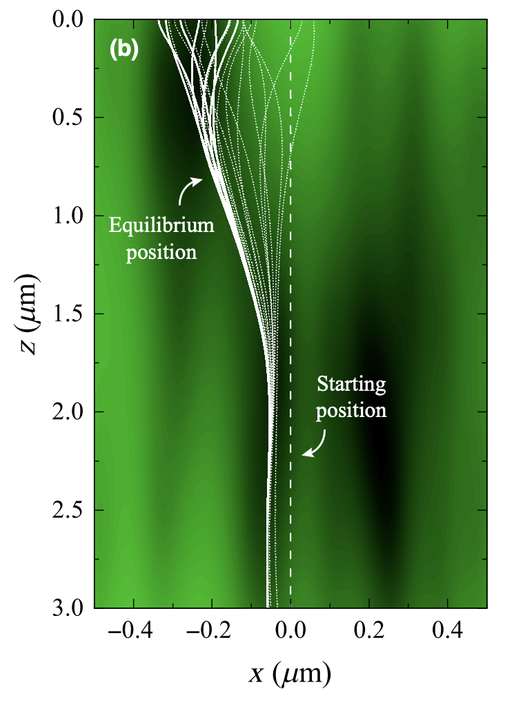
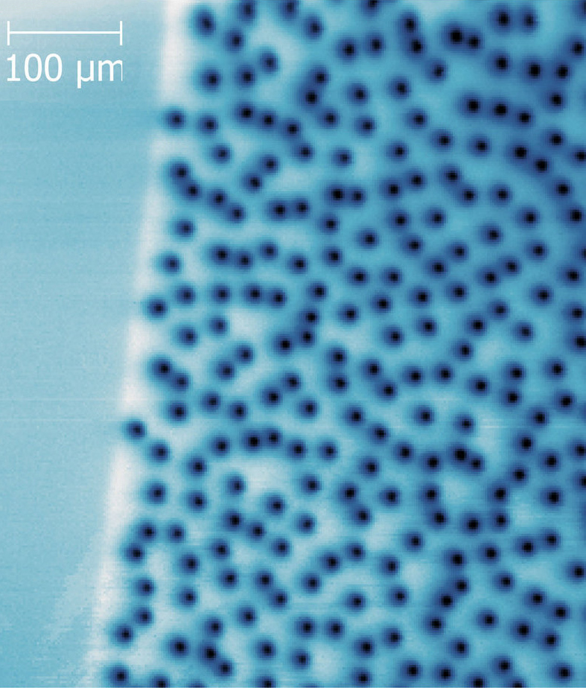
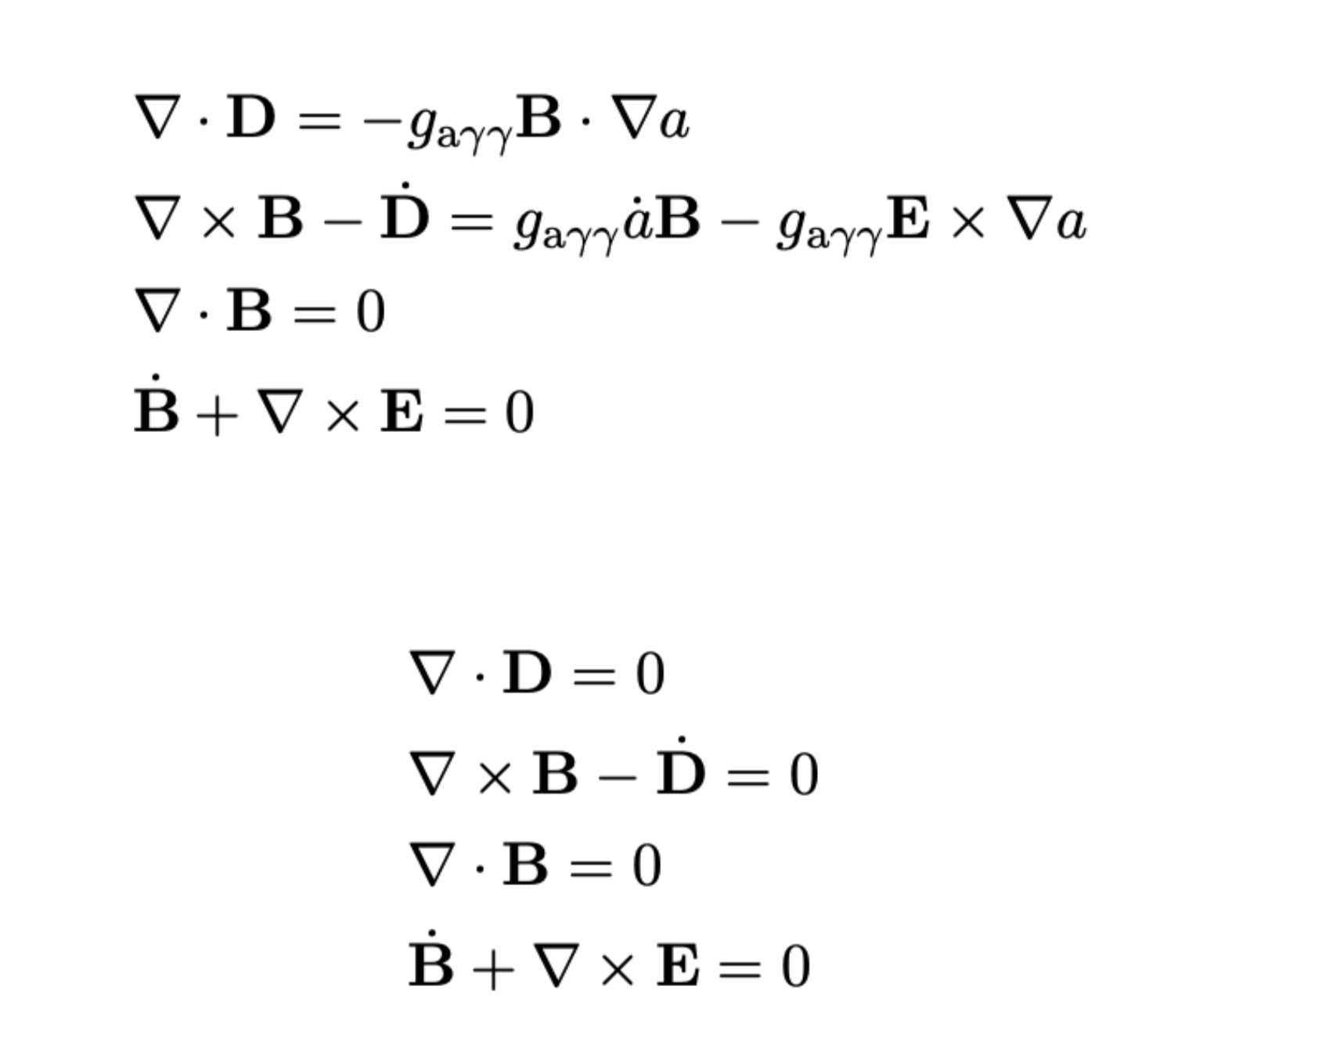
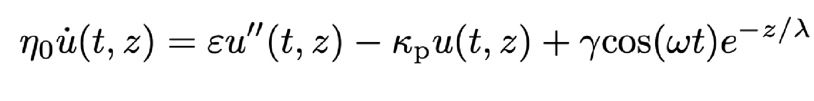
Theory Behind Axion Searches
Jamie McDonald | University of Manchester data analysis workshop Sheffield | 19 - 21 May 2026

Slide 2
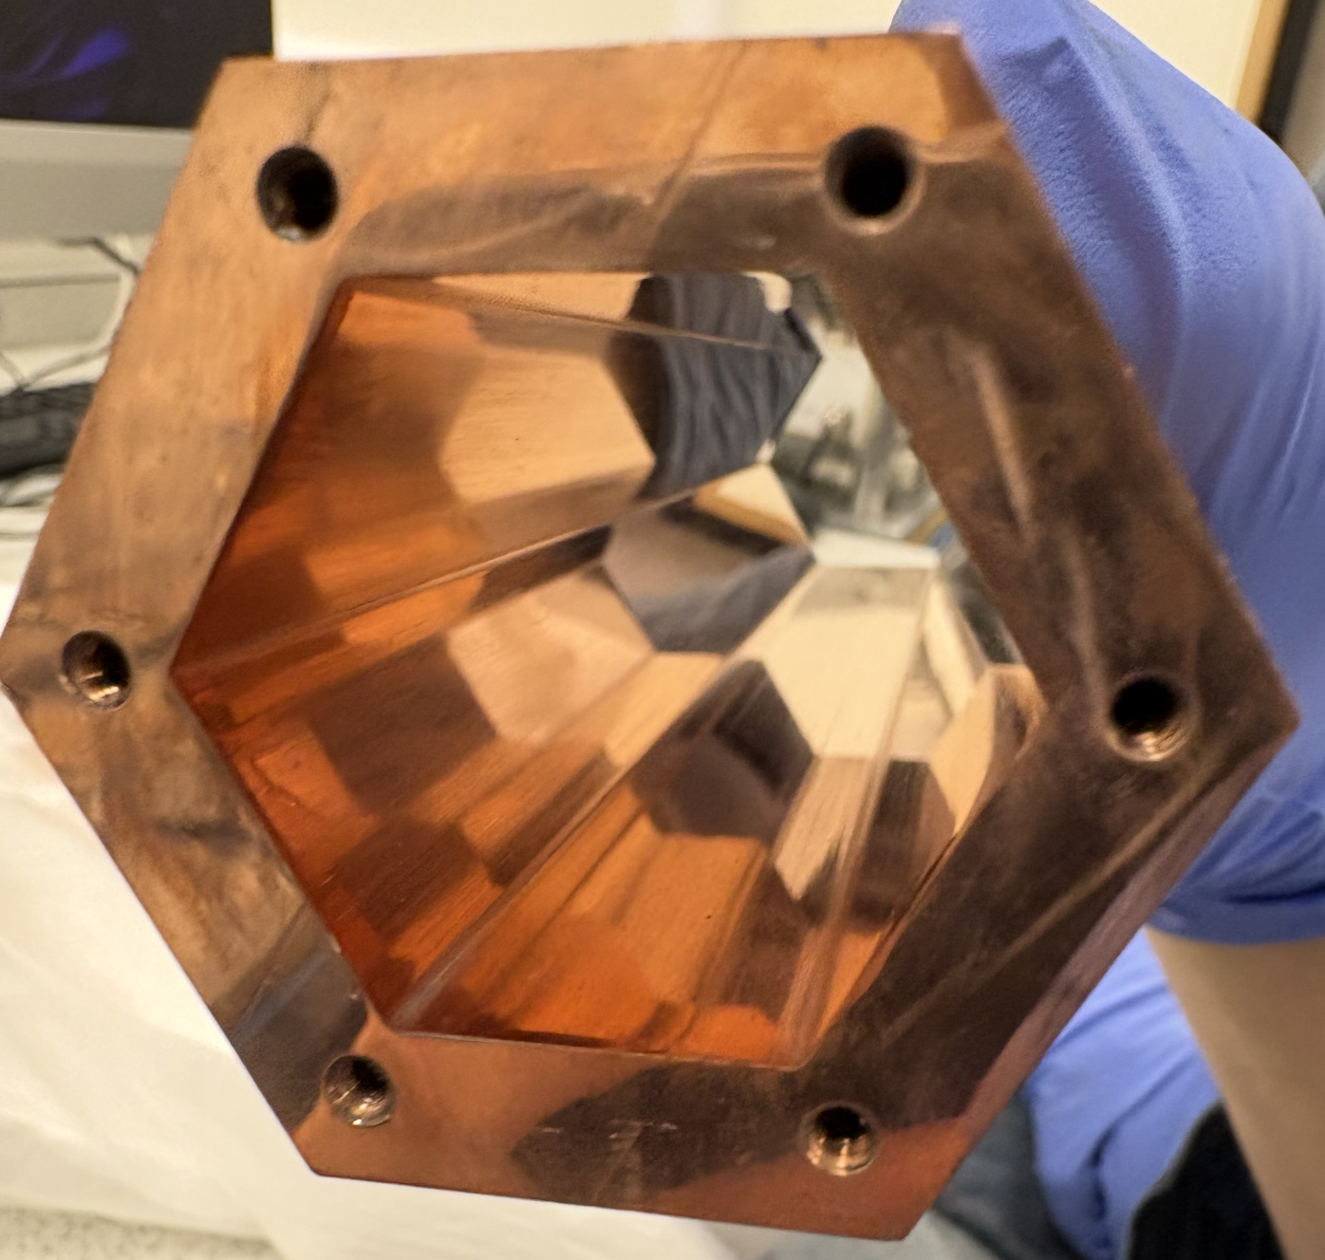
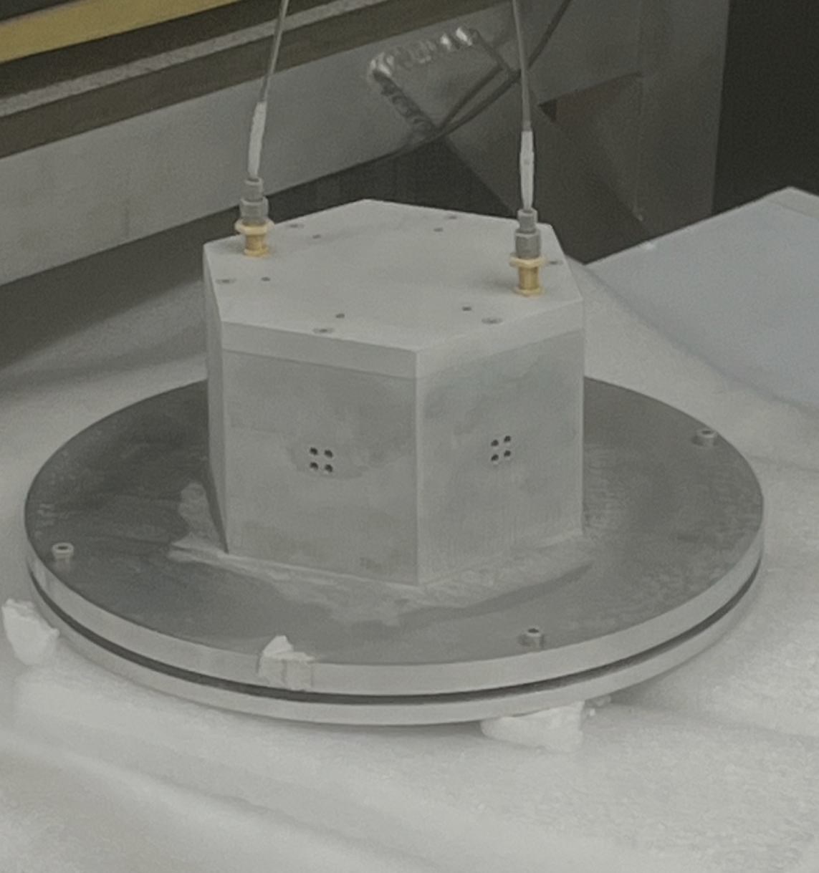
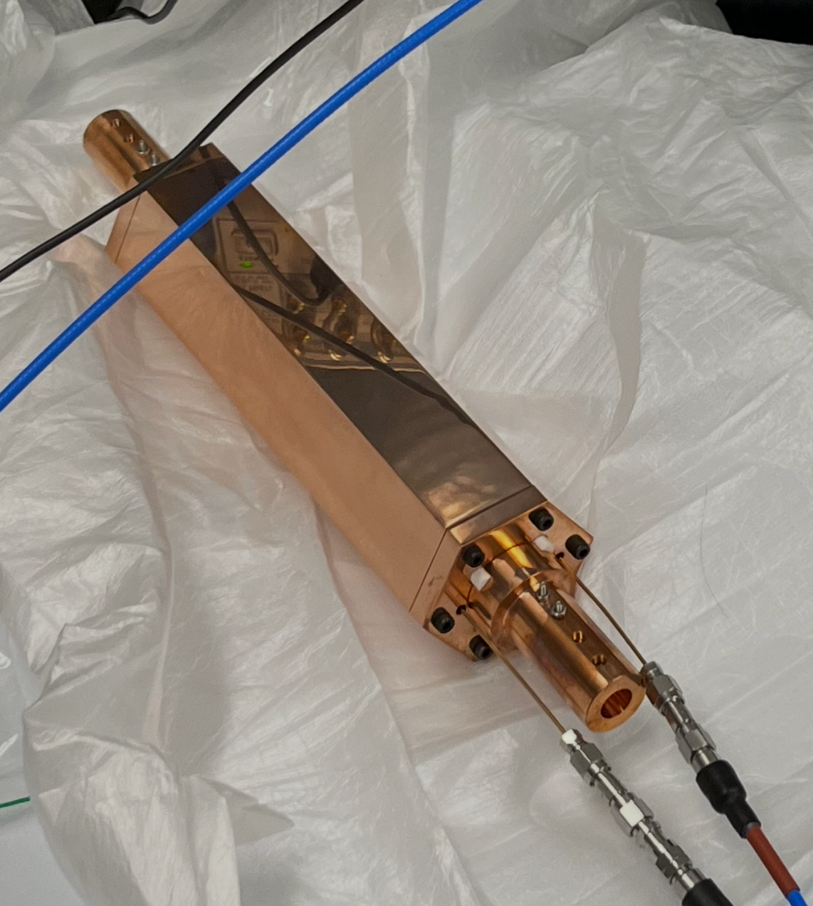
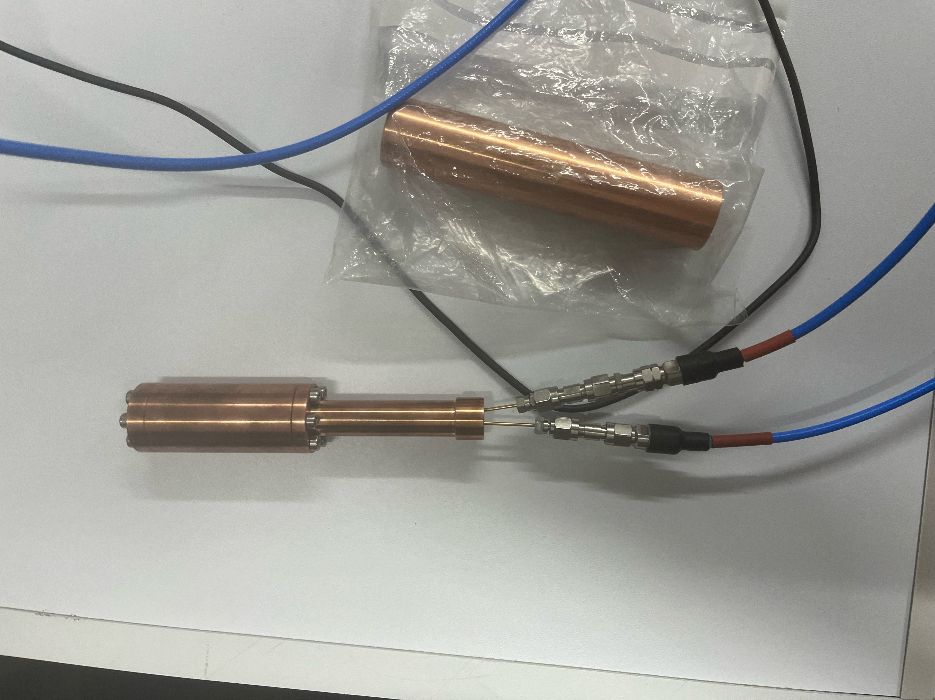
What I normally do these days…

Slide 3
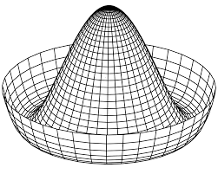
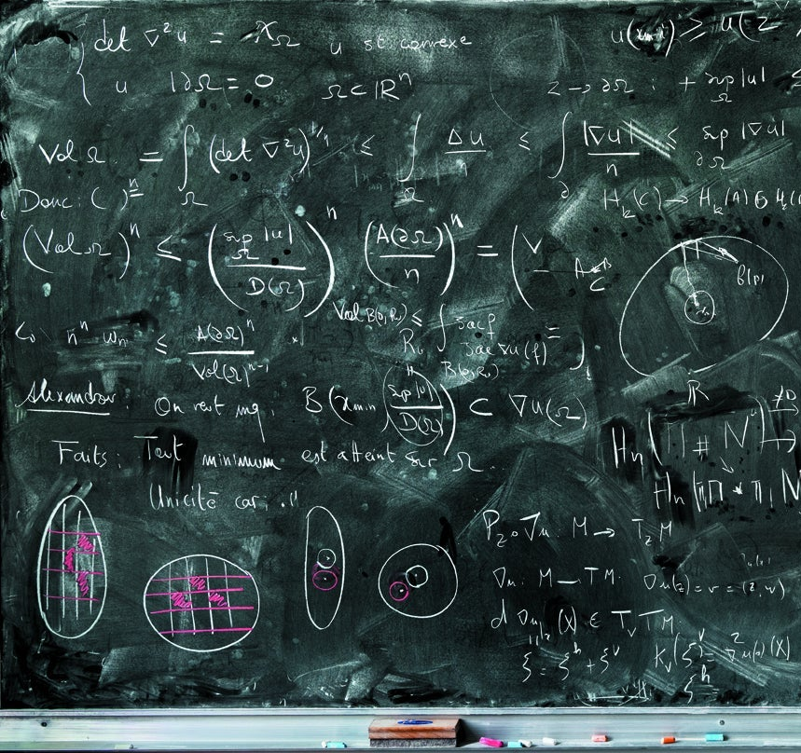
What I think you might want me to do in the next 30 mins…

Slide 4
Theory Behind Axion Searches
(101)
Axions in the Early Universe Sensitivity/Axion Electrodynamics
Superconductors Stochastic processes/signal synthesis
Condensed matter/materials
Open quantum systems/cavity QED
Fundamental Theory
(102)
Practical Theory

Slide 5
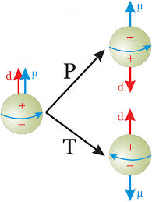
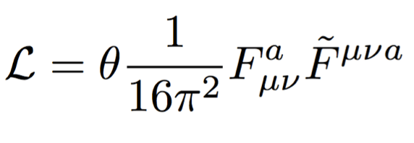
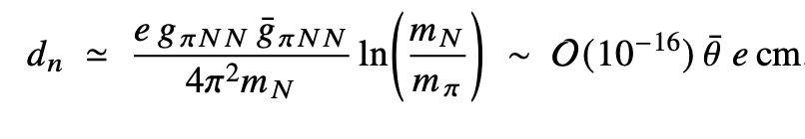
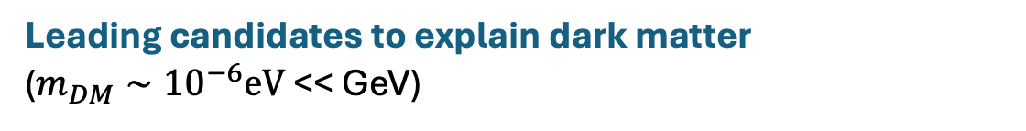
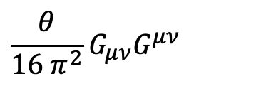
Axions
Solve strong CP problem in QCD (why neutron EDM so small?) Peccei & Quinn (1977)
$$\frac{θ}{16 π^{2}}G_{μν}G^{μν}$$
Leading candidates to explain dark matter ($m_{DM}∼{10}^{−6}eV$ << GeV)
Dine & Fischler (1983), Abbott & Sikivie (1983), Preskill, Wise & Wilczek (1983).

Slide 6
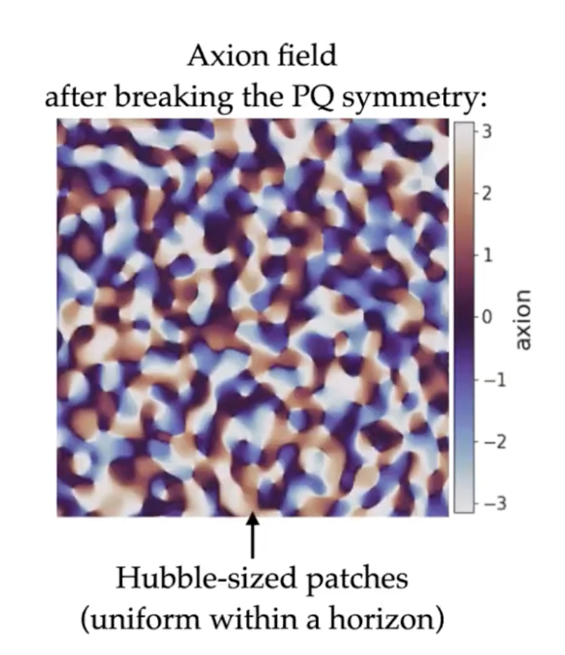
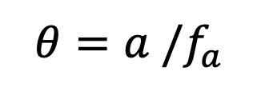
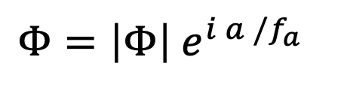

Axion Symmetry Breaking
$$Φ=\left|Φ\right| e^{i a /f_{a}}$$
$$θ=a /f_{a}$$
(field takes values between 0 and $π$)
(Slide courtesy of Malte Buschmann)

Slide 7
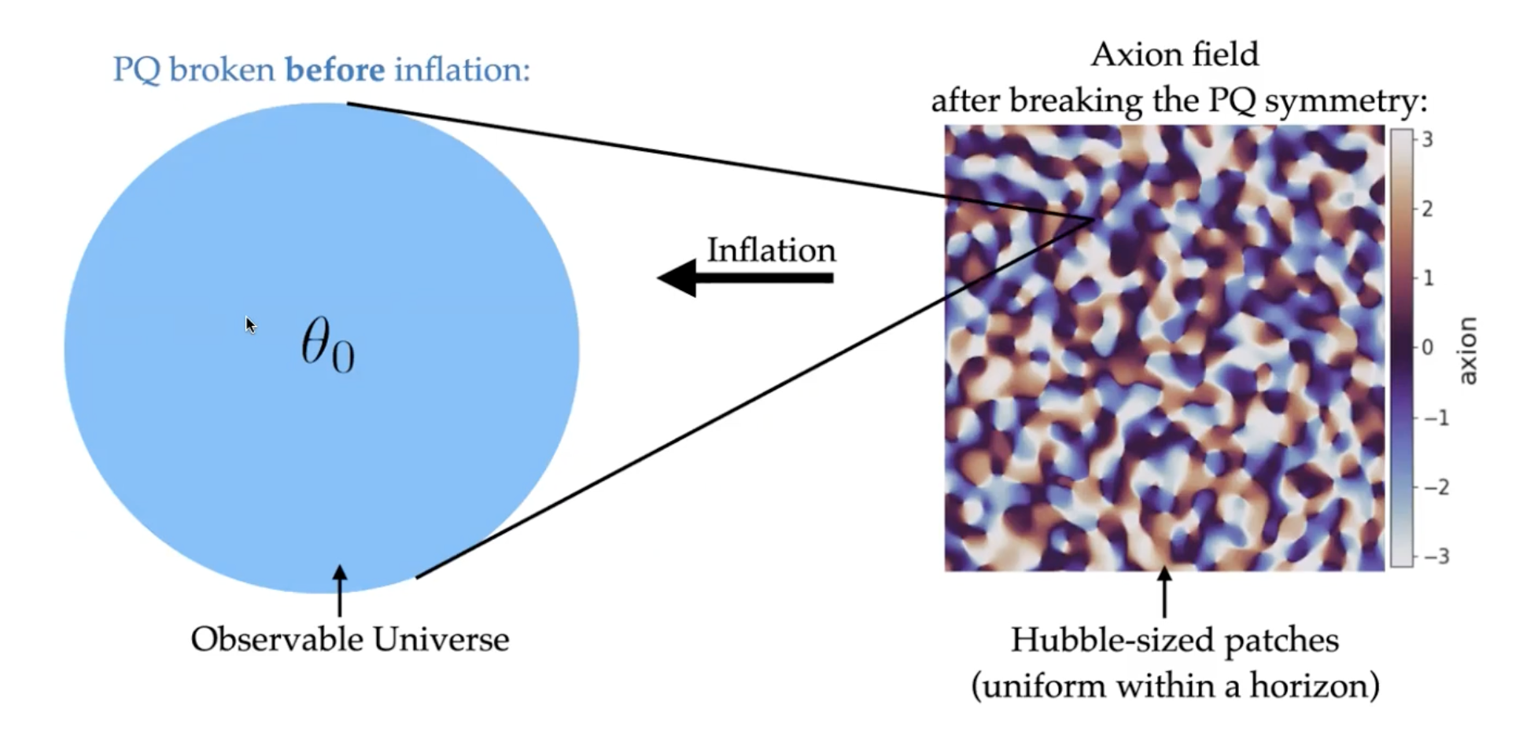
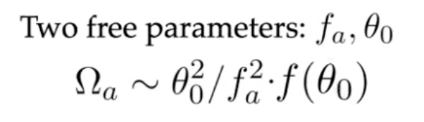


Symmetry Breaking (Before) Inflation
$$θ(x) = a(x)/f_{a}$$
Dark matter abundance
No fine-tuning of $θ$
$$→ m_{a} ∼μeV$$
(Slide courtesy of Malte Buschmann)

Slide 8
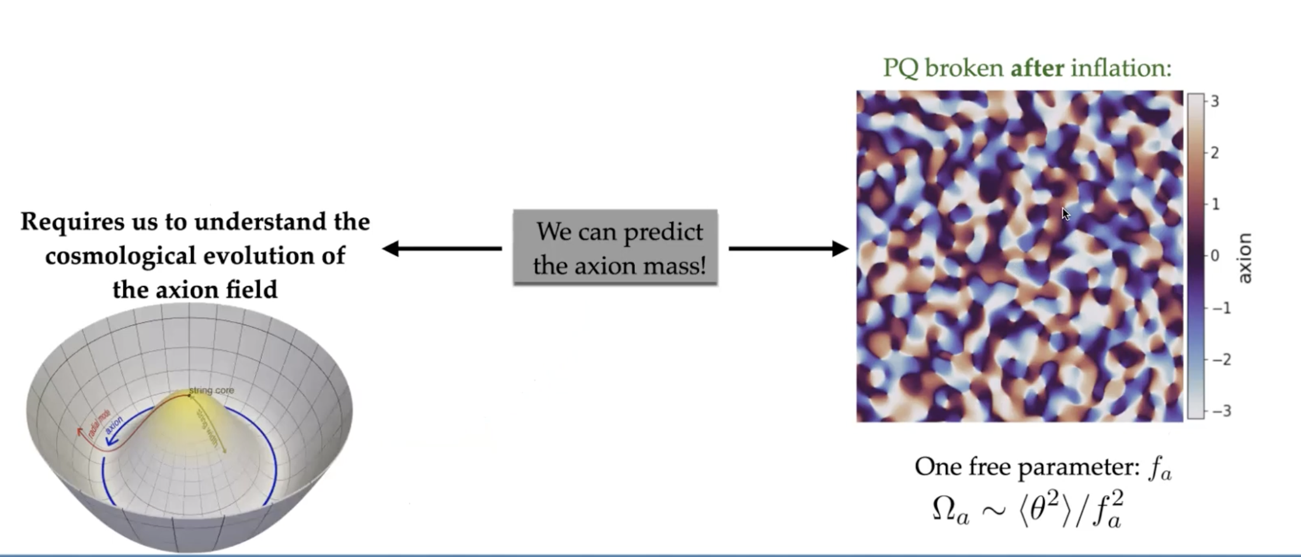
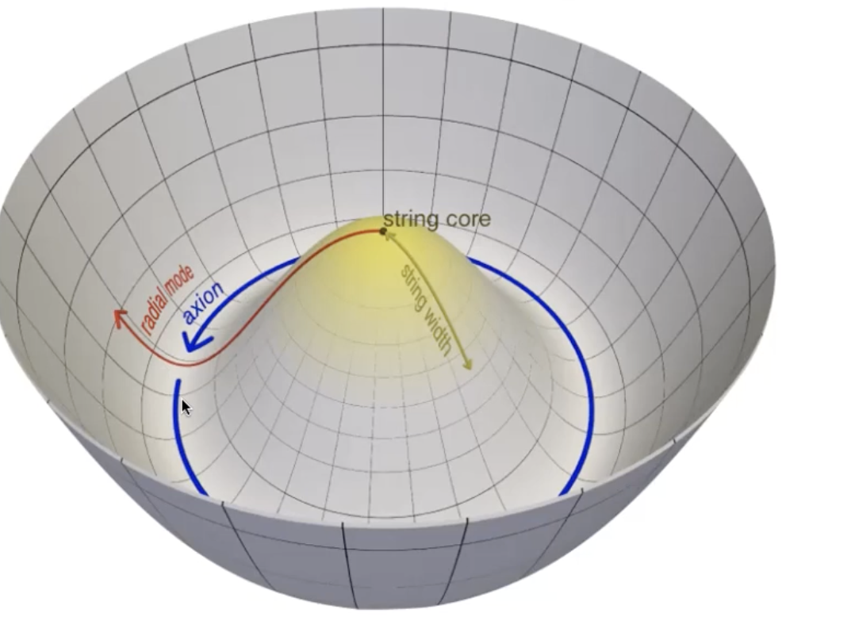
Symmetry Breaking (after) Inflation
axion strings
(Slide courtesy of Malte Buschmann)

Slide 9
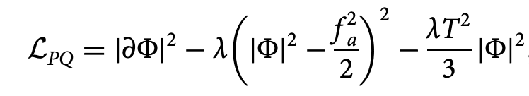
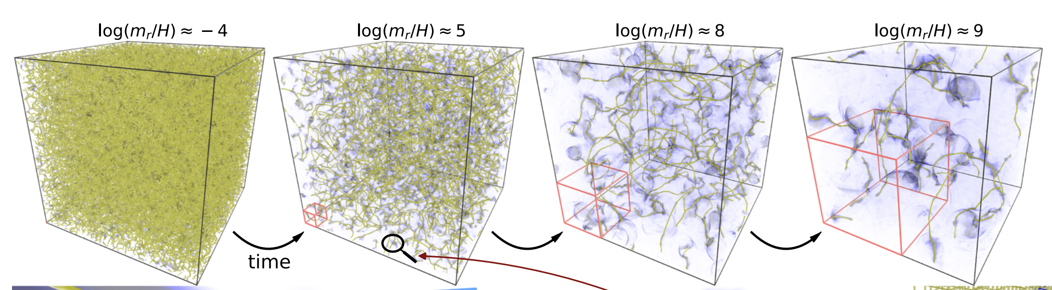
supercomputer simulations of axion strings
Buschmann et al Nature Communications
volume 13, Article number: 1049 (2022)
(Slide courtesy of Malte Buschmann)

Slide 10
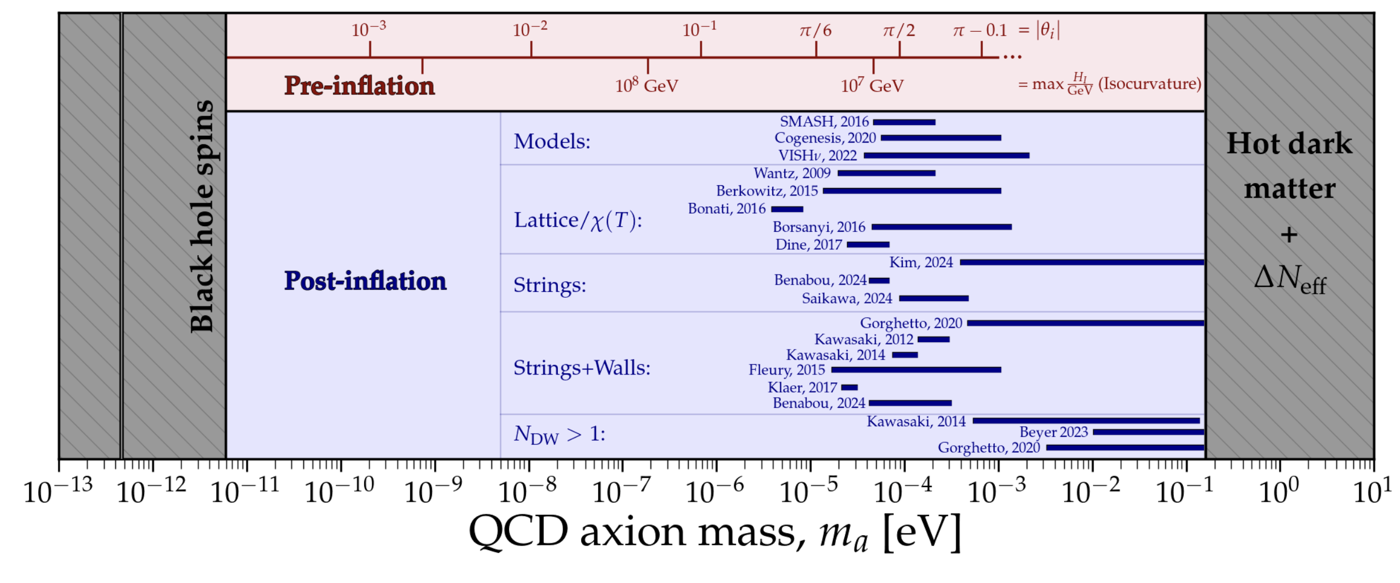
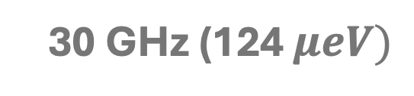
Theory predictions for axion mass
Plot Courtesy: Ciaran O’Hare

Slide 11
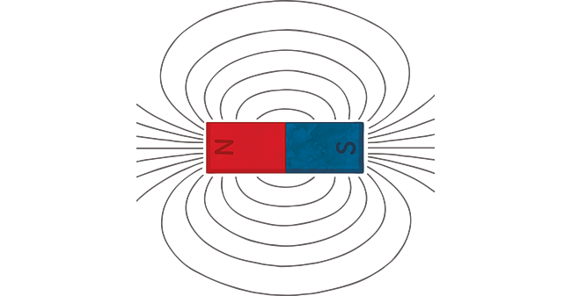
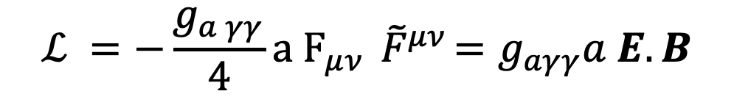
Axion Electrodynamics
$$ℒ =−\frac{g_{a γγ}}{4}a F_{μν}{ \tilde{F}}^{μν}=g_{aγγ}a E.B$$
Axions
Photons

Slide 12
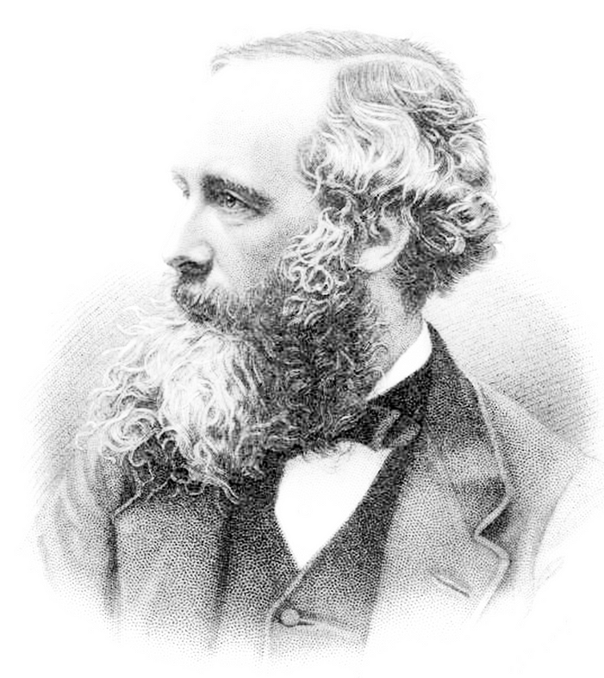
Axion Electrodynamics
Maxwell’s Equations + axions

Slide 13
Axion Electrodynamics
$${−∇}^{2} E+∇\left(∇⋅E\right)−ω^{2}ε.E=g_{a γγ}ω^{2}a B$$
Light
Axion field

Slide 14
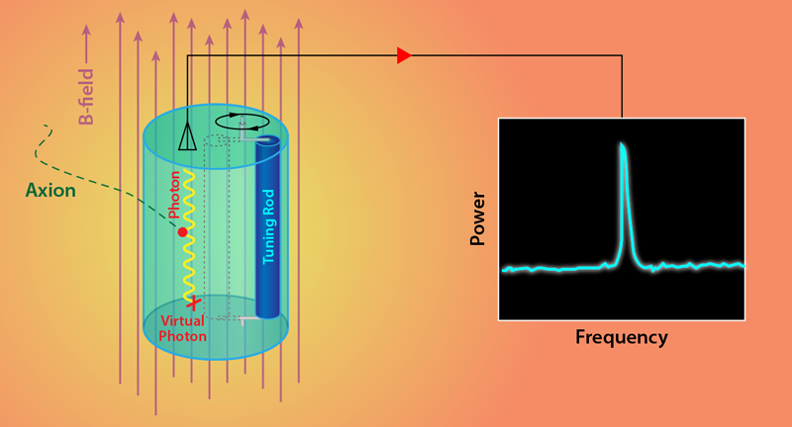


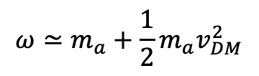





Axion Dark Matter Detection
$$a$$
$$γ$$
$a∝e^{iωt}$
$$ω≃m_{a}+\frac{1}{2}{m_{a}v}_{DM}^{2}$$
$$B_{lab}$$
$$ω≃m_{a}$$
$$V_{DM} \sim 200 km/sec⁡$$
$$ρ=0.45 GeV /cm^{3}$$
$$\frac{Δω}{ω}∼{10}^{−6}$$

Slide 15
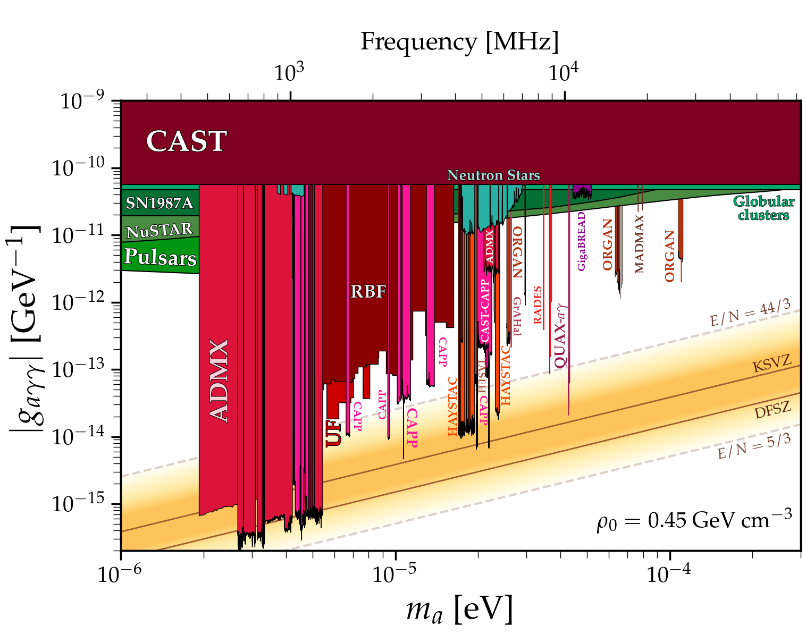
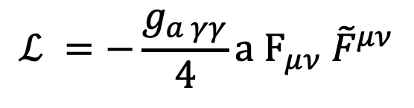
Axion Dark Matter Searches
26 – 40 GHz
Manchester
$$ℒ =−\frac{g_{a γγ}}{4}a F_{μν}{ \tilde{F}}^{μν}$$
Photon Coupling
Dark Matter Mass
Plot Courtesy: Ciaran O’Hare

Slide 16
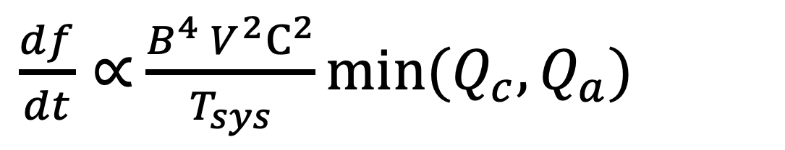
Theory Behind Sensitivity of Axion Experiments
$\frac{df}{dt}∝$ $\frac{B^{4} V^{2}C^{2}}{T_{sys}}min⁡(Q_{c},Q_{a})$
(a story through a formula)

Slide 17

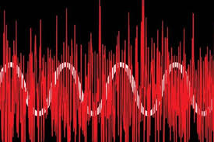
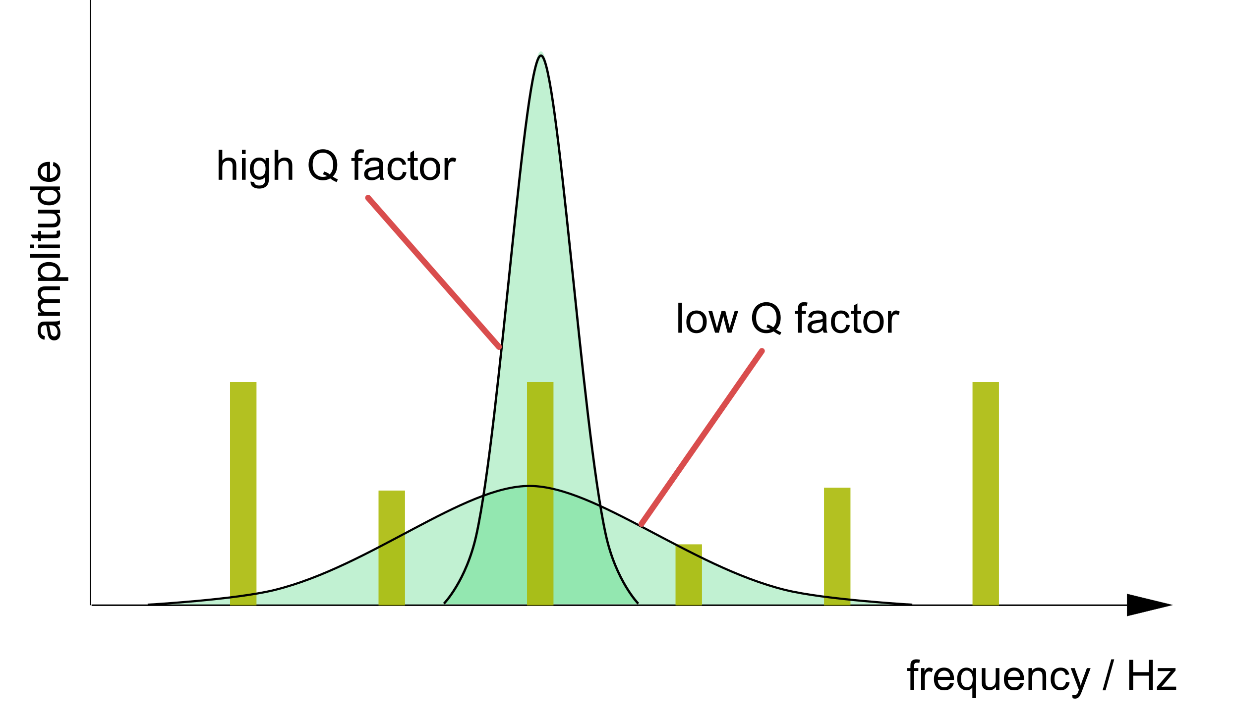
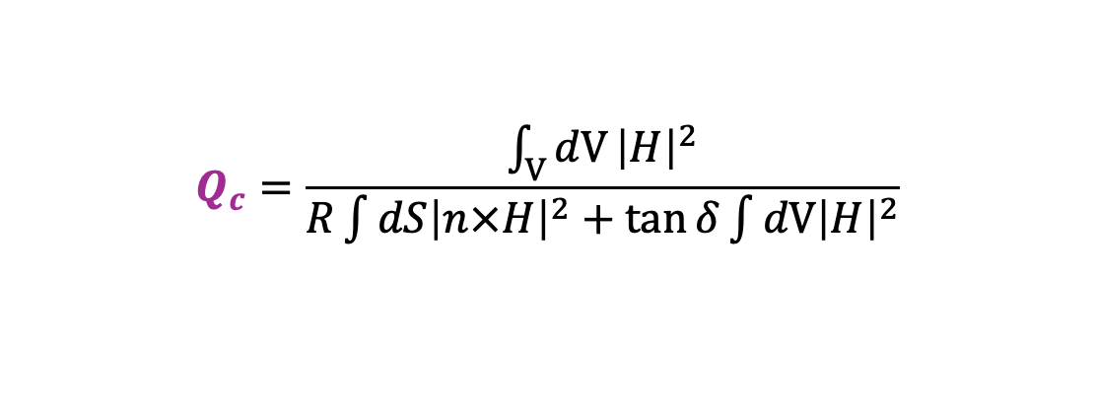
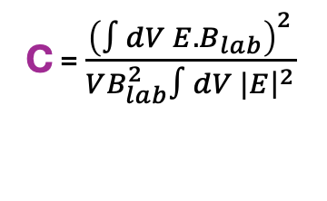
Sensitivity of Axion Experiments
$\frac{df}{dt}∝$ $\frac{B^{4} V^{2}C^{2}}{T_{sys}}min⁡(Q_{c},Q_{a})$
C = $\frac{{\left(∫dV E.B_{lab}\right)}^{2}}{VB_{lab}^{2}∫dV |E{\left.​\right|}^{2}}$
$$Q_{c}=\frac{\int_{V}{dV}{\left|H\right|}^{2}}{R\int{dS{\left|n×H\right|}^{2}}+\tan{δ}\int{dV{\left|H\right|}^{2}}}$$
$$B$$
$$Q_{a}∼10^{6}$$
Surface Resistance
Losses from bulk materials
$$T_{sys}$$

Slide 18
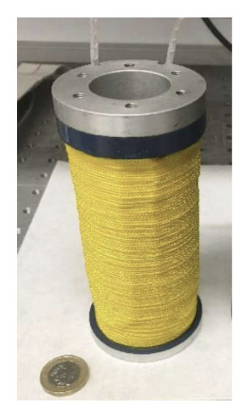
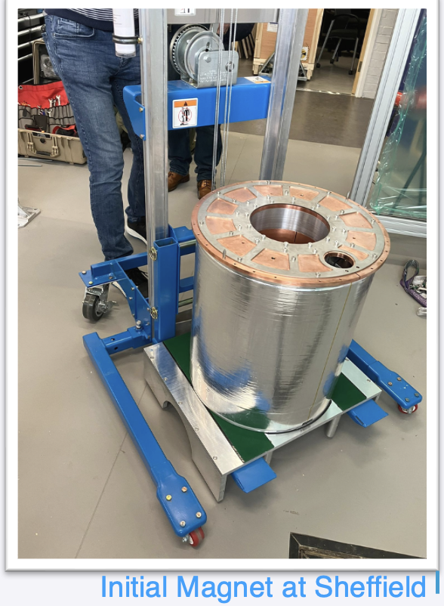

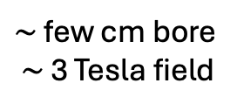
Sensitivity of Axion Experiments
$\frac{df}{dt}∝$ $\frac{B^{4} V^{2}C^{2}}{T_{sys}}min⁡(Q_{c},Q_{a})$
Manchester
Sheffield
~ $10^{2}$ gain in scan rate
$∼$ few cm bore $∼$ 3 Tesla field
20 cm bore 8 T field
*

Slide 19
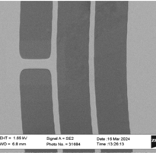
Sensitivity of Axion Experiments
$\frac{df}{dt}∝$ $\frac{B^{4} V^{2}C^{2}}{T_{sys}}min⁡(Q_{c},Q_{a})$
Quantum Noise Limited amplifiers

Slide 20
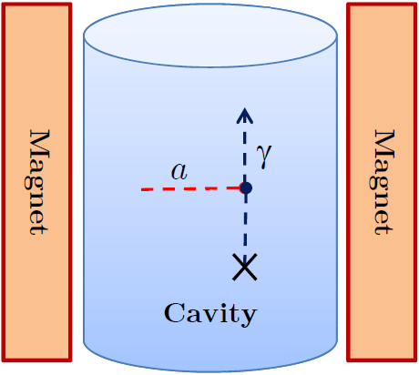
Sensitivity of Axion Experiments
$\frac{df}{dt}∝$ $\frac{B^{4} V^{2}C^{2}}{T_{sys}}min⁡(Q_{c},Q_{a})$
Cavities

Slide 21
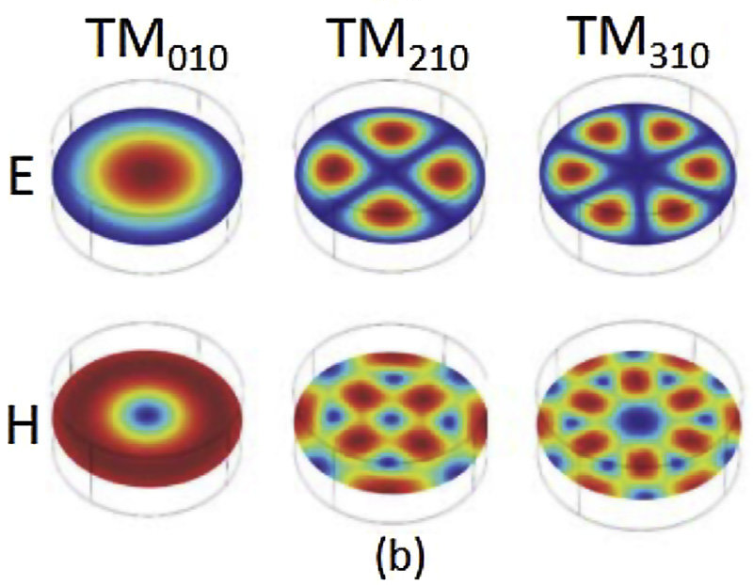
Cavity Searches for Axion Dark Matter
Cavity Modes
$r_{c}$
Cavity
$$f_{lmn}$$
(eigenfrequencies)

Slide 22
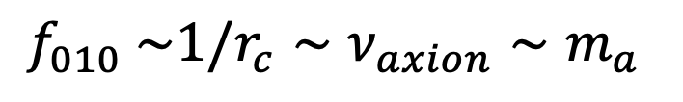
Cavity Searches for Axion Dark Matter
Cavity Modes
Magnet
axion
$r_{c}$
B
Cavity
$$a$$
$$γ$$
$$f_{010} \sim 1/r_{c}∼ν_{axion}∼m_{a}$$
(eigenfrequencies)
$$B_{}$$

Slide 23
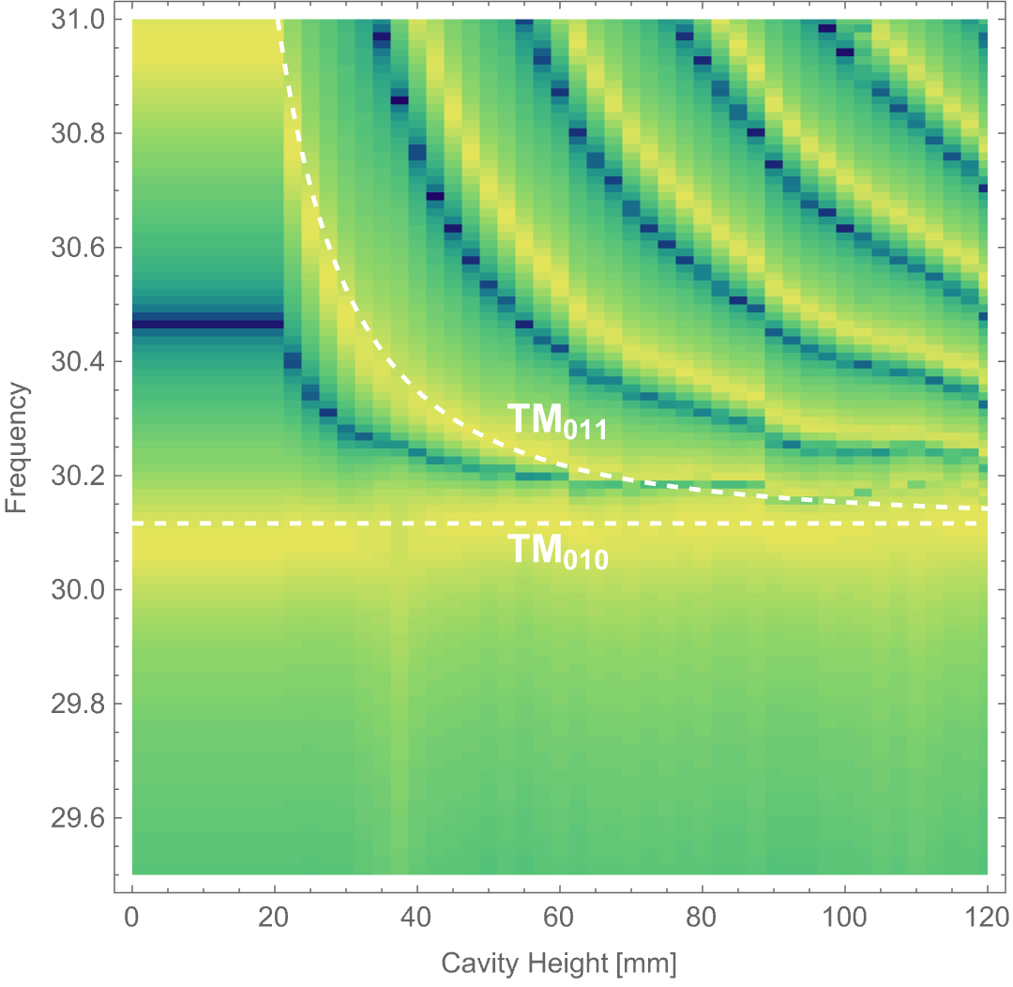
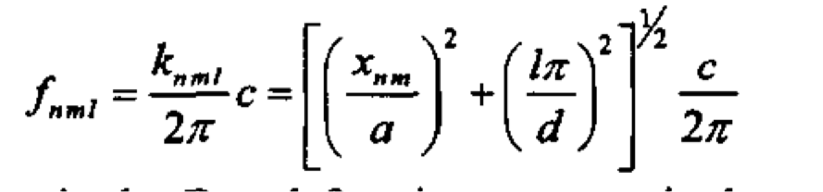
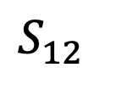

Mode Crowding
$$S_{12}$$
Shorter Bore
$$a$$
Longer Bore
d

Slide 24


Volume Challenge
$$L∼1/m_{a}∼1/ν$$
1 GHz
30 GHz
Magnet
20 cm
$$P_{a}∝g_{aγγ}V Q C$$

Slide 25

Volume Challenge
$$L∼1/m_{a}∼1/ν$$
$$L$$
Repeated Structures
Recover Larger Volume

Slide 26





Volume Challenge
Repeated Structures
$$d$$
$$s$$
Resonant axion conversion
$$ω_{p}^{2}=m_{a}^{2}$$
Wires
Lawson et al PRL 123 (2019) 14, 141802
ALPHA Collaboration

Slide 27

Volume Challenge
Repeated Structures
MADMAX – concept (Caldwell et al PRL 118, 091801 (2017))
ALPHA Collaboration

Slide 28
Volume Challenge
$$L∼1/m_{a}∼1/ν$$
Multi-Cavity Arrays
Magnet
See also: ORGAN, ADMX-ERF, CAPP
20 cm

Slide 29

$\frac{df}{dt}∝$ $\frac{B^{4} V^{2}C^{2}}{T_{sys}}min⁡(Q_{c},Q_{a})$

Slide 30

Signal Synthesis
1

Slide 31


Question: how do I model a given power spectrum as a stochastic process ?
Power Spectrum (PSD)
Stationary Time-Domain Process (Stochastic)
?
Frequency
Time
2

Slide 32

Let’s consider a line signal
Characteristic Voltage:
$${V_{c}\left(f\right)≡\left[S\left(f\right)\right]}^{1/2}$$
$$S\left(ω\right)=∫dτ R\left(τ\right)e^{i ω τ }$$
$$R\left(τ\right)= <a\left(t\right)a\left(t+τ\right)>$$
Power Spectral Density
$$S\left(ω\right)$$
$$V_{c}\left(t\right)≡∫dω e^{i ω t}V_{c}(f)$$
$$2π/m_{a}$$
3
$$t_{coh}∼1/(m_{a}v_{0}^{2})$$

Slide 33

Synthesizing the Signal
$V_{synth}\left(t\right)≡V_{c}\left(t\right)∗W\left(t\right)=∫du V_{c}\left(t+u\right)W(u)$ = $\sum_{i}{V\left(t+u_{i}\right)W(u_{i})}$
(linear filter*)
4

Slide 34


Double Check: Do we Recover the PSD from this synthesized signal?
Re-bin
5

Slide 35
Back to sensitivity
$\frac{df}{dt}∝$ $\frac{B^{4} V^{2}C^{2}}{T_{sys}}min⁡(Q_{c},Q_{a})$

Slide 36





Theory of Losses (copper)
Copper
RRR $=\frac{σ\left(T =4K\right)}{σ(T=300 K)}$

Slide 37

Theory of Losses (superconductors)
Type II Superconductors

Slide 38


Theory of Losses (superconductors)
Mattia Checchin , A. Grassellino PRA 14, 044018 (2020)
Posen et al 2201.10733

Slide 39




Theory of Losses (superconductors)
$$Q=\frac{∫dV {\left| H\right|}^{2}}{∫dS R {\left|n ×H\right|}^{2}}$$
$$Surface Resistivity: R∝B.n$$
Type II Superconductors don’t like B fields
Surface Resistivity Gets Worse at High Frequency
See https://arxiv.org/pdf/2201.10733

Slide 40




Theory of Losses (superconductors)
$$Surface Resistivity: R∝B.n$$
Cigar
Tesla
@3.9GHz
(not clear how to tune)
Posen et al
(Fermilab group)

Slide 41


Theory of Losses (superconductors)
Posen et al 2201.10733

Slide 42
Back to sensitivity
$\frac{df}{dt}∝$ $\frac{B^{4} V^{2}C^{2}}{T_{sys}}min⁡(Q_{c},Q_{a})$

Slide 43



Modelling the C Factor
Magnetic Solenoid
Electric Field

Slide 44
Conclusions
Axion theory predicts a broad range of masses should look everywhere.
Post-inflationary scenario (e.g., strings) motivates higher axion mass searches.
Lots of maths underlying the understanding of axion experiments and how to increase their sensitvity

Slide 45

Backup: Axion mechanism

