Slide 1
ArcLight Degradation Study Update
13.05.2026

Slide 2
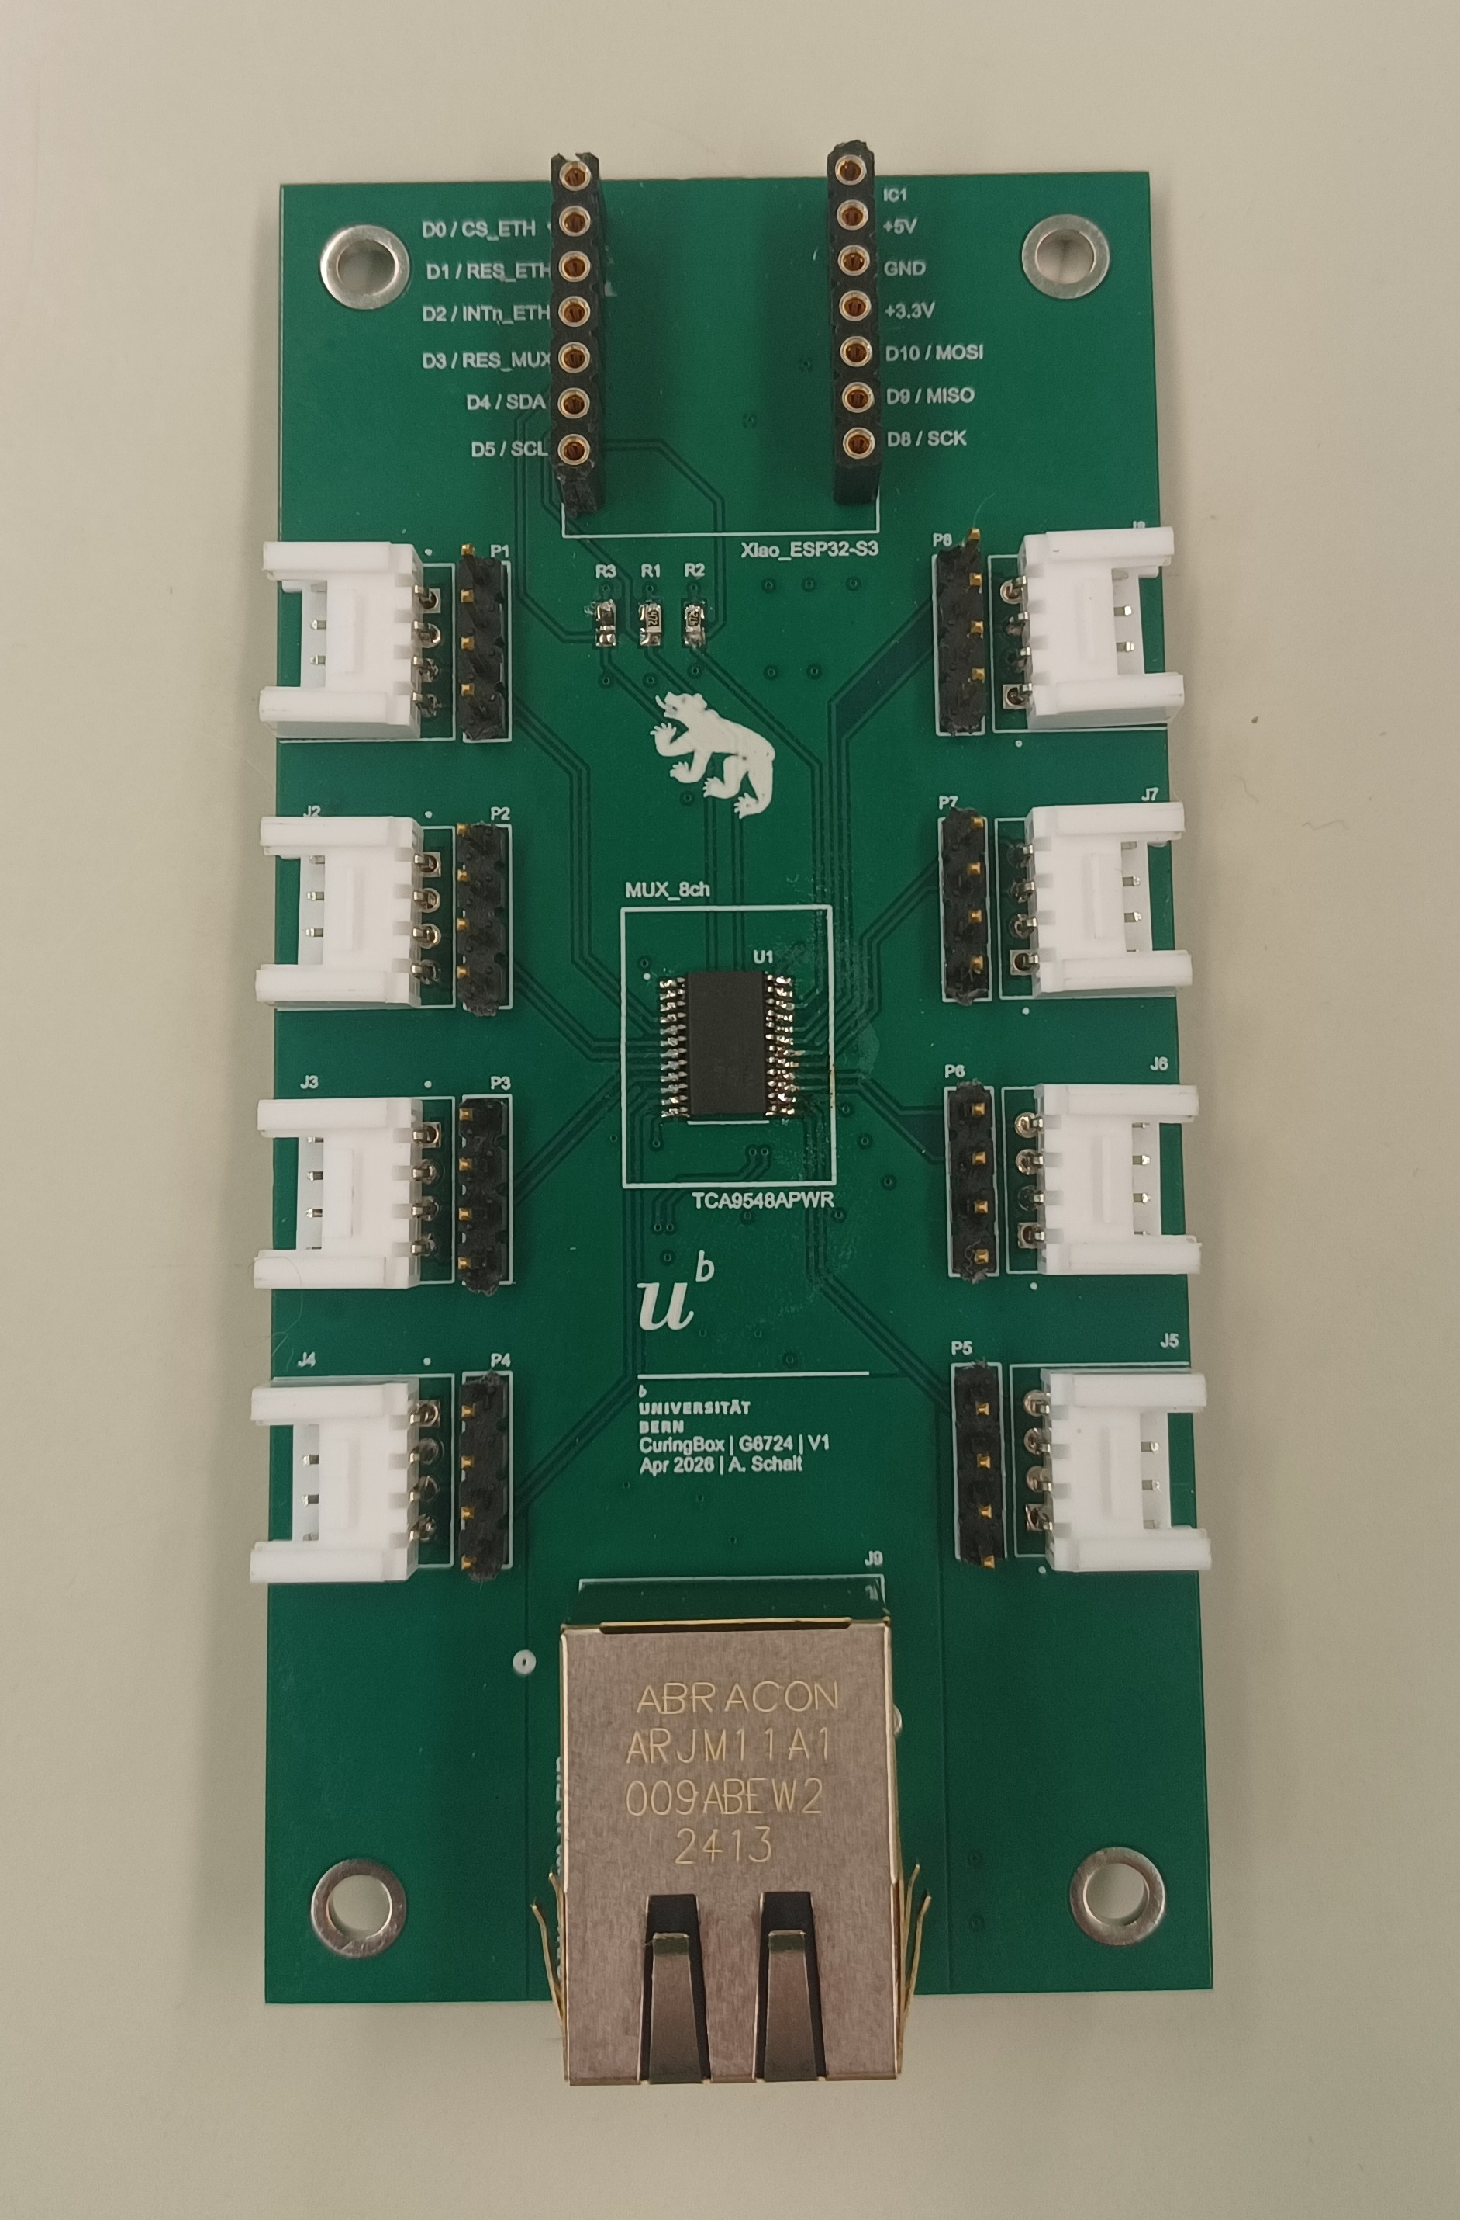
Ongoing
Creation and testing of PCBs for sensors
Coating of first ArcLight next week
SiPMs calibration
Testing of Vacuum-box for Argon Atmosphere

Slide 3
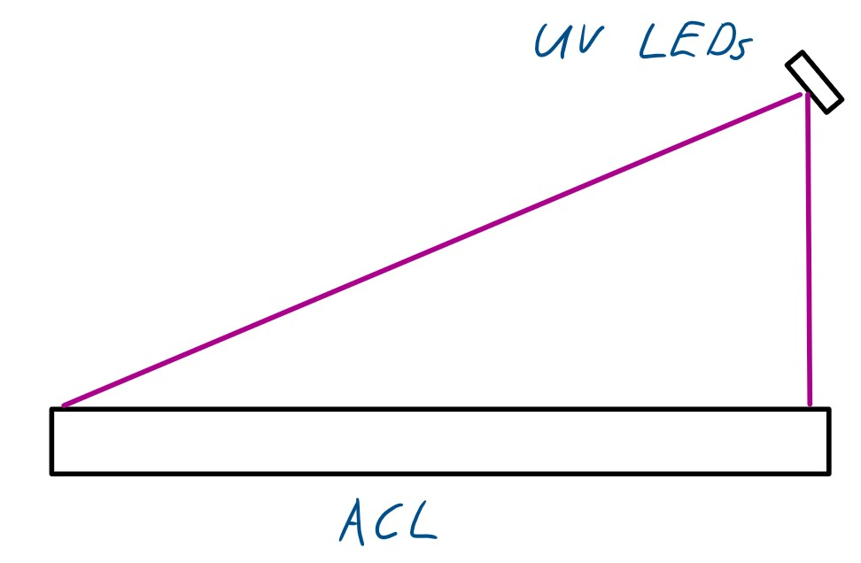
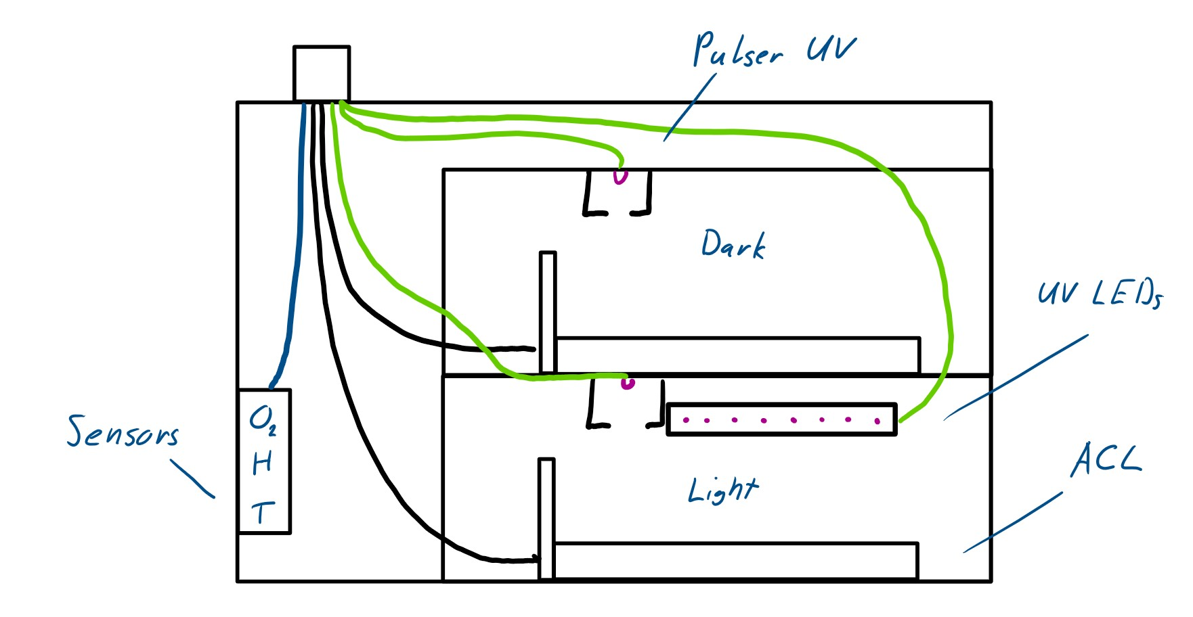
Vacuum-Box Sketches
Sketch of UV LED placement
Sketch of vacuum-box with experiment setup

Slide 4
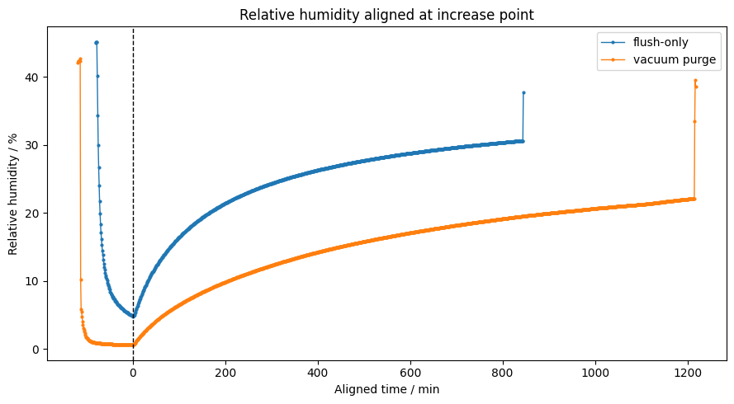
Vacuum-box humidity tests

