Slide 1
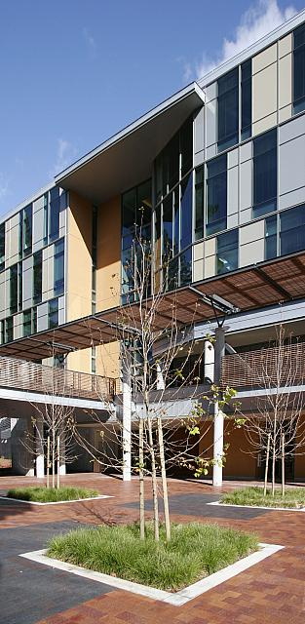

Interface Engineering for Carrier Multiplication in Amorphous Selenium Quantum Superlattices
Kaitlin Hellier
Radiological Instrumentation Laboratory
Electrical and Computer Engineering
ril.soe.ucsc.edu

Slide 2
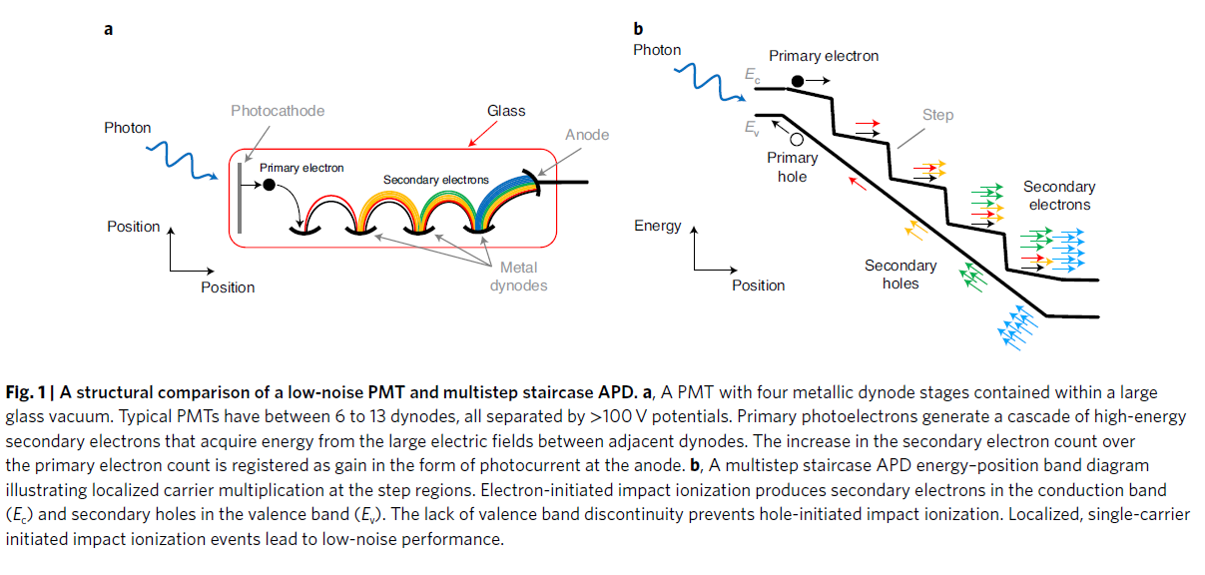
Staircase APDs: A Reference Architecture for Interface-Engineered Multiplication
S. D. March, A. H. Jones, J. C. Campbell, and S. R. Bank, “Multistep staircase avalanche photodiodes with extremely low noise and deterministic amplification,” Nat. Photonics, vol. 15, no. 6, pp. 468–474, 2021
Traditional APDs:
Staircase APDs:
Multiplication occurs throughout a high-field region
Gain is stochastic
Noise increases with gain
Multiplication occurs at engineered interfaces
Gain is stage-by-stage
Noise approaches deterministic behavior
Notes:
ig. 1 | A structural comparison of a low-noise PMt and multistep staircase APD. a, A PMT with four metallic dynode stages contained within a large glass vacuum. Typical PMTs have between 6 to 13 dynodes, all separated by >100 V potentials. Primary photoelectrons generate a cascade of high-energy secondary electrons that acquire energy from the large electric fields between adjacent dynodes. The increase in the secondary electron count over the primary electron count is registered as gain in the form of photocurrent at the anode. b, A multistep staircase APD energy–position band diagram illustrating localized carrier multiplication at the step regions. electron-initiated impact ionization produces secondary electrons in the conduction band (Ec) and secondary holes in the valence band (Ev). The lack of valence band discontinuity prevents hole-initiated impact ionization. Localized, single-carrier initiated impact ionization events lead to low-noise performance.

Slide 3
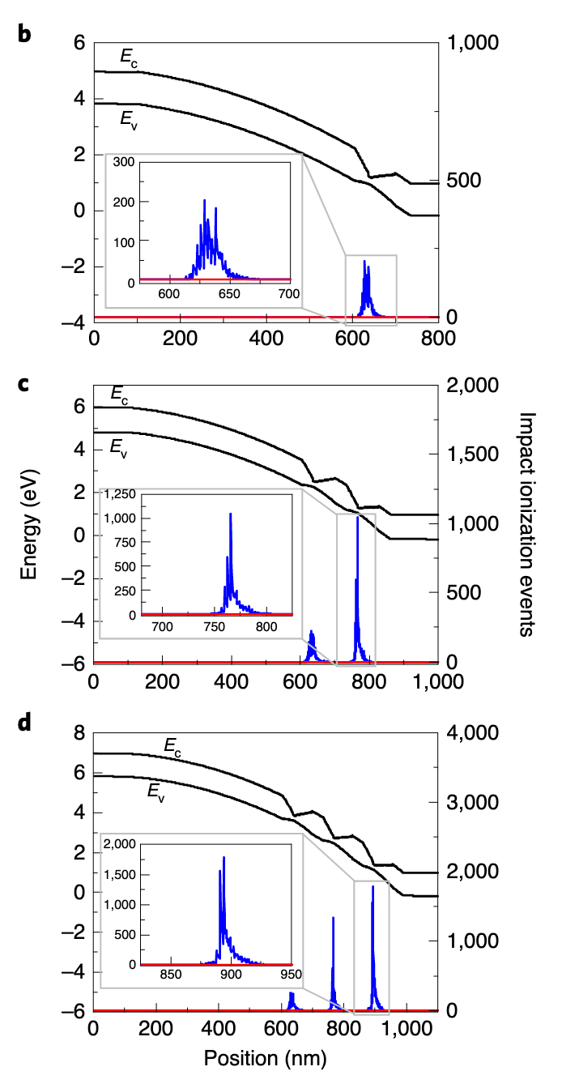
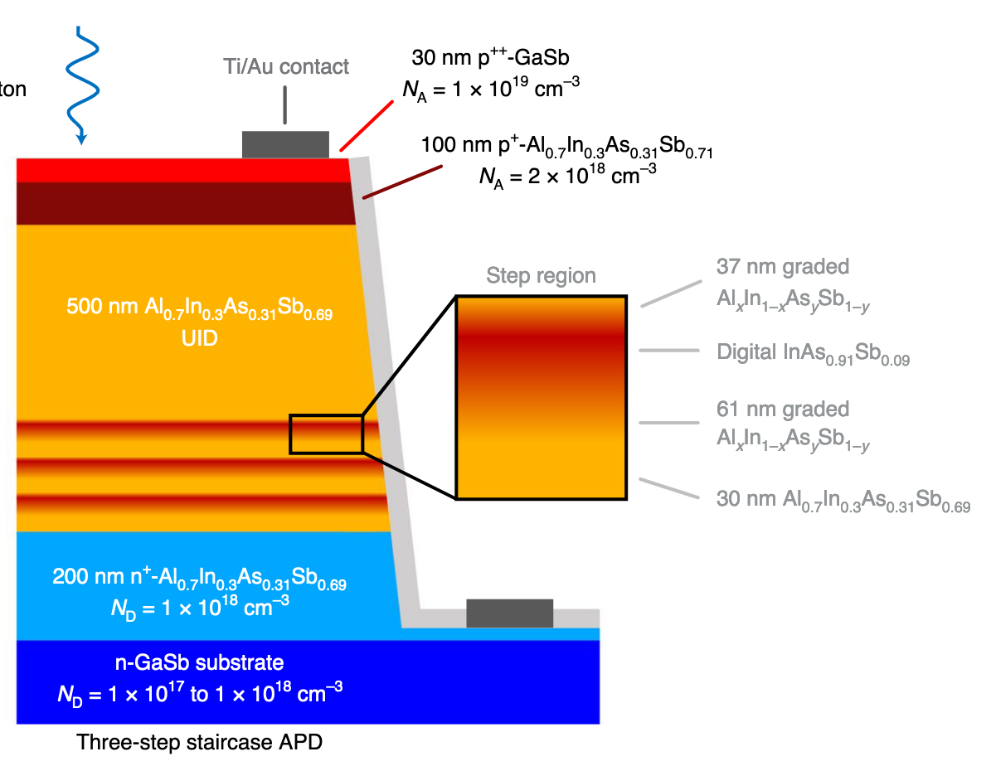
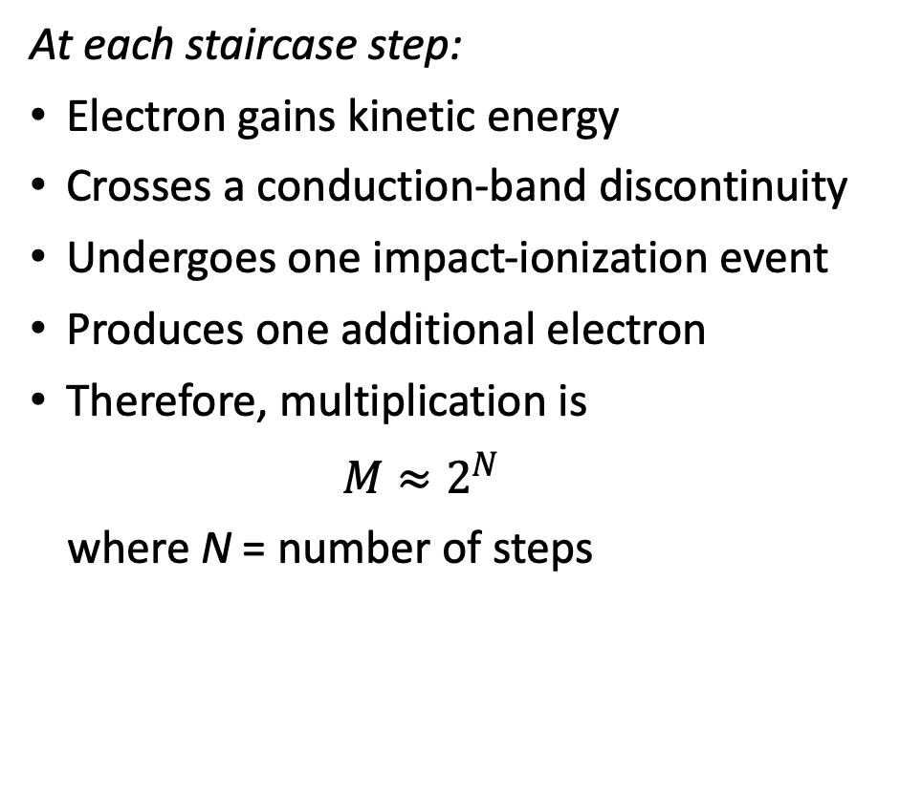
How Staircase Multiplication Works
At each staircase step:
Electron gains kinetic energy
Crosses a conduction-band discontinuity
Undergoes one impact-ionization event
Produces one additional electron
Therefore, multiplication is
  $$M≈2^{N}$$
where N = number of steps
b–d, Simulated bandstructures for one- (b), two- (c) and three-step (d) AlInAsSb staircase APDs operating at −4, −5 and −6 V, respectively, to produce ~2N gain. Modelled impact ionization events initiated by electrons (blue) and holes (red) indicate that electron-only initated impact ionization events dominate and are localized in the step regions.
One-step
Two-step
Three-step
Notes:
impact ionization only at interfaces
electron-only multiplication
localization of multiplication events
Connection to Se superlattices: engineer interfaces rather than bulk material

Slide 4
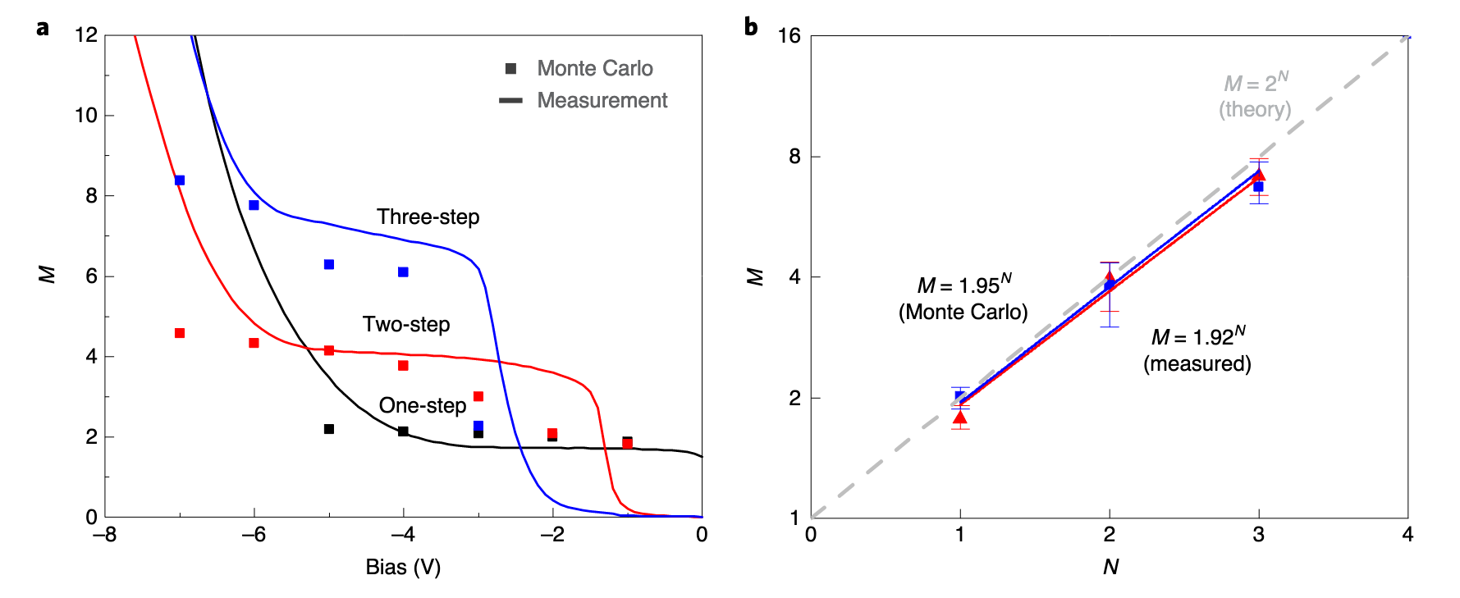
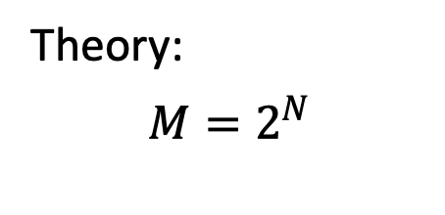
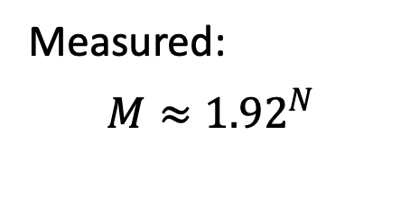
Deterministic Gain Scaling
Measured gains:
Steps | Gain
1 | 1.77
2 | 3.97
3 | 7.14
Theory:
$$M=2^{N}$$
Measured:
$$M≈{1.92}^{N}$$

Slide 5
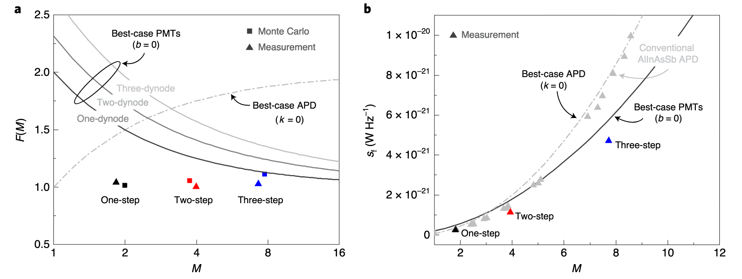
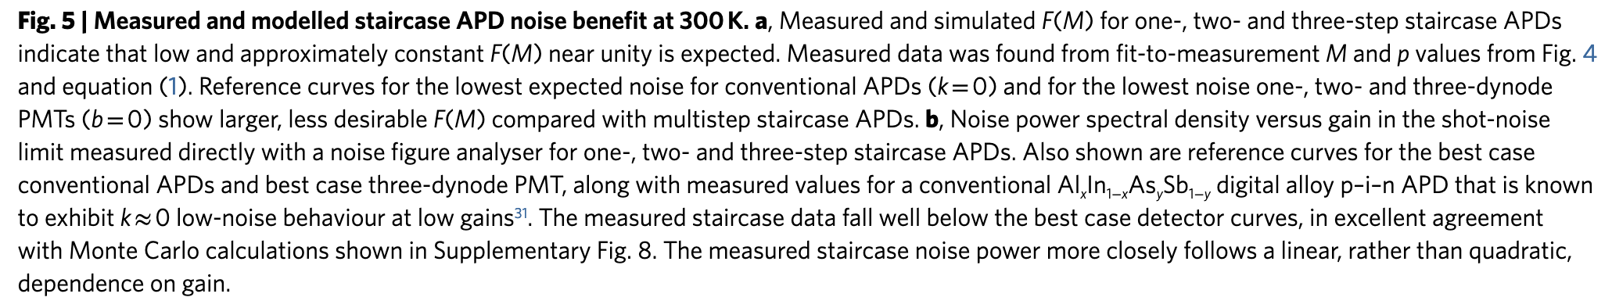
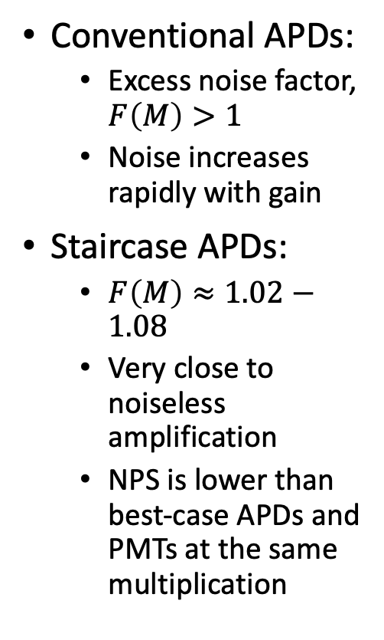
Near-Deterministic Multiplication
Conventional APDs:
  Excess noise factor, $F\left(M\right)>1$
  Noise increases rapidly with gain
Staircase APDs:
  $F\left(M\right)≈1.02−1.08$
  Very close to noiseless amplification
  NPS is lower than best-case APDs and PMTs at the same multiplication
Notes:
Staircase APDs demonstrate that carefully engineered multilayers can fundamentally change multiplication physics.

Slide 6
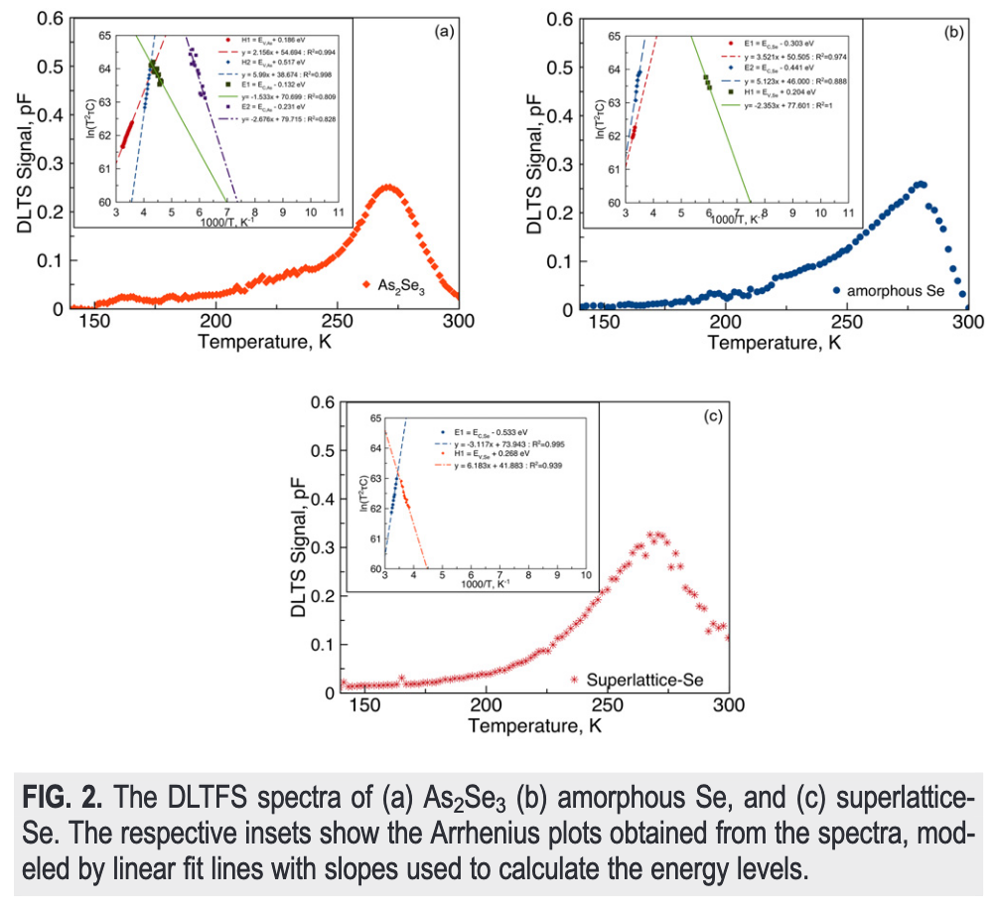
Observation of Two-Level Defect System in Amorphous Se Superlattices
Appl. Phys. Lett., vol. 116, no. 19, p. 192104, 2020
a-Se and As₂S_{e}3 superlattices studied for potential superlattice devices
Performed DLTFS on individual materials and superlattice
Individual materials have multiple defect energy levels, but when combined, periodic structure reorganizes defects into miniband-like states:
  electron miniband, E_{c} − 0.533 eV
  hole miniband, E_{v} + 0.269 eV

Slide 7
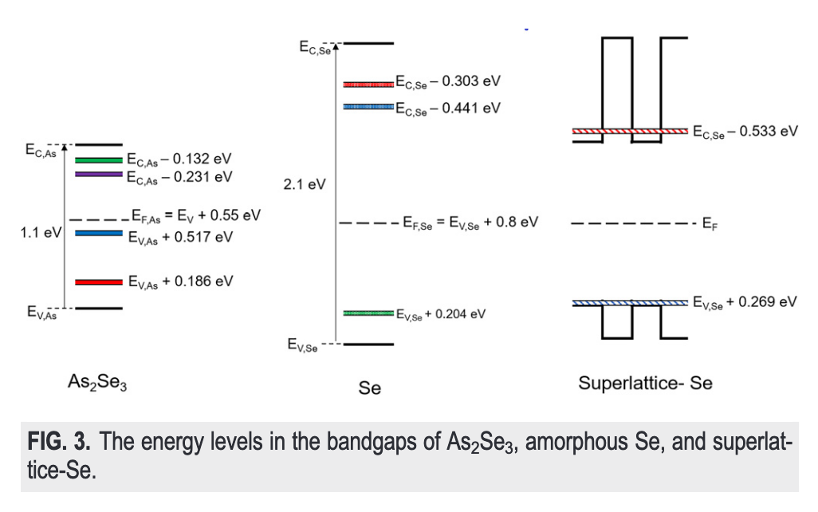
Observation of Two-Level Defect System in Amorphous Se Superlattices
Appl. Phys. Lett., vol. 116, no. 19, p. 192104, 2020
a-Se and As₂S_{e}3 superlattices studied for potential superlattice devices
Performed DLTFS on individual materials and superlattice
Individual materials have multiple defect energy levels, but when combined, periodic structure reorganizes defects into miniband-like states:
  electron miniband, E_{c} − 0.533 eV
  hole miniband, E_{v} + 0.269 eV
→ These become the transport channels for the superlattice

Slide 8
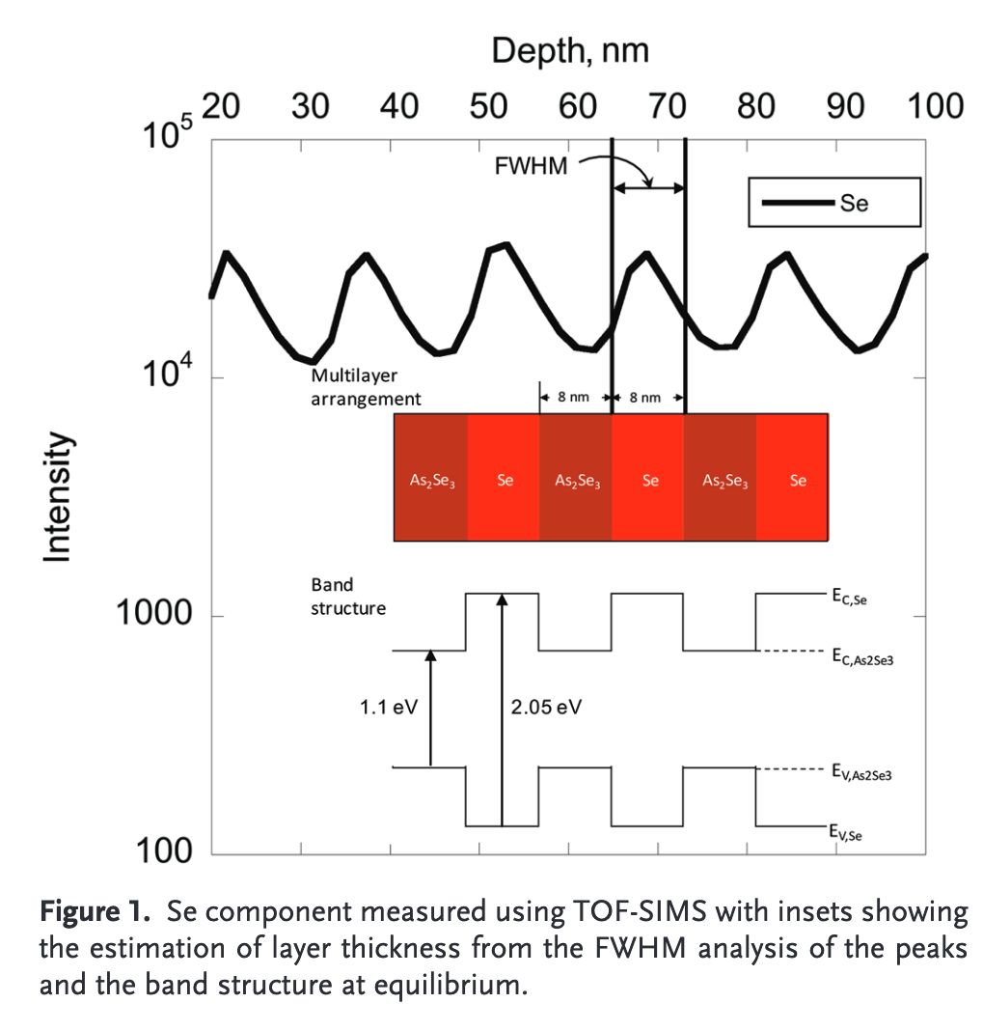
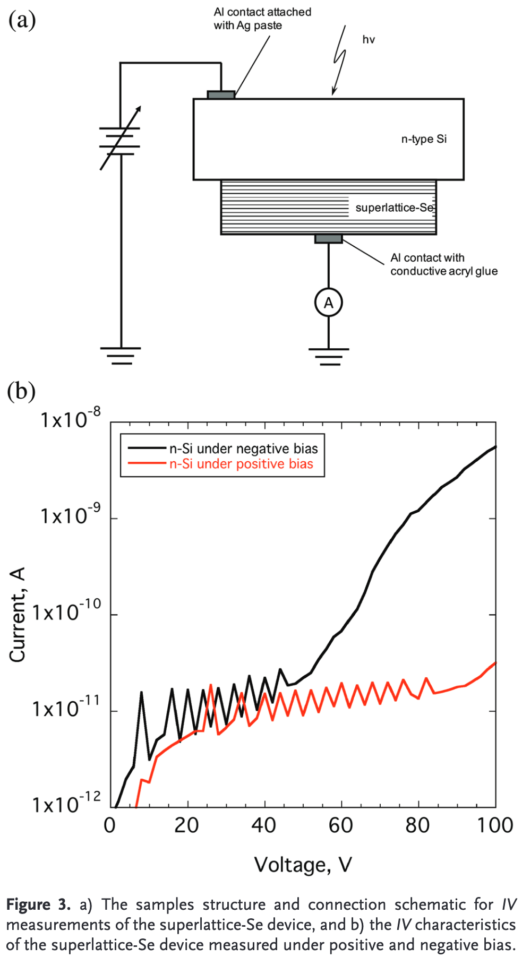
Transport Properties of Se/As₂Se₃ Nanolayer Superlattice
Advanced Functional Materials, vol. 29, no. 40, p. 1904758, 2019
Notes:
TOF-SIMs shows periodic response, indicating nanolayer structure on order of deposited layer thicknesses
See oscillatory I–V curves with increasing response only in one bias direction
See sequential tunneling behavior
Attributed to transport occurring through minibands, quantum wells, or field-induced tunneling

Slide 9
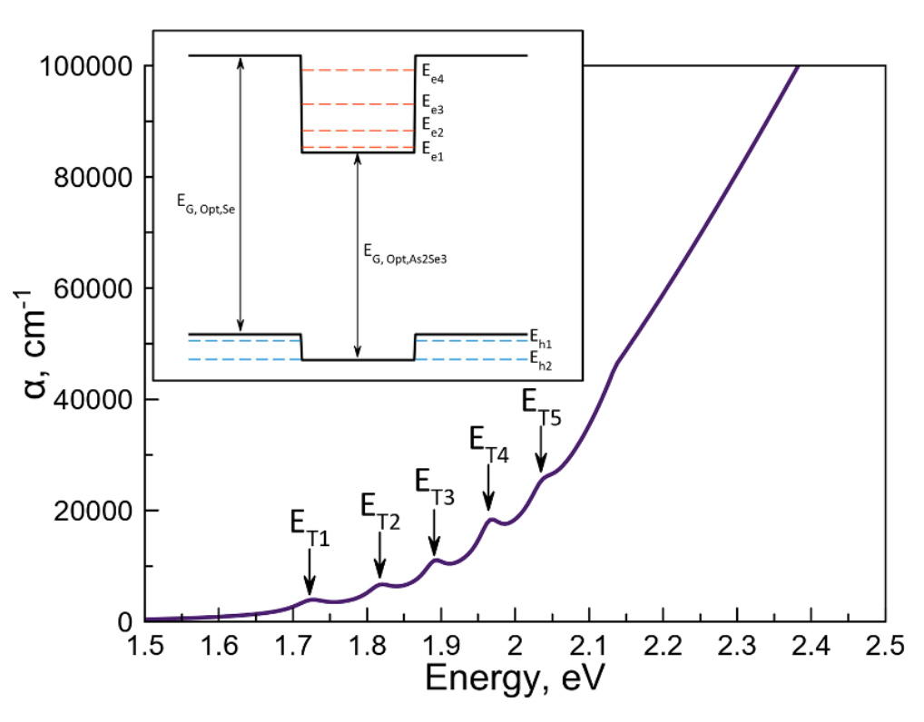
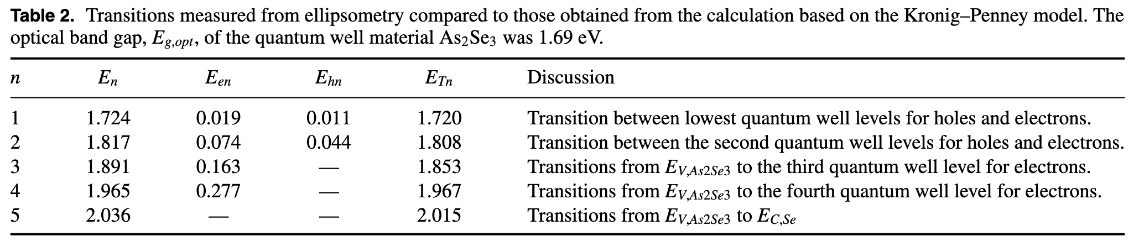
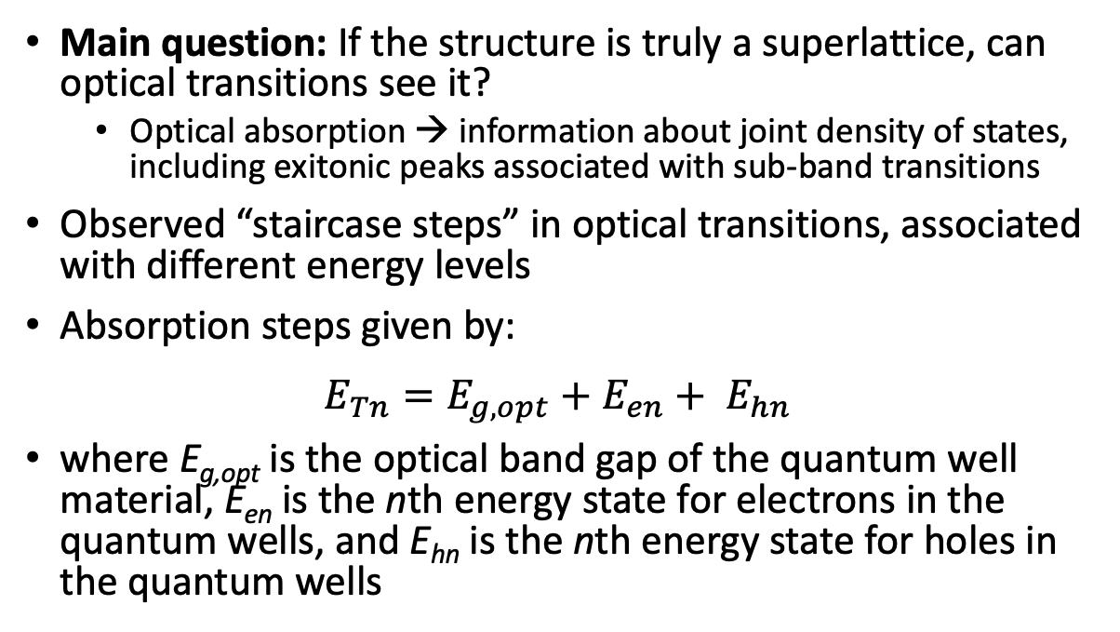
Spectroscopic Ellipsometry of Amorphous Se Superlattices
J. Phys. D: Appl. Phys., vol. 54, no. 25, p. 255106, 2021
Main question: If the structure is truly a superlattice, can optical transitions see it?
  Optical absorption → information about joint density of states, including exitonic peaks associated with sub-band transitions
Observed “staircase steps” in optical transitions, associated with different energy levels
Absorption steps given by:
$$E_{Tn}=E_{g,opt}+E_{en}+ E_{hn}$$
where E_{g,opt} is the optical band gap of the quantum well material, E_{en} is the nth energy state for electrons in the quantum wells, and E_{hn} is the nth energy state for holes in the quantum wells
Notes:
Thus by measuring the optical properties, the nature of the joint density of states can be determined, possibly confirming the superlattice structure of rotationally evaporated Se and As2Se3 superlattices. Spectroscopic ellipsometry provides an accurate, non-destructive method for evaluating the optical properties of layered semiconductor structures [12]. The method has been successfully applied to superlattice structures, showing excitonic peaks associated with sub-band transitions, and also reliably evaluating the quality of superlattice structures from different deposition conditions [13, 14].

Slide 10
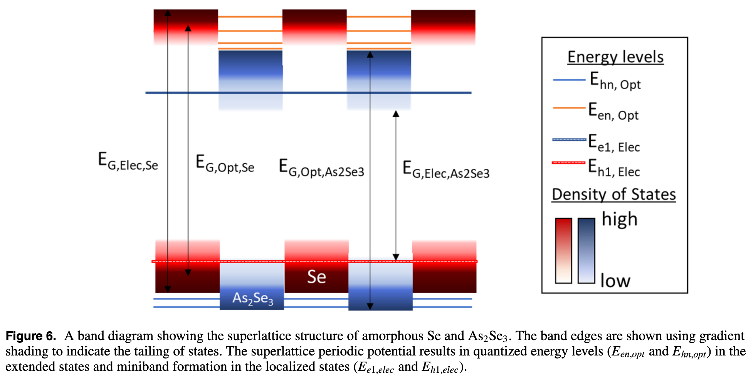
Spectroscopic Ellipsometry of Amorphous Se Superlattices
J. Phys. D: Appl. Phys., vol. 54, no. 25, p. 255106, 2021

Slide 11
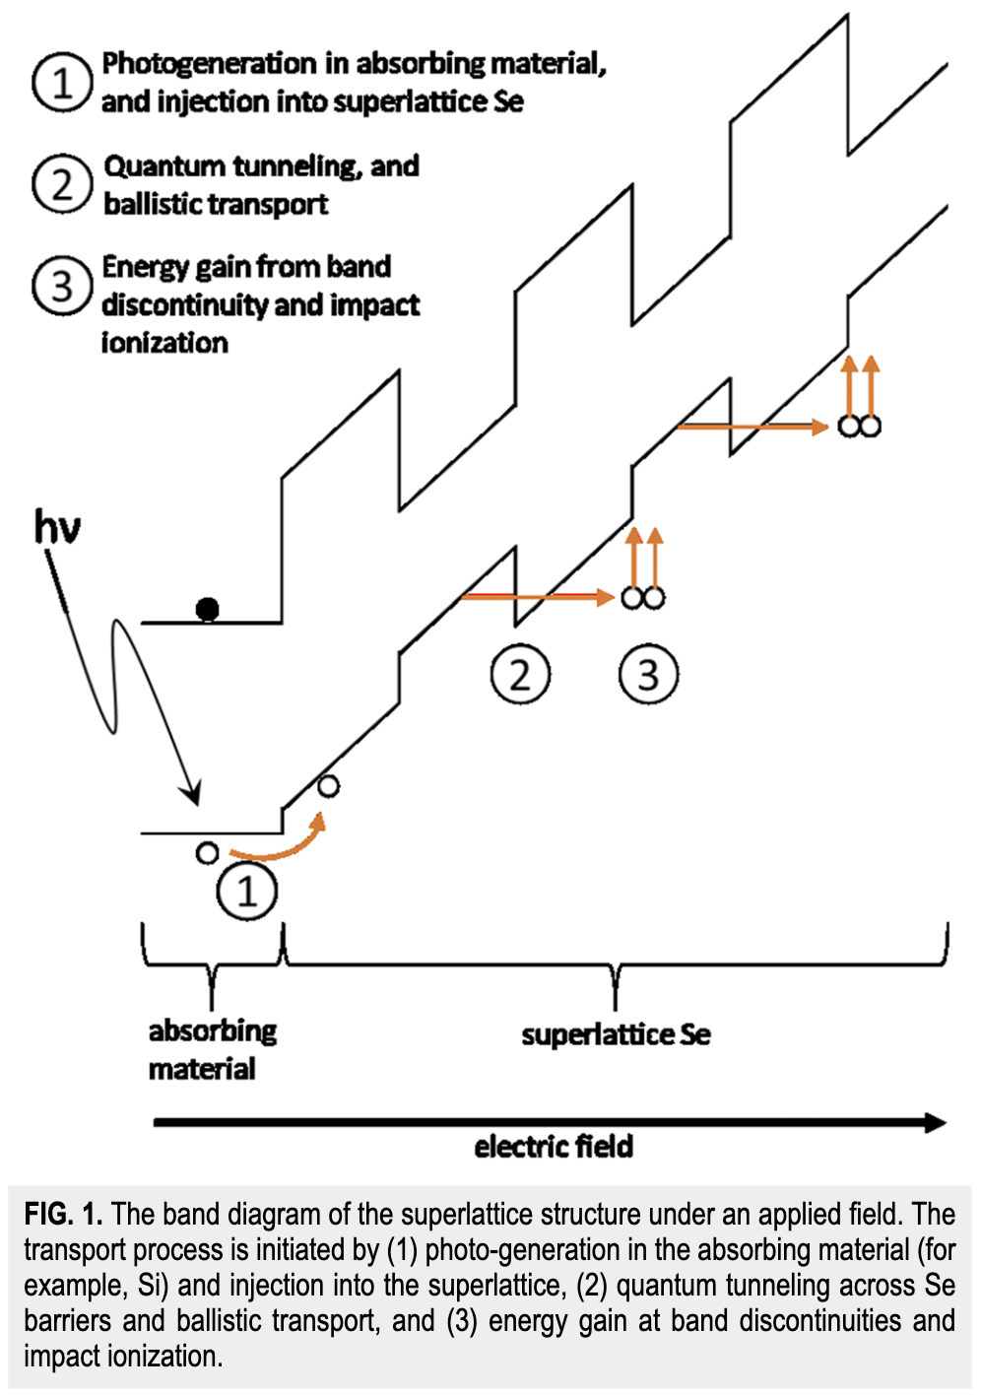
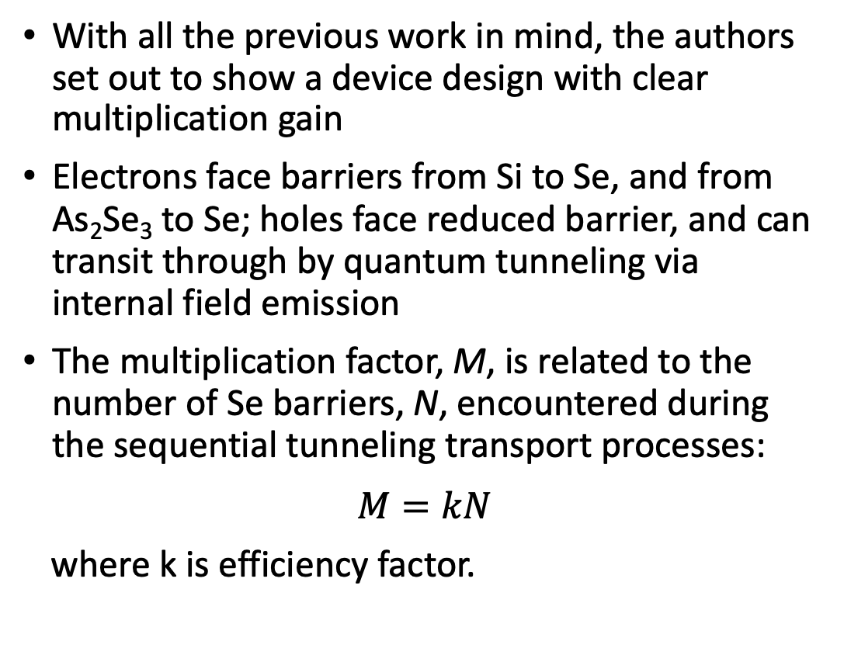
Quantum device designing (QDD) for future semiconductor engineering
Rev. Sci. Instrum., vol. 93, no. 3, p. 034703, 2022
With all the previous work in mind, the authors set out to show a device design with clear multiplication gain
Electrons face barriers from Si to Se, and from As₂Se₃ to Se; holes face reduced barrier, and can transit through by quantum tunneling via internal field emission
The multiplication factor, M, is related to the number of Se barriers, N, encountered during the sequential tunneling transport processes:
$$M=kN$$
where k is efficiency factor.
Notes:
Note, from the authors:
“For noise blocking, this material must either (1) have a narrow bandgap such that its Fermi level aligning with that of Se leaves a sufficiently high barrier to block the electrons entering the superlattice or (2) be n-doped so that the Fermi level once again aligns, leaving a high barrier for electrons. In both cases, a necessary condition is that the first layer of the superlattice, which interfaces with the absorbing material, must be Se to obtain electron blocking and hole injection.”

Slide 12
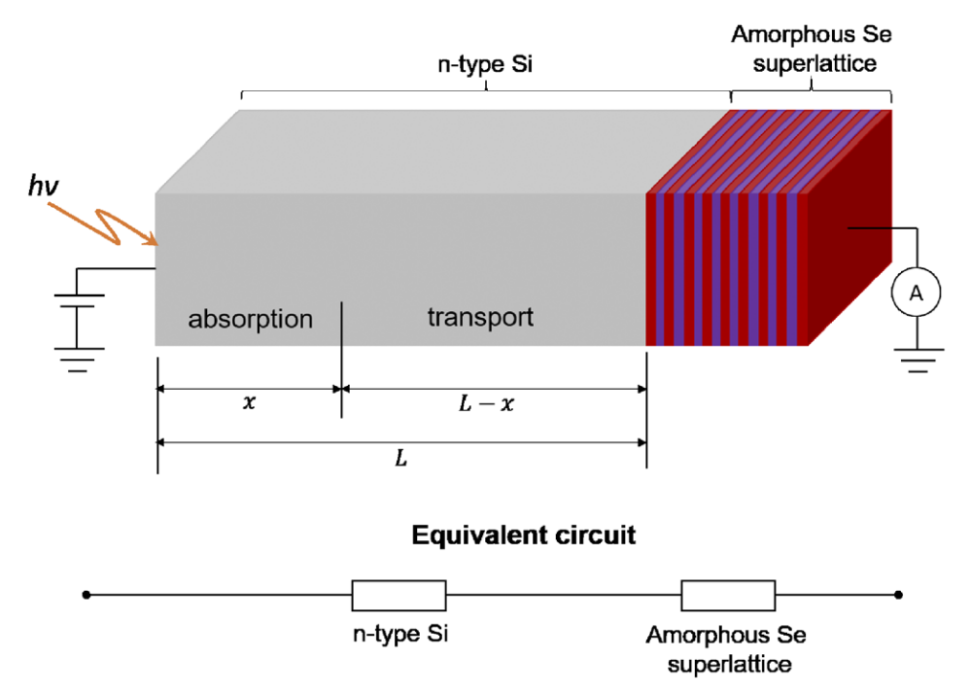
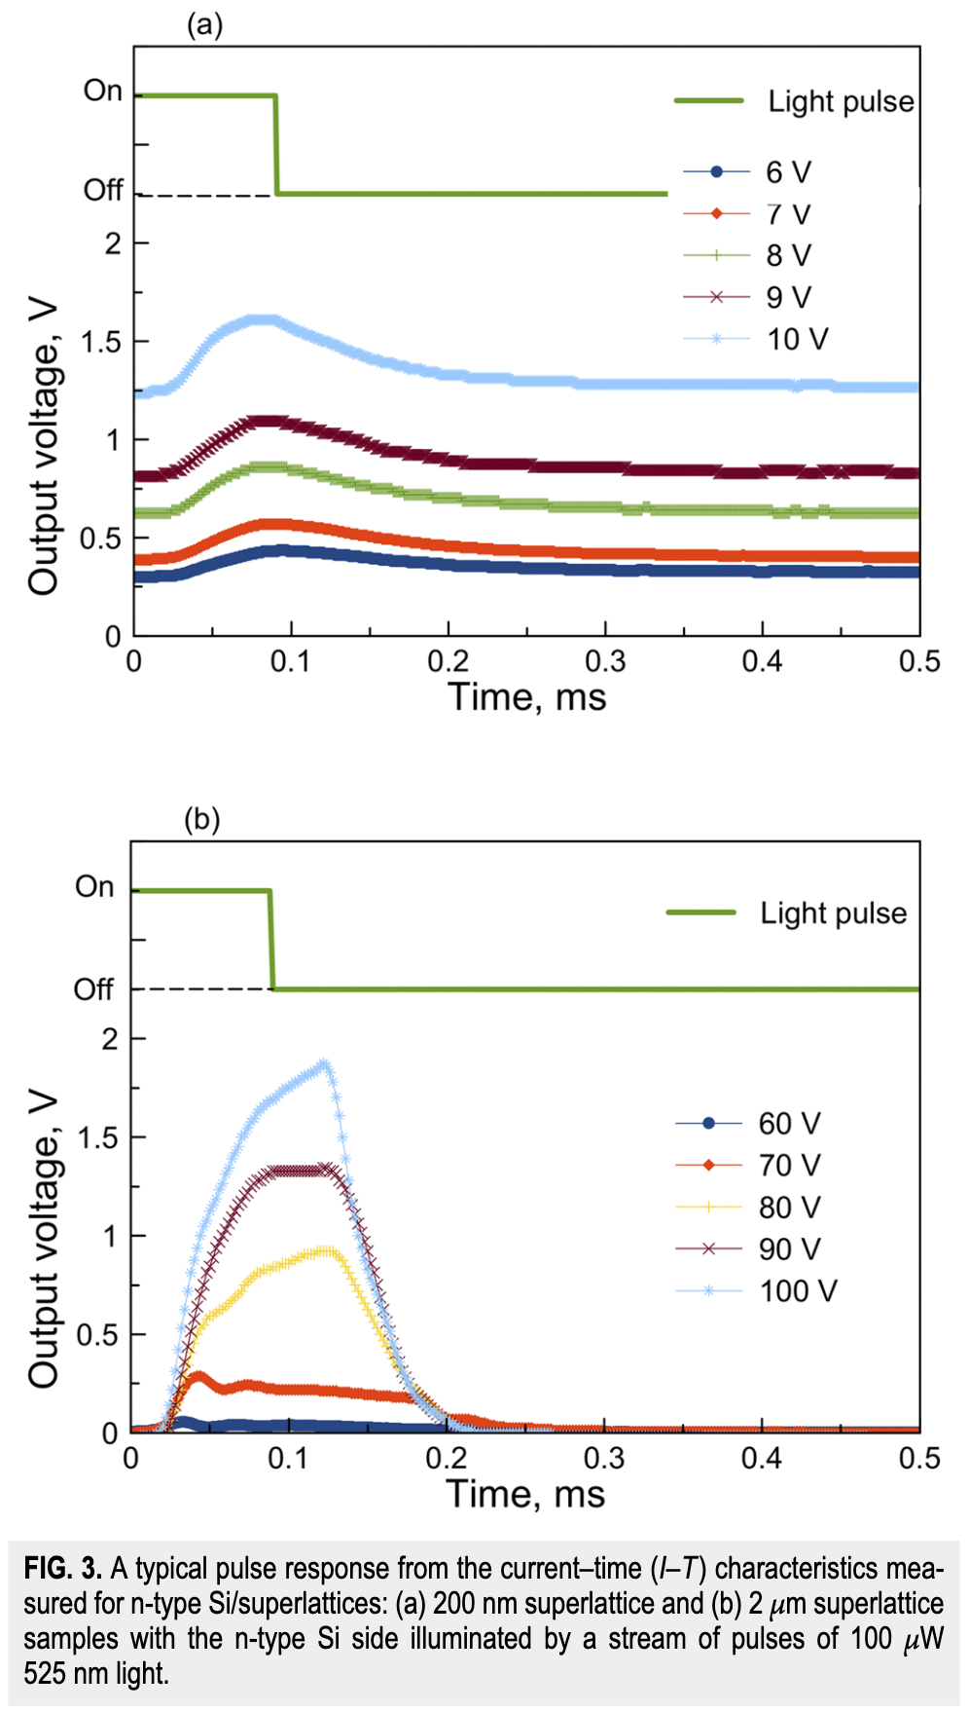
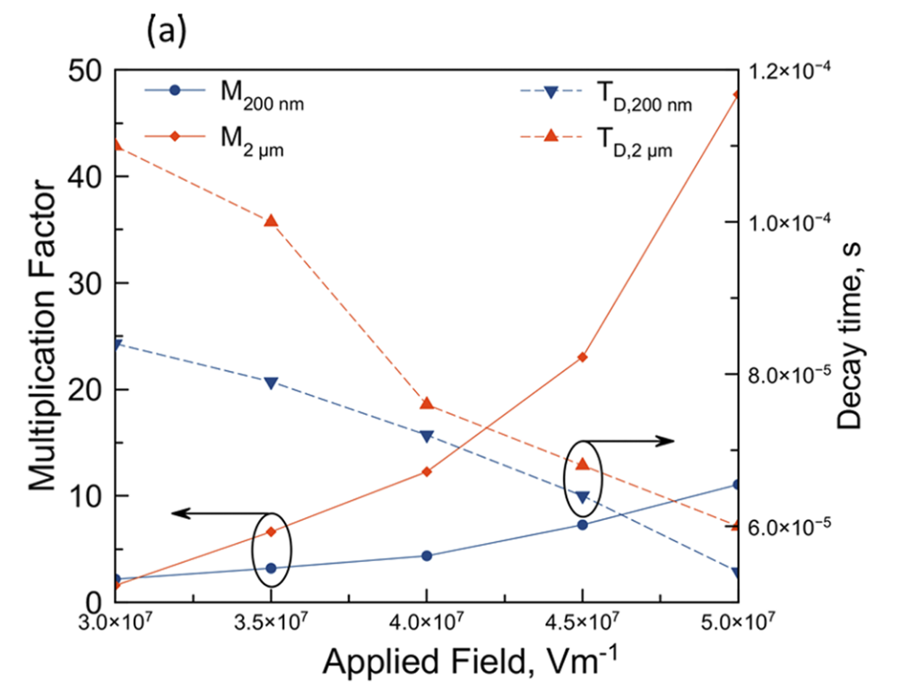
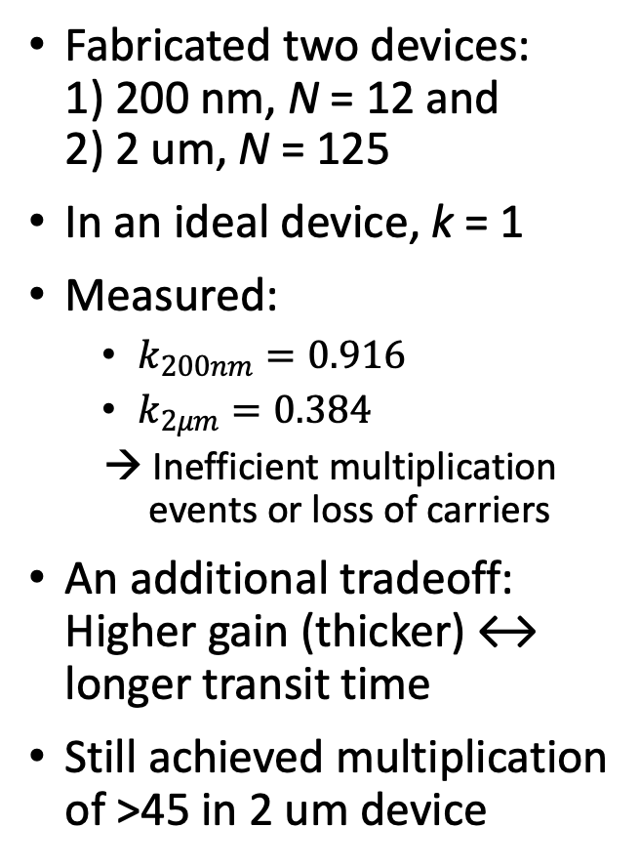
Quantum device designing (QDD) for future semiconductor engineering
Rev. Sci. Instrum., vol. 93, no. 3, p. 034703, 2022
200 nm
Fabricated two devices: 1) 200 nm, N = 12 and 2) 2 um, N = 125
In an ideal device, k = 1
Measured:
  $k_{200nm}=0.916$
  $k_{2μm}=0.384$
  → Inefficient multiplication events or loss of carriers
An additional tradeoff: Higher gain (thicker) ↔ longer transit time
Still achieved multiplication of >45 in 2 um device
2 um

Slide 13
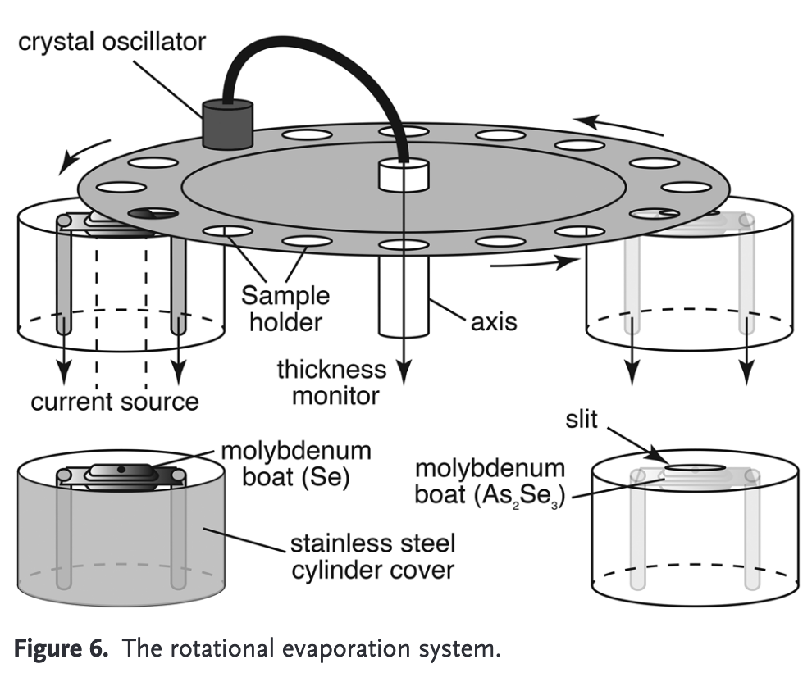
Developing a-Se superlattices in RIL
Okano Lab
Abbaszadeh Lab
Sample rotation:
40 RPM
Sample
High-speed Shutter
Source 2
Source 1
Source 2:
As, Te, Ge
Source 1:
Se

Slide 14
Developing a-Se superlattices in RIL
Initial Test:
a-Se
a-Se
Se₇Te₃
Se₇Te₃
N layers of 10 nm each Se/ Se₇Te₃
  N = 5, 10, 20
Se deposited at rate of 2 Å/s
Te deposited at 0.6 Å/s
Te Shutter opens/closes every 10 nm
→ High level of control in deposition
E_{g} ~ 2 eV
E_{g} ~ 1.4 eV
First Measurements:
Absorption – UV/Vis, photothermal deflection spectroscopy (PDS), ellipsometry
    Superlattice only
Send for TOF-SIMS, DLTS, XPS
    Individual layers, superlattice
  → Will tell us if we can create superlattice structures
…
N Se/Se-Te layers
Glass/ITO

