Slide 1
LBNL LDRD Proposal: Future Instrumentation for Future Colliders
Carl Haber¹ and Tao Yang - Physics Division
Eric Anderssen¹, Todd Clayburgh, and Giorgio Vallone - Engineering Division
co-PI’s
1

Slide 2
Future Colliders for HEP and Berkeley Lab
LDRD is a discretionary process within the national labs to seed new developments in areas which are not yet programmatic
Based upon a %$ tax on grants
Competitive, can be thematic at management’s perogative
FY funded, proposals in Feb-April, decisions in Summer
Up to 3 years but often 2
Propose an R&D effort aimed at precision tracking/timing at a future Higgs Factory

Slide 3
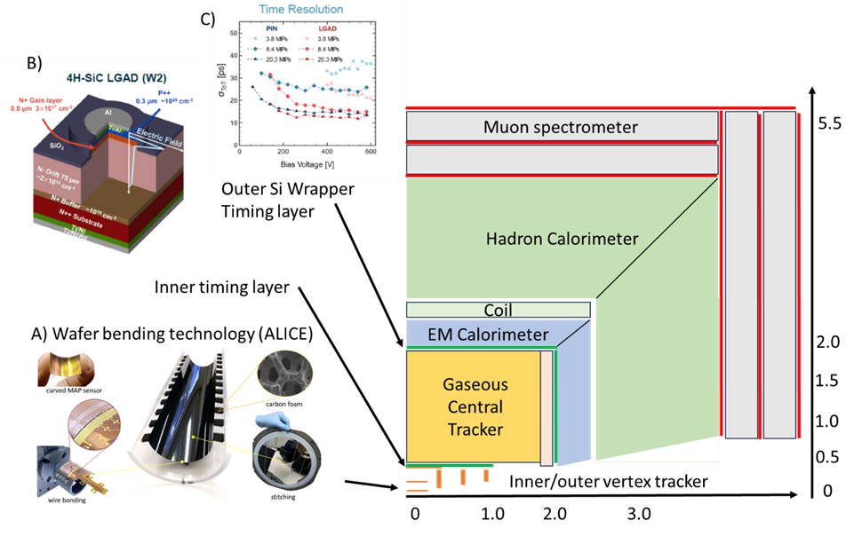
Tracking Requirements for Higgs Factory Collider Detector
Inner vertex with high spatial resolution
MAPS (monolithic active pixel sensor)
Extremely low mass
Thinned sensors and readout
Minimal cooling mass
Gaseous central tracker
Moderate rate
Drift or straw tubes (not TPC)
Particle identification
dE/dx over a wide momentum range using custom FE ASIC
Time of Flight (TOF) at low pT ~ 1 GeV/c, using Low Gain Avalanche Detectors (LGADs)
Timing layers

Slide 4
LBNL Leverage
Strong Engineering Division capabilities in low mass composite mechanics and ASIC design
B77a Composites Facility
ASIC design group
Several past Physical Science Area LDRDs, which all yielded new funding, are directly relevant
Multi-modular structures 2009-10
Precision low mass mechanics 2014-15
Optical metrology 2016-17
Silicon Carbide LGADs (SiC-LGAD) 2021-22
SiC LGADs are a promising approach to fast timing with minimal cooling mass
Ongoing collaboration with North Carolina State University (leading wide band gap expertise) and BNL, on the development of wide band gap LGADs for fast timing
Physics Division LGAD testing lab

Slide 5
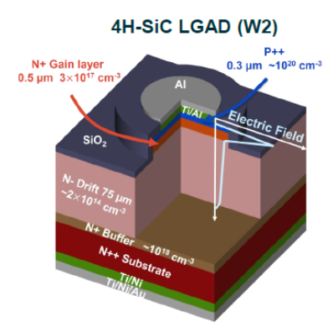
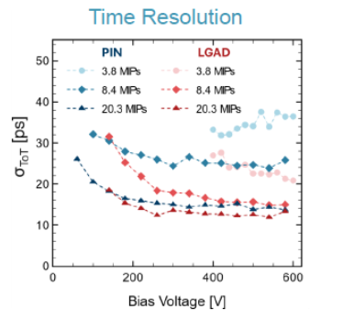
Target of Opportunity
Baseline detector designs call of a fast timing “wrapper” layer at R= 2m to catch ~1 GeV particles which are not well measured by dE/dx (ionization loss gap), t_res ~100 ps
But for high resolution tracking the B field may result in a cutoff > 1 GeV at 2m
Solution is a low mass inner timing layer at R=0.5 m but t_res ~20 ps
At LBNL/NCSU/BNL have developed wide-band-gap Silicon Carbide LGADs
WBG/SiC = high temperature operation and very fast response
If implemented in a low mass layer with passive cooling and appropriate high temperature electronics this could be a great solution to an INNER FAST TIMING LAYER

Slide 6
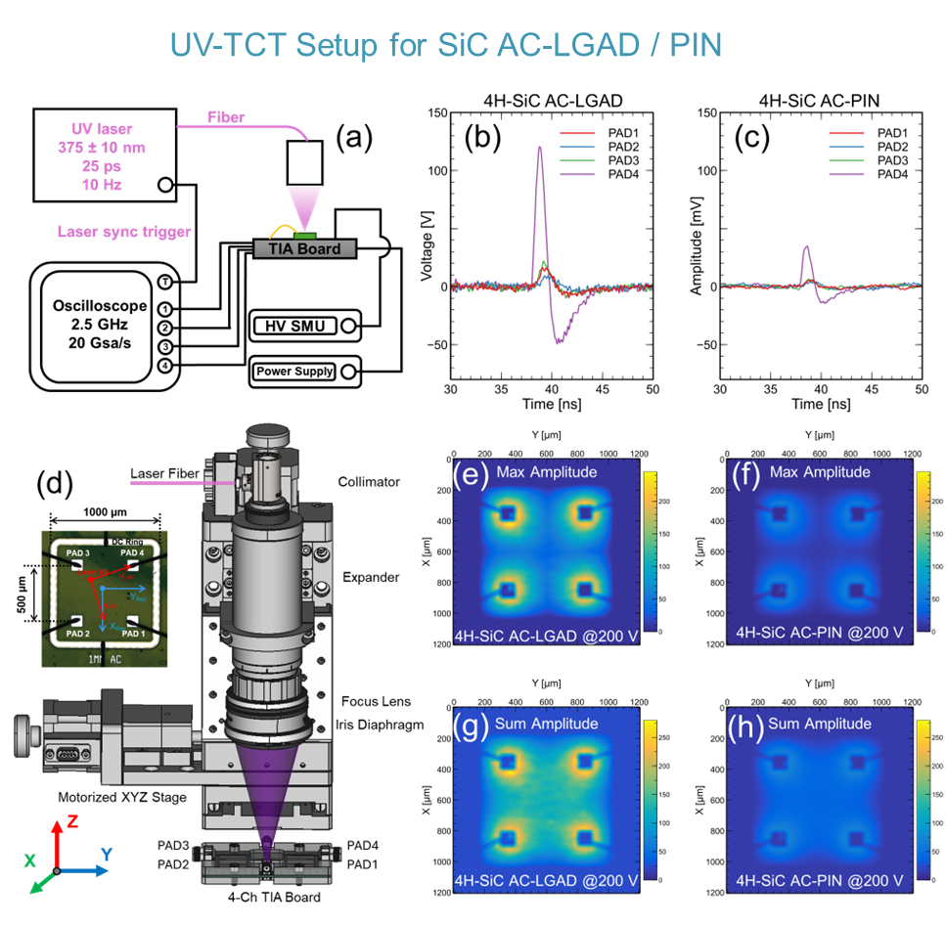

Slide 7
Technical Challenges
The development of SiC-LGAD is funded by DOE HEP Detector R&D and ECA as a generical development
Substantial progress to achieve higher breakdown voltages and full depletion
AC SiC-LGADs – optimization of position reconstruction
A system which runs at RT+ would also require high temperature tolerant front end readout electronics
Emerging WBG (SiC or GaN) ASIC processes could be a possible solution
Present process cannot provide required bandwidth – like Si 30y ago
Example circuits designed at OAW/HEPHY Vienna (see presentation in last BNL tracking workshop)
Mount effort in the US to study these emerging processes

Slide 8
Technical Challenges - continued
How do we handle extremely thin (~50 micron) semiconductors?
What sort of carbon support structures are appropriate?
How can we integrate mechanical/thermal/electrical functions in the most efficient and low mass way?
Tools to simulate stress and fracture in very thin semiconductors.
ATLAS ITk experience shows importance of detailed thermo-mechanical simulation of composite structures across ΔT, thin and possibly “warm” structures are a new area to understand
Novel carbon based materials – ie, electrical conductors

Slide 9
LDRD Year 1 Proposal
We propose to focus on low mass and fast timing technologies
Leverages experience, facilities, and past LDRD and project investments
Eventual focus is an inner fast timing layer with only passive cooling by combining our SiC-LGADs with WBG ASICs and ultrathin supports
Manipulation of extremely thin semiconductors and carbon materials
Layout and design of a high performance inner fast timing/tracking layer
Emerging ASIC design using wide band gap WBG (SiC and GaN) processes to complement our SiC-LGAD effort
Simulation of extremely thin composite structures including thermal effects
Low mass electronic transmission lines in carbon nanotubes
A second year would extend the prototyping of mechanical structure and include a fabrication of wide band gap ASIC

Slide 10
Work Plan Year 1
Manipulation of extremely thin semiconductors and carbon materials
Procure materials, design and prototype tooling for thinning, bending, and support
Layout and design of a high performance inner fast timing layer
First pass engineering design of an inner support layer including services, consistent with full detector concept
Emerging ASIC design using wide band gap (SiC and GaN) processes
Survey emerging processes, acquire s/w toolkit, design and layout of transimpedance amp and/or TDC
In consultation with our NC State collaborators
Simulation of extremely thin composite structures including thermal effects
Low mass electronic transmission lines in carbon nanotubes
Design study

Slide 11
Backup

Slide 13
Why These Choices?
Manipulation of extremely thin semiconductors and carbon materials
State-of-the-Art is 50 um silicon bent into a circular profile, we need to gain experience with these materials and methods
Thinning of non-silicon materials
Layout and design of a high performance inner fast timing layer
Baseline designs call of a timing layer at R= 2m, but B field makes this inefficient for ~1 GeV tracks. Can we design a very low mass inner timing layer (R~<0.5 m), with higher timing resolution?
Emerging ASIC design using wide band gap (WBG) (SiC and GaN) processes
WBG devices can run hot - no cooling?, can we develop readout electronics for SiC-LGADs in an emerging WBG process?

Slide 14
Why These Choices - continued
4. Simulation of extremely thin composite structures including thermal effects
ATLAS ITk experience shows importance of detailed thermo-mechanical simulation of composite structures across T, thin and possibly “warm” structures are a new area to understand
5. Low mass electronic carbon nanotube transmission lines
A new approach to low mass data transmission, may also contribute to mechanical support, no one is doing this yet…

