Slide 1
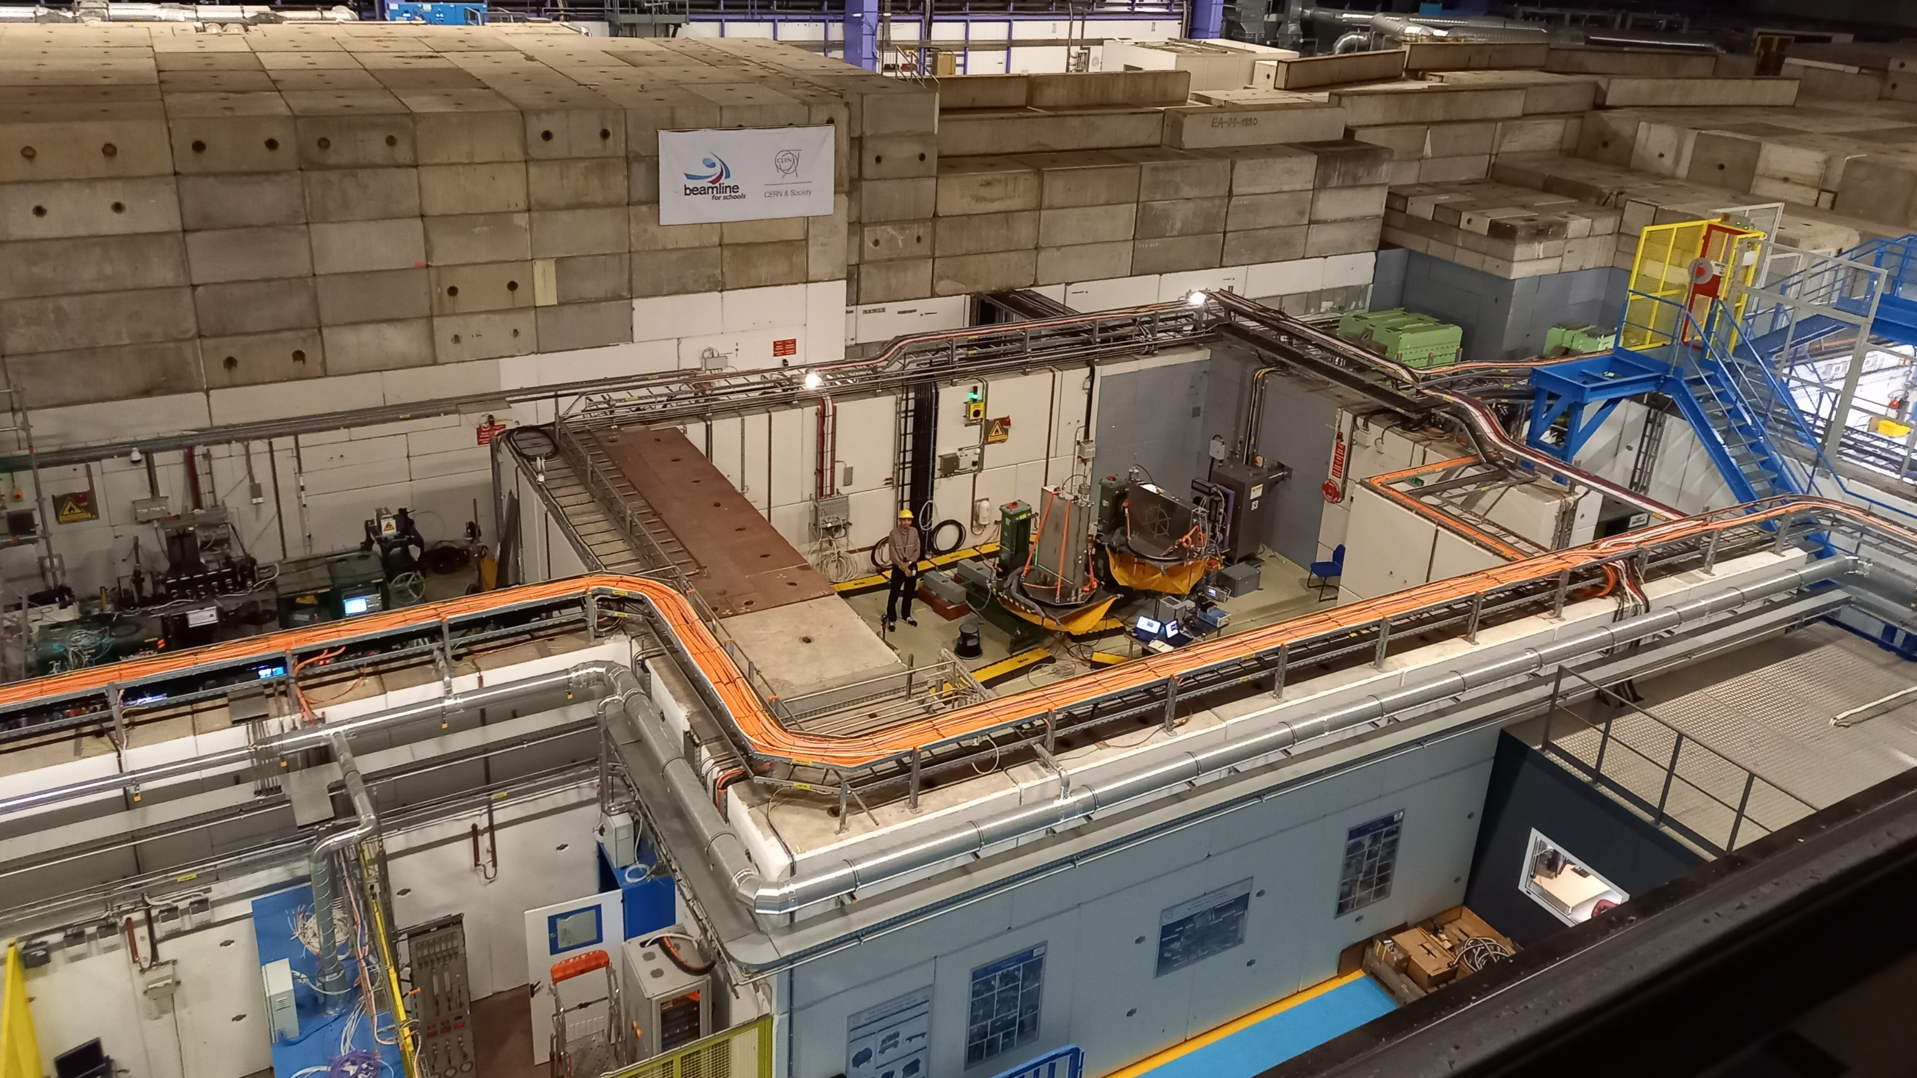

SiPM Signal Reconstruction for Background Tagging in SHiP
Anne Sophie Müller
anne.mueller1@email.uni-freiburg.de
Physikalisches Institut, Albert-Ludwigs-Universität Freiburg
08.05.2026

Slide 2

SHiP Experiment

Slide 3
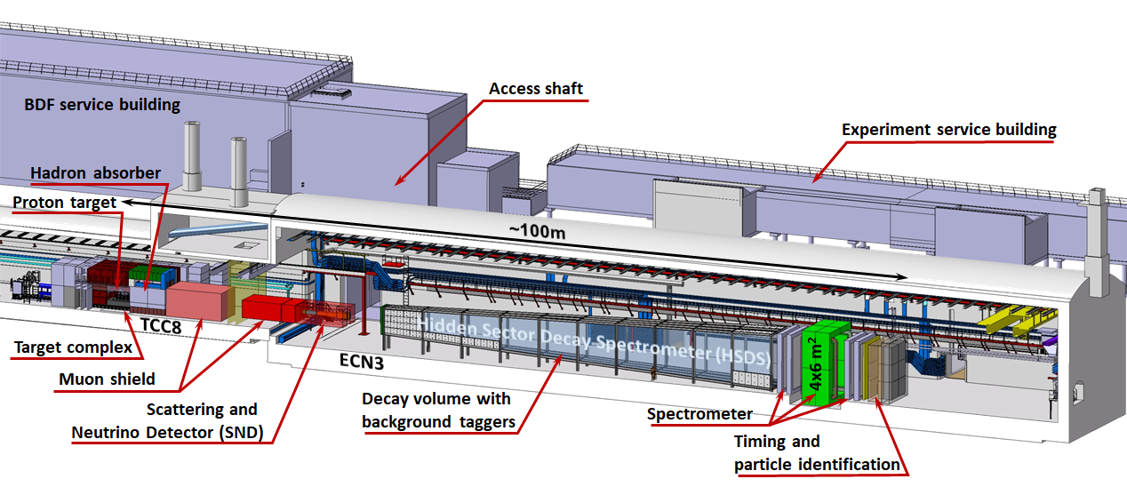
SHiP Experiment

Slide 4
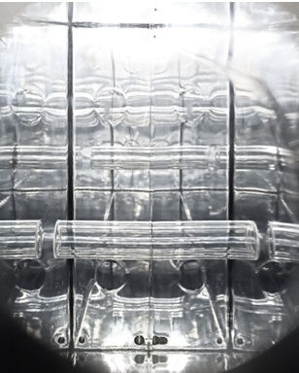
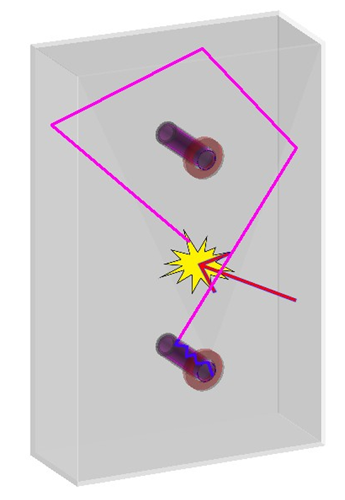
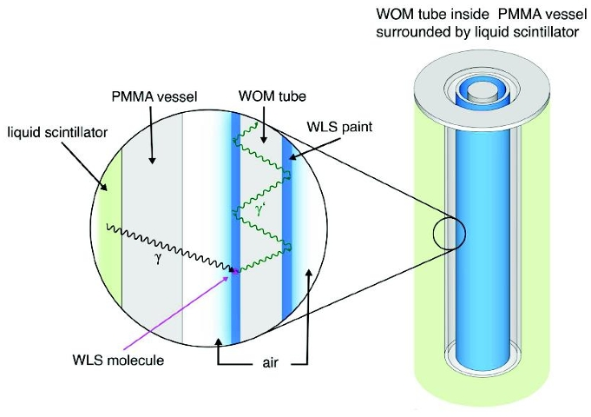
SHiP Experiment
eMUSIC ASIC
SiPM PCB
WOM tube

Slide 5
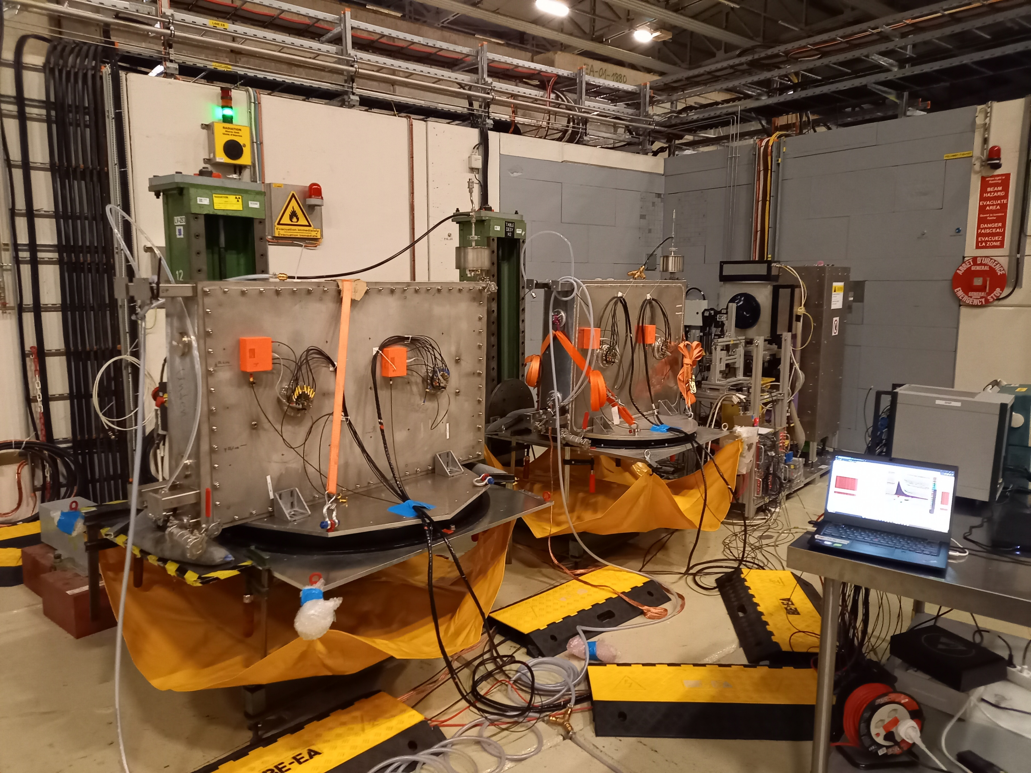
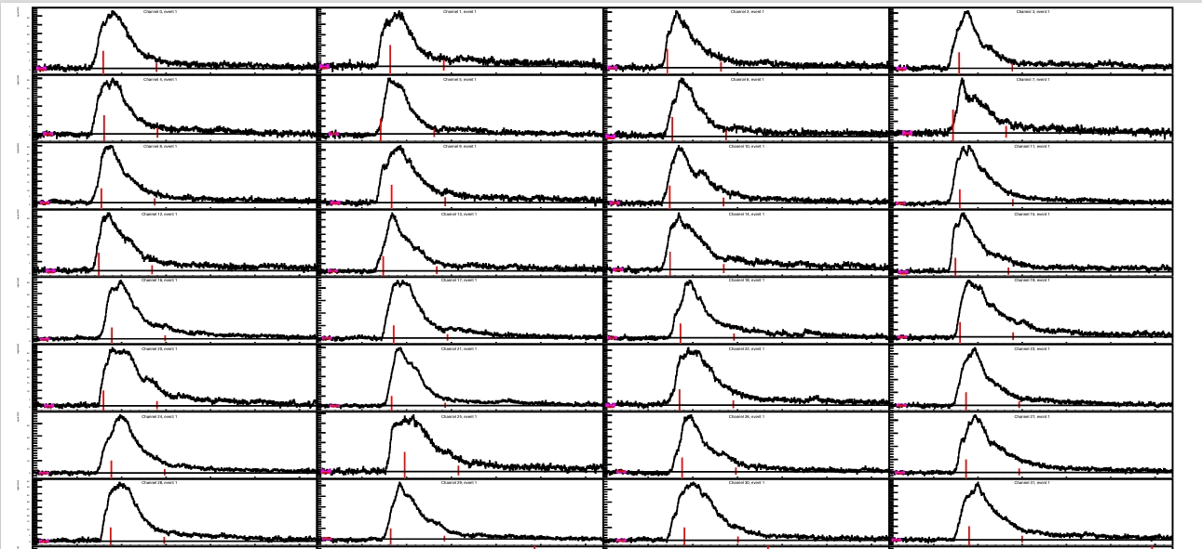
Motivation
Guiding question:
How many photons were recorded in the sensors for a given waveform?

Slide 6
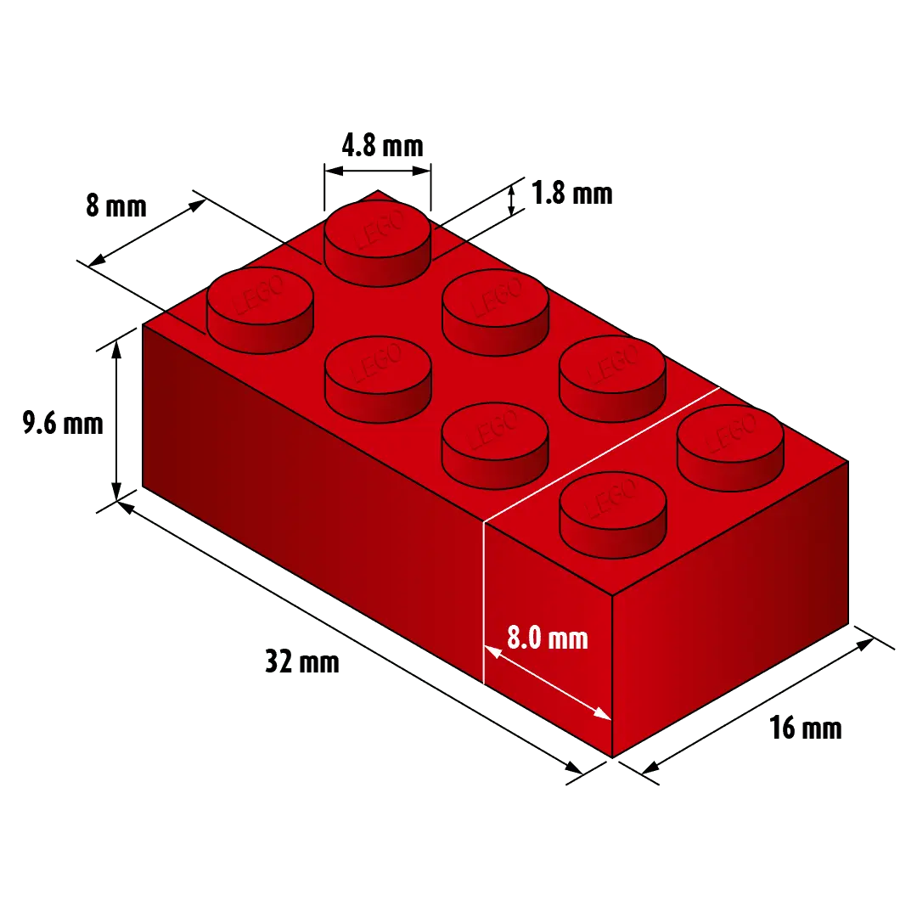
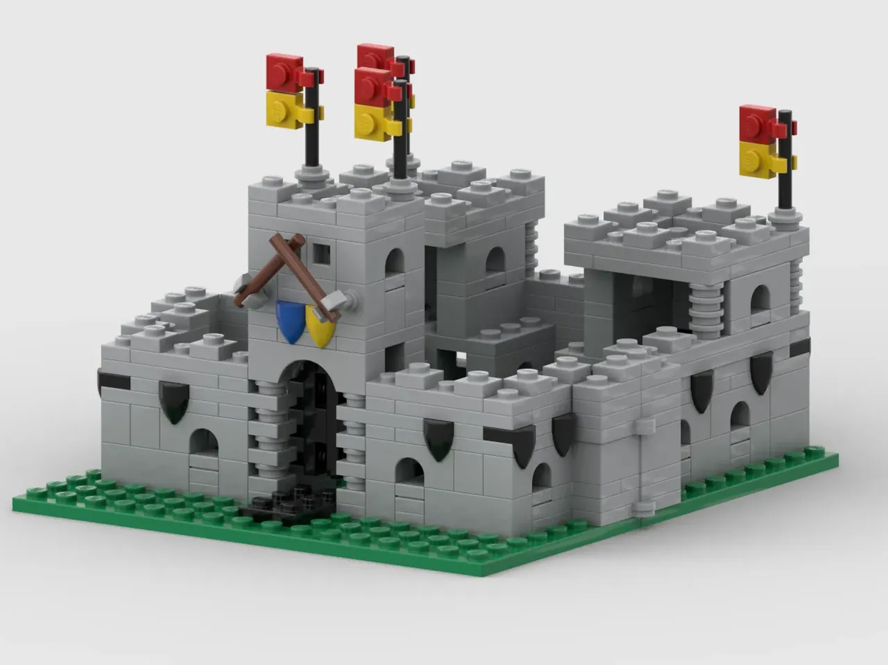
Motivation
Guiding question:
How many photons were recorded in the sensors for a given waveform?

Slide 7
Characterise the detector response to single photons
Prove the working principle for signals with low photon multiplicities
Develop automated template-based reconstruction method for larger waveforms
Find correlations between number of photons in a signal and waveform characteristics

Slide 8

Characterise the detector response to single photons
Prove the working principle for signals with low photon multiplicities
Develop automated template-based reconstruction method for larger waveforms
Find correlations between number of photons in a signal and waveform characteristics

Slide 9
Characterise the detector response to single photons
Prove the working principle for signals with low photon multiplicities
Develop automated template-based reconstruction method for larger waveforms
Find correlations between number of photons in a signal and waveform characteristics

Slide 10
Characterise the detector response to single photons
Prove the working principle for signals with low photon multiplicities
Develop automated template-based reconstruction method for larger waveforms
Find correlations between number of photons in a signal and waveform characteristics

Slide 11
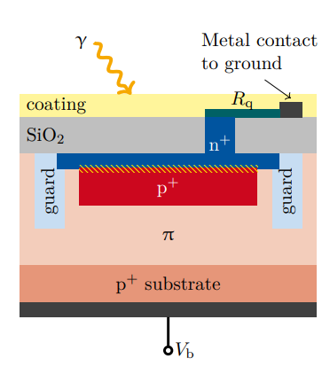
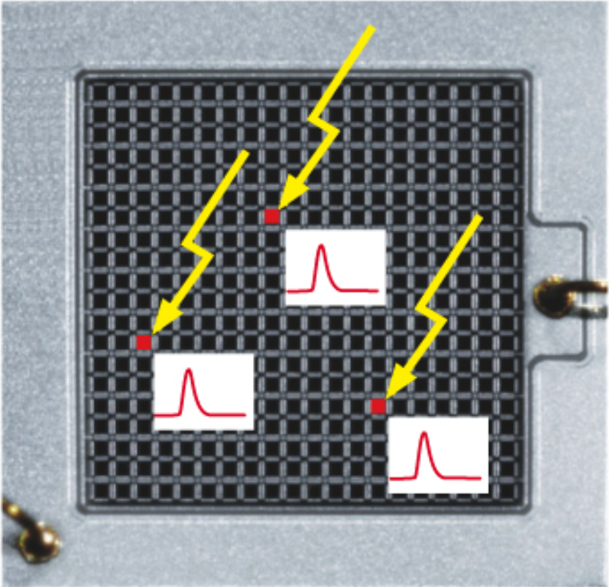
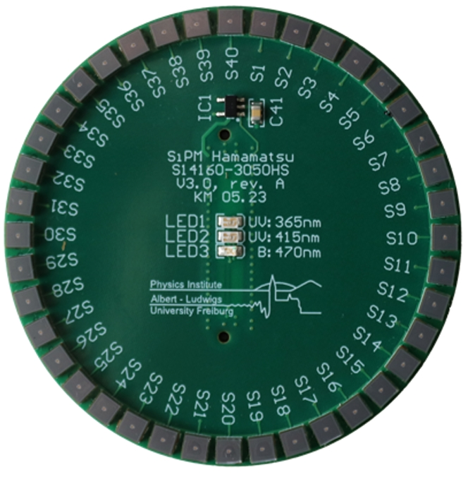
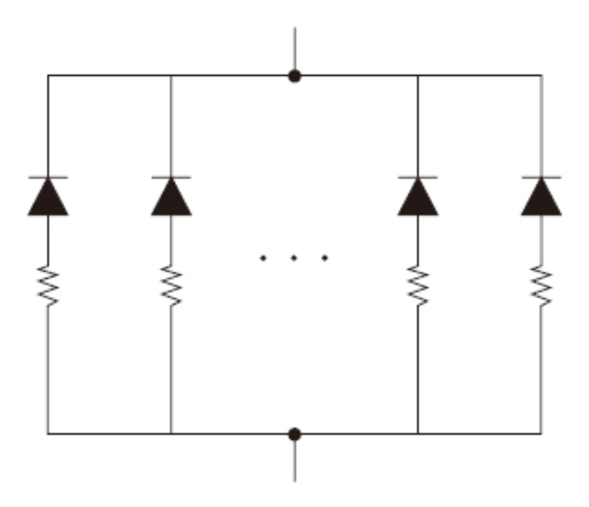

Setup
SPAD
SiPM
SiPM PCB
$$γ$$
Multiplication
Absorption
SiPM PCB
WOM tube

Slide 12
Setup
SPAD
SiPM
SiPM PCB
Multiplication
SiPM PCB
WOM tube

Slide 13
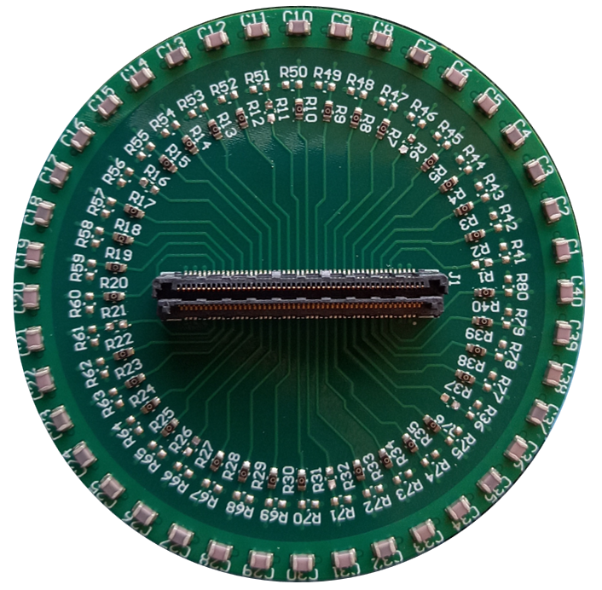
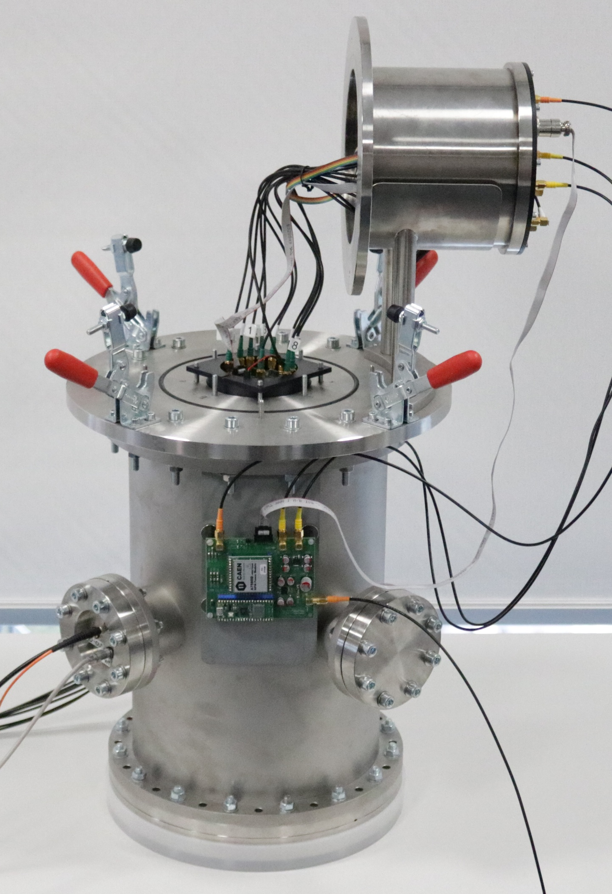
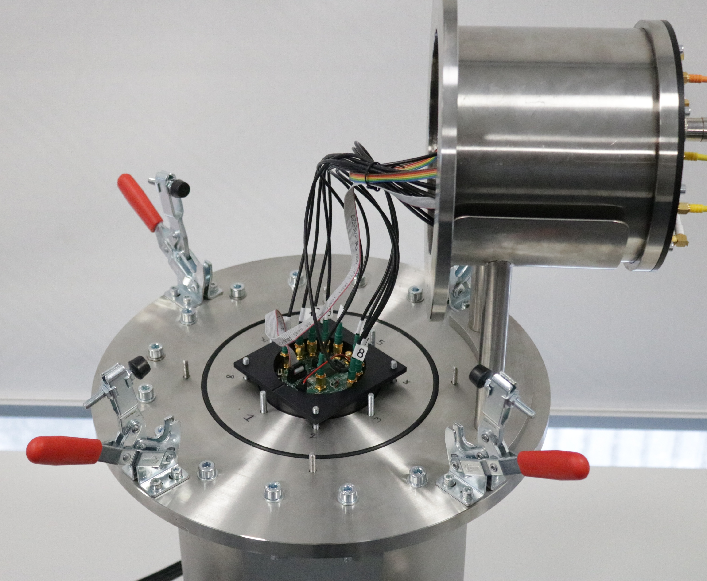
Setup
Dark Count Measurements with Hamamatsu-SiPM Board
Light-tight setup
Modulated noise from generator as random trigger
SiPM PCB Holder
40 cm
25 cm

Slide 14
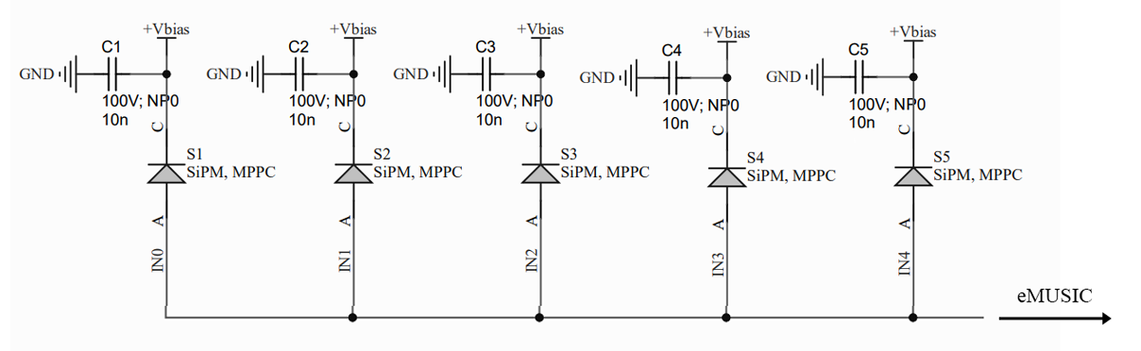
Setup
Dark Count Measurements with Hamamatsu-SiPM Board
Light-tight setup
Modulated noise from generator as random trigger
SiPM PCB Holder
40 cm
25 cm

Slide 15
Setup
SiPMs read out individually:
1 SPAD
2 SPADs
5SiPMs read out in parallel:
1 SPAD
2 SPADs

Slide 16
Setup
SiPMs read out individually:
1 SPAD
2 SPADs
5SiPMs read out in parallel:
1 SPAD
2 SPADs
Obtain representative signal shapes by averaging over many waveforms
→ First need to classify events by their signal type

Slide 17
Event characterisation - Amplitude
1 SiPM
2 SiPMs
3 SiPMs
4 SiPMs
5 SiPMs

Slide 18
Event characterisation - Amplitude
1PE
1 SiPM
2 SiPMs
3 SiPMs
2PE
3PE
4PE
4 SiPMs
5 SiPMs

Slide 19
Event characterisation - Integral
1 SiPM
2 SiPMs
3 SiPMs
4 SiPMs
5 SiPMs

Slide 20
Event characterisation
1 SiPM
2 SiPMs
3 SiPMs
4 SiPMs
5 SiPMs

Slide 21
Event characterisation
5PE
1 SiPM
2 SiPMs
3 SiPMs
3PE
1PE
4PE
2PE
4 SiPMs
5 SiPMs

Slide 22
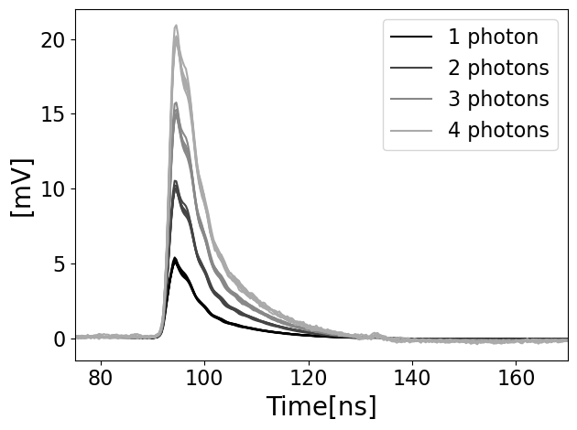
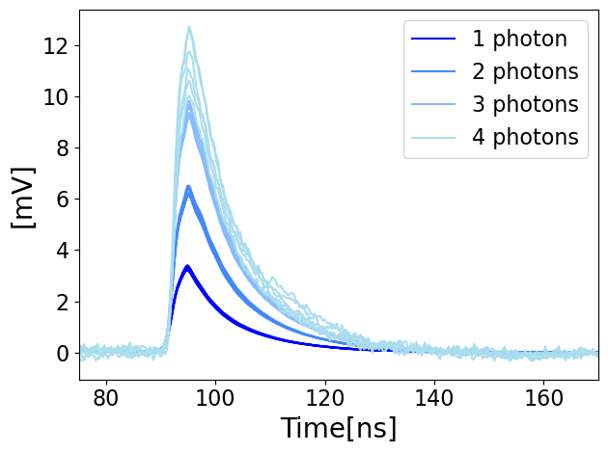
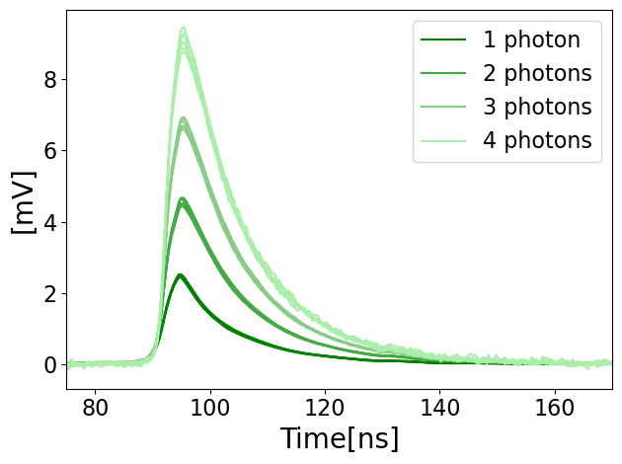
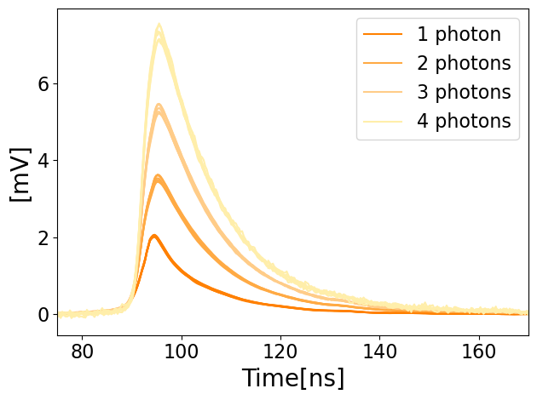
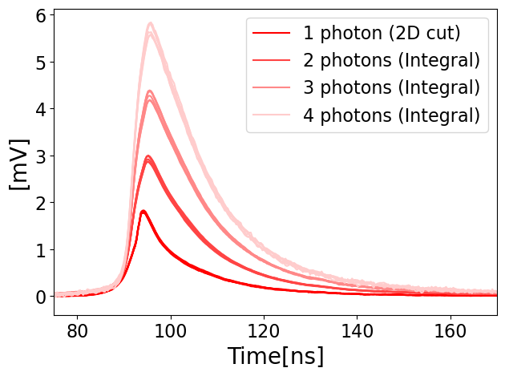
Signal Templates
1 SiPM
2 SiPMs
3 SiPMs
4 SiPMs
5 SiPMs

Slide 23
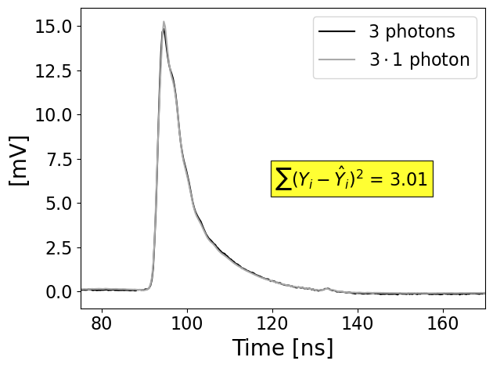
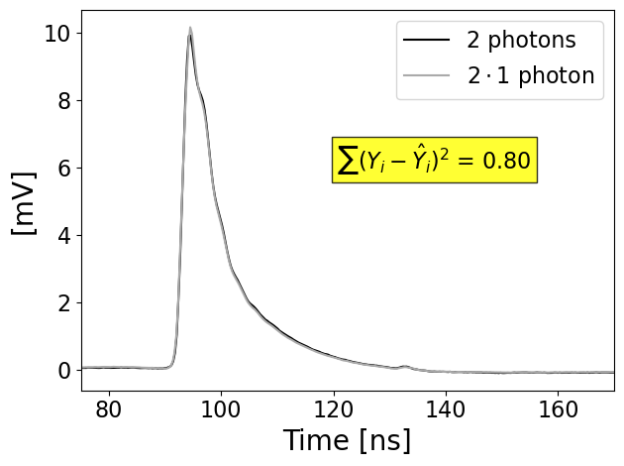
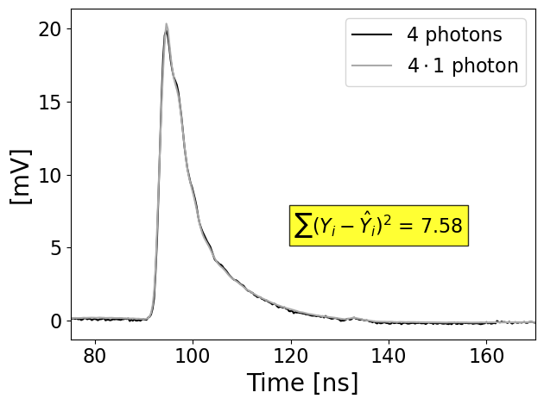
Signal Templates
1SiPM:

Slide 24
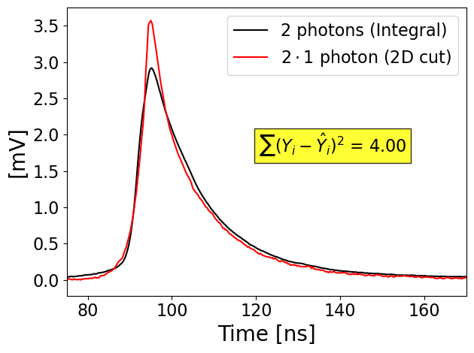
Signal Templates
5SiPMs:

Slide 25
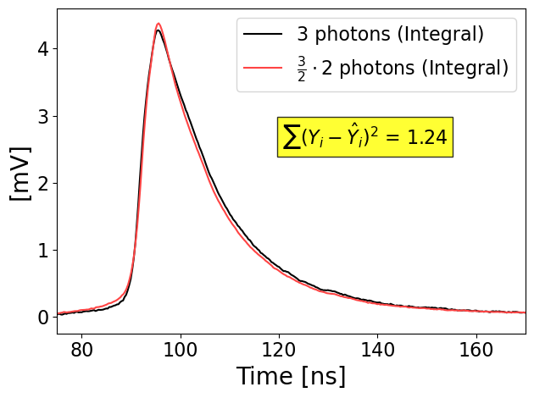
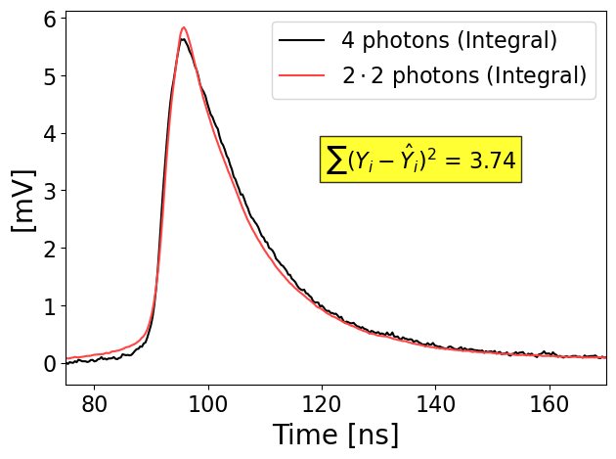
Signal Templates
5SiPMs:
Switching from 1-photon to 2-photon template

Slide 26
Signal Templates
5SiPMs:
Differences caused by misaligned waveforms?
Switching from 1-photon to 2-photon template
Smoothing of WFs before determining the rising edge
→ Used for alignment of the non-smoothed WFs

Slide 27
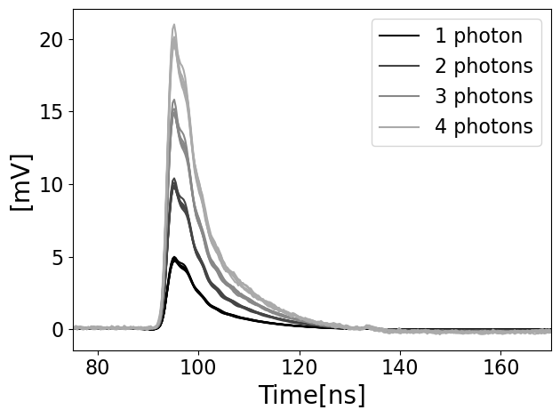
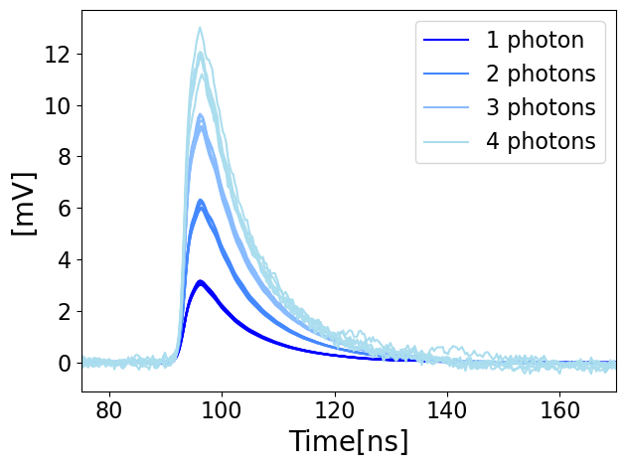
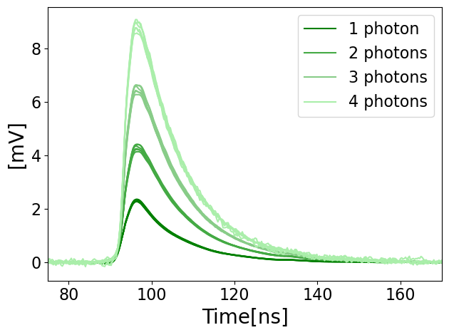

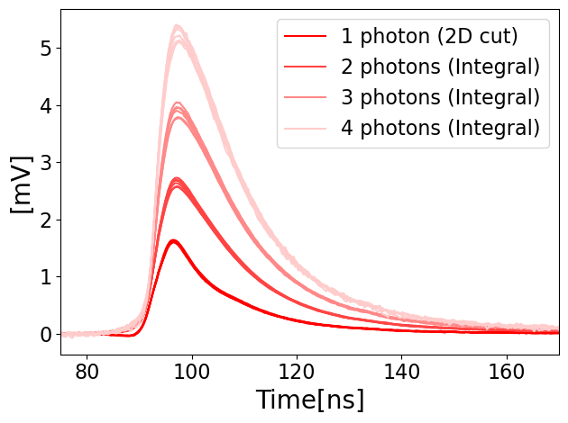
Signal Templates
1 SiPM
2 SiPMs
3 SiPMs
4 SiPMs
5 SiPMs

Slide 28
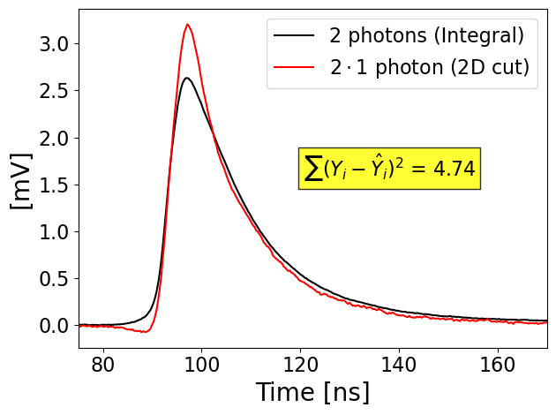
Signal Templates
5SiPMs:

Slide 29
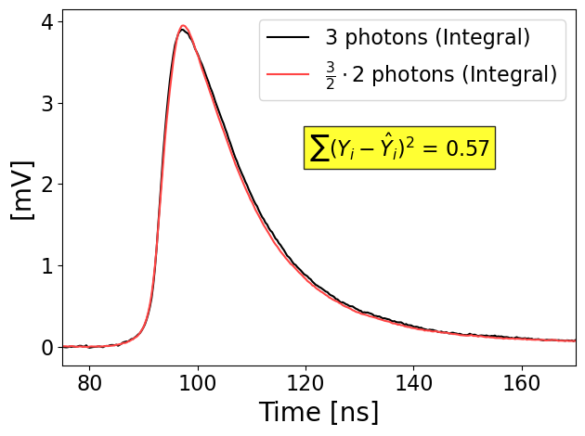
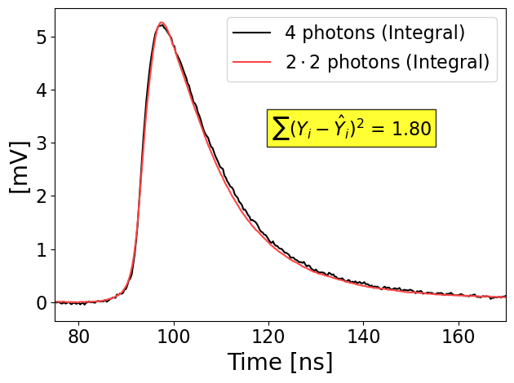
Signal Templates
5SiPMs (using smoothed alignment):
Switching from 1-photon to 2-photon template

Slide 30
Signal Templates
1 Photon
2 Photons halved
1 Photon (smoothed alignment)
2 Photons halved (smoothed alignment)

Slide 31
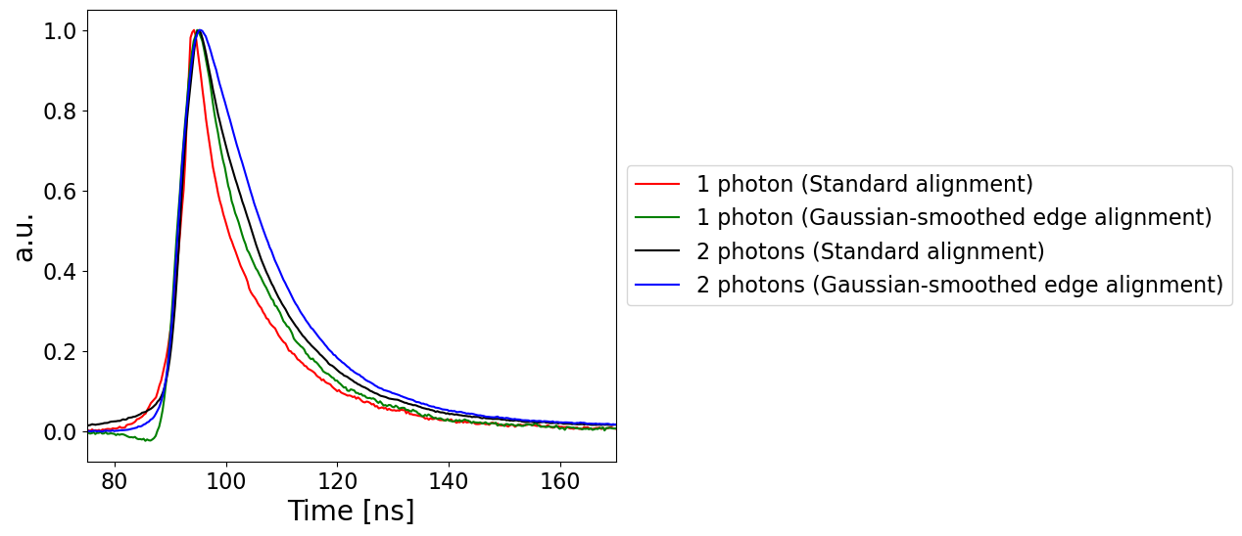
Signal Templates
1 Photon
2 Photons halved
1 Photon (smoothed alignment)
2 Photons halved (smoothed alignment)

Slide 32
Up till now:
Obtained representative templates for detector response to single photons and 2-4 photons
But: Unsure of “true” shape for 5 SiPM setup
Confirmed that the addition of templates to form a larger waveform works for low number of photons

Slide 33
Up till now:
Obtained representative templates for detector response to single photons and 2-4 photons
But: Unsure of “true” shape for 5 SiPM setup
Confirmed that the addition of templates to form a larger waveform works for low number of photons
Next:
Automated template-based reconstruction method for larger waveforms
Testing method with waveforms recorded during the test beam in May at CERN
Looking into correlations between number of photons in a signal and waveform characteristics

Slide 34
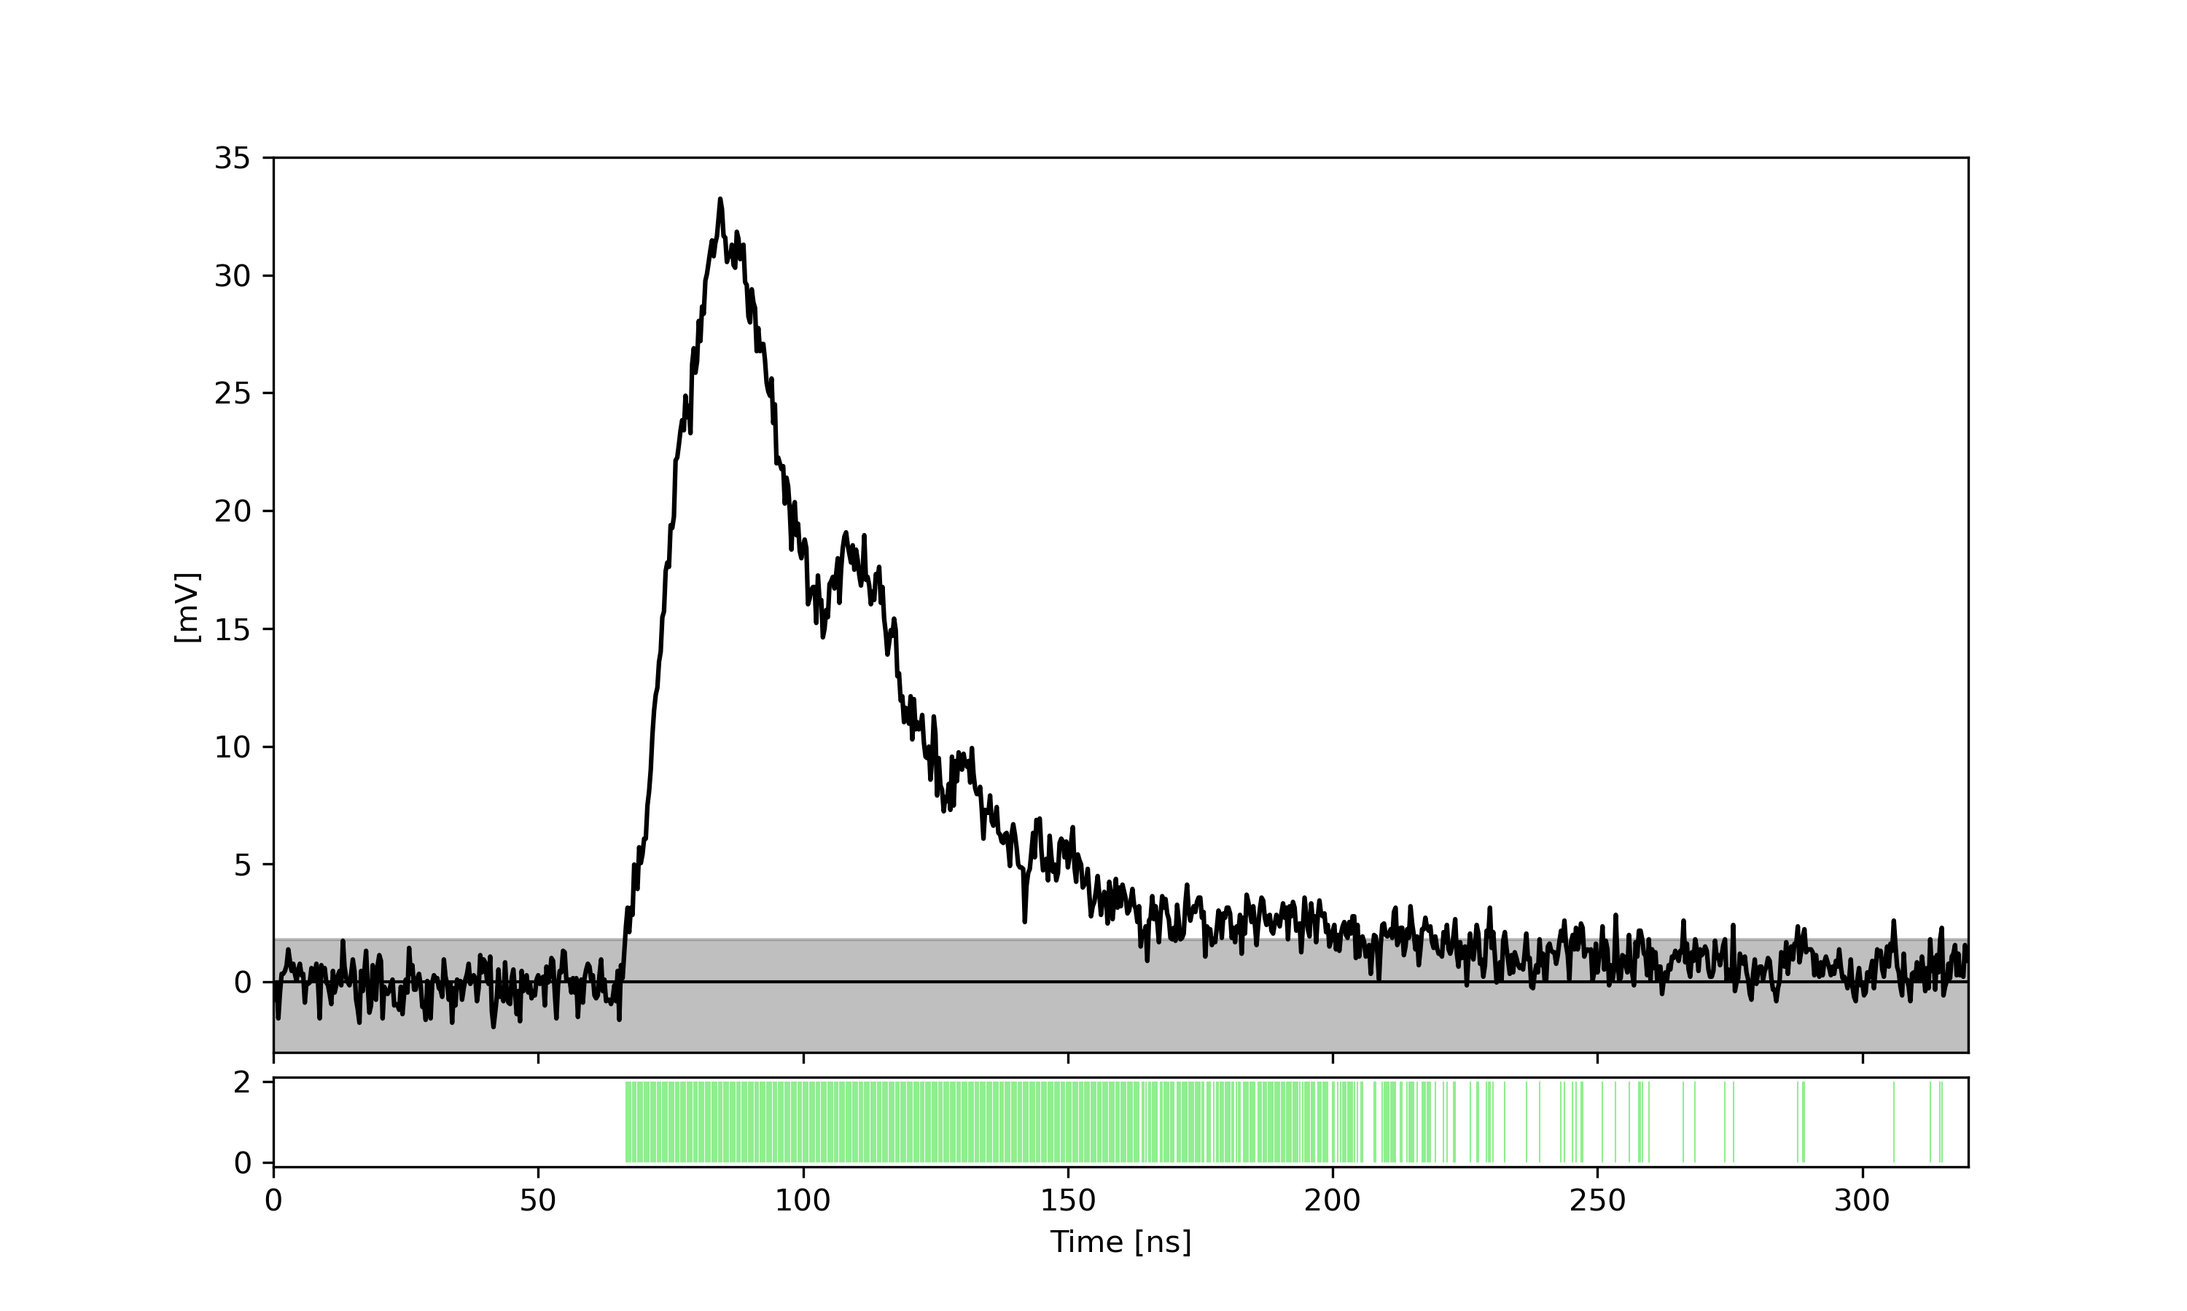
Reconstruction Method
Apply threshold to WF:
90% of the height of the template
These are the only positions where photons can be placed

Slide 35
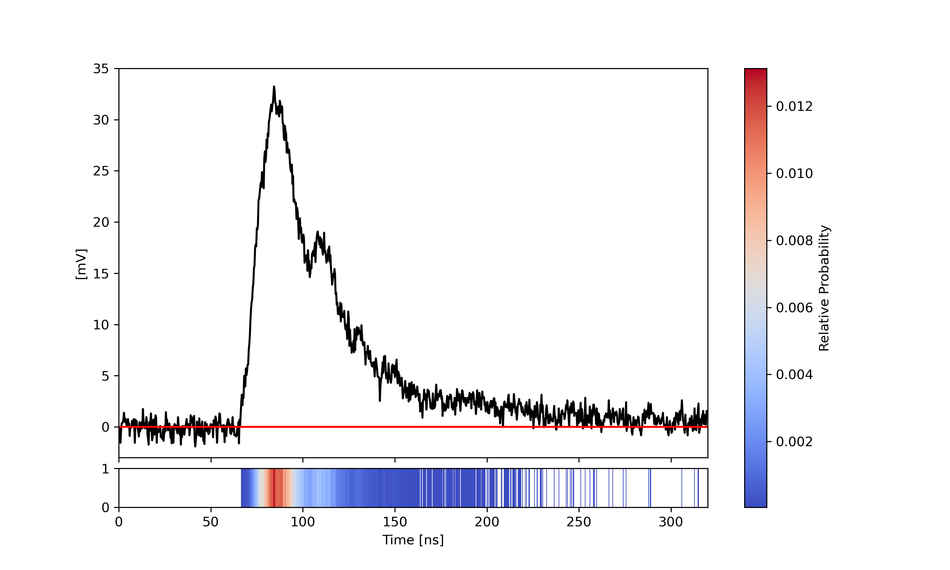
Reconstruction Method
The „basearray“ is the fitted curve:
→ Initially a line at zero

Slide 36
Reconstruction Method
The „basearray“ is the fitted curve:
→ Initially a line at zero
Calculate difference between fitted curve and waveform data for the approved bins
→ Use its squares as weights

Slide 37

Reconstruction Method
Place a photon at position chosen by weighted random generator
Calculate residual sum of squares to determine goodness of fit
Fit does not improve
Fit improves
Save position in new basearray

Slide 38
Reconstruction Method
Place a photon at position chosen by weighted random generator
Calculate residual sum of squares to determine goodness of fit
Stop if all positions have been rejected
Fit does not improve
Reject Position
Fit improves
Choose new Position

Slide 39
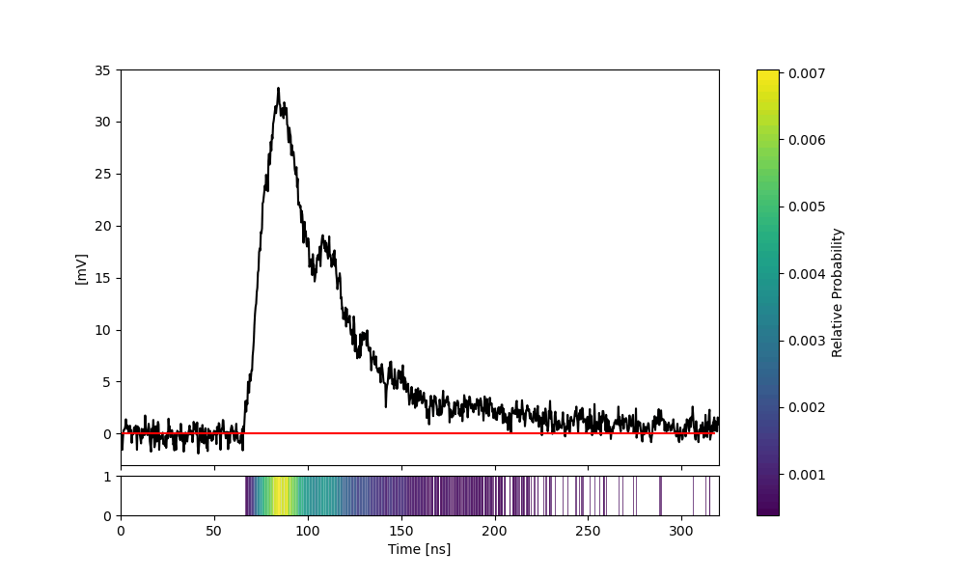
Reconstruction Method
Repeat entire process 1000 times and use best result

Slide 40
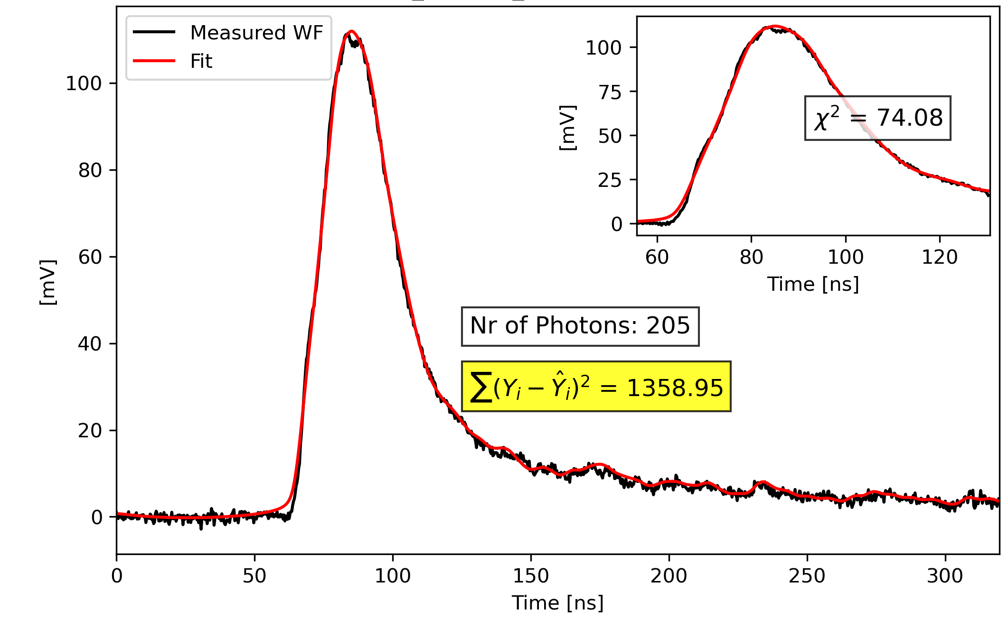
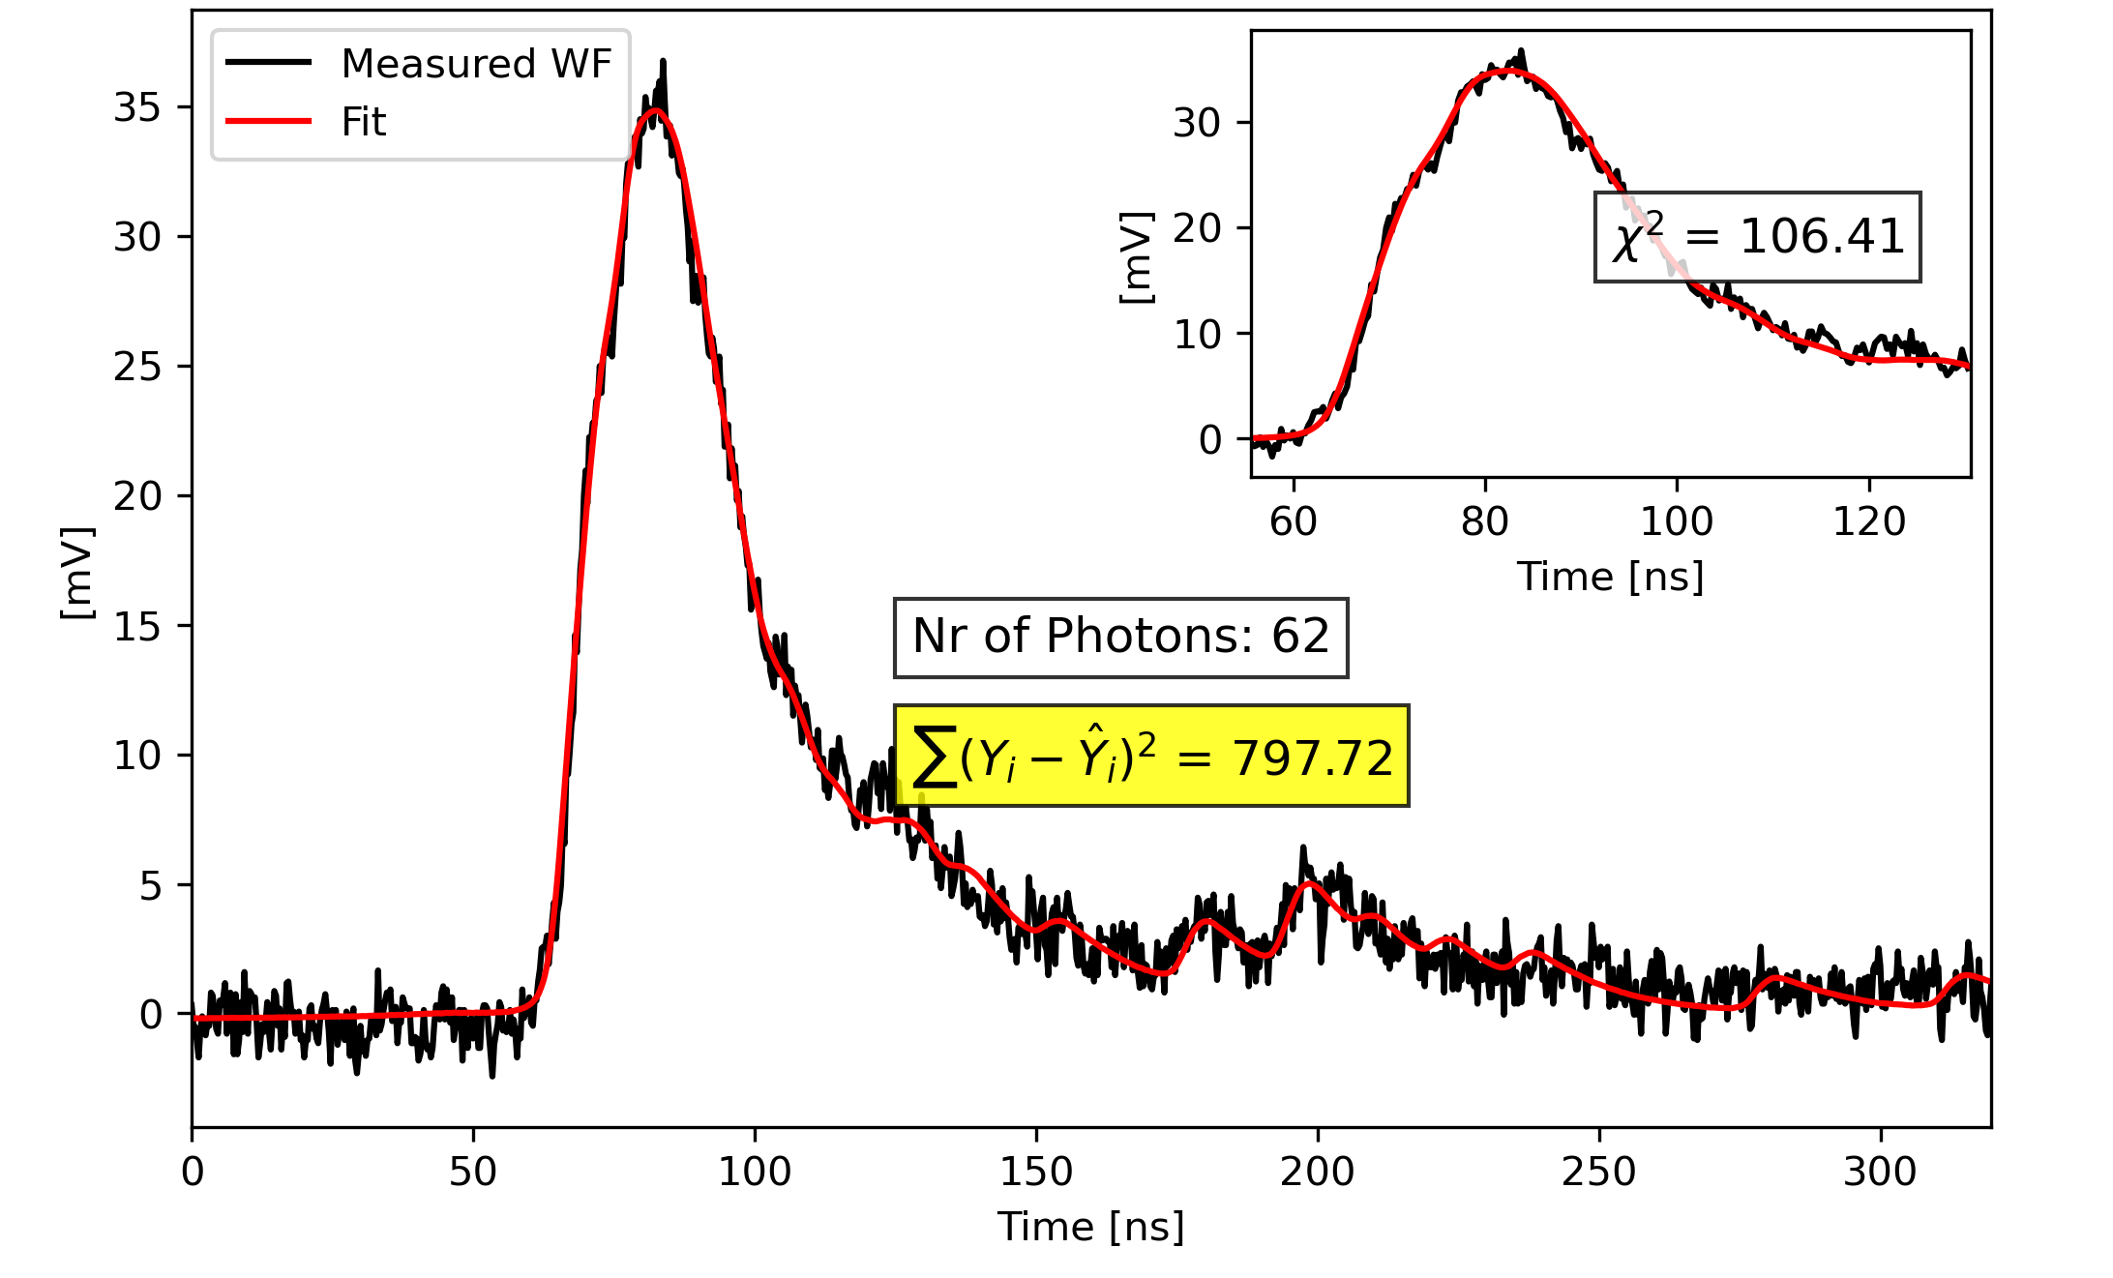
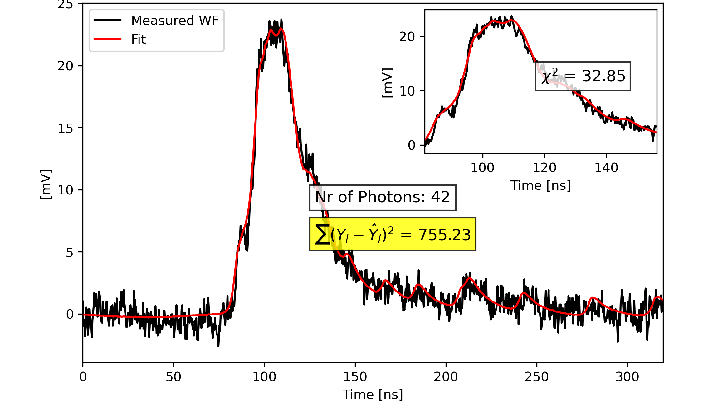
Reconstruction Method
Some results for WFs from Testbeam in May 2025:

Slide 41
Results
Goodness of fit decreases for larger signals
Noise cannot be modelled

Slide 42
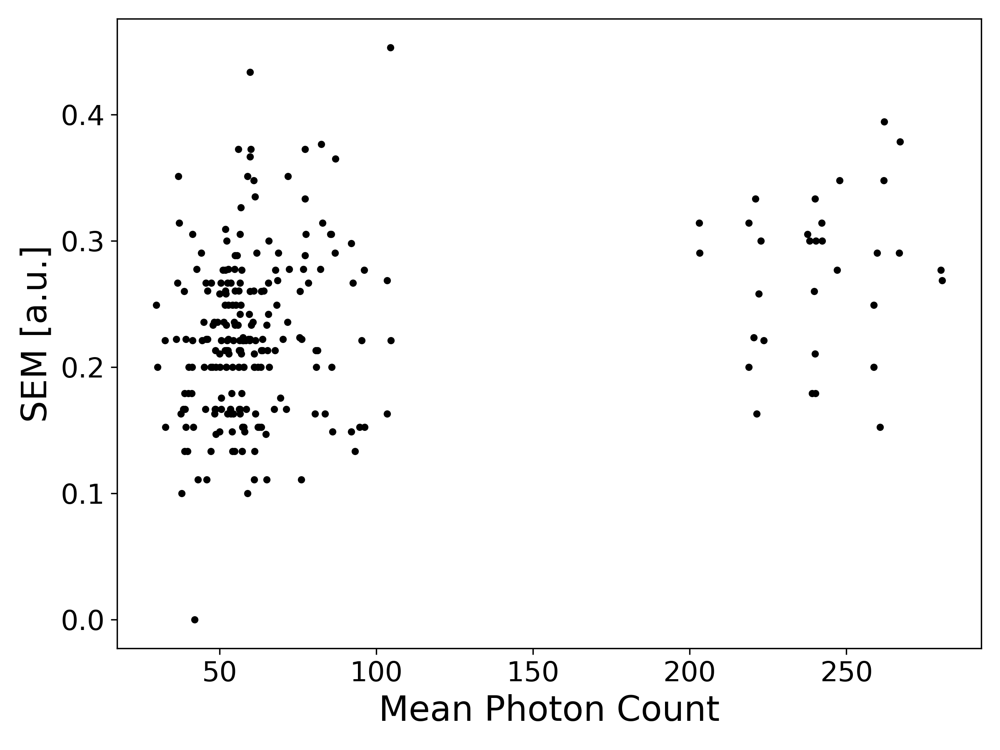
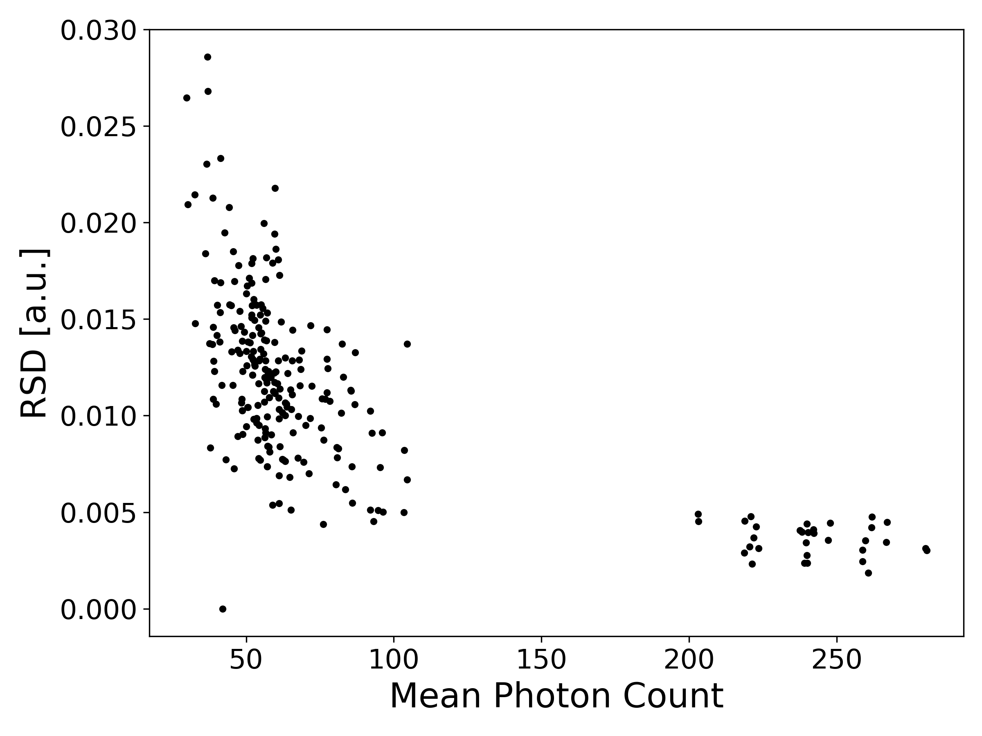
Results
Running the method for the same WFs 10 times
Look into Mean and Stdev of the results
Relative uncertainty decreases with the signal size

Slide 43
Results
Choice of template can affect results significantly

Slide 44
Results
Look into the residual sum of squares for the four templates
Templates of equal photon-multiplicities perform similarly
1-Photon templates perform slightly better

Slide 45
Results
Reconstruction method is computationally expensive
Not feasable to store entire waveforms in the final SBT
→ Find parameter to accurately translate photon number

Slide 46
Results
Amplitude of WF:

Slide 47
Results
Integral over full WF:
Uncertainty: Spread of different templates

Slide 48
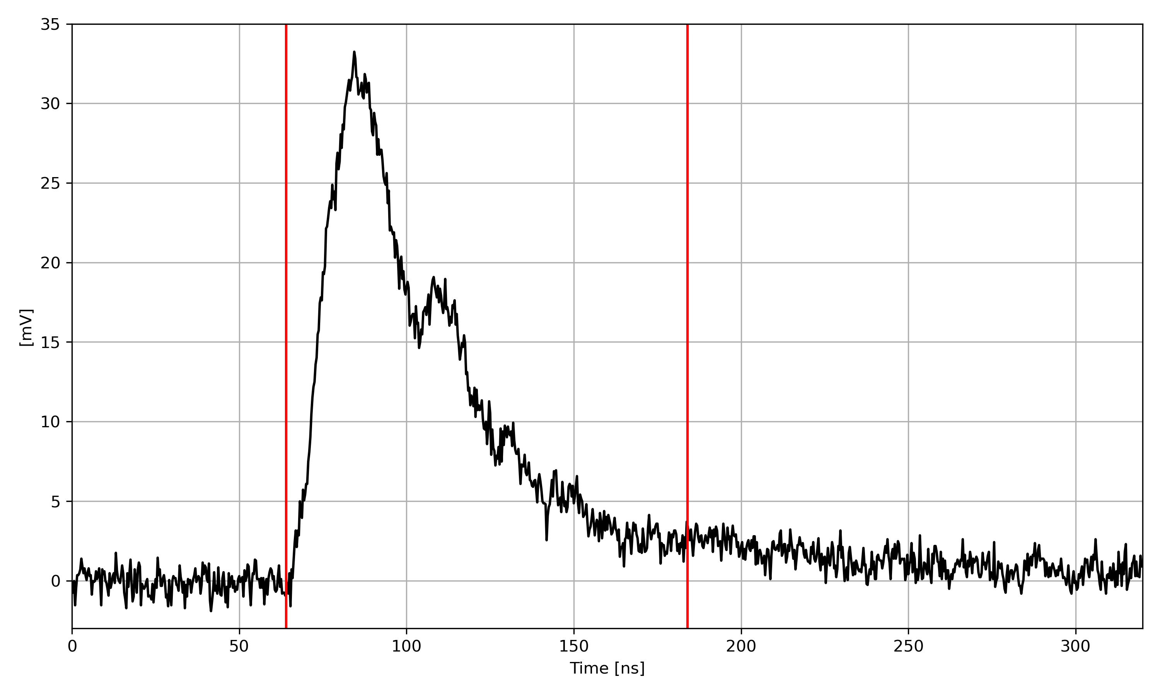
Results
Integral over 120 ns integration window:

Slide 49
Conclusion & Outlook
Quantified detector response to low photon counts for parallel SiPM configurations using Dark Counts
Created reconstruction algorithm for waveform modeling and template matching
Identified candidate for signal characterisation: Integral over full waveform
Confirmed for all four template types

Slide 50
Conclusion & Outlook
For all changes in the electronics new templates will have to be determined
Reliable methodology essential
SHiP plans to start data taking in 2033

Slide 51
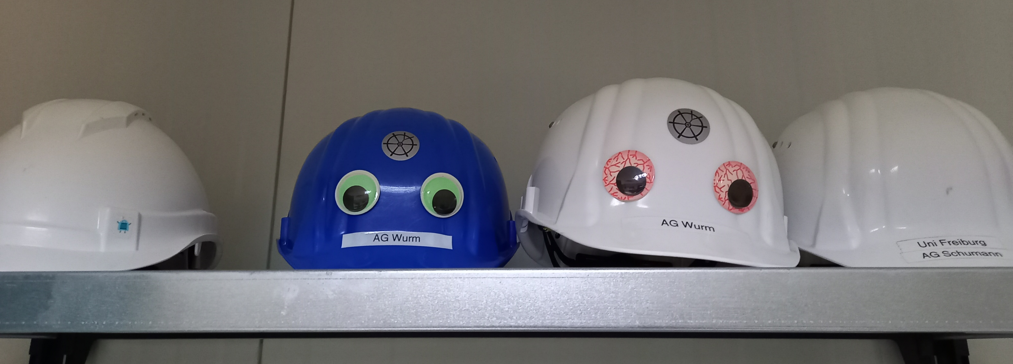
Thank you for your time
Anne Sophie Müller
anne.mueller1@email.uni-freiburg.de
Physikalisches Institut, Albert-Ludwigs-Universität Freiburg
08.05.2026

Slide 53
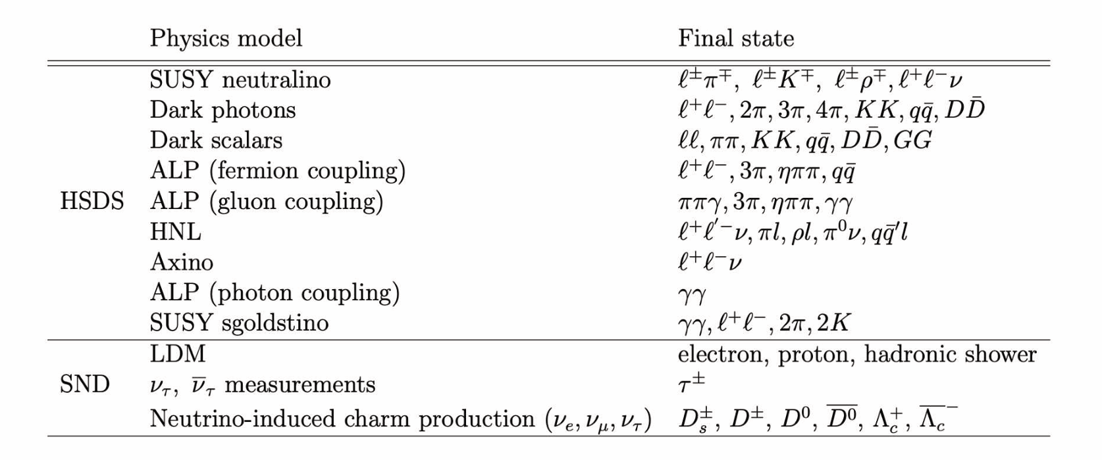

Slide 54
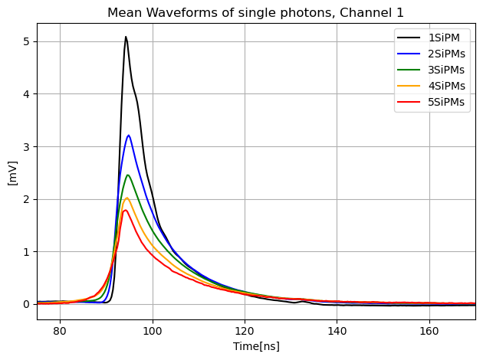
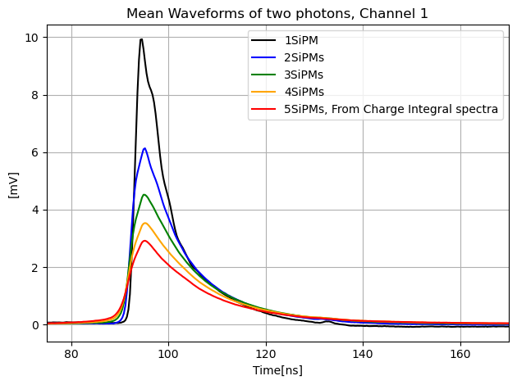
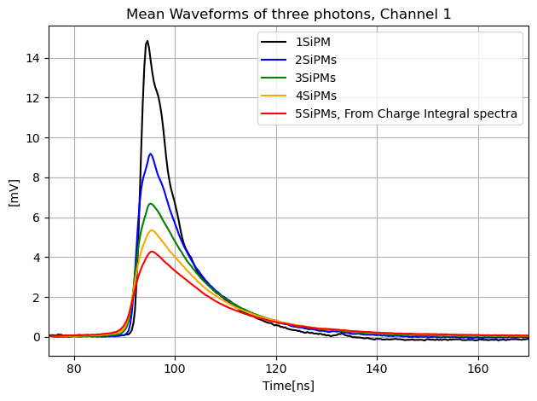

Signal Templates
1 Photon Template
2 Photon Template
3 Photon Template
4 Photon Template

Slide 55



Results

Slide 56


Results
Integral over full WF:

Slide 57
Results
Integral over 120 ns integration window:

Slide 58


Amplitude of WF:

Slide 59


Integral over 120ns integration window:

Slide 60


Slide 61


LASER setup, Freiburg:
TB May 2025, Origin shot:

Slide 62
LASER setup, Freiburg:

Slide 63

Template addition at different positions:

Slide 64

Template addition at different positions:
Place zeros at the beginning
Cut off

Slide 65

Template addition at different positions:
Place zeros at the end
Cut off

Slide 66



Slide 67


