Slide 1
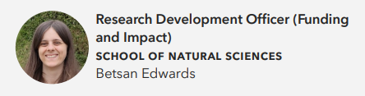
Research, Development & Innovation:
The RDI Team
ECR Workshop
May 5th, 2026

Slide 2
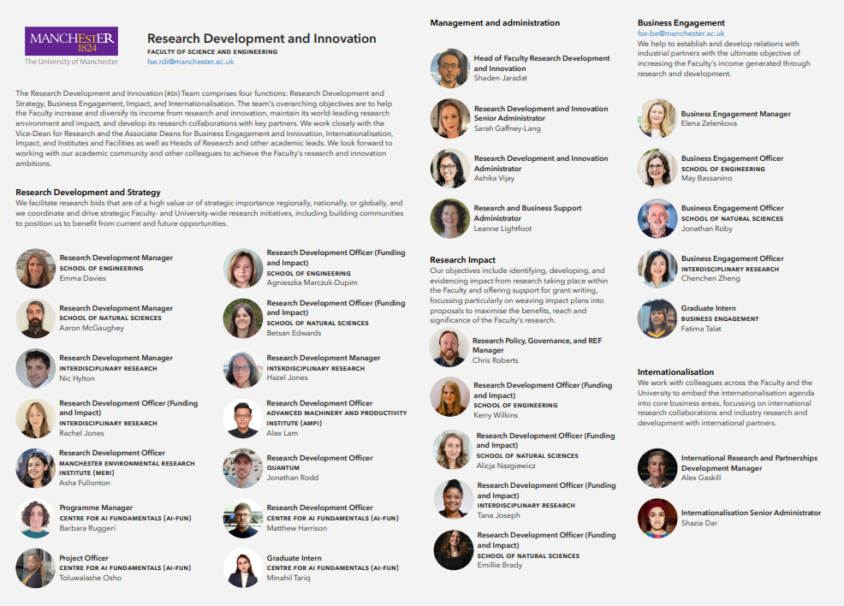

Slide 3
Research Development and Innovation
Research Development and Strategy
Business Engagement
Research Impact
Internationalisation

Slide 4
Other RDI Teams
Impact – help with realising the impact of your research
Business Engagement – help with finding external business partners and negotiating their involvement. Bid request letter template
Internationalisation – Focus on developing international research collaborations with academic and industry partners

Slide 5
Strategic Initiatives
Map expertise in thematic areas across UoM
Bring together groups of academics at workshops aligned to specific calls
Work with you to identify key themes to focus future research in the community
Plan, organise, and support key funder & partner visits

Slide 6
Bid Development
Bring the bid team together
Plan meetings
Coordinate activities in accordance with internal & external timelines
Ensuring deliverables are met
Organising mock interviews
Run collaborative research interactions, such as workshops, training
Identify internal academic partners
Engaging with external partners on proposal scope and development
University letters of support sign off
Reviewing Your Application

Slide 7
Other Funding and Grant Support
Research Professional for funding searches
Research Services - Grant submissions and project mobilisation
Research Strategy and Innovation Funding Bulletin – Upcoming deadlines
FSE.RDI@manchester.ac.uk – Queries and registration to the Faculty’s research newsletter
RDI SharePoint – Further information on the support available to you, including guidance on how to respond to impact and EDIA questions in grant applications
Researcher Development – Help you to reach your potential and make a difference
UMIF – The Innovation Factory help you to realise impact with your IP

Slide 8

Any Questions?

Slide 9
RDI Non-Technical Review
Process Overview
ECR Workshop
May 5th, 2026

Slide 10
What We Can Help With
The structure and consistency of the application.
The case made for the importance and urgency of this project in the context of the scheme aims.
The clarity of the proposed methodology.
The feasibility of the work plan.
Project resources.
The skills and experience of the applicant(s) (R4RI), including external collaborators.
Research culture, including EDIA.
Development plans for the lead and other team members.
Plans for outputs, dissemination and impact.
General readability

Slide 11
Requesting Support
Complete the RDI Bid Development Support Request Form, attaching any initial drafts
Submit reasonably cohesive drafts in MS Word format

Slide 12
Eligibility
Your project must fall into at least one of these criteria
A. The project is expected to deliver £1m+ of revenue (recovered costs) for UoM, per the scheme guidance and/or RS Costing Request Form.
B. Prestigious, high-value early career schemes
C. Other strategically important calls which may arise.
Includes:
FLF
URF
Excludes:
MSCA
Newton
Leverhulme ECF
Notes:
Fall into at least one of these criteria

Slide 13
Eligibility
Your project meet all of these criteria
The project is led by The University of Manchester, and the Principal Investigator/Project Lead is based in FSE (or would be incoming to FSE, in the event of an award to an external candidate).
Where relevant, the team has initial group/departmental approval to go ahead.
Compliance with all relevant RS policies on Applying for Research Funding.
The request falls within the timeline for this service
Notes:
Must meet all of these criteria

Slide 14
What to Expect
You will be assigned a member of the FSE RDI ream with experience of supporting bid development and reviewing applications
Comments will be honest and constructive, highlighting specific potential issues and, where possible, offer suggestions to remedy them.
Feedback may be given as annotations on the draft proposal and/or using the review template.
Evaluating the proposal’s scientific credibility remains the preserve of academic peer reviewers.
The final decision on whether to make any particular change suggested by a reviewer remains with the applicant.

Slide 15
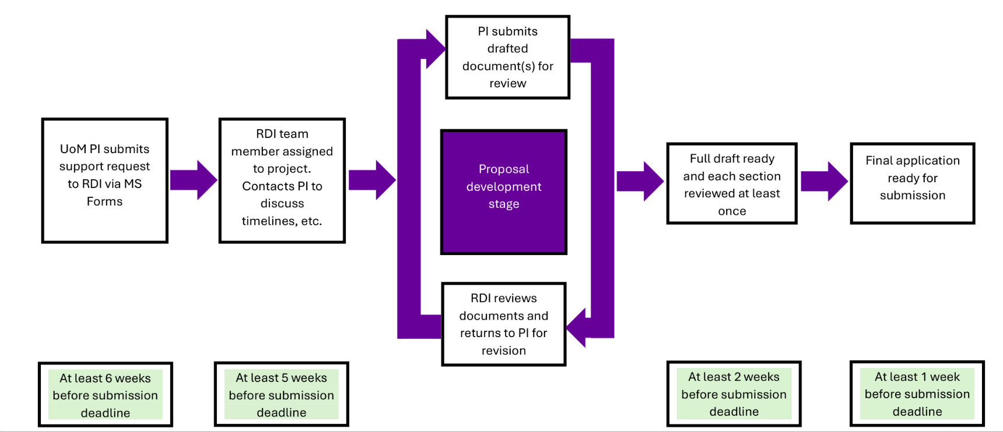
Deadlines

Slide 16
Deadline Exceptions – No guarantee
Calls that are released with less than 6 weeks of notice – submit your request asap
Funder imposed institutional caps leading to delays in candidate selection
Demand management processes leading to delays in candidate selection
Notes:
Institutional timelines to supersede ours

Slide 17
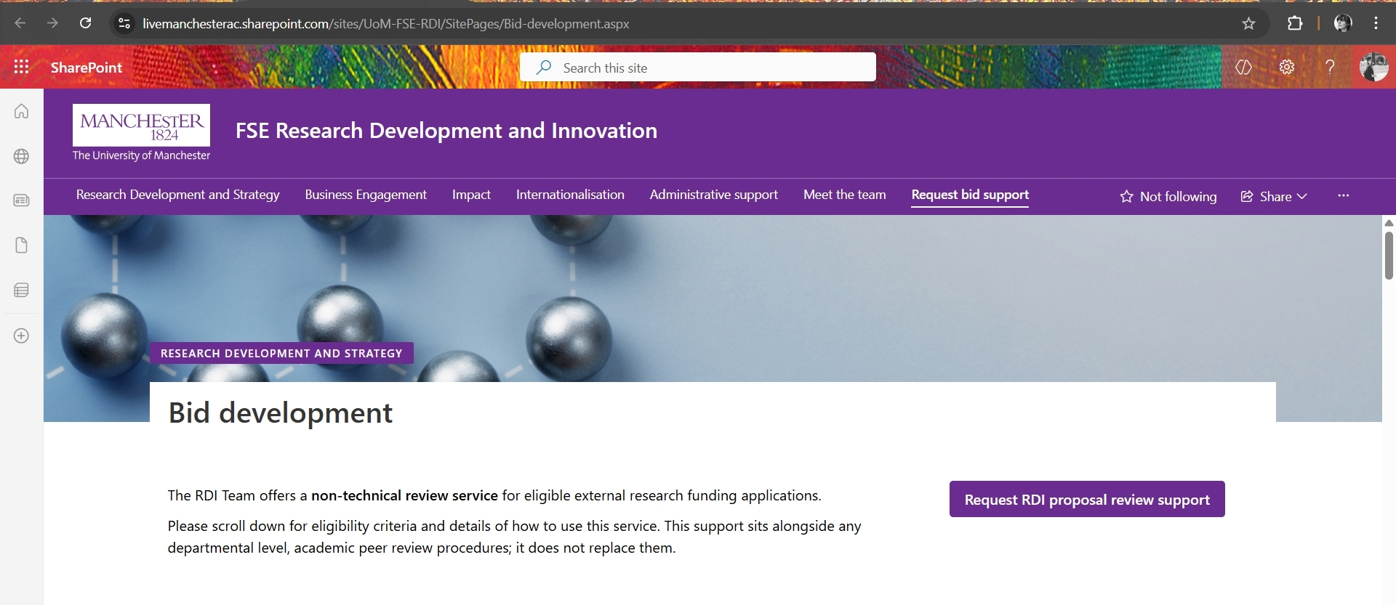
The Form

Slide 18
The Form
Name
Department/Institute affiliation
Link to the funding scheme
Scheme deadline/RS submission deadline
Name of your RS contact
Proposal working title
Confirmation of eligibility
If prepared, proposal draft

Slide 19
More Information
The Request Bid Support page on the RDI SharePoint
Embedding EDIA into funding guidance SharePoint pages
To discuss wider/longer-term bid development strategies or activities, please contact the team aligned to your School or Institute.
Please direct all other queries to fse.rdi@manchester.ac.uk.

Slide 20
Any Questions?

