Slide 1

Research Services
Zoë Darlington
Research support manager (RSm)
For Astronomy and Maths

Slide 2
Team Structure
Head of Faculty RBE
RS Operations Manager (SoE)
RS Operations Manager (SoNS)
Research Support Managers
Research Support Managers
Research Support Officers
Research Support Officers
Reece Farndale
Lottie Tang
Anga Kapunda
Joe Ryan
Derek Ip
Colin Timperley
Rakesh Verma
Stephanie Lai
Lucy Valentine
Alex Matthew-John
Zahid Akhtar
Frank McGrory
Zoe Darlington
Sarah Watson (NGI)
Alex Yates (mat leave)

Slide 3
How can you contact us?
Visit in person!
RSOs:
Nancy Rothwell (MECD), 6th floor, Core 1
RSMs:
Nancy Rothwell (MECD), 6th floor Core 1, Frank/Alex/Zoe: Schuster Building, 2nd Floor, Room 2.54
Email:
RSMs: frank.mcgrory@Manchester.ac.uk; alexandra.sinton@Manchester.ac.uk; zoe.darlington@manchester.ac.uk; sarah.watson@manchester.ac.uk
RSOs: reece.farndale@manchester.ac.uk; lottie.tang@manchester.ac.uk; anganile.kapunda@manchester.ac.uk; joseph.ryan@manchester.ac.uk; derek.ip@manchester.ac.uk; colin.timperley@manchester.ac.uk; rakesh.verma@manchester.ac.uk; stephanie.lai@manchester.ac.uk; lucy.valentine@manchester.ac.uk; alexander.matthew-john@manchester.ac.uk; zahid.akhtar@manchester.ac.uk
MAILBOX: SoNS_researchservices@manchester.ac.uk
Online:
Teams!

Slide 4
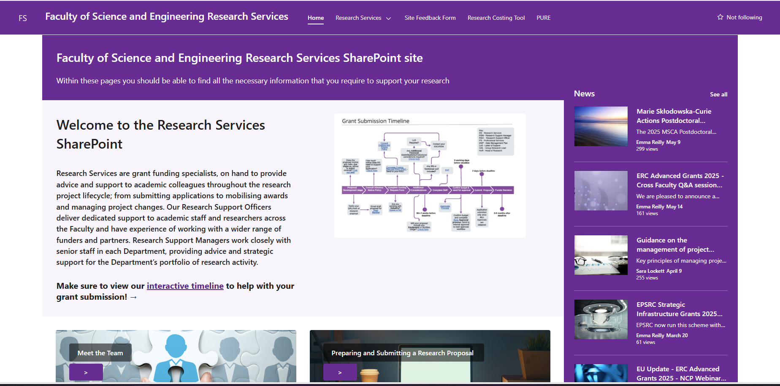
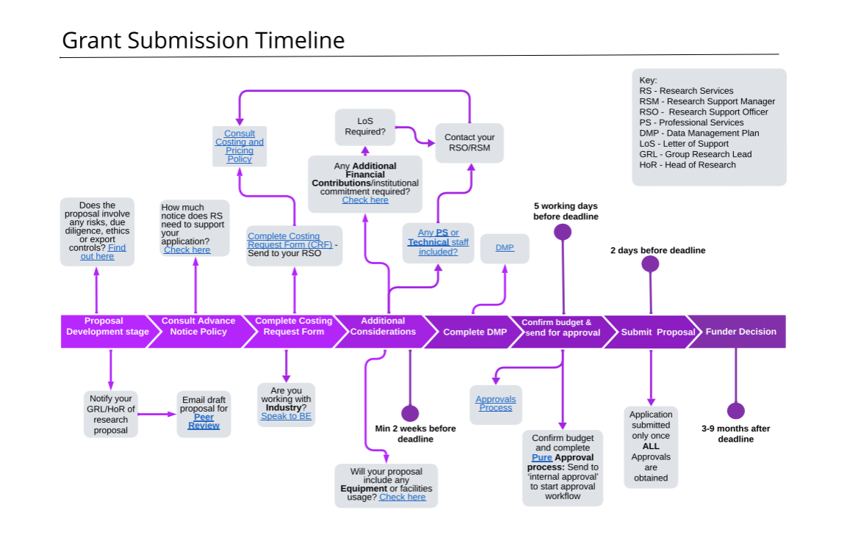
FSE Research Services Sharepoint
Faculty of Science and Engineering Research Services - Home

Slide 5
What Can We Help With?
PRE AWARD
Costing & preparation of applications
Costing Requirements
Eligibility queries
Approvals (tech time, equipment, facilities)
Export Controls
Due Diligence
Letters of Support
Application Form Completion (i.e. budget)
Application Checking (e.g. formatting, project dates)
POST AWARD
Setting up awarded projects
HR related tasks
(Job Adverts/appointments, Staff Changes/ECR Hub)
Project Extensions
Project Change Requests
Subcontracts/Collaboration Agreements (with contracts team)

Slide 6
What Can’t We Help With?
Scientific case – speak to your supervisor/peers
How much money to allocate for travel and subsistence/equipment/consumables – you need to prepare this based on what is necessary
Negotiating prices with industry – speak to Business Engagement, although we can put you in touch with them as we may advise them on your costs
Advertising Studentships – speak to the Doctoral Academy who will work with PGR Admissions
Accessing and Monitoring Expenditure, Setting up Finance Codes – please contact the Research Finance shared inbox

Slide 7
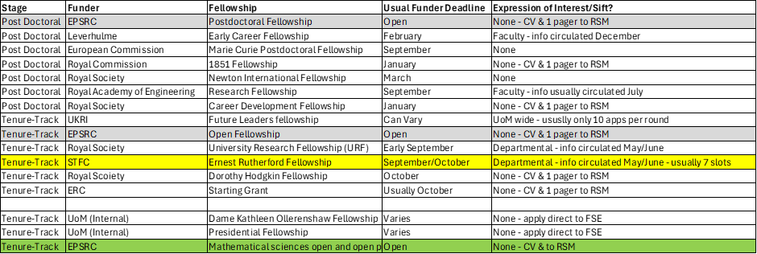
What types of Fellowship are there?

Slide 8
Pre-Application – Internal Sifts
Some Fellowship schemes have strict institutional limits on the number of accepted applications
Internal Review Process or ‘sift’ required at Department, Faculty or University level
Information will be circulated via the departmental mailing list – often require a 2-page outline proposal, details of top 5 publications and a current CV
Unsuccessful - Receive constructive feedback on how they can improve their outline for future rounds and alternative schemes
Successful - Receive feedback on how to improve for the final application

Slide 9
Application
Check eligibility and guidance notes for the scheme, speak to your supervisor!
Contact your relevant Research Support Officer (RSO)
Complete a costing request form (CRF) a minimum of 10 working days before a deadline; 20 working days if including equipment, AFC, or over £1m revenue value
Complete the Research Risk Profiler to highlight any potential research security issues
Generate RDMP number for your project through the DMPOnline service

Slide 10
Application
Work with RSO to finalise the budget and gain technical, facility, IT approval if required – this takes time!
Once a budget is agreed, your RSO will update your Pure record and seek HoD approval prior to submission – at least 5 working days before deadline
Approval received - RSO will support to input finances onto application and check formatting rules before final submission

Slide 11
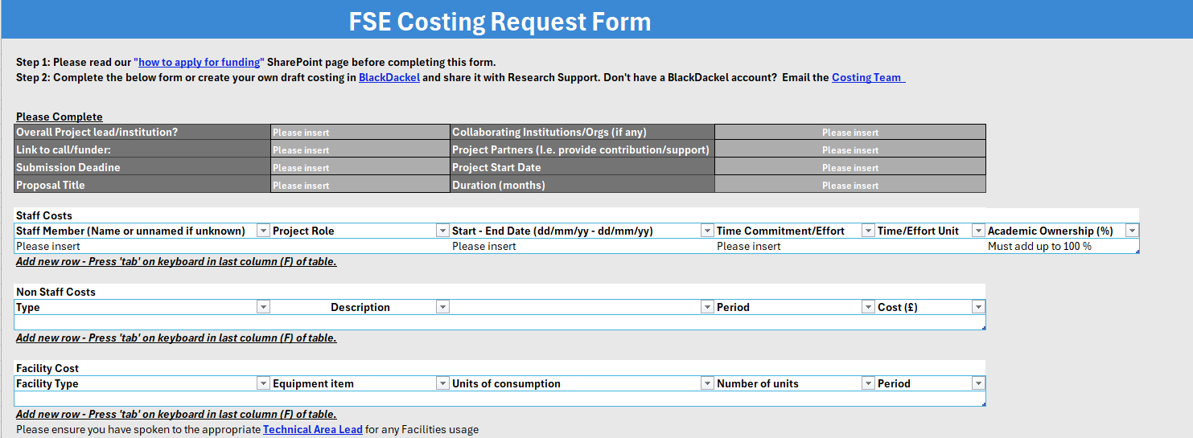
Costing Request Form (CRF)
Available on the FSE SharePoint or email our team for a copy!

Slide 12
What Costs Can I Ask For?
Staff Costs:
  Researcher time (your own time, PDRA, Research Assistant)
  Technician time (engineers, experimental officers, computer tech, software engineers, research IT)
  Note – minimum 30% DA tech time to be included on all projects, where eligible
Non-staff Costs:
  Travel and Subsistence
  Conference costs
  Consumables
  Facilities and Equipment (anything >£25k inc. VAT)
  Etc, etc…

Slide 13
30% DA Technician Time – Why? (exc Maths)
You are encouraged to discuss technical resource requirements for each project with the technical operations team who will be able to advise on the best approach
The Faculty expectation is that the minimum average level of technical resource required to support all research projects is 30% of a Grade 5 technician – in addition to any project specific technical support
Costs to cover the 60 technical staff who are not directly linked to specific research projects.
  FSE Infrastructure & Facilities (I&F) Team
  Stores
  Technical Operations leadership team
Where technician time is eligible, and there is no clear justification to not include it, this will be added to the budget. If there is a clear justification to remove this technician time, please speak to the technical operations team in the first instance

Slide 14
What Are Overheads?
3 Types:
  Estates – Pays for the buildings, labs, maintenance, repair, upkeep, cleaning, insurance etc.
  Indirect Costs – Pays for university functions, e.g. library staff, IT services staff, research support staff, administrators, security etc.
  Technicians Infrastructure – Small overhead charged by departments which use laboratories
NOTE – Overheads are high! – They are calculated per FTE of academic time pro rata – currently they add around £100k+ per annum per 1 FTE of staff. Please bear in mind, your Research Support Officer will include these overheads in your costing based on your request. We cannot change them.

Slide 15
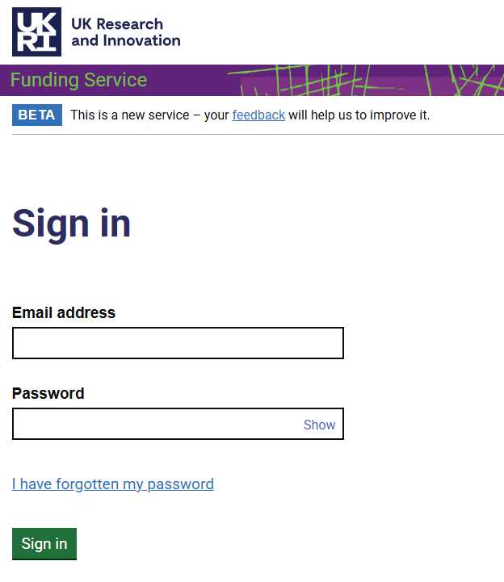
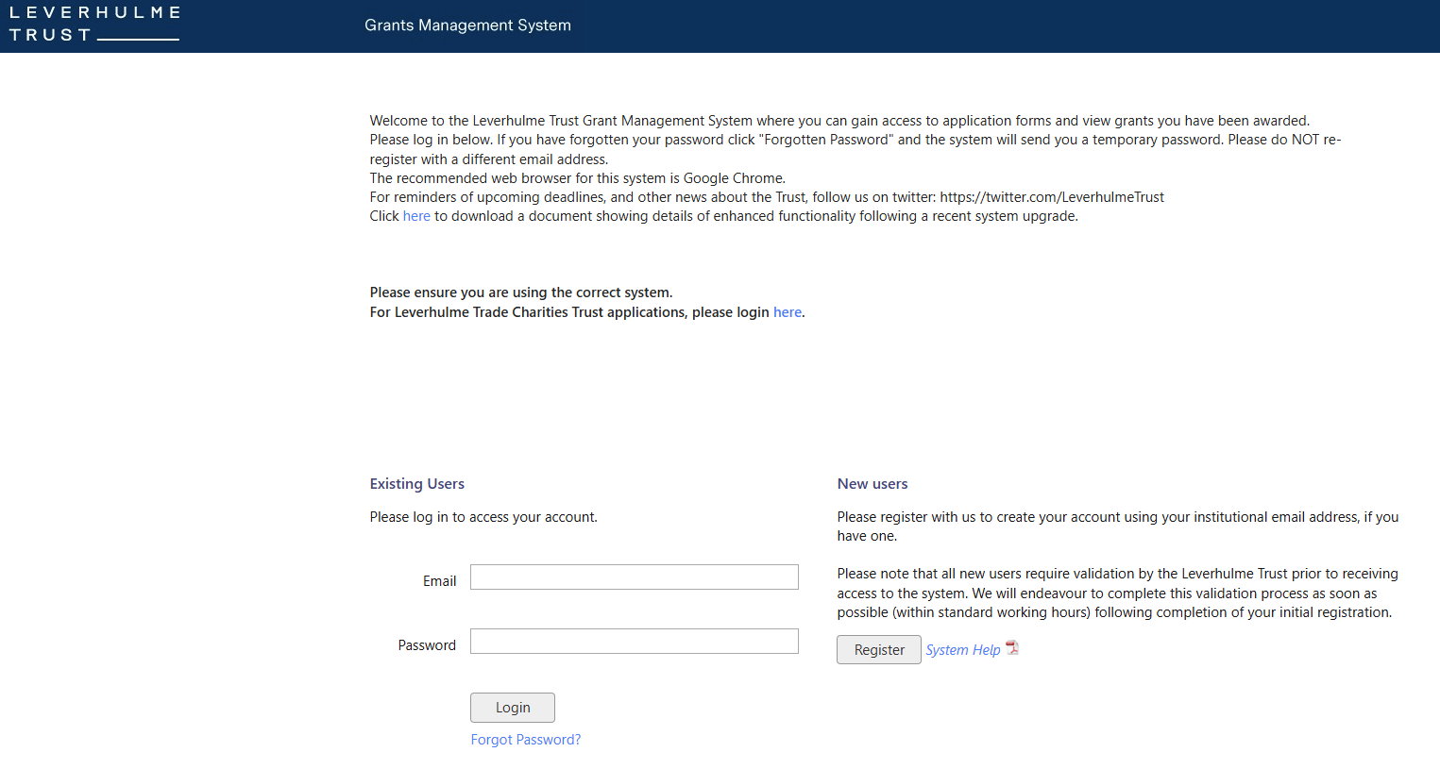
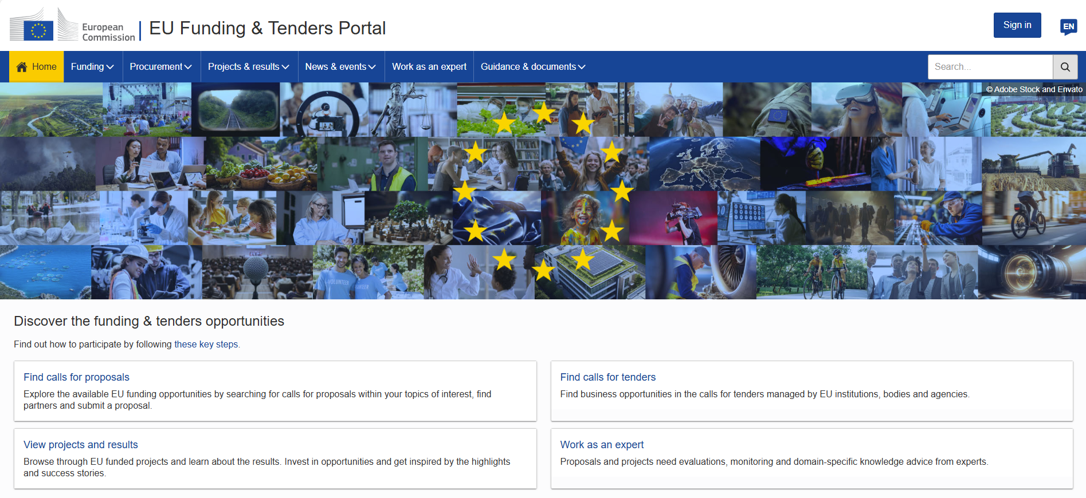
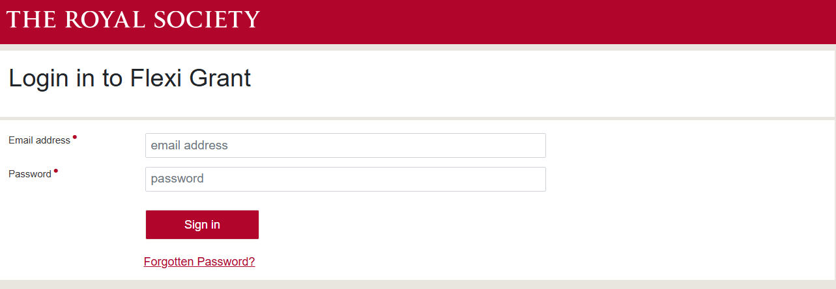
Application Portals
All UKRI applications use The Funding Service (TFS)
Royal Society use Flexigrant
European Commission uses the EU Portal
Leverhulme use the Grants Management System

Slide 16
Award
Notify your RSO contact of the award outcome
Unsuccessful – your RSO will update your Pure application record
Successful – your RSO will use the award confirmation and awarded budget documents to set up your Pure award record
If required, RSO will work with contracts to get any collaboration agreements/other contracts signed
RSO will handover to Research Finance to complete the setup
Recruitment? We will support and help you gain approval for any recruitment you are undertaking (via the ECR system or JobTrain)

Slide 17
Key Message
Here is a list of who we may need to speak to before your application is approved:
Business Engagement
Technical Operations
Research Finance
TIME
Knowledge Exchange
Research Development
Contracts
P&OD
Doctoral Academy
Consultancy
Facility Managers
School Operations
Regulatory Compliance

Slide 18


Any Questions?

