Slide 1
Physics and Astronomy
Fellowships
Darren Graham, Departmental Head of Research
Physics and Astronomy

Slide 2



Fellowships are funding for individual researchers. They allow you to devote time to your own research and provide support for you to develop as a research leader. Fellowships often include career development opportunities like training, mentorship and international placements.
The objectives of the URF programme are to enable outstanding early career scientists with the potential to become leaders in their field to:
Build an independent research career at a UK university or research institution
Gain the freedom, time, and long-term flexible support to pursue high-quality and innovative lines of scientific research
Develop as research leaders by offering tailored high-quality professional development, networking and engagement opportunities.
Giving early career scientists or engineers of exceptional promise the opportunity to conduct research of their own instigation.

Slide 3
What is a Research Fellowship?
- An independent research position held in a university, but (usually) funded by an
external body.
- May be a fixed-term post in its own right, or held (on a fixed-term basis) by somebody
with a substantive position.
- Some universities offer permanent posts to winners of very prestigious fellowships.
Details (eligibility, length, permitted hosts etc) vary wildly between schemes.
Applications: find a host then work with them to apply to funder.
Is a Research Fellowship for Me?
- Yes, if you have (and can articulate!) a clear and convincing vision for your own
research programme.

Slide 4
Fellowships in Physics and Astronomy
Early-Career/Postdoctoral
Marie Curie (3)
Leverhulme Early Career (1)
Royal Commission 1851 (1)
UKRI Steven Hawking (1)
EPSRC Postdoctoral (1)
RAEng Early Career (0)
Early-Career “Tenure Track”
RS URF (7)
RS Dorothy-Hodgekins (2)
RS Career Development (0)
STFC Ernest Rutherford (4)
UKRI Future Leaders Fellowship (5)
EPSRC Open (1)
European Research Council
ERC Starting (4)
Consolidator (1)
Advanced (3)
Internal/tenure-track
DKO (Kathleen Ollerenshaw) (~4)
Presidential Fellowships (2)
Notes:
Total ~40 fellowship equivalent for 132 staff (83 T&R, 19 R, 8 T), although many are “overlapped”

Slide 5
Royal Society University Research Fellowships (URFs)
- Eligible 3-8 years from PhD
- Up to 8 years (!) duration
- Very much open to fundamental research: quality is what matters.
- Seriously competitive.
Last year 15 applications, 9 progressed to 2nd stage, 3 got to interview
University-funded Fellowships
- Tenure-track fellowships (e.g. DKO Fellowships in Manchester) are at least as desirable and competitive as permanent lectureships.
This year we had 42 applications

Slide 6
Sift process
Many fellowships have demand management (limited places per university), such as ERF (7), FLF (10), RAEng (2) or are limited by Faculty for cost reasons (Leverhulme).
For these, we must have a sift process at University, Faculty, School or Department level.
Your RSM will indicate this, and typically a short (1-3 page) expression of interest will be reviewed/ranked by relevant group leads.
If you are not supported, you will not be able to apply via Manchester.

Slide 7
Internal Peer Review
UoM policy is for all grant applications to have an internal peer review.
For Fellowships, we recommend at least two internal reviewers:
Head of prospective group or delegated mentor (Science Case)
Non-domain expert/generalist (Person Case)
Department Head of Research can allocate this.

Slide 8
Group structure
Research Groups
Accelerator Physics (HoG Darren Graham)
Astrophysics (HoG Richard Battye)
Biological Physics (HoG Jian Lu)
Condensed Matter Physics (HoG Andrei Golov)
Nuclear Physics (HoG Kieran Flanagan)
Particle Physics (HoG Andrew Pilkington)
Particle Theory (HoG Jeff Forshaw)
Photon Physics (HoG Mark Dickinson)
Fluids & Soft Matter Physics (HoG Anne Juel)
Theory Group (HoG Ahsan Nazir)
Institutes
Cockcroft @ Daresbury
Director: Stewart Boogart
Jodrell Bank Centre for Astrophysics
Director: Keith Grange
National Graphene Institute
Director: Vladimir Falko
Photon Science Institute
Director: Mark Dickinson
Others beyond P&A:
MIB, Dalton Cumbria, UoM@Harwell, Royce, GEIC, The Christie, etc.

Slide 9
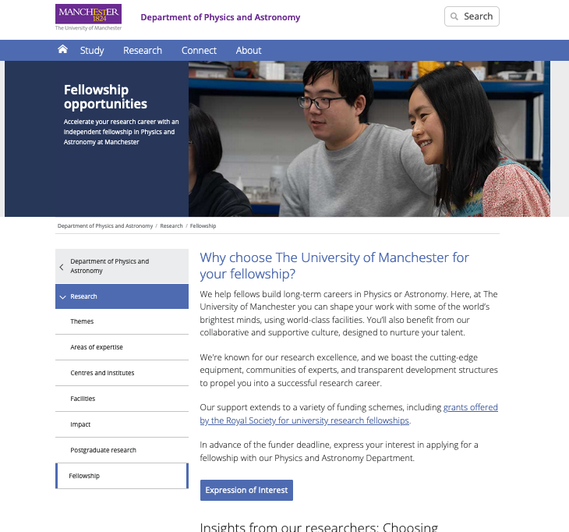
www.physics.Manchester.ac.uk/research/fellowship/ or physics-fellowships@Manchester.ac.uk

Slide 10
My Personal Fellowship Experience
2005 – PhD
2006-2010 – Postdocs (x 3)
2010 – Applied for STFC, RS and EPSRC Fellowships
2011 – EPSRC Career Acceleration Fellowship awarded
2011 – Lecturer at Manchester
2019 – Senior Lecturer
2023 – Reader
2024 – Department Head of Research

Slide 11
Successful Applications?
Scheme
In scope, fit to theme, meets requirements, aligns with objectives
Most schemes are very competitive and there is no recipe for success.
Schemes vary greatly and you need to pay attention to one you are applying for.
Two top tips:
- It is never too soon to prepare “yourself” for an application
- It is more about the person than the project.
Person
Evidence of skills, experience, collaborators, leadership or engagement
Project
Novel, feasible, timely, risk managed, ethical, strategic, resourced

Slide 12
Holding Fellowships in Manchester
Our Department can host most kinds of fellowships.
Can provide extensive support with applying e.g. (internal feedback from experienced
applicants, mock interviews).
Alex and Frank will describe the processes.
But to start with, talk to us!

