Slide 1
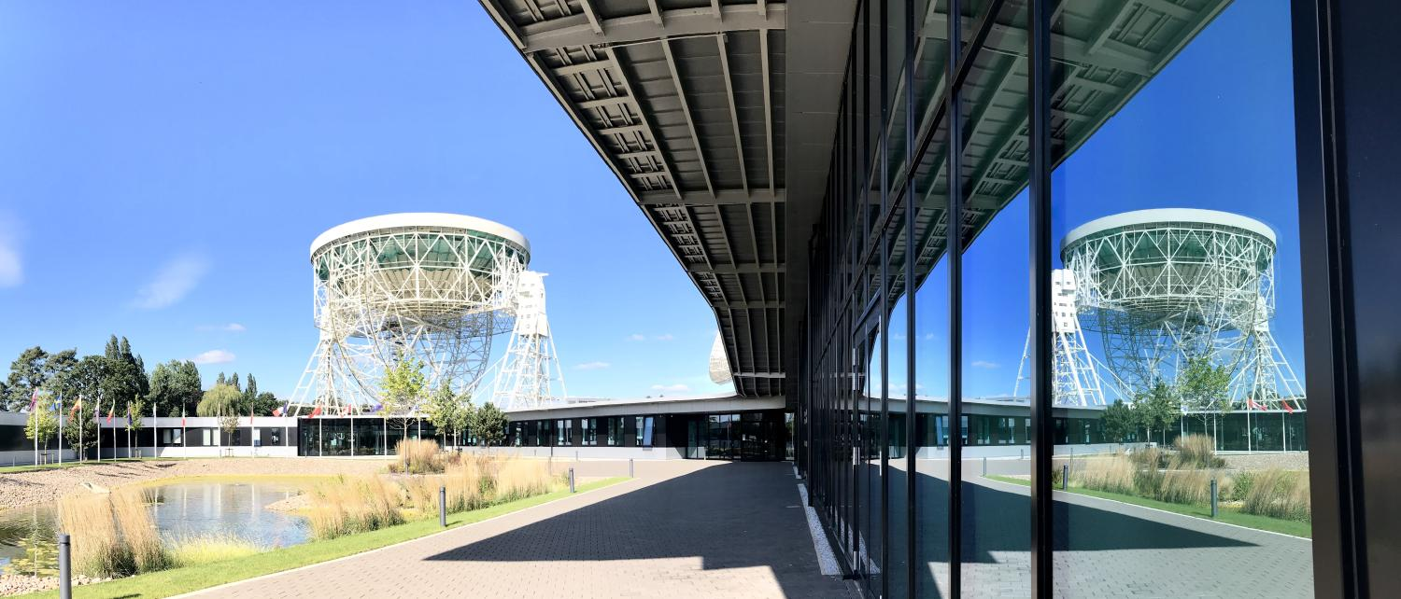
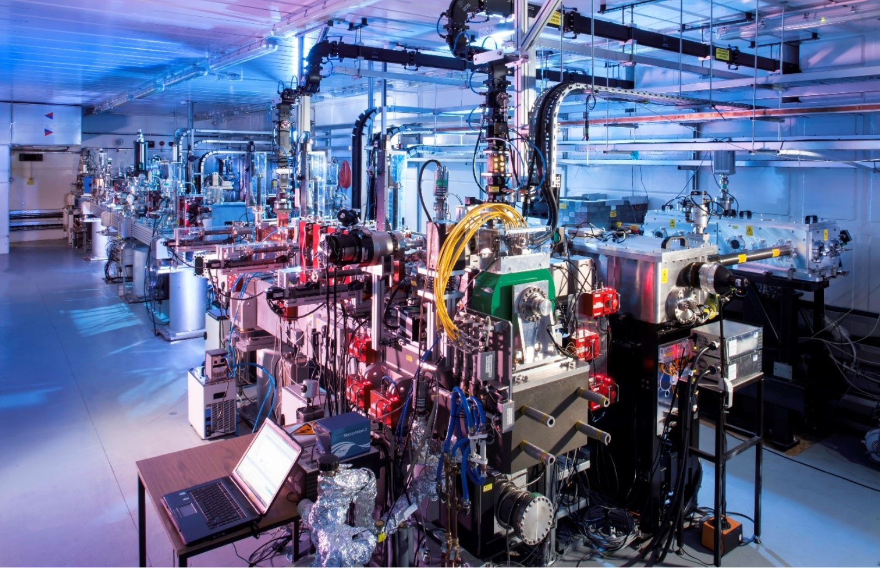
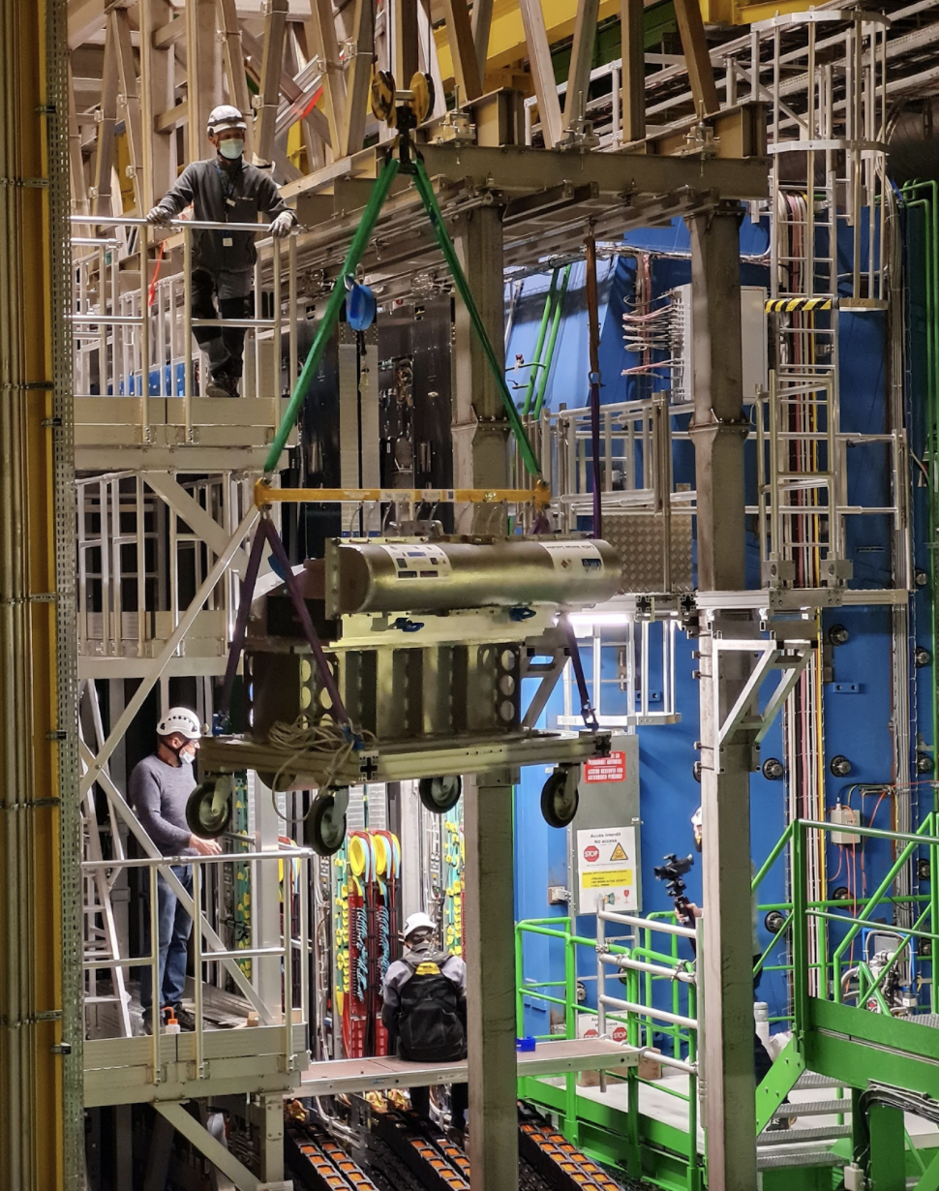
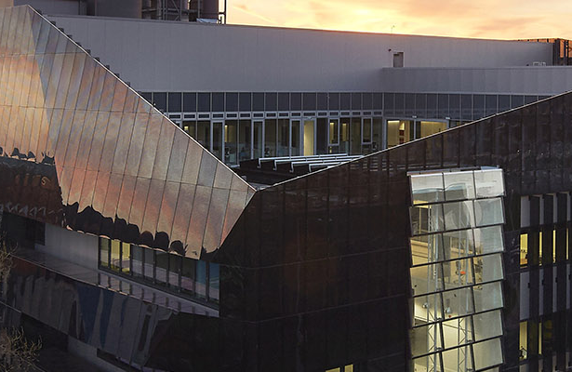
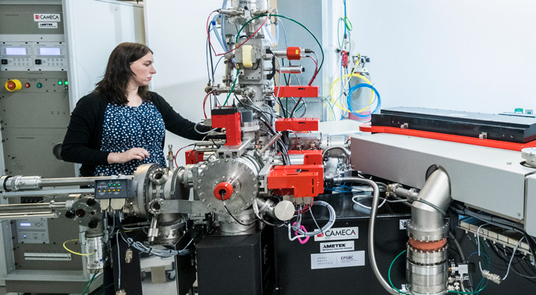
JBCA &
SKA HQ
Physics & Astronomy
5th May 2026
Cockcroft Institute,
Daresbury
Intro to department
Chris Parkes, Head of Department
National Graphene
Institute
Photon Science
Institute
CERN
& LHC

Slide 2
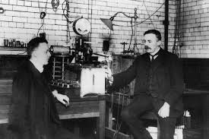
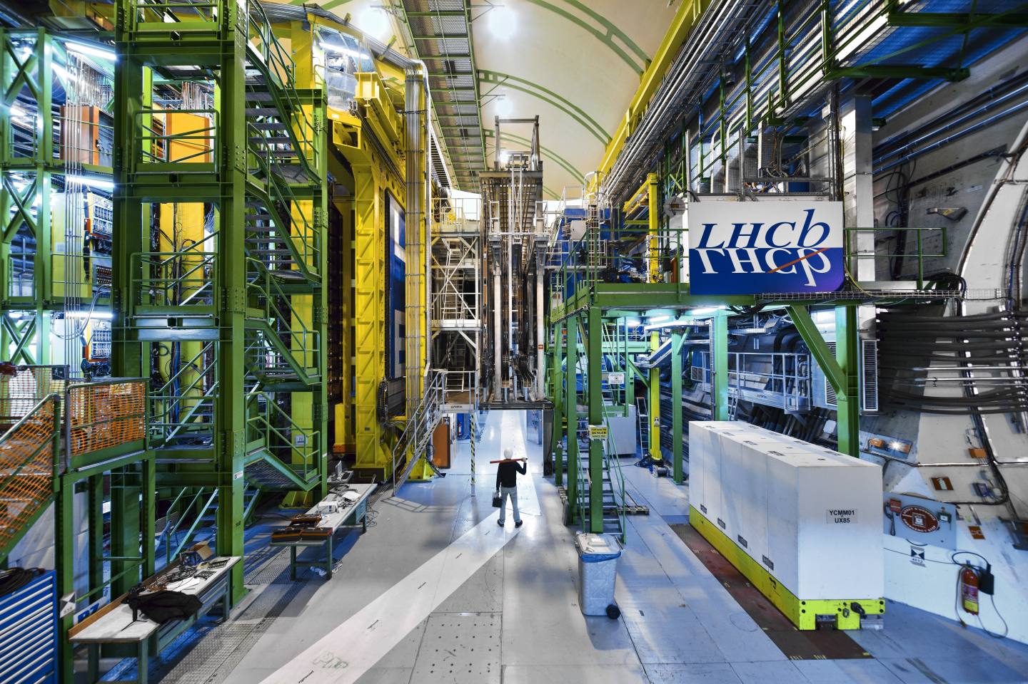
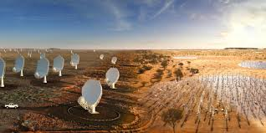
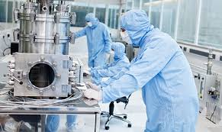
Legacy
Internationally recognized department with 150 year history
One of the birthplaces of following fields:
Nuclear Physics: Discovery of nucleus, splitting of atom
Quantum Physics: Niels Bohr theory, dilution refrigerator
Particle Physics: First non-standard matter particle (Kaon)
Radio Astronomy: Jodrell Bank
2D Materials: Graphene
In many cases our international leadership today can be traced to this lineage

Slide 3

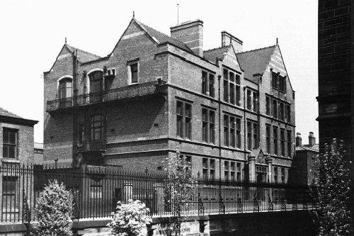
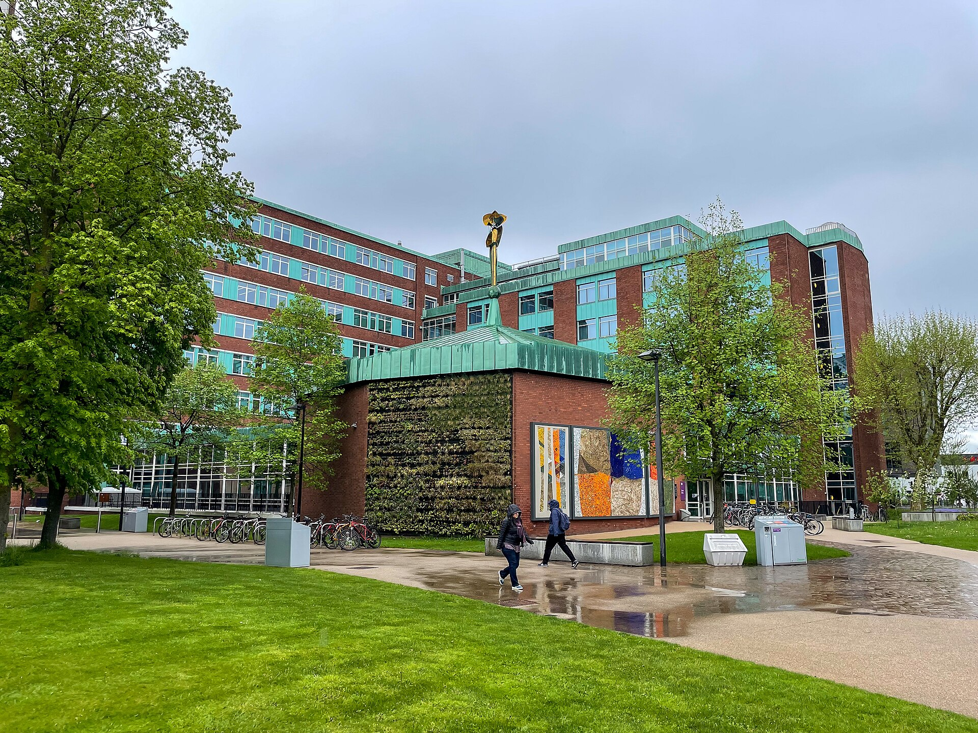
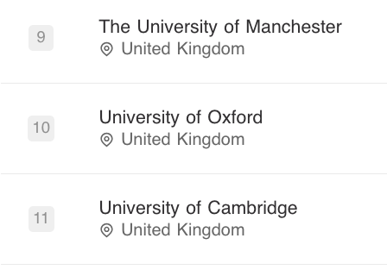
Physics at UoM
150 Years of
Manchester Physics
Large department with wide research portfolio
113 academic staff + senior fellowships
~215 grant supported staff
324 PhD Students
and largest undergrad. cohort in UK
1173 undergraduates
101 taught postgrad (Nuclear Technology)
Physics

Slide 4

Research Groups today
Research Areas: (% academics, <5% Teaching only)
39%: Particle Physics, Nuclear Physics, Accelerator Science
27%: Astrophysics (Cosmology, Extra-Galactic, Galactic, Pulsars…)
34%: Condensed Matter; Quantum Tech; Bio-physics; Fluids; Theory

Slide 5
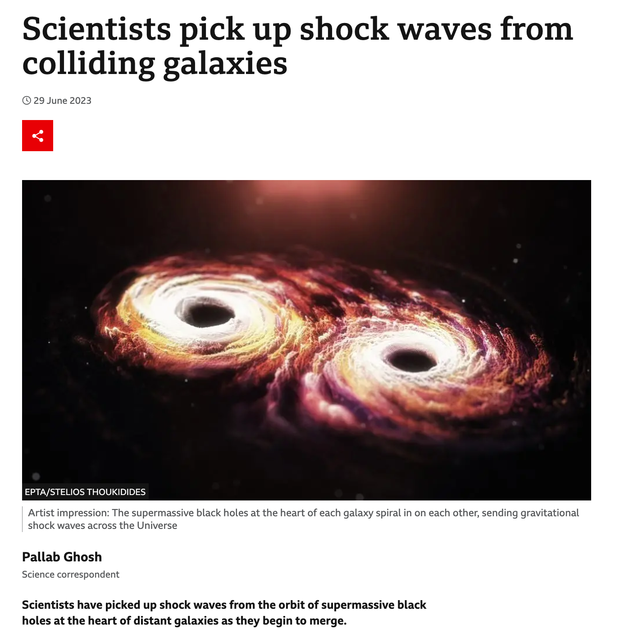
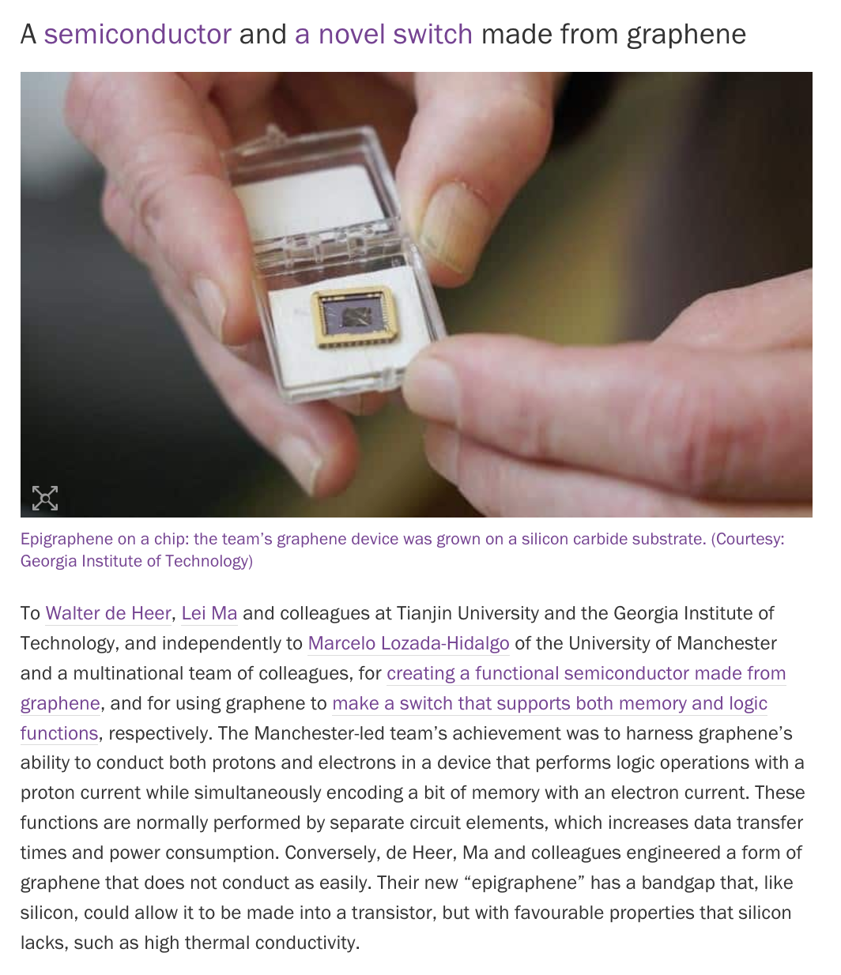
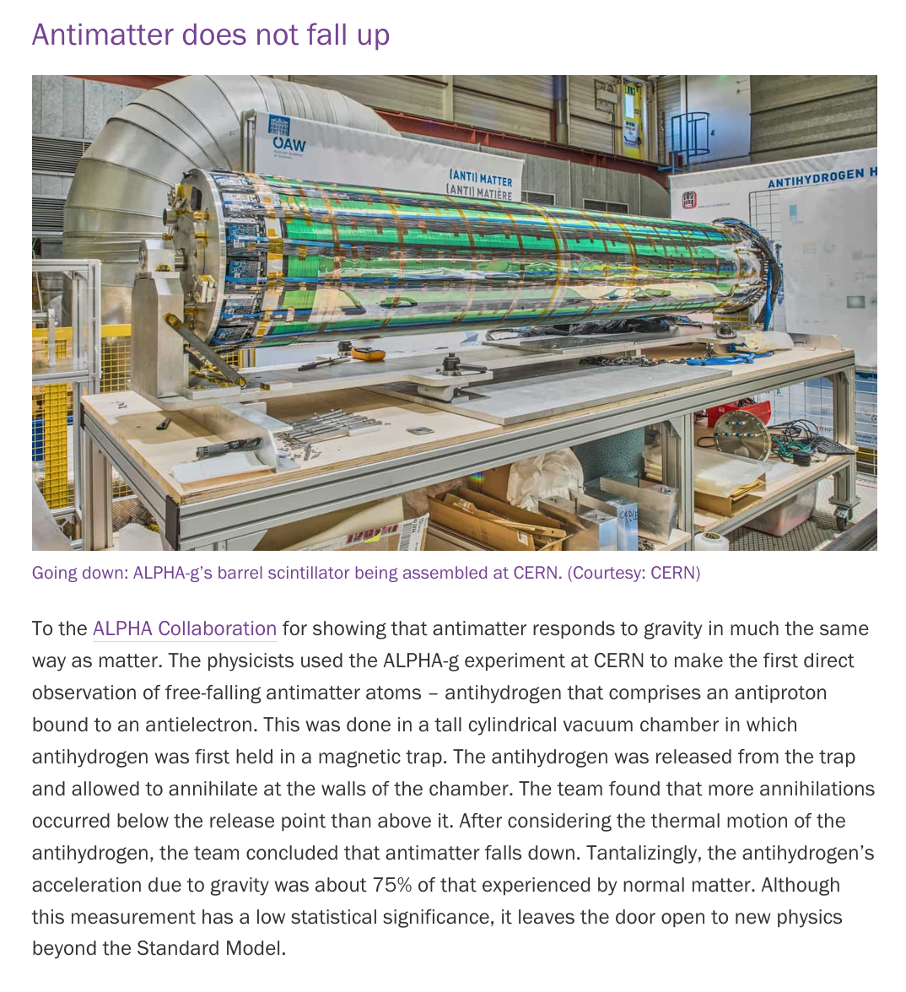
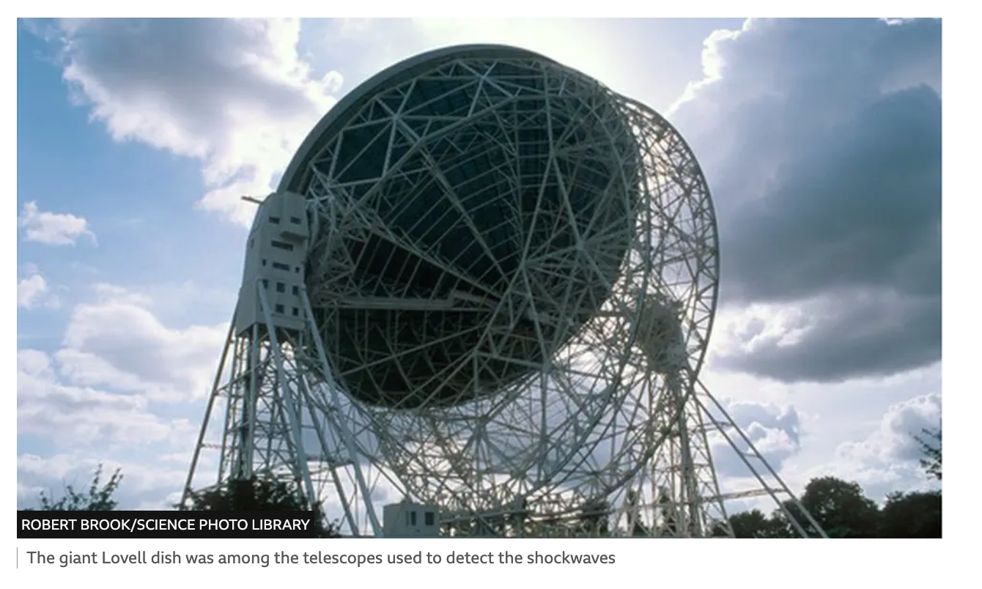
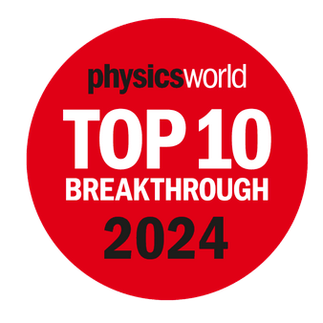
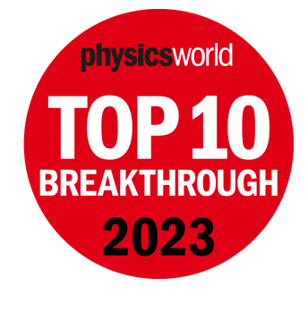

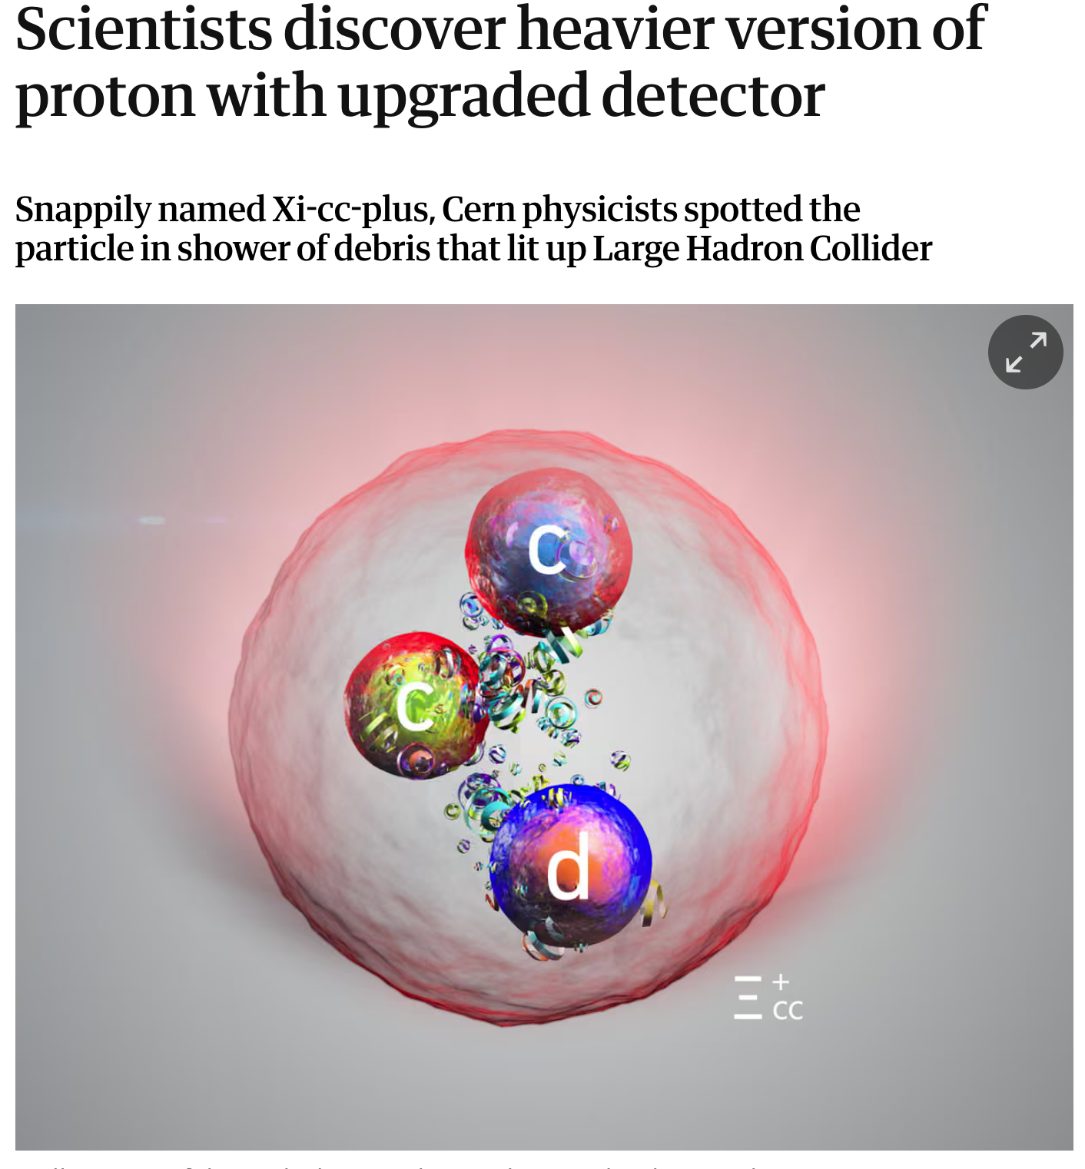


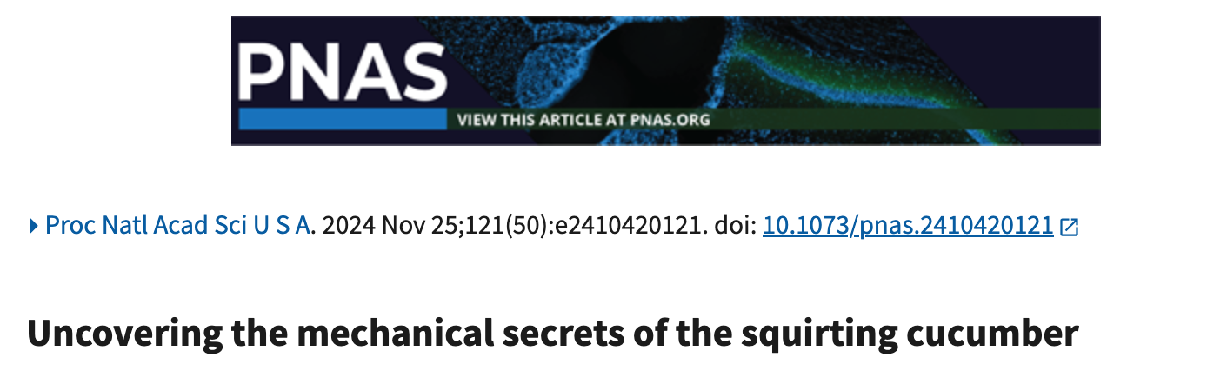
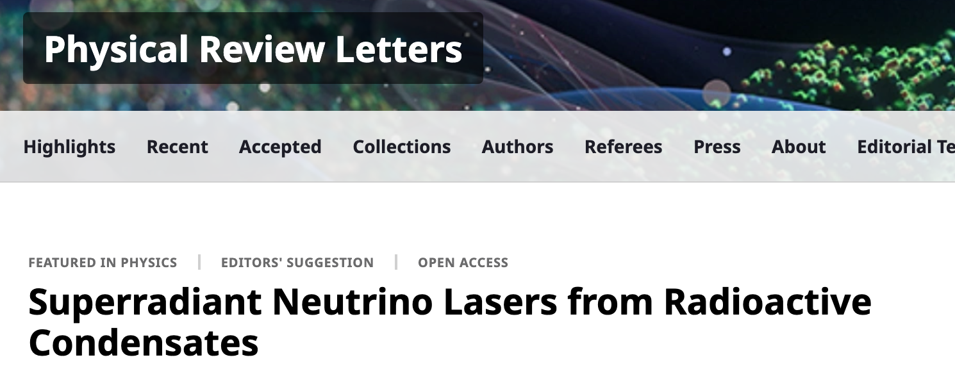
Some recent examples in media

Slide 6
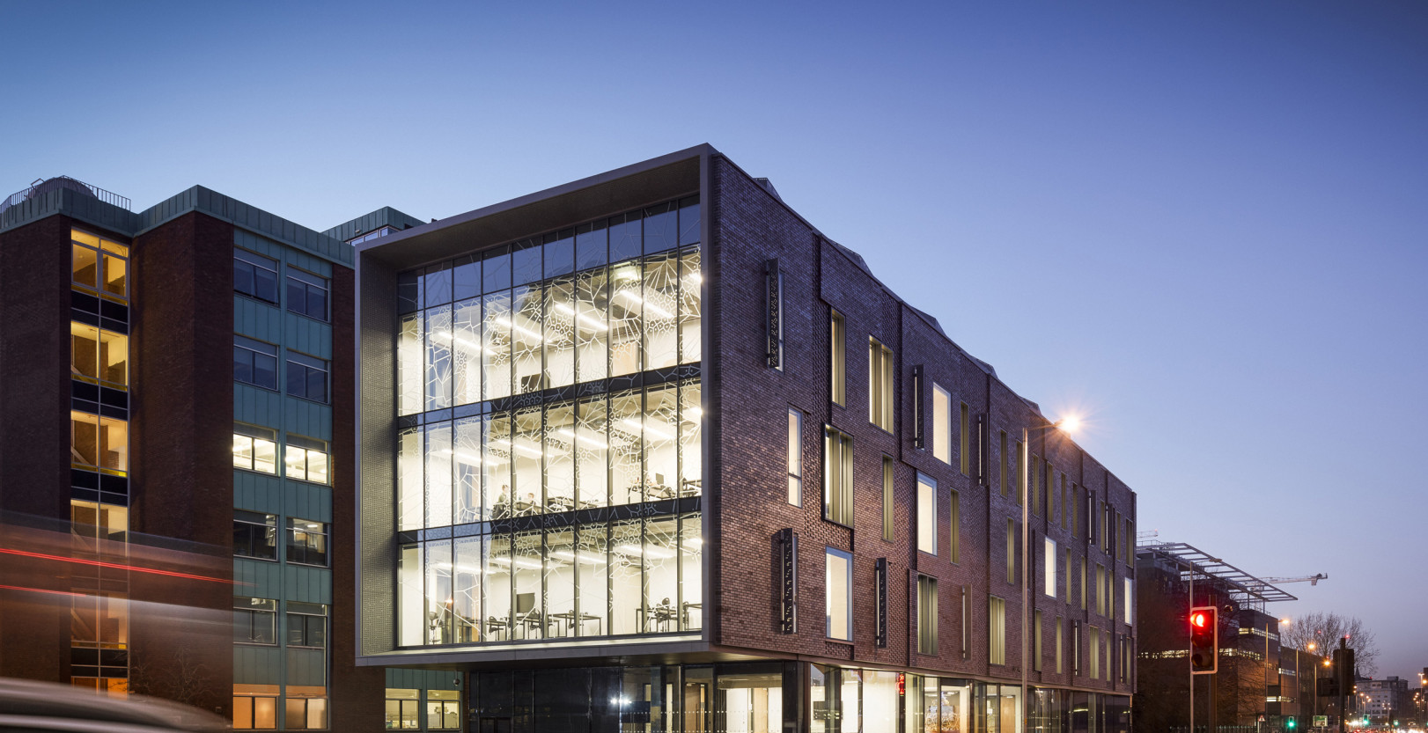
Welcome !
Please take advantage of the opportunities in the department:
Schuster Colloquium, and seminars in your research areas
Summer party - research overview….
Outreach opportunities….
Pleased to hear any ideas for
Improving our department

