Slide 1
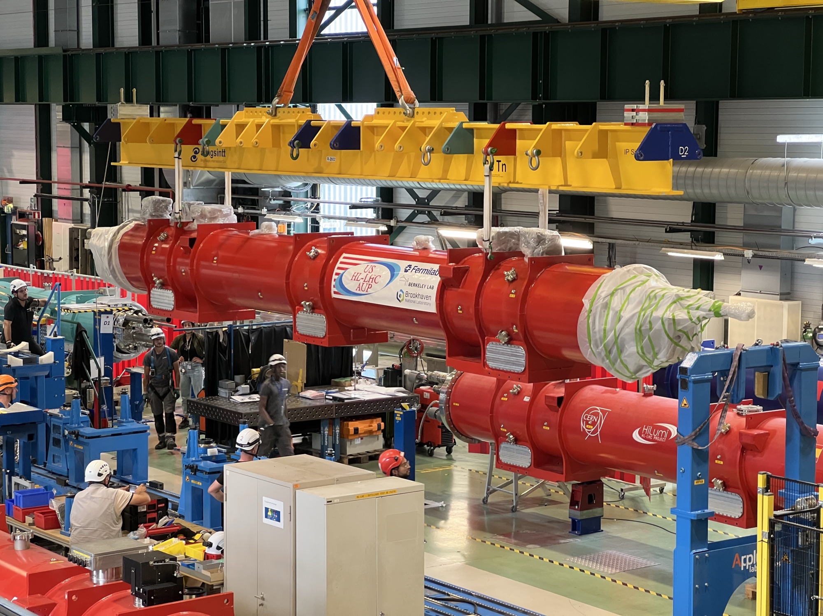

High Field Magnets
May 21, 2026
S. Gourlay
Director, Magnet Technology Division
DPF/DNP Community Meeting

Slide 2
A Historical Perspective to Track the Evolution of “High Field”
The highest achievable field is always determined by the conductor and our ability to utilize it effectively.
Other conductors with interesting properties, but not competitive
MgB₂ (not so HT HTS)
Sr/BaFe₂As₂:K (Iron-Based)
Nb-Ti – 8T
Nb₃Sn – 14T
Bi-2212 – 36T – NMR configuration
ReBCO - > 40T?
All magnets operate with “margin,” typically at about 80% of the conductor limit.
  So, an 8T magnet would in principle reach 10T (LHC example)
  For an ensemble of magnets, margin is required due to manufacturing tolerances, variations in operating environment, etc.

Slide 3
Nb-Ti
1960’s – 1970’s: Early development and proof of principle
  Some prototypes built
  1968 BNL Summer Study (200 physicists and engineers for 6 weeks)
    Major steps toward practical application
    Discussion of doubling the energy of the NAL accelerator using Superconducting magnets
  Panel discussion at the 1971 Particle Accelerator Conference was the kick-off of superconducting magnets in accelerators
    Paper on compact, fully transposed cable produced by Rutherford lab
1980’s: Tevatron – First large-scale deployment (4.5T @ 4.5K)
  Many innovations developed then are still in use today - set the standard for future accelerators.
  Provided a basis for a conductor industry that benefited all subsequent projects.
  Practical limit for Nb-Ti thought to be 5 – 6T
  Considerable parallel effort in developing Nb₃Sn due to potential for higher field. Significant field boost for Nb-Ti in superfluid but cryo considered too expensive and risky at that time.

Slide 4
Nb-Ti Performance Plateau achieved ~ 4 Decades
ISABELLE – BNL
ISR Quads - CERN
Tevatron
1990’s – 2000’s: Maturation and Industrialization
  Became world-wide workhorse for accelerators.
2000’s – Present: LHC – Practical limit of Nb-Ti
  Low-profile R&D started in the 1980’s
  Much was based on SSC and ISABELLE tech
    Collars, Cold Iron Yoke, two-in-one design
    High quality Nb-Ti alloy – US Conductor Development Program
  LHC innovations
    Large-scale industrialization
    Operation at 1.9K
HERA
Other projects around the same time as the FNAL Energy-Doubler
ESCAR – LBL
TRISTAN - KEK
UNK - USSR
SSC
50% Conductor
Improvement
RHIC
LHC

Slide 5
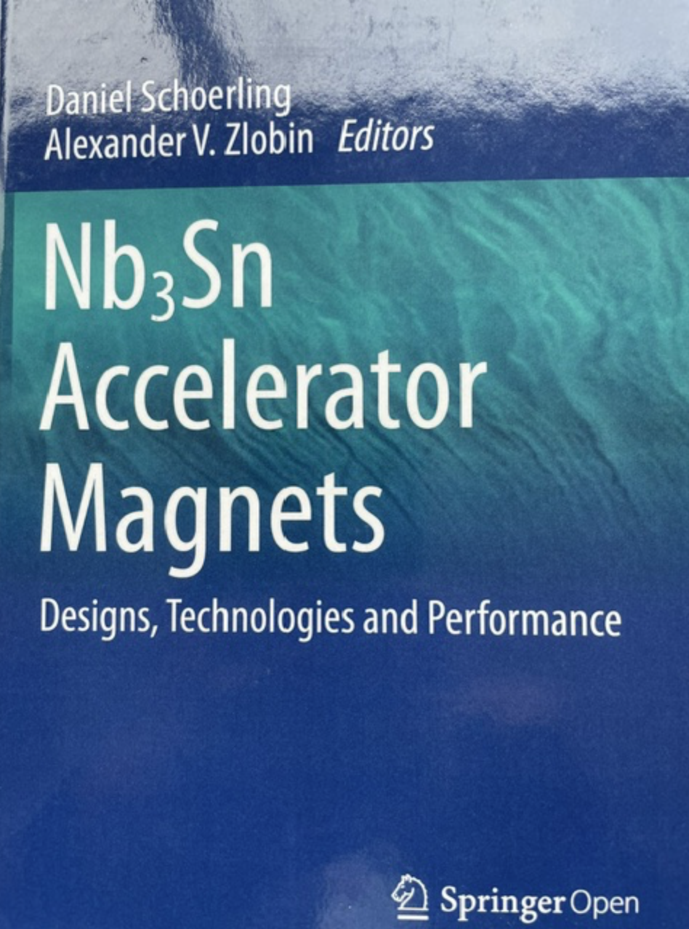
Nb₃Sn
1960’s – 1980’s
  First Nb₃Sn accelerator magnets were built at BNL
  Several other efforts during this time period
    CERN (Asner) – 10T achieved
    CEA Saclay
    LBL D10 – 9T @ 1.8K
    KEK
At the time SSC decisions were made:
  Nb-Ti – mature, ductile, industrialized, proven in accelerators
  Nb₃Sn – higher potential field, but brittle, poor reproducibility at scale, not production ready.
  Industrialization of superfluid cryogenics now deemed easier to achieve,
  less expensive and less risky than Nb₃Sn magnets.
  But, in the background, SSC R&D provided the environment for the development of modern Nb₃Sn accelerator magnets.

Slide 6
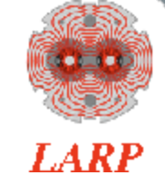



Breakthrough in Nb₃Sn Magnet Technology
1990’s – 2010’s
  First accelerator-style dipoles
    U. Twente – 11T
    LBNL D20 – 13T
  Evolved into a series of high field demonstrations at LBNL D20 HD1 (16T) HD Series
LHC Accelerator Research Program (LARP) established 2003 – develop Nb₃Sn quads for LHC Hi-Lumi upgrade (BNL, FNAL, LBNL)
US Magnet Development Program created in 2015 (BNL, FNAL, LBNL, FSU/NHMFL)
In 2016 LARP transitioned to US Accelerator Upgrade Project – Completion in FY28
Tech X-fer to CERN

Slide 7
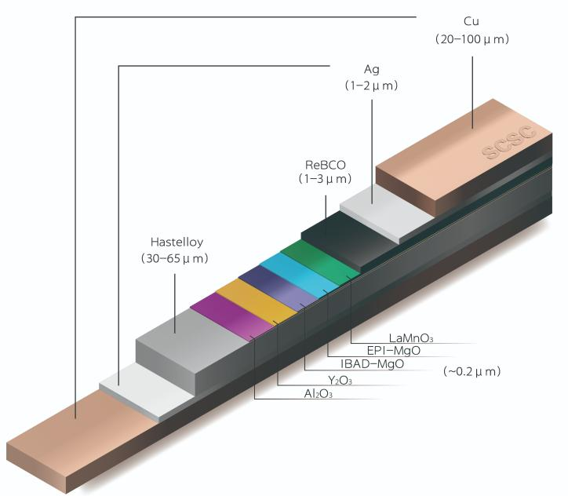
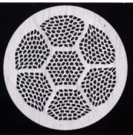
On to a New Frontier
High Temperature, High Field Superconductors
ReBCO (Rare-earth barium copper oxide)
Pros
  Very high field capability >20T
  Very high current density
  Reasonable mechanical strength (some issues)
  No reaction after winding
  Can operate at 20K
  Growing industrial capacity – availability/lower cost
Cons
  Flat tape 2 – 12 mm - Difficult to cable
  Anisotropic
  Quench detection
  Expensive
Bi-2212 (Bismuth strontium calcium copper oxide)
Pros
  Round, Multifilament wire – Rutherford Cable
  20T achieved
  High current density
  Isotropic – better field quality, uniform current distribution
Cons
  Mechanically weak (silver matrix)
  Heat treatment at 890⁰C/ 50 bar O₂
  Limited to low temperatures
  Very limited industrial capacity
  Expensive

Slide 8

Moving Forward – Reality Check
Creating a world-leading US magnet R&D program in the current environment
Funding and completion of current project commitments dictate priorities.
Proposed Strategy
  Focus on ReBCO – huge potential for growth to support future DOE facilities, societal applications
  Expand into fusion magnet technology (symbiotic relationship)
  Solutions to many of the challenges can be explored via small-scale experiments
  Exploit new facilities – e. g. MAGNES (high current cable and magnet test facility funded by HEP/FES)
  Bi-2212 has some advantages for certain applications – but very limited commercial interest
Nb₃Sn outserts for testing HTS coils in high background field
ReBCO prototype achieved 6T
Technology development: design, fabrication methods, instrumentation, quench detection, magnet protection
Conductor development and characterization

