Slide 1
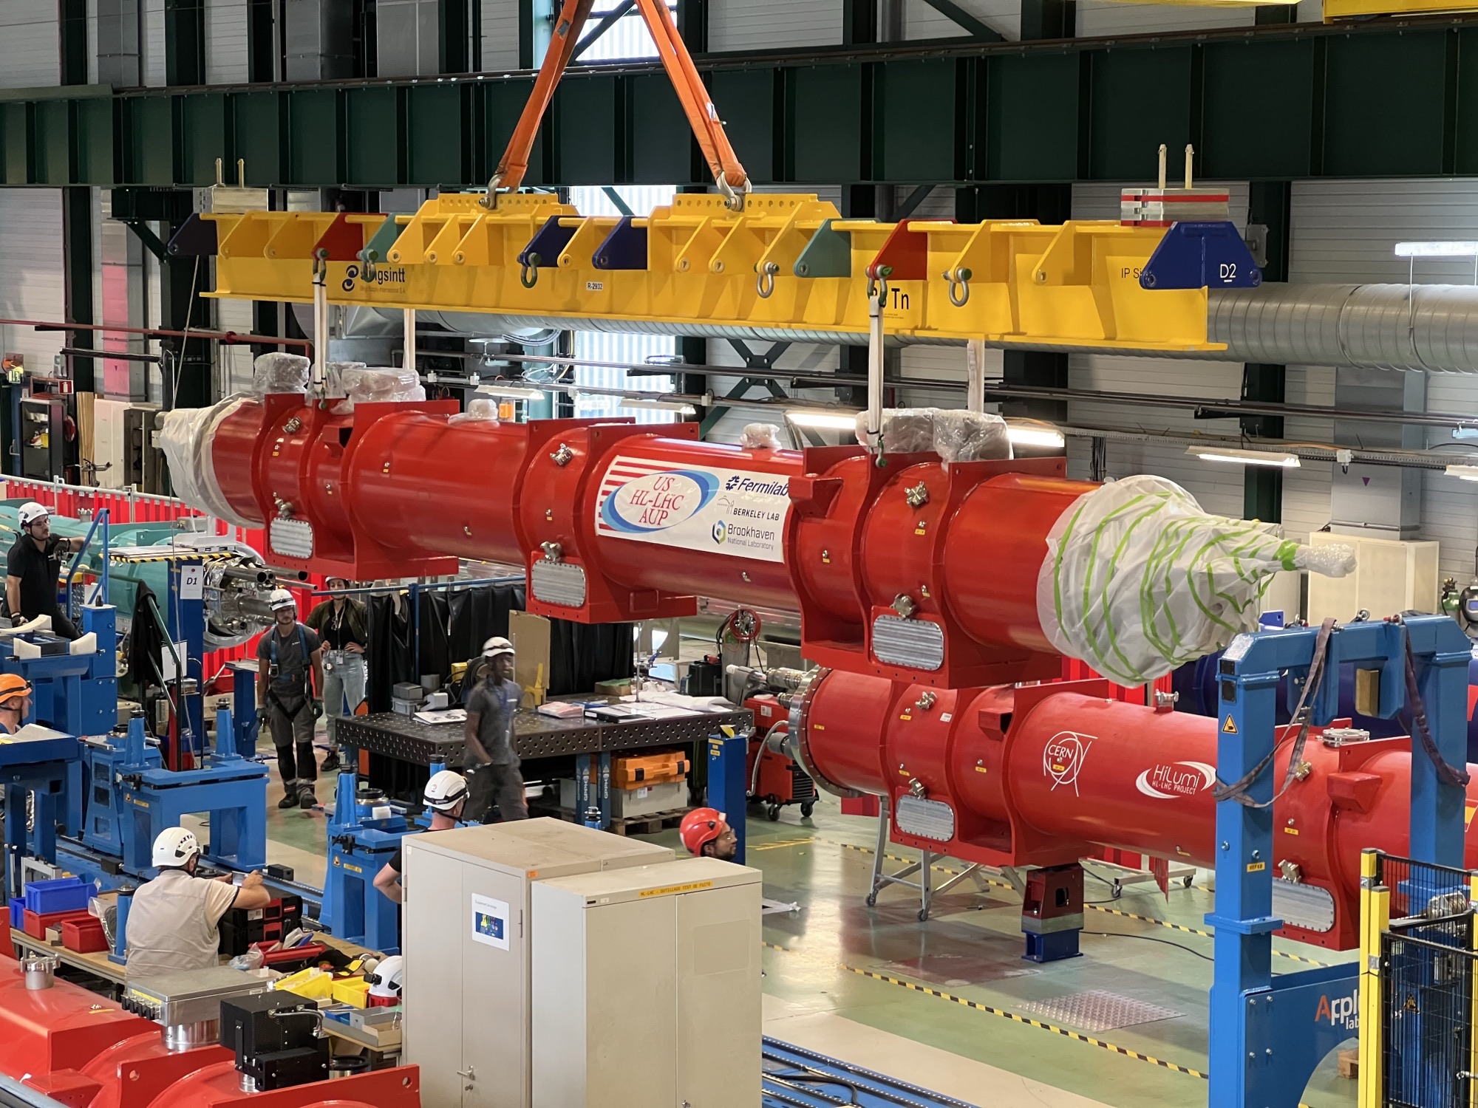

High Field Magnets
May 21, 2026
S. Gourlay
Director, Magnet Technology Division
DPF/DNP Community Meeting

Slide 2
A Historical Perspective to Track the Evolution of “High Field”
The highest achievable field is always determined by the conductor and our ability to utilize it effectively.
Other conductors with interesting properties, but not competitive
MgB₂ (not so HT HTS)
Sr/BaFe₂As₂:K (Iron-Based)
Nb-Ti – 8T
Nb₃Sn – 14T
Bi-2212 – 36T – NMR configuration
ReBCO - > 40T?
All magnets operate with “margin,” typically at about 80% of the conductor limit.
So, an 8T magnet would in principle reach 10T (LHC example)
For an ensemble of magnets, margin is required due to manufacturing tolerances, variations in operating environment, etc.

Slide 3
Nb-Ti
1960’s – 1970’s: Early development and proof of principle
Some prototypes built
1968 BNL Summer Study (200 physicists and engineers for 6 weeks)
Major steps toward practical application
Discussion of doubling the energy of the NAL accelerator using Superconducting magnets
Panel discussion at the 1971 Particle Accelerator Conference was the kick-off of superconducting magnets in accelerators
Paper on compact, fully transposed cable produced by Rutherford lab
1980’s: Tevatron – First large-scale deployment (4.5T @ 4.5K)
Many innovations developed then are still in use today - set the standard for future accelerators.
Provided a basis for a conductor industry that benefited all subsequent projects.
Practical limit for Nb-Ti thought to be 5 – 6T
Considerable parallel effort in developing Nb₃Sn due to potential for higher field. Significant field boost for Nb-Ti in superfluid but cryo considered too expensive and risky at that time.

Slide 4
Nb-Ti Performance Plateau achieved ~ 4 Decades
ISABELLE – BNL
ISR Quads - CERN
Tevatron
1990’s – 2000’s: Maturation and Industrialization
Became world-wide workhorse for accelerators.
2000’s – Present: LHC – Practical limit of Nb-Ti
Low-profile R&D started in the 1980’s
Much was based on SSC and ISABELLE tech
Collars, Cold Iron Yoke, two-in-one design
High quality Nb-Ti alloy – US Conductor Development Program
LHC innovations
Large-scale industrialization
Operation at 1.9K
HERA
Other projects around the same time as the FNAL Energy-Doubler
ESCAR – LBL
TRISTAN - KEK
UNK - USSR
SSC
~X2 Conductor
Improvement
RHIC
LHC

Slide 5
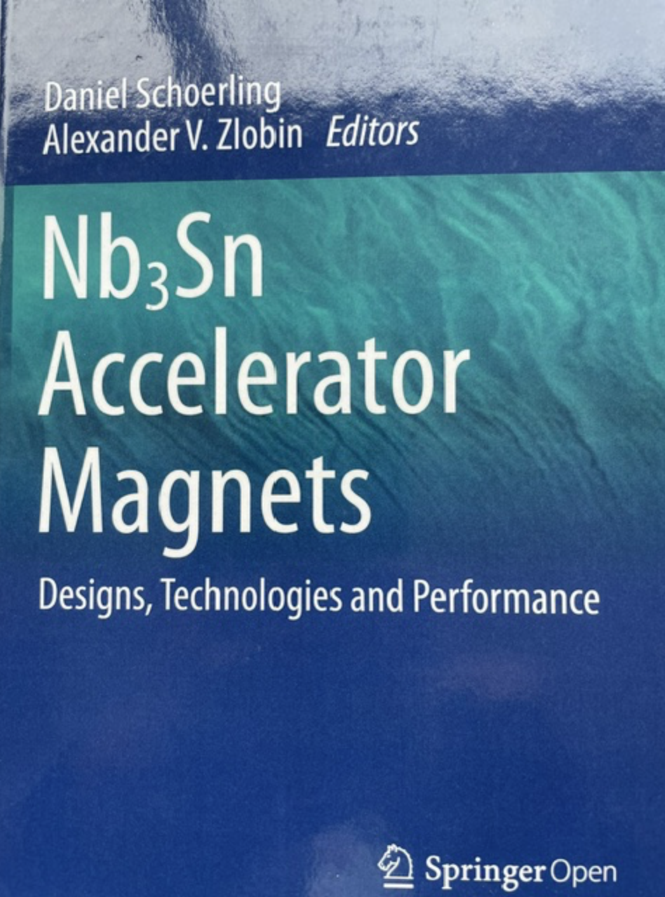
Nb₃Sn
1960’s – 1980’s
First Nb₃Sn accelerator magnets were built at BNL
Several other efforts during this time period
CERN (Asner) – 10T achieved
CEA Saclay
LBL D10 – 9T @ 1.8K
KEK
At the time SSC decisions were made:
Nb-Ti – mature, ductile, industrialized, proven in accelerators
Nb₃Sn – higher potential field, but brittle, poor reproducibility at scale, not production ready.
Industrialization of superfluid cryogenics now deemed easier to achieve,
less expensive and less risky than Nb₃Sn magnets.
But, in the background, SSC R&D provided the environment for the development of modern Nb₃Sn accelerator magnets.

Slide 6
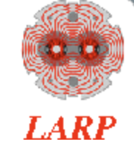



Breakthrough in Nb₃Sn Magnet Technology
1990’s – 2010’s
First accelerator-style dipoles
U. Twente – 11T
LBNL D20 – 13T
Evolved into a series of high field demonstrations at LBNL D20 HD1 (16T) HD Series
LHC Accelerator Research Program (LARP) established 2003 – develop Nb₃Sn quads for LHC Hi-Lumi upgrade (BNL, FNAL, LBNL)
US Magnet Development Program created in 2015 (BNL, FNAL, LBNL, FSU/NHMFL)
In 2016 LARP transitioned to US Accelerator Upgrade Project – Completion in FY28
Tech X-fer to CERN

Slide 7
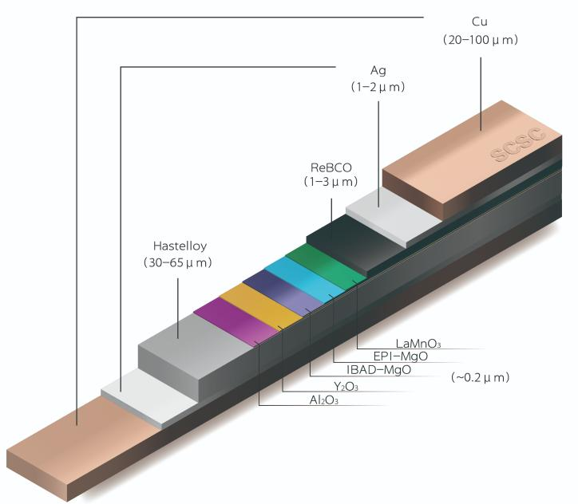
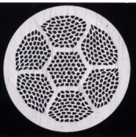
On to a New Frontier
High Temperature, High Field Superconductors
ReBCO (Rare-earth barium copper oxide)
Pros
Very high field capability >20T
Very high current density
Reasonable mechanical strength (some issues)
No reaction after winding
Can operate at 20K
Growing industrial capacity – availability/lower cost
Cons
Flat tape 2 – 12 mm - Difficult to cable
Anisotropic
Quench detection
Expensive
Bi-2212 (Bismuth strontium calcium copper oxide)
Pros
Round, Multifilament wire – Rutherford Cable
20T achieved
High current density
Isotropic – better field quality, uniform current distribution
Cons
Mechanically weak (silver matrix)
Heat treatment at 890⁰C/ 50 bar O₂
Limited to low temperatures
Very limited industrial capacity
Expensive

Slide 8

Moving Forward – Reality Check
Creating a world-leading US magnet R&D program in the current environment
Funding and completion of current project commitments dictate priorities.
Proposed Strategy
Focus on ReBCO – huge potential for growth to support future DOE facilities, societal applications
Expand into fusion magnet technology (symbiotic relationship)
Solutions to many of the challenges can be explored via small-scale experiments
Exploit new facilities – e. g. MAGNES (high current cable and magnet test facility funded by HEP/FES)
Bi-2212 has some advantages for certain applications – but very limited commercial interest
Nb₃Sn outserts for testing HTS coils in high background field
ReBCO prototype achieved 6T
Technology development: design, fabrication methods, instrumentation, quench detection, magnet protection
Conductor development and characterization

