Slide 1
Fermilab 2026
May 21, 2026
NORBERT HOLTKAMP
Fermilab Director

Slide 2
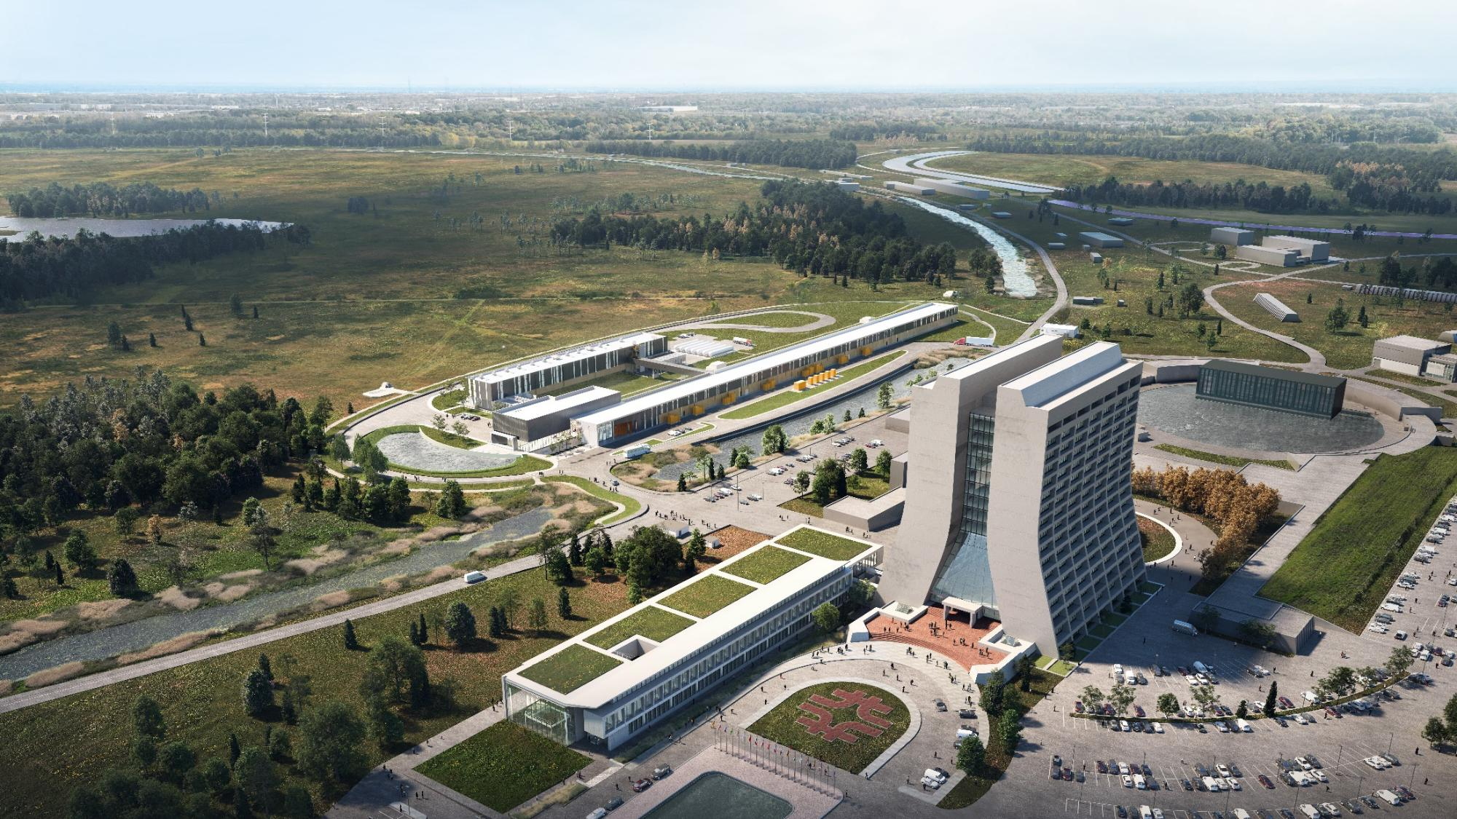
Fermilab at a glance
America's particle physics and accelerator laboratory
Operates the largest US particle accelerator complex
~1,900 staff and ~$780M/year budget
6,800 acres of federal land
Facilities used by 4,000 scientists from >50 countries
As we move into the next 50 years, we will continue to drive leadership in neutrino science and deliver and operate world-leading accelerator and detector facilities that enable transformative discovery.

Slide 3


The future of Fermilab
LONG-TERM VISION
Answering the important science questions in fundamental physics by building new instruments & executing groundbreaking experiments
NEAR-TERM VISION
Current priorities are recognized science drivers and steppingstones towards compelling long-term vision
Resolve the mysteries around the neutrino
Use the Higgs boson as a new tool
for discovery
Drive technology and innovation for the benefit of science and society
From neutrinos to the Higgs boson to quantum science, Fermilab is shaping the
next generation of scientific discovery and technology innovation
Notes:
Our long-term vision is to answer the most important questions in fundamental physics. This vision speaks to the expanding nature of science and the inherent role of a National Laboratory focused on particle physics. A role where the laboratory help conceive and design the instruments needed to conduct groundbreaking experiments that address the highest priority questions of the relevant scientific community.
Near-term: Our near term vision encompasses the focus on three major drivers—neutrinos, Higgs physics, and transformative technologies.
Everything we do ladders up to these strategic pillars.

Slide 4
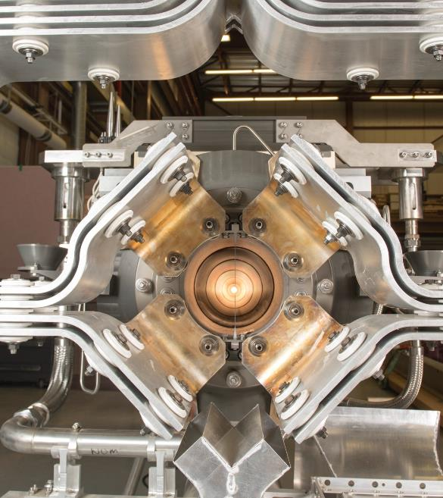
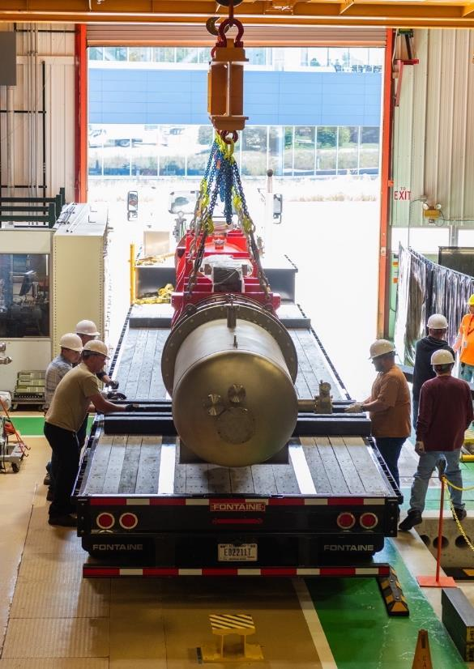
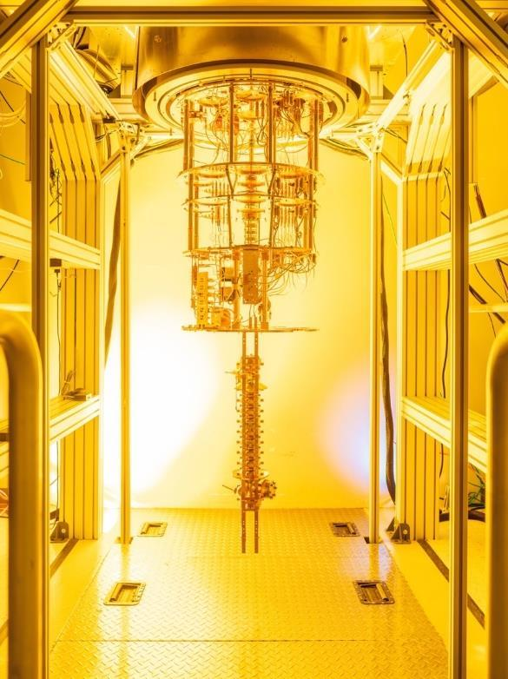
Our top priorities
We are one lab. We all work for science. We focus. We collaborate. We execute.
Beam to
LBNF/DUNE-US
by 2031
HL-LHC
Driving Innovation
Notes:
Mention that AI research is part of the third priority, Driving Innovation.

Slide 5
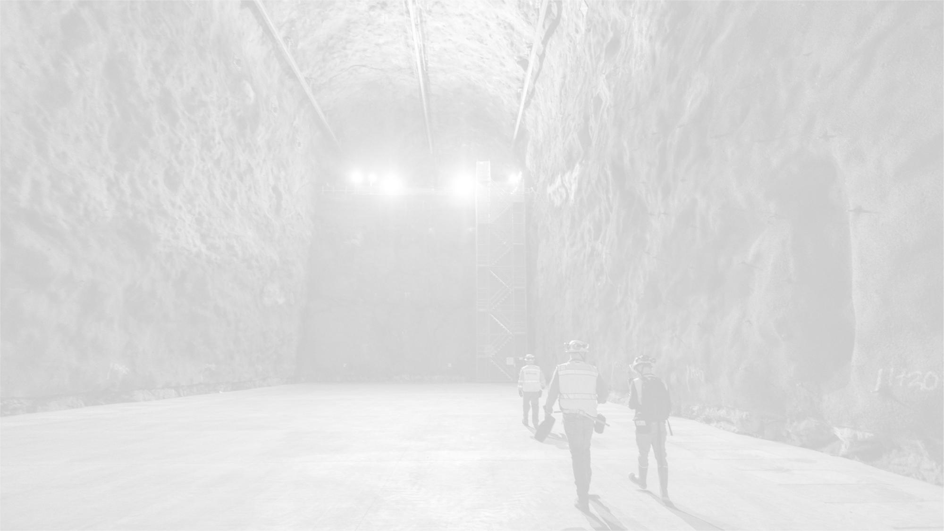
SCIENCE & TECHNOLOGY INITIATIVE
Enable a Next Phase of Neutrino Science with
Beam to the DUNE Program in 2031

Slide 6
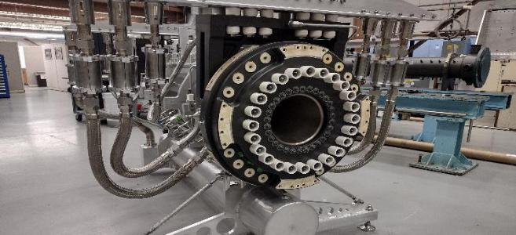
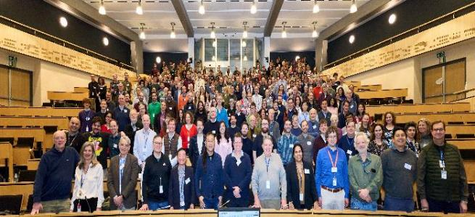
Launching Next Phase of Neutrino Science
Near-Term Vision: Address neutrino mysteries with the Deep Underground Neutrino Experiment (DUNE) and Long Baseline Neutrino Facility (LBNF)
Complete the construction and commissioning of LBNF, the new PIP-II accelerator, and DUNE detectors
Provide a more reliable and resilient Fermilab Accelerator Complex for the DUNE era
Operate the ongoing programs which provide the scientific and technology foundation for DUNE Program
Prototype LBNF Horn
DUNE Collaboration
1,500 scientists and engineers from more than
200 institutions in over 35 countries
DUNE is the culmination of 25 years of global neutrino experiments
Notes:
Summary of key elements of the initiative.
Focus: complete LBNF, PIP-II, and DUNE detector construction and commissioning.
Modernize the accelerator complex to support reliable, 1.2 MW beam delivery.
Maintain strong ongoing programs that feed into DUNE success.
25 years of neutrino oscillation experiments studying parts of the picture - DUNE will study the whole picture
Decades of advancement in both science and technology (i.e., Lar detectors, oscillation physics) culminates in the definitive neutrino experiment.
The DUNE collaboration comprises more than 1,500 collaborators from over 200 institutions in over 35 countries plus CERN.

Slide 7
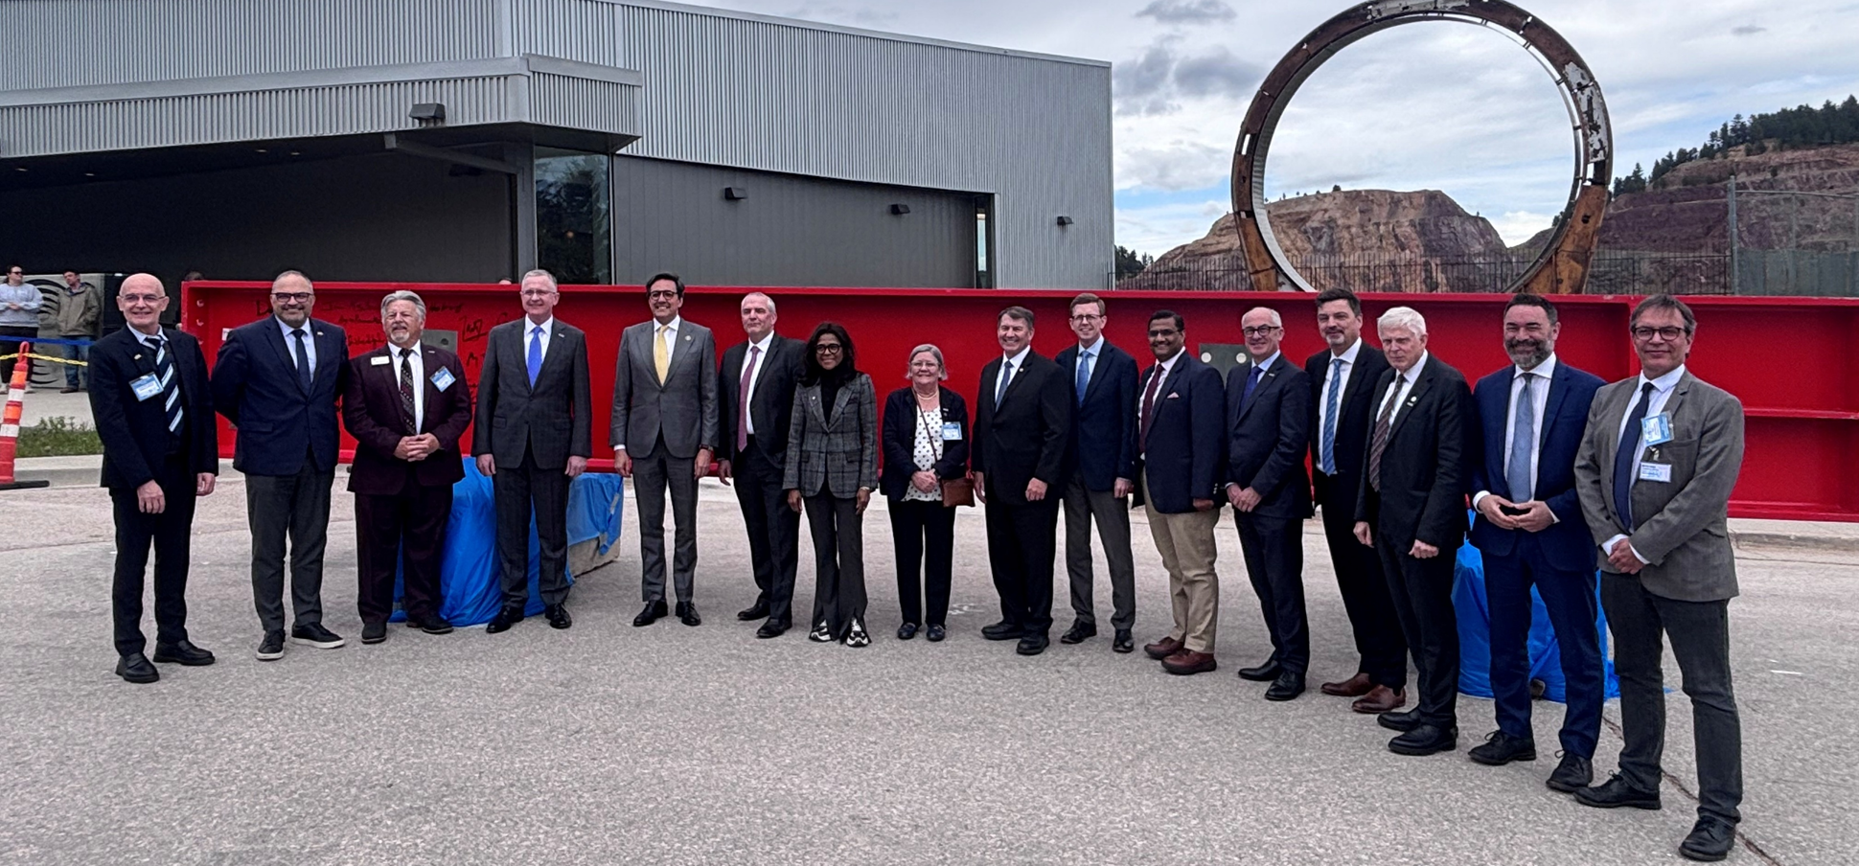
DUNE cryostat construction begins!
Notes:
Far Site… All reviews successfully/positively completed, Far Site will advance on technically limited schedule.
South cavern fully ready for staging of cryostat steel and components week of April 13th
Cryostat construction to start in late summer – deliver science in 2030
LBNF/DUNE named Project of the Year by the Underground Construction Association
ICARUS experiment marks major milestone in first neutrino science results
Near Site… Addressing the challenge to deliver beam in 2031
Driving towards construction start in 2027, addressing all feedback (economic, contractual, technical) received from local market
--Task Force effort from lab and collaboration coming to end, documenting all work – very targeted efforts will continue in specific areas (decay region shielding, ND hall accommodation of near detector components)
Near Detector working on technically driven schedule
Beamline team addressing risks across components
International Contributions :

Slide 8
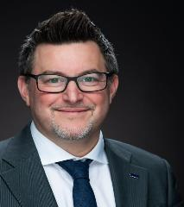
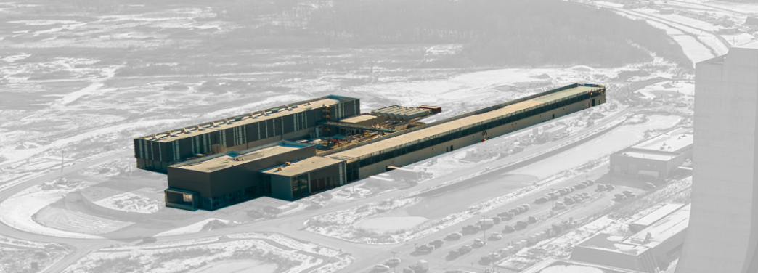
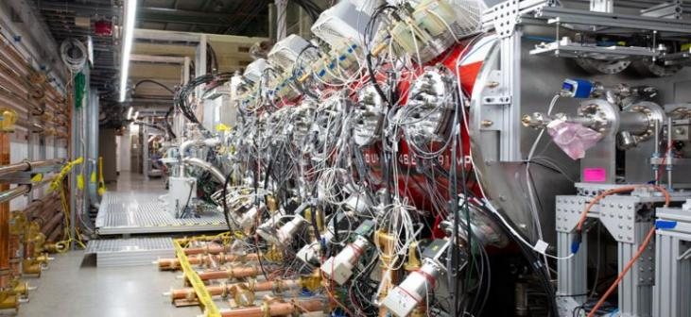
PIP-II: Proton Power for Research and Discovery
Project Director
C. Boffo
2026 // Accelerator installation
2027 // Cryoplant commissioning
2028 // Tie-in to existing complex
2029 // PIP-II commissioning
Milestones
Integrated test of the PIP-II injector
State-of-the-art superconducting linear accelerator
Unique in the US: extremely high duty factor, high power proton beam
2 MW of continuous proton power available for new beamlines in addition to LBNF/DUNE
PIP-II provides a powerful and flexible beam for particle physics and beyond
Notes:
The overall scope includes a new 250m long 800MeV Superconducting RF Linac and upgrades of the existing accelerator complex to support the higher power proton beam made available.
CD2: December 2020
CD3a: March 2021
CD3: April 2023
Early CD4: November 2029
CD-4: December 2032
Project is 63% complete. 2 out of 23 cryomodules completed. Installation started; the room temperature components will start to be commissioned this year.
TPC: $978M ------ IKC contributions: ~$320M Collaborators: India (DAE), Italy (INFN), France (CEA, CNRS), UK (UKRI), Poland (Minor, universities)
The Largest single contribution is the cryoplant from India ($30M).
The Superconducting RF Linac is constituted by 5 different flavor cryomodules of a novel design produced in parallel in the US (Fermilab), France (CEA) and the UK (UKRI) utilizing new technologies such as robotic assembly (in the future AI-assisted operation) in cleanroom.
First bullet: speaks to the use of the latest technologies available in SRF to build a new beyond state of the art superconducting RF linac
Second bullet: speaks to the uniqueness of PIP-II and allows for speaking about potential uses of the new LINAC beyond DUNE
Third bullet: speaks to the potential performance of PIP-II beyond project KPPs while reaching the limits of the single components (Couplers, SSA). The PIP-II tunnel has space for two additional 650 cryomodules to reach 1GeV.
Bottom right picture: in 2020/21 the injection system and the first two cryomodules were tested in the injection test facility and met DUNE beam specifications

Slide 9

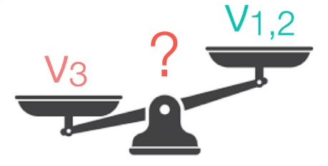
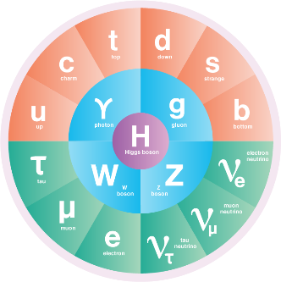
Early data can help answer big questions
Guaranteed unambiguous (>5σ) mass ordering discovery
  Why are neutrinos so light?
  Where does neutrino mass come from?
World-leading measurements of ν_{μ} oscillation parameters
  Are there symmetries in neutrino oscillations?
  How are they broken?
Sensitivity to new physics in neutrino oscillations
  Is the Standard Model complete?
Study neutrinos from the sun and dying stars
  Complete our understanding of solar neutrino emission
  What does the birth of a black hole look like?
Sensitivity to dark matter in the beamline
  What is the nature of dark matter?

Slide 10
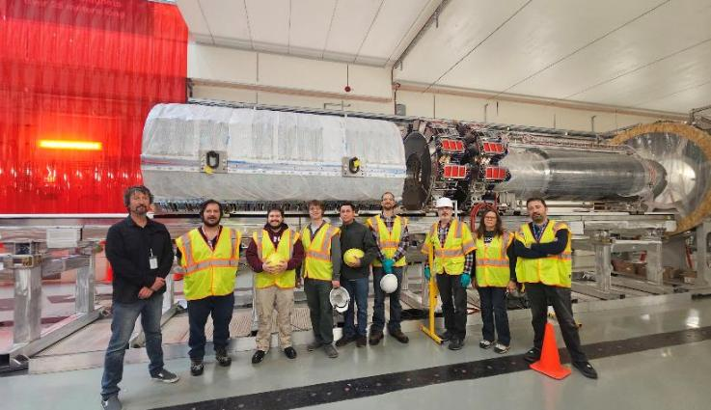
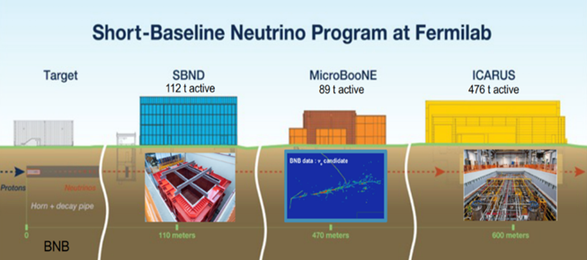
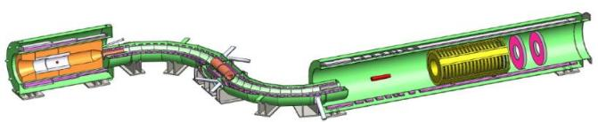
Delivering Science: Building Future Capability
Detector train (tracker, calorimeter,
and muon beam stop) installed in hall
Mu2e
Short Baseline Neutrino Program
Investigating Lepton Flavor Violation
Unprecedented muon intensity
Muon conversion with 10,000× statistics
Measuring neutrino properties and gaining critical experience with liquid argon detectors
Laying a strong foundation – Transition to DUNE
Notes:
Research on ultra-rare processes will be a linchpin for physics discovery during the next few decades. We know quarks mix and neutrinos oscillate, but charged lepton flavor violation has never been observed
The goal of the Mu2e experiment is to identify physics beyond the Standard Model, namely, the conversion of muons to electrons without the emission of neutrinos, which occurs in a number of theoretical models. Many beyond Standard Model theories to address big puzzles, like the light Higgs mass, also predict CLFV
The Mu2e experiment employs a novel system of superconducting magnets to study muons with unprecedented precision that has the potential to make ground-breaking discoveries of new particles and forces. A single signal event observed in Mu2e would revolutionize particle physics.
The international Short-Baseline Neutrino Program at Fermilab examines the properties of neutrinos, specifically how the flavor of a neutrino changes as it moves through space and matter.
All of the detectors are types of liquid-argon time projection chambers, and each contributes to the development of this particle detection technology for the long-baseline Deep Underground Neutrino Experiment (DUNE).
The Short baseline Program has provided not only an R&D platform, but also crucial experience in the long-term operation of these detectors

Slide 11
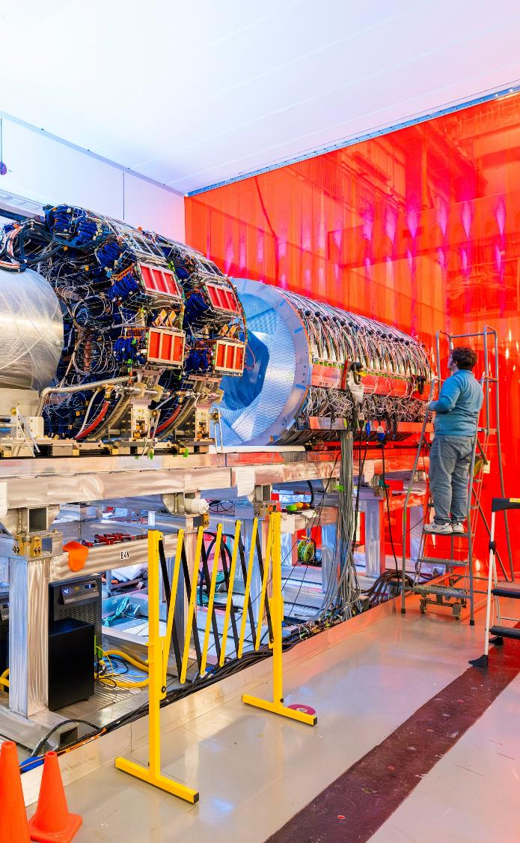
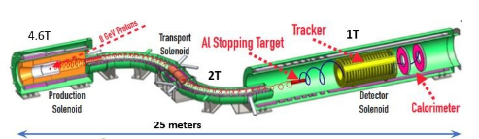
Mu2e progress
Production solenoid [here]
The production solenoid was delivered to Fermilab in Aug. 2025. This solenoid holds the target that creates the pions that decay into the muons for the experiment to study.
Transport solenoid [here]
The two magnets that make up the transport solenoid were moved into the Mu2e hall in Dec. 2023 and Feb. 2024. This solenoid’s unique sinuous shape helps reduce the background noise for the experiment.
Detector solenoid – it’s coming!
The detector solenoid is scheduled to be delivered this year. It will contain two of Mu2e’s subdetectors — the calorimeter and the tracker.
One of the magnets that make up the transport solenoid is lowered into the hall. Photo: Dan Svoboda
Notes:
A muon that does not follow the traditional weak-force decay pattern into a lighter electron and two neutrinos, but converts wholly into an electron would signal the existence of new particles or new forces - particles or forces beyond those included in the Standard Model. These new particles or forces would play a role in the unification process.
Seeing muon-to-electron conversion will be more difficult than finding a needle in a haystack and will require patience and vast quantities of muons
The GA team and our colleagues make great progress. – It’s been significantly delayed, but we work together to bring it here and we anticipate the magnet in July. GA is working really hard to make that happen.

Slide 12
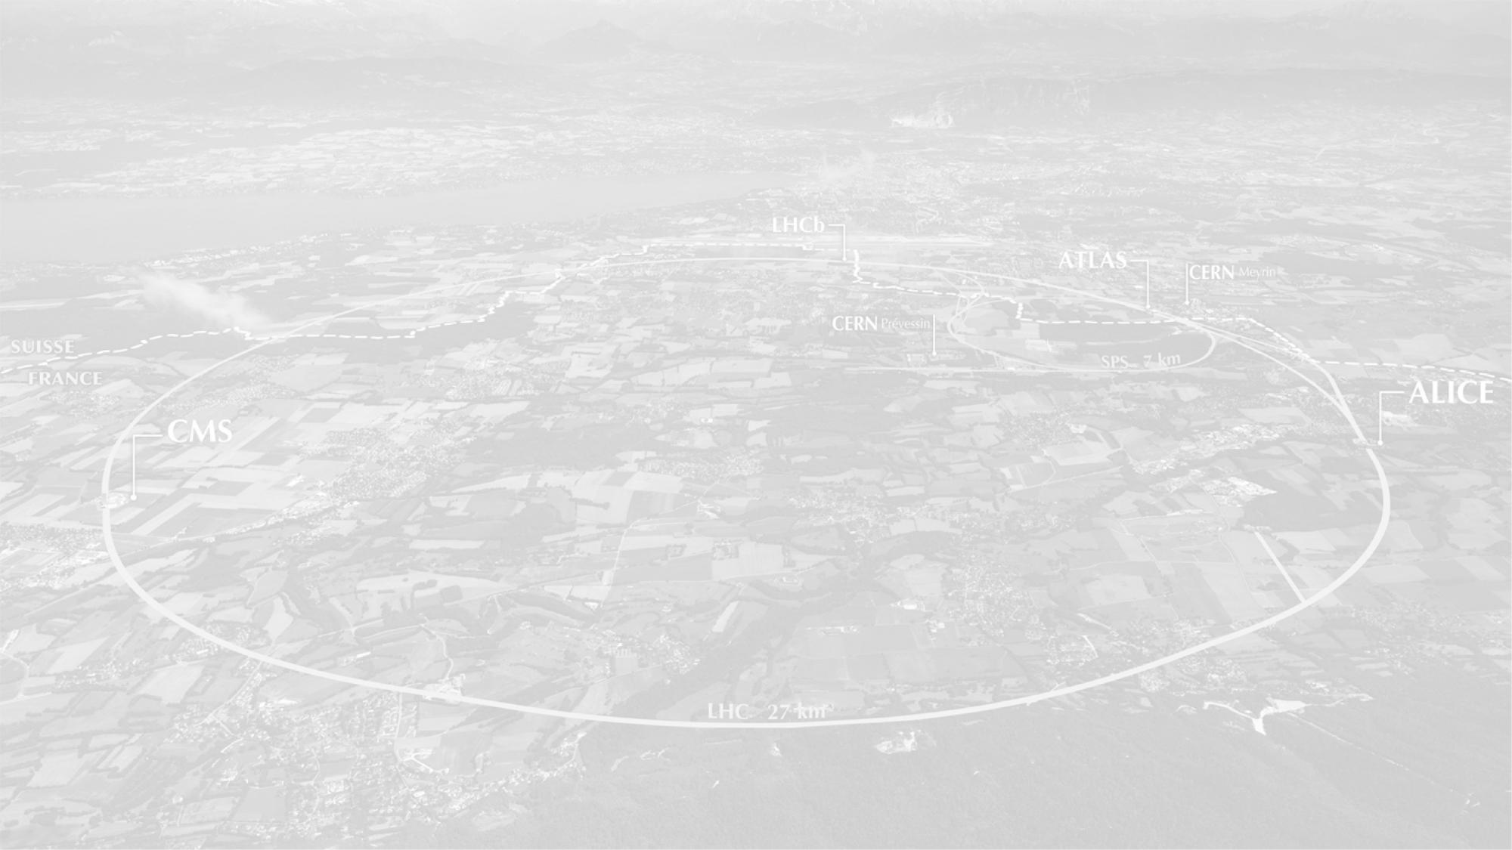
SCIENCE & TECHNOLOGY INITIATIVE
Drive High Luminosity Large Hadron Collider
(HL-LHC) Physics and Discovery

Slide 13
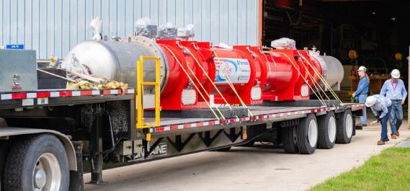
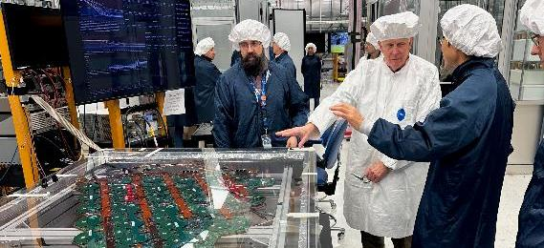
Leading U.S. Efforts at CERN’s HL-LHC
Near-Term Vision: Capitalize on U.S. and international HL-LHC investments to advance Higgs particle science in the 2030s
Complete the U.S. contribution to both the HL-LHC Accelerator and CMS Detector Upgrade Projects
Provide robust support of the CMS research program in the U.S. via our LHC Physics Center
Operate the largest and most capable Tier 1 Data Center for CMS (40% global share)
HL-LHC Magnet produced with advanced Nb₃Sn Technology
Calorimeter Endcap Cassette
Demonstration
Enabling immediate exploitation of the physics of the HL-LHC
Notes:
Fermilab is leading the US effort for the High-Luminosity LHC at CERN, which includes Accelerator and Detector Upgrade projects, CMS Operations, and Research. Carrying out this program includes:
Fermilab is constructing major components of the High Luminosity LHC including new superconducting magnets and an upgraded CMS detector using cutting edge technology, including on-chip AI
High statistics high resolution data is no good without a robust research program to turn that data into measurements – Fermilab has a central role in enabling US scientists through our LHC Physics Center
FNAL is the host lab for the US CMS Operations Program, ~ 30M/year DOE and 10-15M/year NSF endeavor that represents U.S. long term commitment to maximizing the quantity and quality of the data coming from the CMS detector. A key component of FNAL contributions to CMS operations is the Tier-1, where we leverage our expertise in scientific computing
Upper picture: delivery of HL-LHC cryo assembly to Fermilab for testing in February.
Lower picture: Pre-production cassette (30 degree section) of the High Granularity Calorimeter being tested at SiDet

Slide 14
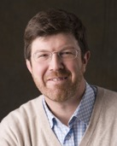
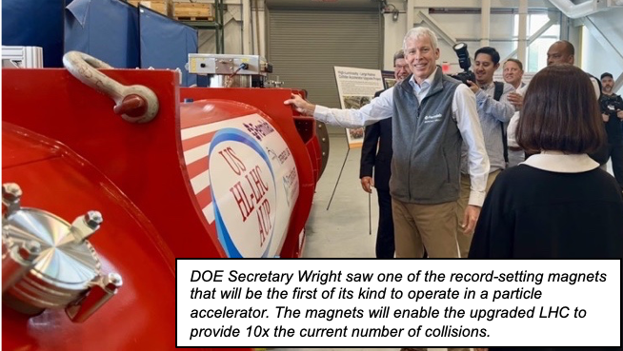
HL-LHC Accelerator Upgrade Project
DOE is contributing to the HL-LHC Accelerator Upgrade Project (AUP TPC - $266M)
  10 Cryo-assemblies
  10 SRF Crab Cavities
Project Manager
G. Apollinari
In-kind deliveries to CERN are in progress (~50% delivered)
Project on track to complete by late CY27 (~2 years ahead of scheduled CD4)
DOE Secretary Wright saw one of the record-setting magnets that will be the first of its kind to operate in a particle accelerator. The magnets will enable the upgraded LHC to provide 10x the current number of collisions.
Higher luminosity beam answers science questions in five versus fifty years
Notes:
DOE is contributing to the HL-LHC Accelerator by delivering 10 cryo-assemblies (containing critical focusing magnets based on US-developed Nb₃Sn technology) and 10 SRF Crab Cavities
US contribution is by far the largest contribution from Collaborators to HL-LHC, amounting to more than 60% of non-CERN scope. The US technology on Nb3Sn applied to Accelerator Magnets is a crown jewel of DOE OHEP investments in accelerator technology. Similarly for SRF Crab Cavities.
Bottom-right picture shows DOE Secretary Wright at FNAL touching one of the magnets yet to be delivered (expected to leave FNAL by Summer '26)
CD-0: 2016
CD1/3a: 2017
CD-2/3b: 2019
CD-3: 2020
CD2 Rebaseline (COVID): 2023

Slide 15
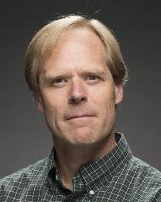
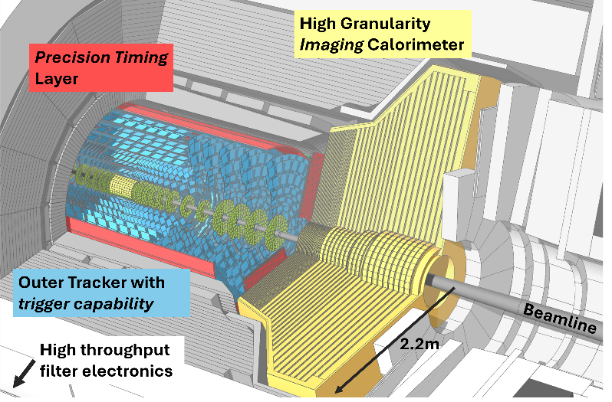
HL-LHC CMS Detector Upgrade Project
Fermilab leads over 45 U.S. institutions building next-gen particle detectors for the HL-LHC
  Cultivates next generation of U.S. scientists
  Maintains U.S. leadership in international science
CMS Detector Upgrade in production (TPC- $200M)
Project Manager
S. Nahn
  Assembly centers across U.S. established, ramping to full throughput
  Early completion of U.S. project end of 2028 (CD-4 at end of 2030)
Extreme environment drives innovation
Microelectronics and
AI initiatives combine in adaptive, rad-hard, and
ultra-fast ECON ASIC with embedded AI
CMS upgrade is detector innovation at the bleeding edge of possibility
Notes:
Fermilab leads 4 dozen U.S. institutes building next-gen particle detectors for the challenges of the HL LHC era
Extreme HL LHC environment drives innovation with new paradigms of particle detection on a large scale and provides fertile field for cultivation of the next generation of U.S. scientists
CMS is Keystone of the U.S. leadership in international science
Cutaway which represents the 4 big deliverables of DOE and why they are special
High Granularity Calorimeter – can image the constituents of Jets, will dramatically improve Higgs physics in forward region
Outer Tracker – first tracker at LHC with capability to provide track information at 40 MHz to the L1 Trigger, dramatically improving the richness of the data sample that is selected for analysis
Timing Layer – orders of magnitude better timing resolution to track particles in time as well as space, leveraging time dimension to isolate physics of interest from pollution of peripheral interactions
(Off detector) L1 Trigger – better resolution and more information, eg tracks, combined with state-of-the-art FPGA resources and high bandwidth electronics allow for particle-flow reconstruction before the first filter level
Status - We are 74% complete on a TPC of 200M, many production parts are being delivered and we are either ramping up or in production assembly of those parts – with some deliverables already at CERN.
ECON detail – made at Fermilab, ECON-T integrates embedded AI to enable adaptive, region-aware compression across the calorimeter, dynamically evolving with detector aging to preserve data fidelity over time. Marriage of AI and Microelectronics initiatives, as well as Lab Priorities 2 and 3

Slide 16
Apply World Leading Capabilities to Deliver Innovative Technologies and Enhance National Competitiveness
DRIVING INNOVATION
Notes:
Slide 22 – Science & Technology Initiative (section opener)
“This brings me to our third strategic priority: advancing technology for science and society.
At Fermilab, technology has always been at the core of discovery—from accelerators to detectors. But today, we are taking a more intentional and expansive approach.
We are leveraging our world-leading capabilities in superconductivity, cryogenics, large-scale systems, and computation to develop technologies that not only enable future science, but also extend our impact beyond traditional high-energy physics.
This includes quantum information science, artificial intelligence, advanced accelerators, and microelectronics.
Main message of the technology section: we view technology at Fermilab as a key pillar that is necessary to:
1) advance the reach of scientific instruments to solve the big scientific questions of today and tomorrow, for HEP and broadly for the office of science (give example of magnets for High Lumi, SRF for LCLS-2 and targetry for LBNF-DUNE);
2) advance instrument and tools that will have impact on society, working in partnership with leading industry players (example can be accelerators for wastewater treatment, partnerships with quantum companies to accelerate their roadmaps like IBM and Rigetti for scaling quantum processors, Maybell Quantum in cryogenics etc);
3) in science per se; the key advances required to bring progress in various technological curves call for solving among the most complex scientific questions of our time. (perfect transition to slide 23)

Slide 17
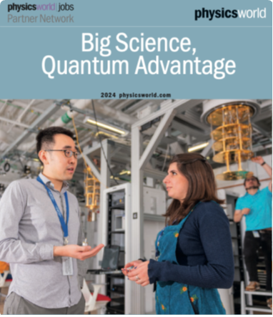
Technology is Shaping the Future of Discovery
What new discoveries become possible with quantum-enabled measurement?
How do we build scalable quantum systems that unlock
new regimes of computation and sensing?
How can cryogenic materials science unlock higher performance in quantum systems and next-generation microelectronics?
How can AI and advanced computing accelerate
scientific discovery across DOE missions?
What breakthroughs in accelerator science are needed
for next-generation facilities?
How do we build integrated, scalable systems that combine physics, engineering, and computation?
Innovating technologies goes hand-in-hand with advancing science
Notes:
Slide 23 – Technologies Shaping the Future of Discovery
Here are some of the key scientific questions that guide our Fermilab goals in the technology area.
On the quantum side, we are asking how new measurement and computation capabilities can open entirely new scientific regimes.​
Fermilab also brings extraordinary depth in materials science at cryogenic temperatures, developed over the years for SRF and magnets applications, we are now applying in depth for quantum devices and we plan to also apply for next-generation microelectronics.​
Artificial intelligence and advanced computing are becoming essential tools to accelerate discovery across DOE missions—from data analysis to design and control of complex systems, Fermilab is applying and advancing these capabilities to accelerate towards our scientific goals.
At the same time, we continue to push the frontier of accelerator science, ensuring we can build the next generation of discovery machines.​
And importantly, we are moving toward integrated systems, where physics, engineering, and computation are developed together.​
This is how we move from individual breakthroughs to scalable, impactful capabilities.”
Photo: SQMS researchers in the SQMS quantum garage at Fermilab on the cover of Physics World for a special feature on quantum capabilities at labs around the world.

Slide 18
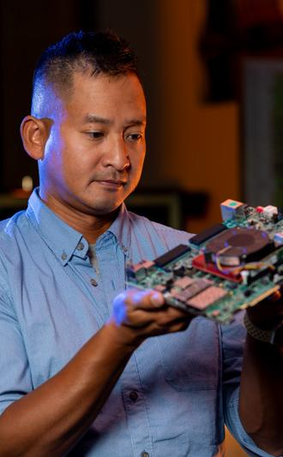
How AI enhances scientific goals of particle physics
Advancing discovery in high-energy physics research
Developing national AI capabilities that build on the challenges of
particle physics and technologies
By integrating AI throughout its research and operations, Fermilab not only propels its own scientific mission forward but also contributes to the evolution of artificial intelligence.
Fostering collaboration to address interdisciplinary AI challenges and share insights with scientific and technology partners

Slide 19

A symbiotic relationship
AI plays a key role across many of our core research and mission areas:
Fermilab plays a central role in the DOE’s Genesis Mission, a national initiative to double U.S. scientific productivity through AI, quantum technologies and advanced computing.
Neutrino experiments
Accelerator research
Quantum information science
Smart detectors and sensors
Particle physics at colliders
Astrophysics
Business operations
  Fermilab’s leadership in AI-enabled research, quantum science, microelectronics, and the design and operation of some of the world’s most complex scientific instruments will be essential to the success of Genesis.

Slide 20
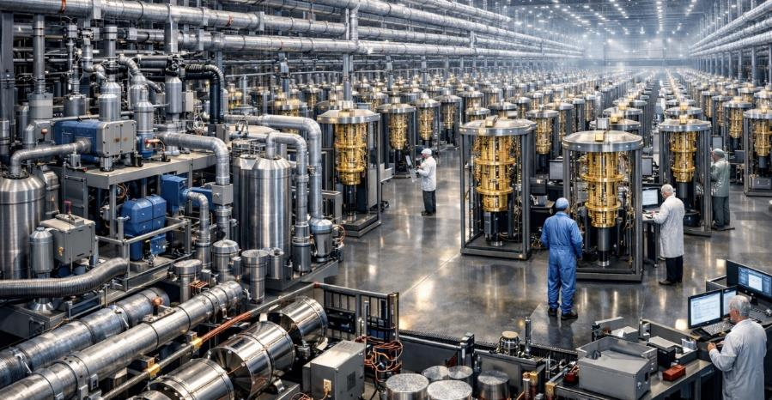
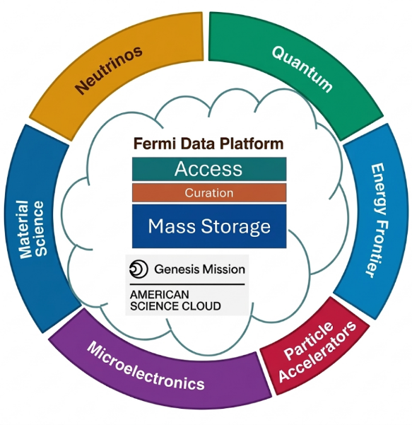
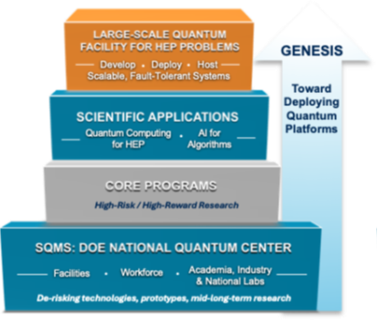
FNAL Vision for Supporting the Genesis Platform
Years of investments have built world-class workforce and infrastructure in quantum S&T, cryogenics, AI-ready data serving, major industry partnerships
Pictorial of Cryogenic Quantum
Computing Facility at Fermilab
Unique infrastructure and expertise to advance the Genesis Platform
Notes:
Slide 29 – FNAL Vision for Supporting the Genesis Platform
Main message: years of investments and building of unique capabilities, facilities and workforce in quantum and computing position Fermilab as a potential key contributor to the Genesis Platform, for both the classical computing/AI and the quantum computing facilities components
Looking ahead, given all of the fast ramping developments I explained, we think Fermilab can play a central role in supporting the Genesis Platform.​
We have already built a strong foundation—world-class expertise in quantum science, cryogenics, AI-ready data infrastructure, and partnerships with leading industry players.​
The vision is to integrate these capabilities into a platform that supports both scientific applications and technology development.​
This includes potentially hosting large-scale quantum computing facilities and integrating them with AI and data systems.​ We are already partnering with leading industry layers like IBM to scale cavity-based interconnects between commercial IBM processors, Maybell to co-develop enabling technologies to scale to efficient cryogenic data centers, Quantum Macines, to enable controls that support fast scaling of qudit architectures and much more. Our vision is to evolve our quantum efforts cohesively from enabling R&D to prototype development to contruction and deployment of a future large scale quantum computing platform which will be build hand in hand between labs and industry, where each contributes with unique strengths and facilities.
What makes Fermilab unique is our ability to bring together multiple domains—quantum, materials, accelerators, and computing—into a coherent platform.​
This is a powerful opportunity to contribute to a national capability.”​
Left image: Fermilab Data Platform, connecting to American Science Cloud, as a key contributor to the Genesis AI platform
Right Image: Pictorial rendering of a future potential onsite Fermilab fault tolerant superconducting quantum computing data center facility, evolution of the current research and prototyping efforts developed at SQMS.

Slide 21

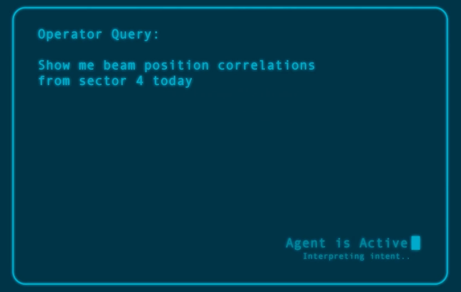
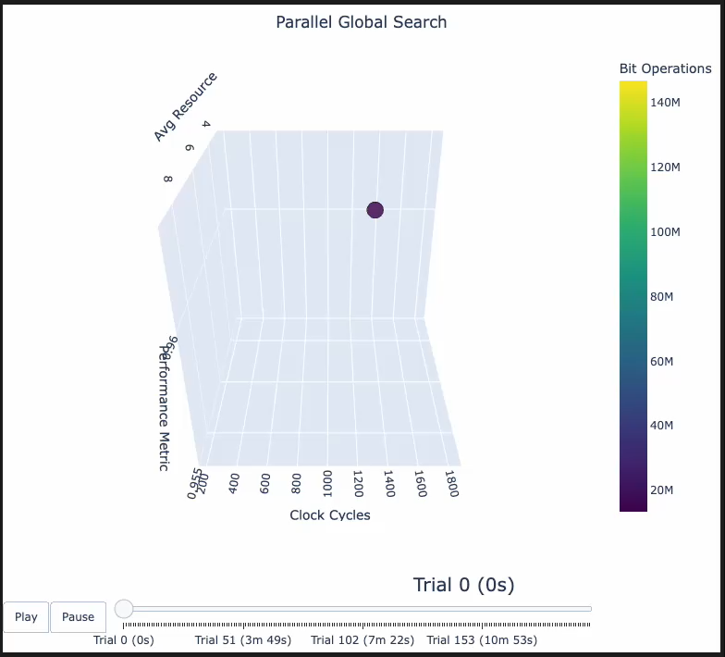


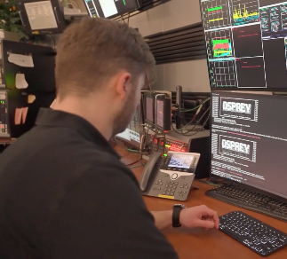
Genesis AI for Science Early Wins
Accelerated Microelectronics Design in Extreme Environments
Speedup of circuit design from months to hours
Agentic AI Accelerator Operations
FNAL high-power proton facility part of multi-lab, cross-facility/program team pushing state-of-the-art for accelerator AI assistant capabilities
Assists operators in rapidly diagnosing issues and optimizing beam parameters
Deploying novel AI surrogates on Genesis compute for 500x speed up in design exploration for qubit readout
Genesis Model Teams working towards June showcase for America 250
Notes:
main message: we are extremely committed to become a key player in the Genesis mission, and in the AI for science space we already have several early wins
We are already seeing early results from our contributions to the Genesis Mission.​
In microelectronics, AI-driven design tools are dramatically accelerating development—reducing design cycles from months to hours, which is transformative for control of quantum systems, HEP detectors and broader applications.​
We are also developing AI-assisted operations for accelerator facilities, enabling faster diagnostics and optimization of complex systems.​
These are concrete examples of how combining AI with Fermilab’s domain expertise can deliver immediate value.​
And importantly, these efforts are being carried out in partnership with industry and across the DOE complex, positioning us for larger-scale impact in the near future.”​

Slide 22
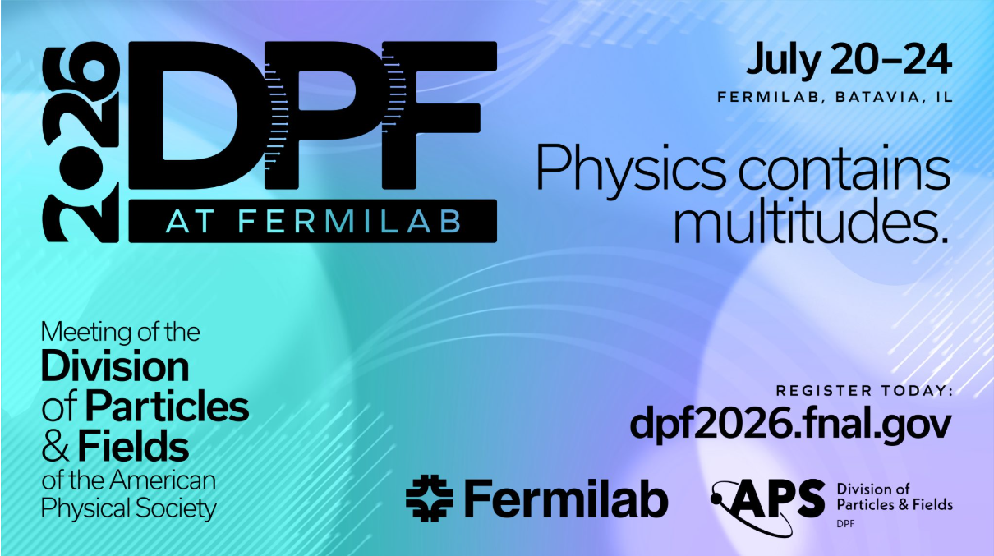

Slide 23

2026 Biannual Meeting Special Events
July 20
  Particle Physics: Uncovering the Secrets of the Universe
  - Public lecture by Mark Thomson, CERN Director-General
  ​
July 24
Future of High Energy Physics
- Panel discussion, in coordination with the Fermilab Users and Affiliates meeting​
Notes:
Registration Meeting deadlines:​​
Friday May 22: registration for in-person attendance for non-US citizens affiliated with certain countries*​​
Monday June 22 at 12:00 pm CDT: Registration for in-person attendance closes.​​
Wednesday July 1 at 5:00 PM CDT: Registration for virtual attendance closes.​​

