Slide 1
EIC International Accelerator Collaboration
Commissioning Tool Workgroup
EIC Virtual Accelerator Updates
Yue Hao

Slide 2
Plans for EIC VA
Control Room
Software, GUI
Infer
Train
USER Interface
(JupyterHub)
AI/ML applications
Machine Model
MADX
Elegant
BMAD
Beam-Beam Sim.
...
Deploy
EIC Virtual Accelerator
Machine Portal / Database
IOC
IOC
IOC
IOC
IOC
EIC Accelerator Complex

Slide 3
EIC VA updates I
Package name: EICVIBE
  EIC Virtual Beam Environment
Current effort : Machine Portal
  Contains machine description that related to beam model
  Machine description adopt PALS concept
  Initial description imported from lattice design
EIC element, lattice use subset of PALS
  Export and Load from Human readable file
  YAML is chosen
EICVIBE, manage (create, save and load) lattice configurations and select proper simulation/modeling mode for the selected configuration.
Control Interface, PVAccess
EIC Machine Portal
Import
Design
Lattice
Machine readable Machine Description file (YAML)

Slide 4
EIC VA updates II
Control Interface, PVAccess
BaseSimulationEngine
XSuite
BMAD
(to be integrated)
Elegant / IMPACT …
(to be implemented)
Design
Lattice
EIC Machine Portal
Import
Machine readable Machine Description file (YAML)

Slide 5
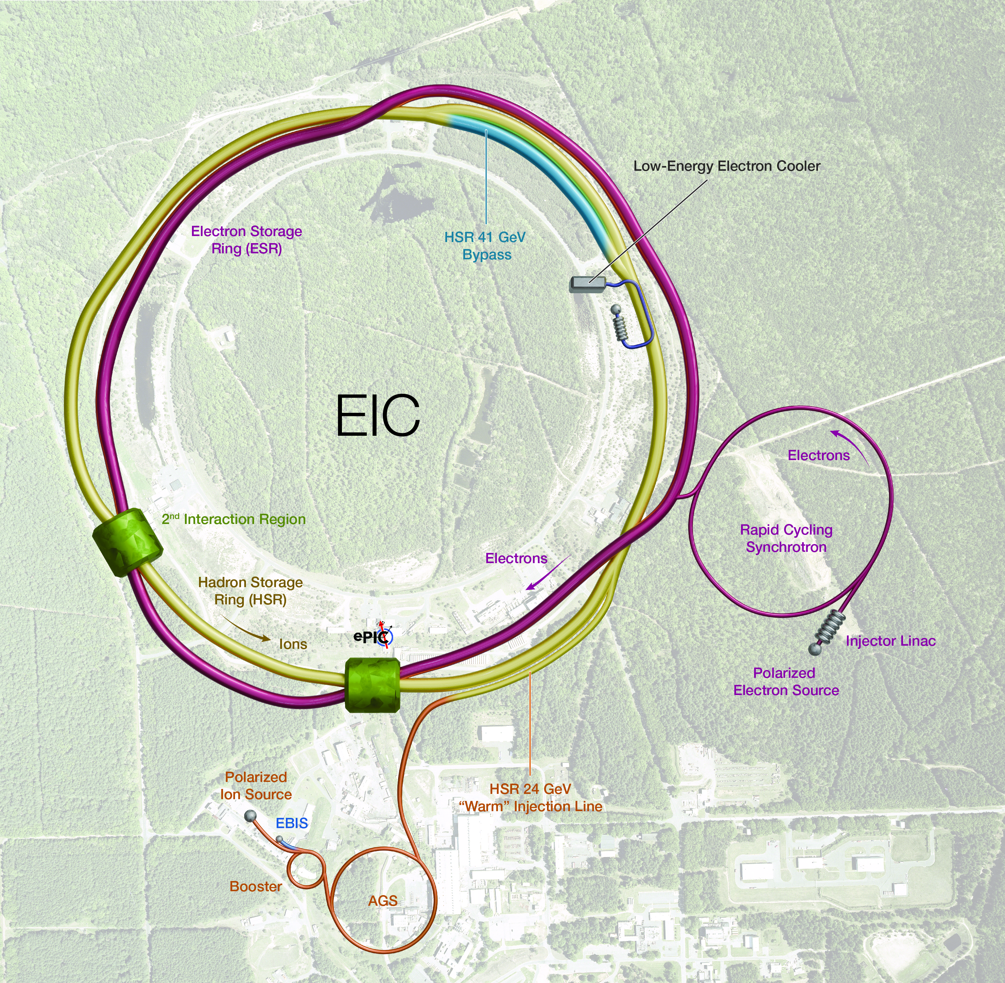
EICVIBE simulation modes
EIC has complicated operation modes
  EIC electron line,
    source → linac → BAR → RCS → ESR
    source → linac → RCS → ESR
  EIC proton line,
    Existing RHIC injector → HSR
  Many transfer lines between them
  Need to support flexible configuration in EICVIBE
3 running modes
  Single pass mode (linac, transfer line, injection, extraction)
  Ring mode (closed orbit, optics, beam dynamics)
  Ramping mode (RCS)

Slide 6
Ring mode
No simulation can match the real machine synchronously yet.
Instead, each simulation is launched from a ‘snapshot’ of current state at the launching time with N turns.
Various simulation engines connects to the EICVIBE asynchronously.
Shared memory for retrieving diagnostic data generated by the simulation engines without interfere the simulation itself.
Different engines has various simulation time
  From near real time to ~ minutes (need good surrogates for self-interactions)
Model goal
  Closed orbit correction,
  Optics / crab crossing tuning
  Prediction of Beam dynamics online optimization, Beam-Beam

Slide 7
Simulation Engines
The interface to all engines is based on BaseSimulationEngine.
  Engine-agnostic integration with multi-engine support
  Convert the EICVIBE lattice to engine specific interface
  With start/stop/pause (if needed) control
  Support all running modes, running in asynchronous loop
  Generate and manage diagnostic data, expose structured output to the EICVIBE core
  Maintain internal buffer for inter-engine communications (in future)
Currently, only XSUITESimulationEngine is implemented.
Each simulation engine runs as a separate subprocess, Managed via ZMQ IPC control channel.
The diagnostic data is currently shared with EICVIBE core and human interfaces by shared memory for zero-copy (limited to local machine).
  Will need to expand to ZMQ for support remote access.

Slide 8
Visualization
Initially, only the Jupyter notebook is planned for user interface. Hard to benchmark all functionality
A simple GUI is made for convenience, with PyQT5+matplotlib
Later integrated with Control system.
May also serve as convenient tool during construction?
BaseSimulationEngine
XSuite
BMAD
(to be integrated)
Elegant / IMPACT …
(to be implemented)
EIC Machine Portal (EICVIBE)
Lattice management
Simulation Engine Selection
Diagnostic data
Collection / Analysis
Launch
Process
EICVIBE GUI
User Inputs
Visualization
Data
Sync

Slide 9
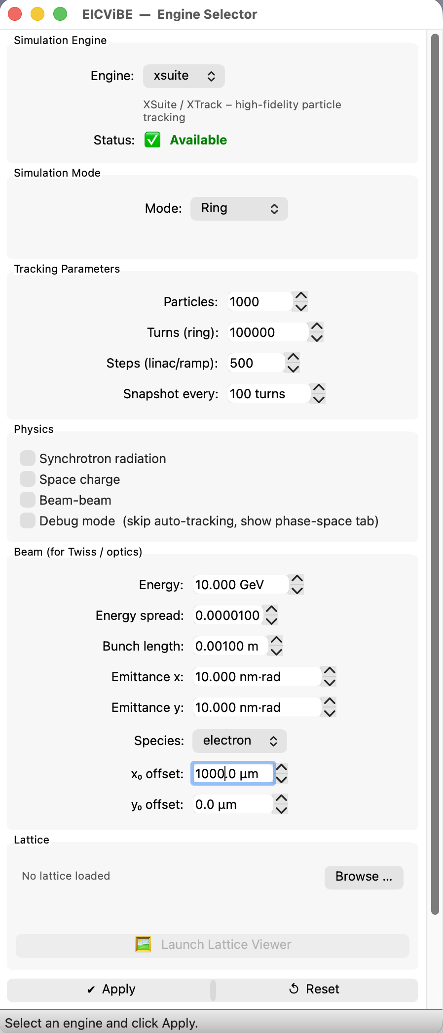
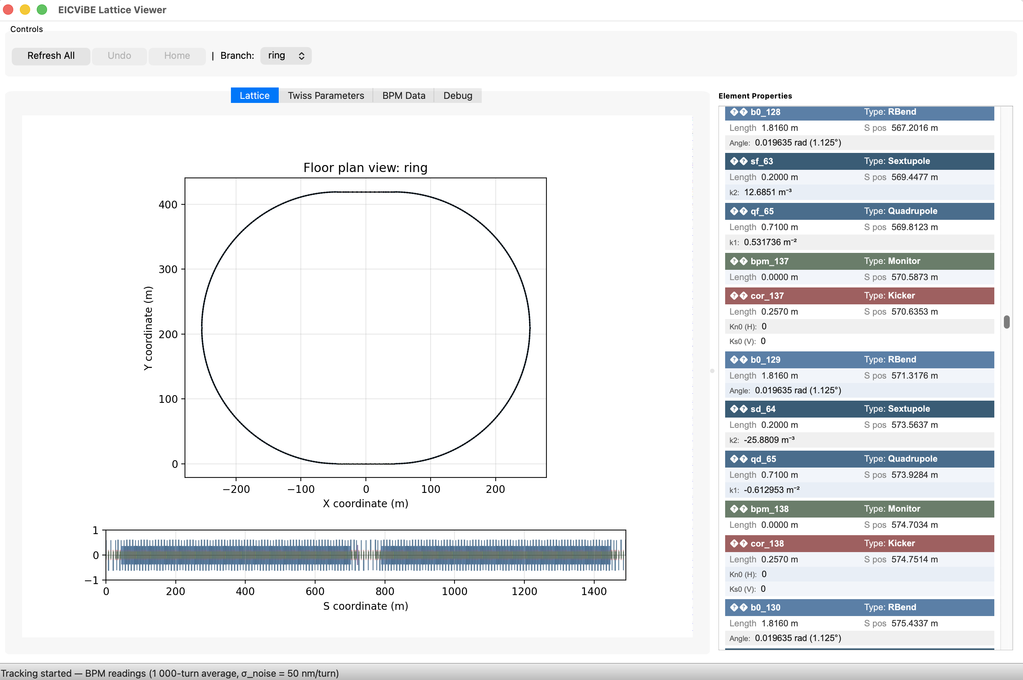
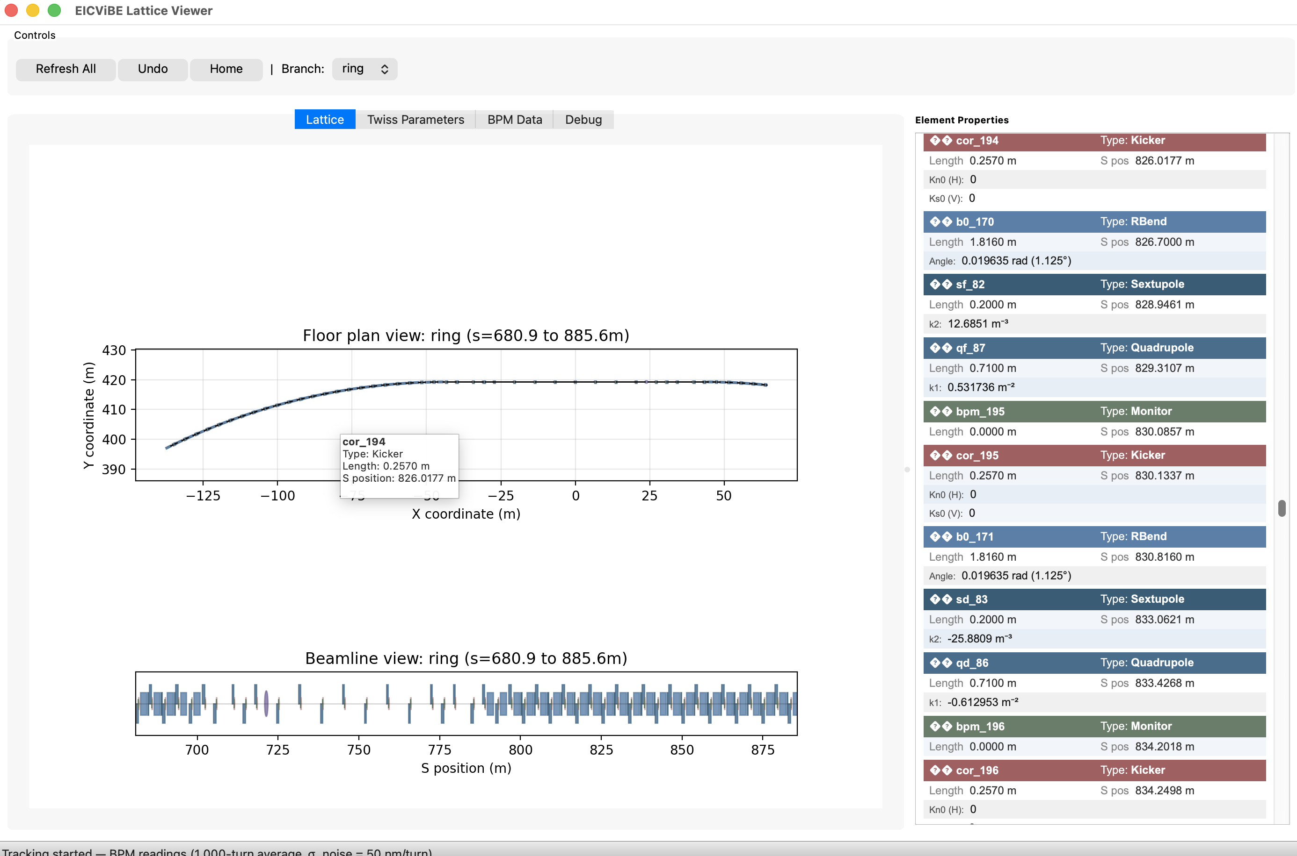
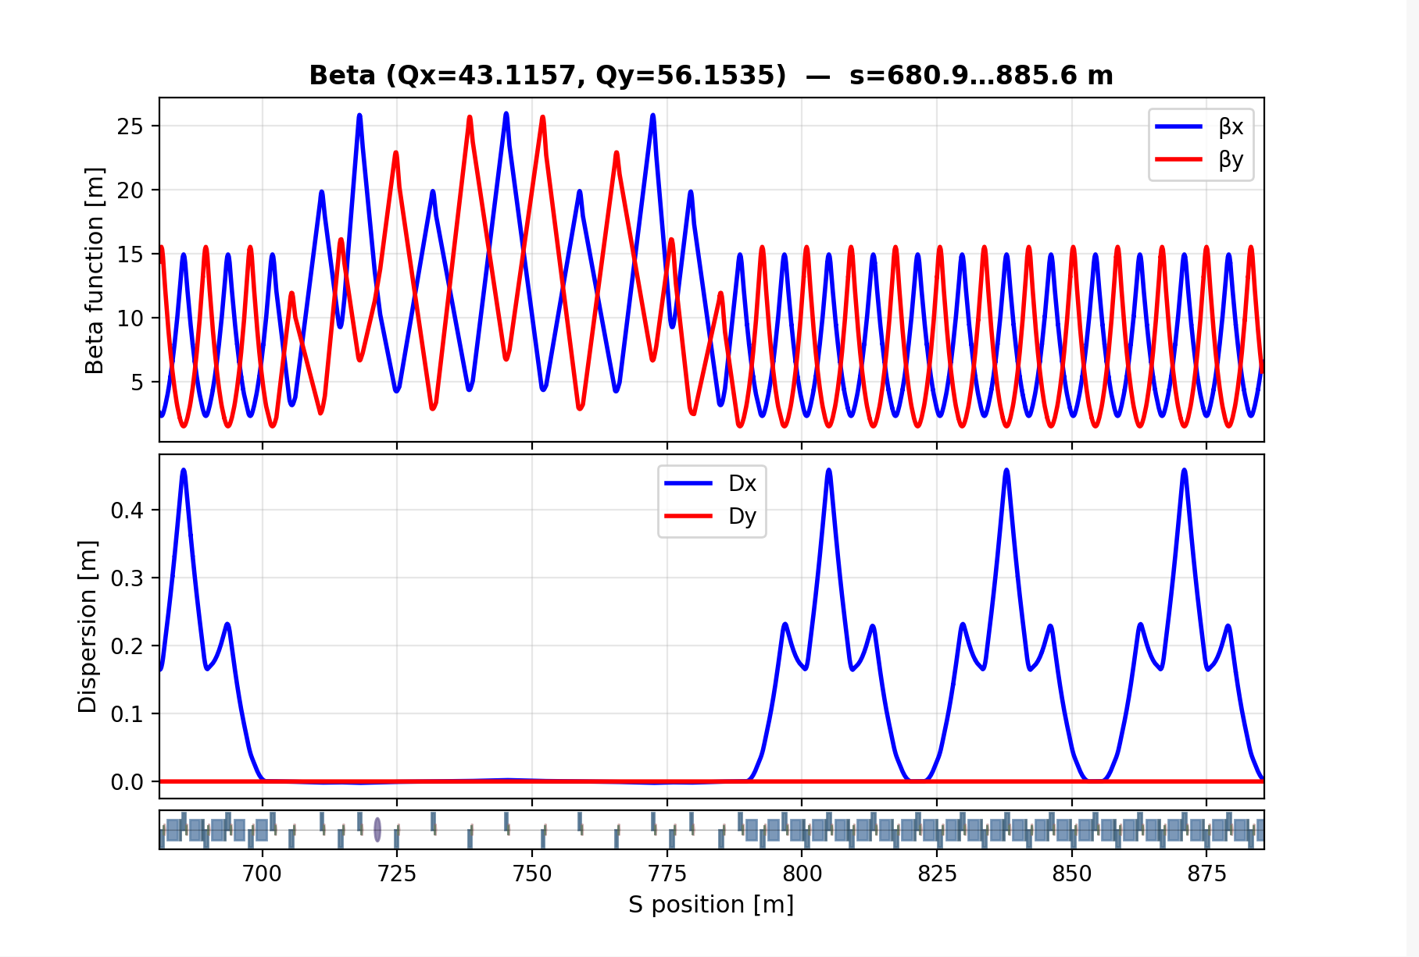
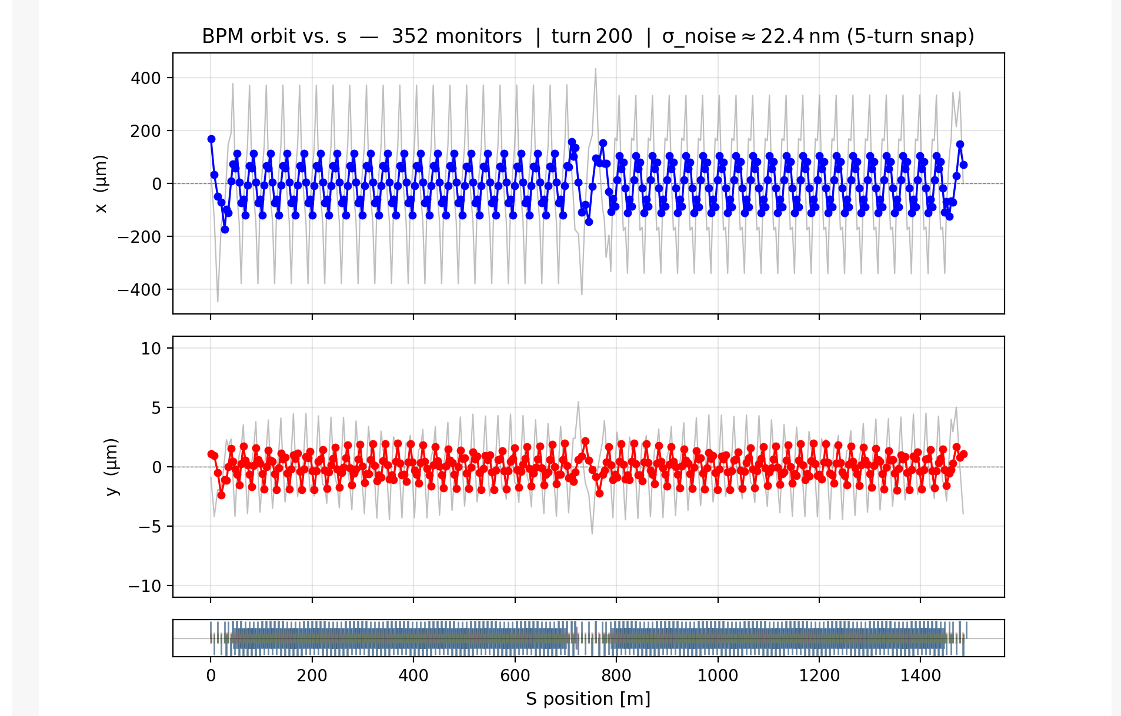
Examples with RCS lattice (Ring mode)

Slide 10
Improvement needed
Create different machine configurations in EICVIBE
Allow engine to run on remote machine, need to implement remote diagnostic data exchange.
  One local engine for near-real-time predictions
  Multiple remote engines for modeling in various time-interval, different dynamics and pre-defined fidelities.
Add algorithm/interface to combine the results from different engines.
Find possible work around of XSUITE engine recompiling each time the lattice is modified at EICVIBE
  For RCS example, 3454 elements need ~60 seconds to compile.

Slide 11
Control integration
Interface Requirement | Access Method - "ICD"
The system shall expose a web-based API for database access, supporting queries and data retrieval. | HTTP REST API (GET/POST), JSON format
Time-series and event data will be available for plotting and analysis via easy-to-use tools. | HTTP REST API for data, with optional custom format support - eg. CSV/JSON output
Secure access will be available to read and update control system parameters. | HTTP REST API (GET/POST/PUT), secure endpoints for PV manipulation; Native API access for PV operations in supported languages; JSON-formatted requests or similar
APIs will be documented and work with graphical tools used to build custom applications | HTTP REST API and native async APIs for GUI event loop compatibility; asynchronous communication via web-sockets, signal-slot, callback, async/wait
The system will support standard plotting libraries to help visualize data. | HTTP REST API for historical data and WebSocket for streaming updates; plotting tools such as PyQtGraph, Matplotlib, QtChart/Charts, Swing/JavaFX charts.
The control system shall provide and maintain documentation, tooling, and libraries to support the development of custom physics applications that utilize core control interfaces | REST API, native bindings (C++, Python, Java), developer documentation
The system shall provide language-specific APIs (e.g. python, java, c++) that expose high-level functions for retrieving and manipulating data, abstracting away transport mechanisms such as HTTP. | Language specific abstraction layer (C++, Python, Java), developer documentation
@ S. Nemesure

Slide 12
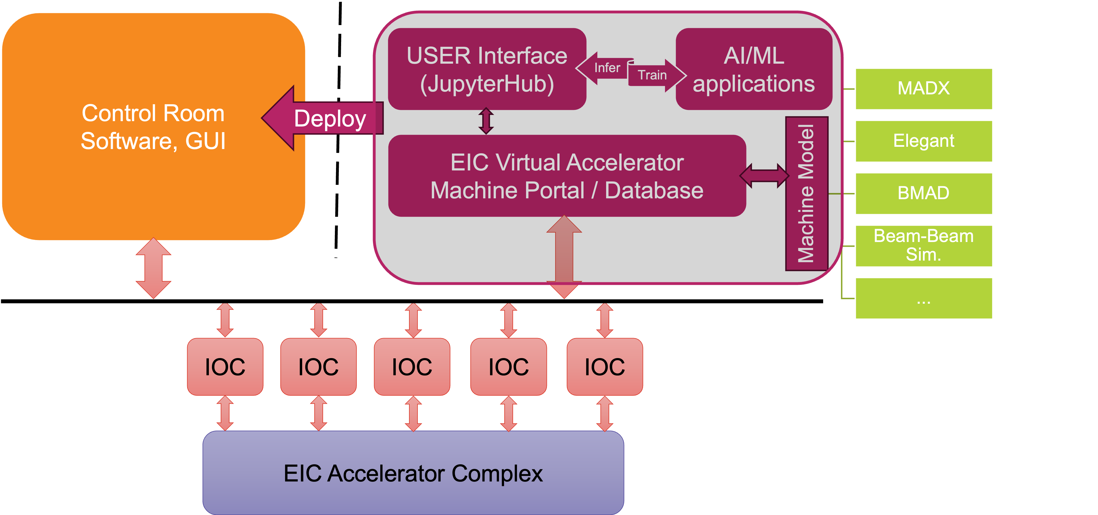
Reconsideration of AI integration
One year ago, we proposed to have AI/ML application to be a separate layer
Benefit from recent Genesis discussions
  Migrating to digital twin
  AI reasoning
  Data readiness
  Uncertainty Quantification
More integrated AI components can be proposed
  Surrogate model for expensive physics process
  AI agent over EICVIBE api for reasoning and auto-workflow
  Integrate optimizer (gradient-based, Bayesian)
  AI process of diagnostic data from simulation and machine
  ML ready data structure

