Slide 1
DAPHNE configuration update
Benan Ünal

Slide 2
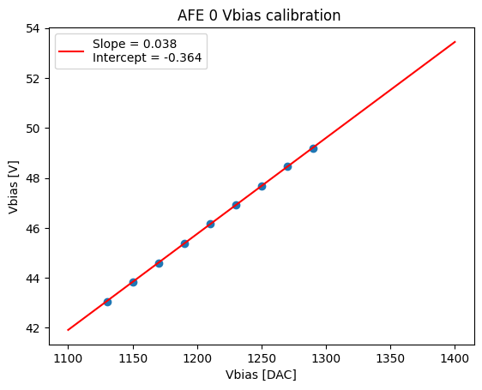

Calibration of AFE 0
Conversion fit:
$$V_{bias }\left[V\right]=0.038 V_{bias} \left[DAC\right]−0.364$$
So far only AFE 0 voltages are measured,
corresponding calibration for other chips will be done in the future.

Slide 3
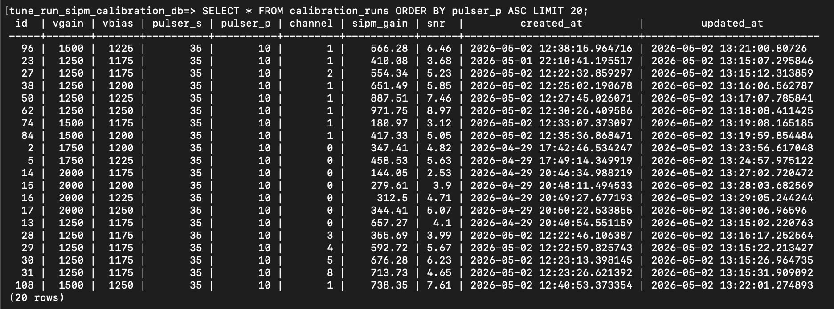
SQL Database
Created an SQL-DB to store and access the analyzed data and their respective parameters.

Slide 4
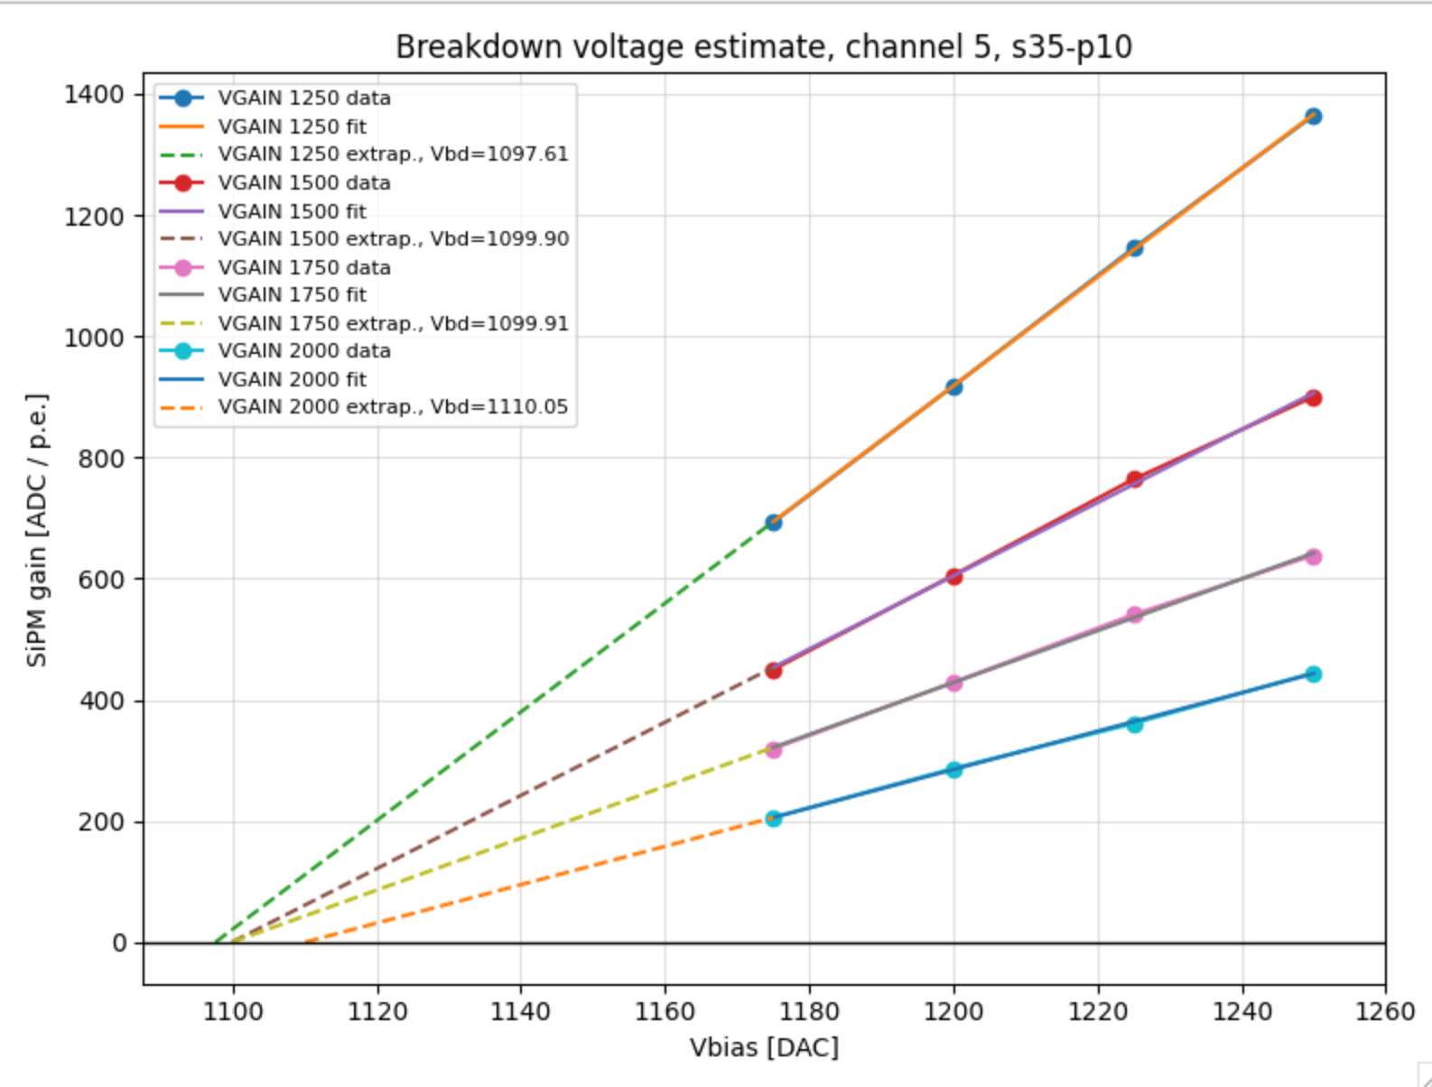
Extracting breakdown voltage
Using the SiPM gain and Vbias entries from the SQL-DB breakdown voltage of CH5 was extracted
  Mean breakdown voltage = 1101.9 DAC = 41.98 V
  Median breakdown voltage = 1099.9 DAC = 41.9 V
For other channels not all x–intercepts coincide → New peak finding or peak spacing computation algorithm needed

Slide 5
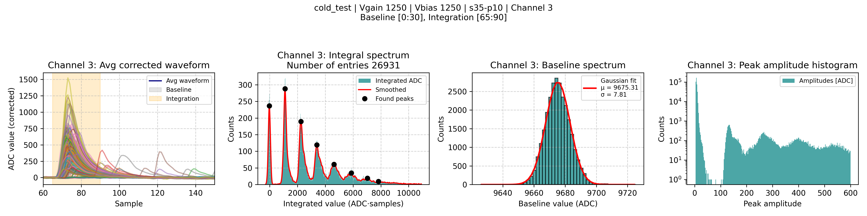
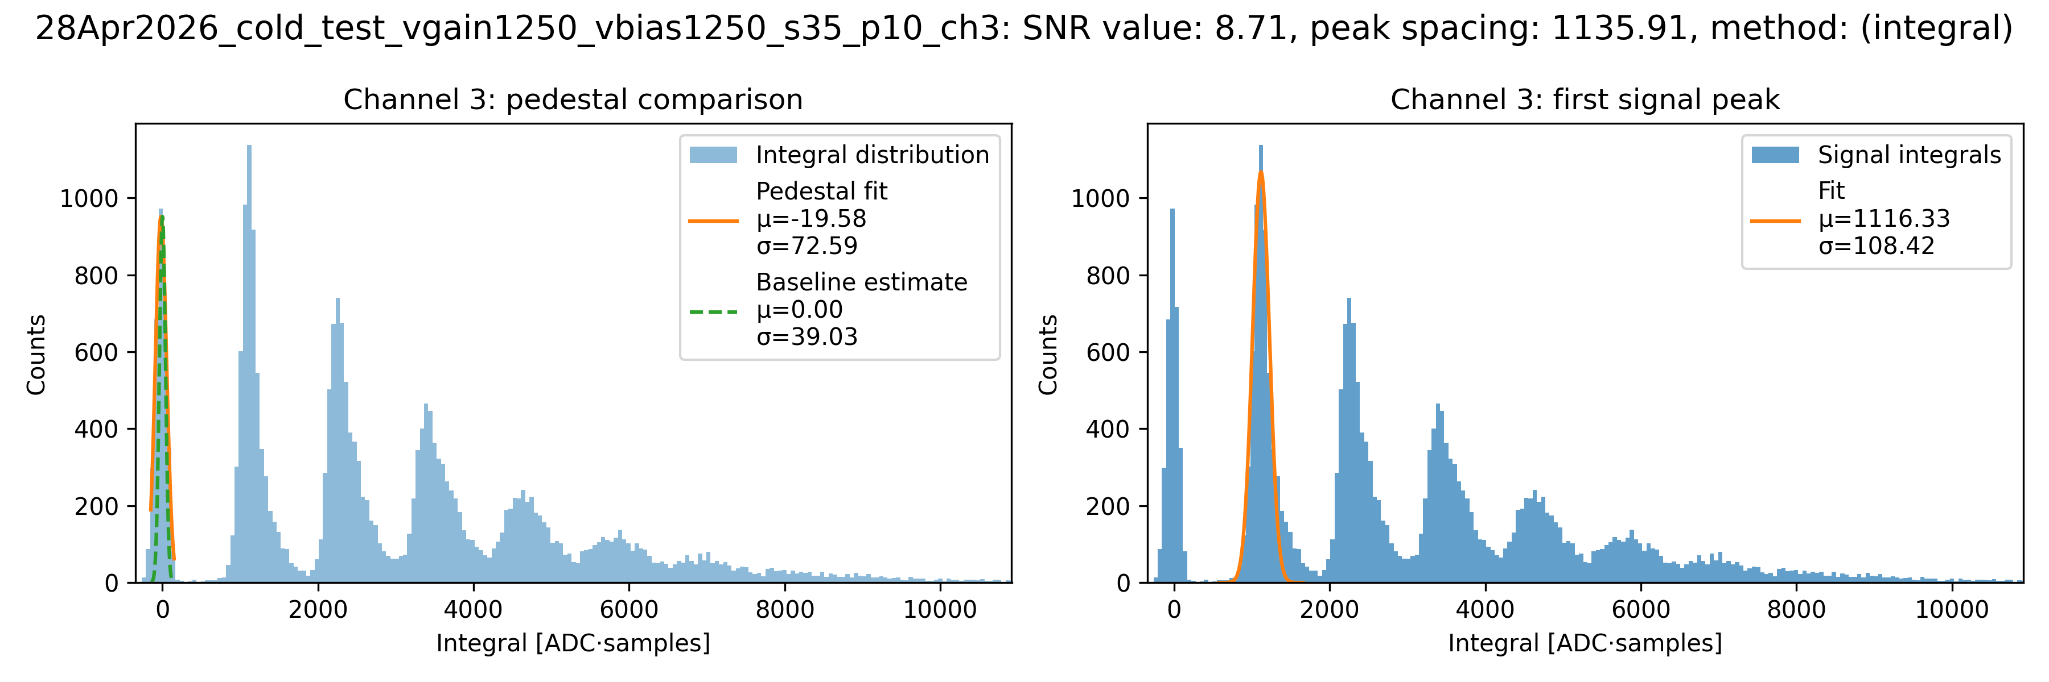
Mean peak spacing = 1121.8

Slide 6
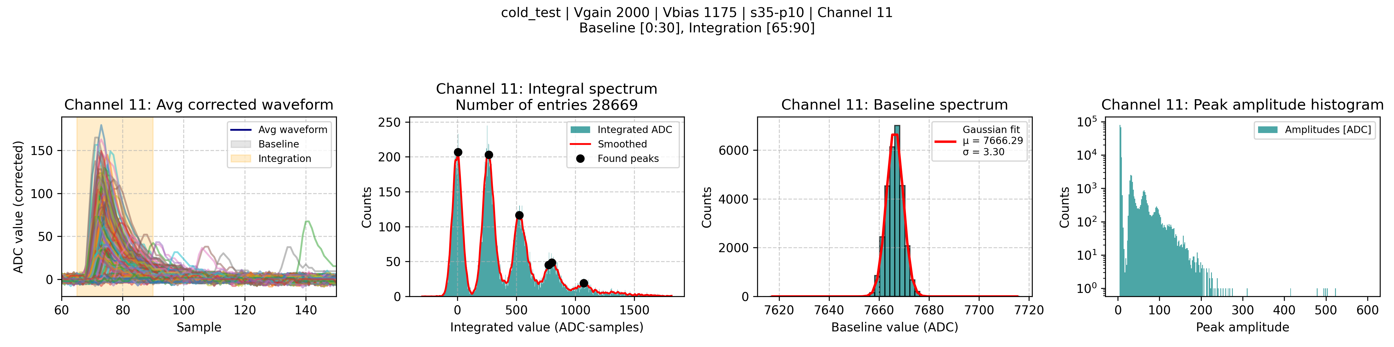
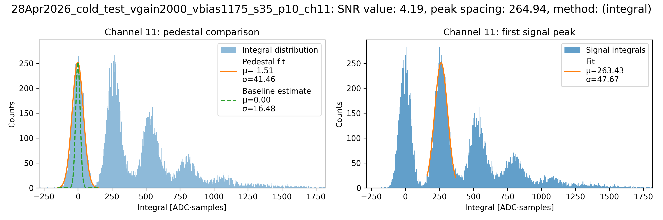
Mean peak spacing = 213.2

Slide 7
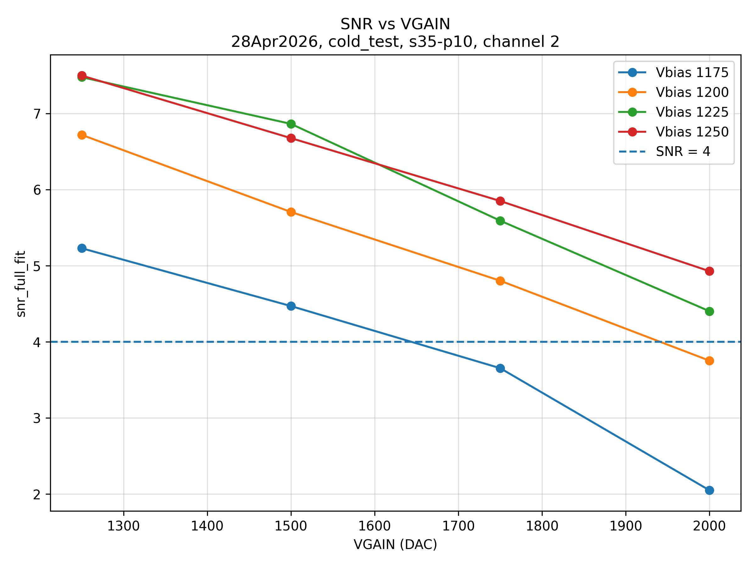
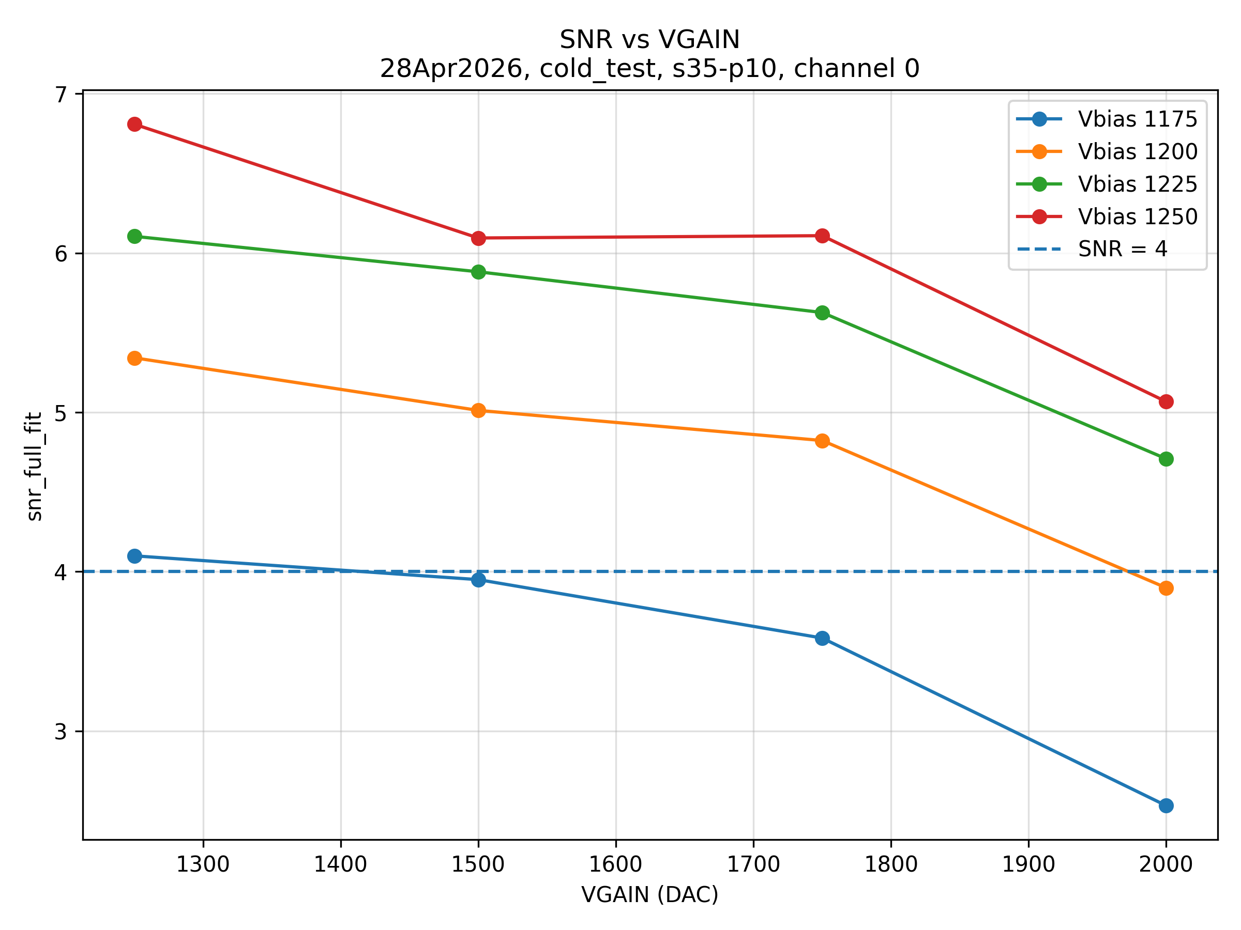
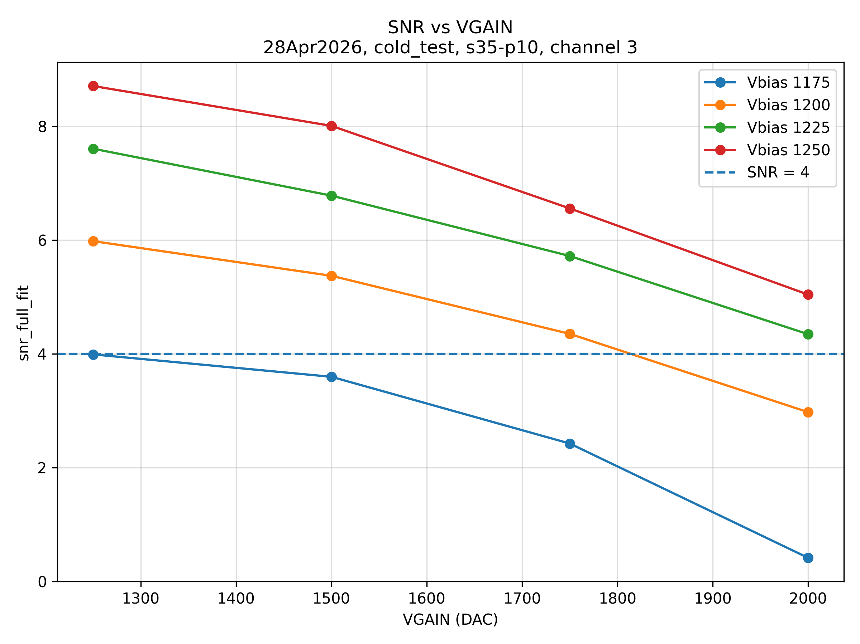
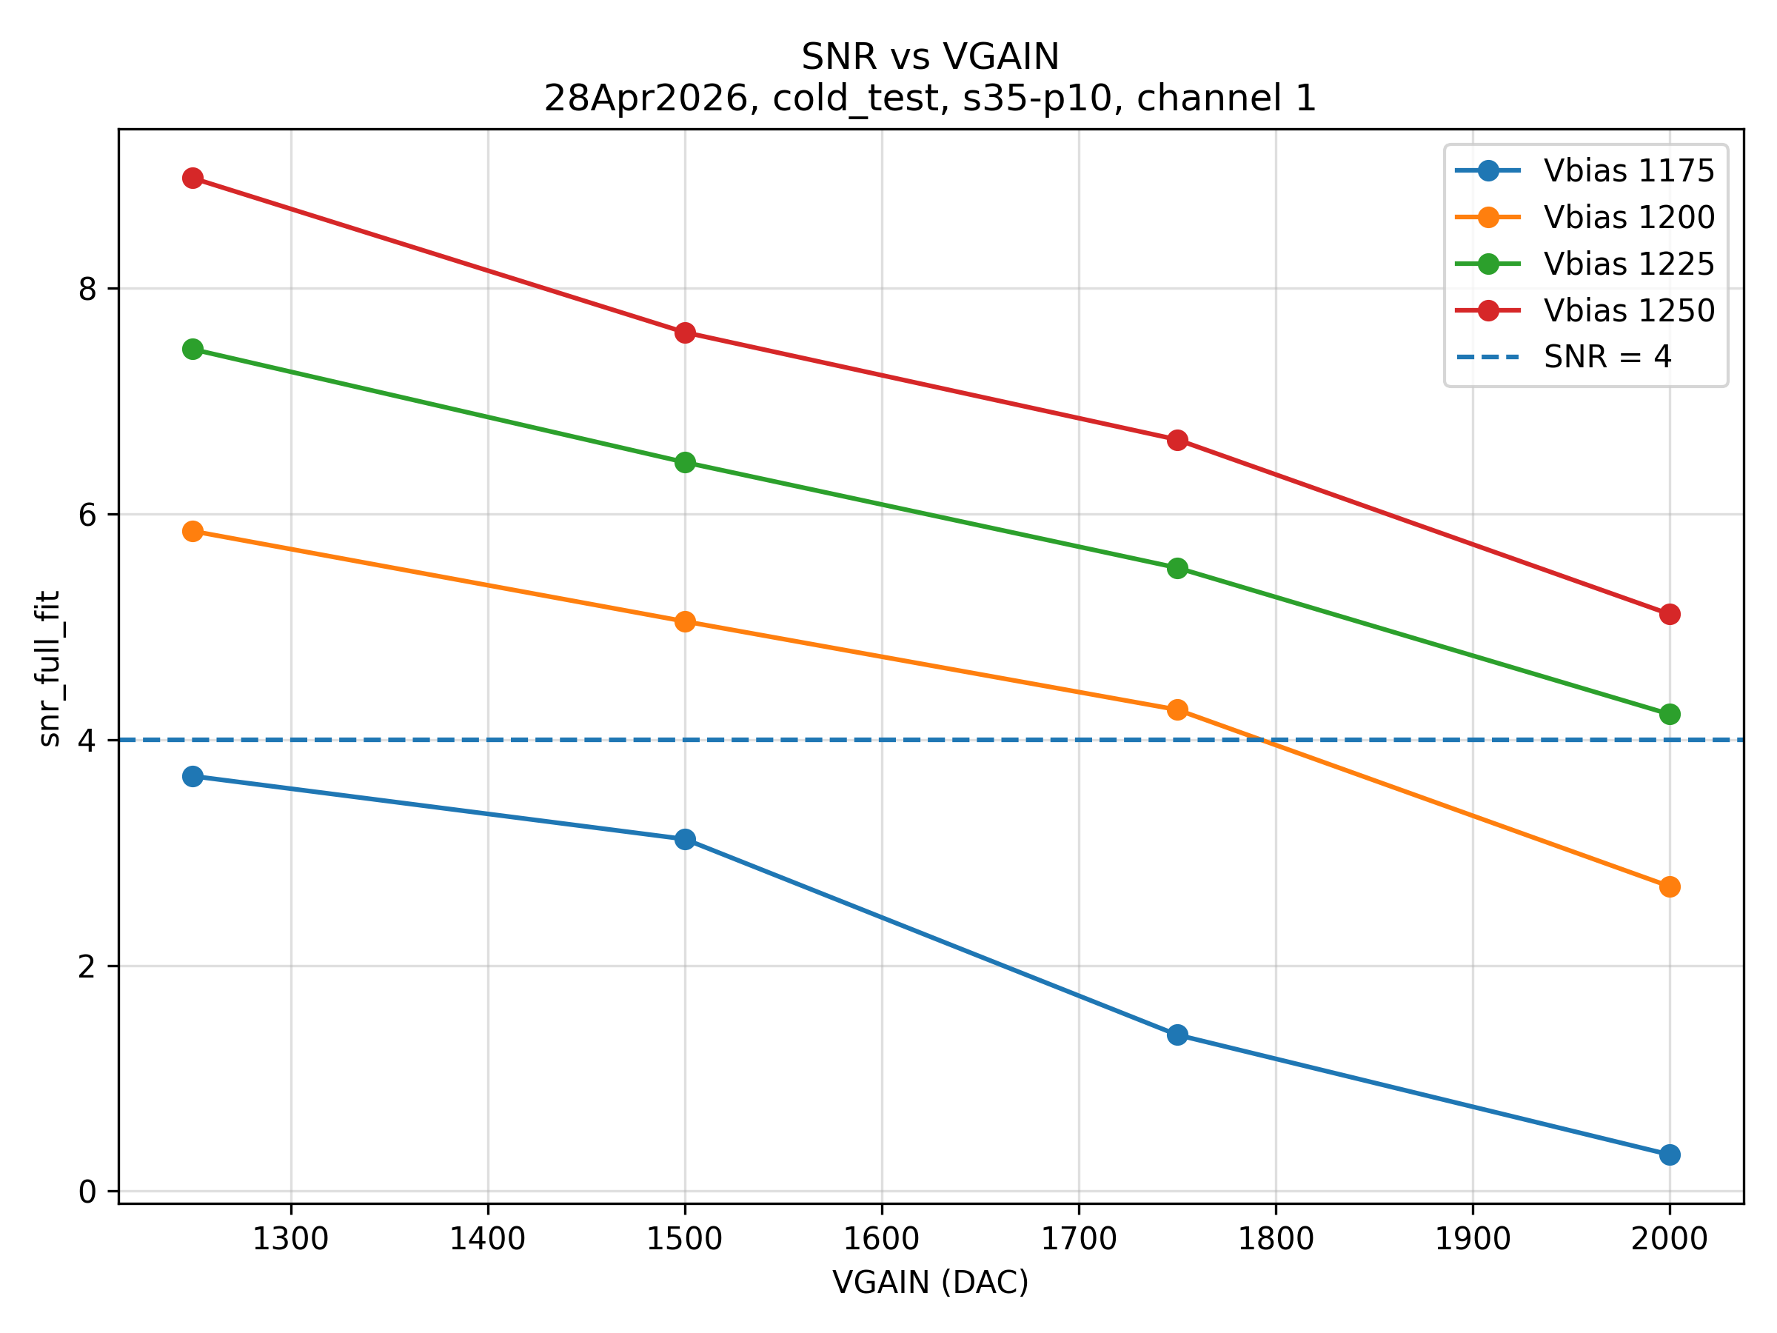
TUNE runs
CH2
CH0
CH3
CH1

Slide 8
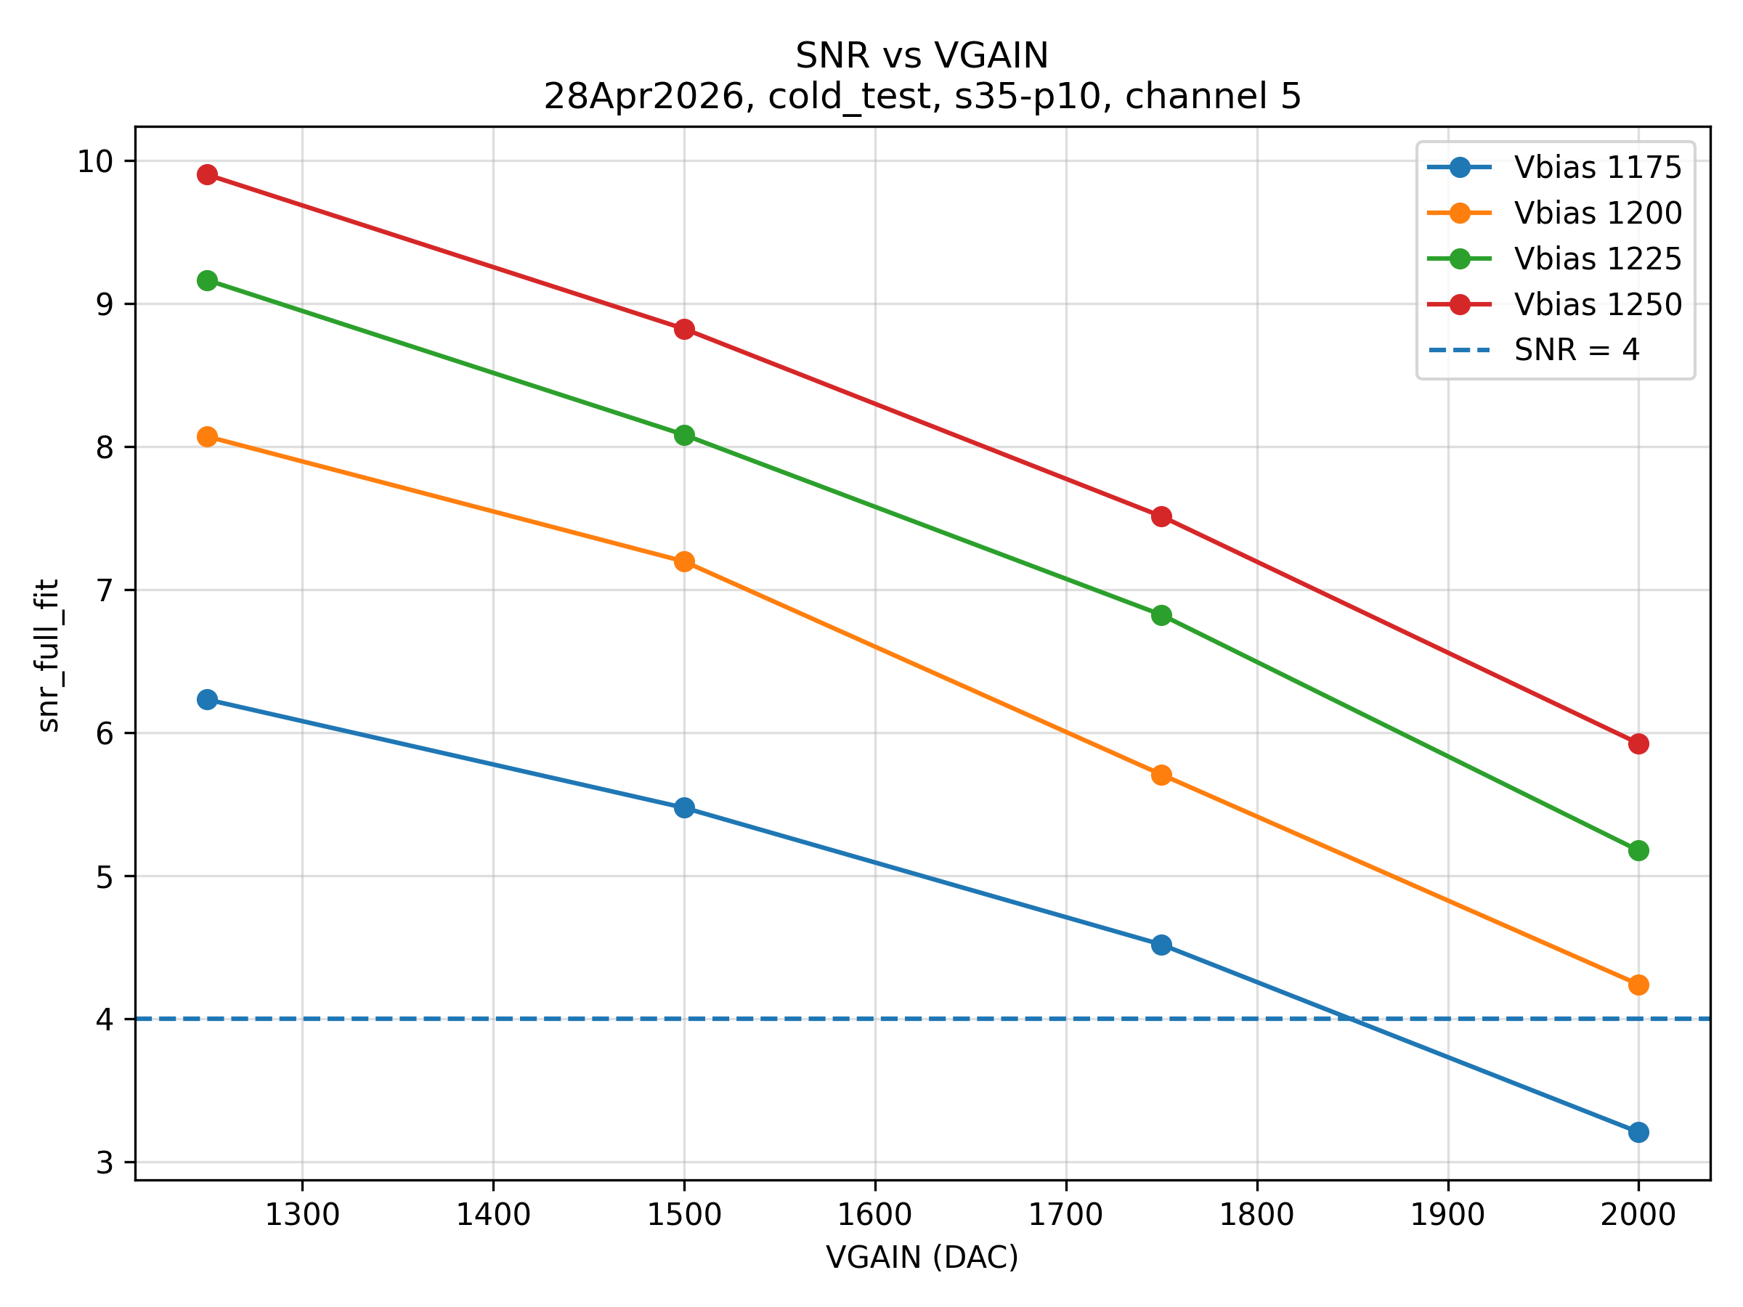
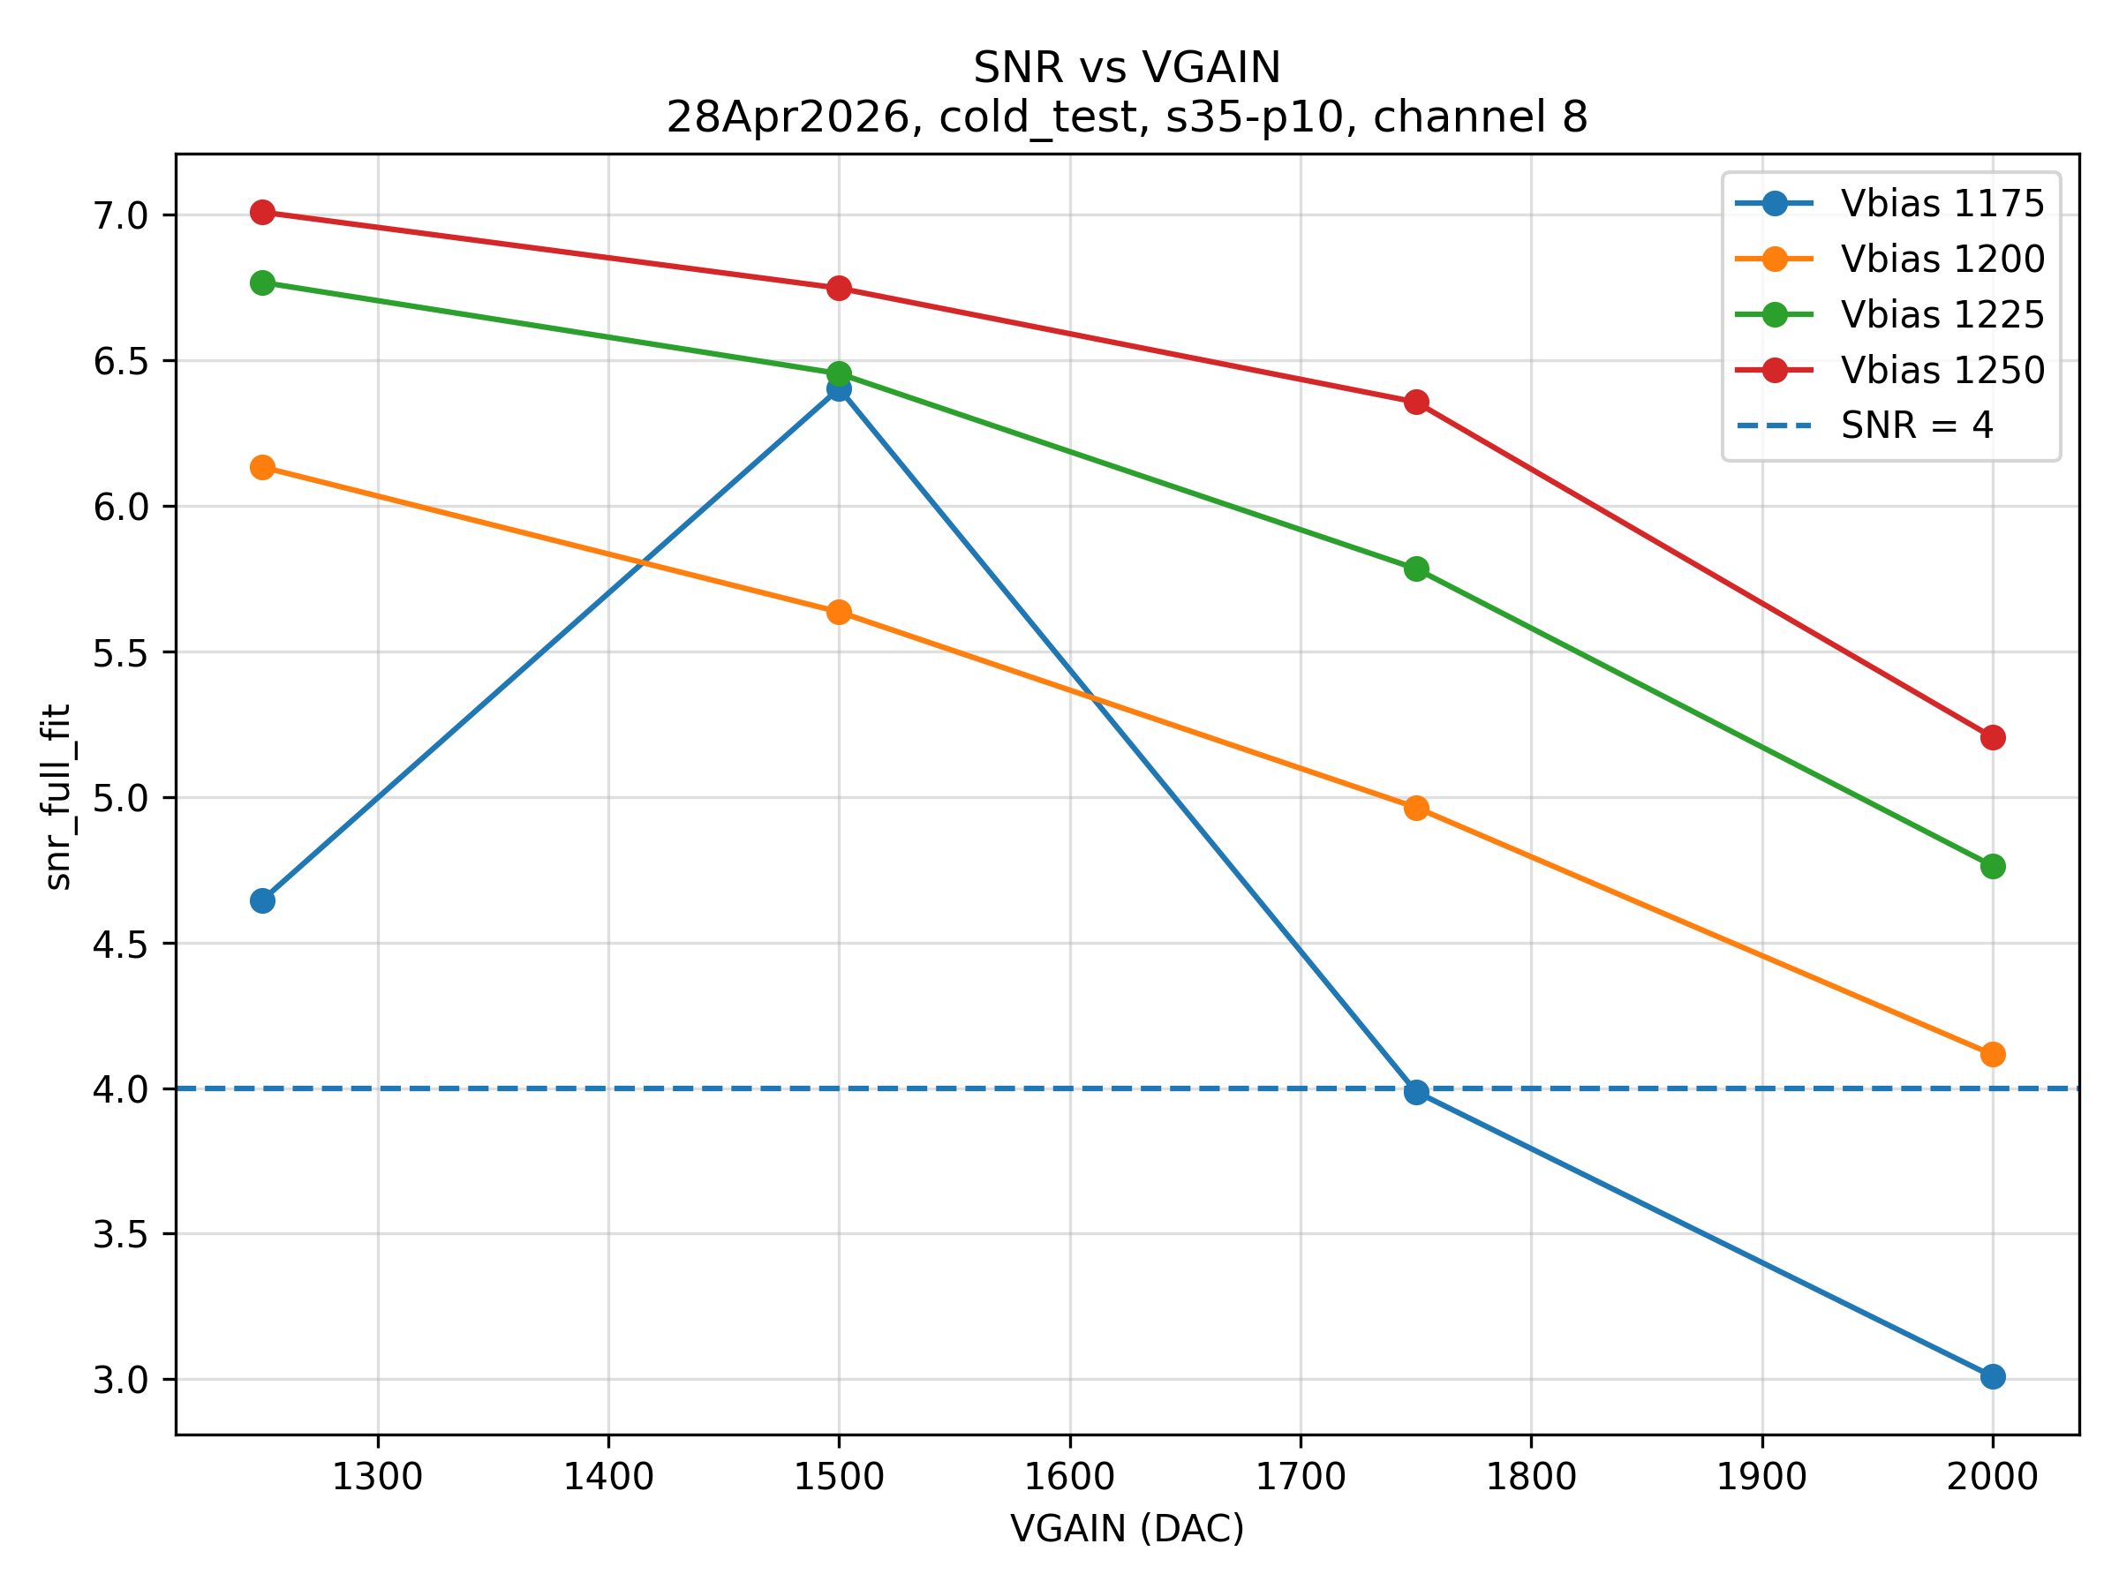
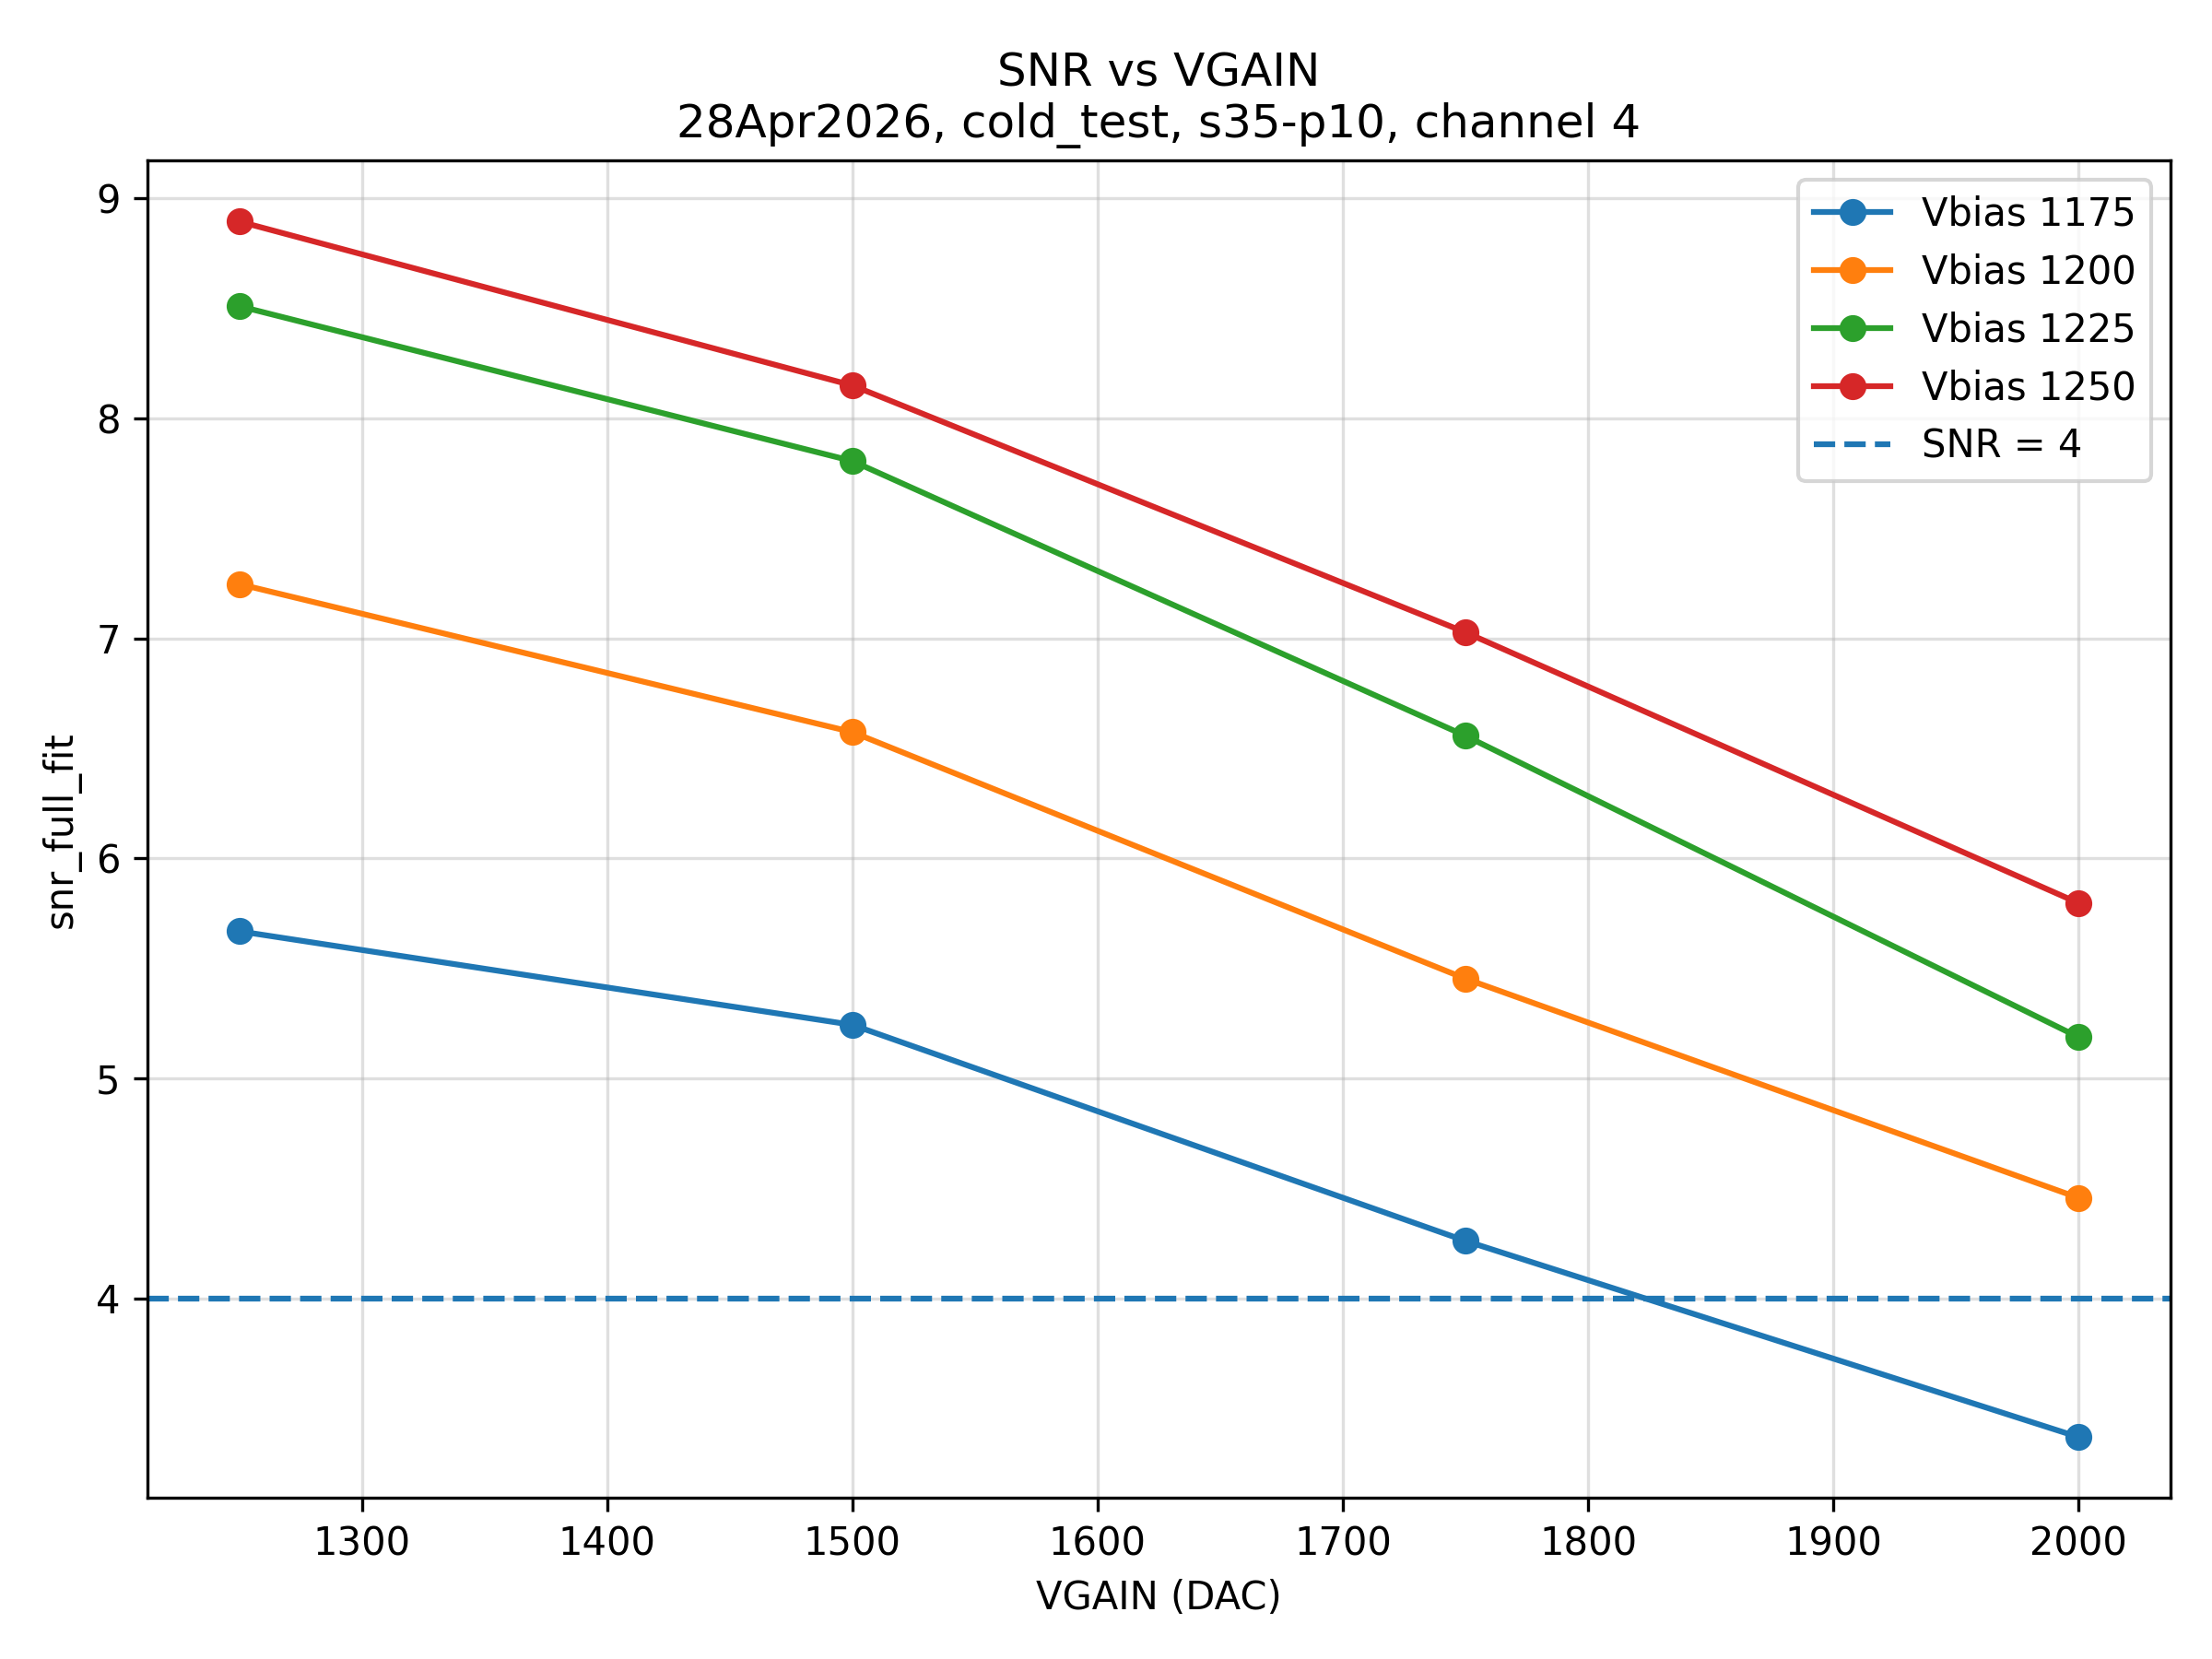
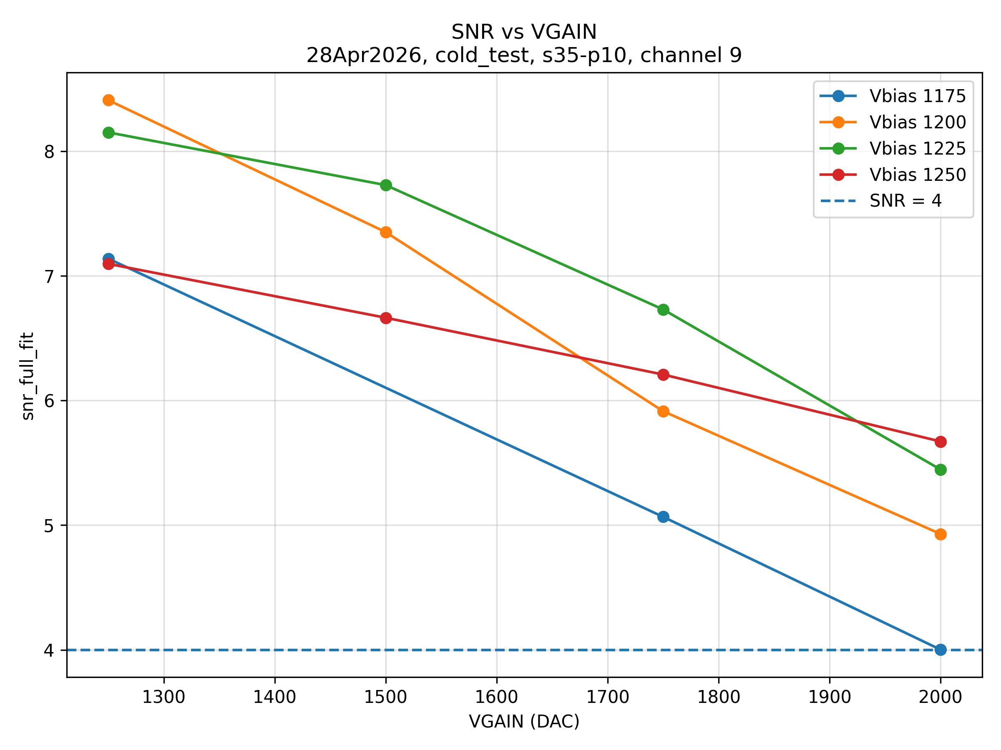
CH5
CH8
CH4
CH9

Slide 9
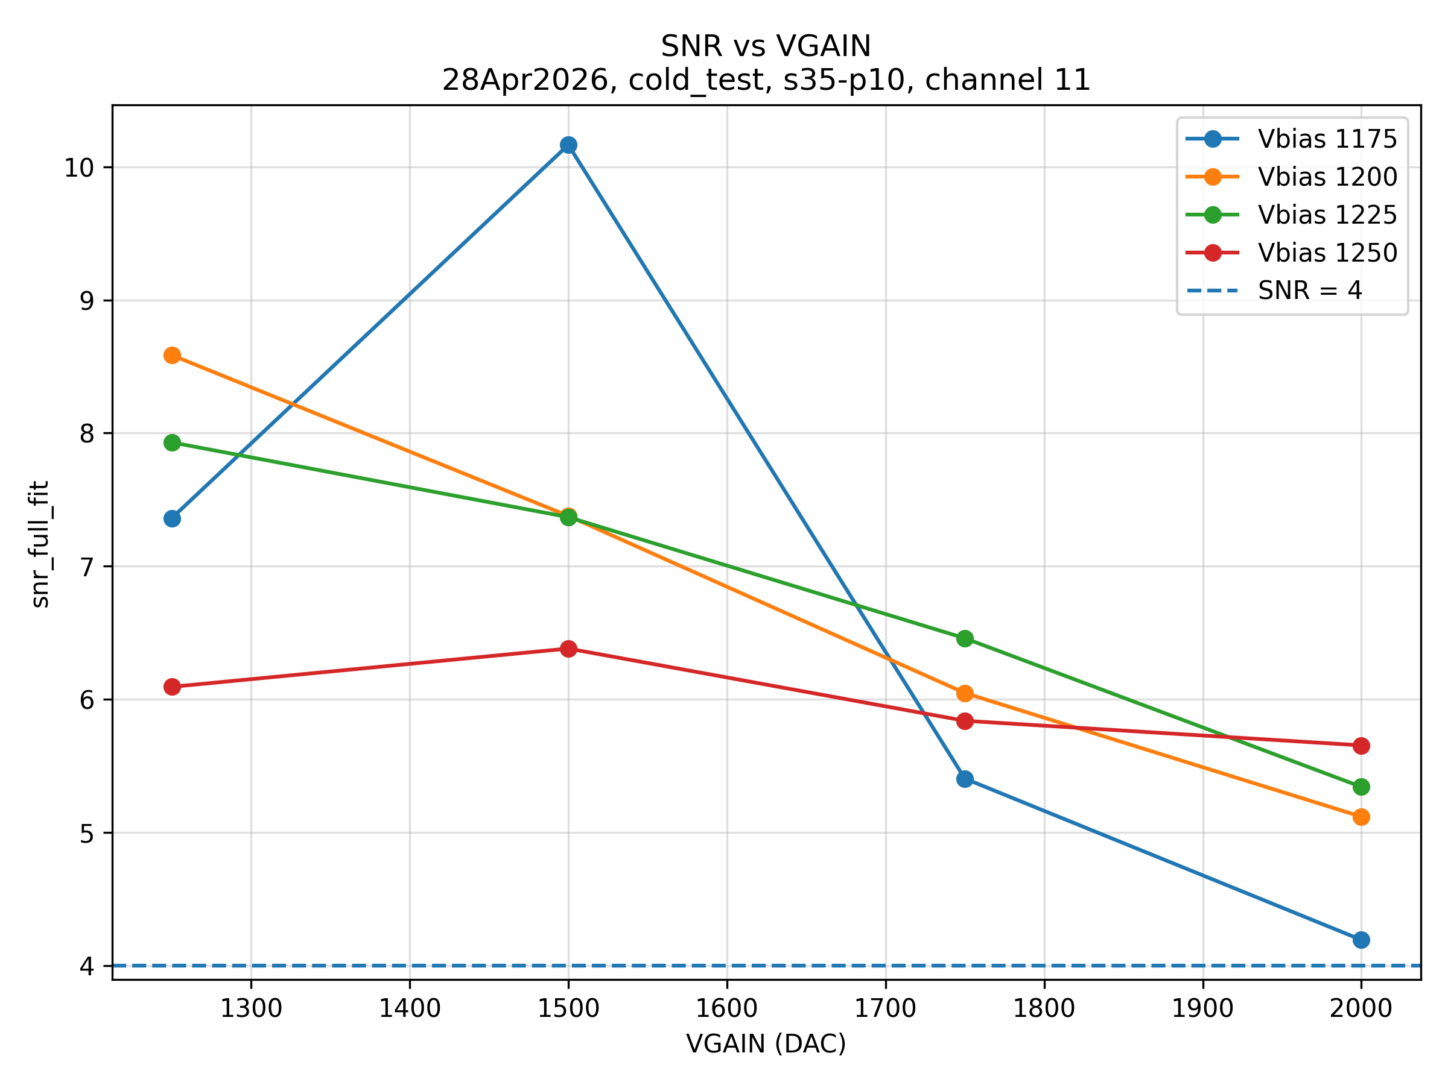
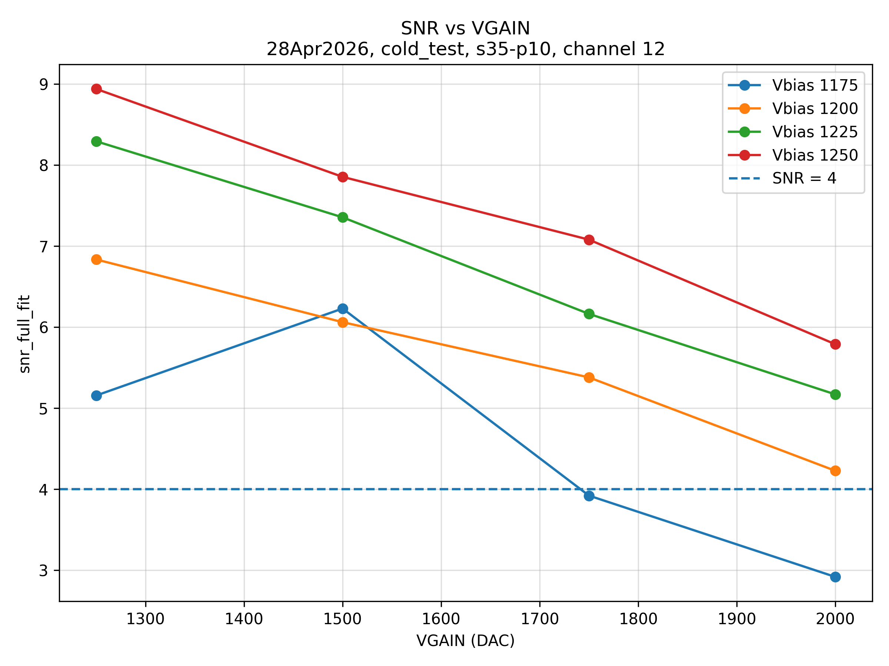
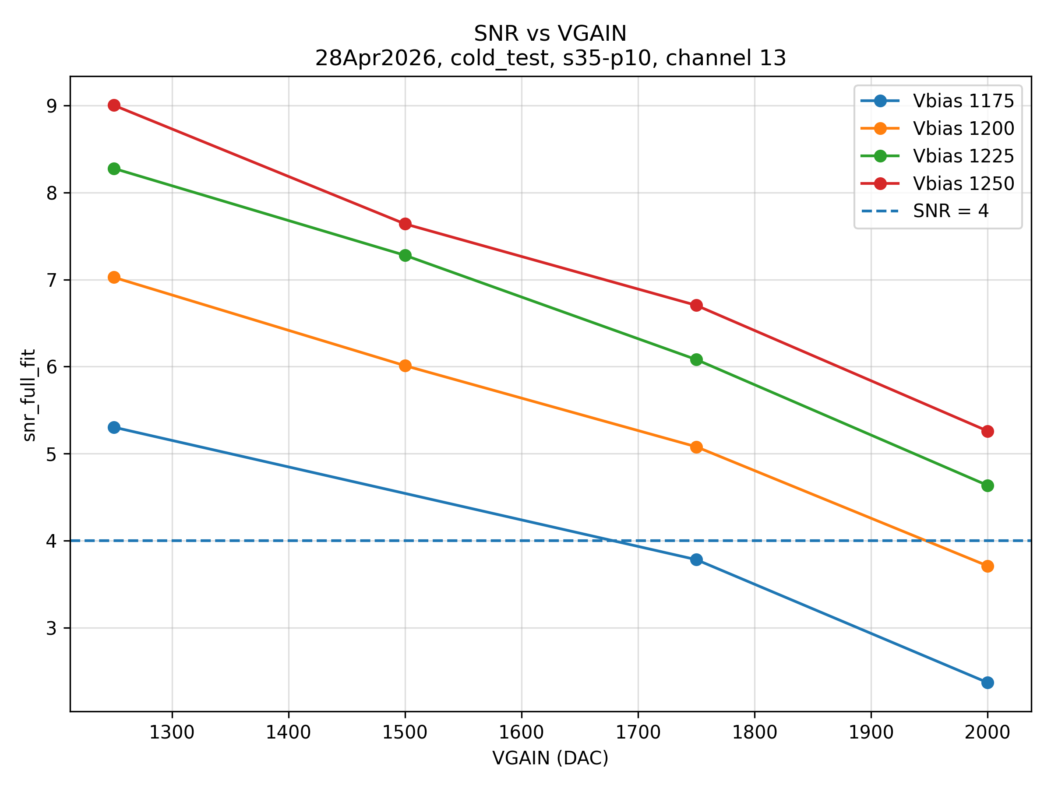
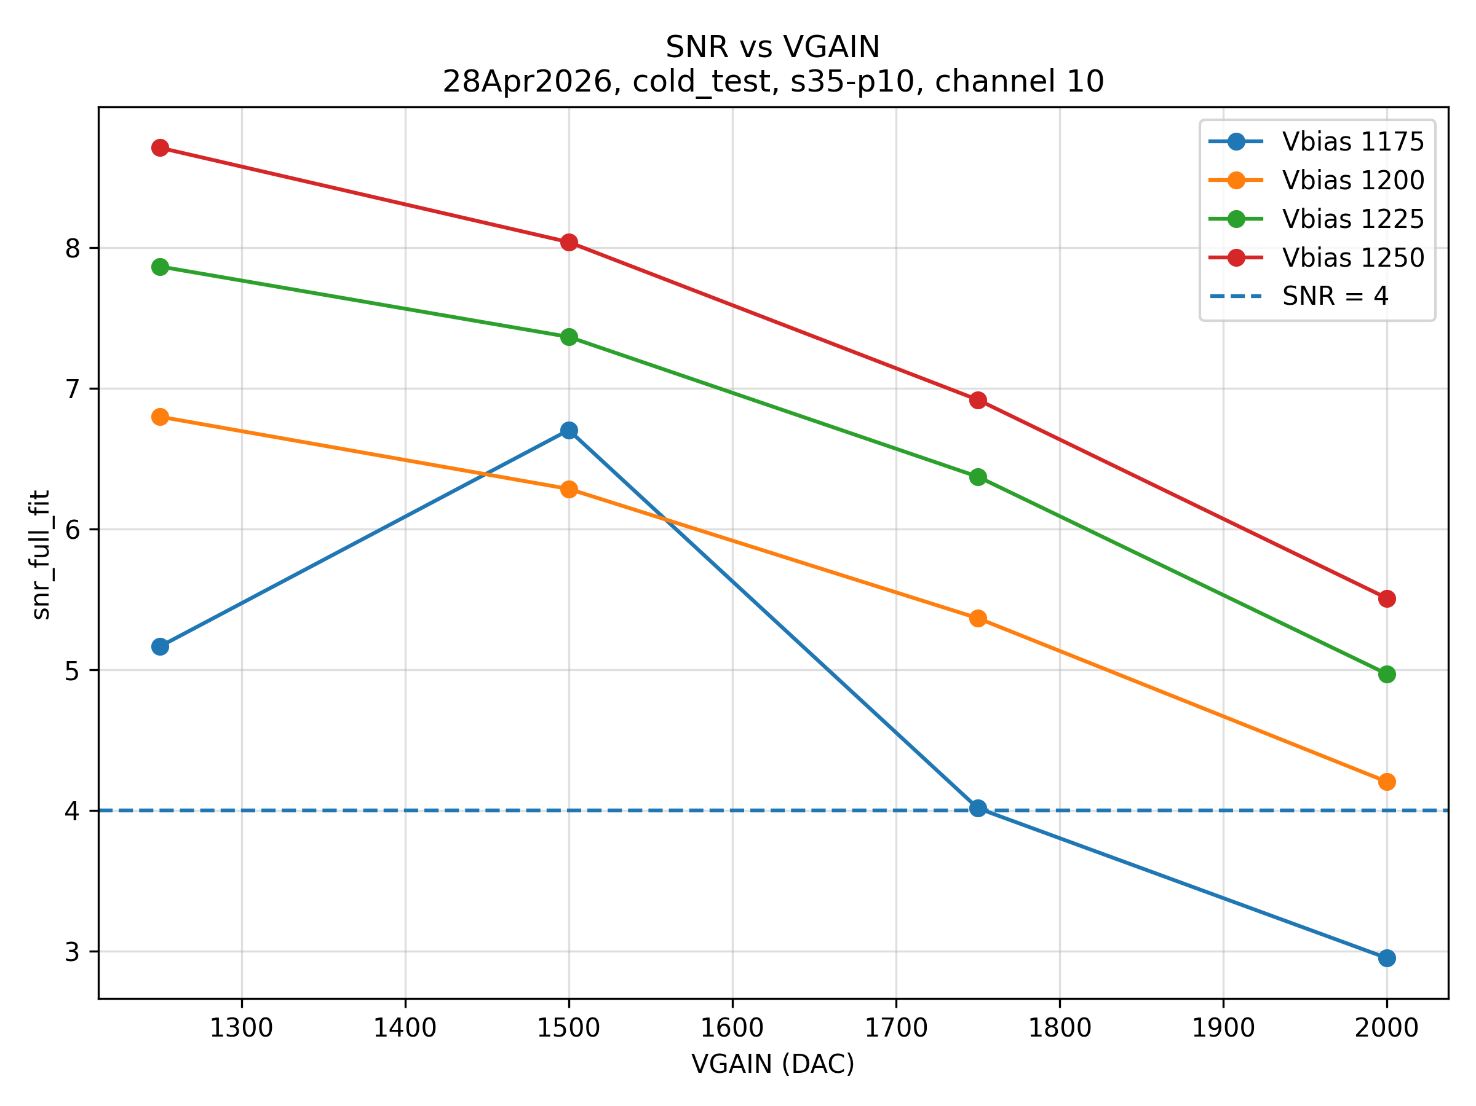
CH11
CH12
CH13
CH10

Slide 10
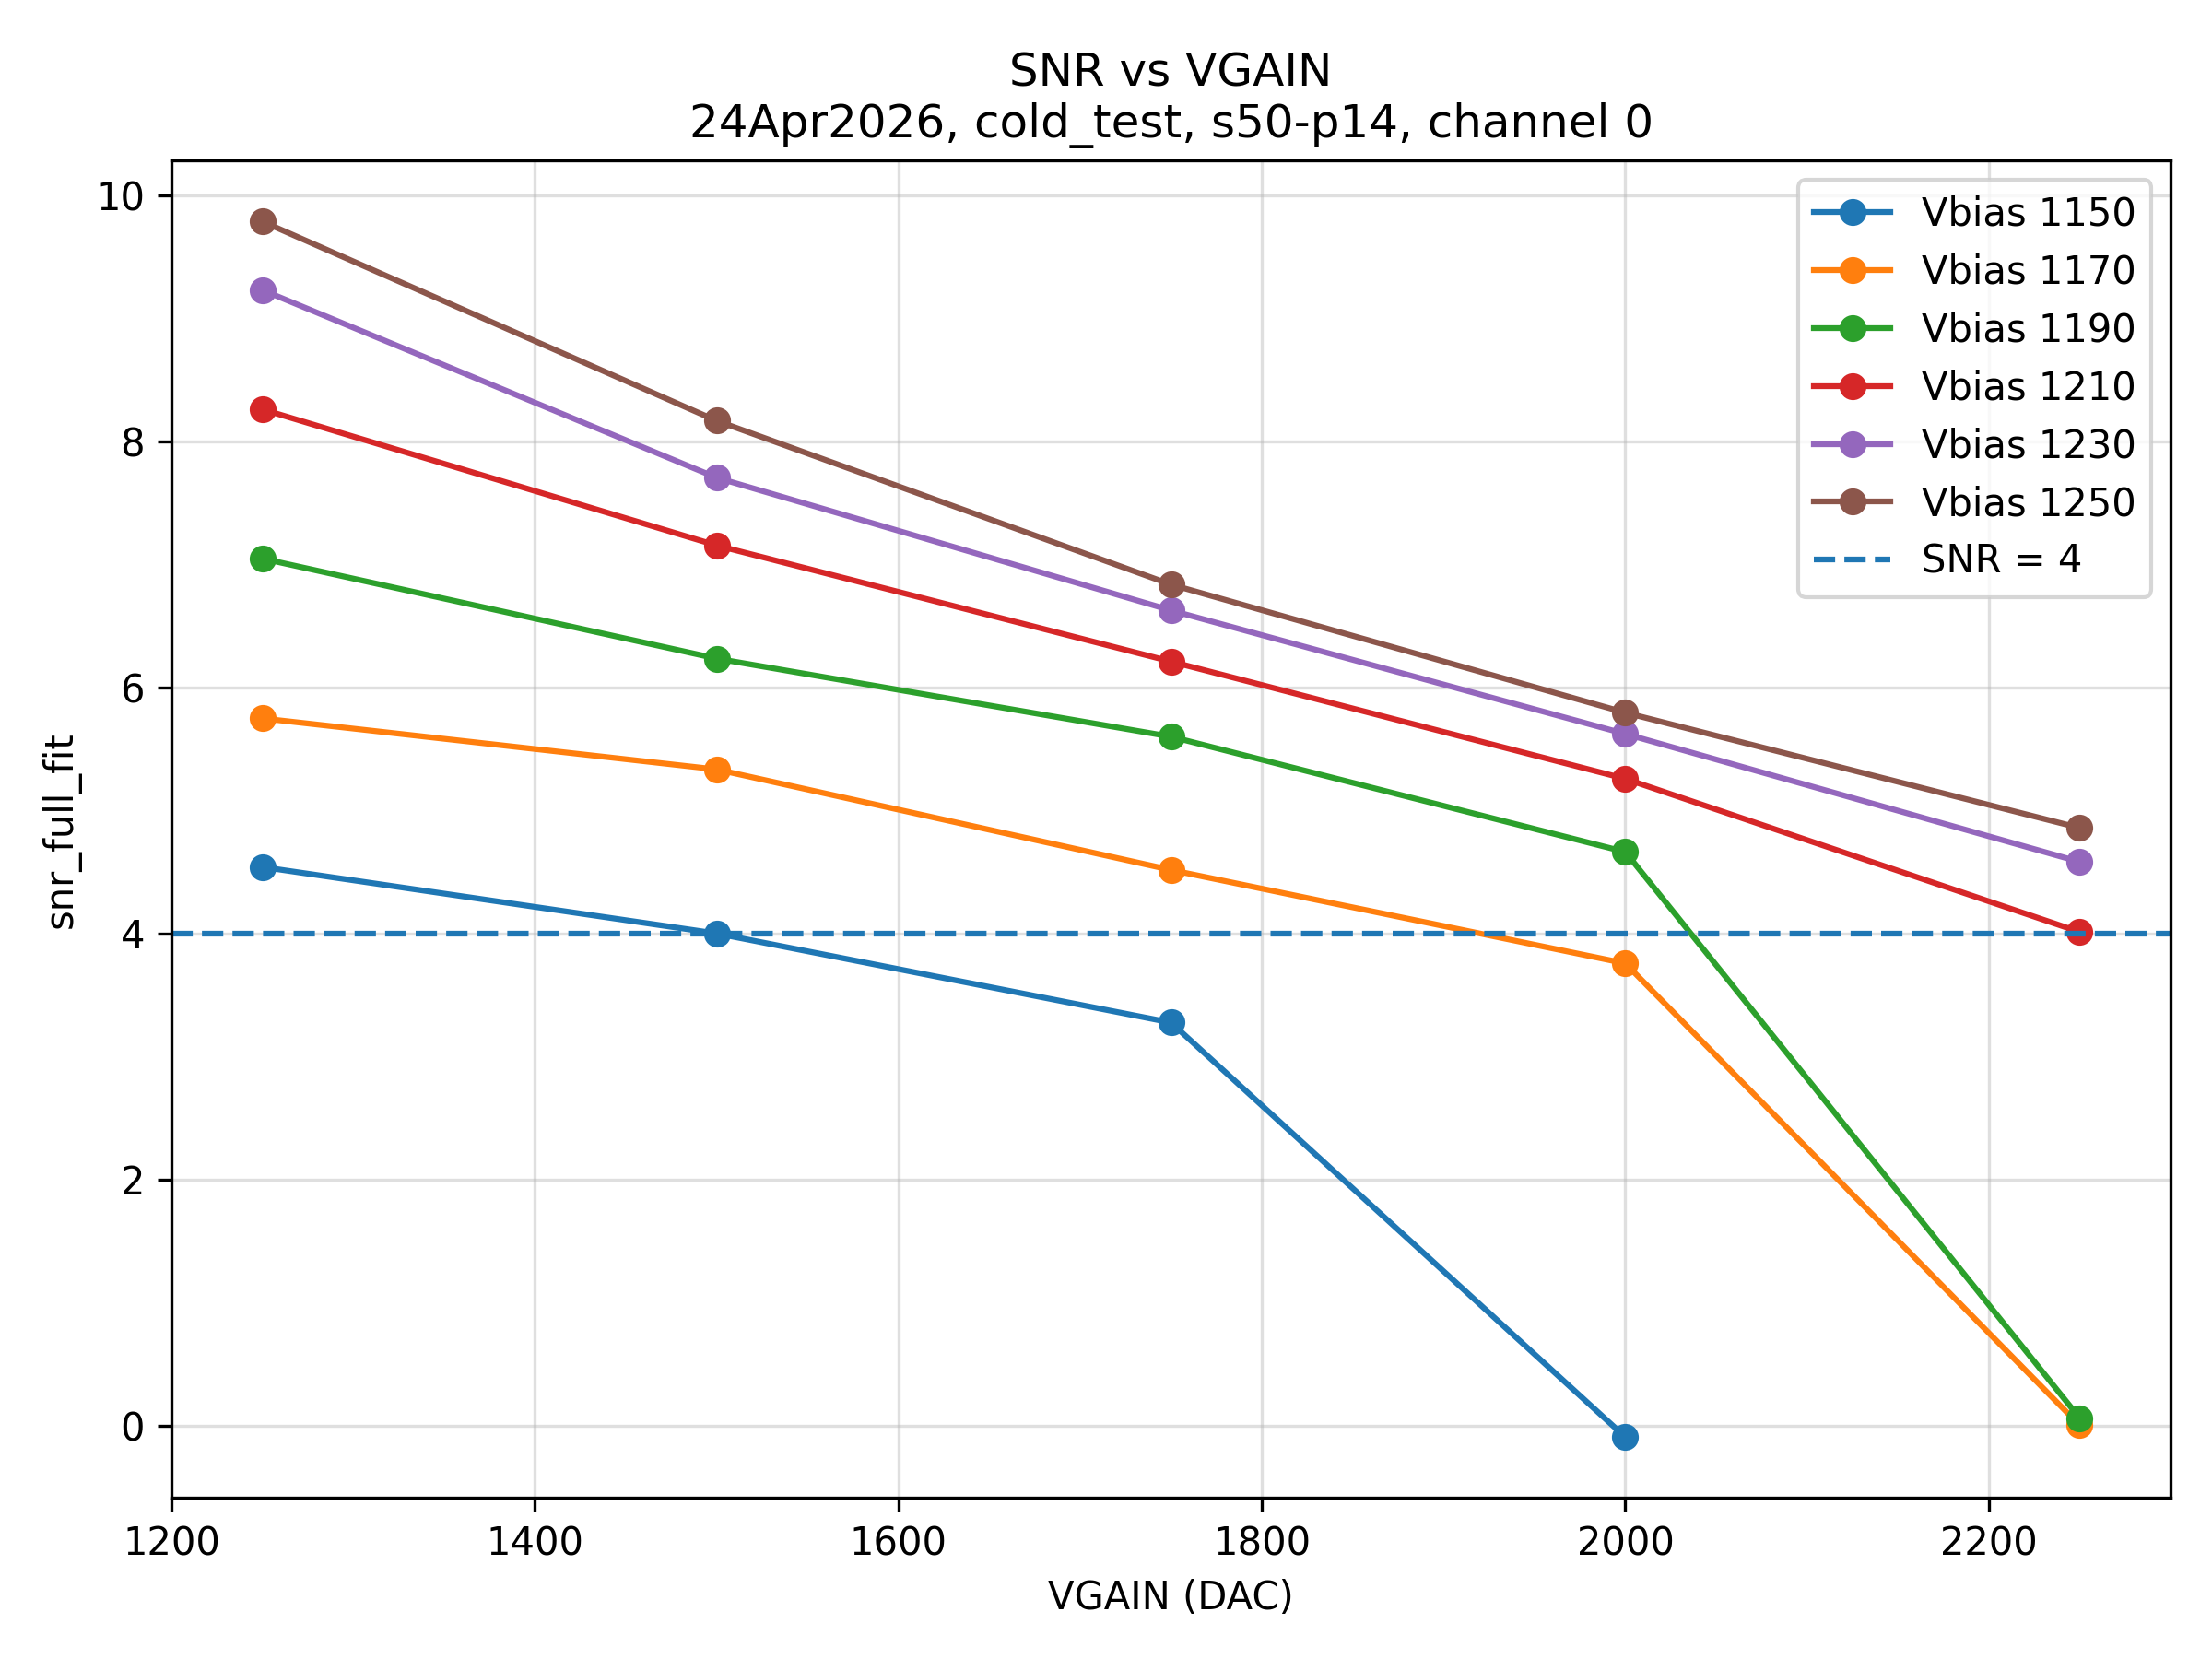
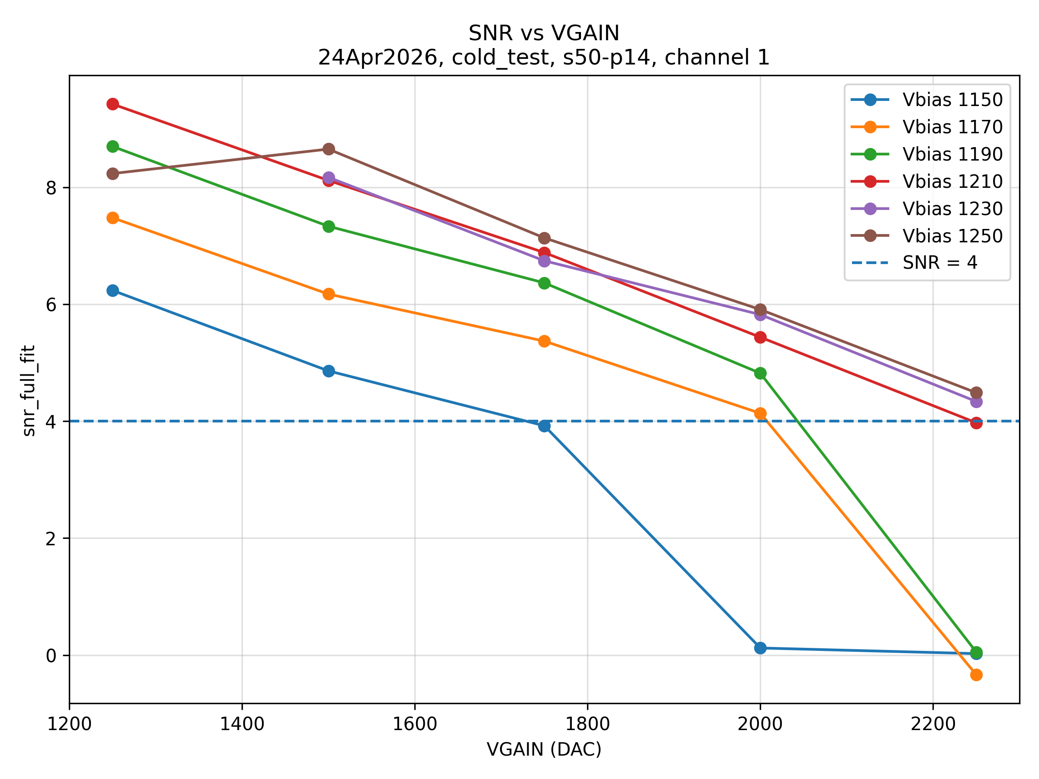
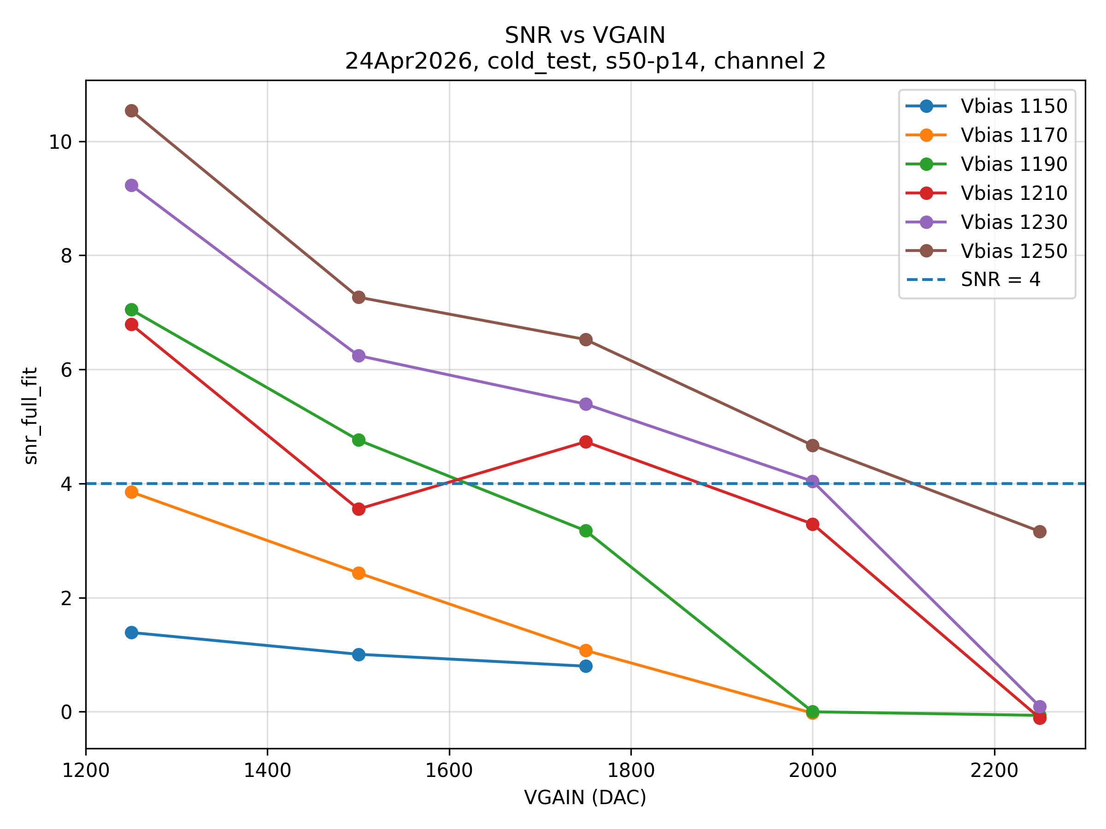
LED runs
CH2
CH1
CH0

Slide 11
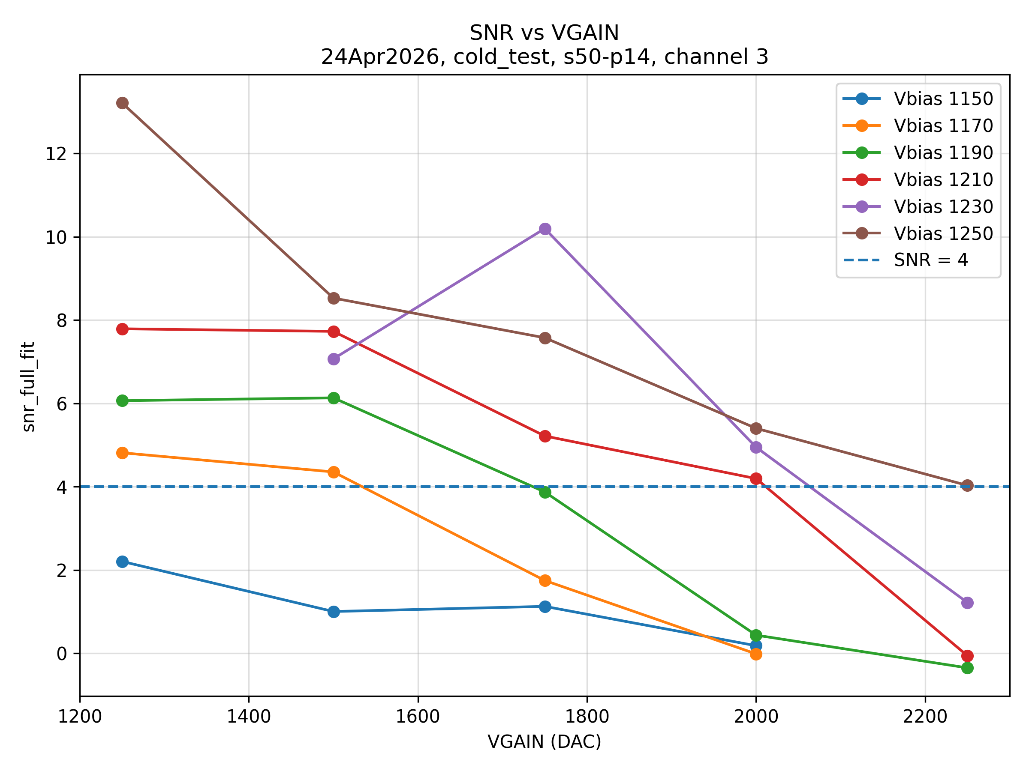
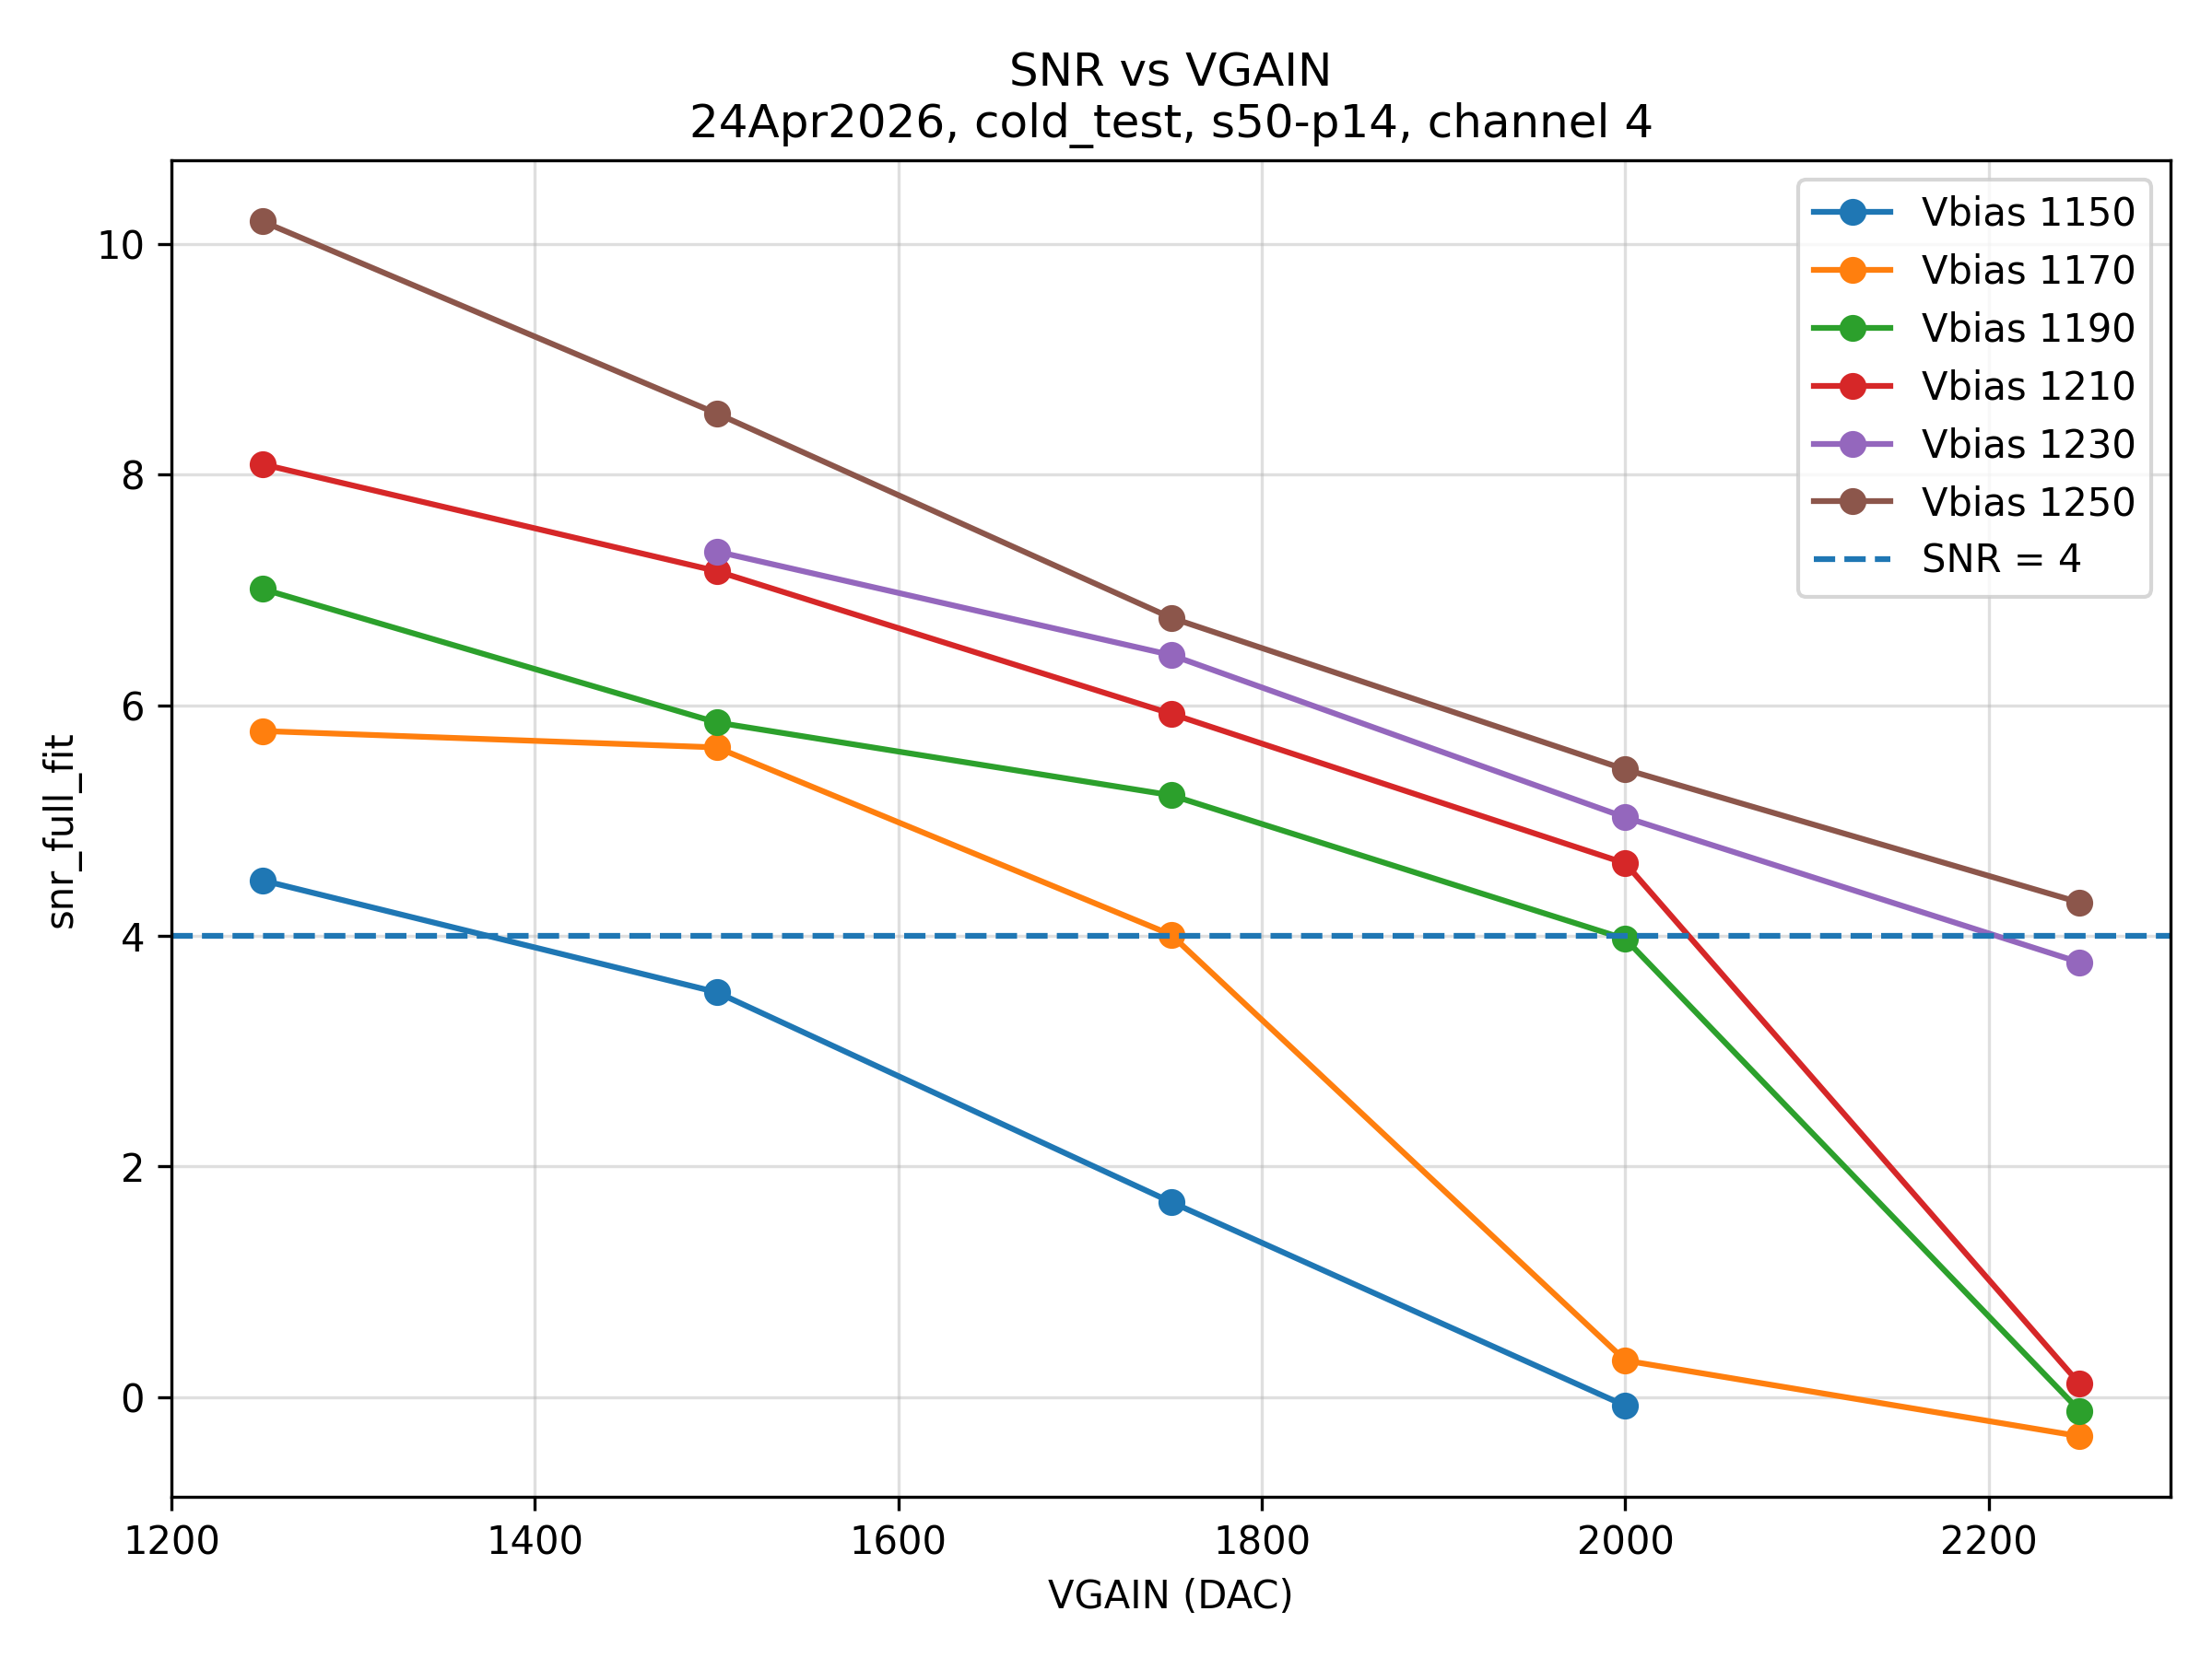
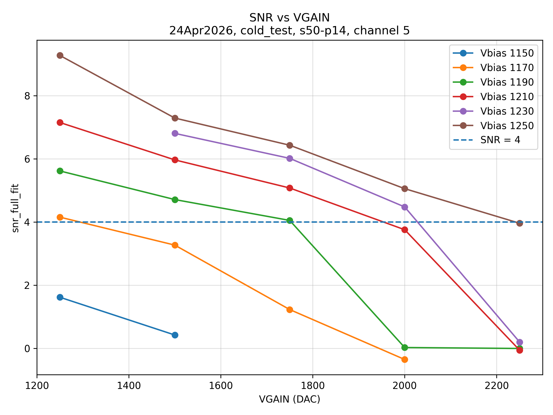
CH5
CH3
CH4

