Slide 1

Wirecell Group Updates
Evander Espinoza
April 30, 2026
Louisiana State University

Slide 2
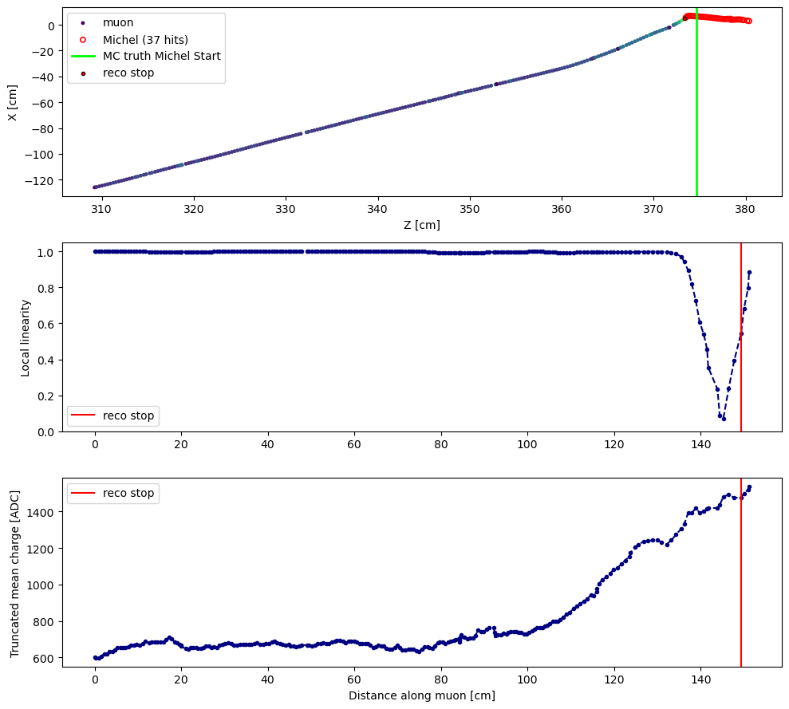
Some questions/motivations
How does charge get accurately reconstructed?
Do spacepoints get clustered? Are they (typically) evenly spaced?
Truncated mean charge calculation is not modeling the track profiles well, meaning the Michels aren’t getting properly tagged

Slide 3
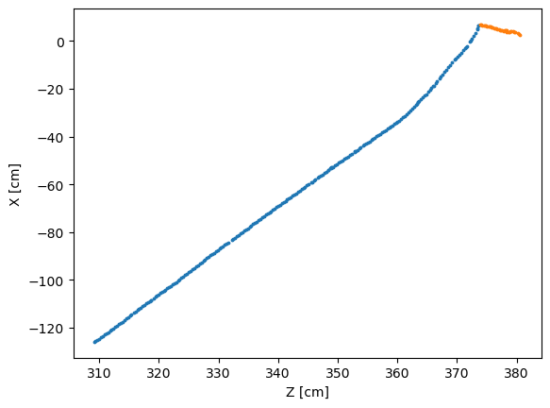
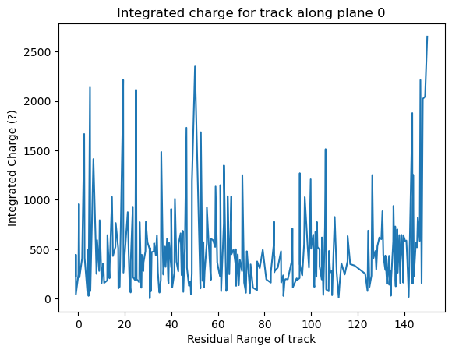
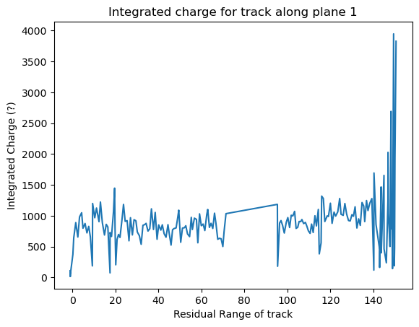
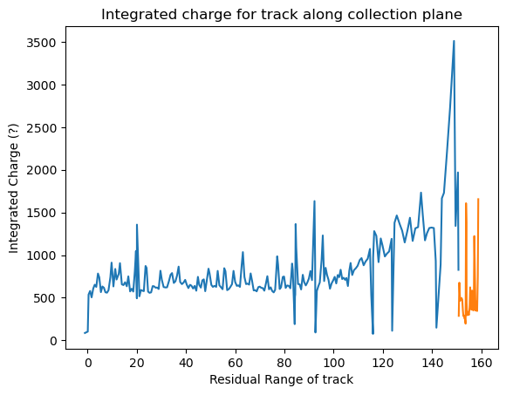
Charge vs residual range profiling shows a distinct “peak” then drop
Charge + res range have same size as spacepoint array, as expected
Notes:
dqdx plot use res range
calculate residual range on my own
Can compare my calculation with these plots to see if dqdx profile is close to this one
Point-by-point -- fluctuation is too high

Slide 4
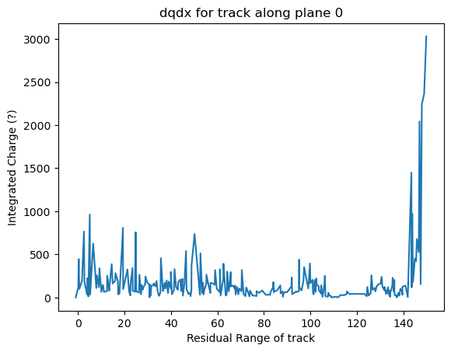
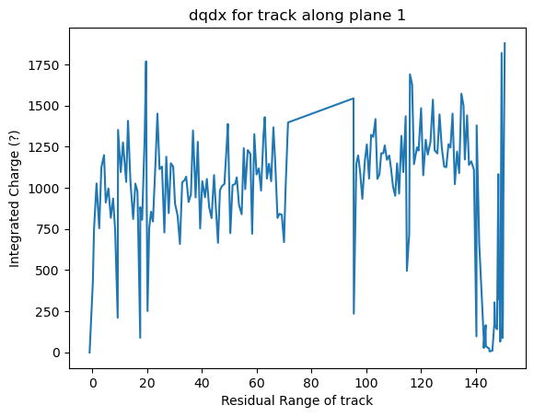
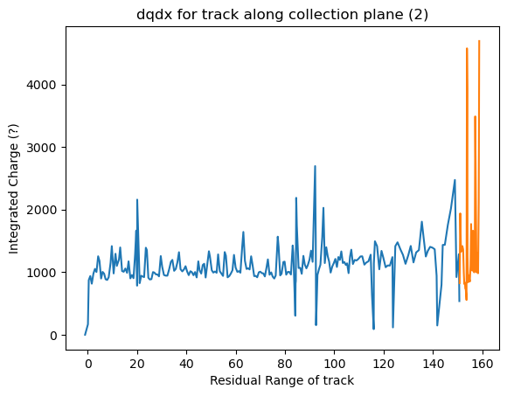
Looking at dqdx information shows a somewhat different story
Same size as sp array, as expected
dqdx as calculated in ntuple
Notes:
For each wireplane, none of them are 3d dqdx
use as a "sanity check" but not much else
Using every 5 points should be better
"true" 3d dqdx should not change
Just compare the MIP part we know dqdx ~constant
Calculate my own 3D dqdx
charge/3d "length"
Compare "true" charge
inefficiency issue: why it is missing etc, can filter out certain events look at truth can ID what the issue is, don't need anymore "samples"

Slide 6
Point clustering/resampling
Looking at dqdx profile, it would be good to calculate my own ‘dqdx’ for comparison
Are some points clustering? These over/underdensities could be why these look off
Individual points fluctuate as well, skewing things like linearity and trunc mean charge calculation
Defining a “standard step length” would be better for evaluation
ds

Slide 7
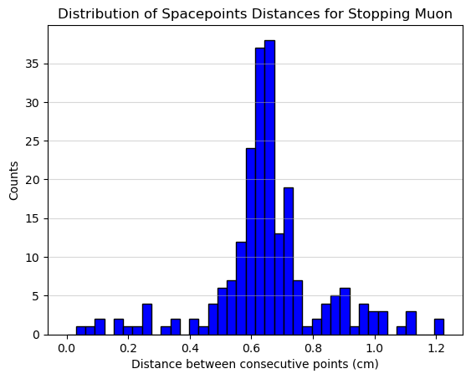
What’s a good spacing size?
Peak around 0.67 cm

Slide 8
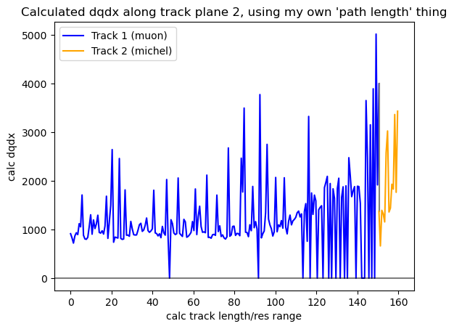
Noisy!

Slide 9
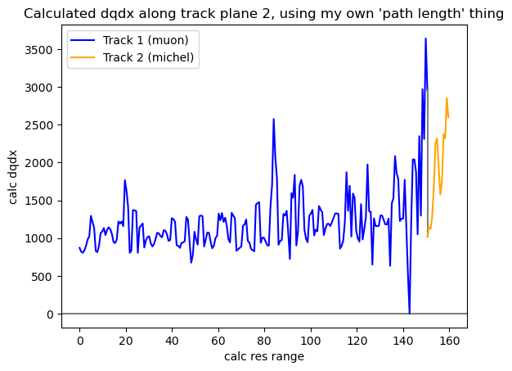
Adding a sliding window to smooth out charges (2 cm)

Slide 10
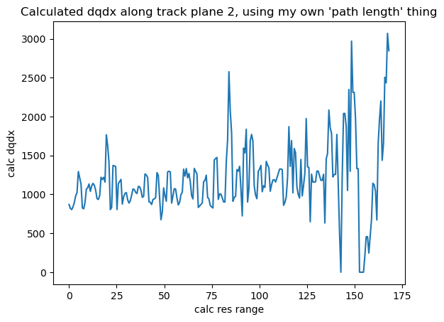
Combining the two tracks… sudden jump in dqdx after muon stops?
Charge seems to bunch up, likely due to the kink
Looks like it makes sense to resample points then concatenate after?

Slide 11
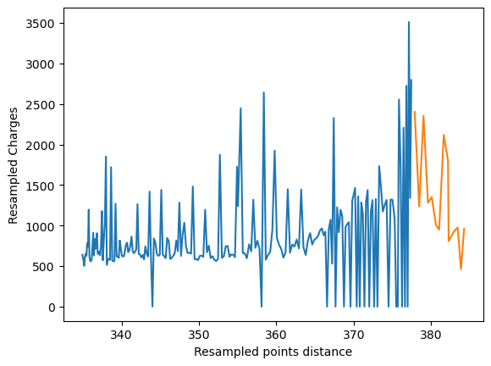
Looking strictly at resampled points vs charge

Slide 12
Extra

Slide 13
