Slide 1
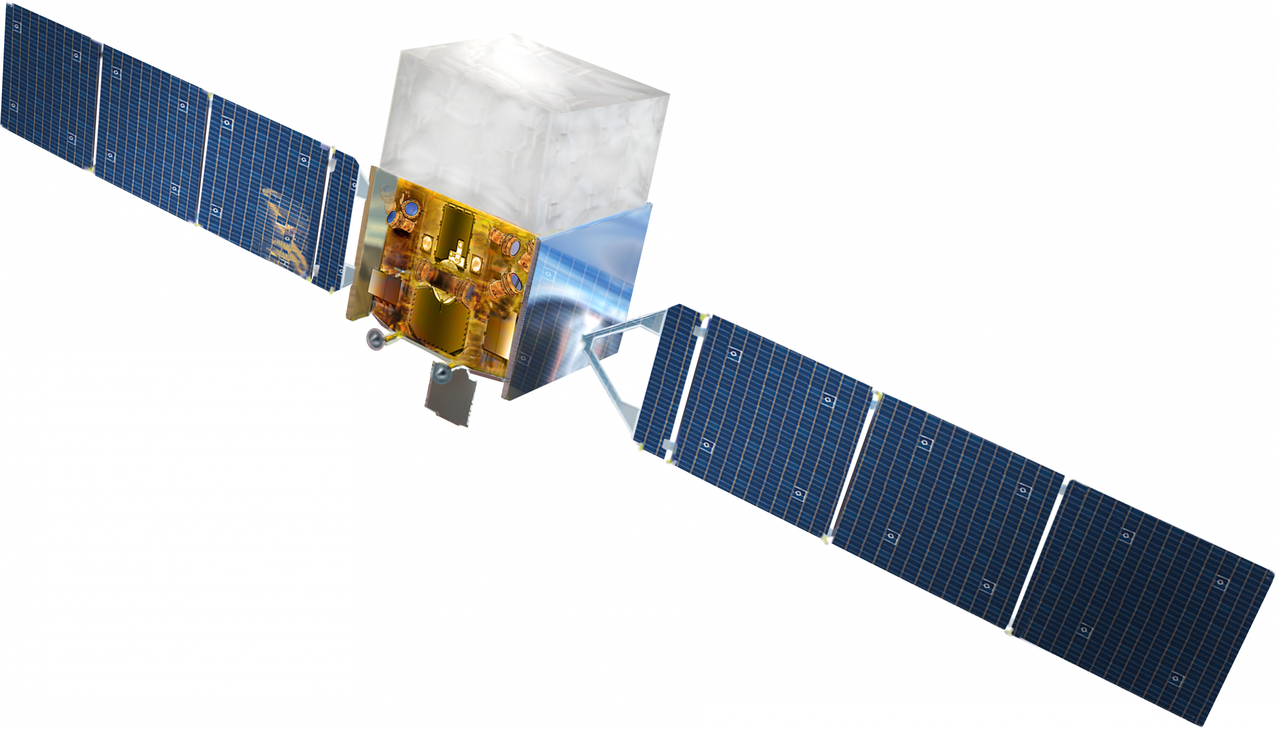
The Fermi Large Area Telescope
Henry Grell
30.06.2026
[1] NASA

Slide 2
Structure
Gamma-ray astronomy
The Fermi Satellite
The Large Area Telescope (LAT)
  Tracking and Calorimeter Modules
  Anticoincidence Detector and Data Acquisition
Discoveries
  Gamma-Ray Bursts
Summary

Slide 3
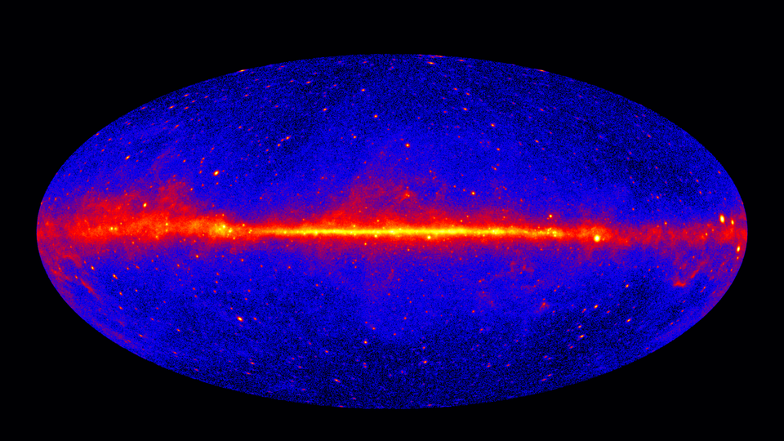
Gamma-ray astronomy
γ-rays allow viewing very high energy events
Electrically neutral→ Origin is easy to trace
Easier to detect than neutrinos and gravitational waves
Goals of γ-ray astronomy:
  Determine the origin of cosmic rays
  Search for γ-rays from dark matter decay/annihilation
  Research the structure/evolution of the universe
[2] NASA/DOE/Fermi LAT Collaboration
γ-ray sky at over 1GeV, observed by Fermi

Slide 4
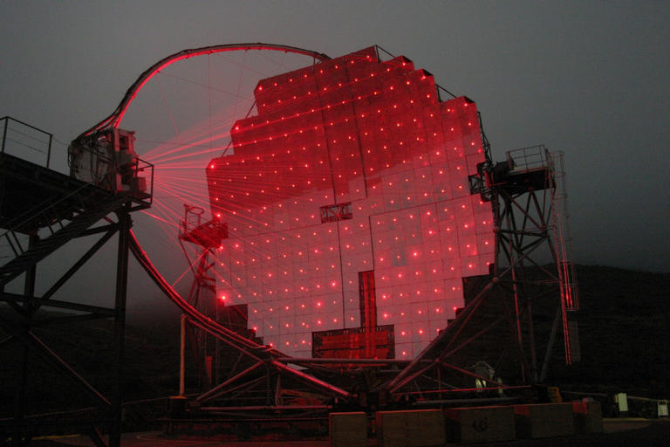
Gamma-ray observation
Space based instruments:
  Direct γ-ray detection
  Broad sky coverage and high angular resolution
  Small detector size
  Sensitive at lower energies
Ground based observation:
  Atmosphere blocks γ-rays → Indirect detection only (Cherenkov radiation)
  Large detection/collection area
  Atmospheric Cherenkov detection only works at night
  Very high energy detection
[3] Robert Wagner
The MAGIC telescope. Focusing reference lasers are visible due to fog

Slide 5
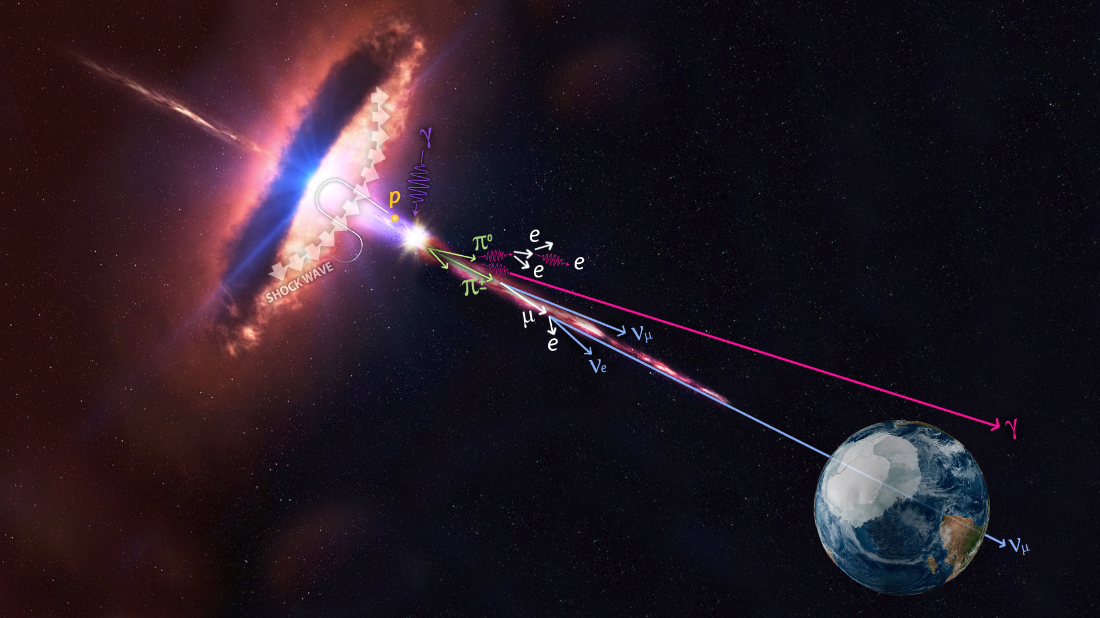
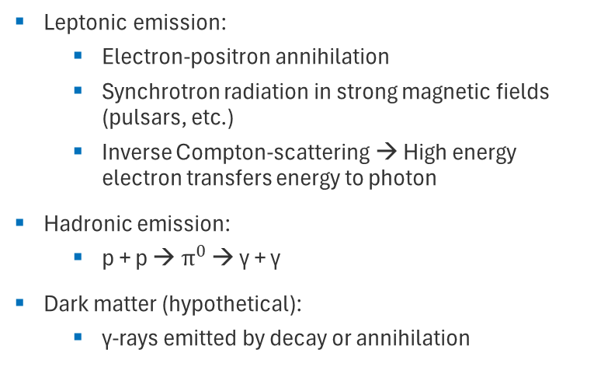
Gamma-ray emitters
Leptonic emission:
  Electron-positron annihilation
  Synchrotron radiation in strong magnetic fields (pulsars, etc.)
  Inverse Compton-scattering → High energy electron transfers energy to photon
Hadronic emission:
  p + p → $π^{0}$ → γ + γ
Dark matter (hypothetical):
  γ-rays emitted by decay or annihilation
[4] IceCube/NASA

Slide 6
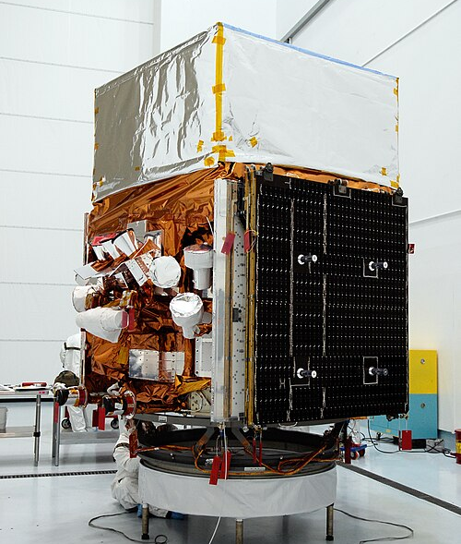
The Fermi satellite
Launched 11.06.2008 as Gamma-ray Large Area Space Telescope (GLAST)
Renamed Fermi Gamma-ray Space Telescope 23.08.2008
Mission goals:
  Determine origin of cosmic rays
  Image the γ-ray sky
  Detect and research γ-ray bursts (GRBs)
  Search for dark matter
Orbits the Earth every 95 minutes, full sky sweep every 3 hours
[5] NASA

Slide 7
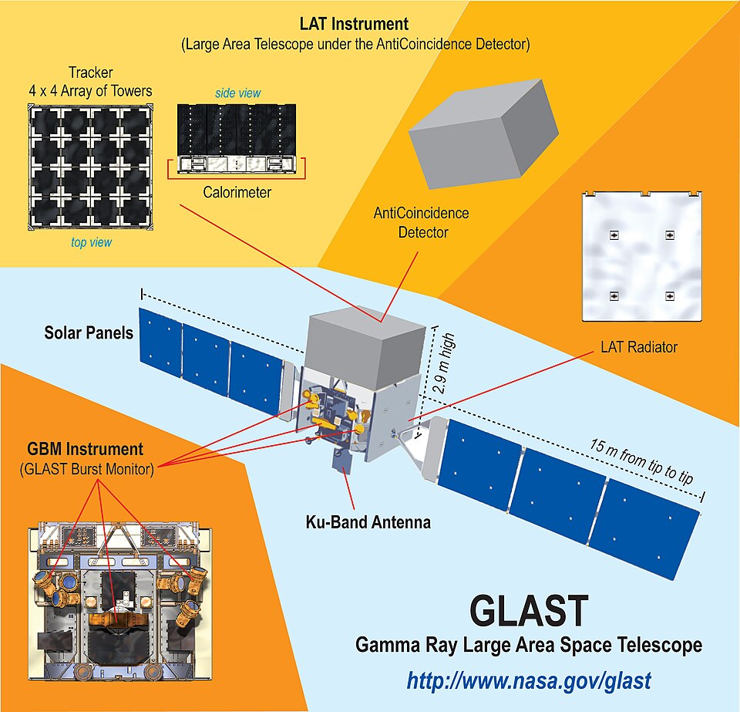
Fermi: Onboard instruments
Large Area Telescope (LAT):
  Imaging γ-ray pair conversion telescope
  Energy range: 20MeV – 300GeV
  Field of view: 20% of the sky
  Successor of the Energetic Gamma Ray Experiment Telescope (EGRET) in most aspects
Gamma Burst Monitor (GBM):
  Scintillation detector passively searching for GRBs
  Energy range: 10keV – 30MeV
  Can „see“ the entire unoccluded sky
[6] NASA

Slide 8
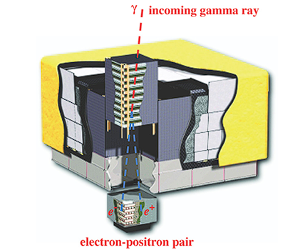
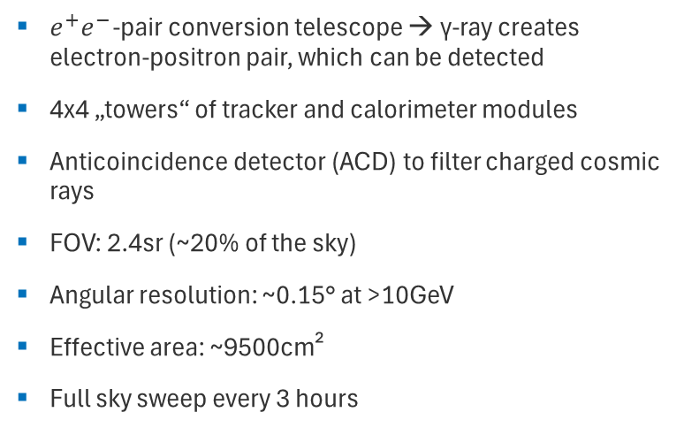
The Large Area Telescope
$e^{+}e^{−}$-pair conversion telescope → γ-ray creates electron-positron pair, which can be detected
4x4 „towers“ of tracker and calorimeter modules
Anticoincidence detector (ACD) to filter charged cosmic rays
FOV: 2.4sr (~20% of the sky)
Angular resolution: ~0.15° at >10GeV
Effective area: ~9500cm²
Full sky sweep every 3 hours
[7] W. B. Atwood et al.

Slide 9
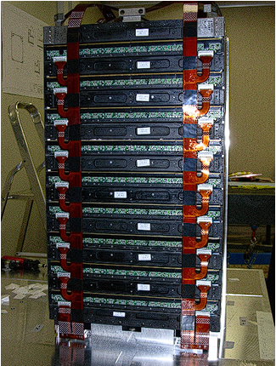
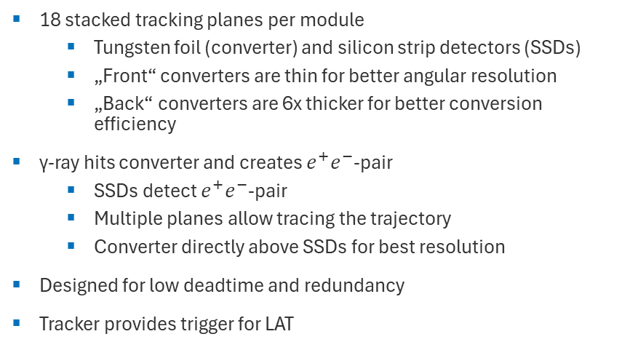
LAT: Tracker Modules
18 stacked tracking planes per module
  Tungsten foil (converter) and silicon strip detectors (SSDs)
  „Front“ converters are thin for better angular resolution
  „Back“ converters are 6x thicker for better conversion efficiency
γ-ray hits converter and creates $e^{+}e^{−}$-pair
  SSDs detect $e^{+}e^{−}$-pair
  Multiple planes allow tracing the trajectory
  Converter directly above SSDs for best resolution
Designed for low deadtime and redundancy
Tracker provides trigger for LAT
[8] W. B. Atwood et al.

Slide 10
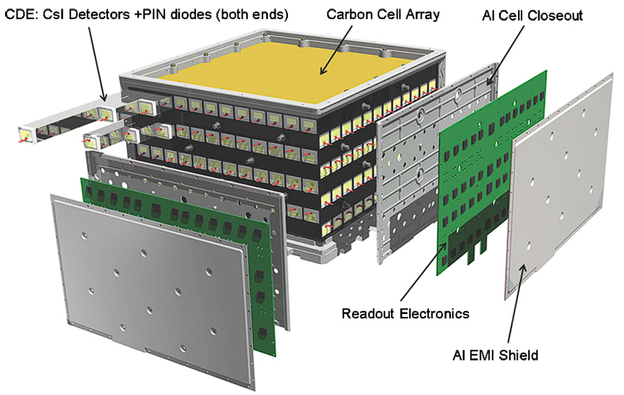
LAT: Calorimeter Modules
96 CsI(Tl) scintillators per module
  Hodoscopic arrangement allows 3d tracking
Calorimeter measures energy of particle shower
  Profile allows for background discrimination
  Position resolution scales with energy
[9] W. B. Atwood et al.

Slide 11
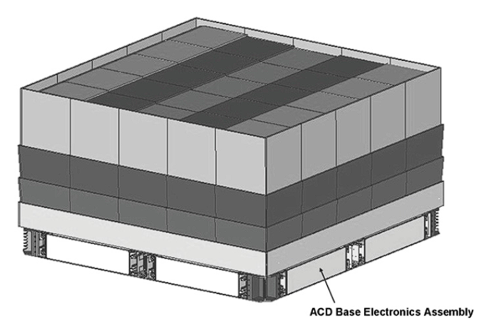
LAT: Anticoincidence Detector
Plastic scintillators surrounding the LAT assembly
Detects charged cosmic rays to filter false signals
  High detection efficiency
Segmented to prevent false veto from backsplash effect
  High energy photons from calorimeter may Compton-scatter in ACD
  Sufficiently high energy deposition in calorimeter disables veto
  Segmentation reduces area that can contribute
ACD is encased by micrometeoroid shield
  Maintains light-tight seal
[10] W. B. Atwood et al

Slide 12
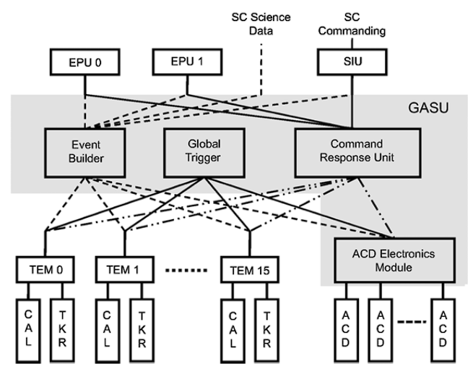
LAT: Data Acquisition System
Onboard signal processing
  Filters out charged particle background
  Can process 1000s of events per second
  Low deadtime (~26.5μs)
Triggers are provided by tower modules:
  If 3 tracker planes trigger in a row
  If certain energy thresholds are exceeded
ACD can veto trigger signals
[11] W. B. Atwood et al.

Slide 13
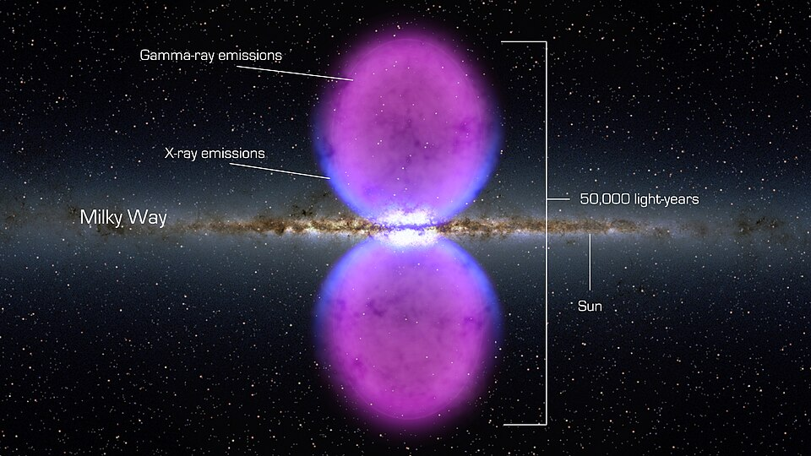
Discoveries
Highest energy GRB to date (on 2 separate occasions)
  ~32GeV photon in 2008
  94GeV photon in 2013
High γ-emission from galactic center
γ-ray emitting bubbles expanding 25000 ly above and below galactic center (Fermi bubbles)
Confirmation of particle acceleration in supernovas
Background γ-ray sources
And more…
[12] NASA
Fermi Bubbles

Slide 14
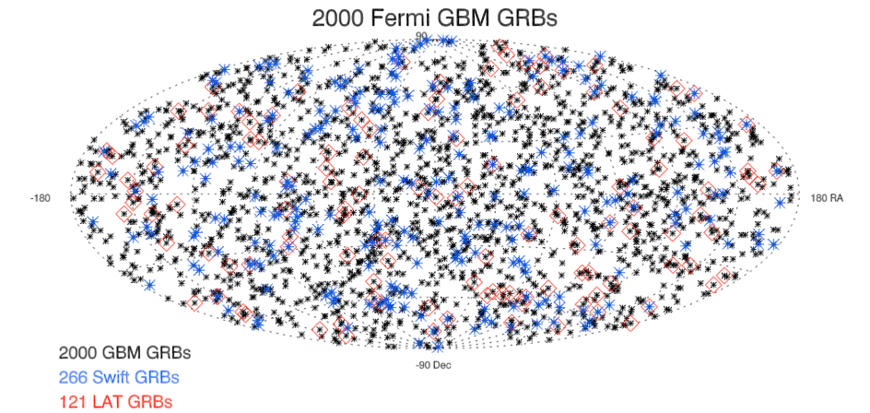
γ-Ray Bursts
Extremely bright and energetic events
Duration from milliseconds to hours
Supernovas and neutron star mergers are known sources
No recorded intragalactic GRBs
Can have x-ray and/or optical afterglow
[13] NASA

Slide 15
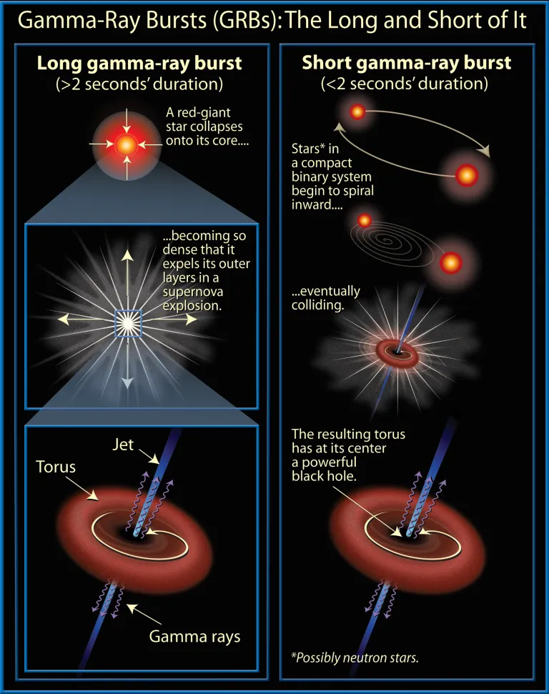
GRBs: Short and long bursts
Short bursts (sGRBs):
~30% of observed GRBs
No link to massive stars
Concurrent measurement of sGRB and gravitational wave confirmed neutron star merger as source
Long Bursts:
Originate from galaxies with rapid star formation
Caused by deaths of massive stars
[14] NASA and A. Feild (STScI)

Slide 16
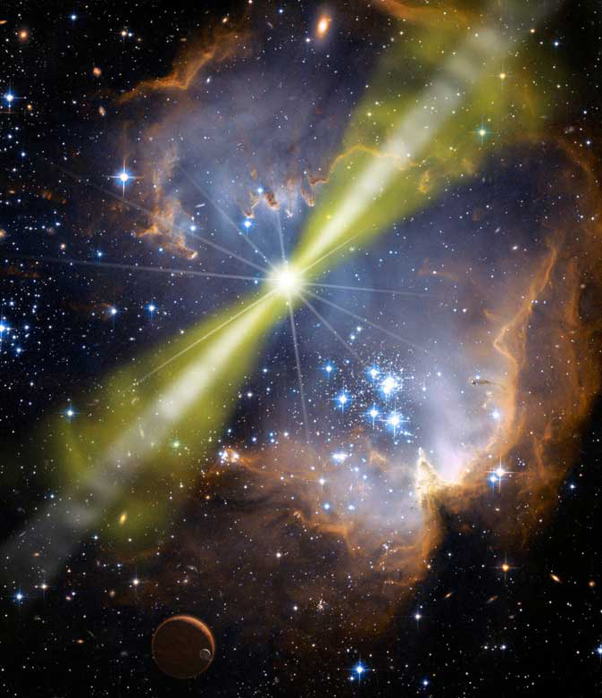
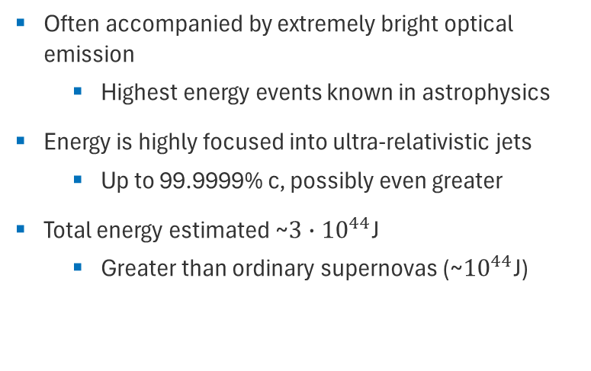
GRBs: Energy
Often accompanied by extremely bright optical emission
  Highest energy events known in astrophysics
Energy is highly focused into ultra-relativistic jets
  Up to 99.9999% c, possibly even greater
Total energy estimated ~$3∙{10}^{44}$J
  Greater than ordinary supernovas (~${10}^{44}$J)
[15] NASA/Swift/Mary Pat Hrybyk-Keith and John Jones

Slide 17
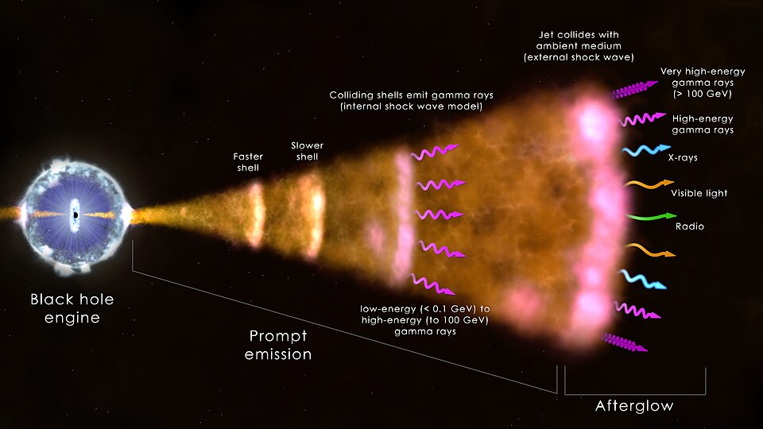
GRBs: Emission
Exact emission mechanism unknown
Very high emission efficiency (~50%)
Likely emitter is inverse Compton scattering from high energy particles accelerated by the source event
Collision of shockwave “shells” likely drives emission
Afterglow is emitted by relativistic shockwave and synchrotron radiation
[16] NASA/Goddard Space Flight Center/ICRAR

Slide 18
Summary
γ-rays show us the highest energy processes in the universe
Fermi LAT is a powerful space-based instrument to detect γ-rays
Fermi has detected 1000s of γ-ray sources and collected valuable data
Open questions remain:
  Ongoing search for dark matter
  How do supernovas, etc. accelerate particles so efficiently
  How are relativistic jets produced/accelerated
  Unidentified γ-ray sources
  And more…

Slide 19
Sources
W. B. Atwood et al. 2009. The Large Area Telescope on the Fermi Gamma-Ray Space Telescope Mission. ApJ. 697:1071. https://iopscience.iop.org/article/10.1088/0004-637X/697/2/1071
Stefan Funk. 2015. Ground- and Space-Based Gamma-Ray Astronomy. Annual Review Nuclear and Particle Science. 65:245-277. https://doi.org/10.1146/annurev-nucl-102014-022036
L. Baldini, L. Tibaldo. 2011. Science Highlights from the Fermi Large Area Telescope. Il Nuovo Cimento. 35:63-75. https://www.sif.it/riviste/sif/ncc/econtents/2012/035/01/article/46
https://en.wikipedia.org/wiki/Fermi_Gamma-ray_Space_Telescope
https://fermi.gsfc.nasa.gov/science/
https://www.dlr.de/de/ar/themen-missionen/weltraumforschung/erkundung-des-weltraums/entstehung-des-universums/fermi-gamma
https://en.wikipedia.org/wiki/Gamma-ray_burst
https://fermi.gsfc.nasa.gov/ssc/observations/types/grbs/
https://en.wikipedia.org/wiki/Gamma-ray_astronomy
https://en.wikipedia.org/wiki/Gamma-ray_burst_emission_mechanisms
https://en.wikipedia.org/wiki/Pair_production
https://heasarc.gsfc.nasa.gov/docs/cgro/egret/egret_tech.html
https://en.wikipedia.org/wiki/Energetic_Gamma_Ray_Experiment_Telescope

Slide 20
Image Sources
[1]: https://en.wikipedia.org/wiki/File:Fermi_Gamma-ray_Space_Telescope_spacecraft_model.png
[2]: https://en.wikipedia.org/wiki/File:Fermi_5_year_11000x6189.png
[3]: https://en.wikipedia.org/wiki/File:The_MAGIC_Telescope_at_night.jpg
[4]: https://physics.ua.edu/2019/08/09/ua-gamma-ray-astrophysics-group-awarded-grant-for-work-on-sources-of-gamma-rays-neutrinos-and-gravitational-waves/
[5]: https://en.wikipedia.org/wiki/File:GLAST_on_the_payload_attach_fitting.jpg
[6]: https://en.wikipedia.org/wiki/File:GLAST_schematic.jpg
[7], [8], [9], [10], [11]: W. B. Atwood et al. 2009. The Large Area Telescope on the Fermi Gamma-Ray Space Telescope Mission. ApJ. 697:1071. https://iopscience.iop.org/article/10.1088/0004-637X/697/2/1071
[12]: https://en.wikipedia.org/wiki/File:800_nasa_structure_renderin2.jpg
[13]: https://fermi.gsfc.nasa.gov/ssc/observations/types/grbs/
[14]: https://science.nasa.gov/mission/hubble/science/science-behind-the-discoveries/hubble-gamma-ray-bursts/
[15]: https://en.wikipedia.org/wiki/File:GRB080319B_illustration_NASA.jpg
[16]: https://en.wikipedia.org/wiki/File:Gamma-ray-burst-Mechanism.jpg
[17]: https://en.wikipedia.org/wiki/File:Pair_production_Cartoon.gif
[18]: https://heasarc.gsfc.nasa.gov/docs/cgro/egret/egret_tech.html

Slide 21
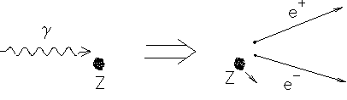
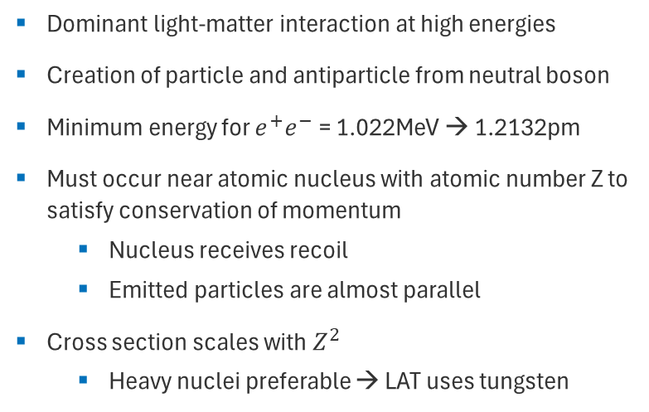
Pair-Production
Dominant light-matter interaction at high energies
Creation of particle and antiparticle from neutral boson
Minimum energy for $e^{+}e^{−}$ = 1.022MeV → 1.2132pm
Must occur near atomic nucleus with atomic number Z to satisfy conservation of momentum
  Nucleus receives recoil
  Emitted particles are almost parallel
Cross section scales with $Z^{2}$
  Heavy nuclei preferable → LAT uses tungsten
[17] Jess H. Brewer

Slide 22
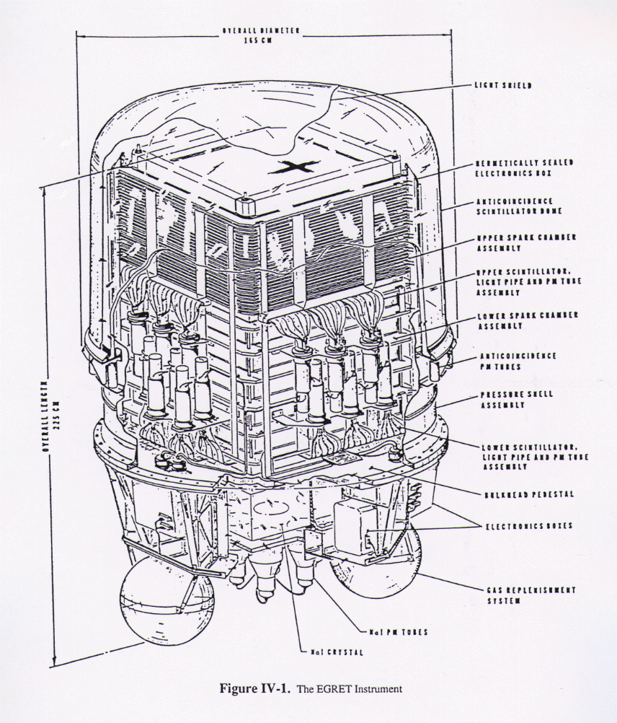
LAT‘s predecessor: EGRET
1991 - 2000
Energy range: 20MeV – 30GeV
Angular resolution: ≤0.5°
Spark chamber, calorimeter, and anticoincidence dome
Effective area: ~1500cm²
271 sources discovered, 170 unidentified
→ LAT is a major technological improvement
[18] NASA/Goddard Space Flight Center

