Slide 1
Long-lived particles
Michael Popinski
30.06.2025

Slide 2
Agenda
Introduction
Theory
Experimental signatures
Background types
Long lived particles, Michael Popinski

Slide 3
1. Introduction
Long lived particles, Michael Popinski

Slide 4
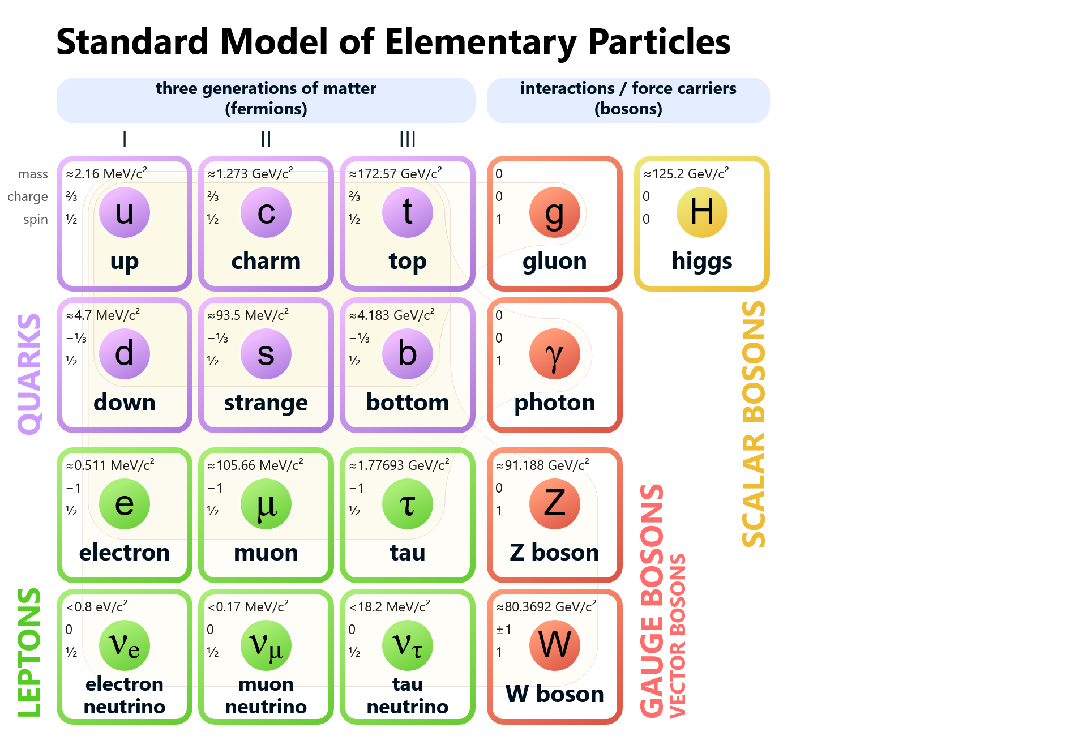
BSM - Beyond the standard model
Standard model as we know it is incomplete
  Gravity
  Dark matter
  …and many more
New theories are necessary
[2] Wikipedia, Standard model
Long lived particles, Michael Popinski

Slide 5
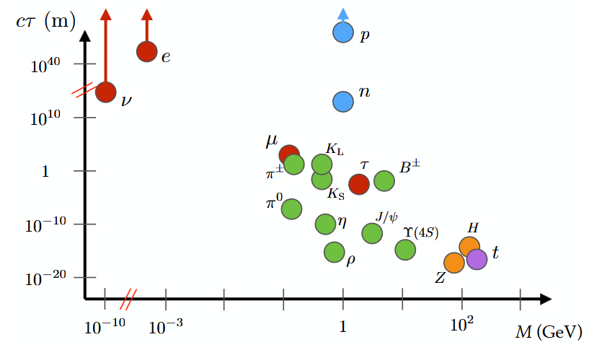
LLPs - long lived particles
Definition: Particles with non-negligible lifetimes
Common theoretical prediction of BSM models explaining SM shortcomings
Examples in SM include B-Mesons or K-mesons
Usually only weakly interacting
[2] B. Shuve
Long lived particles, Michael Popinski

Slide 6
2. Theory
Long lived particles, Michael Popinski

Slide 7
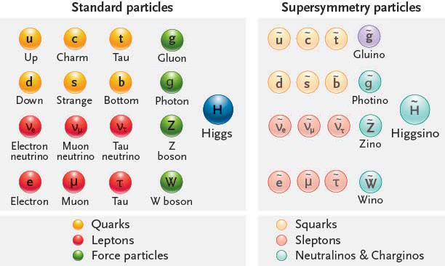
SUSY - Supersymmetry
General framework for new theories
For any “standard” particle there is a SUSY-counterpart
Mass contributions to Higgs mass from each pair nearly cancel
Examples include:
  Minimal SSM: only lowest amount of new particles
  Higgs sector extensions: Higgs particle has new decays into other scalar “Higgs-like” particles
[3] Francis Naukas
Long lived particles, Michael Popinski

Slide 8
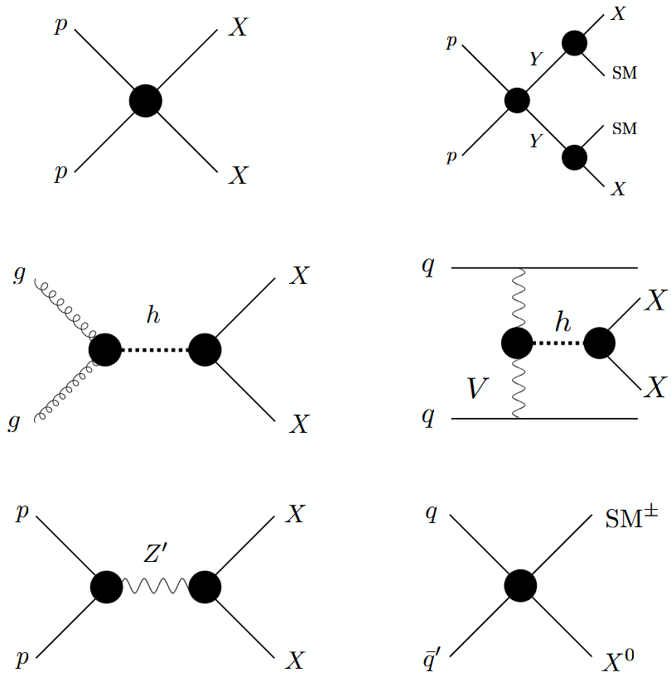
Production mechanisms
Feynman diagrams of the different LLP productions, LLP noted as X
We have:
  Direct pair production
  Heavy parent production
  Higgs modes
  Resonances through heavy force carriers
  Charged currents
[4] Alimena, Juliette, et al
Long lived particles, Michael Popinski
Notes:
Figure 2.1: Schematic illustrations of LLP production modes in
our simplified model framework. From top to bottom and left
to right: direct pair production (DPP); heavy parent (HP); Higgs
modes (HIG), including gluon fusion and VBF production (not
shown here is V H production); heavy resonance (RES); charged
current (CC).

Slide 9
Why long-lived anyway?
Long lifetimes associated with suppressed decays
Decay products have similar masses as LLP
  Small phase space of products
[5] Wikipedia, beta decay
Long lived particles, Michael Popinski

Slide 10
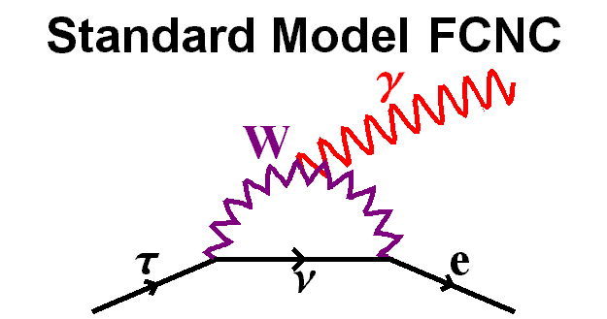
Why long-lived anyway?
Long lifetimes associated with suppressed decays
Decay products have similar masses as LLP
  Small phase space of products
Weak couplings
  Only decays via very weakly coupled processes possible
[5] Wikipedia, flavor changing neutral currents
Long lived particles, Michael Popinski
Notes:
Decay BR is about 1e-54, so basically impossible

Slide 11
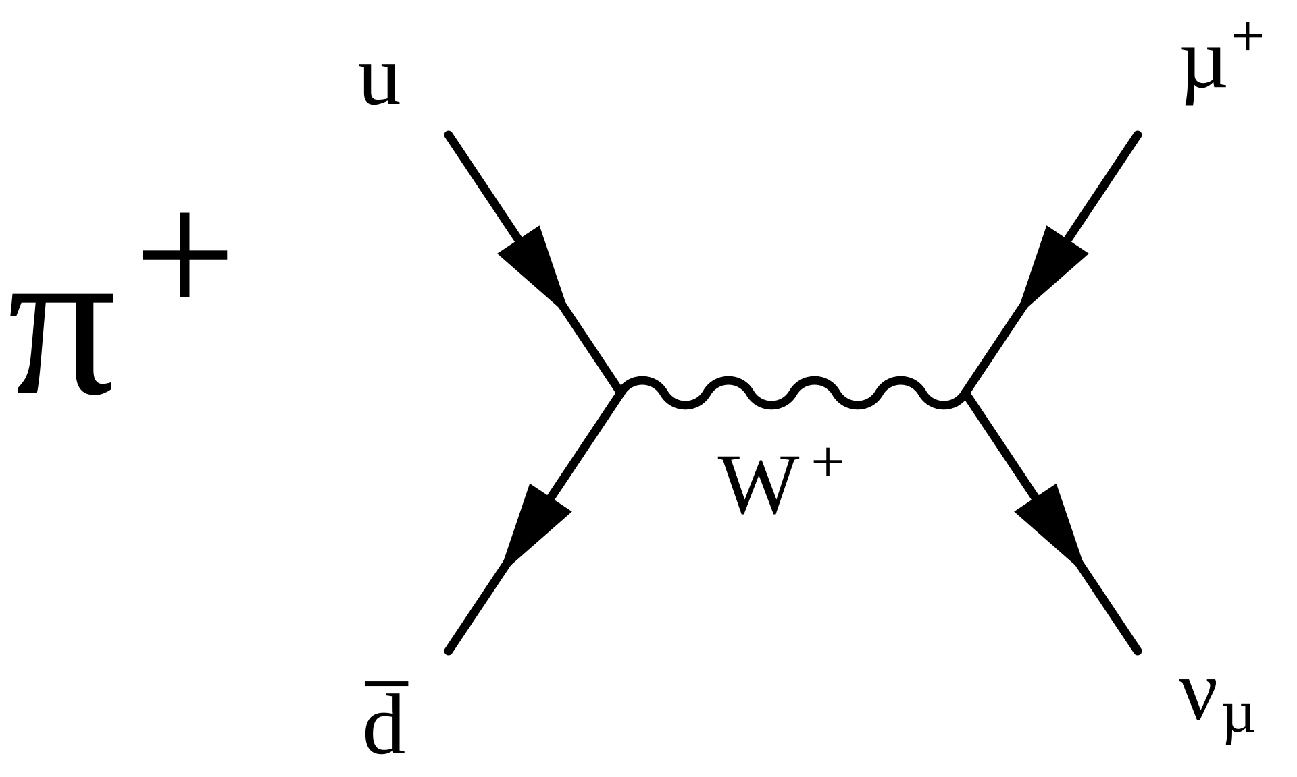
Why long-lived anyway?
Long lifetimes associated with suppressed decays
Decay products have similar masses as LLP
  Small phase space of products
Weak couplings
  Only decays via very weakly coupled processes possible
Off-shell decays
  Decay only possible through a much heavier particle
[6] Wikipedia, pion
Long lived particles, Michael Popinski

Slide 12
3. Experimental signatures
Long lived particles, Michael Popinski

Slide 13
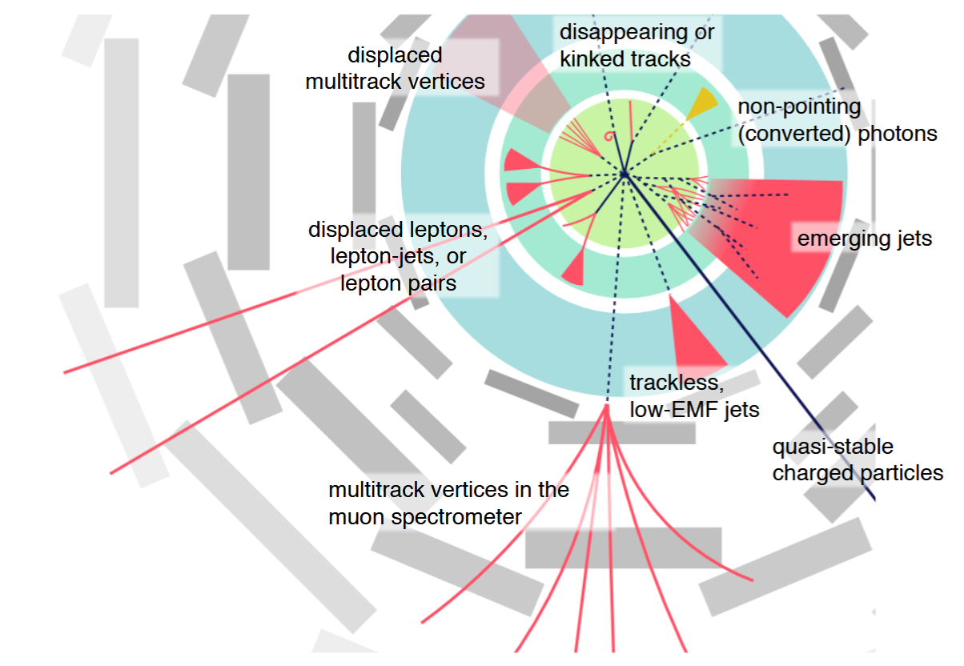
Long-lived Signatures
Vastly different from normal signatures
LLPs themselves often don’t leave tracks
Exact type of signature differs on detector part
  Where the particle is measured depends on its lifetime
  Leads to many different types of searches
  Makes triggering difficult
[8] H. Russell
Long lived particles, Michael Popinski

Slide 14
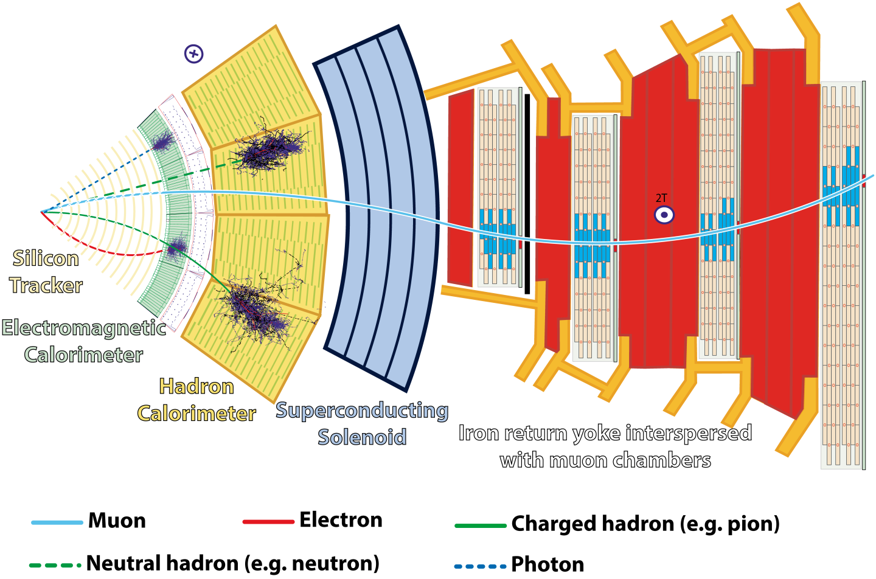
General purpose detectors
Detectors usually have shell structure
Tracker
  Momentum and tracking
Calorimeters
  Total energy measurements based on decays
Muon chambers
  Measures muons via ionization
  Made for few, well separated particles
[9] CMS collaboration
Long lived particles, Michael Popinski

Slide 15
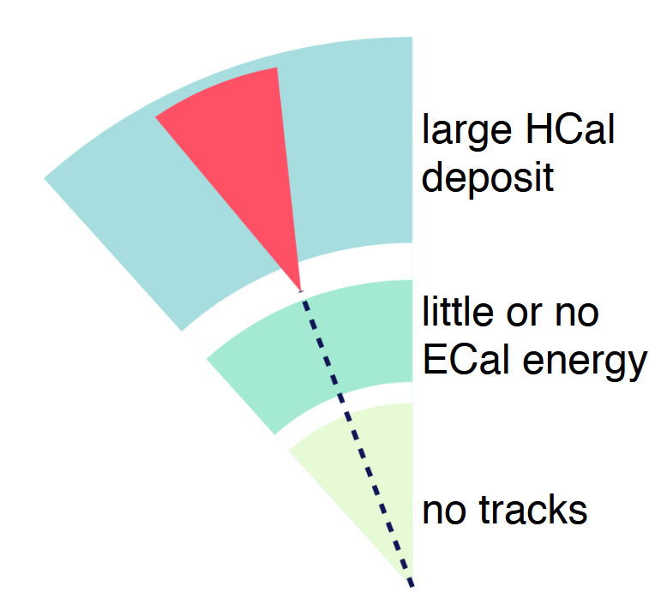
Displaced Vertices/Jets
LLPs can decay in various ways
  E.g. leptonic decays or quarks, which lead to jets
Decays happen well outside of interaction point
  Decay is “displaced”
  Usually no tracker information
Triggering on Jets easy
  Difficulty for “wrong kind” of decay for given calorimeter
  Low-Energy LLPs difficult to measure
[8] H. Russell
Long lived particles, Michael Popinski

Slide 16
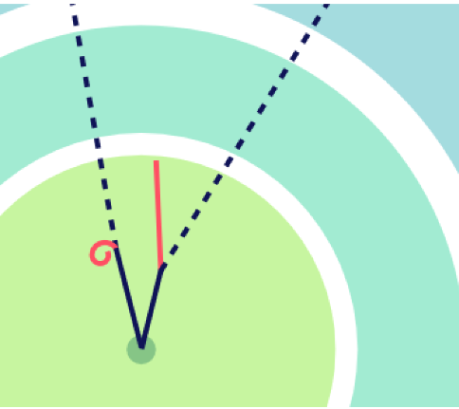
Disappearing Tracks
Especially important for charged LLPs
LLP decays into neutral stable particle and charged particle with only small energy
  Track seems to “disappear”
Very hard triggering, since energy deposition low
Variant: “Kinked” track, with non negligible energy deposit
[8] H. Russell
Long lived particles, Michael Popinski

Slide 17
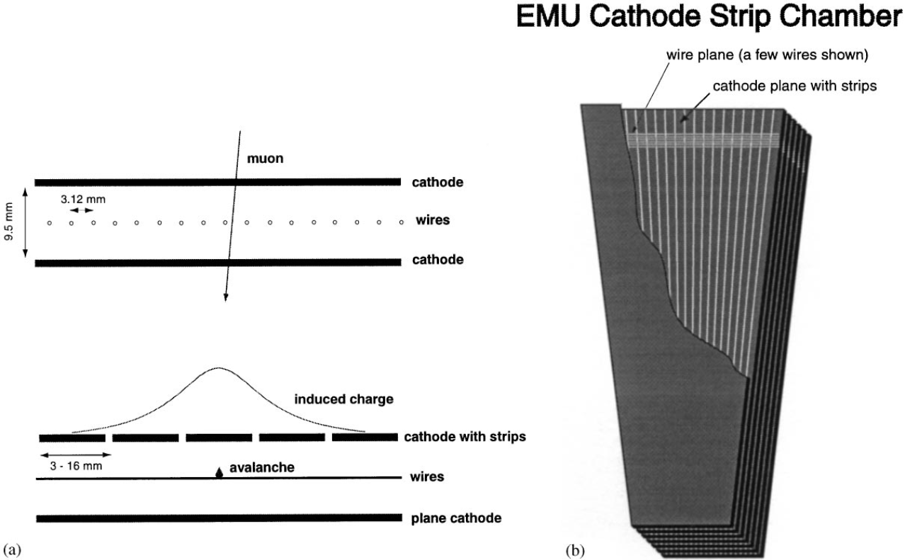
Decays in the muon system
Muon endcaps use the CSC systems
Muons passing through ionize gas inside
Positive Cations flow to strips, electrons to wires
  “Hit” position reconstructed based on the 2 data points
  Problem: What if there are multiple particles close to each other?
  No deterministic way to find hit positions
[10] M.C. Fouz
Long lived particles, Michael Popinski

Slide 18
Long lived particles, Michael Popinski

Slide 19
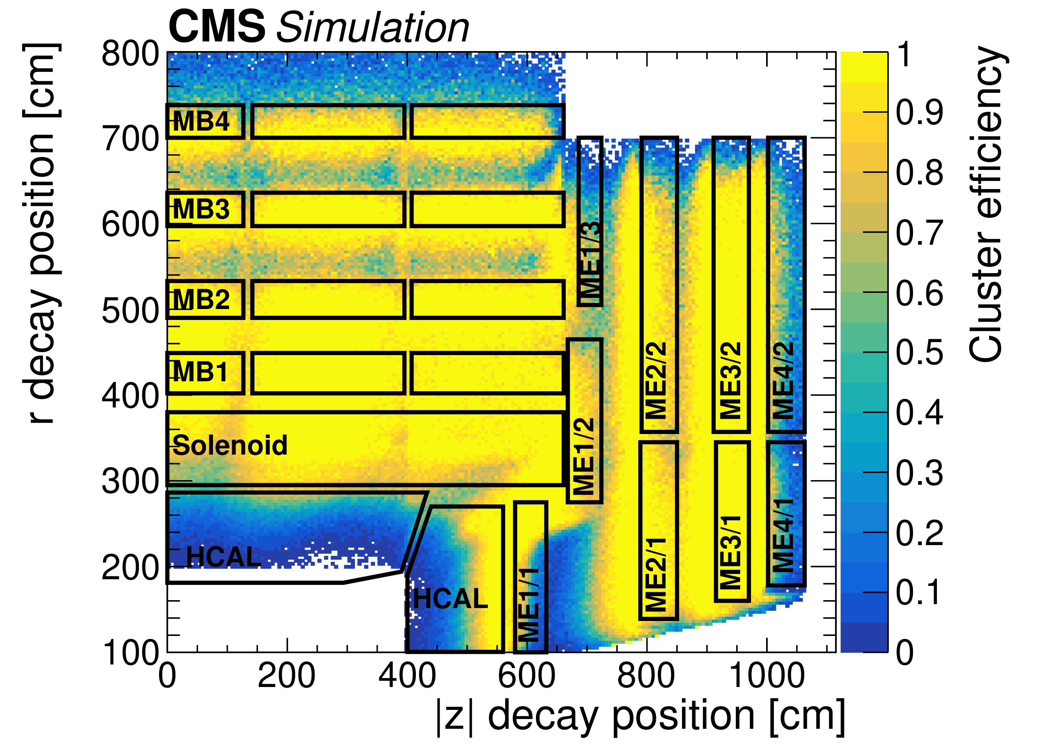
Decays in the muon system
LLPs may decay in muon system, causing particle showers
Muon detector showers (MDS): many hits in confined space
  Hit clusters are formed, efficiency important for measuring physical properties
  Energy, momentum, vertex position…
[11] Hayrapetyan, A. et al., CMS Collaboration
Long lived particles, Michael Popinski

Slide 20
4. Backgrounds
Long lived particles, Michael Popinski

Slide 21
MDS Backgrounds
Muon detector showers can be caused by high energetic muons
Emission of high energetic photons: “Bremsstrahlung”
Photons can pair produce in the steel return yoke and create particle showers
  Steel yoke functions as a “calorimeter”
[11] Hayrapetyan, A. et al., CMS Collaboration
Long lived particles, Michael Popinski

Slide 22
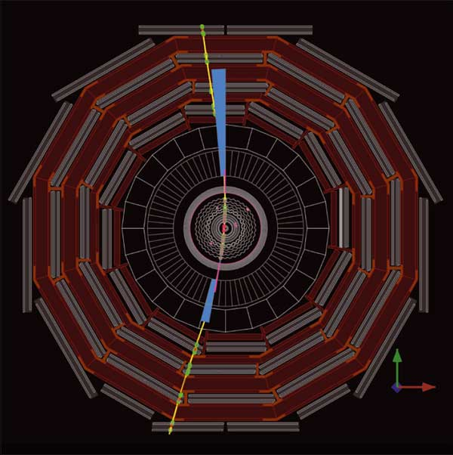
Other Background types
Cosmic muons
  CMS and ATLAS have good cosmic muon detection
Detector noise
  Can look like low energy depositions
Detector/algorithm failure
  Signal seems to exist but is only a detector anomaly
[12] CERNCourier
Long lived particles, Michael Popinski

Slide 23
Summary
LLPs are important product of BSM theories
Searches for LLPs depend highly on lifetime and given detector
  Experimental signatures vastly differ from conventional ones
  Searches for displaced vertices, jets, etc. already happening in many current detectors
  High expectations for future detectors
Background estimations often difficult due to unusual and detector-based origins
More to be discovered in the future!

Slide 24
Literature sources
Literature:
  Alimena, Juliette, et al. “Searching for Long-Lived Particles beyond the Standard Model at the Large Hadron Collider.” Journal of Physics G: Nuclear and Particle Physics, edited by , vol. 47, no. 9, Sept. 2020, p. 90501. Crossref, https://doi.org/10.1088/1361-6471/ab4574.
  Verhaaren, C. B., et al. “Searches for Long-Lived Particles at the Future FCC-Ee.” Frontiers in Physics, edited by , vol. 10, Sept. 2022. Crossref, https://doi.org/10.3389/fphy.2022.967881.
  Hayrapetyan, A. et al., CMS Collaboration, Search for long-lived particles decaying in the CMS muon detectors in proton-proton collisions at 13 TeV, Phys. Rev. D, 110, 3, 2024, American Physical Society, 10.1103/PhysRevD.110.032007, https://link.aps.org/doi/10.1103/PhysRevD.110.032007
  M.C Fouz, The CMS muon system, Nuclear Instruments and Methods in Physics Research Section A: Accelerators, Spectrometers, Detectors and Associated Equipment, Volume 446, Issues 1–2, Pages 366-372, ISSN 0168-9002, https://doi.org/10.1016/S0168-9002(00)00082-6.
Web sources:
  ATLAS seeks out unusual signatures of long-lived particles, https://atlas.cern/updates/briefing/search-long-lived-particles (online, accessed 25.05.26)
  https://www.symmetrymagazine.org/article/the-secret-lives-of-long-lived-particles (online, accessed 14.06.26)
  https://cms.cern/news/detector-far-far-away-searching-elusive-long-lived-travellers-tracing-pairs-muons (online, accessed 14.06.26)
  https://cms.cern/news/delayed-jets-cms-are-just-time-moriond (online, accessed 14.06.26)
Long lived particles, Michael Popinski

Slide 25
Image sources
Image sources:
  Wikipedia contributors. "Standard Model." Wikipedia, The Free Encyclopedia. Wikipedia, The Free Encyclopedia, 22 May. 2026. Web. 25 May. 2026.
  B. Shuve, Theory Overview of Long-Lived Particles at the LHC, https://indico.cern.ch/event/607314/contributions/2542308/attachments/1447888/2231430/LHC- LLP_Shuve.pdf (online, accessed 25.05.26)
  https://francis.naukas.com/files/2016/12/Dibujo20161220-supersymmetry-zoo-sparticles.jpg (online, accessed 25.05.26)
  Alimena, Juliette, et al. “Searching for Long-Lived Particles beyond the Standard Model at the Large Hadron Collider.” Journal of Physics G: Nuclear and Particle Physics, edited by , vol. 47, no. 9, Sept. 2020, p. 90501. Crossref, https://doi.org/10.1088/1361-6471/ab4574.
  Wikipedia contributors. "Beta decay." Wikipedia, The Free Encyclopedia. Wikipedia, The Free Encyclopedia, 13 Mar. 2026. Web. 25 May. 2026.
  Wikipedia contributors. "Flavor-changing neutral current." Wikipedia, The Free Encyclopedia. Wikipedia, The Free Encyclopedia, 2 Oct. 2025. Web. 25 May. 2026
  Wikipedia contributors. "Pion." Wikipedia, The Free Encyclopedia. Wikipedia, The Free Encyclopedia, 9 Apr. 2026. Web. 25 May. 2026.
  H. Russell, An experimental introduction to long-lived particle searches at the LHC , https://indico.cern.ch/event/607314/contributions/2542309/attachments/1447873/2231444/20170424_LLPs.pdf (online, accessed 25.05.26)
  CMS collaboration, instructional material, https://cms-opendata-workshop.github.io/workshop2024-lesson-cms-detector/instructor/index.html, licensed under CC4.0 https://creativecommons.org/licenses/by/4.0/ (online, accessed 31.05.2026)
  M.C Fouz, The CMS muon system, Nuclear Instruments and Methods in Physics Research Section A: Accelerators, Spectrometers, Detectors and Associated Equipment, Volume 446, Issues 1–2, Pages 366-372, ISSN 0168-9002, https://doi.org/10.1016/S0168-9002(00)00082-6.
  Hayrapetyan, A. et al., CMS Collaboration, Search for long-lived particles decaying in the CMS muon detectors in proton-proton collisions at 13 TeV, Phys. Rev. D, 110, 3, 2024, American Physical Society, 10.1103/PhysRevD.110.032007, https://link.aps.org/doi/10.1103/PhysRevD.110.032007
  https://cerncourier.com/a/cms-does-a-full-cosmic-data-run/ (online, accessed 09.06.2026)
Long lived particles, Michael Popinski

