Slide 1
Discovery of Neutrinos
Malik Tischmann
30.06.2026

Slide 2
Contents
General informations
The beta decay problem
The nuclear bomb
Cowan-Reines (Hanford)
Cowan-Reines (Savannah River)
The second and third neutrino

Slide 3
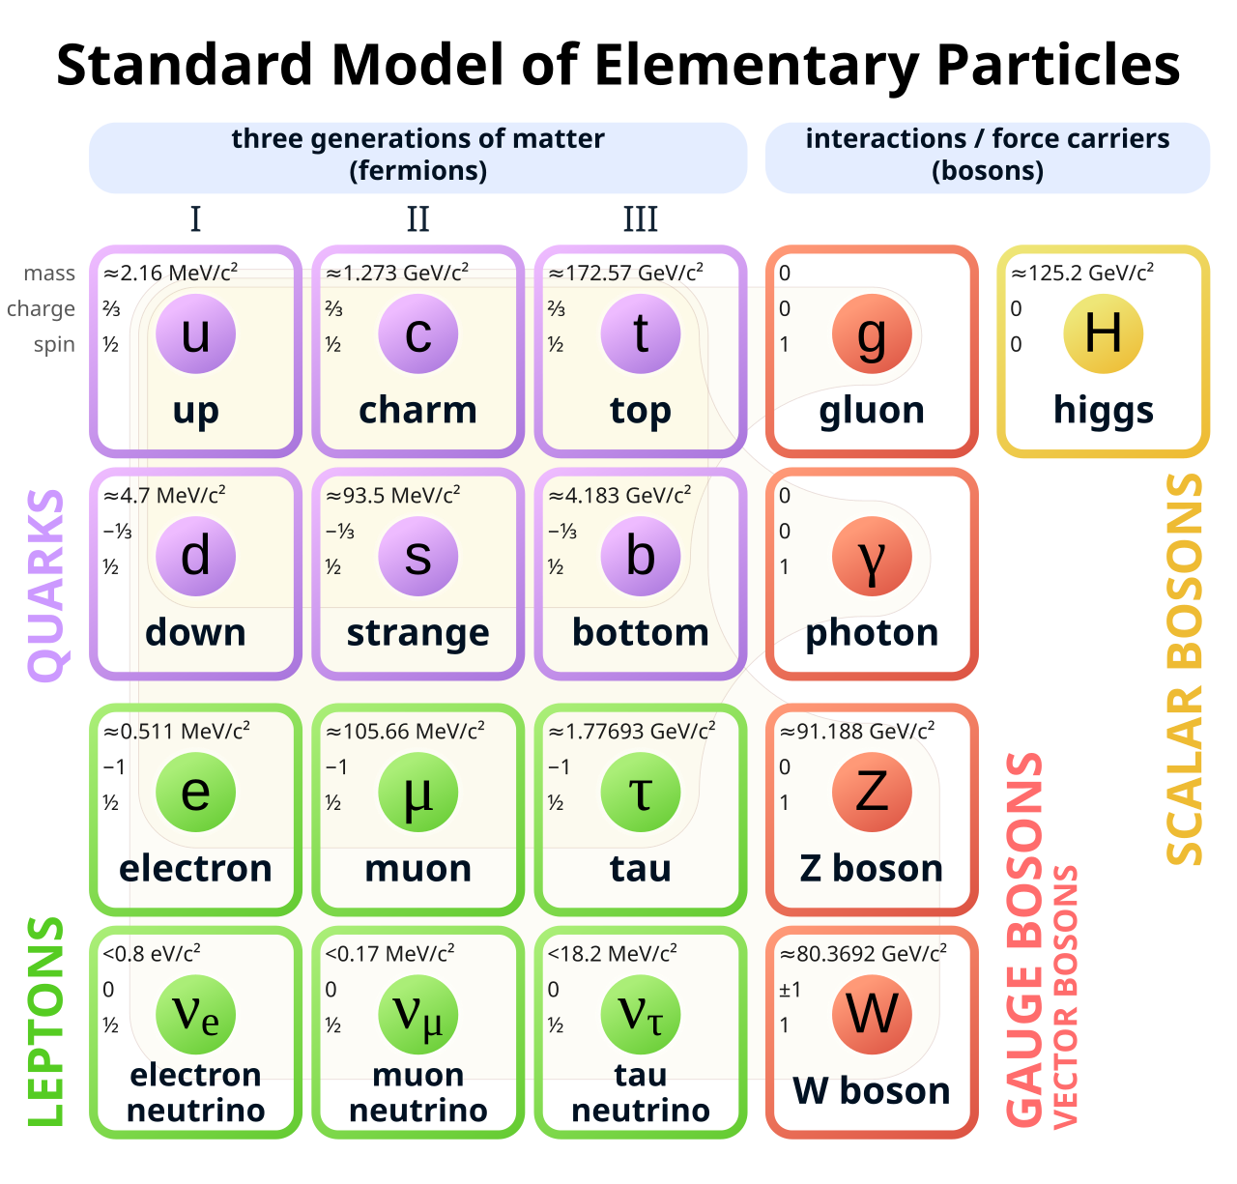
What is a Neutrino?
Elementary particle
Comes in 3 flavors: electron, muon and tau
Electrically neutral
Very small mass
  Exact values are unknown
Interacts using the weak interaction

Slide 4
Origins of Neutrinos
Radioactive decay
  For example in stars
Neutrinos pass through matter
  Difficult to detect
Nuclear reactions in nuclear reactors
  Best source for experiments

Slide 5
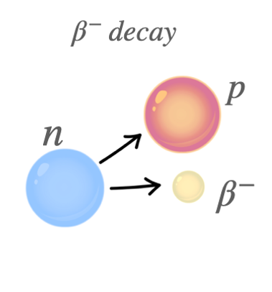
The beta decay
Radioactive nucleus needed
Emission of one electron
the old nucleus transforms into a
new, slightly lighter nucleus
With all masses specified, the Energy of the
new nucleus is fixed

Slide 6
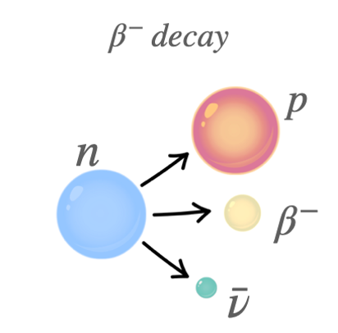
The beta decay problem
Emitted electrons in experiments vary in Energy
  Energy conservation broken
Wolfgang Pauli 1930: A new particle carries
the missing energy
It actually is a neutrino
  In this case a antineutrino

Slide 7
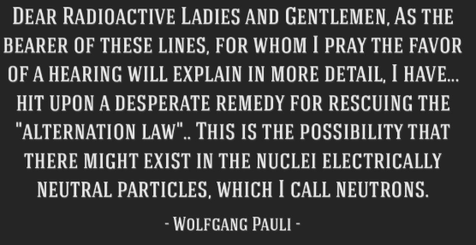
Paulis hypothesis
Electrically neutral particle
Pauli called it the „Neutron“
He was concerned because it had not
been detected
Fermi expands on Paulis theory, calls them „Neutrinos“
  Also introduces the weak force

Slide 8
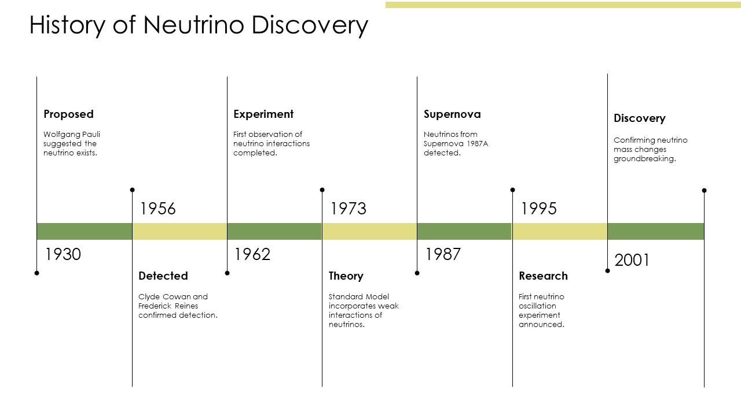
Timeline of events
Neutrinos almost entirely theoretically described
Prediction of further Neutrino flavors
Because Neutrinos pass through matter: No experimental detection

Slide 9
The Cowan-Reines Experiments
Only way of detecting neutrinos is the inverse beta decay
Rise of nuclear science (for example nuclear reactors)
  Reliable source of Neutrinos
Cowan and Reines at Los Alamos
  They plan to use nuclear bombs as a neutrino source
  No reliable detector yet

Slide 10
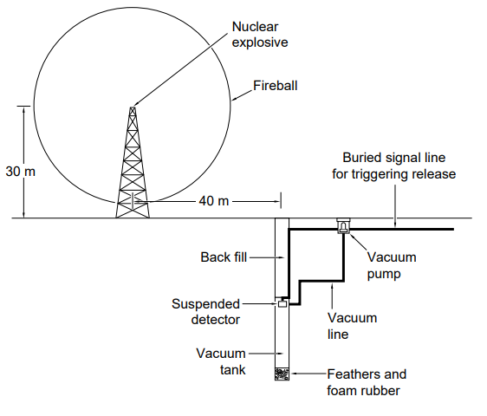
The nuclear bomb
Reverse beta decay as the detection method
When Neutrinos hit protons a neutron and
positron are the result
If positrons were detected there must have
been neutrinos
Giant detector was needed

Slide 11
Change of plan
Proposal of using a nuclear reactor as a neutrino source
The explosion was a better source unless the background could be reduced at the reactor
Solution: detecting both the positron and the neutron
Neutron capture
Detecting a „delayed coincidence“ to prove the existance of Neutrinos

Slide 12
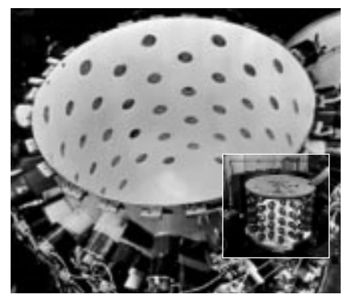
The Hanford Experiment
Over the next couple of months the detector was build
Tested by detecting potassium in the human body
Spring 1953: Setting up at the Hanford reactor
Only probale detection of Neutrinos
Interference from cosmic rays caused problems

Slide 13
The Savannah River Experiment
Complete overhaul of the detector
Now better protected from cosmic rays
November 1955: Setup at the new and powerfull SavannahRiver reactor
Detector placed in basement, 11 meters of concrete protect the detector from neutrons

Slide 14
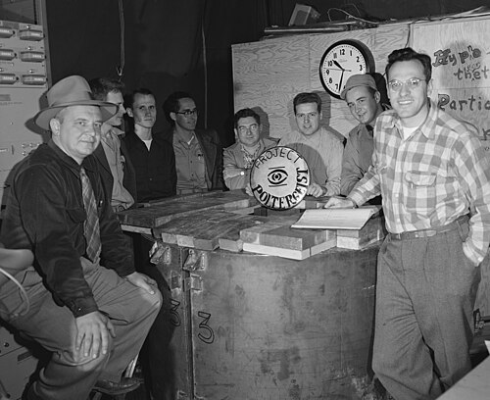
The neutrino detected!
900 hours of data over 5 months
Many additional checks to ensure that actual neutrinos were detected
Successfull detection of multiple Neutrinos
Telegram to Pauli on June 14 1956 oficially confirming the Neutrion detection
Follow-up experiments confirmed these results

Slide 15
The second neutrino
After the discovery of the first neutrino, people were eager to discover the other flavors
A team around Melvin Schwartz generated a proton beam of 15 GeV in 1962
This beam hit a beryllium target, generating pions
The pions quickly decayed into muons and neutrinos

Slide 16
The second neutrino
This beam then passed through a 13.5m thick steel wall
Mainly neutrinos left
Spark chamber to detect the neutrinos
A few low-energy muons also reach this point
Several months of experimental runs

Slide 17
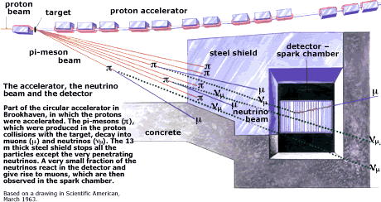
The muon neutrino
Out of 113 events 51 were Neutrinos
No further interactions, meaning the neutrinos were not electron neutrinos

Slide 18
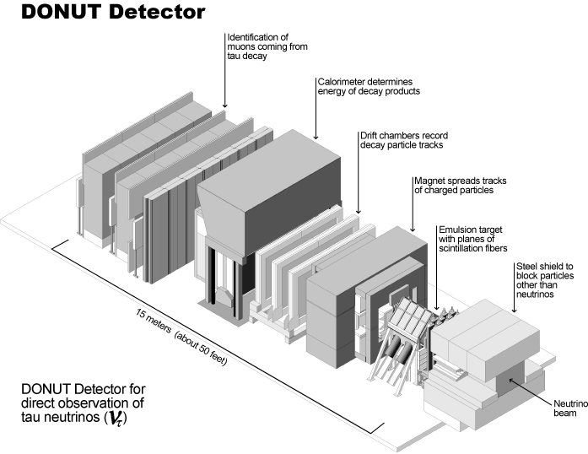
The third neutrino
Tau Neutrino, least studied particle
First detection in July 2000
DONUT experiment from fermilab
Proton beam used to get neutrino beam
Neutrino beam passes through sheets of nuclear emulsion
Charged particles created by neutrinos creae visible tracks

Slide 19
Sources
David J. Griffiths: Introduction to Elementary Particles. John Wiley & Sons, 1987, ISBN 0-471-60386-4.
The Reines-Cowan Experiments: Detecting the Poltergeist. In: Los Alamos Science. 25, 1997, S. 3.
Summary of the discovery story: https://www.weltderphysik.de/gebiet/teilchen/bausteine/neutrinos/entdeckung-und-erforschung/
Discovery of the muon neutrino: https://physics.aps.org/articles/v8/75
https://nudoubt.uni-mainz.de/public.php
https://www.slideteam.net/history-of-neutrino-discovery-ppt-presentation-st-ai-ss.html
https://libquotes.com/wolfgang-pauli/quote/lbj2q7l
https://www.nobelprize.org/prizes/physics/1988/9557-the-hunt-for-the-muon-neutrino/
https://en.wikipedia.org/wiki/Cowan%E2%80%93Reines_neutrino_experiment
https://en.wikipedia.org/wiki/DONUT
https://en.wikipedia.org/wiki/Tau_neutrino

