Slide 1
FY27 Funding Request USHFCC Muon Group - MPGD Effort – May 1, 2026

Slide 2
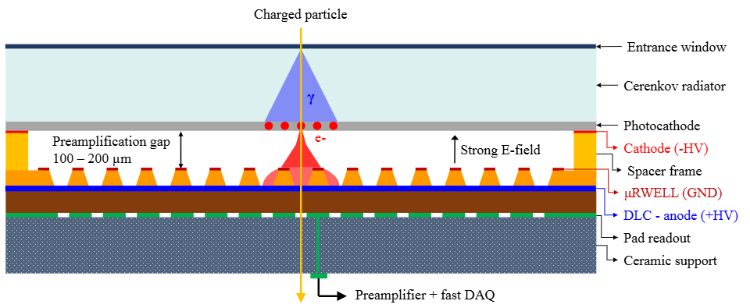
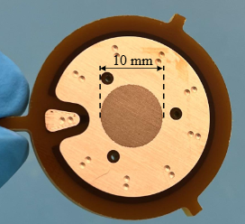
Precision Muon Timing and ToF-based PID with µRWELL-PICOSEC Technology
K. Gnanvo, S. Lee (JLAB) & S. Demarest, M. Hohlmann (FIT)
Motivation (dual use):
Detection of delayed charged particles from long-lived particle decays in muon system, e.g. $\text{H} →X_{LLP}^{0}$ $X_{LLP}^{0}→μ^{+}μ^{−}μ^{+}μ^{−}$
Particle identification using time-of-flight (ToF) detector outside central tracker (“barrel timing wrapper”)
Concept: µRWELL-PICOSEC detector (MPGD with Cherenkov radiator)
gas
JLAB

Slide 3
FY27 R&D Goals
Analysis of 2026 CERN beam test data from 10 cm × 10 cm μRWELL-PICOSEC prototype (JLab / FIT)
Improvement of existing analysis code & methodology
Prepare publication
Performance optimization with new small single-channel prototypes (JLab / FIT)
New μRWELL amplification structure (75 µm thick)
Optimization of hole parameters of μRWELL PCB
More robust photocathodes (DLC, B4C, and metallic) as alternative to CsI
Cost-effective & environmentally friendly gas alternatives to current Ne:CH₄:CF₄ (80:10:10) mixture
Design of larger (20 cm × 20 cm) μRWELL-PICOSEC detector with 100-pad readout (JLab)
Large area critical for application in realistic experiment such as a muon system in experiments at the FCC
20 cm × 20 cm area expected to be sweet spot between performance and technical challenges
100-pad, low channel counts & low capacitance readout with integrated fast pre-amplifier electronics

Slide 4
FY27 Budget Request - JLAB
PI / Scientist support (5%FTE): $17k (fringe & IDC included) – Oversight of project, μRWELL PCB design
Engineer support: $24k (fringe & IDC included) – Mechanical design of 20cm × 20cm prototype
Materials & supplies: $ 5.5k (IDC included) – Lab tests for characterization of small prototypes
Domestic travel: $ 3.5k (IDC included) – Travel b/w JLAB and FIT to set up test bench at FIT
Total fully loaded budget request: $50k
No funds requested by FIT

