Slide 1

The discovery potential of FCC-ee
Gino Isidori
[University of Zurich]
Introduction
  The SM as an effective theory
  Higgs, EW, and Flavour physics @ FCC-ee [highlights]
  Discovery reach in “motivated models” of heavy New Physics
Conclusions
Largely based on studies done in
the context of the ESPPU

Slide 2
Introduction
The Standard Model is a highly successful Theory, which describes with great success physical phenomena over a huge (unprecedented) range of energies. However, already in its historical name, we have a clue that is not “complete”...
ℒ_{SM} = ℒ_{gauge} (A_{a}, ψ_{i}) + ℒ_{Higgs} (ϕ, A_{a}, ψ_{i} )
Natural [only 3 couplings, all of O(1)]
Stable with respect to quantum corr. [largely UV in-sensitive]
Highly symmetric
“Ad hoc” [several couplings, with large hierarchies]
Not stable with respect to quantum corr. [UV sensitive]
Origin of all the problems of the model…

Slide 3
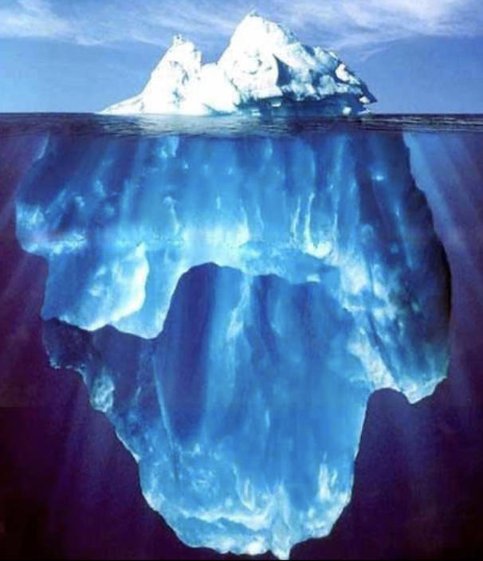

Introduction
Natural to consider the SM Higgs sector, or better the whole SM, as the effective description of an extended, more stable sector
SM
Ultraviolet completion
Renormalizable
interactions
(long-range)
New contact
interactions
(short-range)
heavy
dynamics

Slide 4
Introduction
Finding clear evidences of non-standard contact interactions is (in my opinion…) the main objective of particle physics in the coming decades
SM
Ultraviolet completion
Renormalizable
interactions
(long-range)
New contact
interactions
(short-range)
heavy
dynamics

Slide 5
Introduction
Finding clear evidences of non-standard contact interactions is (in my opinion…) the main objective of particle physics in the coming decades
A positive result cannot be guaranteed (we entered a true exploration phase: no-loose theorems), but there are very good reasons to believe this is possible @ FCC-ee.
If this would happen, it would be a major discovery. By no means, this could be considered less relevant than what we usually call “direct discoveries”
To this purpose, it is worth recalling that
    Essentially the whole SM has been “built” via indirect discoveries.
    This process was neither smooth nor extremely fast.

Slide 6
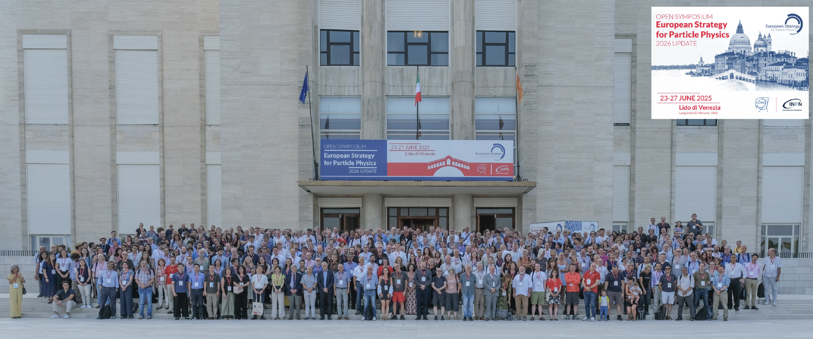
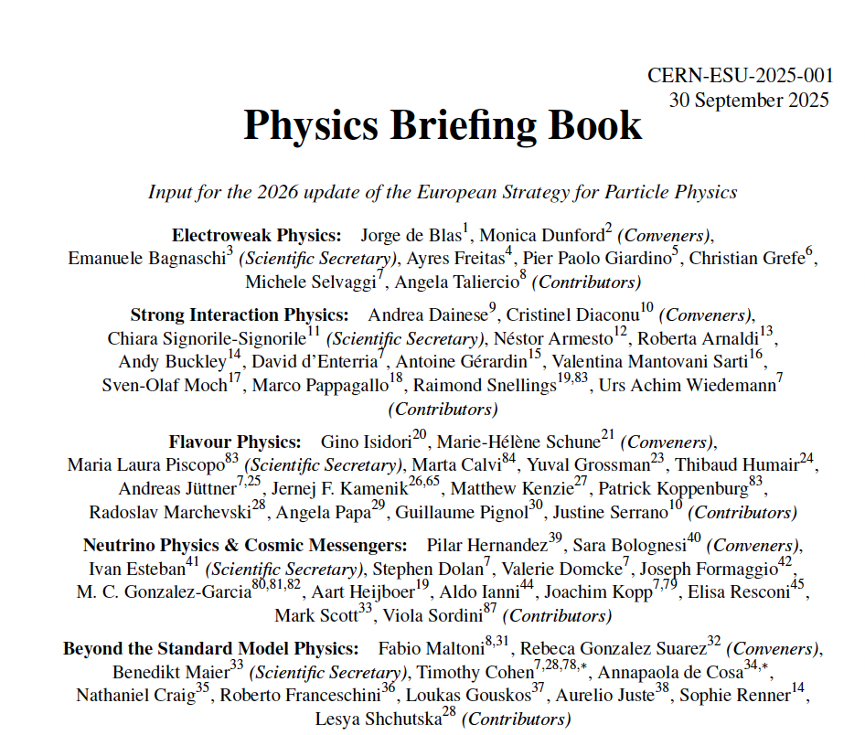
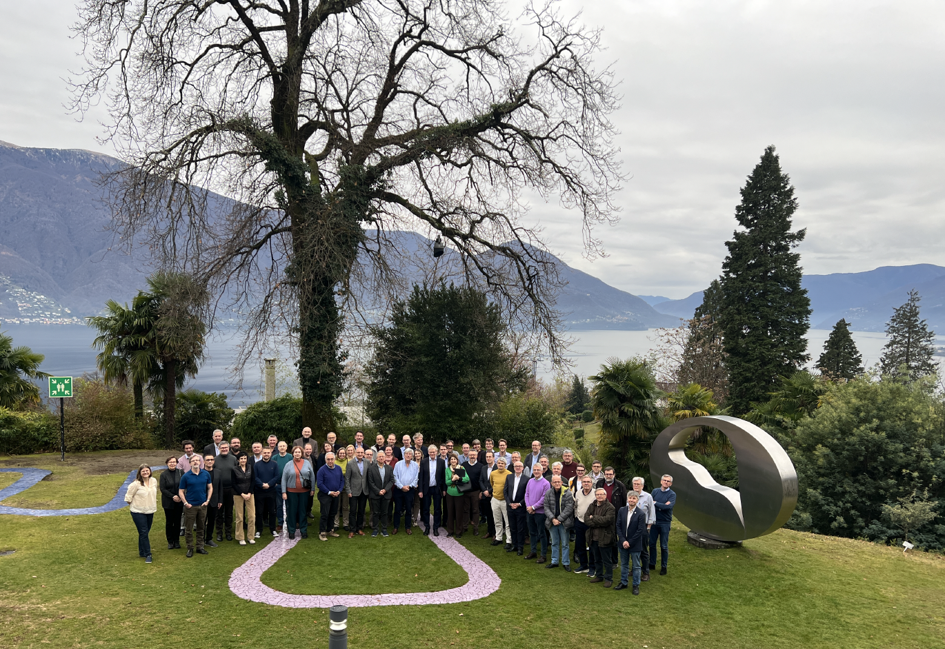
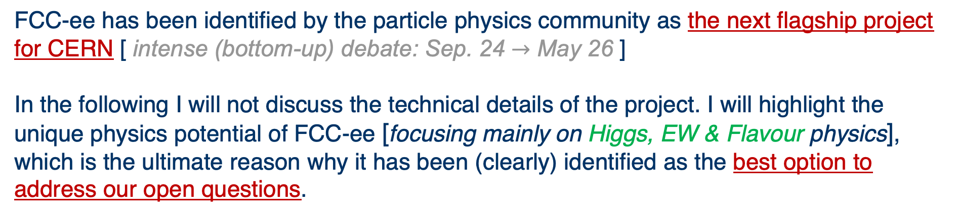
Introduction [a few words on FCC-ee]
FCC-ee has been identified by the particle physics community as the next flagship project for CERN [ intense (bottom-up) debate: Sep. 24 $→$ May 26 ]
In the following I will not discuss the technical details of the project. I will highlight the unique physics potential of FCC-ee [focusing mainly on Higgs, EW & Flavour physics], which is the ultimate reason why it has been (clearly) identified as the best option to address our open questions.
Open Symposium, June ‘25
Briefing Book, Sept. ‘25
Draft. Session, Dec. ‘25

Slide 7
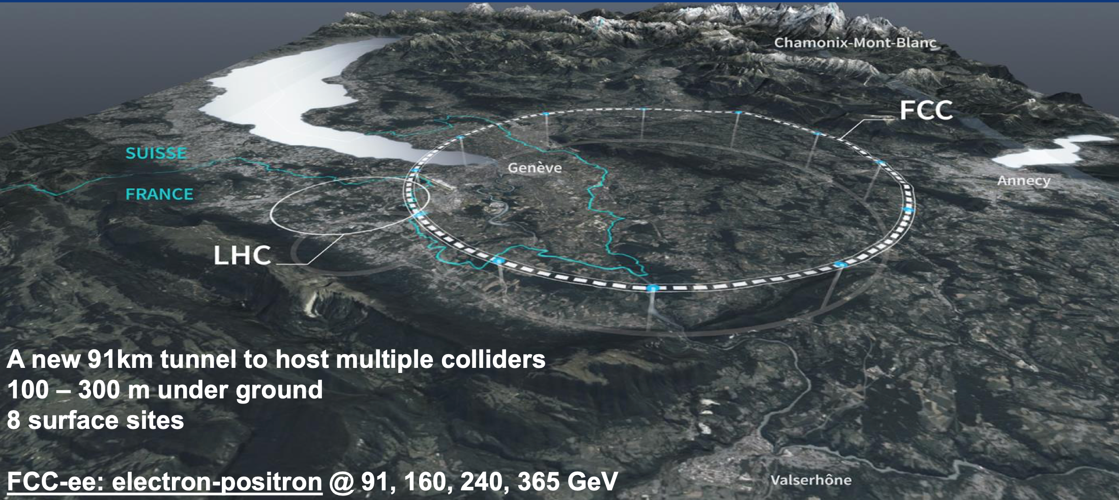
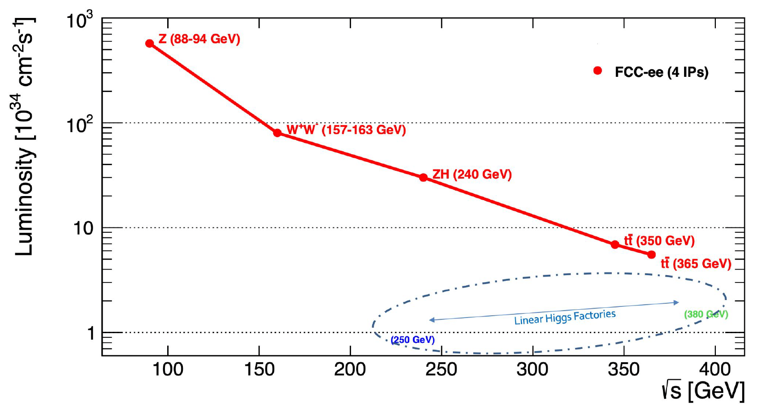
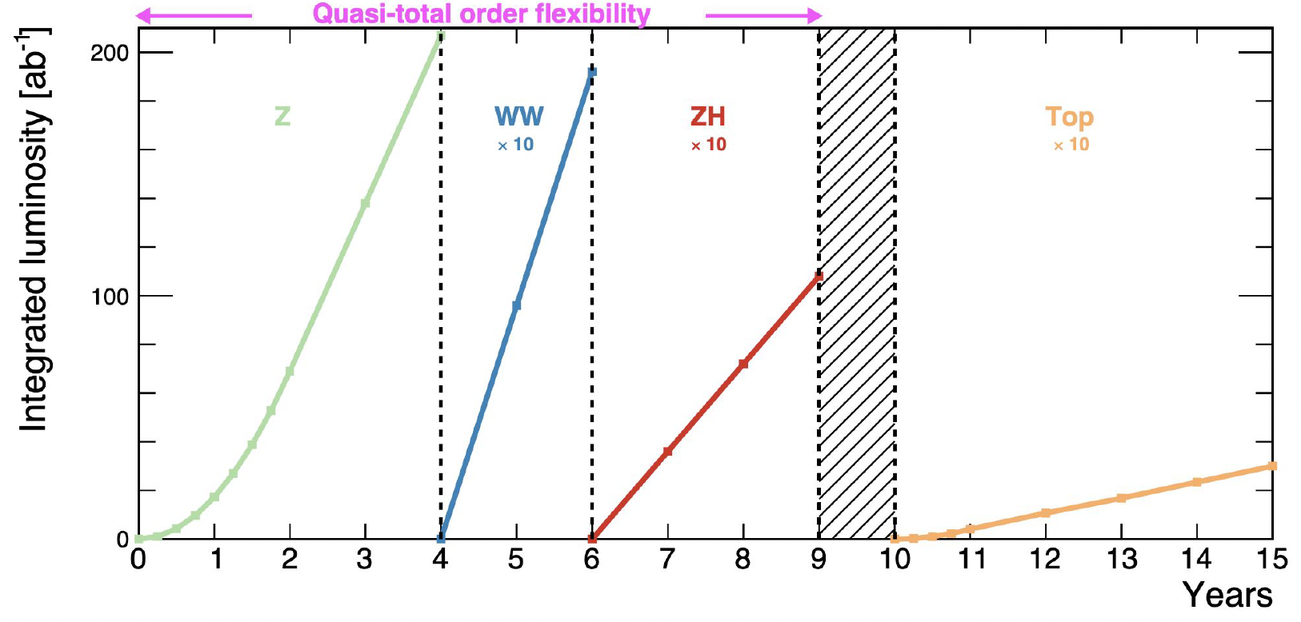
Introduction [a few words on FCC-ee]
Tera-Z
(10⁵ x LEP
statistics)
Higgs
factory
Top factory

Slide 8

Part I
The SM as an effective theory
SM

Slide 9
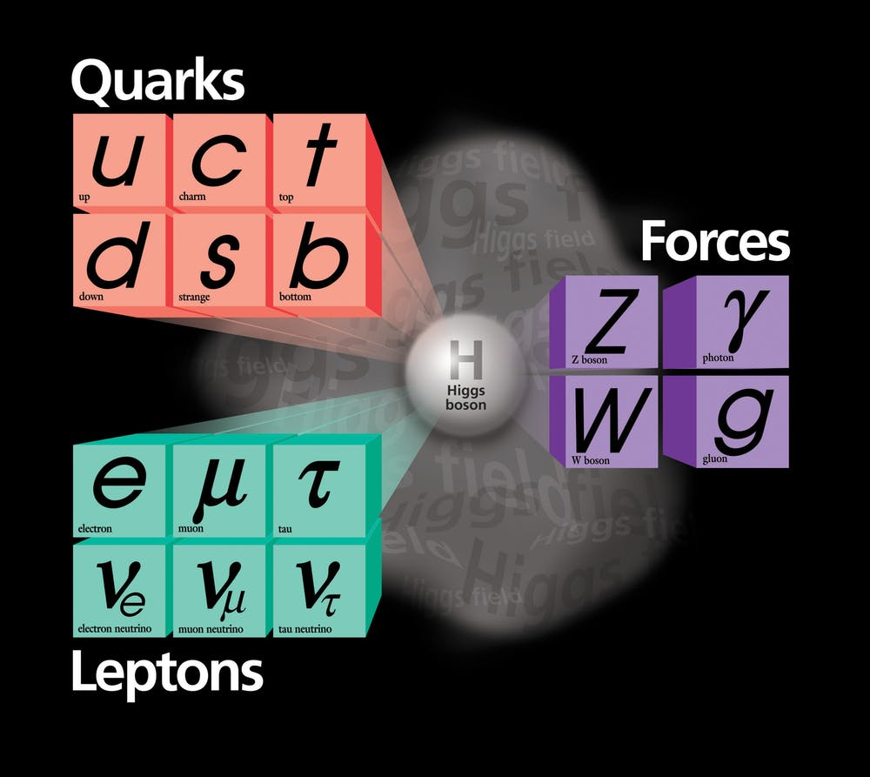
The SM as an effective theory
Despite its renormalizability, the SM should be viewed (as probably any QFT…) as an Effective Field Theory (EFT), or the low energy limit of a more complete theory:
ℒ_{SM-EFT} = ℒ_{gauge} + ℒ_{Higgs} + …
Energy
SM (EFT)
We identified the long-range properties of this EFT
The key message following from current LHC results is that there is a mass-gap above the Fermi scale
Mass-gap
m_{t} [174 GeV]
m_{H}
m_{Z,W}

Slide 10
The SM as an effective theory
Despite its renormalizability, the SM should be viewed (as probably any QFT…) as an Effective Field Theory (EFT), or the low energy limit of a more complete theory:
c_{i}^{[d]}
Λ^{d-4}
Σ
ℒ_{SM-EFT} = ℒ_{gauge} + ℒ_{Higgs} +
O_{i}^{[d]} (ϕ, A_{a}, ψ_{i})
^{d > 4}
What is the value of Λ
(= lowest threshold
for new dynamics)
is the “core question”
of particle physics
heavy
dynamics

Slide 11
The SM as an effective theory
Despite its renormalizability, the SM should be viewed (as probably any QFT…) as an Effective Field Theory (EFT), or the low energy limit of a more complete theory:
c_{i}^{[d]}
Λ^{d-4}
Σ
ℒ_{SM-EFT} = ℒ_{gauge} + ℒ_{Higgs} +
O_{i}^{[d]} (ϕ, A_{a}, ψ_{i})
^{d > 4}
A strong indication of a nearby energy threshold follows from the hierarchy problem:
What is the value of Λ
(= lowest threshold
for new dynamics)
is the “core question”
of particle physics
+
NP
→
m_{H}²
m_{H}²
phys
Λ
Δm_{H}² ~ Λ²
If the Higgs mass is calculable in terms UV physics, then new degrees of freedom must show around TeV energies to “screen it” form its sensitivity to high energies.

Slide 12

The SM as an effective theory
c_{i}^{[d]}
Λ^{d-4}
Σ
ℒ_{SM-EFT} = ℒ_{gauge} + ℒ_{Higgs} +
O_{i}^{[d]} (ϕ, A_{a}, ψ_{i})
^{d > 4}
A closer look to the question of what is the value of Λ reveals many “layers”:
What is the mass scale of the new d.o.f. ?
New dynamics weakly or strongly coupled ?
M
SM field
g
g
1
Λ²
g²
M²
g
$≈$
SM field

Slide 13
The SM as an effective theory
c_{i}^{[d]}
Λ^{d-4}
Σ
ℒ_{SM-EFT} = ℒ_{gauge} + ℒ_{Higgs} +
The large number of SMEFT couplings is not a problem, but an opportunity
[these couplings are not independent model parameters, rather independent observables]
O_{i}^{[d]} (ϕ, A_{a}, ψ_{i})
^{d > 4}
A closer look to the question of what is the value of Λ reveals many “layers”:
What is the mass scale of the new d.o.f. ?
New dynamics weakly or strongly coupled ?
What is the flavor structure?
M
  No flavor symmetry 2499 free couplings [ @ d=6 ]
  Maximal flavor symmetry 47 free couplings [ @ d=6 ]
g
flavor
  The SMEFT is a very useful “map” to characterize BSM effects, especially in precision measurements;
“navigating” with the SMEFT without consistent assumptions (especially about flavor) can be misleading…

Slide 14
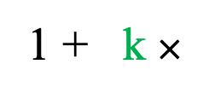
The SM as an effective theory
c_{i}^{[d]}
Λ^{d-4}
Σ
ℒ_{SM-EFT} = ℒ_{gauge} + ℒ_{Higgs} +
O_{i}^{[d]} (ϕ, A_{a}, ψ_{i})
^{d > 4}
  A useful general info is the functional dependence of precision observables (Higgs, EW, or flavor ) from Λ:
  The sensitivity on Λ scales with ~ N^{1/4}
  for precision measurements (vs. linear scale with Energy for high-energy processes)
  Increasing N by 10⁵ implies an increase by more than a factor of 10 in the (indirect) energy reach
m_{W}²
Λ²
A( i → f ) = A_{SM}
1 + k $×$
  SM electroweak
  amplitude

Slide 15



The SM as an effective theory
c_{i}^{[d]}
Λ^{d-4}
Σ
ℒ_{SM-EFT} = ℒ_{gauge} + ℒ_{Higgs} +
O_{i}^{[d]} (ϕ, A_{a}, ψ_{i})
^{d > 4}
  A useful general info is the functional dependence of precision observables (Higgs, EW, or flavor ) from Λ:
m_{W}²
Λ²
A( i → f ) = A_{SM}
1 + k $×$
SM
~ 1/(16 π)²
~ 1
~ (16 π)²
Λ ~ 1 TeV 1%
0.01% O(1)
  no clear sign yet…

Slide 16

The SM as an effective theory
m_{W}²
Λ²
  Currently we have no clear indications of SM failures: up to which scale can we extrapolate the SM validity?
A( i → f ) = A_{SM}
1 + k
“No New Physics up to the Planck scale”
Can we agree on that?
NO !!!
  Current bounds on Λ do not exceed 1-2 TeV in motivated models (more later)
  extrapolating these null results to much higher energies is neither justified nor very useful (at least in my opinion…)

Slide 17
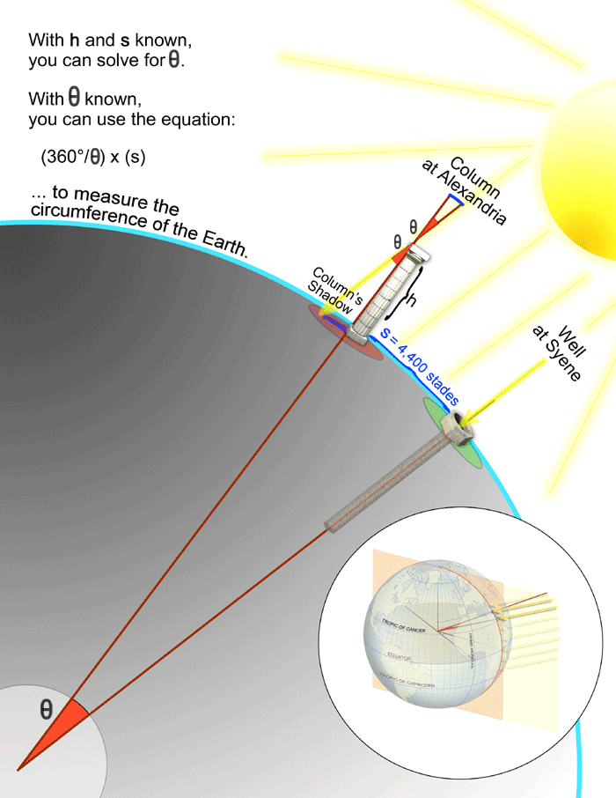

The SM as an effective theory
m_{W}²
Λ²
A( i → f ) = A_{SM}
1 + k
  Current bounds on Λ do not exceed 1-2 TeV in motivated models…
  Embarking into a new high-energy effort without a clear clue of where the new energy threshold could be, is a high risk…
Colombo would have never started his expedition without
an estimate of
earth's radius...
The best strategy is to plan a significant advancement in precision measurements to obtain clear clues about the new energy threshold

Slide 18
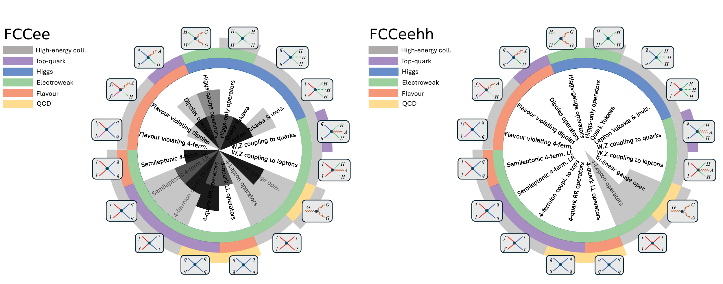
Part II
Highlights of future prospects on
Higgs, EW, and Flavour

Slide 19
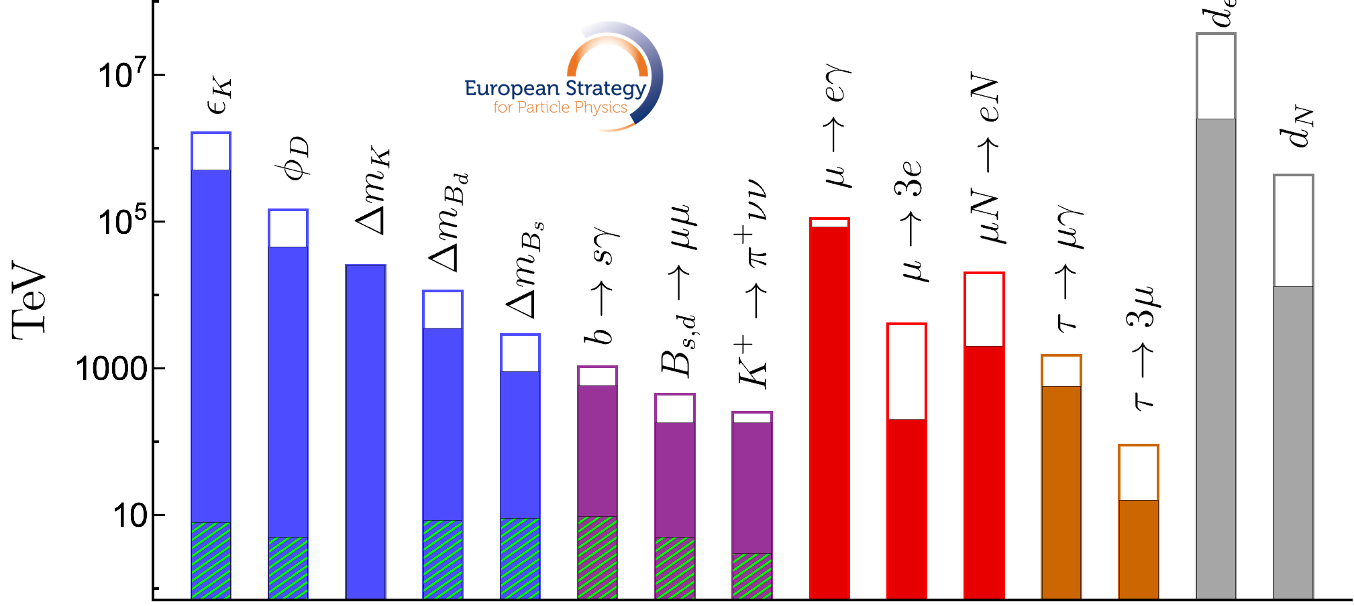
Future prospects in Higgs, EW, and Flavour
Flavour-changing processes represent the numerically largest domain of possible new contact interactions. The strong bounds currently derived by various processes imply that NP is either very heavy or, most likely, has a non-trivial flavour structure (similarly to SM). In both cases, improving current bounds leads to a unique & wide-range sensitivity to physics beyond the SM
1
Λ²
C =
V_{i3}V_{3j}
Λ²
C =

Slide 20
Future prospects in Higgs, EW, and Flavour
γ quarks μ e τ ν
_
b → s μμ R_{bs} (e/μ) b → s ττ b → s νν
b → c μν R_{bc} (e/μ) b → c τν
3_{q} → 2_{q}
b → s γ B_{s} ⟷ B_{s}
_
_
B(B_{s} → μμ),
B(B → K* μμ),
A_{FB}(B → K *μμ),
…
_
B(B → K νν),
B(B → K *νν),
…
b → d μμ R_{bd} (e/μ) b → d ττ b → d νν
b → u μν R_{bu} (e/μ) b → u τν
3_{q} → 1_{q}
b → d γ B_{d} ⟷ B_{d}
R^{τ/μ}(D),
R^{τ/μ} (D*), …
c → u μμ R_{cu} (e/μ) c → u νν
c → s μν R_{cs} (e/μ)
c → d μν R_{cd} (e/μ)
2_{q}
1_{q}
_
2_{q} →
c → u γ D ⟷ D
N.B.: several observables for each transition
2_{l}
1_{l}
τ → μ γ τ → μ qq τ → μ μμ τ → μ ee τ → μ νν
τ → e γ τ → e qq τ → μ ee τ → e ee τ → e νν
3_{l} →

Slide 21
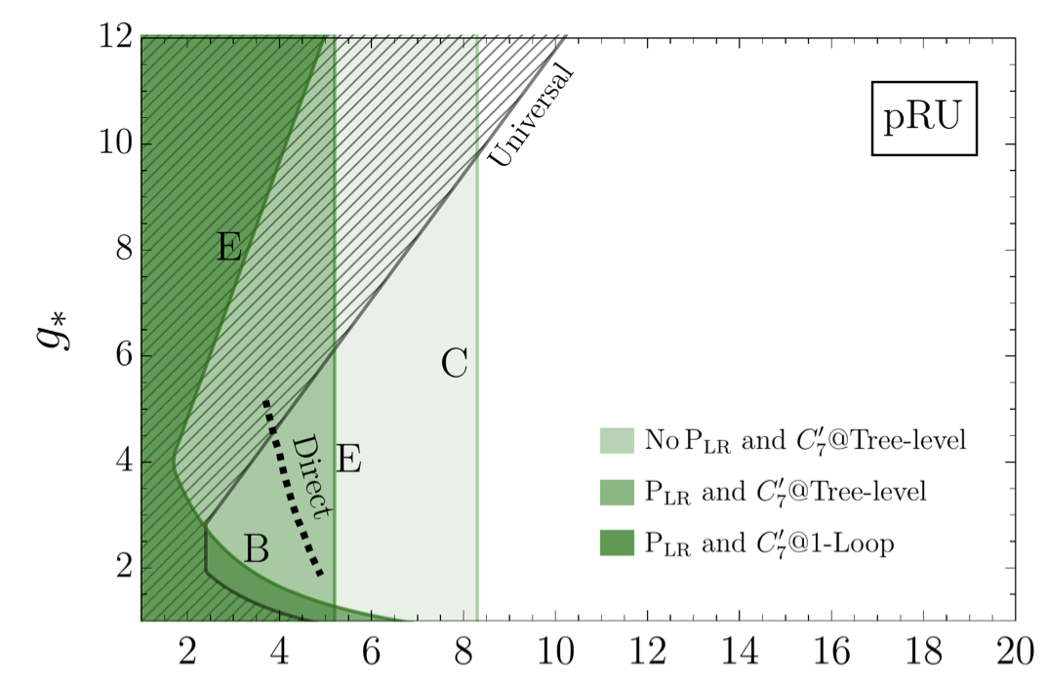
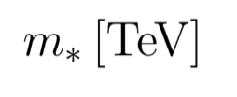
Future prospects in Higgs, EW, and Flavour
γ quarks μ e τ ν
_
b → s μμ R_{bs} (e/μ) b → s ττ b → s νν
b → c μν R_{bc} (e/μ) b → c τν
3_{q} → 2_{q}
b → s γ B_{s} ⟷ B_{s}
E.g.: Partial fermion compositeness
_
b → d μμ R_{bd} (e/μ) b → d ττ b → d νν
b → u μν R_{bu} (e/μ) b → u τν
3_{q} → 1_{q}
b → d γ B_{d} ⟷ B_{d}
[Glioti et al. ‘24]
c → u μμ R_{cu} (e/μ) c → u νν
c → s μν R_{cs} (e/μ)
c → d μν R_{cd} (e/μ)
2_{q}
1_{q}
_
2_{q} →
c → u γ D ⟷ D
FCNCs currently @ 10-30%
  B_{s} →μμ
  TeV-scale constraints in realistic models
  B → K*ee
2_{l}
1_{l}
  ΔM_{Bs}
τ → μ γ τ → μ qq τ → μ μμ τ → μ ee τ → μ νν
τ → e γ τ → e qq τ → μ ee τ → e ee τ → e νν
  Current theory errors 5% - 20% → will reach 1-2%
3_{l} →

Slide 22
Future prospects in Higgs, EW, and Flavour
γ quarks μ e τ ν
_
b → s μμ R_{bs} (e/μ) b → s ττ b → s νν
b → c μν R_{bc} (e/μ) b → c τν
3_{q} → 2_{q}
b → s γ B_{s} ⟷ B_{s}
_
b → d μμ R_{bd} (e/μ) b → d ττ b → d νν
b → u μν R_{bu} (e/μ) b → u τν
3_{q} → 1_{q}
b → d γ B_{d} ⟷ B_{d}
Progress from HL-LHC & Belle-II:
σ reduction by 4 – 10 times
(saturating TH errors)
σ reduction, but still far from SM
precision or ultimate NP sensitivity
c → u μμ R_{cu} (e/μ) c → u νν
c → s μν R_{cs} (e/μ)
c → d μν R_{cd} (e/μ)
2_{q}
1_{q}
_
2_{q} →
c → u γ D ⟷ D
2_{l}
1_{l}
τ → μ γ τ → μ qq τ → μ μμ τ → μ ee τ → μ νν
τ → e γ τ → e qq τ → μ ee τ → e ee τ → e νν
3_{l} →

Slide 23
Future prospects in Higgs, EW, and Flavour
γ quarks μ e τ ν
_
b → s μμ R_{bs} (e/μ) b → s ττ b → s νν
b → c μν R_{bc} (e/μ) b → c τν
3_{q} → 2_{q}
b → s γ B_{s} ⟷ B_{s}
_
b → d μμ R_{bd} (e/μ) b → d ττ b → d νν
b → u μν R_{bu} (e/μ) b → u τν
3_{q} → 1_{q}
b → d γ B_{d} ⟷ B_{d}
Progress from HL-LHC & Belle-II:
σ reduction by 4 – 10 times
c → u μμ R_{cu} (e/μ) c → u νν
c → s μν R_{cs} (e/μ)
c → d μν R_{cd} (e/μ)
2_{q}
1_{q}
_
2_{q} →
c → u γ D ⟷ D
Possible Tera-Z impact [ 6 x 10¹² Z ]:
Further σ reduction by factor of ~ 10
(or more)
2_{l}
1_{l}
τ → μ γ τ → μ qq τ → μ μμ τ → μ ee τ → μ νν
τ → e γ τ → e qq τ → μ ee τ → e ee τ → e νν
3_{l} →

Slide 24
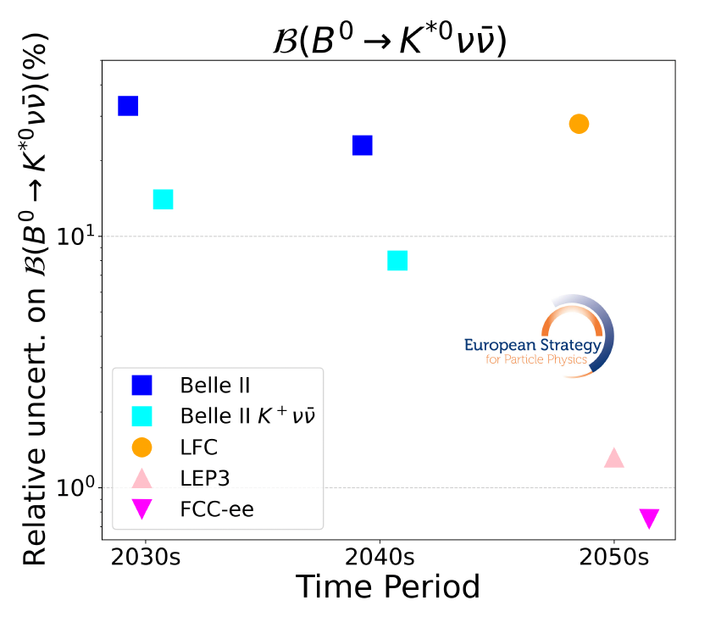
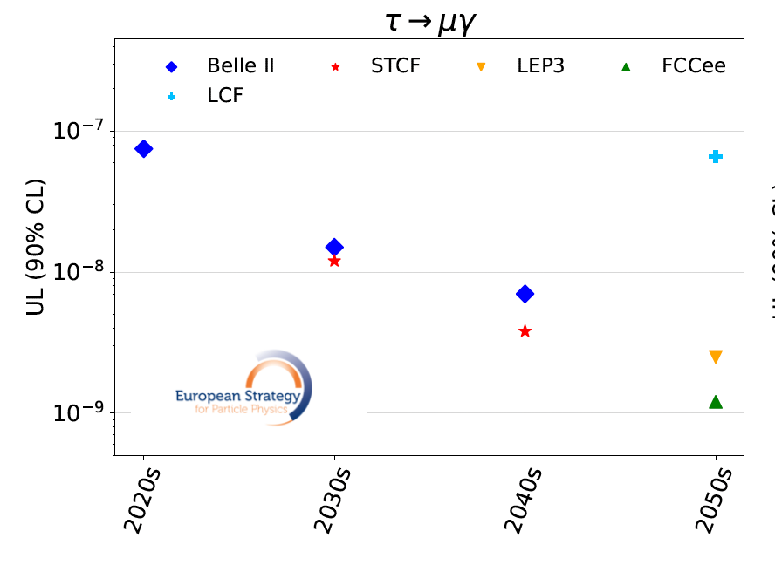
Future prospects in Higgs, EW, and Flavour
Tera-Z [FCC-ee, LEP-3] would lead to a major improvement
Giga-Z [LCF] is not competitive

Slide 25
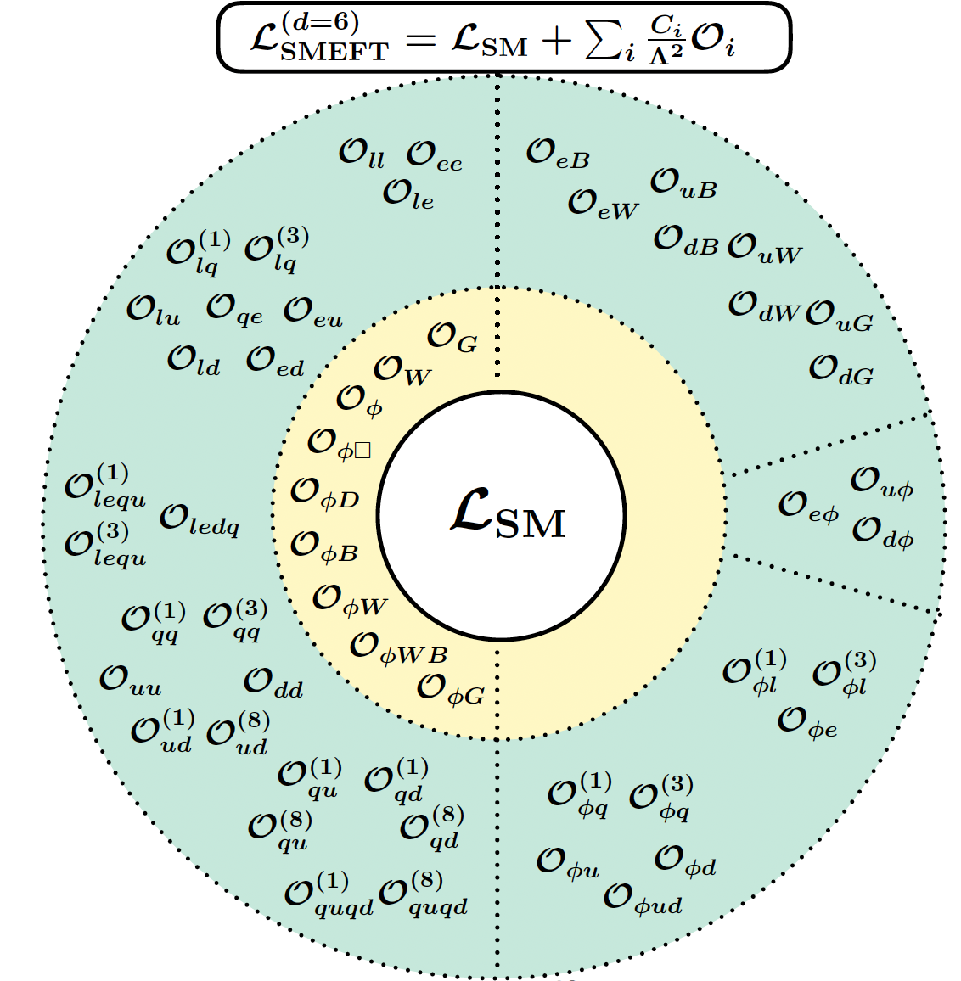
Future prospects in Higgs, EW, and Flavour
Electroweak precision observables allow us to probe the vast majority of the flavour-conserving operators in the SMEFT
[many constraints still dominated by LEP data]
Tree-level
impact
on EWPO
Four-fermion
couplings
affecting EWPO
beyond tree level
J. De Blas ‘25
25

Slide 26
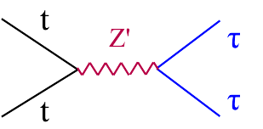
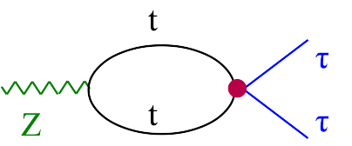
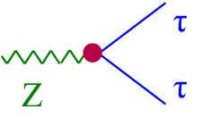
Future prospects in Higgs, EW, and Flavour
Unique potential of EW precision measurements @ FCC-ee:
  The jump in precision of FCC-ee is EW physics is unprecedented:
  5x10¹² Z-boson pairs ~ 10⁵ LEP statistics
  This level of precision opens the sensitivity to TeV-scale physics, even if the new states couple to EW probes only via quantum effects:
E.g.:
Reaching 0.01% precision overcome the (double) suppression, loop x (m_{W}/Λ)²

Slide 27
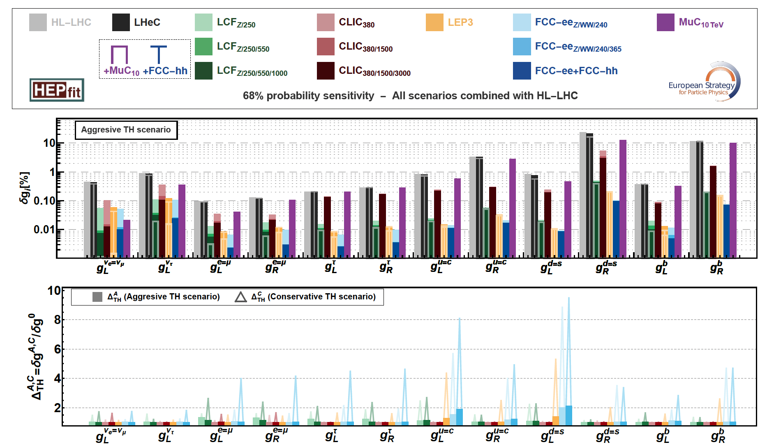
Future prospects in Higgs, EW, and Flavour

Slide 28
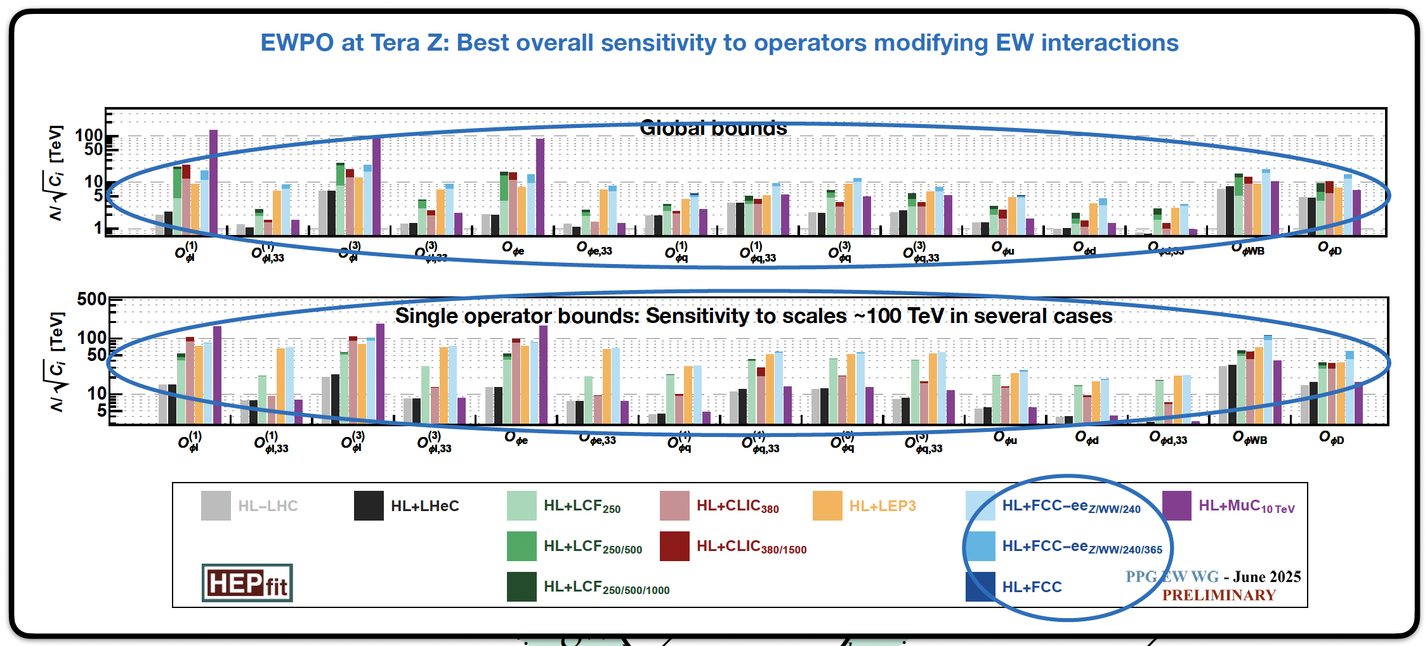
Future prospects in Higgs, EW, and Flavour

Slide 29
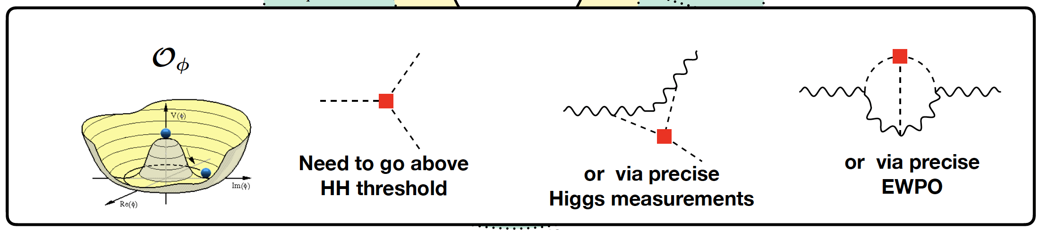
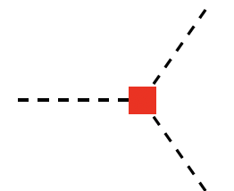
Future prospects in Higgs, EW, and Flavour
Higgs
couplings
Key ingredient: number of Higgs produced in “clean” environment [ e⁺e⁻ → ZH ]
Two distinct
frontiers
Key ingredient: run at (at least) two different energies
Ultimate precision reached by high-energy colliders
Higgs
self-coupling

Slide 30
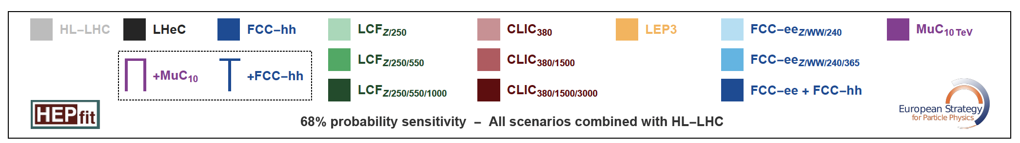
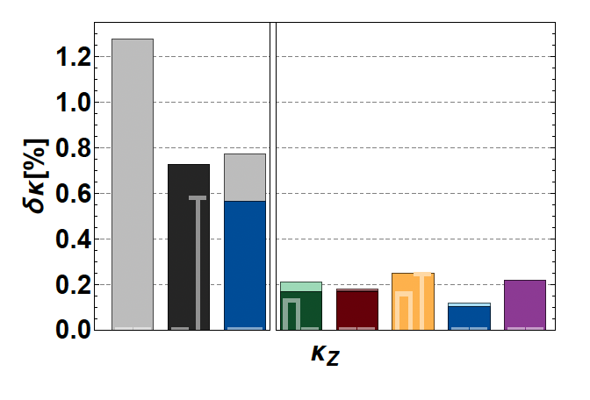
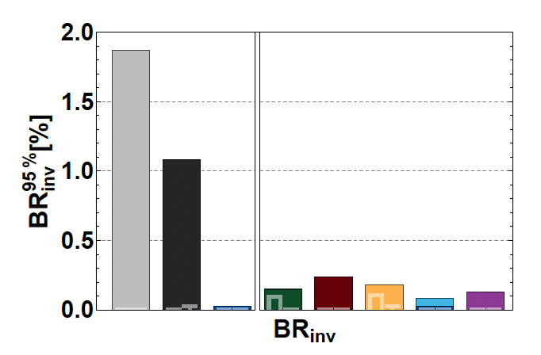
Future prospects in Higgs, EW, and Flavour
0.1% precision [ unique BSM sensitivity ]

Slide 31
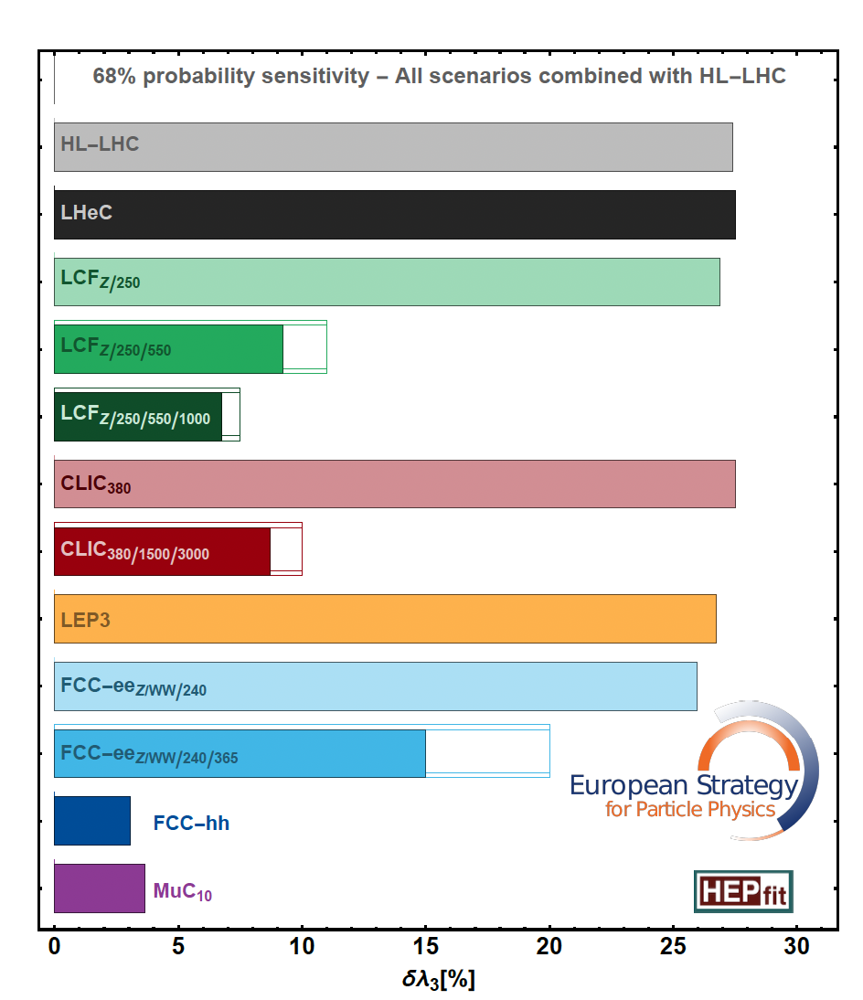
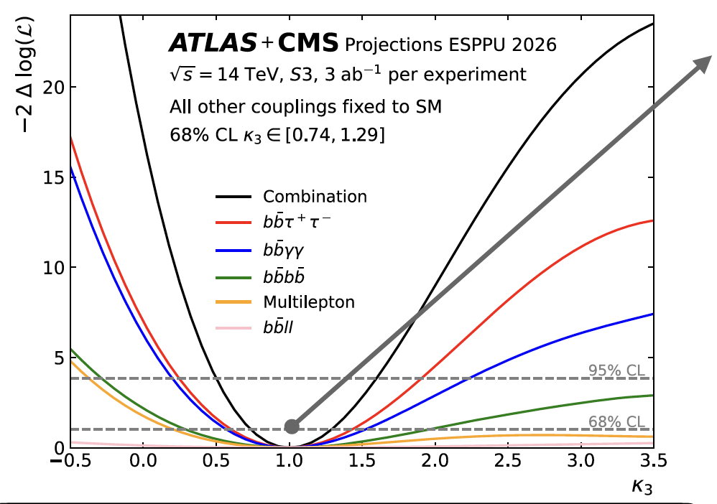
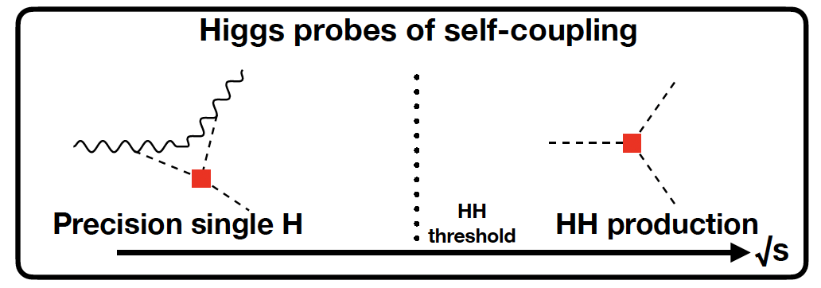
Future prospects in Higgs, EW, and Flavour

Slide 32
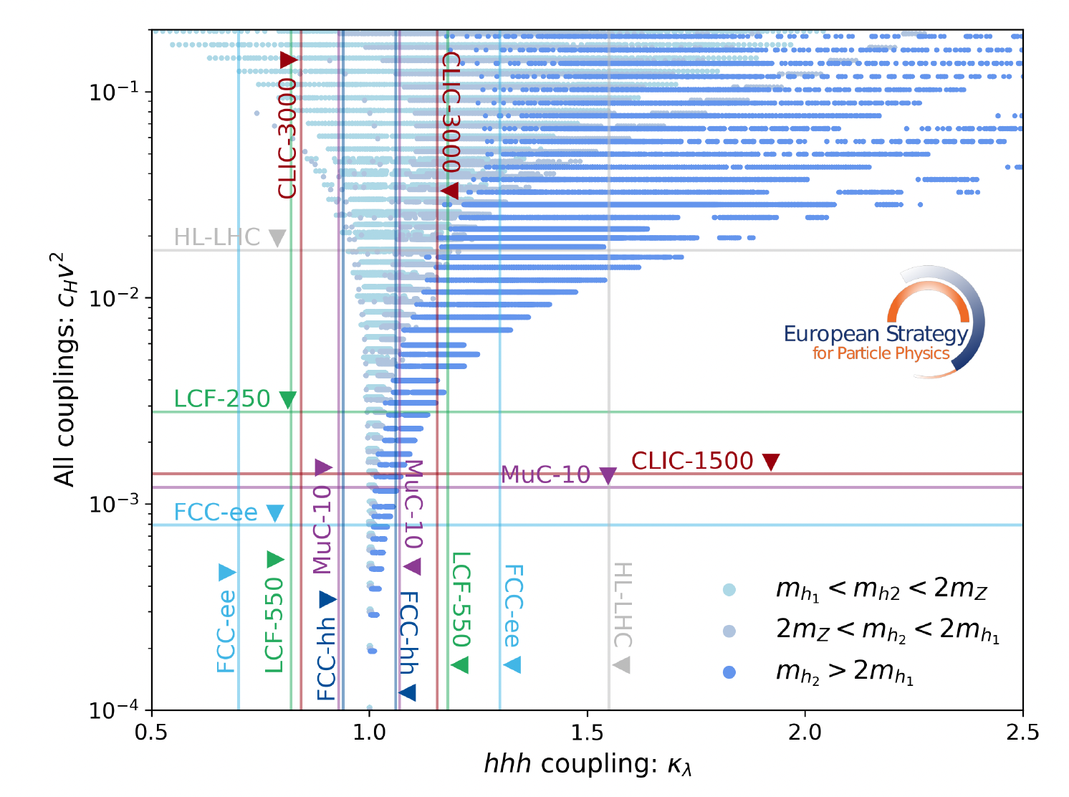
Future prospects in Higgs, EW, and Flavour
The relative role of
couplings vs. self-couplings
is a (BSM)-dependent
question
As general rule: it is hard
(if not impossible...),
having a large impact on the self-coupling without
touching the other couplings
Explicit example in a concrete (minimal) model: mixing of the SM Higgs with a scalar singlet (parameter space leading to first-order EWPT)
HL-LHC (end)
LCF-250
LCF-550

Slide 33
Future prospects in Higgs, EW, and Flavour
The relative role of
couplings vs. self-couplings
is a (BSM)-dependent
question
As general rule: it is hard
(if not impossible...),
having a large impact on the self-coupling without
touching the other couplings
Explicit example in a concrete (minimal) model: mixing of the SM Higgs with a scalar singlet (parameter space leading to first-order EWPT)
FCC-ee

Slide 34
More about future prospects…
The large number of SMEFT coupl. is not a problem, but an opportunity [these couplings are not independent model parameters, rather independent observables]
NP effects are likely to appear in several observables (in correlated form)
H
G
H
H
q
H
G
H
H
q
A
H
H
q
H
q
H
f₃
A
l
H
Higgs-only operators
H
f_{l}
H
l
H
Higgs-gauge ops.
Quark Yukawa
Dipole operators
l₃
q
Flavour-viol. dipoles
Lepton Yukawa
q
H
l_{l}
q
q
A
Flavour-violating 4f
W,Z coupl. to quarks
H
l
q
Semileptonic 4f (LL)
W,Z coupl. to leptons
l
H
l
q
Semileptonic 4f (LR)
A
Trilinear gauge ops.
l
H
Four-fermions tops
Four-lepton ops.
Four-quark ops. (LR)
High-energy coll.
l
q
Four-quark ops. (LL)
G
Top-quark
G
l
q
G
Higgs
Electroweak
f
t
l
l
Flavour
f
t
l
l
QCD
q
q
q
q
q
q
q
q

Slide 35
More about future prospects…
The large number of SMEFT coupl. is not a problem, but an opportunity [these couplings are not independent model parameters, rather independent observables]
NP effects are likely to appear in several observables (in correlated form)
H
G
H
H
q
H
G
H
H
q
A
H
H
q
H
q
H
f₃
A
l
H
Higgs-only operators
H
f_{l}
H
l
H
Higgs-gauge ops.
Quark Yukawa
Dipole operators
l₃
q
Flavour-viol. dipoles
Lepton Yukawa
q
H
l_{l}
q
q
A
Flavour-violating 4f
W,Z coupl. to quarks
H
l
q
Semileptonic 4f (LL)
W,Z coupl. to leptons
l
H
l
q
Semileptonic 4f (LR)
A
Trilinear gauge ops.
l
H
Four-fermions tops
Four-lepton ops.
Four-quark ops. (LR)
High-energy coll.
l
q
Four-quark ops. (LL)
G
Top-quark
G
l
q
G
Higgs
Electroweak
f
t
l
l
Flavour
f
t
l
l
QCD
q
q
q
q
q
q
q
q

Slide 36
More about future prospects…
The large number of SMEFT coupl. is not a problem, but an opportunity [these couplings are not independent model parameters, rather independent observables]
NP effects are likely to appear in several observables (in correlated form)
H
G
H
H
q
H
G
H
H
q
A
H
H
q
H
q
H
f₃
A
l
H
Higgs-only operators
H
f_{l}
H
l
H
Higgs-gauge ops.
Quark Yukawa
Dipole operators
l₃
q
Flavour-viol. dipoles
Lepton Yukawa
q
H
l_{l}
q
q
A
Flavour-violating 4f
W,Z coupl. to quarks
H
l
q
Semileptonic 4f (LL)
W,Z coupl. to leptons
l
H
l
q
Semileptonic 4f (LR)
A
Trilinear gauge ops.
l
H
Four-fermions tops
Four-lepton ops.
Four-quark ops. (LR)
High-energy coll.
l
q
Four-quark ops. (LL)
G
Top-quark
G
l
q
G
Higgs
Electroweak
f
t
l
l
Flavour
f
t
l
l
QCD
q
q
q
q
q
q
q
q

Slide 37
More about future prospects…
The large number of SMEFT coupl. is not a problem, but an opportunity [these couplings are not independent model parameters, rather independent observables]
NP effects are likely to appear in several observables (in correlated form)
H
G
H
H
q
H
G
H
H
q
A
H
H
q
H
q
H
f₃
A
l
H
Higgs-only operators
H
f_{l}
H
l
H
Higgs-gauge ops.
Quark Yukawa
Dipole operators
l₃
q
Flavour-viol. dipoles
Lepton Yukawa
q
H
l_{l}
q
q
A
Flavour-violating 4f
W,Z coupl. to quarks
H
l
q
Semileptonic 4f (LL)
W,Z coupl. to leptons
l
H
l
q
Semileptonic 4f (LR)
A
Trilinear gauge ops.
l
H
Four-fermions tops
Four-lepton ops.
Four-quark ops. (LR)
High-energy coll.
l
q
Four-quark ops. (LL)
G
Top-quark
G
Top-quark
l
q
G
Higgs
Electroweak
f
t
l
l
Flavour
f
t
l
l
QCD
q
q
q
q
q
q
q
q

Slide 38
More about future prospects…
The large number of SMEFT coupl. is not a problem, but an opportunity [these couplings are not independent model parameters, rather independent observables]
NP effects are likely to appear in several observables (in correlated form)
H
G
H
H
q
H
G
H
H
q
A
H
H
q
H
q
H
f₃
A
l
H
Higgs-only operators
H
f_{l}
H
l
H
Higgs-gauge ops.
Quark Yukawa
Dipole operators
l₃
q
Flavour-viol. dipoles
Lepton Yukawa
q
H
l_{l}
q
q
A
Flavour-violating 4f
W,Z coupl. to quarks
H
l
q
Semileptonic 4f (LL)
W,Z coupl. to leptons
l
H
l
q
Semileptonic 4f (LR)
A
Trilinear gauge ops.
l
H
Four-fermions tops
Four-lepton ops.
Four-quark ops. (LR)
High-energy coll.
l
q
Four-quark ops. (LL)
G
Top-quark
G
l
q
G
Higgs
Electroweak
f
t
l
l
Flavour
f
t
l
l
QCD
q
q
q
q
q
q
q
q

Slide 39
More about future prospects…
The large number of SMEFT coupl. is not a problem, but an opportunity [these couplings are not independent model parameters, rather independent observables]
NP effects are likely to appear in several observables (in correlated form)
H
G
H
H
q
H
G
H
H
q
A
H
H
q
H
q
H
f₃
A
l
H
Higgs-only operators
H
f_{l}
H
l
H
Higgs-gauge ops.
Quark Yukawa
Dipole operators
l₃
q
Flavour-viol. dipoles
Lepton Yukawa
q
H
l_{l}
q
q
A
Flavour-violating 4f
W,Z coupl. to quarks
H
l
q
Semileptonic 4f (LL)
W,Z coupl. to leptons
The unique discovery potential of FCC-ee lies in the ability to cover all these sectors with precision & redundancy
l
H
l
q
Semileptonic 4f (LR)
A
Trilinear gauge ops.
l
H
Four-fermions tops
Four-lepton ops.
Four-quark ops. (LR)
High-energy coll.
l
q
Four-quark ops. (LL)
G
Top-quark
G
l
q
G
Higgs
Electroweak
f
t
l
l
Flavour
f
t
l
l
QCD
q
q
q
q
q
q
q
q

Slide 40
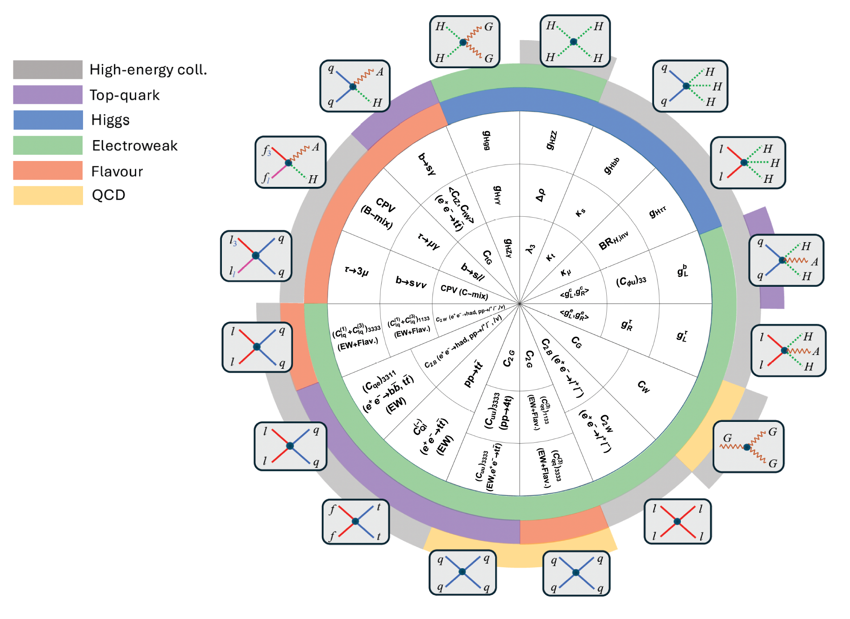
More about future prospects…
16 sectors [classes of contact interactions]
3 layers of observables in each sector [characterized by growing difficulty, need for high E]
Improvement factors in log scale [gray scale]:
HL-LHC defines the initial benchmark
The best reach of any future collider defines the maximal value
Quantitative comparison of the potential of future colliders:
40

Slide 41
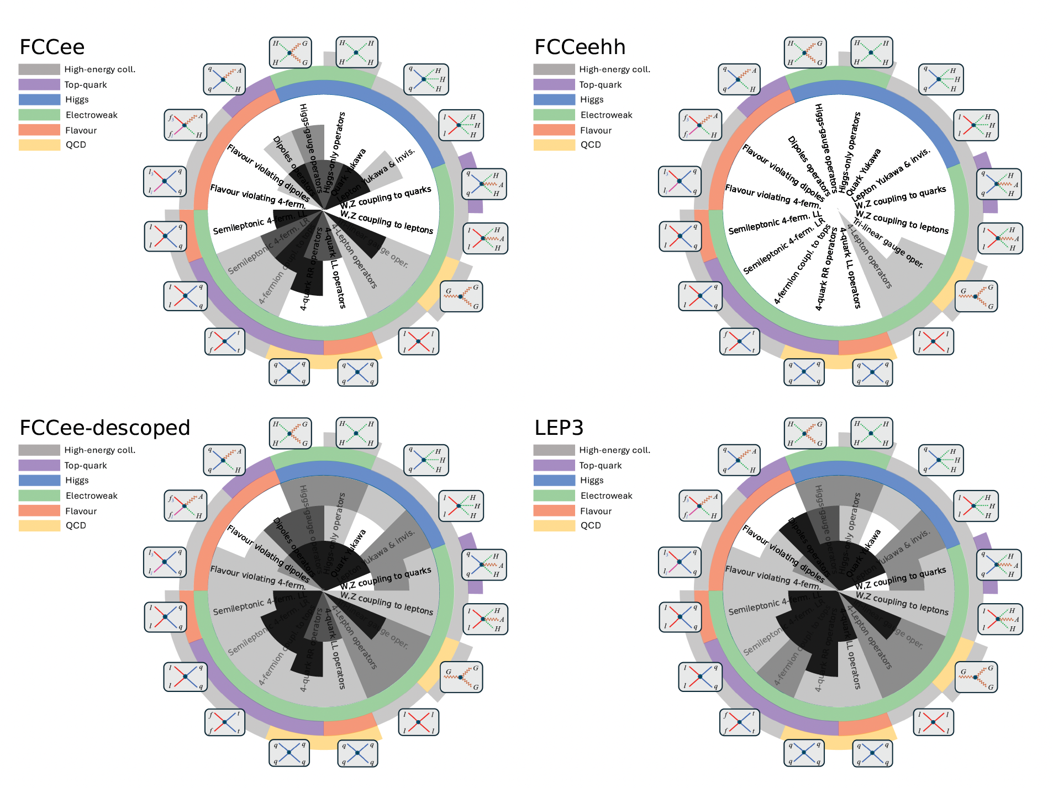
More about future prospects…
16 sectors [classes of contact interactions]
3 layers of observables in each sector [characterized by growing difficulty, need for high E]
Improvement factors in log scale [gray scale]:
HL-LHC defines the initial benchmark
The best reach of any future collider defines the maximal value
Quantitative comparison of the potential of future colliders:
41

Slide 42
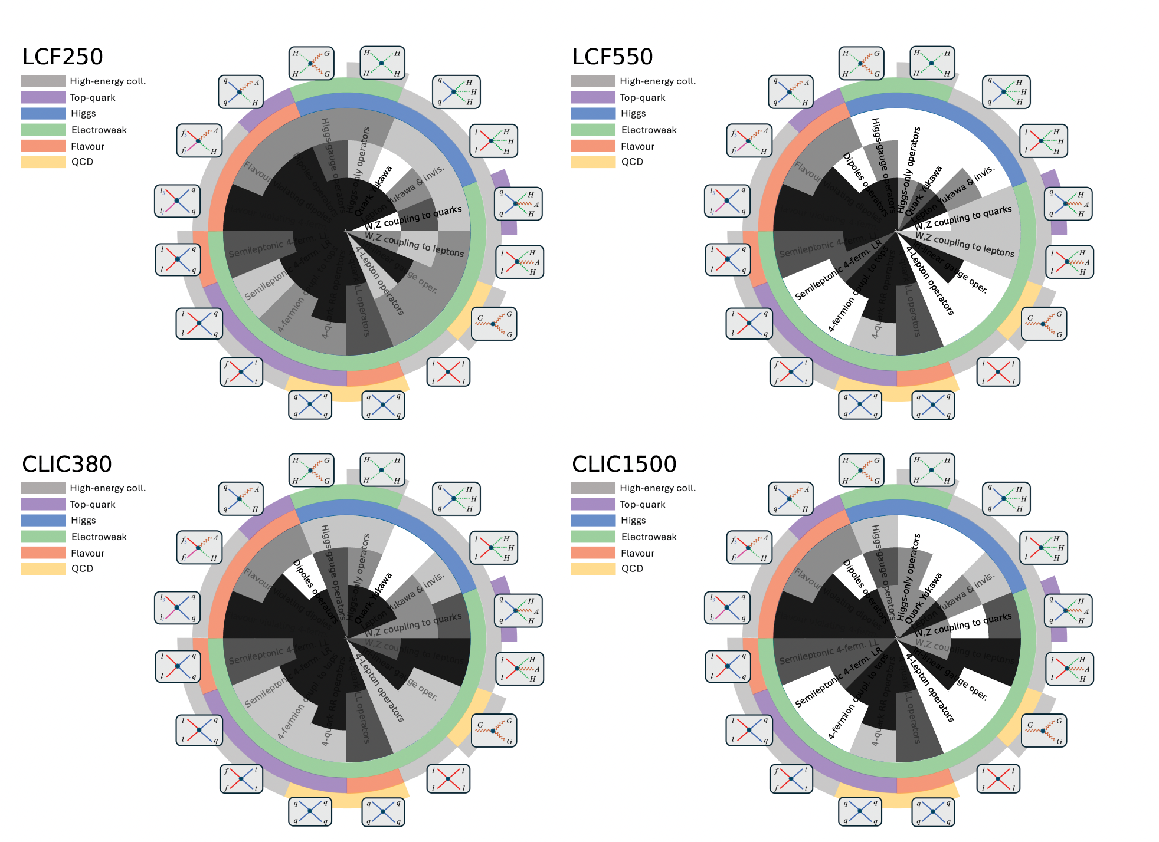
More about future prospects…
16 sectors [classes of contact interactions]
3 layers of observables in each sector [characterized by growing difficulty, need for high E]
Improvement factors in log scale [gray scale]:
HL-LHC defines the initial benchmark
The best reach of any future collider defines the maximal value
Quantitative comparison of the potential of future colliders:
42

Slide 43
Part III
Discovery reach in
“motivated models” of heavy NP
Energy
Λ₁
ψ₁
Λ₂
ψ₂
Λ_{H,3}
H, ψ₃
Λ_{EW}

Slide 44
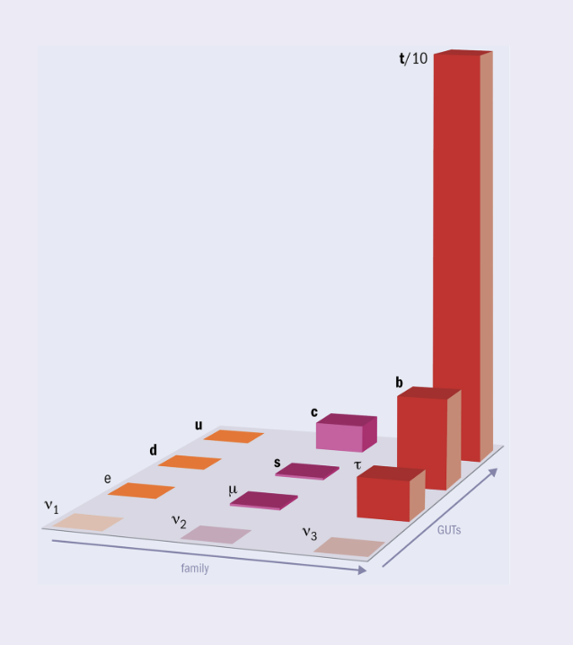
NP reach in “motivated models”
c_{i}^{[d]}
Λ^{d-4}
Σ
ℒ_{SM-EFT} = ℒ_{gauge} + ℒ_{Higgs} +
O_{i}^{[d]} (ϕ, A_{a}, ψ_{i})
E
SM (EFT)
^{d > 4}
  What do we know so far about the SMEFT and its cut-off?
m_{t}
Hierarchy problem → Λ ~ 1 TeV [at least for Higgs & top]
EWPO → Λ > 1 TeV - 10 TeV
m_{H}
m_{Z,W}
Flavour-violating [d=6]:
Flavour-violating [d=4]:
highly non-trivial flavour structure

Slide 45
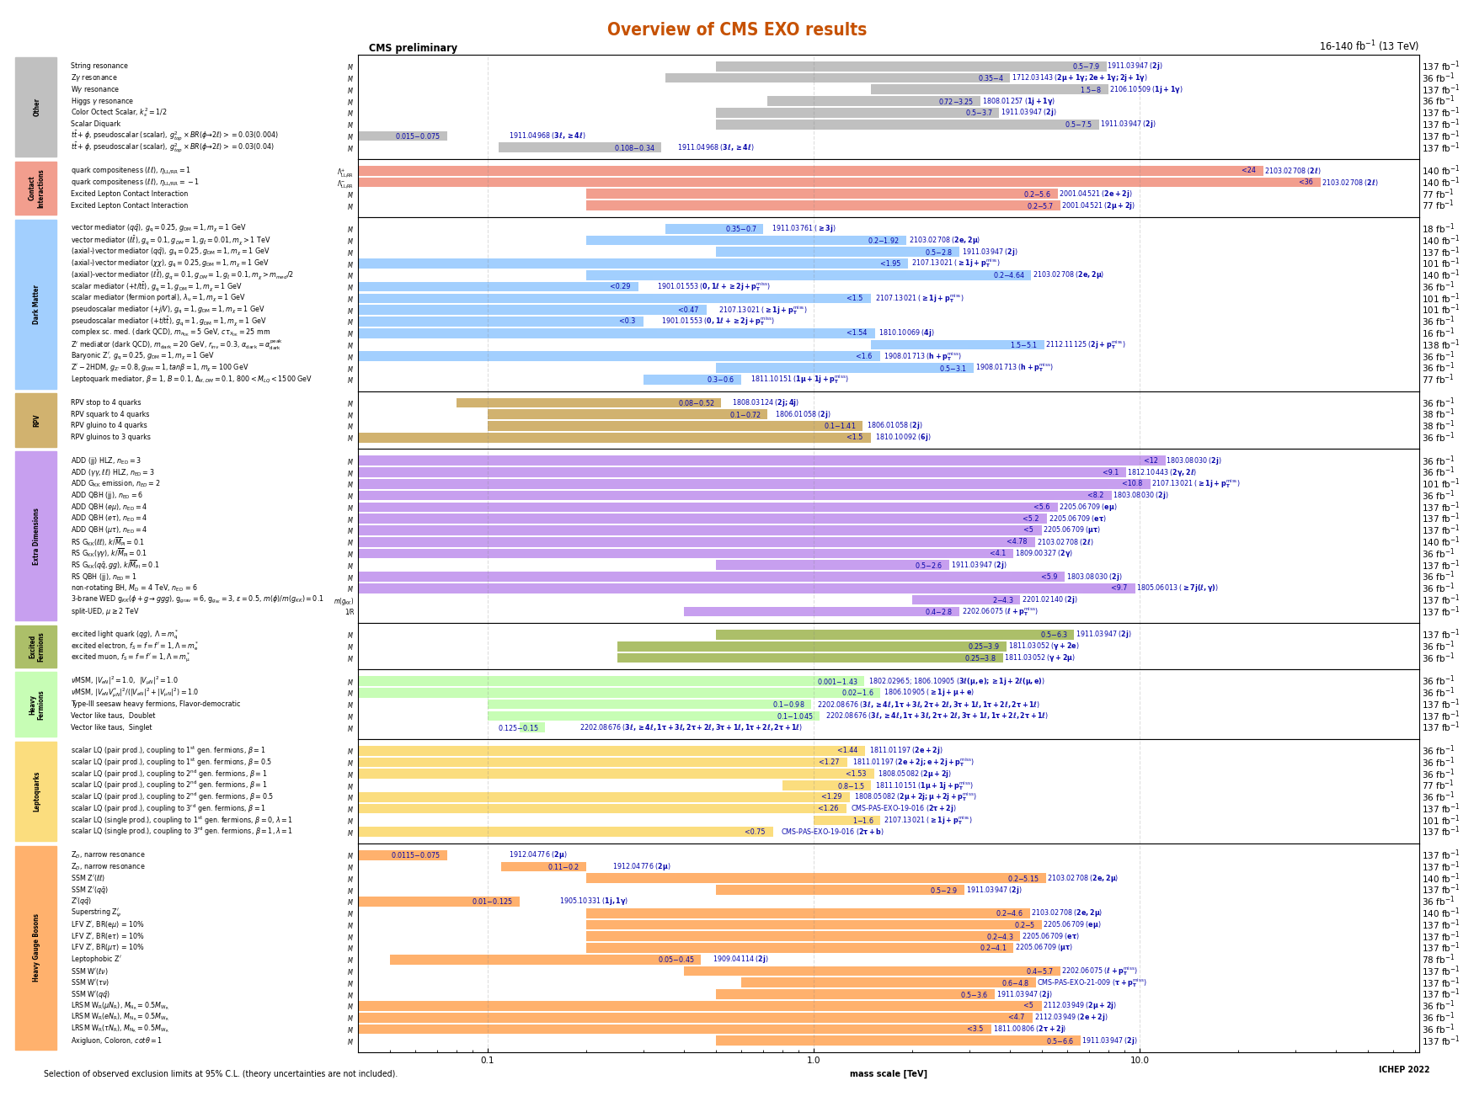
NP reach in “motivated models”
3rd family
NP
Universal
NP
  High-energy searches:
  Also in this case flavour hypotheses play an important role…
100 GeV
1 TeV
10 TeV

Slide 46
NP reach in “motivated models”
If New Physics is there to solve the shortcomings of the Higgs sector, it is natural to assume that it couples in a flavor non-universal manner, mainly to the third generation
  The Yukawa couplings are strongly hierarchal
  The electroweak hierarchy problem and the Higgs instability problem are both related to the large top-quark Yukawa coupling (light quarks play no role…)

Slide 47
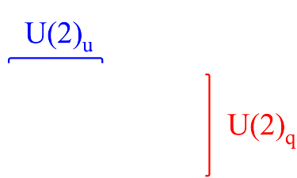
NP reach in “motivated models”
If New Physics is there to solve the shortcomings of the Higgs sector, it is natural to assume that it couples in a flavor non-universal manner, mainly to the third generation
  The Yukawa couplings are strongly hierarchal
  The electroweak hierarchy problem and the Higgs instability problem are both related to the large top-quark Yukawa coupling (light quarks play no role…)
ℒ_{Higgs} = Dϕ⁺ Dϕ – [ –μ² ϕ⁺ϕ + λ (ϕ⁺ϕ)² + Y^{ij} ψ_{L}^{i} ψ_{R}^{j} ϕ ]
0.003
< 0.01
Y_{U} ~
0.04
1

Slide 48
NP reach in “motivated models”
A possible multi-scale completion of the SM:
SM-EFT
with U(2)⁵
flavor symmetry
Energy
Λ₁
ψ₁
Dynamics
responsible
for light-family masses
NP coupled mainly to
ψ₃
few
TeV
Λ₂
ψ₂
Λ_{H,3}
H, ψ₃
Λ_{EW}
Λ_{EW}

Slide 49
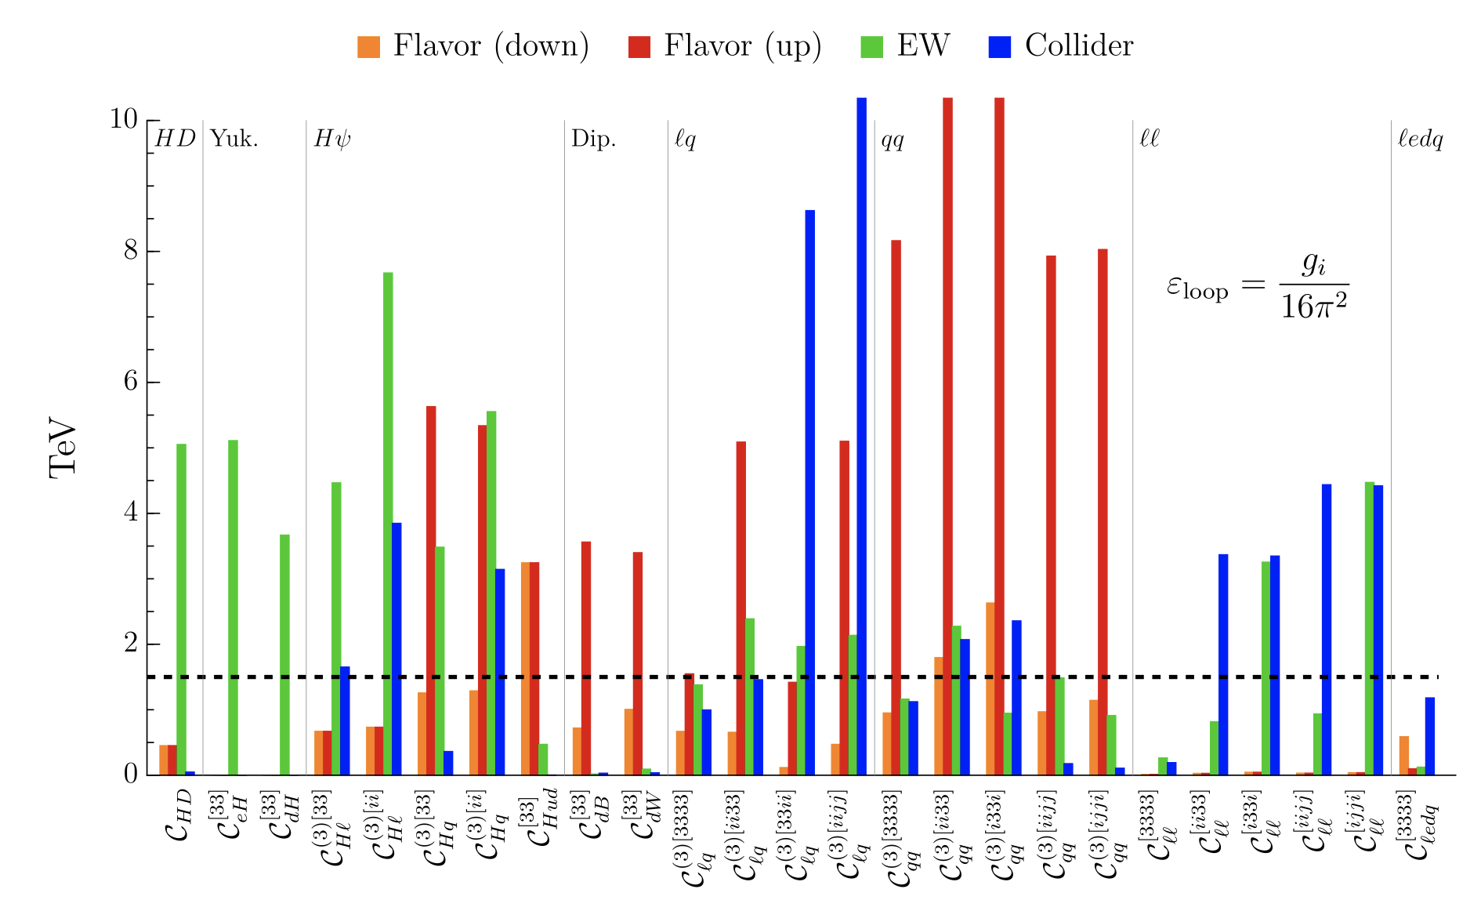
NP reach in “motivated models”
SMEFT for 3rd gen. NP
Assume NP couples differently to the 3rd family and universally 1st & 2nd [120 ops.]
Operators involving only 3rd family fields → collider bounds below 1.5 TeV
  Bounds on Λ (coupling 1/Λ²)
  for representative
  subset of operators:
Allwicher, Cornella, GI, Stefanek ‘24

Slide 50
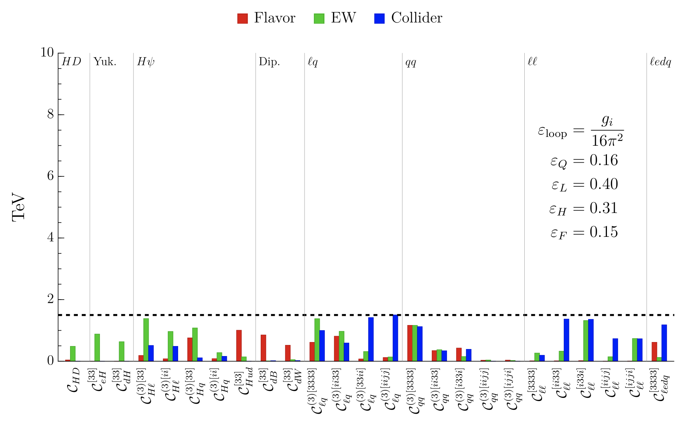
NP reach in “motivated models”
SMEFT for 3rd gen. NP
Assume NP couples differently to the 3rd family and universally 1st & 2nd [120 ops.]
NP can be as low as 1-2 TeV in motivated models ! (no tuning needed to evade present bounds…)
Interplay of flavor + EW + direct searches is essential to discover NP…
Modified bounds implementing the dynamical hypothesis of NP coupled manly to the 3rd generation [mild suppression factors for light families]
Allwicher, Cornella, GI, Stefanek ‘24

Slide 51
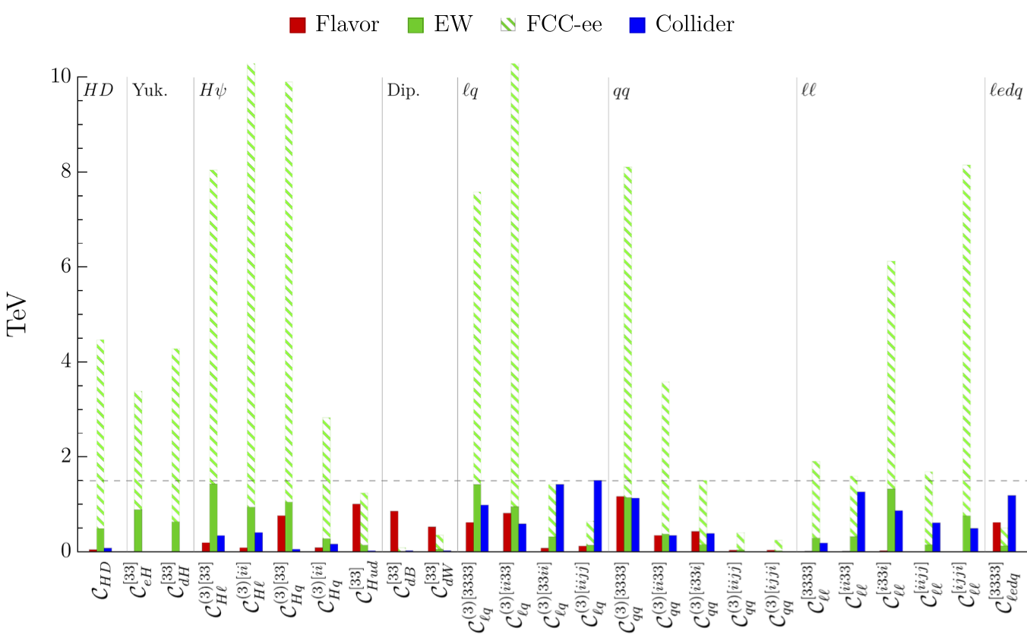
NP reach in “motivated models”
Potential reach of FCC-ee from EW and Higgs measurements
The natural range for
Λ dictated by the hierarchy problem
(i.e. few TeV) would be completely covered

Slide 52
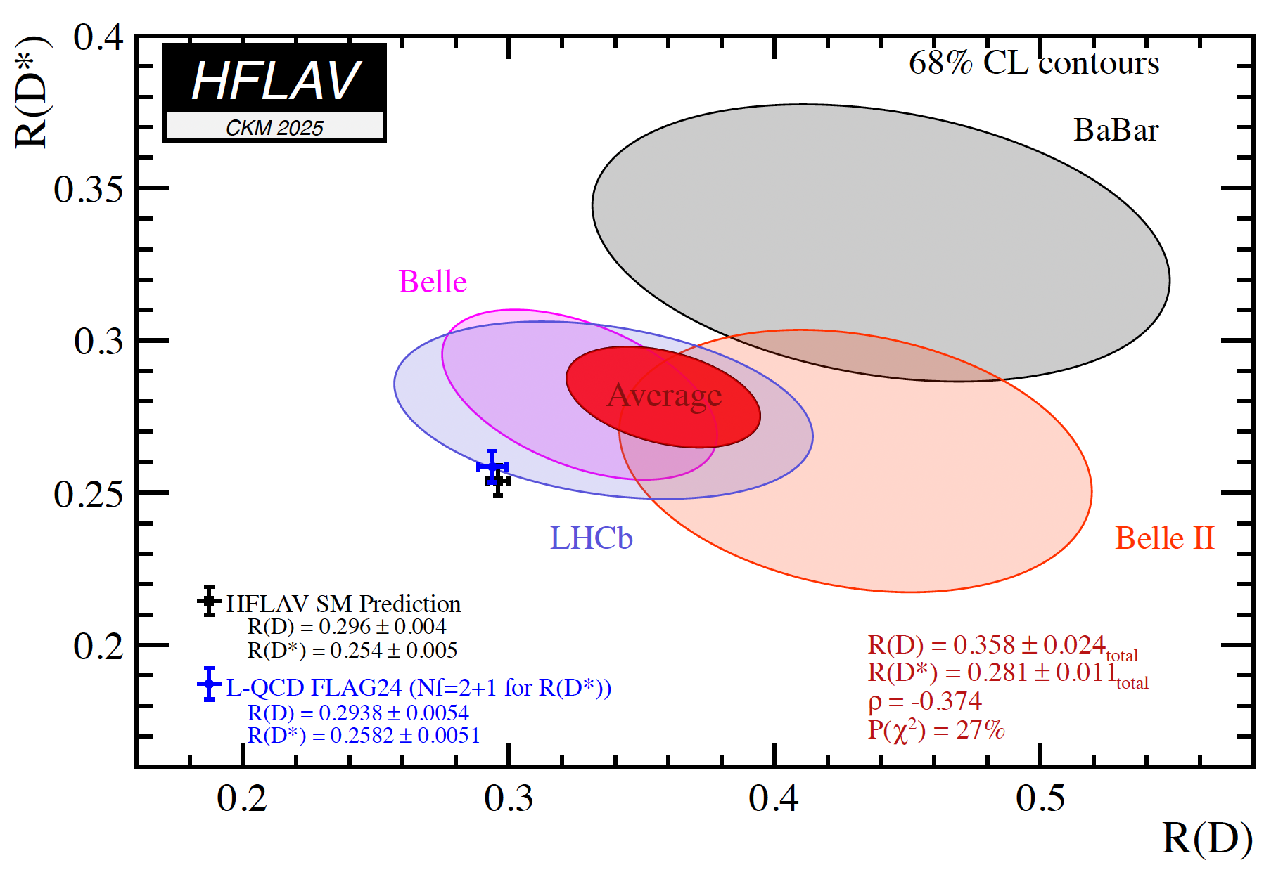
Examples of interplay in indirect NP searches
Looking at bounds from individual observables misses one of the key the main point of indirect NP searches: the interplay of a large number of observables in “decoding” the underlying theory
To illustrate this point, we need to consider an explicit example assuming a NP signal
B(B → D^{(*)} τν)
B(B → D^{(*)} μν)
R(D ^{(*)}) =
52

Slide 53


Examples of interplay in indirect NP searches
Looking at bounds from individual observables misses one of the key the main point of indirect NP searches: the interplay of a large number of observables in “decoding” the underlying theory
b_{L}
ν_{L}
b_{L}
τ_{L}
s_{L}
τ_{L}
s_{L}
ν_{L}
B →K νν
B →K ττ
W
τ_{L}
b_{L}
τ_{L}
Z
τ_{L}(ν_{L})
ν_{L}
b_{L}
τ_{L}
Ζ → ττ (νν)
τ →μνν
σ(pp →ττ)
τ_{L}(ν_{L})
53

Slide 54


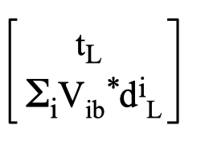
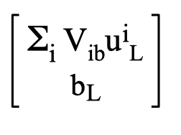
Examples of interplay in indirect NP searches
Looking at bounds from individual observables misses one of the key the main point of indirect NP searches: the interplay of a large number of observables in “decoding” the underlying theory
A simple, consistent, description
of the system involves (at least)
3 parameters:
2 Wilson coefficients,
1 flavour-mixing parameter, ε = O(1): = b_{L} + ε |V_{ts}| s_{L}
_{ti}
ε
up
down
54

Slide 55
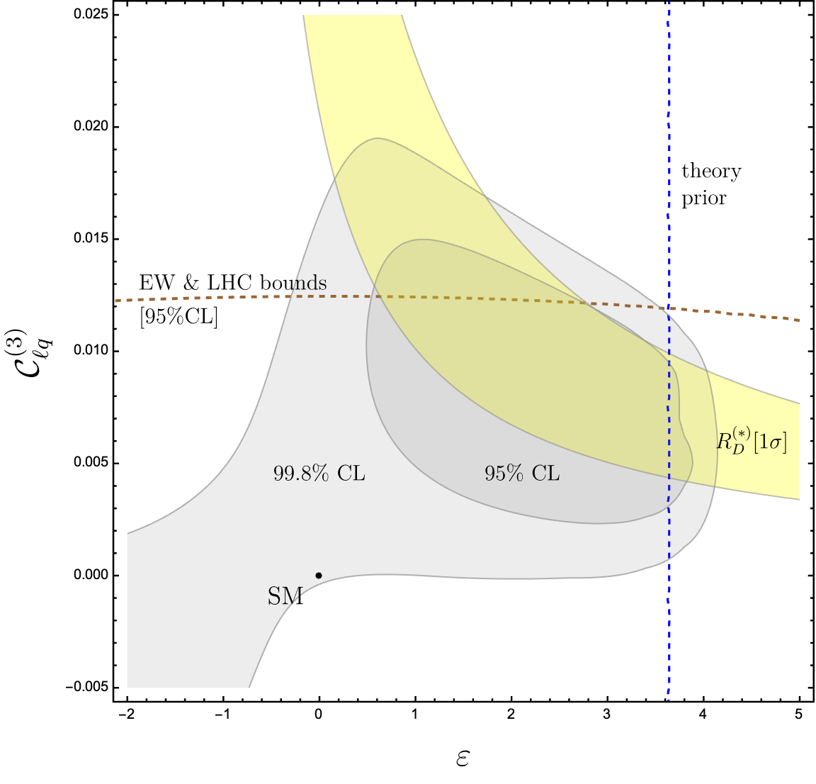
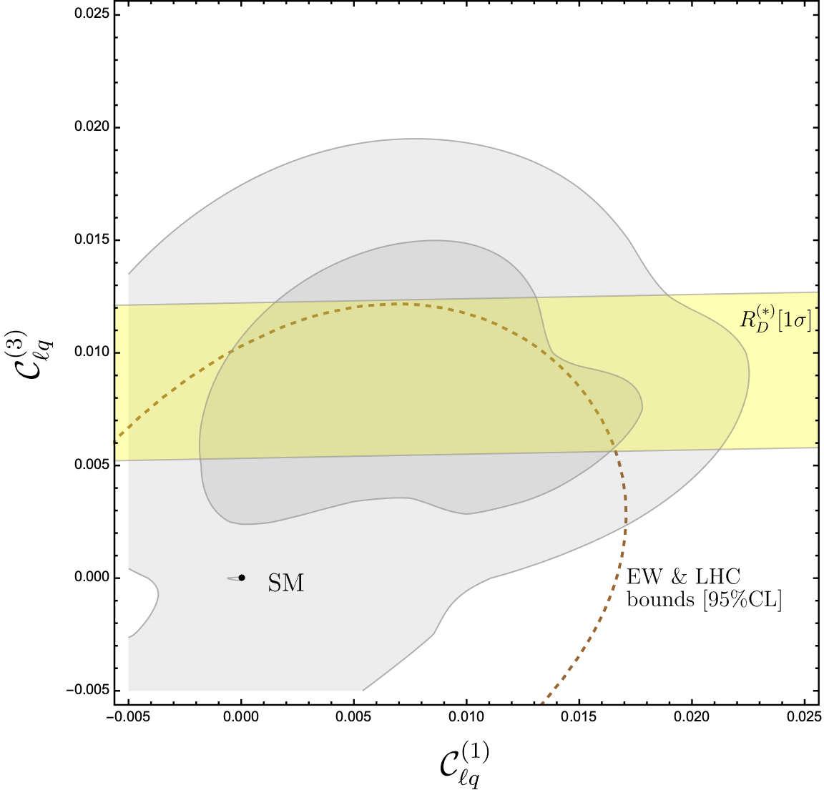
Examples of interplay in indirect NP searches
W_{i}’
g/M
U_{i}
1 TeV
2 TeV
Z’
55

Slide 56
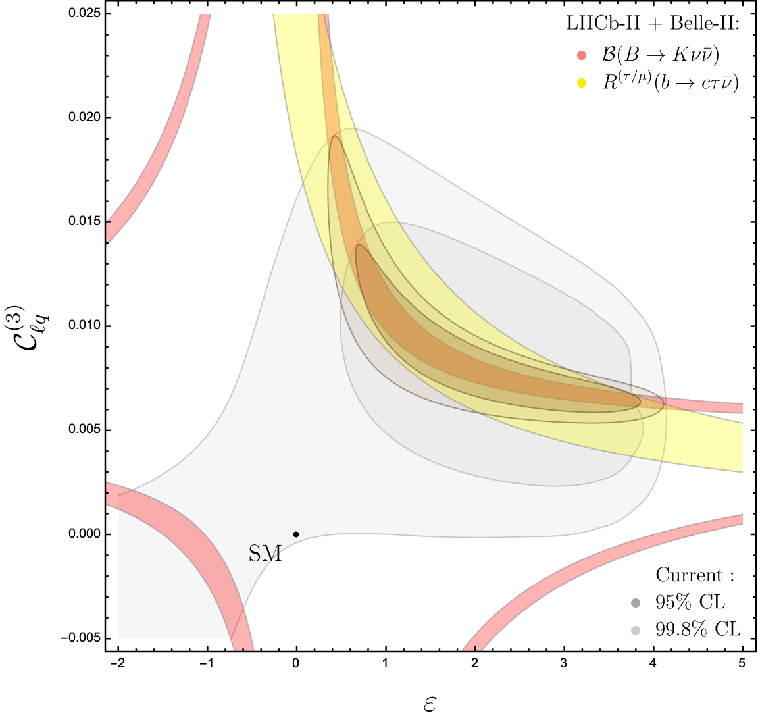
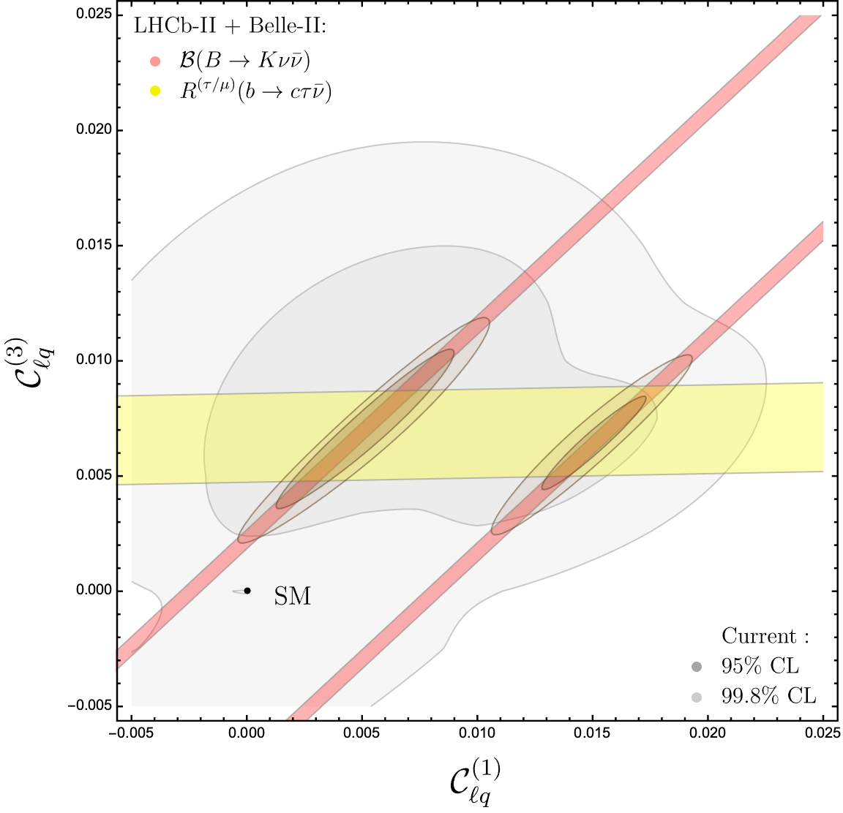
Examples of interplay in indirect NP searches
56

Slide 57
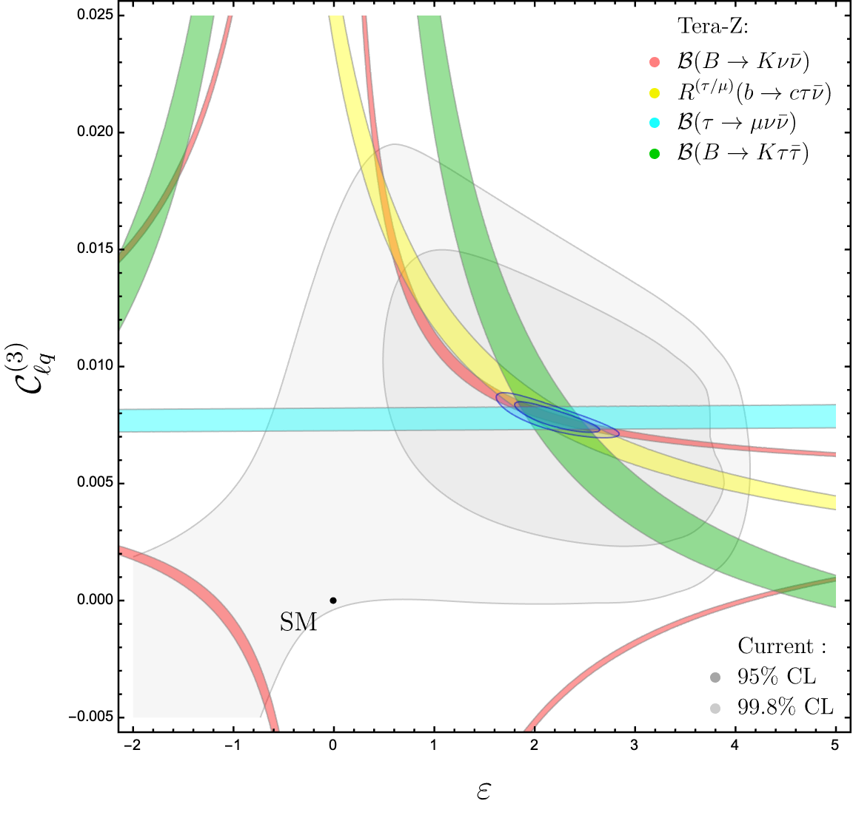
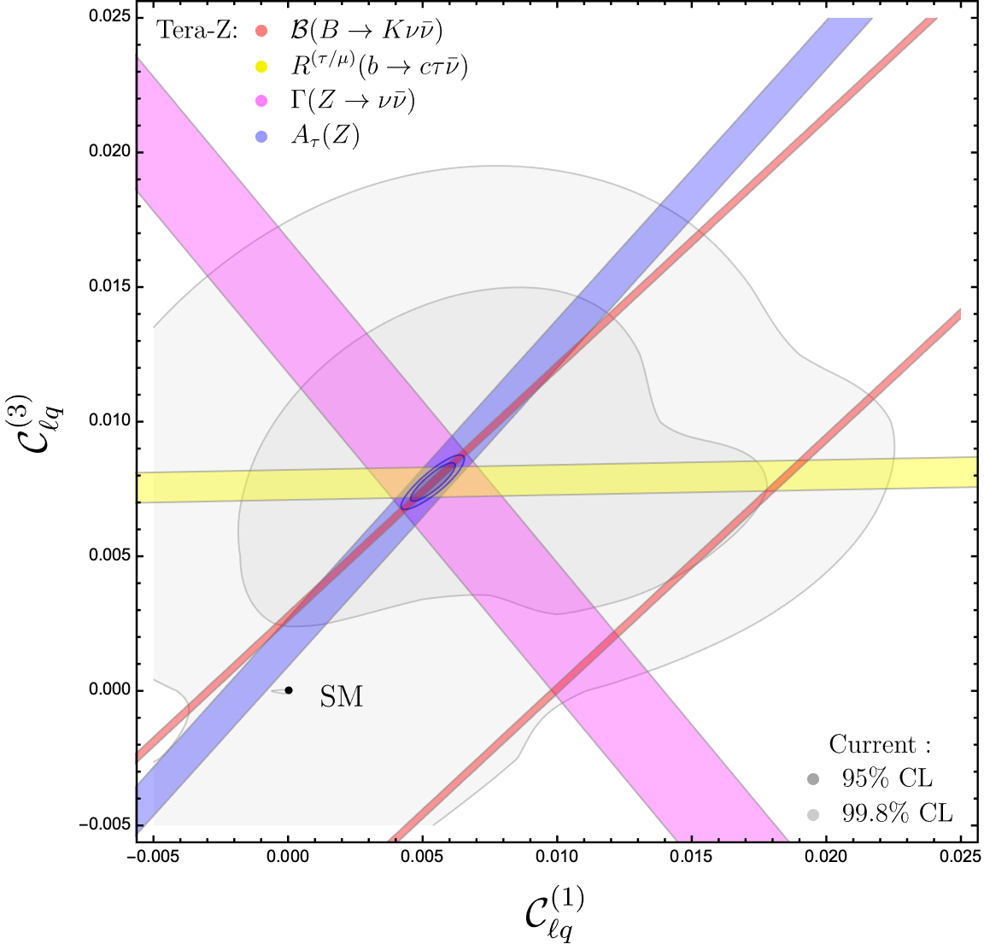
Examples of interplay in indirect NP searches
57

Slide 58

Last but not least…[beyond indirect searches]
While heavy NP leads to contact interactions among SM fields, other classes of NP could lead to to new light states with tiny interactions to the SM fields (motivated by dark matter, neutrino physics, …)
SM
Ultraviolet completion
Renorm.
interactions
(long-range)
Light New
Physics
New contact
interactions
(short-range)
Exotic long-range
structure
heavy
dynamics

Slide 59
Last but not least…[beyond indirect searches]
While heavy NP leads to contact interactions among SM fields, other classes of NP could lead to to new light states with tiny interactions to the SM fields (motivated by dark matter, neutrino physics, …)
The smallness of such interactions (forced by data) naturally leads to consider the so-called portals [ = lowest-dim. operators involving the exotic fields ]
SMEFT
Portals
c_{i}^{[d]}
Λ^{d-4}
1
f
Σ
aF_{μν}F^{μν} + y_{N} LϕN + δ_{χ}(ϕ⁺ϕ)χ⁺χ + …
ℒ_{NP} = ℒ_{gauge} + ℒ_{Higgs} + +
O_{i}^{[d]} (ψ_{SM})
^{d > 4}
heavy
dynamics
Light New
Physics

Slide 60



Last but not least…[beyond indirect searches]
In this case the NP parameter range is much wider $→$ no hope for complete coverage with a single set-up. However, the high statistics & clean environment provided by FCC-ee would allow us to probe large unexplored regions, e.g.:

Slide 61
Conclusions
What I have illustrated at the end of this talk are specific examples, but the conclusions that can be drawn are very general:
In motivated classes of SM extensions NP can still be around few TeV. To discover it, the interplay of a large number of observables is a key ingredient, both to “decode” the underlying theory & to “validate” possible discoveries
Precision Higgs, electroweak, and flavour physics are three faces of the same strategy: their primary objective are indirect discoveries, and in realistic model with TeV-scale NP, they provide very complementary information
Natural synergy of the precision frontier with the data-driven searches for “exotic” NP models with light weakly-coupled new particles [high intensity is the driving factor]
  In view of all these considerations, the FCC-ee program is very exciting !
61

Slide 62

Conclusions

