Slide 1

Field Theory for Neutronics
Partikeldagarna 2026
Jacob Persson¹, Eliel Camargo-Molina¹, Stefano Moretti¹ and Andreas Solders²
High Energy Physics¹ and Applied Nuclear Physics², Department of Physics and Astronomy, Uppsala University
Lund University, Lund, Sweden
2026-09-17
Supported by Vattenfall Nuclear Fuel (VNF) and Swedish Centre for Nuclear Technology (SKC)
In collaboration with Ringhals

Slide 2
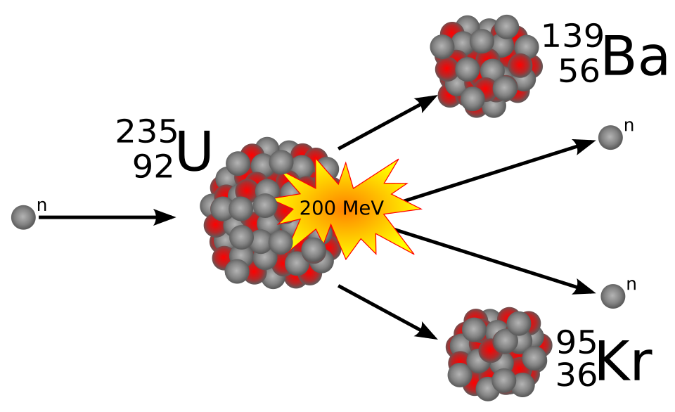
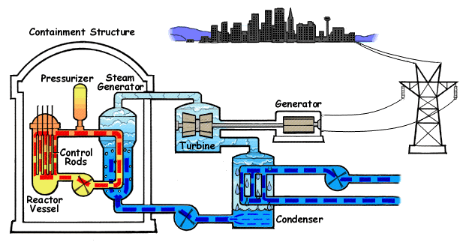
Purpose & motivation
Stefan-Xp. “Nuclear fission of uranium 235” commons.wikipedia.org. Accessed: 29 Jan. 2026. [Online]. Available: https://commons.wikimedia.org/wiki/File:Kernspaltung.svg.
Interactions between neutrons and U-235 can cause fission which release energy
The modelling of neutron transport is important to many aspects of nuclear reactor operation
We want to improve the model of neutron transport by including fluctuations and feedback effects using methods from statistical field theory
U.S.NRC. “Pressurized Water Reactor.” commons.wikipedia.org. Accessed: 29 Oct. 2025. [Online]. Available: https://commons.wikimedia.org/wiki/File:PressurizedWaterReactor.gif.

Slide 3
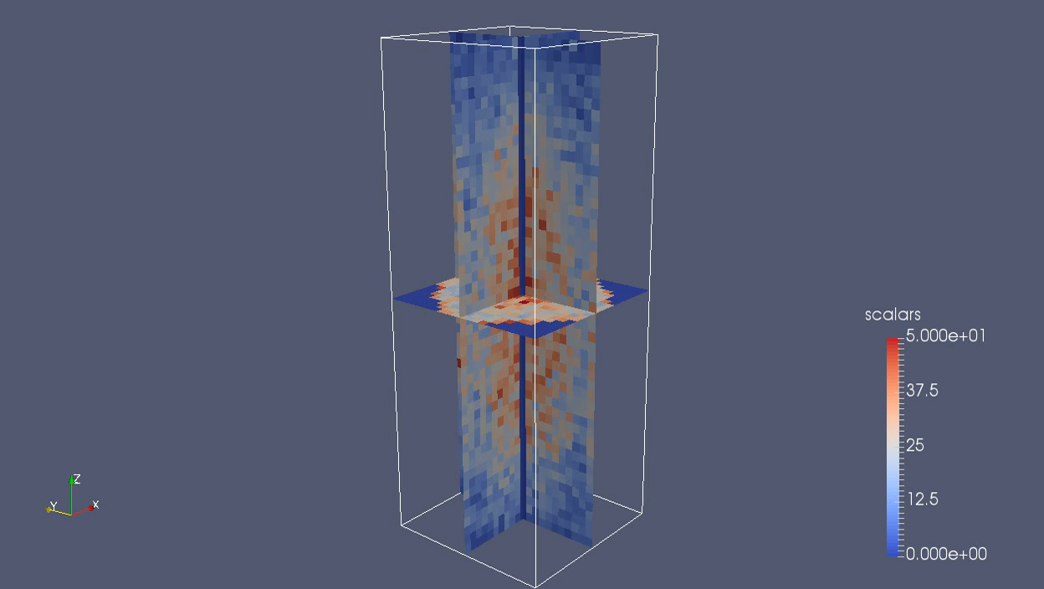
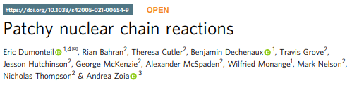
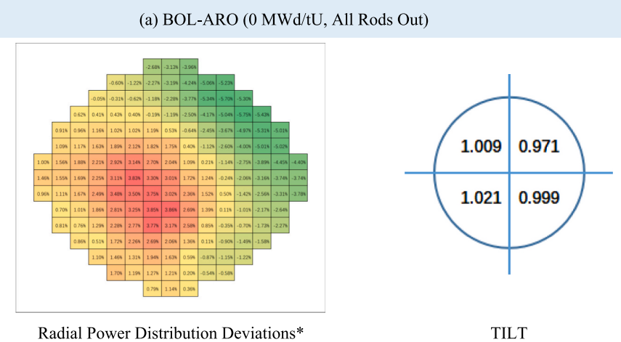
Background
Experiments have found connections between neutron fluctuations and spatial correlations of the neutron distribution
This might contribute to the asymmetry of power distribution seen in large reactors
Li, X., Cai, D., Wang, X., He, M., Li, Z., Zhao, C., & Wang, X. (2025). Neutronic analysis of PWR fuel-assembly bowing based on measurement data. Nuclear Engineering and Design, 443, 114283.

Slide 4
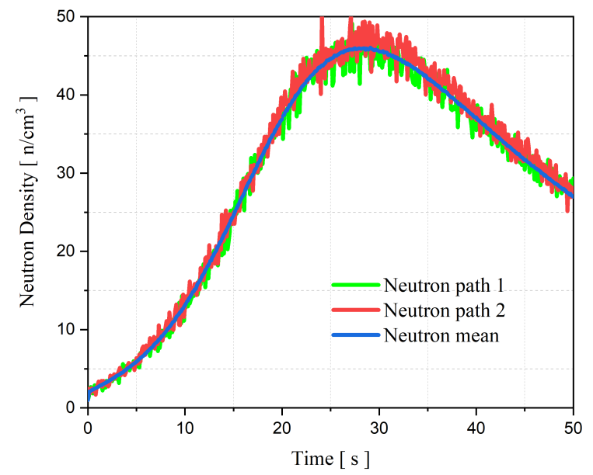
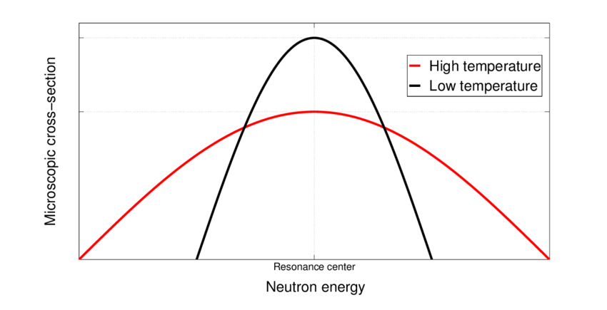
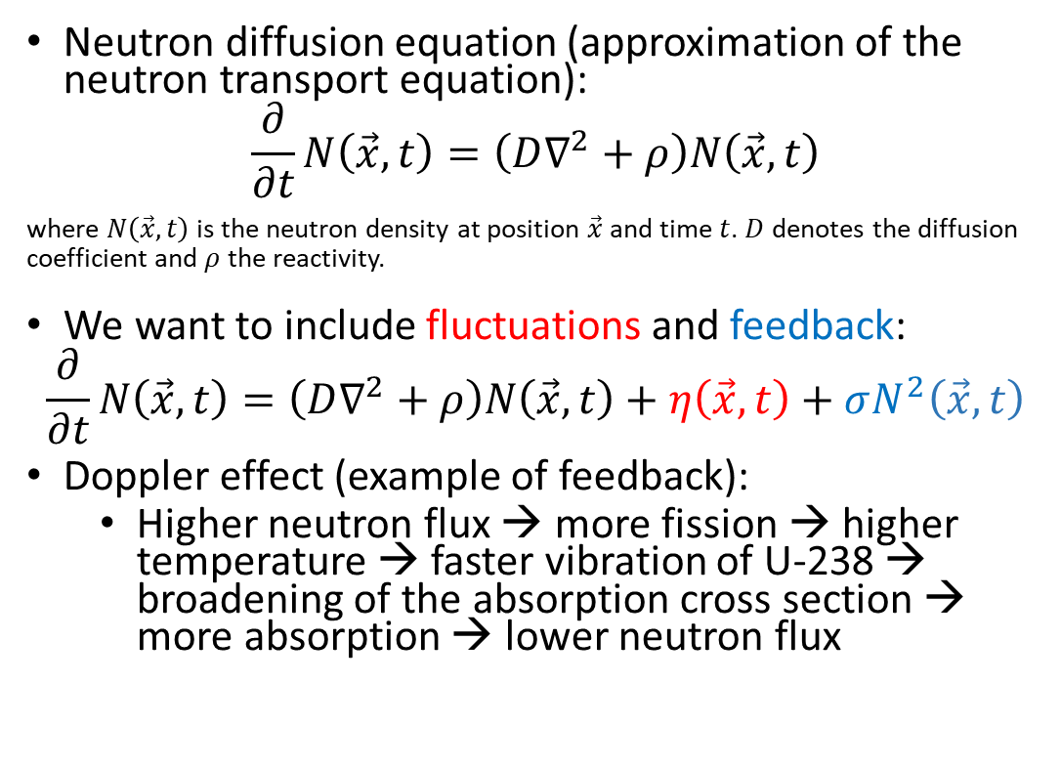
Neutron transport
Neutron diffusion equation (approximation of the neutron transport equation):
$$\frac{∂}{∂t}N\left(\vec{x},t\right)=\left(D∇^{2}+ρ\right)N\left(\vec{x},t\right)$$
where $N\left(\vec{x},t\right)$ is the neutron density at position $\vec{x}$ and time $t$. $D$ denotes the diffusion coefficient and $ρ$ the reactivity.
We want to include fluctuations and feedback:
$$\frac{∂}{∂t}N\left(\vec{x},t\right)=\left(D∇^{2}+ρ\right)N\left(\vec{x},t\right)+η\left(\vec{x},t\right)+σN^{2}\left(\vec{x},t\right)$$
Doppler effect (example of feedback):
  Higher neutron flux → more fission → higher temperature → faster vibration of U-238 → broadening of the absorption cross section → more absorption → lower neutron flux
Suescún-Díaz, D., “Stochastic Neutron Population With Temperature Feedback Effects Using The Implicit Runge-Kutta Scheme,” J. Appl. Sci. Eng., vol. 28, no. 8, pp. 1795-1803, Sept. 2024, doi: http://dx.doi.org/10.6180/jase.202508_28(8).0016.
Qvist, S. A. (2013). Safety and core design of large liquid-metal cooled fast breeder reactors. University of California, Berkeley.

Slide 5

Statistical field theory
Write 1 such that it resembles field theory
Insert into average
Assume Gaussian noise with zero mean and covariance
Then, correlation functions can be written with the action as statistical weight

Slide 6



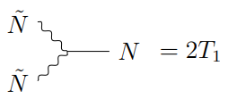
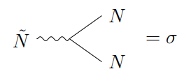
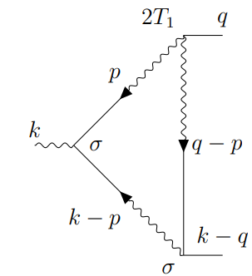
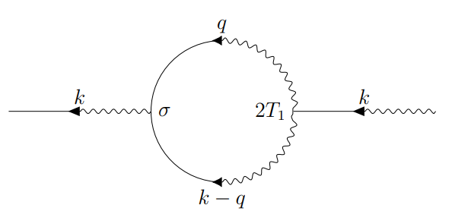
Feynman diagrams
The free response propagator:
Vertices:
Diagrams:

Slide 7

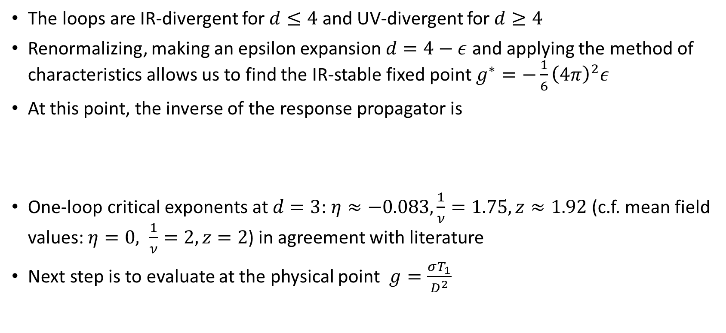
Critical exponents
The loops are IR-divergent for $d≤4$ and UV-divergent for $d≥4$
Renormalizing, making an epsilon expansion $d=4−ε$ and applying the method of characteristics allows us to find the IR-stable fixed point $g^{∗}=−\frac{1}{6}{\left(4π\right)}^{2}ε$
At this point, the inverse of the response propagator is
One-loop critical exponents at $d=3$: $η≈−0.083,\frac{1}{ν}=1.75, z≈1.92$ (c.f. mean field values: $η=0, \frac{1}{ν}=2, z=2$) in agreement with literature
Next step is to evaluate at the physical point $g=\frac{σT_{1}}{D^{2}}$

Slide 8
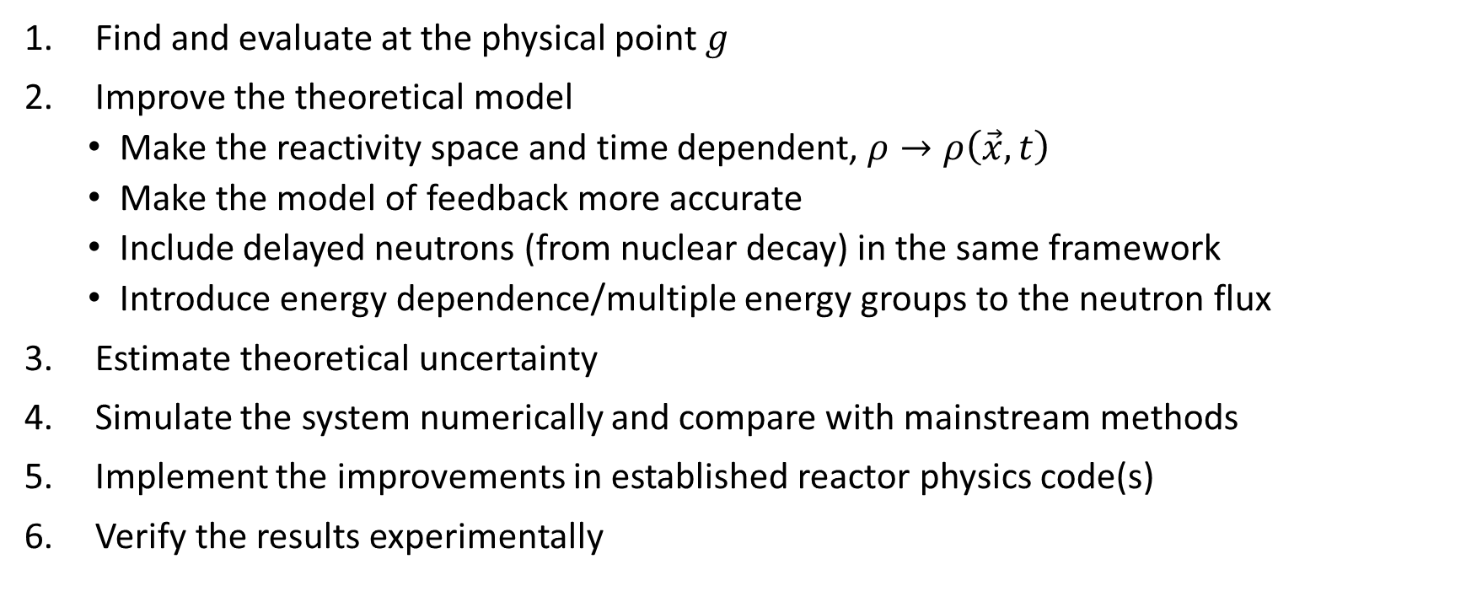
Plan
Find and evaluate at the physical point $g$
Improve the theoretical model
  Make the reactivity space and time dependent, $ρ→ρ\left(\vec{x},t\right)$
  Make the model of feedback more accurate
  Include delayed neutrons (from nuclear decay) in the same framework
  Introduce energy dependence/multiple energy groups to the neutron flux
Estimate theoretical uncertainty
Simulate the system numerically and compare with mainstream methods
Implement the improvements in established reactor physics code(s)
Verify the results experimentally

Slide 9
Backups

Slide 10


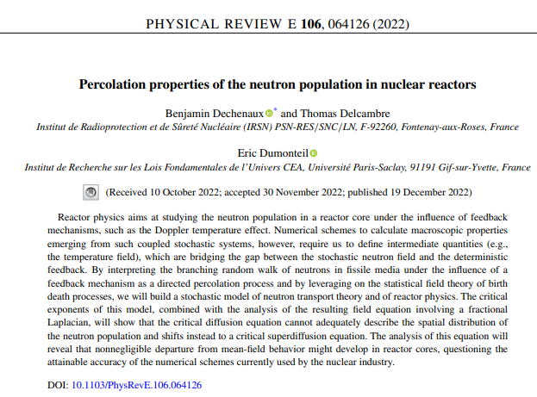

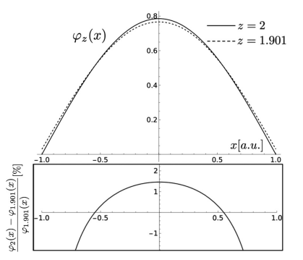
Previous work

Slide 11
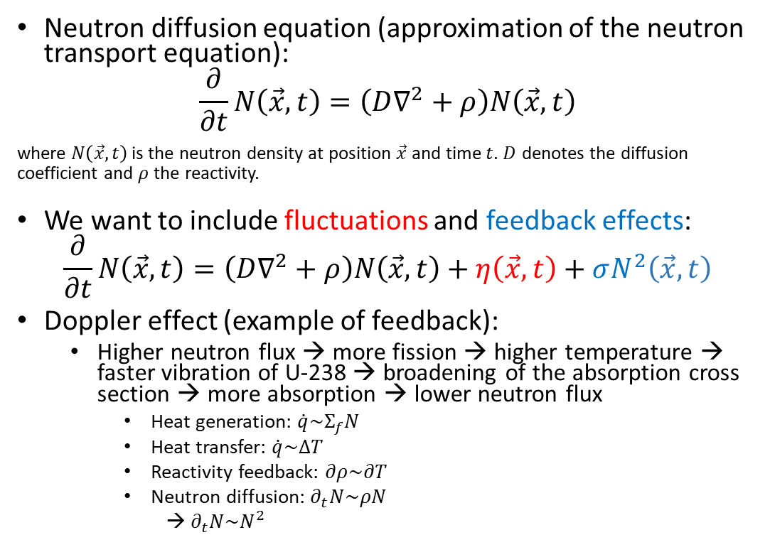
Neutron transport
Neutron diffusion equation (approximation of the neutron transport equation):
$$\frac{∂}{∂t}N\left(\vec{x},t\right)=\left(D∇^{2}+ρ\right)N\left(\vec{x},t\right)$$
where $N\left(\vec{x},t\right)$ is the neutron density at position $\vec{x}$ and time $t$. $D$ denotes the diffusion coefficient and $ρ$ the reactivity.
We want to include fluctuations and feedback effects:
$$\frac{∂}{∂t}N\left(\vec{x},t\right)=\left(D∇^{2}+ρ\right)N\left(\vec{x},t\right)+η\left(\vec{x},t\right)+σN^{2}\left(\vec{x},t\right)$$
Doppler effect (example of feedback):
  Higher neutron flux → more fission → higher temperature → faster vibration of U-238 → broadening of the absorption cross section → more absorption → lower neutron flux
    Heat generation: $\dot{q}\sim Σ_{f}N$
    Heat transfer: $\dot{q}\sim ΔT$
    Reactivity feedback: $∂ρ\sim ∂T$
    Neutron diffusion: $∂_{t}N\sim ρN$
    → $∂_{t}N\sim N^{2}$
Suescún-Díaz, D., “Stochastic Neutron Population With Temperature Feedback Effects Using The Implicit Runge-Kutta Scheme,” J. Appl. Sci. Eng., vol. 28, no. 8, pp. 1795-1803, Sept. 2024, doi: http://dx.doi.org/10.6180/jase.202508_28(8).0016.
Qvist, S. A. (2013). Safety and core design of large liquid-metal cooled fast breeder reactors. University of California, Berkeley.

Slide 12
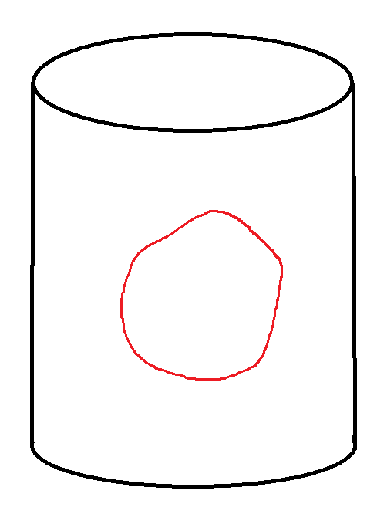
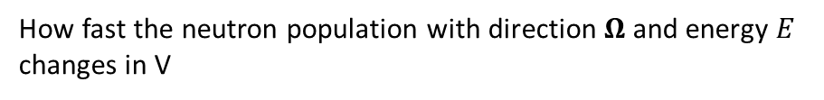
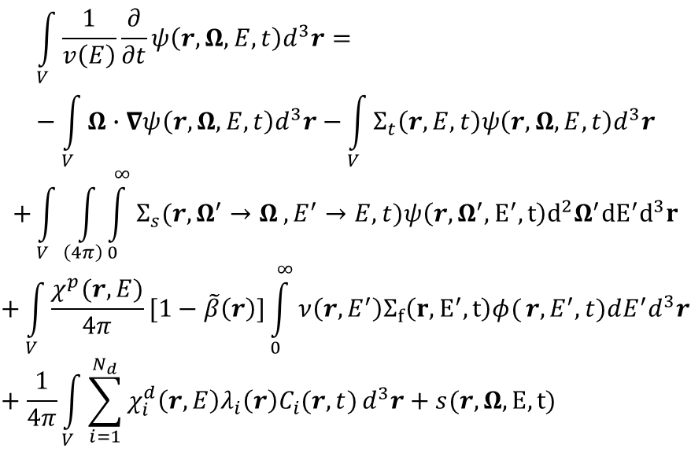
Neutron transport
How fast the neutron population with direction $Ω$ and energy $E$ changes in V
Absorption + scattering
$$\int_{V}^{ }{\frac{1}{v\left(E\right)}\frac{∂}{∂t}ψ\left(r,Ω,E,t\right)d^{3}r=}−\int_{V}^{ }{Ω∙∇ψ\left(r,Ω,E,t\right)d^{3}r−}\int_{V}^{ }{Σ_{t}\left(r,E,t\right)ψ\left(r,Ω,E,t\right)d^{3}r}$$
$$+\int_{V}^{ }{\int_{\left(4π\right)}^{ }{\int_{0}^{∞}{Σ_{s}(r,Ω^{′}→Ω}}},E^{′}→E,t)ψ\left(r,Ω^{′},E^{′},t\right)d^{2}Ω^{′}{dE}^{′}d^{3}r$$
$$+\int_{V}^{ }{\frac{χ^{p}(r,E)}{4π}[1−\tilde{β}\left(r\right)]\int_{0}^{∞}{ν\left(r,E^{′}\right)Σ_{f}\left(r,E^{′},t\right)φ(}}r,E^{′},t)dE^{′}d^{3}r+\frac{1}{4π}\int_{V}^{ }{\sum_{i=1}^{N_{d}}{χ_{i}^{d}\left(r,E\right)λ_{i}\left(r\right)C_{i}(r,t)}d^{3}r}+s(r,Ω, E, t)$$
Fissile material
Outgoing - incoming neutrons
Outgoing neutron
Volume V
Scattering
Fission
Fission
Absorption
Source
Delayed neutrons
Scattering
$$C_{i}\left(r,t\right)=\tilde{β_{i}}\left(r\right)\int_{−∞}^{∞}{\int_{0}^{∞}{ν\left(r,E\right)Σ_{f}\left(r,E,t\right)φ\left(r,E,t\right)dE−λ_{i}\left(r\right)C_{i}\left(r,t\right), }} \\ i=1,…,N_{d}$$
Incoming neutron
https://en.wikipedia.org/wiki/Neutron_transport#Neutron_transport_equation

Slide 13

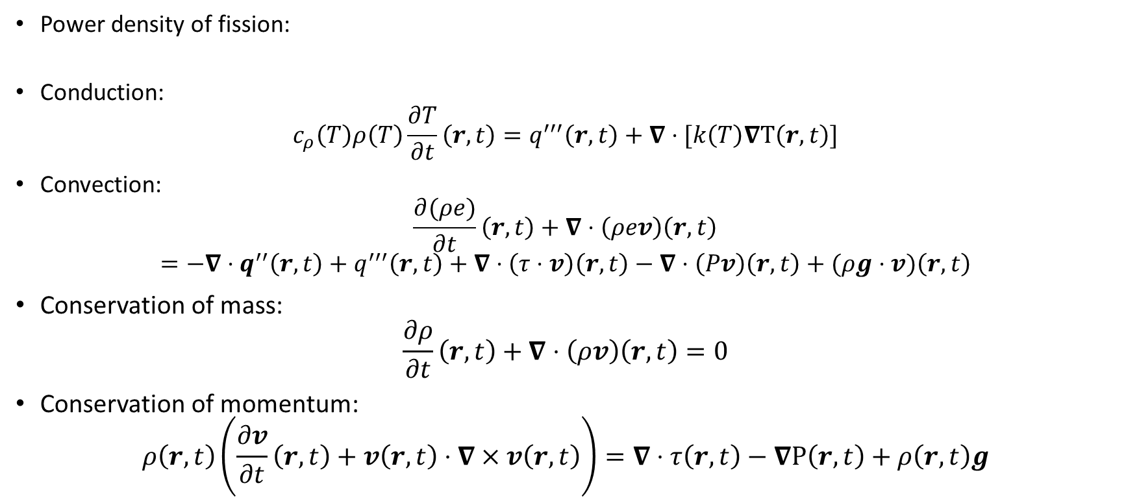
Thermal hydraulics
Power density of fission:
Conduction:
$$c_{ρ}\left(T\right)ρ\left(T\right)\frac{∂T}{∂t}\left(r,t\right)=q^{′′′}\left(r,t\right)+∇⋅[k\left(T\right)∇T\left(r,t\right)]$$
Convection:
$$\frac{∂(ρe)}{∂t}\left(r,t\right)+∇⋅\left(ρev\right)\left(r,t\right)$$
$$=−∇⋅q^{′′}\left(r,t\right)+q^{′′′}\left(r,t\right)+∇⋅\left(τ⋅v\right)\left(r,t\right)−∇⋅\left(Pv\right)\left(r,t\right)+(ρg⋅v)\left(r,t\right)$$
Conservation of mass:
$$\frac{∂ρ}{∂t}\left(r,t\right)+∇⋅\left(ρv\right)\left(r,t\right)=0$$
Conservation of momentum:
$$ρ\left(r,t\right)\left(\frac{∂v}{∂t}\left(r,t\right)+v\left(r,t\right)⋅∇×v\left(r,t\right)\right)=∇⋅τ\left(r,t\right)−∇P\left(r,t\right)+ρ\left(r,t\right)g$$

Slide 14








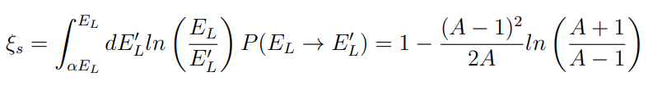
Doppler feedback
Temperature coefficient of reactivity:
Resonance escape probability:
Resonance integral:
IAEA, Evaluated Nuclear Data File (ENDF), 2026, https://nds.iaea.org/exfor/endf.htm.

Slide 15




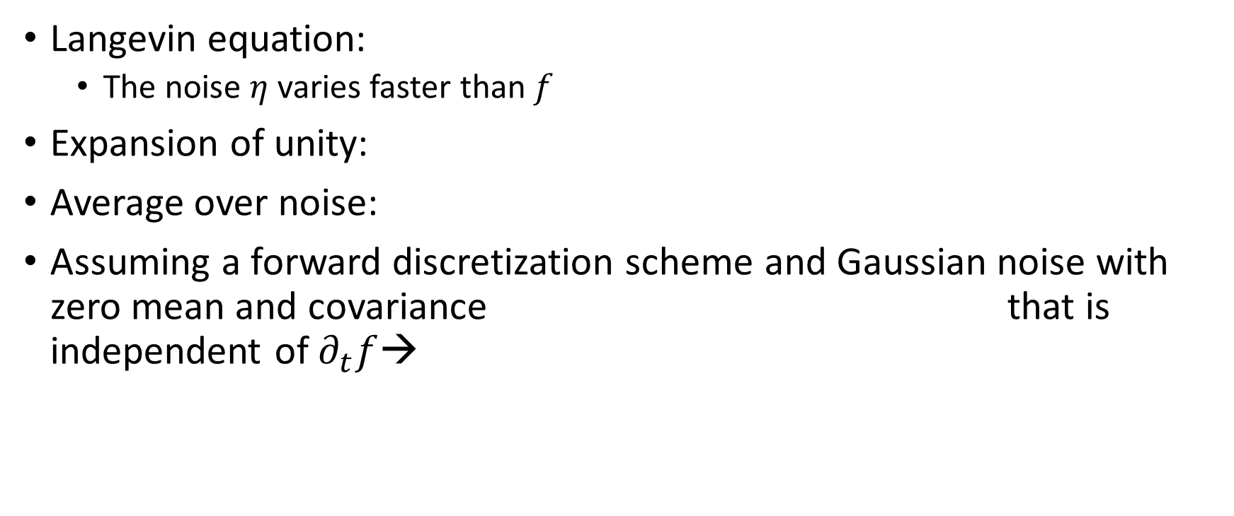
Derivation – Langevin equation
Langevin equation:
  The noise $η$ varies faster than $f$
Expansion of unity:
Average over noise:
Assuming a forward discretization scheme and Gaussian noise with zero mean and covariance that is independent of $∂_{t}f$→

Slide 16


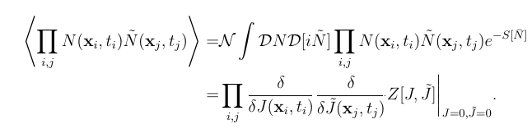


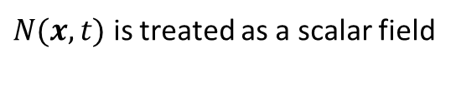
Derivation – Correlation functions
Stochastic neutron diffusion equation:
  →
Generating functional:
Correlation functions:
→
$N(x,t)$ is treated as a scalar field
(assuming that the noise is independent of $N$)

Slide 17





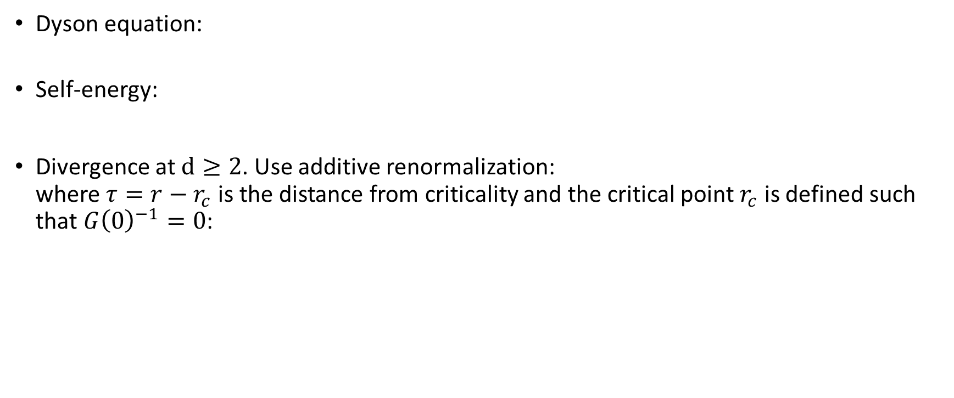
Self-energy
Dyson equation:
Self-energy:
Divergence at $d≥2$. Use additive renormalization:
where $τ=r−r_{c}$ is the distance from criticality and the critical point $r_{c}$ is defined such that $G{\left(0\right)}^{−1}=0$:

Slide 18

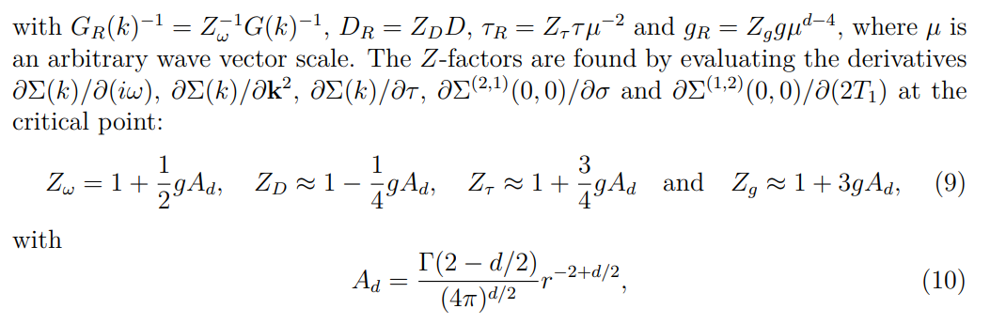
Renormalization
Inverse of renormalized response propagator:

Slide 19
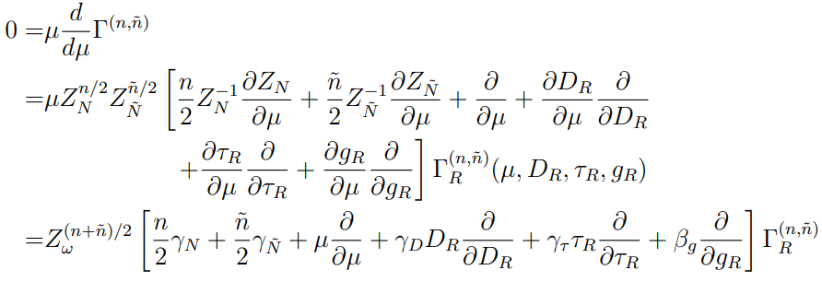
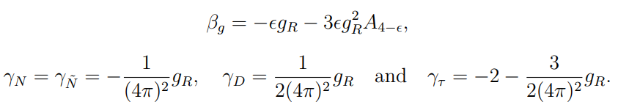
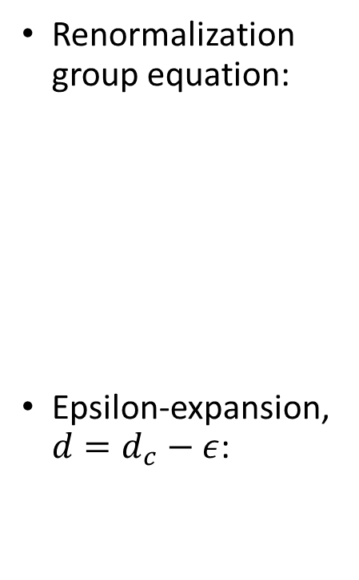
Renormalization
Renormalization group equation:
Epsilon-expansion, $d=d_{c}−ε$:

Slide 20


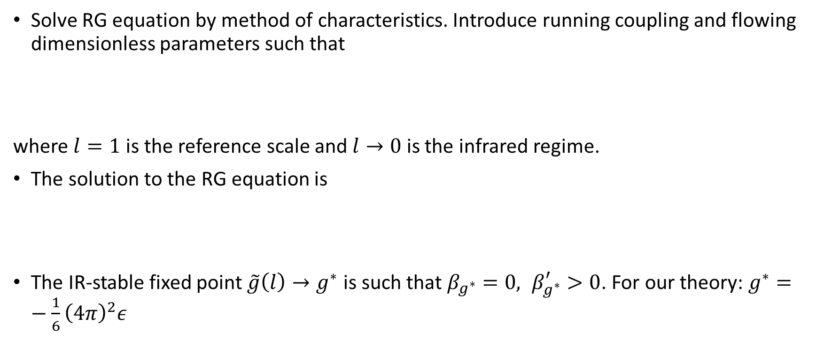
Renormalization
Solve RG equation by method of characteristics. Introduce running coupling and flowing dimensionless parameters such that
where $l=1$ is the reference scale and $l→0$ is the infrared regime.
The solution to the RG equation is
The IR-stable fixed point $\tilde{g}\left(l\right)→g^{∗}$ is such that $β_{g^{∗}}=0, β_{g^{∗}}^{′}>0$. For our theory: $g^{∗}=−\frac{1}{6}{\left(4π\right)}^{2}ε$

Slide 21
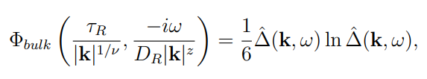

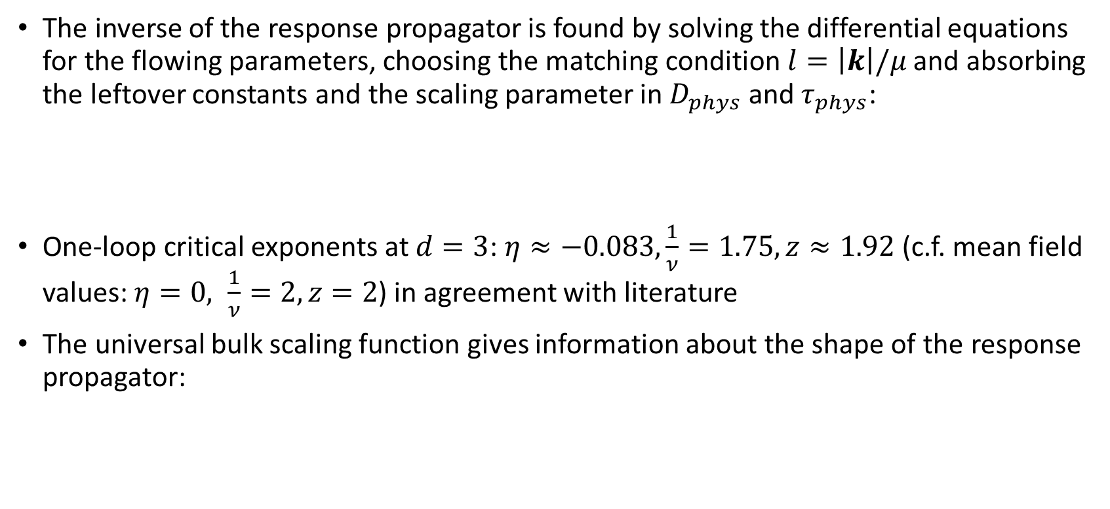
Critical exponents
The inverse of the response propagator is found by solving the differential equations for the flowing parameters, choosing the matching condition $l=\left|k\right|/μ$ and absorbing the leftover constants and the scaling parameter in $D_{phys}$ and $τ_{phys}$:
One-loop critical exponents at $d=3$: $η≈−0.083,\frac{1}{ν}=1.75, z≈1.92$ (c.f. mean field values: $η=0, \frac{1}{ν}=2, z=2$) in agreement with literature
The universal bulk scaling function gives information about the shape of the response propagator:

Slide 22
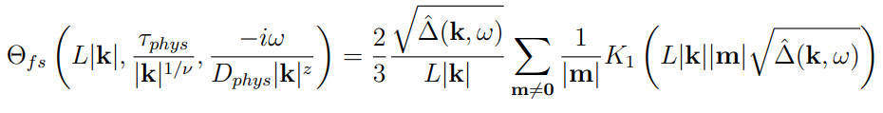
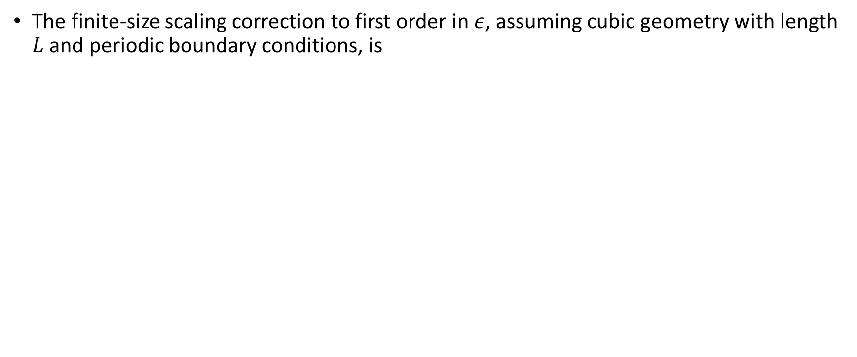
Finite-size corrections
The finite-size scaling correction to first order in $ε$, assuming cubic geometry with length $L$ and periodic boundary conditions, is

Slide 23





Space-dependent reactivity
Eigenbasis:
Action:
Matrix Dyson equation in frequency space:
Self-energy:

