Slide 1
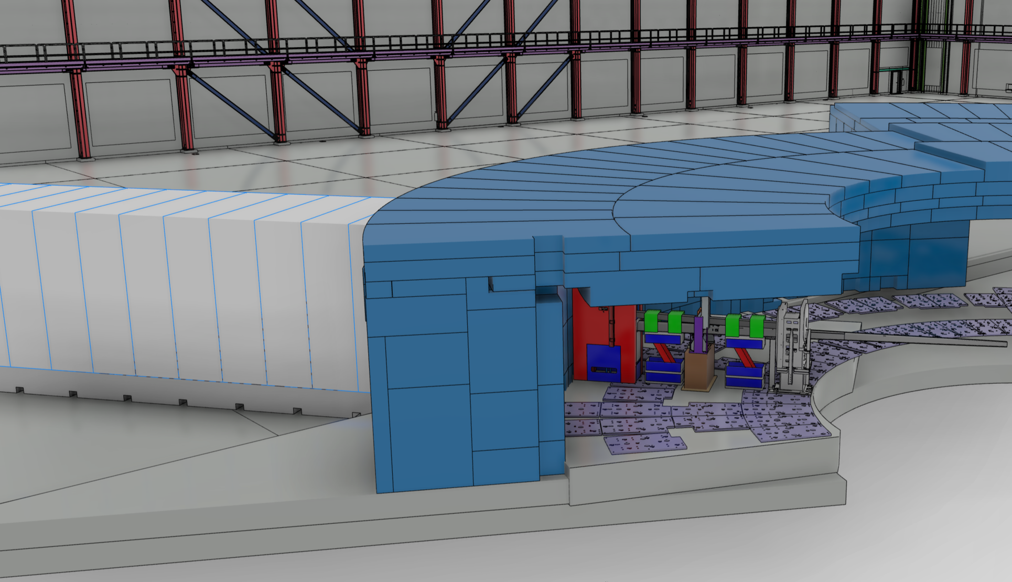


The FINESSE beamline at ESS
Linus Persson, linus.persson@fysik.lu.se

Slide 2
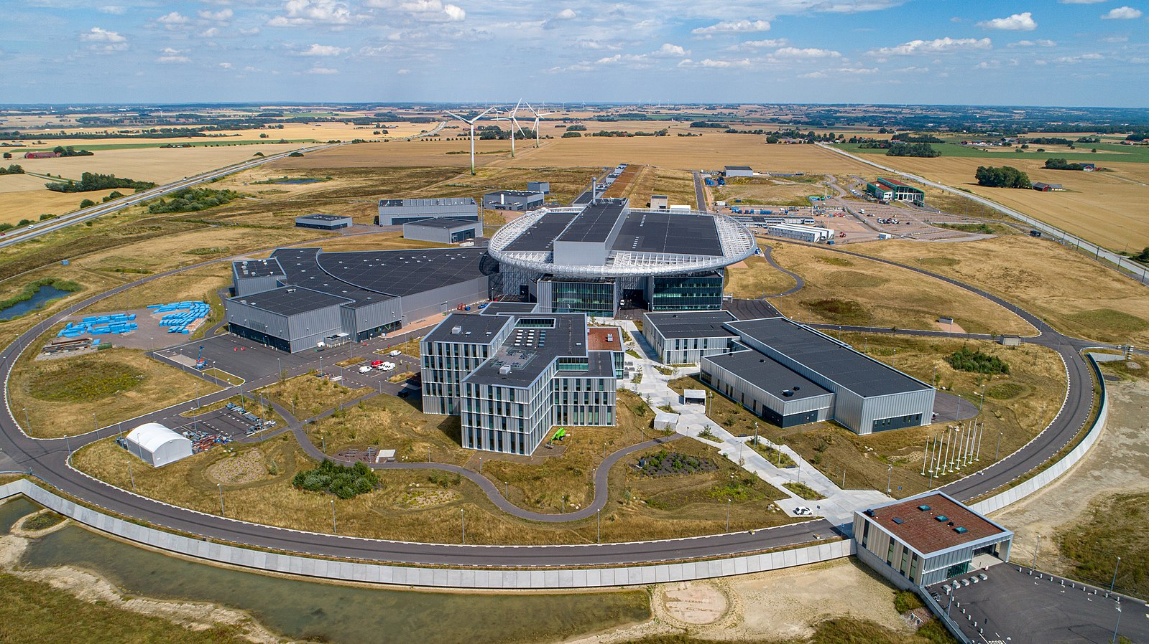
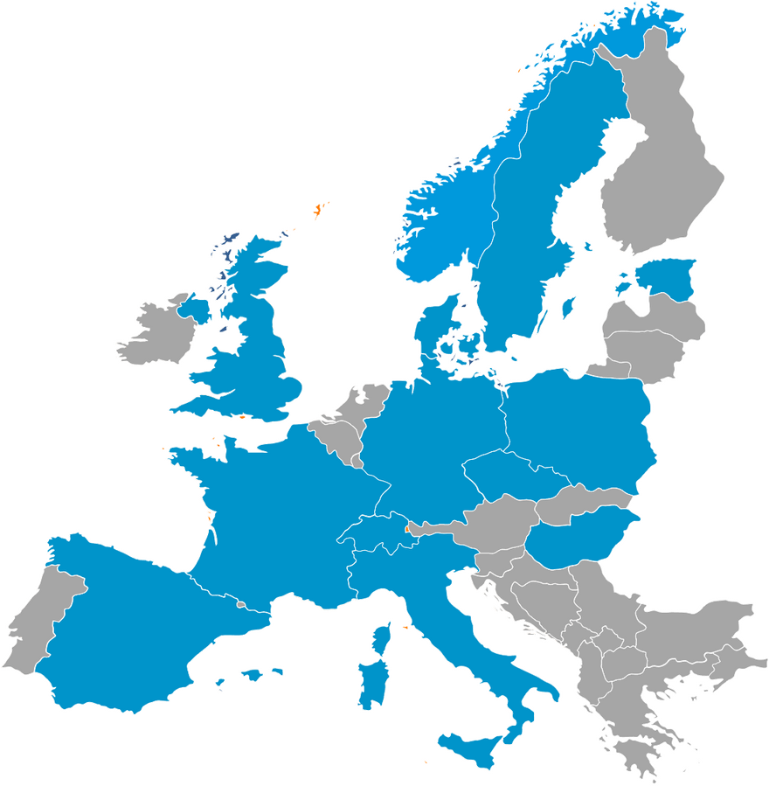
The European Spallation Source
Designed to become the world’s brightest spallation neutron source.
13 European member states, construction cost of about ~€3B.
First neutrons by mid-2027, routine user operations from 2028.
Currently 15 neutron beamlines approved for construction, no particle physics yet!

Slide 3
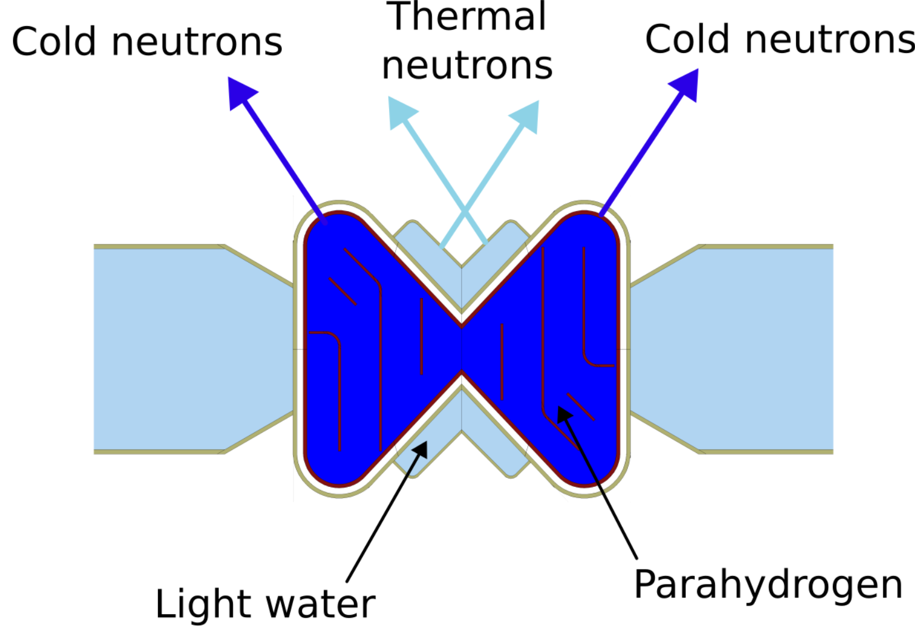
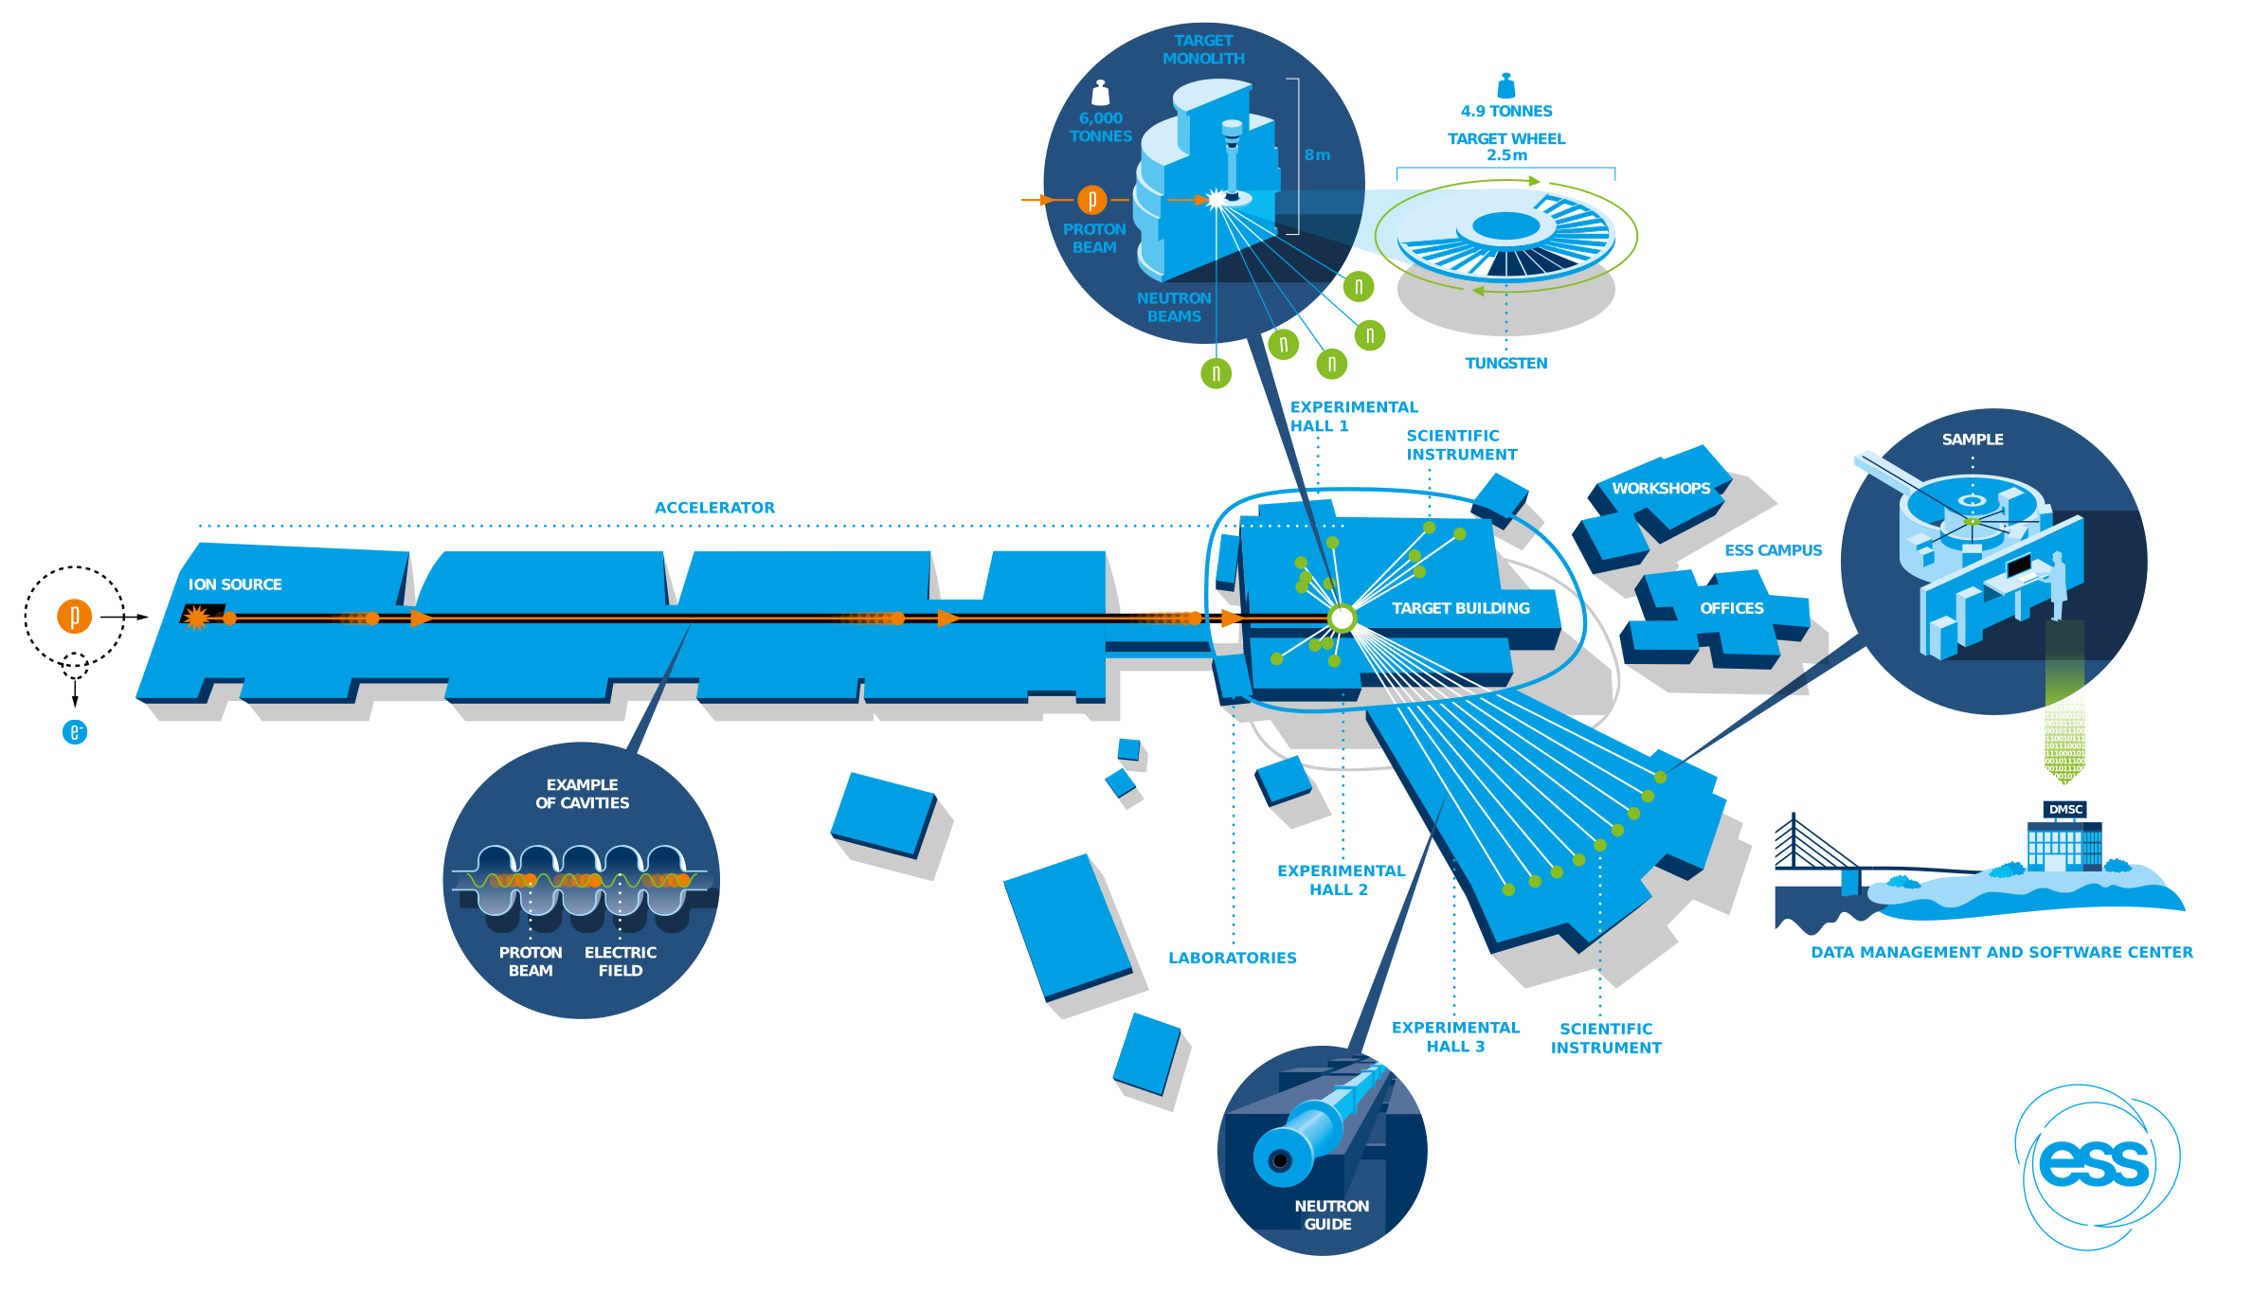
ESS overview
Frequency: 14 Hz
Pulse length: 2.86 ms
Energy: 800 MeV (2 GeV)
Beam power: 2 MW (5 MW)

Slide 4


What is FINESSE?
Fundamental Interactions with Neutrons at the European Spallation SourcE.
A versatile beamline for fundamental physics.
The crux: Different experiments want different neutron beam properties.
We need high flux!
We need high intensity!
$$n$$
We need 8.9 Å neutrons!
We need low backgrounds!

Slide 5
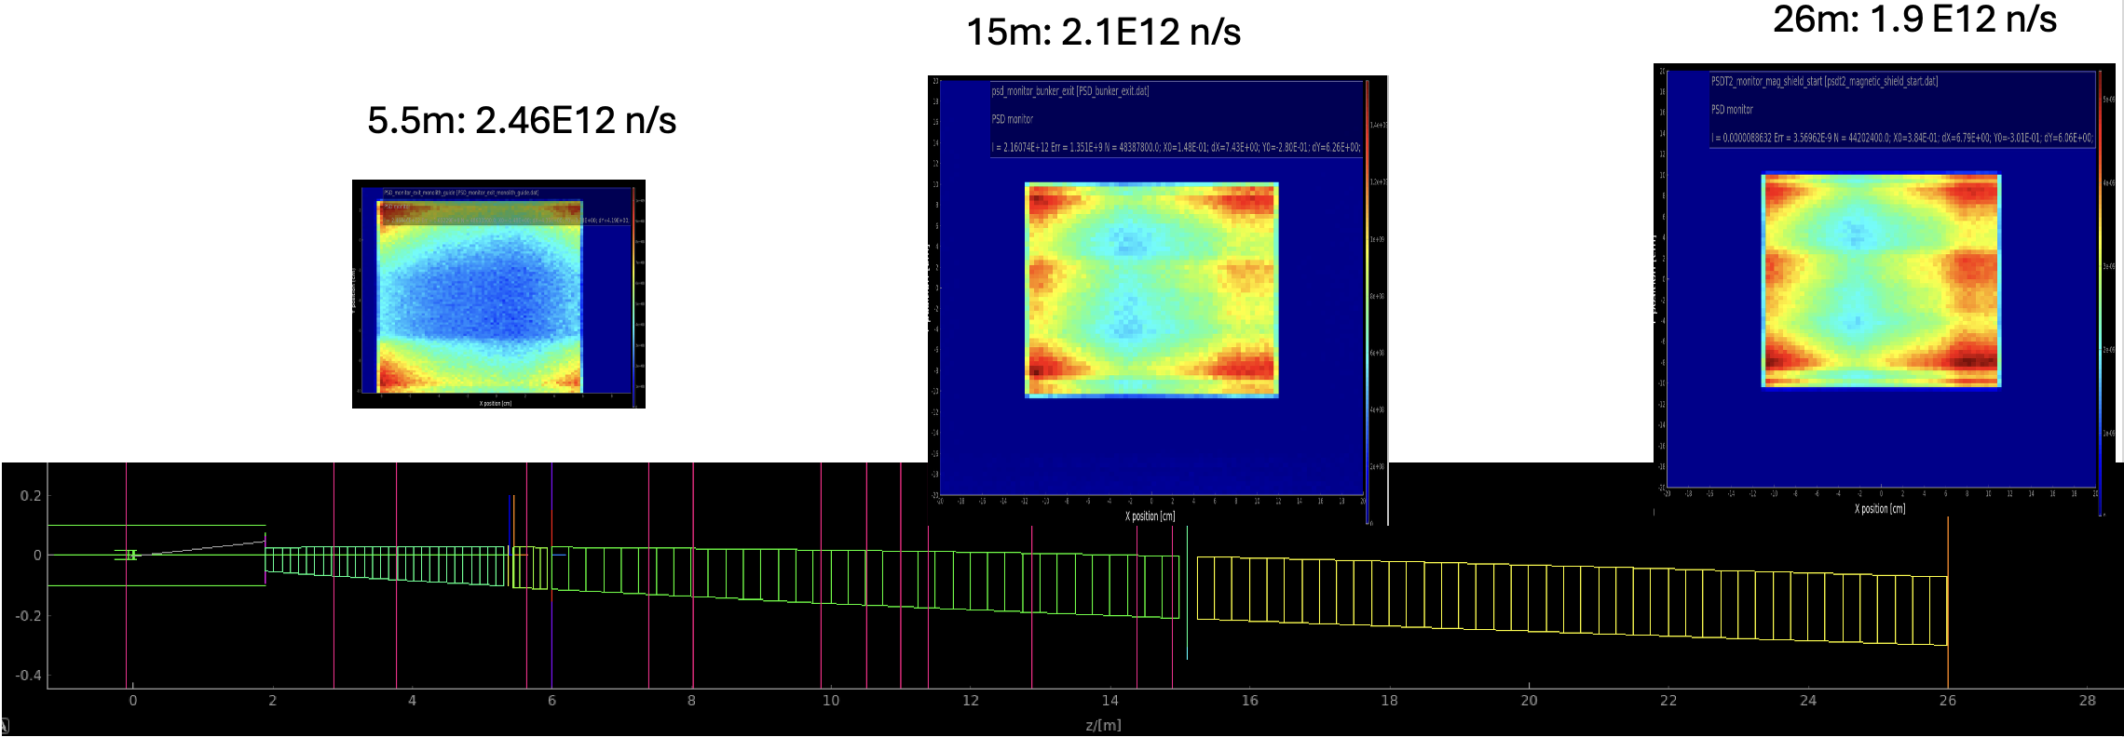
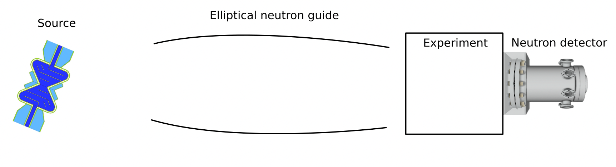


What determines the beam properties?
The neutron beam properties are largely decided by the neutron guide close to the source.
High-flux configuration

Slide 6
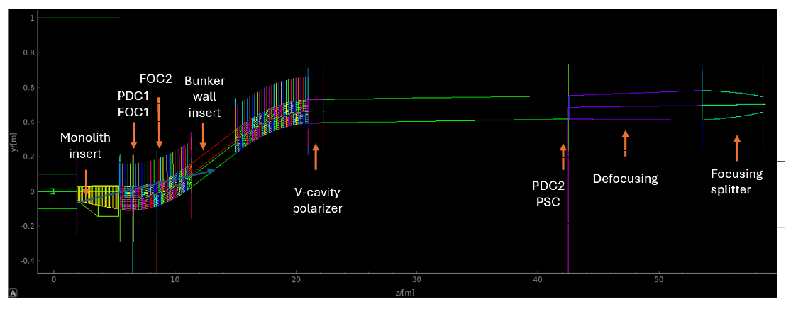
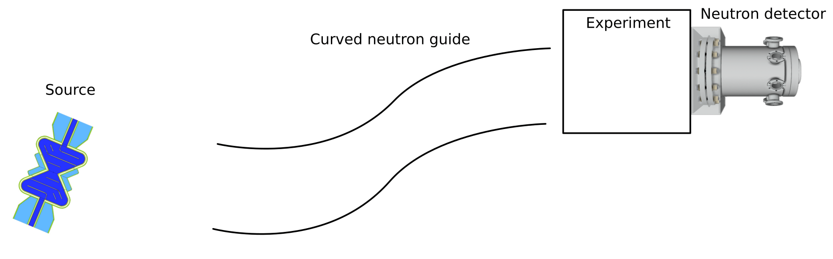
What determines the beam properties?
The neutron beam properties are largely decided by the neutron guide close to the source.
Low-background configuration

Slide 7
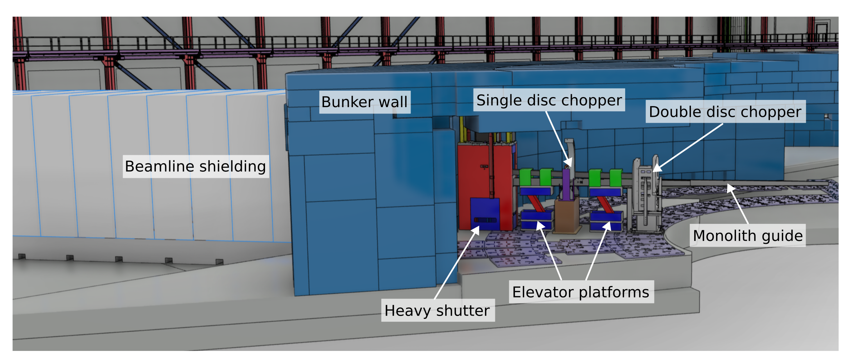
One beamline, two configurations
We can switch between the two configurations without needing to wait for a long shutdown to access the space inside the bunker.
BUY 1
GET 2

Slide 8
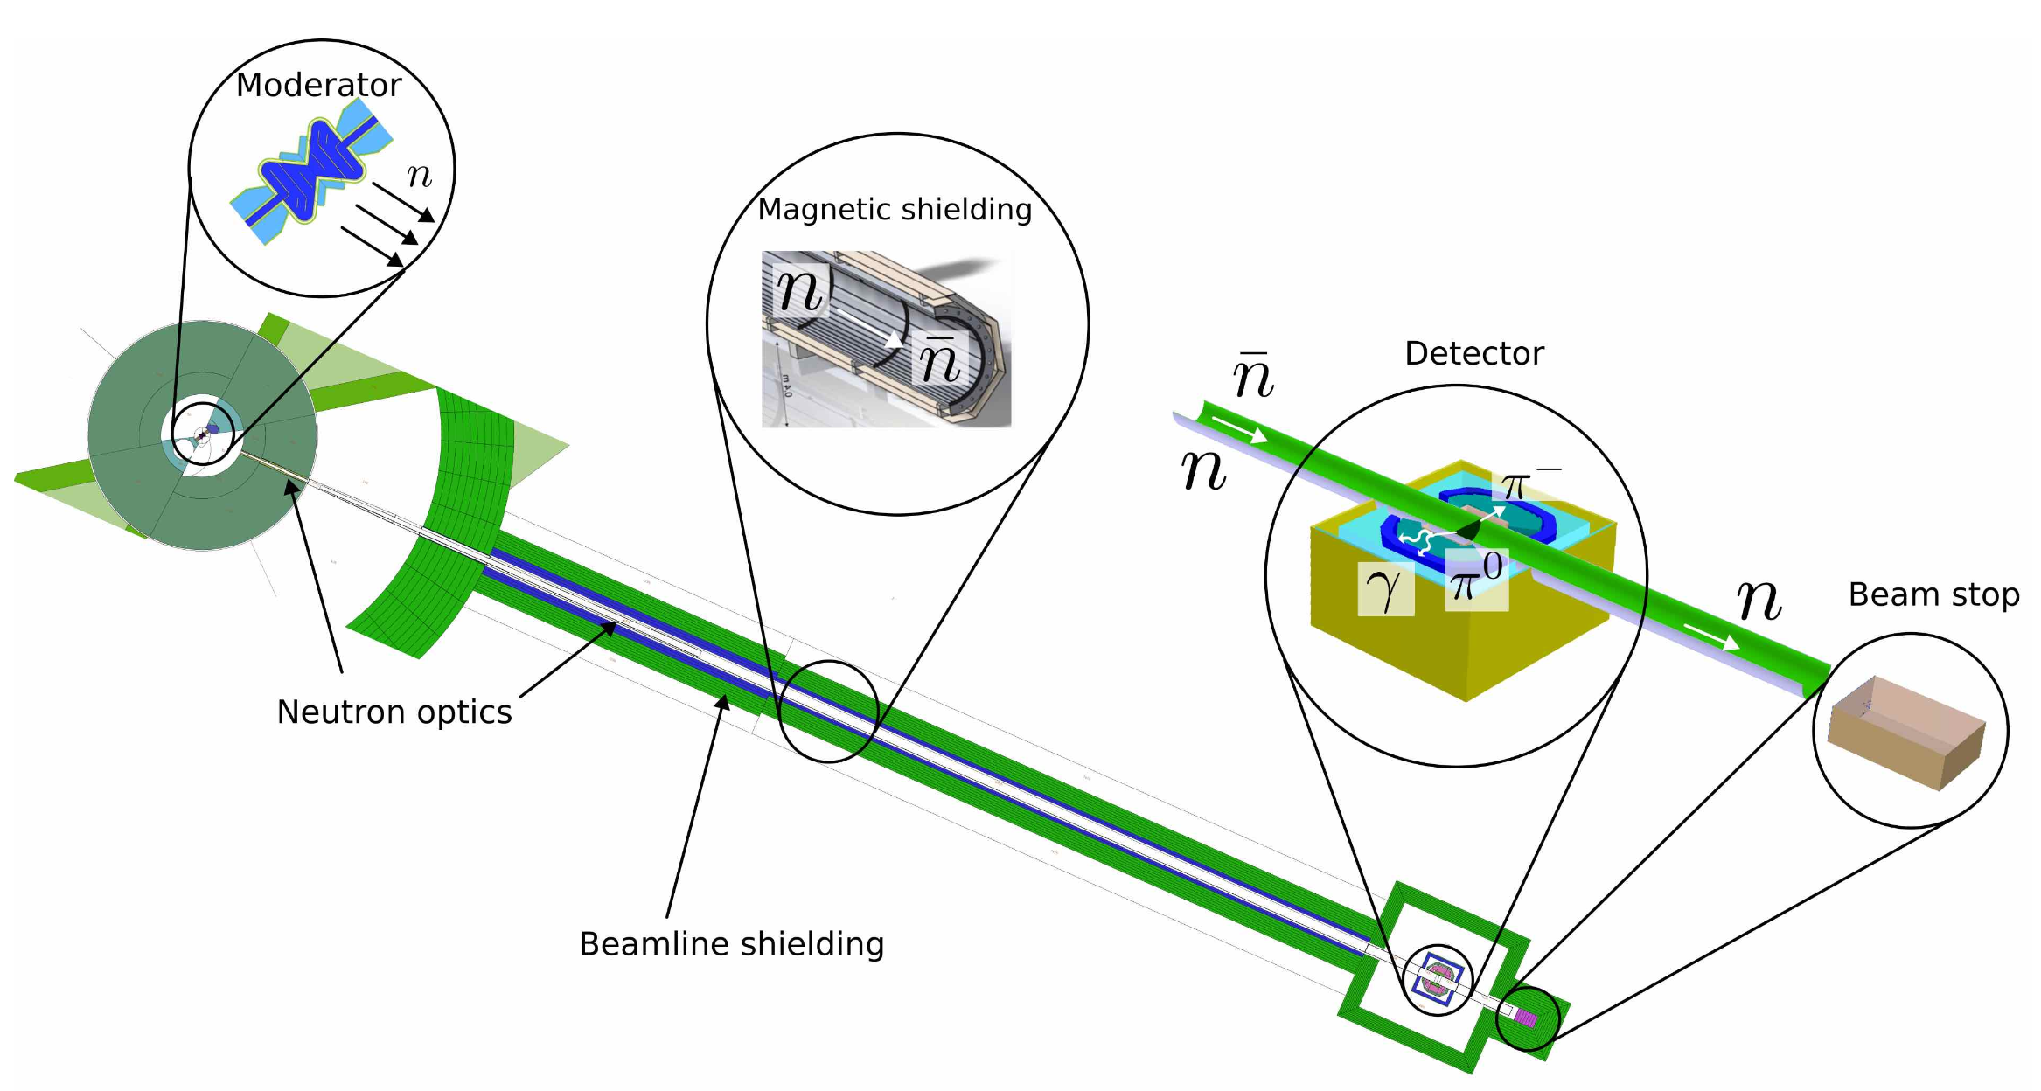
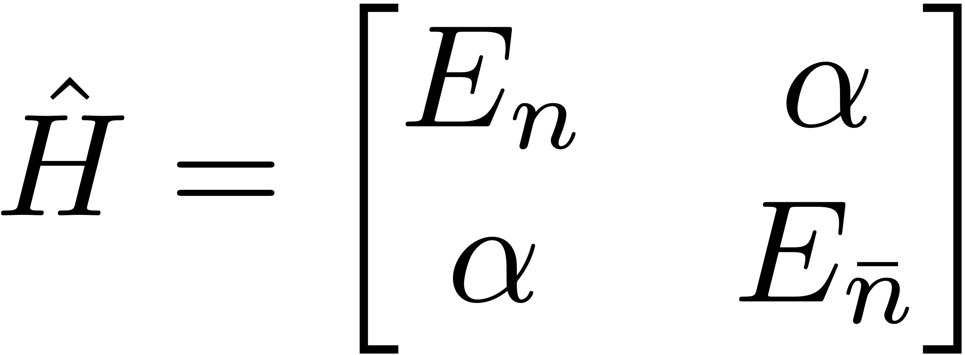
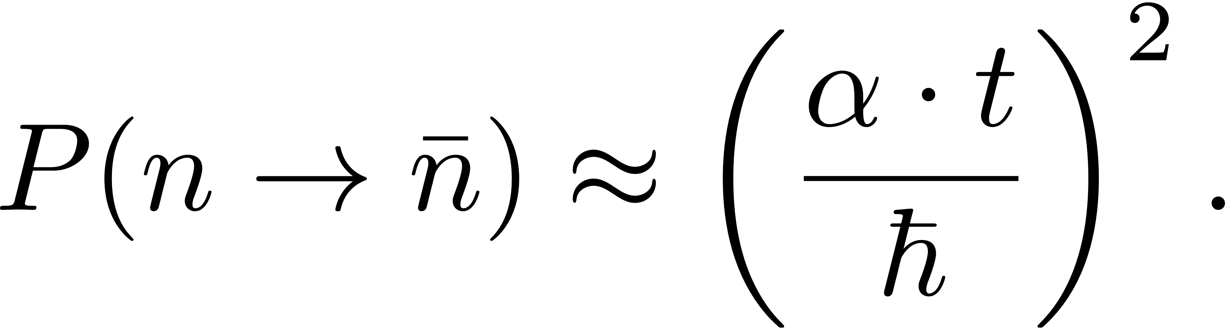
Neutron-antineutron oscillation
Baryon number violation is a key condition for explaining the matter-antimatter asymmetry.
Further reading: V. Santoro et al. J. Phys. G: Nucl. Part. Phys. 52 040501 (2025).

Slide 9
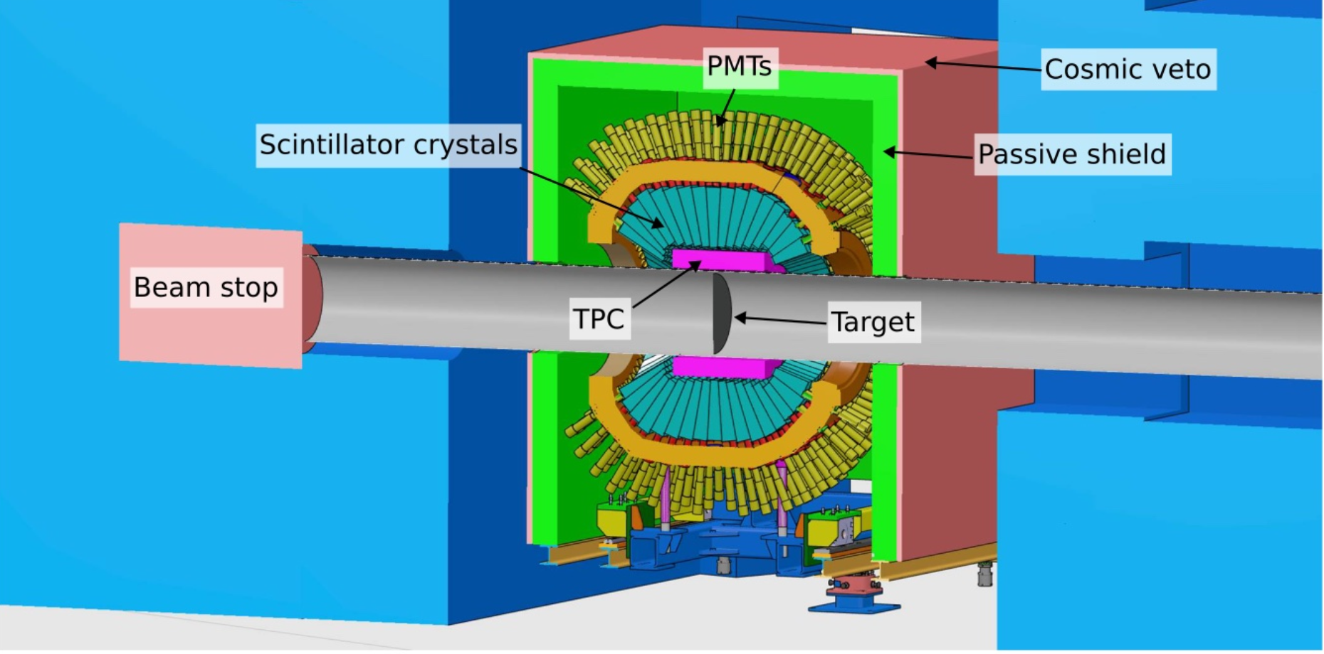
Annihilation detector
To claim a discovery, we need full background rejection.
Detector combines tracking, calorimetry and cosmic veto.

Slide 10
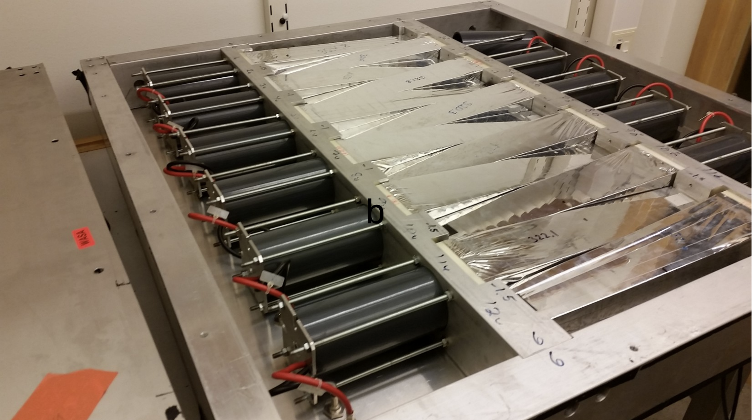
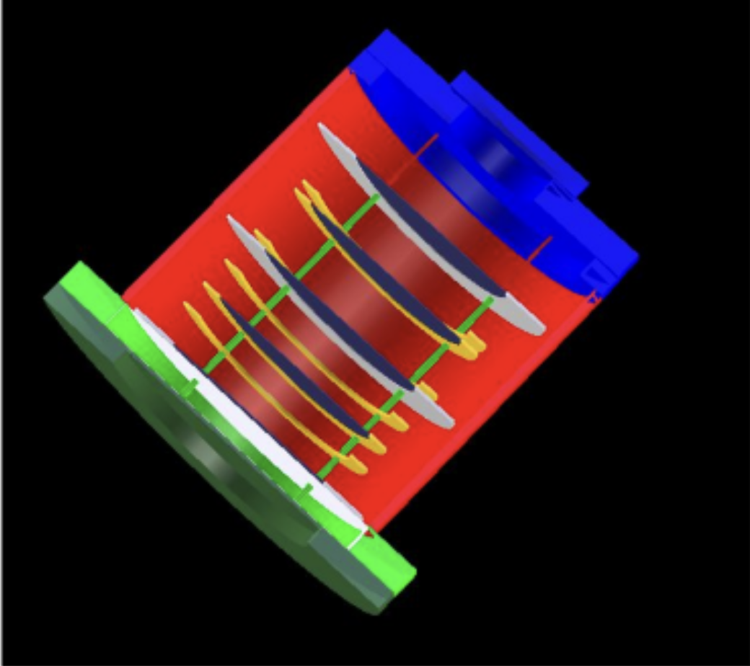
Prototype and simulation work in Sweden
LU: TPC prototype, tracking algorithm, background characterisation and simulation.
SU: HRD/LEC prototypes, front-end electronics, vertexing algorithms (see A. Burgman’s talk today at 14:45).
UU: WASA crystal characterisation with furbished light guides.
TPC
HRD
WASA crystal characterisation setup
Geant4 detector simulation
Prototype test at CCB, Dec. 2025
TPC track reconstruction

Slide 11
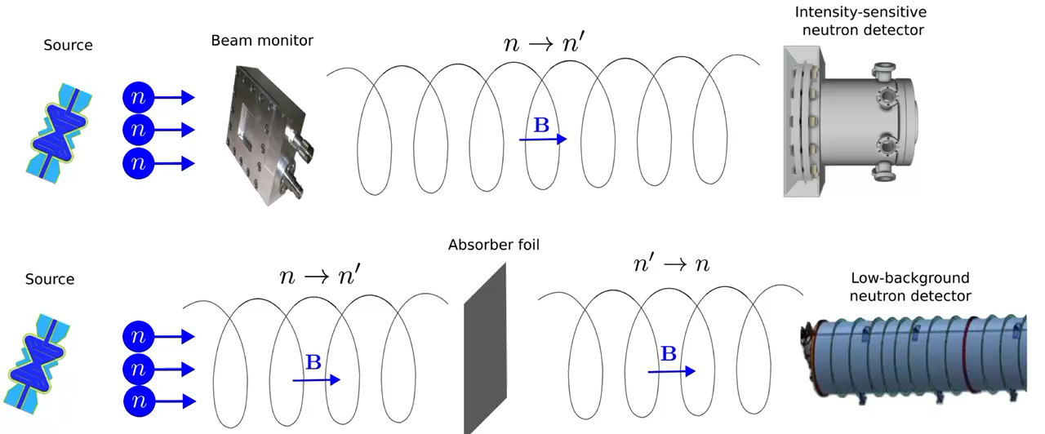
Sterile neutron oscillation
What if the dark sector is a copy of the Standard Model?
Can search for sterile neutrons by disappearance or regeneration experiments.
Further reading: J. Rogers et al. arXiv:2608.21120 (2026).

Slide 12
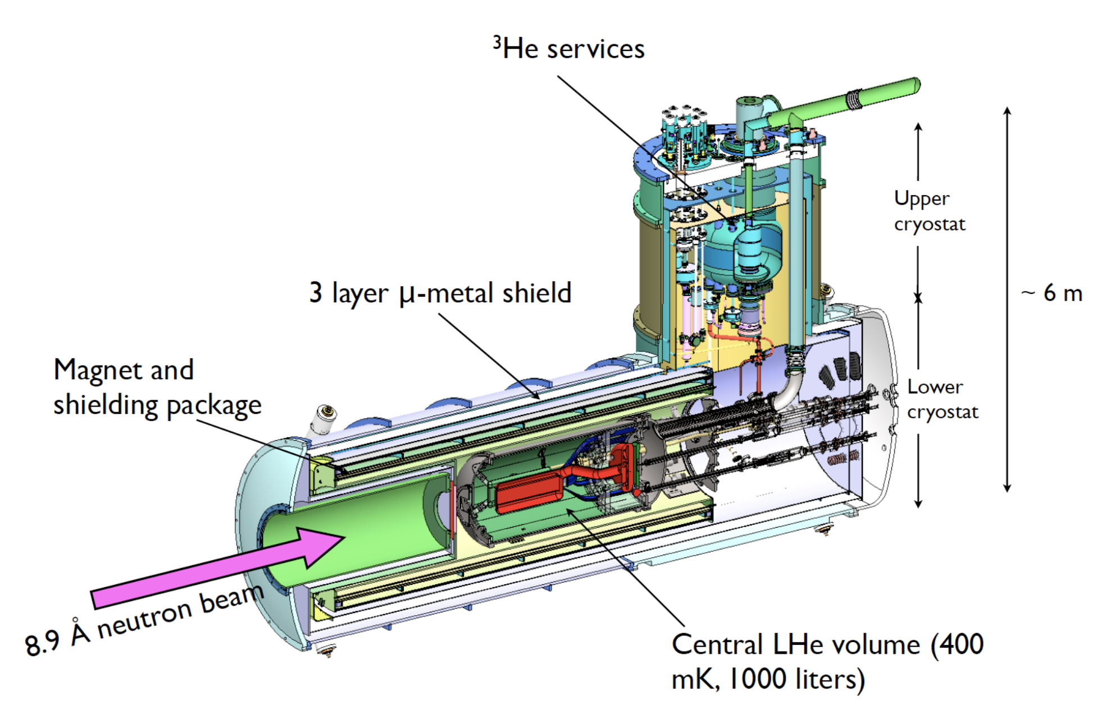
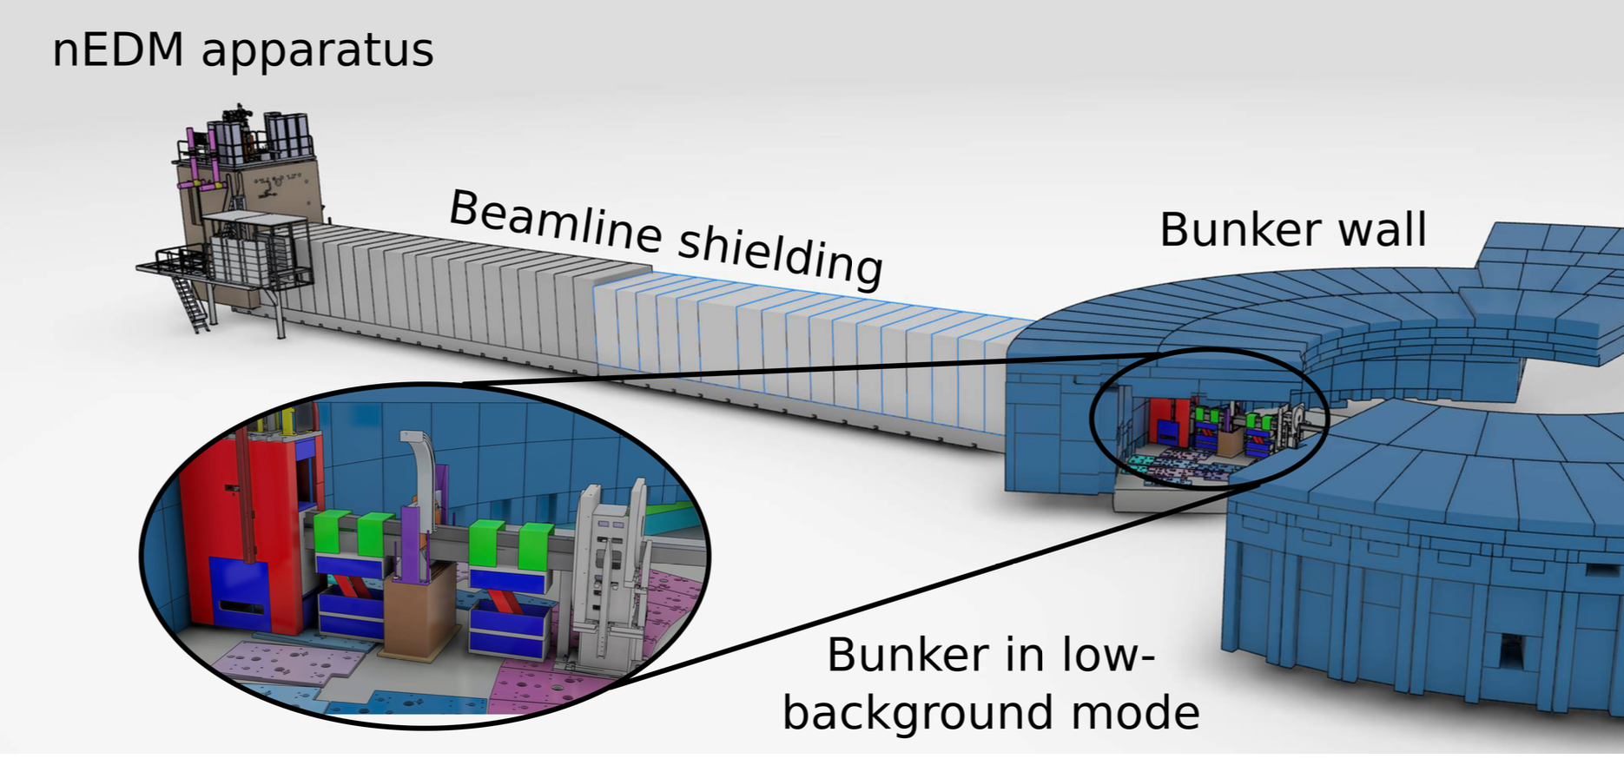
Search for neutron electric dipole moment (nEDM)
A non-zero nEDM is T-violating and thus CP-violating. The known CP-violation is insufficient to explain the matter-antimatter asymmetry.
Superfluid ⁴He converts 8.9 Å neutrons to UCN, which precess in strong electric and controlled magnetic fields.
Equipment designed for the cancelled SNS experiment could be transferred to ESS.
Further reading: M.W. Ahmed et al. JINST 14 P11017 (2019).

Slide 13
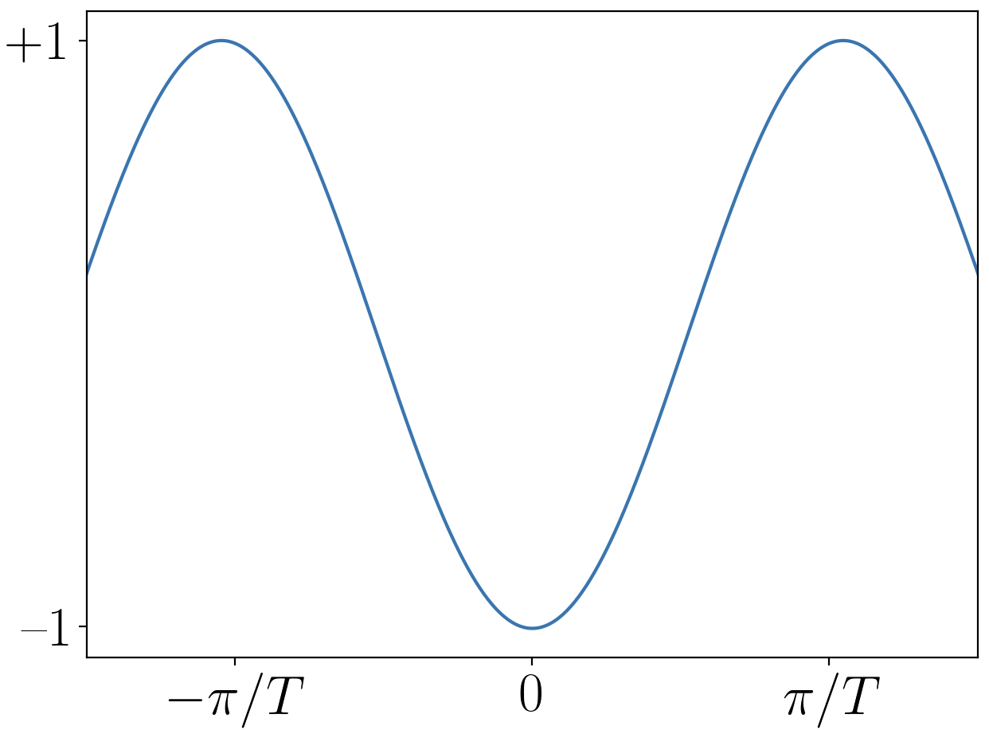
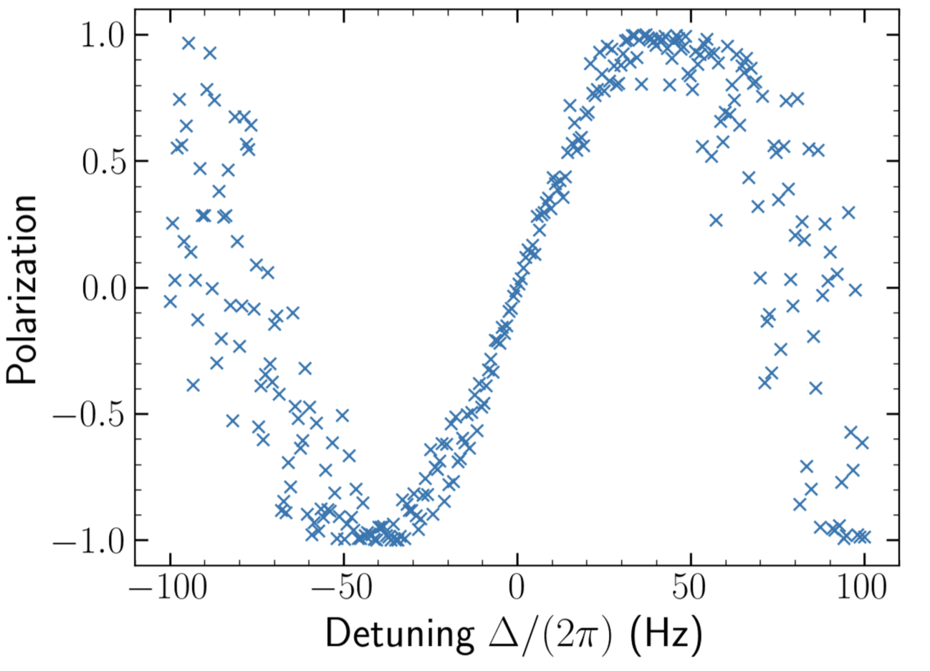
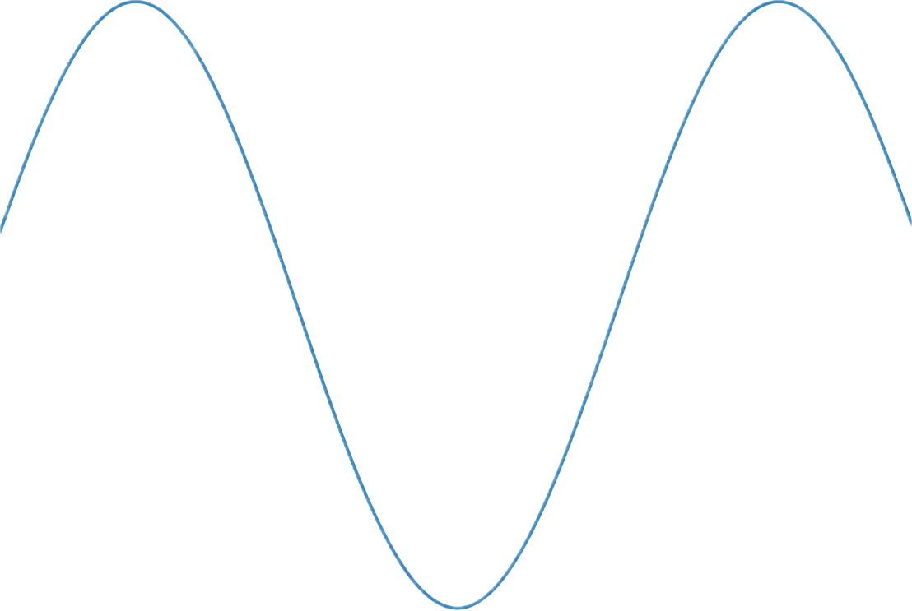

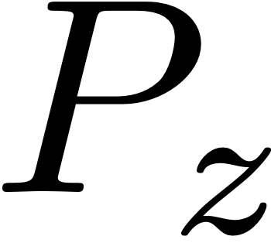

Axion-like particle search
Ultralight axion-like particles interact with neutron spins as a pseudo-magnetic field.
Measurable phase shift through Ramsey interferometry.
Simulated in RamseyProp
Further reading: L.B. Persson et al. JINST 21 P08004 (2026).

Slide 14
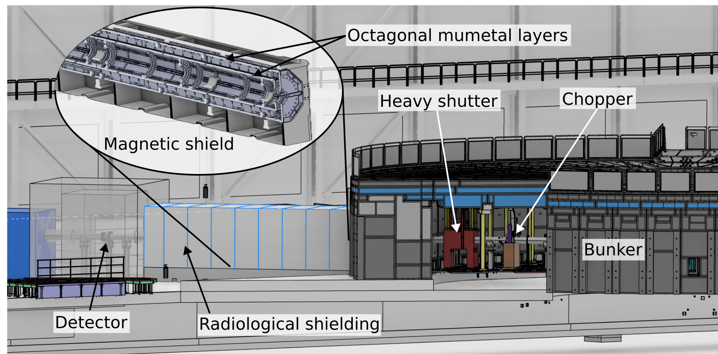
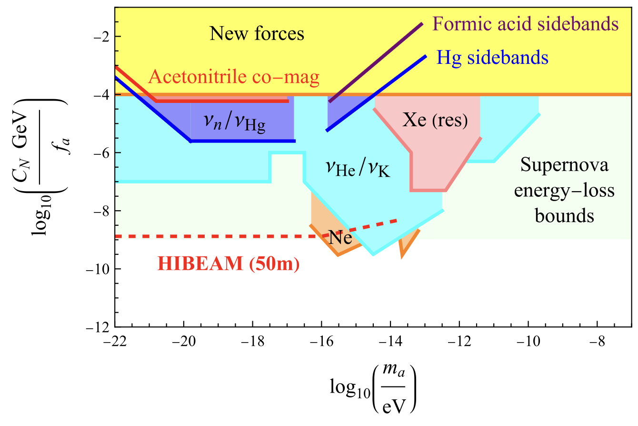
Short FINESSE
The axion experiment can be performed at a 10-meter version of the beamline.
Funded by the Swedish Foundation for Strategic Research (15 MSEK) and Swedish Research Council (4.7 MSEK).
A 10-meter magnetic shield prototype soon to be procured and tested in Lund.
FINESSE (50 m)

Slide 15












The FINESSE proposal
+ many more…
95 scientists from 51 institutions signed a proposal on 27 March for the ESS Instrument Roadmap.
Currently being evaluated by external committees, first step to become an approved instrument.
New collaborators are welcome!

Slide 16
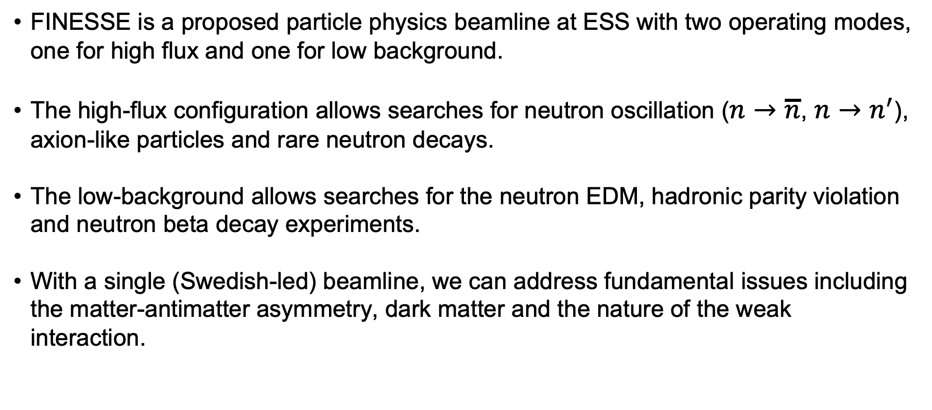
Summary
FINESSE is a proposed particle physics beamline at ESS with two operating modes, one for high flux and one for low background.
The high-flux configuration allows searches for neutron oscillation ($n→\overline{n}$, $n→n^{′}$), axion-like particles and rare neutron decays.
The low-background allows searches for the neutron EDM, hadronic parity violation and neutron beta decay experiments.
With a single (Swedish-led) beamline, we can address fundamental issues including the matter-antimatter asymmetry, dark matter and the nature of the weak interaction.

