Slide 1



ALPHA Status and Resonator Development at Stockholm University
Jacob Lindahl, Stockholm University

Slide 2
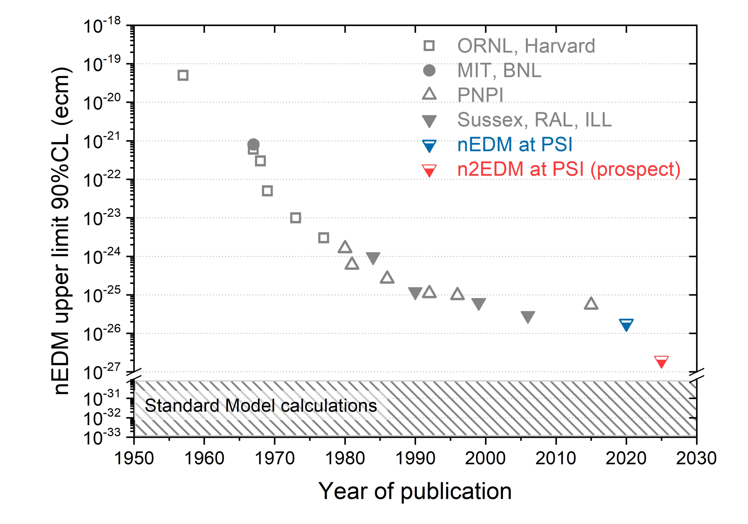
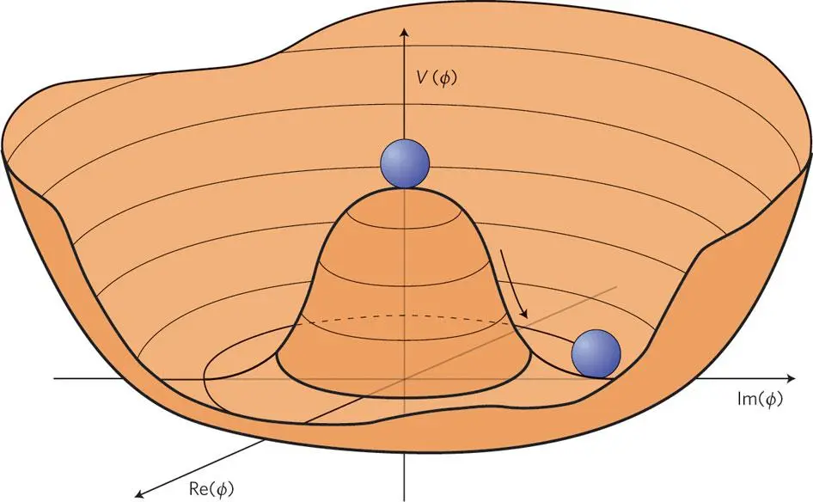
Why the axion?
Strong CP Problem
Peccei Quinn Mechanism
Credit: nEDM Search Collaboration at PSI
Peccei-Quinn Field showing spontaneous symmetry breaking

Slide 3
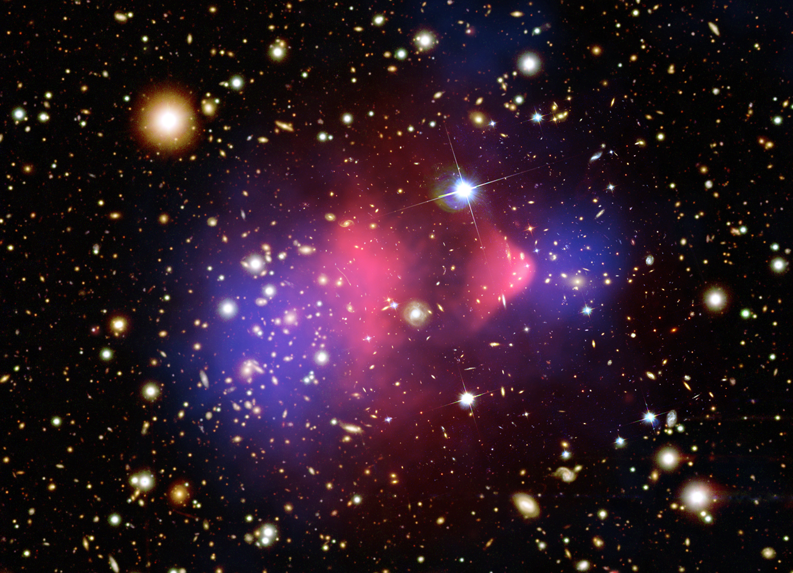
Why the axion?
Cold Dark Matter
Bullet Cluster with hot intracluster gas marked in pink and dark matter in blue

Slide 4
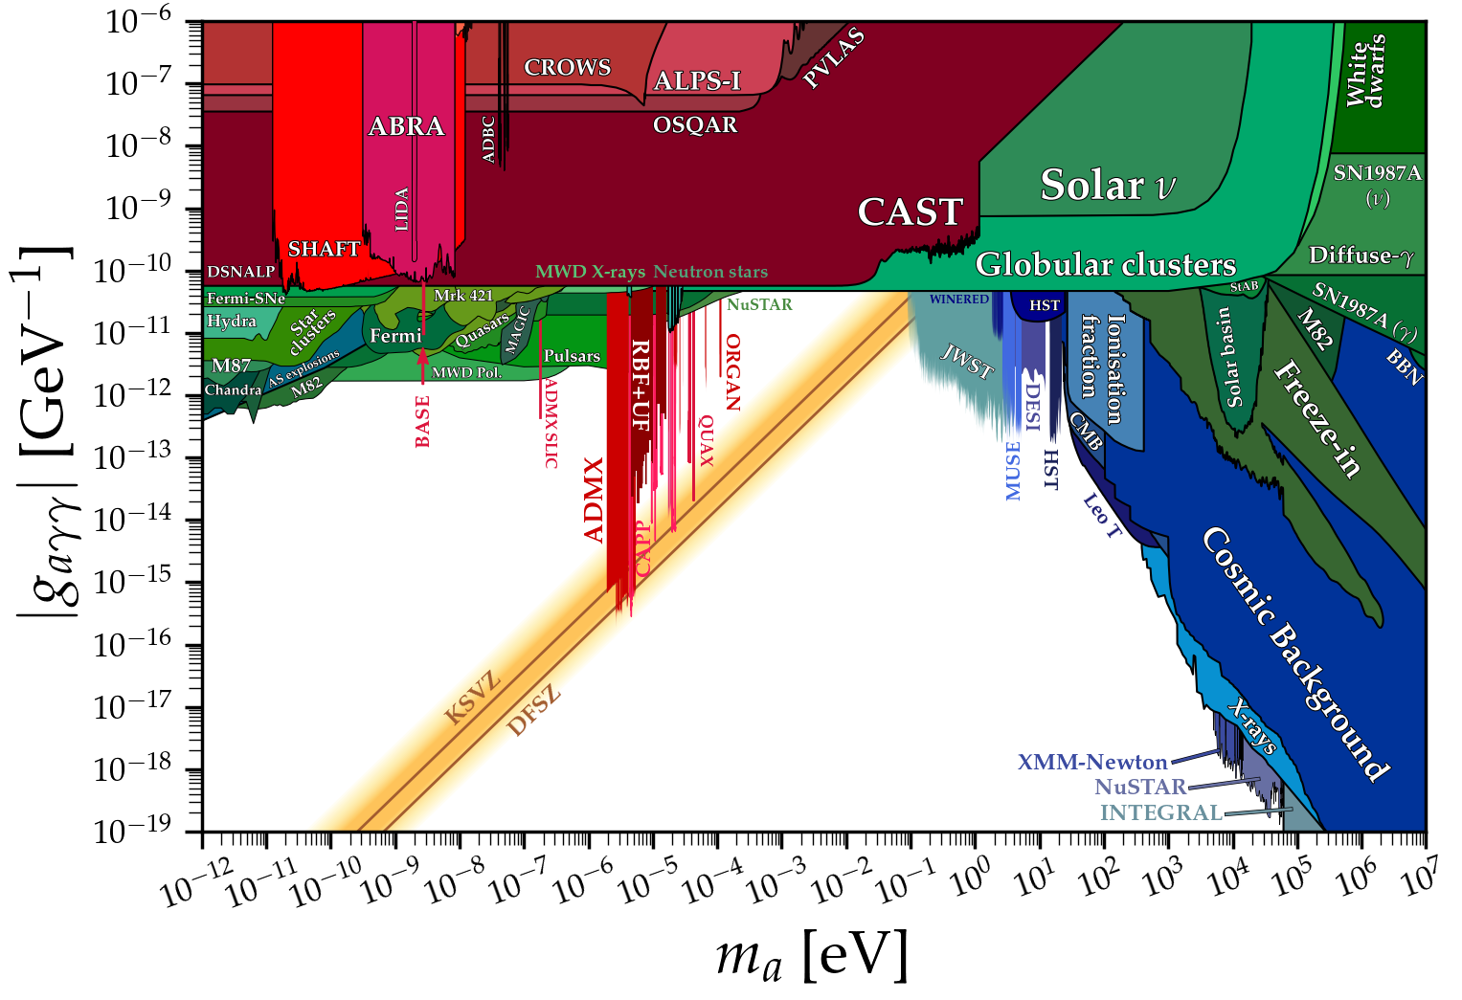
Axion Parameter Space
Credit: Ciaran O’Hare. cajohare/axionlimits: Axionlimits. https://cajohare.github.io/AxionLimits/, September 2026

Slide 5
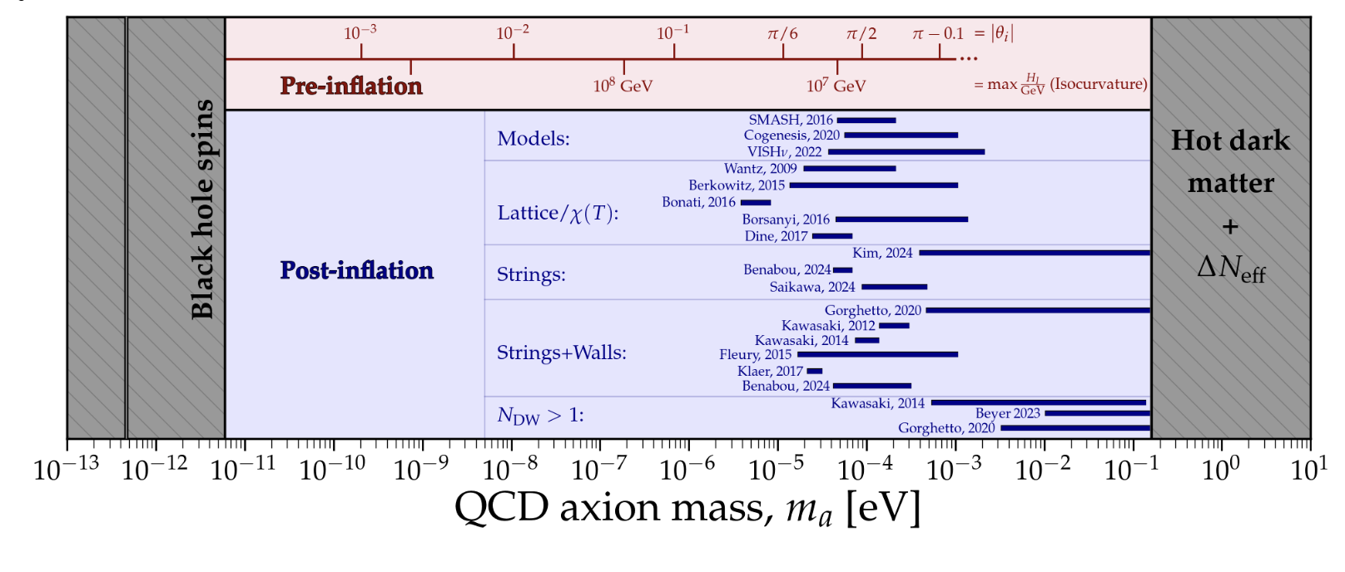
Post-Inflation Axion
Credit: Ciaran O’Hare. cajohare/axionlimits: Axionlimits. https://cajohare.github.io/
AxionLimits/, September 2026

Slide 6
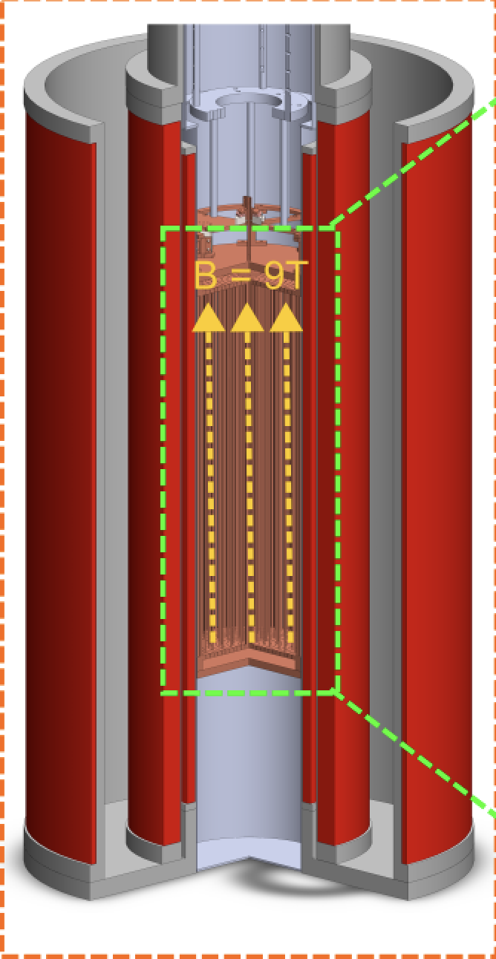


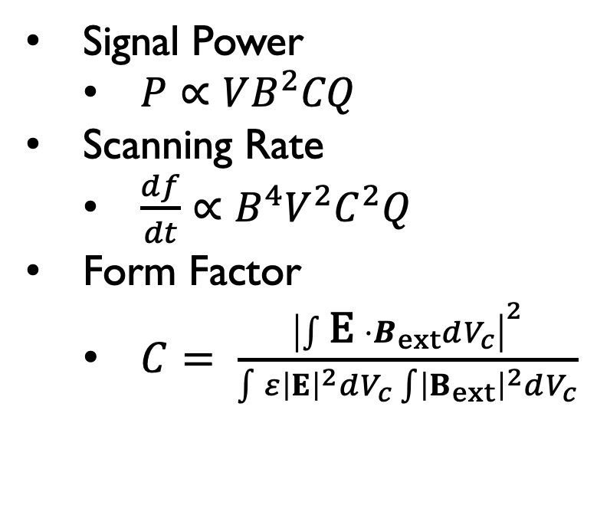



Cavity Haloscope
Signal Power
  $P∝VB^{2}CQ$
Scanning Rate
  $\frac{df}{dt}∝B^{4}V^{2}C^{2}Q$
Form Factor
  $C= \frac{{\left|\int{\text{E }⋅B_{ext}dV_{c}}\right|}^{2}}{\int{ε{\left|E\right|}^{2}dV_{c}\int{{\left|B_{ext}\right|}^{2}dV_{c}}}}$
$$a$$
$$g_{aγγ}$$
$$γ$$
$$γ^{∗}$$
$$B$$
Inverse Primakoff Effect
Example Haloscope Inside Magnet Bore

Slide 7
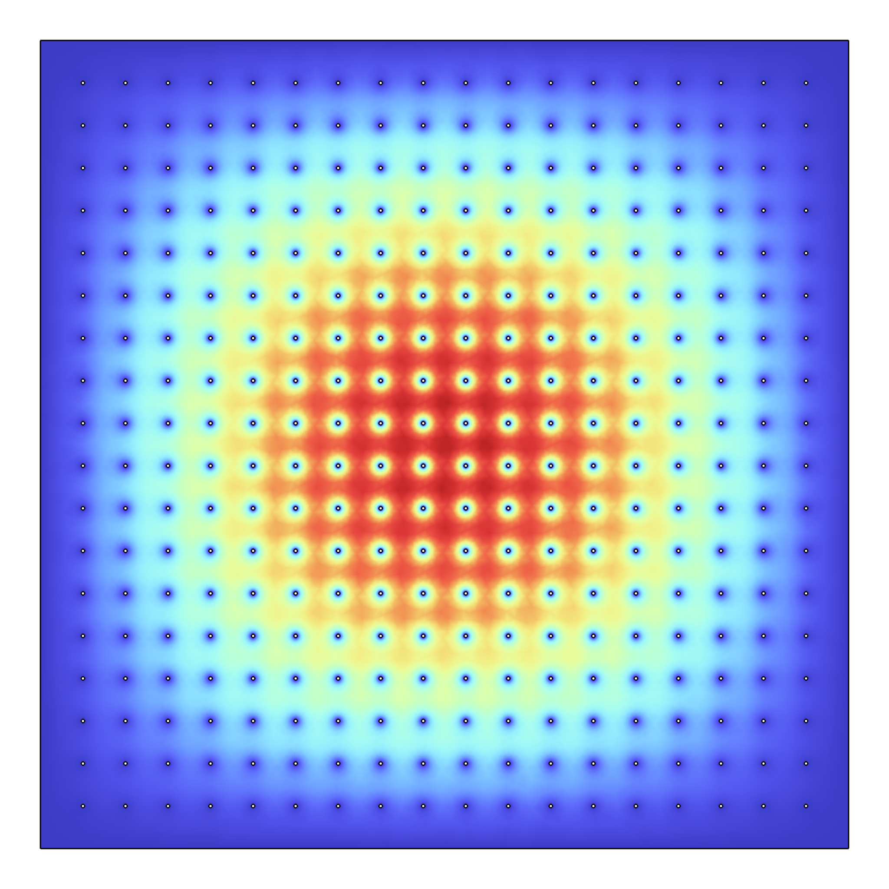
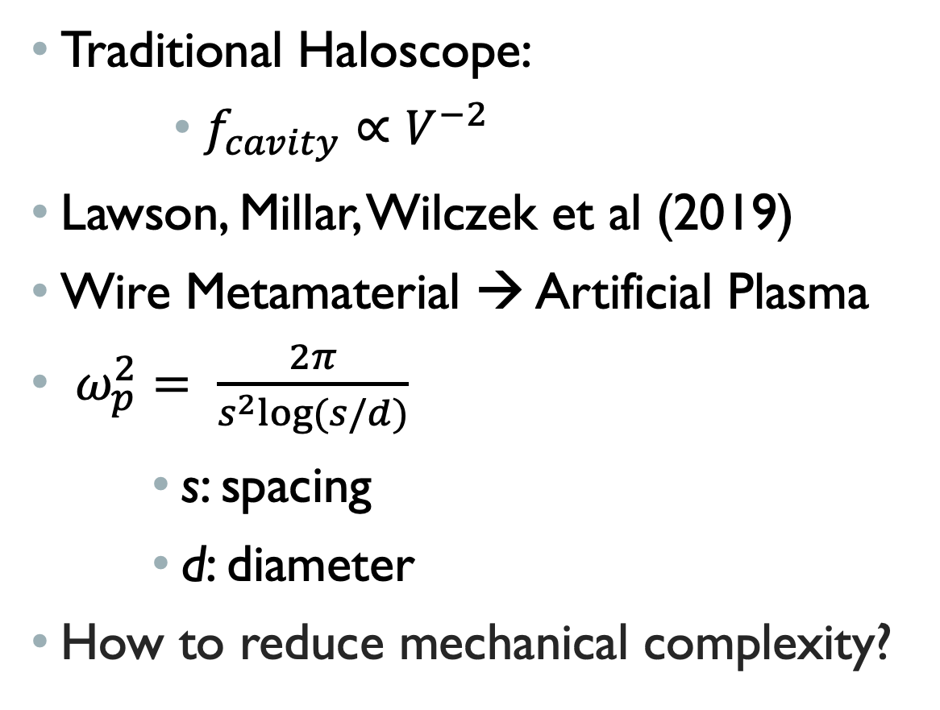
Plasma Haloscopes
Traditional Haloscope:
          $f_{cavity}∝V^{−2}$
Lawson, Millar, Wilczek et al (2019)
Wire Metamaterial → Artificial Plasma
$ω_{p}^{2}= \frac{2π}{s^{2}log⁡(s/d)}$
        s: spacing
        d: diameter
How to reduce mechanical complexity?
Electrical Field of TM010 mode inside a wire metamaterial

Slide 8
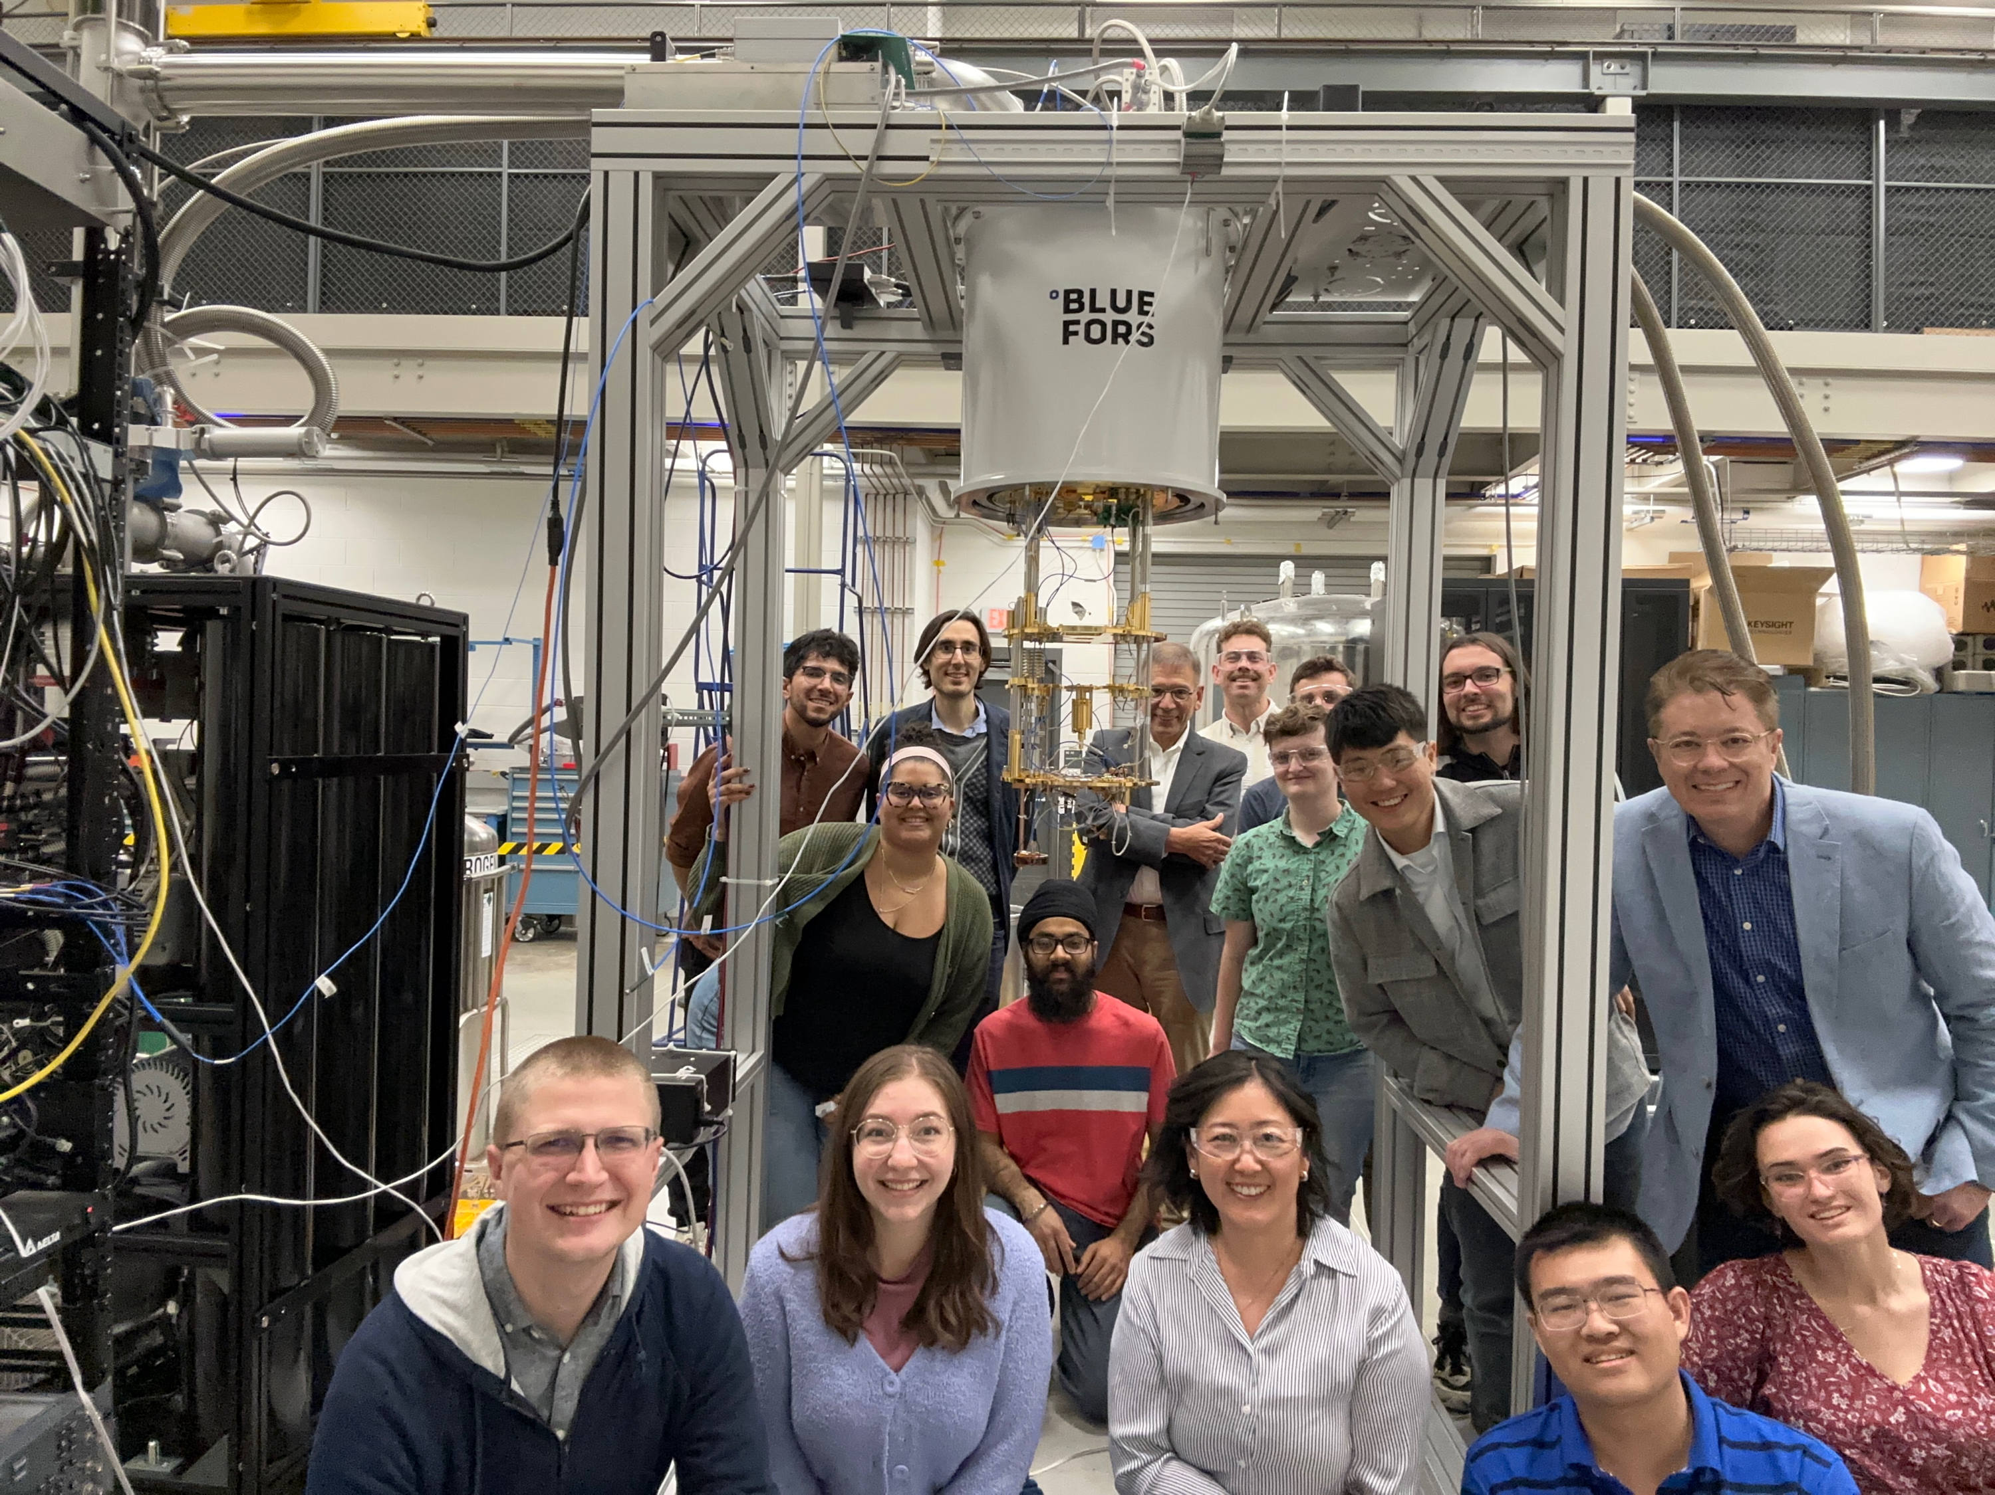






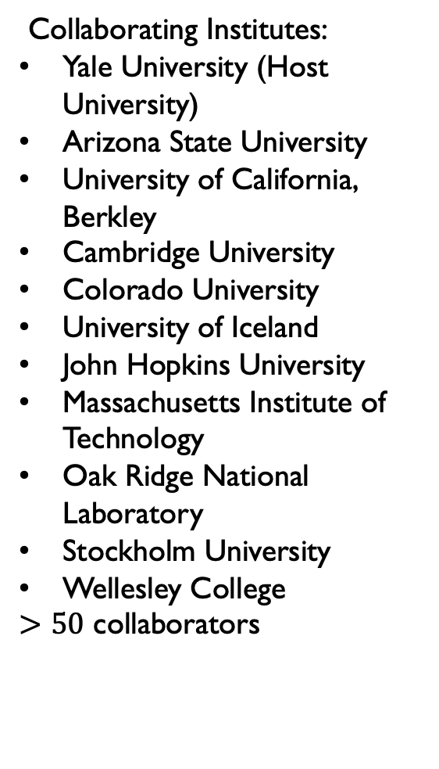
ALPHA: Axion Longitudinal Plasma Haloscope
Collaborating Institutes:
Yale University (Host University)
Arizona State University
University of California, Berkley
Cambridge University
Colorado University
University of Iceland
John Hopkins University
Massachusetts Institute of Technology
Oak Ridge National Laboratory
Stockholm University
Wellesley College
$>50$ collaborators
Supported by:

Slide 9
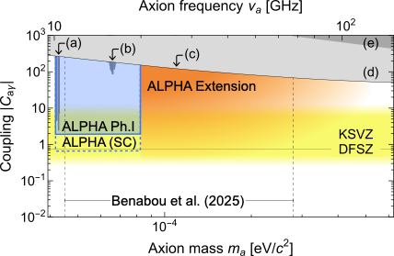
ALPHA: Phase 1
Hosted at Yale Wright Lab
Frequency Range:
  10 - 20GHz (40-80 ueV)
Readout:
  Quantum limited readout
  KSVZ sensitivity
Magnet:
  9T / Φ202.4x1000 mm
Phase I Design Paper: arXiv:2608.10292
ALPHA Phase 1 sensitivity projection from 10-20GHz

Slide 10
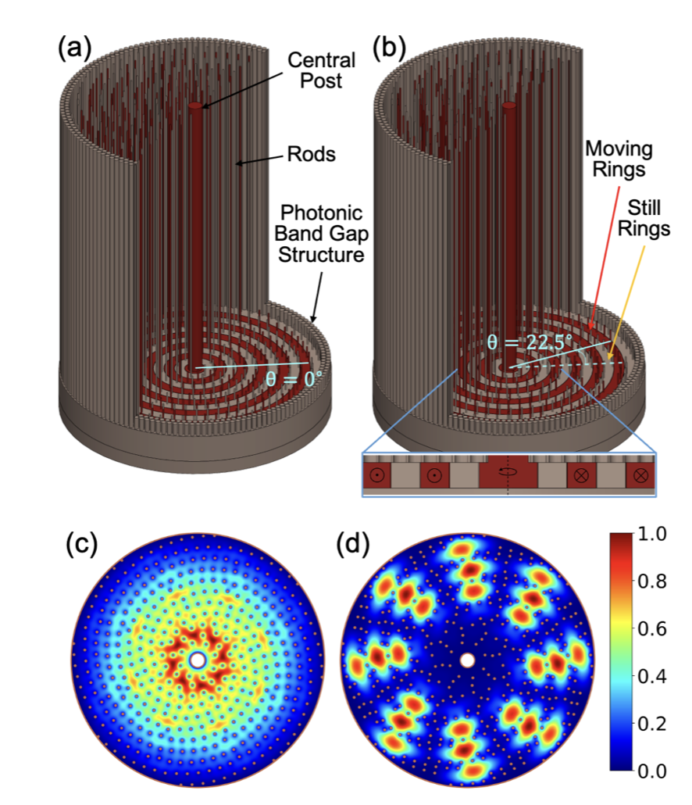
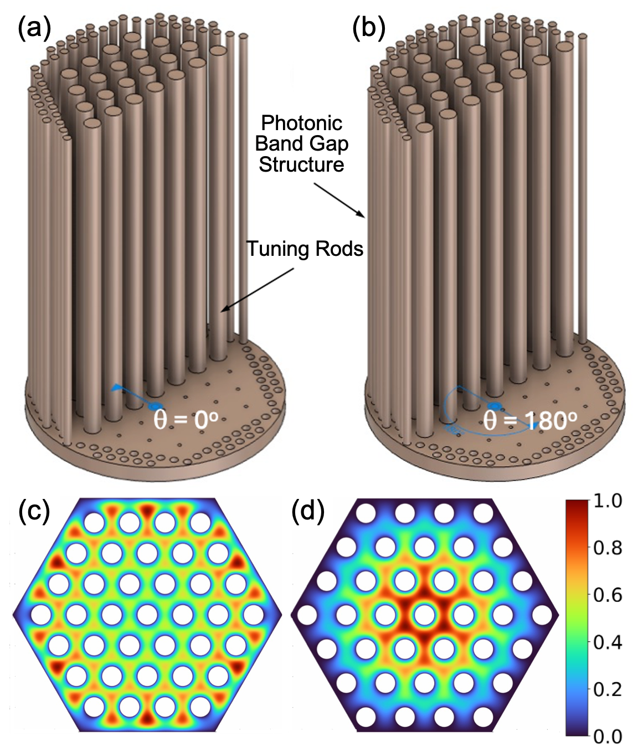
ALPHA: Phase 1Resonator
Rinnegan Design (Stockholm University Group)
Symmetric Lattice Design (Berkley University Group)

Slide 11
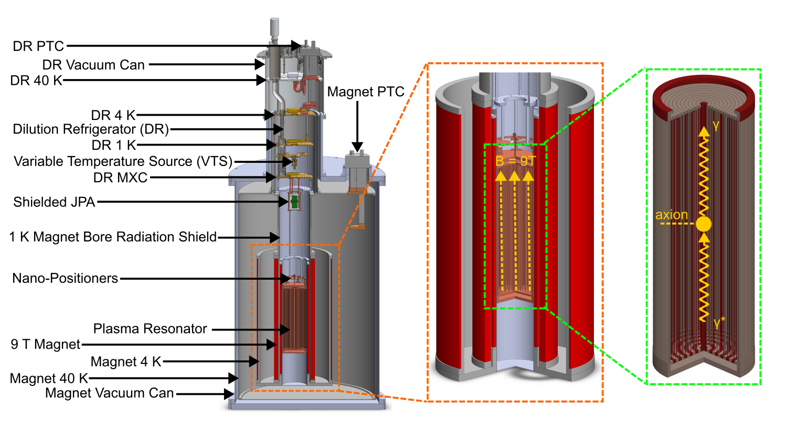
ALPHA: Phase 1 Experiment Setup
Experimental setup for ALPHA Phase I

Slide 12
Major Upcoming Milestones
Spiral Dark Photon Run: 2026
Magnet Delivery: 2027
First Axion Science Run: 2028-

Slide 13
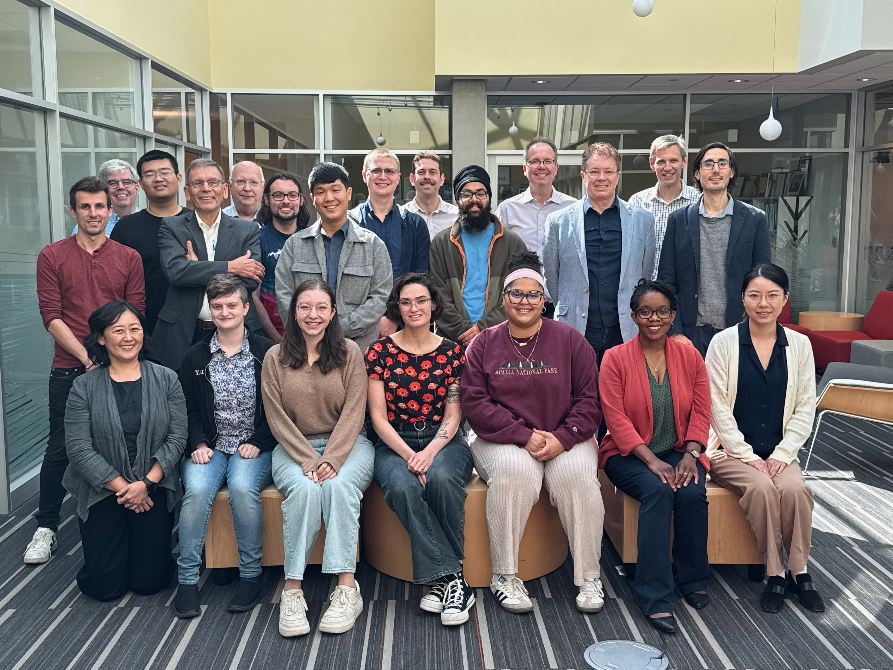
ALPHA: Stockholm University
Resonator:
  Junu Jeong (Resonator co-lead)
  Jon E. Gudmundsson [former spokesperson] (U of Iceland)
  Rustam Balafendiev (U of Iceland)
  Gagandeep Kaur
  Jianyang Qi
  Jacob Lindahl
Analysis:
  Jan Conrad (Deputy Spokesperson)
  Andrea Gallo Rosso (Analysis co-lead)
  Andy Meyer (See his talk for analysis overview!)

Slide 14
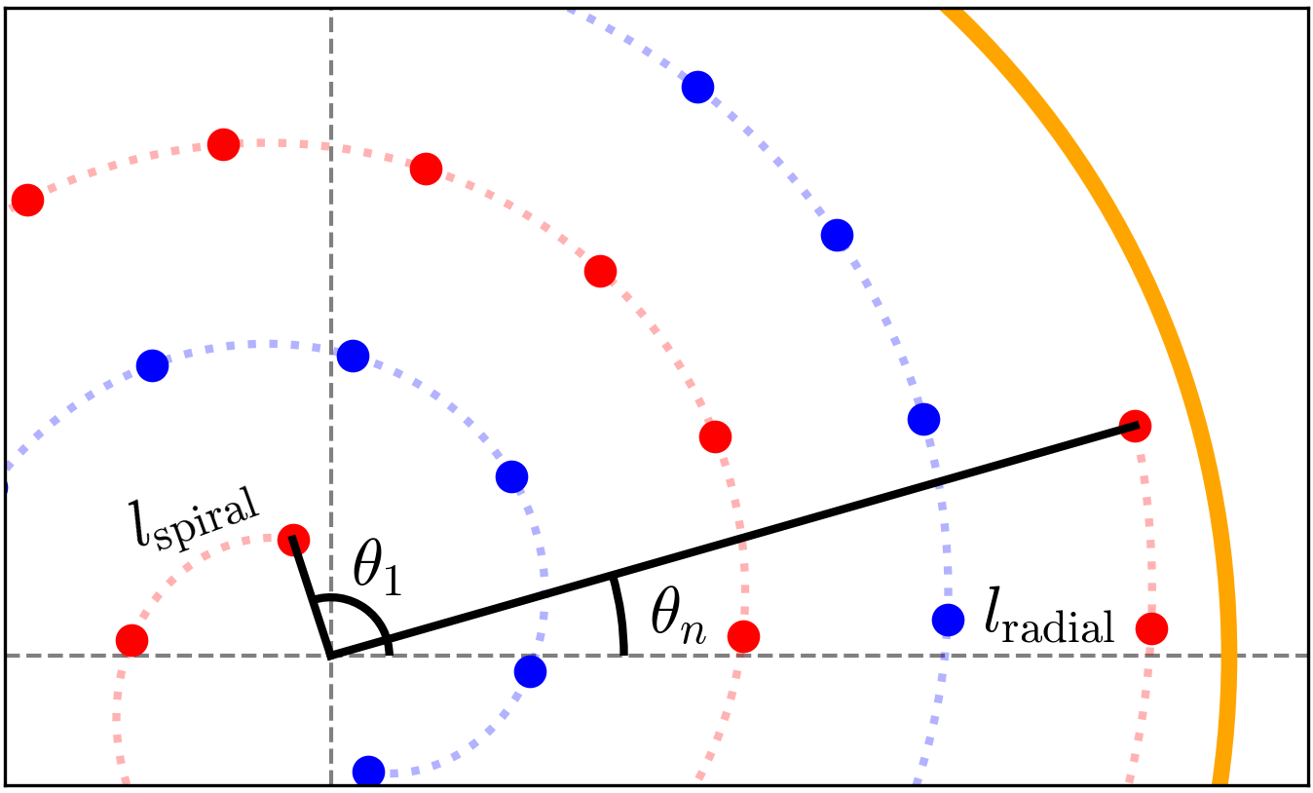
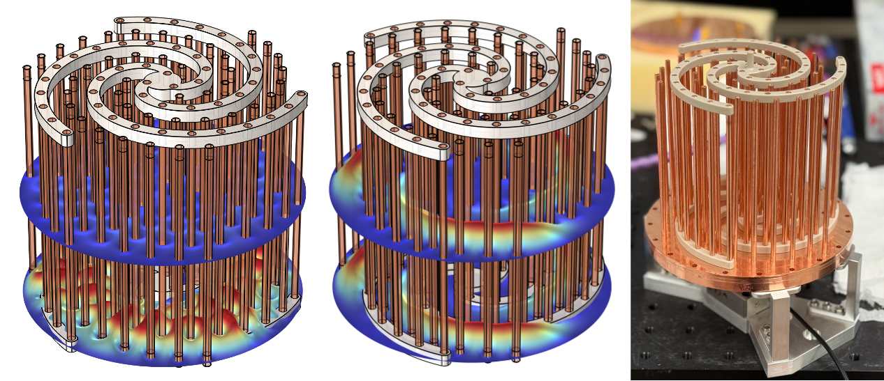
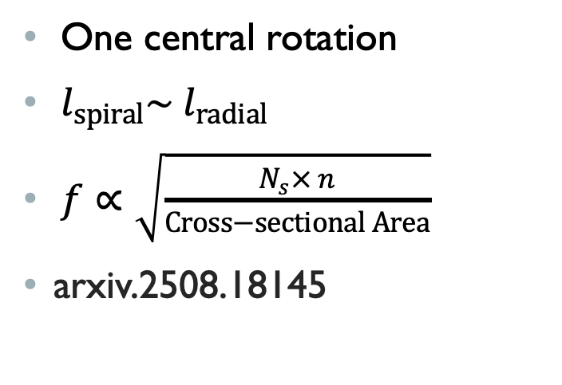
Spiral Tuning Method
Fixed arm
Tunable arm
One central rotation
$l_{spiral}\sim l_{radial}$
$f∝\sqrt{\frac{N_{s}× n}{Cross−sectional Area}}$
arxiv.2508.18145
Spiral bundle geometry for wire positioning. Red and blue dots are locations of wires corresponding to one spiral.

Slide 15
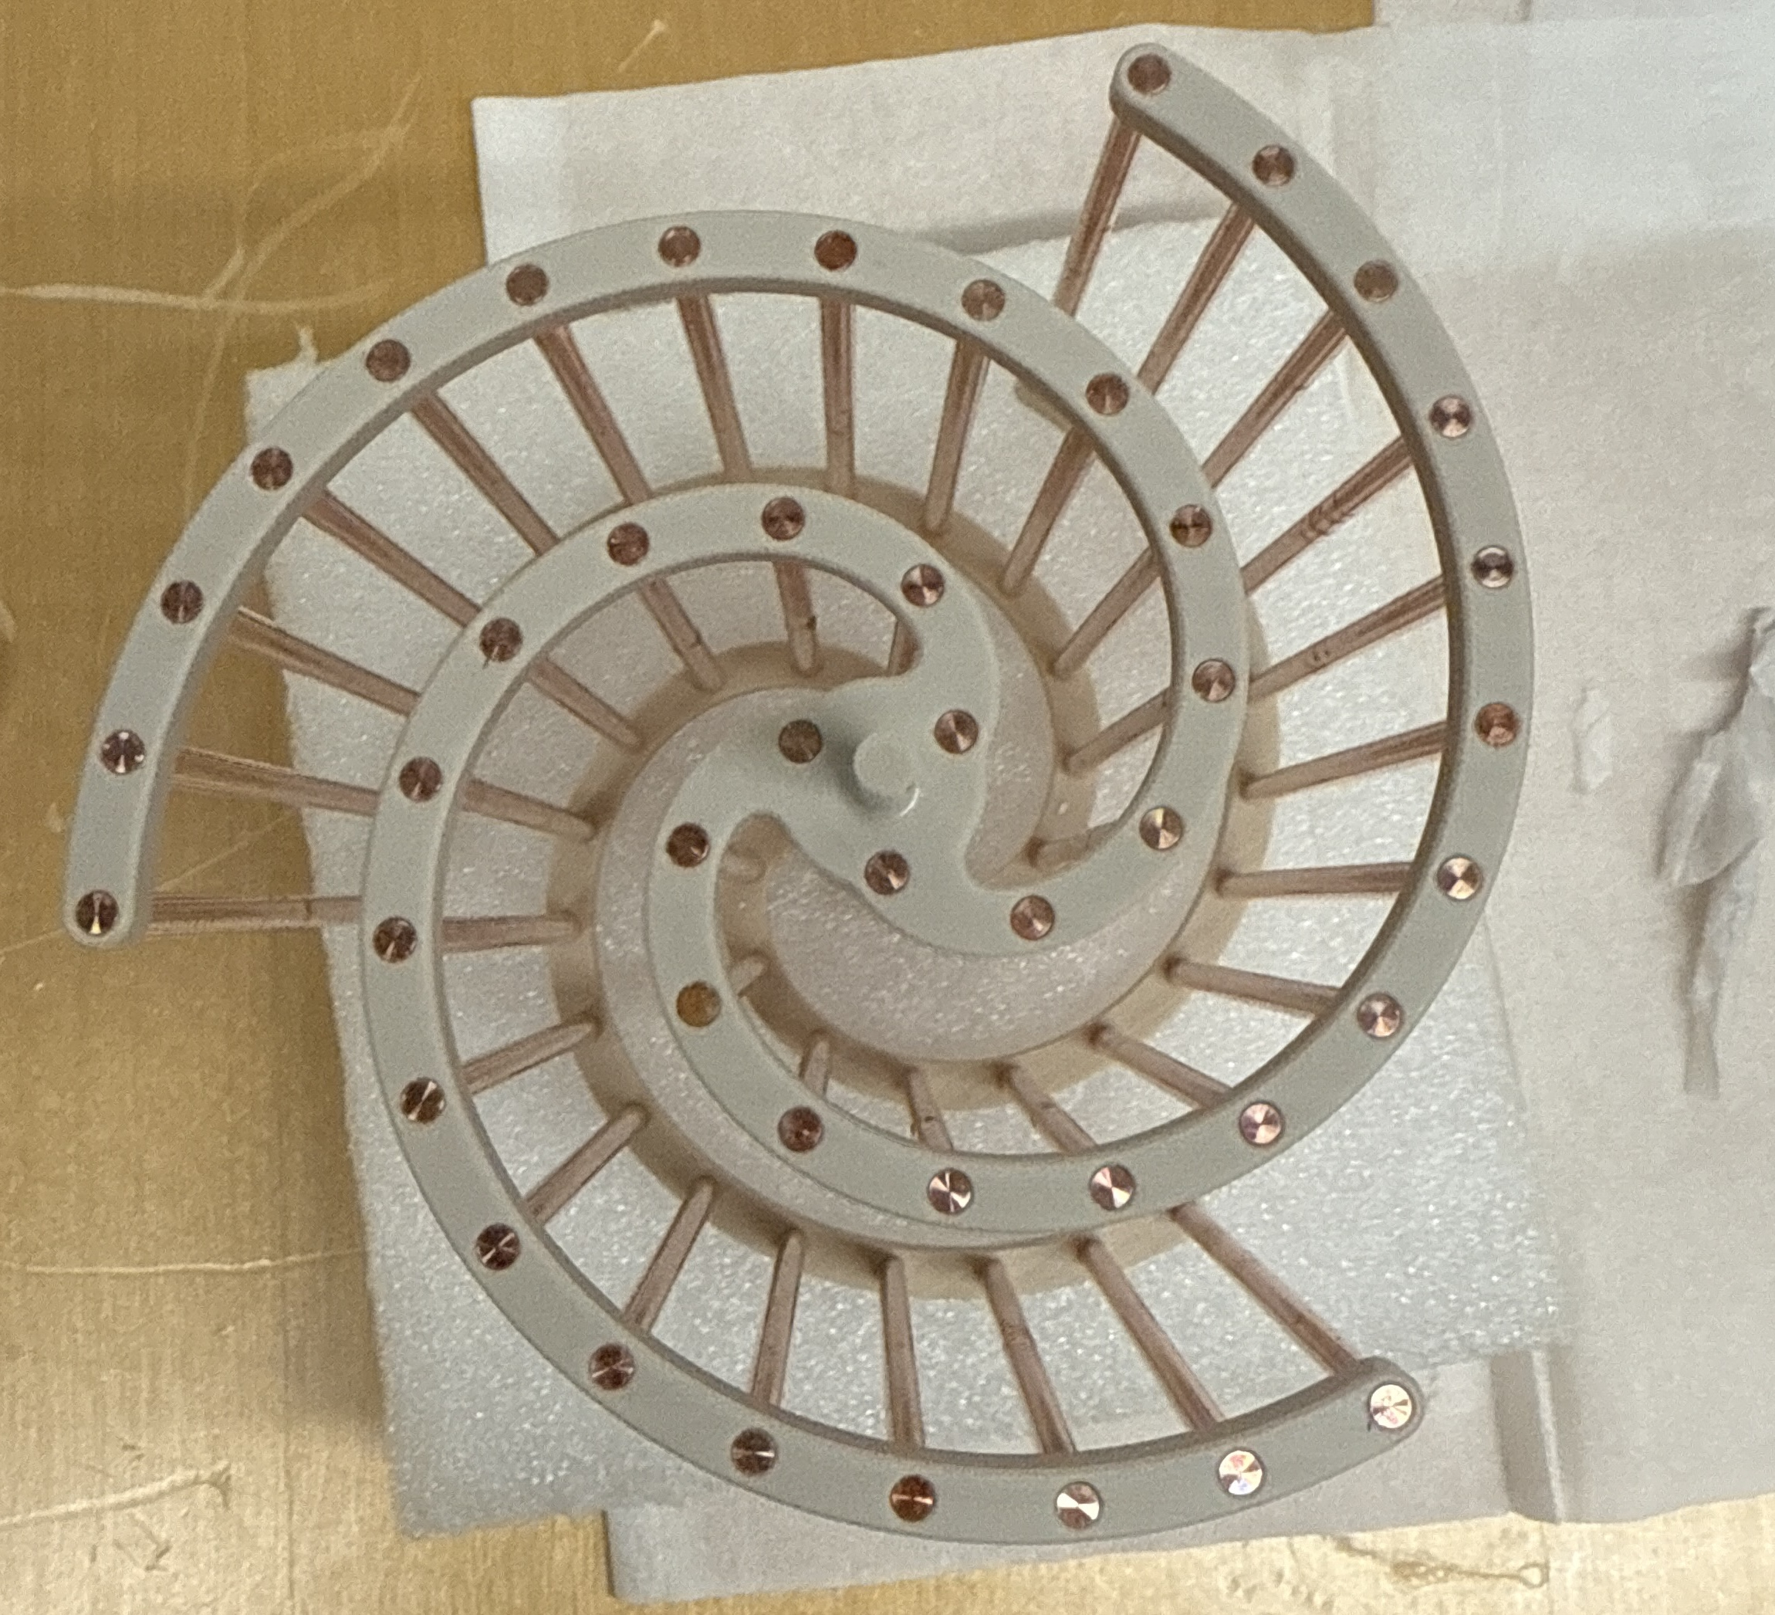
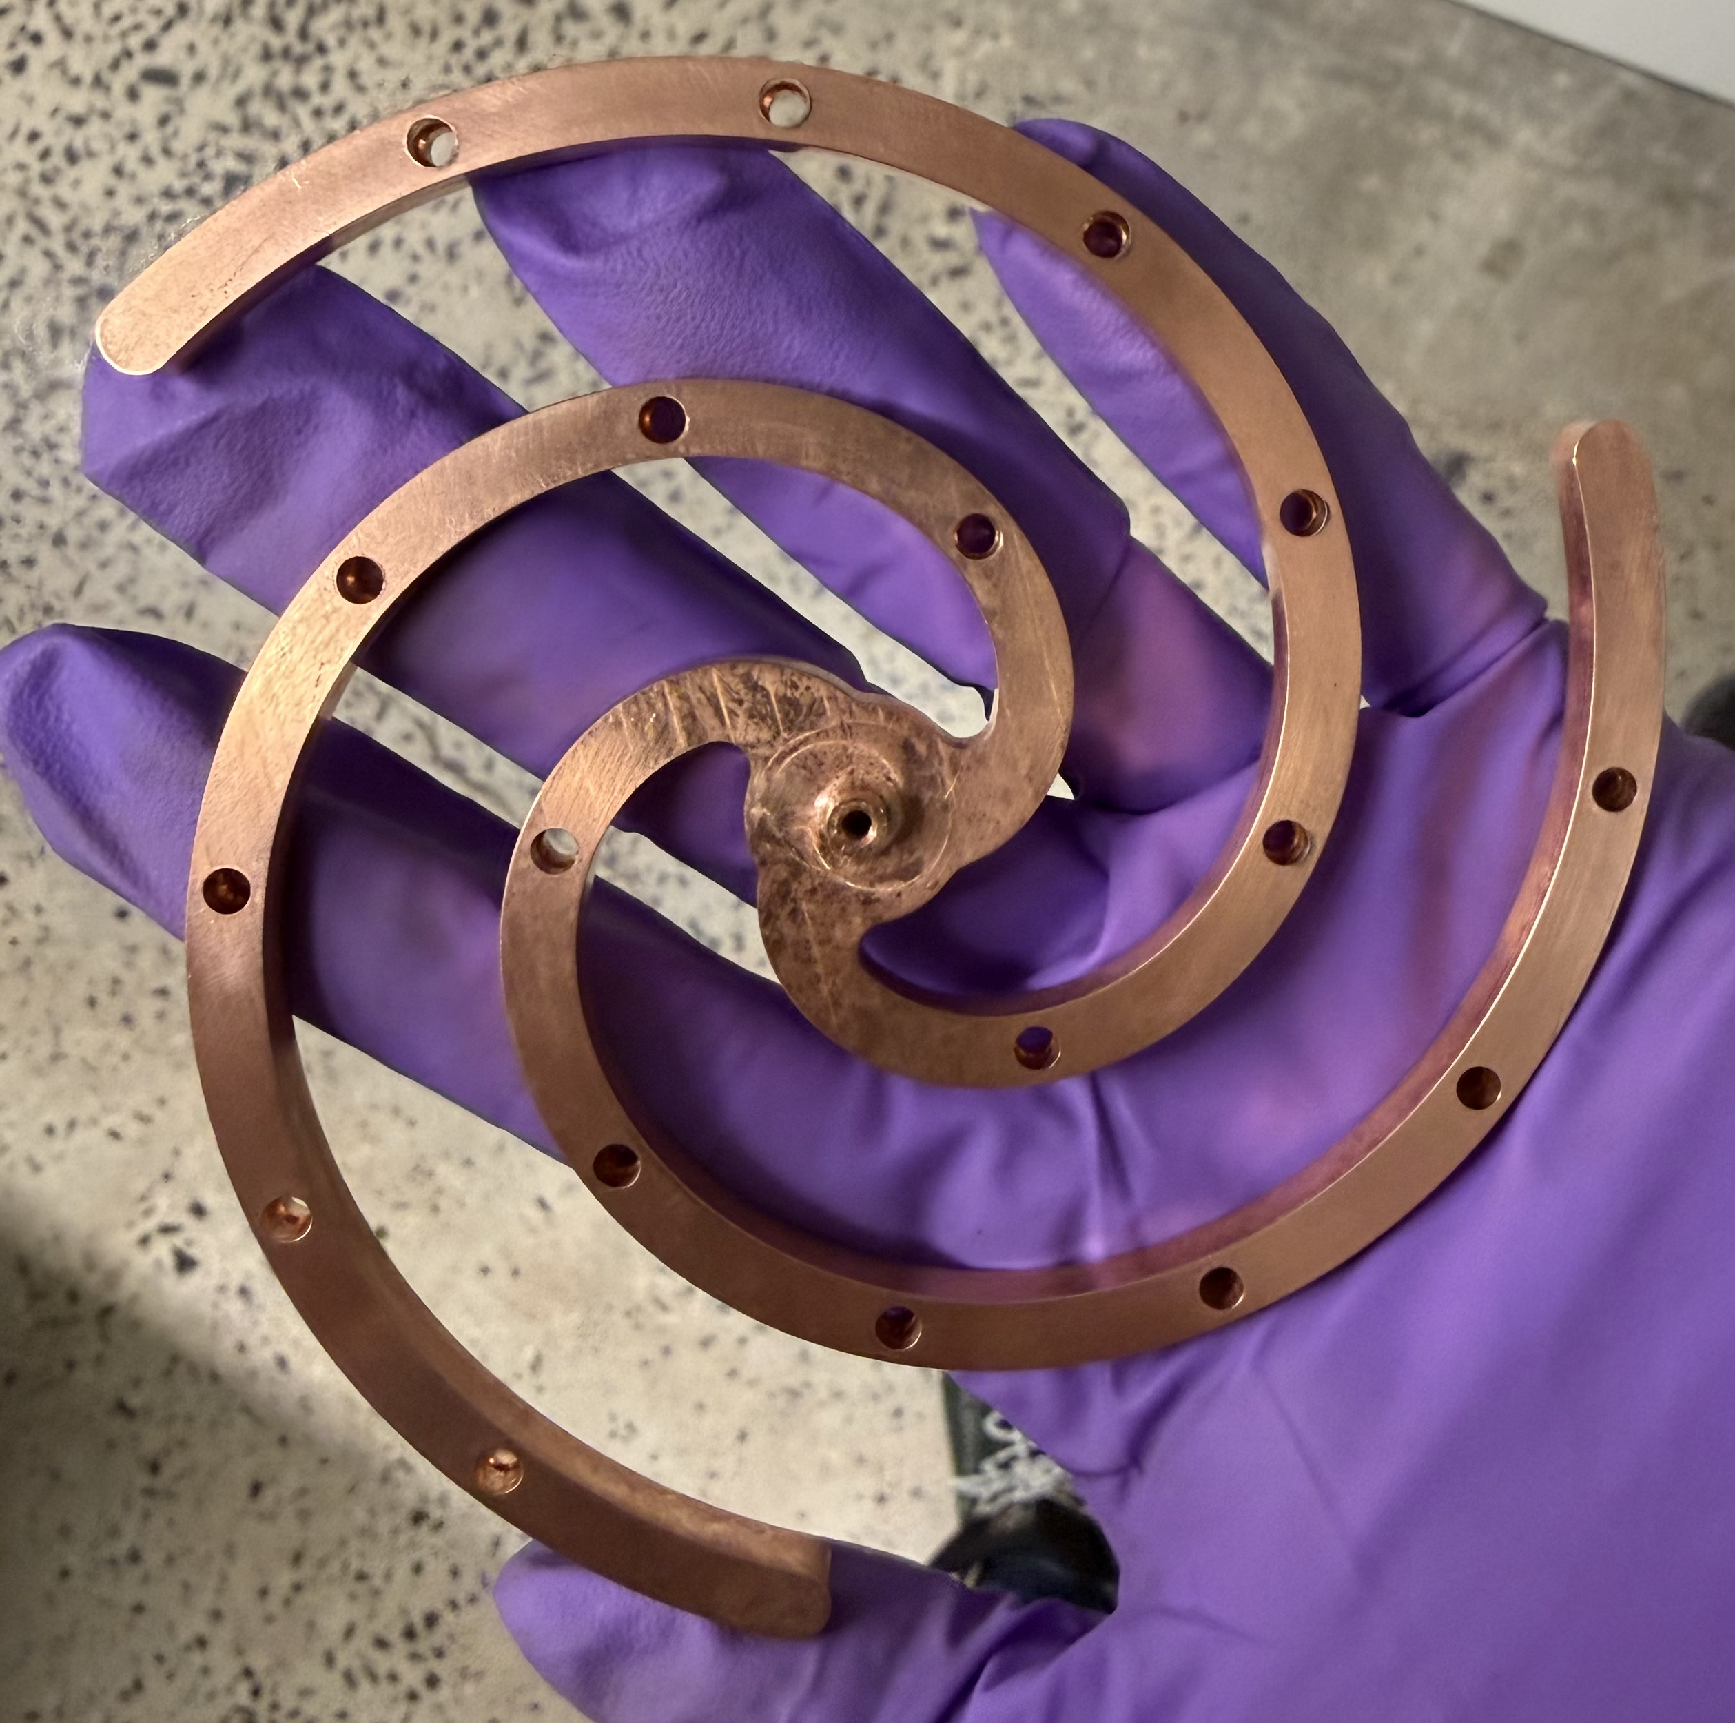
Dark Photon Cavity
PEEK Support Spiral
Copper Support Spiral
Wire Diameter changed from 3.175mm to 2.5mm and focused on 10.5-11GHz

Slide 16
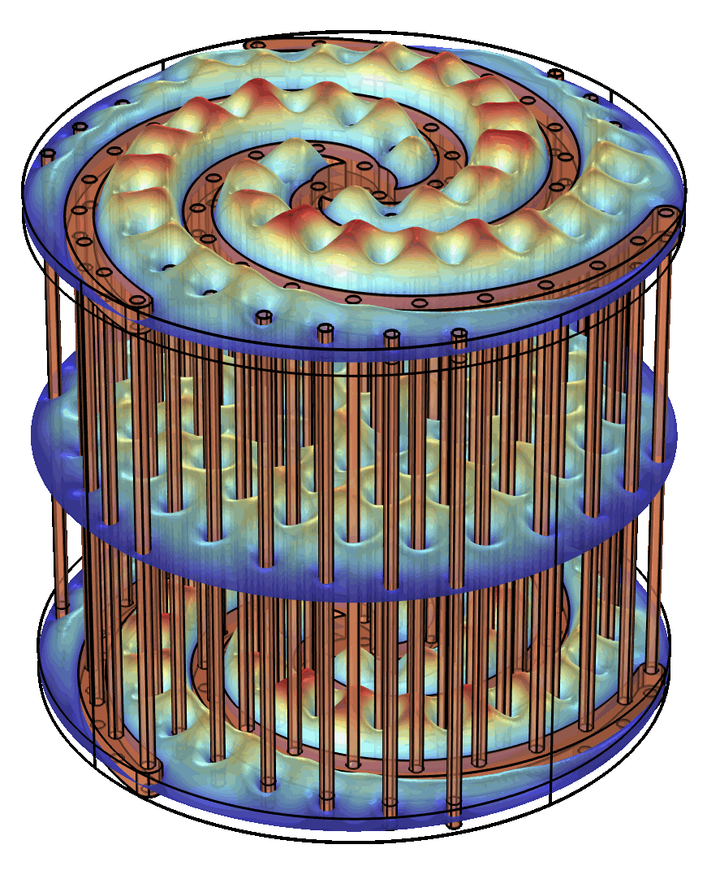
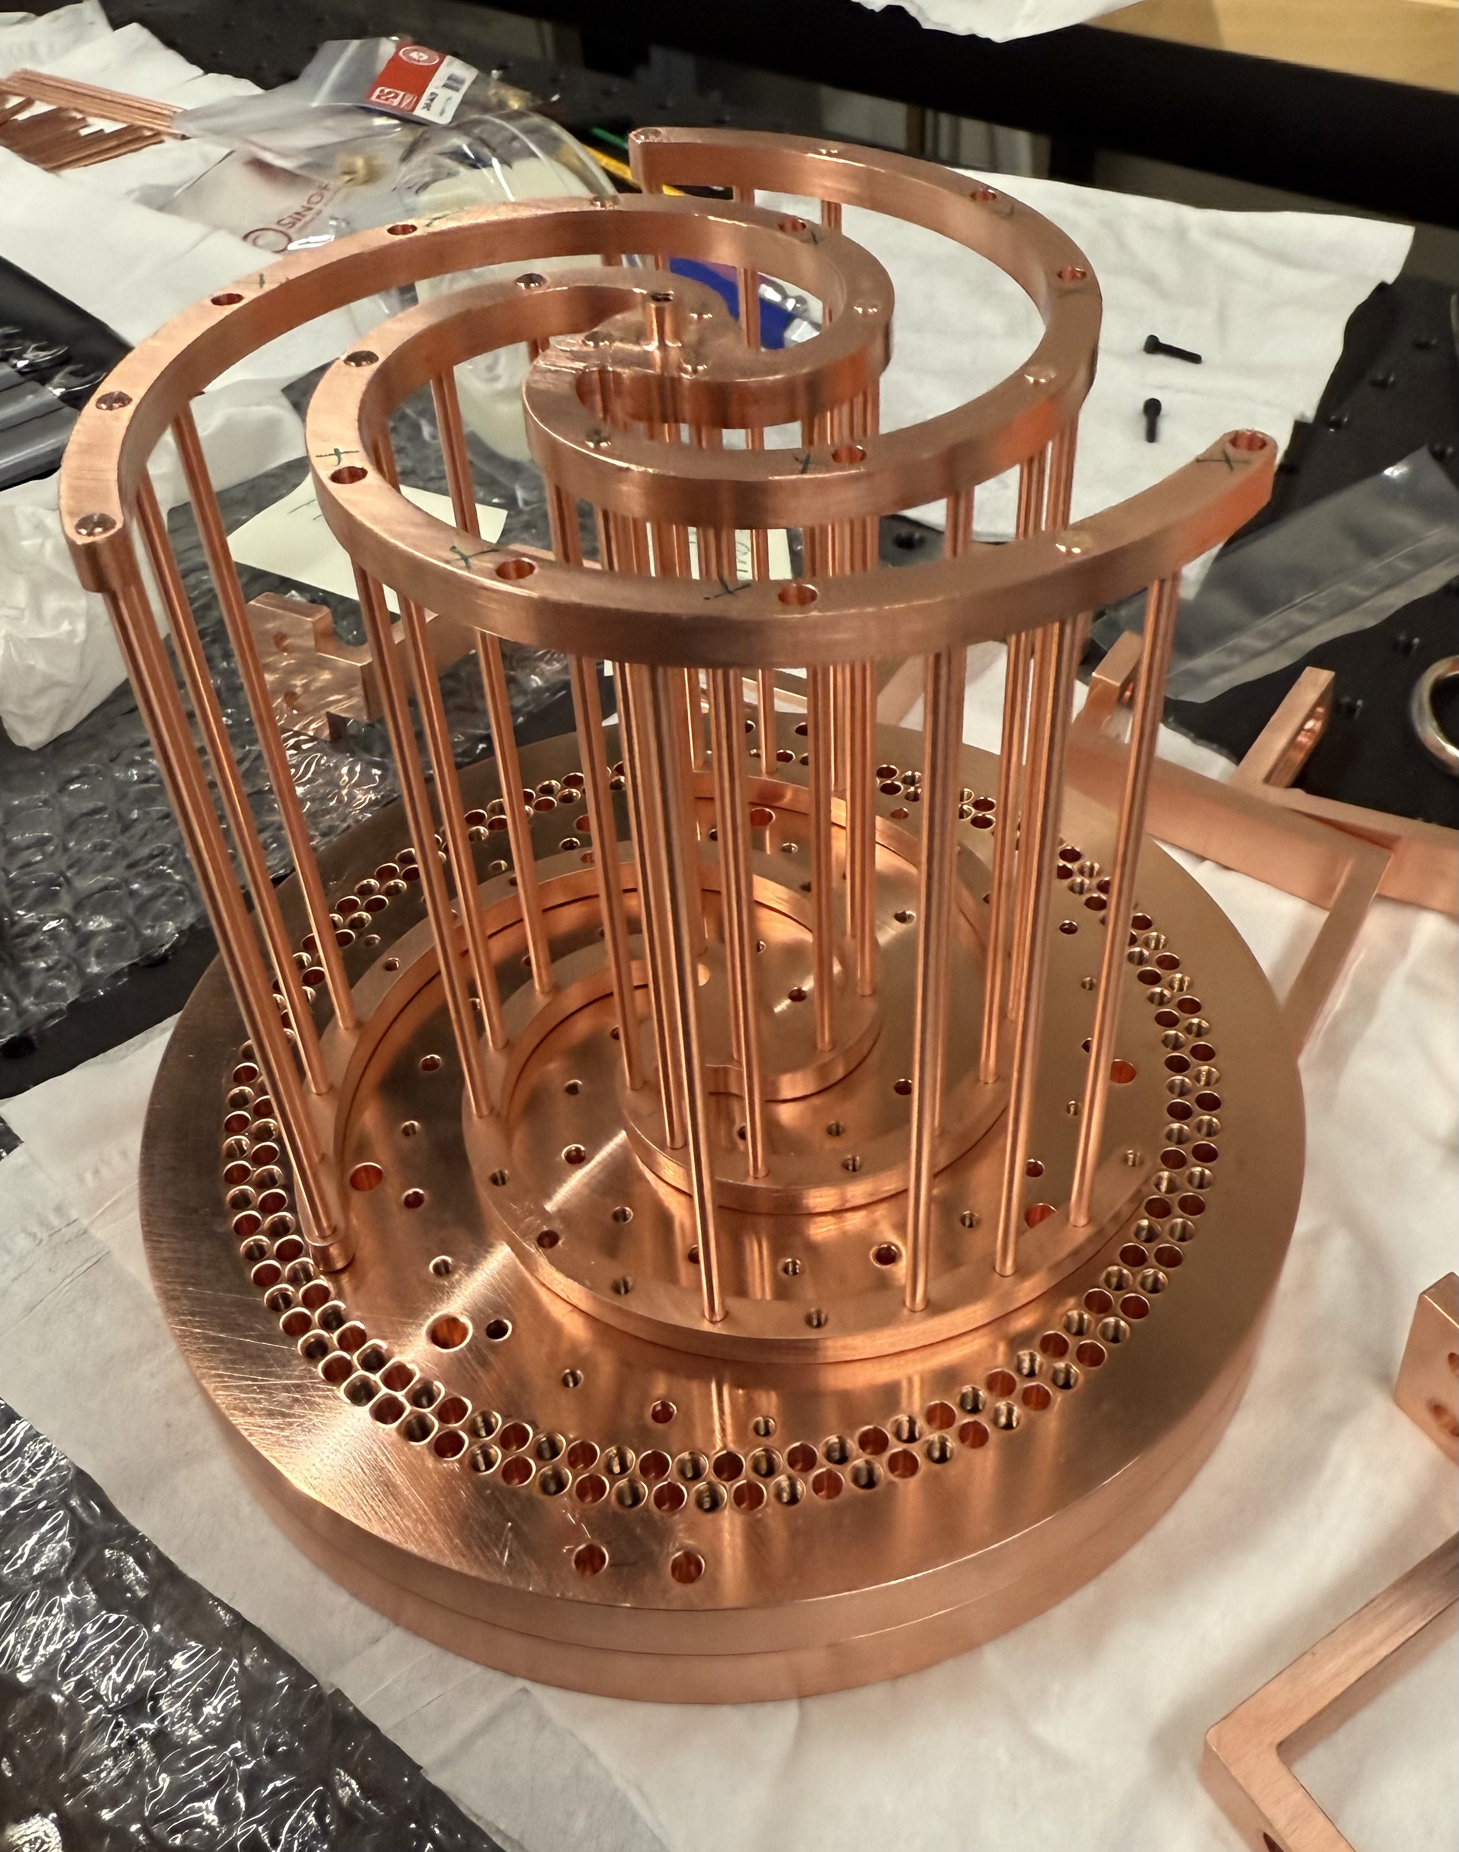
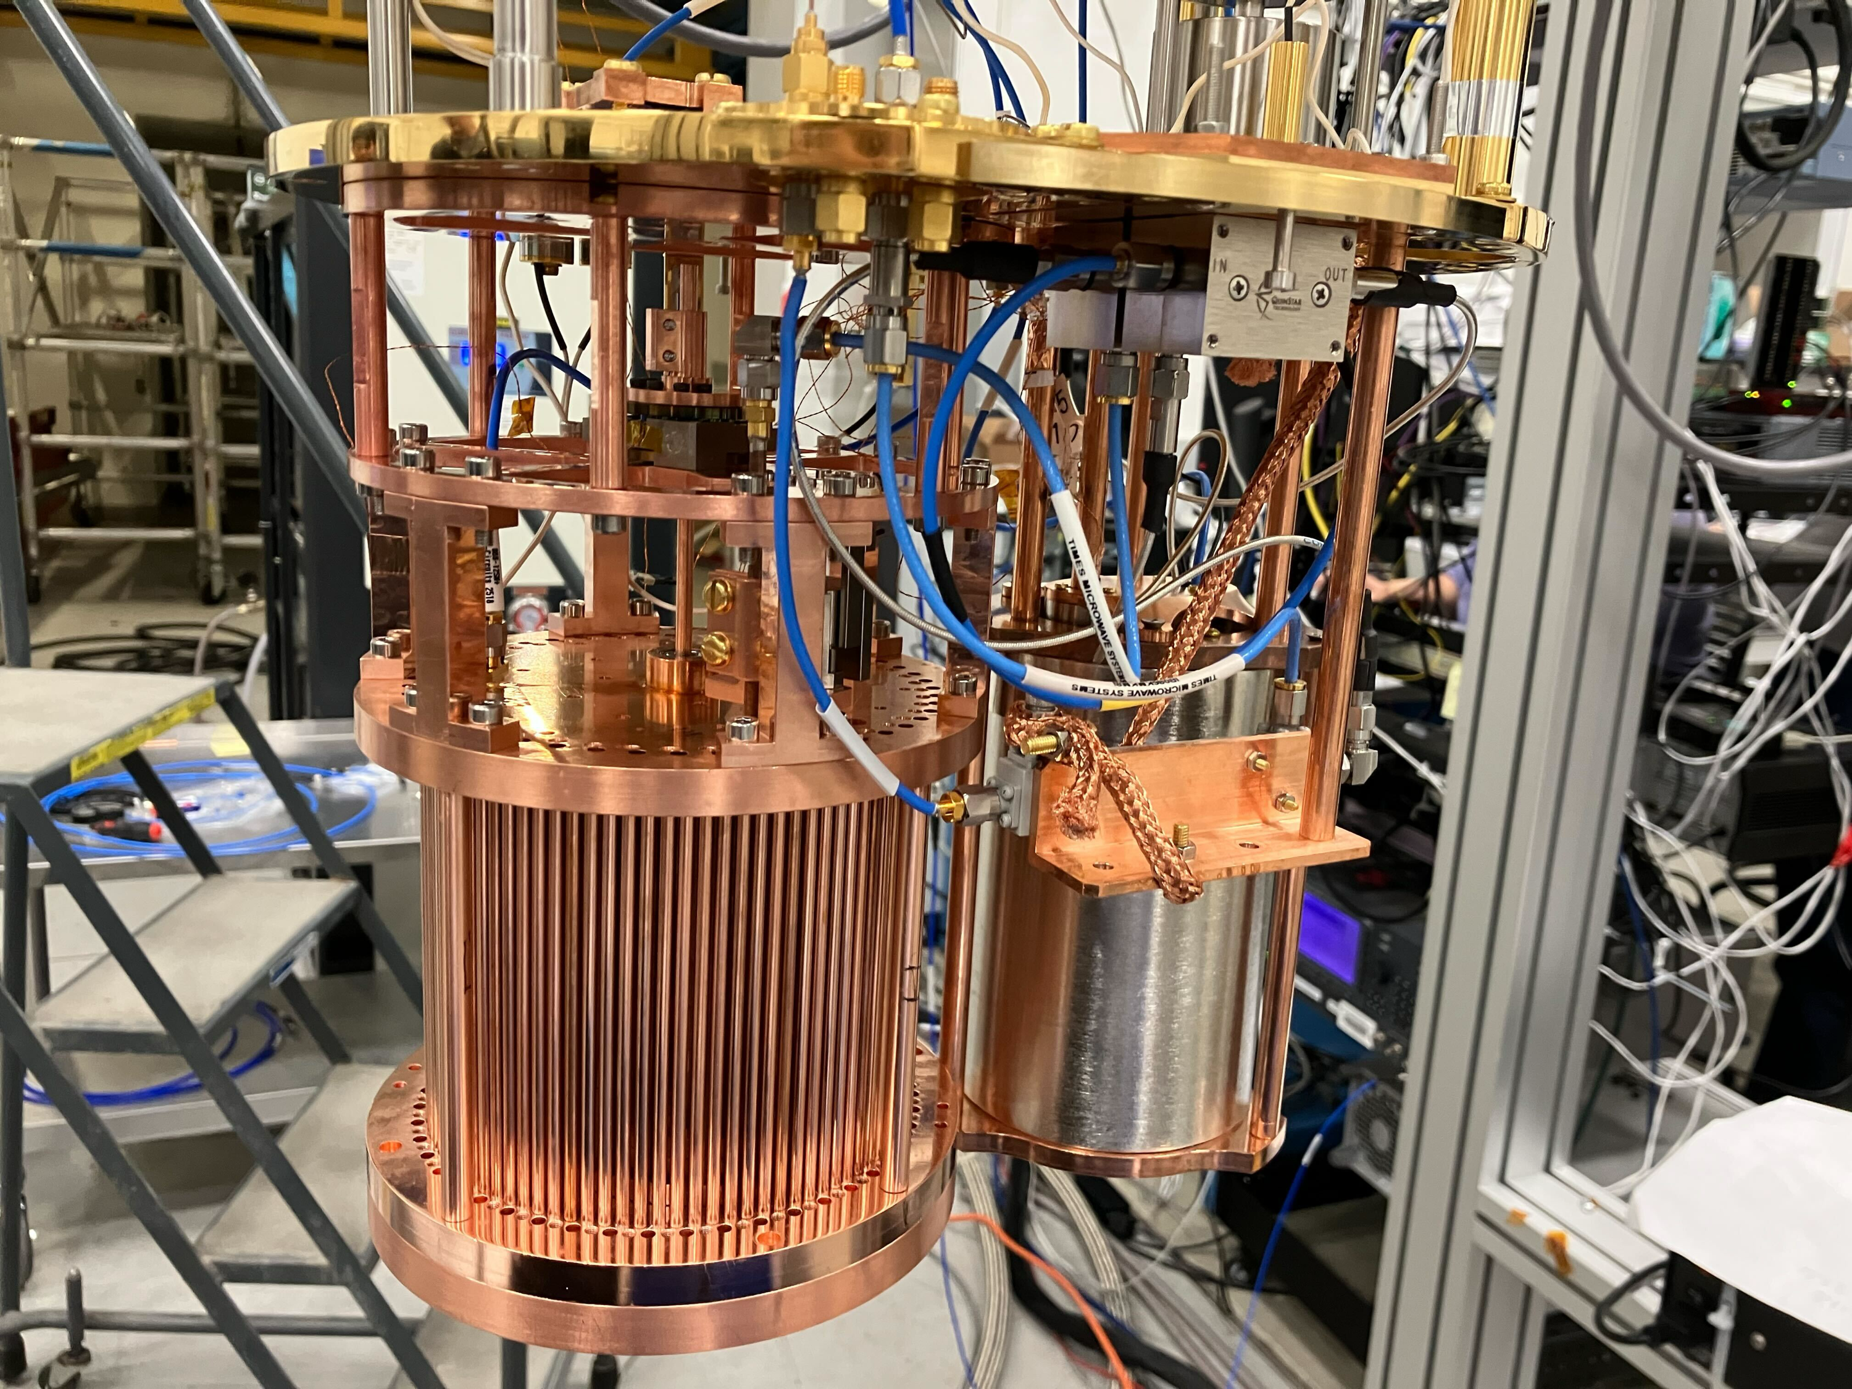
Dark Photon Cavity
Electrical field profile under rotation
Half-assembled cavity
Cavity mounted inside ALPHA fridge

Slide 17
ALPHA DP Run Projection
ALPHA Spiral Run projected sensitivity of 10.5-11GHz for 40 days integration time compared with other limits with data collection starting this year!

Slide 18
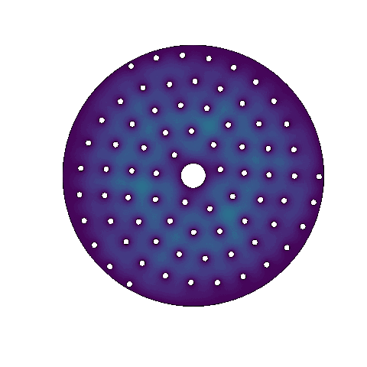
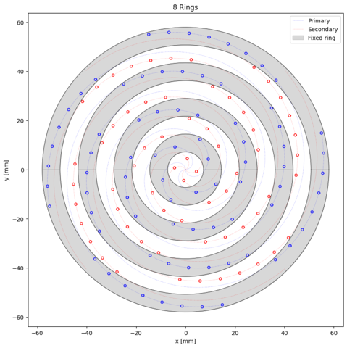
Ring Nested Group Rotation
(RINNEGAN)
One central rotation
Spiral distributed across series of concentric rings
Flush surface
  No longitudinal symmetry breaking
Wires spread across 8 rings
2D simulation of tuning

Slide 19
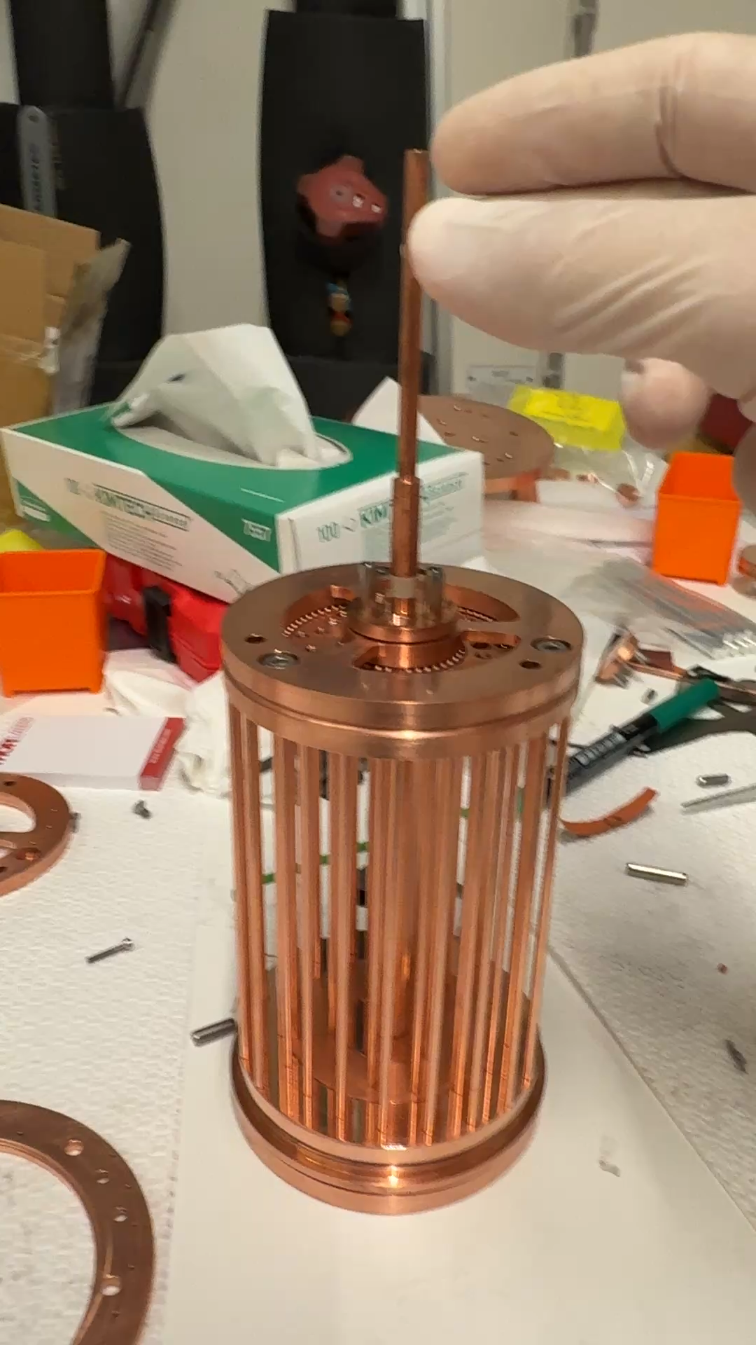
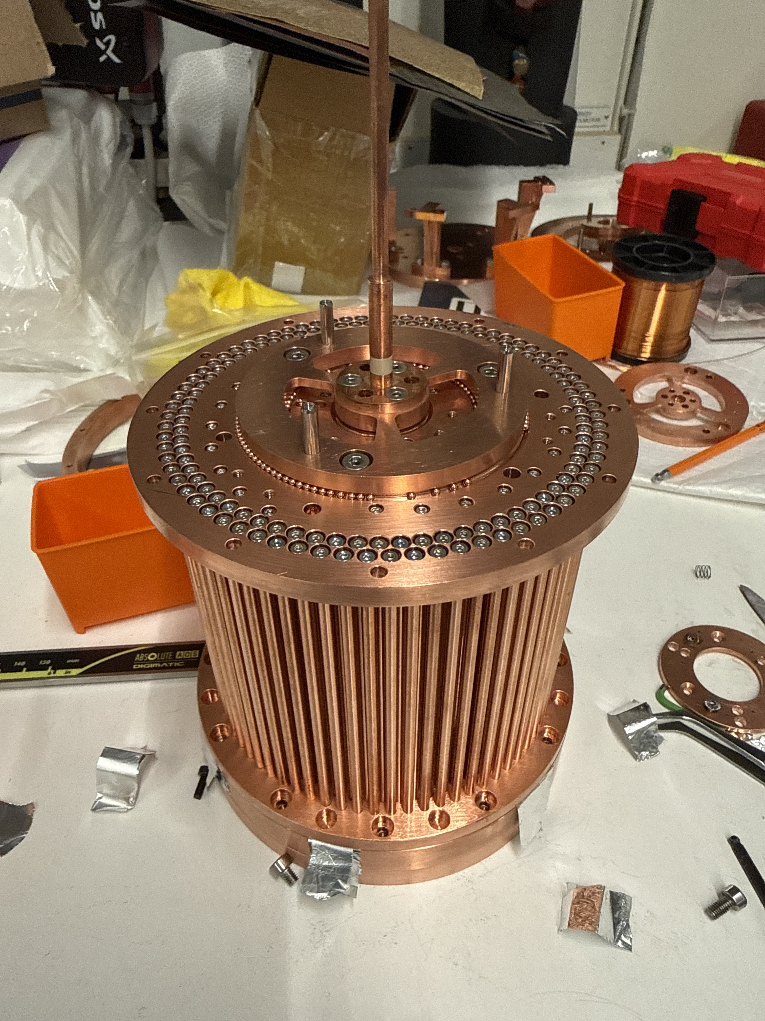
Rinnegan Prototype
Confirmed rotation of rings in cryogenics
Prototype Measurements happening now!
Will be used for simultaneous Dark Photon search at Stockholm University!
Rotation test of protype rings
Assembled Rinnegan Prototype

Slide 20
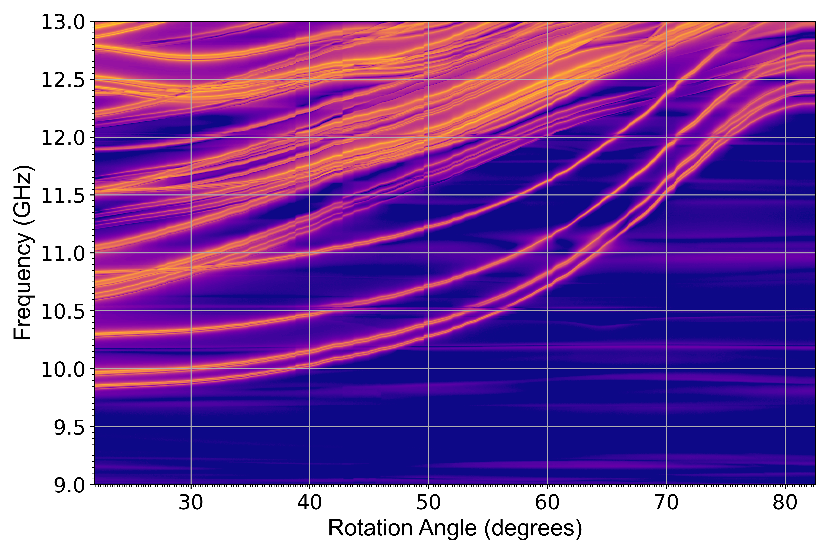
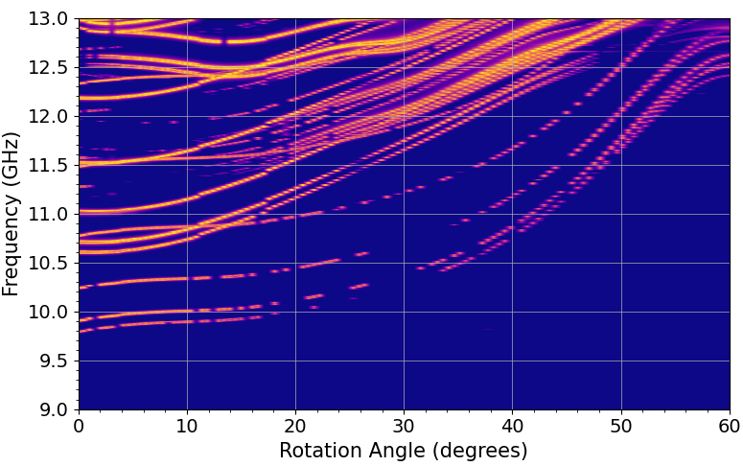
Rinnegan Modemap
Measured Modemap
3D Simulated Modemap
Preliminary
Preliminary

Slide 21
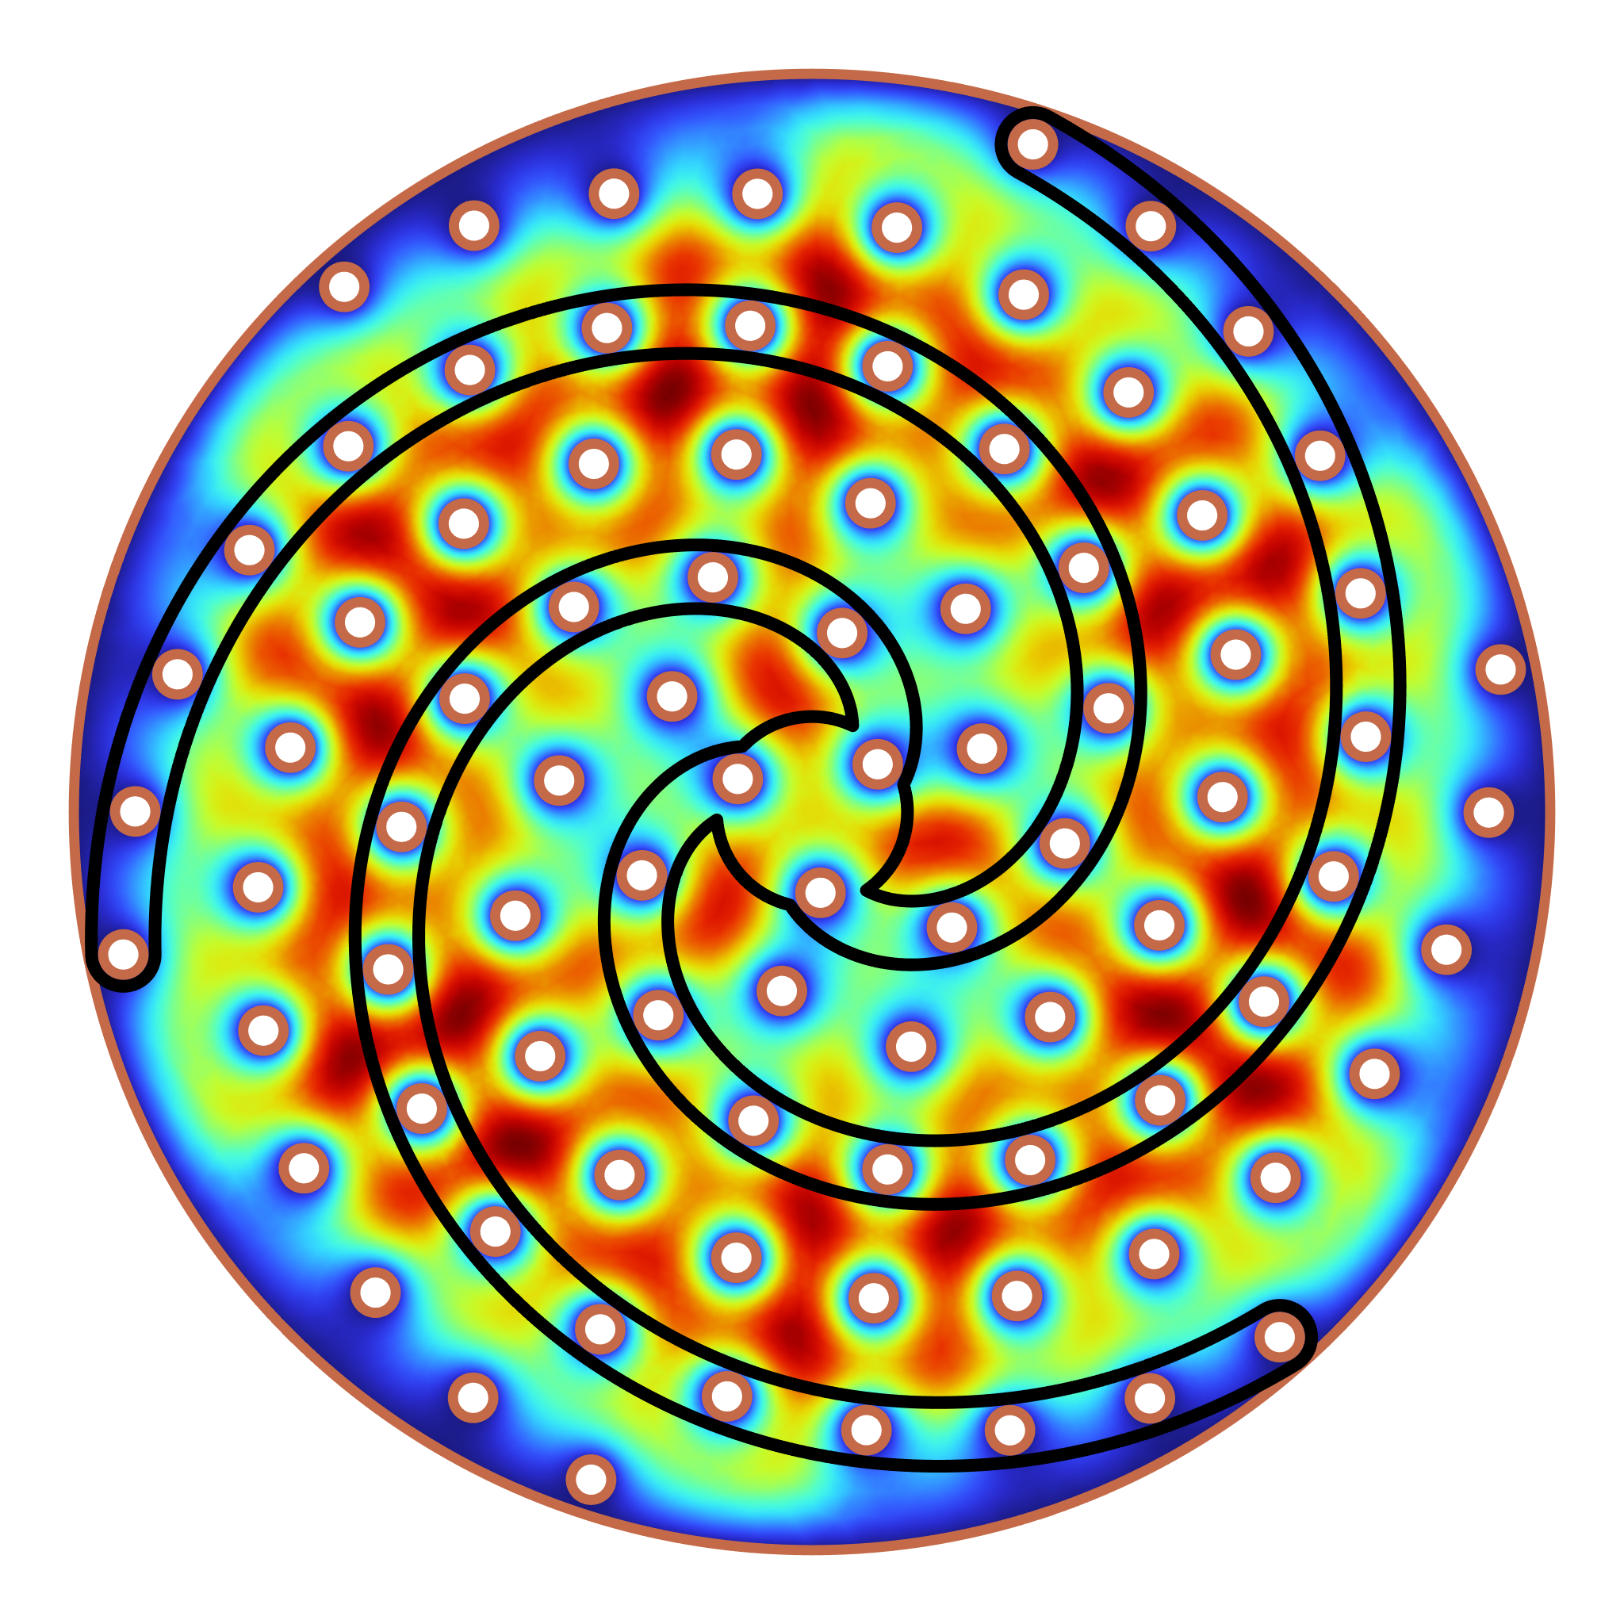
Conclusions
ALPHA Phase I will scan 10-20 GHz at KSVZ sensitivity
First dark photon science run in 2026
Spiral design will be used for the 10.5 - 11 GHz dark photon run
Rinnegan prototype is being tested
Simultaneous Dark Photon search 10.5-11 GHz at SU
2D 6-arm simulated Electrical field

Slide 22
Backup Slides

Slide 23
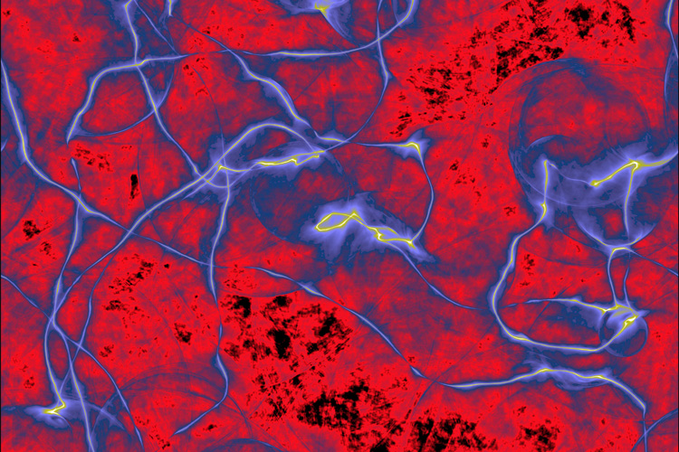
Post-inflation Axion
Simulation of early universe axion energy density
Credit: Malte Buschmann, Princeton University

Slide 24
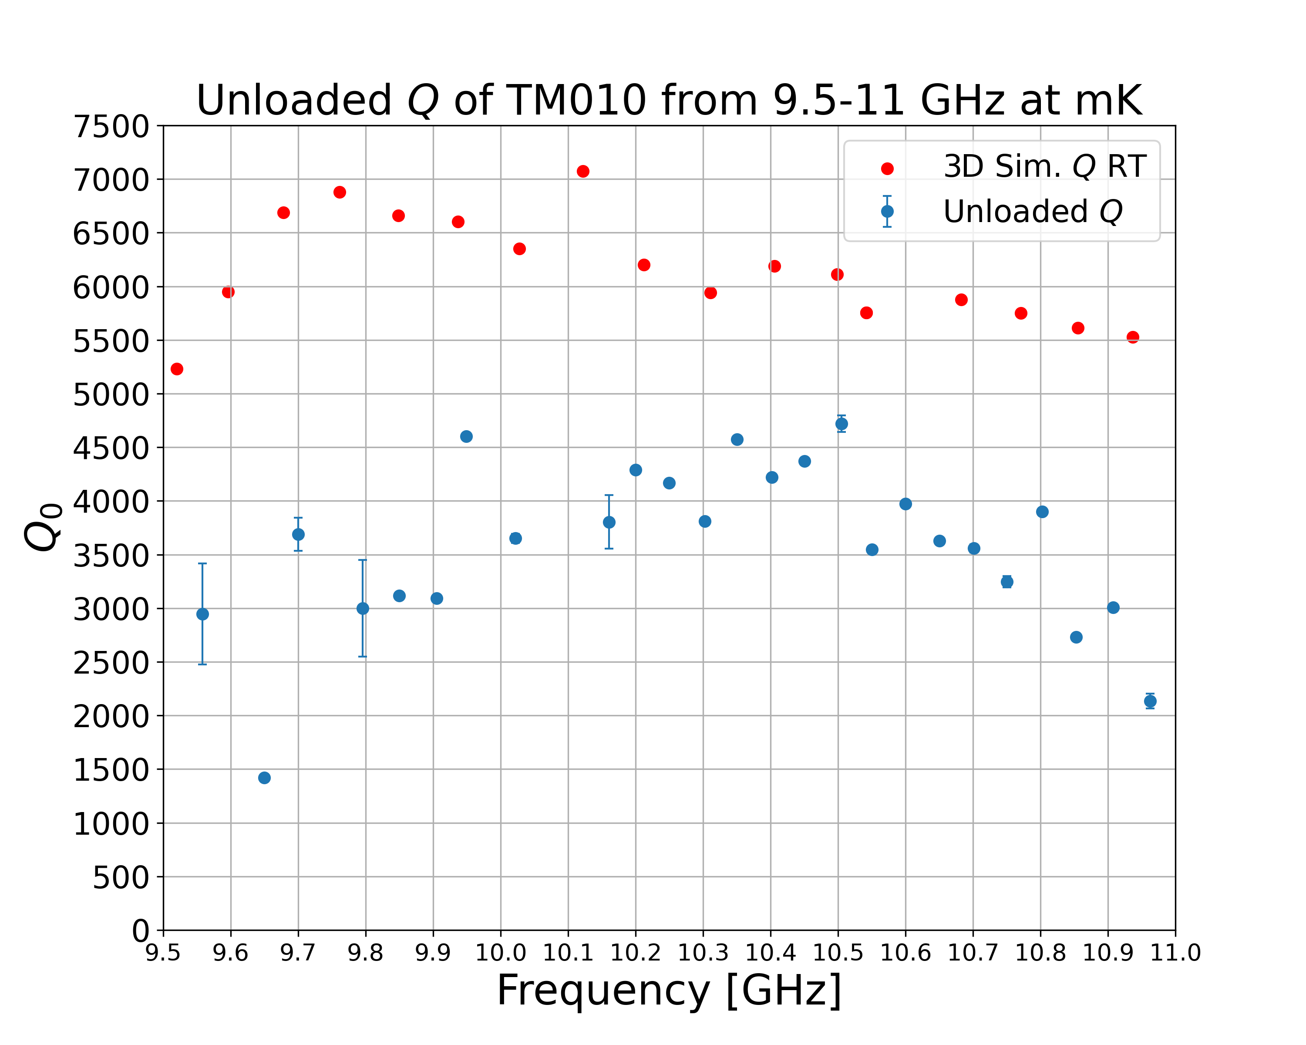
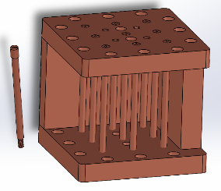
DP Cavity Quality Factor
Factors Affecting the Q
  Contact Resistance
  Surface Roughness
Measured and 3D simulated quality factor at 100 mK
Contact Resistance Test Cavity

Slide 25
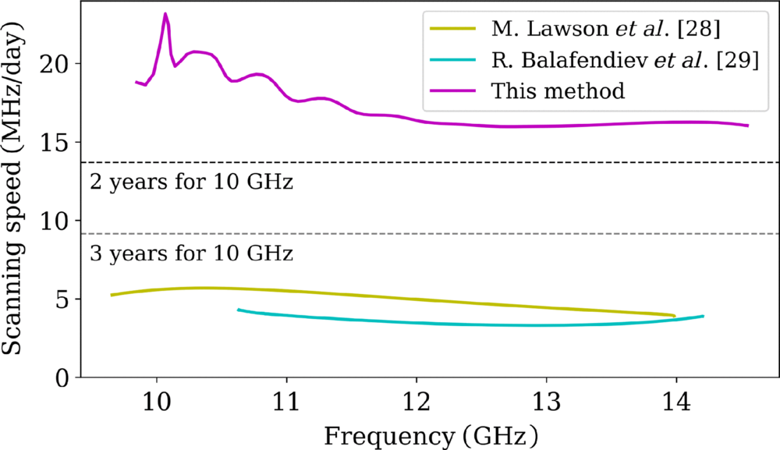
Scanning Rate comparison
Scanning rate comparison for an 8-arm spiral cavity with dominant contribution from spiral packing

Slide 26
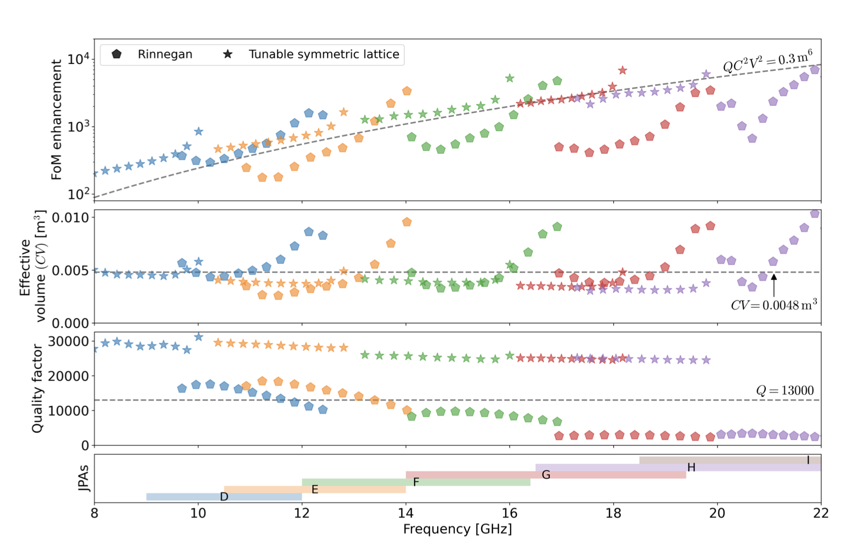
Resonator Scanning Rate Comparison

Slide 27
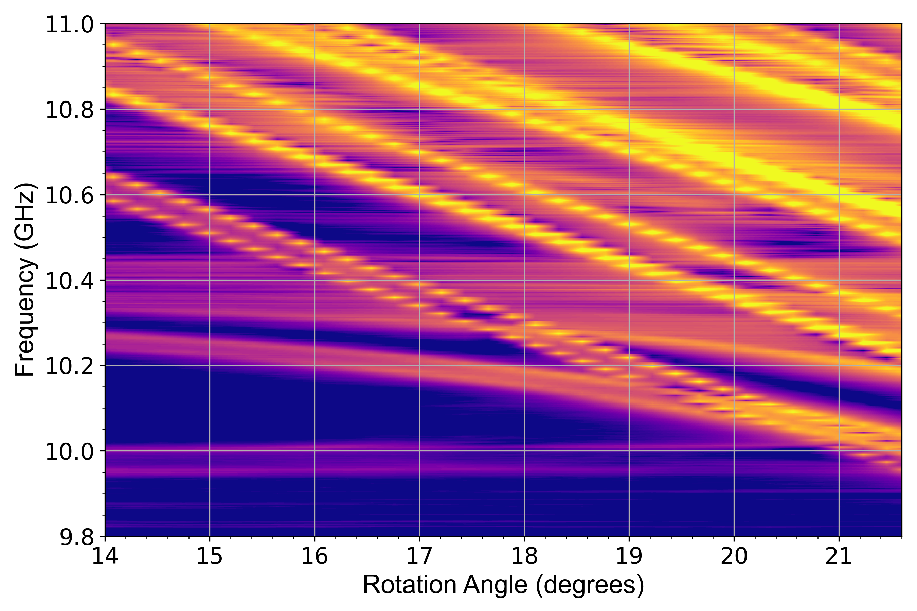
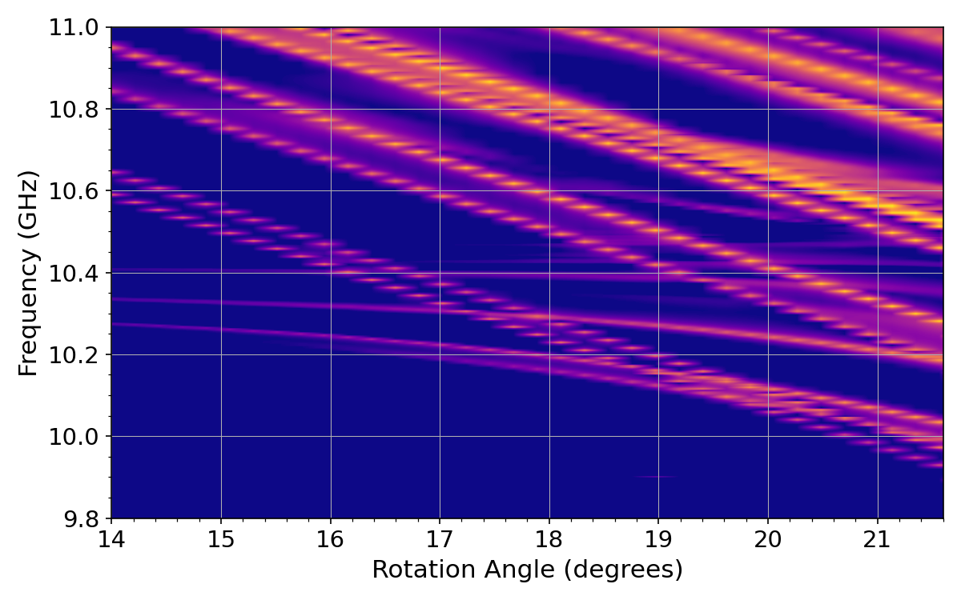
Dark Photon Cavity Modemap
Measured Modemap
3D Simulated Modemap

