Slide 1
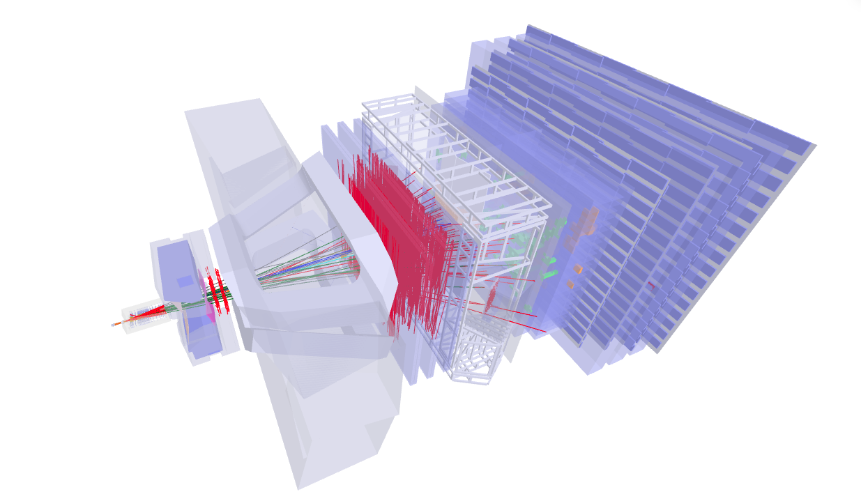





LHCb and Codex-β IGFAE-USC
IGFAE-USC
IGFAE retreat 2026
22 June 2026
https://lhcb-eventdisplay.web.cern.ch/

Slide 2

Research Team 2025-2026
9 Senior Staff:
Paula Álvarez, Xabier Cid (now at CMS and Codex-β), Abraham Gallas, Antonio Romero, Juan Saborido, Cibrán Santamarina, Charlotte Van Hulse (VUB), Pablo Vázquez, María Vieites
Semileptonic B decays
Ions and QCD
Rare B decays
Very rare/Exotica
Instrumentation
Codex-β
Julio Nóvoa
Cristina López
Bhagyashree Pagare (PostDoc)
Alessandra Gioventù (PostDoc)
Clara Landesa
Iván Cambón
Lidia Carcedo
Carlos Barbero
Victoria Valcarce
Juan A. Teijeiro
Samuel Belin (PostDoc)
Javier Dorta
Brais Fernández
Camille Normand (PostDoc)
Richard Williams (PostDoc)
Pablo F. Menéndez
María Pereira (now at CMS)
Alberto Martínez
Alejandro Novo
Brais Fernández
Ángel Morcillo
Miguel Fernández (PostDoc)
Emilio X. Rodríguez (PostDoc)
Titus Mombaecher (PostDoc)
Many on part time dedication
Federico de Benedetti
Francisco Piernas
Efrén Rodríguez
Juan Pablo Escandón
Iris García Rivas
Antonio Fernández (PhD Engineer)
Eliseo Pérez
Antonio Pazos
+ several students working on TFG, TFM projects
Notes:
VUB : VRIJE UNIVERSITEIT BRUSSEL

Slide 3
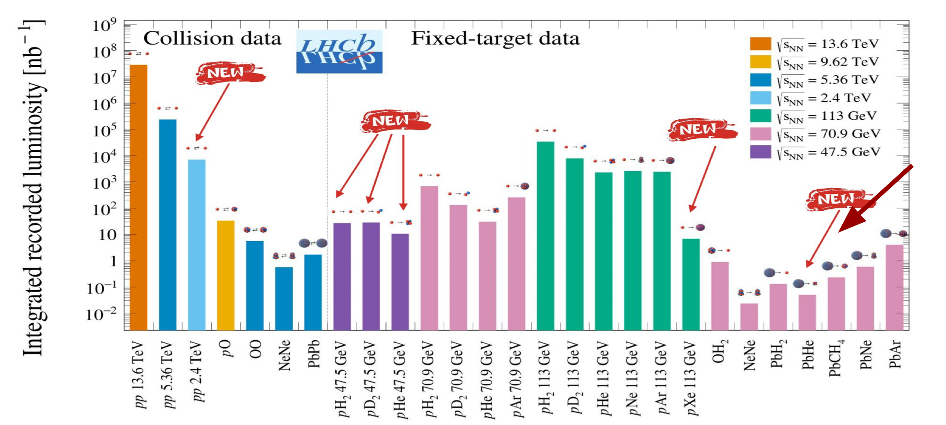



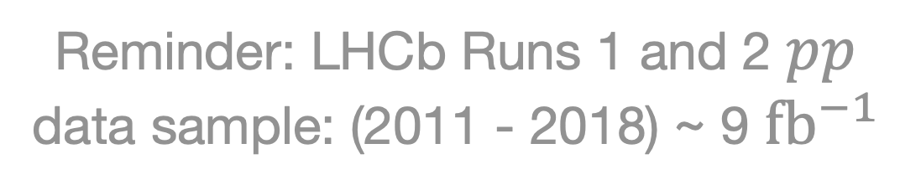
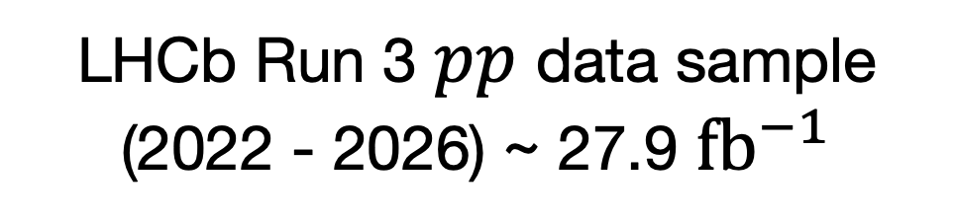
LHCb Run 3: Upgraded Detector Data
Total of 27 collision systems!
Reminder: LHCb Runs 1 and 2 $pp$ data sample: (2011 - 2018) ~ 9 ${fb}^{−1}$
LHCb Run 3 $pp$ data sample (2022 - 2026) ~ 27.9 ${fb}^{−1}$
Fixed target, injecting different gasses in the collision region
Finishing “Run 2” analyses
Starting “Run 3” analyses, with much increased (or new/better) data samples
Notes:
LHCb Run 3: Data with the new detector
pp 2.4 TeV: Special LHC Low Energy Run – LHCb goes to space: pH2 and pD2 antiproton production low sqrt(sNN) = 47.5GeV.
A 2-day run – at 1.2 TeV instead of 6.8 TeV per beam – enables a range of unique physics measurements. The primary goal is to provide crucial input into the interpretation of measurements of antimatter production in cosmic rays from space-borne experiments such as AMS and PAMELA. Deviations from the expected antimatter abundances can serve as a test for for the presence of Dark Matter. However, reducing cross-section uncertainties in the theoretical inputs is essential to verify that such observations cannot be explained by standard astrophysical processes.

Slide 4

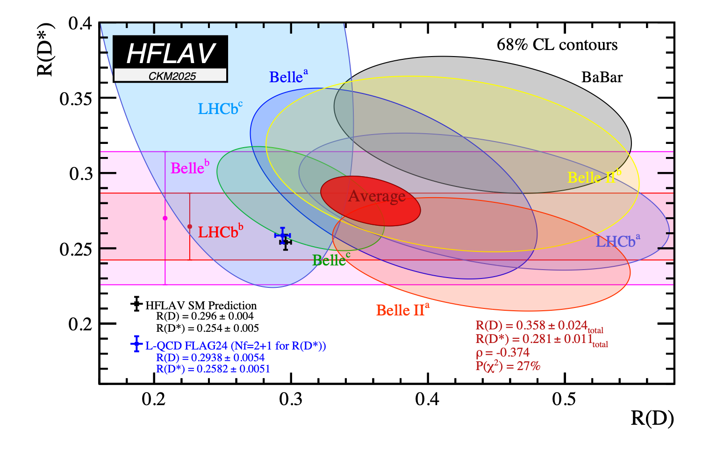
Main physics analysis lines: SL
Comparison between semitauonic (𝜏) and semimuonic (𝜇) decays sensitive to NP, which could modify branching fractions and angular distributions $→$ Tensions with the SM seen, strong interest in new measurements to clarify experimental/form factor related effects.
Semileptonic B decays
Julio Nóvoa
Cristina López
Bhagyashree Pagare (PostDoc)
Alessandra Gioventù (PostDoct)
2 Run 2 analyses ongoing. One of them at LHCb Review Committee (RC) stage (publication expected this year)
Both analyses being updated with Run 3 data.

Slide 5
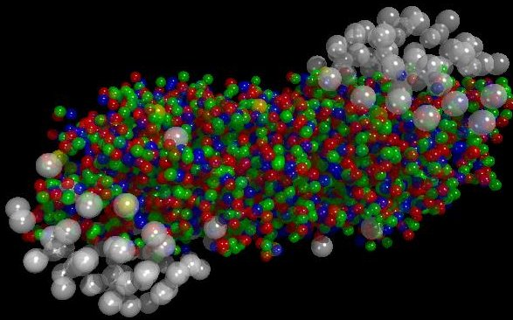
Main physics analysis lines: IFT and QCD
Exploit the very rich and abundant data samples with ions to pin-point Quark Gluon Plasma phenomenology, disentangling Cold-Nuclear-Matter effects and isolating newly observed phenomena (collectivity, strangeness suppression, nuclear modification factor, multiplicity dependent observables, temperature of the QGP …)
Ions and QCD
Clara Landesa
Iván Cambón
Lidia Carcedo
Carlos Barbero
Victoria Valcarce
Juan A. Teijeiro
Samuel Belin (PostDoc)
(+Sara Sellam’s analysis)
1 thesis defended last year / another one to be defended tomorrow
3 analyses in RC stage
Mostly ongoing analyses with Run 2 data samples (lead-lead, p-lead)
3 theses in progress with Run 3 data samples
2 theses in progress focused on spectroscopy and hadronic properties
Very significant work on enabling data taking (trigger and reconstruction sequences) as well as on performance improvements (w.r.t. pp data taking algorithms)
Notes:
Ion Physics and Fixed Target

Slide 6
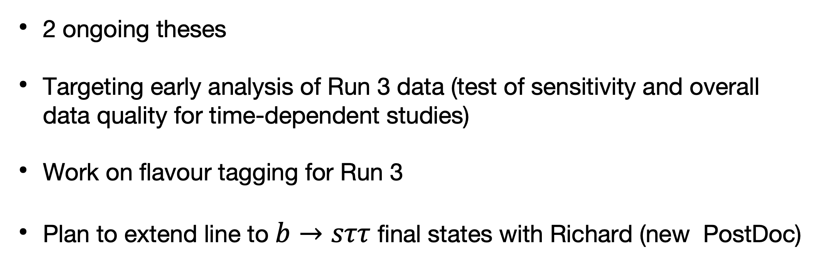
Main physics analysis lines: RD
Emerging line, started end of last year. Targeting time-dependent CP asymmetry measurements in rare $b→d(s)μμ$ B decays, particularly, in modes like $B^{0}→K_{S}^{0}μμ$ and $B_{s}^{0}→f^{0}(980)μμ$.
Mixing-induced and direct CPV
Rare B decays
Javier Dorta
Brais Fernández
Camille Normand (PostDoc)
Richard Williams (PostDoc)
2 ongoing theses
Targeting early analysis of Run 3 data (test of sensitivity and overall data quality for time-dependent studies)
Work on flavour tagging for Run 3
Plan to extend line to $b→sττ$ final states with Richard (new PostDoc)

Slide 7
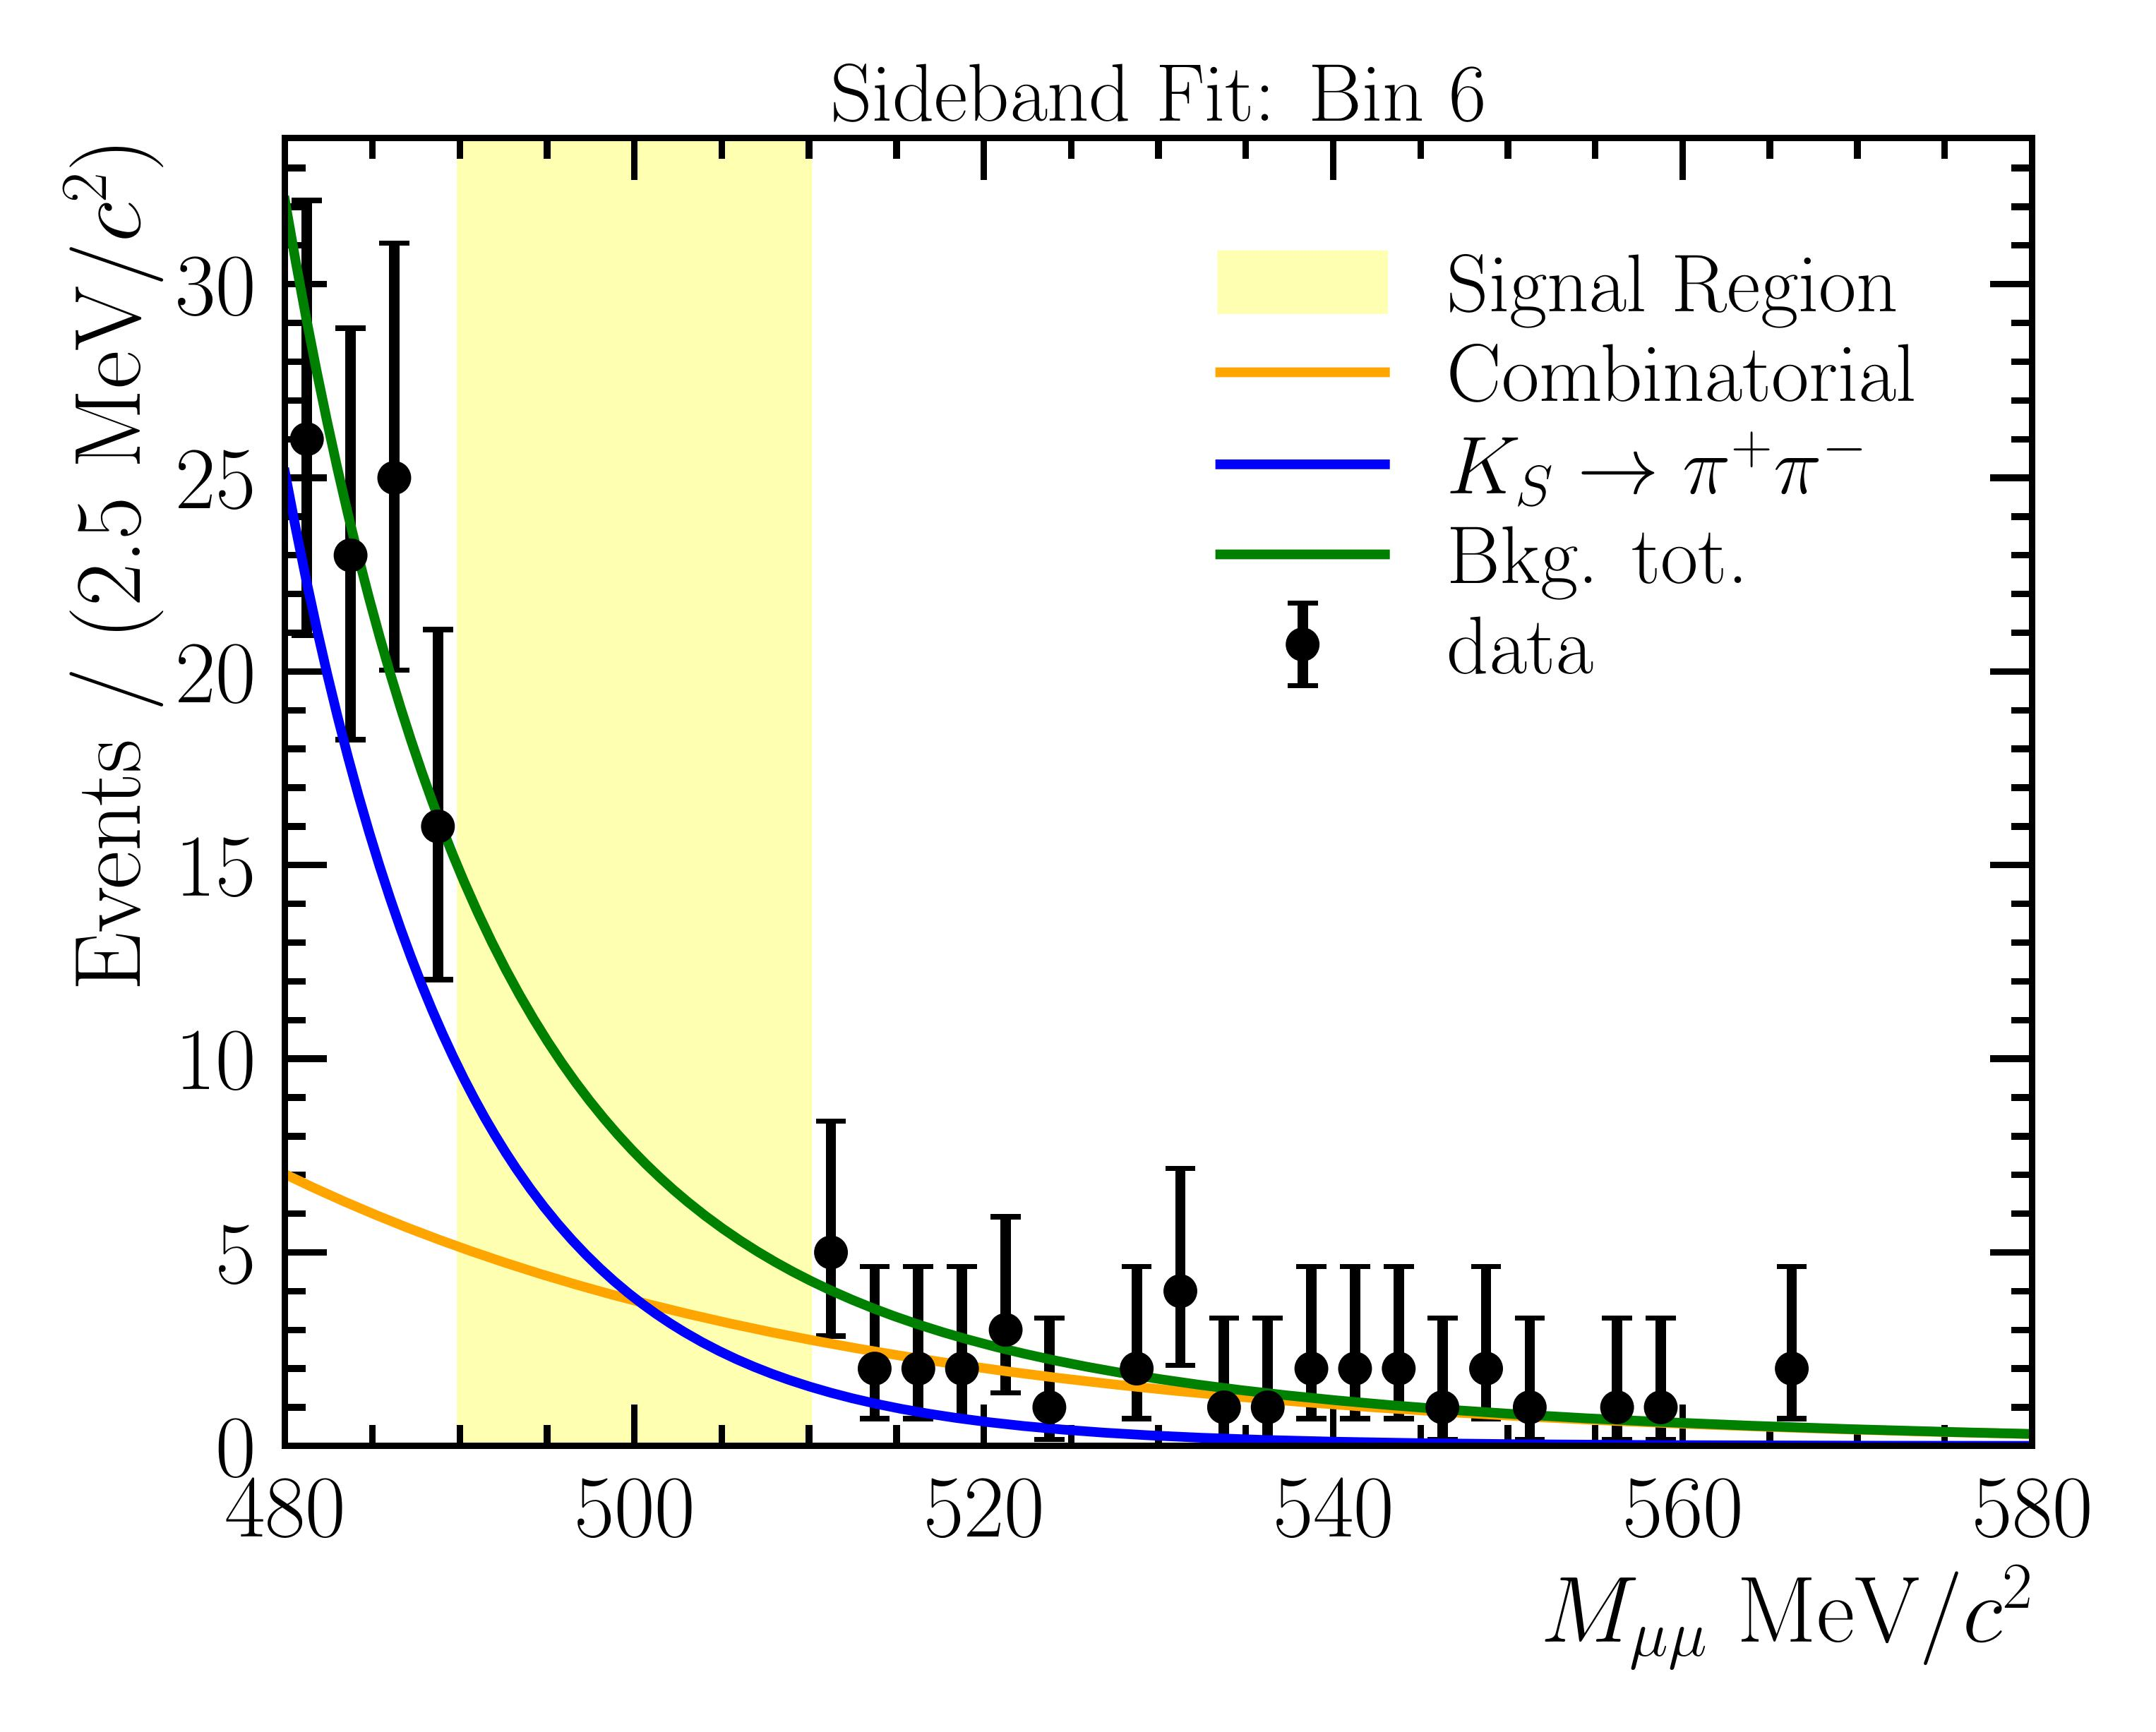
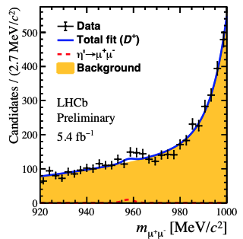
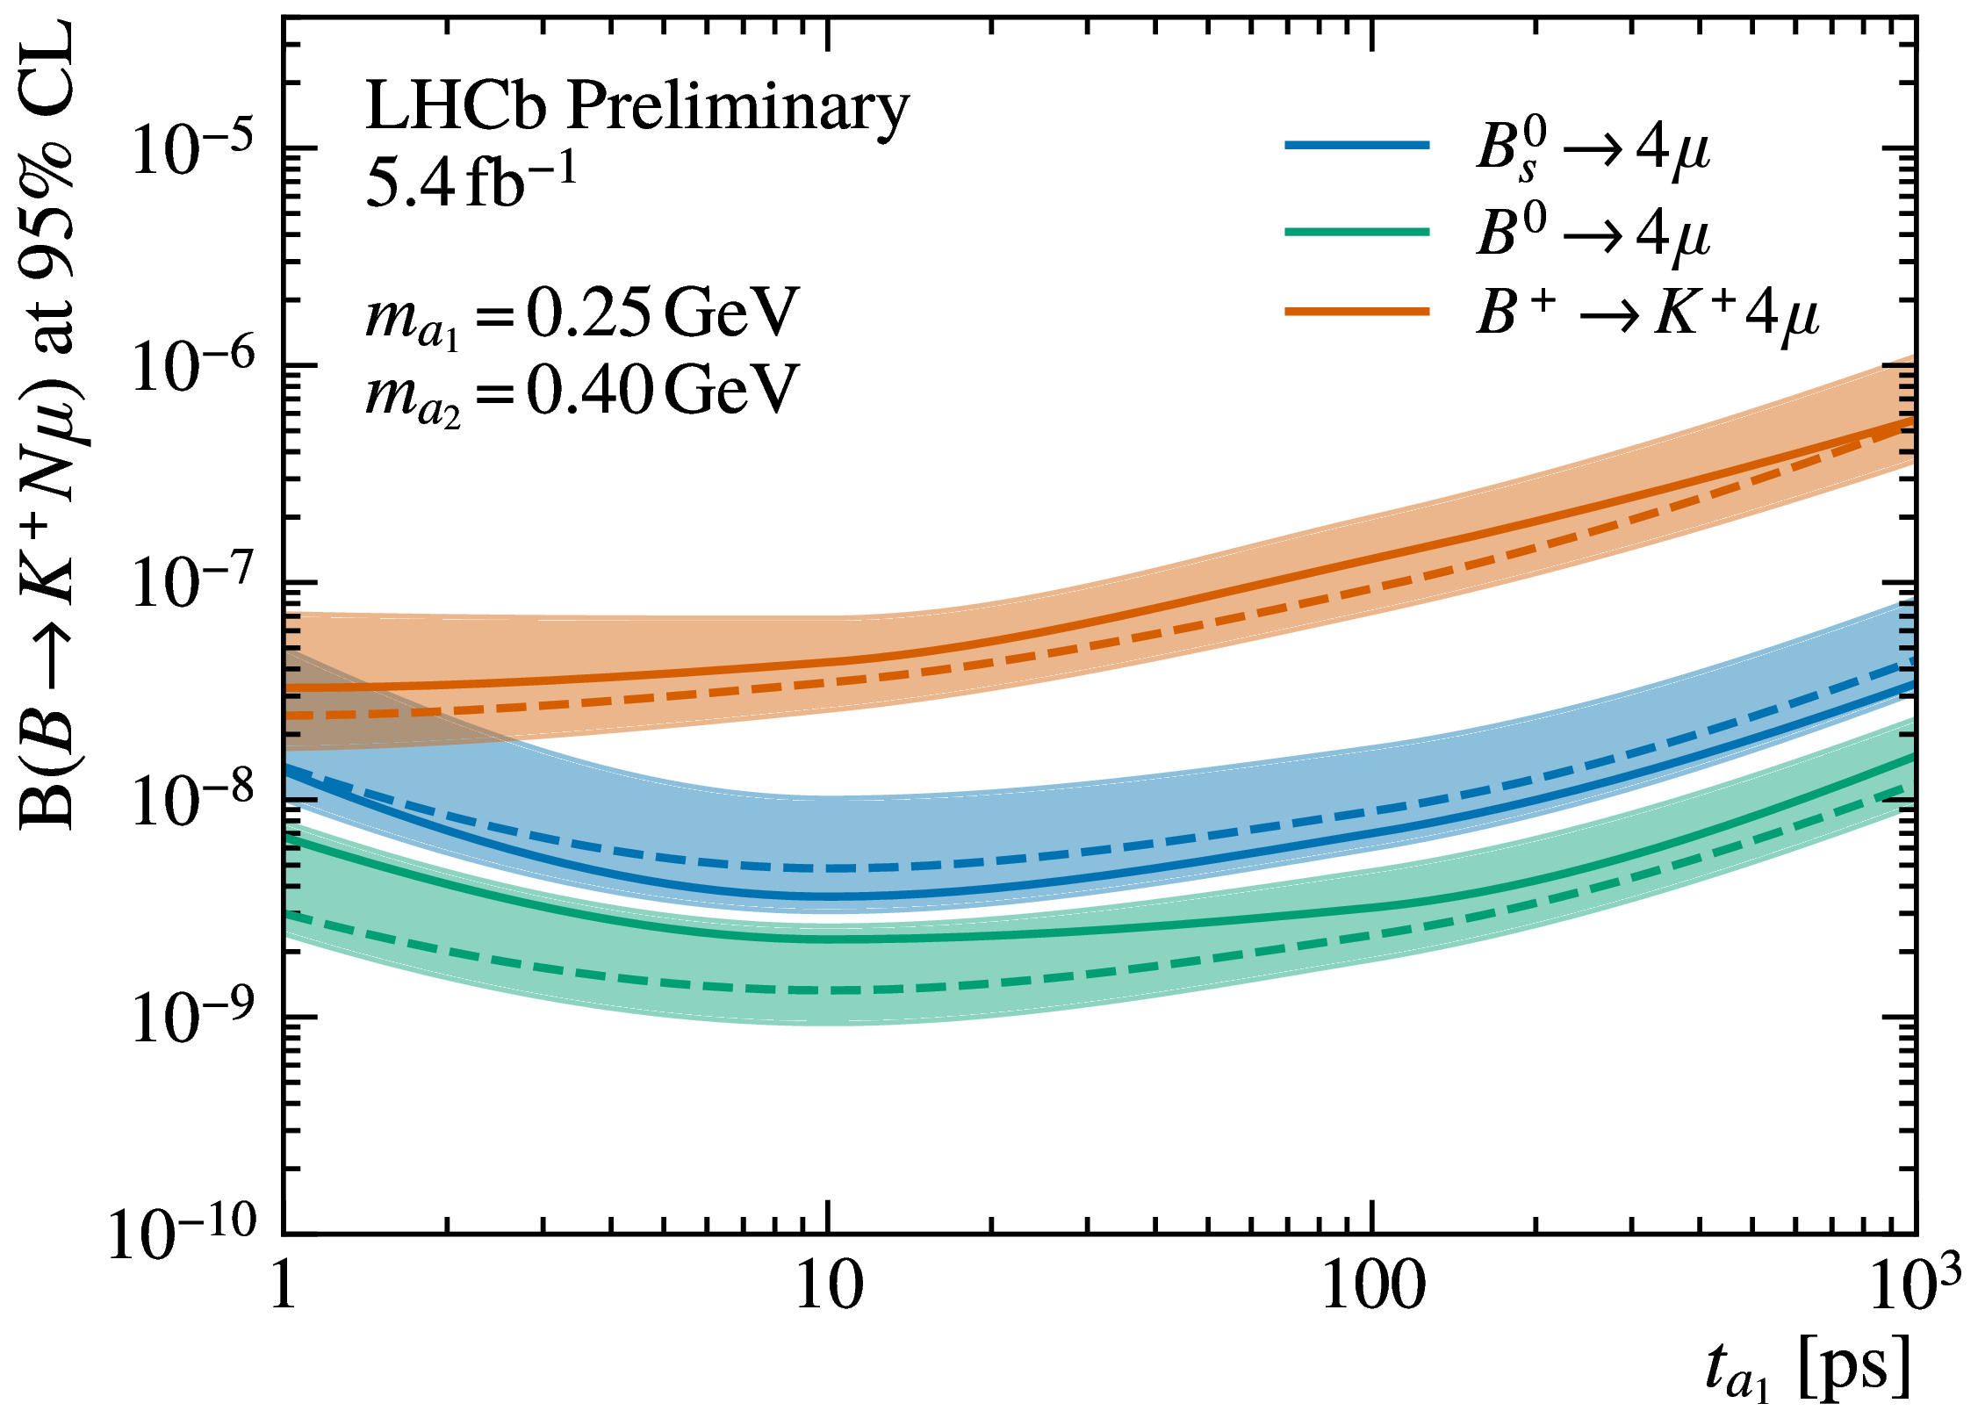
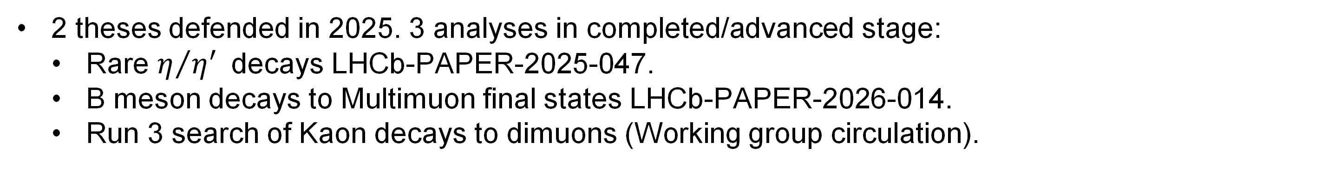
Main physics analysis lines: Very rare/Exotica
Exotica searches: very active line with many complementary analyses. Focusing on signatures of direct DM production as well as very searches for rare/suppressed decays and of long-lived particles: rare charm decays, direct DM production, very rare B decays, ALPs, …
Very rare/Exotica
Pablo E. Menéndez
María Pereira
Alberto Martínez
Alejandro Novo
Brais Fernández
Ángel Morcillo
Miguel Fernández (Postdoc)
Emilio X. Rodríguez (Postdoc)
Titus Mombaecher (Postdoc)
2 theses defended in 2025. 3 analyses in completed/advanced stage:
  Rare $η/{η^{′}}$decays LHCb-PAPER-2025-047.
  B meson decays to Multimuon final states LHCb-PAPER-2026-014.
  Run 3 search of Kaon decays to dimuons (Working group circulation).
  Search for invisible DM decays and direct searches for Dark Sector decays.
New Machine Learning trigger techniques for exotic topologies.

Slide 8
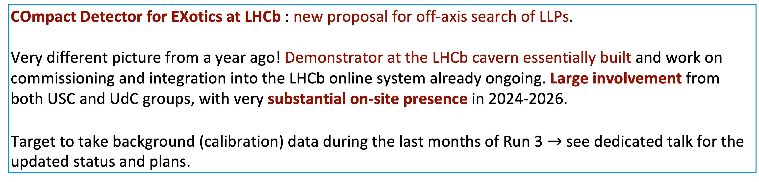
Instrumentation: LHCb Upgrade and CODEX-b
Instrumentation
LHCb instrumentation: VELO project. Very significant contributions to the electronics and read-out systems of the current VELO, plan to work on consolidation and maintenance of this detector during LS3.
Broad lines for VELO Upgrade II (4D tracking): contribute to the construction of detector modules, develop data acquisition and control systems, and verify Front-End ASICs and sensors.
Federico de Benedetti
Francisco Piernas
Efrén Rodríguez
Juan Pablo Escandón
Antonio Fernández (PhD Engineer)
Eliseo Pérez
Antonio Pazos
Iris García Rivas
COmpact Detector for EXotics at LHCb : new proposal for off-axis search of LLPs.
Very different picture from a year ago! Demonstrator at the LHCb cavern essentially built and work on commissioning and integration into the LHCb online system already ongoing. Large involvement from both USC and UdC groups, with very substantial on-site presence in 2024-2026.
Target to take background (calibration) data during the last months of Run 3 $→$ see dedicated talk for the updated status and plans.
Codex-β
Alejandro Novo
Alberto Martínez

Slide 9
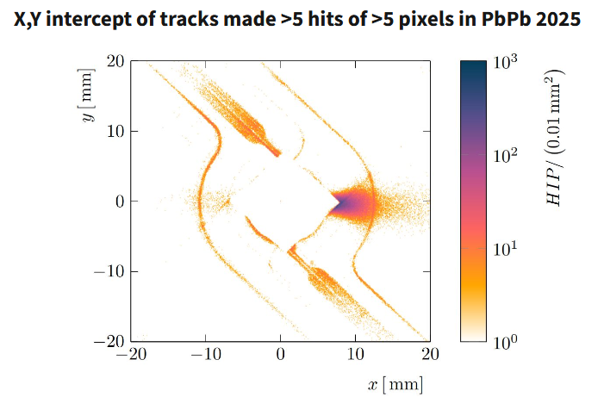
VELO operations
In 2025 at the beginning of the ion run several ASICs (across 7 modules) were damaged during the operation
  Run until the 2026 long shutdown of the LHC at 400V.
  Impact on data quality
Issue involve a mix of the high voltage, sensor behaviour, ASIC and beam background condition
  On-going studies to understand the failure
Module replacement during LS3
VELO piquet Shifts (Kudos to Cristina, Adrián)

Slide 10
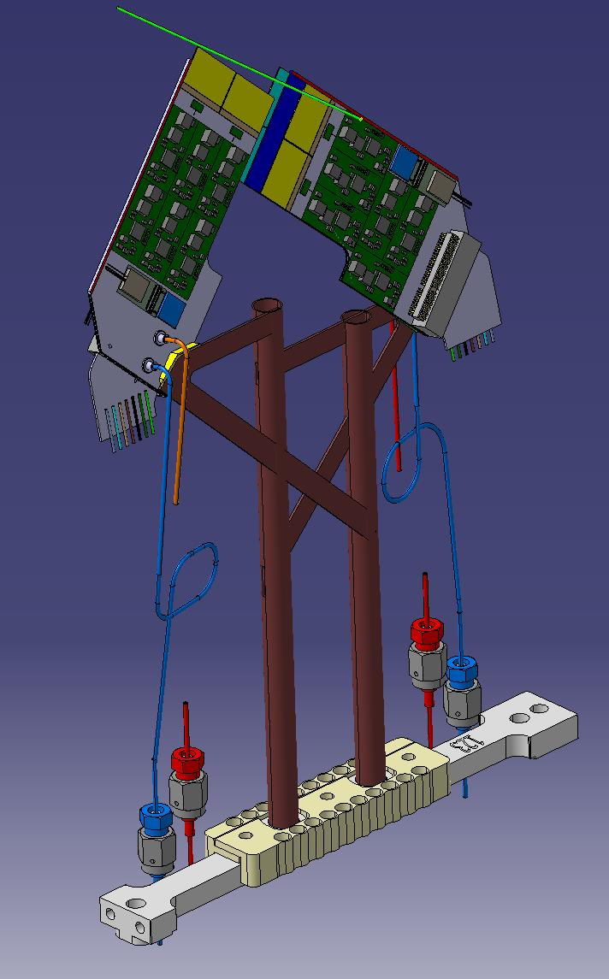
VELO Upgrade II
Converging different R&D lines towards TDR (Q1 2027)
Mechanics: Considered detector on primary vacuum. Now evaluating secondary vacuum with 300μm Beryllium box
Sensors: 3D
ASICs: New generation of ASICs taped out by TDR
Electronics:
  Designing the first module prototypes
  Silicon photonics readout preferable solution
Notes:
On 17th June the CERN Research Board gave green light to go to TDR phase of Upgrade II

Slide 11
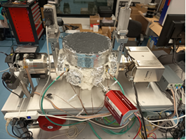
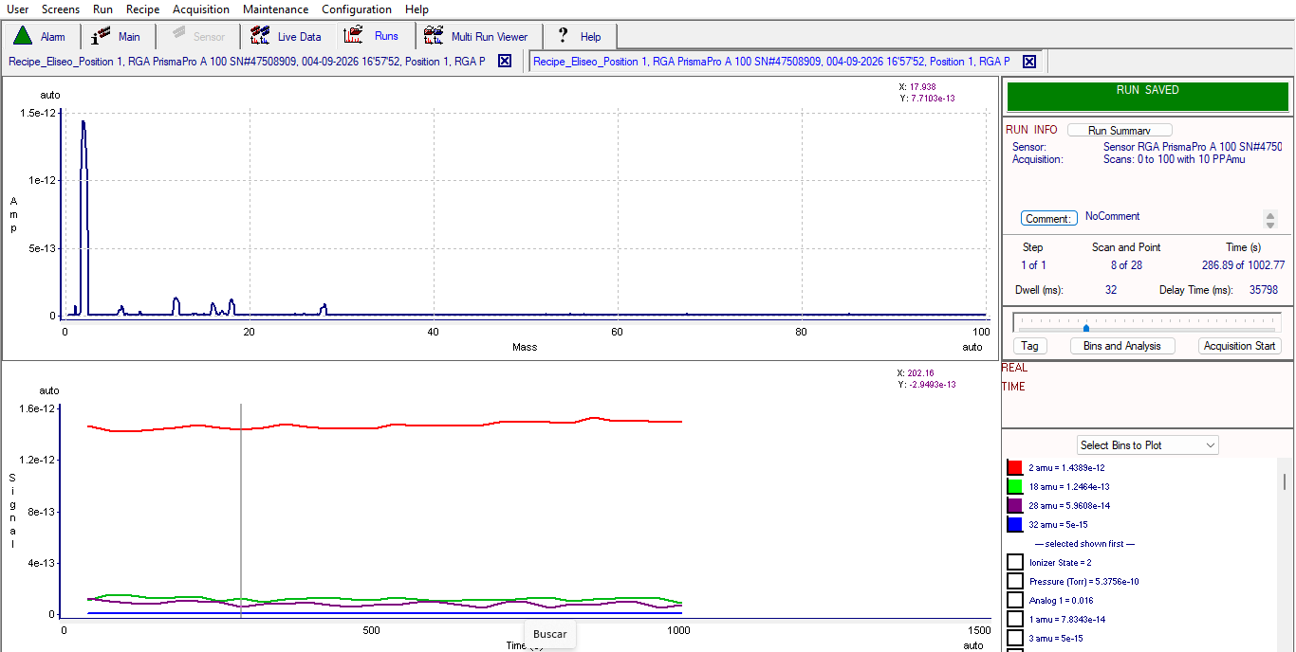
VELO upgrade II
The role of IGFAE for VELO Upgrade II
Sensor development
  3D sensor productions running in FBK and Sintef
  Sensor characterization.
  TimePix 4 beam telescope paper published on NIMA
  Exploring hybridization and sensor integration at INL (Braga)
  Developing new sensors (SiEM). PhD Federico de Benedetti
Electronics
  Setting the specs for ASIC design. Two LHCb technical notes
  Developing control and DAQ electronics.
  Converging to module design
  PhD Francisco Piernas Díaz
Vacuum compatibility
  Outgassing setup: 10⁻¹⁰ mbar, 230ºC, gas composition spectrometer (RGA)
  To test: ceramics, optical fibres, feedthroughs, PCBs, foil samples, etc.

Slide 12
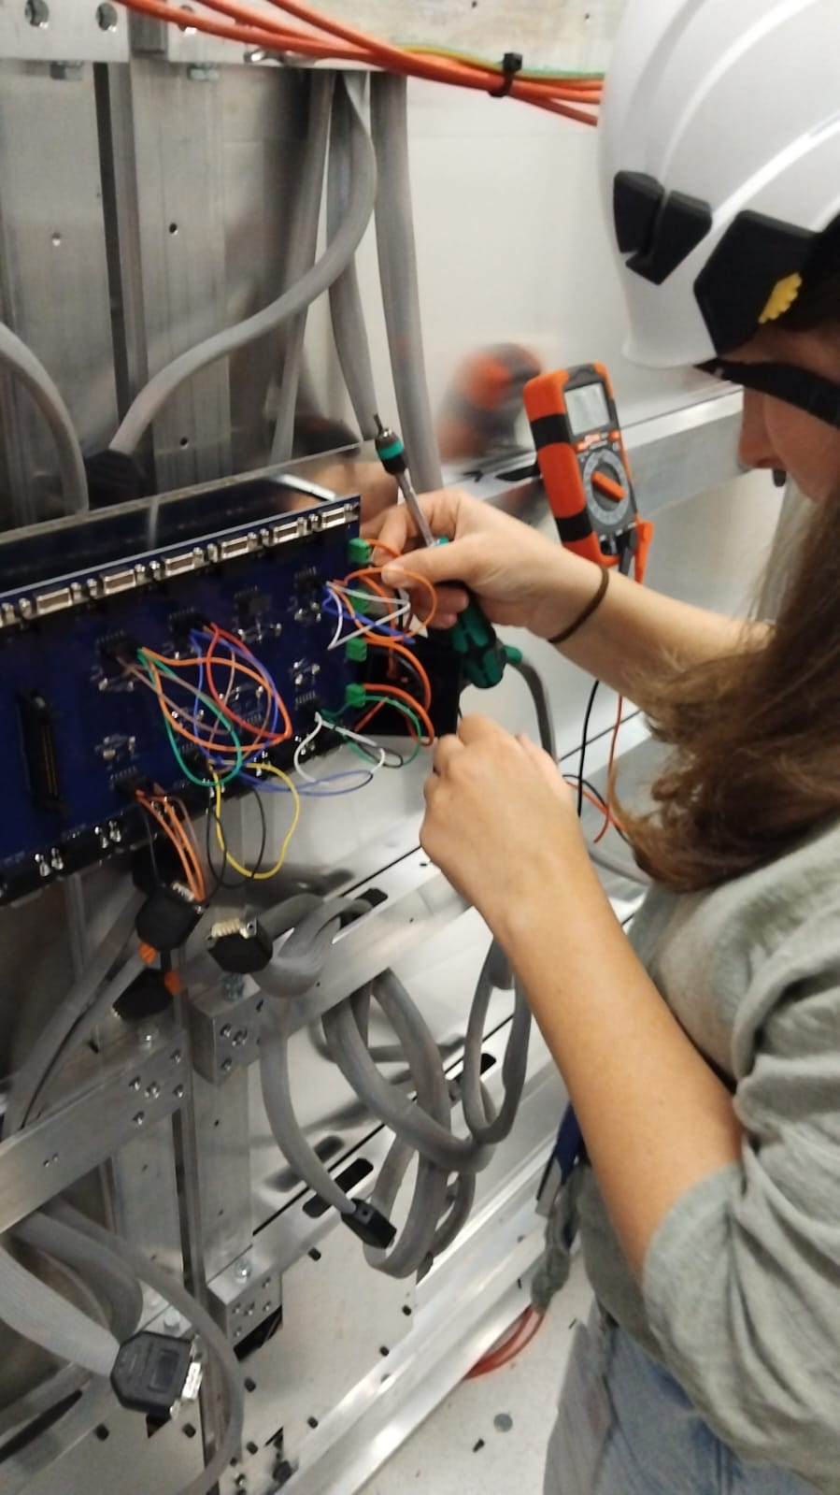
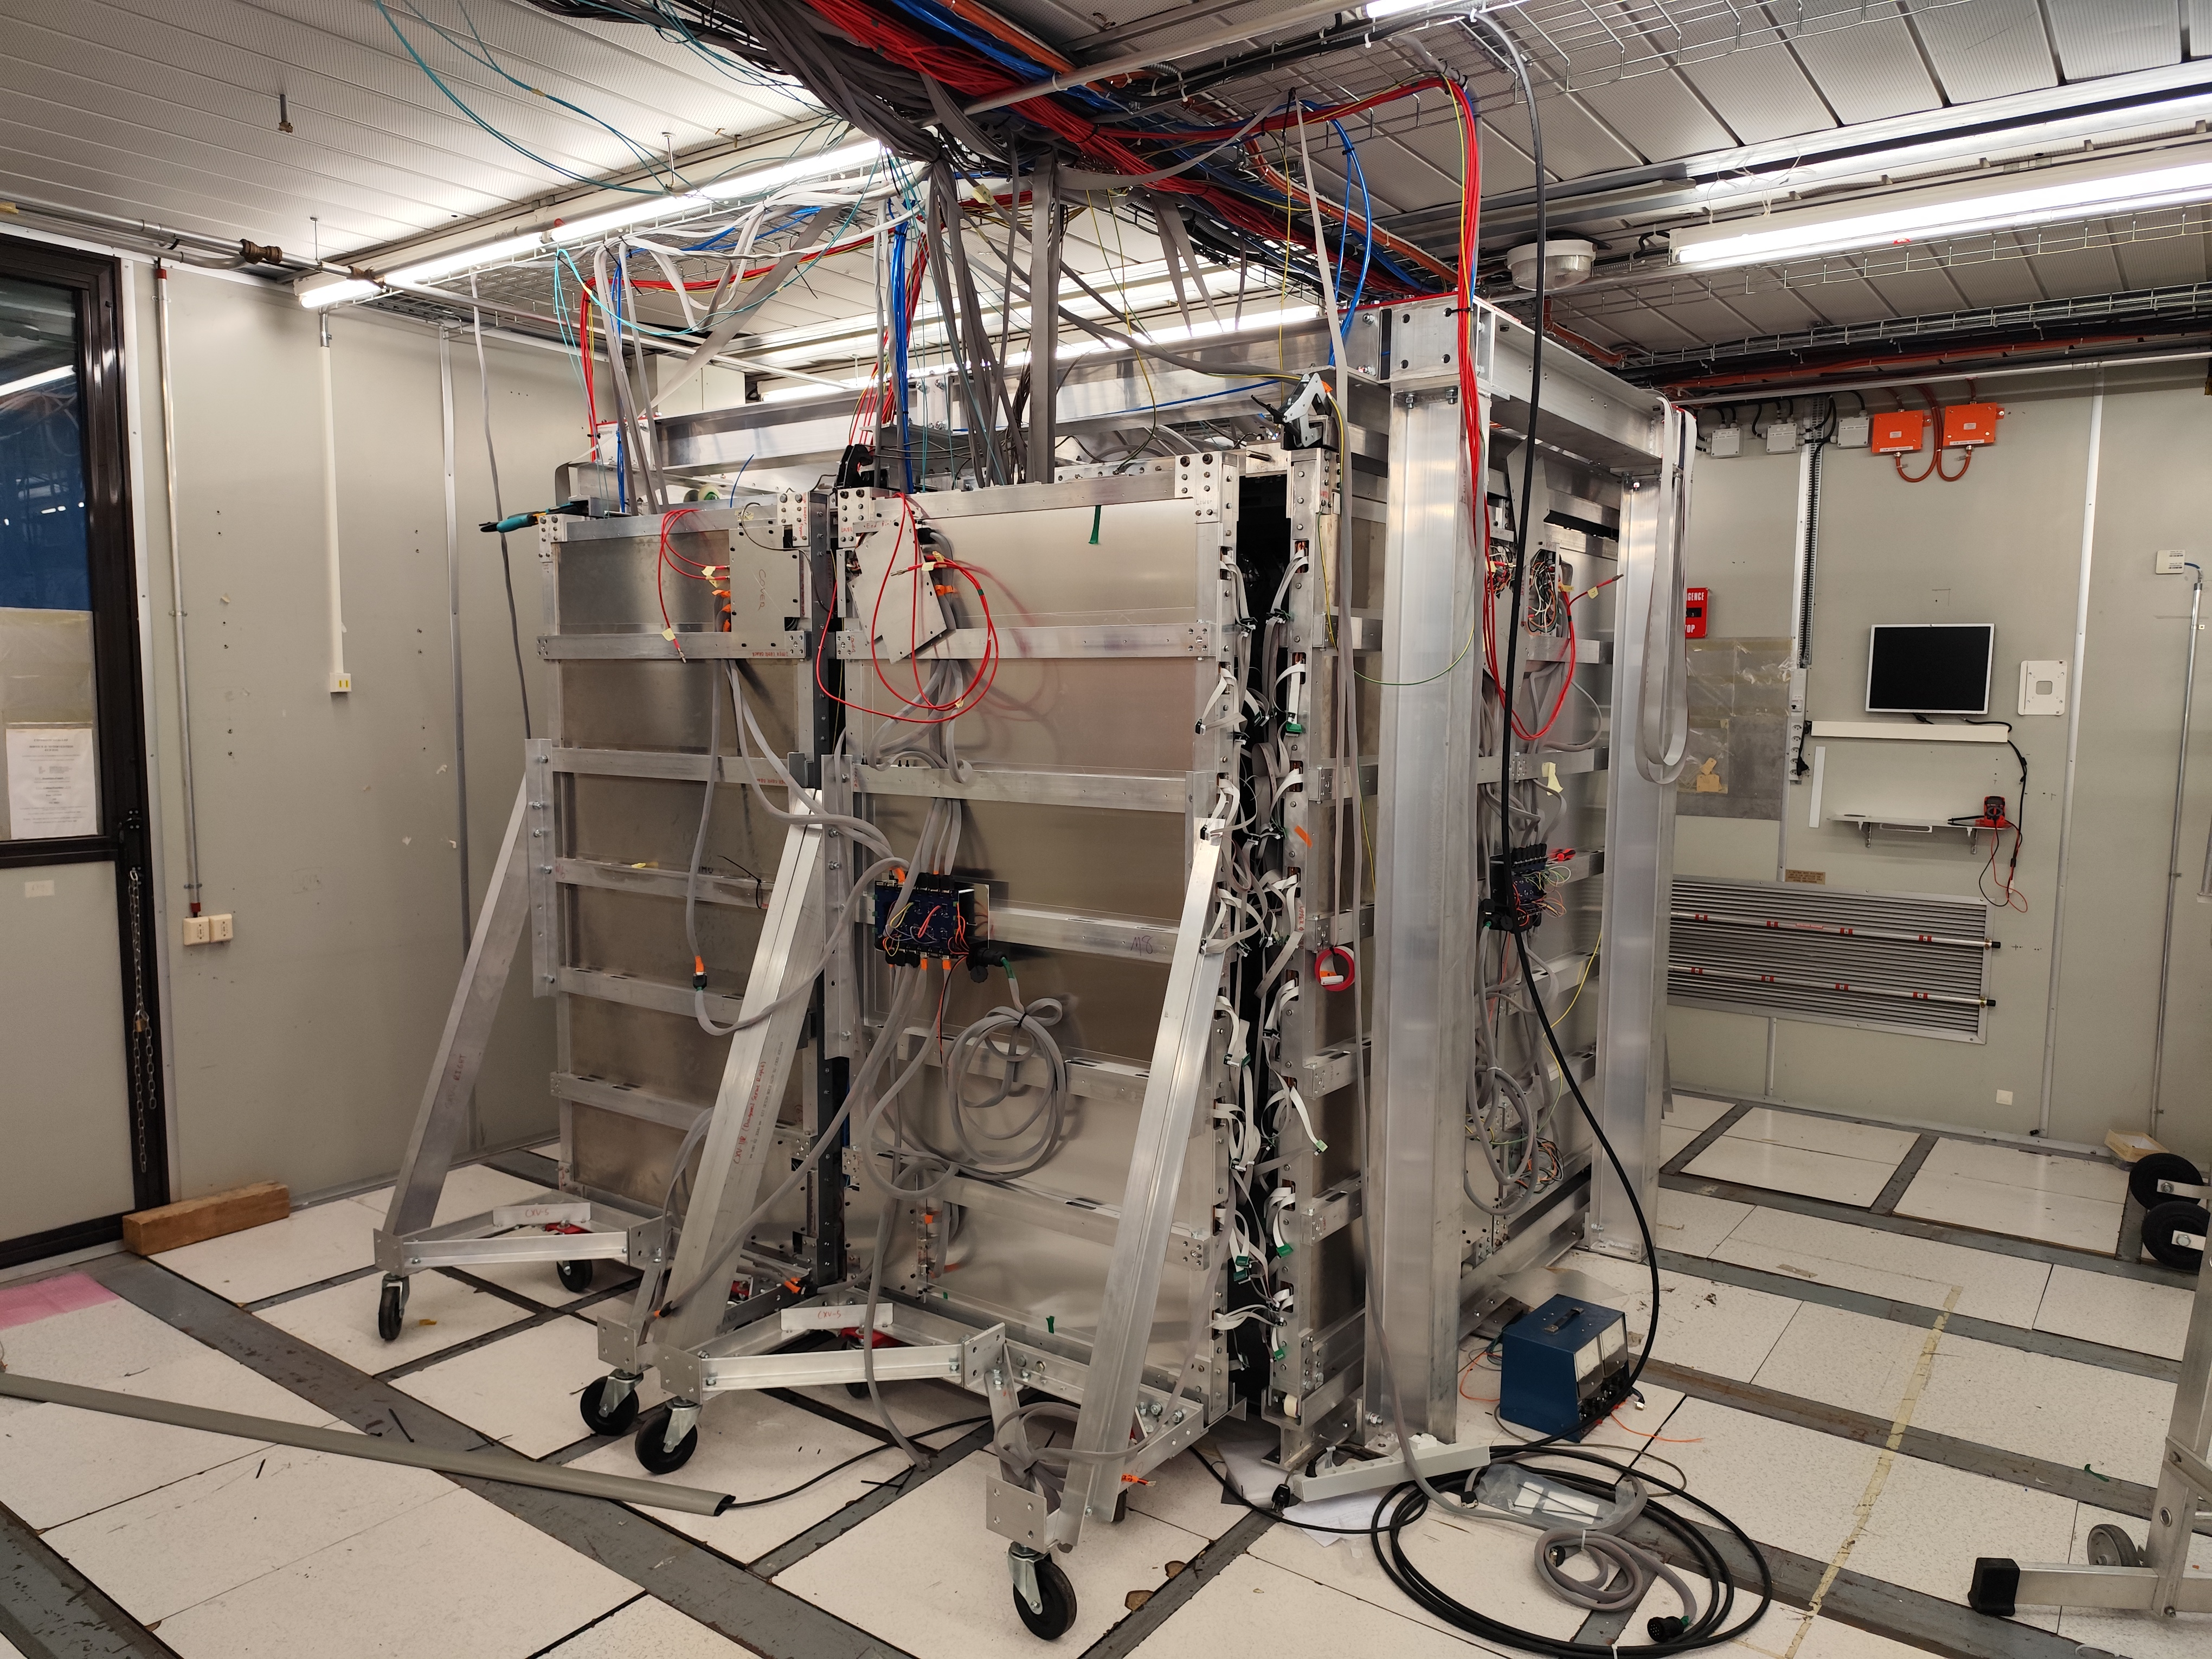
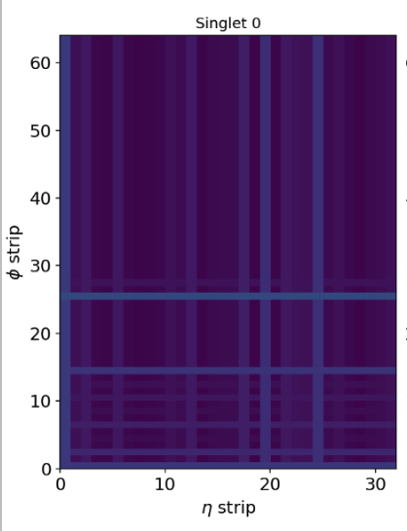
CODEX-β
Installation of a reduced-size prototype CODEX-beta completed during Run 3.
Hardware:
  RPC triplets installed and tested.
  Service routing (Low Voltaje/High Voltaje/Gas) completed.
  DAQ units connected and integrated within LHCb readout.
Software:
  Trigger and reconstruction implemented: time alignment in progress.
  ECS integrated with LHCb.
  Simulation software.
  Offline analysis framework COBRA.

Slide 13
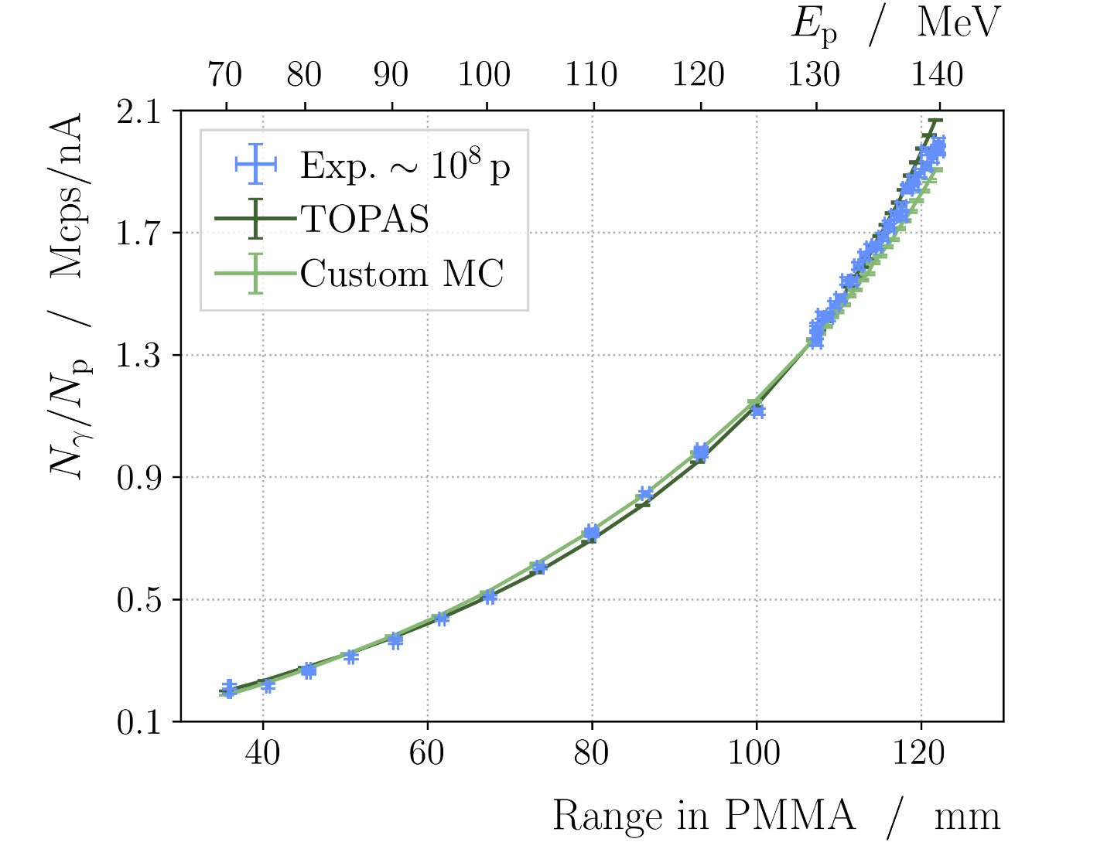
Beyond LHCb
Proton therapy. PhD Iris García Rivas
Proof of principle demonstrated
  Publication of detector hardware on JINST
  Publication with clinical beam submitted in May 2026
DRD3. IGFAE IGNITE.
  Goal is to position the institute on key detector technologies towards FCC-ee
  (Monolithic Active Pixel Sensors- DMAPS)
  Collaboration with IFIC & IFCA to build a telescope based on Belle II DMAPS ASICs
  IGFAE is focus on system integration and DAQ electronics
DRD7. IGFAE IGNITE
  Goal is to develop the next gen. of radiation hard high-speed transceivers
  IGFAE is focus on the operation of these devices at extreme environments (like VELO)
Notes:
PMMA (Poly(methyl methacrylate))

Slide 14
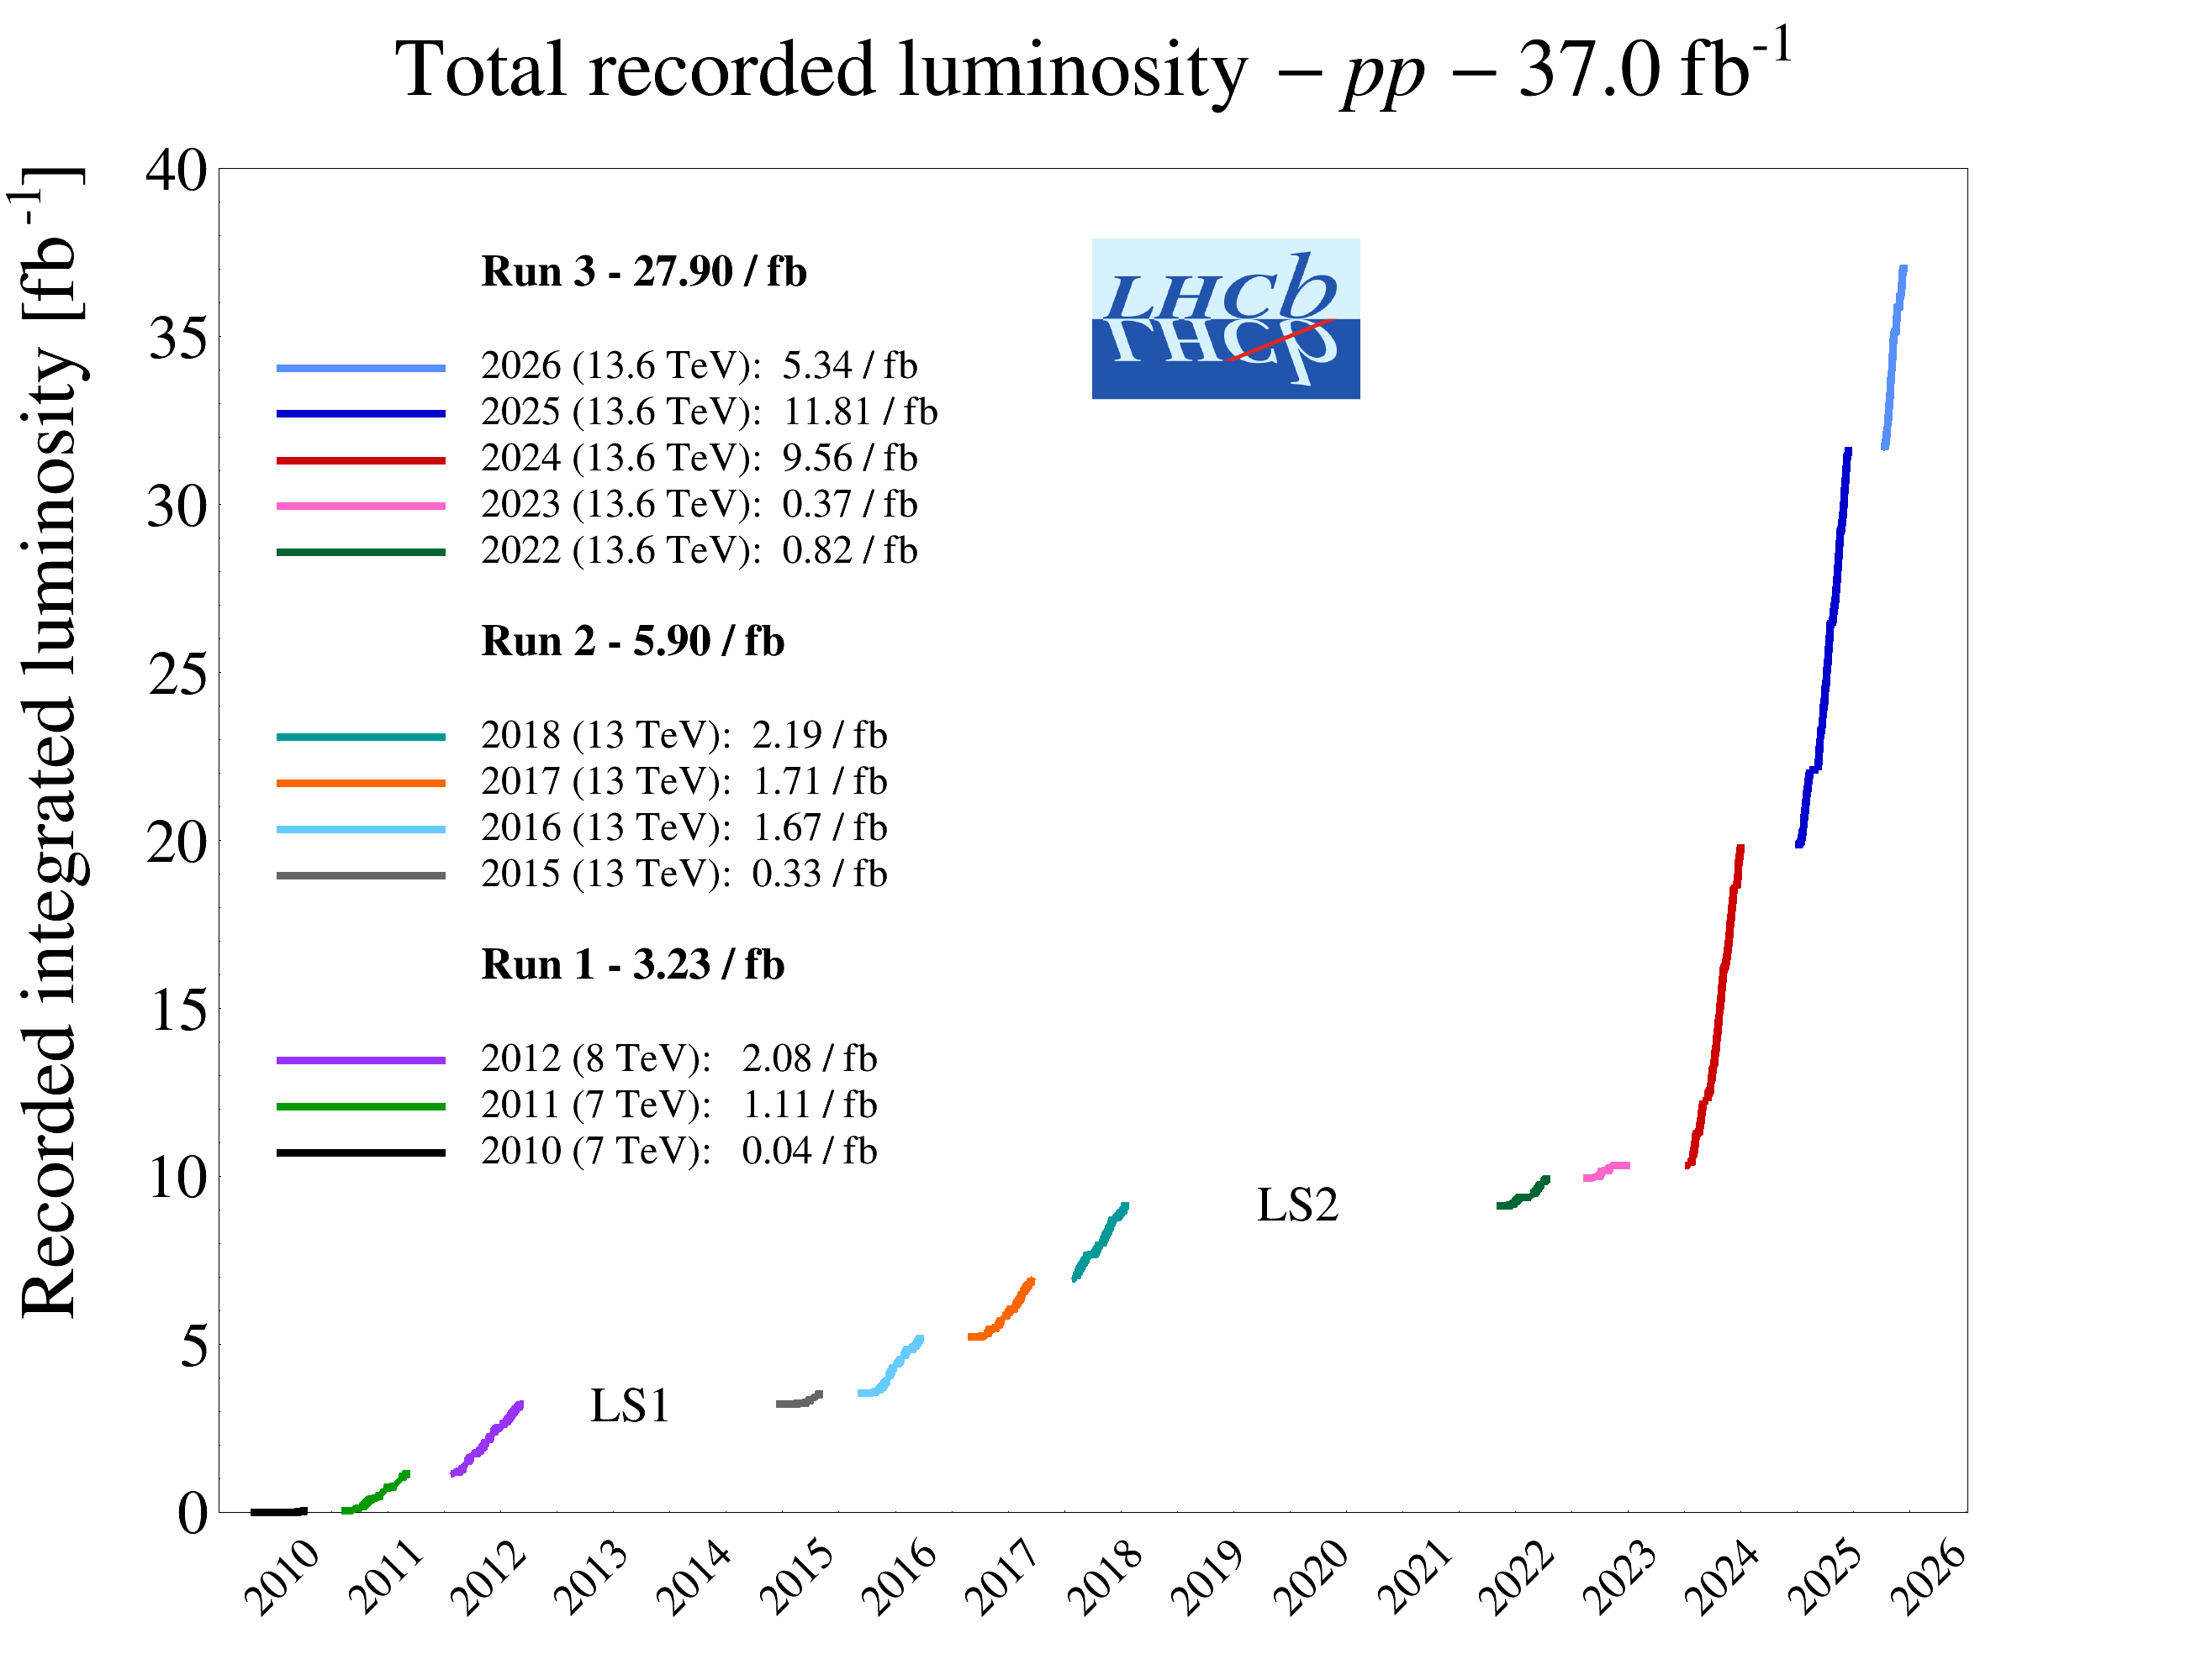
Summary
Very active group, broad physics programme
  Did not mention every single analysis on this talk, focused on describing strategic lines
  Physics-output oriented, many developments of tools and internal LHCb/Codex-b software not covered
Long-term planning and involvement in instrumentation, mainly, through the LHCb VELO system, but also participating in the DRD3 and DRD7 collaborations for future developments.

Slide 15
Backup slides

Slide 16
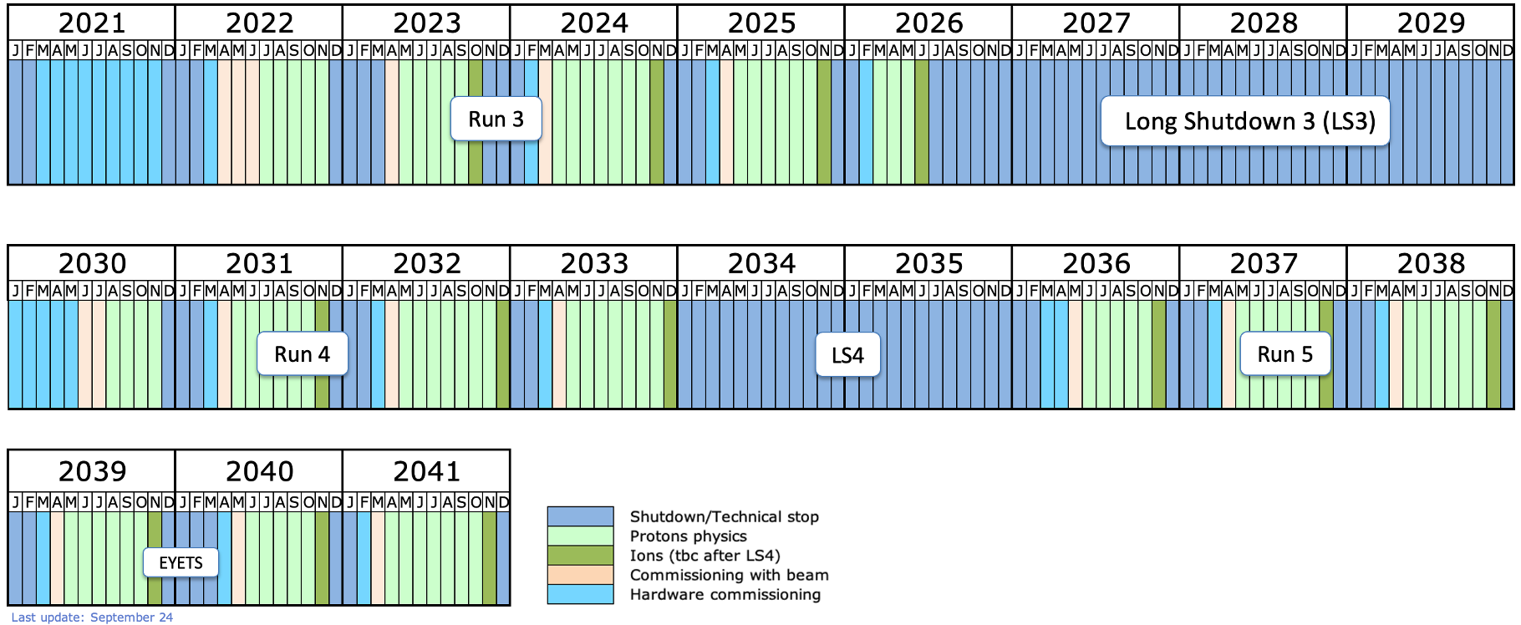
LHC Schedule
ATLAS, CMS UPGRADES. HL-LHC installation
LHCb-II, ALICE3 upgrades (tbc)

Slide 17
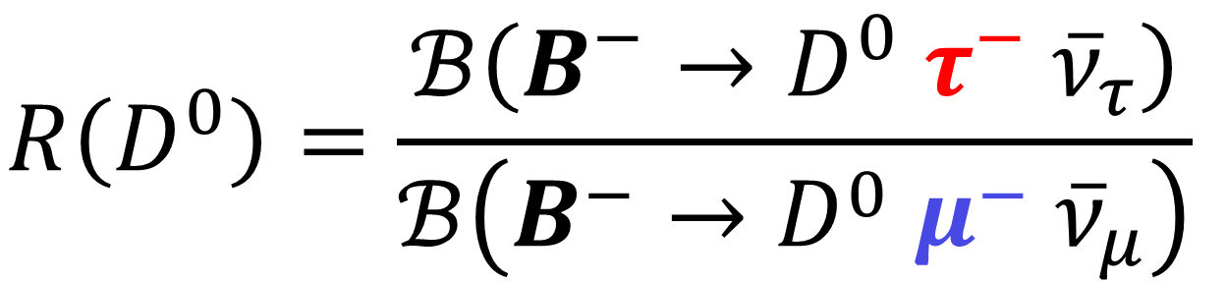
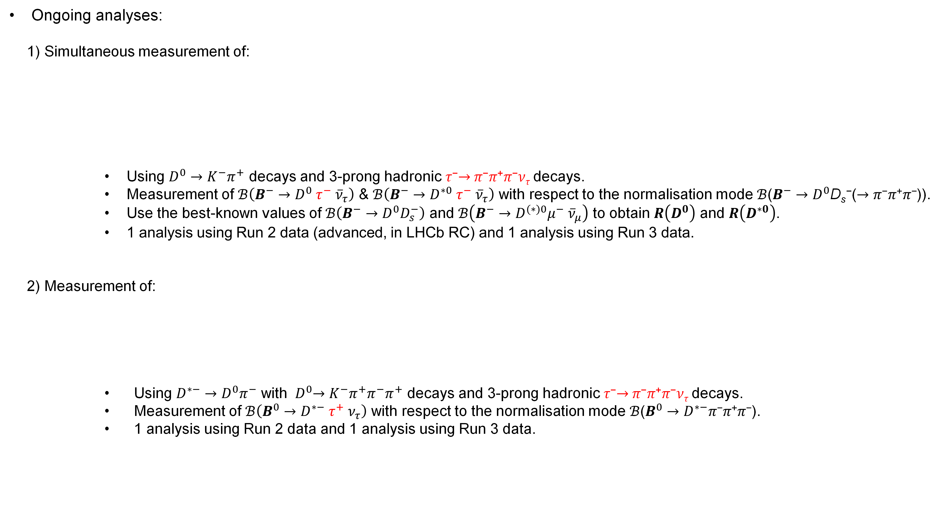
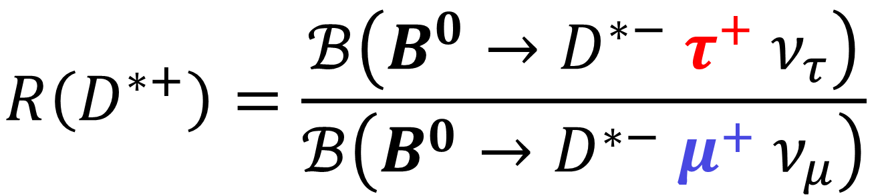
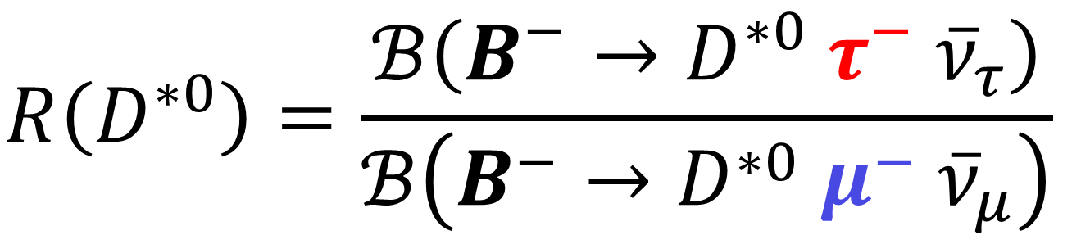
Measurement of R(D^{(*)0}) using 3-prong hadronic tau decays
Ongoing analyses:
  1) Simultaneous measurement of:
    Using $D^{0}→K^{−}π^{+}$ decays and 3-prong hadronic 𝜏⁻$→$𝜋⁻𝜋⁺𝜋⁻𝜈_{𝜏} decays.
    Measurement of $ℬ\left(B^{−}→D^{0} τ^{−} {\overline{ν}}_{τ}\right)$ & $ℬ\left(B^{−}→D^{∗0} τ^{−} {\overline{ν}}_{τ}\right)$ with respect to the normalisation mode $ℬ$($B^{−}→D^{0}$D_{s}⁻($→\text{π}\text{−}\text{π}\text{+}\text{π}\text{−}$)).
    Use the best-known values of $ℬ\left(B^{−}→D^{0}D_{s}^{−}\right)$ and $ℬ\left(B^{−}→D^{(∗)0}μ^{−} {\overline{ν}}_{μ}\right)$ to obtain $R\left(D^{0}\right)$ and $R\left(D^{∗0}\right)$.
    1 analysis using Run 2 data (advanced, in LHCb RC) and 1 analysis using Run 3 data.
  2) Measurement of:
    Using $D^{∗−}→D^{0}π^{−}$ with ${ D}^{0}→K^{−}π^{+}π^{−}π^{+}$ decays and 3-prong hadronic 𝜏⁻$→$𝜋⁻𝜋⁺𝜋⁻𝜈_{𝜏} decays.
    Measurement of $ℬ\left(B^{0}→D^{∗−} τ^{+} ν_{τ}\right)$ with respect to the normalisation mode $ℬ$($B^{0}→D^{∗−}\text{π}\text{−}\text{π}\text{+}\text{π}\text{−}$).
    1 analysis using Run 2 data and 1 analysis using Run 3 data.
$$R\left(D^{0}\right)=\frac{ℬ\left(B^{−}→D^{0} τ^{−} {\overline{ν}}_{τ}\right)}{ℬ\left(B^{−}→D^{0} μ^{−} {\overline{ν}}_{μ}\right)}$$
$$R\left(D^{∗0}\right)=\frac{ℬ\left(B^{−}→D^{∗0} τ^{−} {\overline{ν}}_{τ}\right)}{ℬ\left(B^{−}→D^{∗0} μ^{−} {\overline{ν}}_{μ}\right)}$$
$$R\left(D^{∗+}\right)=\frac{ℬ\left(B^{0}→D^{∗−} τ^{+} ν_{τ}\right)}{ℬ\left(B^{0}→D^{∗−} μ^{+} ν_{μ}\right)}$$

Slide 18
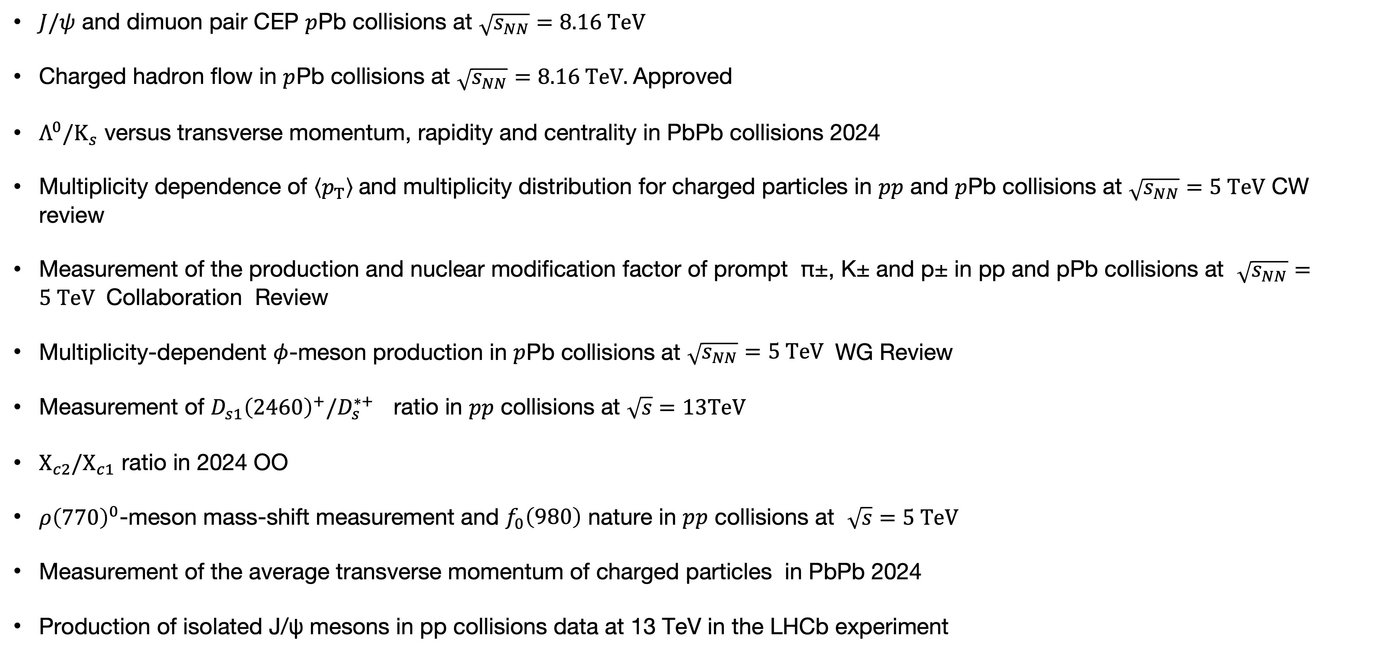
QCD and Heavy-Ion collisions and Spectroscopy
$J/ψ$ and dimuon pair CEP $p$Pb collisions at $\sqrt{s_{NN}}=8.16 TeV$
Charged hadron flow in $p$Pb collisions at $\sqrt{s_{NN}}=8.16 TeV.$Approved
$Λ^{0}/K_{s}$ versus transverse momentum, rapidity and centrality in PbPb collisions 2024
Multiplicity dependence of $\left\langle p_{T}\right\rangle$and multiplicity distribution for charged particles in $pp$ and $p$Pb collisions at $\sqrt{s_{NN}}=5 TeV$ CW review
Measurement of the production and nuclear modification factor of prompt π±, K± and p± in pp and pPb collisions at $\sqrt{s_{NN}}=5 TeV$ Collaboration Review
Multiplicity-dependent $φ$-meson production in $p$Pb collisions at $\sqrt{s_{NN}}=5 TeV$ WG Review
Measurement of $D_{s1}{\left(2460\right)}^{+}/D_{s}^{∗+}$​ ratio in 𝑝𝑝 collisions at $\sqrt{s}=13TeV$
$Χ_{c2}/Χ_{c1}$ ratio in 2024 OO
$ρ{\left(770\right)}^{0}$-meson mass-shift measurement and $f_{0}\left(980\right)$ nature in $pp$ collisions at $\sqrt{s}=5 TeV$
Measurement of the average transverse momentum of charged particles in PbPb 2024
Production of isolated J/ψ mesons in pp collisions data at 13 TeV in the LHCb experiment

