Slide 1
CERN Programme & Plans
KfB-Verbundforschungsworkshop “Teilchen 2027-2030”
13 Mai 2026
Frank Tecker
Material from Mark Thompson
and Oliver Brüning
Content
CERN Strategy and Priorities 2026-2030
  HL-LHC
  FCC-ee
  Long Shutdown LS3
Some examples for technology R&D plans

Slide 2
CERN Strategy and Priorities for 2026-2030
Strongly based on European Strategy for Particle Physics

Slide 3
slide from Karl Jacobs

Slide 4
The importance of the HL-LHC
The LHC has been an outstanding scientific success
A unique machine that has outperformed all expectations!
Higgs discovery
Well over 4000 papers from ALICE + ATLAS + CMS + LHCb
We are now ready to take the next steps with the High-Luminosity LHC and the major upgrades of ATLAS and CMS
Greater than a factor five more data than the LHC and almost a factor 10 more than has been currently analysed by ATLAS and CMS
We will have much more capable detectors
The particle physics community is doing a great job of improving analysis techniques using AI
This will be a massive step forward; we are just at the start of the LHC journey
Much more data, better detectors, advances in analysis
HL-LHC will be incredibly exciting – with real discovery potential

Slide 5
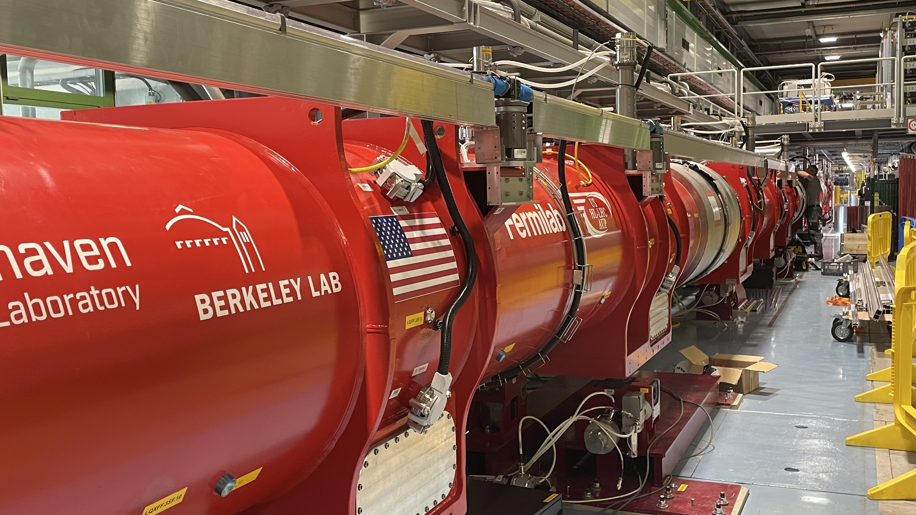
HL-LHC: let us not forget
The construction of the HL-LHC and the ATLAS/CMS upgrades will dominate the next five years at CERN
Long Shutdown 3 (LS3) for the LHC commences on 30 June 2026
The plan and clear intent is to be commissioning the machine and detectors in 2030
This is a major task
The HL-LHC installation will be the largest project undertaken by CERN in around 20 years
The Phase 2 detector upgrades, are the largest projects undertaken by ATLAS and CMS since the construction of the original detectors
The HL-LHC and the detector upgrades represent by far the highest priority for CERN in the coming years
Meeting the current schedule, which is our intention, will require laser focus
Accordingly, CERN will prioritise resources to maximize the likelihood of success
HL-LHC and the Phase 2 upgrades are CERN’s highest priority

Slide 6
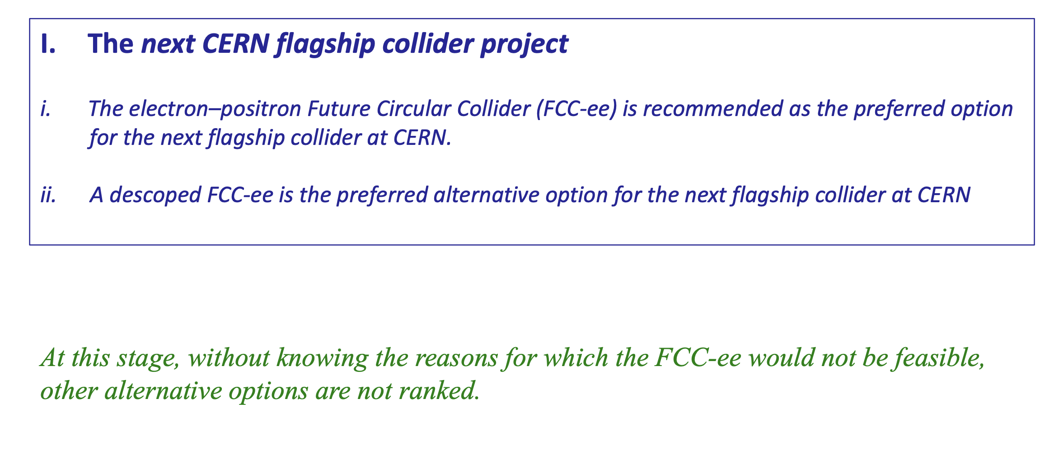
Recommendations on next collider at CERN
slide from Karl Jacobs

Slide 8
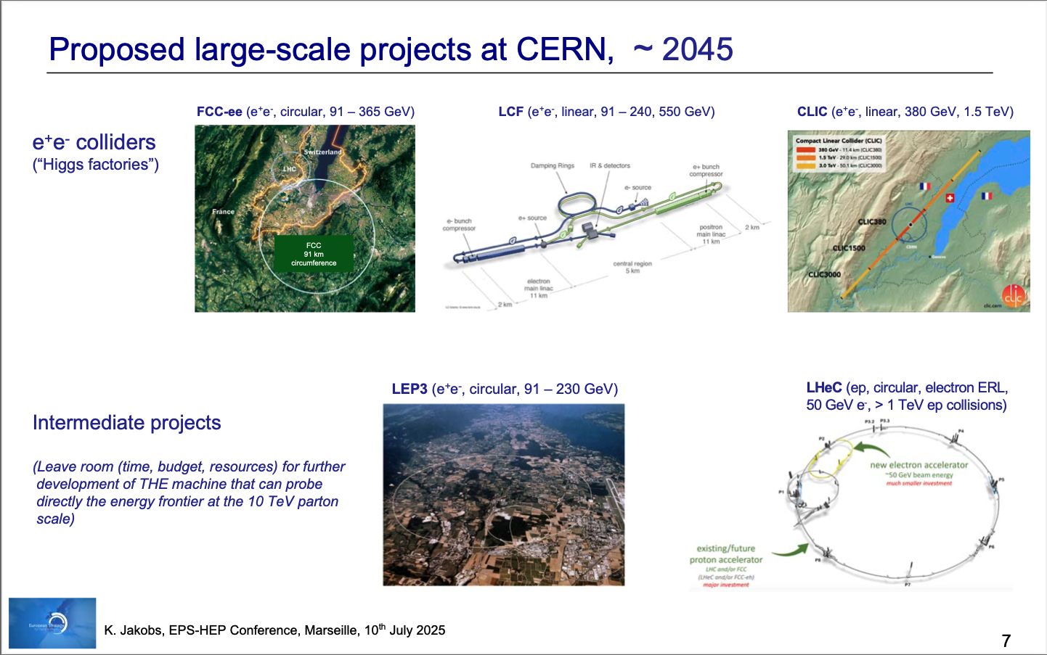
FCC-ee clearly identified as THE preferred option in the ESPP update process!
The focus is FCC, but some other projects should also be studied to prepare CERN for case that FCC timescale or cost turn
out to be challanging
Notes:
CERN Long term future

Slide 9
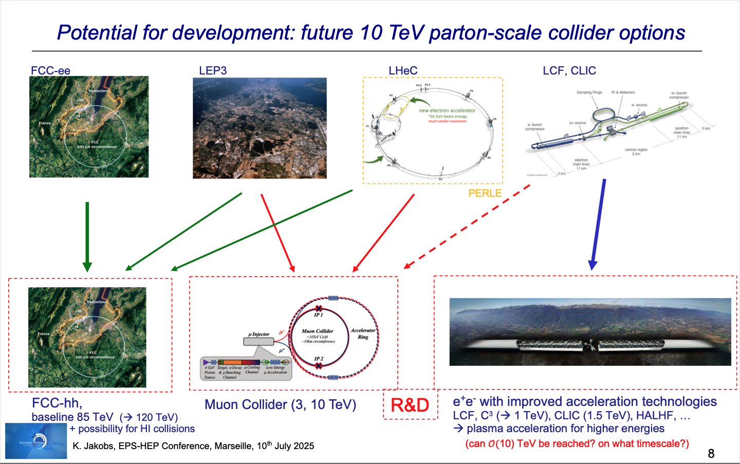
Next Steps:
Council discussion in June 2026
➔ Likely for CERN to follow as Plan B studies LEP3 and ILC250 in preparation for an FCC-ee decision by 2028/2029
9
Notes:
CERN Long term future

Slide 14
What lies ahead of us:
Key Challenges for the Coming 5 years
Finishing successfully the LHC Run3 in 2026
Notes:
Challenges for this mandate

Slide 15
Key Challenges for the Coming Term
Finishing successfully the LHC Run3 in 2026
Complete the HL-LHC IT-String test in 2026
January 2026
ATS Management address to the Sector
Notes:
Challenges for this mandate

Slide 16
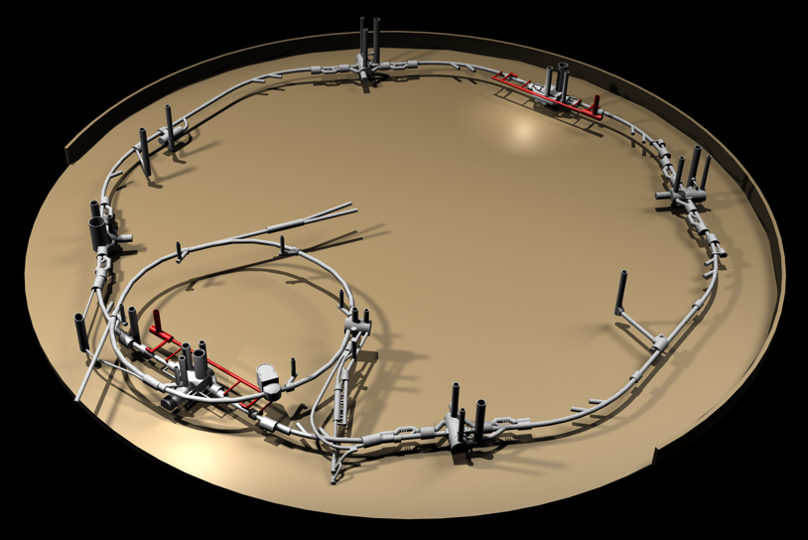
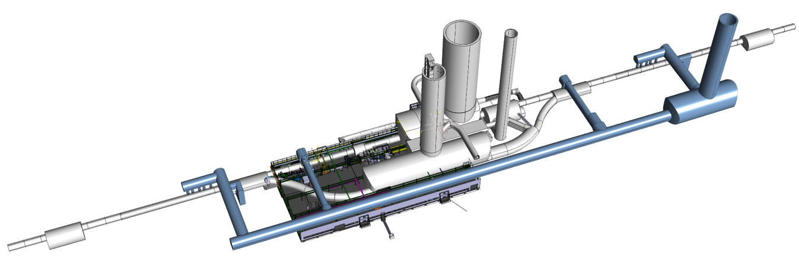
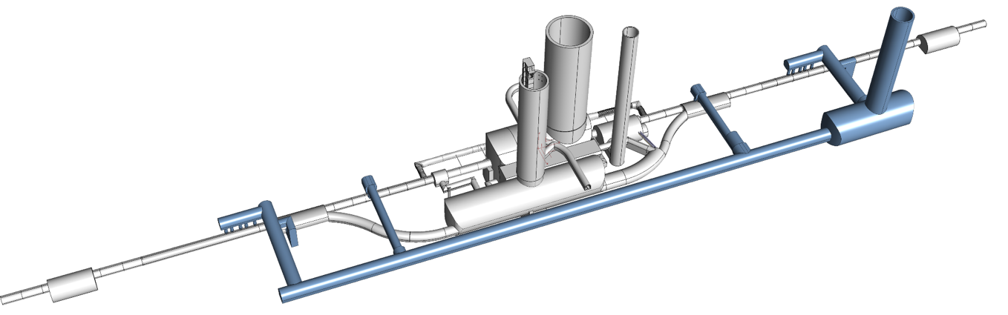
IT-String Update
Focus 2025: HL-LHC IT STRING
P4
P5
P5
P3
P2
HL-LHC
P6
P5R
SPS
P7
P1
P5L
P8
January 2026
ATS Management address to the Sector
Notes:
Challenges for this mandate

Slide 17
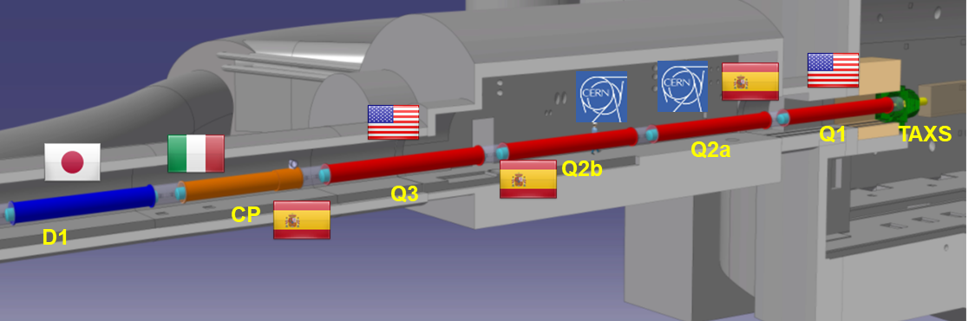
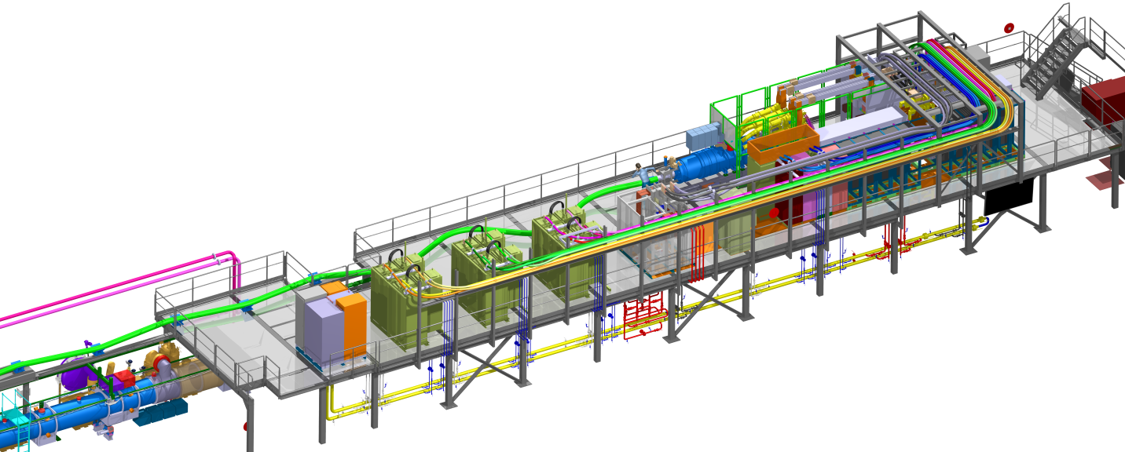
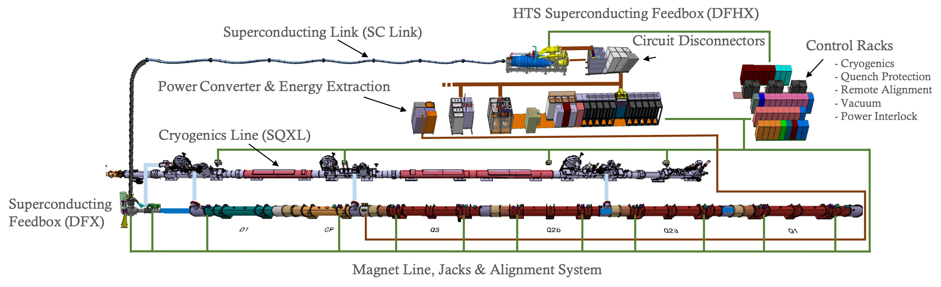
IT-String Update
Inner Triplet String installation was completed and preparation for cool down started in July 2025
The Inner Triplet String Testbed
January 2026
ATS Management address to the Sector
Notes:
Challenges for this mandate

Slide 18
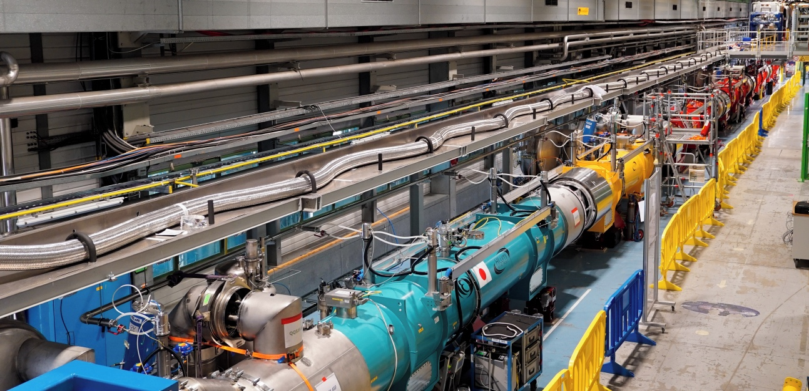
IT String repair completed by end 2025 –
Cooldown completed and powering ongoing
Preparation for cooldown showed vacuum leaks at 2 locations in 2025
Cause of the leaks was swiftly identified, unveiling a conceptual problem of the N-Line system [power lines across the assembly] for the installation in the tunnel
Preparation for cooldown showed vacuum leaks at 2 locations in 2025
Cause of the leaks was swiftly identified, unveiling a conceptual problem of the N-Line system [power lines across the assembly] for the installation in the tunnel
with time for developing design upgrades!!!
The IT-String will provide validation of the HL-LHC magnetic and powering concept and provide valuable operational experience before the start of LS3
January 2026
ATS Management address to the Sector
Notes:
Challenges for this mandate & important lessons to learn before we enter LS3!

Slide 20
Key Challenges for the Coming 5 years
Finishing successfully the LHC Run3 in 2026
Complete the HL-LHC IT-String test in 2026
Launch and conduct the Long Shutdown 3 according to Schedule
  Start of LS3 for the LHC end June 2026
  Re-start of the accelerator complex [Linac3, Linac 4, PS, PSB, ISOLDE, LEIR and the anti-proton complex] in 2028
  NA-Cons implementation
  Restart of the SPS in 2029
  Implement the HL-LHC project during LS3 and start HL-LHC operation in 2030
January 2026
ATS Management address to the Sector
Notes:
Challenges for this mandate

Slide 21
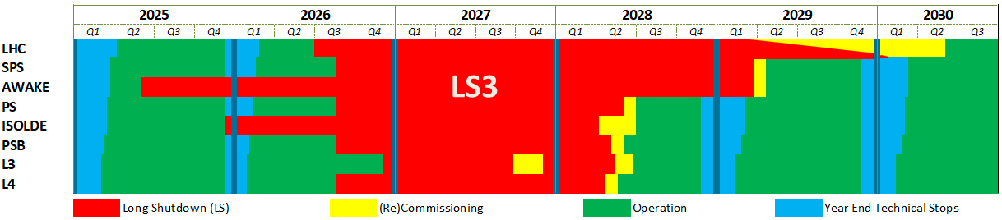
Long Shutdown (LS3)
LS3 start
AWAKE: 02.06.2025
ISOLDE: 08.12.2025
LHC: 29.06.2026
Injectors: 31.08.2026
L3: 30.11.2026
Inj. Operation restart
L4 : May 2028
PSB : May 2028
PS : July 2028 (*)
SPS : April/May 2029 (*)
(*) To be optimised
LHC restart
1st sectors cooldown : Early 2029
Final HW Com (P1&5) : January 2030
Caverns closure : Mid May 2030
Beam vac valves op : End May 2030
January 2026
ATS Management address to the Sector
Notes:
Challenges for this mandate

Slide 22
LS3 Schedule: Latest Version [October’25] fits into 47 months!
LS3 Schedule – TCC October 2025
Q2 2026
LSS dismantling after cryo lockout
Plus
Injector Complex
North Area Consolidation
HI-ECN3
Experiments (+CO2 cooling)
…
Cabling dismantling
Core excavation (LHC side)
Cabling installation
LSS installation
It fits, but with a success oriented planning
We are working on options to provide additional flexibility
Triplet installation planned for Q1 to Q2 2029
CC installation planned for Q4 ‘28 to Q2 ‘29
Cool-down, related test and HWC
Long Shutdown 3 (LS3) is going to be very busy!
Q2 2030
January 2026
ATS Management address to the Sector
Notes:
Challenges for this mandate

Slide 23
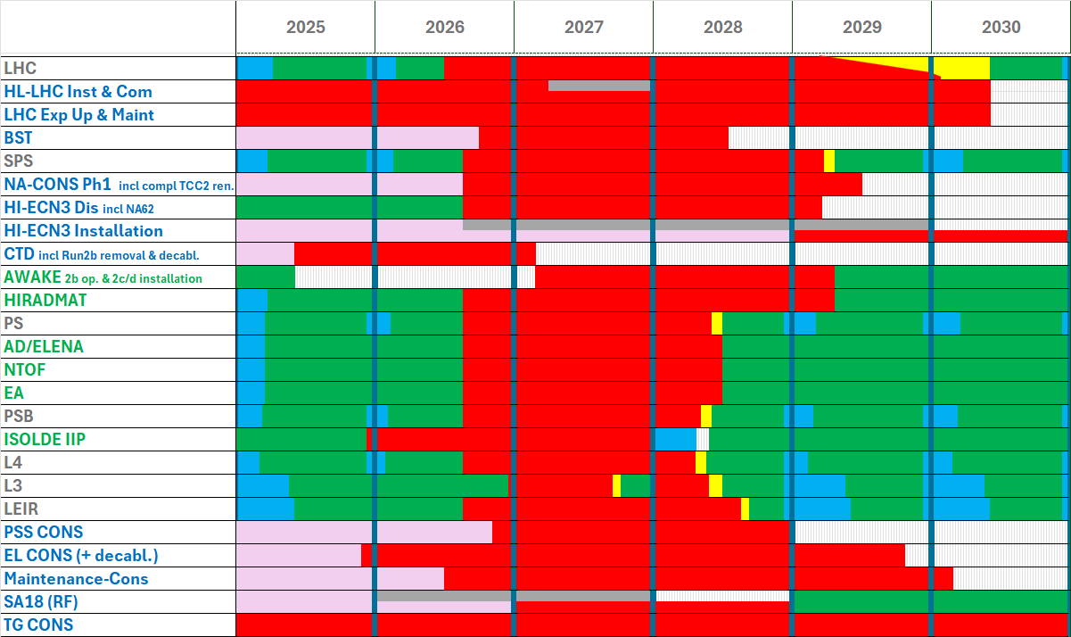
LS3
Requires flexibility and efficient coordination across all departments!
Safety
Quality
Schedule
January 2026
ATS Management address to the Sector
Notes:
Challenges for this mandate

Slide 24
CERN Technology R&D Examples
Twin aperture FCC-ee main bending magnet
High-Temperature Superconducting Magnets:
Final Focus FCC-ee quads
Lattice combined function quad/sextupole
Positron capture solenoid
Short straight section quad/sextupole
SRF: synergetic technologies
400 MHz FCC 2-cell cavity cryomodule
800 MHz cryomodule
Triston – High-Efficiency RF power source
High-Field Magnet Program

Slide 25
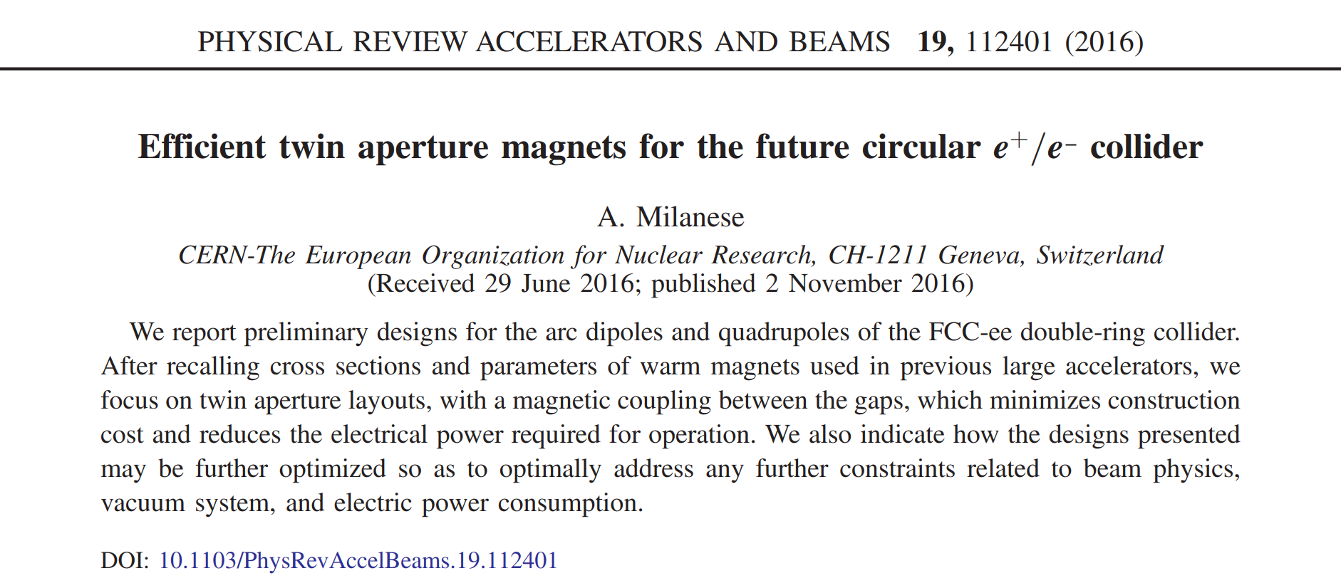
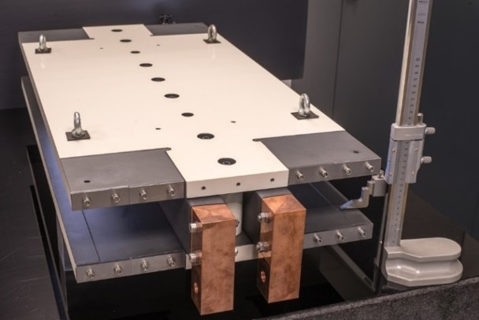
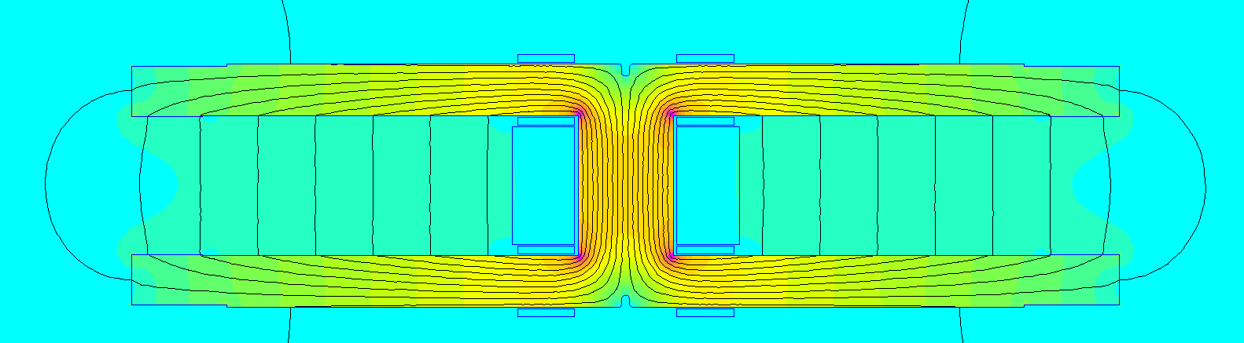
Sustainable main bending magnets are being proposed for
FCC-ee, with a twin layout, a low current density and aluminum conductor
First paper on efficient resistive magnets for FCC-ee
First model of FCC-ee collider main dipole
Twin layout allows 50% energy (and material) reduction with respect to separate magnets, as the Ampere turns are recycled in the second aperture
Cross section of FCC-ee bending magnet as of May 2025
April 23rd 2026

Slide 26
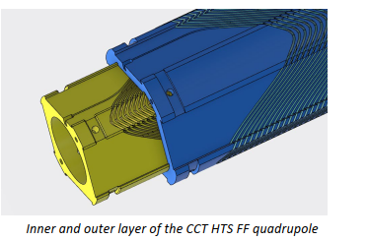
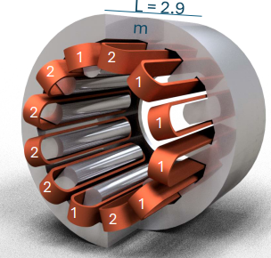
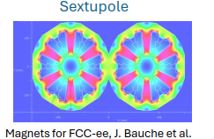
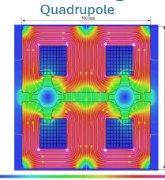



HTS REBCO Studies for FCC ee (1/2)
High-gradient applications (performance-driven)
System-level energy-efficient lattice magnets
Machine Detector Interface
Collider Ring
Final Focus FCC-ee Quadrupoles
Baseline: Nb-Ti
Lattice combined function MQ/MS
Baseline: resistive iron dominated magnets
2900 quadrupoles and 4700 sextupoles in the 80 km arc cells
REBCO CCT at ~ 30 K
REBCO at ~ 20-50 K
Two opposed solenoid fields
Superconductor in a groove
Dodecapole structure allowing quadrupole, sextupole, and combined operation

Slide 27


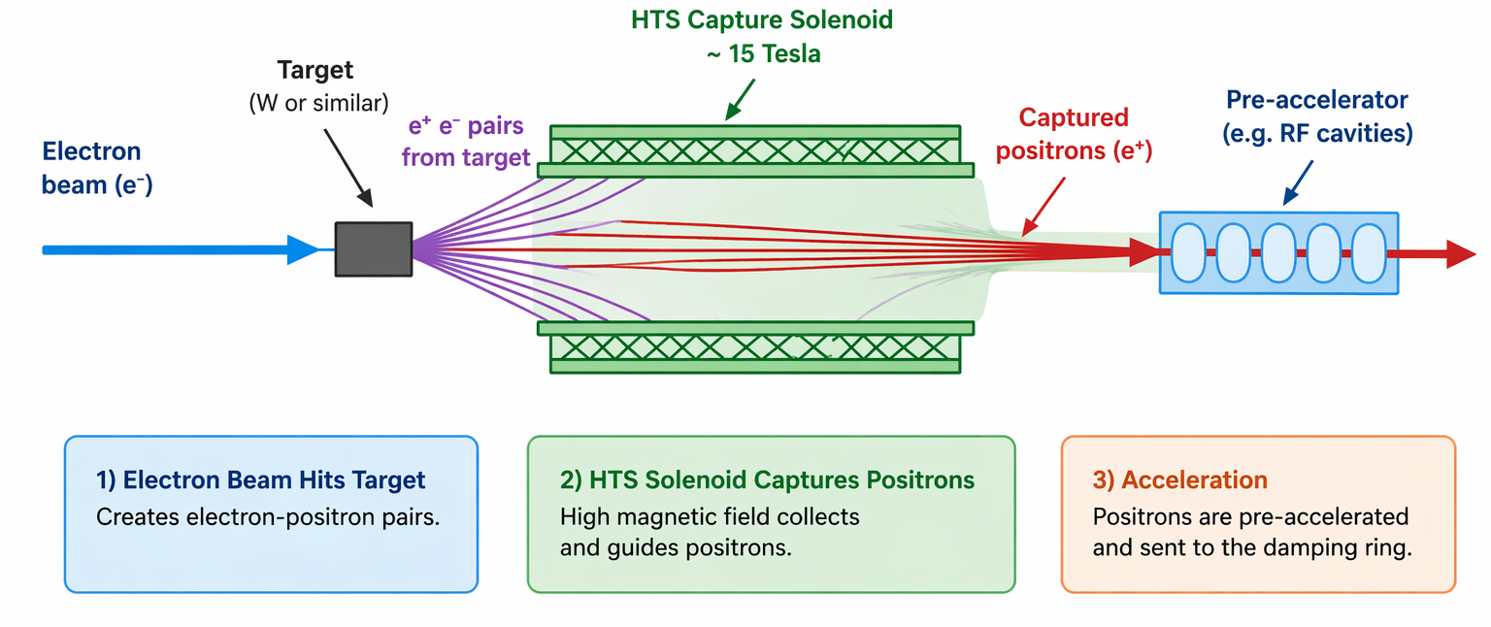
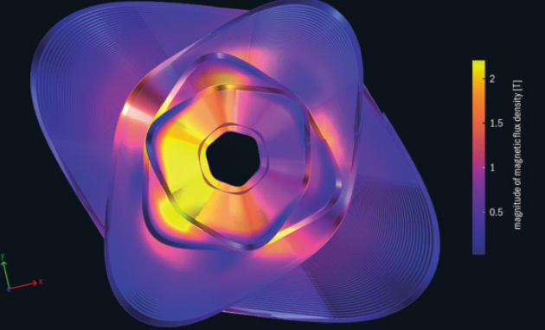
HTS REBCO Studies for FCC ee (2/2)
HTS studies complementary to main lattice and final-focus systems
Positron capture solenoid
→ High-field REBCO (~15 T, ~15 K),
compact source region
Short Straight Sections (nested Q-S magnets) → Energy-efficient optics,
increased filling factor
REBCO matching/capture solenoid at the
target (one per positron source line).
Demonstration in the P³ experiment at PSI
REBCO (~2T, ~40 K)
Cooling < 11 MW
Resitive baseline:
~ 39 MW average power
HTS in FCC-ee spans both traditional high-field applications and
new energy-efficiency-driven concepts
April 23rd 2026
Notes:
Simplified schematic of positron production

Slide 28
SRF R&D
O. Brüning iSAS 2nd annual meeting @ HZB
April 23rd 2026
28

Slide 29
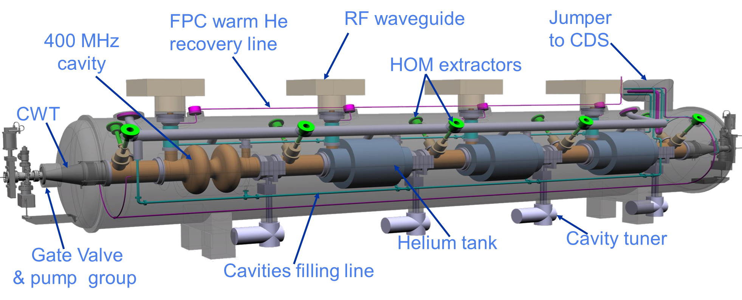
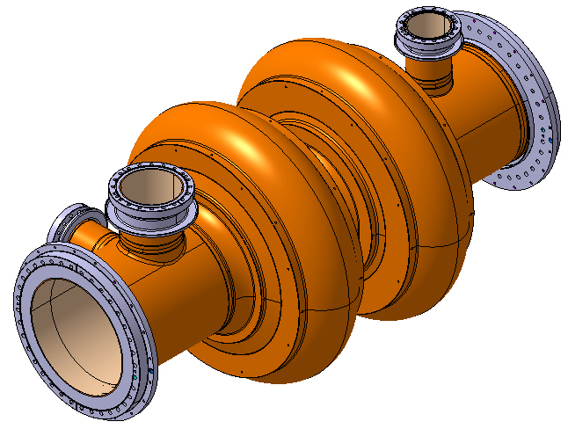
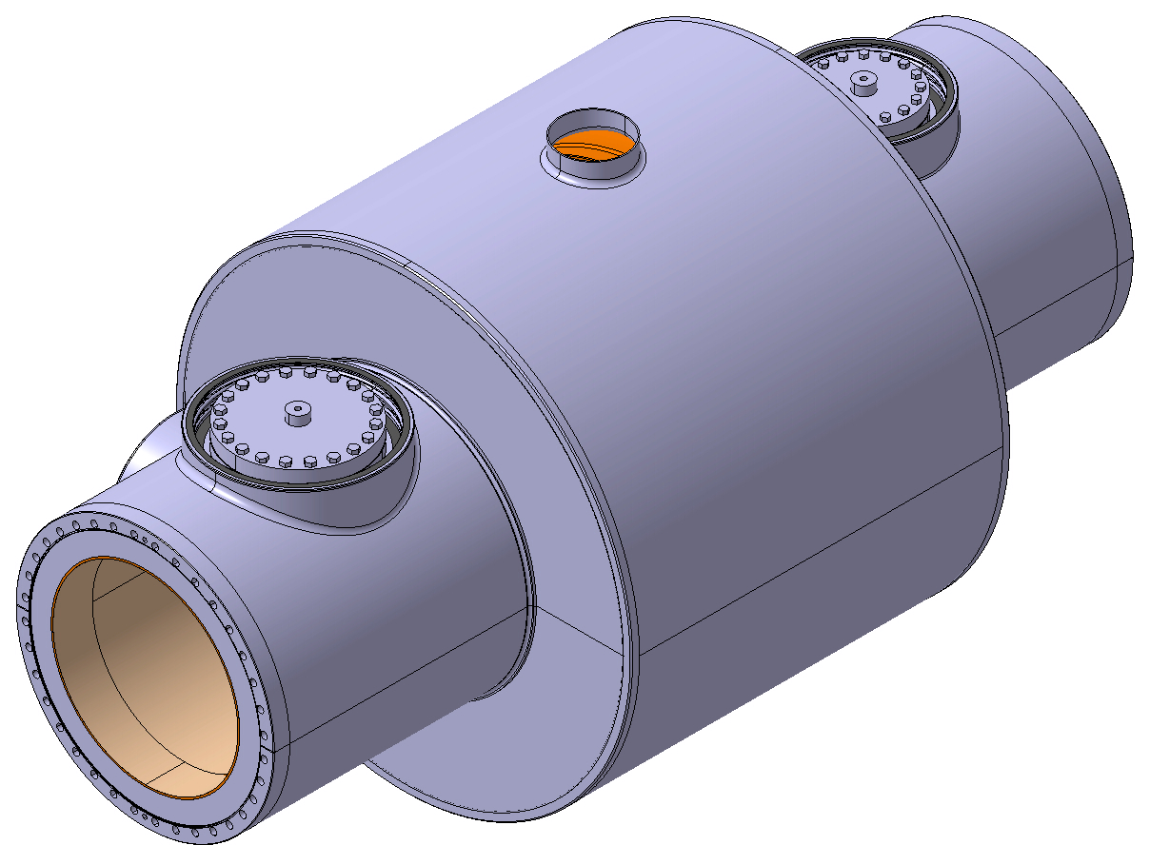
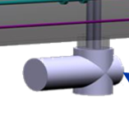
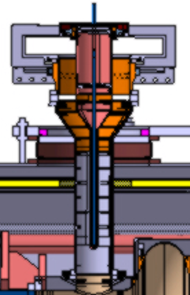
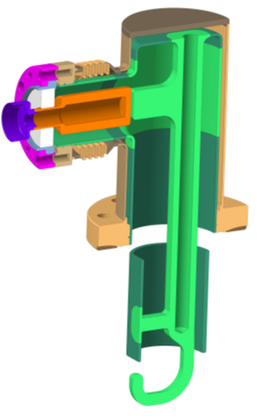
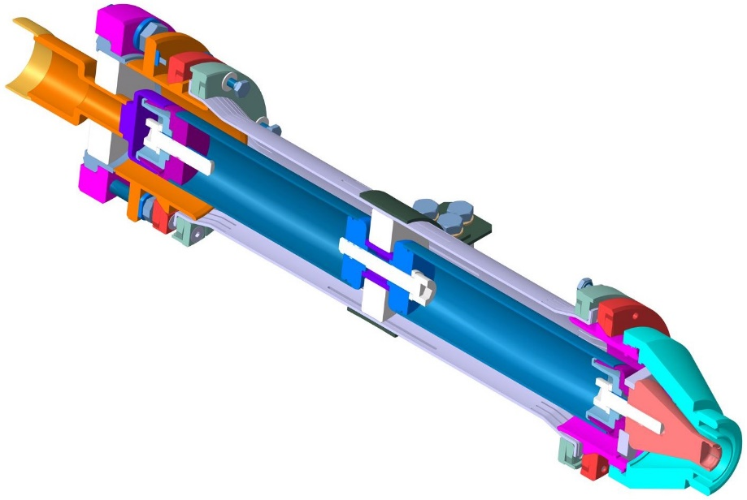
Build 400 MHz Demo, an FCC 2-cell cavity full size cryomodule
Parameter (machine installed) | Value
No. cryomodules | 66
2-cell cavities per cryomodule | 4
CM length (GV flange to flange) | ~ 11 m
RF frequency (MHz) | 400.79
Cavity voltage (MV) | 7.95
Cavity gradient Eacc (MV/m) | 10.6
Qo | 2.7E+09
Dyn. HL (CW)/cavity at 4.5 K | 129 W
Stat. HL/CM | 197 W
Environ. Magnetic field | ≤ 5 mG
RF power (kW, CW) | 380
Q _{L} (optimum coupling) | 9.2E+05
HOM power per CM: Z (W/H/ttbar) | 62.3 kW (coax. Extractor for 15/20 kW peak!) (lower for W/H/ttbar)
Items to be designed, built and qualified (non exhaustive list!)
Cavity Nb sputtered
He tank
Tuning system
FPC
HOMs, RF extraction lines (LHC/Crab designs shown)
Derived from LHC SRF, but final designs will be considerably different !
April 23rd 2026

Slide 30
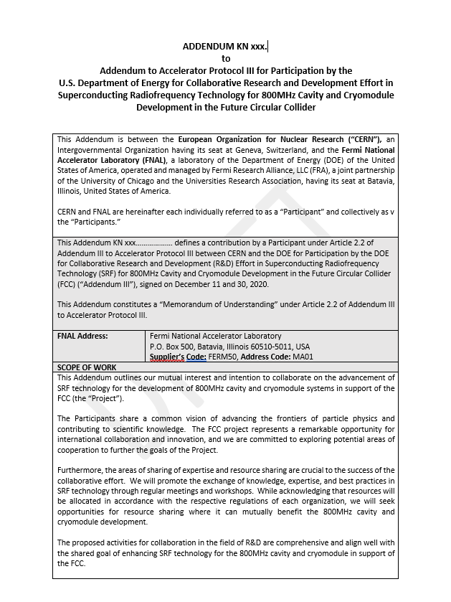
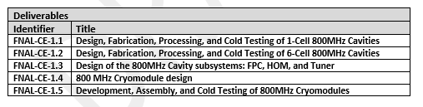
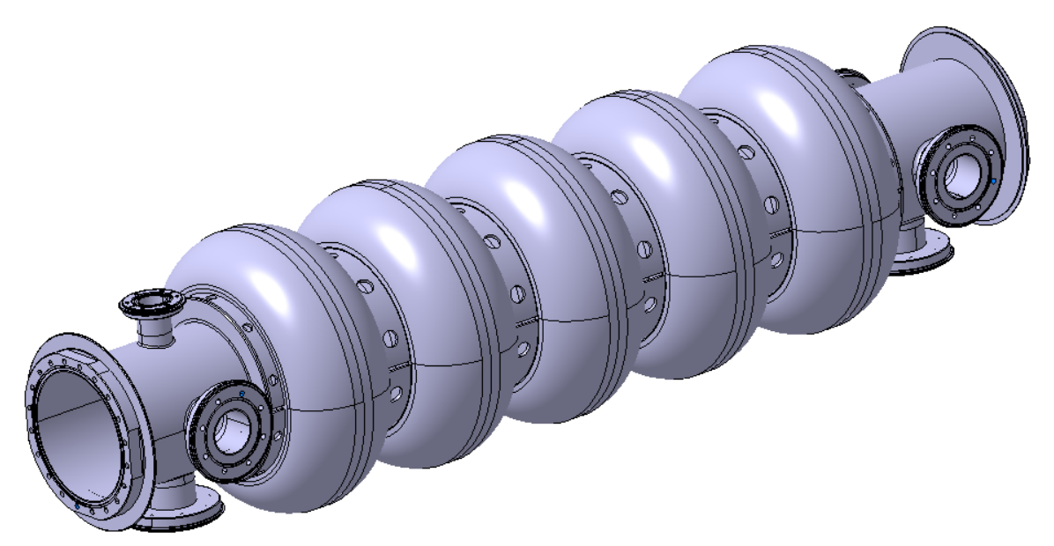
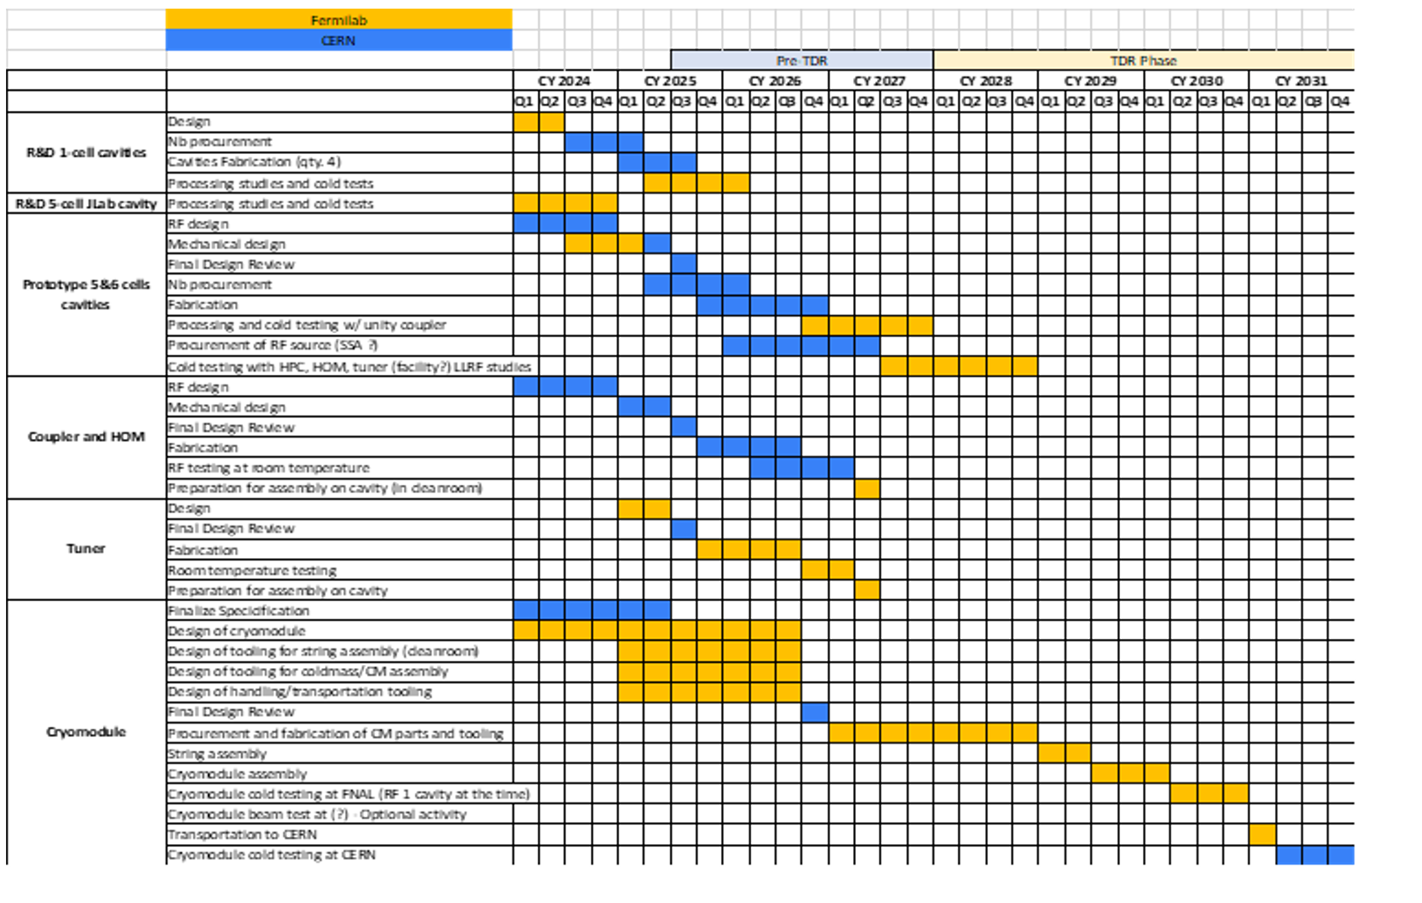
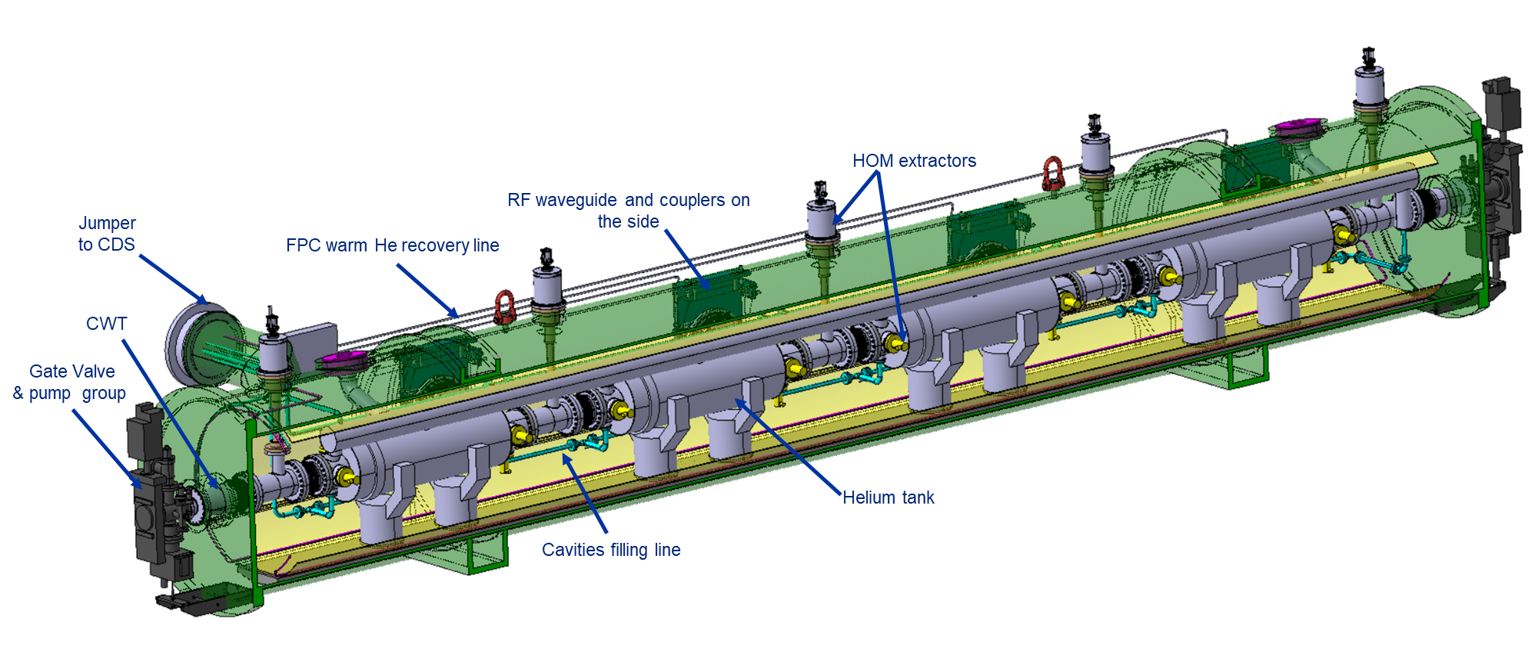
800 MHz with collaborations: FNAL, DESY, HZB, IJCLAB, CEA
Draft MOU
FNAL schedule: 2025-2031
High Qo studies (under FCC project funding):
5 single cell cavities in fabrication at CERN (MME), 3 to be supplied to FNAL (June ‘25)
FNAL improving EP process on a 5-cell cavity (cold testing now)
Mid T baking and retesting of same cavity to follow
Single cell processing to follow
800 MHz CM plan for assy & testing by 2031
Regular fruitful exchanges with FNAL (every 2 weeks)
But funding still pending (FNAL made a cost estimate)
FCC management agreed to fund 4 6-cell cavities through FCCee (but now funding is postponed)
We have limited funding under SRD-D project (1.4 MCHF) → purchase of Nb
CERN conceptual design
based on FNAL PIP –II features
April 23rd 2026

Slide 31
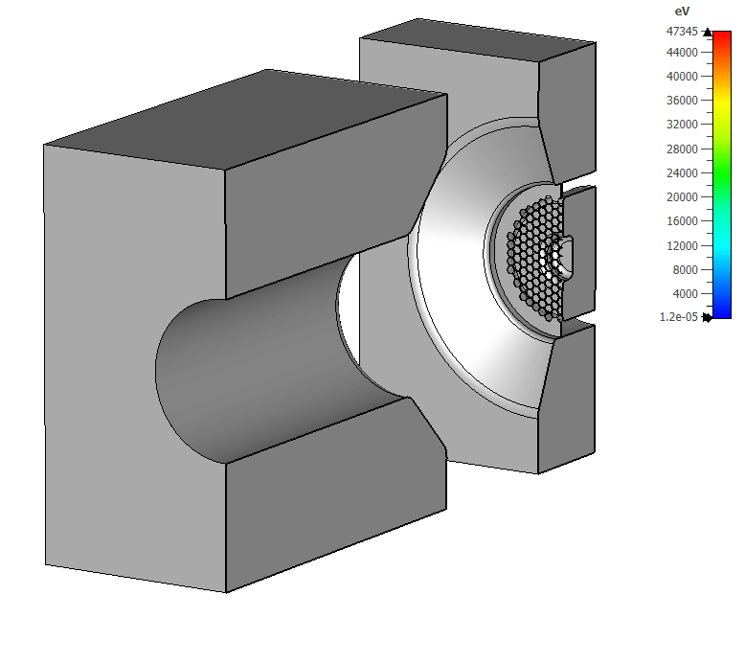

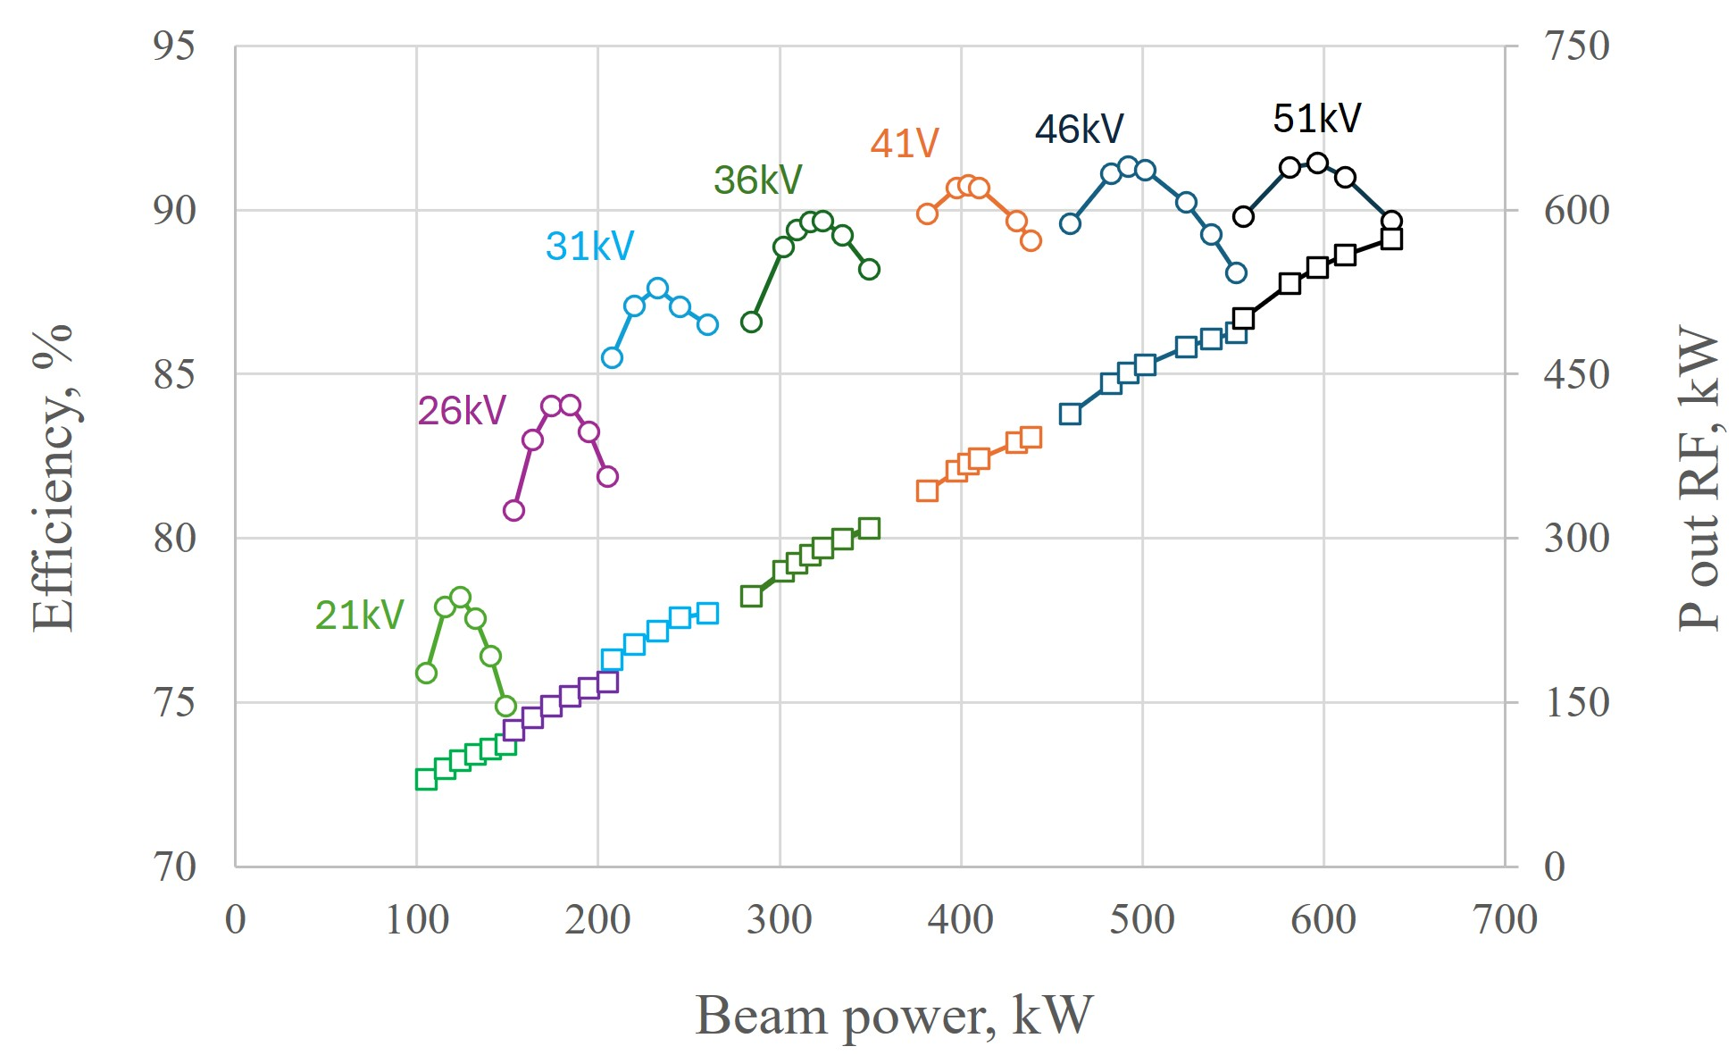
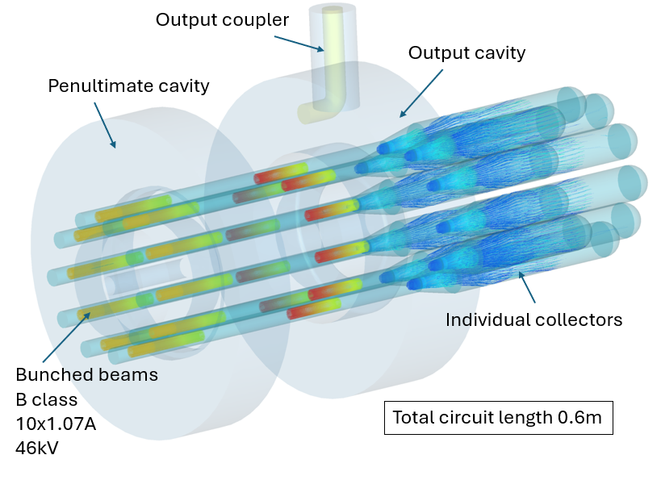
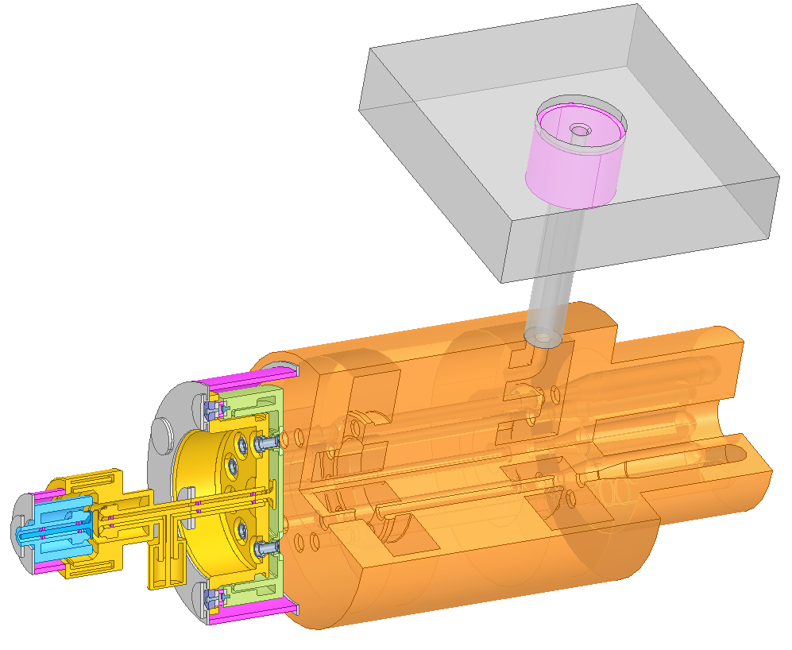
Tristron Gridded cathode
CST PIC simulations.
FCC_{ee} 400MHz, 0.5MW, CW MB Tristron
April 23rd 2026

Slide 32
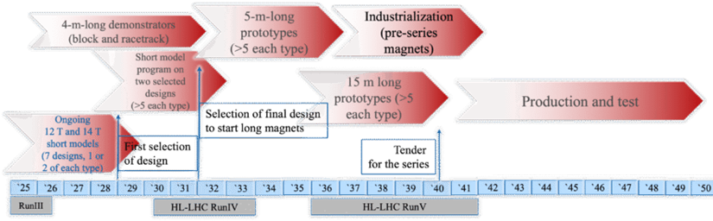
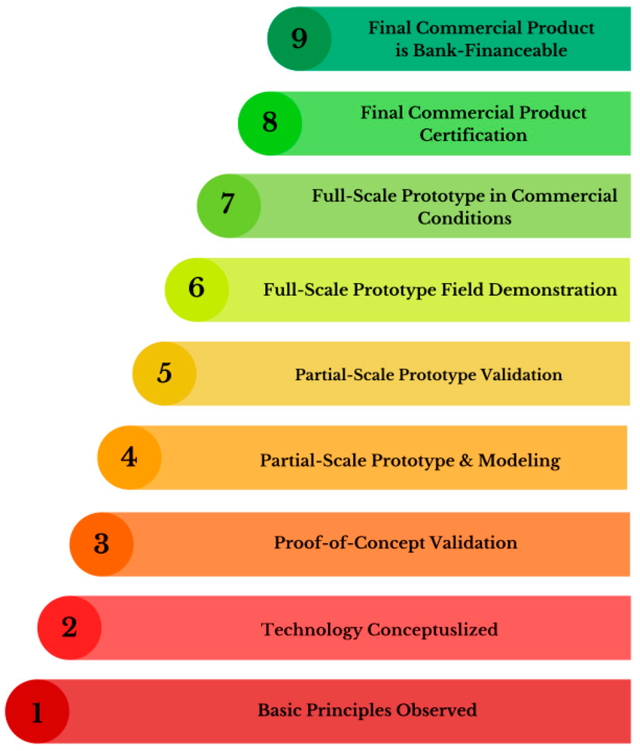

Preparing for the Future
The High Field Magnets Programme (HFM)
  An essential R&D activity that is relevant for all future accelerators
  Developing long, 14 T accelerator dipole magnets capable of being industrialized by 2040 [Nb₃Sn]
  Develop HTS magnet technology for accelerators
Targets for 2026-2030
  Bring the Technology Readiness Level for 14 T Nb₃Sn magnets from yellow towards green through short models
    Address costs by looking at hybrid options
  Bring the Technology Readiness Level for 14 T HTS
  High Temperature Superconductor magnets from red to yellow through various demonstrators
    Short model foreseen for mid 2030’s

