Slide 1
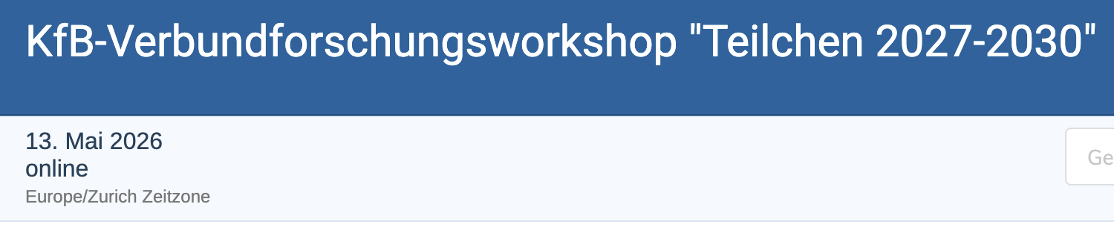
GSI / FAIR
R. Aßmann
Head „Accelerator Operations & Development“ GSI
KfB-Verbundforschungsworkshop
"Teilchen 2027-2030"
13. Mai 2026
https://indico.global/event/17830

Slide 2
Accelerator R&D Interests at GSI/FAIR
High Current Hadron Beams for Science, Applications, Health & Fusion
Innovative hadron accelerators for fixed target experiments, colliders, irradiation (cancer/materials), secondary particle production. Cooling / Spin / …
High Power Phelix laser facility, integrated in ion user facility.

Slide 3


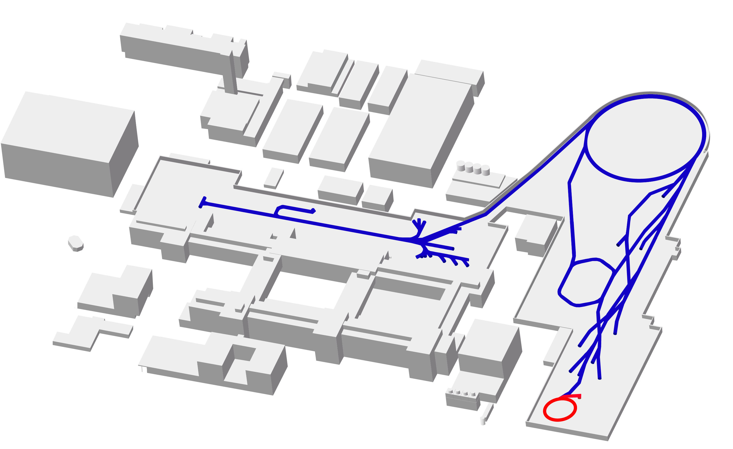
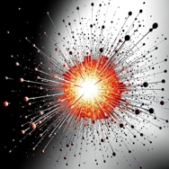
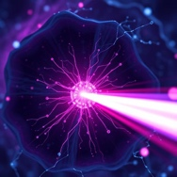


GSI & FAIR Facilities
100 m
Synchrotron ring
SIS-18 (1990)
FAIR Synchrotronring
SIS-100 (2028)
Ion sources
(1991 &1999)
Linear trap
HITRAP (2025)
Transfer
HEST
Linear accelerator
UNILAC (1975)
Storage ring
ESR (1990)
FAIR Super
Fragment Separator
SFRS (2027)
Storage ring
CRYRING (2021)
Heavy ion
research
Heavy ion
tumor irradiation

Slide 4
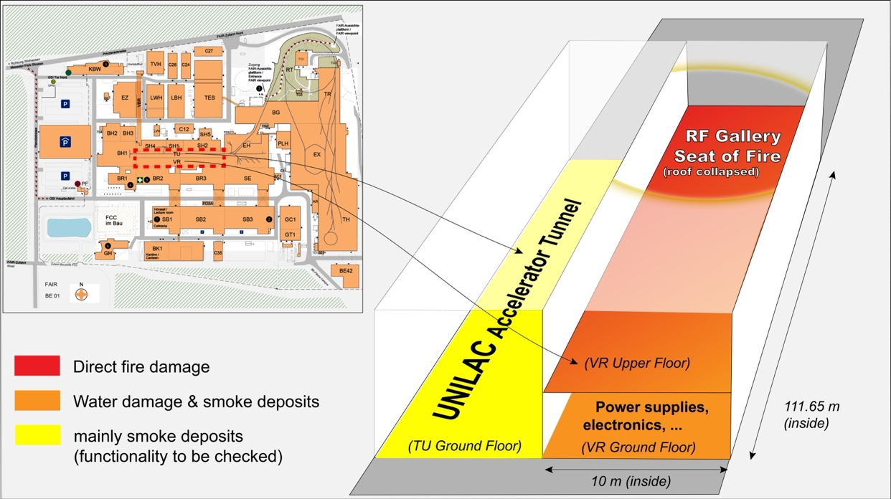
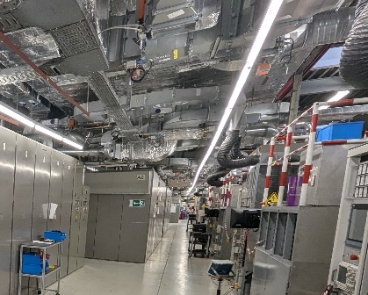
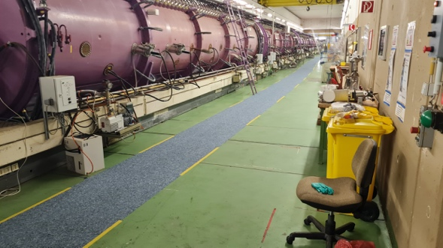
Impact of Recent Fire Incident at GSI
5 Feb 2026
A fire was initiated by a short circuit in an air-cooled 1 MW anode power supply from 1975 (in the 20 kV entry circuit), located in the RF gallery of the UNILAC.
All systems reacted as designed. Two GSI intervention teams on site within 15 minutes → could not intervene due to heavy smoke. Fire brigades quickly on place to intervene.
No injuries in employees & fire fighter.
Building structure (except the roof) and UNILAC accelerator survived fire and can be reused to present analysis.
UNILAC structures still with rest of vacuum.
Full RF system (20 MW of installed power) and many electronics equipment destroyed by fire or water.
Full UNILAC restoration will take until end of 2030.
Two interim options proposed for FAIR
commissioning from 2027 and interim
science from 2028.
UNILAC accelerator after fire
UNILAC RF gallery before fire

Slide 5
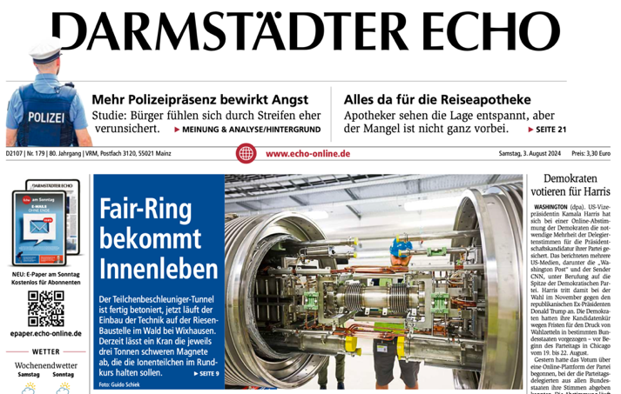
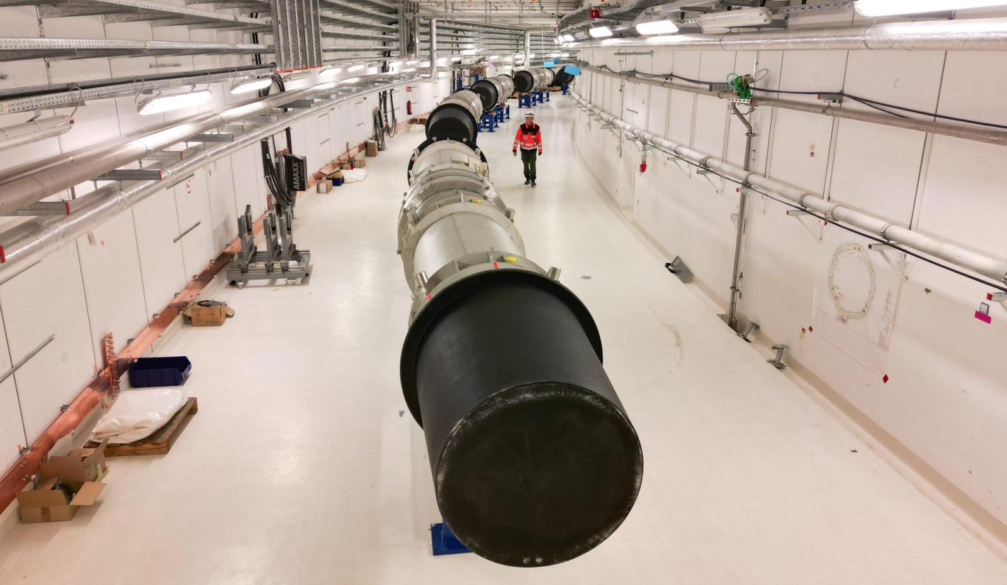
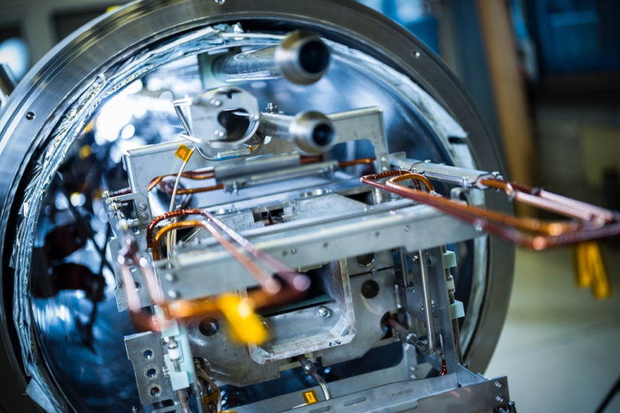
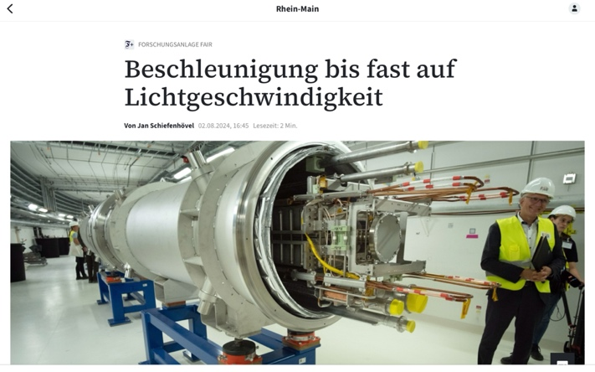

FAIR completion proceeding as planned
Beam commissioning foreseen in 2027/28

Slide 6
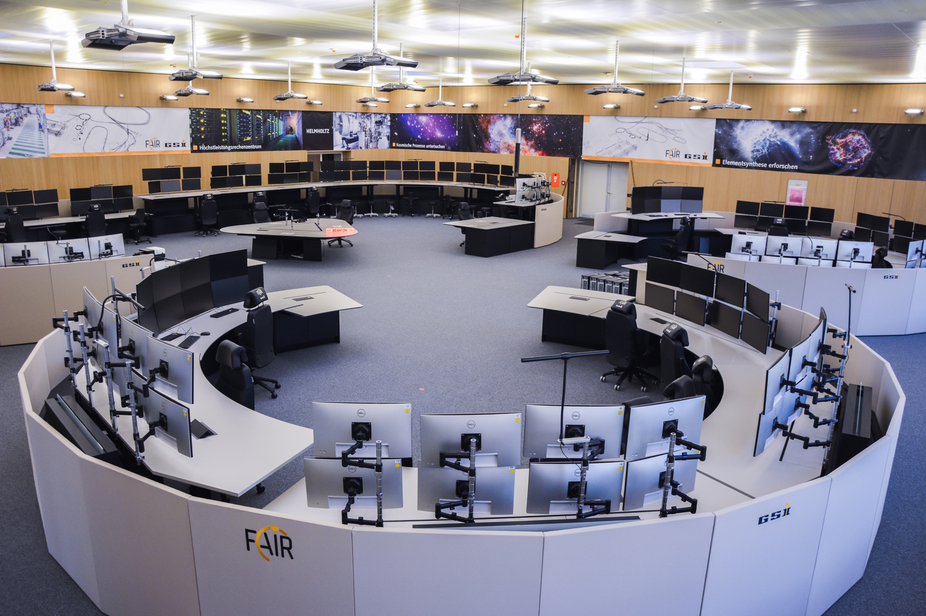
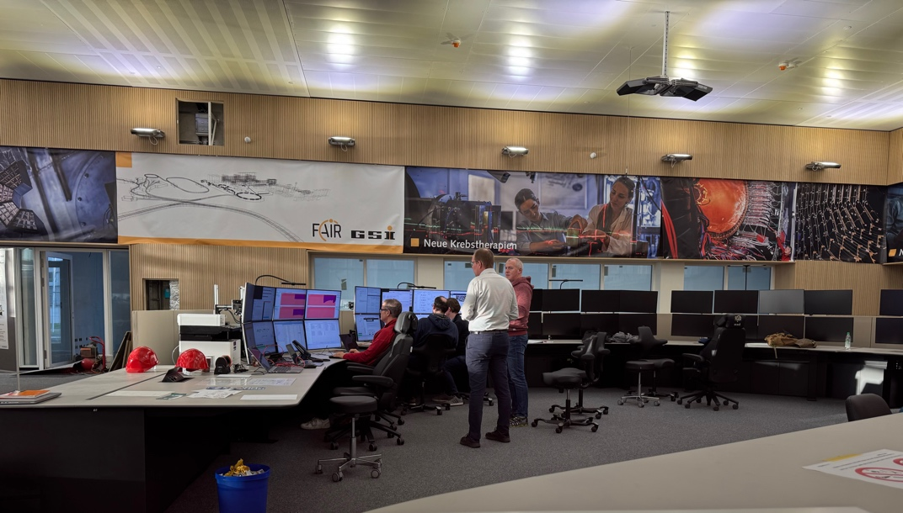
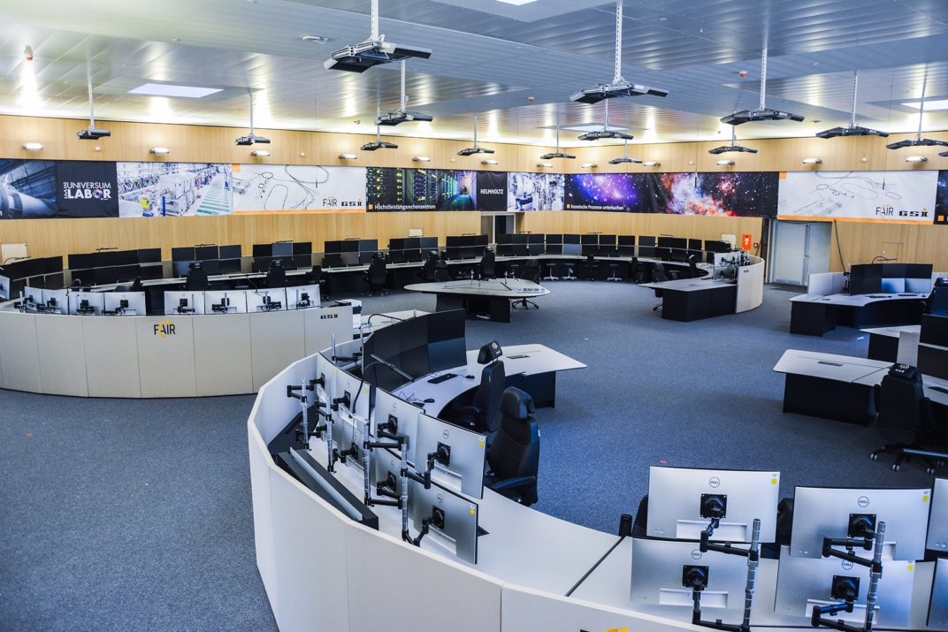
New FAIR Control Center (FCC)
First beam operation from FCC (CRYRING) in Feb 2026

Slide 7
GSI R&D Interests in detail
Innovative high power hadron accelerators for fixed target experiments, colliders, irradiation (cancer/materials), secondary particle production. Cooling / Spin / …
High Power Phelix laser facility, integrated in ion user facility.

Slide 8
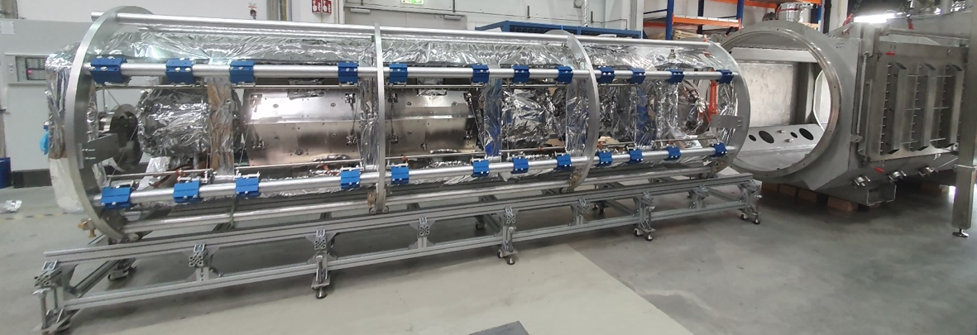
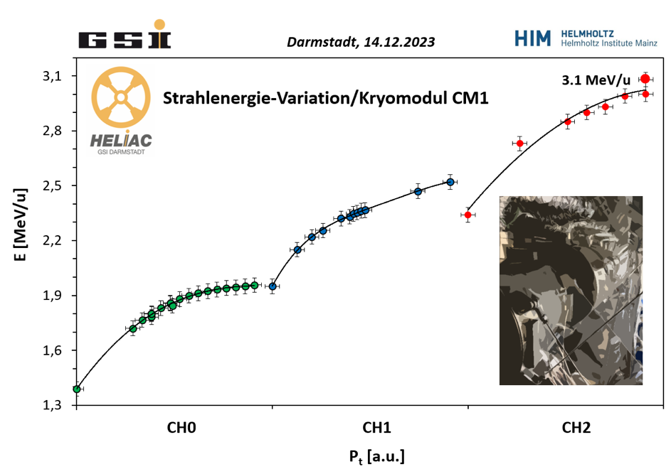

R&D on Superconducting RF: cw HELIAC* (Demonstration)
* HElmholz LInear ACcelerator
Development of energy efficient super-conducting RF technology for heavy ion linacs (HELIAC)
Result: Potential to reduce energy required for particle acceleration by up to 90%
3.5-7.6
Measurement of the beam energy when varying the accelerating voltage (Pt) of the superconducting crossbar H-mode cavities used
Maksym Miski-Oglu and Winfried Barth (GSI, HIM, Johannes Gutenberg Universität Mainz)

Slide 9
Test Area at GSI → Cryo-Module 1 of HELIAC
SIBAF Facility
Supraleitender Ionenbeschleuniger als BAsistechnologie für die Fusionsforschung

Slide 10
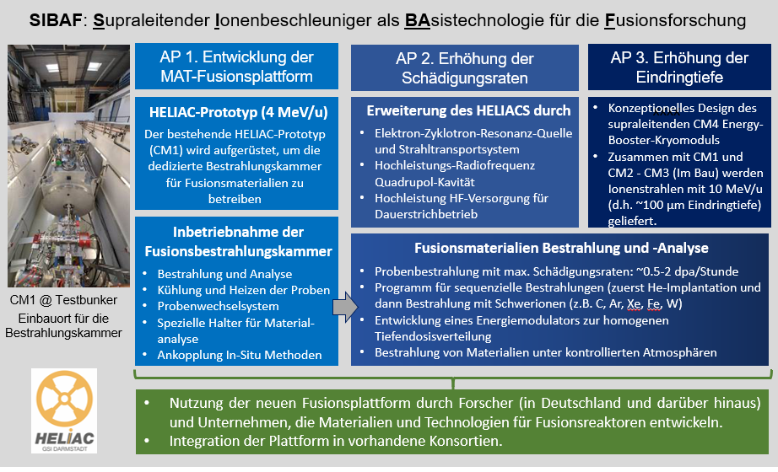
SIBAF
Supraleitender Ionenbeschleuniger als BAsistechnologie für die Fusionsforschung
BMFTR-Funding measure „Basistechnologien für die Fusion – Modul B“
Approved with full budget.
HLI injector delivers ion beams at 25% duty factor. In combination with the HELIAC prototype CM1, experiments with ion beams up to
4 MeV/u are possible.
A new irradiation chamber for tests on fusion materials is designed and built behind CM1.
The HELIAC accelerator is expected to achieve damage rates of up to 2 dpa per hour in continuous wave operation at 100% duty factor – compared to a maximum of 20 dpa per year in today's reactors (dpa = displacements per atom).

Slide 11
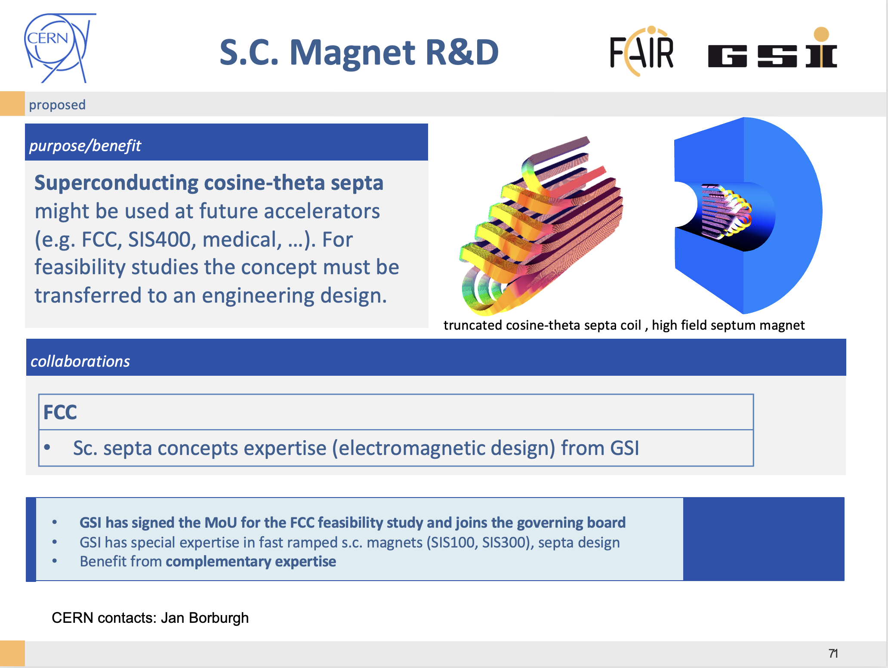
GSI contacts:
Kei Sugita
Group Leader: Superconducting Magnet Technology
Peter Spiller
Christian Roux
Close exchange / collaboration with CERN.

Slide 12
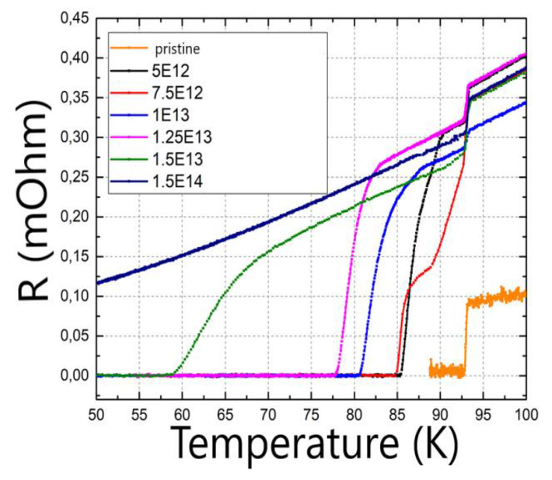
R&D on High Temperature SC Tapes: Effects of Heavy Ion Irradiation
Irradiation has an effect on the properties of superconductors, which is beneficial up to a point but for higher doses leads to degradation.
  https://dx.doi.org/10.1088/1361-6668/ad2fda
  https://dx.doi.org/10.1088/1361-6668/ac1523
GSI wants to investigate and quantify the effect of heavy ion irradiation on HTS tapes, i.e. critical current, magnetization.
GSI can provide a wide variety of heavy ions, i.e. carbon, argon, uranium, at different fluences and energies.
https://dx.doi.org/10.1109/TASC.2022.3164629
HTS irradiation with 6.3 MeV Cu²⁺
→ P. Spiller

Slide 13

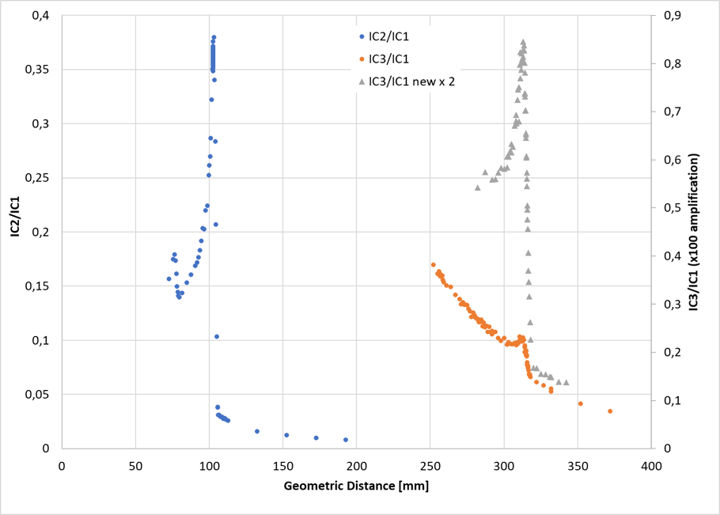

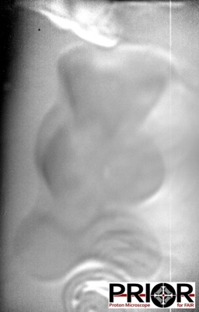
Courtesy Ion Source Dept. F. Maimone et al with C. Graeff et al
Mixed Ion Beam for Tumor Therapy (new, world-wide first)
Carbon used for tumor irradiation. Helium penetrates through body and is used for real time imaging.
Proposal of Biophysics Dept. ERC CoG C. Graeff Accelerator work in sources, linac, SIS-18.
Integrals over one spill for the depth dose
C
+ O
Ion mass He + C ( 5-20% He)
Ion charges ⁴He⁺ und ¹²C³⁺ from CH₄
Energy 225 MeV/u
Beam intensity 10⁸, Slow extraction
Stability goal No variation of He, C and O
Contamination of ¹⁶O⁴⁺ As low as possible
24% He
Two ‘working points‘: 8% He and 24% He (relation to C), 7% O throughout
8% He
Possible contrast at low-density differences
A gummy bear in a gelatin block (edge length 6 cm), can be imaged exclusively with the helium portion of the beam.
Measurements with a matrix IC detector (also time-resolved) and films providing location information collected as well.
0 50 100 150 200 250 300 350 400
Water-equivalent range (mm)
Measured ion contributions to image:
¹²C⁶⁺: 0.167%
⁴He²⁺: 99.833%
- IC2: front chamber with O and C peak
- IC3 : back chamber with 8% He concentration
- IC3 : back chamber with 24% He concentration

Slide 14
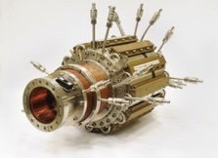
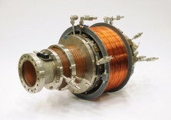
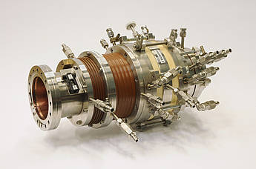
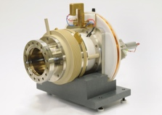
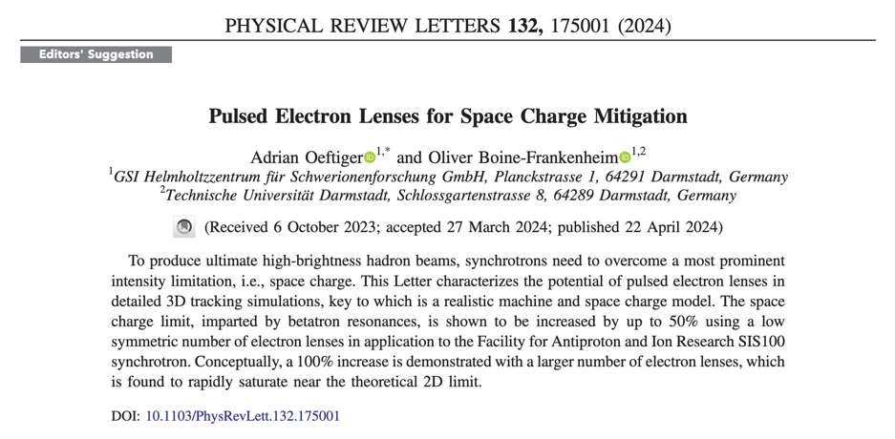
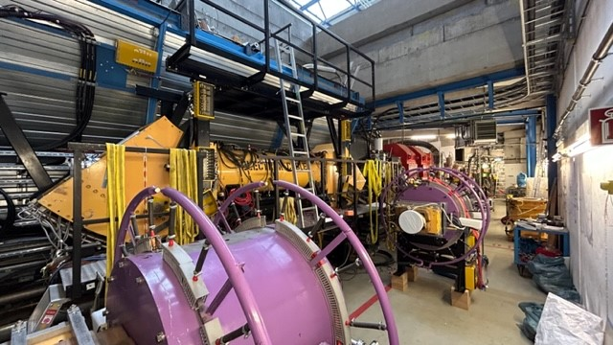
R&D on Facilities / Beam Dynamics for High Intensity Hadron Accelerators & Colliders
Ion beam dynamics: space charge, space charge compensation, simulation, theory, cooling theory, decelerator theory, …
Beam cooling technology (e-beam cooling, stochastic cooling, laser cooling)
Fast and slow extraction techniques
Close exchange / collaboration with CERN
ESR electron cooler during Dec 2023 reassembly

Slide 15
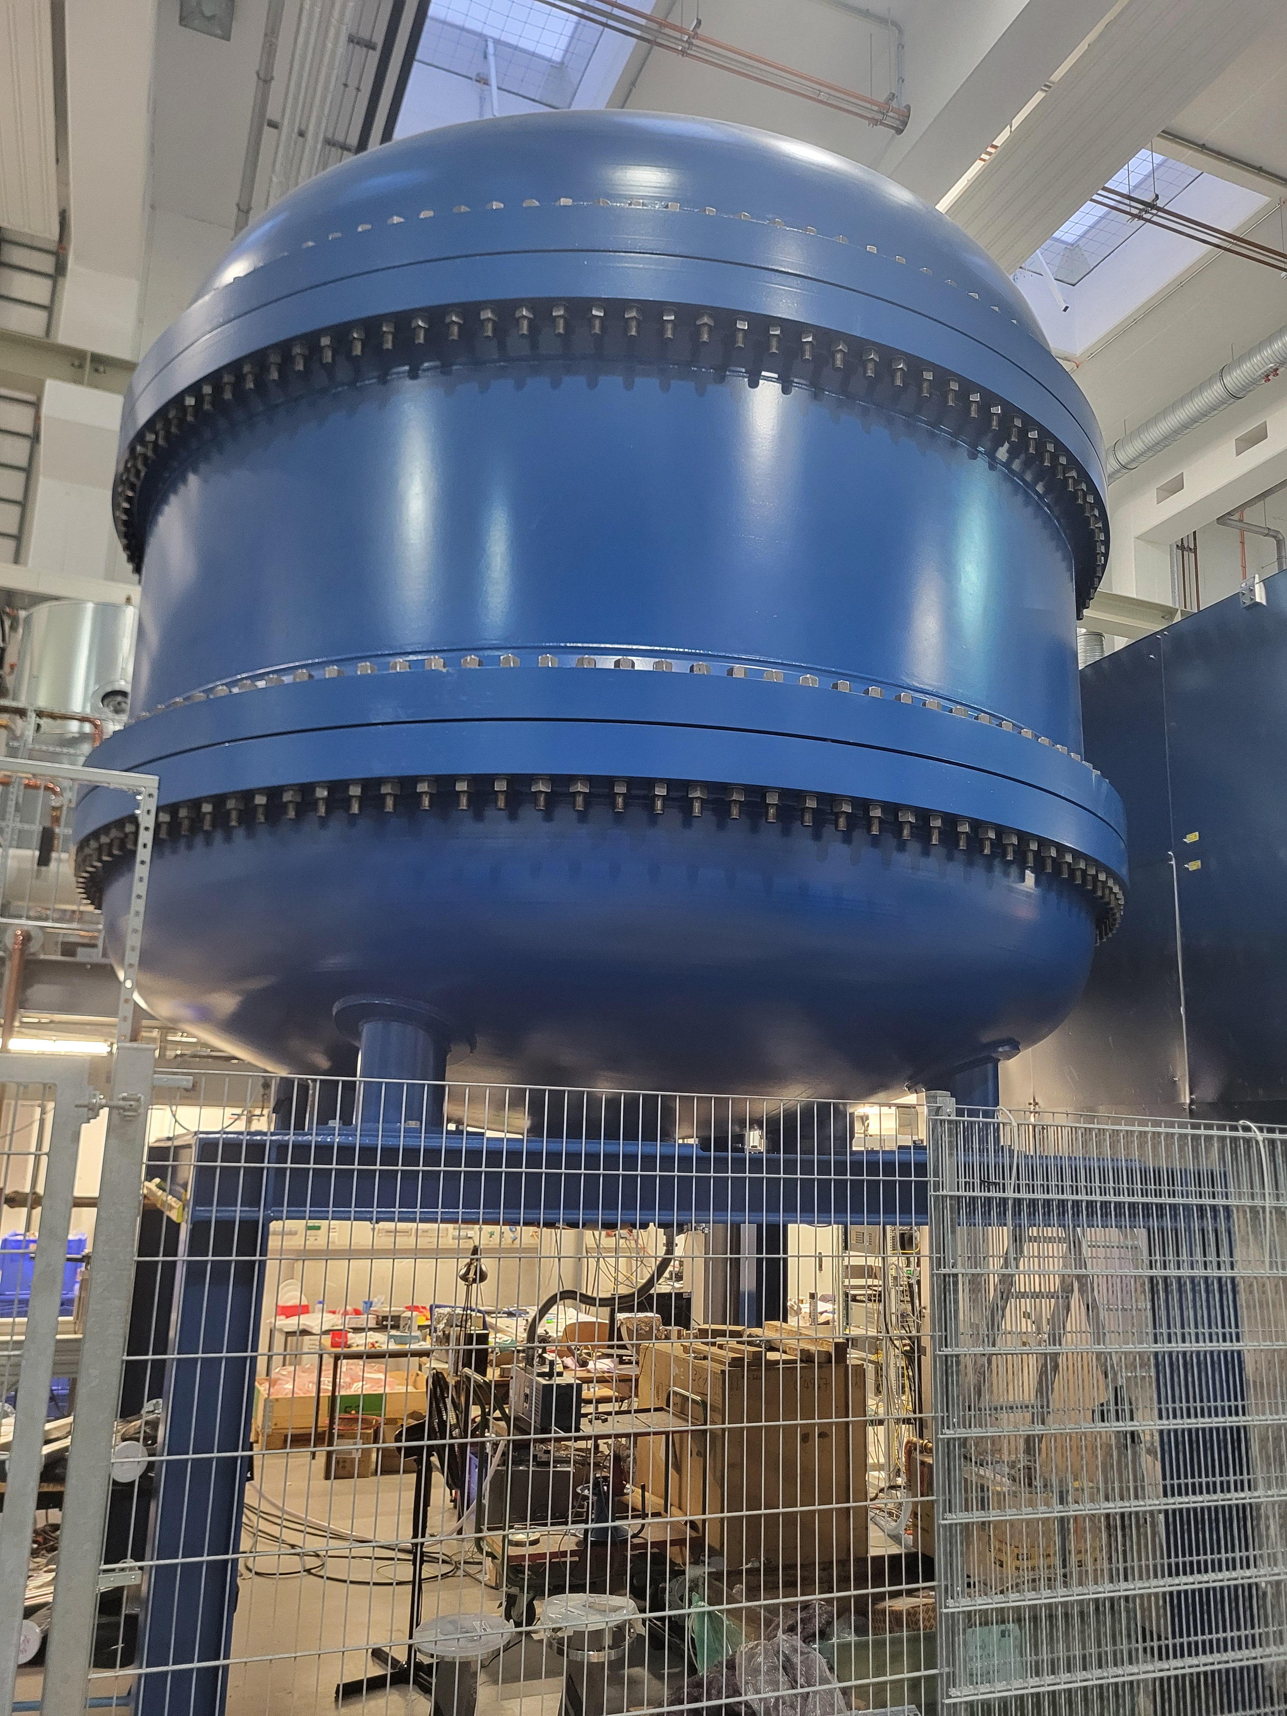
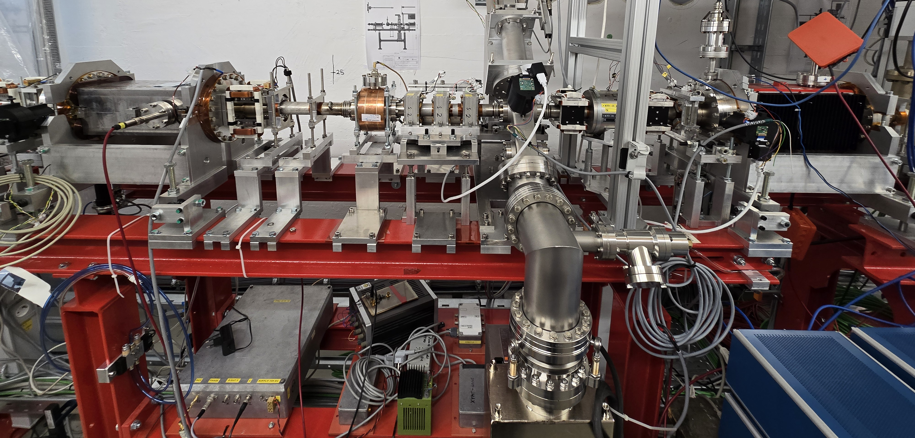
Using Existing Infrastructure & Competence to Continue EDM-Searches at World Class Level
World-class expertise and infrastructure at Aachen/JGU Mainz/HIM/GSI (→ K. Aulenbacher et al)
Searches for systematic effects on storing spin polarized charged electrons, aiming to control EDM limits smaller than achieved for free elementary particles so far
We want to investigate
the effectivity of using:
1.) the existing HESR
cooler prototype at HIM
(tank and high voltage
platform)
2.) Copies of the existing
MESA polarized source
and spin -manipulators
4m
Unique features HESR cooler prototype:
kW el. power available at 600kV
on large HV-platform
Ample space above platform…
due to pressure tank
design for 2 platforms
2 m
3d-spin rotator at MESA

Slide 16
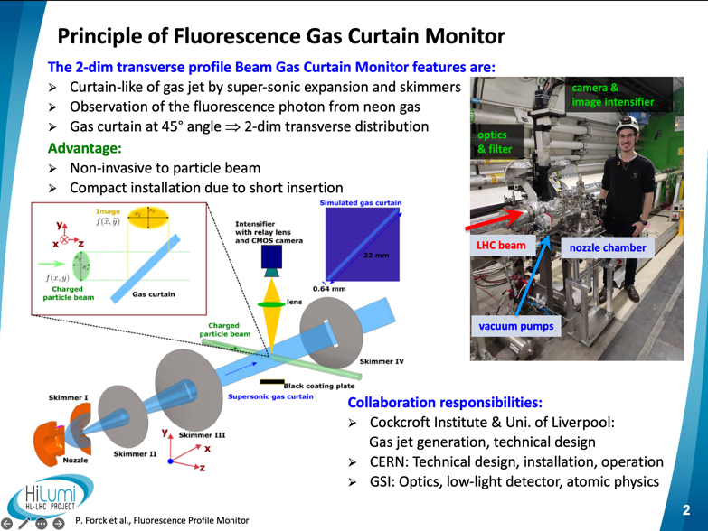
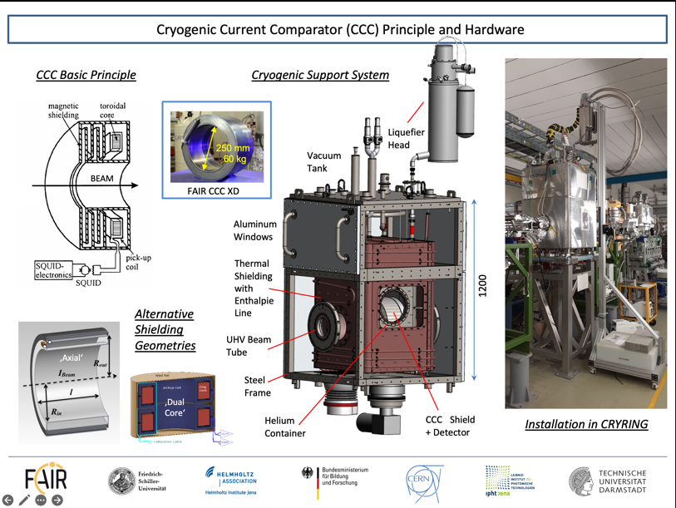
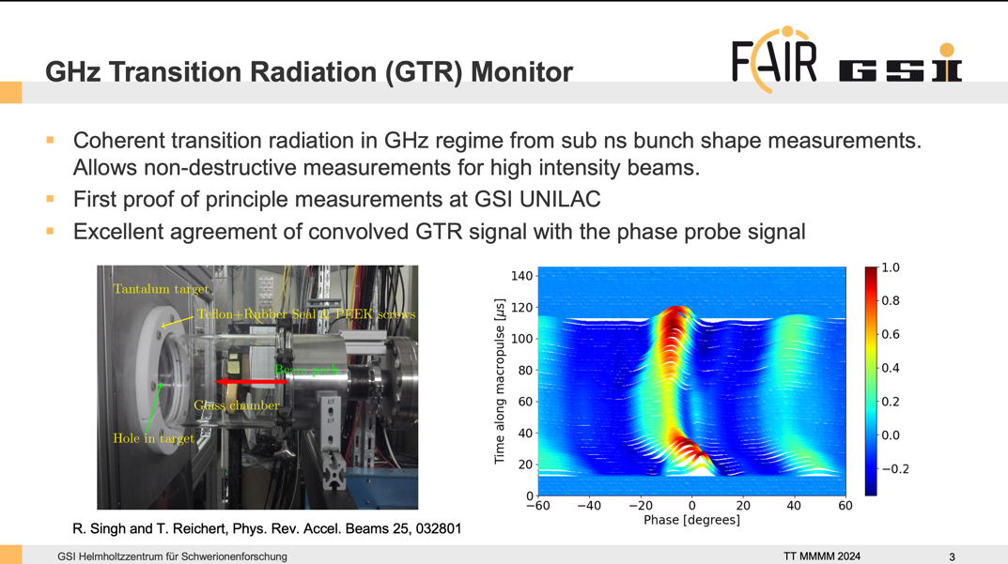
R&D in Advanced
Diagnostics I
Close exchange / collaboration with CERN

Slide 17
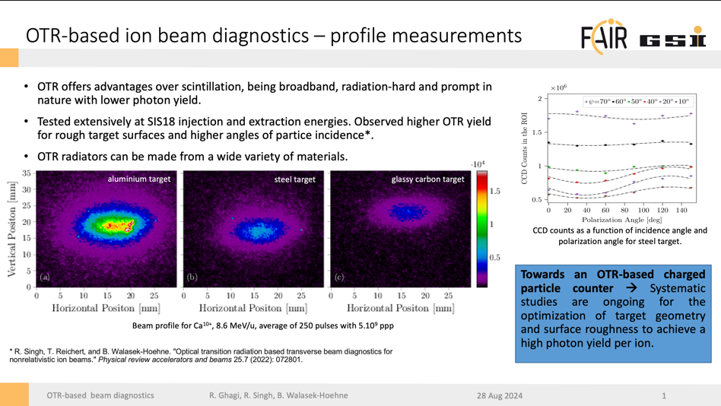
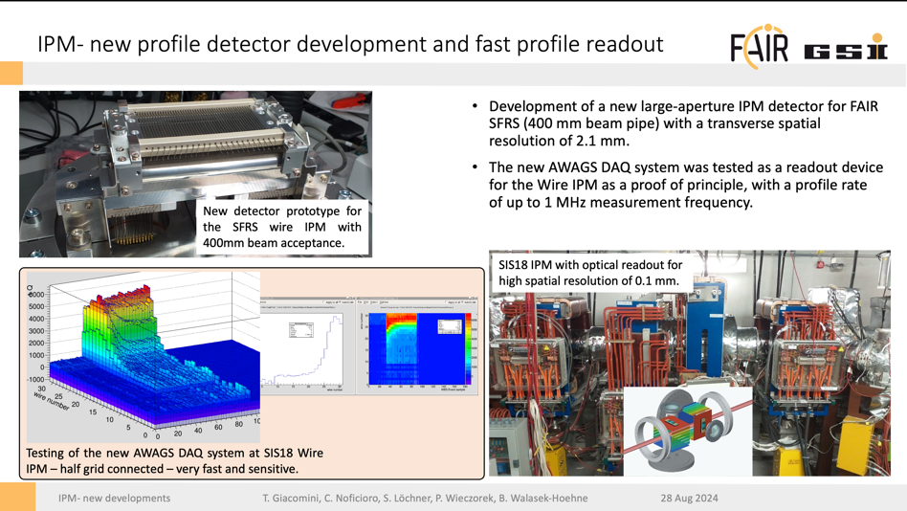
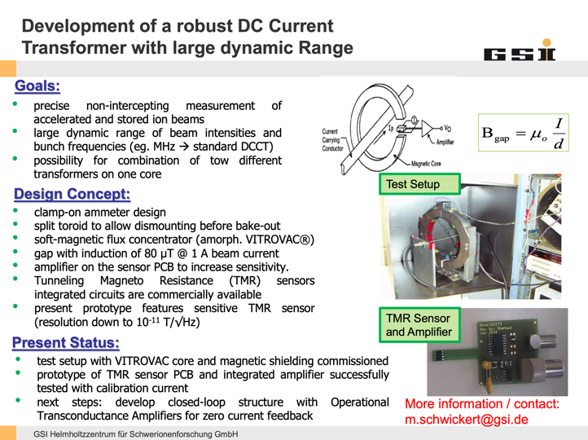
R&D in Advanced Diagnostics II
Close exchange / collaboration with CERN

Slide 18
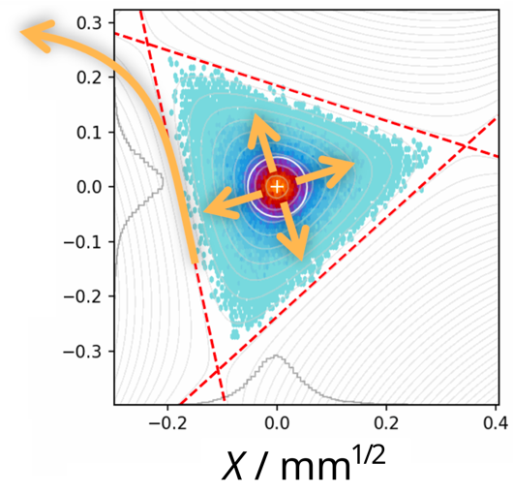
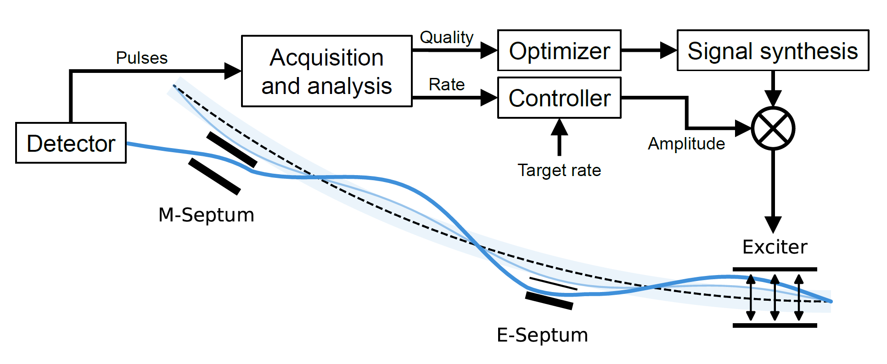
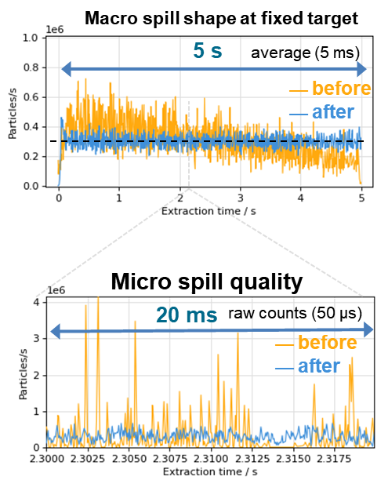
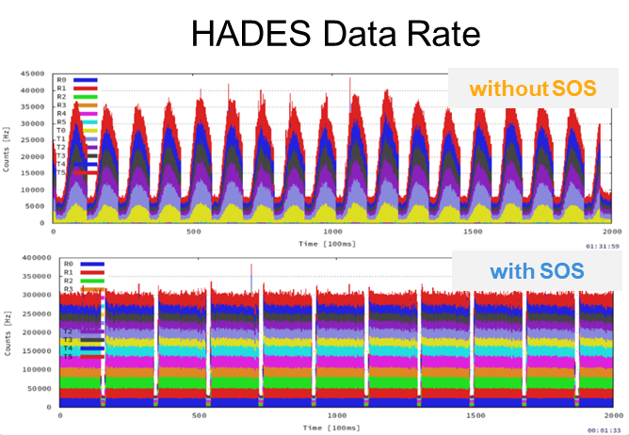
R&D on Automatic Tools → Semi-Autonomous Operation
“Digital Spill Optimization System (SOS)”
Extract on 3rd order resonance.
1. Macro spill (ms to s): Detector feedback to improve spill shape
  2. Micro spill (µs to ms): optimized excitation by variable multiband signal
  Collaboration in place with Heidelberg Ion Therapy (HIT) center
Amplifier
  Factor 2 gain in average detector rate → HADES. Shorter beam time & higher resolution.
Time along macro-pulse →

Slide 19
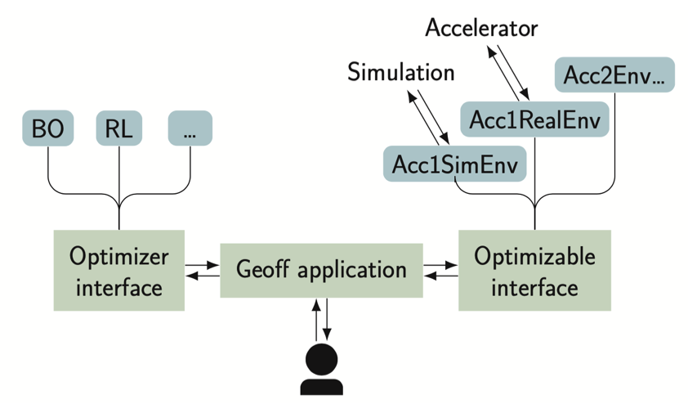
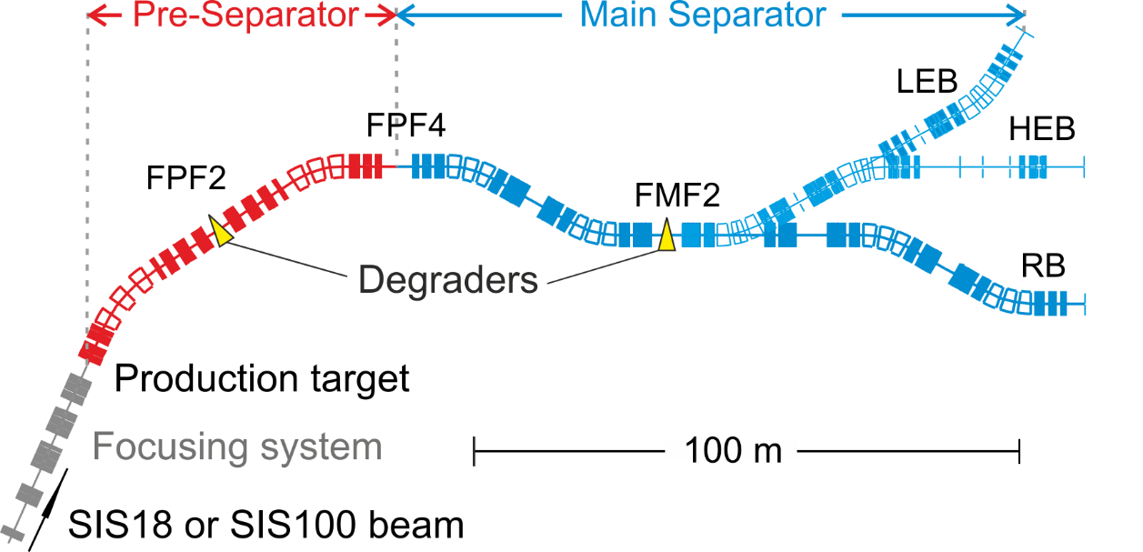
Automation and AI for accelerators
Geoff¹ enables reliable accelerator tuning with python at FAIR and CERN
Geoff developed by CERN and GSI; easily integrates RL + BO; handles complex problems
Automation for beam lines, SIS18/SIS100 and Super-FRS are needed
→ Automation of operational tasks essential for Super-FRS
¹https://doi.org/10.1016/j.softx.2025.102335
Algorithms of interest: Bayesian Optimization (BO), Multi-Fidelity BO, Digital Twins, Reinforcement Learning (RL), etc.
  → Development of new methods and algorithmic improvements
  in collaboration with universities (TU Darmstadt + etc).
FAIR/GSI control system is based on CERN‘s LSA control system
Contact: s.appel@gsi.de, S. Appel, GSI

Slide 20
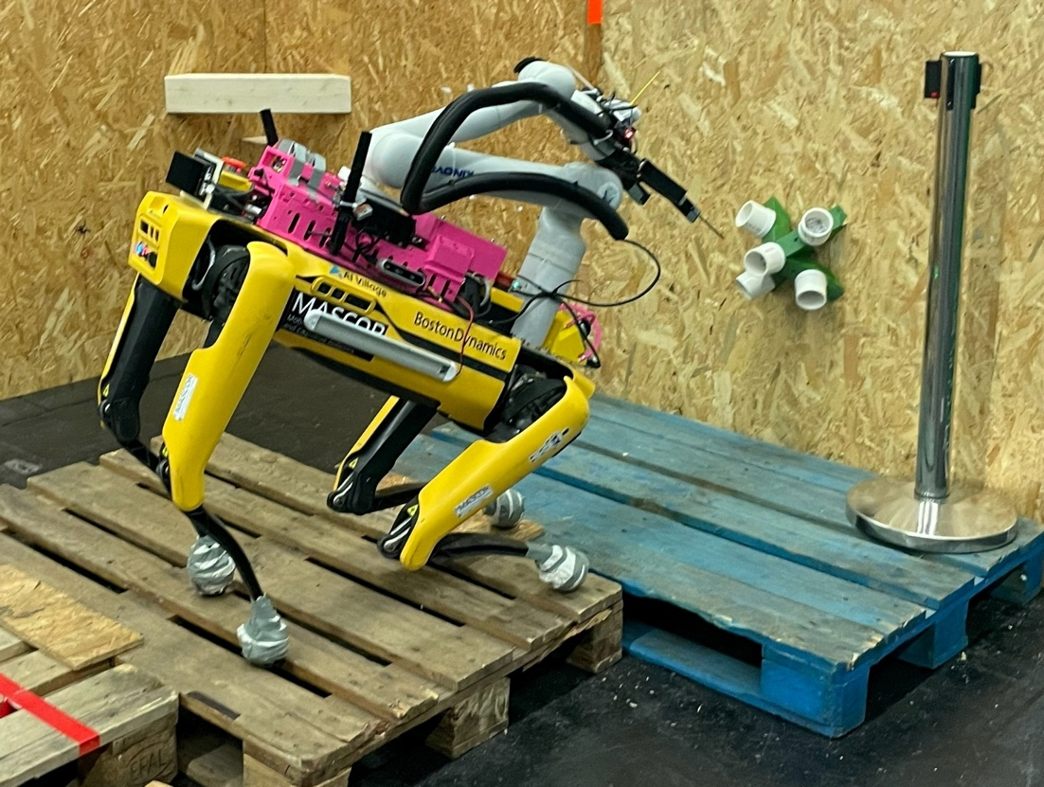
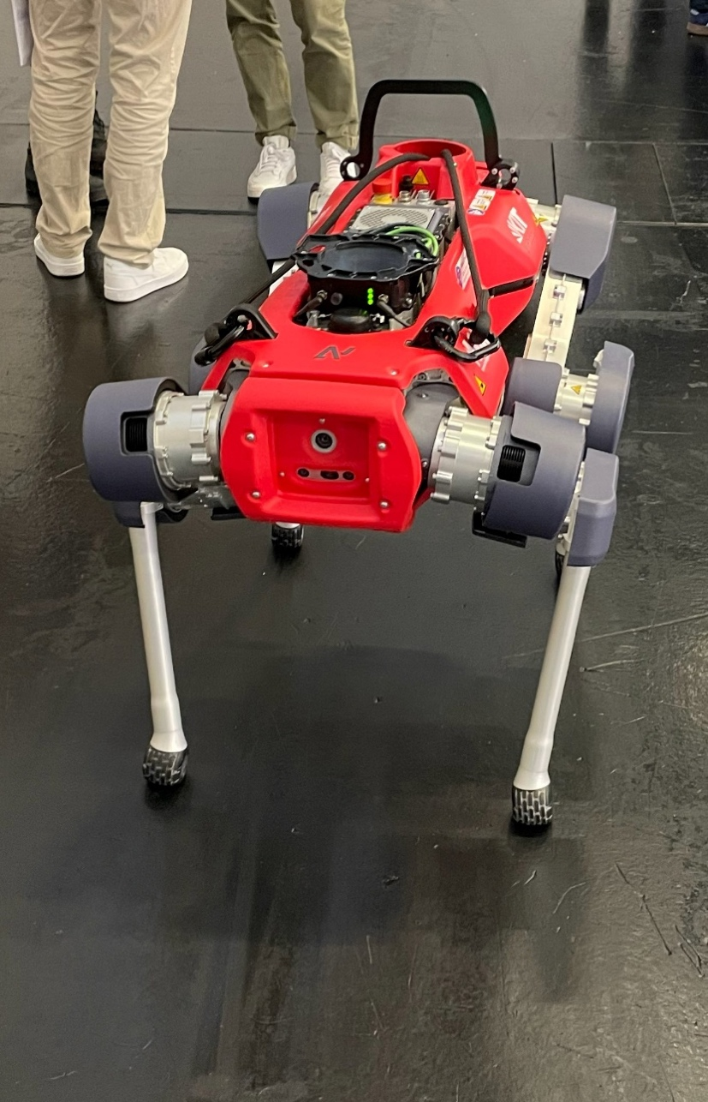
Use of Robots at Particle Accelerators
→ Y. Valdau, GSI

Slide 21
Herausforderungen für Roboter @ GSI
Tunnelroboter mit Selbstnavigation
  Hindernisse auf dem Boden
  Hindernisse in unbekannter Höhe
  Plastiklamellen als Staubschutz
  Brandschutzkonformer Übergang zwischen den Abschnitten
  Sicherheitskonforme Roboter-Schleuse
  Selbstständige Aufzugsfahrt
  Sensible Beschleunigerkomponenten (Kabel, Keramikteile, Elektronik)
  Treppen
  Strahlung während des Beschleunigerbetriebs
Tunnelroboter mit Fernsteuerung
  Unzuverlässiges WLAN
  Keine erfahrenen Roboter-Operateure
  Spezielle austauschbare Sensoren für den Manipulator
Vakuumroboter
  Vakuum als Umgebung
  Kleine Dimensionen
  Kommunikation mit dem Operateur
  Spezielle Sensoren
Kommerzielle Lösung
Selten, Entwicklungsfeld
Entwicklungsfeld, nicht für den ersten Versuch
Hauptherausforderung
Kommerzielle Lösung
Entwicklungsfeld, nicht für den ersten Versuch
Entwicklungsfeld, nicht für den ersten Versuch
Reine Entwicklungsfeld

Slide 22
R&D Arbeitspakete für Roboter Integration @ GSI
AP1: Navigation im Beschleunigertunnel
  Selbstnavigation und Orientierung
  Beschleunigerspezifische Hindernisse
  Interaktion mit Menschen im Tunnel
AP2: Interaktion mit Sicherheitskomponenten
  Konzept für Brandschutzkomponenten Adaptation
  Konzept für Strahlenschutzkomponenten Adaptation
  Konzept für Aufzugfahrt
AP3: Roboter Integration
  Selbständige WLAN Errichtung für Fernsteuerung
  Adaptation von Standard Sensoren für Robot Manipulator
  Roboter Operator Ausbildung
AP4: Roboter und Strahlenschutz
  Roboter Optimierung für die Arbeit im Radiationsfeld
  Roboter Einsatzkonzept für Strahlenschutz
  Dosimeter Integration mit Roboter Systemen
AP5: Robot im Vakuum
  Suche nach der passenden Plattform
  Suche nach den passenden Sensoren
  Einschleusen Konzept
  Konzept für Robotereinsatz im Vakuum
Plan for close exchange / collaboration with TUD and CERN

Slide 23
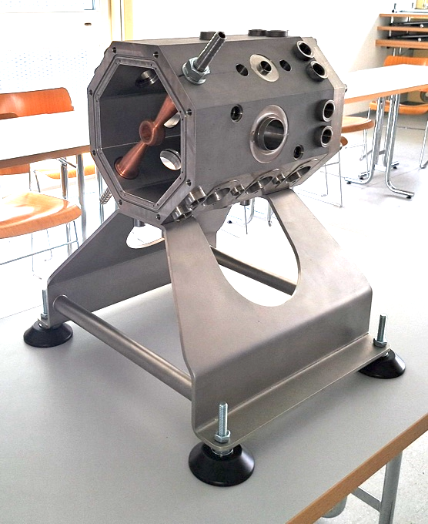
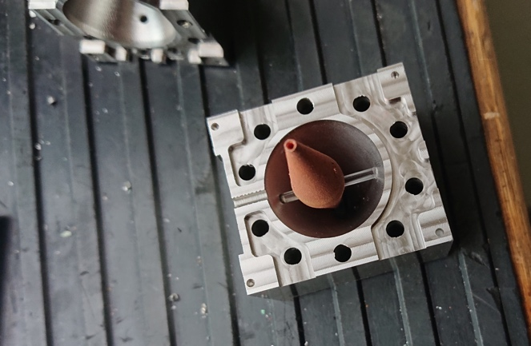
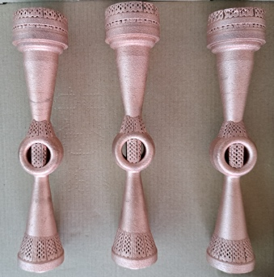
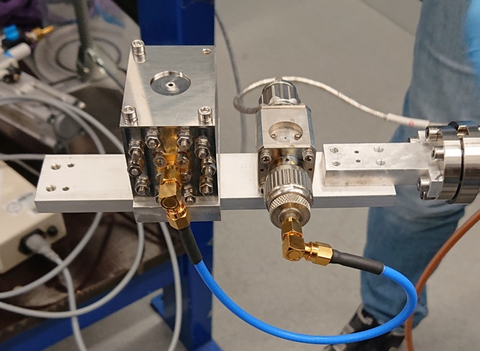

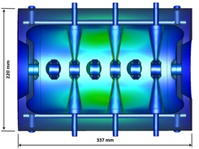
R&D on Accelerator Components
Produced with Additive Machining (3D)
704.4 MHz CH prototype
3D Printed Copper FFC
A tapered design with a larger entrance hole for higher SNR at the cost of lower time resolution
First additive manufactured RF beam diagnostic component (manufactured at: IWS Fraunhofer Institute)
Demonstration of secondary electron suppression "by- design"
copper-electrodes
704 MHz-CH (size compared with a football)
S. Klaproth, R. Singh et al. Manuscript in preparation
Courtesy C. Zhang et al

Slide 24
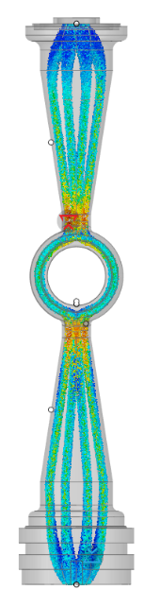
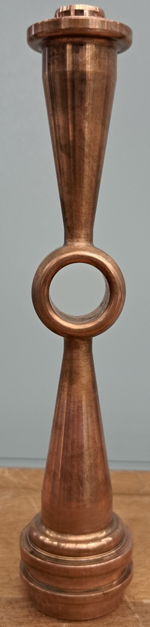



R&D of a 216.816 MHz Heavy Ion Accelerator for a Better Injection to SIS18 or Future Compact Particle Therapy Facilities using Metal Additive Manufacturing and AI
Design Energy: 1.4 MeV/u (as energy booster for HLI‘) or 3 MeV/u (as booster for HLI‘-booster)
Design Particle A/q: 8.5
C. Zhang
30 mm
Preliminary Design
(to be optimized by AI)
Realized fully-3D-Printed Cavity
New Cooling-Channel Design
enabled by 3D-Printing

Slide 25





Additive Manufacturing for High Duty Factor RF Structures
Cw operated RFQ
Gyroidal cooling channels of printed RFQ stems (planned)
Cw operated
CH-DTL cavity
H. Podlech
H. Hänel
Conventionally produced cooling channels
Geometry of printed stems of a CH-DTL cavity

Slide 26










Transport & Injection Laser-Plasma p or Ion Beam
ILIGHT Proposal – Injection into Synchrotron
ARD
LIGHT beamline produces p and ion beams in a laser plasma accelerator
Beam captured and transported
V. Bagnoud
→ next: inject to TK transfer line and SIS-18 synchrotron
New connection needed
Parameter | Protons (2014) | Protons (2019) | C⁴⁺ (2021) | Protons (2022)
Energy | 9.7 MeV | 7.72 MeV | 0.60 MeV/u | 0.63 MeV
Pulse width | / | 0.74 ns | 1.23 ns | 0.76 ns
Energy spread | 2.7% | 4.91% | / | /
Particle number | ~ 1.7 x 10⁹ | ~ 7 x 10⁸ | ~ 2 x 10⁸ | ~ 6 x 10⁸

Slide 27

Optical Probing of Ultrafast Laser-Induced
Solid-to-Overdense-Plasma Transitions
ARD
Visualization of generation & evolution of laser-generated plasma with optical probing
Found collisional ionization as dominant mechanism for initial plasma formation
Exp. results reproduced with 2-step model:
  solid-state interaction model
  (band structure + collisional ionization)
  Plasma heating and expansion with PIC
Knowledge of target conditions essential for thin-foil ion acceleration
Extension of the model to other materials and targets (Al, Au, solid/liquid H₂…)
Y. Azamoum et al., Light: Science & Applications 13, 109 (2024)
M. Kaluza

Slide 28
Conclusion
Right time to reinforce development projects with universities: maximize GSI / FAIR capabilities, advance new technologies, deliver more/other ions. Interests:
  Improved instrumentation Diagnostics for ion beams and radiation to experiments
  Automatisation / AI semi-autonomous accelerator operation, robots, limiting OP costs
  Better materials Supporting advanced and new applications
  New accelerator technologies SC RF, SC magnets, HTS, new kinds of RFQ‘s, IH‘s, plasma acc., …
  New manufacturing methods Just in-time printing of spare parts, spare cavities, …
  Advanced beam dynamics Extreme beams, collective limits, beam cooling, crystalline beams, …
Collaborating with many universities in Rhein-Main area (new common master accelerator study program) and beyond.
Our ambition:
  Innovation – go further with better technologies, increase science reach, better efficiency/sustainability
  Training young scientists and technicians, also for FAIR commissioning and operation

Slide 29

Thank you for your attention
r.assmann@gsi.de

Slide 30
Acknowledgements
Input and slides from the following persons are acknowledged (many thanks and apologies if your slide could not be shown due to limited time):
A. Adonin, A. Andreev, S. Appel, K. Aulenbacher, V. Bagnoud, W. Barth, R. Berezov, J. Blaurock,
A. Blazevic, O. Boine-Frankenheim, T. Dettinger, C. Düllmann, P. Forck, M. Galonska, O. Geithner,
T. Giacomini, R. Ghagi, L. Groening, H. Hähnel, F. Herfurth, F. Heymach, R. Hollinger, M. Kaluza,
S. Löchner, F. Maimone, J. Mäder, S. Mickat, M. Miski-Oglu, P. Niedermayer, C. Noficioro,
H. Podlech, R. Lang, S. Reimann, B. Schlitt, G. Schreiber, M. Schwickert, T. Sieber,
R. Singh, P. Spiller, M. Steck, Y. Valdau, M. Vossberg, B. Walasek-Hoehne, G. Walter, U. Weinrich,
P. Wieczorek, C. Zhang, …

