Slide 1
TCAD simulation VII
E. Giulio Villani
UK HEP Instrumentation Summer School, Oxford 1-12 July 2024

Slide 2
Overview
Simulation example of 2D PN junction using SPROCESS and SDEVICE
CV
UK HEP Instrumentation Summer School, Oxford 1-12 July 2024

Slide 3
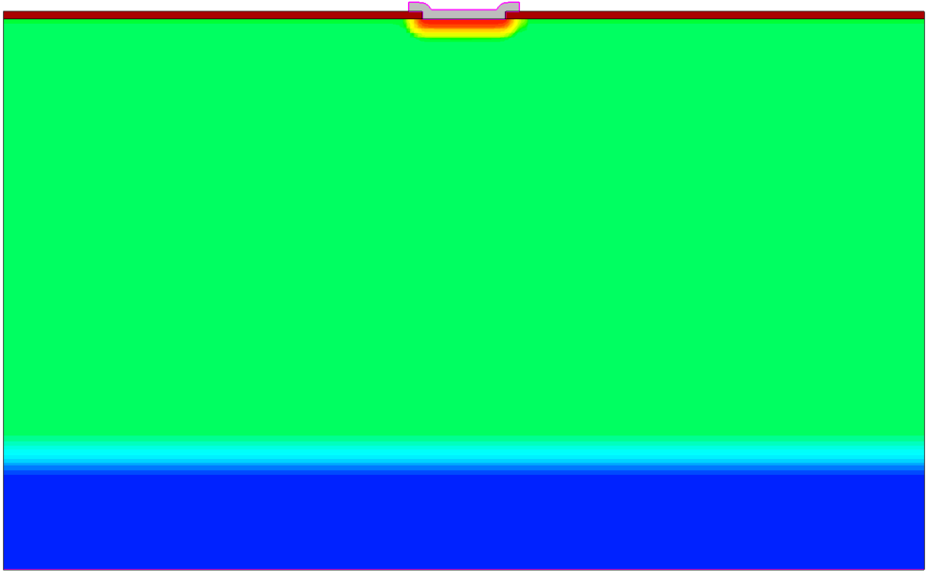

TCAD Synopsys Simulation
N-well cathode
SDEVICE simulation of 2D pn junction
  CV
100 um
9 um
P - HR
P++
1
UK HEP Instrumentation Summer School, Oxford 1-12 July 2024

Slide 4
TCAD Synopsys Simulation
Effects on the CV with/without JTE
Effects on the CV with/without oxide charge
2
UK HEP Instrumentation Summer School, Oxford 1-12 July 2024

Slide 5
TCAD and simulation VII
Simulation example : 2D pn using SPROCESS
CV : JTE and Oxide charge effects
    Thank you
    giulio.villani@stfc.ac.uk
3
UK HEP Instrumentation Summer School, Oxford 1-12 July 2024

