Slide 1
TCAD simulation VI
E. Giulio Villani
1
UK HEP Instrumentation Summer School, Oxford 1-12 July 2024

Slide 2
Overview
Simulation example of 2D PN junction using SPROCESS and SDEVICE
IV / BV effects of JTE
IV / BV effects of interface charge
2
UK HEP Instrumentation Summer School, Oxford 1-12 July 2024

Slide 3
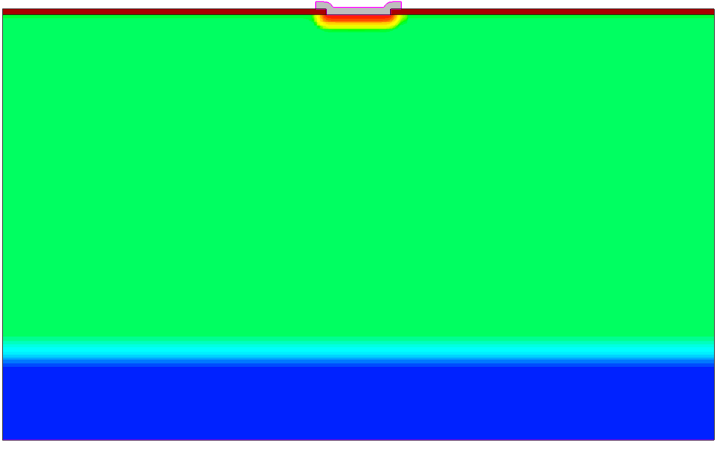

TCAD Synopsys Simulation
N-well cathode
SDEVICE simulation of 2D pn junction
  IV
  SC/Depletion region visualisation
  Breakdown voltage
The Junction Termination Extension (JTE) is added to the edges of the cathode to spread over a wider region the potential drop. This reduces the field and increases the breakdown voltage
100 um
9 um
P - HR
P++
3
UK HEP Instrumentation Summer School, Oxford 1-12 July 2024

Slide 4
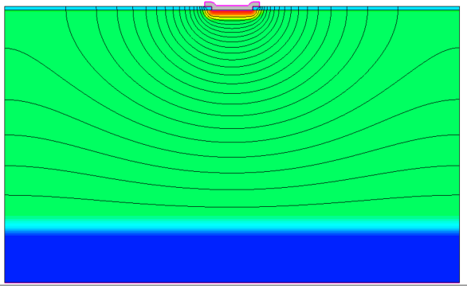
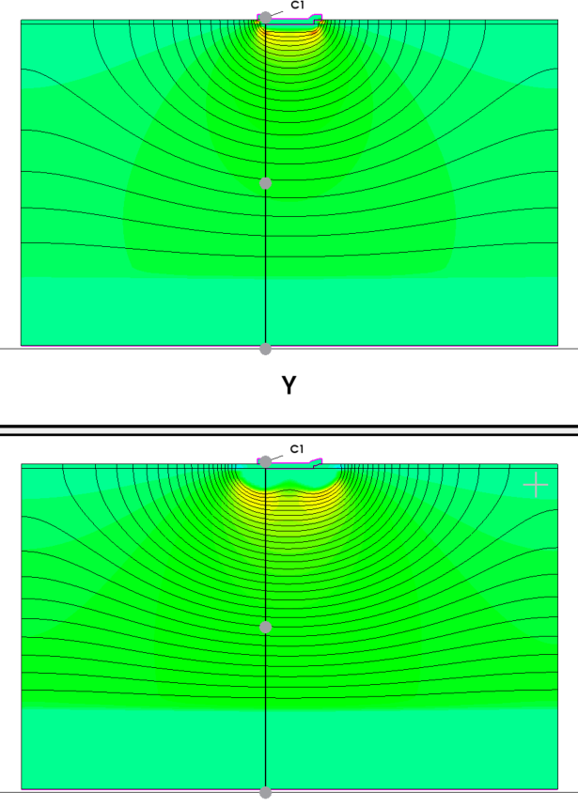
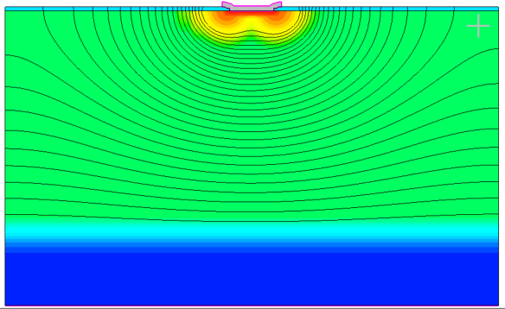
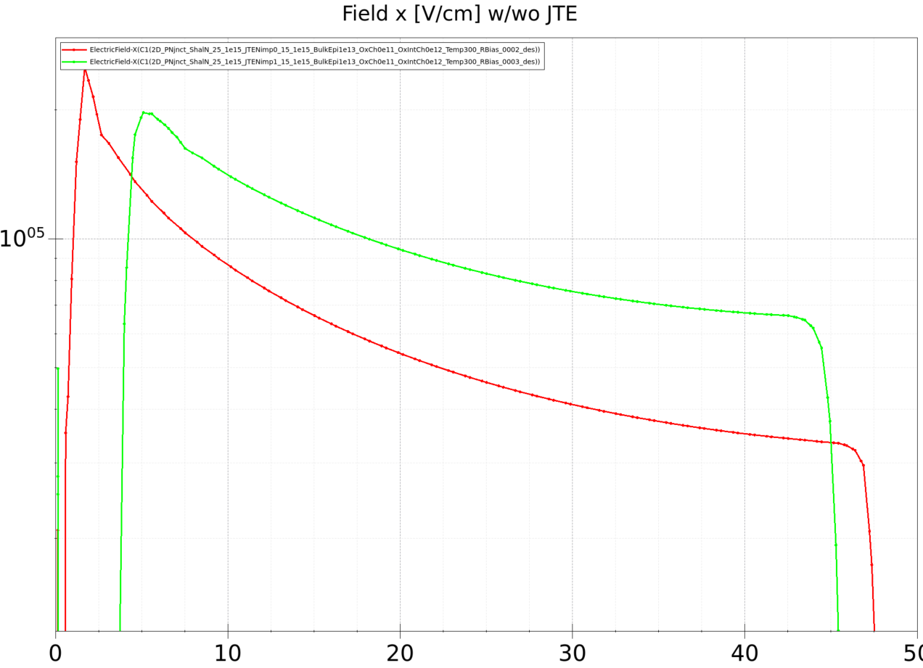
TCAD Synopsys Simulation
Pics showing the field with/without JTE
  The potential drop is extended over a wider region with the JTE, increasing the BV
JTE
4
UK HEP Instrumentation Summer School, Oxford 1-12 July 2024

Slide 5
# Physics
### if Oxide charge not zero it includes effects due to SiO2 interface surface states ###
#if @OxchargeConc@ !="0"
#include "OXIDE_TRAPS"
#endif
TCAD Synopsys Simulation
  Effects due to the oxide trapped and interface charge
5
UK HEP Instrumentation Summer School, Oxford 1-12 July 2024

Slide 6
TCAD Synopsys Simulation
Physics(Material="Oxide")
{
### Nox: SiO2 fixed trapped charge definition
### Nox: fixed
Charge(Conc=@OxchargeConc@)
}
Physics(MaterialInterface="Silicon/Oxide")
{
### Nint: 0.8 - 0.9 of Nox
### it just uses Gaussian distribution for interface traps
### donor-like Si-SiO2 interface traps Gaussian, Ev+0.7eV,sigma= 70mEv
### acceptor-like Si-SiO2 interface traps Gaussian,[ Ec-0.4eV,0.4 of Nint; Ec-0.6eV, 0.6 of Nint], sigma = 70meV
### Reference [1]
Traps((hNeutral Conc=@OxIntchargeConc@ Gaussian EnergyMid=0.70 EnergySig=0.07 fromValBand eXsection=1e-15 hXsection=1e-15 )
(eNeutral Conc=@<0.4*@OxIntchargeConc@>@ Gaussian EnergyMid=0.40 EnergySig=0.07 fromCondBand eXsection=1e-15 hXsection=1e-15 )
(eNeutral Conc=@<0.6*@OxIntchargeConc@>@ Gaussian EnergyMid=0.60 EnergySig=0.07 fromCondBand eXsection=1e-15 hXsection=1e-15 ))
}
TrappedCarDistrPlot {
### plots the interface traps distribution vs. E at some 'typical' location near the Si/SiO2 interface
MaterialInterface="Silicon/Oxide" {(0.132 -260 )}
### plots the silicon region traps
}
  Effects due to oxide trapped and interface charge
[1] F. Moscatelli et al., Measurements and TCAD simulations of bulk and surface radia-
tion damage effects in silicon detectors, IEEE Nuclear Science Symposium and Medical Imaging Conference (NSS/MIC), San Diego, CA, USA, 2015, p. 1-6, doi: 10.1109/NSS-MIC.2015.7581944, 2015
6
UK HEP Instrumentation Summer School, Oxford 1-12 July 2024

Slide 7
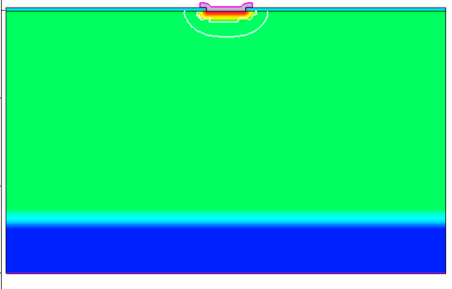
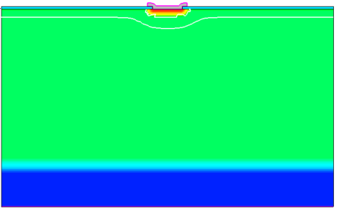
TCAD Synopsys Simulation
No oxide charge
  Effects due to oxide trapped and interface charge
    Effects on depletion, leakage current
1e11 cm-2 oxide charge
7
UK HEP Instrumentation Summer School, Oxford 1-12 July 2024

Slide 8
TCAD and simulation VI
Simulation example : 2D pn using SPROCESS
IV (FWD/REV), SC, Depletion region
JTE effects
Oxide charge
    Thank you
    giulio.villani@stfc.ac.uk
8
UK HEP Instrumentation Summer School, Oxford 1-12 July 2024

