Slide 1
TCAD simulation V
E. Giulio Villani
UK HEP Instrumentation Summer School, Oxford 1-12 July 2024

Slide 2
Overview
Semiconductor fabrication process
  Fabrication process flow
  Silicon epitaxial growth
  Oxidation
  Resist deposition
  Photolithography/etching
  Implantation
  Thermal annealing/Activation
  Metalization
Process simulation in TCAD
  2D process simulation of PN junction
Addendum: Fabrication process details
UK HEP Instrumentation Summer School, Oxford 1-12 July 2024

Slide 3
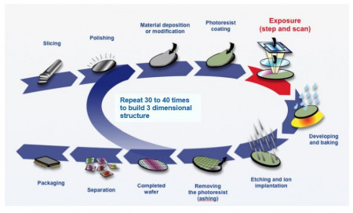
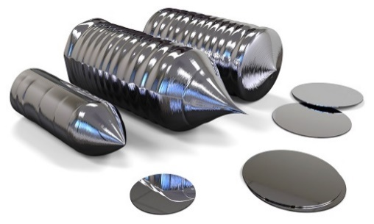
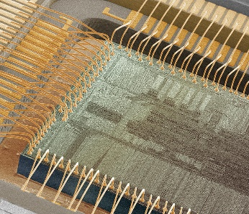
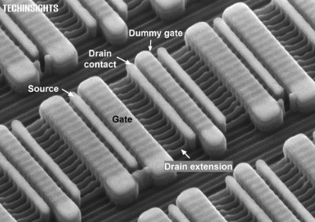

Semiconductor fabrication process
The fabrication of semiconductor devices is a rather complex process
Many intermediate steps and manufacturing precision at atomic level
It starts with the growth of high purity Si crystals
1
UK HEP Instrumentation Summer School, Oxford 1-12 July 2024

Slide 4
Silicon process fabrication example
Wafer substrate
Start with Si wafer cleaned and polished
The wafer top is covered by insulating layer, SiO₂
Light-sensitive layer (photoresist) deposited
A photomask with the desired pattern is aligned with the wafer
Oxidation
Resist depo
Masks alignment/ exposure
2
UK HEP Instrumentation Summer School, Oxford 1-12 July 2024

Slide 5
Silicon process fabrication example
Exposure/Develop
Exposure to UV light makes the photoresist not covered by masks easily removable
Once the developed resist is removed, the unprotected SiO₂ is etched away, using chemical process. Remaining resist is stripped off
The exposed areas of Silicon are then doped, e.g. to obtain PN junctions
Metallization followed by a similar photolithographic process to obtain a final device
Etching
Implantation/ Annealing
Metalization
3
UK HEP Instrumentation Summer School, Oxford 1-12 July 2024

Slide 6
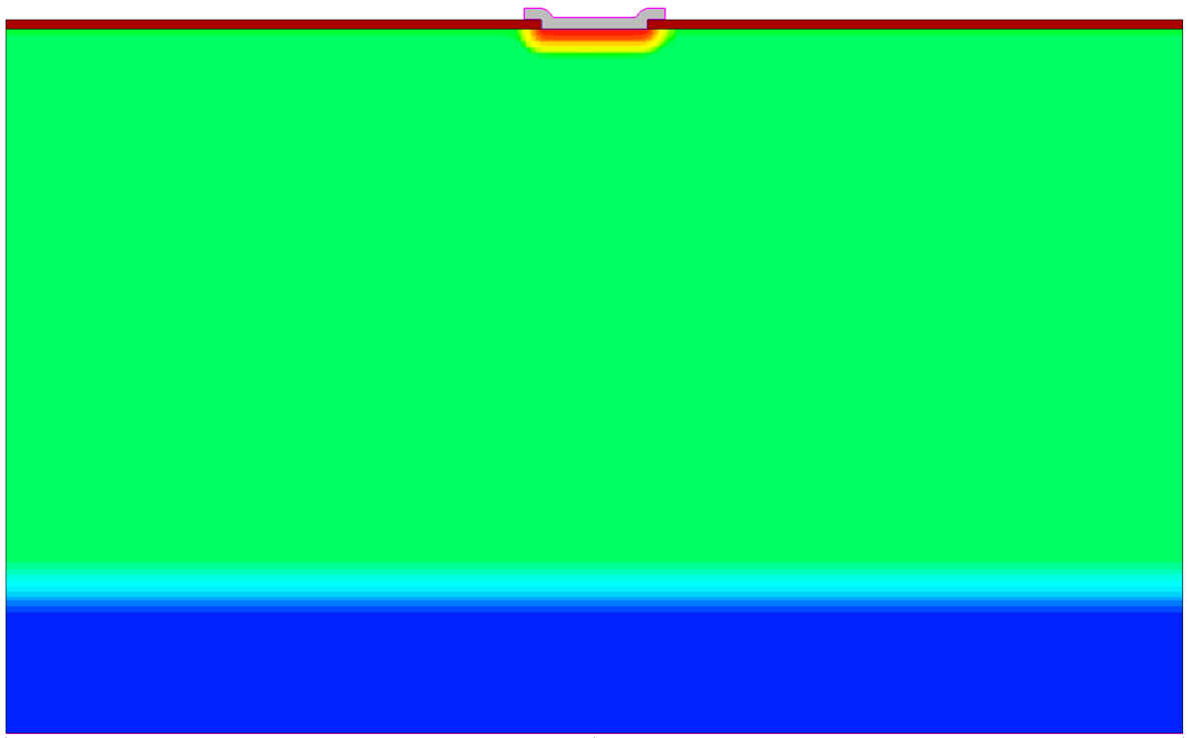
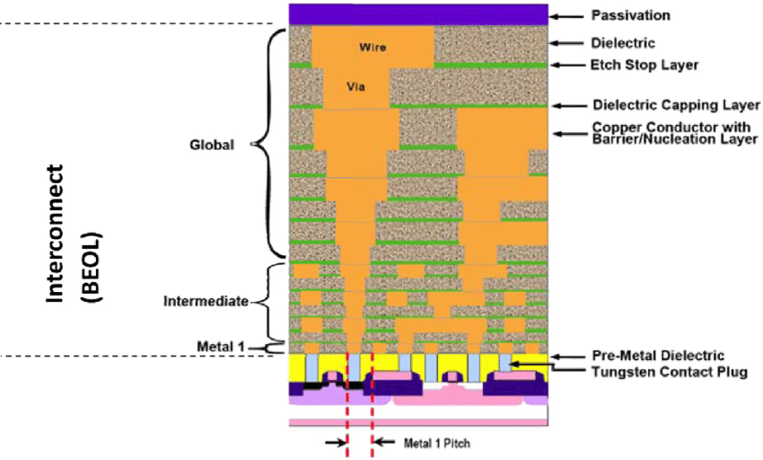
Silicon process fabrication example
Additional layers of conducting or insulating materials can be added, to obtain multilayers structures
10s of layers in modern submicron CMOS process
  PN junction cross section example – 1 layer
Diagram of a cross-section of a VLSI circuit
from ITRS 2005, http://www.itrs.net/Links/2005itrs/ home2005.htm. 58
4
UK HEP Instrumentation Summer School, Oxford 1-12 July 2024

Slide 7
Process simulation in TCAD
E. Giulio Villani
5
UK HEP Instrumentation Summer School, Oxford 1-12 July 2024

Slide 8

Silicon process fabrication example in TCAD
100 um
SiO₂
Al cathode
Simulate the fabrication process of a PN junction
Epitaxial layer thickness and doping can be modified by the user
Thermal silicon oxide growth, implantation, etching, diffusion and metal cathode deposition
9 um
P-epi
P++
6
UK HEP Instrumentation Summer School, Oxford 1-12 July 2024

Slide 9
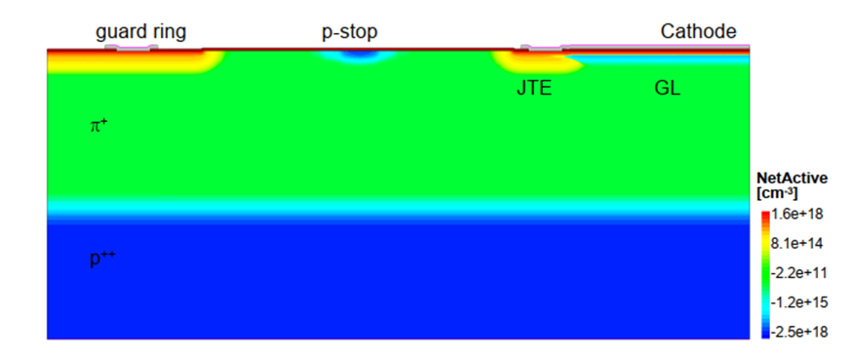
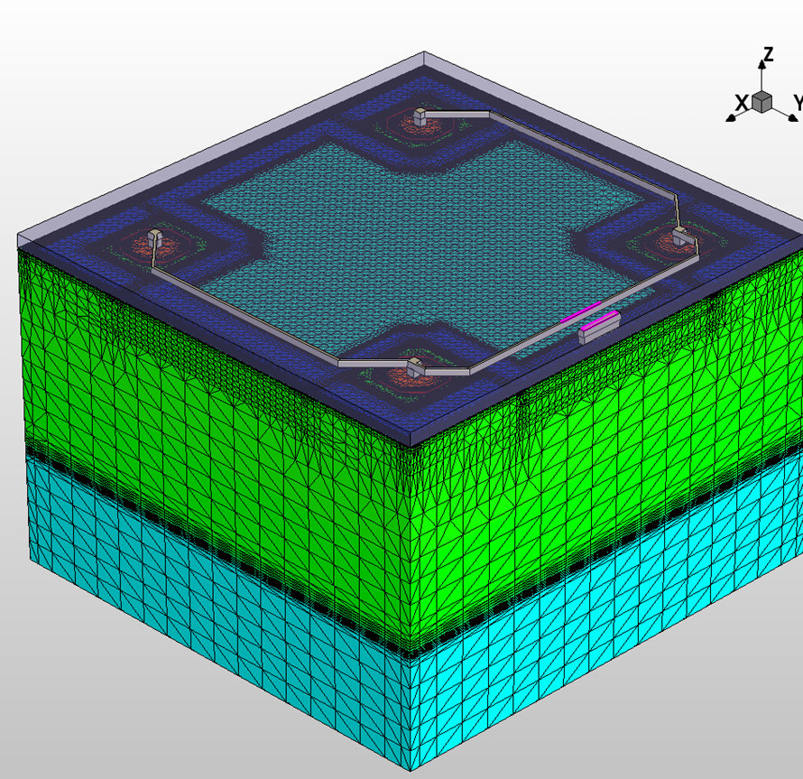
Silicon process fabrication example in TCAD
The Synopsys tool SPROCESS can simulate the fabrication process of semiconductor device, 1/2/3D
Simulated steps include epitaxial growth, implantation, etching, thermal annealing, metal deposition
Analytical and MC simulation possible for realistic results
Simulation of crystal damage following implantation
Cross section of 2D simulated Low Gain Avalanche Detector (LGAD)
A 3D simulated OVERMOS sensor
7
UK HEP Instrumentation Summer School, Oxford 1-12 July 2024

Slide 10
Silicon process fabrication example in TCAD
Script in SPROCESS to simulate the fabrication of a PN junction on a epitaxial layer
  Doping and thickness of the epi layer can be modified (device parameters)
  Fabrication parameters can be modified (energy/dose of the implant, presence of oxide/JTE and oxidation time)
The obtained mesh will then be simulated for IV, CV and Charge collection
Device parameters
Fabrication parameters
8
UK HEP Instrumentation Summer School, Oxford 1-12 July 2024

Slide 11
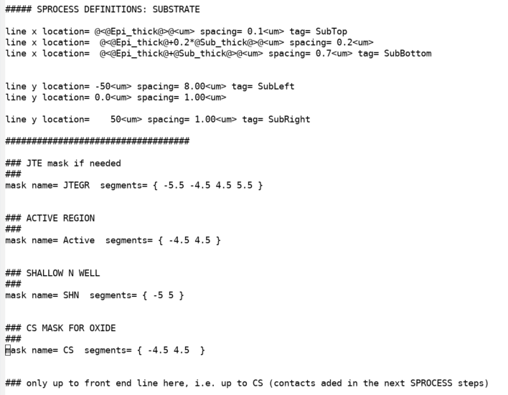
Silicon process fabrication example in TCAD
Substrate and mask definition: parameters taken from the main workbench window
Additional SPROCESS parameters configuration
9
UK HEP Instrumentation Summer School, Oxford 1-12 July 2024

Slide 12
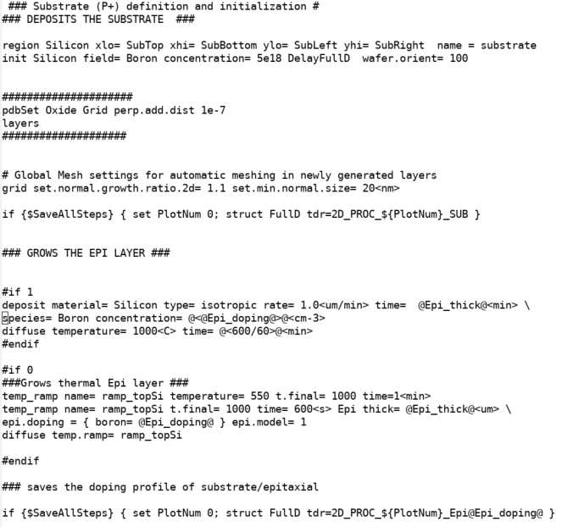
Silicon process fabrication example in TCAD
Substrate deposition and Epitaxial layer growth
Saves the structure
10
UK HEP Instrumentation Summer School, Oxford 1-12 July 2024

Slide 13
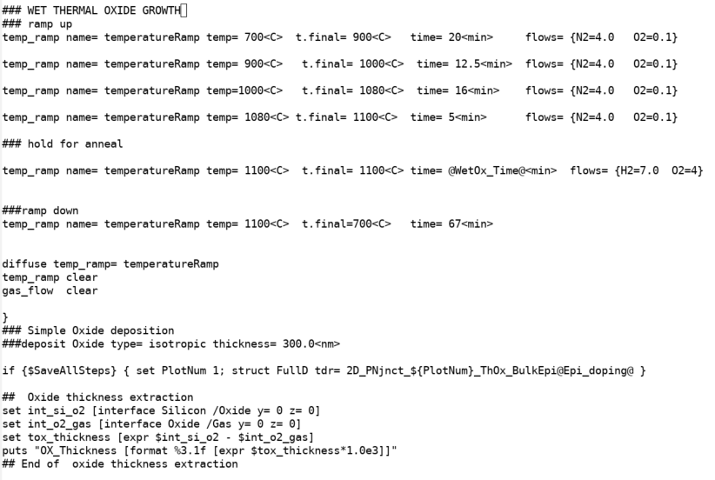
Silicon process fabrication example in TCAD
Thermal oxide growth 300 nm
Oxide thickness extraction
Saves the structure
11
UK HEP Instrumentation Summer School, Oxford 1-12 July 2024

Slide 14
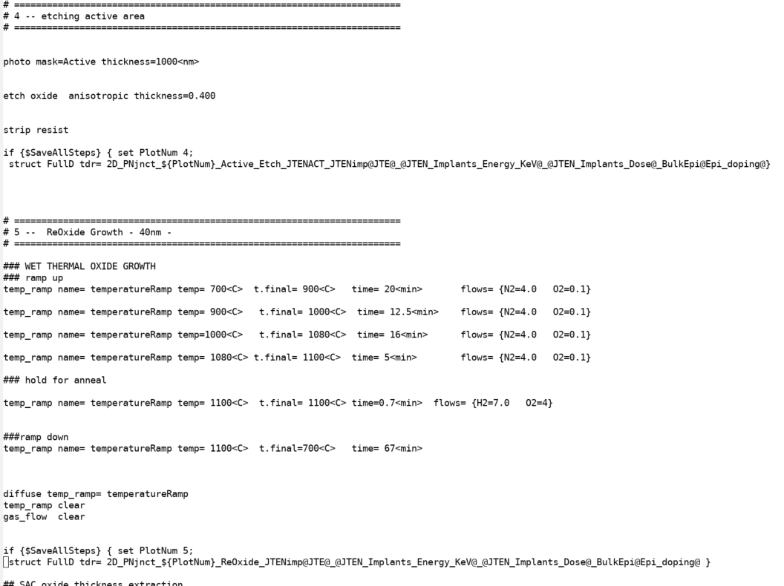
Silicon process fabrication example in TCAD
Optional JTE
Etching of Active area and growth of sacrificial oxide
Saves the structure
12
UK HEP Instrumentation Summer School, Oxford 1-12 July 2024

Slide 15
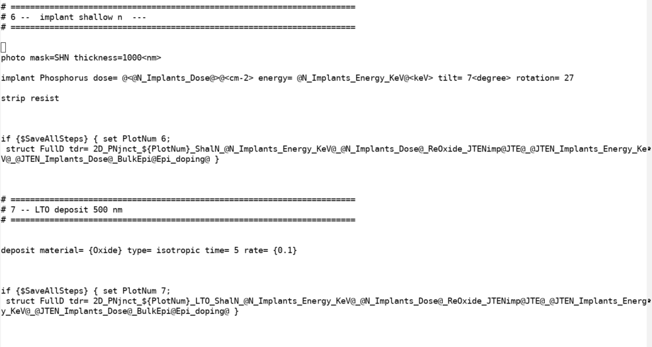
Silicon process fabrication example in TCAD
Implantation of N well: beam tilting to suppress channeling effect
Low Temperature Oxide (LTO) deposition
Saves the structure
13
UK HEP Instrumentation Summer School, Oxford 1-12 July 2024

Slide 16
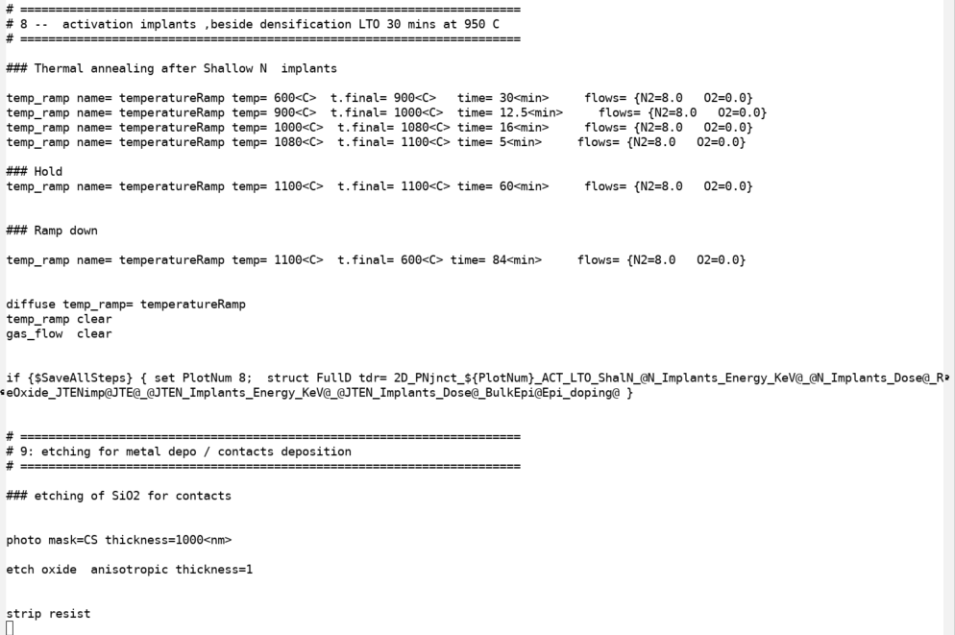
Silicon process fabrication example in TCAD
Activation of implanted ions and LTO densification
Etching of SiO2 for contact placement
Saves the structure
14
UK HEP Instrumentation Summer School, Oxford 1-12 July 2024

Slide 17

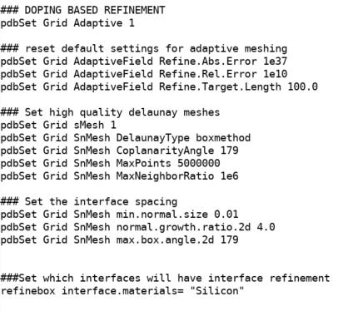
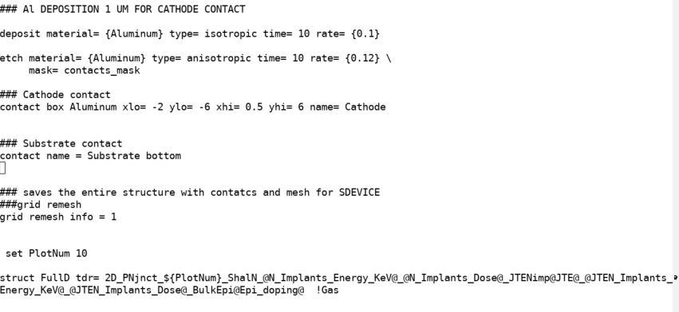
Silicon process fabrication example in TCAD
The second SPROCESS re-meshes for device simulation
Contact mask definition
Metal deposition for contact and etching
Saves the structure
15
UK HEP Instrumentation Summer School, Oxford 1-12 July 2024

Slide 18
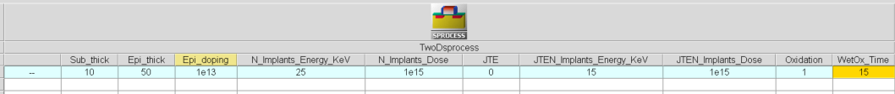
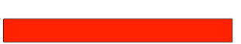
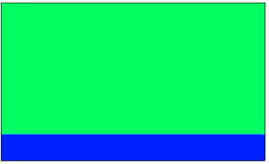
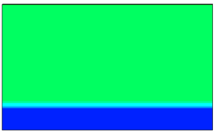
Silicon process fabrication example in TCAD
Substrate
Substrate and mask definition
Epitaxial layer growth
Thermal oxide growth 300 nm
Substrate + Epi
ThOx
Substrate + Epi
16
UK HEP Instrumentation Summer School, Oxford 1-12 July 2024

Slide 19
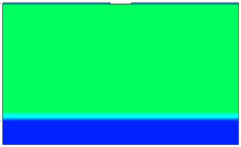
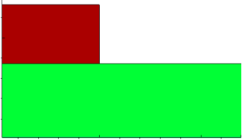
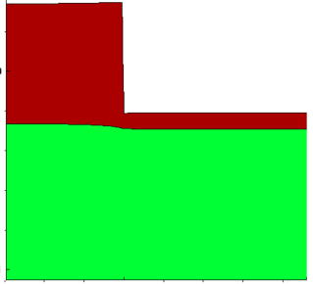
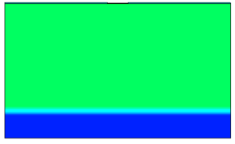

Silicon process fabrication example in TCAD
SiO2 etching
SiO2 etching
Sacrificial SiO2 growth
Implant N well
SiO2 growth
Implant
17
UK HEP Instrumentation Summer School, Oxford 1-12 July 2024

Slide 20
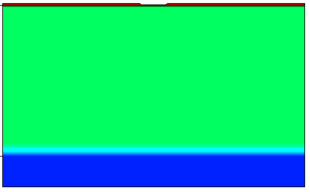
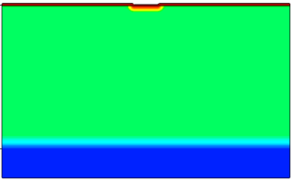
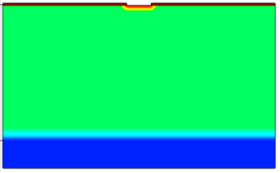
Silicon process fabrication example in TCAD
LTO
LTO (Low Temp Oxide) deposition
Activation / annealing
Etching cathode contact
Activation
Etching
18
UK HEP Instrumentation Summer School, Oxford 1-12 July 2024

Slide 21
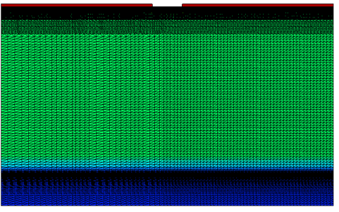
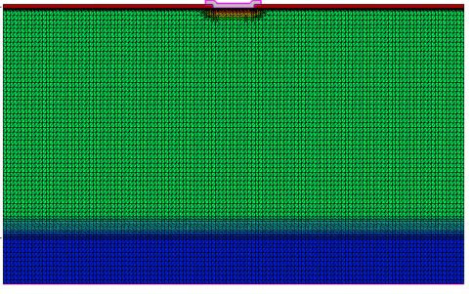
Silicon process fabrication example in TCAD
Meshing 1
Metal contact deposition and etching
Remeshing for device simulation:
  Delaunay meshing
  Specify refinement in region of electrical simulation interest, i.e. near the junction, at the interface
Re- Meshing +Al deposition + etching
19
UK HEP Instrumentation Summer School, Oxford 1-12 July 2024

Slide 22
Addendum: More details on fabrication process
20
UK HEP Instrumentation Summer School, Oxford 1-12 July 2024

Slide 23
Silicon process fabrication details
The fabrication of semiconductor devices is a rather complex process
Many intermediate steps and manufacturing precision at atomic level
Some details of the manufacturing steps are provided in the next slides
21
UK HEP Instrumentation Summer School, Oxford 1-12 July 2024

Slide 24
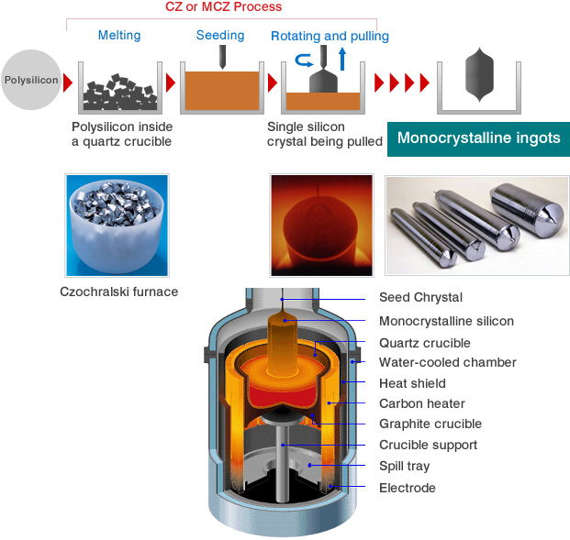
Silicon crystal growth Czochralski
The majority of ICs are made on single-crystal Si wafers grown in large ingots using CZ (Czochralski, 1915 ^{[1]} ) method
  High purity polysilicon (99.9999999% or 9N) crushed into powder, put into a quartz crucible and heated until it melts
  A seed crystal is dipped into liquid silicon. As the stick is rotated and slowly pulled up, an ingot of monocrystalline silicon is formed that has the same atomic arrangement as the seed crystal
For detector grade Si, the smallest concentration of contaminants is required. The Floating- Zone (FZ ^{[2]}) process is usually employed for this
¹ Development of Crystal Growth Technique of Silicon by the Czochralski Method, Vol. 124 ACTA PHYSICA POLONICA, 2013
² T.F. Ciszek, T.H. Wang, Silicon defect and impurity studies using float-zone crystal
growth as a tool, Journal of Crystal Growth, 237, p. 1685-1691, 2002
  * Oxygen Impurities might be introduced from the quartz crucible into the ingot
  * Czochralski discovered this by accident: instead of dipping his pen into his inkwell, he dipped it in molten tin, and drew a tin filament, which later proved to be a single crystal
22
UK HEP Instrumentation Summer School, Oxford 1-12 July 2024

Slide 25
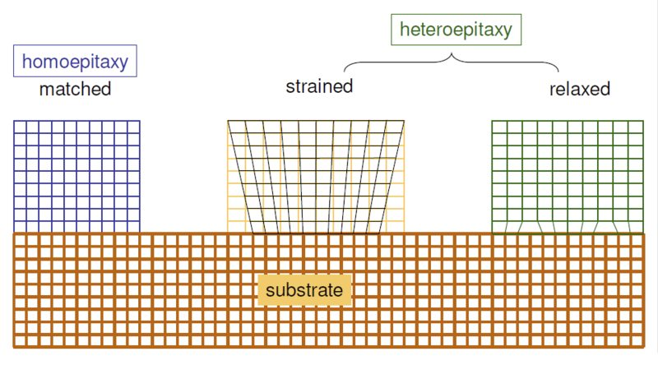
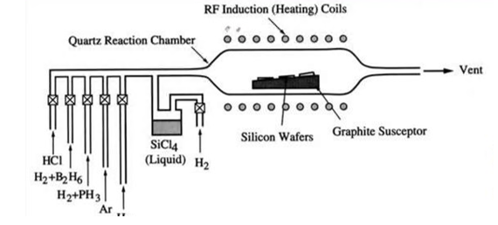
Silicon crystal growth
Epitaxy
Arrangement of atoms over existing planes of crystalline substrate, to form an extended crystal
The deposited layer can have very different doping of the substrate, allowing doping profiles unattainable with implantation.
Different materials can be grown (heteroepitaxy)
The epitaxially grown layer can be oxygen free
SiCl₄ [gas] + 2H₂ [gas] = Si [solid] + 4HCl [gas]
  Chemical Vapour Deposition (CVD) is the formation of solid films on a substrate by exploiting a chemical reaction of reactants in vapour phase.
  Reactants introduced in reaction chamber decompose and react with the heated
  ^{surface to form the film}
23
UK HEP Instrumentation Summer School, Oxford 1-12 July 2024

Slide 26
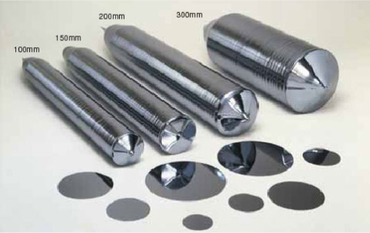
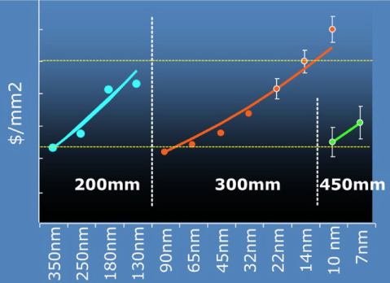
Silicon crystal
The cylindrical ingot is sliced into thin circular wafers, polished, etched, and cleaned until their surface is almost roughness free (<< 1 nm)
The diameter of Si ingots grew over the years: currently 300 mm diameter, driven by keeping the cost/area constant
As per 2022, worldwide Si wafer area around 10e6 m² , for an approximate 1.15x10¹² semiconductor chips produced
24
UK HEP Instrumentation Summer School, Oxford 1-12 July 2024

Slide 27
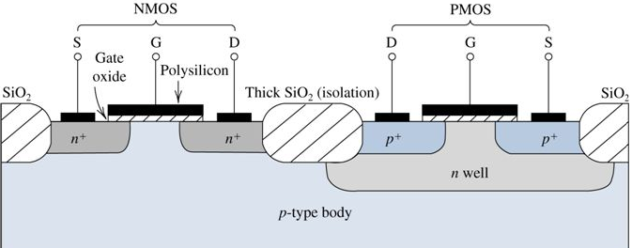
Oxidation process
_{Ions implanted}
SiO₂
The purpose of oxidation is essentially to provide isolation:
Barrier against dopants diffusion/implantation
Electrical insulator between devices (critical field ~ 10⁷ V/cm)
Si
Parasitic MOS
25
UK HEP Instrumentation Summer School, Oxford 1-12 July 2024

Slide 28
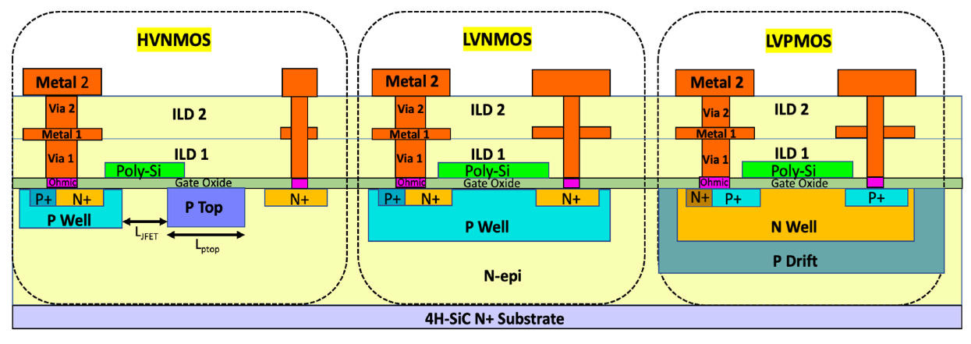
Oxidation process
Two deposition methods:
  Thermal growth
    Dry: best quality, slow growth rate: used for gate oxide
    Wet: lower quality, faster growth rate: used for field oxide (isolation)
  Chemical vapor deposition ^{[3]} (lower quality, fast)
    Used when no Si is available for oxidation (Interlayer Layer Dielectric, ILD)
  ^{[3]} J. K. Wang, D. R. Denison, Advanced techniques for interlayer dielectric
  deposition and planarization, Proc. SPIE 2090, https://doi.org/10.1117/12.156535, 1993.
26
UK HEP Instrumentation Summer School, Oxford 1-12 July 2024

Slide 29
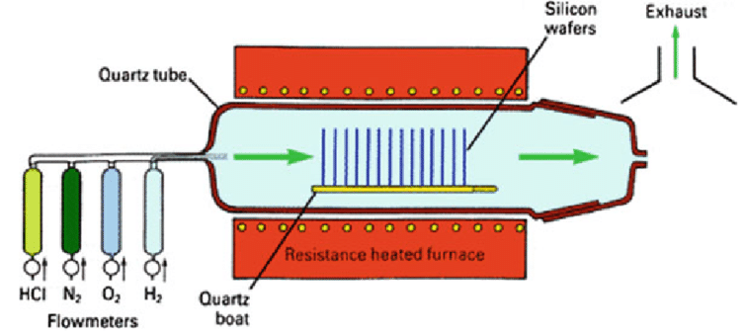
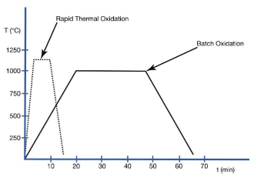
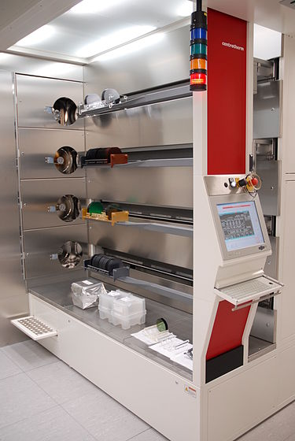


Oxidation process tools
Thermal oxidation:
  oxide is grown at high temperature (~ 1000° C) by supplying oxygen that reacts with silicon wafer to form SiO₂ at the surface
Wafers inserted on a suspended boat into a tubular reactor of quartz, heated by resistance
Dry oxidation: best quality, slow (10 nm/hr)
Wet oxidation: lower quality, faster (>x10)
Wet oxidation is faster because H₂O molecules smaller than O₂ leading to faster diffusion through SiO₂
27
UK HEP Instrumentation Summer School, Oxford 1-12 July 2024

Slide 30
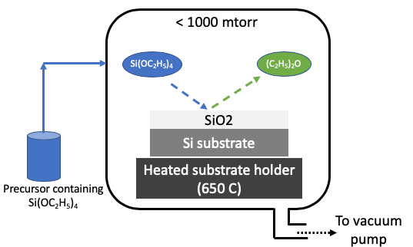
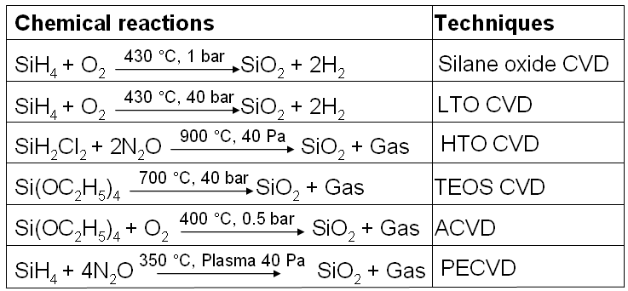
Oxidation process tools
Chemical Vapor Deposition (CVD) :
reaction of vapor phase chemicals containing the material to deposit form the solid film on substrate. Reactant gases decompose and form the film.
  SiO₂ growth rate >x10 compared to thermal oxide, but lower quality
  CVD is also used for growing dielectric materials of different electrical permittivity (high k/low k material)
28
UK HEP Instrumentation Summer School, Oxford 1-12 July 2024

Slide 31

Oxide quality
SiO₂
mobile charges
Na⁺,K⁺
Mobile charges (contamination - make insulator conductive)
Fixed charges (incompletely oxidized Si - create an extra electric field affecting the devices in Si)
Oxide trapped charge (broken Si-O bonds, due to radiation)
Interface trapped charges (dangling bonds – affect mobility and increase noise)
Oxide trapped charges (+), (-)
Fixed charges (+)
interface trapped charges (+)
Si sub
29
UK HEP Instrumentation Summer School, Oxford 1-12 July 2024

Slide 32
Resist deposition
_{Coat with photoresist}
SiO₂
The purpose of photoresist deposition is to prepare the wafer for the next step of lithography
The pattern needs to be reproduced on the photoresist, using a special camera that projects the image of the photomask onto the photoresist
Photoresist must allow to form a high-res image of the pattern (photo) and be able to stop etching (resist) to transfer the pattern onto the wafer
Si
_{Align and expose}
mask
_{Develop}
30
UK HEP Instrumentation Summer School, Oxford 1-12 July 2024

Slide 33
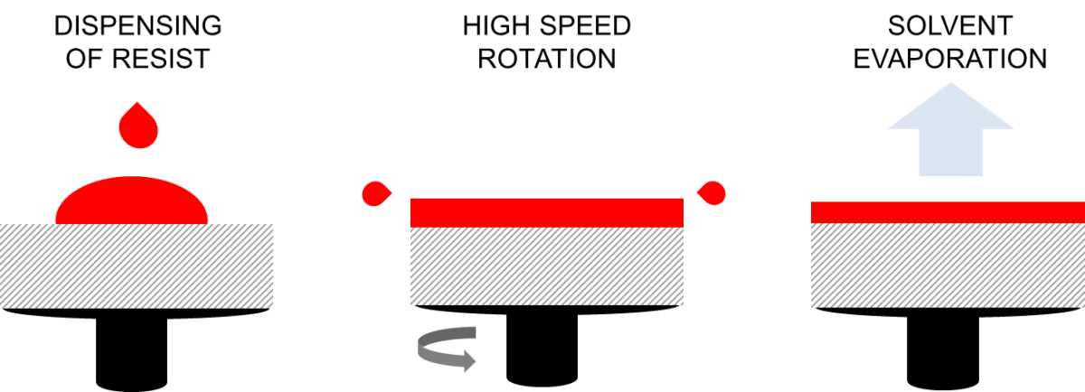
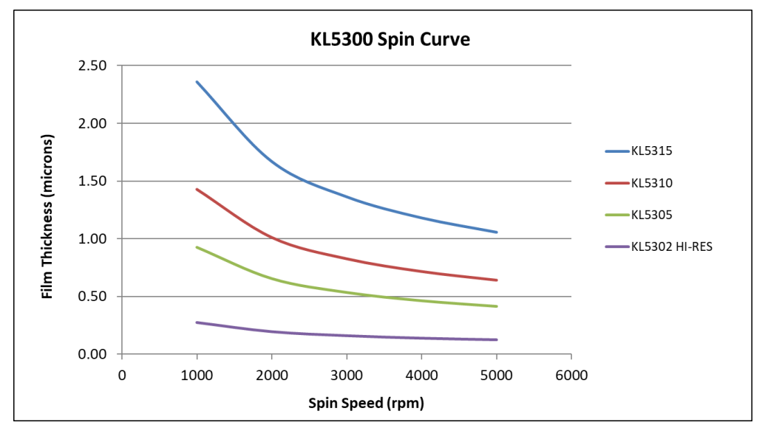

Resist deposition
A small amount ( ~ml ) of photoresist, with its solvent, is poured onto the wafer surface
The wafer is spun at high speeds, the resist spreads out. The air flow increases the viscosity of the photoresists, by evaporating the solvent, which leads to a very uniform photoresist layer spread over the surface
A post-apply bake is usually performed to further stabilize the film before lithography
The obtained uniformity is of the order of < 1nm over the entire wafer surface
From KemLab website, https://www.kemlab.com/
Resist thickness $\sim \frac{1}{\sqrt{ω}}$
31
UK HEP Instrumentation Summer School, Oxford 1-12 July 2024

Slide 34
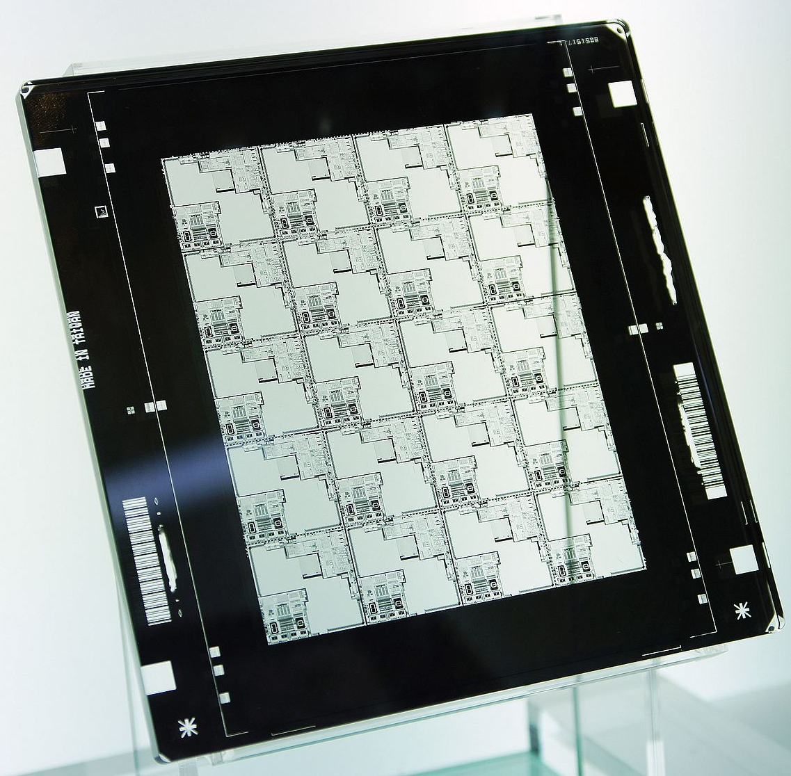
Mask/photolithography
_{Align and expose}
photomask
The photomask, usually made of chrome on quartz substrate, around 5 mm thick, includes the pattern to be reproduced onto the wafer. It can be put in direct contact (contact litho), kept at small distance (proximity litho) or projected onto the wafer (projection litho)
The photomask is typically bigger (x4-x5) than the wafer pattern
resist
From Wikipedia
The photomask itself is an example of high-resolution photolithography, usually obtained by electron beams to expose a photoresist
32
UK HEP Instrumentation Summer School, Oxford 1-12 July 2024

Slide 35

Mask/photolithography
_{Contact lithography}
Contact printing provides a resolution near the wavelength λ of light used, but every contact damages the mask, that can be used only for a number of times
Proximity printing keeps mask and wafer separated, around 10 um to avoid cumulative defectiveness, but resolution is about $\sqrt{λd}$
The modern lithography process makes use of projection printing, where the mask is illuminated by UV light and the image is projected on the wafer
_{Proximity lithography}
_{Gap d}
_{Projection lithography}
_{Lens}
33
UK HEP Instrumentation Summer School, Oxford 1-12 July 2024

Slide 36
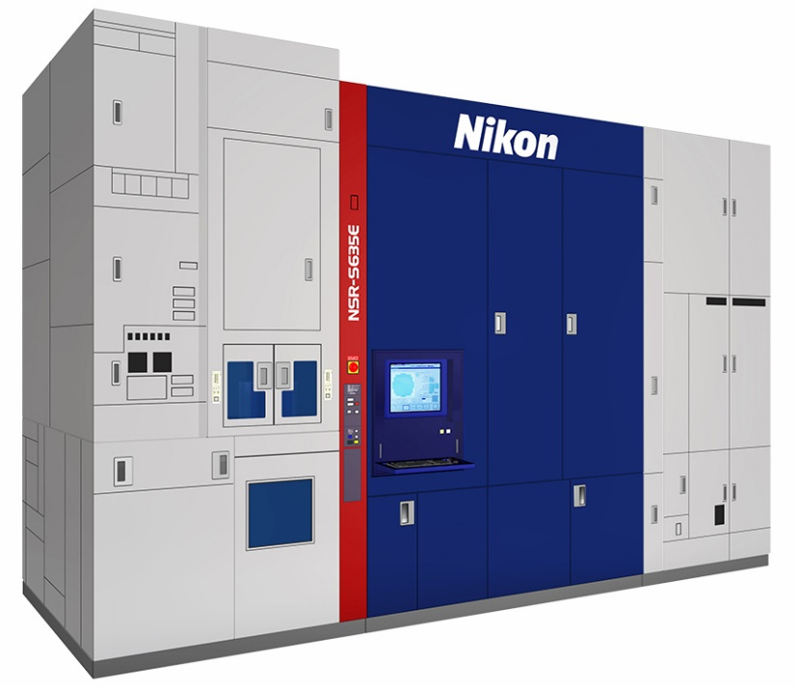
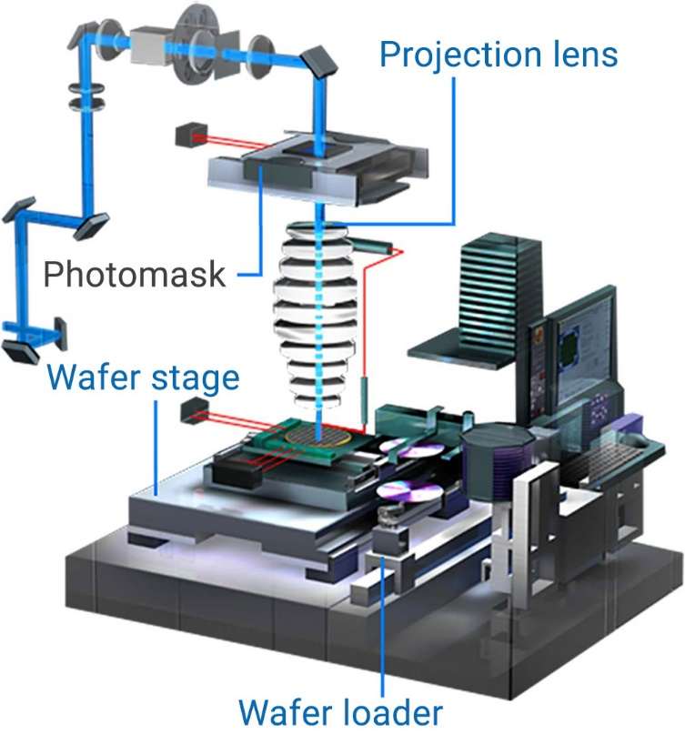
Mask/photolithography
The cost of lithography process is around 30 % - 50 % of the entire fabrication process and bound to increase for the most modern technology nodes
Lithography is a gating technology, which leads the advancement in semiconductor industry
From Nikon website
34
UK HEP Instrumentation Summer School, Oxford 1-12 July 2024

Slide 37
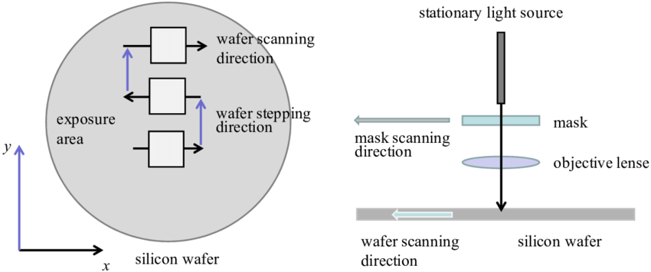
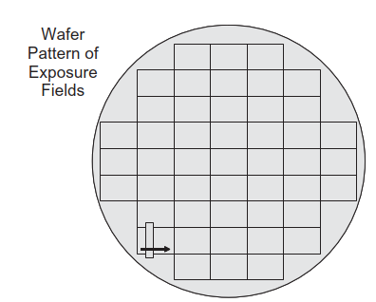
Mask/photolithography
The patterning of the image is done using a step and scan procedure
The light goes through a slit and the mask and wafer are scanned across the length of a field (mask pattern)
Once a field is scanned, the wafer/mask are stepped along the orthogonal direction and the scanning is repeated
Field size typically 26 x 33 mm², slit 25 x 8 mm²
35
UK HEP Instrumentation Summer School, Oxford 1-12 July 2024

Slide 38
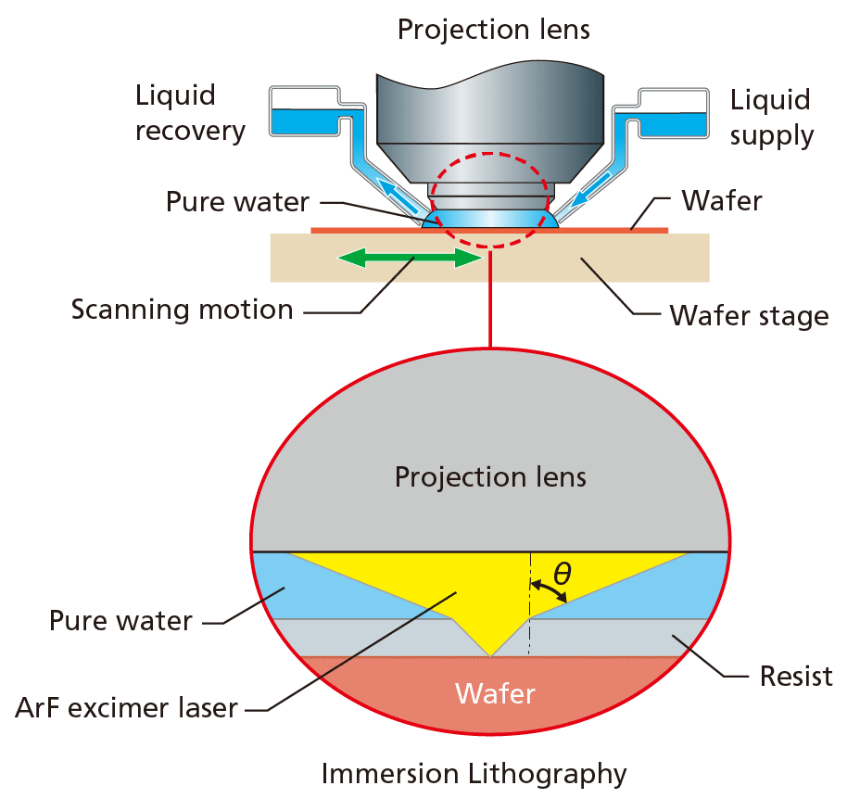
_{Light source}
Mask/photolithography
_{Focusing lens}
The projection method used by modern processes consist of a light source and a lens system
Currently state-of-the-art photolithography ^{[4]} uses Deep Ultraviolet (DUV) light λ = 193 nm from an ArF excimer Laser
The printing of nanometers feature size is possible using immersion lithography, where a media of higher refractive index (DI) is used between the lens and the wafer surface
^{[4]} B. Lin, Optical lithography—present and future challenges, C. R. Physique 7 (2006) 858–874
_{Photomask}
_{Objective lens}
_{resist}
_{wafer}
36
UK HEP Instrumentation Summer School, Oxford 1-12 July 2024

Slide 39
Resist development
_{Coat with photoresist}
SiO₂
After photoresist deposition the mask is aligned and the process of exposure takes place
Currently state-of-the-art photolithography uses Deep Ultraviolet (DUV) light λ = 193 nm ArF excimer Laser
After the exposure, a post-bake to stabilize the film is performed , before the development
Si
_{Align and expose}
mask
_{Develop}
37
UK HEP Instrumentation Summer School, Oxford 1-12 July 2024

Slide 40
Etching
oxide
After lithography, the process of etching usually follows
Its purpose is to transfer a pattern onto the wafer, by removing material from some areas
Either ‘wet’ or ‘dry’ etching is used
Selectivity: etch rate ratio,e.g. s=etch_{SiO2}/etch_{res} (>= 4-5)
Anisotropy: A= 1 – e_{h}/e_{v}
Also high etch rates is required, 1 – 10 nm/s
Si
Good selectivity: only the material to be etched is removed
Poor selectivity: the material to be etched and the material below are etched
Good anisotropy: vertical sidewalls
Poor anisotropy: round sidewalls
38
UK HEP Instrumentation Summer School, Oxford 1-12 July 2024

Slide 41

Etching
Wet etching example: Buffered HF etching of SiO₂
$${SiO}_{2}+6HF→H_{2}SiF_{6}+{2H}_{2}O$$
Wet etching uses chemistry and might provide very high selectivity
Plasma etching also uses reactive free radicals that chemically reacts with the material
Usually poor anisotropy A= 1 – e_{h}/e_{v}
Cheap and good selectivity but not suitable for precision etching, i.e. nanostructures
F displaces O atoms and dissolves oxide, no effect on Si: very high selectivity
After resist development
Wet etching
After resist stripping
39
UK HEP Instrumentation Summer School, Oxford 1-12 July 2024

Slide 42

Etching
Sputter etching is a purely ‘physical’ process, i.e. no chemical reaction involved
Anisotropy very high but poor selectivity
The wafer is bombarded with chemically inert ions e.g. Ar⁺
Possible damage to the crystal (similar to ion implantation)
Plasma generates ion beam (Ar+) which are extracted and accelerated towards the sample
The ions sputter off atoms of the target
Low pressure (1e-4 Torr) to increase mean free path and provide line of sight travel to increase anisotropy
40
UK HEP Instrumentation Summer School, Oxford 1-12 July 2024

Slide 43
Etching
Ideally one wants to combine selectivity using chemical reactions (like in wet etching) and anisotropy (like in sputter etching)
Using Reactive Ion Etching (RIE) it is possible to achieve both high selectivity and anisotropy
RIE uses ions bombardment to enhance the chemical process
Chemical etching happens where the ions strike, leading to high selectivity and anisotropy
 | High selectivity | Low selectivity
High anisotropy | Reactive Ion etch (RIE) | Sputter etch
Low anisotropy | Wet/plasma etch
41
UK HEP Instrumentation Summer School, Oxford 1-12 July 2024

Slide 44




Etching
Reactive-ion etching (RIE) uses chemistry and ions to simultaneously provide high selectivity and anisotropy
The wafer is negatively biased
Positive ions are accelerated towards its surface
A plasma creates reactive species which diffuse towards the wafer
The exposed parts of the wafer react and are etched
Etch byproducts may deposit onto the surface and provide sidewall passivation as they do not react with the reactive species
Unique RIE recipe for a specific etching process
Polysilicon
$${CF}_{4}{/O}_{2}$$
SiO2
$${CF}_{4}{/H}_{2}$$
Resist
$$O_{2}$$
42
UK HEP Instrumentation Summer School, Oxford 1-12 July 2024

Slide 45

Etching
Issues with RIE etching:
  Ion damage to wafer
  Etch loading (the etch rate changes depending on the mask pattern, i.e. Si with bigger aperture or narrow trenches etch more slowly )
A wide trench allows fluorine radicals to reach the bottom more easily, hence fast etch rate compared to the narrow trench
Source: https://www.samcointl.com/opto/
43
UK HEP Instrumentation Summer School, Oxford 1-12 July 2024

Slide 46

Ion Implantation
…the layer is formed by bombardment of one face of the N-type body with nuclear particles and the N-type zones in the layer are produced by masking the surface areas of the layer from the bombarding particles.
Technique to introduce atoms of dopants into a semiconductor material and create regions of different electrical characteristics
Historically proposed by Shockley in 1949, became common in the 70’s
Ionized gas ions are accelerated by strong electric field and injected into a target wafer ( a few nm to a few µm depth). Ion implanters spin-off from particle accelerator technology
44
UK HEP Instrumentation Summer School, Oxford 1-12 July 2024

Slide 47


Ion Implantation
B⁺
P⁺
B⁺
Pros
Precise control of dose and depth profile, complex profiles
RT process (can use photoresist as mask)
Wide selection of masking materials e.g. photoresist, oxide, poly-Si, metal
Excellent dose uniformity across wafers
Little lateral dopant diffusion, important for small devices
P-epi
4 implantations process, 1 metal layer
>10 implantations process
45
UK HEP Instrumentation Summer School, Oxford 1-12 July 2024

Slide 48


Ion Implantation
Cons
Equipment big and expensive (> 1M$)
Radiation damage: reticle damage due to implantation not always possible to correct
Difficult to obtain very shallow and very deep doping
Masks material can be scattered into the wafer, creating impurities and defects
Estimates of the number of commercial ion implanters sold per year, mainly for IC fabrication, showing the ‘5 year cycle’
46
UK HEP Instrumentation Summer School, Oxford 1-12 July 2024

Slide 49

Ion Implantation
Ions used: As, B, P, In, O, Ar
Energy: 1 - ∼1000’s keV
Flux: 10¹² – 10¹⁴ cm⁻² s⁻¹
Dose: 10¹¹ – 10¹⁸ cm⁻²
Uniformity: ± 1% across 12’’ wafers
Absolute dose accuracy: ± 10 -15 %
Temperature: RT
Dose and atom energy regions for CMOS transistor doping (gold), high dose hydrogen implants for Si layer splitting (lavender), and direct implantation of oxygen to form Silicon-on-Insulator (SOI) wafers (green).
47
UK HEP Instrumentation Summer School, Oxford 1-12 July 2024

Slide 50

Ion Implantation tools
Typical ion implanter for semiconductor process consists of several elements
1: Ion source
2: Analyzing Magnetic
3: Ion Accelerator
4: Beam manipulating system
5: End station
48
UK HEP Instrumentation Summer School, Oxford 1-12 July 2024

Slide 51

Ion Implantation doping profile
Adiabatic approximation : Scattering of ions with target is described using two separate collision processes:
S_{n} collisions with nuclei (energy loss and geometry of trajectory)
S_{e} collisions with electrons (energy loss only).
S_{n} screened potential classical two-body scattering Binary Collision Approximation BCA)
S_{e} interactions of ion with target electrons (Lindhard’s Bethe-Bloch)
49
UK HEP Instrumentation Summer School, Oxford 1-12 July 2024

Slide 52


Ion Implantation doping profile
At low energy, nuclear collisions dominate: at the end of its range the ion has low energy, S_{n} dominates leading to more crystalline damage
At high energy, electronic collisions dominate, from scattering of electrons ~ Ohm’s law
Nuclear and electronic stopping powers versus energy in reduced units
E₂(As)=800 keV
E₂(B) = 16 keV
50
UK HEP Instrumentation Summer School, Oxford 1-12 July 2024

Slide 53




Ion Implantation doping profile
From $\frac{dE}{dx}$ ,the total energy stopping power, one can estimate the average ion range
R: range
R_{p}: projected range along axes of incident ion, with straggle ΔR_{p}
R_{s} perpendicular distance
$$\frac{dE}{dx}={\left(\frac{dE}{dx}\right)}_{n}+{\left(\frac{dE}{dx}\right)}_{e}$$
$$R=\int_{0}^{E}{\frac{dE}{−\frac{dE}{dx}}}$$
51
UK HEP Instrumentation Summer School, Oxford 1-12 July 2024

Slide 54



Ion Implantation doping profile
Projected range Rp and Straggle ΔRp for common dopants
Transverse spread increases with R_{p} ($R=(1+M2/3M1)Rp$
limiting factor on lower limit of mask opening, which affects maximum device density
Projected range R_{p}
Straggle ΔR_{p}
52
UK HEP Instrumentation Summer School, Oxford 1-12 July 2024

Slide 55




Ion Implantation doping profile
B¹¹(120keV) in Si
R_{p}
Example of MC (>5000 runs) ion range simulations (SRIM*) of B¹¹ and P³¹ implanted in amorphous Si
No annealing, i.e. no dopants activation, no thermal diffusion
P³¹(120keV) in Si
R_{p}
*http://srim.org/
53
UK HEP Instrumentation Summer School, Oxford 1-12 July 2024

Slide 56



Ion Implantation doping profile
The range distribution of implanted impurities is described, as a first approximation, by a symmetrical Gaussian distribution ( 2 moments: R_{p} : projected range, ΔR_{p} : straggle)
N$\left(x\right)=N_{pk}e^{−\frac{{\left(x−R_{p}\right)}^{2}}{{2\left({∆R}_{p}\right)}^{2}}}$= $\frac{Q}{\sqrt{2π}{∆R}_{p}}e^{−\frac{{\left(x−R_{p}\right)}^{2}}{{2\left({∆R}_{p}\right)}^{2}}}$
$$Dose=\int_{0}^{L}{N}\left(x\right)=Q={\sqrt{2π}{∆R}_{p}N}_{pk}\left[atoms∙{cm}^{−2}\right]$$
54
UK HEP Instrumentation Summer School, Oxford 1-12 July 2024

Slide 57







Ion Implantation doping profile
B(1000keV) in Si
$$Q=m_{0}=\int_{−∞}^{+∞}{N\left(x\right)dx}$$
$$R_{p}=m_{1}=\int_{−∞}^{+∞}{xN\left(x\right)dx}$$
Higher moments are needed to describe realistic profiles:
  skewness (γ), describing asymmetry of distribution
  kurtosis (β), describing peak sharpness of the profile
P(1000keV) in Si
$${∆R}_{p}=m_{2}=\int_{−∞}^{+∞}{{(x−R_{p})}^{2}N\left(x\right)dx}$$
$$γ=m_{3}=\frac{1}{{{∆R}_{p}}^{3}}\int_{−∞}^{+∞}{{(x−R_{p})}^{3}N\left(x\right)dx}$$
$$β=m_{4}=\frac{1}{{{∆R}_{p}}^{4}}\int_{−∞}^{+∞}{{(x−R_{p})}^{4}N\left(x\right)dx}$$
55
UK HEP Instrumentation Summer School, Oxford 1-12 July 2024

Slide 58



Ion Implantation doping profile
$$\frac{df}{dx}=\frac{\left(x−a\right)f}{b_{0}+b_{1}x+b_{2}x^{2}}$$
Pearson distribution function defined as DE solution
Analytical description of doping profiles can be obtained from Pearson distribution
Coefficients of Pearson’s equation are related to the four moments
Explicit formula for the implanted profile can be obtained
Generic profile formula from Pearson distribution
A. F. Tasch et al., “An Improved Approach to Accurately Model Shallow B and BF 2 Implants in Silicon,” Journal of the Electrochemical Society, vol. 136, no. 3, pp. 810–814, 1989,
56
UK HEP Instrumentation Summer School, Oxford 1-12 July 2024

Slide 59


Ion Implantation doping profile
Analytical doping profiles description reasonably accurate for heavy ions
Lighter ions more accurately described using MC (crystal orientation depending)
SIMS and Pearson IV distribution – 31P
SIMS, Pearson IV distribution and MC run – 11B
57
UK HEP Instrumentation Summer School, Oxford 1-12 July 2024

Slide 60


Ion Implantation masking
mask
Si
Lateral scatter around the impact point
Purpose of the mask is to Implant only in certain parts of the wafer, using a suitably thick mask (i.e. that its R_{p} lies within the mask material)
The thickness of the mask should be large enough that the tail of the implant profile in the silicon should not significantly alter the doping concentration (C_{B})
58
UK HEP Instrumentation Summer School, Oxford 1-12 July 2024

Slide 61


Ion Implantation channeling
During ions implantation in a periodic structure, directional effects due to nuclear scattering might confine the ions into regions minimizing interactions along the path.
Channelling: Average penetration depth is larger, affecting the final doping profile
59
UK HEP Instrumentation Summer School, Oxford 1-12 July 2024

Slide 62



Ion Implantation channeling
To minimize channelling:
pre-amorphization of the wafer via implantation
the wafer is tilted by some degrees with respect to ion beam: the value of the critical angle below which there is channelling depends on crystal orientation and energy of the ion. In practice a tilting angle of 7 degrees is used
60
UK HEP Instrumentation Summer School, Oxford 1-12 July 2024

Slide 63



Ion Implantation damage and annealing
Ion implantation creates defects in the target crystal, by displacing atoms from their regular lattice sites (see radiation damage lectures)
The elementary radiation defect consists of Frenkel defect, i.e. displaced atom (interstitial) plus the related vacancy.
More complex defects form as a result of accumulation and clustering of interstitials and vacancies (divacancies V-V, vacancy impurities, like V-O, As-I…)
61
UK HEP Instrumentation Summer School, Oxford 1-12 July 2024

Slide 64


Ion Implantation damage and annealing
An example of doping profile from ¹¹B implantation in <100> Si, as implanted and after thermal annealing
After the implantation process, a thermal treatment is required to electrically activate the dopant (i.e. to have them moved to substitutional positions) and to restore the crystalline order of the semiconductor
Annealing at high temperature (~1000°C) could result in perfect crystal, but leads to dopant diffusion. Particularly serious issue in modern technologies, where very shallow junctions are used
As implanted
Thermally annealed
Isochronal annealing of boron. The ratio of the free-carrier to dose (fraction of boron atoms located in substitutional lattice points ) is plotted versus the anneal temperature for three doses of boron.
62
UK HEP Instrumentation Summer School, Oxford 1-12 July 2024

Slide 65


Ion Implantation damage and annealing
Activation energy for removal of point defects (V and I) usually higher than that of impurity diffusion.
Different slopes in Arrhenius plots allow to use high temperature to enhance annealing and depress diffusivity:
Rapid Thermal Annealing (RTA)
Dislocation removal rate in As implanted Si and As diffusivity vs. 1/T
63
UK HEP Instrumentation Summer School, Oxford 1-12 July 2024

Slide 66



Ion Implantation damage and annealing
Rapid thermal annealing of wafers (RTA) optimizes the defects suppression, whilst minimizing dopants diffusion
Wafers are rapidly heated by lamps (10’s kW) to 1000 C for 1 – 20 secs max
Various methods to measure the wafer temperature (optical, acoustic)
https://photonexport.com/rapid-thermal-processing/
64
UK HEP Instrumentation Summer School, Oxford 1-12 July 2024

Slide 67


Schottky diode on P-type Si wafer
Metallization
Once devices have been fabricated in the wafer (Front End of Line), metal layers are deposited to form the conductive connections
Modern technologies moved from Al to Cu to reduce resistivity in interconnect in Back End of Line (BEOL). This is a more complex process (Dual Damascene process) than sputtering
Al guard ring
Al cathode
65
UK HEP Instrumentation Summer School, Oxford 1-12 July 2024

Slide 68

Metallization
Sputtering (PVD, Physical Vapor Deposition) is one of the most common method to deposit thin film of metal
Good step coverage obtained by reducing the mean free path of sputtered atoms (increasing Ar ions, magnetron sputtering)
Sputtering also used to clean wafer before deposition, by Ar⁺ etching
Cathode (target -) is the material to deposit, generally cooled
An inert gas (Ar) is ionized, accelerated and collides with the target. Ejected atoms have energies ~ 10’s eV
Some atoms sputters off and, after scattered paths, land and deposit onto the wafer (+)
66
UK HEP Instrumentation Summer School, Oxford 1-12 July 2024

Slide 69


Appendix :The Deal-Grove oxidation model
The Deal Grove Model is a simple kinetic model for oxide thermal growth, wet and dry
Developed by Andy Grove (Intel’s CEO) and Bruce Deal in the 60’s
  B. E. DEAL AND A. S. GROVE General Relationship for the Thermal Oxidation of Silicon, JOURNAL OF APPLIED PHYSICS VOLUME 36. NUMBER 12 DECEMBER 1965
67
UK HEP Instrumentation Summer School, Oxford 1-12 July 2024

Slide 70
The Deal-Grove oxidation model
C_{G}
1
2
3
C_{s}
SiO₂
Si
1: Oxygen diffuses from bulk (C_{G})to wafer surface (C_{S} )
2: Oxygen diffuses from wafer surface (C_{O}) to Si surface (C_{i})
3: Oxygen reacts with Si at interface to form SiO₂
C₀
C_{i}
T_{ox}
F₁
F₂
F₃
Gas flux
Diffusion flux
Reaction flux
68
UK HEP Instrumentation Summer School, Oxford 1-12 July 2024

Slide 71










The Deal-Grove oxidation model
Oxygen diffusion through gas: Fick’s 1st Law approximated as linear equation
Adsorbed concentration C_{o} on surface $∝$ partial pressure (Henry’s Law)
Oxygen diffusion through SiO₂ Fick’s 1st Law approximated as linear equation
1st order reaction at Si interface
$1: F_{1}=D\frac{dC}{dx}≈\frac{D_{g}}{δ}\left(C_{g}− C_{s}\right)=h_{g}(C_{g}−$ $C_{s})$
$$C_{o}=HP_{s}=HC_{s}kT$$
$2: F_{2}=D\frac{dC}{dx}≈\frac{D_{ox}}{t_{ox}}(C_{o}−$ $C_{i})$
$$C_{g}=\frac{P_{g}}{kT}$$
Reactant concentration
H
Henry’s gas law coefficient
$$3: F_{3}=k_{s}C_{i}$$
$$t_{ox}$$
SiO2 thickness
$$D_{ox}$$
Oxygen diffusivity in SiO2
$$h_{g}$$
Mass transfer coefficient
69
UK HEP Instrumentation Summer School, Oxford 1-12 July 2024

Slide 72





The Deal-Grove oxidation model
Steady state: all fluxes are equal (Si interface reaction is the rate-limiting step)
$$F_{1}={ F}_{2}=F_{3}=F_{OX}$$
$F_{OX}=\frac{Hk_{s}P_{g}}{1+\frac{k_{s}}{h}+\frac{k_{s}t_{ox}}{D_{ox}}}$ = $\frac{dt_{ox}}{dt}N_{ox}$
; h$=\frac{h_{g}}{HkT}$
Oxygen flux $F_{OX}$= v_{ox} N_{ox}
$$\frac{dt_{ox}}{dt}=\frac{Hk_{s}P_{g}}{1+\frac{k_{s}}{h}+\frac{k_{s}t_{ox}}{D_{ox}}}\frac{1}{N_{ox}}$$
70
UK HEP Instrumentation Summer School, Oxford 1-12 July 2024

Slide 73






The Deal-Grove oxidation model
$$t_{ox}^{2}+At_{ox}=B\left(t+τ\right)$$
$$A=2D_{ox}\left(\frac{1}{h}+\frac{1}{k_{s}}\right)$$
Integrating over t gives the expression for oxide thickness $t_{ox}$ vs. time t
$$B=\left(\frac{2D_{ox}HP_{g}}{N_{ox}}\right)$$
$$τ=\left(\frac{t_{0}^{2}+At_{0}}{B}\right)$$
The model requires coefficients adjustments for different crystal orientations
<111> Si
71
UK HEP Instrumentation Summer School, Oxford 1-12 July 2024

Slide 74

The Deal-Grove oxidation model
Comparison of Deal-Grove model with measured oxide thickness (Dry oxide)
Deal Grove
Measured
With the correct coefficients (P,T, crystal ) the Deal-Grove model works nicely for single crystal silicon (~%’s accuracy). Model extensions to 3D exist
Additional tweaking needed for high Si doping
The model fails for Polysilicon
* Self-limiting growth of native oxide saturates at around 2-3 nm
‘Growth of native oxide on a silicon surface’ Journal of Applied Physics, Volume 68, Issue 3, August 1, 1990, pp.1272-1281
72
UK HEP Instrumentation Summer School, Oxford 1-12 July 2024

Slide 75

The Deal-Grove oxidation model
SiO₂
X_{Ox}
The oxide grows at the expense of Silicon: during oxidation around half of Silicon is consumed
Si
Si
X_{Si}
$X_{Si} N_{Si}=$ $X_{Ox} N_{Ox}→$ $X_{Si}$=$\frac{{ X}_{Ox} N_{Ox}}{ N_{Si}}≡{ X}_{Ox}\frac{2.3 {10}^{22}}{5 {10}^{22}}={ X}_{Ox} 0.46$
$$N_{Ox}=molecular density SiO_{2}$$
$$N_{Si}=atomic density Si$$
73
UK HEP Instrumentation Summer School, Oxford 1-12 July 2024

