Slide 1
TCAD simulation VIII
E. Giulio Villani
UK HEP Instrumentation Summer School, Oxford 1-12 July 2024

Slide 2
Overview
Simulation example of 2D PN junction using SPROCESS and SDEVICE
Charge generation and collection
UK HEP Instrumentation Summer School, Oxford 1-12 July 2024

Slide 3
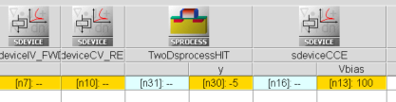
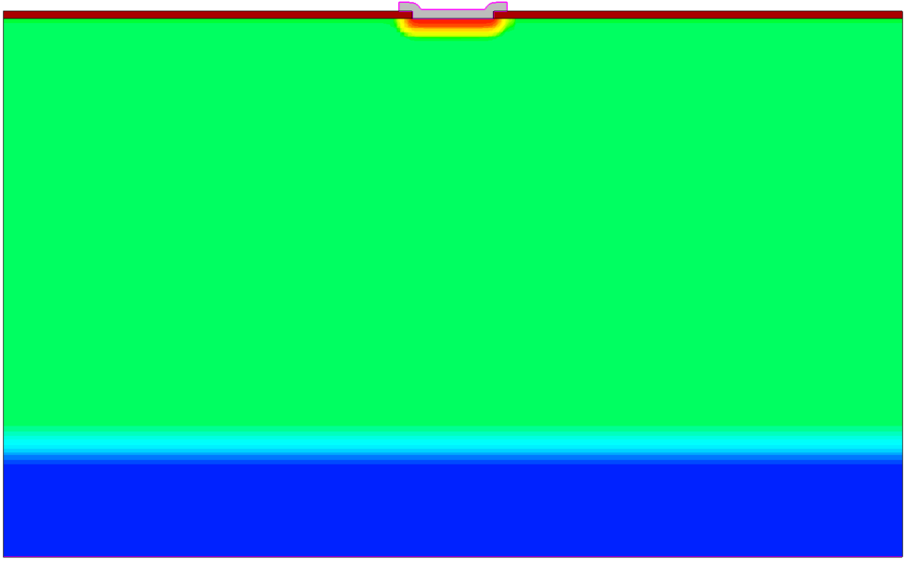

TCAD Synopsys Simulation
N-well cathode
SDEVICE simulation of 2D pn junction
  Charge generation
Within SDEVICE, charge injection by particles can be modelled using the models for carrier generation by gamma radiation, alpha particles and heavy ions (optical generation is also available)
HeavyIon generation:
100 um
9 um
P - HR
Glet: linear energy transfer(LET) generation density
R(w,t): spatial distribution (exponential/Gaussian)
T(t): temporal profile
P++
1
UK HEP Instrumentation Summer School, Oxford 1-12 July 2024

Slide 4
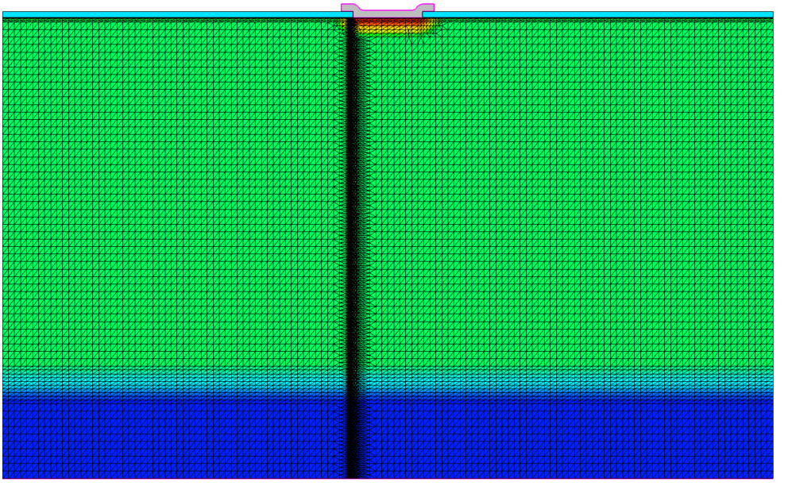
TCAD Synopsys Simulation
### if {$HIT} {
## MIP
### From G4 MIP sims, the meshing in the track region needs to be as small as nm's...
refinebox Silicon name= HIT min= {0 @<@y@-0.1>@} max= {@<@Epi_thick@+@Sub_thick@>@ @<@y@+0.1>@} xrefine= {.05 .05 .05} yrefine= { .05 .05 .05}
### }
Additional SPROCESS to increase the mesh resolution in the region of the hit: vertical hit at coordinate (0,Y)
SDEVICE command file: physics section
2
UK HEP Instrumentation Summer School, Oxford 1-12 July 2024

Slide 5
TCAD Synopsys Simulation
Physics {
####if "@Ionization@" =="MIP"
#include "MIP_EXC"
…
SDEVICE command file: physics section
  The ionisation is obtained by a Minimum Ionising Particle (MIP)
  Details of the ionisation are included in a file (MIP_EXC) which has the LET and spatial parameters required for MIP emulation
#define WT_hi 0.1
HeavyIon (
Time = HitTime
Location = (0, 0) ### Hits at the top surface, right in the middle of the device
Direction = (1.0,0.0) ### Perpendicular hit
###LET_f = [1.28e-5 1.28e-5 1.28e-5] ### 80 e/h per micron is 1.28E-5 for THICK sensor
LET_f = [1.056e-5 1.056e-5 1.056e-5] ### 66 e/h per micron as MPV for 50 um thick active region
### LET_f = [1.15e-5 1.15e-5 1.15e-5] ### 72 e/h per micron as MPV for 300 um thick active region
Wt_hi = [WT_hi WT_hi WT_hi ] ### ro = 0.1/0.2 micron
Length = [ 0.0 20 60 ] ### LET @ different depths, irrelevant for a MIP
PicoCoulomb
Gaussian
)
3
UK HEP Instrumentation Summer School, Oxford 1-12 July 2024

Slide 6
TCAD Synopsys Simulation
MIP transient
  Effects due to different bias
  Charge collection vs. hit location
  Charge collection vs. meshing resolution
  Charge collection vs. doping
4
UK HEP Instrumentation Summer School, Oxford 1-12 July 2024

Slide 7
TCAD and simulation VIII
Simulation example : 2D pn using SPROCESS
MIP Charge generation and collection
    Thank you
    giulio.villani@stfc.ac.uk
5
UK HEP Instrumentation Summer School, Oxford 1-12 July 2024

