Slide 1
TCAD simulation IIII
E. Giulio Villani
UK HEP Instrumentation Summer School, Oxford 1-12 July 2024

Slide 2
Overview
Simulation example of 2D PN junction using SDEVICE
Charge generation and collection
UK HEP Instrumentation Summer School, Oxford 1-12 July 2024

Slide 3
TCAD simulation
SDEVICE
UK HEP Instrumentation Summer School, Oxford 1-12 July 2024

Slide 4


1 File Section: input/output files
2 Electrode Section: electrode definition, matching those in the input grid
3 Physics Section: physics models to use in the simulation
4 Plot Section: variables to plot
5 Math Section: solvers
6 Solve Section: what to solve (IV,CV, Charge injection)
TCAD Synopsys Simulation
Sentaurus Device is a numeric semiconductor device simulator, capable of simulating the electrical, thermal, and optical characteristics of various semiconductor devices.
It simulates 1D, 2D, and 3D device behaviour over a wide range of operating conditions, including mixed-mode circuit simulation, combining numerically simulated devices with their compact modeling, which is performed on a SPICE-based circuit simulation level.
A typical command file of Sentaurus Device consists of several sections (or statement blocks), with each section executing a relatively independent function. The default extension of the command file is _des.cmd, for example, pp1_des.cmd. To start: sdevice
1
UK HEP Instrumentation Summer School, Oxford 1-12 July 2024

Slide 5

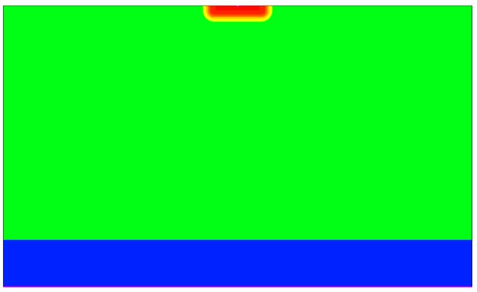
TCAD Synopsys Simulation
N-well cathode
SDEVICE simulation of 2D pn junction
  Charge generation
Within SDEVICE, charge injection by particles can be modelled using the models for carrier generation by gamma radiation, alpha particles and heavy ions (optical generation is also available)
HeavyIon generation:
100 um
10 um
P - HR
G(l,w,t)=Glet(l)R(w,l)T(t)
Glet: linear energy transfer(LET) generation density
R(w,t): spatial distribution (exponential/Gaussian)
T(t): temporal profile
P++
2
UK HEP Instrumentation Summer School, Oxford 1-12 July 2024

Slide 6
TCAD Synopsys Simulation
###### 2D PN junction CCE analysis ######
#define Vdd @Vbias@
#define HitTime 1e-8
#define HitTime_Step 1e-11
#define Transient_Time 5e-9
## Input and Output Files
Device PNjnct {
File {
grid = "2D_PNjnct_msh.tdr"
}
SDEVICE command file: transient analysis:
  File Section: input/output files
  Electrode Section: electrode definition, matching those in the input grid
  Physics Section: physics models to use in the simulation
  System: defines a mixed mode setup consisting of the device(s) and sources attached to it
  Plot Section: variables to plot
  Math Section: solvers to use
3
UK HEP Instrumentation Summer School, Oxford 1-12 July 2024

Slide 7
TCAD Synopsys Simulation
Physics {
####if "@Ionization@" =="MIP"
#include "MIP_EXC"
…
SDEVICE command file: physics section
  The ionisation is obtained by a Minimum Ionising Particle (MIP)
  Details of the ionisation are included in a file (MIP_EXC) which has the LET and spatial parameters required for MIP emulation
#define WT_hi 0.1
HeavyIon (
Time = HitTime
Location = (0, 0) ### Hits at the top surface, right in the middle of the device
Direction = (1.0,0.0) ### Perpendicular hit
###LET_f = [1.28e-5 1.28e-5 1.28e-5] ### 80 e/h per micron is 1.28E-5 for THICK sensor
LET_f = [1.056e-5 1.056e-5 1.056e-5] ### 66 e/h per micron as MPV for 50 um thick active region
### LET_f = [1.15e-5 1.15e-5 1.15e-5] ### 72 e/h per micron as MPV for 300 um thick active region
Wt_hi = [WT_hi WT_hi WT_hi ] ### ro = 0.1/0.2 micron
Length = [ 0.0 20 60 ] ### LET @ different depths, irrelevant for a MIP
PicoCoulomb
Gaussian
)
4
UK HEP Instrumentation Summer School, Oxford 1-12 July 2024

Slide 8
### Solve procedure
Solve {
Coupled(Iterations= 700 LineSearchDamping= 1e-4){ Poisson }
Coupled(Iterations= 70 LineSearchDamping= 1e-4){ Poisson Electron Hole }
### DC bias
NewCurrentPrefix="2D_PNjnct_Temp@Temp@_CCE_DCVbias@Vbias@"
### ramps up to the max Vbias for CCE investigation
Quasistationary
( InitialStep= 1e-3 MinStep= 1e-15 MaxStep= 0.25
Increment= 2.0 Decrement= 4.0
Goal { Parameter = vc.dc voltage = Vdd }
)
{ Coupled { Poisson Electron Hole } }
### Starts the transient
NewCurrentPrefix="2D_PNjnct_Temp@Temp@_CCE_TRVbias@Vbias@"
### initial reset time until HIT_Time - 10ps...
Transient ( InitialTime = 0 FinalTime = @<HitTime-0.01e-9>@
InitialStep = 1e-9 MaxStep = 2e-9 MinStep = 1e-15 )
{
Coupled (Iterations = 10 ) { Poisson Electron Hole }
}
TCAD Synopsys Simulation
SDEVICE command file: solve
  The voltage is first ramped up to the required bias voltage
  Then the transient simulation starts
  The time resolution is increase just before the hit
5
UK HEP Instrumentation Summer School, Oxford 1-12 July 2024

Slide 9
### starts the transient analysis in 'HiRes' , set by Hit_Time_Step, until Hit_time + 1 ns
Transient ( InitialTime = @<HitTime-0.01e-9>@ FinalTime = @<HitTime+1e-9>@
InitialStep = 0.1e-12 MaxStep = HitTime_Step MinStep = 1e-15 )
{ Coupled (Iterations = 5 ) { Poisson Electron Hole }
Plot ( FilePrefix = "2D_PNjnct_Temp@Temp@_CCE_TRVbias@Vbias@"
Time = (
HitTime
) NoOverwrite )
}
### after the first 1 ns after the hit the transient is in 'MediumRes' of 0.1 ns
Transient ( InitialTime = @<HitTime+1e-9>@ FinalTime = @<HitTime+Transient_Time>@
InitialStep = 1e-12 MaxStep = .1e-9 MinStep = 1e-15 )
{
Coupled (Iterations = 10 ) { Poisson Electron Hole }
}
TCAD Synopsys Simulation
SDEVICE command file: solve
  When the particle hits the devices, the temporal resolution is optimised for the first ns, it is relaxed afterwards
6
UK HEP Instrumentation Summer School, Oxford 1-12 July 2024

Slide 10
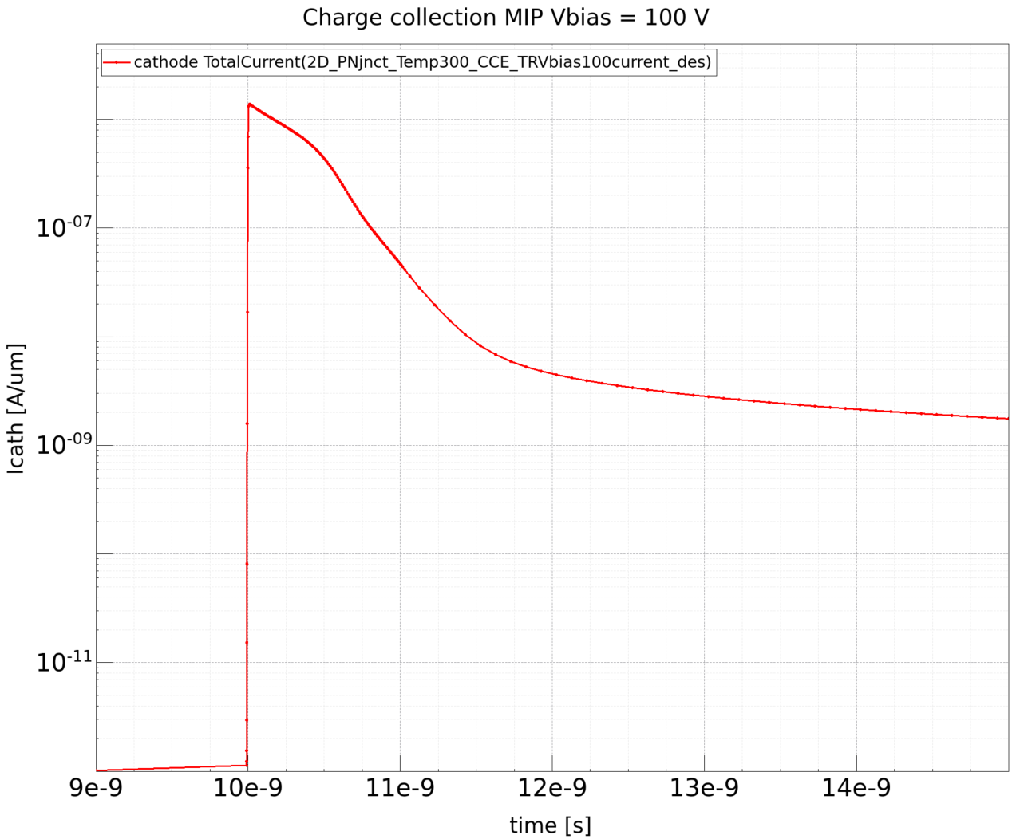
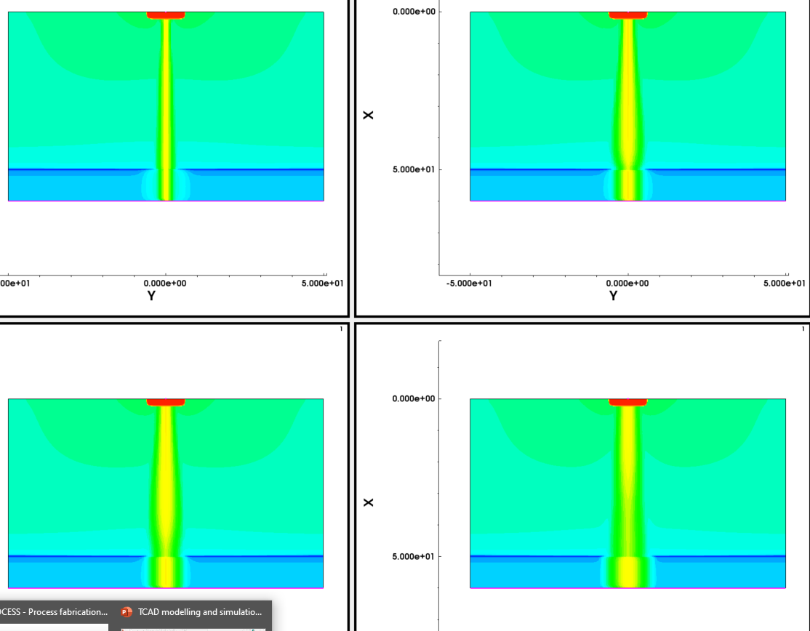

TCAD Synopsys Simulation
Icathode transient
– MIP hit @ 10 ns -:
No Ramo’s theorem used
$$Q=\oint{ε\vec{E}∙dS}$$
Visualize the resulting mesh using SVISUAL
  Re-mesh the structure changing the p – doping
  Visualise the meshing
  I transient vs. bias
  Charge collected vs. bias
  Plots of charge density vs. time
Icathode transient
– MIP hit @ 0, 100,200,500 ps
7
UK HEP Instrumentation Summer School, Oxford 1-12 July 2024

Slide 11
TCAD and simulation I
Simulation example : 2D pn using SDEVICE
Charge generation and collection from MIP hit
    Thank you
    giulio.villani@stfc.ac.uk
8
UK HEP Instrumentation Summer School, Oxford 1-12 July 2024

