Slide 1
From Archeology To Axions
Timepix3 and Timepix4 activities at The University of Oxford

Slide 2
Cast and Characters…
I’m Presenting on behalf of many people who’s work this is:
Particle Physics: Richard Plackett, Dan Wood, & Nina Dimova
Atomic and Laser Physics: Gianluca Gregori, & Jack Halliday
Chemistry: Groups of Mark Brouard & Claire Vallance
Materials Science: Group of Angus Kirkland
Archology: Jean-Luc Schwenninger, & Raju Kumar
CERN Beam Instrumentation: James Storey, Bernadette Kolbinger
Quantum Detectors Ltd: Roger Goldsborough, Liam O’Ryan, & Giulio Crevatin
Detector Readouts supplied by NIKHEF, ADVACAM, & Quantum Detectors

Slide 3
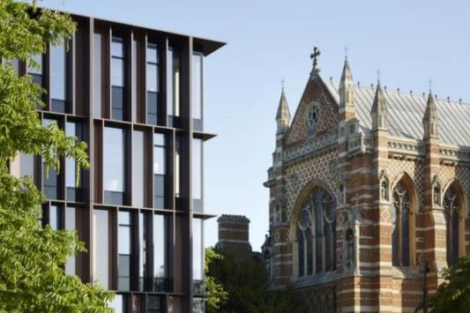
Outline & Disclaimer
I will present very quick overviews of five small projects we have been working on at Oxford . However, I may not be able to answer detailed questions on the non-detector aspects of all of them…
Micro-dosimetry for Luminescence Dating
Time of Flight Mass Spectrometry
Beam Gas Vertex Tracker for the HL-LHC
Looking For Axions at Eu-XFEL with Timepix3
Timepix4 resolution in an Electron Microscope

Slide 4
Archaeology: Luminescence Dating
Luminescence Dating is a technique for dating mineral samples that does not rely on the presence of organic matter for C₁₄ dating.
Measuring ancient sunlight trapped in rocks that have been collected at midnight …
Luminescence dating stimulates the emission of charge in unstable defect traps in various mineral grains.
This charge accumulates at a determinable rate due to naturally occurring radioactive isotopes.
The traps are emptied by bombarding the sample with heat, light or radiation.
The technique allows the determination of the last time a mineral sample was exposed to sunlight or significant heat. ie when was it buried…
Oxford Luminescence Dating Laboratory, part of
Research Laboratory for Archaeology and the History of Art. https://www.arch.ox.ac.uk/research-lab-archaeology-and-history-art/

Slide 5
Micro Dosimetry
By determining the distribution, type, and activity of radioactive grains in the sample a more accurate dating process can be achieved.
We are using Timepix3 to measure samples placed directly on the sensor to localise individual grains as sources of radiation.
Understanding over dispersion in single-grain equivalent dose (D_{e}) distributions.
Micro-dosimetry
Mapping the distribution of radionuclides within archaeological materials, sediments and rocks.
Deriving spatially-resolved α/β dose rate distributions.

Slide 6
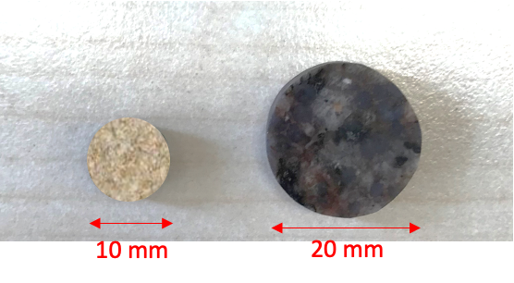
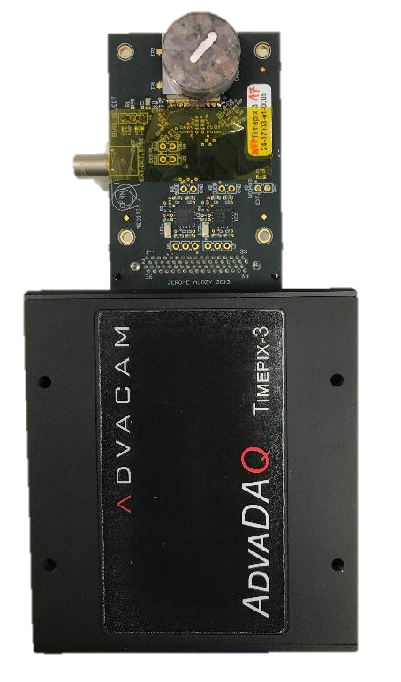
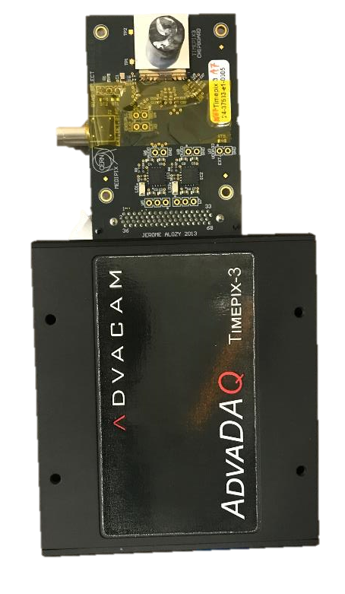
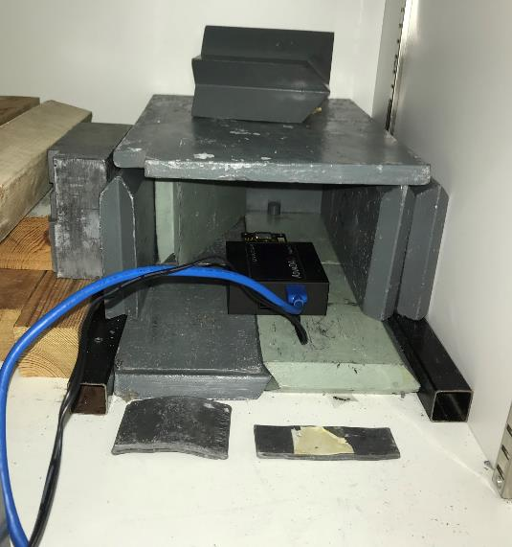
Microdosemitry: Experimental Setup
Fine sandstone and Granite placed directly on sensor ~ 2 week exposure in low radiation environment

Slide 7
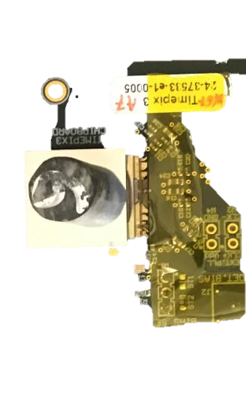
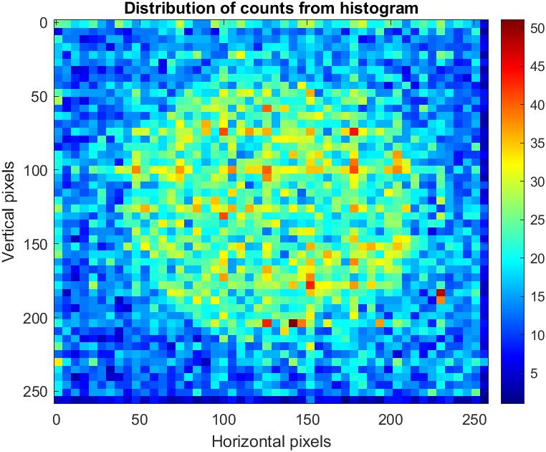
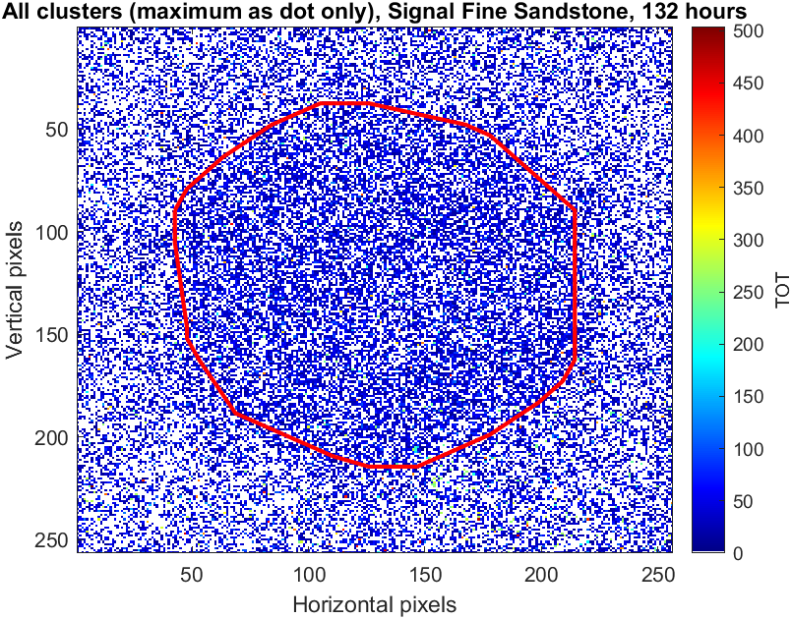
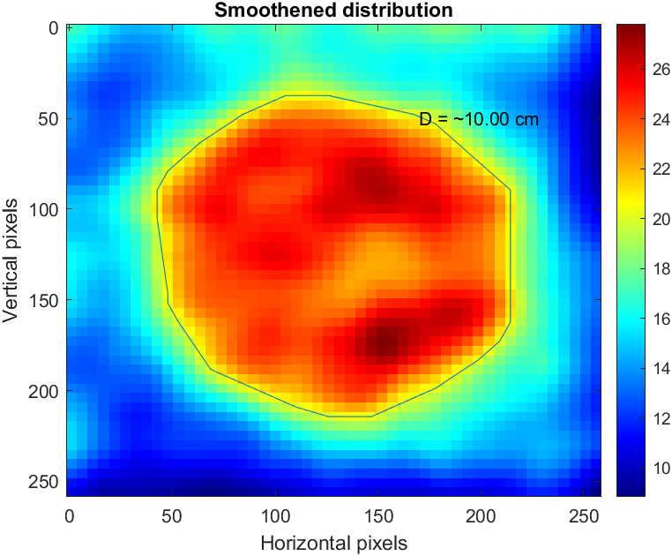
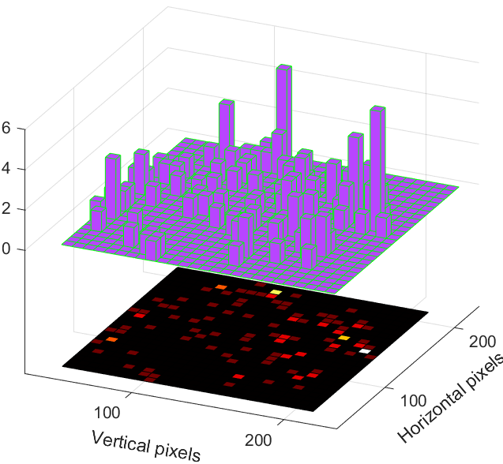
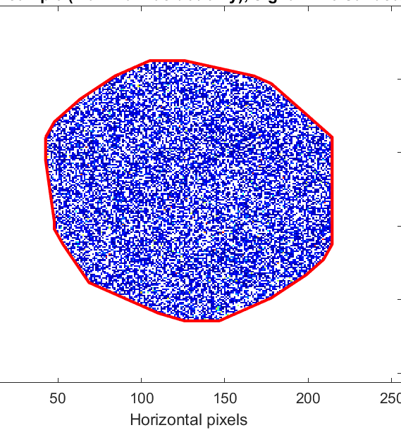
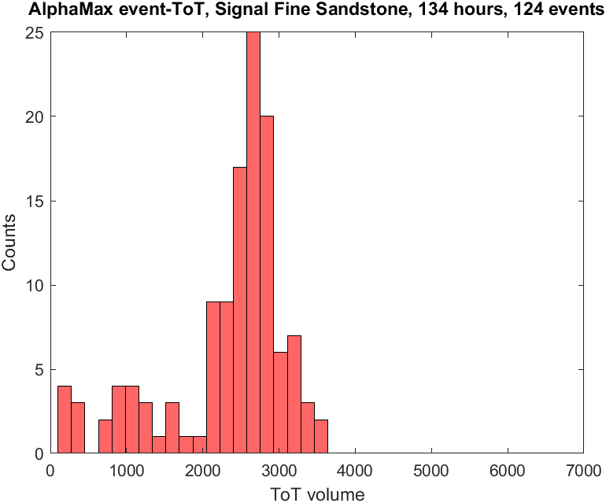
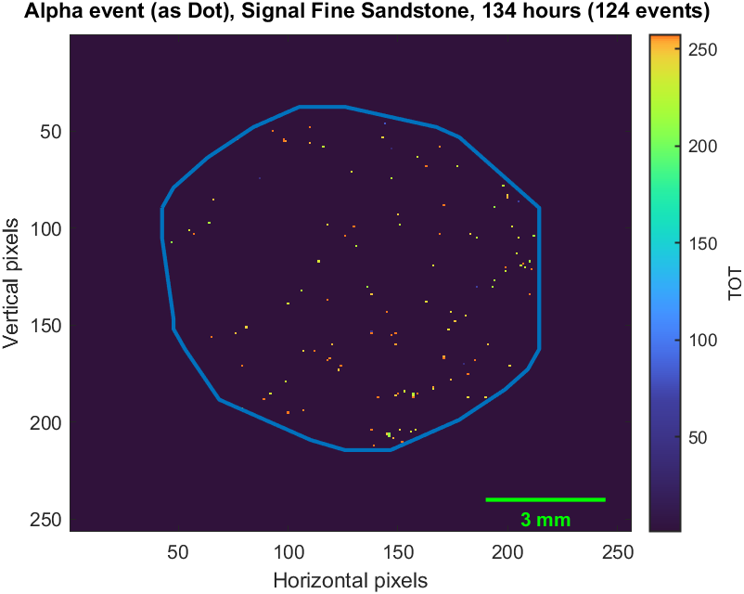
Analysis of Long Acquisitions
Only α-particle events shown here.

Slide 8
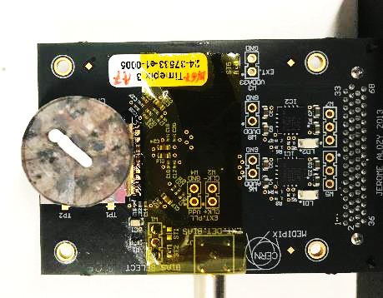
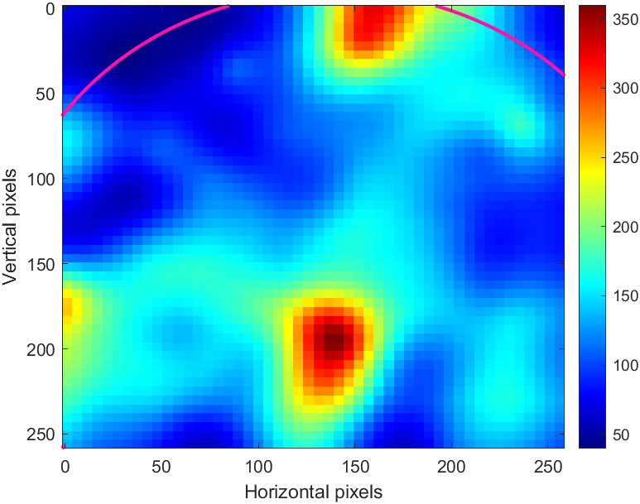
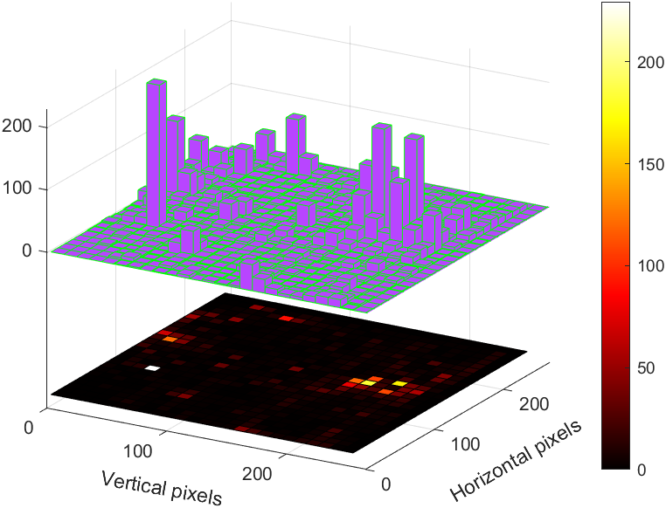
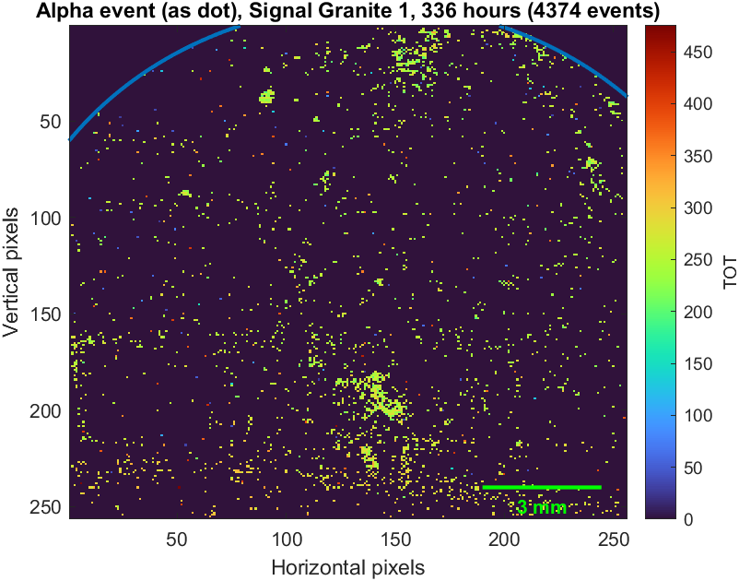
Mapping of alpha-particles (α): Granite
Distribution of all particles
229
Distribution of α-particles
90
183
167
110
Heterogeneous distribution of α-particles (origin: U or Th?) with some hotspots!

Slide 9
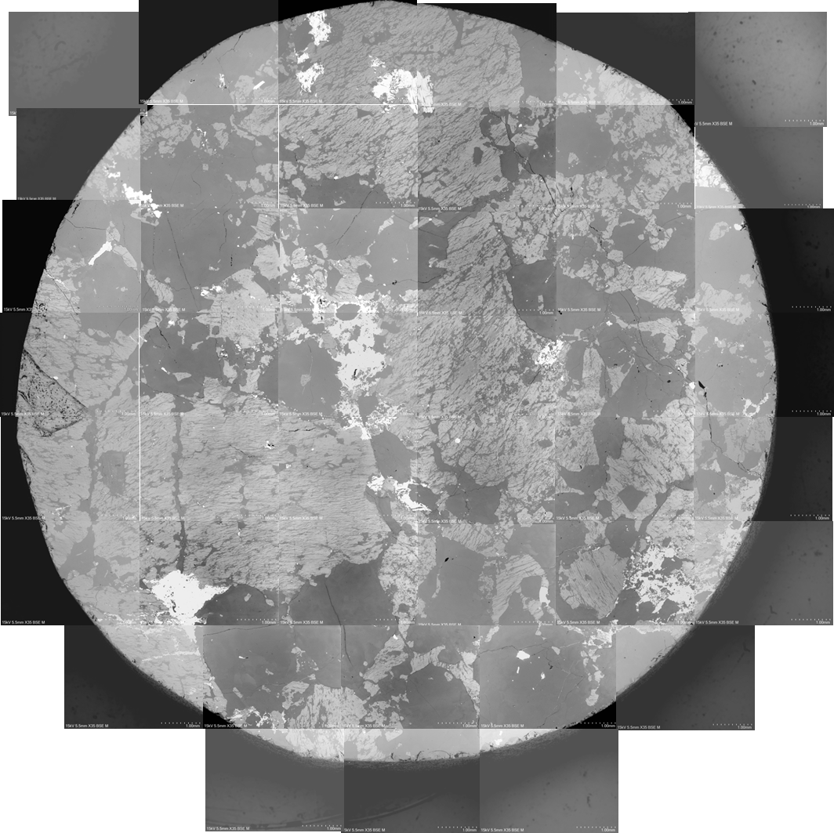
Implications for micro-dosimetry
quartz
quartz
*The scale of the SEM image is different!
Dark grey regions are quartz grains.
Any quartz grains close to hotspots would receive higher doses.
It appears the β-electrons originating from U or Th are the key factor.
Obviously low bandwidth, but a larger area sensor/tiled array is very attractive, thick of High Z sensor for better energy range
We would like to upgrade to a Timepix4 with only slow control readout…

Slide 10
Chemistry: Time of Flight Mass Spectrometry
Several Medipix institutes are working on ToFMS.
Use Time of Flight of electrostatically accelerated ions to determine their mass and so original chemical identity
Timepix allows us to perform imaging TofMS and to record the full event in a single shot.
This can either be used to raster scan across a heterogeneous sample (eg tissue sample) or have many samples are prepared in a matrix for high throughput testing.
Oxford Chemistry (CRL) is investigating both of these but initial work has been targeting the high throughput operations.
Chemistry Department previously worked with STFC-RAL to develop the PImMS detector. Recent measurements show that Timepix3 has surpassed this in an operational setting.
Example of spatial imaging mass spectrum in which a spatial map of the ion (top row), as originally positioned at source, is obtained for each mass peak

Slide 11
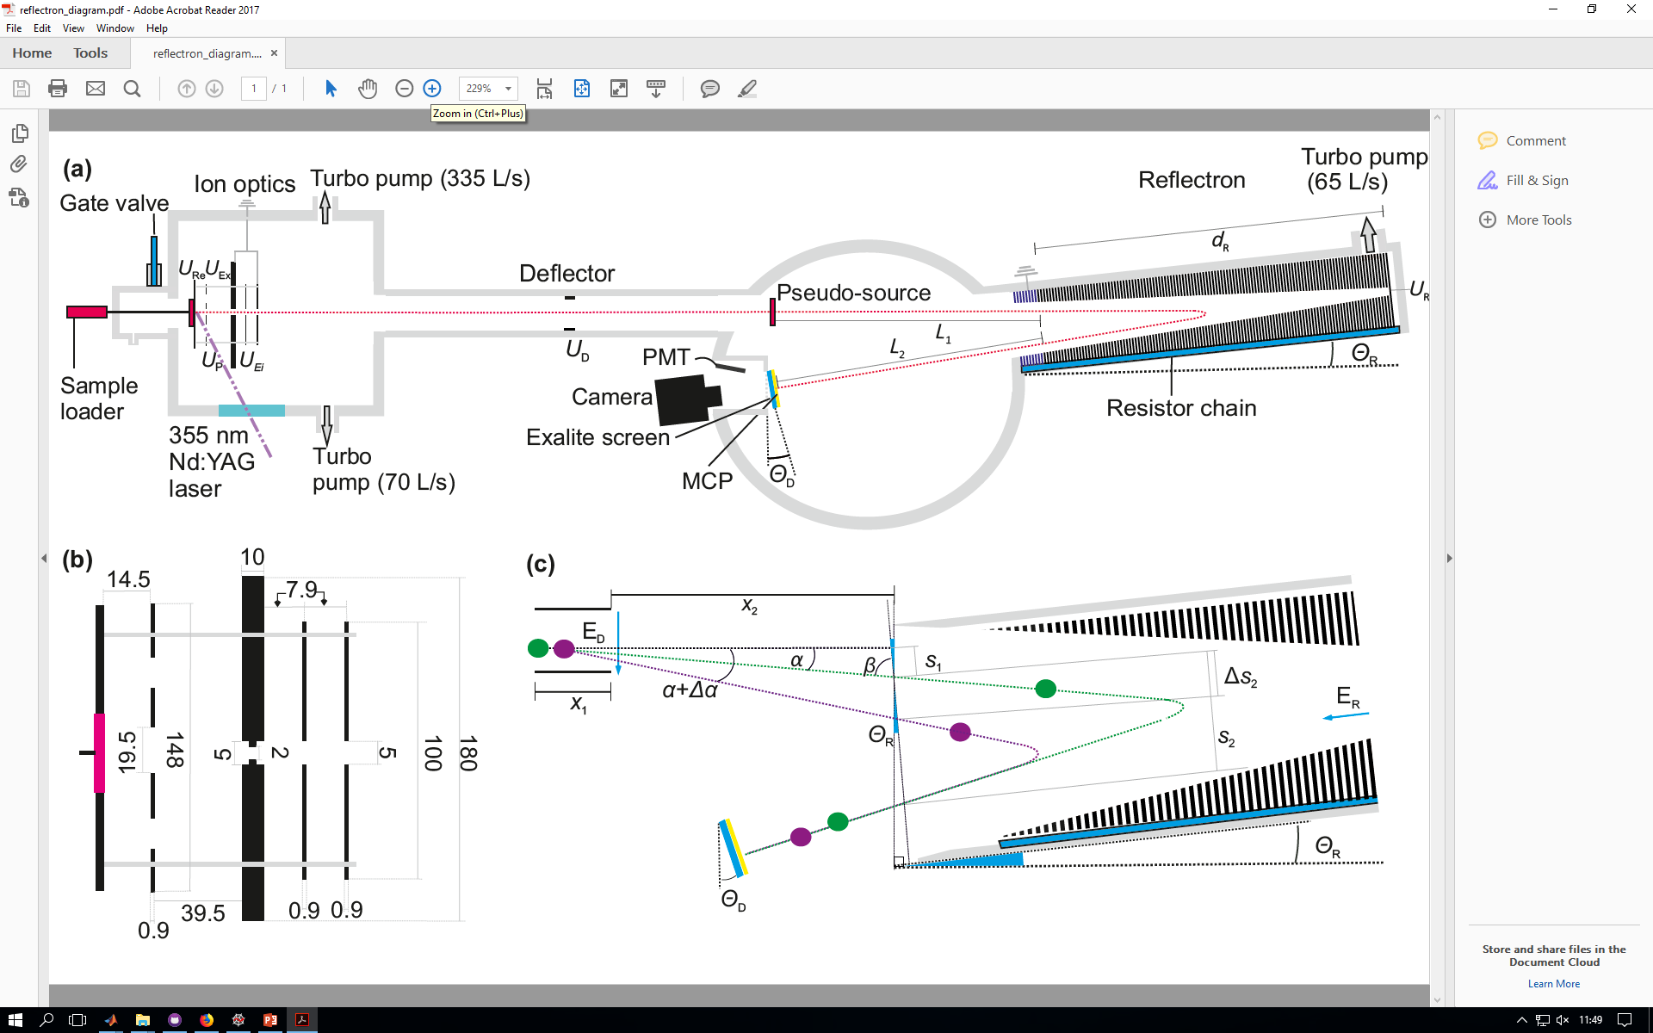
ToFMS: How Does it Work
Reflectron reduces KE dispersion by decelerating ions in initial direction of momentum.
Micro channel plate and custom photo-luminescent screen, rise time ~4ns

Slide 12
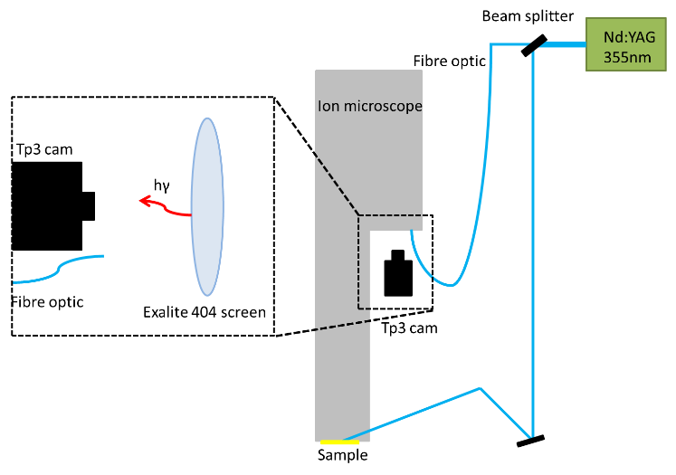
Optical Time Synchronisation
Nanosecond precision time synchronization with external equipment is always challenging – a work around used there is to project a secondary laser spot on the sensor to have t=0 point in the matrix data
The beam enters a beam-splitter, a portion is transmitted along an optical fibre and reflected back from the screen onto the sensor corner for use as an ‘optical trigger’.
300um sensor with thinned entrance window for visible wavelength sensitivity. (produced by FBK and sold as TimepixCam)
Advacam AdvaDAQ for readout, now moving to a SPIDR3
Custom mount for a 18-55mm F-mount lens for focusing light spots onto sensor.
Fast PMT for comparison and retrospective time alignment.

Slide 13
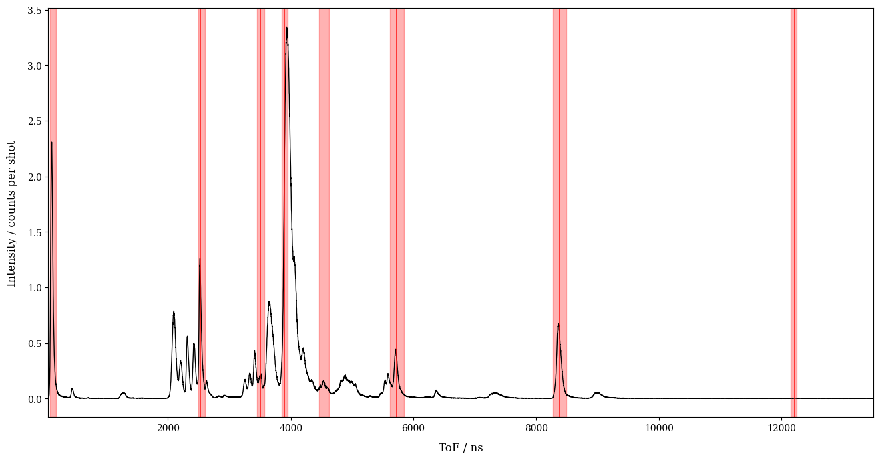
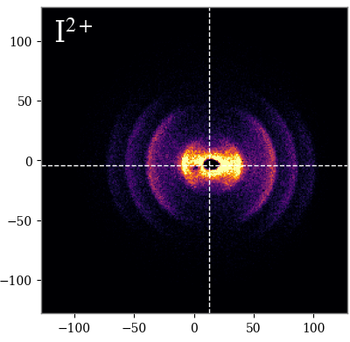
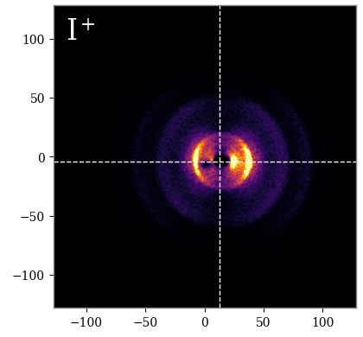
Iodine Sample
Here we see the recorded spectra form an iodine ‘standard candle’ sample

Slide 14
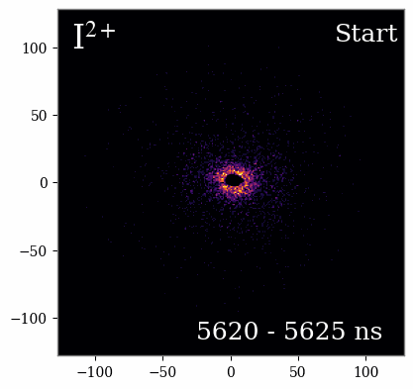
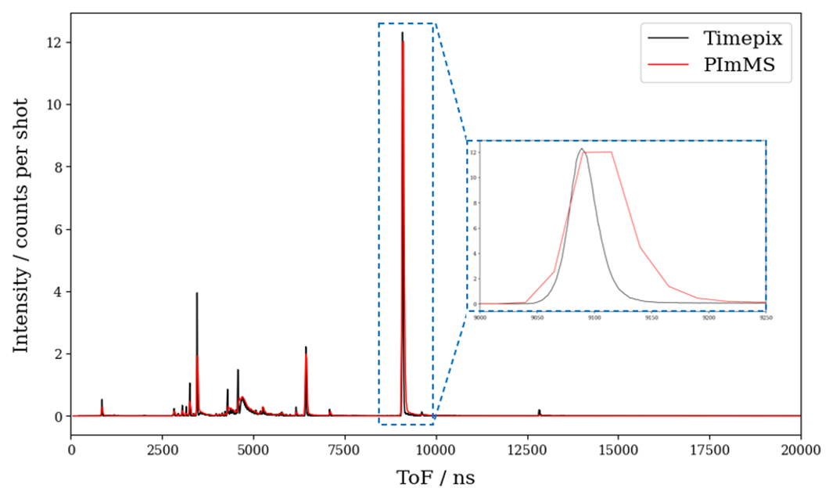
Improvement in System Resolution
Animation of 5 ns slices through a newton sphere
Timepix3 vs PImMS2 ToF spectrum
https://pubs.acs.org/doi/10.1021/jasms.2c00223. (Paper)
We plan to remove the current phosphor limitation by putting Timepix4 in the system vacuum and collect charge cloud directly from the MCP without a sensor.

Slide 15
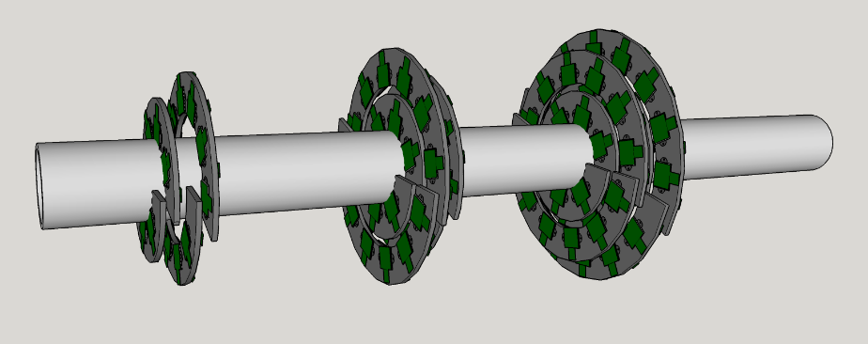
Physics: Beam Monitor for HL-LHC
The CERN Beam Instrumentation group is developing tools to locate and profile the HL LHC beam.
This is challenging due to the power of the beam – any direct detector physically strong enough to survive disturbs the beam too much.
Investigating two approaches based on the beam interaction withy a gaseous target – Beam Gas Ionisation and Beam Gas Vertexing
BGI looks for the track of ionisation with an off axis Timepix and a large magnet system giving a 2D profile.
BGV reconstructs ‘forward scattered’ interactions like a Particle Physics vertex tracker and gives a 3D profile. Oxford was part of a proposal to build this tracker out of ~200 Timepix4s based on our experience with Timepix, LHCb VELO, and ATLAS Outer Endcap construction.

Slide 16
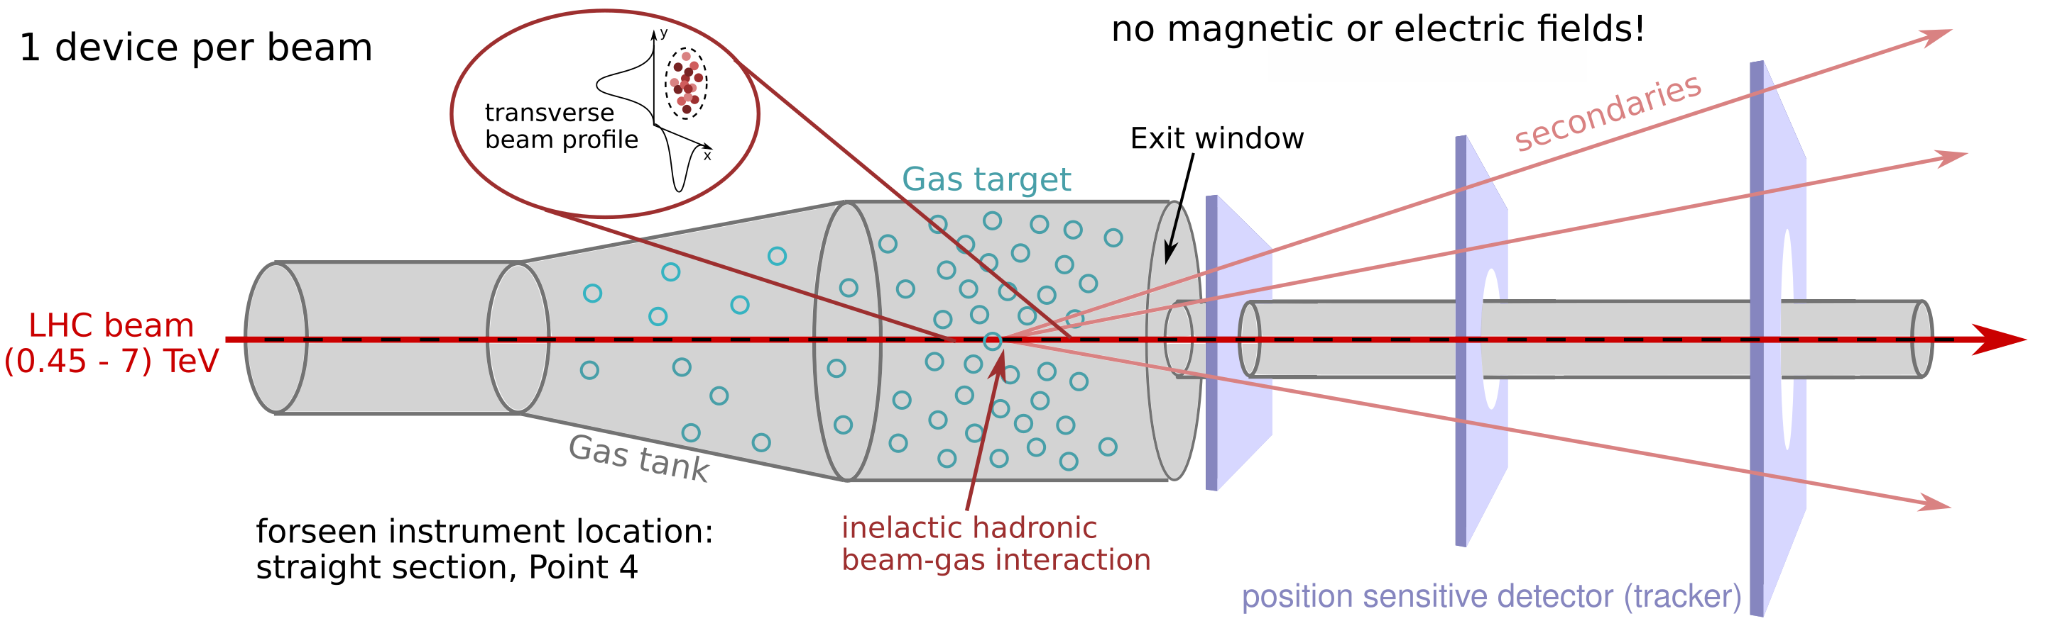
BGV Operational Concept
Non invasive transverse beam profile monitor based on the reconstruction of vertices of inelastic hadronic beam-gas interactions - BGV (Beam Gas Vertex) monitor.
Provide continuous emittance and beam profile measurement throughout the LHC accelerator cycle (450 GeV to 7 TeV).
Consists of: a Neon gas target, a forward tracking detector and computing resources dedicated to event reconstruction.
Vertex resolution of 164 µm and measurement of vertex response.
Enough statistics in 1 min for bunch width measurement with +/-1% precision.
Dist. gas-1st layer | 1st layer [r_{inner}, r_{outer}] | Distance btw. layers | 3rd layer [r_{inner}, r_{outer}] | Spatial resolution | x/X₀ per layer
~550 mm | ~[24, 65] mm | 250 mm | ~[45, 125] mm | ≲16 µm | ≲ 2 %

Slide 17
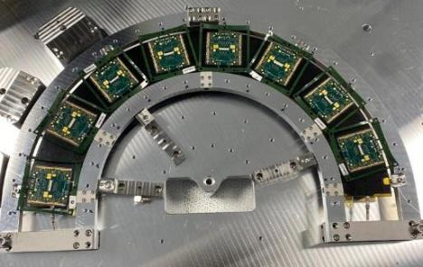
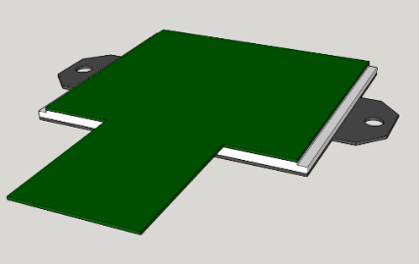
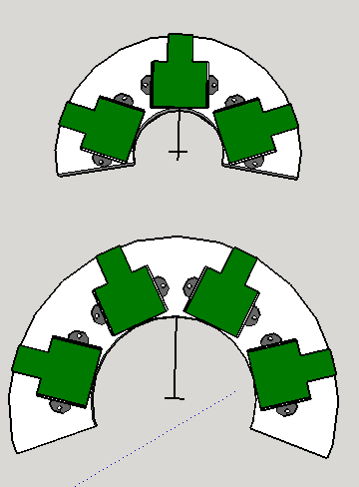
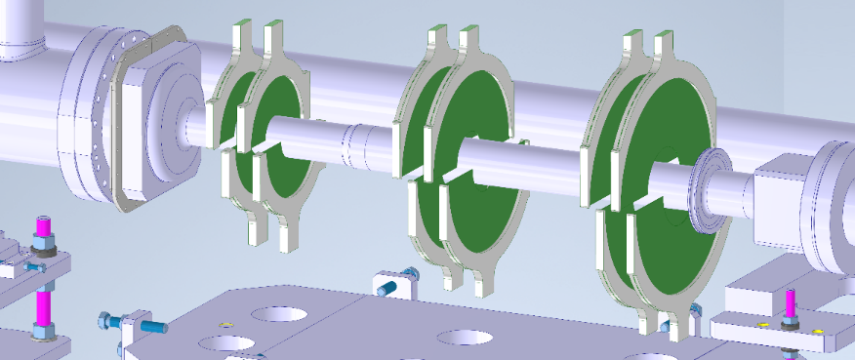
Beam Gas Vertex Monitor
An instrument to monitor the profile and intensity of the HL-LHC beam
Low mass forward tracker design reuses many elements from ATLAS ITK endcap robotic production to save time and money. A proven technique
A full construction & testing plan and costing was developed for the project
Timepix4 module with flex and CF attachment points
ATLAS Inner half ring
Potential BGV ring layout

Slide 18
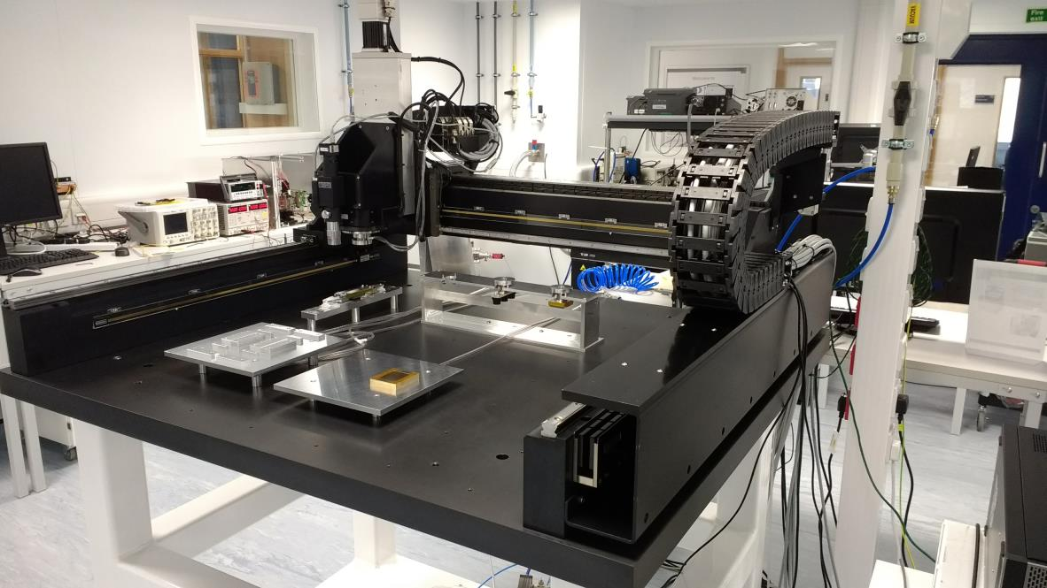
Robotic Construction at OPMD
Vacuum pick-up ‘Bridge tool’ in docking station
Camera w/ microscope lens and lighting
Vacuum spreader tool in tool rack
Glue stamp tool in tool rack
Flex and bare module vacuum chucks
on vacuum baseplate
Aerotech 4-axis Gantry Positioning System +/-5um accuracy
Glue reservoir on vacuum baseplate

Slide 19
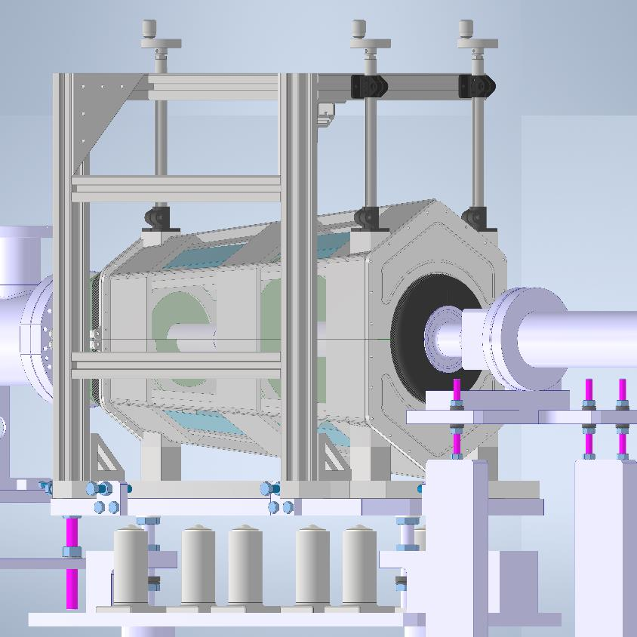
Engineering Plans for BGV Detector
Significant engineering, scheduling, and financial detail was worked out for the detector including: cooling, DAQ, power and control, installation hardware, and low mass mechanical structures.
Presented in November 22 for review.
Sadly Reviewers chose the BGI system as Beams group needed to hire a physicist with tracking experience to maintain the system.

Slide 20
Physics: Looking for Axions
Axions are particles that probably don’t exist…
Working with Atomic and Laser Physics Sub Department at Oxford to use a Timepix to look for them.
If they do they will be observed in interactions between strong magnetic fields and photons.
Using the magnetic fields in a Bragg crystal and the very high photon flux of the Eu-XFEL beam (10^22) we can attempted to generate and then reconvert an Axion bean that will pass through a shield where photons will not.
Bragg crystals were Germanium 220, Laue geometry
Experiment conducted over Easter Weekend 2023…

Slide 21
Axion Search Experimental Setup
Experiment
shield
Crystal
Crystal
Detector
9.8 keV X-ray beam
Axions
X-ray beam
Control – remove first crystal
Detector
X-ray beam
Crystal
shield

Slide 22
Axion Search
This difficulty is not in the experimental technique but in shielding background from 10²² photons and stray radiation at a FEL beamline.
Timepix3 is very good at this using ns fine time slicing around the beam, ability to reject on hit energy and veto cosmic and charged particles based on cluster shape.
Sadly due to policy difficulties with Eu-XFEL, and their Timepix not working with their beamline software, we were forced to use the Timepix3 as only a cross check and the beamline integrated Jungfrau as the main detector…
Sadly we didn’t see any Axions… A paper on how that affects the experimental limits will be published soon.
A future experiment at GSI with heavy ions and plasmas is planned with the ALP group for Feb24

Slide 23
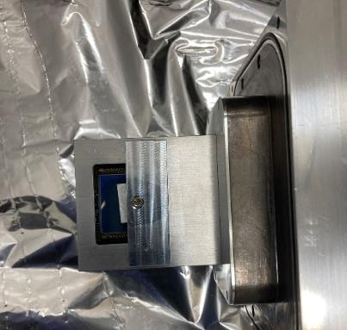
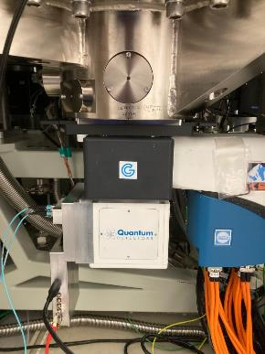
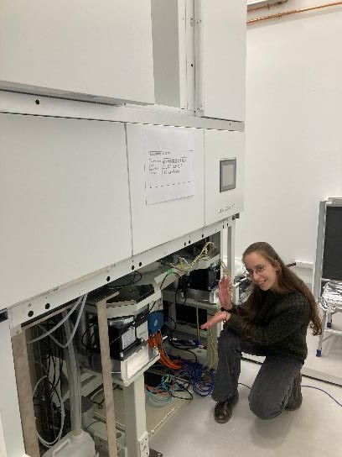
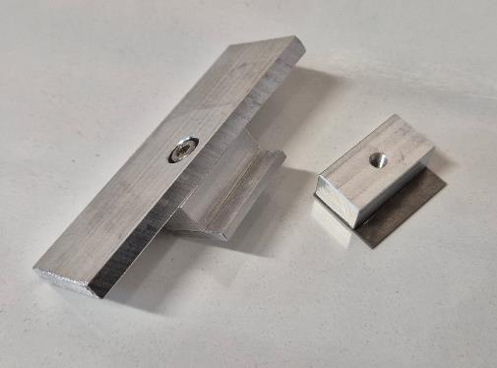
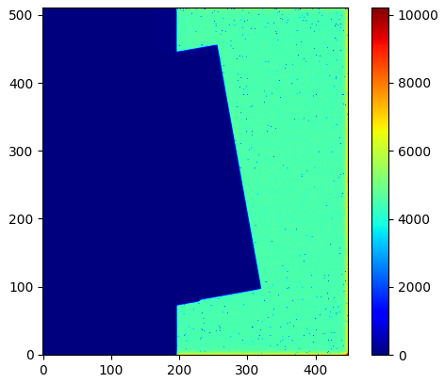
Timepix4 Electron Microscopy
Data Taken at RFI at Harwell with 100 and 200 keV electron beams using the slanted knife edge resolution measurement technique.
A collaboration between OPMD, Quantum Detectors, and RFI to get new detectors operational for transmission electron microscopy (TEM)
Actual work on this was carried our by Nina Dimova as part of her CASE DPhil at Oxford & QD
Electron hitmap:
Electrons: Al
X-rays: W
Number of hits
ROI
Al edge to reduce electron scattering
Notes:
PSF: the image of a point source

Slide 24
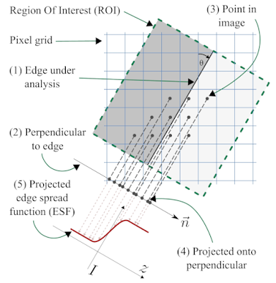
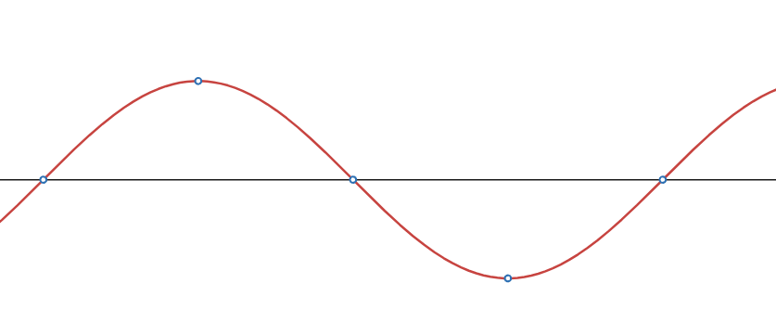
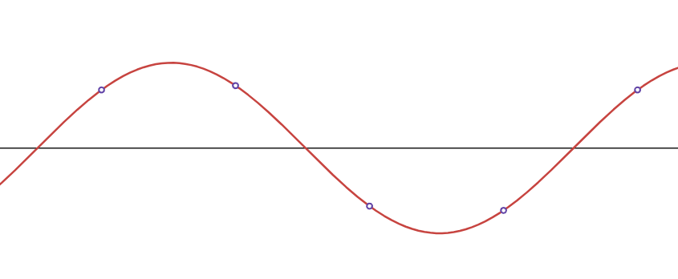
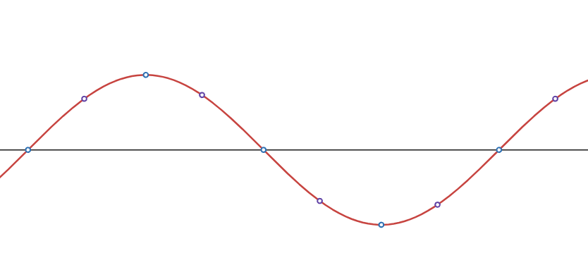
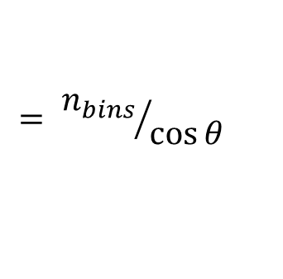
Slanted edge
Slanted-edge (OMNI-8) method
  Aliasing
  Oversampling
$$= {n_{bins}}/{\cos{θ}}$$
[https://mtfmapper.blogspot.com/2019/08/aliasing-and-slanted-edge-method-what.html]
Notes:
PSF: the image of a point source

Slide 25
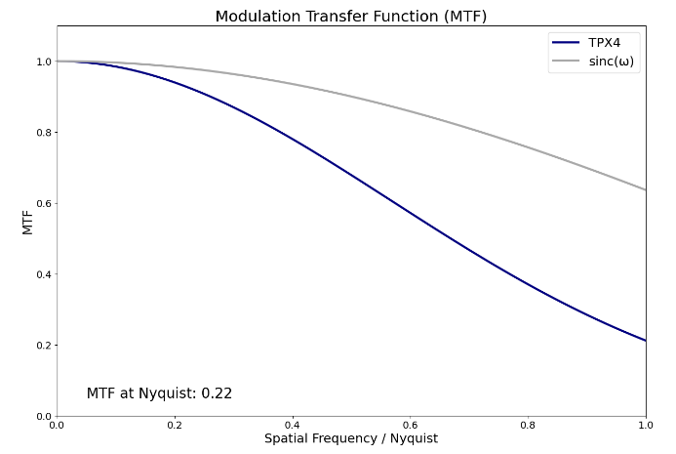

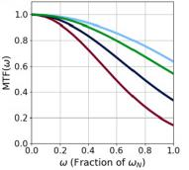
Single-pixel-mode electrons
Single-pixel-mode-like images
  Threshold at about 10keV
Flatfield correction
100keV electrons, 10deg angle:
120keV electrons:
Consistent with TEM characterisation studies of MPX2 and MPX3.
Paton et al: https://www.sciencedirect.com/science/article/pii/S0304399121000851
Faruqi and McMullan: https://pubmed.ncbi.nlm.nih.gov/21524337/
Notes:
PSF: the image of a point source

Slide 26
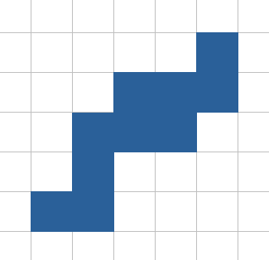


Clustering electrons
TPX4: ToA-based clustering
  100ns time window, 7x7 pixel window
  ToT centroid: $1/4$ pixel resolution
  Increase MTF while keeping threshold low.
Notes:
PSF: the image of a point source

Slide 27
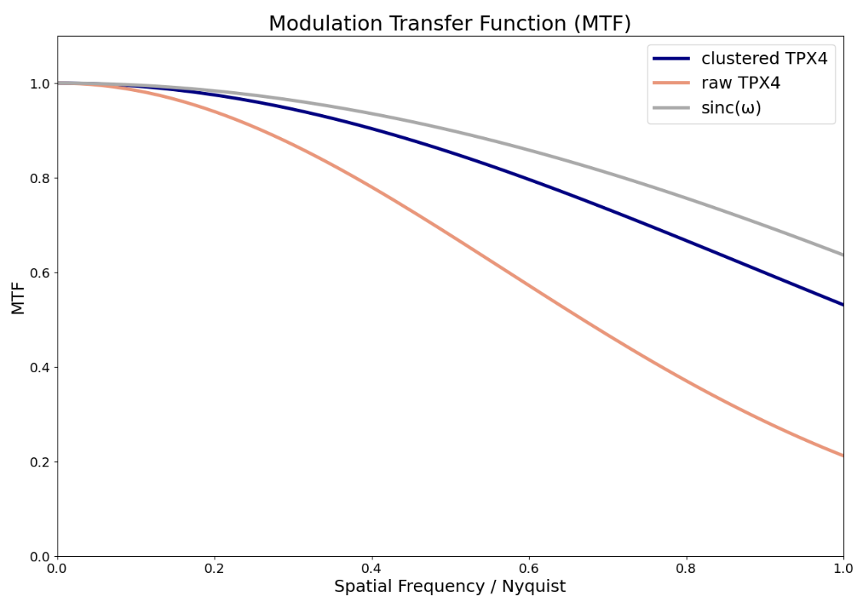
Clustered electrons MTF
TPX4: ToA-based clustering
Raw MTF at Nyquist: 0.22
Clustered MTF at Nyquist: 0.53
Notes:
PSF: the image of a point source

Slide 28
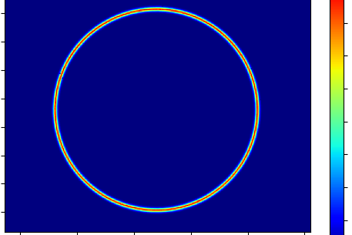
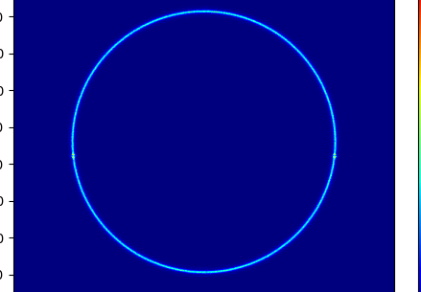




Clustering electrons
TPX4: ToA-based clustering
  100ns time window, 7x7 pixel window
  ToT centroid: ¼ pixel resolution
Test-data provided by Jonathan Bernard and Marcus Gallagher-Jones (Correlated Imaging Group, Prof Angus Kirkland, RFI):
  Increase MTF while keeping threshold low.
Focused electron beam pixel scanning
Notes:
PSF: the image of a point source

Slide 29


Clustering electrons
TPX4: ToA-based clustering
  100ns time window, 7x7 pixel window
  ToT centroid: ¼ pixel resolution
Test-data provided by Jonathan Bernard and Marcus Gallagher-Jones (Correlated Imaging Group, Prof Angus Kirkland, RFI):
  Increase MTF while keeping threshold low.
Notes:
PSF: the image of a point source

Slide 30
Overall Conclusions & Future Outlook
We are supporting many different groups at Oxford and beyond with Timepix work, as well as starting our own measurements on Timepix4.
In particular we will focus on transitioning from Timepix3 to Timepix4 for our partners in Chemistry, Atomic and Laser Physics, Materials Science and Archaeology. All have different requirements for detector performance, calibration and cost.
We are also planning future projects looing at the effect of LGAD sensors + Timepix4 with some of these applications and more.
And if anyone needs a massive Timepix4 particle tracker we would be more then happy to talk to you.

