Slide 1
ATLAS Inner Tracker (ITk) modules
Richard Bates

Slide 2
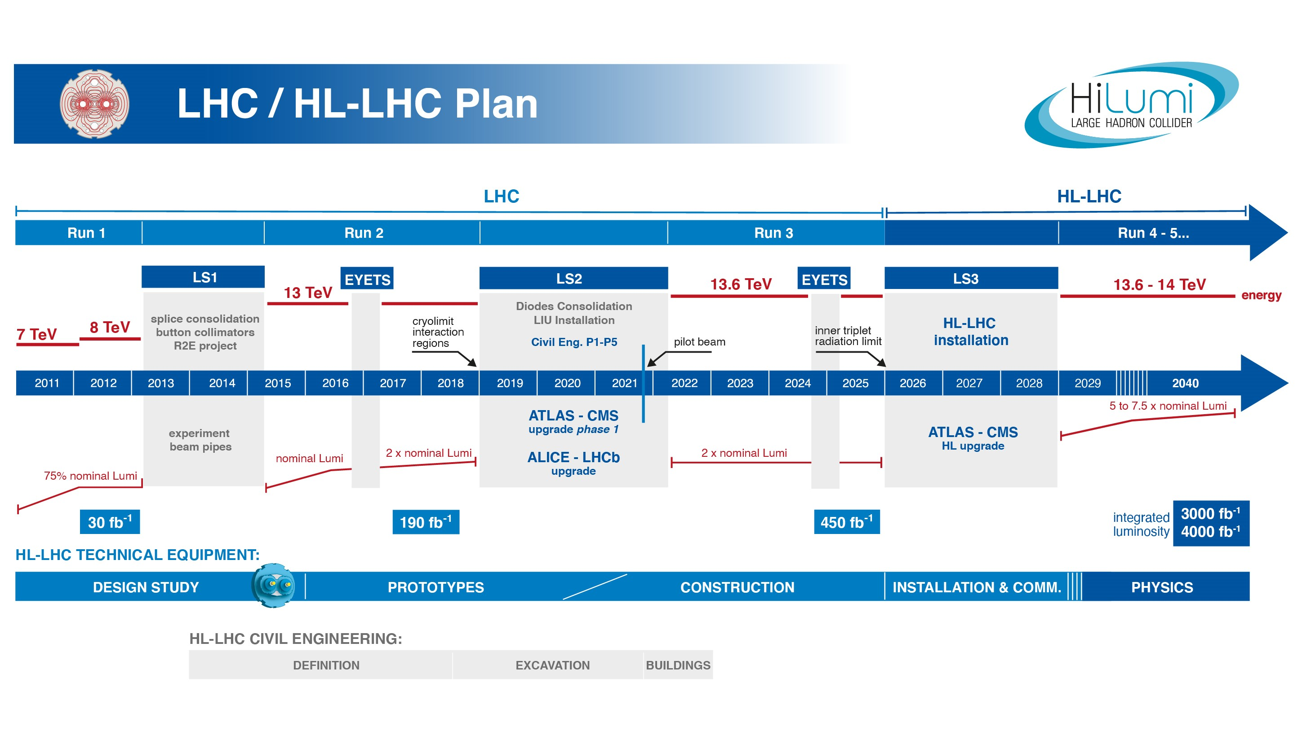
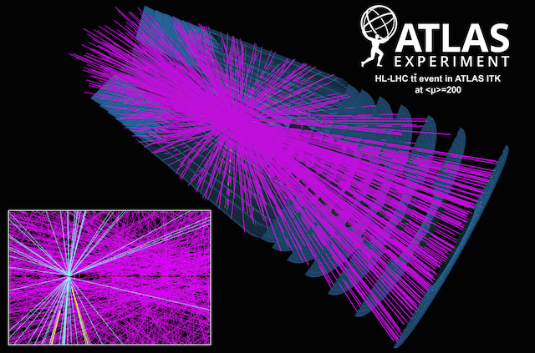
LHC timeline
HL-LHC luminosity ~7x10³⁴cm⁻²s⁻¹ integrated ~3000fb⁻¹
  ~3.5 times Run-3 peak luminosity
  ~x5 times integrated luminosity at end of Run-3
Increased luminosity → Increased pile-up:
  Up to 200 pile-up events expected at the HL-LHC compared to ~48 in current Run-3 data
  Increased pile-up compromises pattern recognition and requires higher granularity and higher readout rates
Increased luminosity → Increased radiation damage
  Damage scales approximately linearly with luminosity ~x10 increase
Today
“Phase-II” upgrade of ATLAS in ~2027
Simulated ttbar events with 200 pileup
ATLAS public plot

Slide 3
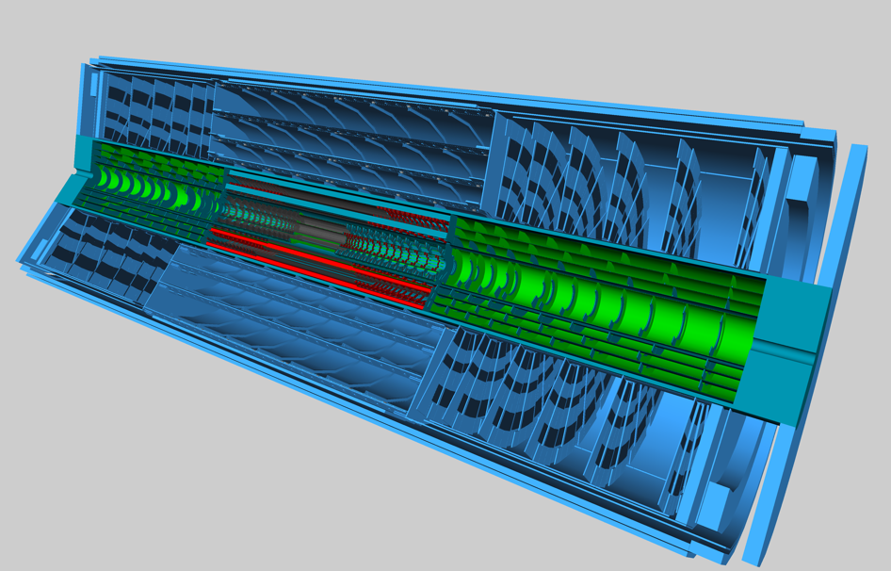
ATLAS Inner Tracker (ITk)
Current Inner Detector System
The current inner detector system will be replaced with a new all-silicon tracking system -- ITk
New tracker
  Targeting the same or better performance than current Inner Detector
  Increased granularity to maintain occupancy <1%
  Low mass mechanics, cooling and serial powering to minimize material
  Increased radiation hardness
Phase-II Inner Tracker (ITk)
Strip Barrel
Strip Endcap
Pixel Endcap
Pixel Outer Barrel
Pixel Inner Layers
Notes:
ATLAS is planning an extensive Phase-II upgrade
This includes the replacement of the current inner detector system
Strips and pixel layout optimised for HL-LHC tracking

Slide 4
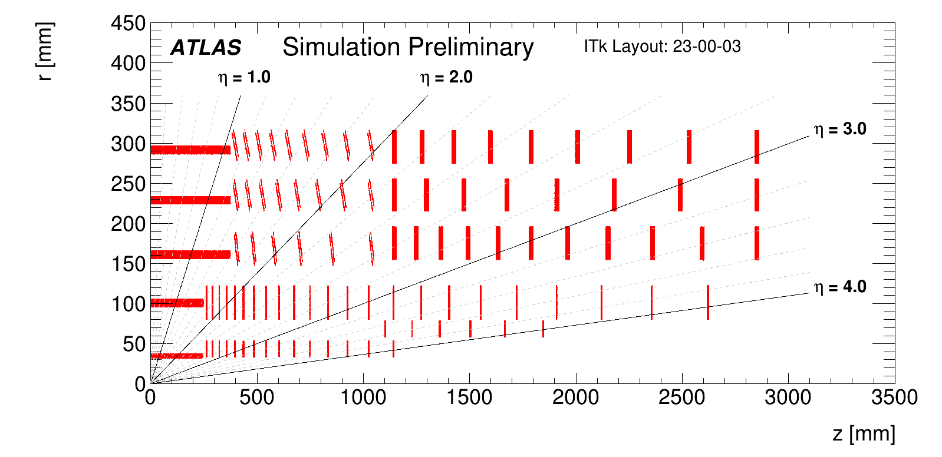
ITk Pixel detector layout
Outer Barrel:
3 layers of flat staves and inclined rings
Si n-in-p planar quad modules
4472 quad modules, 6.94m²
2.3x10¹⁵n/cm⁻² 1.7MGy @4000fb⁻¹
Endcap:
3 layers of rings
Si n-in-p planar quad modules
2344 modules, 3.64m²
3.1x10¹⁵n/cm⁻² 3.5MGy @4000fb⁻¹
5 layers of pixel detectors
Layers 0-1 : Inner System (IS)
Layers 2-4: Outer System (OS)
  Outer Barrel (OB)
  Endcaps (EC)
Current pixel system
~92M pixels
~2000 modules
~1.9m² active area
ITk Pixel System
~5G pixels
~9,400 modules
~13m² active area
Outer Barrel
Outer Endcap
Outer System
Replaceable Inner System
Inner Barrel and Endcaps
Inner System Replaced after about 1500fb⁻¹
2 layers of flat staves and rings
L0: 396 3D Si triplet modules and 1160 L1: n-in-p planar quad modules, 2.4m²
9.2x10¹⁵ncm⁻² 7.3MGy @2000fb⁻¹
Layout described in
ATL-PHYS-PUB-2021-024
Notes:
Numbers are from Fluka simulations 3.1Q6
Fluence and dose do not include safety factors
X10 in pixels
X5 in modules
X6 in area

Slide 5
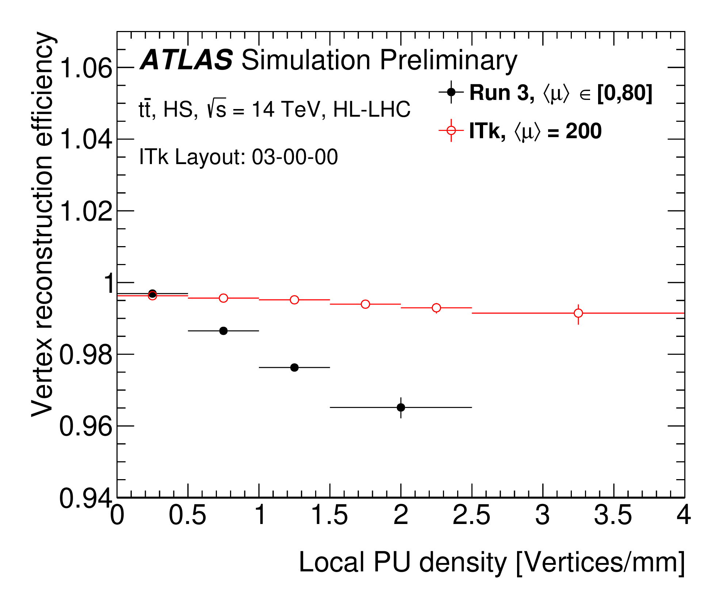
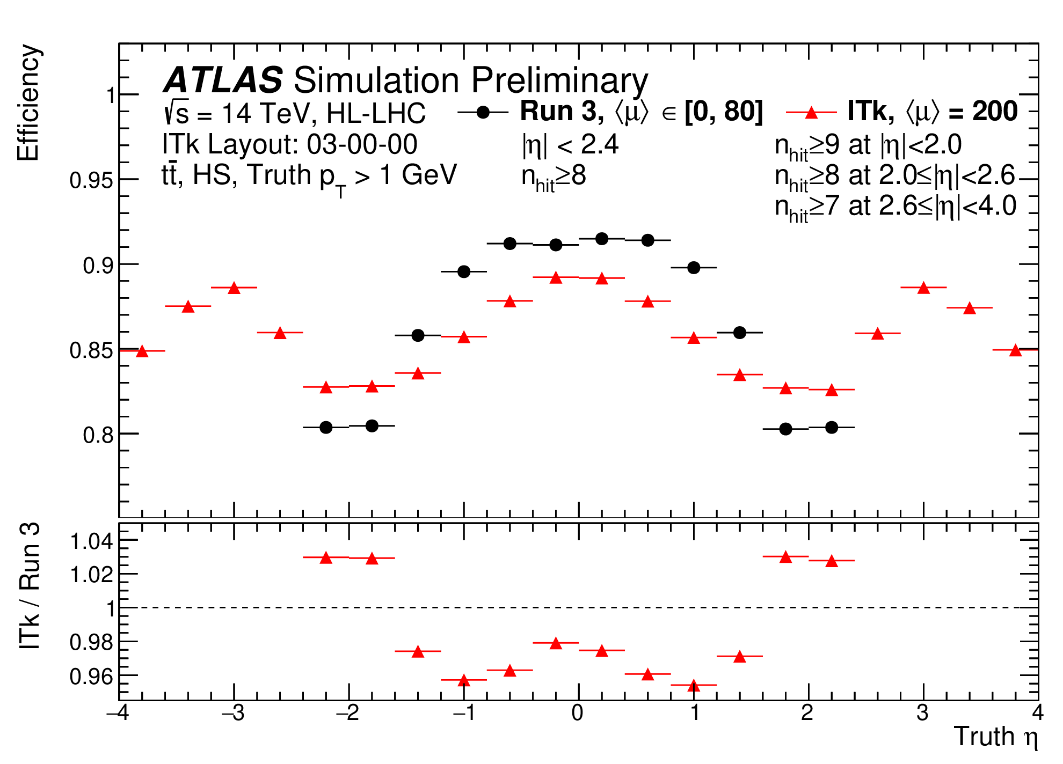
Simulation studies of performance
Aim for a performance as good as or better than the current inner tracker
IDTR-2023-05
IDTR-2023-05
Vertex reconstruction efficiency
vs pileup density
Track efficiency in ttbar events
Notes:
Aim to maintain current or improve detector performance
ATLAS Public plots for tracking: Expected tracking performance of the ATLAS Inner Tracker Upgrade for Phase-II
Vertex reconstruction efficiency in tt¯ events at 200 pileup (PU) events (⟨μ⟩ = 200), as a function of the local pileup density. The ITk reconstruction is compared with the Run 3 detector and reconstruction with a flat pileup profile μ∈[0,80]. In both cases, the AMVF algorithm (described in \href{https://cds.cern.ch/record/2670380}{ATL-PHYS-PUB-2019-015}) is tuned to the respective detector and used to identify and reconstruct primary vertices.
Tracking efficiency for tt¯ events at 200 pileup (PU) events (⟨μ⟩ = 200) and a center-of-mass energy s√=14 TeV, as a function of true pseudo-rapidity η using the ITk Layout 03-00-00. The particles considered must satisfy pT>1 GeV and |η|< 4.0, and be produced by the primary interactions. The efficiency is defined as the number truth particles with at least one reconstructed track matched to them, divided by the total number of truth particles. A track is considered matched if the matching probability is over 50\% for a truth particle. A comparison of the ITk reconstruction with the Run 3 detector and reconstruction using a flat pileup profile μ∈[0,80] is shown. The Run 3 reconstruction requires at least 8 silicon hits on a track, while the ITk reconstruction requires at least 9 hits for |η|<2.0, 8 for |η|<2.6 and 7 otherwise. Although requiring substantially more hits for successfully finding a track, the efficiency in the overlapping region is comparable to the current ATLAS Run 3 detector. This reflects the fact that the ITk detector has less material per measurement compared to the current ATLAS Inner Detector.

Slide 6
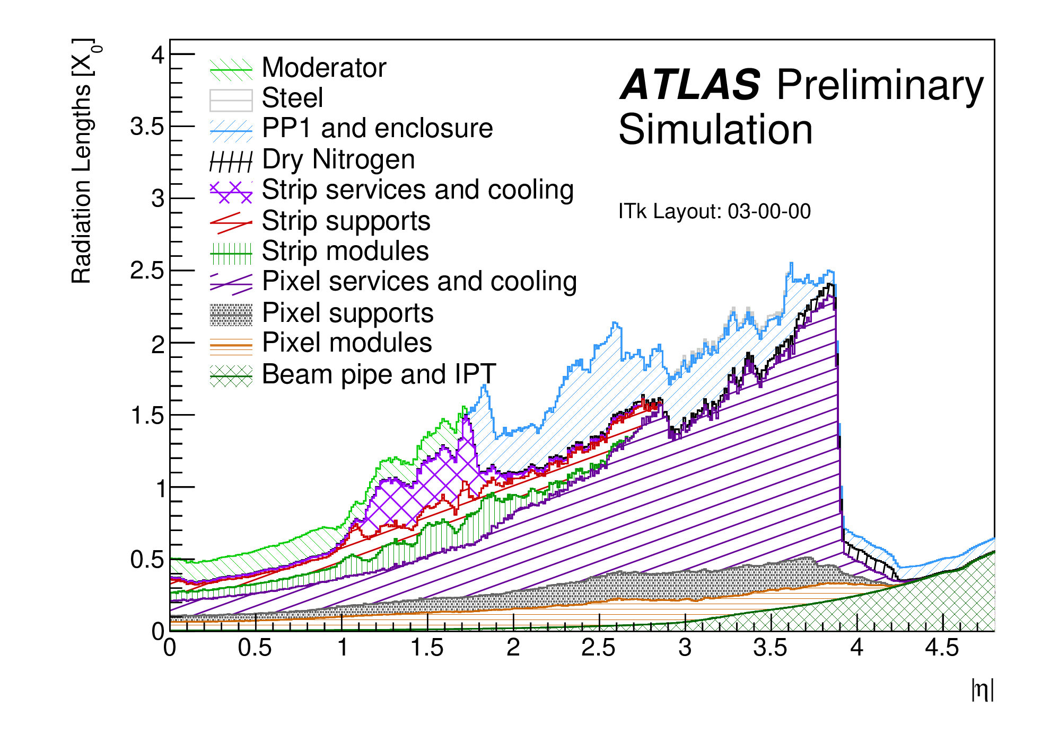
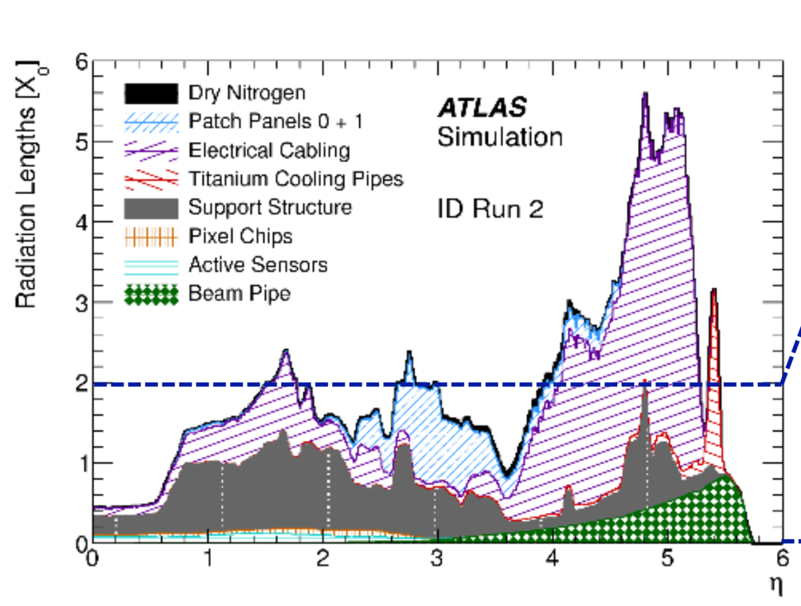
Material
ITK-2023-001
Material impacts tracking, radiation levels, data rates and downstream detectors such as the calorimeter.
It is important to minimize the material.
Reduce material using
  CO₂ cooling with thin titanium pipes
  Modules with thin Si sensors (100-150μm) and FE-chips (150μm)
  Serial powering of pixel modules to reduce cabling
  Low-mass carbon structures for mechanical stability and mounting
  Optimize number of readout cables using data link sharing
Notes:
C02 cooling – low mass
Thin modules -- silicon and FE-chips ← constraints on bump-bonding and module
Avoid large connectors, but need reliability, welding – constraints on mechanical design and electrical damage during construction
Material distribution within the ITk volume in radiation lengths (X₀) versus the pseudorapidity |η| for the ITk Layout 23-00-03, broken down by sub-system and material category.
A lot of work put into implementing engineering information into the simulation
Despite having a more complex detector – material has not significantly increase compared to ID Run-2

Slide 7
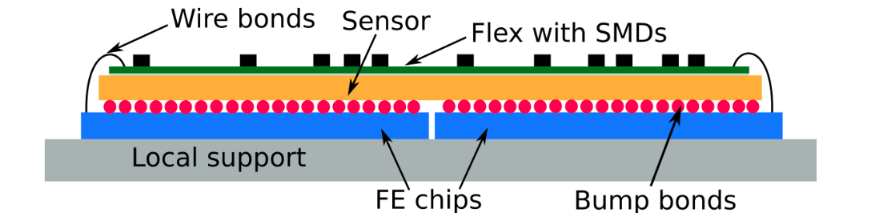
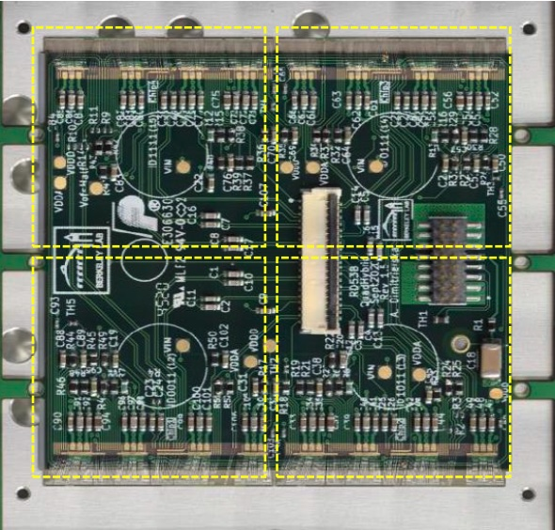
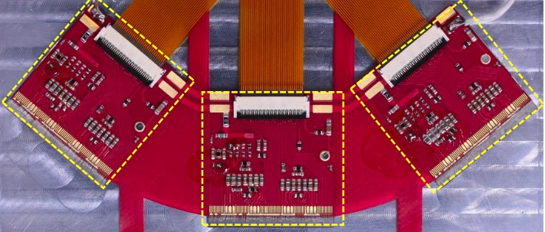
Modules
1 or 4 FE chips bump-bonded to sensor
  Quad modules: 4 FE-chips bonded to 1 sensor
  Triplet module: 1 FE-chip bonded to 1 sensor
Cu-Kapton flex hybrid glued to sensor
  Flex provides connections for power, DCS and data
Mix of materials with different coefficients of thermal expansion make the module design challenging
  Modules assembled at. +20ºC, but lowest module temperature can be -45ºC in the experiments
  Difference in CTE between Cu and Si leads to thermal stress on the bumps
  Amount of Cu needs to be carefully balanced between low power requirements and thermal stress on the bumps
  Qualify bump-strength of solder-based bumps after 100 thermal cycles (-55ºC +60ºC) for different vendors
  Good results from qualification, being followed up in the pre-production
  Indium bumps needs further evaluation
parylene coating
Quad module
Triplet module
Notes:
The lowest nominal evaporation temperature of the cooling system is -35°C at the inlet of the boiling channel. However, in case the thermal load is suddenly cut on the detector, the pressure drops along the exhaust line disappears and the boiling channel sets to the pressure of the accumulator in the cooling plant. This leads to a saturation temperature of -45C.
On the warm side, the interlock system will turn off the module power supplies if the temperature of a module exceeds 40°C.
Therefore, the Operational Temperature Range (OTR) is set to -45°C <T<+40°C

Slide 8
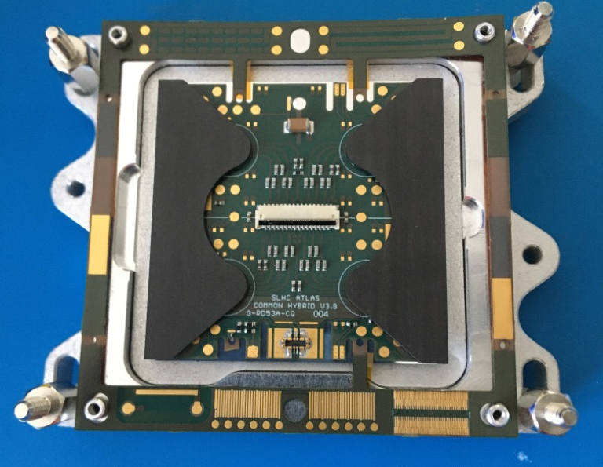
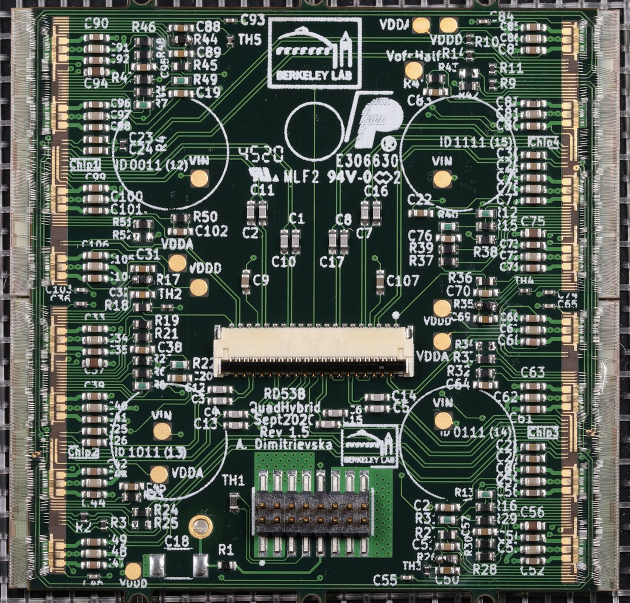
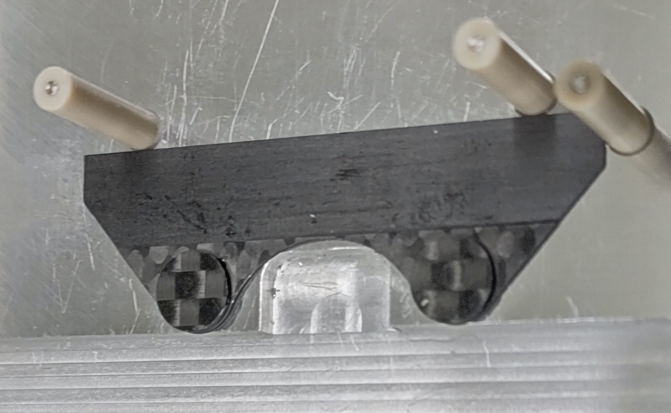
Module Flavors: Quads
Quad modules on L1-4
  L1: 100 um thick sensor
  L2-4 150 um thick sensor
    EC modules
    OB modules with wire bond protection canopy
Slightly smaller in x & y for the L1 modules

Slide 9
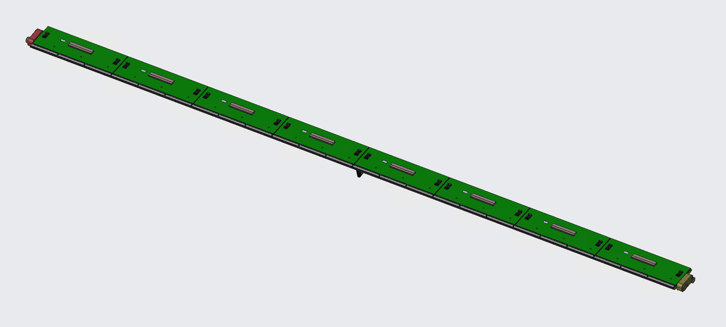
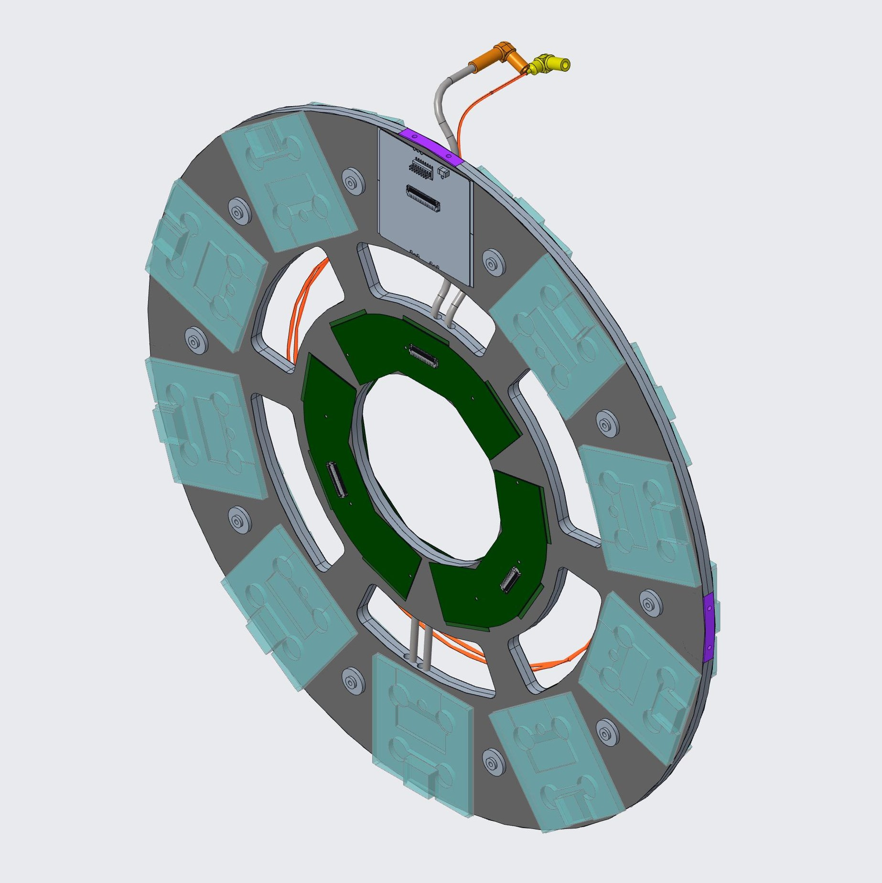
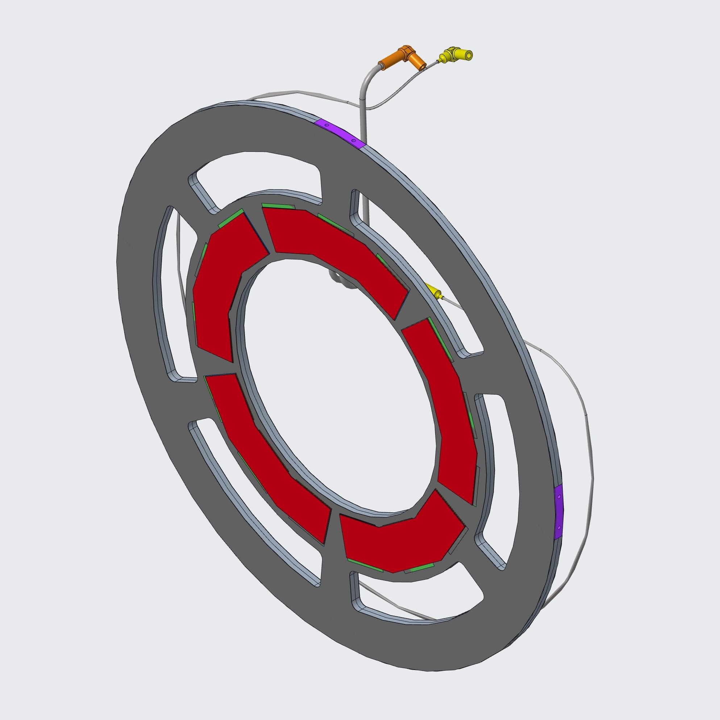
Module Flavors: IS
Pseudo-triplet modules for L0
  3 single bare modules glued to triplet hybrid
Linear Triplet:
12 L0 staves x8 triplets = 96
R0 Coupled-ring Triplet:
30 rings x6 triplets = 180
R0.5 Intermediate-ring Triplet:
12 rings x10 triplets = 120
R0 = 33mm radius
R0.5 = 58.5mm radius

Slide 10
Module Production Numbers
Item | Pre-production | Production | Installed | Yield factor
Module hybrids | 839 | 12370 | 8372
L0 – Stave | 10 | 141 | 96 | 1.46
L0 – Coupled Rings | 18 | 264 | 180 | 1.46
L0 – Endcap Rings | 12 | 176 | 120 | 1.46
Common Quad Hybrids | 799 | 11789 | 7976 | 1.48
Assembled Modules | 849 | 12011 | 8372
L0 – Stave | 10 | 141 | 96 | 1.47
L0 – Coupled Rings | 18 | 264 | 180 | 1.47
L0 – Endcap Rings | 12 | 176 | 120 | 1.47
L1 Quad | 120 | 1690 | 1160 | 1.46
L2-L4 | 683 | 9740 | 6816 | 1.43
Yields from MoU/BoE document and may change

Slide 11
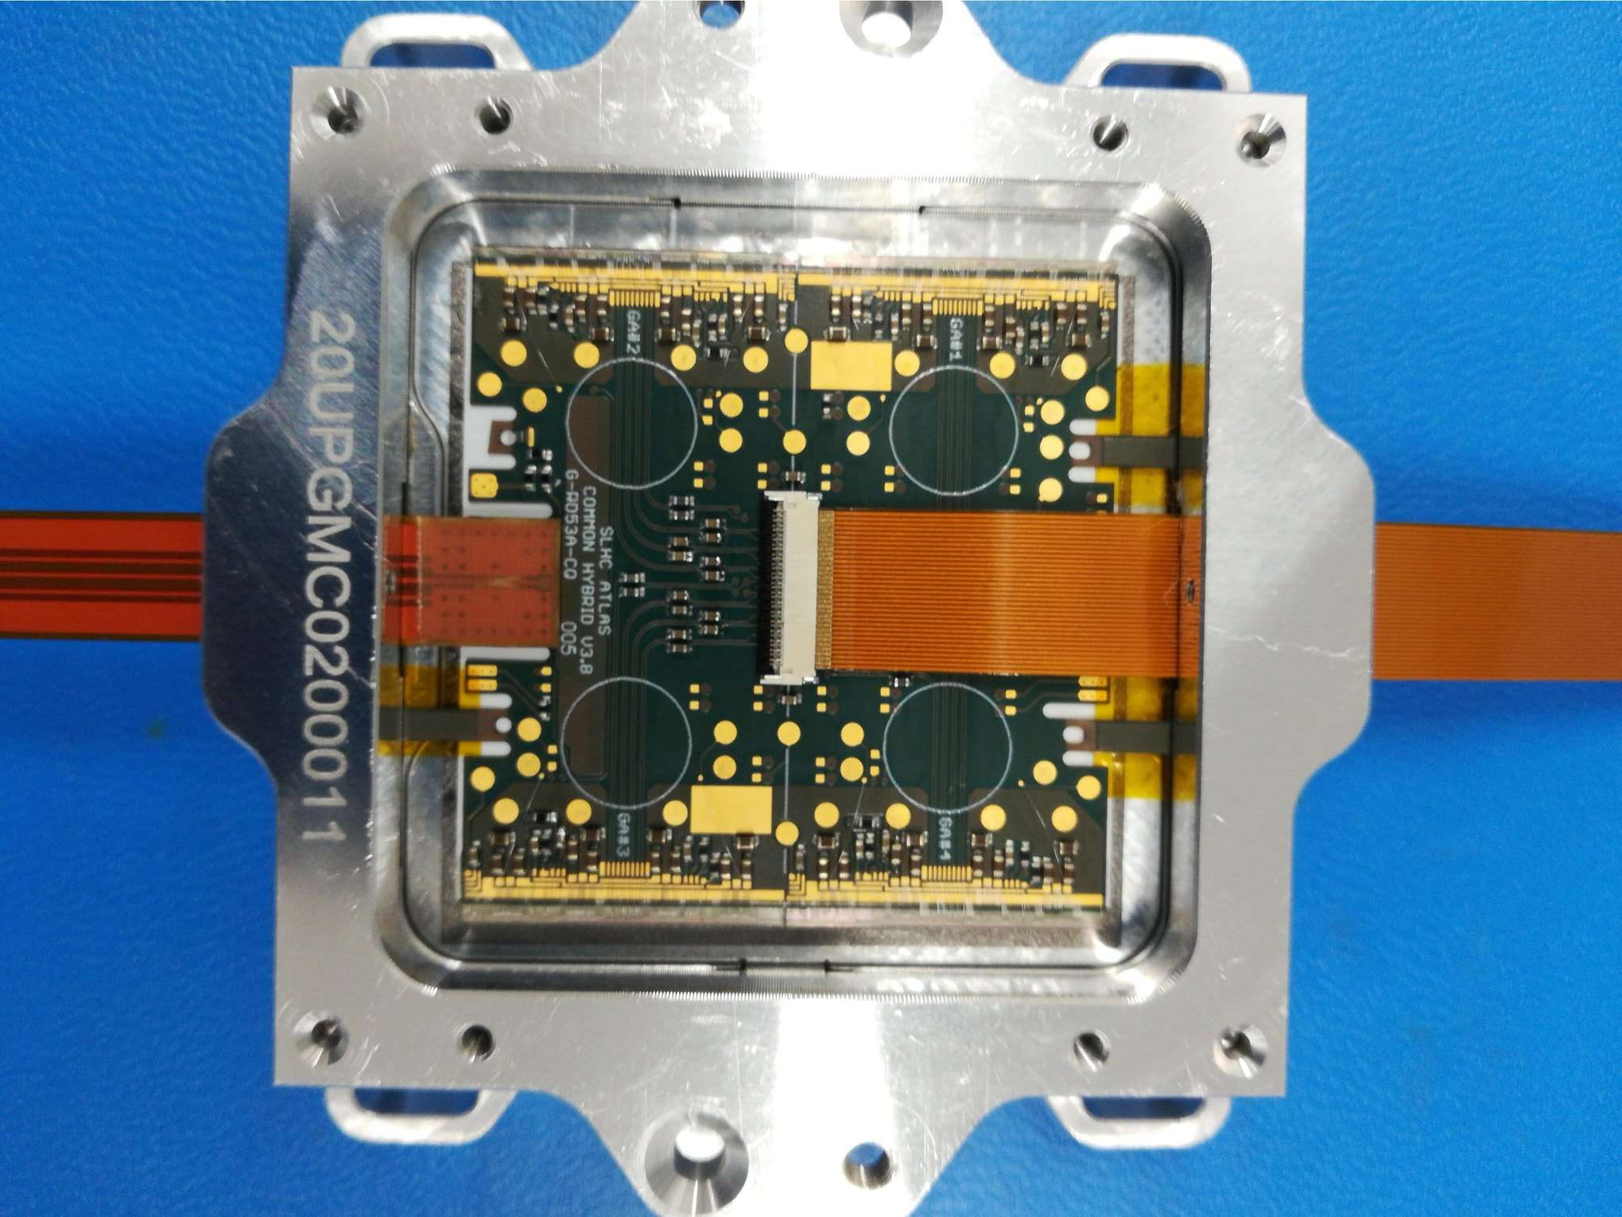
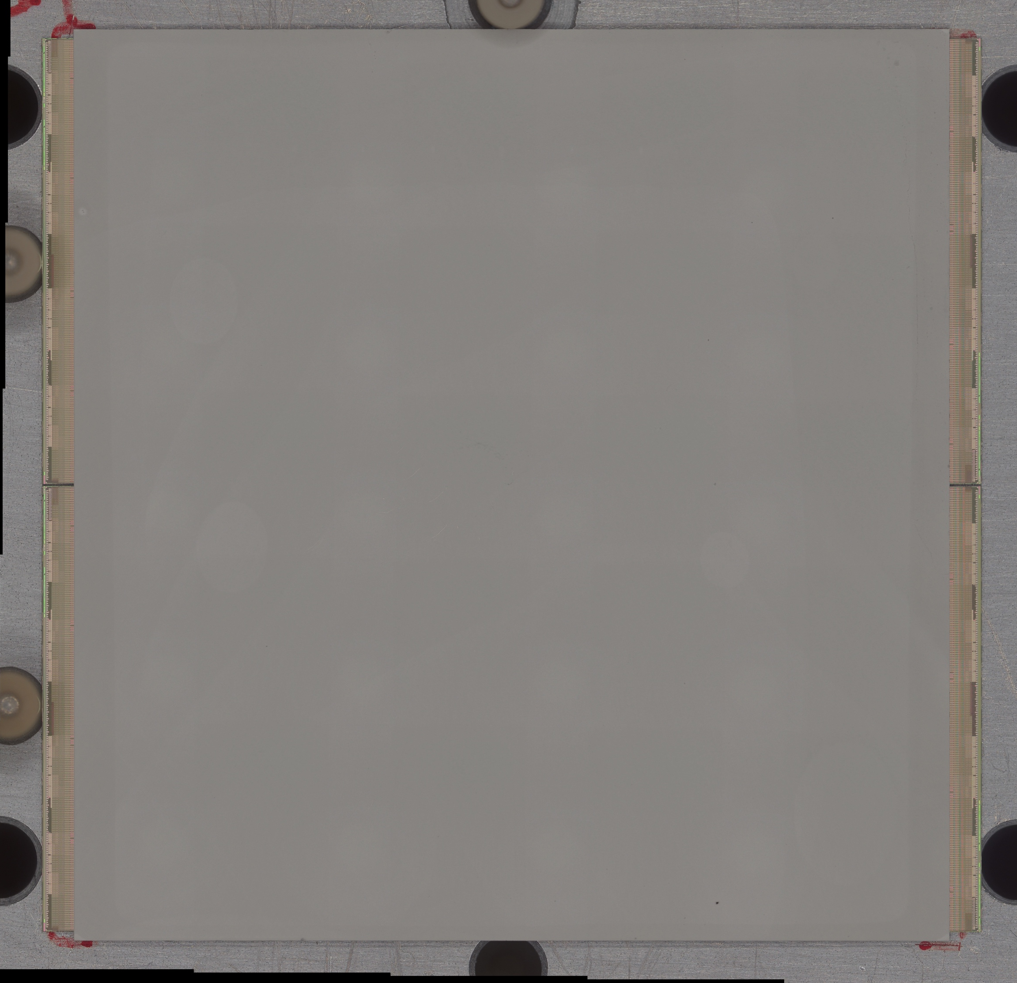
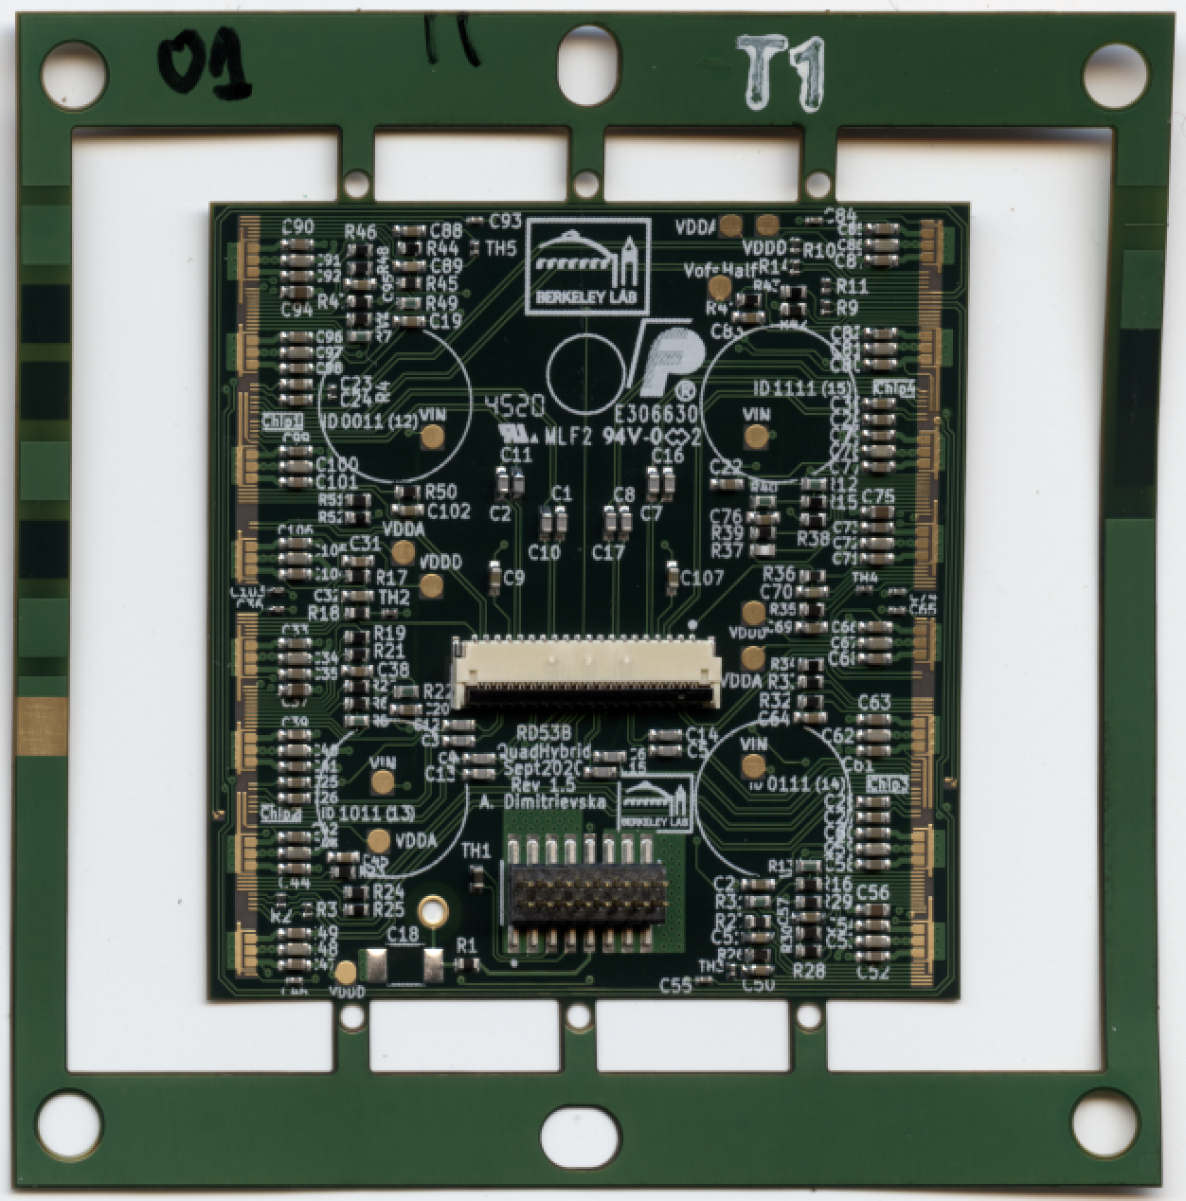
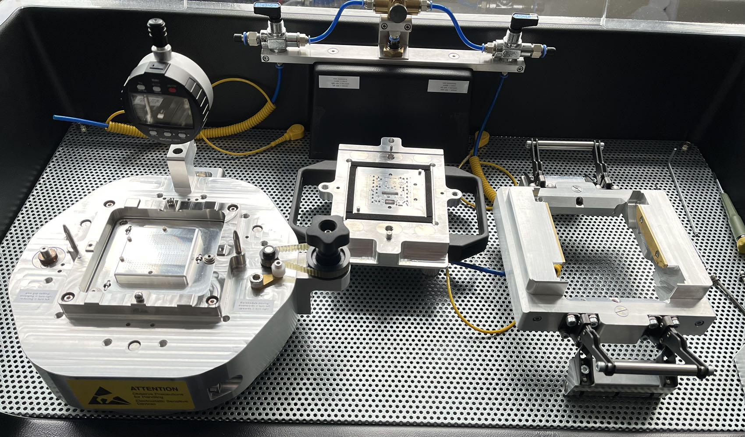
Overview
Bare Module metrology + IV
Module PCB to bare module attach
Cell Loading
(OB only)
Wire Bonding
Initial QC tests
Masking
Module PCB metrology
Parylene coating
De-masking
QC
Thermal Cycling
Module shipment to loading site
Bare Module
Quad Hybrid
Assembly
Testing

Slide 12
Quality Control
Bare to PCB Assembly
Wirebonding
Initial module characterisation
Parylene masking
Parylene coating
Parylene unmasking
Glue information
Optical inspection
Module metrology
Mass
Coplanarity
Wirebond information
Optical inspection
Wirebond pull test
ADC calibration
Basic scans
Sensor IV
Tuning
SLDO VI
Bump bond quality
Optical inspection
Parylene information
Optical inspection
Optical inspection
Coplanarity
Basic scans
Sensor IV
Bump bond quality
Reception if shipment between stages
Reception at loading site
Burn-in
Thermal cycling
Wirebond protection
Optical inspection
Basic scans
Sensor IV
Bump bond quality
Optical inspection
Coplanarity
Basic scans
Sensor IV
Tuning
SLDO VI
Bump bond quality
Thermal cycling information
Optical inspection
Coplanarity
Basic scans
Sensor IV
SLDO VI
Bump bond quality
Optical inspection
Roof envelope metrology (for OB quad modules)
Basic scans
Sensor IV
Bump bond quality
QC procedures well defined
Implemented in production data base and production diagrams
(includes strain relief)

Slide 13
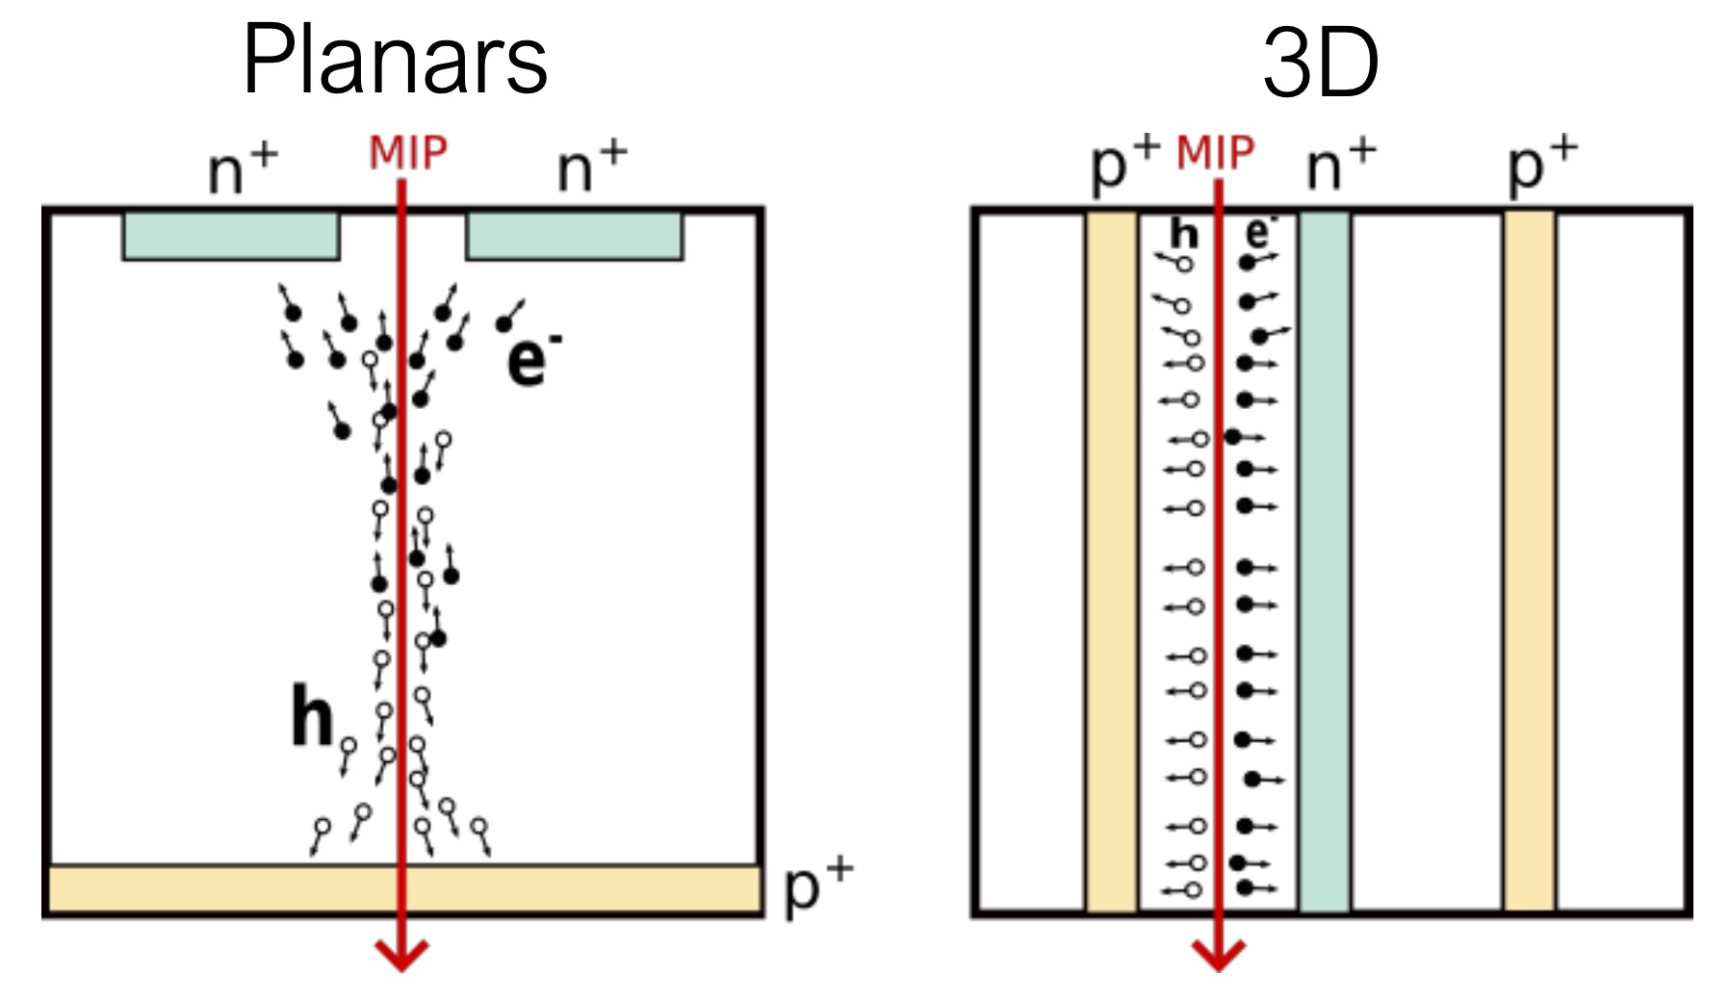
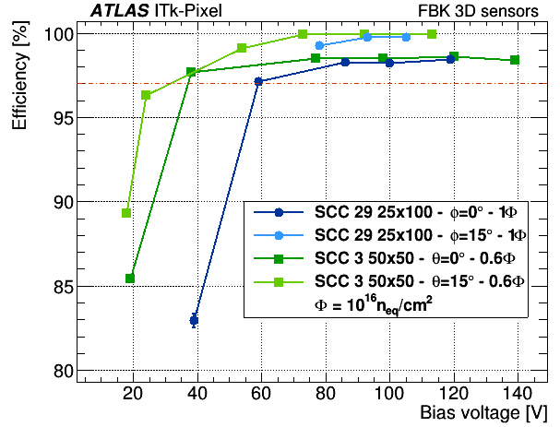
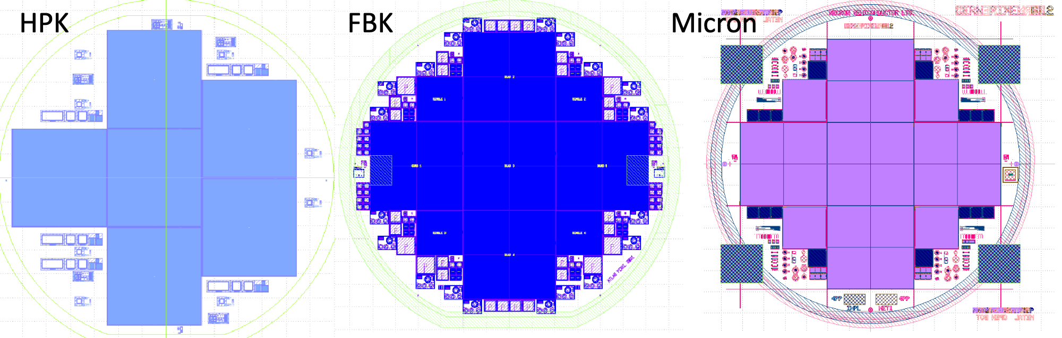
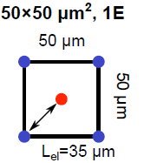
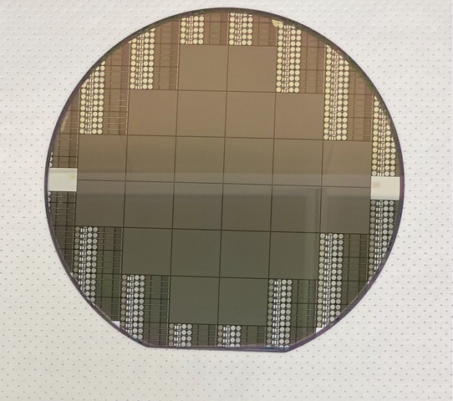
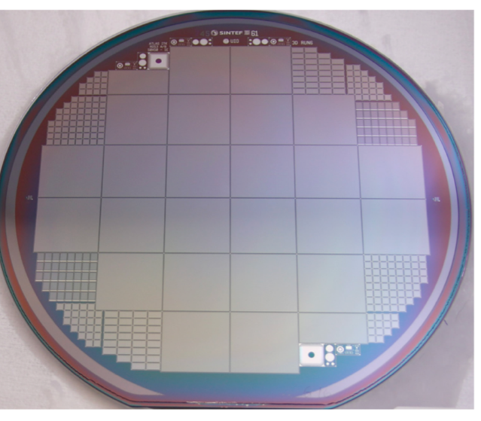
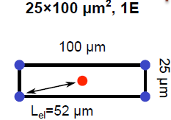
Sensors
Improve radiation hardness by:
  Using thin planar sensor 100+150μm thickness
  Use 3D sensors in inner layer
100 or 150 μm
50 μm
50 μm
Planar silicon
Irradiated 3D 25x100mm² & 50x50μm² module with ITkPixV1.1 readout irradiated to 1x10¹⁶n_{eq}cm⁻²
3D sensors
FBK
Sintef
Planar preproduction complete and 3D close to completion
Notes:
3D sensors
Masked pixels:FBK 25x100: ~10-2%
SINTEF: 0.7-1.6% (60 V)

Slide 14
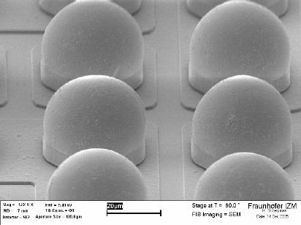
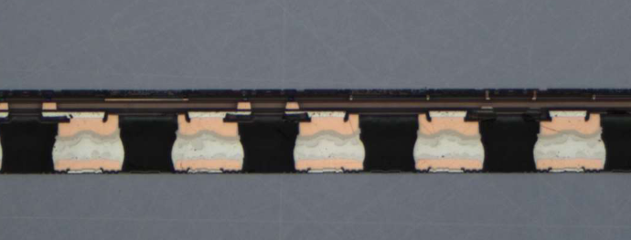
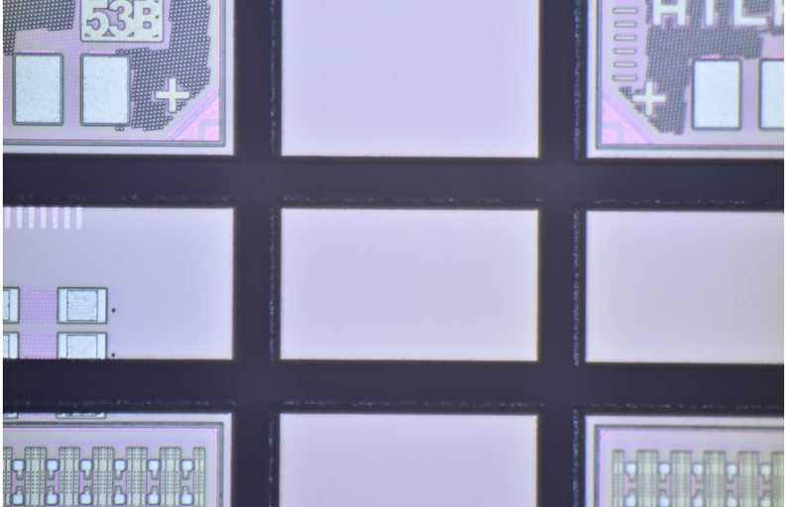
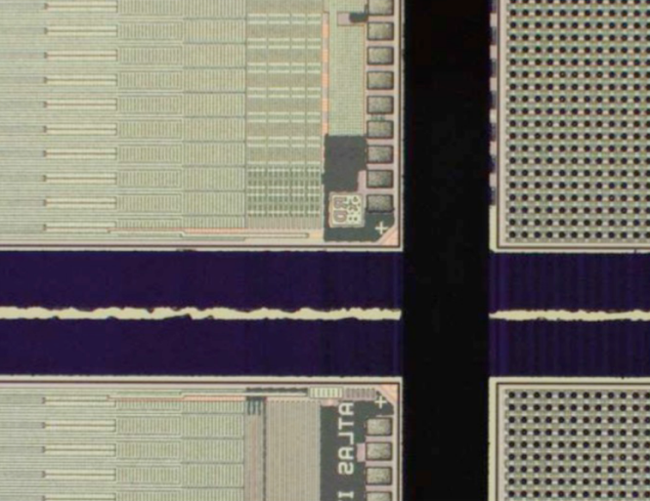
Hybridization
Number of modules requires 4 hybridization vendors to meet the needed capacity
Technical issues
  Dicing of FE-chips can lead to chipping and debris
  flip-chip of multiple FE-chips to a sensor has caused problems for some vendors
  Handling the bow of sensors during flip-chip
Currently, approximately 380 quad modules and 100 3D single modules delivered for technical evaluation and module pre-production
Cross-section of sensor & FE-chip connection
Solder bumps
laser pre-grooving and dicing
blade dicing
Notes:
10 Advacam+Micron100 prototypes at CERN, fast QC done
60 Advacam+Micron150 pre-production at CERN
20 HPK+HPK prototypes at KEK, fast QC done
56 HPK+HPK pre-production at KEK, fast QC ongoing
10 IZM+Sintef prototypes at Bonn, fast QC done
(20 IZM+FBK50x50 from special production alredy delivered and used)

Slide 15
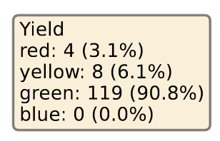
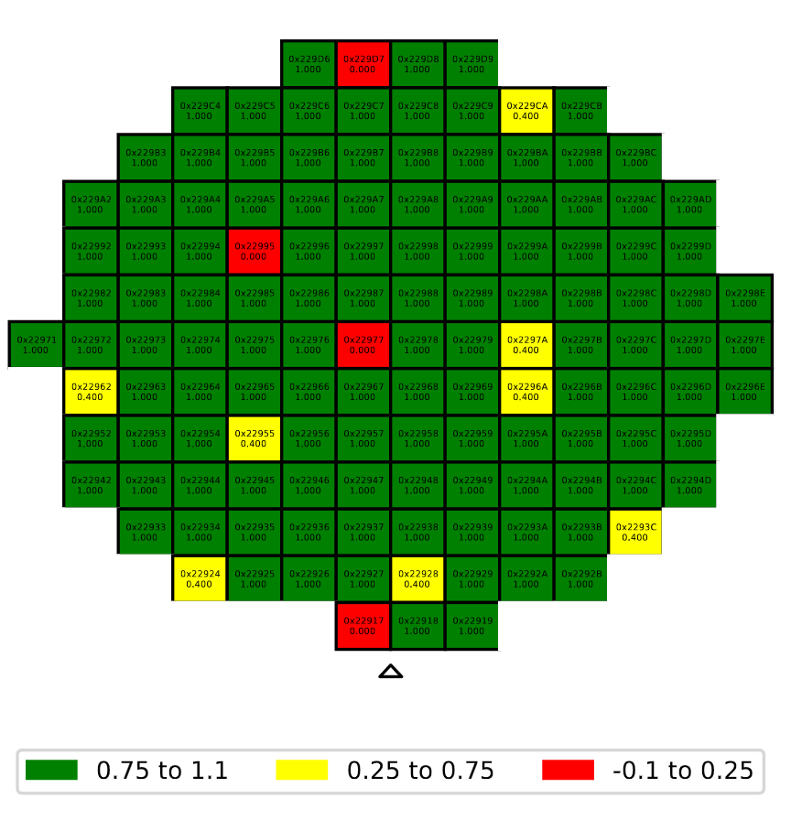
FE-chip: ITkPixV2
Wafer probing yield map
RD53 Collaboration: joint R&D for ATLAS and CMS ASIC in TSMC 65nm
Main features for ATLAS
  65nm technology, 152800 pixels per chip, 50x50 μm² pitch, total area 2x2cm²
  Tracking in dense environments
    Low threshold operation
    Cluster charge readout using Time over Threshold
  Radiation environment
    Sensor leakage current compensation
    SEE hardening
  1.28Gb/s data rates
    4 data links per chip at 1.28 Gb/s
    data compression
  Optimization of services
    Merging of chip data in module
    Integrated shuntLDO regulator for serial powering
Final chip ITkPixV2 submitted March 2023
  Wafer probing yield around 90% based on first 100 wafers
131 chips per wafer
Probing of full wafer takes about 24hrs
Yield map based on test of power, digital and analog functionality
Notes:
SEE hardening: full triplication with phase in EoC, partial triplication in pixel matrix – not enough space
Improved sLDO for serial powring – turn-on at low temperatures was not reliable – related to bandgap circuit.

Slide 16
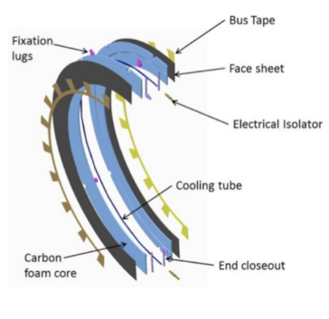
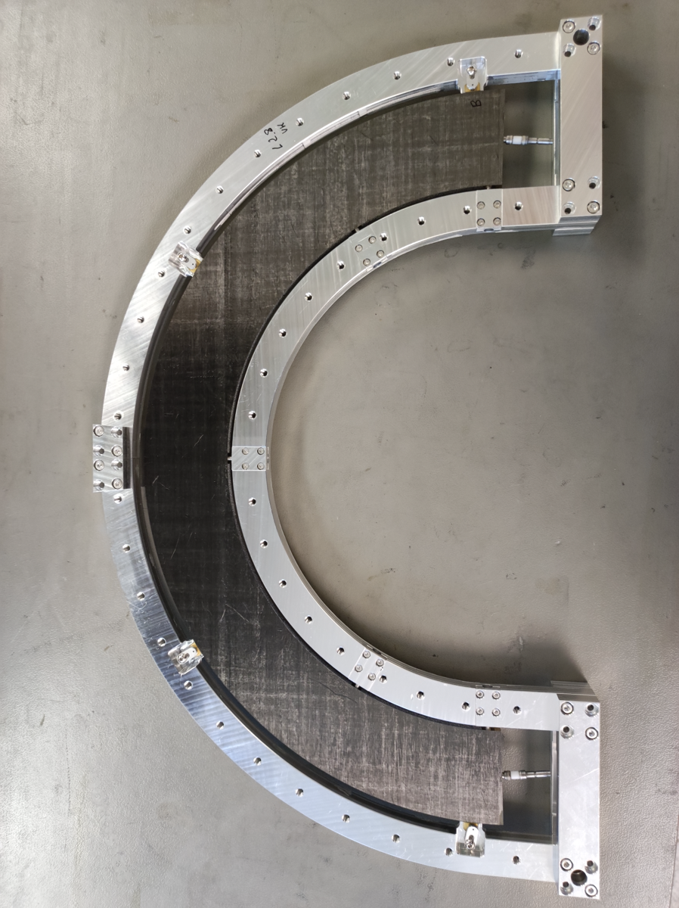
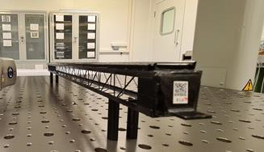
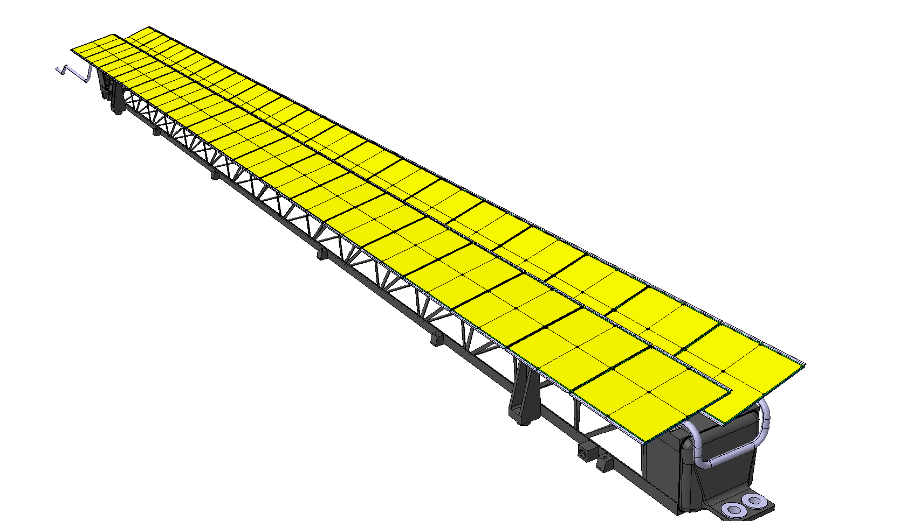
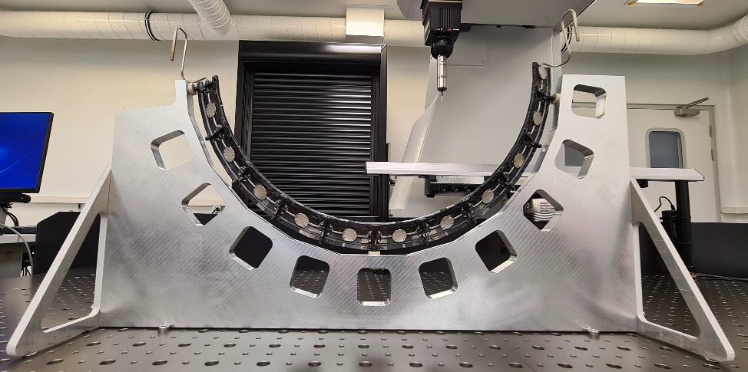
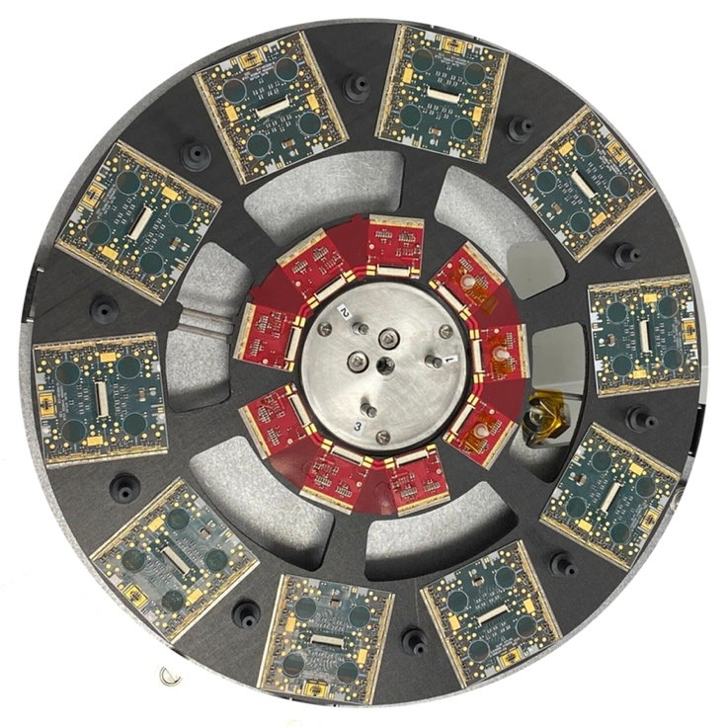
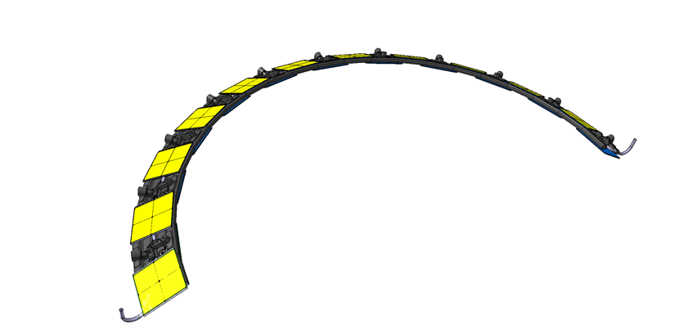
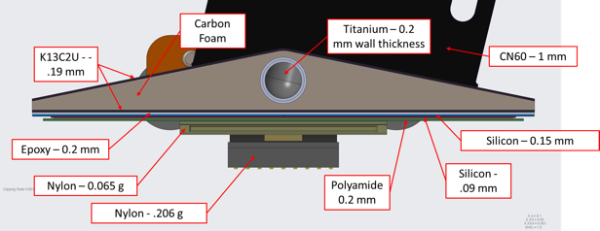
Local Supports
Local supports provide stable low-mass supports for modules and services
Critical element is interface between module and cooling pipes
Production of parts underway

Slide 17
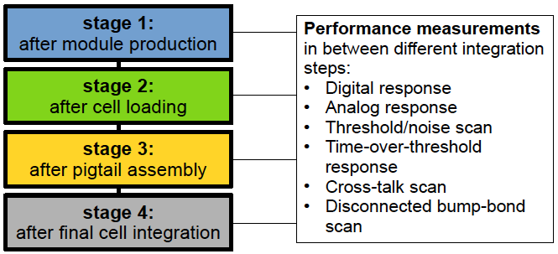
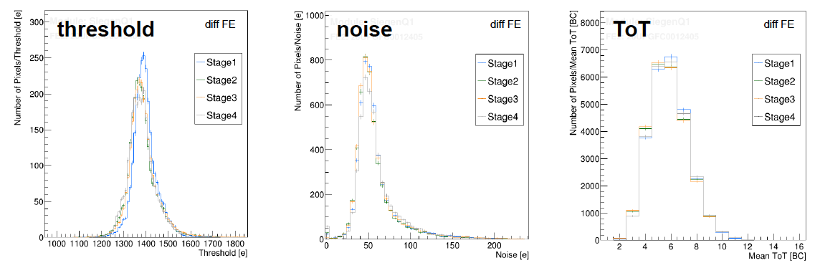
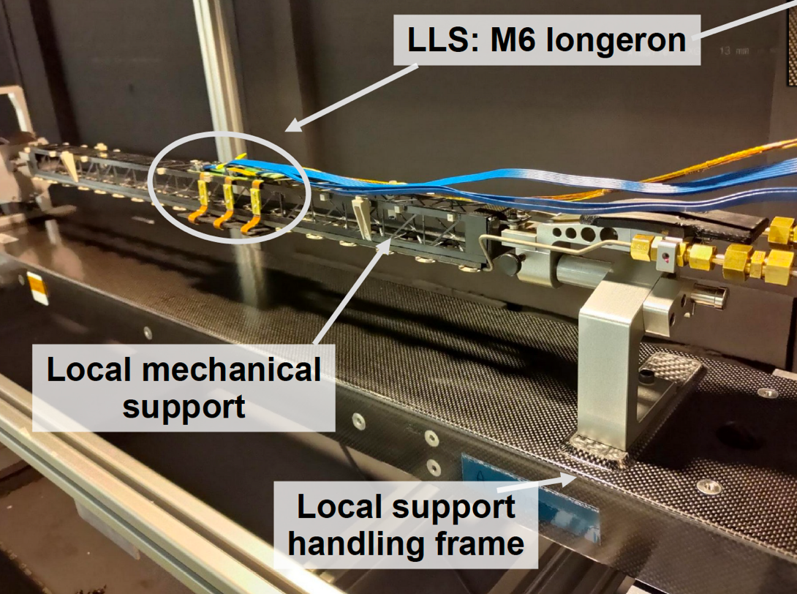
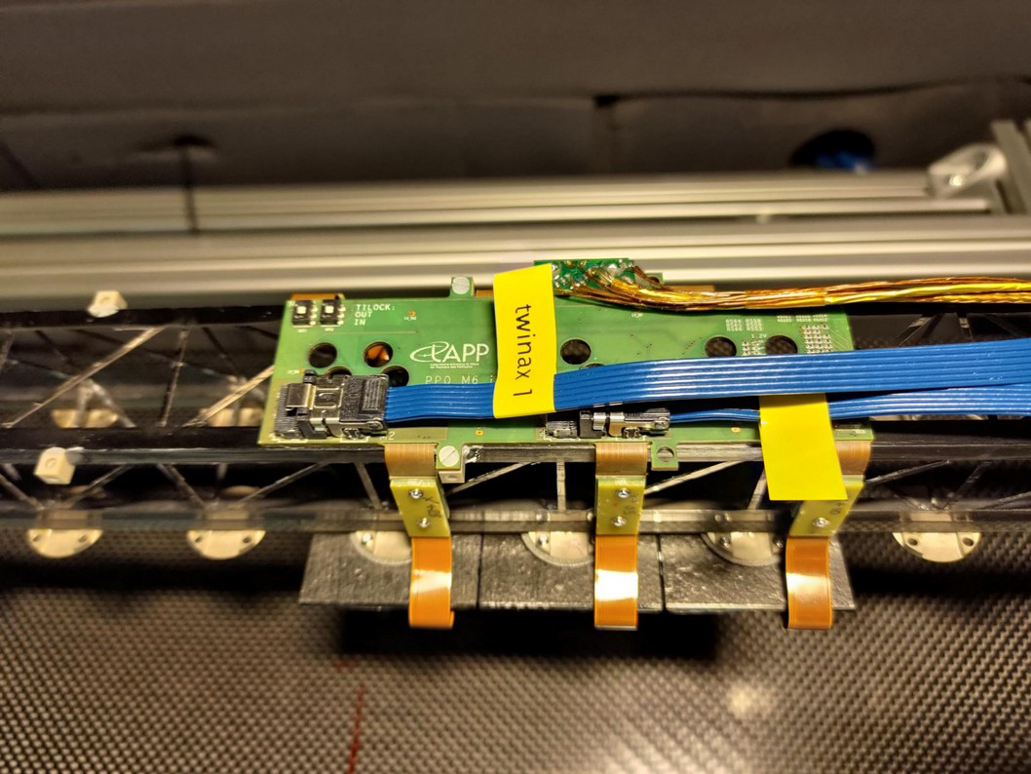
Loaded Local Supports and System test
Outer barrel module loading and system tests
  RD53 prototype modules loaded on to cells and thermally tested mounted onto local supoerts system test
  Performance of modules monitored through the loading process
  Work on system tests preproduction items in progress

Slide 18
Summary
The ATLAS ITk Pixel detector has been designed to operate in the challenging HL-LHC environment and maintain the performance of the current tracking system
  Increased radiation hardness
  Maintain pixel hit occupancy at 1% by increasing granularity
  Low mass achieved using carbon based mechanics, serial powering and data merging
The project is now in pre-production
  Large scale production brings a new set of problems as more sensitive to rare problems
Moving from development of individual items system level tests
  Loaded local support system tests are underway, excellent testbed for integration issues
Notes:
But now reality starts to bite
Scale-up productions to meet the challenging schedule
Services now have to be integrated onto the mechanics, the devil is in the detail
The interfaces are now critical

Slide 19
Thank you for your time

Slide 20
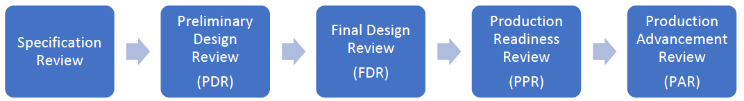
Status of the project
Completion
in 2027
Project Stages
Currently
R&D
Pre-production
Production
Tenders for major components complete and contracts in place for major components:
  Planar sensors
  3D sensors
  FE chips
  Module hybridisation
  Power supplies
Timeline
Not to scale!

