Slide 1
Testbeams

Slide 2
Testbeams
Why testbeams?
The key underlying issues of a testbeam
  Efficiency & Purity
  Error on the predicted position
Different facilities and their good and bad points
Experimental issues
Lecture block after this is on hit and track reconstruction, so will not go in detail into algorithms here.

Slide 3
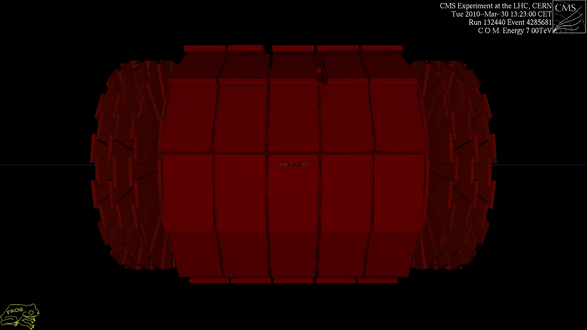
Let’s start at the end…

Slide 4
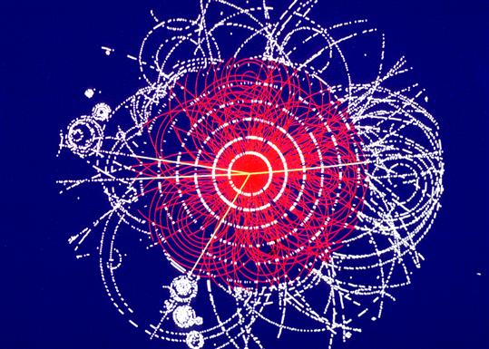
What did you see?
You see dots lighting up.
  Sometimes due to noise
  Sometimes due to traversing particles

Slide 5
What did you see?
You see dots lighting up.
  Sometimes due to noise
  Sometimes due to traversing particles
Then you connect the dots and you are doing particle physics….
Key question to ask
  Did the dot light up due to a particle or noise?
Secondary question
  How certain are you of the hit position?

Slide 6
Hit or noise?
Need to understand signal and noise
Many ways to test this
  Laser
  Radio-active sources
  Cosmics
  Test charges/pulses
All come with issues
  Was there actually a particle or input pulse?
  Where on the sensor?
  Are the input charges representative of actual particles?
It is all about efficiency and purity.

Slide 7
Efficiency & Purity
Efficiency
  If a particle traverses your detector, do you see it?
Purity
  If you see a hit, was it a particle?
Getting efficiency & purity right is VITAL for experiments.
  The job of a tracker is to reconstruct tracks.
  Only few layers available (~<10). Track has 3 parameters.
  Many tracks close to each other; large scope for confusion.

Slide 8
Tracking
Good efficiency and high purity means easy tracking.
Good efficiency and bad purity make tracking difficult.
Bad efficiency and good purity make tracking difficult.
Bad efficiency and bad purity make it impossible.
Do you notice that I can live with bad purity? This allows to use a low threshold and thus improve the efficiency. The track fit will clean things up.

Slide 9
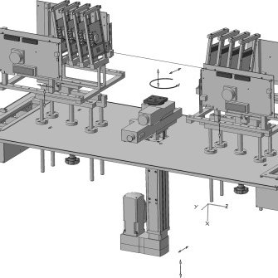
Why a testbeam program?
Measure efficiency & purity
Fire particles at the sensor under test
Reconstruct the incoming particle position with other detectors (a telescope).
Ultimate test of a sensor system
  Puts down a clear marker that the system works!
  Know where particle hits the sensor
  “Only” way to measure efficiency & purity

Slide 10
Main aims of a testbeam
Measure key parameters of sensors
  Efficiency & Purity
  Signal to noise ratio
  Position resolution
    Optimize position reconstruction algorithms
  Cluster sizes
  Charge sharing
  In-pixel variations
  …
And debug DAQ systems
  Some groups even built their entire detector by testing all modules in the beam test

Slide 11
Efficiency and purity
particle?
Efficiency and purity are the MOST important parameters for a detector.
  Efficiency: if a particle goes through a detector, does the detector record it?
  Purity: if a detector records a particle, was it actually a particle?
Which arrow points at a particle?
  How can you tell?
You cannot! It is a statistical thing: you can evaluate the probability.
signal
time

Slide 12
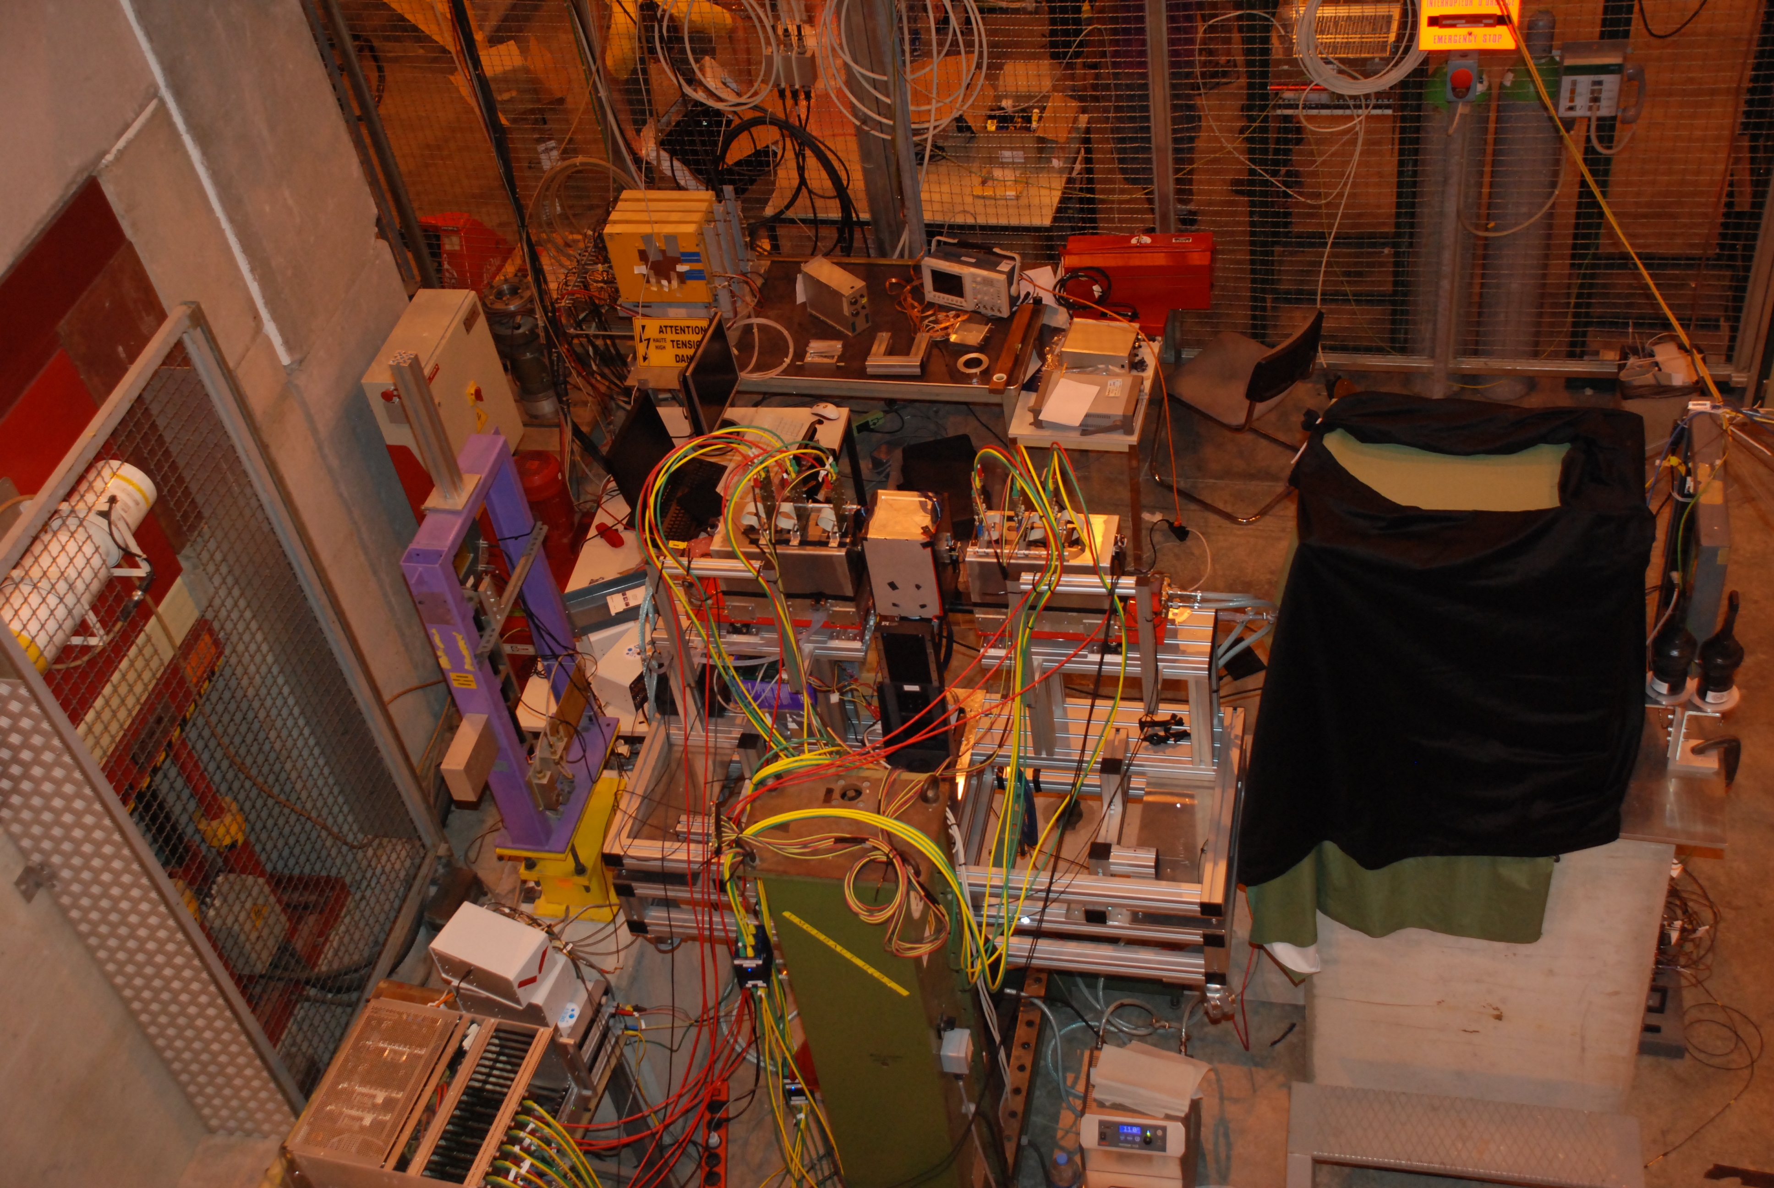
An example: FORTIS
We fire particles and measure where they go.
    pion beam

Slide 13
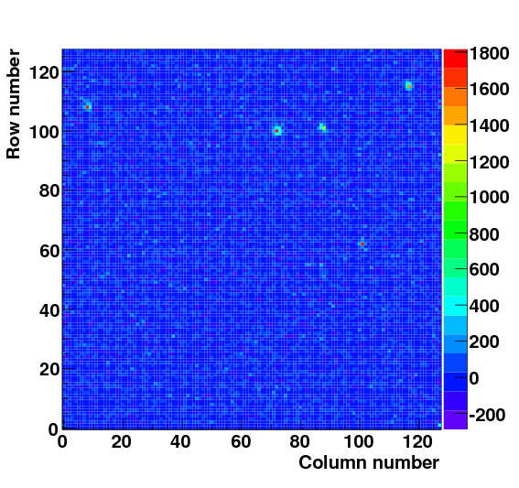
An example: FORTIS
Here you see an event
Do you think we see hits?
And what about those?

Slide 14
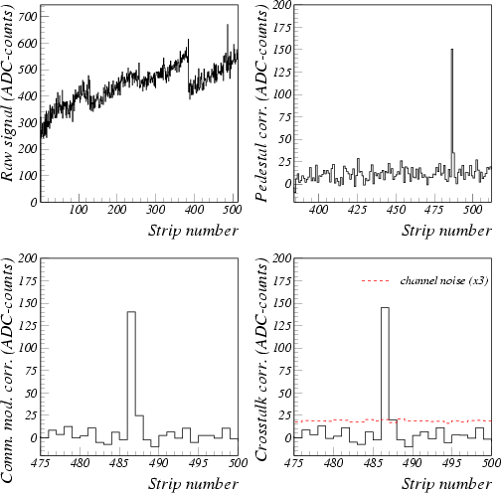
Raw data reconstruction
event i
channel k
Every channel has own offset (pedestal) and gain.
Due to fluctuations in ground voltage, all channels show common behaviour in each event (common mode)
Each channel own random noise
Some channels carry signal

Slide 15
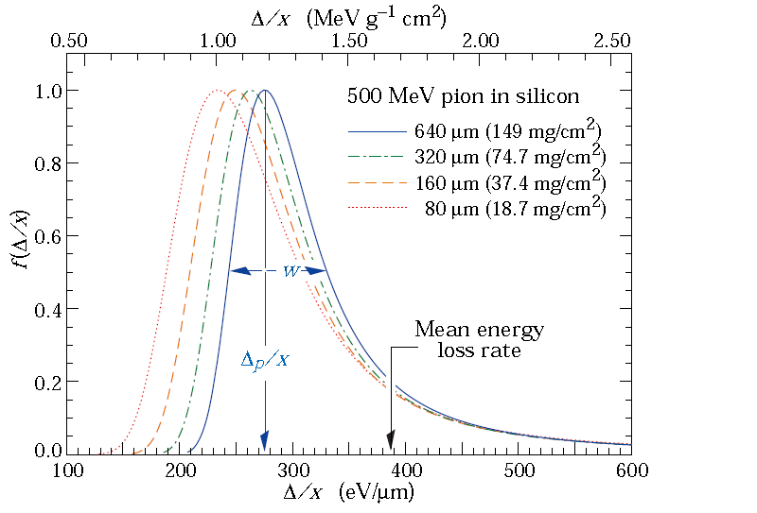
Cluster language
The signal from a minimum ionizing particle follows a Landau distribution.
  Gaussian with a tail to the right.
The signal is shared between neighboring strips (or pixels) and some gets lost.
  Seed strip (pixel) is the signal with the highest signal.
  Neighbors are all other pixels that are part of the cluster.

Slide 16
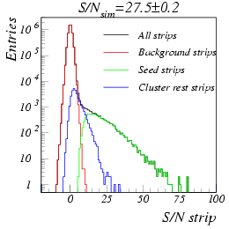
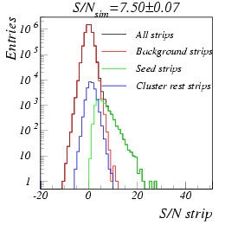
Signal or noise?
Hits are selected based on either signal or signal/noise.
Need to set a threshold. E.g. S/N_{seed} > 5noise.
Defines how many real hits and how many fakes are found.

Slide 17
Signal or noise?
Hit selection cut defines how many real hits and how many fakes are found.
For dotted line
  hardly any fake hits left, so excellent purity, but missing lots of real seeds, so bad efficiency.
For solid line
  Lots of fake hits left, so bad purity, but found almost all real seeds so excellent efficiency.

Slide 18
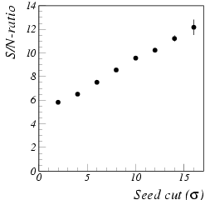
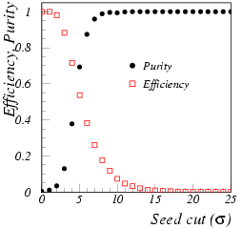
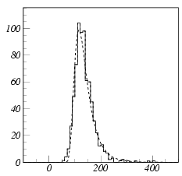
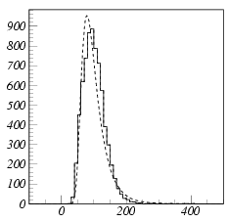
Signal or noise?
Seed cut is compromise between efficiency and purity.
It also affects measured properties like S/N and position resolution!
  Can fabricate excellent performance by selecting a bad seed cut.
Cut=10σ
S/N=10
Cut=4σ
S/N=6

Slide 19
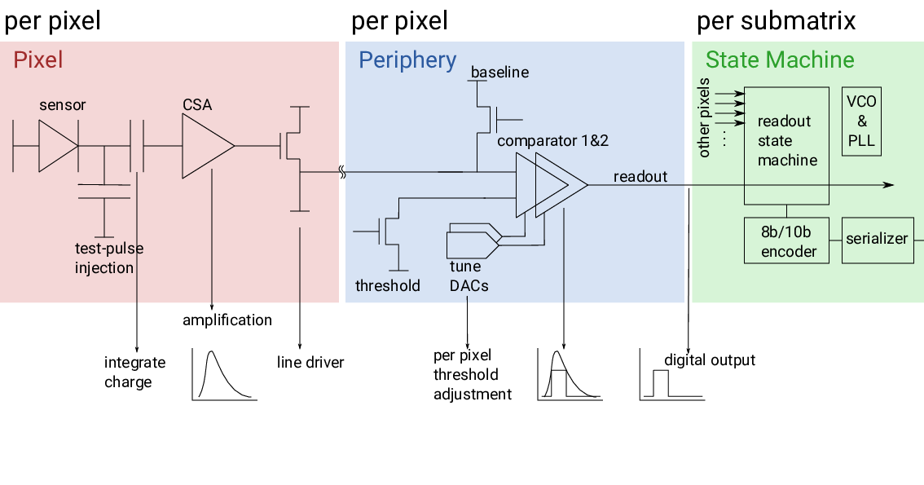
Binary or ToT sensors
Binary or ToT sensors
  have a similar frontend
  signal components the same but only read out if a hit is registered
    every pixel has a discriminator that needs to be tuned

Slide 20
Binary or ToT sensors
The threshold is fixed but there is a channel by channel offset.
  This needs to be tuned, similar to seed cut.
Tuning
  Insert fixed number of test pulses and change amplitude of the pulses.
  Count how many over threshold.
  Repeat for different offset
The counting integrates the noise.

Slide 21
Binary or ToT sensors
Integrated random noise gives an error function.
  Fit to extract the noise
Now decide your operating point
  What efficiency do you want for what input signal?
  Same principle as the offline seed cut, you just cannot directly see it.

Slide 22
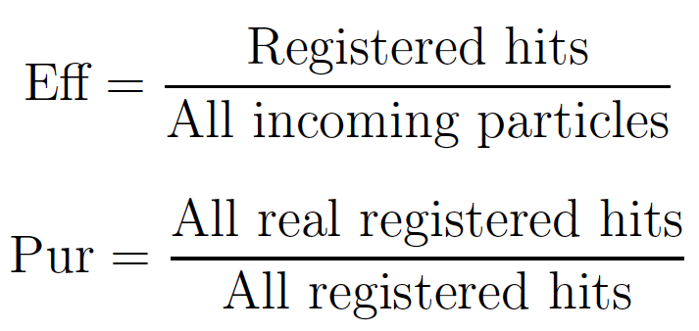
Measuring Efficiency & Purity
Key issue: need to define what is a good hit
  Track needs to point at it
  Need to define what a good track is and how close the match needs to be.
    Will get back to that.
Efficiency without Purity is useless

Slide 23
Track reconstruction
Telescope consists of reference detectors.
  Can be the same or different detectors.
Hits are reconstructed in all planes and tracks are reconstructed. The track is extrapolated on to the device under test.
  It is key to accurately predict the track position.

Slide 24
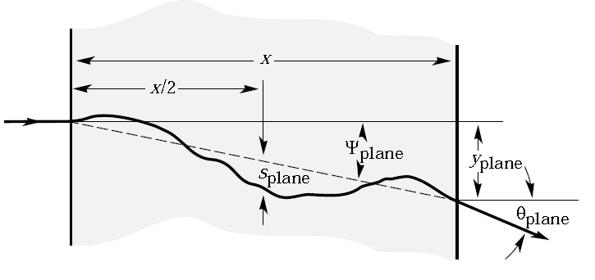
Multiple scattering
When a charged particle enters
a material, it encounters the electric
fields of the electrons and nuclei.
In the Coulomb interactions it
loses energy and changes direction.
The particle exits under an angle 𝜃. The spectrum is almost Gaussian
Where X₀ radiation length is the mean distance over which a high-energy electron loses all but 1/e of its energy by bremsstrahlung.
Note that:
  most particles go straight on
  want high momentum beam
  thin detectors

Slide 25
Multiple scattering
We always assume that the particle went on a straight line.
That is not true!
  Particle undergoes multiple scattering.
  The hit positions are also reconstructed imperfectly.
You see that the reconstructed position is wrong.
There is an uncertainty on the predicted position.

Slide 26
Error on the predicted position
The error on the predicted position is the difference between the red line and the purple one.
It depends on the
  position of the Device Under Test (DUT)
  position resolution telescope modules
  energy of the particles
  thickness of the detectors

Slide 27
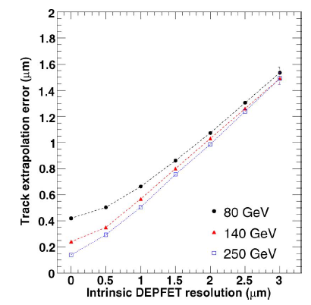
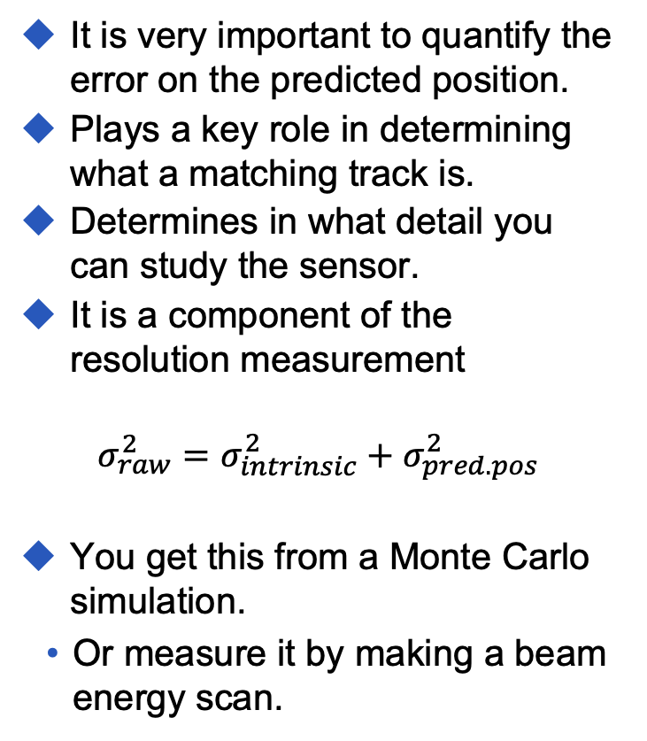
Error on the predicted position
It is very important to quantify the error on the predicted position.
Plays a key role in determining what a matching track is.
Determines in what detail you can study the sensor.
It is a component of the resolution measurement
$$σ_{raw}^{2}=σ_{intrinsic}^{2}+σ_{pred. pos}^{2}$$
You get this from a Monte Carlo simulation.
  Or measure it by making a beam energy scan.

Slide 28
Error on the predicted position
Telescope’s key role is to provide precise tracking.
Ideal spacing depends on beam energy, hit precision, spacing and detector material.
  Extrapolation relies on the position of multiple detectors and thus improves further away from one detector plane.
  Multiple scattering gives a random deviation of a straight line, therefore gets worse in between two telescope planes.
Multiple scattering
Precision
Extrapolation
Distance between sensors

Slide 29
Error on the predicted position
Simple MC for our CEPC testbeam at DESY
  500 micron thick detectors, 17 micron resolution for telescope planes.
  2.5cm between planes, DUT not in fit, 5cm DUT spacing.
  6 GeV electrons give 10.6 micron precision on DUT.
  High energy limit 6.0 micron

Slide 30
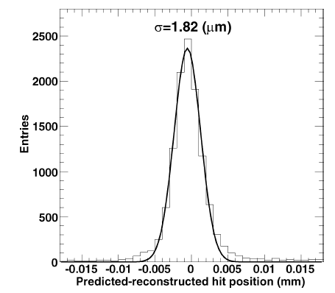
Good tracks and matching hits
A good track is defined by a 𝜒²-cut. Can include a time as well as spatial coordinates.
  Not strictly correct. We do not know the error on the hit position and residual distribution is non-Gaussian
    Will get back to that.
The 𝜒²-cut is arbitrary. You pick it. It mainly affects your spatial resolution and efficiency & purity results.
  Some of the outliers are due to “weird” tracks. Can cut them out, but is it fair?
  If you make the 𝜒²-cut extremely tight, you also exclude events where a big scatter happened in the DUT. These typically have worse resolution.

Slide 31
Problematic cases
Here there was a big scatter on the track, but 𝜒²-cut would leave the track in.
  If you cut it, your efficiency drops and your purity gets worse.
  If you keep it, your position resolution gets worse.

Slide 32
Problematic cases
Here there was a big scatter in the DUT, 𝜒²-cut would cut it.
  If it scatters, the path gets longer so signal increases.
  If you cut it, your S/N drops

Slide 33
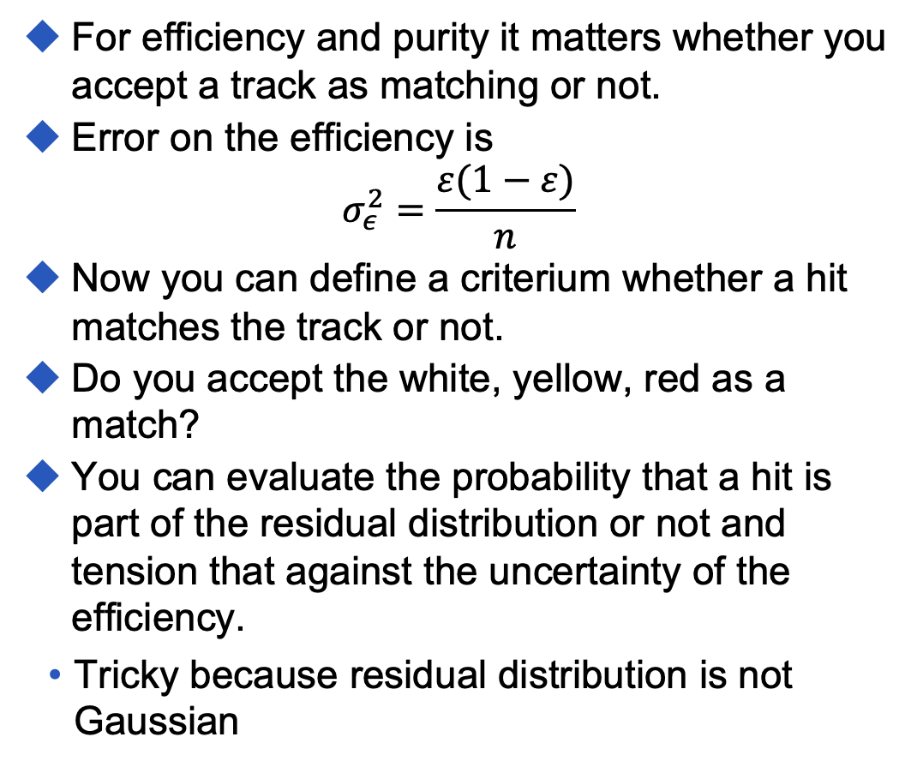
Good tracks and matching hits
For efficiency and purity it matters whether you accept a track as matching or not.
Error on the efficiency is
$$σ_{ε}^{2}=\frac{ε(1−ε)}{n}$$
Now you can define a criterium whether a hit matches the track or not.
Do you accept the white, yellow, red as a match?
You can evaluate the probability that a hit is part of the residual distribution or not and tension that against the uncertainty of the efficiency.
  Tricky because residual distribution is not Gaussian

Slide 34
Position reconstruction
The most reported parameter is the position resolution
Many algorithms exist
  Binary
    Pick largest signal
  Digital
    Use 1 threshold, average positions
  Centre-of-Gravity
  η-algorithm
  HT-algorithm (angled tracks)
  …
Will not go in details here. That’s for the next block.

Slide 35
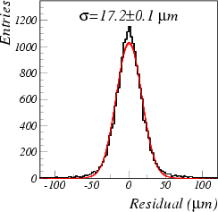
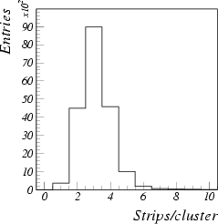
Centre-of-Gravity
CoG is most often used algorithm
Expected resolution
Note: σ∝(S/N)⁻¹
Centre-of-Gravity assumes linear charge sharing
  Resolution gets bad due to large clusters with non-linear charge sharing
  The weight for the strips at the end of the cluster, who have the lowest S/N, is very high.

Slide 36
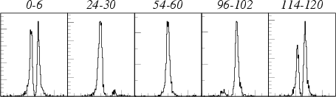
Position resolution depends on hit position
The non-linear charge sharing leads to different position resolutions at different positions between strips or in-pixel.
If you hit in the middle between the readout strips, the charge is evenly shared between the strips.
  x₂≈x₃ and x₁ and x₄ are small
  x₂<x₃ and x₁ and x₄ are small and x₅ comes in play
  x₃ is large and x₂≈x₄ and x₁ is small
For the resolution add up all distributions. Not a proper Gaussian.
x₁%
x₂%
x₃%
x₄%
x₅%

Slide 37
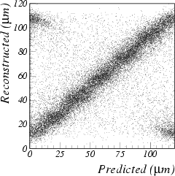
Position resolution depends on hit position
Here you see a scatter plot of the predicted and the reconstructed position for a strip detector.
You notice that the charge sharing is not linear.
This yields different resolution between the strips.
Therefore, we cannot calculate the actual 𝜒² of the track until we know where it has hit the sensors.

Slide 38
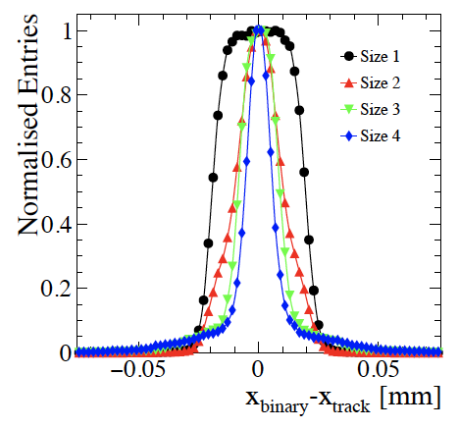
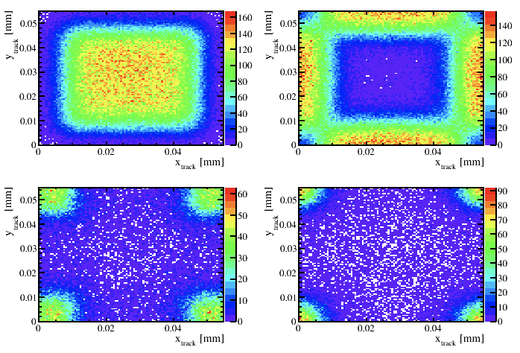
Position resolution depends on hit position
Charge sharing in the TimePix3.
Large pixels wrt charge cloud.
  Huge area of single pixel clusters
  Along the edges 2 pixel clusters
  In the corners 3 and 4 pixel clusters
For each area expect a resolution of the area/√12
1
2
3
4

Slide 39
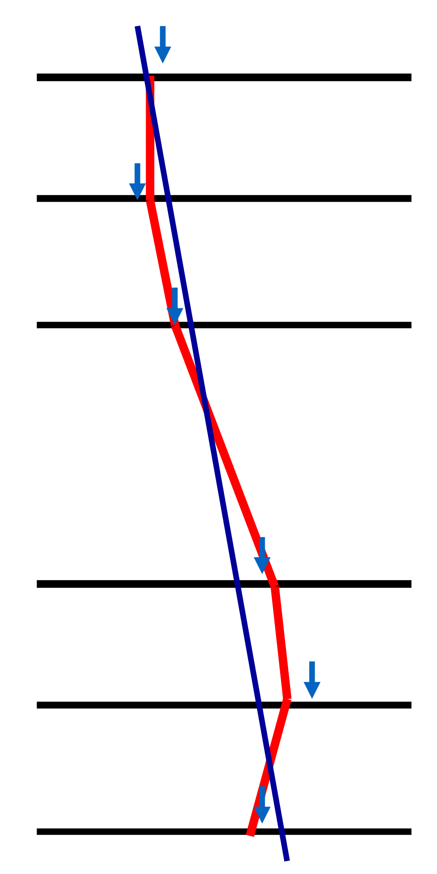
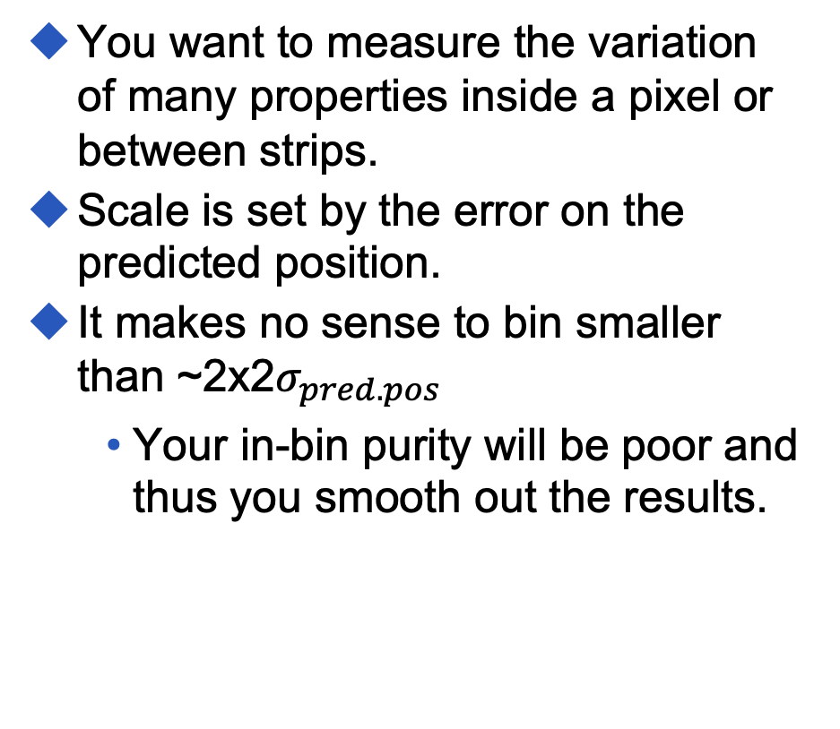
In-pixel variations
You want to measure the variation of many properties inside a pixel or between strips.
Scale is set by the error on the predicted position.
It makes no sense to bin smaller than ~2x2$σ_{pred.pos}$
    Your in-bin purity will be poor and thus you smooth out the results.

Slide 40
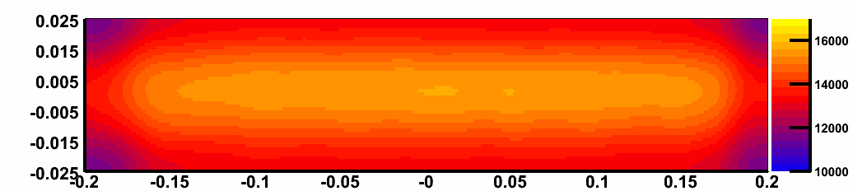
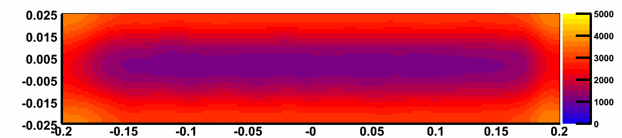
Charge division
Example of an in-pixel study of the collected signal in a diamond detector coupled to an ATLAS FE-I3
Seed signal (e⁻)
E=1 V/µm
Y (mm)
Preliminary
X (mm)
Sum neighbour signals (e⁻)
Y (mm)
Preliminary
X (mm)

Slide 41
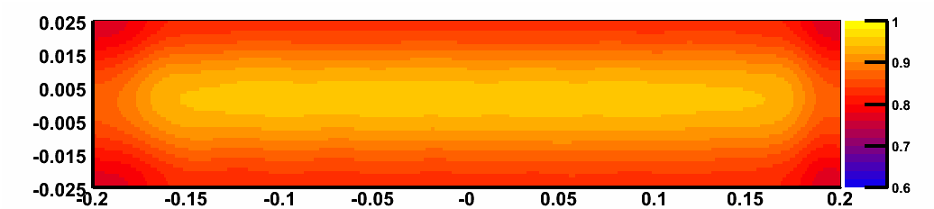
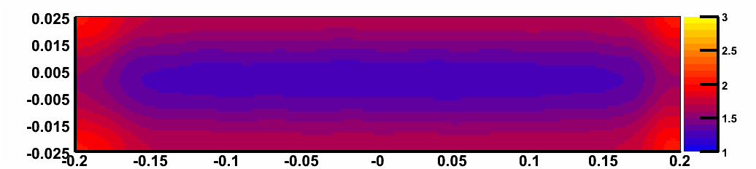
Charge division
Example of an in-pixel study of the collected signal in a diamond detector coupled to an ATLAS FE-I3
S_{seed} ⁄ ∑S_{cluster}
Y (mm)
Preliminary
Cluster size
X (mm)
Y (mm)
Preliminary
X (mm)

Slide 42
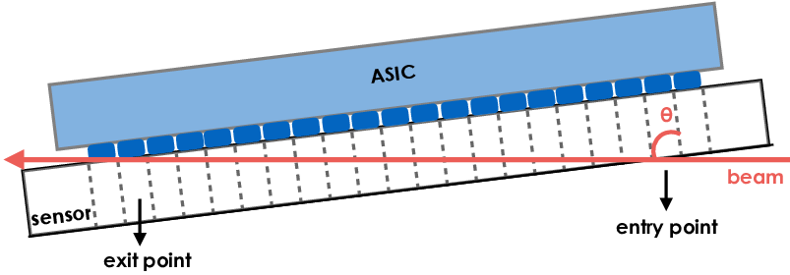
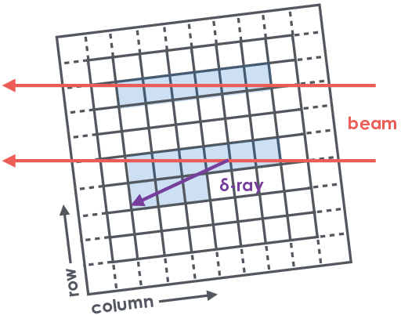
Telescope free testbeam: grazing angle
Most testbeams are using perpendicular beams.
Here they use a grazing angle, i.e. almost parallel to the sensor.
  gives long tracks in the detector.
Now you can use your own detector as a telescope and DUT at the same time.

Slide 43
Telescope free testbeam: grazing angle
For unirradiated sensors all depths contribute the same amount until depletion depths.
  carrier lifetime >> collection time
Can see this using grazing angle method.
  Expect 3.8ke MPV per pixel at this angle.
Signal drops really quick at depletion edge.
  Charge is collected due to generated charge diffusing into depleted area.
  (In this analysis will always measure at least 1500e)

Slide 44
Telescope free testbeam: grazing angle
It also allows to study from how deep in the sensor your charge is collected.
Here you see a partially depleted detector.
  If the bias voltage is not high enough parts of the sensor do not contribute to the signal.

Slide 45
Telescope free testbeam: grazing angle
It also allows to study from how deep in the sensor your charge is collected.
Here you see a partially depleted detector.
  If the bias voltage is not high enough parts of the sensor do not contribute to the signal.
  This gets worse with radiation.

Slide 46
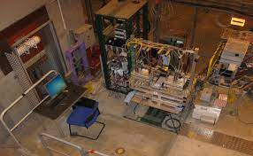
Test beam facilities
There are many places where you can go for a test beam.
  CERN
    SPS
    PS
  Fermilab
  DESY

Slide 47
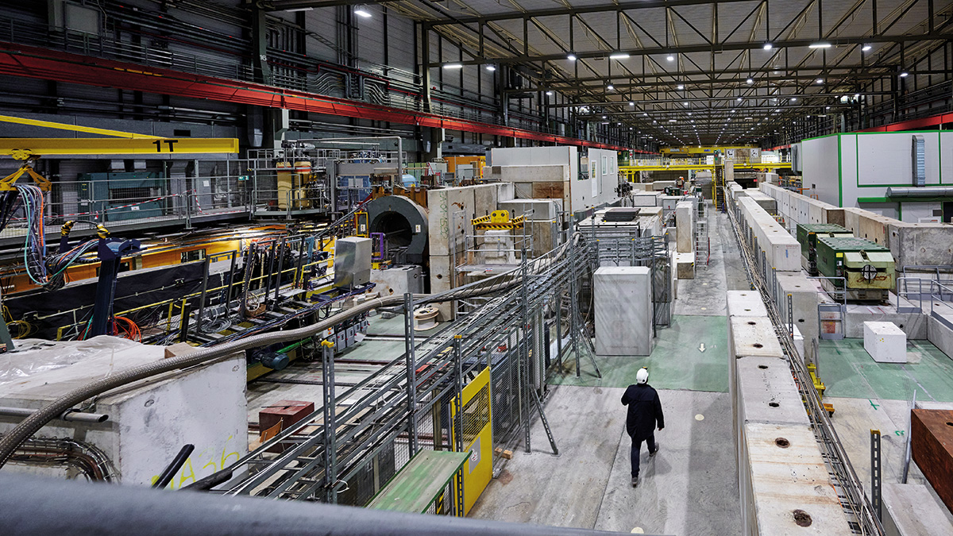
CERN-SPS
Best place for testbeams
Can get protons and pions
Highest energy available
  20-400 GeV protons/pions
  minimizes multiple scattering
Beam specs
  spill duration approx. 5 seconds
  usually every 14s
  2×10⁸ per spill

Slide 48
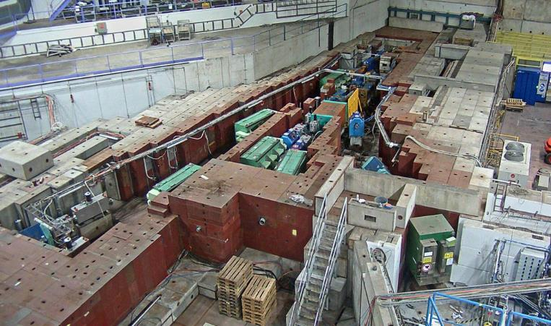
CERN-PS
15 GeV protons
  2×10⁸ per spill
  1 spill every 33.6 s

Slide 49
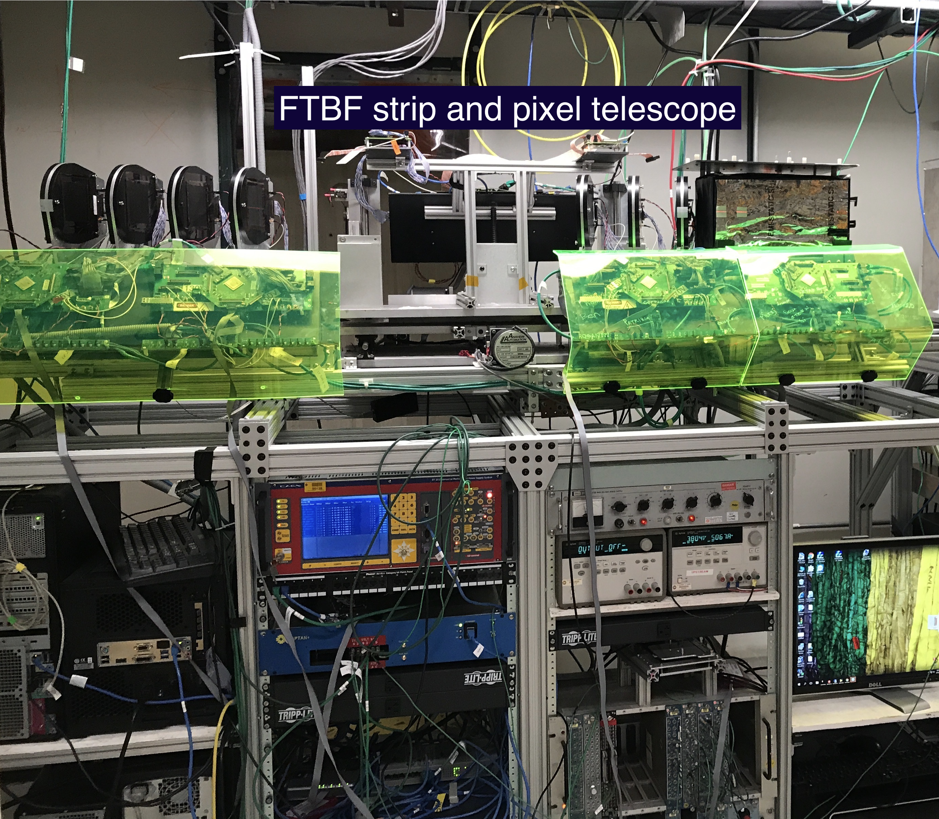
Fermilab
120 GeV protons
one 4.2 s spill per minute with about 100,000 protons.
The beam is bunched at 53MHz, so lots of particles close together in time.
Comes with telescope
  four 100×150μm² pixel layers and fourteen strip modules with 60μm pitch
nominal resolution of 10–15μm

Slide 50
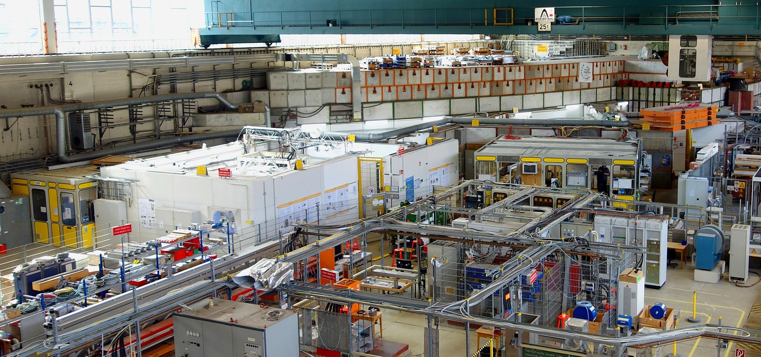
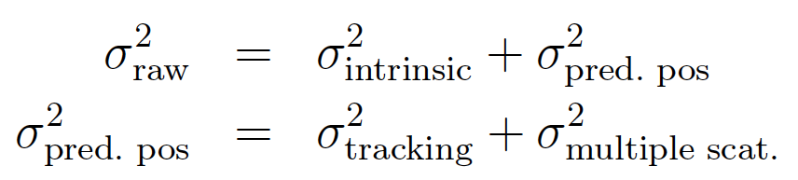
DESY
1-6 GeV electrons
comes with telescope
low momentum bad for multiple scattering.
can extract the position resolution from energy scan.
Plot resolution vs (1/p)². Gives straight line.
Error on predicted position ~2μm for naked telescope.

Slide 51
The ugly truth…
Testbeams are very simple but there are many issues.
Need to reconstruct the track that goes with your hit
  Need to look at all detectors
  at the same time and have
  them all lined up.
  Not easy!
Most need a trigger.
  usually provided by coincidence of scintillators

Slide 52
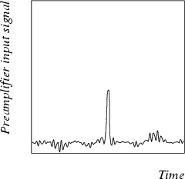
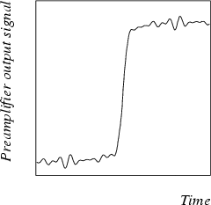
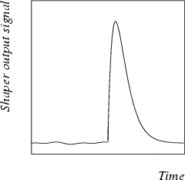
“Triggered” systems
Detector signal
Older systems have a preamp, shaper and sample and hold circuit.
  Still in common use.
Every clock the output of the shaper is stored in a pipeline.
When a trigger occurs, one of the pipeline columns is marked for read out.
  You need to set the correct delay to sample the correct pipeline column.
    Can do this partly in the lab, but the correct delay depends on the DAQ system.
Data combination is easy as long as the detector is not integrating
After preamp
After shaping

Slide 53
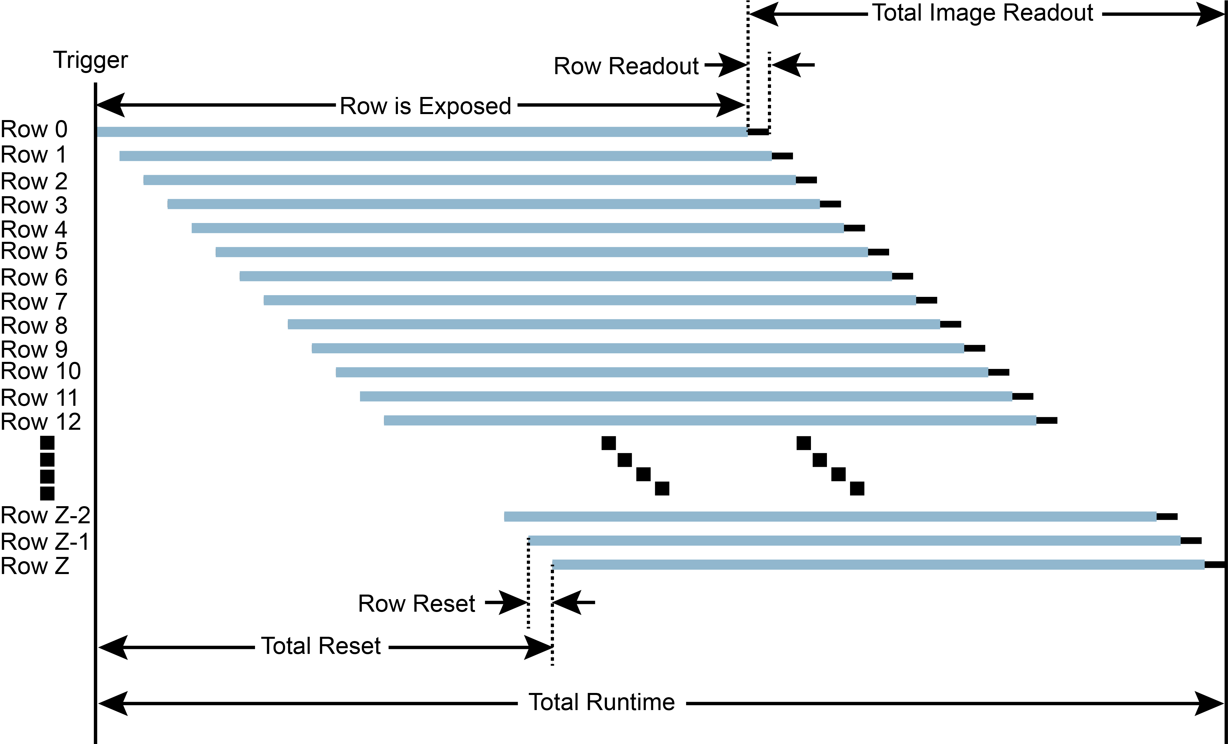
Rolling shutter readout
Many monolithic active pixel sensors are traditionally read out in rolling shutter mode.
  Row 1 is read out, reset and
  starts integrating.
  Row 2 is read out, reset and
  starts integrating.
  Row 3 is read out, reset and
  starts integrating.
For each row the integration
start and stop time are different.
The trigger signal is used as
a tagger. From the trigger time, you know what row is read out. Need to store 2 frames to be guaranteed to reconstruct the hit.

Slide 54
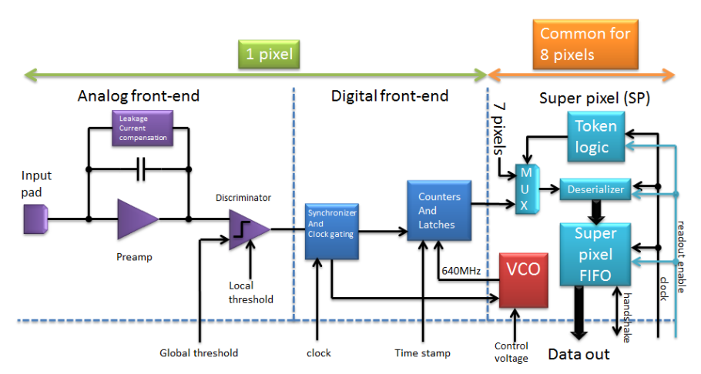
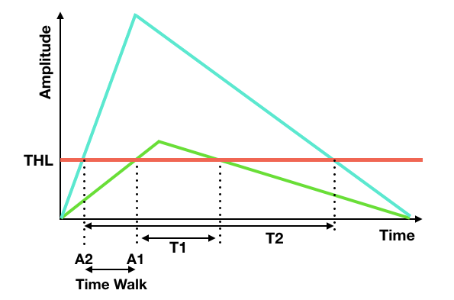
Data-driven read out
Some chips have a data driven mode (asynchronous).
Each pixel has its threshold. When the shaped signal exceeds the threshold, a hit is registered.
  Output contains:
    Pixel address
    Time stamp for passing threshold
    Time over threshold
“Simple” to combine data if you have synchronicity signal.
  In practice, problematic because you need to read a large chunk of data and try to find same time stamps

Slide 55
Using multiple types of sensors
Need to think how to make a failsafe system to combine the data.
Difficult
  Can block the trigger using BUSY logic for triggered systems.
  Integrating devices will still see all the hits though.
  How to match data? Time stamps? Trigger counting?
  How to keep the clocks synchronous?
  Time walk in data driven systems.
No real solutions
  special synchronization signals
  short runs
  limit the beam rate

Slide 56
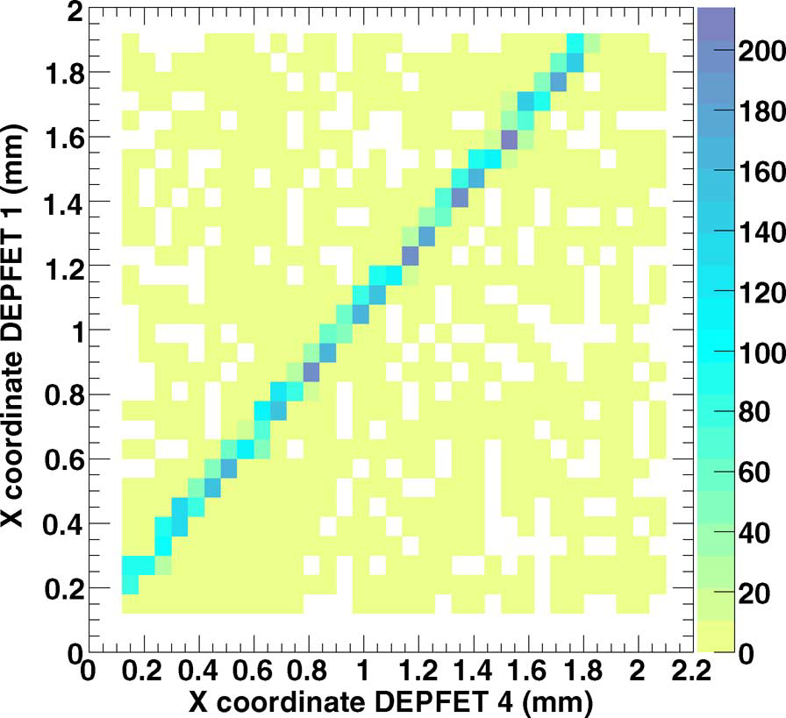
Alignment
Can fix small alignment issues offline.
Online you might be firing the beam (partly) next to the DUT.
  Needs online analysis!
  Can look at hit correlations and shadow plots.
  Can use additional scintillators

Slide 57
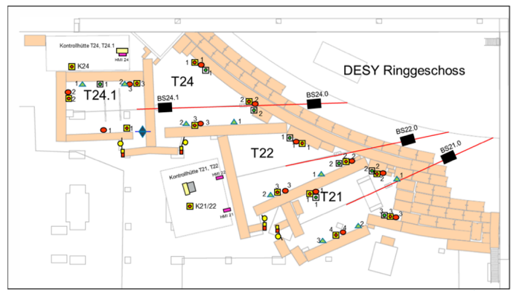
Other things to think about
Data quality monitoring essential

Slide 58
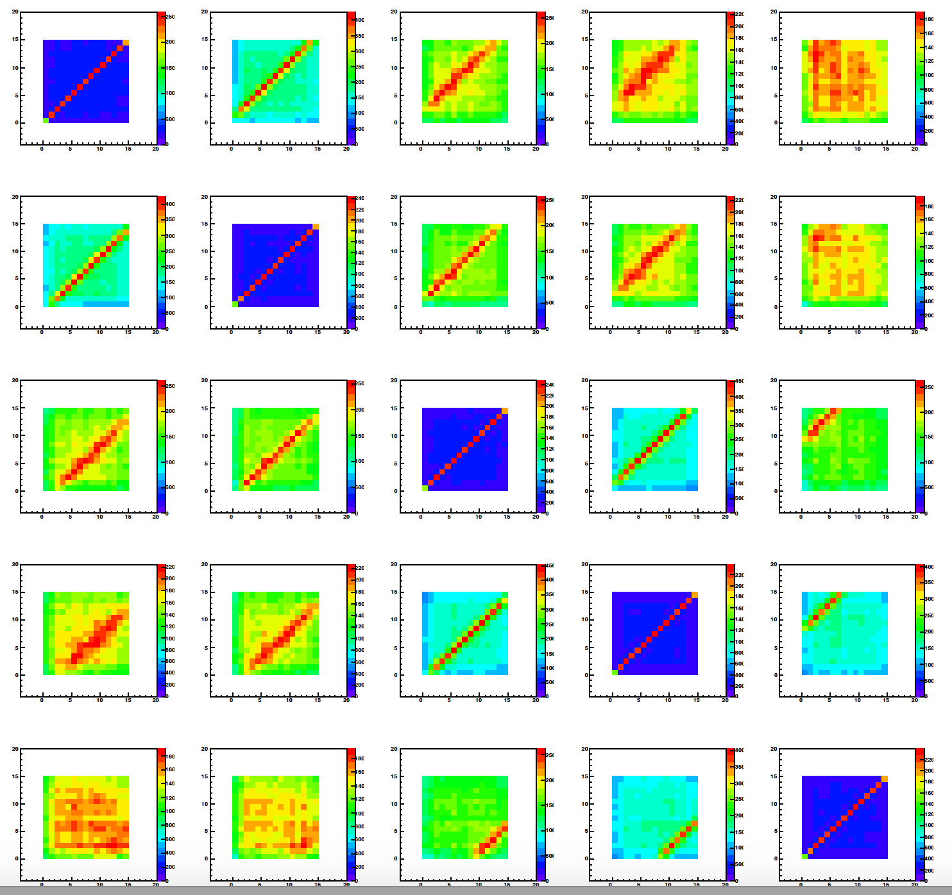
Data quality monitoring
Make a quick version of the analysis.
Use simple hit finder.
Exploit all hit maps and correlations
This HAS to look okay if you want to be successful.

Slide 59
Other things to think about
Data quality monitoring essential
Pretest detectors and software
Data handling
  bring enough disks
Bring enough computers and cables
  got a control hut and a beam area
Have a good test beam team
  good leaders and good followers
  good plan catering for various scenarios
Power plugs
Transport of people and equipment
Safety courses, inspections and health certificates

Slide 60
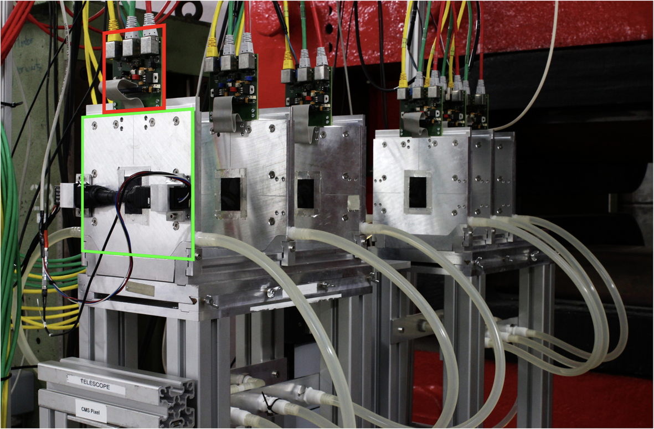
Standard telescope or bring your own
At DESY, you get the EUDET telescope.
  6 MIMOSA26 MAPS with 18.4 μm×18.4 μm pitch and total area 21.2 ×10.6 mm². Each 50 μm thick
  Trigger Logic Unit (TLU) providing trigger logic, time stamp and a data acquisition system.
  σ_{M26} = (3.24 ± 0.09) μm.
Error on predicted position is (1.83±0.03)μm
Disadvantage
  Need to integrate your sensor with DAQ AND online software.
Advantages
  Most of the work done for you
  Only need 1 sensor

Slide 61

Standard telescope or bring your own
Our ATLASPIx3 telescope.
Advantages
  Same DAQ system and software as in our labs when testing with cosmics.
  Test several sensors at once.
Disadvantages
  Need to write own DAQ and online analysis software.
  Need at least 4 sensors.

Slide 62
Alternatives to testbeam
Cosmics
  You can put a stack of detectors together and measure tracks.
  Works just as well. However, there are issues.
    Rate is low.
    Beam is not parallel. This makes alignment very complicated.
    You do not know the momenta and thus the error on the predicted position.
Laser
  The laser spot is usually much larger than the error on the predicted position.
  Can be difficult to get signal in the sensor due to the metallization.
Radio-active sources
  Can use sources but you do not know where the particles hit and how many you have.
Test charges/pulses
  You essentially test the electronics only.

Slide 63
Summary
In this lecture we discussed the basis behind test beams.
Key issues
  Need to understand your telescope and most importantly, the error on the predicted position.
  Can fabricate all kinds of beautiful results if you do not report your efficiency and purity.
Can do testbeams without a telescope using the grazing angle method.
  There are also other alternatives that are almost just as good.
Main places for test beam are: CERN, DESY & Fermilab.
We discussed main complications.
  Integration is complicated
  Your telescope or standard one
Good luck with your next test beam!

Slide 64
Back up

Slide 65



Energy loss – “remaining” electron
If the electron gets enough energy, then it will ionize the atom.
This electron is mobile! This is vital to our detection challenge.
If it gets more energy, it will travel and ionize more atoms.
These are low energy electrons so they will not travel far and deposit a lot of energy.
  Called 𝛿-electrons

Slide 66
Energy loss: Landau distribution
The amount of energy lost
by a traversing particle will
vary due to statistical
fluctuations.
The distribution looks like a Gaussian with a tail on the right. This is due to the 𝛿’s: some electrons get enough energy to ionise more particles.
    𝛿’s mostly go along the original particle direction, but can have big angles

Slide 67
Energy loss: Landau distribution
Landau assumed a thin detector with an infinite sea of free electrons. In practise this is not true.
However, in practise the measured signal distributions look a lot like Landau distributions and any Gaussian with a tail signal distribution is called a Landau distribution.
If the detectors get very thin, the distributions look very different.
For thin detectors, thinner than say 10 or 20𝜇m thick, there are not enough energy transfers to smooth out the distribution and the 𝛿-rays reach the end of the detector material before they would stop.

Slide 68


Energy loss: Landau distribution
The dependence on the thickness was measured.
The plot shows that the energy loss per micron increases with increasing thickness.
Very important when choosing detector thickness

