Slide 1
DAPHNE Configuration
Benan Ünal

Slide 2
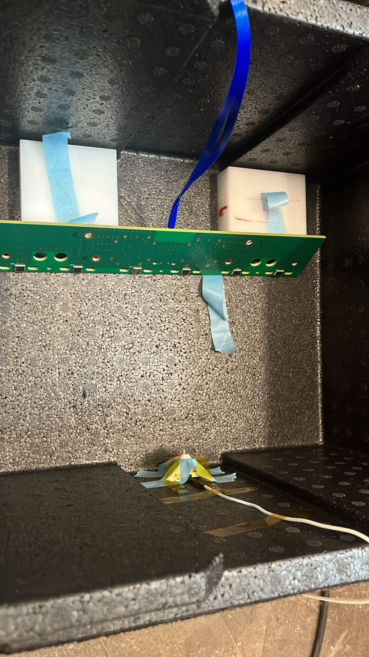
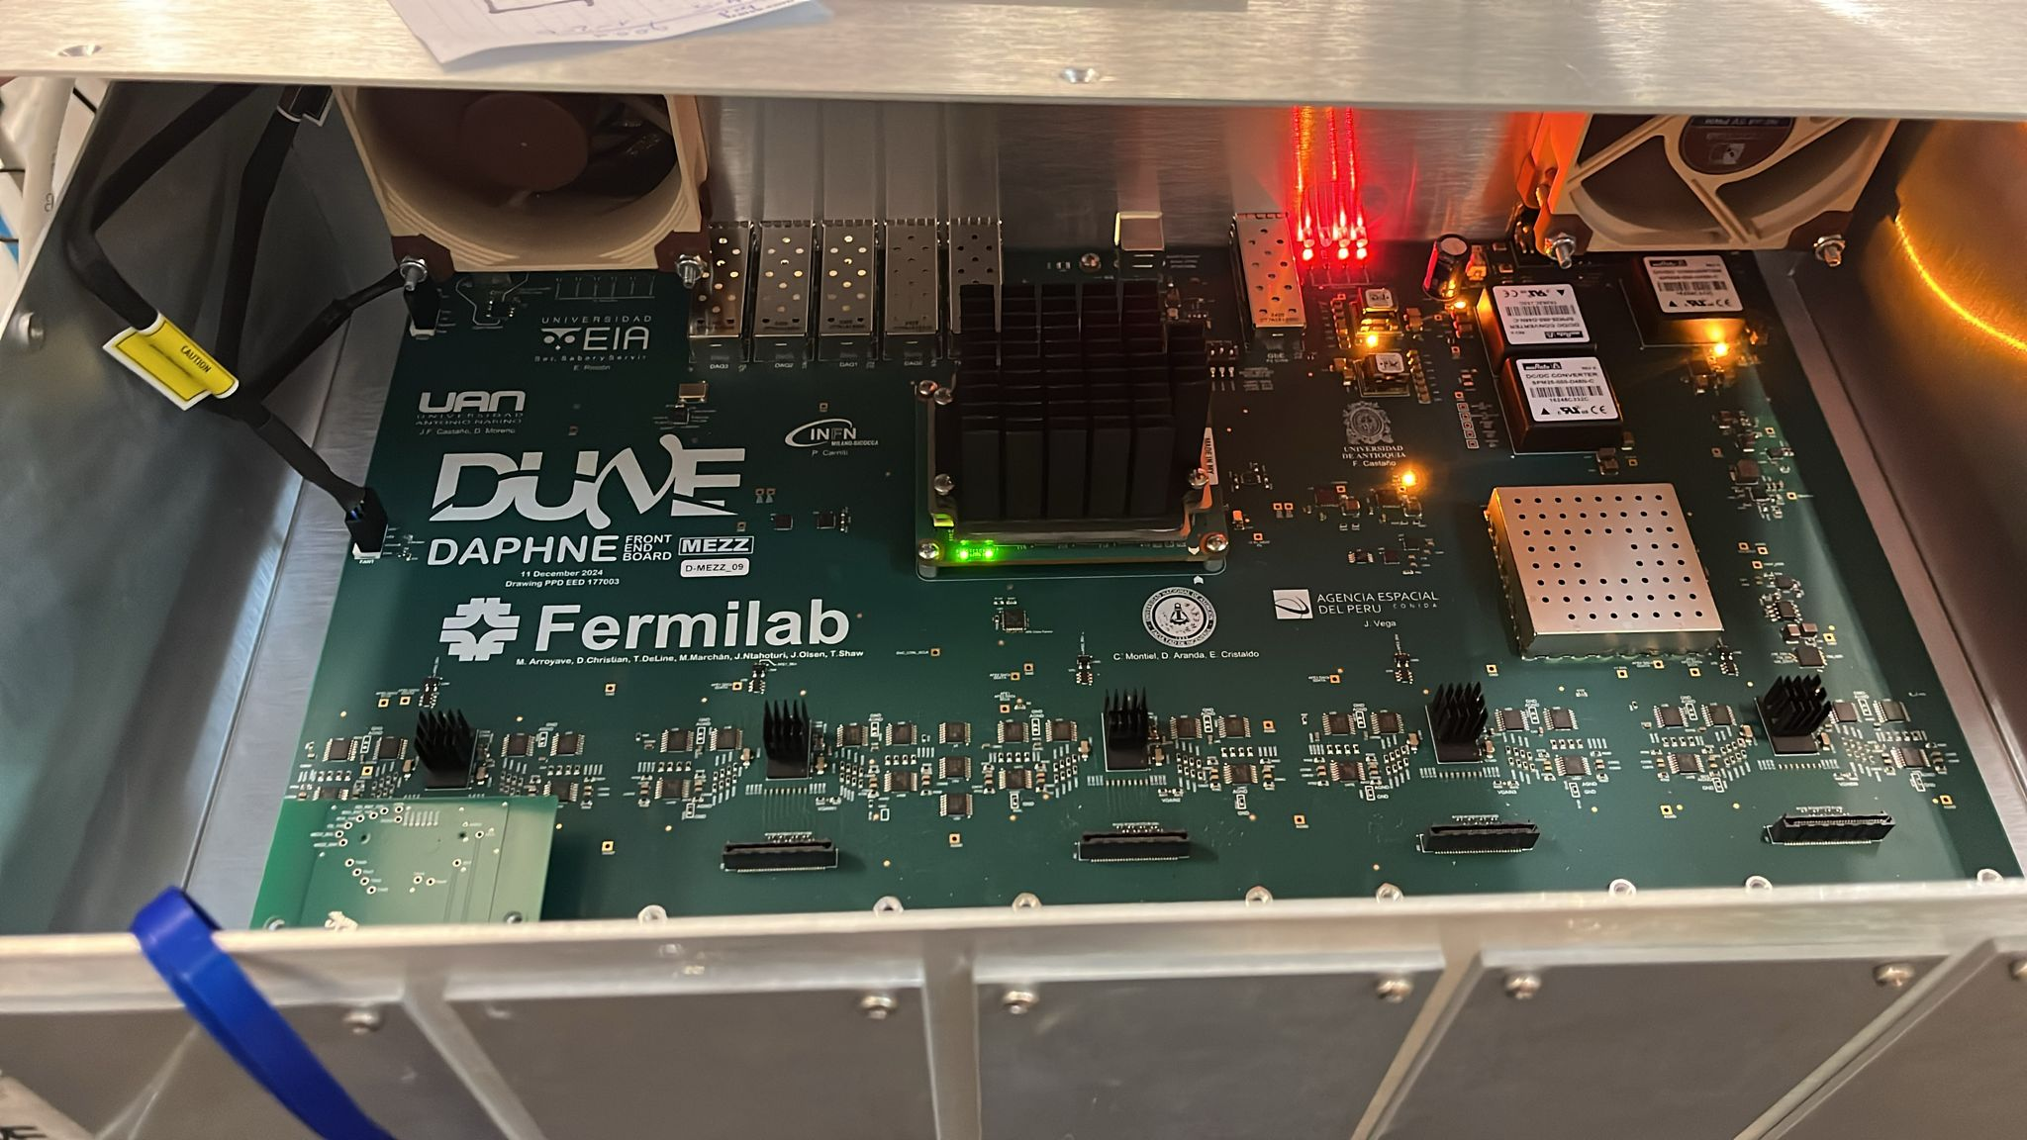
Setup
DAPHNE board
Coldbox with SiPM and Pulser

Slide 3
Trigger types
Software trigger and Hardware trigger (not available to us )
Random Trigger
Periodic random signal (300Hz / 3.3ms) that triggers the data acquisition
Self-Trigger Threshold
Threshold is set as a configuration parameter depending on weather the system is cold or warm.
Warm → more noise →higher threshold
Cold → less noise → lower threshold
Any signal (pulser/dark count) that exceeds the set threshold generates a waveform
Self triggering algorithm:
moving average of 15 ticks compared to the next tick, if threshold is exceeded
frame is saved

Slide 4
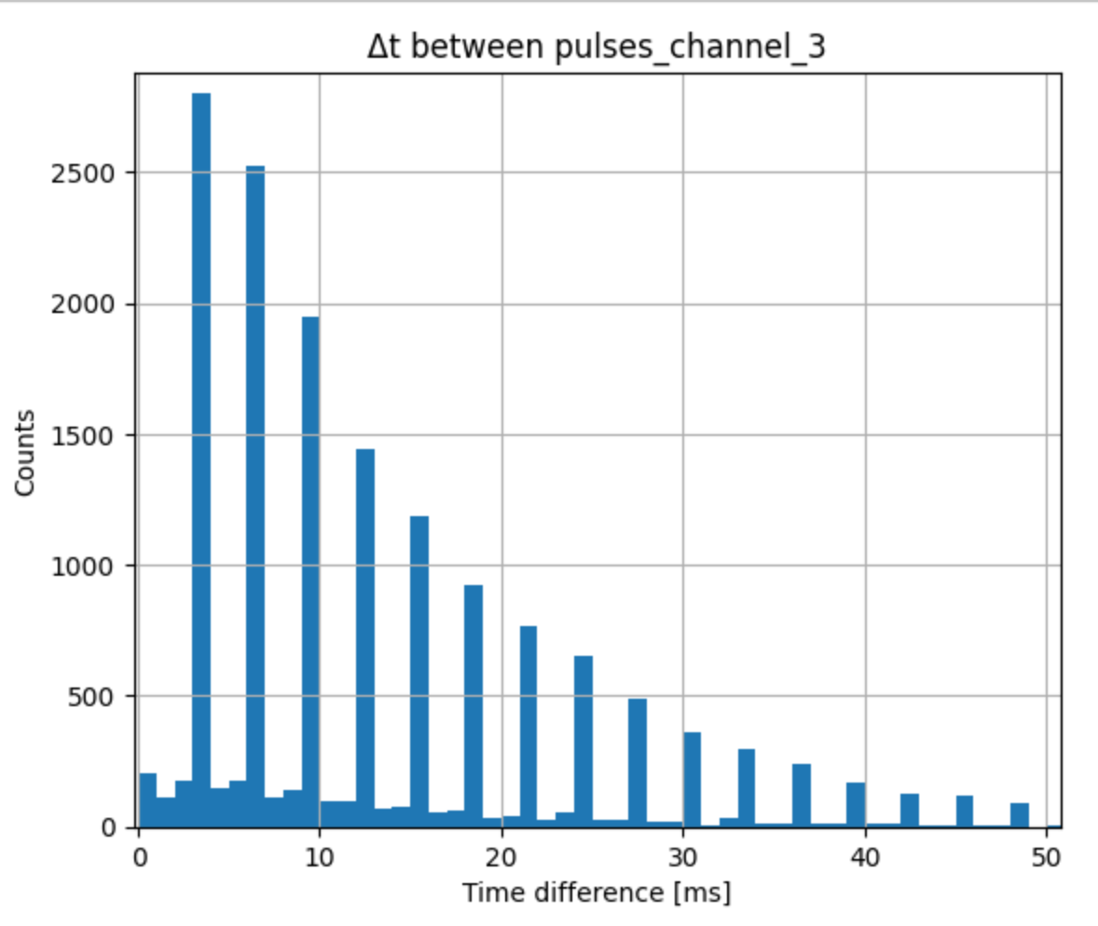
Readout window
Random trigger → save fixed time interval of samples before and after trigger → Waveform
1.5 ms
Random Trigger
1.5 ms
Fastest the pulser can run is 3 ms and Δt between consecutive peaks confirm this behavior

Slide 5
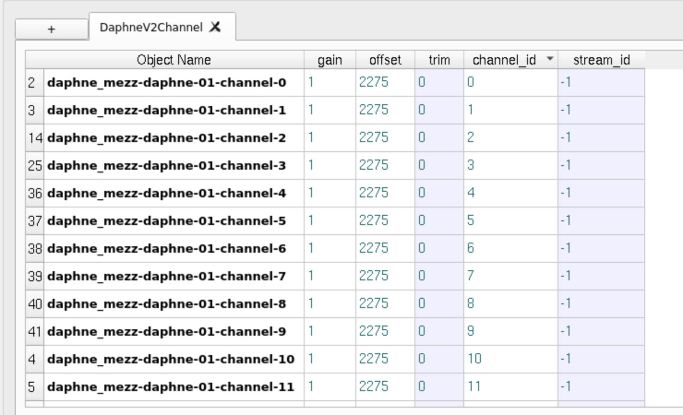
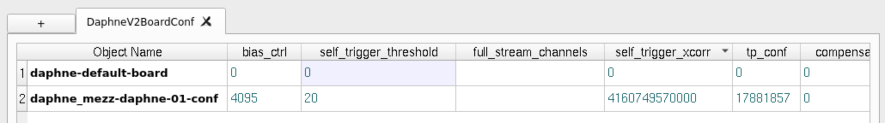
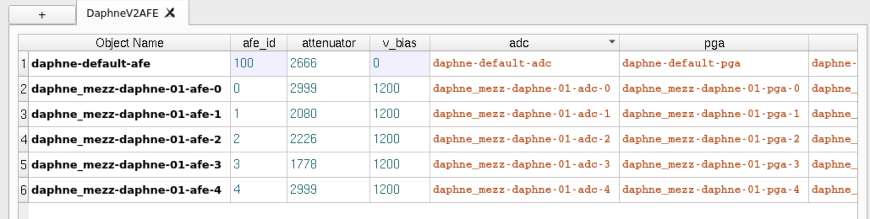
Configurations

Slide 6
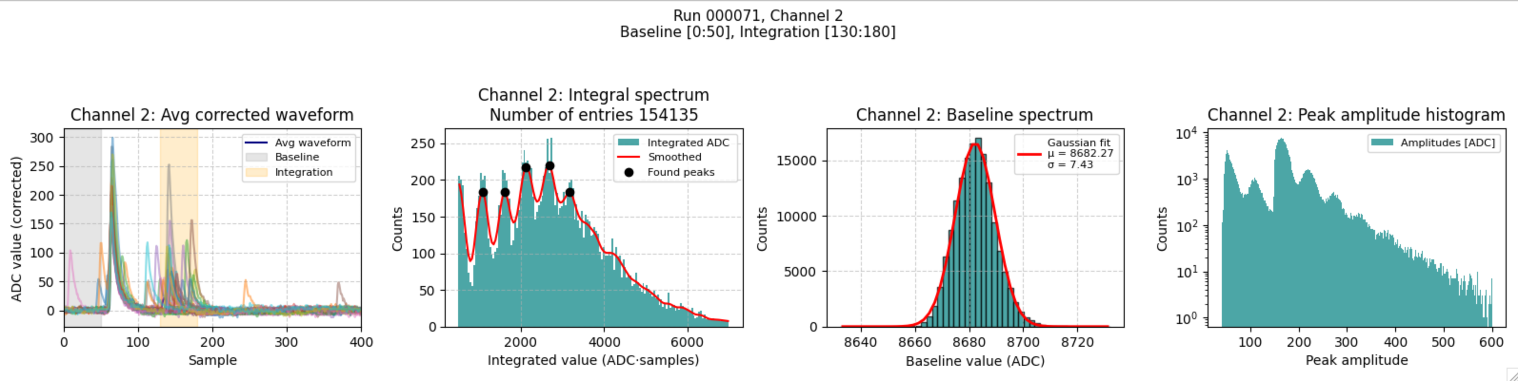
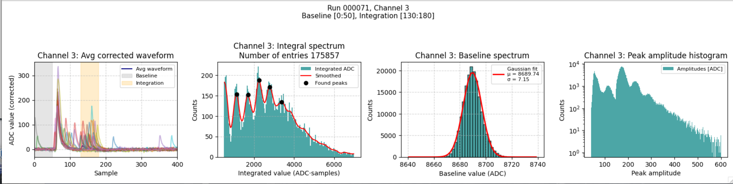
*Attenuator = 2000 for all data
Avg. peak spacing (gain) = 520
Avg. peak spacing (gain) = 563.3

Slide 7
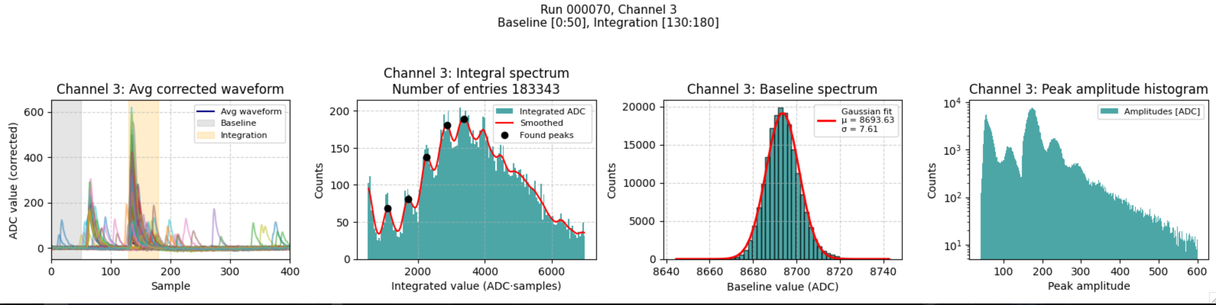
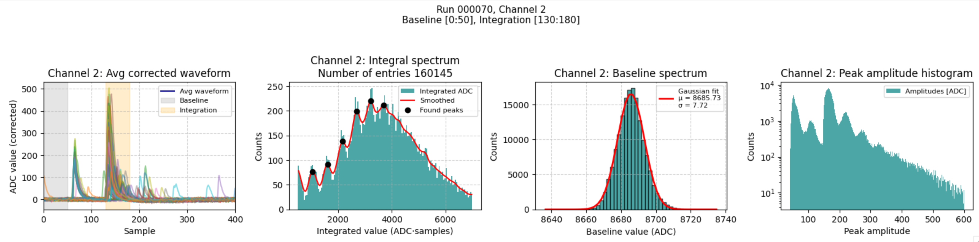
Avg. peak spacing (gain) = 574.2
Avg. peak spacing (gain) = 528.6

Slide 8
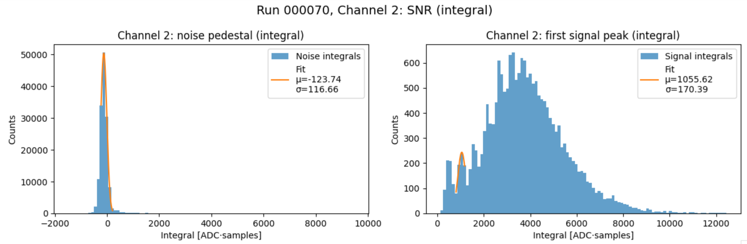

SNR with second photopeak = 5.71
SNR with second photopeak = 6.36

Slide 9
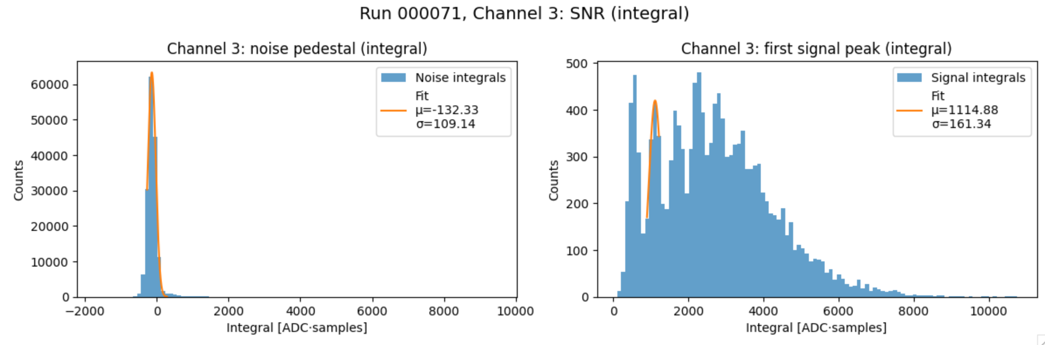
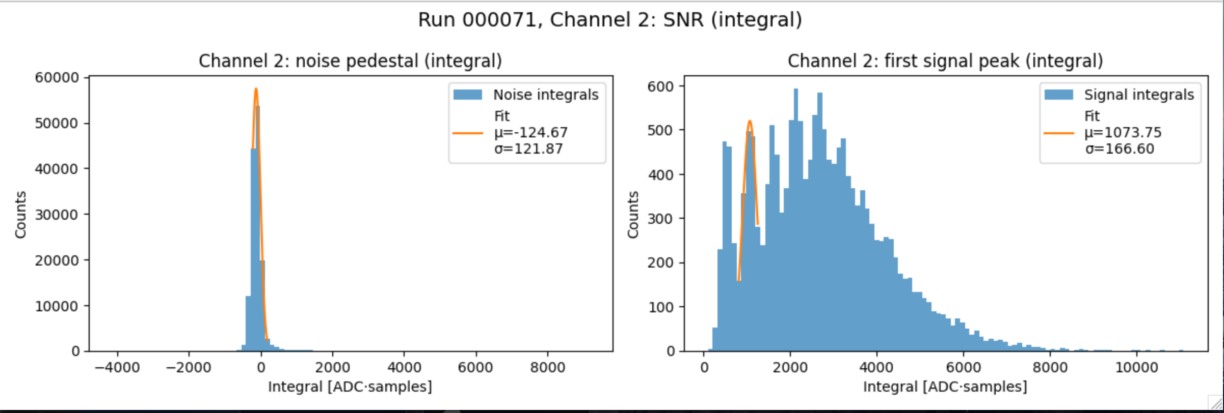
SNR with second photopeak = 6.40
SNR with second photopeak = 5.80

Slide 10
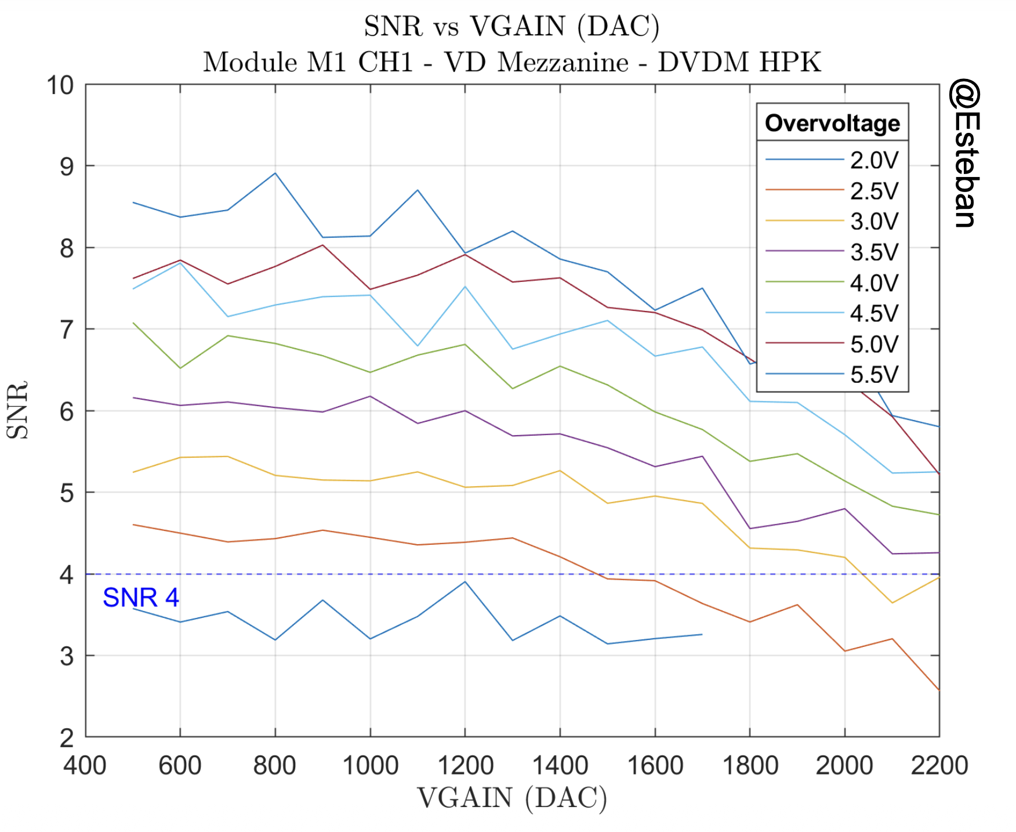
What next…
Find gains for different settings
Find breakdown voltage
Vgain vs SNR scans for different overvoltages to find optimal working conditions.
Try to isolate peaks of waveforms
Automate the process and see for all channels
Move onto the TPC

Slide 11
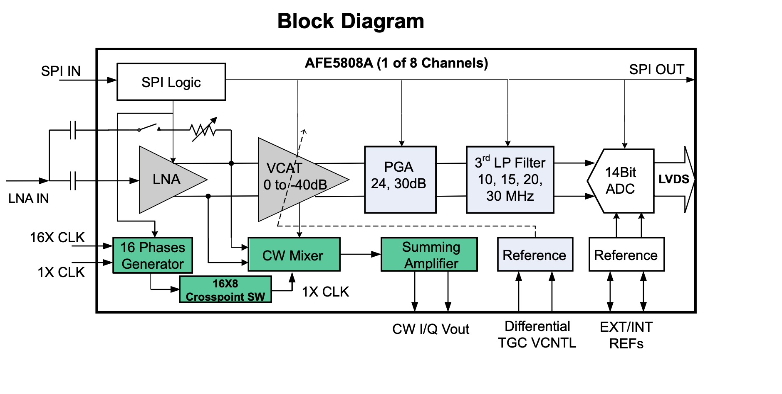
Backup

