Slide 1

Circuits and Layouts
I
E.G. Villani
Instrumentation Training Lectures, Oxford 09/05/2023

Slide 2
Overview
Introduction, definitions
Layout and interconnects in IC technology
Transistor MOS layouts
Passive components layouts
Instrumentation Training Lectures, Oxford 09/05/2023

Slide 3
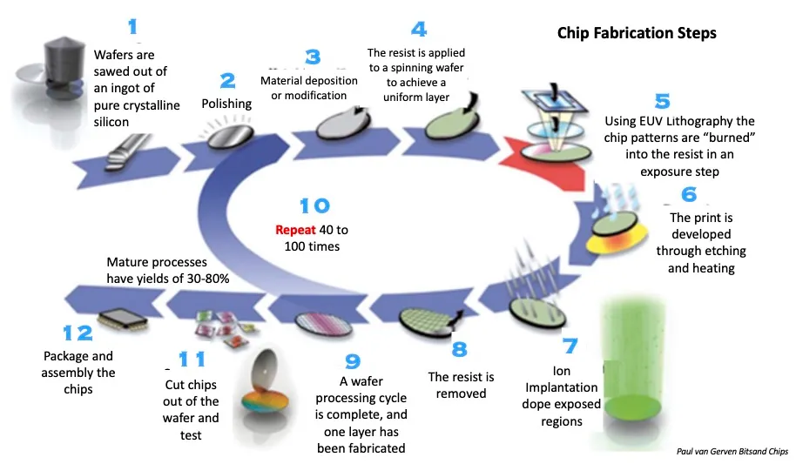
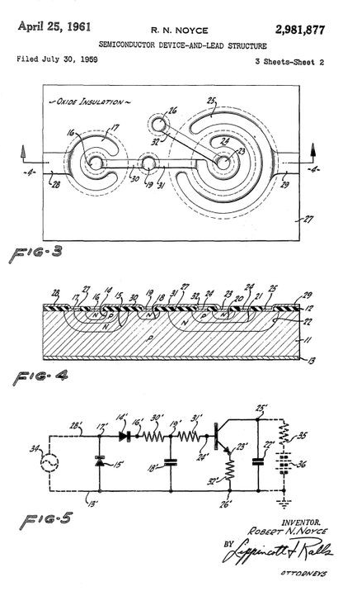
Introduction
  IC (integrated circuits) single silicon chip that includes active and passive interconnected devices to implement complex operations (analogue, digital)
  Planar technology: the processing steps are implemented in a thin layer of the surface of the chip
  Fabrication of chip is an extremely complex process, requiring several steps of atomic precision
First planar IC patent, 1961
1
Instrumentation Training Lectures, Oxford 09/05/2023
Notes:
A few definitions…

Slide 4
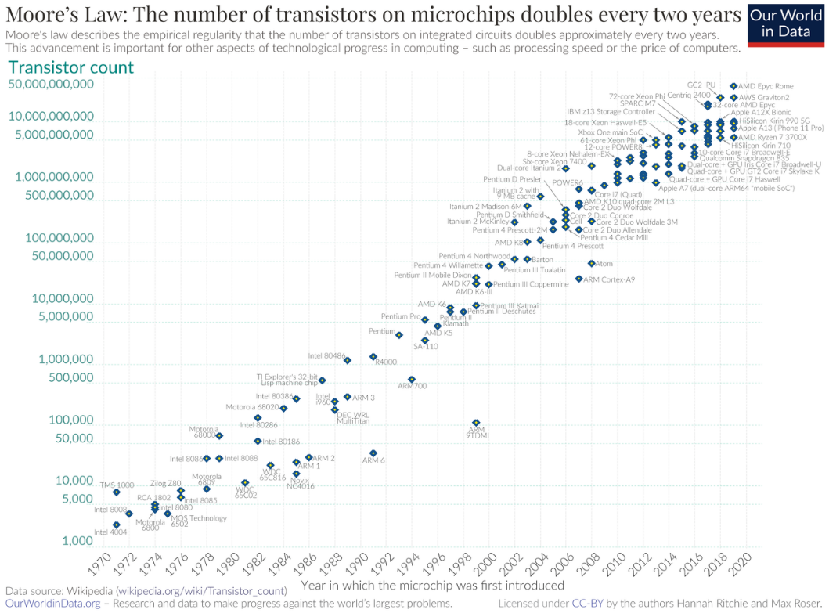
Layout and interconnects
  Device scaling implies increased speed per transistor and increased functionalities
  Due to the high number of transistors on chip, layout optimization at chip level has become as important as transistors fabrication
  Interconnecting the devices has become the bottleneck for IC performances
2
Instrumentation Training Lectures, Oxford 09/05/2023
Notes:
the continous shrinking in the technology, or device scaling…

Slide 5
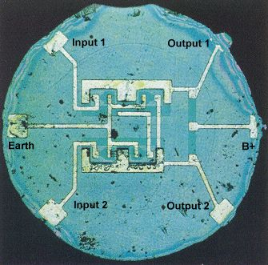
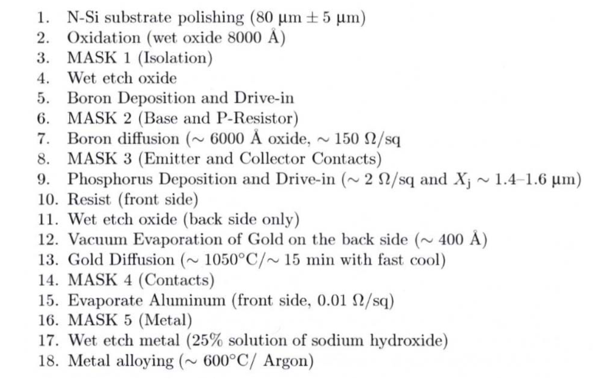
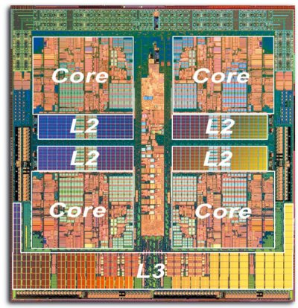
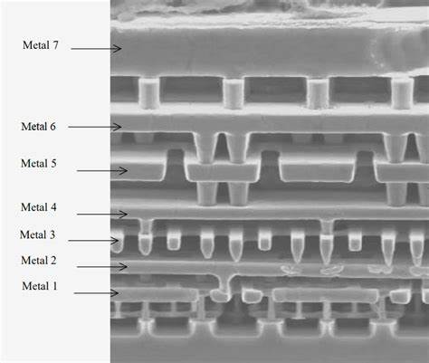
Layout and interconnects
The processing steps involved in fabricating transistors and their immediate interconnect is called front-end-of-line (FEOL)
That includes typical steps of device fabrication, i.e. implantation, oxide growth, diffusion…and first metal
Interconnecting all the devices together with additional layers of metals is the back-end-of-line (BEOL)
As the number of transistors on chips grew, it became impossible to make all connections in a single layer
Added additional vertical levels of interconnects
Simpler IC might have a few metal layers, complex ICs can exceed 10 layers
First commercial IC, Fairchild Semiconductor, 1961. Flip-Flop
Original Planar process flow (from Fairchild Semiconductor)
3
Instrumentation Training Lectures, Oxford 09/05/2023
Notes:
First layout had single metal layer, technology node around 25 um (check!)
Nowadays, exceeding 1e9 devices on chip, we have more than 10 metal layers, also using different metals to optimize speed of interconnection

Slide 6
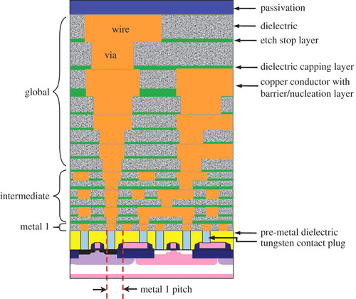
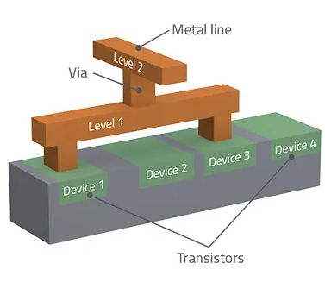
Layout and interconnects
Various levels of interconnects are present in modern ICs:
  Metal 1, for short local interconnects
  Intermediate, to connect devices within blocks
  Global interconnects, for long, low resistivity connections, including power, grounds. Cu is often used today
Various levels are connected by vias and separated by dielectrics
BEOL
FEOL
4
Instrumentation Training Lectures, Oxford 09/05/2023

Slide 7
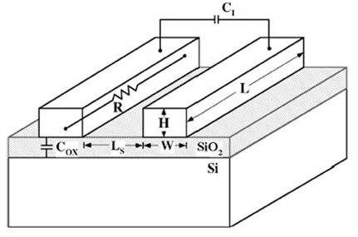





Layout and interconnects
Interconnects and their layouts are of increasing importance as the feature size of circuit elements become smaller
Delay times of interconnect transmission line
Delay time proportional to area
$$R=ρ\frac{L}{WH}$$
$$C_{ox}=ε_{ox}ε_{o}\frac{WL}{t_{ox}}$$
$τ_{I}≅ε_{ox}ε_{o}ρ\frac{L^{2}}{WH}(\frac{W}{t_{ox}}+\frac{H}{L_{s}}$)
$$C_{I}=ε_{ox}ε_{o}\frac{HL}{L_{s}}$$
$C_{tot}≅C_{I}$+ $C_{ox}$
5
Instrumentation Training Lectures, Oxford 09/05/2023
Notes:
In this slide we look at an example of importance of interconnect: delay time due to RC of inter and intra connections, for example lines of metal running in parallel separated by distance Ls and from the si substrate by tox.
Total RC is proportional to L^2, i.e. the area

Slide 8




Layout and interconnects
As the technology size decreases:
  W, L_{s} and H decrease
  t_{ox} decrease at ∼ the same rate as W and H i.e. scaling factor λ
  The distance L for local interconnect decreases as the sized of devices gets smaller (∼ λ)
  Time delay $τ_{Ioc}$for local interconnect remains ∼ constant
$τ_{I}≅ε_{ox}ε_{o}ρ\frac{L^{2}}{WH}(\frac{W}{t_{ox}}+\frac{H}{L_{s}}$)
$τ_{I}≅ε_{ox}ε_{o}ρ\frac{L^{2}}{WH}(\frac{\text{∼λ}}{\text{∼λ}}+\frac{\text{∼λ}}{\text{∼λ}}$)
$$τ_{Ioc}≅ε_{ox}ε_{o}ρ\frac{{\text{∼λ}}^{2}}{λ^{2}}$$
6
Instrumentation Training Lectures, Oxford 09/05/2023

Slide 9
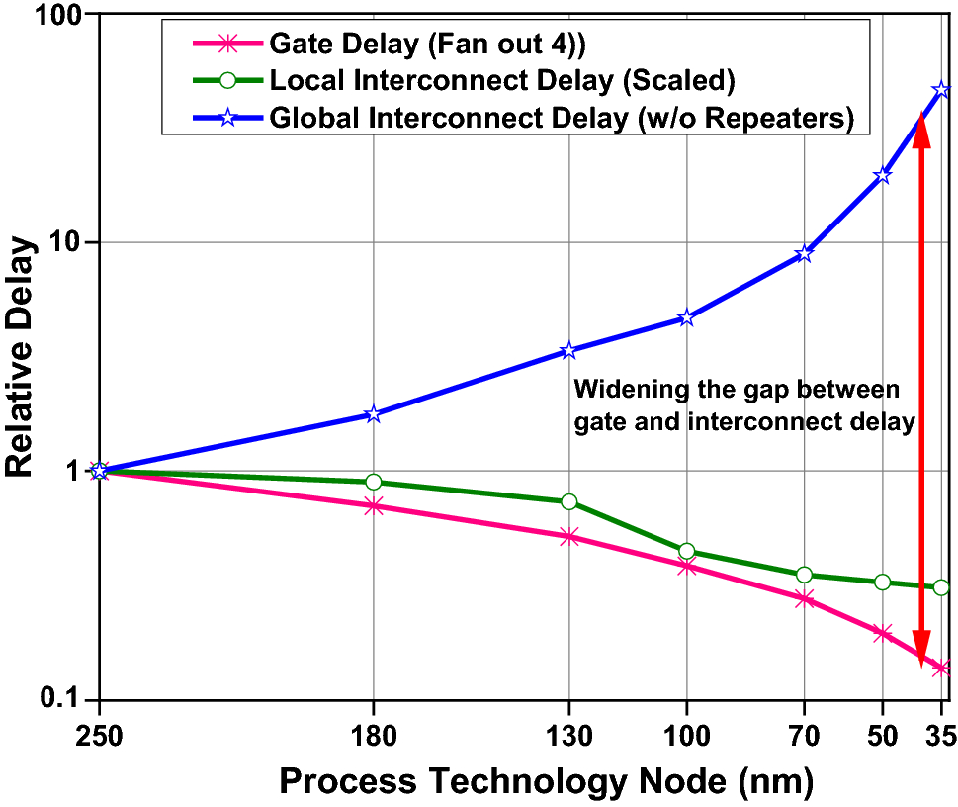


Layout and interconnects
As the technology size decreases:
  Area of the die tends to increase
  Length of global interconnect increases √S
  Time delay $τ_{gIo}$for global interconnect tends to increase
$$τ_{gIo}≅ε_{ox}ε_{o}ρ\frac{S}{λ^{2}}$$
7
Instrumentation Training Lectures, Oxford 09/05/2023

Slide 10
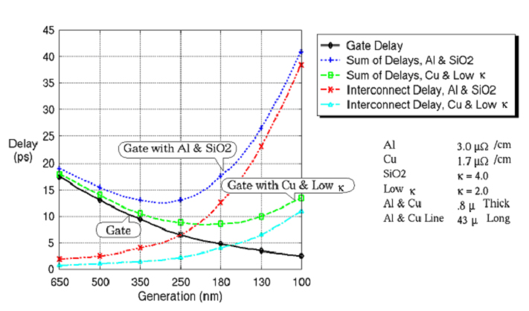


Layout and interconnects
Time delay for global interconnect tends to increase as the technology size decreases ∝ λ⁻²
Different materials can be used for the interconnect to reduce ρ and ε
The global interconnect delay $τ_{gIo}$vs. technology node for standard and advanced materials
$$τ_{gIo}≅ε_{ox}ε_{o}ρ\frac{S}{λ^{2}}$$
8
Instrumentation Training Lectures, Oxford 09/05/2023

Slide 11
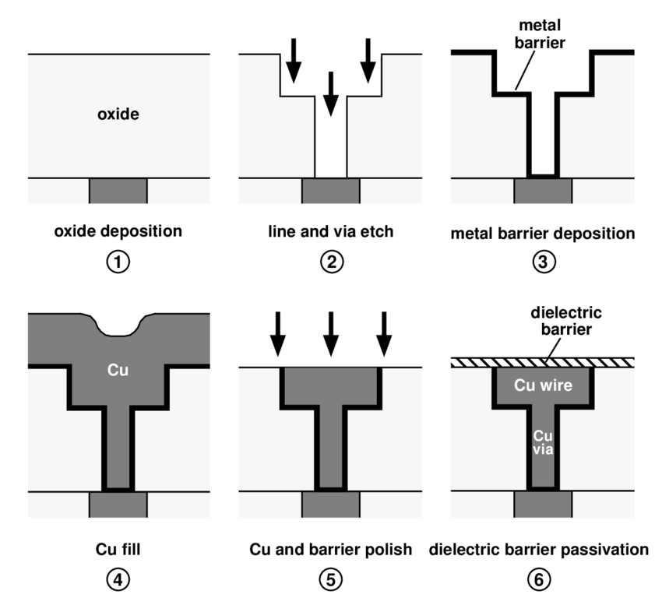
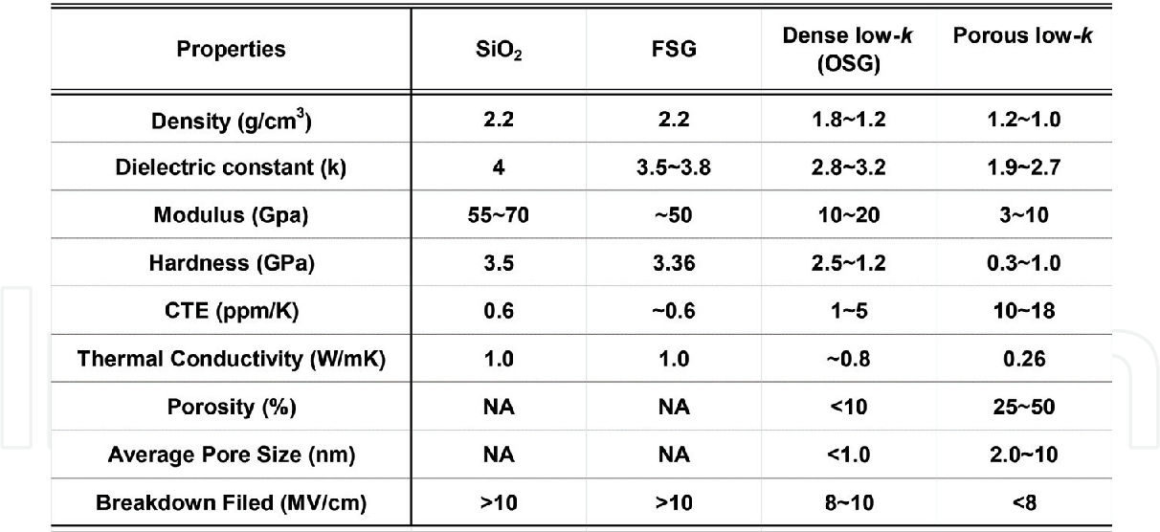
Layout and interconnects
Reducing ρ has been achieved by using Cu instead of Al (Damascene process)
Reduce ε is more challenging: low-K dielectrics can be obtained using F and other dopants but resulting dielectric show poorer quality
Air gaps used in some locations in <10 nm nodes
Dual Damascene* process. An additional metal barrier (W) is deposited first to avoid Cu contamination of Si. Cu deposited by electroplating. CMP is needed as Cu does not plasma etch.
Low- dielectrics have been used for < 100 nm nodes. Reliability issues with very low k-dielectrics
*from ancient sword making technique in Damascus, Syria
9
Instrumentation Training Lectures, Oxford 09/05/2023

Slide 12
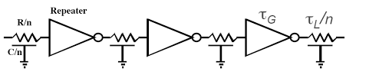

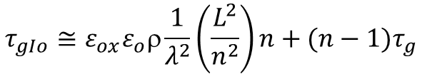

Layout and interconnects
Another way to reduce interconnect delay is to use pass transistors (or repeaters)
A long interconnect is broken into n shorter lines, with the delay of each section reduced quadratically
A small repeaters’ delay leads to a reduced global delay but at the expenses of increased occupied area and additional power consumption
A long interconnect line L is broken into n segments
$$τ_{gIo}≅ε_{ox}ε_{o}ρ\frac{L^{2}}{λ^{2}}$$
$$τ_{gIo}≅ε_{ox}ε_{o}ρ\frac{1}{λ^{2}}\left(\frac{L^{2}}{n^{2}}\right)n+(n−1)τ_{g}$$
$${nτ}_{g}<ε_{ox}ε_{o}ρ\frac{1}{λ^{2}}L^{2}$$
10
Instrumentation Training Lectures, Oxford 09/05/2023
Notes:
Questions up to here?

Slide 13
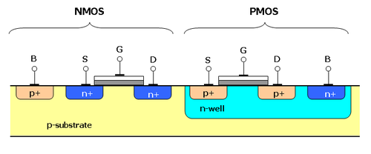
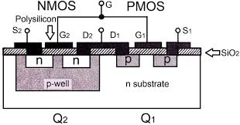
MOS transistor layout
Very often standard silicon wafers are P type and devices, including MOS transistors, are implemented in them
This stems from performances optimization: NMOS are faster than PMOS (e⁻ mobility higher than h⁺)
Fastest NMOS is obtained from high resistivity (low doping) P substrate rather than lower resistivity (higher doping) P well
NMOS
W
S
L
D
PMOS
11
Instrumentation Training Lectures, Oxford 09/05/2023
Notes:
Lets look at device layouts…

Slide 14
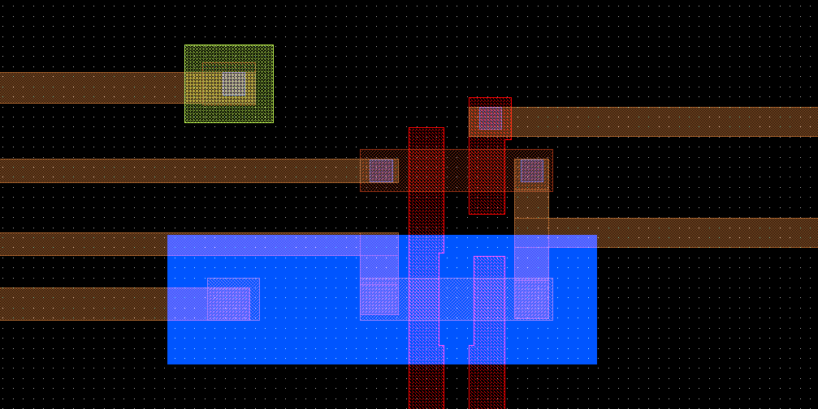


MOS transistor layout
NMOS
W
In digital circuits transistors are normally designed with minimum size, to increase density of functions/storage /area
In analog circuits a large form factor W/L is usually required, to increase transconductance g_{m}
S
L
D
PMOS
NWell
GATE
12
Instrumentation Training Lectures, Oxford 09/05/2023

Slide 15
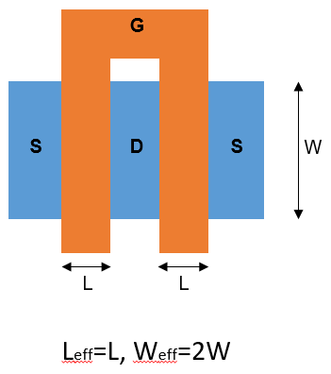
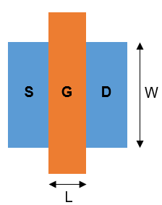
MOS transistor layout
In layout of analog transistors the aspect ratio W/L is crucial as it determines g_{m} (straight structures preferable)
But high W might increase Gate resistance/capacitance:
multi-finger layouts in analog design
Single finger
Two fingers: W are summed
13
Instrumentation Training Lectures, Oxford 09/05/2023

Slide 16
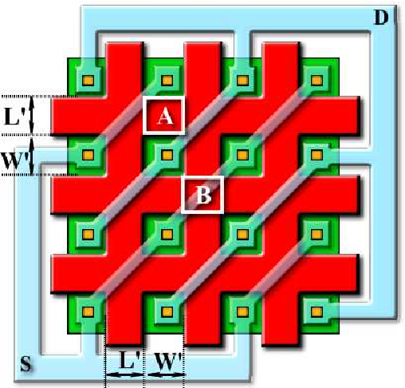



MOS transistor layout
Multi finger structures decrease the Gate resistance but increase the parasitic effects (drain-gate coupling, gate to substrate)
Special structure (Waffle structure) used for RF CMOS applications
P. Vacula 1,2, M. Husák, M. 2013
Waffle MOS channel aspect ratio calculation with Schwarz-Christoffel
Transformation
14
Instrumentation Training Lectures, Oxford 09/05/2023

Slide 17
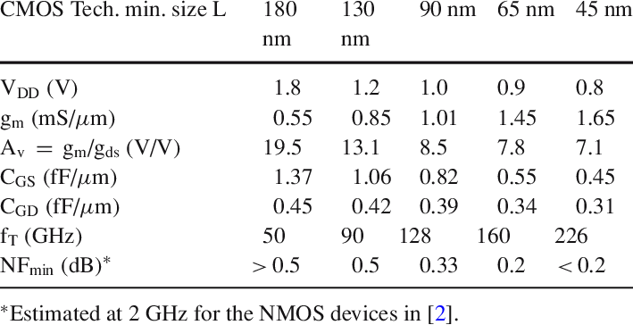
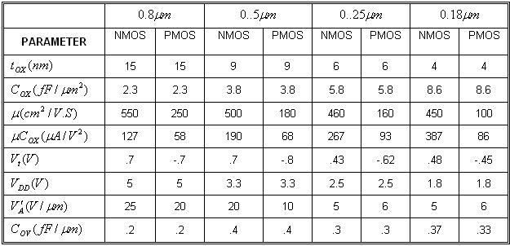
MOS transistor layout
Typical figures of CMOS process vs. size
Scaling down does not imply better device characteristics per se
15
Instrumentation Training Lectures, Oxford 09/05/2023
Notes:
Note that the minimum voltage does not scale down as the geometry factor
Decreasing the tox increases the gm but decreases the mobility
Overall decreasing the size the operating frequency has increased at gate level

Slide 18
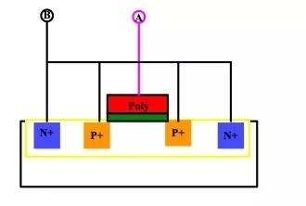
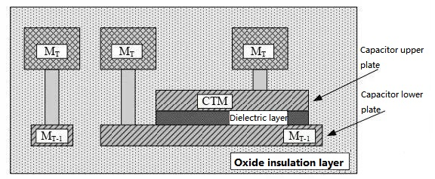
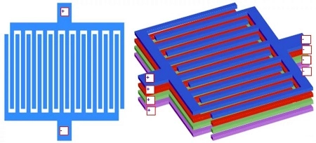
Passive components layout
MOS capacitor changes with voltage but save area
Integrated Capacitors are normally obtained by structures close to the silicon substrate
Three type of capacitors:
  MOS (Poly Oxide Well)
  MiMs (Metal Insulator Metal)
  Parasitic (MoM)
MIM use different layers of metal and interposed dielectric to form a capacitor. Similar to plate capacitor, good stability but require additional masks
MOM use interdigitated capacitors formed by metal connections, placed in close proximity – preferred choice for advanced CMOS, also no additional mask required
16
Instrumentation Training Lectures, Oxford 09/05/2023
Notes:
To conclude we can briefly look at passive components layouts…

Slide 19
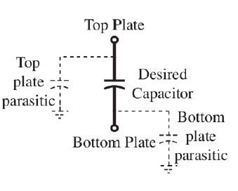
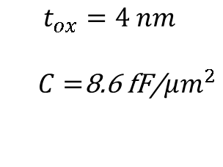


Passive components layout
$$t_{ox}=4 nm$$
$C=$8.6 fF/$μm^{2}$
$$C=\frac{ε_{0}ε_{r}}{t_{ox}}WL$$
Typical values of capacitance
Typical dielectric layers are SiO₂ or Si₃N₄
Use of high k materials is common in more advanced CMOS technologies
MIM/MOMs parasitic
$C_{t,p}=$0.1 % C
$C_{b,p}=$1 % C
17
Instrumentation Training Lectures, Oxford 09/05/2023

Slide 20
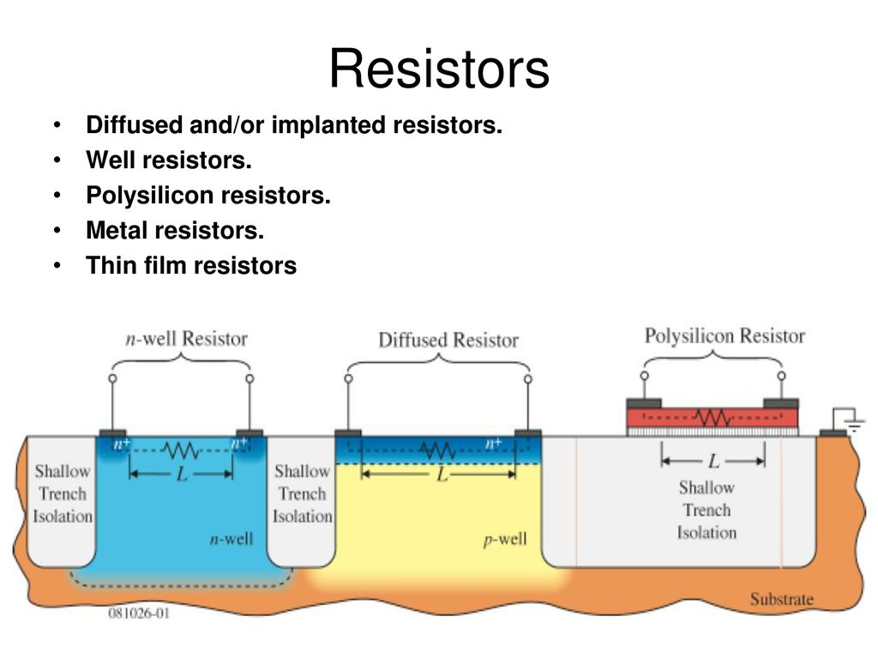



Passive components layout
Integrated Resistors are normally obtained by thin strips of resistive layers
Insulation from surrounding achieved by oxide layers or reversed biased junctions
$$Nwell: ρ_{∎}\sim 1 kΩ/∎$$
$$Poly: ρ_{∎}\sim 10 Ω/∎$$
$Metallic: ρ_{∎}\sim 0.1 Ω/∎$ $R=$ $ρ_{∎}\frac{L}{W}$
18
Instrumentation Training Lectures, Oxford 09/05/2023

Slide 21
Circuits and layout I
Layouts and interconnects in IC
  FEOL and BEOL different characteristics
  Interconnect delays and ways to mitigate them
Transistors layouts intro
Passive components layouts intro
    Thank you
    giulio.villani@stfc.ac.uk
19
Instrumentation Training Lectures, Oxford 09/05/2023

