Slide 1
UK Advanced Instrumentation Training
PCB Layout
Sneha Naik
sneha.naik@glasgow.ac.uk
May 2023

Slide 2
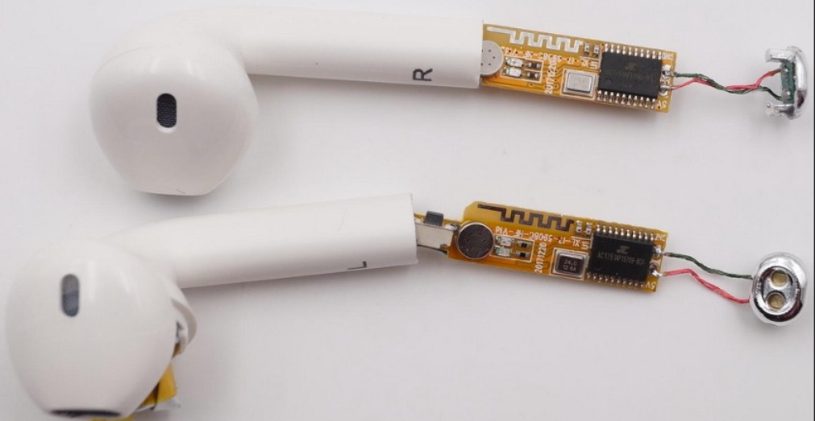

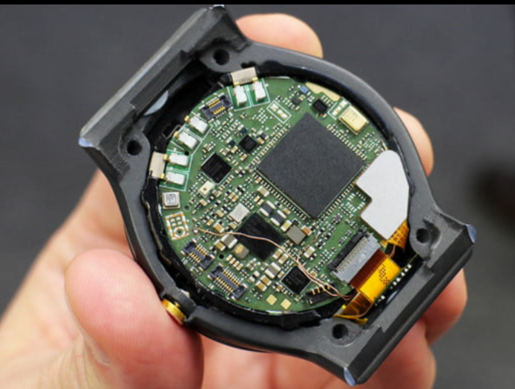
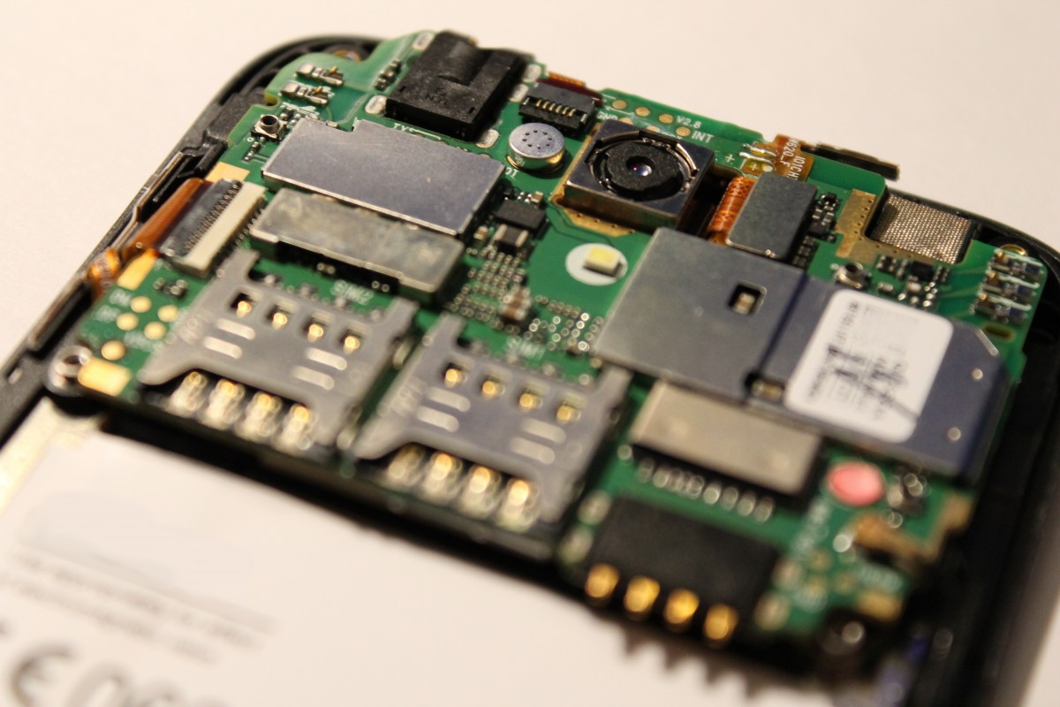
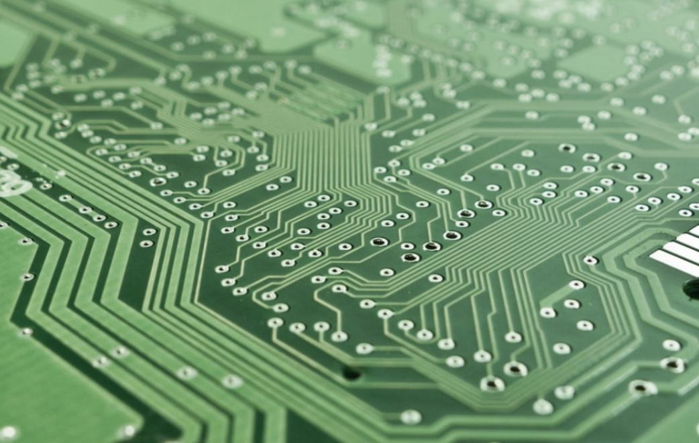
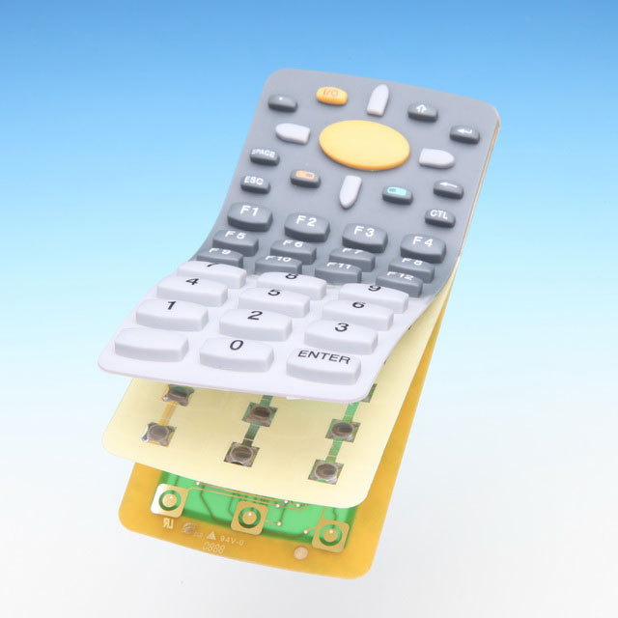
What is a Printed Circuit Board (PCB)
A printed circuit board (PCB) is present in electronic devices, ranging from smartphones to home appliances. It is an electronic assembly that uses copper conductors to create electrical connections between components.
It provides mechanical support for electronic components so that a device can be mounted in an enclosure.
It can be rigid, flex, rigid-flex hybrid and the thickness can range from a few millimeter to a few microns based on technology.

Slide 3
PCB design process
Schematic design and creating a netlist
Setting the PCB design environment
PCB layout
Generating manufacturing data
Submitting files for fabrication
Quality control (QC)

Slide 4
Schematic design and creating a netlist
Defines the circuit with symbols and nets
Creating symbols and footprints
Associating symbols and footprints
Creating rules for critical nets
Creating a netlist
Netlist is a description of the connectivity of the circuit.
Describes each component and its connections

Slide 5
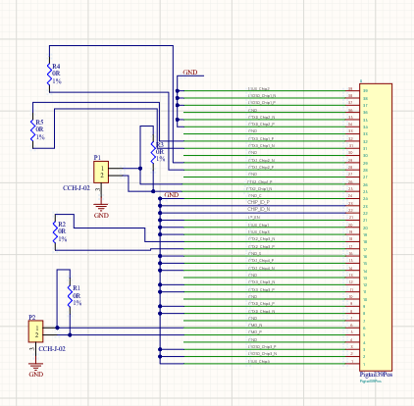
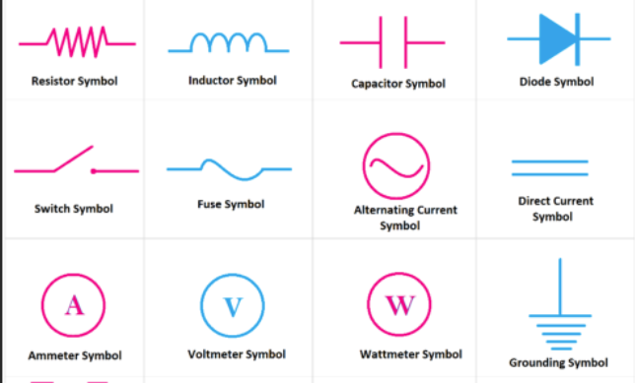
Schematic design
Schematic comprises of –
  Symbols
  Nets (connections)
Design Rules are rules added to the schematic like no duplicate reference designator, floating net labels etc.
Design Validation highlight the errors /warnings based on the defined rules.

Slide 6
Setting the PCB environment
Layer stackup and design rules
PCB composition
PCB configuration

Slide 7
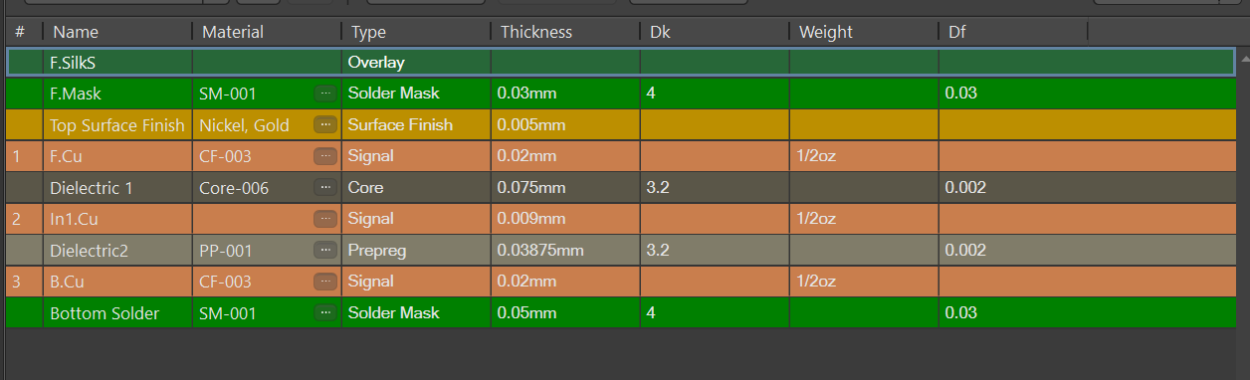
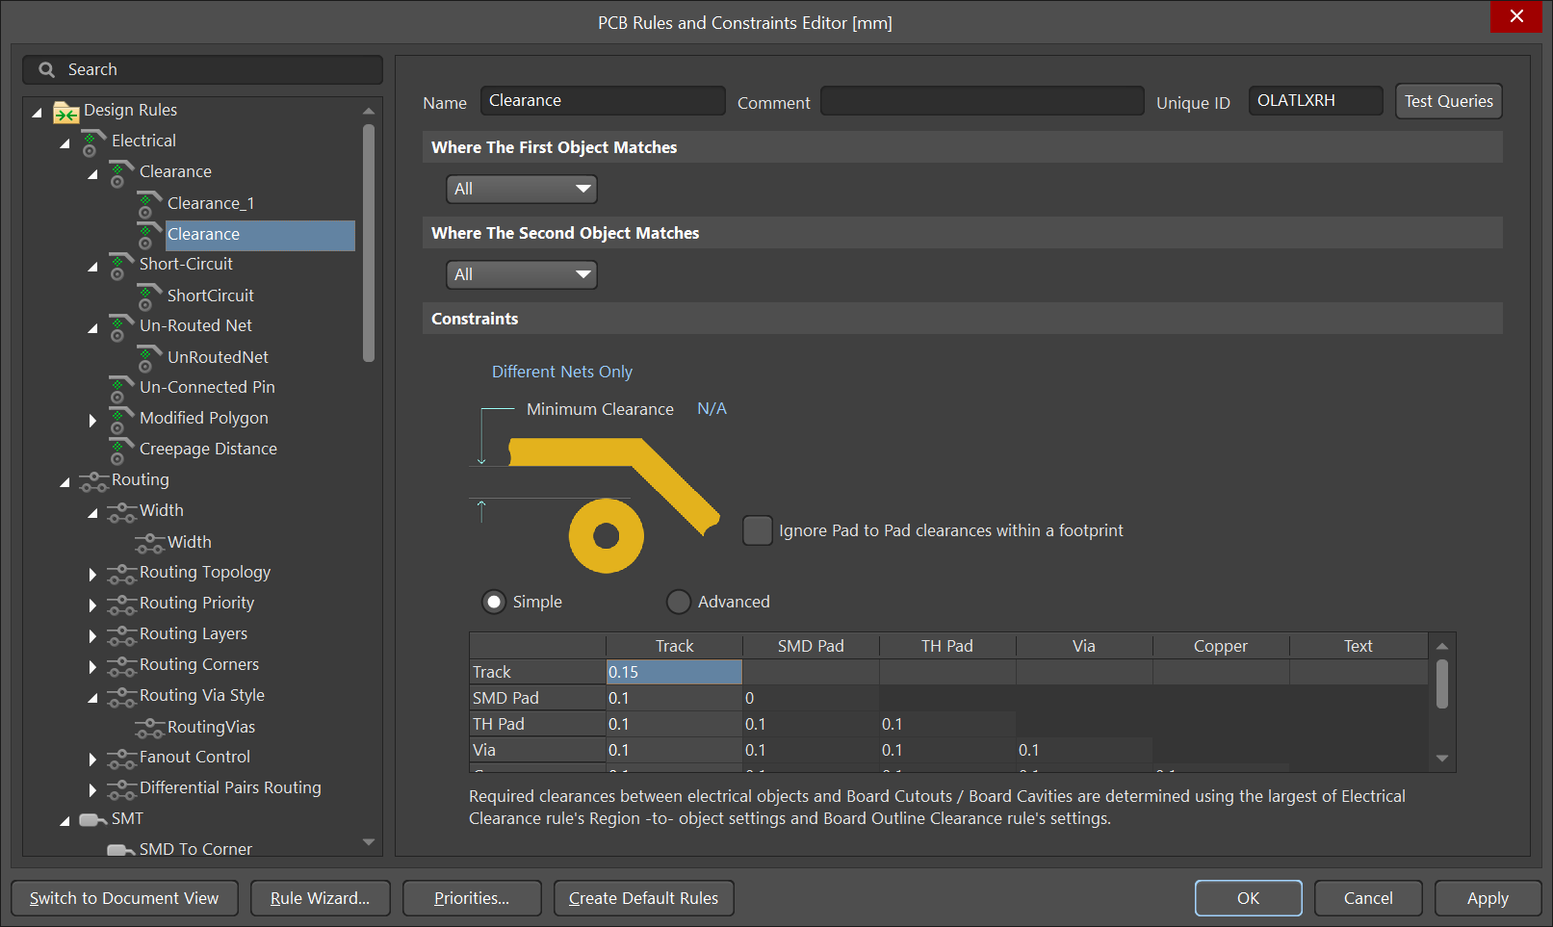
Layer Stackup and design rules
Define how many layers the PCB design would include.
  Single sided, double sided or multilayer
  Rigid, flex, rigid-flex
Define design rules
  Clearance from traces to pads
  Min/max hole size
  Clearance of Cu from edge of the PCB
  Routing layers, routing topology
  Via geometry, etc.

Slide 8
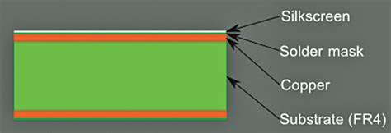
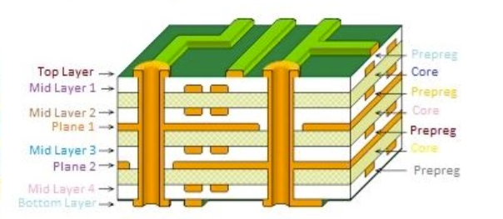
PCB composition
Different layers that make up a PCB
Copper foil
Substrate (FR4, Polyamide)
Solder mask
Silkscreen
Paste mask
Protect the copper from oxidation and shorts during operation.
Ink trace used to identify the PCB components, marks, logos, symbols
Data for creating stencil for assembly of components
Via -consists of two pads in corresponding positions on different layers of the board, that are electrically connected by a hole through the board

Slide 9
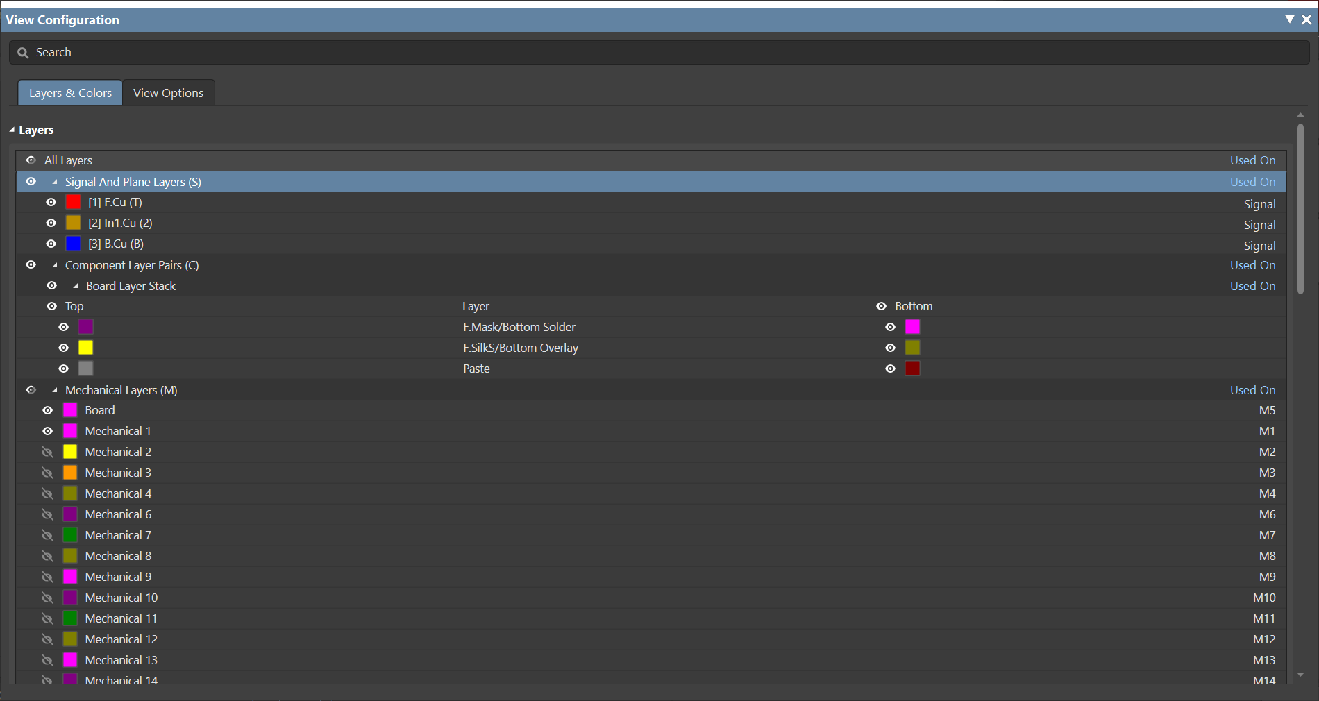
PCB configuration
Layer stack definition reflects in the configuration window.
Here the colours for the individual layers can be changed
The layers can be turned on and on as required.
Additional mechanical layers are available that can be used to add board outlines, DXFs etc.

Slide 10
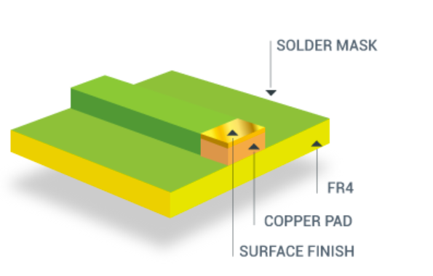
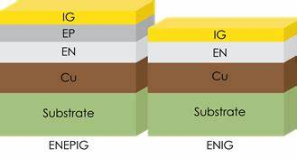
PCB surface finishes
The purpose of surface finish
    Prevent the copper from oxidizing
    Provide a solderable surface.
Types of surface finish
    Hot Air Solder Leveling (HASL)
    Organic Solderability Preservative (OSP)
    Electroless Nickel Immersion Gold (ENIG)
        This finish provides a thin, gold, solderable layer that protects the copper traces with a nickel barrier between it and the copper. ENIG is a good lead-free option that results in a durable, long-lasting finish.
        Suitable for Aluminum wedge wirebonding
    Electroless Nickel Immersion Palladium Immersion Gold (ENIPEG)
      Ideal for gold wirebonding
      Addresses the Black Pad (the corrosion of underlying nickel)
      issue.

Slide 11
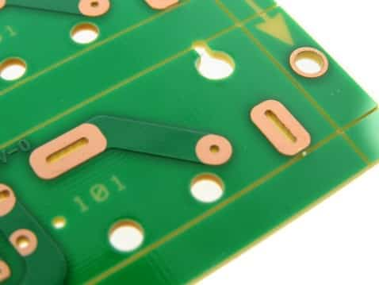
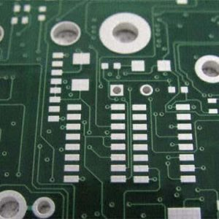
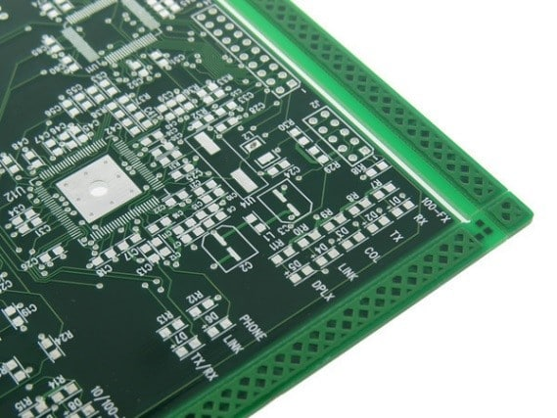
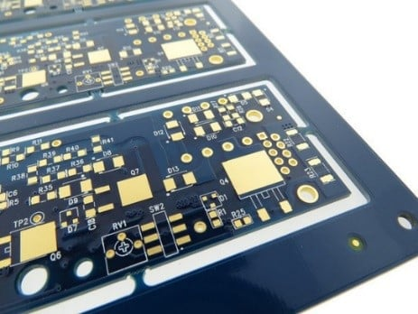
PCB surface finishes
Key Considerations When Choosing Your PCB Finish
Price
Availability
Shelf life
Reliability
Assembly process
Compliances like Restriction of Hazardous Substances (RoHS)
Examples:
If you do not need to be RoHS, Sn/Pb HASL may be your best option. It is low in cost and widely available.
If your boards need to be RoHS and have fine pitch components including BGA’s it is recommended to use ENIG or immersion silver.

Slide 12
PCB layout
Placement of components
Define routing strategy, layout guideline, signal integrity etc.
Routing and design rule check
Mechanical considerations

Slide 13
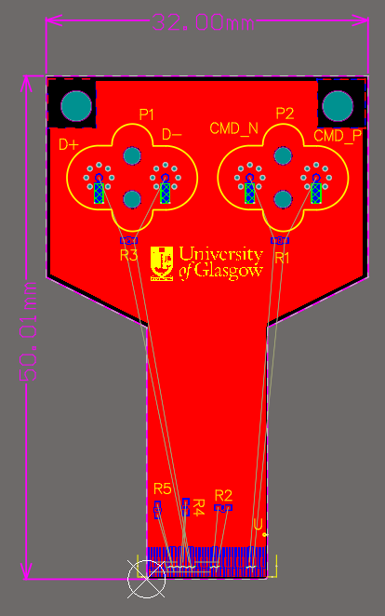
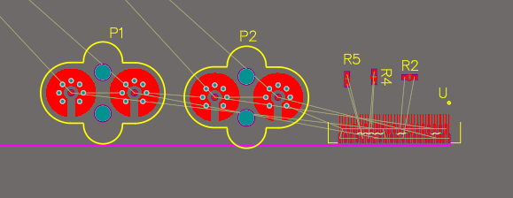
Placement of components
Import design from schematic to bring the associated footprints and nets into the PCB file.
There are libraries for symbols (schematic library) and for footprints (PCB library)
Mechanical requirements shall be considered to define the shape and size of the PCB. This includes mechanical hole positions, sizes as well as cutouts.
Footprints can then be placed on the PCB considering routing strategy.

Slide 14
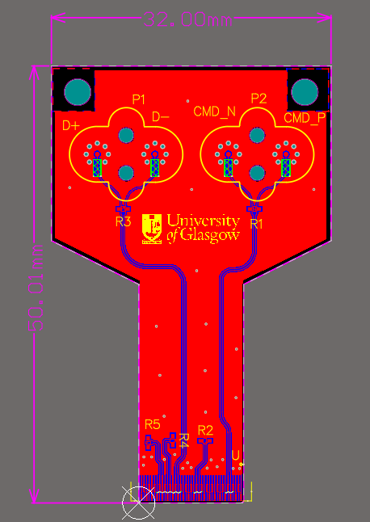
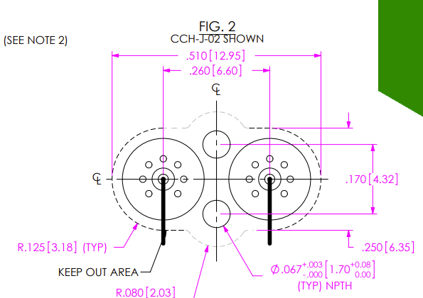
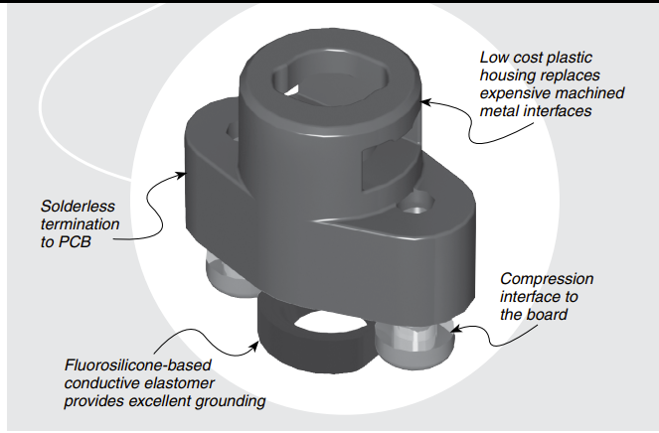
Routing and design rule check (DRC)
In the PCB layout –
  The Symbols translate to footprints
    The footprint is drawn to specifications as specified in the datasheet of the component.
  Nets translate to traces
Rules and constraints
  These are added to the design rules as per requirement of the design.
Design rule check
  This will highlight errors based on the set design rules.
Information from the datasheet

Slide 15
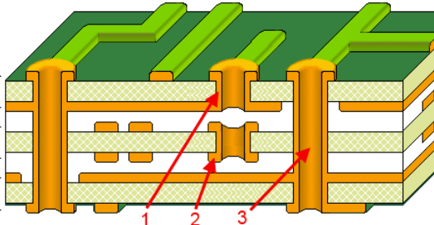
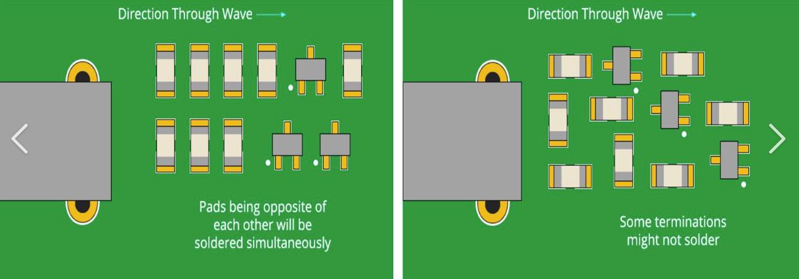
PCB Layout considerations
Board Constraints
    Estimate the size and shape of the board
    Work around the mechanical requirements to fit the circuit.
    Define the number of layers required
  Manufacturing process/technology
    Surface mounted/through hole blind and buried
    vias (high density interconnect (HDI))
  Placement and routing priorities
    Placement sequence: Interconnects ->Power circuit ->High speed/critical circuits ->non-critical parts.
    Orientation of components to ease assembly
      Place passives in one direction to the
      extent possible.
  Single sided/Double sided/multilayer PCB
1- Blind via; 2- Buried via; 3 –Through via

Slide 16
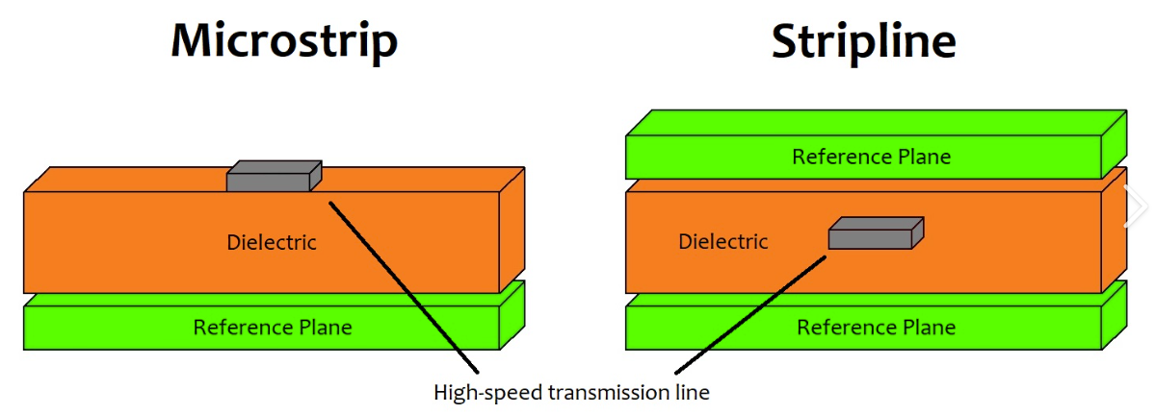
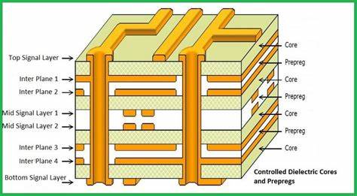
PCB Layout considerations
Routing signals on PCB
  Signals can be routed as Microstrip or Stripline
    Microstrip or Stripline are transmission line structures on PCB
    Signals in Microstrip move faster but are more prone
    to noise
    Signals in Stripline have a more influence of the
    dielectric surrounding it but are more shielded.
  Defining layer stackup is important to ensure the signal routing technique is defined
    Signal and plane layers based on density of the components and routing.
  Critical signals should be routed with a continuous GND reference to ensure controlled impedance of the trace.
  Power and ground planes
    Keep the power and ground planes internally in the PCB stackup.
    Ideally planes should be centered and symmetrical to prevent bowing and twisting of the PCB
    Keep the analog and digital grounds, power grounds separate.

Slide 17
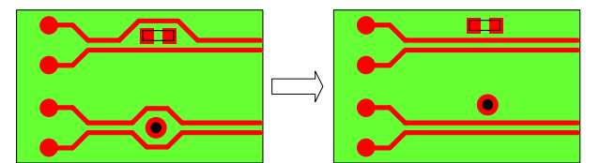
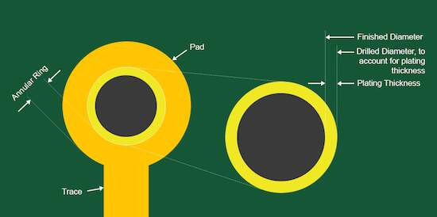
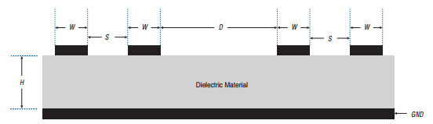
PCB Layout considerations
  Trace widths/trace spacings/ Via geometry
    Ensure that the specifications are such that the PCBs can be readily manufactured in industry.
    Design to meet the impedance requirement for high-speed signals (transmission lines at high speed).
    Keep critical signals well spaced from fast switching signals.
    Check via geometry meets thermal requirement
  Signal Integrity
    Avoid large loops of signal and ground-return lines that carry high frequencies.
    Ensure continuous ground reference for critical signals
    Try using differential signaling scheme that is less prone to crosstalk
    Eliminate antennas, which can radiate electromagnetic energy
    Reduce trace stubs, reduce vias, terminate traces with termination resistors.
    Choose material suitable for high-speed signal transmission
Routing technique
Via definition
D>2S
Clearance rules to avoid crosstalk

Slide 18
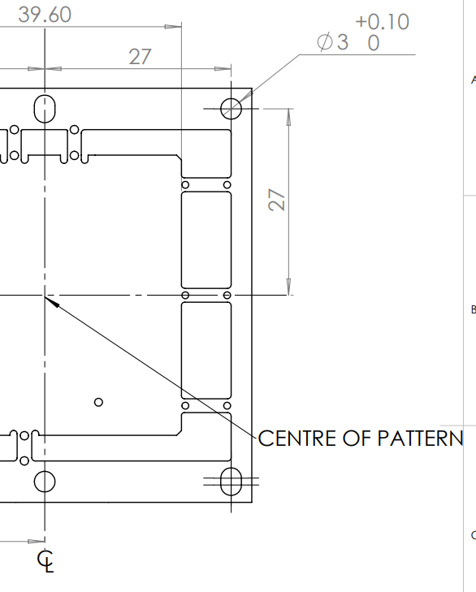
Mechanical Considerations
Every PCB layout would have some mechanical requirements on allowed dimensions, thickness, allowed components heights, envelop etc.
It is a critical step to liaise with mechanical team to understand these requirement and add these as constraints to the PCB layout.
DXF/DWG files are a good way to share the design details between mechanical and electronics design.
After the layout is complete, a final DXF is shared with the mechanical team to ensure the design is meeting the specifications.

Slide 19
Manufacturing data
Gerber files (artwork) and drill files
Documentation for fabrication and assembly (mounting components)
Creating specific documented highlighting the requirements for fabrication/assembly

Slide 20
Submitting files for fabrication
Data checked by vendor
Solve engineering queries from vendor on the Gerber files.
Close issues to start fabrication

Slide 21
Quality control (QC)
Check to ensure PCBs are fabricated as per specifications
IPC standard are used for PCB manufacturing and assembly
In-house QC tests like visual inspection, layer thickness measurements, etc. based on the application.

Slide 22
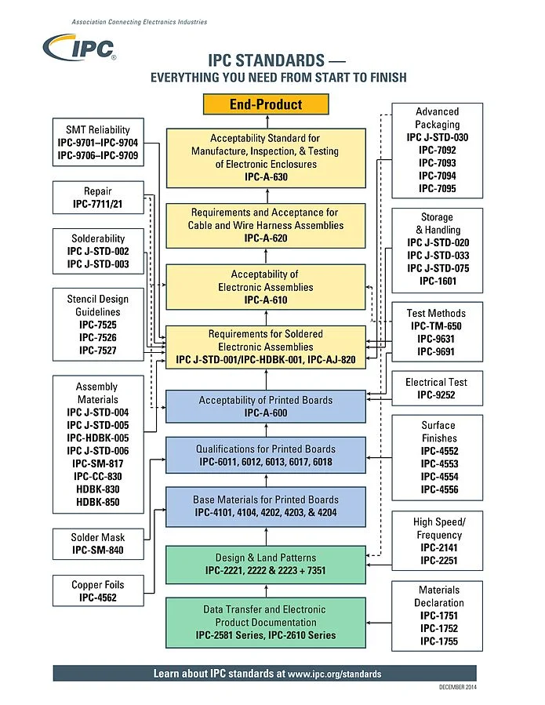
IPC Standards
IPC formerly called the Institute for Printed Circuits, presently called the Association Connecting Electronics Industries standards.
It is a trade association whose aim is to standardize the assembly and production requirements of electronic equipment and assemblies.
There is an extensive set of IPC documents that ensure PCB are produced the right way.
Every step for fabrication and assembly is associated with an IPC standard to carry out the process.
Similar IPC tests are linked to the assembly process of mounting PCBs with components.
IPC also defines various testing procedures for testing PCB as a part of QC process .

Slide 23
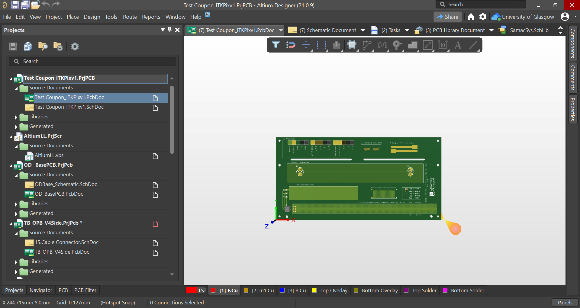
In-house QC tests
  The QC tests will vary based on application and specifications. Some example tests are-
  Visual inspection
    Check PCBs for contaminations and defects
  Metrology
    Measure size of the PCB, holes etc.
  Layer stackup check for individual layers
  Signal transmission tests
  (TDR measurements for impedance)
  Electrical tests to test functionality

Slide 24
Conclusion
PCB designing can vary from a simple single sided design to a complex multilayer design.
The complexity of PCB layout increases as we –
  try building products smaller in size and need more circuitry to fit in.
  work with component packages like BGA, fine pitch connectors etc.
  work with high-speed signals where timing, noise, impedance become critical.
Being methodical with PCB layout is very important.
  Many parameters to consider and adhering to steps helps mitigate errors.
PCB layout is an important skillset to have when working with electronics and circuit designing.
In addition to just doing the layout, you gain a good understanding of the overall PCB manufacturing process.

Slide 25
Thank you for listening
Any questions?

