Slide 1
Process fabrication III
E.G. Villani
Instrumentation Training Lectures, Oxford 09/05/2023

Slide 2
Overview
Semiconductor technology
    Introduction
    Moore’s Law
    Dennard’s Law
Semiconductor fabrication process I
  Introduction
  Silicon crystal growth
  Fabrication process flow
  Oxidation
    Purpose
    Tools/equipment
    Deal-Grove model
Instrumentation Training Lectures, Oxford 09/05/2023

Slide 3
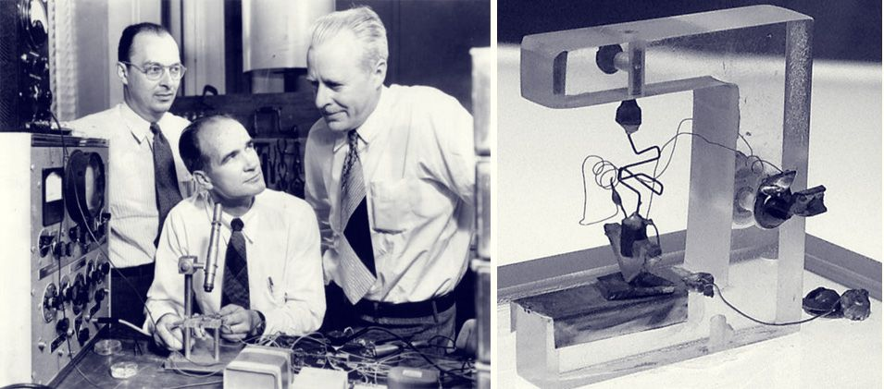
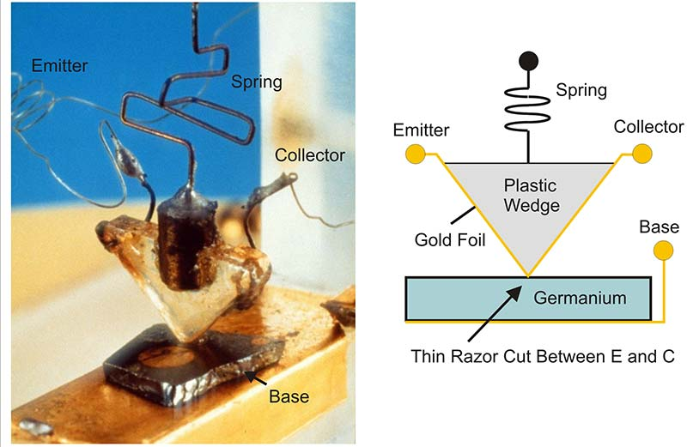

Introduction
First bipolar (PNP Ge) transistor invented in 1947 (US patent 2569347A, 1948)
Research on solid state devices to replace vacuum tubes
Resulted from failed attempts to build a field-effect transistor (FET)
1
Instrumentation Training Lectures, Oxford 09/05/2023
Notes:
First slide to underline the importance of technology and fabrication process lets look at the firt ever transistor , a PNP Ge

Slide 4
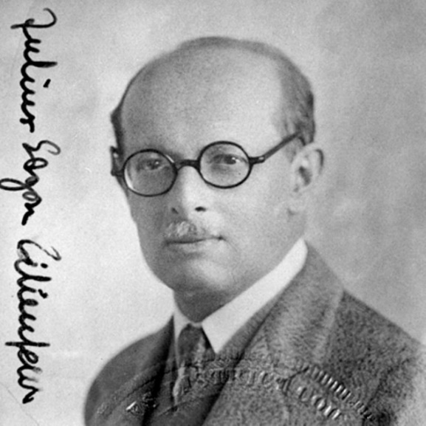
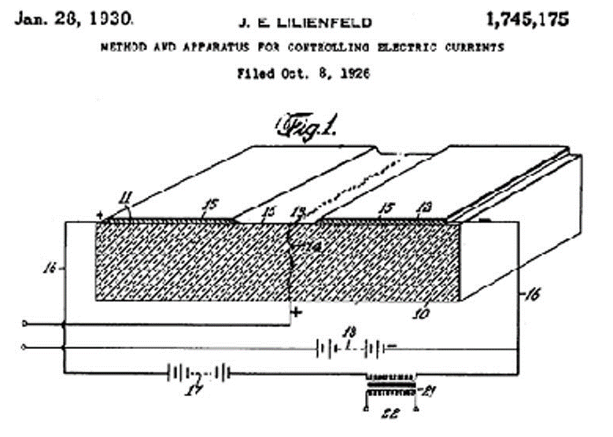
Introduction
First FET (Field Effect Transistor) patented filed in 1930 (US patent 1745175A,1930)
Serious problems with surface states/ dielectric defects prevented the devices from working
First practical working device invented in 1959, using SiO₂ as dielectric (MOSFET, Metal Oxide Silicon Field Effect Transistor)
2
Instrumentation Training Lectures, Oxford 09/05/2023

Slide 5
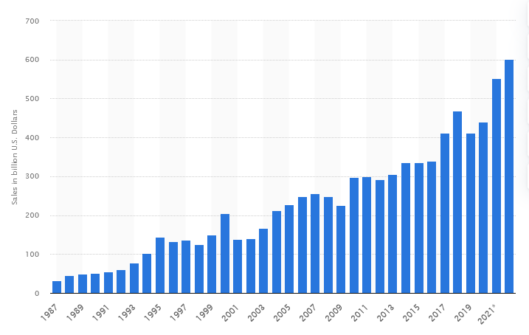
Introduction
MOSFETs by far the most widely used (99%) transistor device
Estimated > 10²² devices produced since 1960 (> 10¹² produced only in 2021)
Sales of semiconductors in 2021 >550 10⁹ USD
Semiconductor market size worldwide from 1987 to 2022
3
Instrumentation Training Lectures, Oxford 09/05/2023

Slide 6
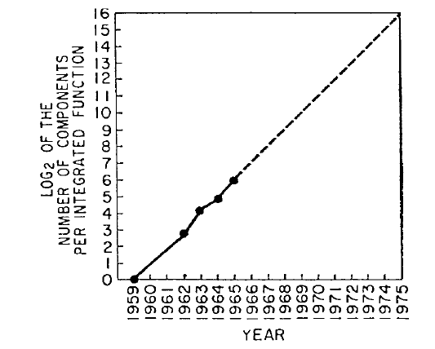
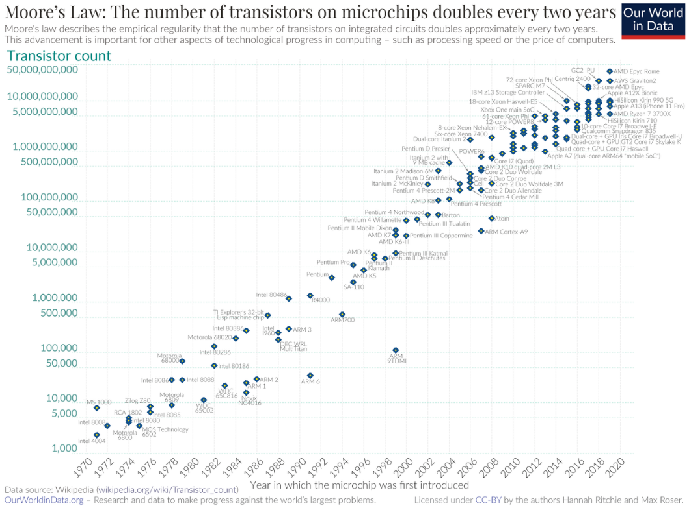
Moore’s Law
“With unit cost falling as the number of components per circuit rises, by 1975 economics may dictate squeezing as many as 65 000 components on a single silicon chip.”
G.E.Moore, “Cramming More Components onto Integrated Circuits”,Electronics Vol. 38, No. 8 Apr. 1965
Semiconductor industry started around 1960 (First hybrid:, Kilby, Jack S. "Miniaturized Electronic Circuits", U.S. Patent 3,138,743, February 1959)
In 1965 G. Moore predicted a doubling number of integrated components every year, to promote the idea of integrating devices. From mid ‘70s the trend is doubling every ~2 years
Such trend has been maintained for almost 60 years, leading to ~2^{60/2}= 10⁹ transistors count on chip
4
Instrumentation Training Lectures, Oxford 09/05/2023
Notes:
Just after the beginning of semiconductor industry in 1960, Gordon Moore exposed probably the most famous Law of IT and computong

Slide 7
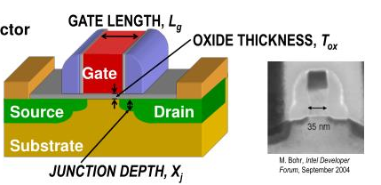
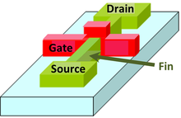
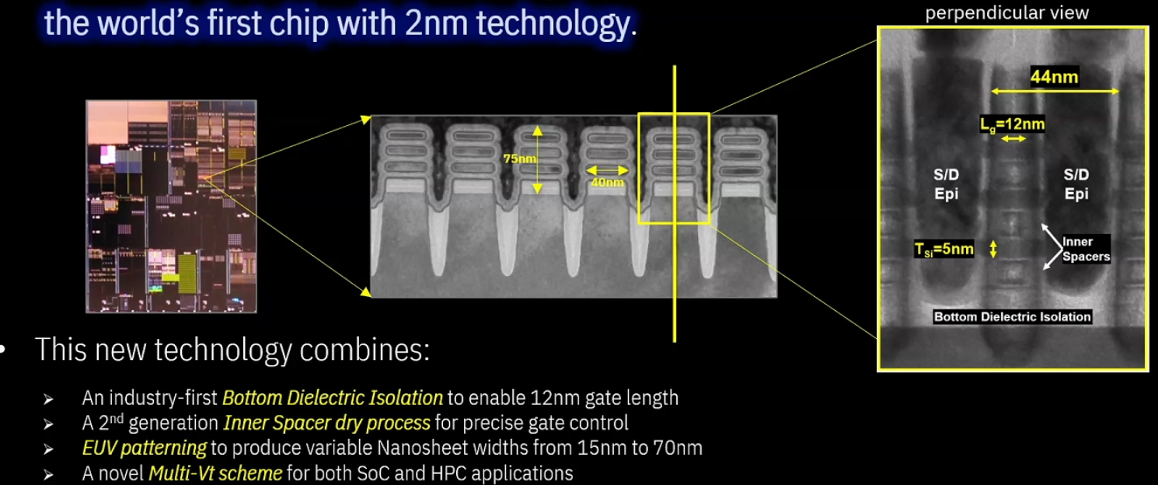
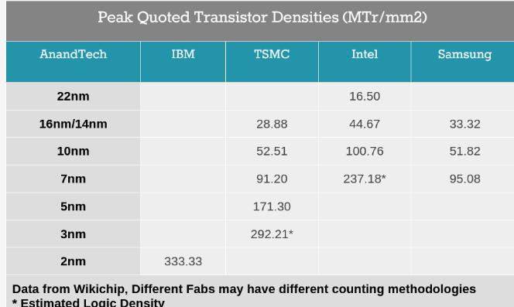
Moore’s Law
Planar MOSFET. The gate material runs over the channel region
Non-planar Fin-MOSFET. The gate material wraps around the channel region and provides better control of the channel conductivity
Technology size referred to actual minimum MOS transistor gate length
Since the advent of non-planar 3D structures the name of nodes means an equivalent gate length size of a planar device
Reducing the size of the devices requires considerable technological efforts and investments
Gate all around (GAA) MOSFET. The gate material surrounds the channel region on all sides.
IBM announced 2 nm technology
https://www.anandtech.com/show/16823/intel-accelerated-offensive-process-roadmap-updates-to-10nm-7nm-4nm-3nm-20a-18a-packaging-foundry-emib-foveros
5
Instrumentation Training Lectures, Oxford 09/05/2023
Notes:
When we talk about having mrre devices integrated we shold clarify what we mean when talking about a specifi size

Slide 8
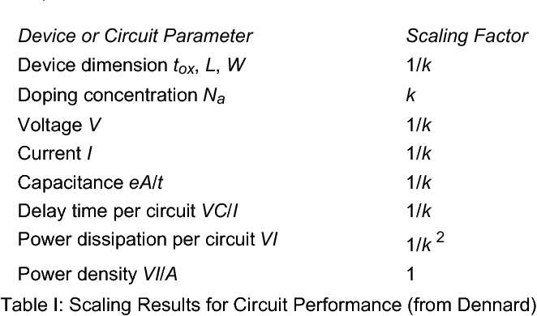
Dennard’s Law of scaling
From Dennard’s 1974 paper: smaller feature size can only bring benefits
Smaller -> Faster, Less power dissipation; Power density remains the same!
R. H. Dennard et al., "Design of ion-implanted MOSFET's with very small physical dimensions," Oct. 1974, doi: 10.1109/JSSC.1974.1050511
6
Instrumentation Training Lectures, Oxford 09/05/2023

Slide 9
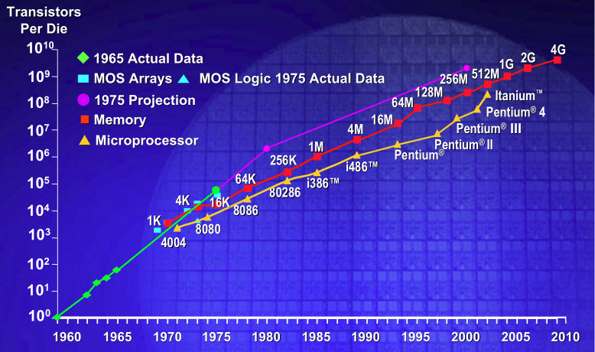
Dennard’s and Moore’s Law
By keeping the cost/area of chip constant:
  More powerful chip for the same price
  Same chip for a lower price: the scaling down of transistor area reduces the cost of a transistors by 30%/year.
  This trend has continued for around 20-25 years (1975-2000)
7
Instrumentation Training Lectures, Oxford 09/05/2023

Slide 10
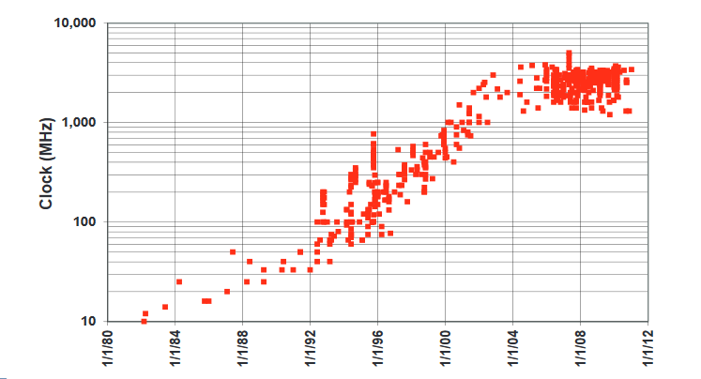
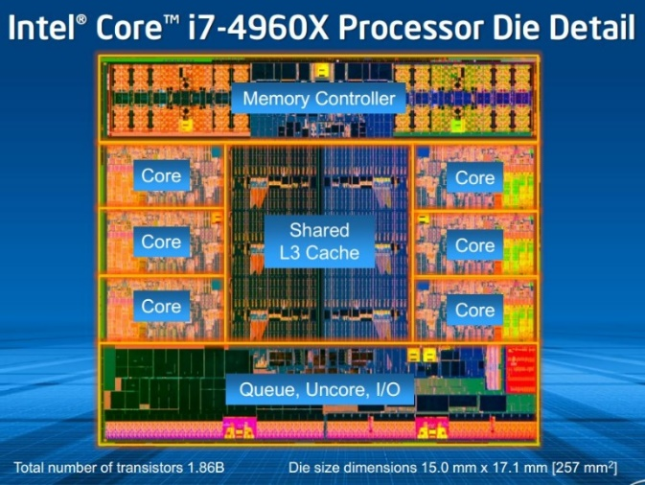
Dennard’s Law of scaling
This scaling ignores quantum tunnelling and noise, i.e. leakage current, which leads to power dissipation, and threshold voltage which do not scale with size (~1/√k)
Power wall, limiting the frequency of processors to around 4 GHz since 2006
8
Instrumentation Training Lectures, Oxford 09/05/2023

Slide 11
Dennard’s and Moore’s Law
  Moore’s law is not a physics law per se: keeping the cost/area the same (for example increasing the wafer size) despite rising cost of fabrication is the result of human efforts.
  Dennard’s law is based on physics, but it does not completely justify anymore the continuous trend in size reduction.
  Nowadays the main benefit to reduce the size of transistor is to reduce cost/function
9
Instrumentation Training Lectures, Oxford 09/05/2023
Notes:
Questions up to here?

Slide 12
Overview
Semiconductor technology
  Introduction
  Moore’s Law
  Dennard’s Law
Semiconductor fabrication process I
  Introduction
  Silicon crystal growth
  Fabrication process flow
  Oxidation
    Purpose
    Tools/equipment
    Deal-Grove model
10
Instrumentation Training Lectures, Oxford 09/05/2023

Slide 13
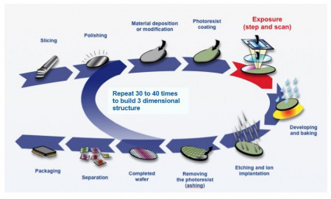
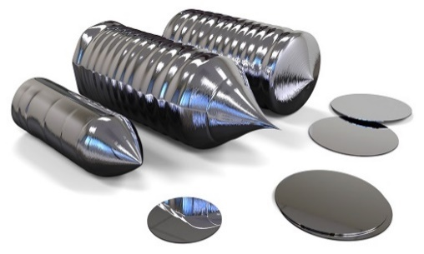
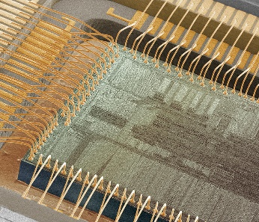
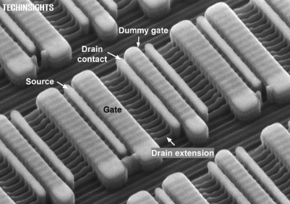
Introduction
The fabrication of semiconductor devices is a rather complex process
Many intermediate steps and manufacturing precision at atomic level
A few of process steps (crystal growth, oxidation and implantation) will be described in some details here
Other steps described in different lectures by Andrew Blue
11
Instrumentation Training Lectures, Oxford 09/05/2023

Slide 14
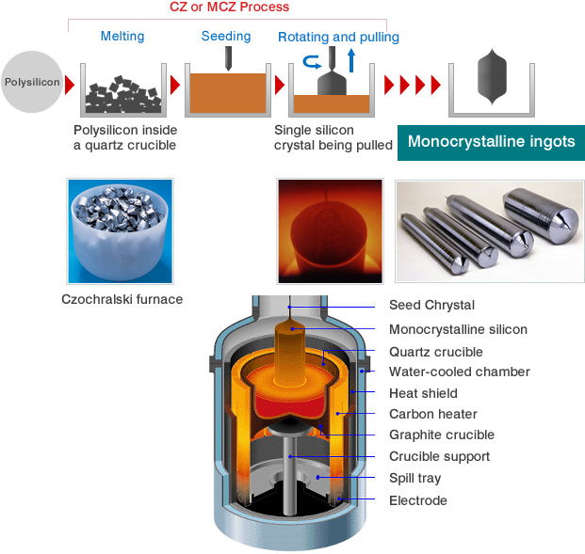
Silicon crystal growth
Czochralski
The majority of ICs are made on single-crystal Si wafers grown in large ingots using CZ (Czochralski, 1915*) method
  High purity polysilicon (99.9999999% or 9N) crushed into powder, put into a quartz crucible and heated until it melts
  A seed crystal is dipped into liquid silicon. As the stick is rotated and slowly pulled up, an ingot of monocrystalline silicon is formed that has the same atomic arrangement as the seed crystal
  * Oxygen Impurities might be introduced from the quartz crucible into the ingot
  * Czochralski discovered this by accident: instead of dipping his pen into his inkwell, he dipped it in molten tin, and drew a tin filament, which later proved to be a single crystal
12
Instrumentation Training Lectures, Oxford 09/05/2023

Slide 15
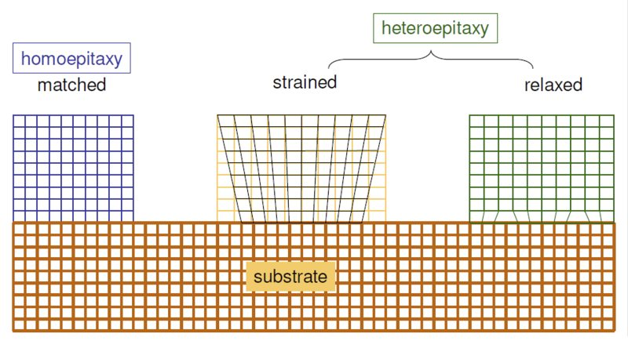
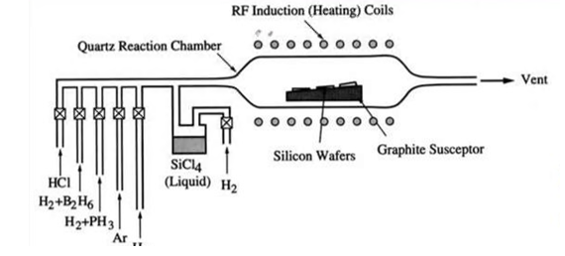
Silicon crystal growth
Epitaxy
Arrangement of atoms over existing planes of crystalline substrate, to form an extended crystal
The deposited layer can have very different doping of the substrate, allowing doping profiles unattainable with implantation.
Different materials can be grown (heteroepitaxy)
The epitaxially grown layer can be oxygen free
SiCl₄ [gas] + 2H₂ [gas] = Si [solid] + 4HCl [gas]
  Chemical Vapour Deposition (CVD) is the formation of solid films on a substrate by exploiting a chemical reaction of reactants in vapour phase.
  Reactants introduced in reaction chamber decompose and react with the heated
  ^{surface to form the film}
13
Instrumentation Training Lectures, Oxford 09/05/2023

Slide 16
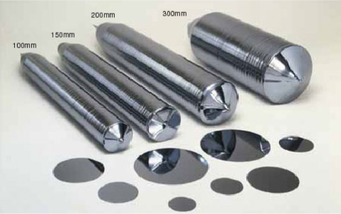
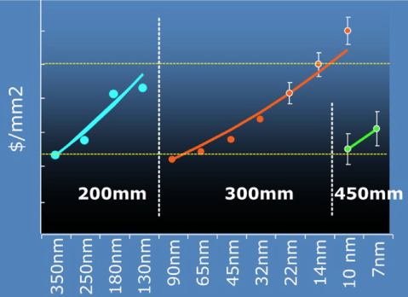
Silicon crystal growth
The cylindrical ingot is sliced into thin circular wafers, polished, etched, and cleaned until their surface is almost roughness free (<< 1 nm)
The diameter of Si ingots grew over the years: currently 300 mm diameter, driven by keeping the cost/area constant
As per 2021, worldwide Si wafer area around 9x10⁶ m² , for an approximate 1.15x10¹² semiconductor units produced
14
Instrumentation Training Lectures, Oxford 09/05/2023

Slide 17
Silicon process fabrication example
Wafer SUBS
Start with Si wafer cleaned and polished
The wafer top is covered by insulating layer, SiO₂
Light -sensitive layer (photoresist) deposited
A photomask with the desired pattern is aligned with the wafer
Oxidation
Resist depo
Masks / photolito
15
Instrumentation Training Lectures, Oxford 09/05/2023
Notes:
As mentioned earlier, the IC manufacturing is a very complex procedure, lets look a t a simplified one to understand the overall process

Slide 18
Silicon process fabrication example
Exposure
Photolithography: exposure to UV light makes the photoresist not covered by masks easily removable (stripping)
The unprotected SiO₂ is then etched, using chemical process, resist is stripped
The exposed areas of Silicon are then doped, via implantation or diffusion, e.g. to obtain PN junctions
Metallization followed by similar photolithographic process to obtain a final device
Etching
Implantation
Metalization
16
Instrumentation Training Lectures, Oxford 09/05/2023

Slide 19
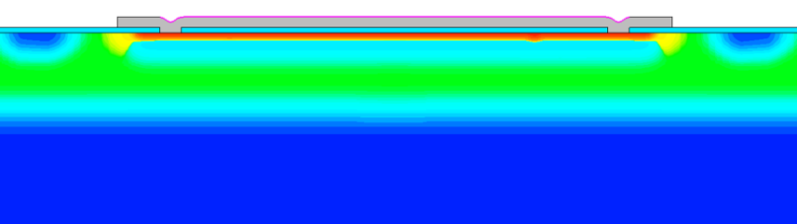
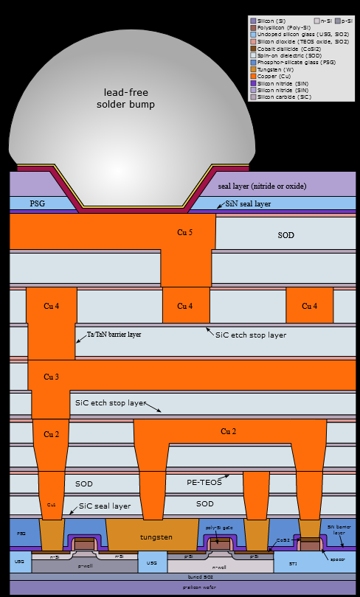
Silicon process fabrication example
Additional layer of conducting or insulating materials can be added, to obtain multilayers structures
> 10 layers in modern submicron CMOS process
  Example of cross section of LGAD devices – single Al layer
  Example of cross section of modern CMOS IC – multiple metal layers (Cu to reduce resistivity of interconnections)
17
Instrumentation Training Lectures, Oxford 09/05/2023

Slide 20
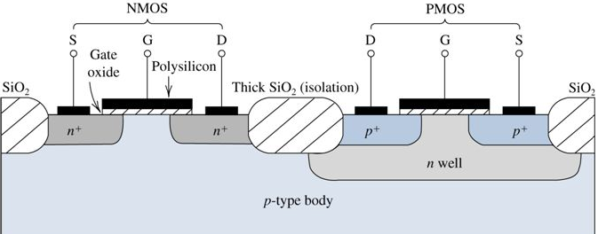
Oxidation fabrication process
_{Ions implanted}
SiO₂
The purpose of oxidation is essentially to provide isolation:
  Barrier against dopants diffusion/implantation
  Electrical insulator between devices (critical field ~ 10⁷ V/cm)
Si
Parasitic MOS
18
Instrumentation Training Lectures, Oxford 09/05/2023

Slide 21
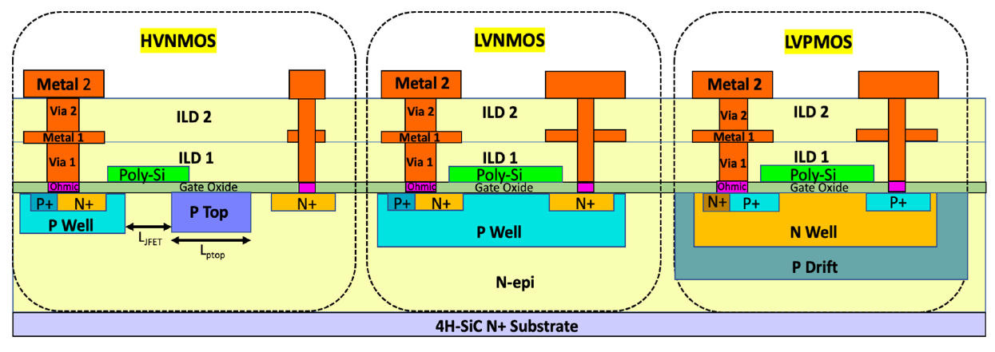
Oxidation fabrication process
Two deposition methods:
  Thermal growth
    Dry: best quality, slow growth rate: used for gate oxide
    Wet: lower quality, faster growth rate: used for field oxide (isolation)
  Chemical vapor deposition (lower quality, fast)
    Used when no Si is available for oxidation (Interlayer isolation)
19
Instrumentation Training Lectures, Oxford 09/05/2023

Slide 22
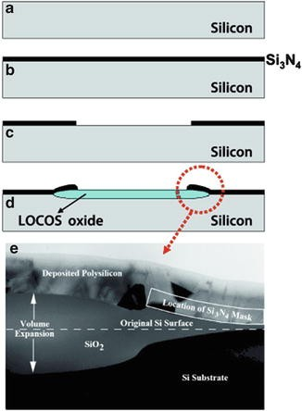
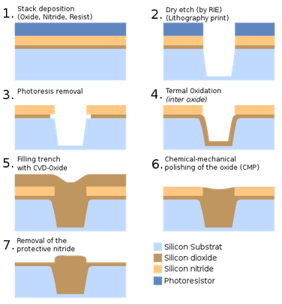
Oxidation fabrication process
LOCOS (local Oxidation of Si) process, rarely used nowadays:
Thermal oxide is grown in etched region: bird’s beak means Si area loss
STI process
STI (Shallow Trench Isolation) process: (<250 nm)
CVD oxide is deposited in the etched region: reduced Si area loss
LOCOS process
20
Instrumentation Training Lectures, Oxford 09/05/2023

Slide 23
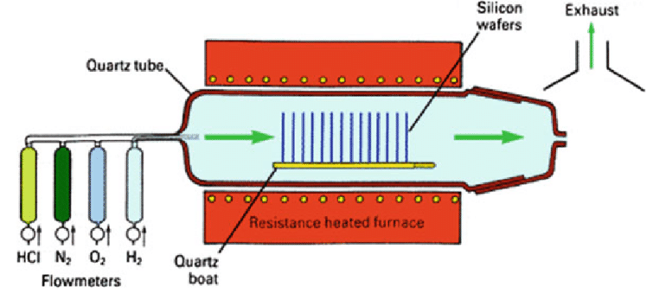
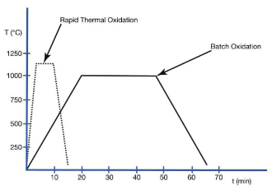
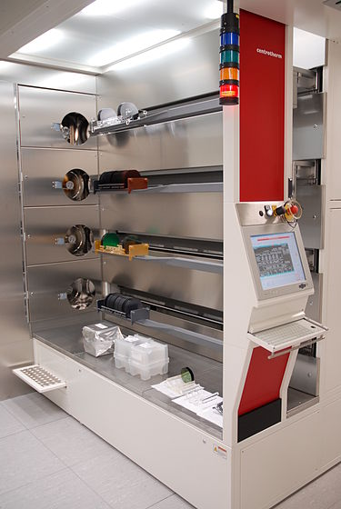


Oxidation process tools
Thermal oxidation:
  oxide is grown at high temperature (~ 1000° C) by supplying oxygen that reacts with silicon wafer to form SiO₂ at the surface
Wafers inserted on a suspended boat into a tubular reactor of quartz, heated by resistance
Dry oxidation: best quality, slow (10 nm/hr)
Wet oxidation: lower quality, faster (>x10)
21
Instrumentation Training Lectures, Oxford 09/05/2023

Slide 24
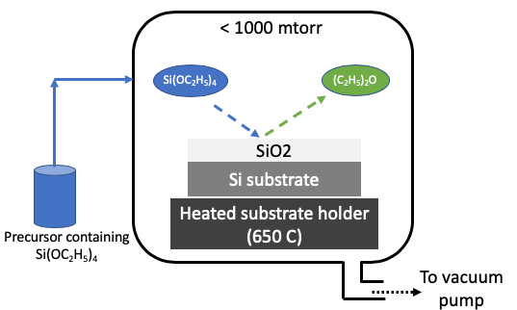
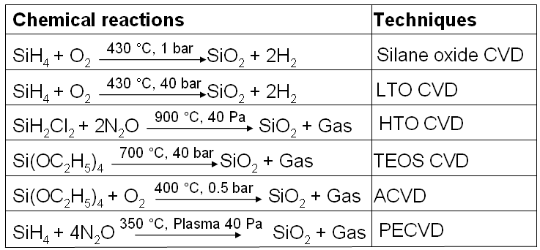
Oxidation process tools
Chemical Vapor Deposition (CVD) :
reaction of vapor phase chemicals containing the material to deposit form the solid film on substrate. Reactant gases decompose and form the film.
  SiO₂ growth rate >x10 compared to thermal oxide, but lower quality
  CVD is also used for growing dielectric materials of different electrical permittivity (high k/low k material)
22
Instrumentation Training Lectures, Oxford 09/05/2023

Slide 25
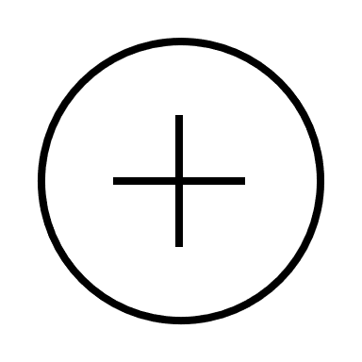
Oxide quality
SiO₂
mobile charges
Na⁺,K⁺
Mobile charges (contamination - make insulator conductive)
Fixed charges (incompletely oxidized Si - create an extra electric field affecting the devices in Si)
Oxide trapped charge (broken Si-O bonds, due to radiation)
Interface trapped charges (dangling bonds – affect mobility and increase noise)
Oxide trapped charges (+), (-)
Fixed charges (+)
interface trapped charges (+)
Si sub
23
Instrumentation Training Lectures, Oxford 09/05/2023

Slide 26
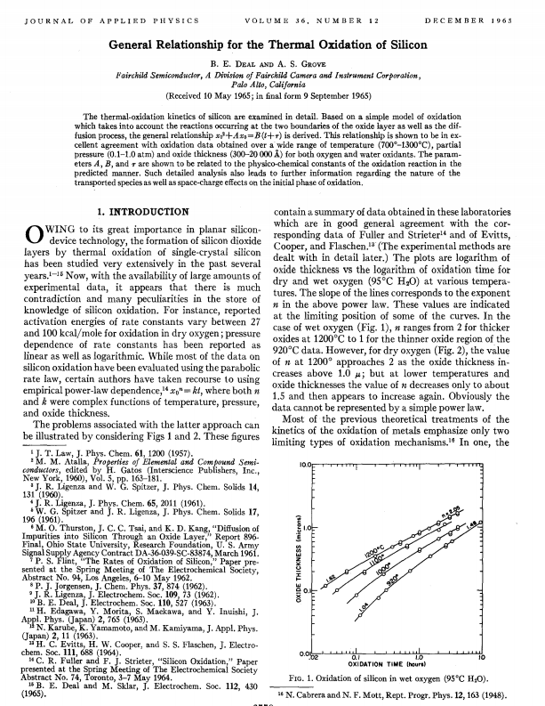
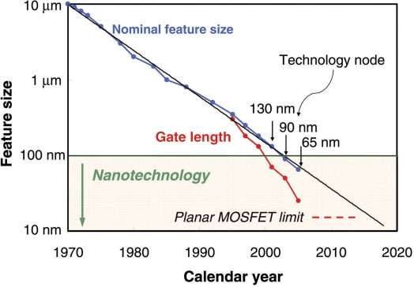
The Deal-Grove oxidation model
The Deal Grove Model is a simple kinetic model for oxide thermal growth, wet and dry
Developed by Andy Grove (Intel’s CEO) and Bruce Deal in the 60’s
  B. E. DEAL AND A. S. GROVE General Relationship for the Thermal Oxidation of Silicon, JOURNAL OF APPLIED PHYSICS VOLUME 36. NUMBER 12 DECEMBER 1965
24
Instrumentation Training Lectures, Oxford 09/05/2023

Slide 27
The Deal-Grove oxidation model
C_{G}
1
2
3
C_{s}
SiO₂
Si
1: Oxygen diffuses from bulk C_{G} to wafer surface C_{S}
2: Oxygen diffuses from wafer surface C_{O} to Si surface C_{i}
3: Oxygen reacts with Si at interface to form SiO₂
C₀
C_{i}
T_{ox}
F₁
F₂
F₃
Gas flux
Diffusion flux
Reaction flux
25
Instrumentation Training Lectures, Oxford 09/05/2023

Slide 28
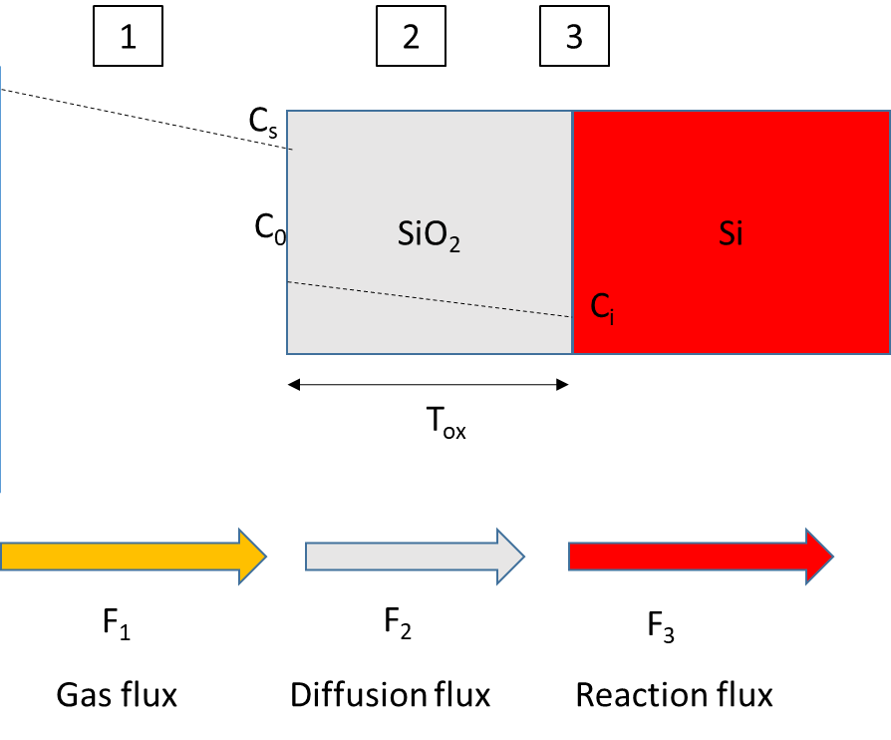









The Deal-Grove oxidation model
Oxygen diffusion through gas: Fick’s 1st Law approximated as linear equation
Adsorbed concentration C_{o} on surface $∝$ partial pressure (Henry’s Law)
Oxygen diffusion through SiO₂ Fick’s 1st Law approximated as linear equation
1st order reaction at Si interface
$1: F_{1}=D\frac{dC}{dx}≈\frac{D_{g}}{δ}\left(C_{g}− C_{s}\right)=h_{g}(C_{g}−$ $C_{s})$
$$C_{o}=HP_{s}=HC_{s}kT$$
$2: F_{2}=D\frac{dC}{dx}≈\frac{D_{ox}}{t_{ox}}(C_{o}−$ $C_{i})$
$$C_{g}=\frac{P_{g}}{kT}$$
Reactant concentration
H
Henry’s gas law coefficient
$$3: F_{3}=k_{s}C_{i}$$
$$t_{ox}$$
SiO2 thickness
$$D_{ox}$$
Oxygen diffusivity in SiO2
$$h_{g}$$
Mass transfer coefficient
26
Instrumentation Training Lectures, Oxford 09/05/2023

Slide 29
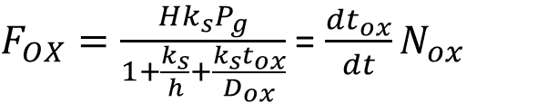



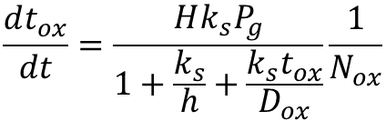
The Deal-Grove oxidation model
Steady state: all fluxes are equal (Si interface reaction is the rate-limiting step)
$$F_{1}={ F}_{2}=F_{3}=F_{OX}$$
$F_{OX}=\frac{Hk_{s}P_{g}}{1+\frac{k_{s}}{h}+\frac{k_{s}t_{ox}}{D_{ox}}}$ = $\frac{dt_{ox}}{dt}N_{ox}$
; h$=\frac{h_{g}}{HkT}$
Oxygen flux $F_{OX}$= v_{ox} N_{ox}
$$\frac{dt_{ox}}{dt}=\frac{Hk_{s}P_{g}}{1+\frac{k_{s}}{h}+\frac{k_{s}t_{ox}}{D_{ox}}}\frac{1}{N_{ox}}$$
27
Instrumentation Training Lectures, Oxford 09/05/2023

Slide 30
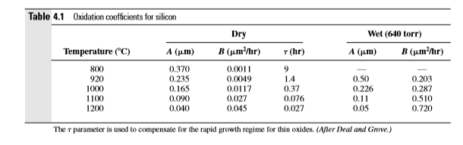

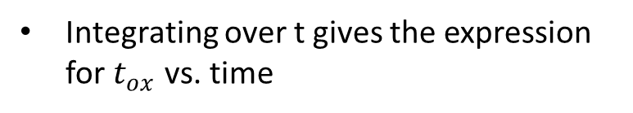
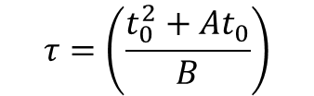


The Deal-Grove oxidation model
$$t_{ox}^{2}+At_{ox}=B\left(t+τ\right)$$
$$A=2D_{ox}\left(\frac{1}{h}+\frac{1}{k_{s}}\right)$$
Integrating over t gives the expression for $t_{ox}$ vs. time
$$B=\left(\frac{2D_{ox}HP_{g}}{N_{ox}}\right)$$
$$τ=\left(\frac{t_{0}^{2}+At_{0}}{B}\right)$$
The model requires coefficients adjustments for different crystal orientations
<111> Si
28
Instrumentation Training Lectures, Oxford 09/05/2023

Slide 31
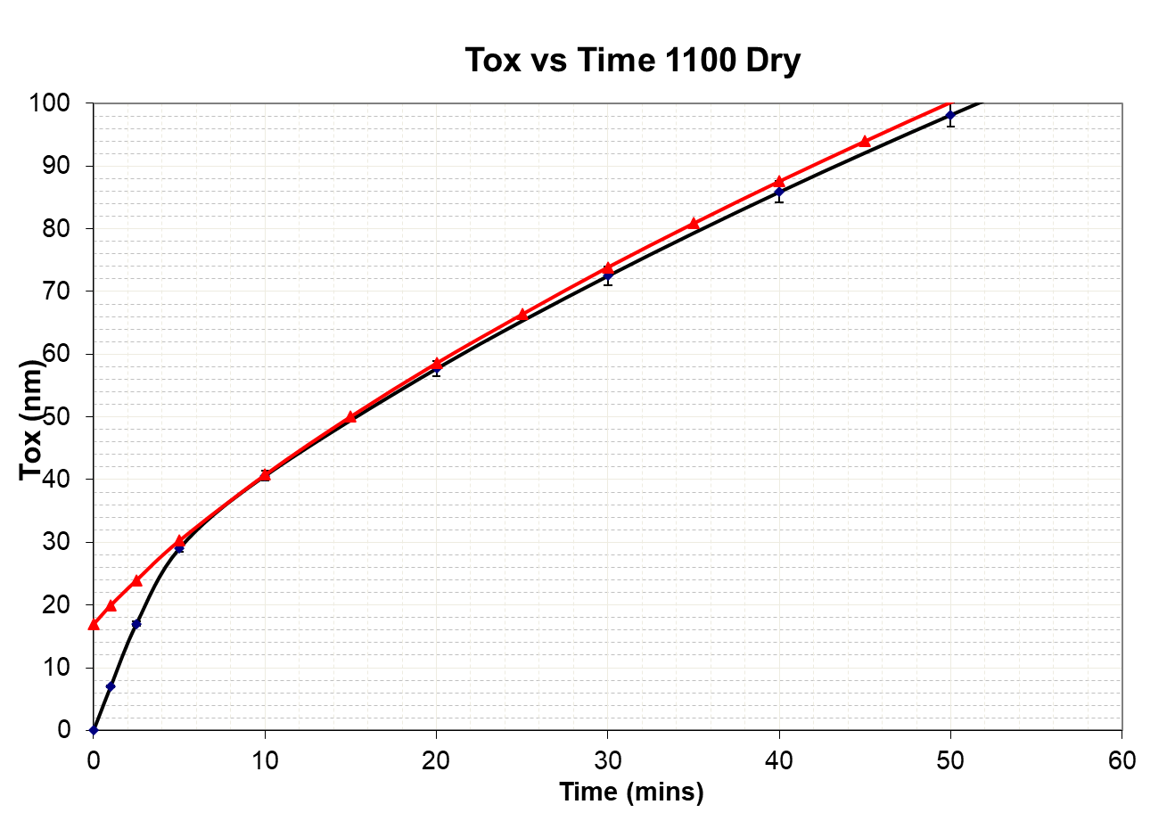
The Deal-Grove oxidation model
Comparison of Deal-Grove model with measured oxide thickness (Dry oxide)
Deal Grove
Measured
With the correct coefficients (P,T, crystal ) the Deal-Grove model works nicely for single crystal silicon (~%’s accuracy). Model extensions to 3D exist
Additional tweaking needed for high doping Si
The model fails for Polysilicon
* Self-limiting growth of native oxide saturates at around 2-3 nm
‘Growth of native oxide on a silicon surface’ Journal of Applied Physics, Volume 68, Issue 3, August 1, 1990, pp.1272-1281
29
Instrumentation Training Lectures, Oxford 09/05/2023

Slide 32

The Deal-Grove oxidation model
SiO₂
X_{Ox}
The oxide grows at the expense of Silicon: during oxidation around half of Silicon is consumed
Si
Si
X_{Si}
$X_{Si} N_{Si}=$ $X_{Ox} N_{Ox}→$ $X_{Si}$=$\frac{{ X}_{Ox} N_{Ox}}{ N_{Si}}≡{ X}_{Ox}\frac{2.3 {10}^{22}}{5 {10}^{22}}={ X}_{Ox} 0.46$
$$N_{Ox}=molecular density SiO_{2}$$
$$N_{Si}=atomic density Si$$
30
Instrumentation Training Lectures, Oxford 09/05/2023

Slide 33
Process fabrication III Summary
  Introduction to Semiconductor technology
  Differences between Moore’s (economic) and Dennard’s (physics) law, miniaturization and Power wall
  Process fabrication I, Introduction and typical process flow
  Silicon wafer
  Oxidation: purpose, tools. Modeling (Deal-Groove)
    Thank you
    giulio.villani@stfc.ac.uk
31
Instrumentation Training Lectures, Oxford 09/05/2023

